Slide 1
A User’s World
Seattle, 28 January 2013
Findings from User Behavior Studies
Lynn Silipigni Connaway, Ph. D.
Senior Research Scientist OCLC
connawal@oclc.org

Slide 2
Introduction
Many information options
Library resources not the first choice
Convenience rules
Develop effective library systems & services, to understand users’ engagement with digital environment

Slide 3
Then and Now
Then: The user built workflow around the library
Now: The library must build its services around user workflow
Then: Resources scarce, attention abundant
Now: Attention scarce, resources abundant
(Dempsey, 2008)
Notes:
Dempsey, L. (2008). Always on: Libraries in a world of permanent connectivity. First Monday [Online], (14)1. Retrieved from http://www.firstmonday.org/htbin/cgiwrap/bin/ojs/index.php/fm/article/view/2291/2070
Today, more than 1.7 billion people, or almost one out of every four humans on the planet, are online (Wasserman, 2012).
Wasserman, S. (2012, June 18). The amazon effect. The Nation. Retrieved from http://www.thenation.com/article/168125/amazon-effect

Slide 4
Studies
The Digital Information Seeker: Report of the Findings from Selected OCLC, RIN, and JISC user Behavior Projects.
Visitors and Residents: What Motivates Engagement with the Digital Information Environment
Notes:
Connaway, L. S., Dickey, T. J., OCLC Research., & Joint Information Systems Committee. (2010). The digital information seeker: Report of the findings from selected OCLC, RIN, and JISC user behaviour projects. Bristol, England: HEFCE.
White, D., & Connaway, L.S. (2011). Visitors and Residents: What Motivates Engagement with the Digital Information Environment. Funded by JISC, OCLC, and Oxford University. http://www.oclc.org/research/activities/vandr/.

Slide 5
Towards a Profile of the Researcher of Today: What Can We Learn from JISC Projects?
Digital Information Seekers: Report of findings from selected OCLC, JISC & RIN User Behavior Projects
Funded by JISC
Analysis of 12 user behavior studies
Conducted in US and UK
Published 2005-2010
Synthesis
Better understand user information-seeking behavior
Identify issues for development of user-focused services and systems
Notes:
Connaway, L. S., Dickey, T. J., & Joint Information Systems Committee. (2009). Towards a profile of the researcher of today: What can we learn from JISC projects? : Common themes identified in an analysis of JISC virtual research environment and digital repository projects. England: JISC. . Retrieved from: http://ierepository.jisc.ac.uk/418/2/VirtualScholar_themesFromProjects_revised.pdf
Calhoun, K., Cantrell, J., & Gallagher, P. (2009). Online catalogs: What users and librarians want: An OCLC report. Dublin, OH: OCLC. Retrieved from http://www.oclc.org/us/en/reports/onlinecatalogs/default.htm
De Rosa, C. (2005). Perceptions of libraries and information resources: A report to the OCLC membership. Dublin, OH: OCLC Online Computer Library Center. http://www.oclc.org/us/en/reports/2005perceptions.htm
De Rosa, C. (2006). College students' perceptions of libraries and information resources: A report to the OCLC membership. Dublin, OH: OCLC Online Computer Library Center. http://www.oclc.org/us/en/reports/perceptionscollege.htm
Dervin, B., Reinhard, C. L. D., Kerr, Z. Y., Song, M., & Shen, F. C. (Eds.)(2006). Sense-making the information confluence: The whys and hows of college and university user satisficing of information needs. Phase II: Sense-making online survey and phone interview study. Report on National Leadership Grant LG-02-03-0062-03 to Institute of Museum and Library Services, Washington, D.C. Columbus, OH: School of Communication, Ohio State University. http://imlsproject.comm.ohio-state.edu/imls_reports/imls_PH_II_report_list.html
Connaway, L. S., Prabha, C., & Dickey, T. J. (2006). Sense-making the information confluence: The whys and hows of college and university user satisficing of information needs. Phase III: Focus group interview study. Report on National Leadership Grant LG-02-03-0062-03, to Institute of Museum and Library Services, Washington, D.C. Columbus, OH: School of Communication, The Ohio State University. Retrieved from http://imlsproject.comm.ohiostate.edu/imls_reports/PHASE_III/PH_III_report_list.html
Prabha, C., Connaway, L.S. & Dickey, T.J. (2006). Sense-making the information confluence: The whys and hows of college and university user satisficing of information needs. Phase IV: Semi-structured interview study. Report on National Leadership Grant LG-02-03-0062-03, to Institute of Museum and Library Services, Washington, D.C. Columbus, OH: School of Communication, The Ohio State University. Retrieved from http://imlsproject.comm.ohio-state.edu/imls_reports/imls_PH_IV_report_list.html
Research Information Network. (2006). Researchers and discovery services: Behaviour, perceptions and needs. London: Research Information Network. Retrieved from http://www.rin.ac.uk/our-work/using-and-accessinginformation-resources/researchers-and-discovery-services-behaviour-perc
Consortium of University Research Libraries, and Research Information Network. 2007. Researchers' use of academic libraries and their services: A report. London: Research Information Network and Consortium of University Research Libraries (CURL).
Centre for Information Behaviour and the Evaluation of Research. (2008). Information behaviour of the researcher of the future: A CIBER briefing paper. London: CIBER. Retrieved from http://www.jisc.ac.uk/media/documents/programmemes/reppres/gg_final_keynote_11012008.pdf
Radford, M. L., & Connaway, L. S. (2008). Seeking synchronicity: Evaluating virtual reference services from user, non-user, and librarian perspectives: IMLS final performance report. Report on Grant LG-06-05-0109-05, to Institute of Museum and Library Services, Washington, D.C. Dublin, OH: OCLC Online Computer Library Center.
Research Information Network. (2009). E-journals: Their use, value and impact. London: Research Information Network. Retrieved from http://www.rin.ac.uk/our-work/communicating-and-disseminating-research/ejournals-their-use-value-and-impact
JISC and UCL. (2009). JISC national e-books observatory project: Key findings and recommendations: Final report.
Hampton-Reeves, S., Mashiter, C., Westaway, J. , Lumsden, P., Day, H., Hewerston, H. & Hart, A. (2009). Students’ use of research content in teaching and learning: A report of the Joint Information Systems Council (JISC). Retrieved from http://www.jisc.ac.uk/media/documents/aboutus/workinggroups/studentsuseresearchcontent.pdf
Wong, W., Stelmaszewska, H., Bhimani,N., Barn, S., & Barn, B. (2009). User behaviour in resource discovery: Final report. http://www.jisc.ac.uk/whatwedo/programmes/inf11/userbehaviourbusandecon.aspx

Slide 6
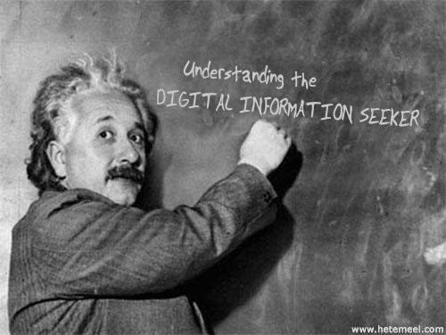
What We Learned
Notes:
Image created at : http://www.hetemeel.com/einsteinform.php

Slide 7
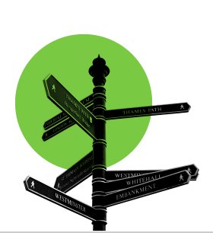
How Individuals Work
Convenience
Is it readily accessible online?
Does it contain the needed information & is it easy to use?
How much time will it take to access & use the source?
Is it a familiar interface and easily navigable interface?
Google and Wikipedia
Value human resources
Contextually based rational decisions
Situational needs determine search
virtual library
physical library
complex search
simple
search
(Connaway & Radford, 2011)
Notes:
Image: Microsoft Clip Art
Convenience often dictates choices between physical and virtual library and is based on context and situation.
Connaway, L. S., & Radford, M. L. (2011). Seeking synchronicity: Revelations and recommendations for virtual reference. Dublin, OH: OCLC Research. Retrieved from http://www.oclc.org/reports/synchronicity/full.pdf
“They do often advise that we go to the library and look for books but I would normally go to the internet and go to the library as my last sort of option really. (Laughter) It just takes me – I don’t really know how to use the library, I’ve got to be honest, but I know how to use the internet. Yes, I would normally use the internet or sort of word of mouth if someone else knows how to do it – that kind of thing – first.” (UKU5 0:14:19, Female, Age 19, Digital Visitors and Residents)
“I find Google a lot easier than going to the library website because I don’t know, it’s just like sometimes so many journals come up and when you look at the first ten and they just don’t make any sense I, kind of, give up. Google, I don’t know. It’s just Google it’s – I find it easier just to look through anything.”, (USU7 0:34:11, Female, Age 19, Digital Visitors and Residents)
“I could easily have found the information she found for me, but the fact that I could just ask her question and have them look up the reference and read through articles instead of me having to look through like a million Googled articles…it was definitely a nice convenience and would definitely make it more likely for me to go to them and actually ask a librarian a question or figure it out on my own.” – Seeking Synchronicity, User (Focus Group, Rutgers University, July 11, 2006)
Although campus Information Commons, with cafes and 24/7 access to the facilities and resources, are still popular with students and faculty, convenient access to resources, whether human, print, or electronic is the most critical factor. After all, “If it is too inconvenient I’m not going after it.”
Connaway, L. S., Dickey, T. J., & Radford, M. L. (2011). "If it is too inconvenient I'm not going after it": Convenience as a critical factor in information-seeking behaviors. Library & Information Science Research, 33 (3) 188.

Slide 8
How Individuals Work
Power browsing
Scan small chunks of information
View first few pages
No real reading
Squirreling
Short basic searches
Download content for later use
(Center for Information Behaviour and the Evaluation of Research, 2008)
Notes:
“You know, I generally didn’t sit back in my chair and just read the journal, I searched maybe 50 journals at two or three topics I’m looking for and want to read about today, get those topics and read the articles on that” (Focus Group 01, Faculty, Sense-making the Information Confluence)
User behaviors in this electronic environment tend toward quick views of a few pages, and “bouncing” between resources. This seems to contradict the notion of the hard-core researcher but supports the need for more user behavior research addressing situation and context. DIS, p. 34.
Connaway, L. S., & Dickey, T. J. (2010). The digital information seeker: Report of findings from selected OCLC, RIN, and JISC user behavior projects. Retrieved from http://www.jisc.ac.uk/media/documents/publications/reports/2010/digitalinformationseekerreport.pdf
Dervin, B., Connaway, L.S., & Prabha, C. (2003-2006). Sense-making the information confluence: The whys and hows of college and university user satisficing of information needs. Funded by the Institute of Museum and Library Services (IMLS). http://imlsosuoclcproject.jcomm.ohio-state.edu/
60% of e-journal users view <4 pages
65% of e-journal users do not return to the journal (p.10)
Centre for Information Behaviour and the Evaluation of Research. (2008). Information behaviour of the researcher of the future: A CIBER briefing paper. London: CIBER (p. 31).

Slide 9
Behaviors
Students
Confident in skills
Satisficing
Speed & convenience key
Keyword searches
Researchers
Differ with discipline
Satisficing
Awareness of open access is low
Lack understanding of copyright & signed publisher agreements
Confident in skills
(Hampton-Reeves, et.al., 2009)
(Consortium of University Research Libraries, and Research Information Network, 2007)
Notes:
Hampton-Reeves, S., Mashiter, C., Westaway, J. , Lumsden, P., Day, H., Hewerston, H. & Hart, A. (2009). Students’ use of research content in teaching and learning: A report of the Joint Information Systems Council (JISC). http://www.jisc.ac.uk/media/documents/aboutus/workinggroups/studentsuseresearchcontent.pdf (p.3).
Connaway, L. S., Dickey, T. J., OCLC Research., & Joint Information Systems Committee. (2010). The digital information seeker: Report of the findings from selected OCLC, RIN, and JISC user behaviour projects. Bristol, England: HEFCE (p. 32, 36).
Researchers in the sciences are most satisfied, Arts and Humanities researchers indicated serious problems (p. 75)
“Satisficing” (p. 31)
Awareness of open access is low (p. 64).
Consortium of University Research Libraries, and Research Information Network. (2007). Researchers’ use of academic libraries and their services: A report. London: Research Information Network and Consortium of University Research Libraries (CURL) (p. 31, p.64).
Research Information Network. (2006). Researchers and discovery services: Behaviour, perceptions and needs. London: Research Information Network (p. 75).

Slide 10
Information Literacy Skills
Students
Confident with information discovery tools
Determine credibility by:
Common sense (83%)
Cross-checking (71%)
Reputation of company/organization (69%)
Credible recommendations (68%)
Researchers
Self-taught in discovery services
No formal training (62%)
Doctoral students learn from dissertation professor
(De Rosa, 2006)
(Research Information Network, 2006)
Notes:
Most researchers self-taught in discovery services
62% report no formal training (p.64)
Confident in their skills (p.9)
Research Information Network. (2006). Researchers and discovery services: Behaviour, perceptions and needs. London: Research Information Network.
De Rosa, C. (2006). College students' perceptions of libraries and information resources: A report to the OCLC membership. Dublin, Ohio: OCLC Online Computer Library Center. http://www.oclc.org/us/en/reports/perceptionscolle
“Studying for my Earth science class, just Google the question, the first answer that pops up, if it’s right or wrong, that’s what I’m going to study.” (USU8, 0:25:58, Female, Age 19, Digital Visitors and Residents)
Usually websites that have like one colour backgrounds, where it’s a lot of just like basic text, there’s not a lot of graphics. They don’t really look nice, they look, kind of, like somebody just threw a website together and put it up online. It’s like I don’t trust those because it’s like, you know, they didn’t put a whole lot of time into this, I wonder how credible they are, so I don’t trust them usually. (USU4 0:32:59, Male, Age 19, Digital Visitors and Residents)
“It is kind of like a guess and check to see which one works best or which one gives you the most information. It is not necessarily to see which one is more credible because if you want credibility you are not necessarily going to look online for it.” (USU3 0:18:31, Male, Age 19, Digital Visitors and Residents)
“I always stick with the first thing that comes up on Google because I think that’s the most popular site which means that’s the most correct. So I tried that and it didn’t work.” (USS1 0:21:57, Female, Age 17, Digital Visitors and Residents,)
“I often just click on the first page, I’m not sure why. Don’t really go further. But yes, it’s hard to know what to trust though.” (UKS1 00:18:19, Male, Age 18, Digital Visitors and Residents)
“You know, let’s say it’s not even in an academic context. I have to see the same conclusion reached by lots of different people in different contexts. Like I need to see the same answer again and again and again. And maybe at some point that’s enough time where it starts to gel to me that this probably is a good approximation of the truth. It might not be the truth but this seems to be what a lot of people perceive as the truth. So that would be the simplest way to do it.” (USF3 0:29:48, Male, [no age listed], Digital Visitors and Residents)
“That’s the only problem, just knowing what information to use and why.” (UKS1 00:24:05, Male, Age 18, Digital Visitors and Residents)

Slide 11
Frustrations
Students
Need desktop access to full text
Library
Website hard to navigate
Inconvenient
Associate with books
Researchers
Accessing online journal articles & back files
Need desktop access
Discovery of non-English content
Unavailable content
Irrelevant information in result list
Lack of specialist search engines
(Connaway & Dickey, 2010)
(Research Information Network, 2006)
Notes:
“She was very direct about certain stuff and wanted me to go to the library. Of course like the library’s like a second home for me, so that’s fine. But the research I needed wasn’t showing up. So I was like okay, I’m going to the internet. And I had to find quotes from books, so I just like was able to go on Google, Google book search, and find the quote I needed. And I didn’t write down it was from the internet .... So she doesn’t really know (Laughter) that it’s from the internet.” (USU2 0:31:50, Female, Age 19, Digital Visitors and Residents)
“I have better things to do than go drive all the way to the library when I can just sit at home and type it into my computer.” (USU1 0:33:12, Female, Age 19, Digital Visitors and Residents)
“Yes, I’m sure, because, you know, going to the library was a task. And part of, I’m sure, a lot of people, and as far as me is concerned from laziness, it was much easier to just scrap around. It’s so much easier to just strain to find something on the internet than to, like, drive to the library. But that was in high school. In college, and especially grad school, I’m not afraid to go to the library anymore because we have a very good [assist 0:45:56] and we have a very good website.” (USG2 0:45:28, Male, Age 25, Digital Visitors and Residents)
“I don’t use the library. Most students really don’t anymore, I know a couple of people that live here but they don’t actually use it for books, they use it as a quiet place to study.” (USU4 0:36:27, Male, Age 19, Digital Visitors and Residents)
Connaway, L.S., & Dickey, T.J. (2010). Digital information seekers: Report of findings from selected OCLC, RIN, and JISC user behavior projects. http://www.jisc.ac.uk/media/documents/publications/reports/2010/digitalinformationseekerreport.pdf (p.4).
“It can be difficult for a UK professional who does not speak foreign languages to get a good academic translation. Would like a very good translation service specifically geared for academics,” (Physical Sciences Researcher, Research Information Network. 2006. Researchers and discovery services: Behaviour, perceptions and needs. London: Research Information Network.)
Accessing online journal articles & back files (p. 67)
Need desktop access (p. 4)
Discovery of non-English content (p. 75)
Unavailable content (p. 75)
Irrelevant information in result list (p.75)
Lack of specialist search engines (p. 67)
Connaway, L.S., & Dickey, T.J. (2010). Digital information seekers: Report of findings from selected OCLC, RIN, and JISC user behavior projects. http://www.jisc.ac.uk/media/documents/publications/reports/2010/digitalinformationseekerreport.pdf (p.4).
Research Information Network. (2006). Researchers and discovery services: Behaviour,
perceptions and needs. London: Research Information Network. (p. 67, p. 75)

Slide 12
Tools Used
Students
Undergraduate Students
Online resources
Google, Wikipedia
Also use library website and e-journals
Human resources
Other students/classmates
Family & relatives
Friends
Graduate students
Professors, advisors, mentors
Electronic databases
Researchers
Online resources
Google, Web of Science, PubMed, Science Direct, JSTOR
99.5% use journals as primary resource
Human resources
Coworkers
Colleagues
Other professionals
(De Rosa, 2006)
(Connaway & Dickey, 2010)
(Research Information Network, 2006)
Notes:
Google, Web of Science, PubMed, Science Direct, JSTOR (p.27)
Increasingly important to research process at all levels (p.4)
Articles are central type of resource for researchers (p.34-35)
99.5% say journals are primary resource (p. 34-35)
71% rank journals in their top three resources (p. 34-35)
90% mention expertise of individuals as important resource (pp.7, 34-35)
Connaway, L.S., & Dickey, T.J. (2010). Digital information seekers: Report of findings from selected OCLC, RIN, and JISC user behavior projects. http://www.jisc.ac.uk/media/documents/publications/reports/2010/digitalinformationseekerreport.pdf (p.4).
Research Information Network. (2006). Researchers and discovery services: Behaviour, perceptions and needs. London: Research Information Network (p. 27, p. 34-35).
“One of my favourite ways of getting information is by asking people. Instead of Googling the whole time I mostly have faith in the fact that people are actually learning, if I can go to a tutor and ask them something”. (UKU3 0:19:34, Female , Age 19, Digital Visitors and Residents)
“Like usually with homework I usually can do it myself. But like, like sometimes I will just like IM my friend on Facebook and will be like, “Hey do you know how to do this?” That is usually how I will do it or I will text somebody but for the most part if I can’t figure it out then I just kind of star that question because there is usually just one or two questions. Or I will just go to my parents or my Grandma or something.” (USS6 0:17:08, Female, Age 17, Digital Visitors and Residents)
“I use my friends a lot. I use people that I know know things about like if they’re, maybe not specialised but know what they are. Ask them first and then they’ll give me information. Because for me as I said I’m a people person. I trust what my friends say. I know what to take from them. Maybe they may not be the same as me and may not believe the same stuff. I know what I can take from them at least. Does that make sense?” (USS5 01:01:42, Male, Age 18, Digital Visitors and Residents)
Connaway, L.S., & Dickey, T.J. (2010). Digital information seekers: Report of findings from selected OCLC, RIN, and JISC user behavior projects. http://www.jisc.ac.uk/media/documents/publications/reports/2010/digitalinformationseekerreport.pdf (p. 39).
De Rosa, C. (2006). College students' perceptions of libraries and information resources: A report to the OCLC membership. Dublin, Ohio: OCLC Online Computer Library Center.

Slide 13
Visitors and Residents: What motivates engagement with the digital information environment
Funded by
JISC
OCLC
Lynn Silipigni Connaway, Ph.D.
Oxford University
David White
Alison Le Cornu, Ph.D.
In partnership with
University of North Carolina, Charlotte
Donna Lanclos, Ph.D.
Notes:
Microsoft Clip Art
White, D., & Connaway, L.S. (2011). Visitors and Residents: What Motivates Engagement with the Digital Information Environment. Funded by JISC, OCLC, and Oxford University. http://www.oclc.org/research/activities/vandr/.
Research Questions:
What are the most significant factors for novice & experienced researchers in choosing their modes of engagement with the information environment?
Do individuals develop personal engagement strategies which evolve over time & for specific needs & goals, or are the educational contexts (or, in the context of this study, “educational stages”) the primary influence on their engagement strategies?
Are modes of engagement shifting over the course of time, influenced by emergent web culture & the availability of “new” ways to engage, or are the underlying trends & motivations relatively static within particular educational stages?

Slide 14
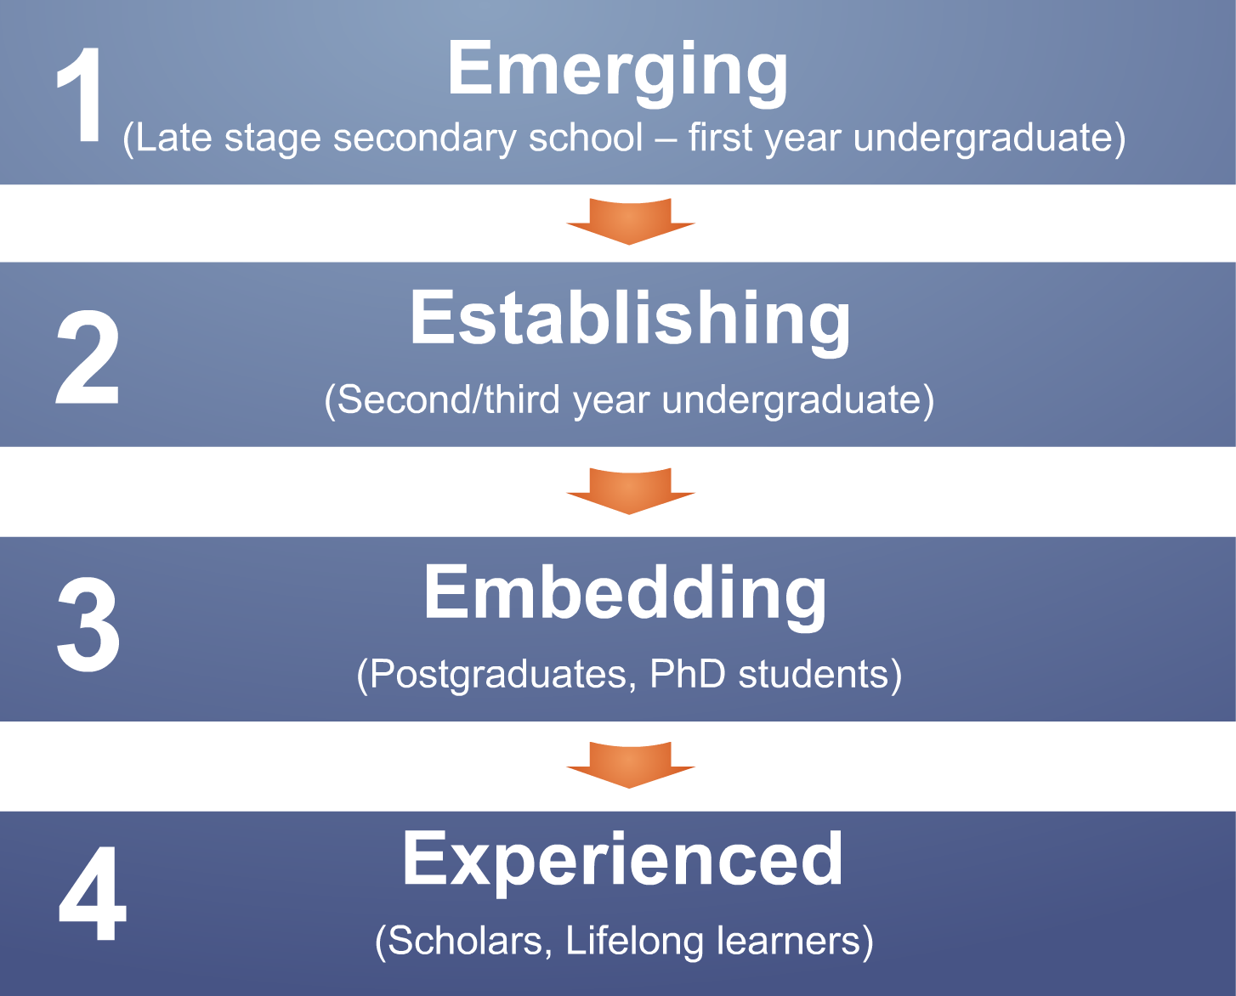
Notes:
White, David, and Lynn Silipigni Connaway. Visitors & Residents: What Motivates Engagement with the Digital Information Environment. 2011-2012. Funded by JISC, OCLC, and Oxford University. http://www.oclc.org/research/activities/vandr/.
Phase I and 2: Participant Demographics (All Stages)
There were 31 Emerging participants, and 10 each for Establishing, Embedding, and Experienced.
15 Secondary students, 46 University students and faculty
Ethnicities (All)
5 African-American, 38 Caucasian, 2 Two or more, 1 Asian, 2 Hispanic, 13 Unidentified
Genders (All)
34 females, 27 males
Economic class:
Attempts were made to recruit secondary students from schools with a wide range of socio-economic backgrounds. This is basically a convenience sample of students—those who were willing to be interviewed by us, in institutions that allowed us entry.
We also asked questions about parents’ educational backgrounds, and current/past vocations, to enrich our picture of interviewee backgrounds. We then analyzed the highest degree attained (the parents’ highest degree attained for students) to create an economic proxy.
Phase 1:
Interviewed Emerging educational stage individuals
Majority of students aged 18 & 19 with a few outliers
Phase 2:
Interviewed individuals in
Establishing (second/third year undergraduate),
Embedding (postgraduates, PhD students), &
Experienced (Scholars) stages
Some Phase 1 and Phase 2 participants agreed to submit monthly diaries (8 in the US and 6 in the UK)
Phase 3:
Continue interviews
Continue collecting diaries
Test interview & diary results with in-depth survey
50 participants from each educational stage from US & UK
Phase 4:
Interview second group of 12 students in Emerging stage
Help determine if methods of engagement change over time

Slide 15
Academic Disciplines (By Stages)
Notes:
These are the Academic Disciplines for the 46 participants not labeled as still being in Secondary school (Undergraduates, Graduates, and Faculty), pulled from all 4 educational stages.
Because there were so many majors and disciplines, they have been filtered down to the six basic groups. You can find them here http://en.wikipedia.org/wiki/List_of_academic_disciplines.
Professions & Applied Sciences: Agriculture, Architecture and Design, Business, Divinity, Education, Engineering, Environmental Studies and Forestry, Family and Consumer Science, Health Science, Human Physical Performance and Recreation, Journalism, Media Studies and Communication, Law, Library and Museum Studies, Military Sciences, Public Administration, Social Work, Transportation.
Natural sciences: Space sciences, Earth sciences, Life sciences, Chemistry, Physics
Formal sciences: Computer sciences, Logic, Mathematics, Statistics, Systems science
Emerging
8 Professions and Applied Sciences (3 UK, 5 US)
2 Undeclared (0 UK, 2 US)
2 Humanities (2 UK, 0 US)
2 Natural Sciences (2 UK, 0 US)
1 double major (0 UK, 1 US)
1 Social Sciences (0 UK, 1 US)
Establishing
4 Professions and Applied Sciences (3 UK, 1 US)
4 double major (1 UK, 3 US)
1 Humanities (1 UK, 0 US)
1 Formal Sciences (0 UK, 1 US)
Embedding
2 Professions and Applied Sciences (2 UK, 0 US)
3 Humanities (3 UK, 0 US)
2 Natural Sciences (0 UK, 2 US)
3 Unidentified (0 UK, 3 US)
Experiencing
2 Humanities (2 UK, 0 US)
3 Professions and Applied Sciences (2 UK, 1 US)
1 Social Sciences (1 UK, 0 US)
1 Natural Sciences (0 UK, 1 US)
3 Unidentified (0 UK, 3 US)
White, D. S., & Connaway, L. S. (2011-2012). Visitors and residents: What motivates engagement with the digital information environment. Funded by JISC, OCLC, and Oxford University. Retrieved from http://www.oclc.org/research/activities/vandr/

Slide 16
Emerging, Establishing, Embedding, Experienced
Convenience,
ease of use,
accessibility
Connection,
sharing with
others
Authority,
legitimacy
Relevance
Distraction
Create
Reliability
Searching
Collaborate
Speed
Fun,
enjoyment
Quantity
Visitors and Residents
Notes:
N=61 (31 Emerging 10 for the each of the other stages)
Give an overview of the ways in which our participants engage – emphasise that Connection and Collaborate are quite high here.
“Oh, definitely one of my teachers just being able to appear, definitely. Just to be able to have maybe a professor or someone that is an expert in that area, and just for them to be there when I want them to, so that if I don’t get something they can explain it to me. Because that’s the other thing, it’s more verbal communication that I find easier, so not always the website, although I do usually use the internet it’s not my preferred choice. So I would usually speak to someone about it. ” (UKS4, Secondary School, Female, Age 17, Digital Visitors and Residents)
= Importance of people as potential sources—says that although uses internet most often, isn’t actually preferred method/source.
This is the counterpoint view from faculty:
“I don’t get involved with things like Facebook and Twitter. I have major misgivings about the confidentiality of things such as that and the fact that people do trawl it to see who said what, and it’s not easy to wipe off what you said at some later stage. …I don’t have an objection to them in principle, but I think in practice they can actually be quite dangerous weapons.” (UKF4 Faculty, Economics, Male, Age 57, Digital Visitors and Residents)

Slide 17
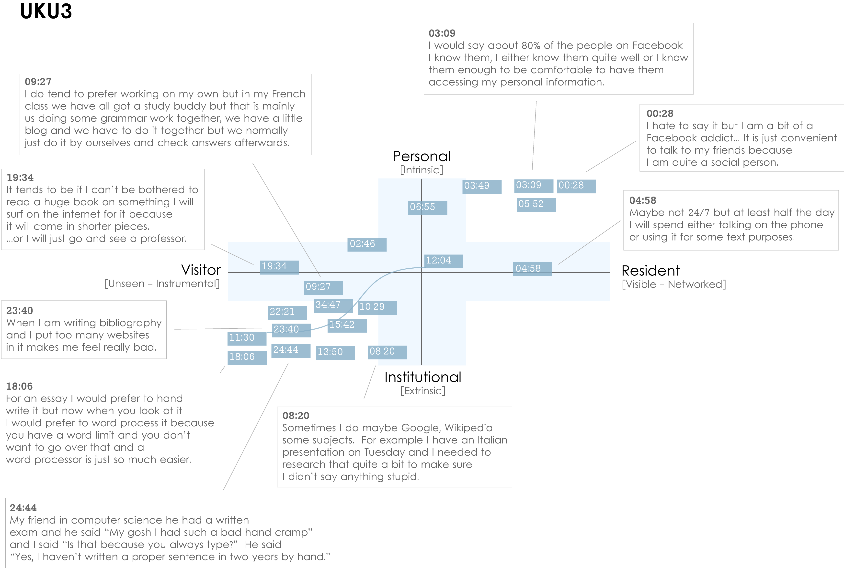
Notes:
Institutional Resident Gap
UKU3 (UK 1st year undergraduate)
This participant has a clear demarcation between Resident modes of engagement in her personal life and Visitor modes of engagement for study.
The map is a mode of engagement landscape onto which individuals can be plotted. The limits of the map have been defined by the four major framing concepts of the project: V&R – Personal and Institutional. The Personal end of the axis encompasses an individual’s private life, and the Institutional is their professional and/or academic life.
The data from the Emerging educational stage seem to suggest that individuals were engaging with systems and materials not provided by their institutions to do institutional work (e.g., consulting Wikipedia to write an essay). Such user-owned literacies, when mapped like this, take a prominent role in the academic work of many of our research subjects. Given the effect that the internet is having on collapsing the relationship between certain modes of activity and specific physical spaces, it is important not to tie notions of the intuitional and the personal to ideas of “school/university/library” and “home” as buildings.
White, D., & Connaway, L.S. Visitors & Residents: What Motivates Engagement with the Digital Information Environment. 2011-2012. Funded by JISC, OCLC, and Oxford University. http://www.oclc.org/research/activities/vandr/.

Slide 18
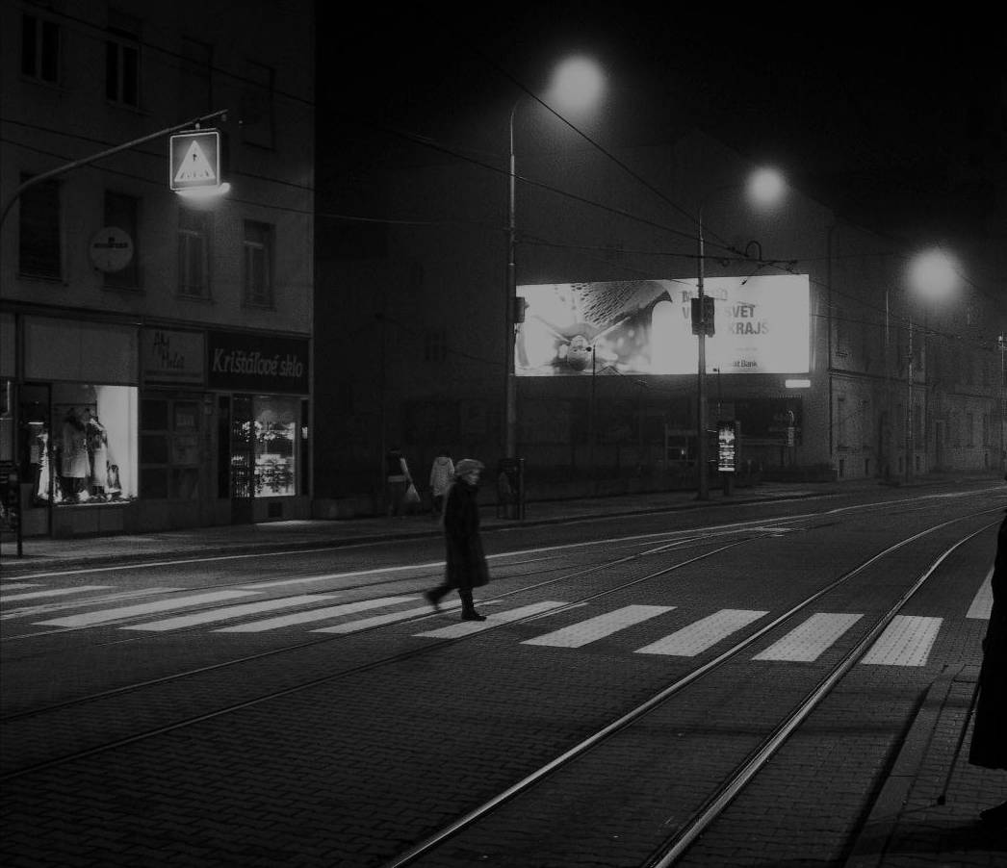
The Learning Black Market
Covert online study habits
Wikipedia
Don’t cite
Widely used
Guilt
Students & teachers disagree
Quality sources
http://wp.me/pLtlj-fH
There are alternate ways to get info you need
(White & Le Cornu, 2011)
Notes:
Image: http://wp.me/pLtlj-fH
There is a “Learning Black Market”: learners use non-traditional sources but feel they cannot talk about them in an institutional context. Wikipedia usage is an example of this. (White & Connaway, 2011)
White, D. S., & Le Cornu, A. (2011). Visitors and Residents: A new typology for online engagement. First Monday, 16(9). Retrieved from http://firstmonday.org/htbin/cgiwrap/bin/ojs/index.php/fm/article/viewArticle/3171/3049

Slide 19
Taking Action

Slide 20
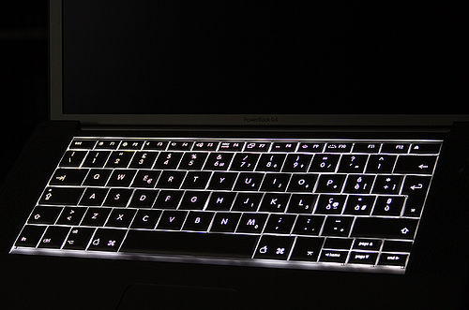
What We Can Improve
OPACs
Traditional library source access
Full-text online sources
Library systems as search engines & web services
Advertise resources, brand & value
Provide search help at time of need
Chat & IM help during search
Mobile technology
‘Resident’ modes of engaging users (on & off-line)
Counter perception of institution as physical space
Better understand user web behavior
Need help?
(Dervin, Connaway & Prabha, 2003-2006)
Notes:
OPACs are difficult to use; this belief is held by all participants (pp. 11-14)
“Make it as easy as a Google Book Search,” one survey respondent requested when discussing the catalog (Calhoun et al. 2009, p. 14).
One survey respondent suggested, “I wish the results page would list a short blurb (one line) about the book similar to the way Google shows you a tiny bit about what a site link is about” (Calhoun et al. 2009, p. 17).
Calhoun, K., Cantrell, J., & Gallagher, P. (2009). Online catalogs: What users and librarians want: An OCLC report. Dublin, OH: OCLC. Retrieved from http://www.oclc.org/us/en/reports/onlinecatalogs/default.htm
Dervin, B., Connaway, L.S., & Prabha, C. 2003-2006 Sense-making the information confluence: The whys and hows of college and university user satisficing of information needs. Funded by the Institute of Museum and Library Services (IMLS). http://imlsosuoclcproject.jcomm.ohio-state.edu/ (pp. 11-14, 16-17)
Use electronic mediation to reach more traditional library resources, such as Google, Facebook with friends, etc. (pp.11-14)
More online sources, including all print and other physical materials available online (pp.16-17)
Online catalogs: What users and librarians want, 2009. DIS, p. 18.
Information studies students: (Bertot, et al., 2012, p. 213)
28% use OPAC daily or weekly
86% use Google daily or weekly
Bertot, J. C., Berube, K., Devereaux, P., Dhakal, K., Powers, S., & Ray, J. (2012). Assessing the usability of WorldCat Local: Findings and considerations. The Library Quarterly, 82(2), 207-221.
Link users to special collections
Facebook (“On Facebook, Librarian Brings 2 Students From the Early 1900s to Life,” January 6, 2012, Nick DeSantis, Chronicle of Higher Education. http://chronicle.com/blogs/wiredcampus/on-facebook-librarian-brings-two-students-from-the-early-1900s-to-life/34845
Joe McDonald, sophomore at University of Nevada, Reno in 1913, and girlfriend and future wife, Leola Lewis
University of Washington includes its special collections in the references in Wikipedia
Library systems need to look and function more like search engines, e.g., Google and Yahoo, and services, e.g., Amazon.com since these are familiar to users who are comfortable and confident in using them (p.5).
36% of respondents reported being extremely familiar with search engines while only 26% reported being very familiar with libraries (p. 1-8)
VRS meets users where they are
Text, e-mail, chat
Librarians’ expertise can deliver quality sources to users through VRS that they cannot find with a Google search
“However, I would have used Google if I had had internet connection, because if you spell something incorrectly, there is a notice saying “did you mean to spell ____?” with the correct spelling of the word. So that would have been my first choice of thing to do in this situation, but the dictionary application worked fine since I did not have internet connection.” (USS3 , Emerging, Diary 2 / 5/15/2011, Female, Age 19, Digital Visitors and Residents)
Connaway, L. S., & Dickey, T. J. (2010). The digital information seeker: Report of findings from selected OCLC, RIN, and JISC user behavior projects. Retrieved from http://www.jisc.ac.uk/media/documents/publications/reports/2010/digitalinformationseekerreport.pdf
De Rosa, C. (2005). Perceptions of libraries and information resources: A report to the OCLC membership. Dublin, Ohio: OCLC Online Computer Library Center (p.1-8).
White, D., & Connaway, L. S. (2011). Visitors and residents: What motivates engagement with the digital information environment. Funded by JISC, OCLC, and Oxford University. http://www.oclc.org/research/activities/vandr/
Libraries and librarians need to work to counter the notion of the library as only a physical space. There should be more ‘Resident’ practice both on and off line e.g. Posting information experts in departments, placing collection links on Wikipedia, providing links to expertise and services via social media etc.

Slide 21
Making the Library More Attractive
User-centered development approach
Metadata creation
Interface design
Mobile
Chat/IM
(Center for Information Behaviour and the Evaluation of Research, 2008)
Notes:
Convenience
Instant gratification at a click (p. 8)
Provide seamless access to digital content
Deliver answers (p. 8)
User-centered development approach
Serve different constituencies
Adapt to changing user behaviors
Create metadata based on user needs
Centre for Information Behaviour and the Evaluation of Research. (2008). Information
behaviour of the researcher of the future: A CIBER briefing paper. London: CIBER (p. 8).
Digital Information Seeker, pg. 45.
A synthesis of findings from these major user studies points toward a number of implications for libraries. The implications below represent broad tendencies. The various user studies themselves do take into account differences in behaviour based on age and gender of the subjects, and context and situation of the information needs. Differences based on academic discipline have been a common finding throughout the user behaviour studies. Even though the studies ask different questions of their subjects, the findings present a rich portrait of user behaviours. In order to generalize findings and to present a valid portrait of user behaviours, it is necessary to conduct longitudinal studies of large populations.
Implications for libraries which are shared by multiple studies include the following:
The library serves many constituencies, with different needs and behaviours.
Library systems must do better at providing seamless access to resources.
Librarians must increasingly consider a greater variety of digital formats and content.
Both academics and non-academics believe more digital resources of all kinds are better.
Library systems and content must be prepared for changing user behaviours.
High-quality, robust metadata is becoming more important for discovery of appropriate resources.
The library must advertise its brand, its value, and its resources better within the community.
Connaway, L. S., & Dickey, T. J. (2010). The digital information seeker: Report of findings from selected OCLC, RIN, and JISC user behavior projects. Retrieved from http://www.jisc.ac.uk/media/documents/publications/reports/2010/digitalinformationseekerreport.pdf

Slide 22
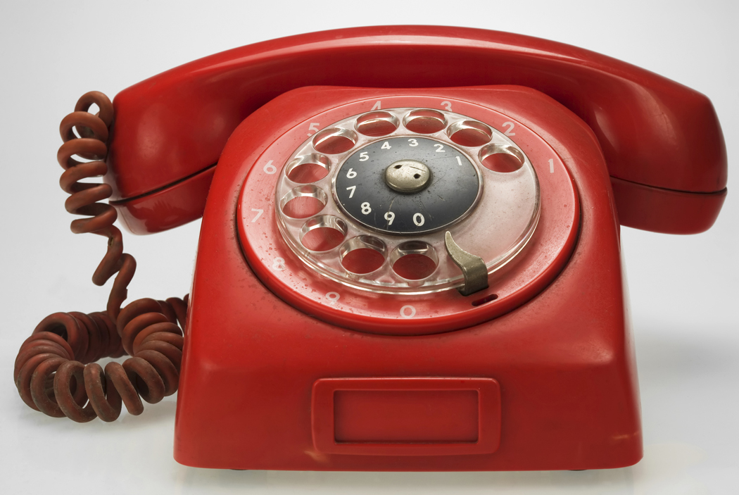
Future Research
Digital Visitors & Residents
Online survey
Continue with diaries & interviews
Initial interviews & monthly diaries with 6 new Emerging Stage participants
Develop tool kits
Educational Technology
Library
Notes:
White, D., & Connaway, L.S. (2011). Visitors and Residents: What Motivates Engagement with the Digital Information Environment. Funded by JISC, OCLC, and Oxford University. http://www.oclc.org/research/activities/vandr/.

Slide 23
References
Bertot, J. C., Berube, K., Devereaux, P., Dhakal, K., Powers, S., & Ray, J. (2012). Assessing the usability of WorldCat Local: Findings and considerations. The Library Quarterly, 82(2), 207-221.
Calhoun, K., Cantrell, J., & Gallagher, P. (2009). Online catalogs: What users and librarians want: An OCLC report. Dublin, OH: OCLC. Retrieved from http://www.oclc.org/us/en/reports/onlinecatalogs/default.htm
Centre for Information Behaviour and the Evaluation of Research. (2008). Information behaviour of the researcher of the future: A CIBER briefing paper. London: CIBER. Retrieved from h http://www.jisc.ac.uk/media/documents/programmes/reppres/gg_final_keynote_11012008.pdf
Centre for Information Behaviour and the Evaluation of Research. (2009). JISC user behavior observational study. London: CIBER.
Connaway, L. S., Dickey, T. J. (2009). Towards a profile of the researcher of today: What can we learn from JISC projects? : Common themes identified in an analysis of JISC virtual research environment and digital repository projects. Retrieved from http://repository.jisc.ac.uk/418/2/VirtualScholar_themesFromProjects_revised.pdf
Connaway, L. S., & Dickey, T. J. (2010). The digital information seeker: Report of findings from selected OCLC, RIN, and JISC user behavior projects. Retrieved from http://www.jisc.ac.uk/media/documents/publications/reports/2010/digitalinformationseekerreport.pdf
Connaway, L. S., Dickey, T. J., & Radford, M. L. (2011). "If it is too inconvenient I'm not going after it": Convenience as a critical factor in information-seeking behaviors. Library & Information Science Research, 33(3).
Connaway, L. S., Prabha, C., and Dickey, T. J. (2006). Sense-making the information confluence: The whys and hows of college and university user satisficing of information needs. Phase III: Focus group interview study. Report on National Leadership Grant LG-02-03-0062-03, to Institute of Museum and Library Services, Washington, D.C. Columbus, Ohio: School of Communication, The Ohio State University.

Slide 24
References
Connaway, L. S., & Radford, M. L. (2011). Seeking synchronicity: Revelations and recommendations for virtual reference. Dublin, OH: OCLC Research. Retrieved from http://www.oclc.org/reports/synchronicity/full.pdf
Connaway, L. S., Radford, M. L., Dickey, T. J., DeAngelis Williams, J., & Confer, P. (2008). Sense-Making and synchronicity: Information-Seeking behaviors of Millennials and Baby Boomers. Libri (58) 2, 123-135.
Consortium of University Research Libraries, and Research Information Network. (2007). Researchers' use of academic libraries and their services: A report. London: Research Information Network and Consortium of University Research Libraries (CURL).
Dempsey, L. (2008). Always on: Libraries in a world of permanent connectivity. First Monday [Online], (14)1. Retrieved from http://www.firstmonday.org/htbin/cgiwrap/bin/ojs/index.php/fm/article/view/2291/2070
De Rosa, C. (2005). Perceptions of libraries and information resources: A report to the OCLC membership. Dublin, Ohio: OCLC Online Computer Library Center. Retrieved from http://www.oclc.org/us/en/reports/2005perceptions.htm
De Rosa, C. (2006). College students' perceptions of libraries and information resources: A report to the OCLC membership. Dublin, Ohio: OCLC Online Computer Library Center. Retrieved from http://www.oclc.org/us/en/reports/perceptionscollege.htm
Dervin, B., Connaway, L.S., & Prabha, C. (2003-2006). Sense-making the information confluence: The whys and hows of college and university user satisficing of information needs. Funded by the Institute of Museum and Library Services (IMLS).
Dervin, B, & Reinhard, C. L. D. (2007). Sense-making the information confluence: The whys and hows of college and university user satisficing of information needs. Final Report. Report on National Leadership Grant LG-02-03-0062-03, to Institute of Museum and Library Services, Washington, D.C. Columbus, Ohio: School of Communication, The Ohio State University.

Slide 25
References
Dervin, B., Reinhard, C. L. D., Adamson, S. K., Lu, T. T., Karnolt, N. M., & Berberick, T. (Eds.) (2006). Sense-making the information confluence: The whys and hows of college and university user satisficing of information needs. Phase I: Project overview, the Three-Field Dialogue project, and state-of-the-art reviews. Report on National Leadership Grant LG-02-03-0062-03, to Institute of Museum and Library Services, Washington, D.C. Columbus, Ohio: School of Communication, The Ohio State University.
Dervin, B., Reinhard, C. L. D., Kerr, Z. Y., Song, M., & Shen, F. C. (Eds.) (2006). Sense-making the information confluence: The whys and hows of college and university user satisficing of information needs. Phase II: Sense-making online survey and phone interview study. Report on National Leadership Grant LG-02-03-0062-03 to Institute of Museum and Library Services, Washington, D.C. Columbus, Ohio: School of Communication, Ohio State University.
De Santis, N. (2012, January 6). On Facebook, librarian brings 2 students from the early 1900s to life. Chronicle of Higher Education. Retrieved from http://chronicle.com/blogs/wiredcampus/on-facebook-librarian-brings-two-students-from-the-early-1900s-to-life/34845
Hampton-Reeves, S., Mashiter, C., Westaway, J. , Lumsden, P., Day, H., Hewerston, H. & Hart, A. (2009). Students’ use of research content in teaching and learning: A report of the Joint Information Systems Council (JISC). Retrieved from http://www.jisc.ac.uk/media/documents/aboutus/workinggroups/studentsuseresearchcontent.pdf
JISC and UCL. (2009). JISC national e-books observatory project: Key findings and recommendations: Final report.
Prabha, C., Connaway, L.S. & Dickey, T.J. (2006). Sense-making the information confluence: The whys and hows of college and university user satisficing of information needs. Phase IV: Semi-structured interview study. Report on National Leadership Grant LG-02-03-0062-03, to Institute of Museum and Library Services, Washington, D.C. Columbus, OH: School of Communication, The Ohio State University.

Slide 26
References
Radford, M. L., & Connaway, L. S. (2008). Seeking synchronicity: Evaluating virtual reference services from user, non-user, and librarian perspectives: IMLS final performance report. Report on Grant LG-06-05-0109-05, to Institute of Museum and Library Services, Washington, D.C. Dublin, OH: OCLC Online Computer Library Center.
Research Information Network. (2006). Researchers and discovery services: Behaviour, perceptions and needs. London: Research Information Network. Retrieved from http://www.rin.ac.uk/our-work/using-and-accessing-information-resources/researchers-and-discovery-services-behaviour-perc
Research Information Network. (2009). E-journals: Their use, value and impact. London: Research Information Network. Retrieved from http://www.rin.ac.uk/our-work/communicating-and-disseminating-research/e-journals-their-use-value-and-impact
Wasserman, S. (2012, June 18). The amazon effect. The Nation. Retrieved from http://www.thenation.com/article/168125/amazon-effect
White, D., & Connaway, L.S. (2011). Visitors and Residents: What Motivates Engagement with the Digital Information Environment. Funded by JISC, OCLC, and Oxford University. Retrieved from http://www.oclc.org/research/activities/vandr/
White, D. S., & Le Cornu, A. (2011). Visitors and Residents: A new typology for online engagement. First Monday, 16(9). Retrieved from http://firstmonday.org/htbin/cgiwrap/bin/ojs/index.php/fm/article/viewArticle/3171/3049
Wong, W., Stelmaszewska, H., Bhimani,N., Barn, S., & Barn, B. (2009). User behaviour in resource discovery: Final report. Retrieved from http://www.jisc.ac.uk/media/documents/publications/programme/2010/ubirdfinalreport.pdf

Slide 27
Questions & Discussion
Lynn Silipigni Connaway connawal@oclc.org
Notes:
27
27
27

