Slide 1
Usability: What’s Hot, What’s Not
Dr. Lynn Silipigni Connaway
Senior Research Scientist
connawal@oclc.org
Usability Programme Meeting
London, UK
1 June 2011

Slide 2
What’s Hot
Search is KING
Simple Search
Prioritize results on documents’ importance
Best Bets
Notes:
Ensure that the search box on your website is easy to see. Dark backgrounds and fancy graphics will impair usability, so keeping it white or light gray is best. Also, make sure the search box is large enough relative to other important elements on the page, thus maintaining its position in the visual hierarchy.
Image Notes: Google, YouTube, baidu.com (top Chinese search engine), Amazon.

Slide 3
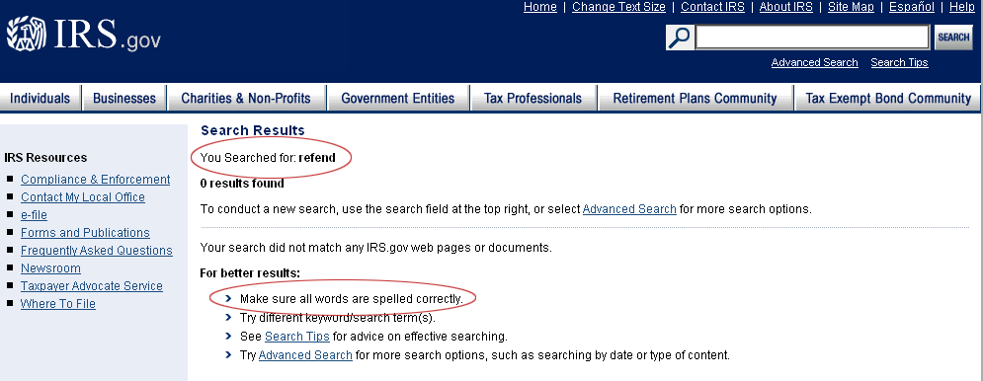
What’s Not
Bad Search
Unable to handle typos, plurals, & hyphens
Results prioritized on number of query terms
Notes:
Image Notes: You would think the IRS would be able to handle the misspelling of refund.. It has to be one of their top search terms.

Slide 4
What’s Hot
Write for online, NOT print

Slide 5
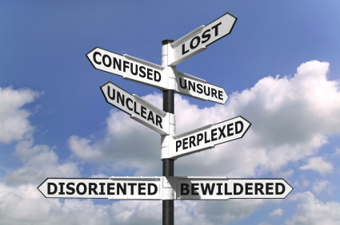
What’s Not
Not answering users’ questions or solving their problems
Notes:
What visitors care about is solving their problems. Now. Most people visit a website to solve one or more of these four problems:
They want/need information
They want/need to make a purchase / donation.
They want/need to be entertained.
They want/need to be part of a community.

Slide 6
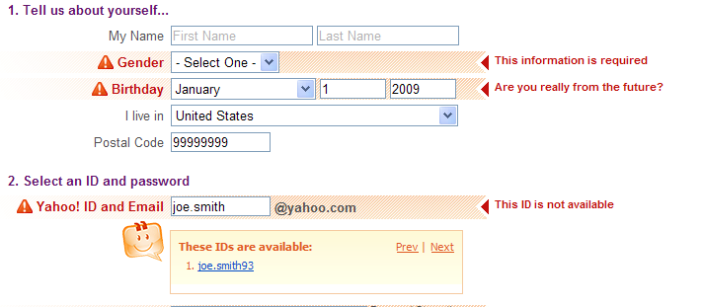
What’s Hot
Notify users when system fails
Give descriptive messages and progress indicators
Notes:
A variant on lack of feedback is when a system fails to notify users that it's taking a long time to complete an action. Users often think that the application is broken, or they start clicking on new actions.
From: http://quince.infragistics.com/Patterns/Inline%20Validation.aspx?lang=en
Yahoo sign up form; consistent across the form in how and where they indicate problems, surrounding problem fields with red, turning the label red, adding a warning icon, and augmenting this will the error message to the right, which points at the field it refers to. You can’t get much more explicit and effective with your validation problem messages than this.

Slide 7
What’s Not
Inconsistency
Remember the double-D rule:
differences are difficult
Notes:
Using the same name for the same thing in the same place makes things easy.

Slide 8
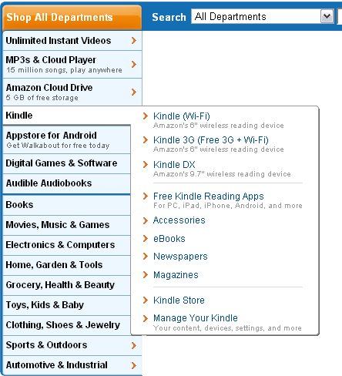
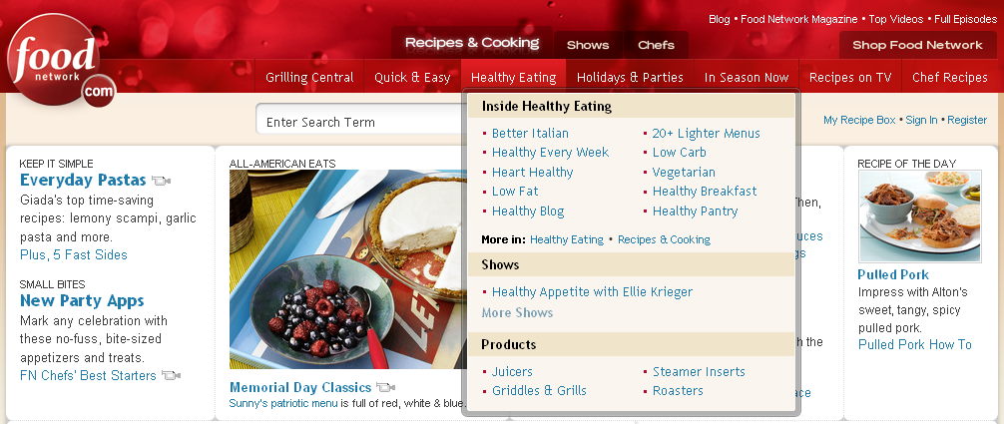
What’s Hot
Browsing hierarchies
Notes:
Avoid lists of links – users don’t want to scroll through them.
Image Notes:
Images from: http://www.foodnetwork.com/
Large, overall hierarchy across top… select one.. Additional menus are broken down by product types.
http://www.amazon.com/ - everyone is familiar with Amazon’s hierarchy and menuing…

Slide 9
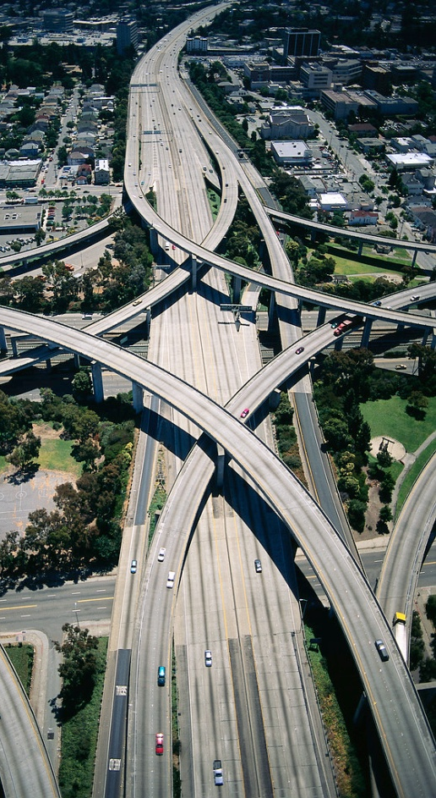
What’s Not
Overdevelopment

Slide 10
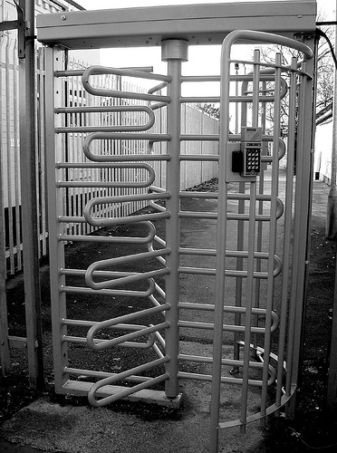
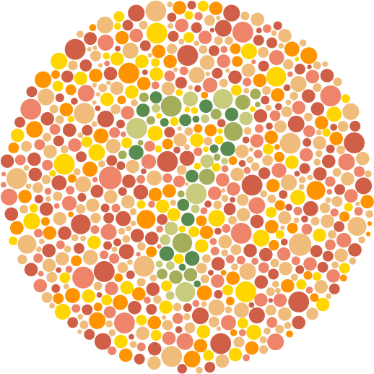
What’s Hot
Accessibility
Notes:
Don’t embed in PDF
Color coding is not relevant for those who are color blind
People don’t understand images without explanation
The turnstile photo is from Flickr - http://www.flickr.com/photos/30890318@N06/3031865704/
Note the CC Flickr user name is actually insert_user_name

Slide 11
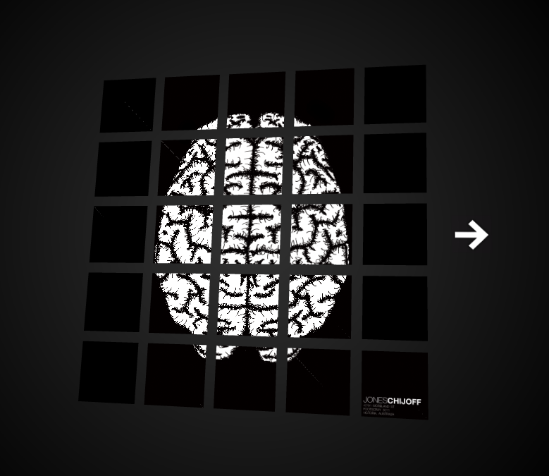
What’s Not
Style no substance
Notes:
Flashing objects, videos – distractions; cannot find what you may be looking for; takes long to download
Image: this page lots of Flash, not substance or any idea what its for, or what the boxes do… http://www.joneschijoff.com/.
Really, really strange. Page does absolutely nothing – bottom corner is owners name and address I guess.

Slide 12
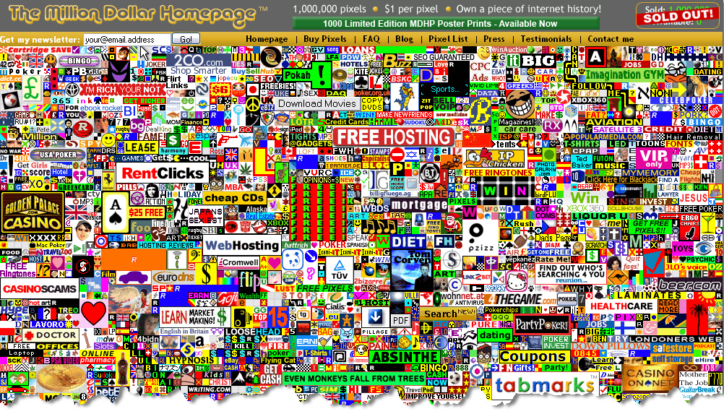
What’s Not
Style no substance
Notes:
Flashing objects, videos – distractions; cannot find what you may be looking for; takes long to download
Image: this page has no style or substance, but it’s awesome -http://www.milliondollarhomepage.com/

Slide 13
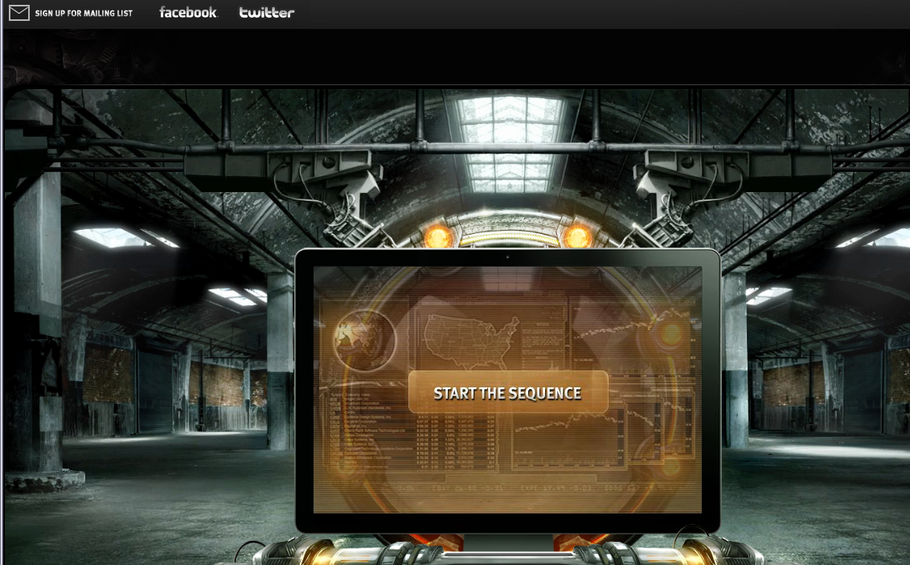
What’s Not
Style no substance
Notes:
Flashing objects, videos – distractions; cannot find what you may be looking for; takes long to download
Image: this page is: http://www.start-the-change.org/
It loads this lovely Flash movie, lots of voice over… but nowhere on the page itself does talk about the product, or what they are selling.

Slide 14
What’s Hot
User-centered development!
Talk to and listen to the users
Notes:
Camels - http://www.flickr.com/photos/peternijenhuis/199686509/sizes/m/in/photostream/

Slide 15
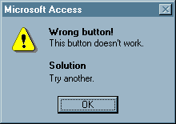
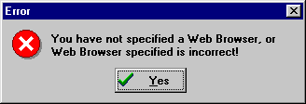
What’s Not
Ambiguous or incorrect error messages
Don’t blame the user for failures of the programmer!
Notes:
Image is from: http://homepage.mac.com/bradster/iarchitect/errormsg.htm (not sure how you want attribute these)

Slide 16
Selected Readings
“Interface Hall of Shame.” Isys Information Architects. http://homepage.mac.com/bradster/iarchitect/shame.htm (accessed May 24, 2011).
Krug, Steve. Don’t Make Me Think: A Common Sense Approach to Web Usability. Berkeley, CA: New Riders, 2006.
Lazaris, Louis. “Best Practices for 6 Common User Interface Elements.” Webdesigner Depot (November 5, 2009), http://www.webdesignerdepot.com/2009/11/best-practices-for-6-common-user-interface-elements/.

Slide 17
Selected Readings
Nielsen, Jakob. “Top-10 Application-Design Mistakes.” Alertbox (February 19, 2008), http://www.useit.com/alertbox/application-mistakes.html.
Nielsen, Jakob. “Top 10 Mistakes in Web Design.” Alertbox (2011), http://www.useit.com/alertbox/9605.html.
Nielsen, Jakob. “Usability in the Movies—Top 10 Bloopers.” Alertbox (December 18, 2006), http://www.useit.com/alertbox/film-ui-bloopers.html.
“User Interface Design.” Usernomics: A Division of Interface Analysis Associates. http://www.usernomics.com/user-interface-design.html (accessed May 24, 2011).

Slide 18
Image Credits
What’s Not: Bad Search: http://www.irs.gov/
What’s Hot: Search is King: http://www.google.com, http://www.youtube.com, http://www.baidu.com, http://www.amazon.com
What’s Not: Notify users when systems fail: http://quince.infragistics.com/Patterns/Inline%20Validation.aspx?lang=en
What’s Hot: Browsing hierarchies: http://www.foodnetwork.com, http://www.amazon.com
What’s Not: Style no substance: http://www.milliondollarhomepage.com/
What’s Not: Style no substance: : http://www.start-the-change.org/
What’s Hot: Accessibility: http://colorvisiontesting.com/, CC insert_user_name: http://www.flickr.com/photos/30890318@N06/3031865704/
What’s Not: Ambiguous or incorrect error messages: http://homepage.mac.com/bradster/iarchitect/errormsg.htm
What’s Hot: User Centered Development: CC Peter Nijenhuis: http://www.flickr.com/photos/peternijenhuis/199686509/

Slide 19
Group Work
Four groups (based on the colour of your badge)
Describe your website/tool to the group
Choose one of the resources and group discusses its main usability/learnability issues
Prioritise the top 2 issues associated with the resource you discussed
One person present back from each group
What was the resource you selected?
What were the top two usability/learnability issues?

