Slide 1
Terramo, Italy • 15 October 2018
Factors Influencing Research Data Management Programs
Lynn Silipigni Connaway, PhD
Director of Library Trends and User Research
connawal@oclc.org
@LynnConnaway

Slide 2
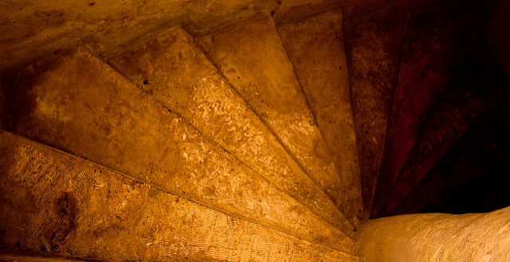
Research data management (RDM) programs
“activities and processes…involving the design and
creation of data, storage, security, preservation,
retrieval, sharing, and reuse, all taking into account
technical capabilities, ethical considerations, legal
issues and governance frameworks.”
(Cox and Pinfield, 2014, p. 300)
Image: https://www.flickr.com/photos/darioalba/5327305159 by Kellerio2007 / CC BY-NC 2.0
Notes:
Image: https://www.flickr.com/photos/darioalba/5327305159 by Kellerio2007 / CC BY-NC 2.0
Andrew M. Cox and Stephen Pinfield, “Research Data Management and Libraries: Current Activities and Future Priorities,” Journal of Librarianship and Information Science 46, no. 4 (2014): 300, doi:10.1177/0961000613492542.
Pinfield, Cox, and colleagues went on to develop a library focused institutional RDM model based on a qualitative study of librarians in the UK. The model describes 4 key components of an RDM program - drivers, program elements, influencing factors, and stakeholders. See Stephen Pinfield, Andrew M. Cox, Jen Smith, and Pascal Launois, “Research Data Management and Libraries: Relationships, Activities, Drivers and Influences,” PLoS ONE 9, no. 12 (2014): e114734, accessed September 12, 2016, http://journals.plos.org/plosone/article?id=10.1371/journal.pone.0114734.

Slide 3
The Study
Notes:
Of particular interest for this current study were the factors that influence (facilitate/constrain) librarians’ ability to support researchers’ RDM needs.
It focuses on librarians’ experiences with RDM in the United States and it is also qualitative.

Slide 4

Research methodology
Data Collection
Individual interviews (n=10)
Focus group interviews (n=26)
Data Analysis
1st cycle coding
  based on interview protocols
  more codes added as necessary
2nd cycle of thematic and numerical analysis of influencing factors
Image: https://www.flickr.com/photos/pagedooley/7427165626 by Kevin Dooley / CC BY 2.0
Notes:
Image: https://www.flickr.com/photos/pagedooley/7427165626 by Kevin Dooley / CC BY 2.0
Data were collected through individual interviews and three focus groups.
In the individual interviews, 10 library professionals were asked about current and planned RDM services, advantages and challenges associated with helping researchers with RDM, what made it difficult and easy to spend time helping researchers, supporters versus detractors of RDM efforts, and perceived competence and confidence that they were helping researchers and meeting needs.
Next, 26 library professionals participated in one of three focus groups. Modeled after the individual interviews, the focus group interview questions had similar topics of inquiry.
During data analysis, an initial set of codes were developed based on the interview protocols and the set was expanded as new codes emerged from analysis of the transcripts. The results are based on a second cycle of thematic and numerical analysis of the influencing factors.

Slide 5
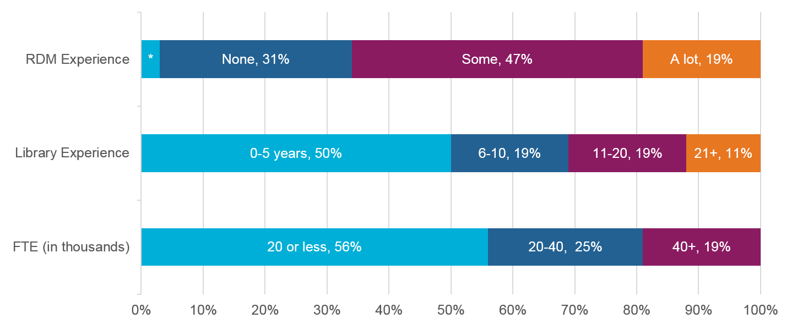
Snapshot of library professionals
*Not indicated, 3%
The percentages sum to less than 100 due to rounding.
n=36
Notes:
A snapshot of study participants:
66% had some or a lot of RDM experience - 47% some and 19% a lot.
69% were early in their careers with 10 years of library experience or less.
56% worked at institutions with less than 20 thousand full-time student enrollment
20,001-40,000: 25%
40,001 and More: 19%
The majority of the participants were female (86%), and less than 45 years old (53%).
They represented a variety of roles including – subject specialist, liaison librarian, scholarly communication librarian, reference librarian, data management specialist, digital initiatives librarian, and head of library systems.

Slide 6
Top 3 RDM services
67% data deposit
61% data management planning
41% data management
n=36
Notes:
Here you see, the top 3 RDM services, by the percentage of librarians who mentioned providing or planning to provide them.
A wide range of activities comprised the data deposit services. The activities ranged from reaching out to researchers to identify data for deposit, to helping them curate and document their data, to ensuring researchers’ needs were being met at disciplinary repositories. As the service levels varied, so did the time commitments depending on the work involved.
One librarian envisioned data management planning as “subject librarians meeting with grad students and faculty, and going over the guidelines for grant funding for data management, and helping them kind of understand what kind of information they're going to need to provide, in order to have a good grant proposal” (Librarian 13). This was pretty typical.
Librarians envisioned data management as a focus “on day-to-day data management…file protection, file organization, documentation as you’re collecting the data” (Librarian 22).

Slide 7
findings

Slide 8
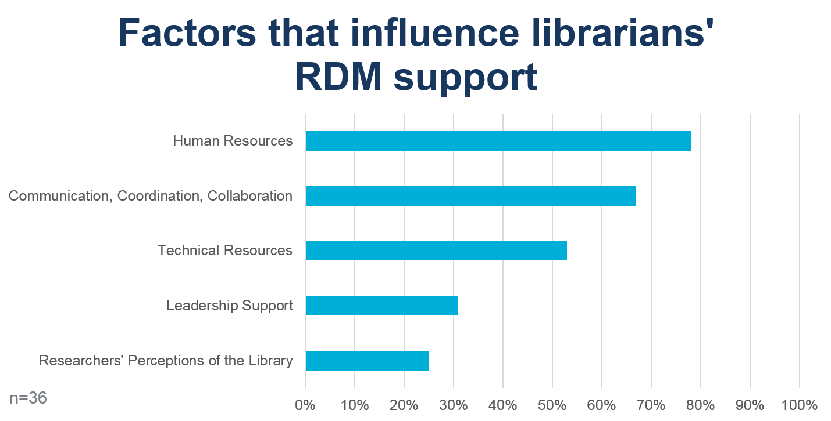
Notes:
Findings showed five factors influenced RDM programs:
Human resources (78%)
Communication, coordination, and collaboration (67%)
Technical resources (53%)
Leadership support (31%)
Researchers’ perceptions of the library (25%).
In each of these instances, librarians described situations where different aspects of the factors were perceived to facilitate and/or constrain their ability to support researchers RDM needs.

Slide 9
constraints

Slide 10
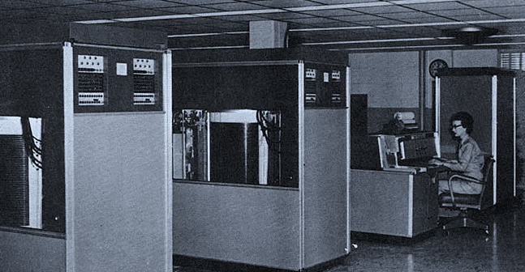
Data storage and preservation technical resources
“Are we going to look for researchers to write to their grants, data storage costs now? Because as a library, we can't afford to take on these costs…our IT folks say, ‘We can't store that in perpetuity’….”
– Librarian 16
Image: RTC from U.S. Army Red River Arsenal [Public domain], via Wikimedia Commons
Notes:
Image: RTC from U.S. Army Red River Arsenal [Public domain], via Wikimedia Commons
A little over a third of librarians (36%) mentioned challenges with data storage and preservation as a constraint on RDM services.
Sustaining institutional repositories over the long term came with challenges which included significant financial commitment. It was expected to stretch most libraries’ infrastructures beyond capacity, given shrinking budgets and uncertain pricing structures.
Long term management of the variety of file formats and whether front end functionality of current institutional repositories would support data discovery also were mentioned as challenges.
Librarians were unsure of repositories’ ability to help researchers retrieve and reuse data.

Slide 11
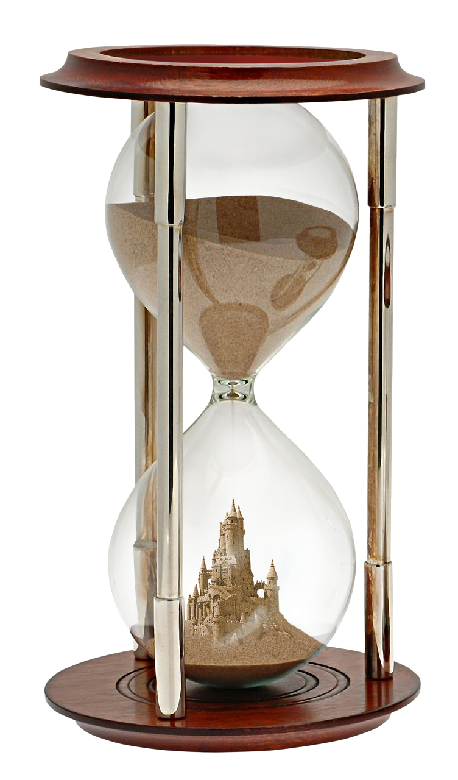
Limited time, limited experts
human resources
“…it’s just not scalable. So if we’re successful, we’re in big trouble, because we just don’t have the time, it could be a real time sink. I think it would be really fun, but I wouldn’t be able to do anything else I’m supposed to do.”
– Librarian 01
Image: Public Domain via pixabay.com
Notes:
Image: Public Domain via pixabay.com
Almost a third of librarians (31%) expressed concern over the competing demands on time that RDM services would create.
Even in the early stages, several librarians were concerned about scaling RDM with too few dedicated staff members. Librarian 01 explained the trouble with success in terms of time and scalability.
Yet hiring a team of dedicated experts was not an option for most. As Librarian 05 explained, the common model was to have librarians do a little bit of everything.
Lack of skilled staff also was a concern; 22% of the librarians mentioned it. As Librarian 22 explained, their expertise was at the end of the research lifecycle. They were not used to providing support at the beginning and middle of the research cycle as data were being collected and managed.

Slide 12
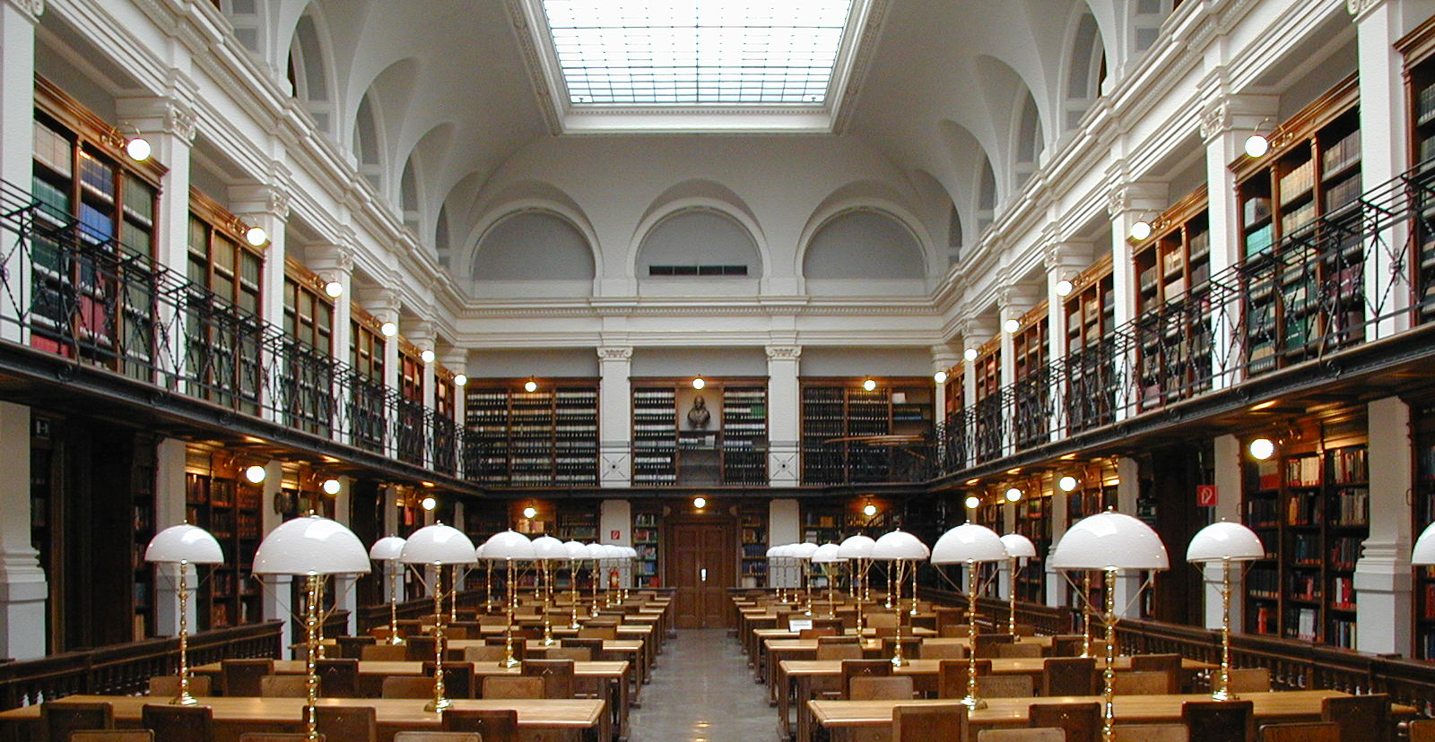
Researchers’ perceptions of the library
“But it is a challenge to get them to move from thinking of us as a big place with books. And going to this much more abstract concept of data management and preservation, and access to their materials.”
– Librarian 06
Image: Dr. Marcus Gossler (Own work) [CC BY-SA 3.0 https://creativecommons.org/licenses/by-sa/3.0/], via Wikimedia Commons
Notes:
Image: Dr. Marcus Gossler (Own work) [CC BY-SA 3.0 https://creativecommons.org/licenses/by-sa/3.0/], via Wikimedia Commons
Researchers’ perceptions about the library also constrained librarians’ ability to support researchers, according to 25% of the librarians. The key issue was that researchers did not recognize the librarians’ areas of expertise or the services that libraries could offer. Librarian 06 captured this well, many researchers’ perceptions of the libraries and librarians were tied to books.
Some librarians also acknowledged their late entry into RDM as cause for researchers’ perceptions. In some cases, researchers or their departments/schools on campus had begun to developed their own solutions.
As one librarian noted it’s difficult to introduce and embed new library services into researchers’ workflows, once the researchers had established their own practices.

Slide 13
facilitators

Slide 14
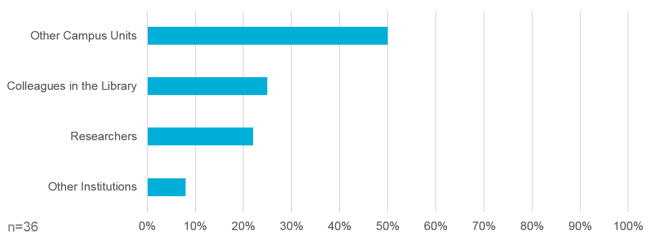
Communication, coordination, and collaboration
Notes:
Librarians described communication, coordination, and collaboration as a facilitator of RDM services.
50% mentioned communication, coordination, and collaboration with other units on campus (e.g. research office, information technology services, academic affairs, Provost’s office, etc.)
25% with colleagues in the library
22% with researchers
8% with other institutions

Slide 15
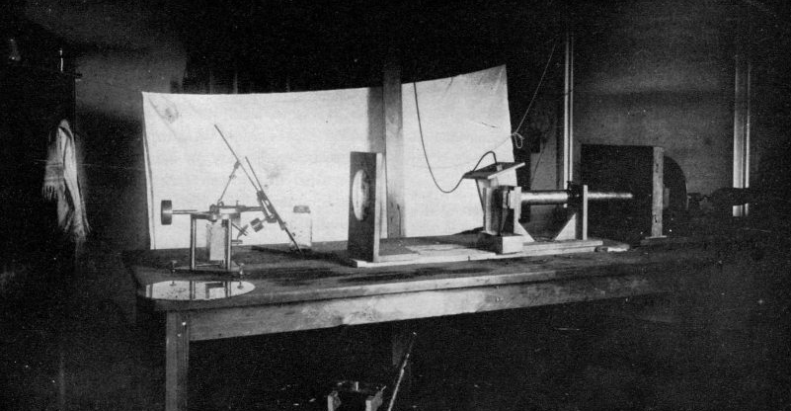
Librarians and researchers
communication, coordination, and collaboration
“I've been working in collaboration with our new STEM librarian to figure out what path the library can embark upon to assist faculty.”
- Librarian 18
Image: Volta Laboratory, 1884, Public domain, via Wikimedia Commons
Notes:
Image: Volta Laboratory, 1884, Public domain, via Wikimedia Commons
A quarter (25%) mentioned partnering with colleagues in their library. As Librarian 18 explained library colleagues helped to define, develop, and deliver RDM.
Others described pooling different areas of expertise within the library to better support researchers and spread the workload. For instance, a data manager talked about plans to work with liaison librarians to improve their data management skills so they could lead the more discipline specific questions when needed.
Almost a quarter (22%) mentioned partnering with researchers. The goal was to develop and deliver more effective RDM that matched researcher needs, or as Librarian 05 described, “getting to our communities and perceiving what the need is.”
For some librarians these exchanges led to new services – such as a data management workshop for first year graduate students. For others, it allowed for learning which departments were already supporting themselves vs. which departments needed support and for considering how to capitalize on existing activities.

Slide 16
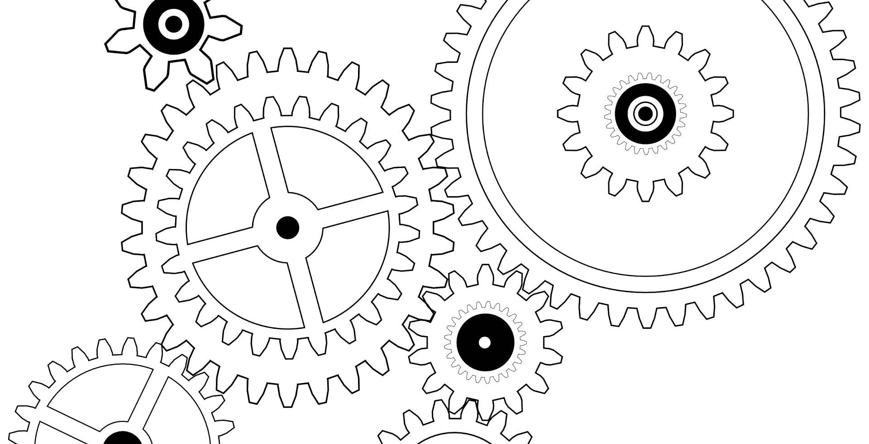
Other units, other institutions
communication, coordination, and collaboration
“It’s not a one or the other. It’s gonna be a group effort, Research Office, IT, libraries…Who knows? Maybe, I’m missing somebody.”
- Librarian 08
Image: Cogs Illustration, Public domain, via publicdomainpictures.net
Notes:
Image: Cogs Illustration, Public domain, via publicdomainpictures.net
Similar to partnerships with colleagues in the library, partnerships with other campus units was a way for librarians to further define, develop, and deliver RDM services and pool expertise. Interestingly, twice as many (50%) saw a real need to collaborate with other campus units such as the research office, information technology services, academic affairs, and the Provost’s office.
Far fewer mentioned partnering with other institutions off campus - only 8%. And only one really considered the idea of connecting with other institutions to see what they were doing and consider joint activities.

Slide 17
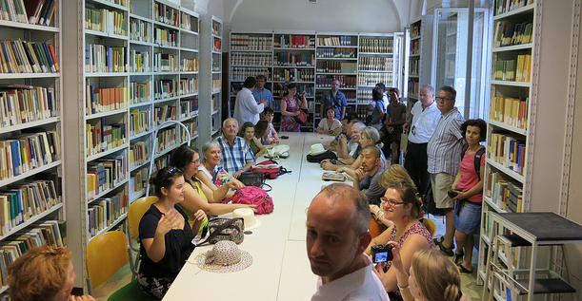
“…the plan is that, our social sciences librarians will team up with the [research center]…to get experience, to be in the room, to see exactly what kind of questions you need to ask and what kind of information you need to gather…”
- Librarian 13
Experts and education
human resources
Image: https://www.flickr.com/photos/jensvermeersch/7599314862 by Jens Vermeersch / CC BY-NC-ND 2.0
Notes:
Image: https://www.flickr.com/photos/jensvermeersch/7599314862 by Jens Vermeersch / CC BY-NC-ND 2.0
Half of the librarians (50%) discussed having a full-time expert dedicated to RDM as an ideal solution. Others found that they were able to leverage special areas of expertise to support researchers changing needs. For example:
One librarian used prior experience practicing law to develop terms of service agreements for data sharing and reuse.
Another drew on archival experiences in engineering and research and development organizations, others drew on prior experiences conducting research.
Just over half of the librarians (56%) described continuing education and on-the-job training as a facilitator of RDM services, regardless of their existing skills or expertise.
Continuing education tended to be acquired via conferences, webinars, classes, workshops, email groups, self-study, and peer instruction.
On-the-job experiences varied across institutions, ranging from immersive experiences with data experts to collaborative summer projects.

Slide 18

Leadership support
“our Dean of Libraries has said, if I’m in my office, I’m not doing my job. So, she is helping to change that culture…I also meet with our Associate Dean…she is very aware of faculty on campus and those political partnerships. She is also there to help me navigate the waters.” – Librarian 09
Image: https://www.flickr.com/photos/psulibscollections/5755107896 by Penn State University Libraries Architecture and Landscape Architecture Library / CC BY-NC 2.0
Notes:
Image: https://www.flickr.com/photos/psulibscollections/5755107896 by Penn State University Libraries Architecture and Landscape Architecture Library / CC BY-NC 2.0
Almost one-third of librarians (31%) saw leadership support, both inside the library and within the broader campus community, as a facilitator of RDM. Librarians who had leadership support mentioned specific administrative leaders within and outside of the library and explained the number of ways they helped, including changing library culture and facilitating relationship building.
Librarians described leaders taking charge as champions and advocates who created new jobs, provided rationale for RDM investments and plans, gained support from other areas of the institution, and highlighted the library’s RDM expertise and services.
Those who expressed a need for leadership support wanted assurances that RDM support was moving forward and seen as key part of what the library was doing.

Slide 19
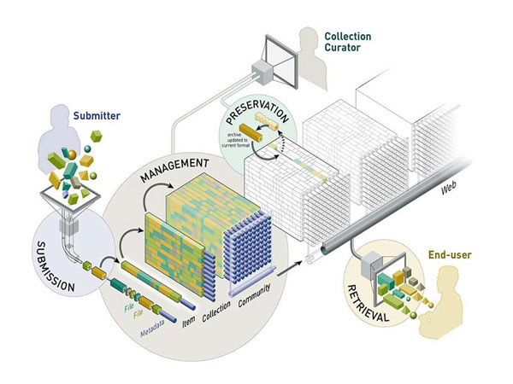
Digital repositories
technical resources
“I think that the library with an institutional repository could really lower that threshold and make participation much simpler and hopefully, easier and more robust.”
- Librarian 17
Image: https://duraspace.org/wp-content/uploads/dspace-files/DSpace_Diagram.pdf by DSpace / CC 4.0
Notes:
Image: https://duraspace.org/wp-content/uploads/dspace-files/DSpace_Diagram.pdf by DSpace / CC 4.0
Almost 17% the librarians mentioned digital repositories as part of an envisioned RDM program that would make it easier for them to support researchers’ needs.
Similar to Librarian 17, several librarians described the need for an institutional repository. Librarian 17 saw a library supported institutional repository lowering researchers’ barriers to participation by providing a system that was easy to use and more robust.

Slide 20
takeaways

Slide 21
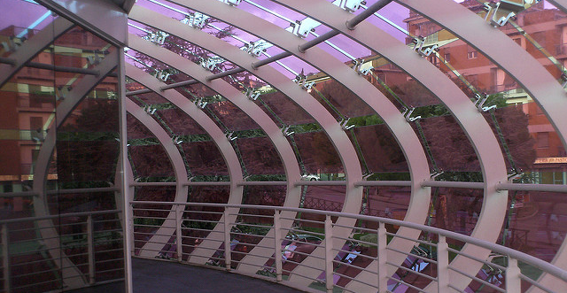
Implications
Have institution-wide conversations about researchers’ needs versus institutional resources
Pool expertise more broadly to include stakeholders on and off campus
Library administrator-led approach to outreach and education
Image: https://www.flickr.com/photos/perugiabella/4238613768 by Perugiacity.com / CC BY 2.0
Notes:
Image: https://www.flickr.com/photos/perugiabella/4238613768 by Perugiacity.com / CC BY 2.0
The influence of human and technical resources and communication, coordination, and communication on RDM suggest the need for institution-wide, rather than library-centric conversations about researchers’ needs versus institutional resources to determine what solutions are possible. For instance, institutional repositories were seen as a means to support researchers. Yet, unresolved questions about associated factors were getting in the way, such as costs, data storage and preservation, and repository functionality.
More often than not, libraries do not have the capacity to support RDM throughout the data lifecycle. Findings also suggest they pursue partnerships beyond their campus community to support the range of services needed. By looking to pool expertise more broadly, librarians can draw upon a wider range of expertise and capacity to address specific aspects of researchers’ needs they cannot support themselves.
Outreach is important, but consider employing approaches that extend the liaison librarian model and engage researchers earlier in the research lifecycle. Findings also suggest a library administrator-led approach to outreach. Findings suggest creating a coalition of administrators as stakeholders that can champion and support the RDM program across the full set of service organizations on campus is critical.

Slide 22
Acknowledgements
I would like to thank Brittany Brannon for her assistance in preparing this presentation.

Slide 23
References
Andrew M. Cox and Stephen Pinfield, “Research Data Management and Libraries: Current Activities and Future Priorities,” Journal of Librarianship and Information Science 46, no. 4 (2014): 300, doi:10.1177/0961000613492542.
Faniel, I. M., & Connaway, L. S. (2018). Librarians’ perspectives on the factors influencing research data management programs. College & Research Libraries, 79(1), 100-119. doi:https://doi.org/10.5860/crl.79.1.100

Slide 24
Questions?
Lynn Silipigni Connaway, PhD
Director of Library Trends and User Research
connawal@oclc.org
@LynnConnaway

