Slide 1
SLA-AGLA • 6 March 2018
Investing in Library Users and Potential Users The Many Faces of Digital Visitors and Residents
Lynn Silipigni Connaway, PhD
Senior Research Scientist & Director of User Research, OCLC
connawal@oclc.org
@LynnConnaway

Slide 2
Global internet usage
Region | Number of internet users (in millions)
Middle East | 146.97
North America | 320.06
Europe | 659.63
Asia | 1,938.08
Statista 2018
Notes:
Statista. (2018). Number of internet users worldwide from 2009 to 2017, by region (in millions). https://www.statista.com/statistics/265147/number-of-worldwide-internet-users-by-region/.
“Social networking is one of the most popular online activities and Facebook is the most popular online network based on active usage. As of the fourth quarter of 2016, there were a total of roughly 1.86 billion monthly active Facebook users, accounting for almost half of internet users worldwide. Connecting with family and friends, expressing opinions, entertainment and online shopping are amongst the most popular reasons for internet usage.”
Statista. (2018). Number of internet users worldwide from 2005 to 2017 (in millions). https://www.statista.com/statistics/273018/number-of-internet-users-worldwide/.

Slide 3
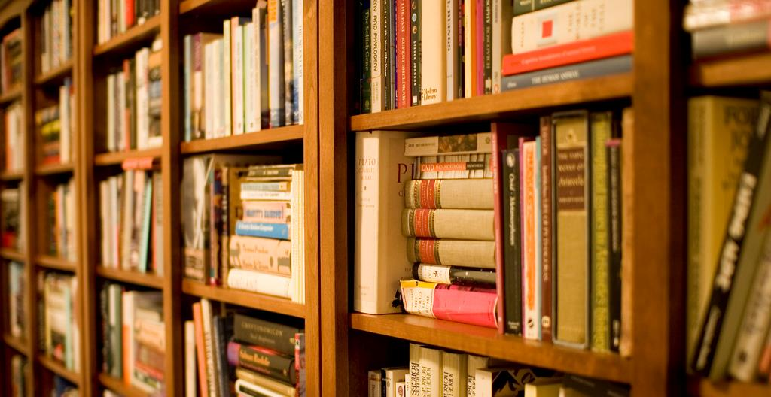
“No es que conegui com funciona la Biblioteca, però crec que Google ho ha de portar millor.”
(UOCG3, Male, Age 28, Arts & Humanities)
“In fact, I don’t know how the library works, but I think that Google must do it better.”
Notes:
Image: https://www.flickr.com/photos/stewart/99129170/ by Stewart Butterfield / CC BY 2.0
….related with the perceived value of the library in comparison with other information sites like Google.
Despite the perception about the search capability of the library website indicated by this participant, it should be pointed out that library is seen as the key source for non-digital resources or digital resources not freely available in other places.
…and sometimes, the use of place is a question of blind trust in the way the search functions……
“Si aquest llibre no està digitalitzat per Google, l’he d’anar a buscar a la Biblioteca.” (UOCU7, Male, Aged 31, Computer Science)
“If this book is not digitized by Google, then I must go to the library.” (UOCU7, Male, Aged 31, Computer Science)
“The students don’t have to go to the library to find knowledge, they have knowledge in the internet.” (UOCFI1, Male, Aged 43, Computer Science)

Slide 4
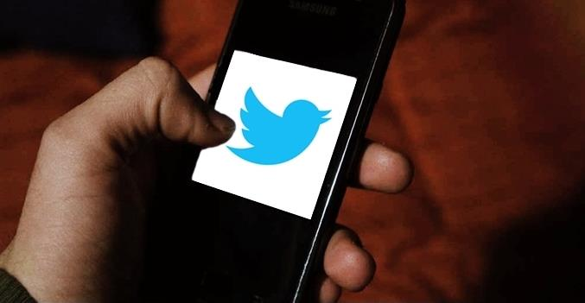
“As of August 2017, two-thirds (67%) of Americans report that they get at least some of their news on social media – with two-in-ten doing so often...” (Shearer and Gottfried 2017)
Notes:
Image: https://www.flickr.com/photos/esthervargasc/9775119174/ by Esther Vargas / CC BY-SA 2.0
“As of August 2017, two-thirds (67%) of Americans report that they get at least some of their news on social media – with two-in-ten doing so often, according to a new survey from Pew Research Center. This is a modest increase since early 2016, when (during the height of the presidential primaries) 62% of U.S. adults reported getting news from social media. While a small increase overall, this growth is driven by more substantial increases among Americans who are older, less educated, and nonwhite. This study is based on a survey conducted August 8-21, 2017, with 4,971 U.S. adults who are members of Pew Research Center’s nationally representative American Trends Panel.
For the first time in the Center’s surveys, more than half (55%) of Americans ages 50 or older report getting news on social media sites. That is 10 percentage points higher than the 45% who said so in 2016. Those under 50, meanwhile, remain more likely than their elders to get news from these sites (78% do, unchanged from 2016).”
Shearer, Elisa, and Jeffrey Gottfried. 2017. “News Use Across Social Media Platforms 2017.” Pew Research Center, September 7. http://www.journalism.org/2017/09/07/news-use-across-social-media-platforms-2017/.

Slide 5
Digital visitors & residents

Slide 6

About Digital Visitors and Residents
Identify how individuals engage with technology
How they acquire their information
Why they make their choices
(White, Connaway, Lanclos, Hood, and Vass 2014)
Notes:
Image: https://www.flickr.com/photos/27805557@N08/5088872975 by JoesSistah / CC BY-NC 2.0
V&R project
identify how individuals engage with technology and sources
how they acquire their information
why they make the choices that they do.
Understand the contexts that surround engagement with digital resources, spaces, and tools
(InfoKit Intro)

Slide 7
Connaway, Lynn Silipigni, Vanessa Kitzie, Erin M. Hood and William Harvey. 2017. The Many Faces of Digital Visitors & Residents: Facets of Online Engagement. With contributions from Allison Benedetti, Agustí Canals, Liliana Gregori, Eva Ortoll Espinet, Daniel Lozano, Melissa Man, Josep Cobarsí Morales, Sara Giuliana Ricetto, Riccardo Melgrati, Eva M. Méndez Rodríguez, Andrea Sada, Peter Sidorko, Paolo Sirito, Virginia Steel, Titia van der Werf, and Esther Woo. Dublin, OH: OCLC Research. doi:10.25333/C3V63F
https://www.oclc.org/content/dam/research/publications/2017/oclcresearch-many-faces-digital-vandr-a4.pdf.
Notes:
Connaway, Lynn Silipigni, Vanessa Kitzie, Erin M. Hood and William Harvey. 2017. The Many Faces of Digital Visitors & Residents: Facets of Online Engagement. With contributions from Allison Benedetti, Agustí Canals, Liliana Gregori, Eva Ortoll Espinet, Daniel Lozano, Melissa Man, Josep Cobarsí Morales, Sara Giuliana Ricetto, Riccardo Melgrati, Eva M. Méndez Rodríguez, Andrea Sada, Peter Sidorko, Paolo Sirito, Virginia Steel, Titia van der Werf, and Esther Woo. Dublin, OH: OCLC Research. doi:10.25333/C3V63F

Slide 8
V&R Framework
#vandr
Visitors and Residents resources http://www.oclc.org/research/themes/user-studies/vandr.html
(White and Le Cornu 2011)
Notes:
This is a continuum and individuals may display visitor or resident characteristics in different contexts and situations.
White, David S., and Alison Le Cornu. 2011. "Visitors and Residents: A New Typology for Online Engagement." First Monday 16,9 (5 September). Available online at: http://firstmonday.org/htbin/cgiwrap/bin/ojs/index.php/fm/article/view/3171/3049.

Slide 9

Visitor Mode
Functional use of technology
Formal need
Invisible online presence
Internet is a toolbox
(White and Connaway 2011-2014)
Notes:
Image: https://www.flickr.com/photos/28481088@N00/11186264874 by tanakawho / CC BY 2.0
Visitors: functional use of technology, often linked to formal need (such as use of software for specific coursework, or organizing meetings through email contact); less visible/more passive online presence, more likely to favor face-to-face interactions (even as they use the internet to organize/schedule those interactions)

Slide 10
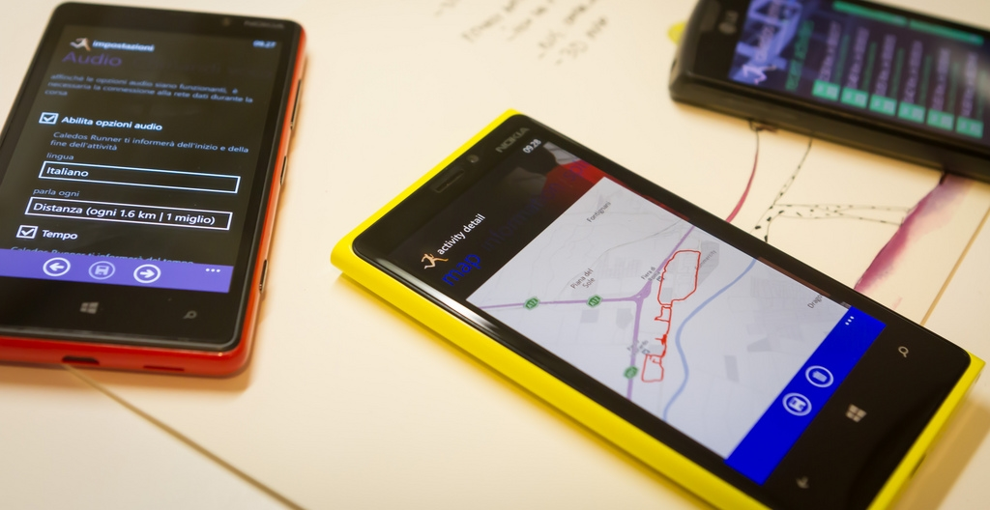
Resident Mode
Visible and persistent online presence
Collaborative activity online
Contribute online
Internet is a place
(White and Connaway 2011-2014)
Notes:
Image: http://www.flickr.com/photos/15216811@N06/8521338394 by N i c o l a / CC BY 2.0
Residents: significant online presence and usage; high level of collaborative activity online; contributions to the online environment in the form of uploading materials, photos, videos.

Slide 11
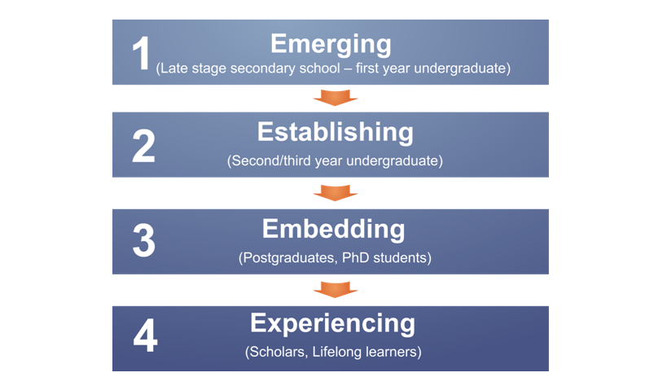
Educational Stages
(Connaway, White, and Lanclos 2011)
Notes:
1. Emerging (Late stage secondary school/First year undergraduate);
2. Establishing (Second/third or third/fourth year undergraduate);
3. Embedding (Postgraduates, PhD students);
4. Experienced (Faculty, Researchers, Scholars Lifelong Learners).

Slide 12
DATA COLLECTION & Analysis

Slide 13

Data Collection Tools
4 Project Phases
Semi-structured interviews
Diaries/monthly semi-structured interviews
Written
Video
Skype or telephone
Second group of semi-structured interviews
Online survey
Notes:
Image: https://www.flickr.com/photos/vamapaull/3775032790 by Paul Istoan / CC BY-NC 2.0

Slide 14
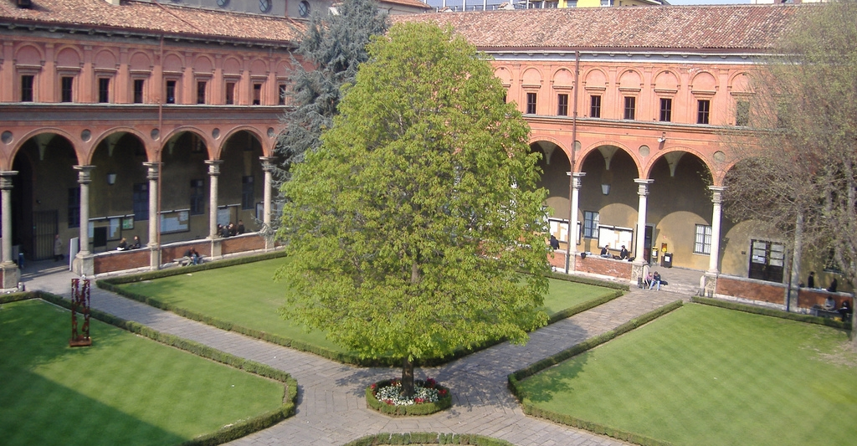
Visitors and Residents Interviews
United States
United Kingdom
Universidad Carlos III de Madrid (Madrid, Spain)
Università Cattolica del Sacro Cuore (Milan, Italy)
Universitat Oberta de Catalunya (Barcelona, Spain)
Notes:
Image: https://www.flickr.com/photos/elena_87/2567662128/ by Elena / CC BY-NC-ND 2.0

Slide 15
Visitors and Residents Interview Demographics
Educational Stage | Universidad Carlos III de Madrid (Madrid) | United States | United Kingdom | Universitat Oberta de Catalunya (Barcelona) | Università Cattolica del Sacro Cuore (Milan)
Emerging Participants | 8 | 22 | 21 | 6 | 3
Establishing Participants | 10 | 5 | 5 | 7 | 6
Embedding Participants | 10 | 5 | 5 | 7 | 6
Experiencing Participants | 10 | 5 | 5 | 13 | 5
Total | 38 | 37 | 36 | 33 | 20
(n=164)
Notes:
We have 36 Interviews from the United Kingdom and the United States, with a higher number from Emerging participants as these were conducted as longitudinal studies. Diaries and Follow-up Interviews were conducted but for this analysis, we are only using the initial Interview. We have also pulled in 20 Interviews from Milan and 33 from Barcelona, all more equally distributed. Total = 164

Slide 16
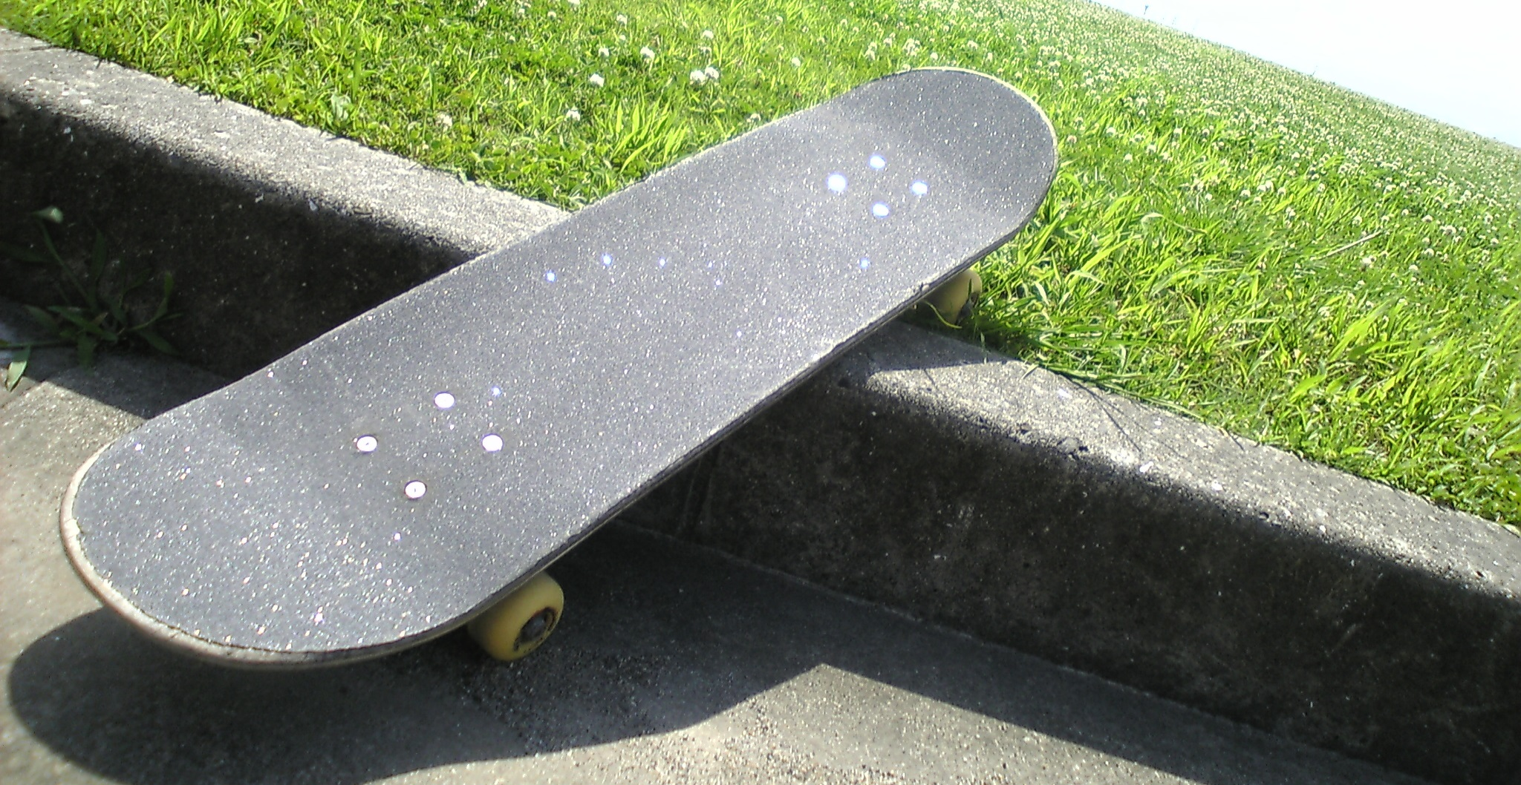
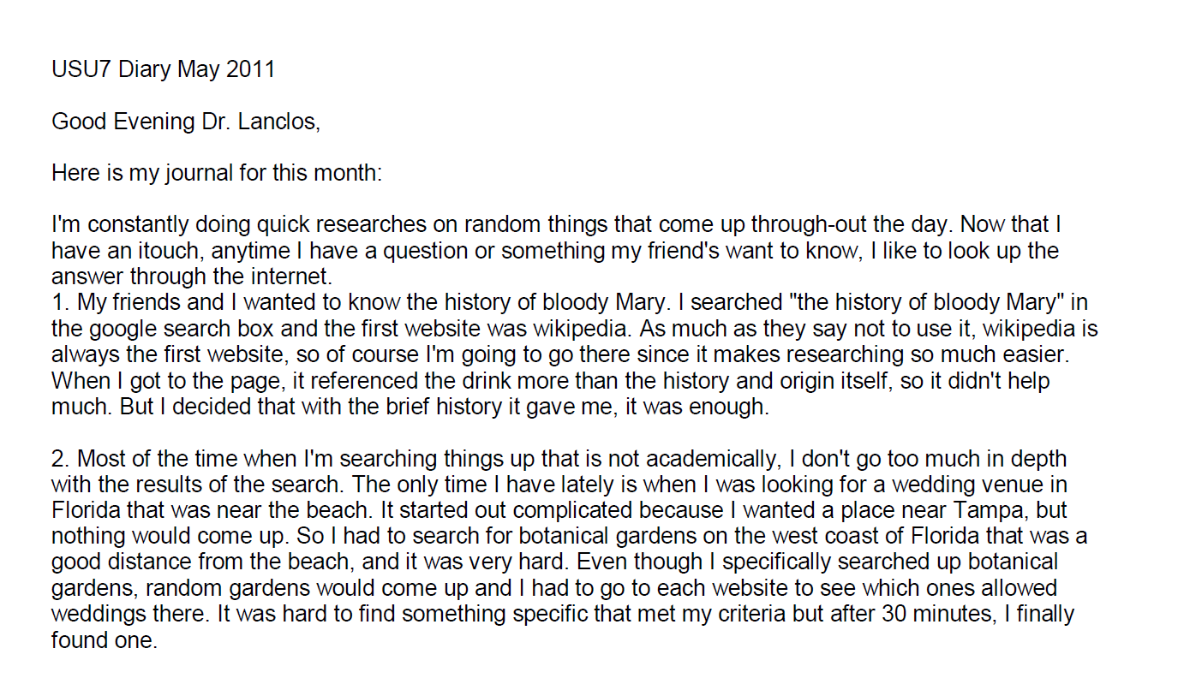
Example: Digital Visitors and Residents Diaries
Notes:
Image: https://www.flickr.com/photos/dancingpapa2007/3674686528 by Naoki Tomeno / CC BY 2.0
Screenshot: USU7 Emg Dry1 Ph1 (Digital Visitors and Residents, USU7, Female, Age 19)
“March was a little more serious. We’re nearing election time and all that jazz, and this is the first election I’ll be able to vote in, so I’ve been doing a bit of reading on a few of the candidates (not much, mind you). As a side note, I’m kind of debating whether or not I should actually vote in this election since I have such little knowledge on the candidates.” (Digital Visitors and Residents, USU12, Male, Age 19) USU12 Est Dry2 Ph2
“Um they do have a search box but I didn’t—I didn’t use that. Um I pretty much just, I pretty much just clicked links.” (Digital Visitors and Residents, USU12, Male, Age 19, 30:37) USU12 Est Follup Int1 Ph3
White, David S., and Lynn Silipigni Connaway. 2011-2014. Visitors & Residents: What Motivates Engagement with the Digital Information Environment. Funded by JISC, OCLC, and Oxford University. http://www.oclc.org/research/activities/vandr/.

Slide 17
Where do people expect to find information?

Slide 18
Sources
Notes:
Let’s talk about the information sources people use to get information…
Human
Digital, i.e., journals web sites, TV , Wikipedia, VLE
Physical

Slide 19
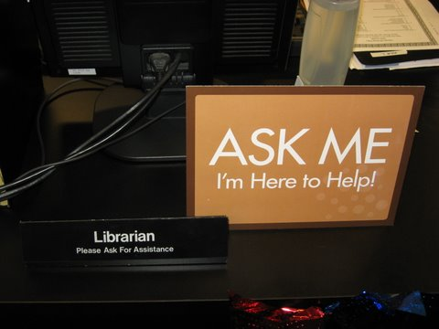
Students from any group rarely mentioned librarians
Faculty of all groups
Mentioned librarians slightly more often
Still less than half of the time
Notes:
Image: https://www.flickr.com/photos/deathtogutenberg/798918705/ by Austin Kleon / CC BY-NC-ND 2.0
A specific example of personal source is a librarian.
In this sense, faculty members mention more the librarians than students. For instance, one UOC faculty member said that “librarians are nice people”
When human sources are not possible, Google and Wikipedia are the most used sources to get information.

Slide 20
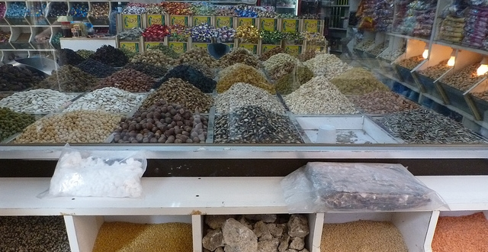
The Learning Black Market
“It’s like a taboo I guess with all teachers, they just all say – you know, when they explain the paper they always say, ‘Don’t use Wikipedia.’”
(Digital Visitors and Residents, USU7, Female, Age 19, Political Science)
Notes:
Image: https://www.flickr.com/photos/mrsdkrebs/11625280293 by Denise Krebs / CC BY 2.0
“I go to Wikipedia, scroll down to the bottom, and there’s like references that Wikipedia used and I click on those references and like check those links. Cause I’m like ‘that’s the fastest way to find a good link.’ Cause like if I’m gonna search like, I don’t know heart attack cases or something. Like that’s gonna take me forever to find like, a good website, or book to talk about what I’m looking for when I can just type in Wikipedia like, heart attacks or something, scroll to the bottom, there’s already books and websites there for me.” (Digital Visitors and Residents, 2USU1, Emerging, Male, Age 18, Engineering)

Slide 21
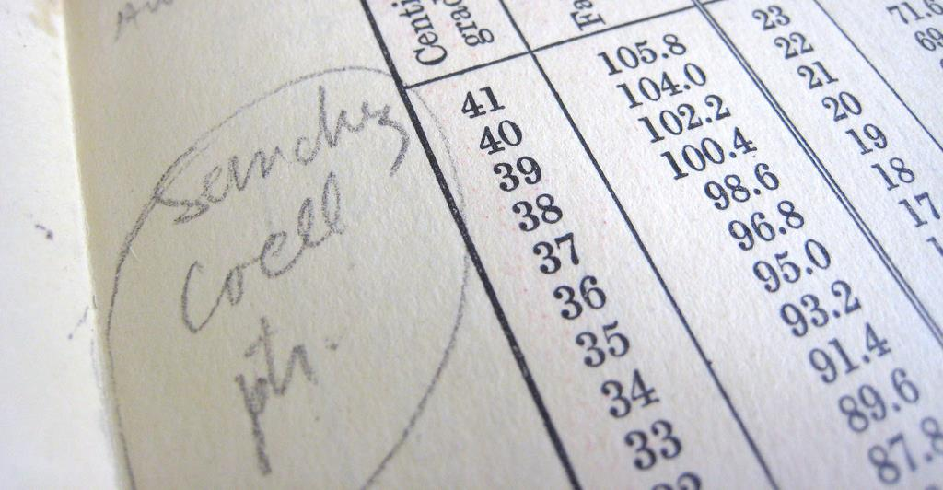
“Wikipedia… it’s perfect, because it gives you the words, the things, the technical words that you need to look, keywords, so Wikipedia is always, always the first step.”
(UOCG1, Male, Age 35-44, Professions and Applied Sciences)
Notes:
Image: https://www.flickr.com/photos/mayopants/4021073588/ by stateofplace / CC BY-NC 2.0
In relation to Wikipedia, we have to mention the research project leaded by Eudard Aibar, a UOC researcher. In that project ……..
In our study we find that people consult Wikipedia when they need to be introduced to a new subject, or to find definitions or concrete concepts.
“I always read everything I am looking for …the first thing that I learned during my degree, the first thing you have to look for always is a central or a first approach. Wikipedia it’s perfect, because it gives you the words, the things the technical words that have to look, keywords, so Wikipedia is always, always the first step.” UOC Barcelona (Universitat Oberta de Catalunya) (UOCG1, Embedding, Male, Age 35-44, Professions and Applied Sciences)
“I used to seek information in Wikipedia, even my colleagues said that there are wrong things on it…but I said Enciclopedia Larousse [Traditional encyclopedias] also have mistakes…the only difference is that it is printed and is impossible to correct the mistakes once you have the printed version…Mistakes are not about technology, they are about people.”
“I use Wikipedia as a guide, to introduce myself to a topic…but then I browse the references…or I go to Google to make a more concrete search.” (UOCU5, Female, First semester Student, 30, Education)
Wikipedia
Sources AND Educational Stage By Sources Non-Aggregated
Experiencing Interviews
Sources: Wikipedia
UC3M Madrid: 9, 90%
US: 1, 20%
UK: 4, 80%
UOC Barcelona: 6, 67%

Slide 22

“I used to seek information in Wikipedia, even my colleagues said that there are wrong things on it…but I said Enciclopedia Larousse [Traditional encyclopedia] also have mistakes…the only difference is that it is printed and is impossible to correct the mistakes once you have the printed version…Mistakes are not about technology, are about people.”
(Digital Visitors and Residents, UOCFE6, Male, Age 53, Computer Science)
Notes:
Image: http://www.flickr.com/photos/20452143@N08/3841271286 by Adam DeClercq / CC BY-NC-SA 2.0
Sources
Librarians, faculty, and graduate students mention using Wikipedia. When undergraduate students mention using Wikipedia, they say that faculty don’t allow them to use it because anyone can edit it.
Almost all interviewees say they use Wikipedia to familiarize themselves with a topic.
Wikipedia
Sources AND Educational Stage By Sources Non-Aggregated
Experiencing Interviews
Sources: Wikipedia
UC3M Madrid: 9, 90%
US: 1, 20%
UK: 4, 80%
UOC Barcelona: 6, 67%
“I use Wikipedia as a guide, to introduce myself in a topic…but then I browse the references…or I go to Google to make a more concrete search”.
(UOCU5, Female, First semester Student, 30, Education)
White, David S., and Lynn Silipigni Connaway. 2011-2014. Visitors & Residents: What Motivates Engagement with the Digital Information Environment. Funded by JISC, OCLC, and Oxford University. http://www.oclc.org/research/activities/vandr/.

Slide 23
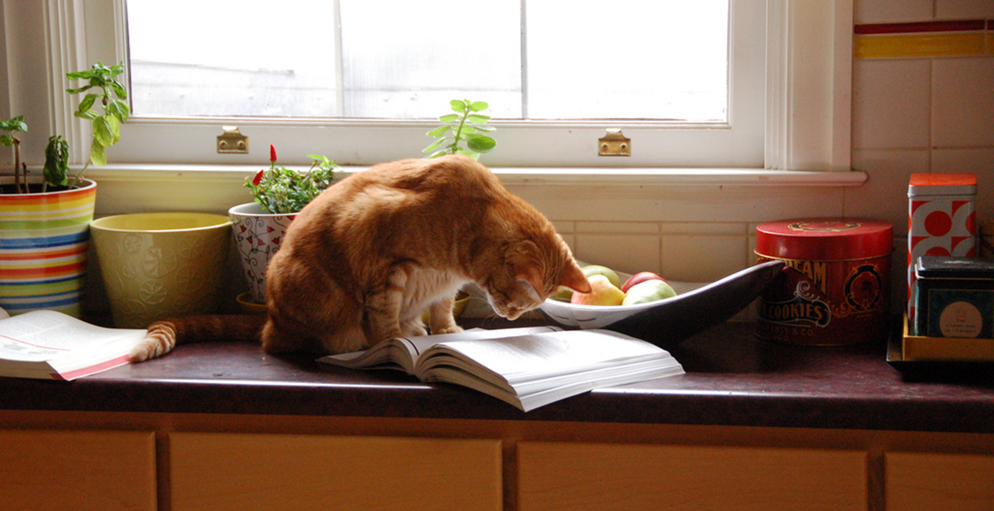
“Convenient” Isn’t Always Simple
“At first I started looking online, and it was a little bit overwhelming…I ended up reaching into my mom’s cupboard and using a recipe that I found in one of her old cookbooks. The recipe was just what I was looking for...”
(Digital Visitors and Residents, USS3, Emerging, Female, Age 17, High School Student)
Notes:
Image: http://www.flickr.com/photos/95792332@N00/3226023555 by Jacob Davies / CC BY-SA 2.0
“This morning I was looking for a homemade bread recipe that I could use to bake and then blog about. (I just started my own food blog: gritsgonegreen.wordpress.com). At first I started looking online, and it was a little bit overwhelming. There were so many different recipes with different flavors and crazy combinations. The one thing that was good about looking at the online recipes was viewing the user comments and seeing how people liked or disliked each recipe. I ended up reaching into my mom’s cupboard and using a recipe that I found in one of her old cookbooks. The recipe was just what I was looking for: it was a simple homemade white bread. I was about to search on the internet how to knead and punch bread, but I flipped the page, and there was a whole glossary of bread making terms. I must admit, I was a little bit surprised by the amount of information and instruction found in the cookbook. I thought I was going to have to look up an instructional video online.” (Digital Visitors and Residents, USS3, Emerging, Female, Age 17, High School Student)

Slide 24
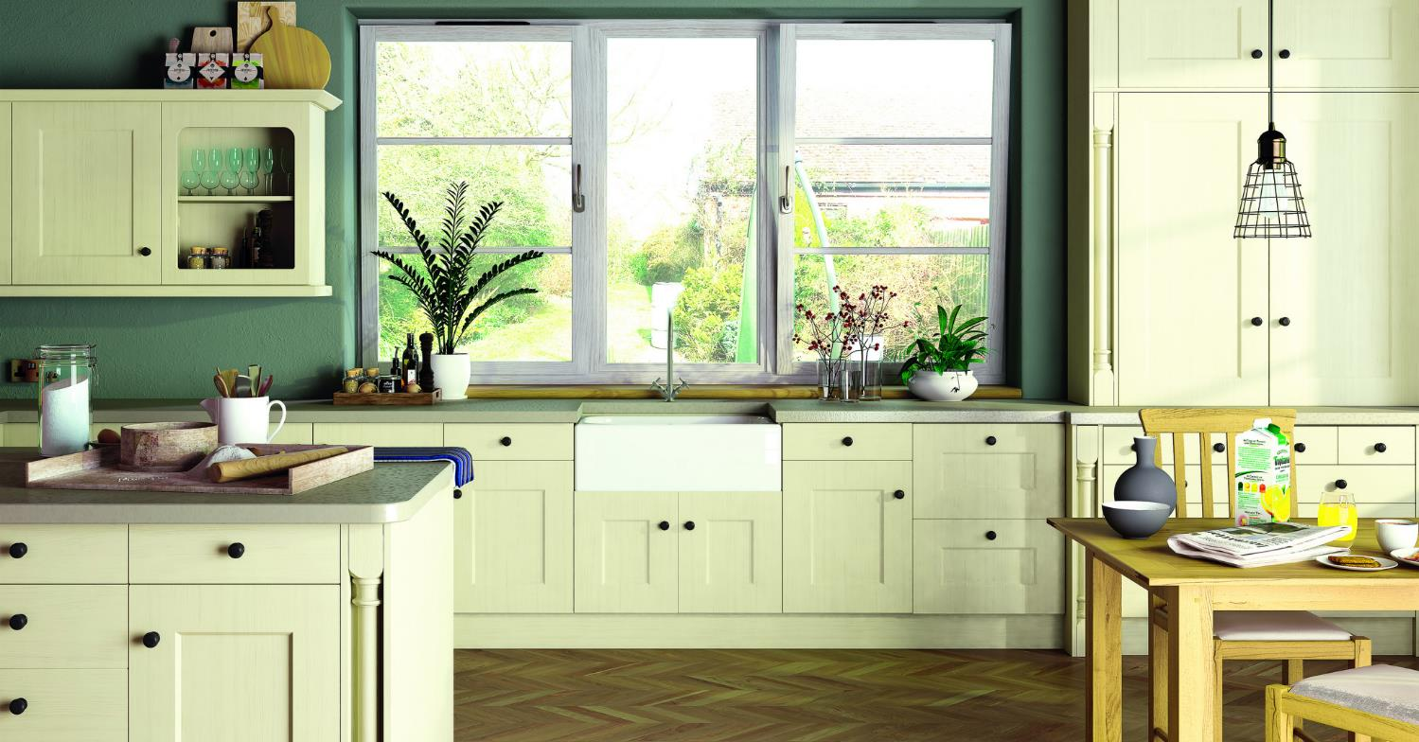
“Quan vaig aprendre a fer beixamel, la meva mare hagués estat encantada d’ensenyar-me a fer-ne però com no hi era vaig buscar per Internet...vaig buscar un vídeo.”
(UOCG3, Male, Age 28, Computer Science)
“When I learned to make béchamel sauce, my mother would have gladly taught me, but she was not available, so I searched on the internet… I searched for a good video.”
Notes:
Image: https://www.flickr.com/photos/124705972@N06/14597368868/ by Steve Larkin / CC BY-NC 2.0
Is interesting to note that most people interviewed consider the use of human sources as the best way to access to information. Since this is not always possible, people consult digital information including video, images and interactive capabilities.

Slide 25
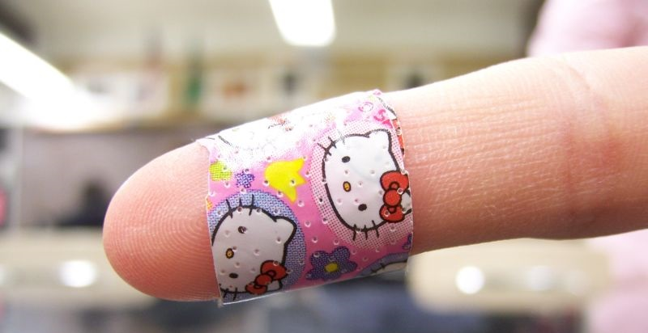
“En temes de salut o així no solo acudir a Internet per res perquè ...poses que et fa mal un dit i acabes tenint pesta bubònica...no es fiable, a internet...lo probablement improbable és lo segur. Aquí si que acudiria a contactes reals.”
(UOCG3, Male, Age 28, Computer Science)
“Regarding health affairs, I usually don’t search on the internet because… you have pain in one finger and then you end up [thinking] you have the bubonic plague… It is not reliable… improbable things become sure. For this situation, I would use personal contacts.”
Notes:
Image: https://www.flickr.com/photos/caseyann/1250856017/ by Casey Smith / CC BY-NC-ND 2.0
Personal contacts are used for important matters, such as health questions, because people feels that expert advice is the best way to access the correct and contextualized information fulfill their needs.

Slide 26
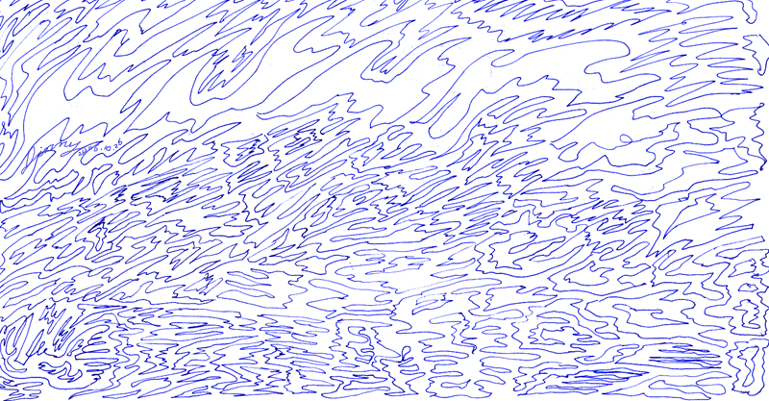
“A vegades per a que la informació sigui significativa, i arribi d’una forma clara, necessites que hi hagi algun vincle emocional amb aquella informació. Si només és la informació pura és més difícil. Millor si hi ha un contacte previ amb l’informant.“
“Sometimes for information to be significant and to arrive in a clear way, you need some kind of emotional link with that information. If there's only information, it is more difficult. [It is] much better if there is previous contact with the information provider."
(UOCG4, Male, Age 41, Health Sciences)
Notes:
Image: https://www.flickr.com/photos/tormentmoon/285212694 by Jinny / CC BY-NC-ND 2.0
….In this sense, people recognize the importance of having some kind of context in relation to digital information landscape, so as to enrich the meaning of this information.
Place AND Educational Stage By Sources Non-Aggregated
Place: Home All Interviews/All Levels
US N=37: 7, 19%
UK N=36: 23, 64%
UOC Barcelona N=33: 15, 45%
Unicatt Milan N=20: 8, 40%
UC3M Madrid N=38: 9, 24%

Slide 27
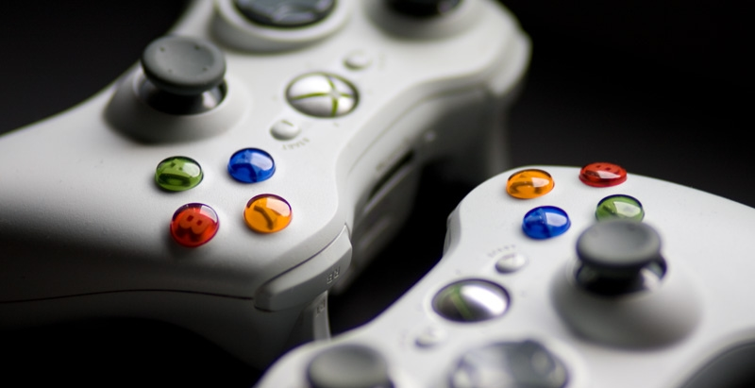
The magic future would be…
The future…
“Una persona sàvia. M’agraden els llibres i la tecnologia, però les persones són millors.”
“A wise person. I like books and technology, but people are better.”
(UOCU1, Female, 19-25, Professions and Applied Sciences)
Notes:
Image: https://www.flickr.com/photos/kgregory/4675828550/ by Katie Mollon / CC BY-NC-ND 2.0
...again, the deside of our interview participants are related to the importance of the human side of information.
“Voldria tenir un xip al cap amb tota la informació. (UOCFI1)
“Having tags. If you want to upload a sound or music, tag it. Because if not, it’s impossible to share, to search…” (UOCG1)
“Una persona sàvia. M’agraden els llibres i la tecnologia, però les persones són millors que els llibres” (UOCU1)

Slide 28
The magic future would be…
The future…
“The Google they want to sell us but that it is not…, the one that you could use with natural language and that the system will interpret for you. As simple as presenting my father with the “best patatas bravas recipe” and it appears...but that was a simple question...”
(UOCFE5, Female, 26-34, Formal Sciences)
Notes:
Image: https://www.flickr.com/photos/kgregory/4675828550/ by Katie Mollon / CC BY-NC-ND 2.0
And the perfect information sources would be “all in open acces and with a personalized filter....” “Tot en OpenAcces...i un filtre personalitzat” (UOFE3)
Another person said that the perfect source would be an “expert person in everything, a kind of android”
“Una persona experta en tot. Un androide...que coneix més que tú el tema i alhora et coneix a tu i et dona la informació justa” (UOCG3)
“El Google que ens volen vendre però que no és..., que amb llenguatge natural el sistema t’interpreti. Com un dia que mon pare li va preguntar a google “la millor recepta de patates braves del món” i li va aparèixer...però clar, això era una pregunta senzilla...i que no calgués que t’anessis identificant als serveis de pagament, perquè el sistema ja sap que ets tu” (UOCFE5)

Slide 29
place
Notes:
And where do people interact with information? We have a wide range of places. Let’s see some of them:
Internet
Search Engines
Social Media
Library
Home
School
Other

Slide 30
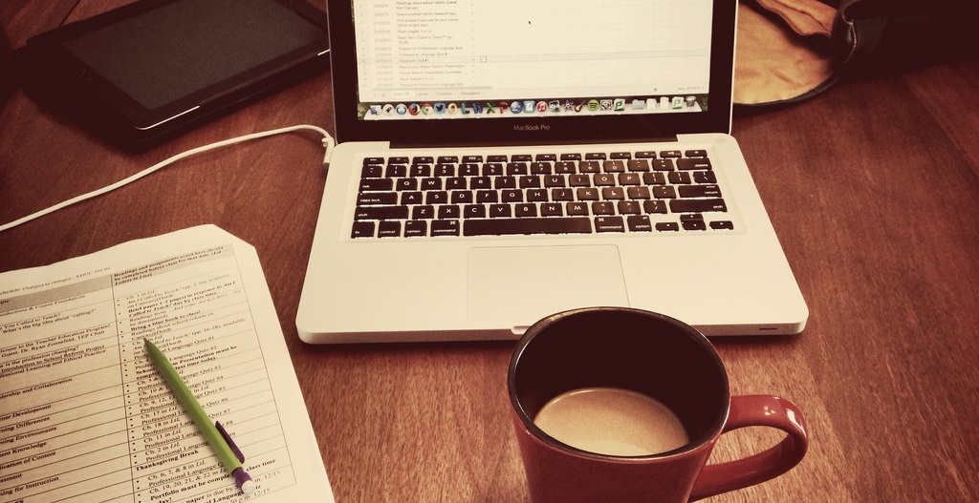
Social Media was mentioned at least 80% of the time by participants between 12-54 years old.
Notes:
Image: http://www.flickr.com/photos/113026679@N03/15646186494 by David Mulder / CC BY-SA 2.0
Social Media AND Age By Sources Interviews Only
12-18 Years Old (N=26): 25, 96%
19-25 Years Old (N=27): 27, 100%
26-34 Years Old (N=13): 13, 100%
35-44 Years Old (N=16): 14, 88%
45-54 Years Old (N=15): 12, 80%
55-64 Years Old (N=3): 2, 67%
64+ Years Old (N=1): 0, 0%
White, David S., and Lynn Silipigni Connaway. 2011-2014. Visitors & Residents: What Motivates Engagement with the Digital Information Environment. Funded by JISC, OCLC, and Oxford University. http://www.oclc.org/research/activities/vandr/.

Slide 31
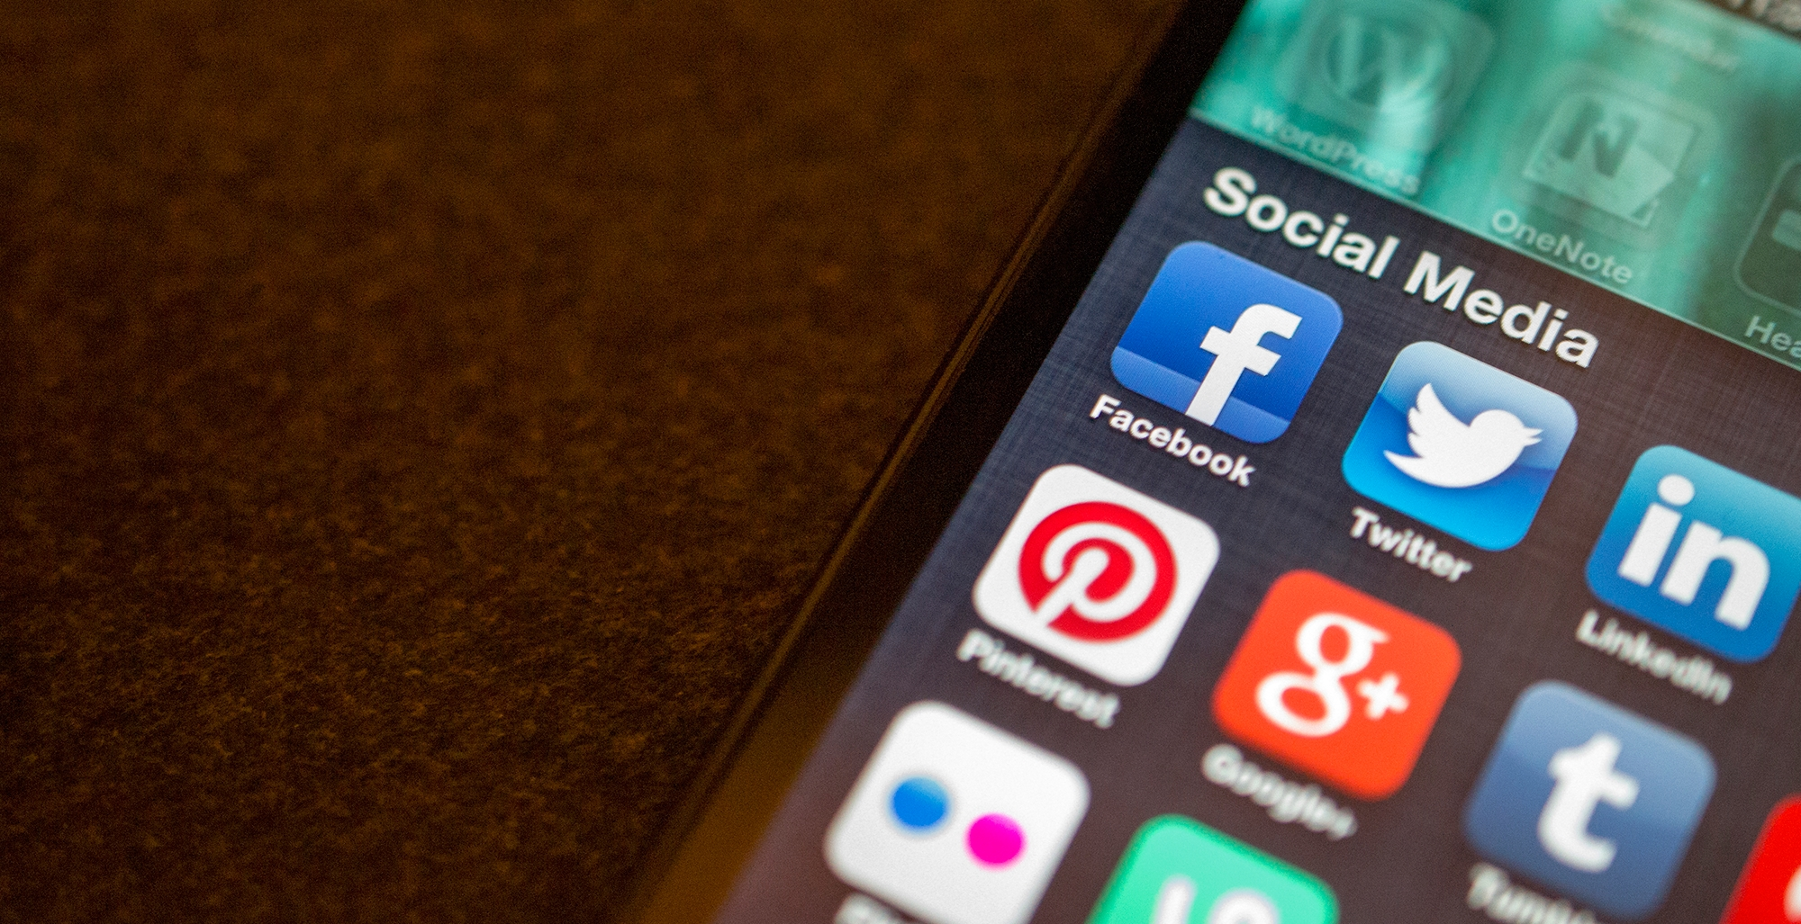
Social Media was mentioned across all Faculty groups, with Facebook being mentioned the most.
“Hi ha moltes xarxes socials. Hauria d’estar vivint a diferents espais…i la vida és una. Facebook et genera una personalitat, Twitter te’n genera una altra, i...no tinc vocació d’esquizofrènic.”
“There’s a lot of social media places. I must be living in different places…and life is just one. Facebook makes you one personality, Twitter makes you another personality, and...I have no intention of being schizophrenic.” (UOCFI5, Male, Age 44, Law)
Notes:
Image: https://www.flickr.com/photos/jasonahowie/8583949219 by Jason Howie / CC BY 2.0
Social Media
Place AND Educational Stage By Sources Aggregated
Experiencing Interviews
Place: Social Media
UC3M Madrid: 8, 80%
US: 5, 100%
UK: 5, 100%
UOC Barcelona: 9, 100%
Place: Facebook
UC3M Madrid: 8, 80%
US: 4, 80%
UK: 5, 100%
UOC Barcelona: 8, 89%
Social Media: Twitter
UC3M Madrid: 7, 70%
US: 2, 40%
UK: 5, 100%
UOC Barcelona: 8, 89%
Social Media coded: Blogging, Facebook, Flickr, Twitter, YouTube

Slide 32
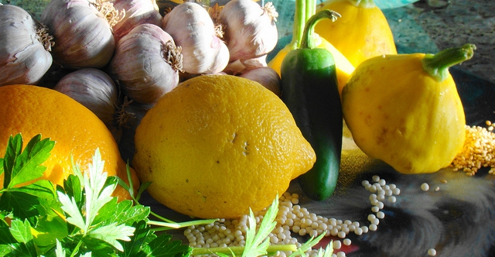
" A casa és, a l’hora de l’àpat el cap de setmana quan estem junts són els dos nois dient ‘voleu deixar el mòbil, sisplau?’ a la meva dona i jo que estem amb el mòbil."
“At home, at dinner time on weekends, when we are all together our sons ask my wife and I: ‘could you please leave your smartphone?’ [because we are texting all the time].” (UOCFI6, Male, Age 53, Arts & Humanities)
Notes:
Image: https://www.flickr.com/photos/veganfeast/4915226686 by Vegan Feast Catering / CC BY 2.0
As mentioned in relation to study habits, the intensive use of technology is not always related with the people’s age or generation. A good example of this is the following quote.
Obviously, one traditional place in which to interact with information in an academic context is a library…

Slide 33
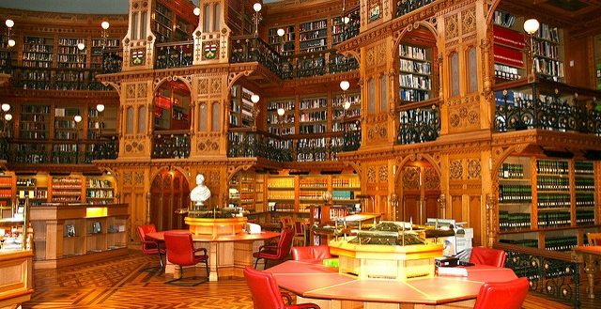
Academic Library
Barcelona: 88%
US: 70%
Milan: 65%
UK: 56%
Madrid: 26%
Notes:
Image: https://www.flickr.com/photos/vladimir04/4438286546 by vl04 / CC BY 2.0
In fact, the academic library is mentioned a lot by the UOC sample mainly because the library is virtual and embedded in the classroom. But awareness and use of the library is not always…
Place AND Educational Stage By Sources Non-Aggregated
Place: Academic Library All Interviews/ All Levels
US N=37: 26, 70%
UK N=36: 20, 56%
UOC Barcelona N=33: 29, 88%
Unicatt Milan N=20: 13, 65%
UC3M Madrid N=38: 10, 26%

Slide 34

“T’hi passes moltes hores, a Sant Google. Ens encomanem a Sant Google i això doncs ens ho soluciona.”
(UOCFI6, Male, Age 53, Arts & Humanities)
“You spend many hours with Saint Google. We entrust ourselves to Saint Google and that solves it for us.”
Notes:
Image: https://www.flickr.com/photos/34547181@N00/15031497490 by Philippe Put / CC BY 2.0

Slide 35
The magic future would be…
The future…
“Tenir tota la informació al mateix lloc, que quedi integrada.”
“Have all the information available in the same place, so it will be integrated there.”
(UOCU9, Female, Age 45-54, Arts/Humanities)
Notes:
Image: https://www.flickr.com/photos/kgregory/4675828550/ by Katie Mollon / CC BY-NC-ND 2.0
...it doesn’t matter what place is best, the desire of participants is to have all the information in one place.
“Voldria tenir un xip al cap amb tota la informació. (UOCFI1)
“Molt fàcil, només parlant. Que jo li digui a l’ordinador “mira necessito això” i que l’ordinador m’ho donés. (...) (UOCG6)
“Tenir la informació als ulls, per telepatia. Sense emprar cap estrí” (UOCU8)

Slide 36
Why do people make the choices they do for getting information?

Slide 37
Motivation and Choice
Notes:
What motivates people’s choice of information?
Convenience
Repetition
Relevancy
Authority
Available Time
Speed

Slide 38
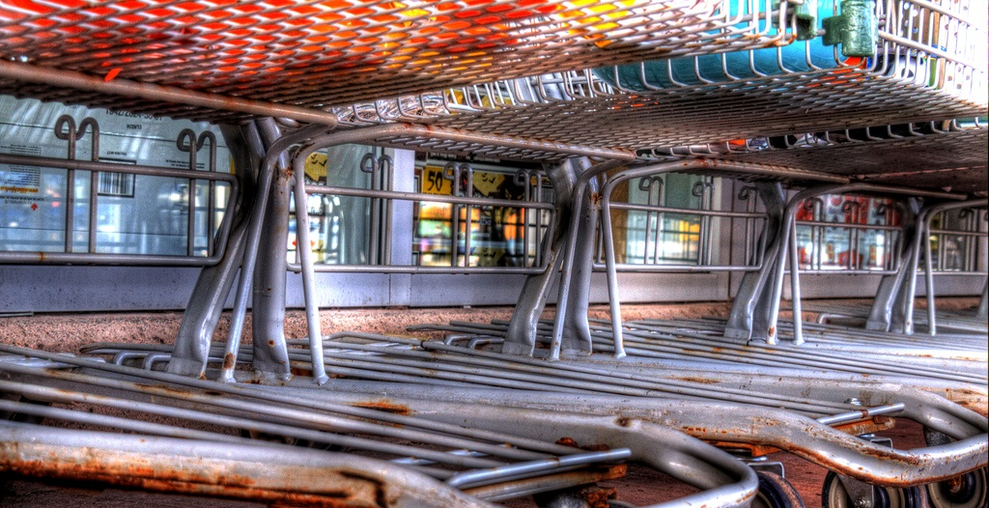
Convenience/Ease of Use/Accessibility as reasons for selecting a source were mentioned often by all groups.
Notes:
Image: http://www.flickr.com/photos/79743208@N05/10229498105 by Matthew Matheson / CC BY-NC-ND 2.0
It seems that convenience is a predominant factor when selecting both the source and the information. But convenience is a complex concept, ant it changes greatly depending on the situation and the context.
If we look at the reasons people use to select information…
Convenience
Decision/Choice AND Educational Stage By Sources Non-Aggregated
All Interviews/All Levels
Decision/Choice: Convenience/Ease of Use/Accessibility
US N=37: 33, 89%
UK N=36: 30, 83%
UOC Barcelona N=33: 30, 91%
Unicatt Milan N=20: 19, 95%
UC3M Madrid N=38: 35, 92%

Slide 39

“So I check three or four websites and if it is more or less the same, so ok, I am confident.”
(ESG01, Embedding, Female, Age 26-34, Formal Sciences)
Notes:
Image: https://www.flickr.com/photos/jakerust/16226034713/ by GotCredit / CC BY 2.0
….we can see that REPETITION is a usual criteria. In fact, people stop looking for information when they realize that the results are more or less the same all the time.
Other criteria to select information include….
“So I check three, or four websites and if is more or less the same, so ok, I am confident.” UC3M Madrid (Universidad Carlos III de Madrid) (ESG01, Embedding, Female, Age 26-34, Formal Sciences)
“Cuando veo que está todo repetido, que no sale nada. Que no hay cosas nuevas, es cuando paro” (UOCU2, Female, Aged 28, Information Sciences)
“When I see that everything is the same, that nothing new appears. That there’s nothing new, then i stop looking for information.”(UOCU2, Female, Aged 28, Information Sciences)
“Miro dos o tres recursos. Si hi ha coincidència entre les dos o tres primeres pàgines, aleshores paro” (UOCFE1, Male, Aged 43, Information Sciences)
“I look for two or three resources. If there’s a repetition between the two or three first pages, then I stop.” (UOCFE1, Male, Aged 43, Information Sciences)

Slide 40

Positive = Ability to find almost anything.
Negative = Experience information overload & need to determine & manage what is relative & accurate.
The amount of information available was mentioned as a motivating factor in choosing sources by 100% of UOC Faculty, 60% of UC3M Faculty, & 40% of both US & UK Faculty.
Notes:
Image: https://www.flickr.com/photos/bern4dette/15817093566/ by Bernadette van Hellenberg Hubar / CC BY-NC 2.0
In fact the quantity of information has two effects. The positive one is that you can find everything you need. The negative one is information overload and how to manage and filter good and pertinent information.
Quantity
Decision/Choice AND Educational Stage By Sources Non-Aggregated
Experiencing Interviews
Decision/Choice: Quantity
UC3M Madrid (N=10): 6, 60%
US (N=5): 2, 40%
UK (N=5): 2, 40%
UOC Barcelona (N=9): 9, 100%

Slide 41
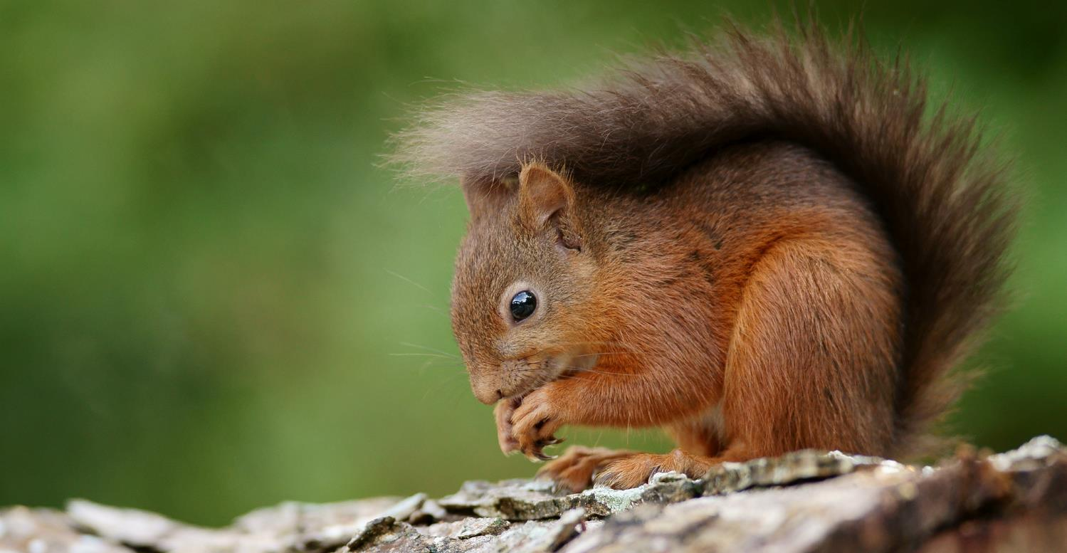
“My capacity to process information is overloaded. I’m just accumulating information as a hamster.”
(UOCFE1, Male, Age 43, Information Sciences)
“Squirelling away” information
Notes:
Image: https://www.flickr.com/photos/peter-trimming/9566245040/ by Peter Trimming / CC BY 2.0
The literature refers to keeping all the information you find as a “squirreling away” of information.
In this sense, those interviewed keep information in their computer “in case they need it in the future” but in fact, they confessed to us that when they need it they often repeat the original search because they forget that they already have the information or don’t remember where it is stored.
“…ara està tot allí (Internet). Qualsevol afició, per rara que sigui, sempre trobes alguna cosa.” (UOCFE6, Male, Age 53, Computer Sciences)

Slide 42
The magic future would be…
The future…
“To have access to all full text…and more criteria to select…To have a criteria tool for helping me to personalize my experience”
(UOCFI2,Male, Age 34-44, Social Sciences)
“Un sistema personalitzat que coneixés els teus atributs personals i et presenti els resultats en una combinació de vídeo i mapa conceptual”
“A personalized system that would know your personal attributes and show you the results in a combination of video and conceptual map” (UOCU3, Female, Age 19-25, Social Sciences)
Notes:
Image: https://www.flickr.com/photos/kgregory/4675828550/ by Katie Mollon / CC BY-NC-ND 2.0
... some kind of personalized filter that help you to select the pertinent information. People want to be aided to select, but also they want to have some kind of control of the final select decisions.
Another aspect we were interested inwas in which way people contact and communicate with others...
“Els sistemes actuals ja funcionen força bé...per mi un equip especialitzat de professionals que t’orientés per accedir a tota la informació que necessites, però només aquella”
“Un sistema personalitzat que coneixés els teus atributs personals i et presenti els resultats en una combinació de vídeo i mapa conceptual” (UOCU3)
“Que el sistema tingui uns algoritmes personalitzats i et torni allò que necessites. Després ja és decisió teva si ho utilitzes o no” (UOCU7)

Slide 43
What technologies do people use to get information?

Slide 44
Tools

Slide 45
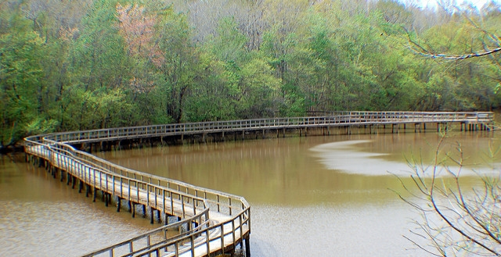
Tablets, computers, smartphones and papers…
“I could live without the smartphone, but I can't work without the smartphone, which are two different things.”
(UCSCG2, Embedding, Female, Age 25, Humanities)
Notes:
Image: https://www.flickr.com/photos/edgarpierce/5601664933/ by Edgar Pierce / CC BY 2.0
In our study we found that all interviewed people use computers and other electronic devices to access and work with information, both in private and professional life.

Slide 46
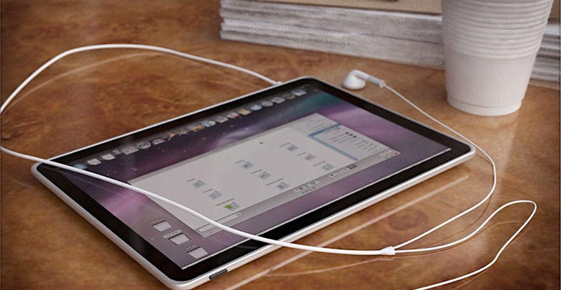
At least 80% of UC3M, UOC, & UK Faculty mentioned Tablets, only 40% of US Faculty mentioned them.
Smartphones were mentioned by 79%- 100% of all Faculty.
Notes:
Image: https://www.flickr.com/photos/12905355@N05/4293966039/ by Photo Giddy / CC BY-NC 2.0
Faculty at UOC: Tablet perfect for a pregnant woman. It’s light and you can put it on your stomach to watch tv.
Ferran: I feel guilty that I give the tablet to my children to watch films so that I am able to work.
Tablet used in UK and Spain more for group/family entertainment. In US the tablet is used more by individuals and television is used for group entertainment.
Tablets
Tools AND Educational Stage Aggregated By Sources (Tablets, iPads, Other Tablets)
Experiencing Interviews
UC3M Madrid: 8, 80%
US: 2, 40%
UK: 4, 80%
UOC Barcelona: 8, 89%
Whatsapp
“Yes, I have [Whatsapp] groups of friends and family, we are quite practical. I just send messages for useful matters, because I don’t like bothering people.”
(UOCU7, Male, Age 31, Computer Science)
White, David S., and Lynn Silipigni Connaway. 2011-2014. Digital Visitors and Residents: What Motivates Engagement with the Digital Information Environment. Funded by JISC, OCLC, and Oxford University. http://www.oclc.org/research/activities/vandr.html.

Slide 47
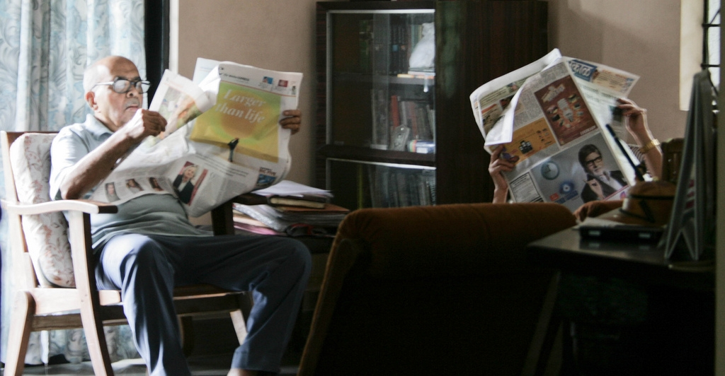
“…around half of newspaper readers consume newspapers only in their printed form. They are more likely to often watch local TV news than those newspaper readers who access the paper online instead of or in addition to the print edition.”
(Barthel 2016)
Notes:
Image: https://www.flickr.com/photos/draconianrain/3982985600/ by Meghana Kulkarni / CC BY-NC 2.0
People prefer the printed version.
“Data from Pew Research Center and other sources show that around half of newspaper readers consume newspapers only in their printed form. They are more likely to often watch local TV news than those newspaper readers who access the paper online instead of or in addition to the print edition. This difference persists even when controlling for age.”
Barthel, Michael. 2016. “Around Half of Newspaper Readers Rely Only on Print Edition.” Pew Research Center, January 6, www.pewresearch.org/fact-tank/2016/01/06/around-half-of-newspaper-readers-rely-only-on-print-edition.

Slide 48
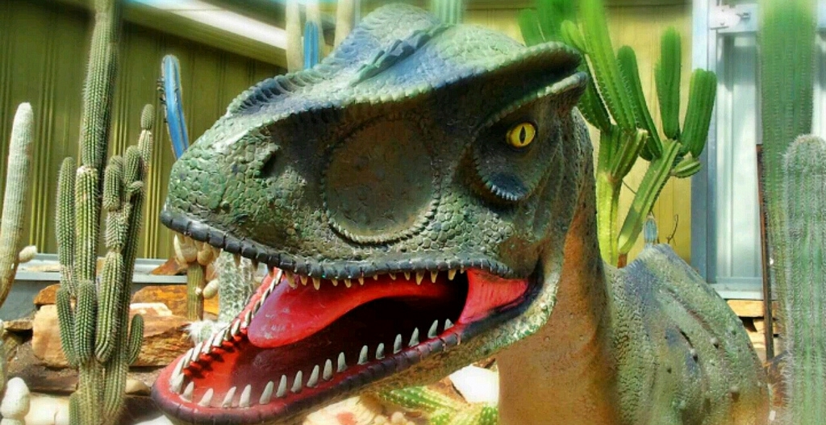
“So, it's... I mean, people who use books are dinosaurs now.”
(UCSCF2, Experiencing, Male, Age 39, Social Sciences)
“(With digital information alerts)….It is like with books, you keep them but you don’t want to trash them because you have some kind of emotional relationship with books…”
(UOCG4, Health Sciences Postgraduate Student, male, aged 41)
Notes:
Image: https://www.flickr.com/photos/bonitoclub/9910937863/ by Tony & Wayne / CC BY-NC 2.0
And again, we can see that the use of paper is a question of habits but also very related with emotional aspects…as pointed out by several people interviewed.

Slide 49
The magic future would be…
The future…
“Seria un mix de telèfon mòbil i dron, que jo parlant li pogués fer una pregunta, i ell em projectés una imatge o em donés la informació sense que jo tingués que deixar de fer el que estic fent...deslligar-me del transport d’aparells. Que voli al meu costat...projecta’m la pel.licula a la pared....”
“A mix of mobile phone and a ‘drone.’ Just talking with it, it would provide me all the information, for example, to project a film on the wall…just not to have to use an artefact, not to transport tools...” (UOCFE6, Male, Age 53, Health and Computer Science Faculty)
Notes:
Image: https://www.flickr.com/photos/kgregory/4675828550/ by Katie Mollon / CC BY-NC-ND 2.0
In the interview we asked people if they had a magic wand how they would like to access information.
An example of the perfect tool, that people would have is: A technology that is integrated with you...and you are the ultimate interface (UOCFE2) or the mix of mobile and a drone.....

Slide 50
Recommendations

Slide 51
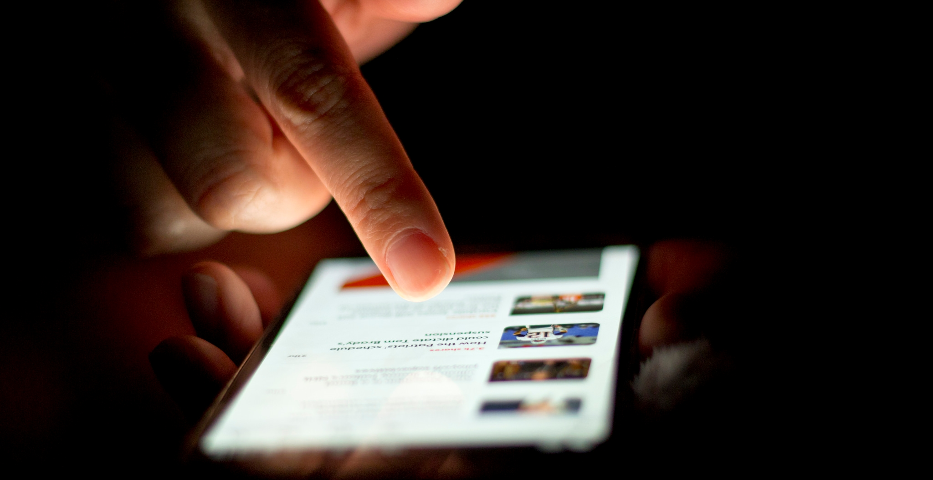
It’s time for a change
“Librarians have an opportunity to become part of users’ social networks and to put resources in the context of users’ information needs.”
(Connaway 2015, 23)
Notes:
Image: https://www.flickr.com/photos/68532869@N08/17470913285/ by Japanexperterna.se / CC BY-SA 2.0
“Librarians have an opportunity to become part of users’ social networks and to put resources in the context of users’ information needs.” (p. 23)
Connaway, Lynn Silipigni, comp. 2015. The Library in the Life of the User: Engaging with People Where They Live and Learn. Dublin, OH: OCLC Research. http://www.oclc.org/content/dam/research/publications/2015/oclcresearch-library-in-life-of-user.pdf.

Slide 52

“Nearly 60 percent of the world’s people are still offline.”
(Pattillo 2016)
Notes:
Image: https://www.flickr.com/photos/backgroundsetc/3424524913 by Backgrounds Etc / CC BY 2.0
“Digital technologies have spread rapidly in much of the world, but the broader development benefits from using these technologies have lagged behind. While more than 40 percent of the world’s population has access to the Internet, nearly 6 billion people do not have high-speed Internet, making them unable to fully participate in the digital economy. Nearly 60 percent of the world’s people are still offline. The less educated and the bottom 40 percent of the welfare distribution worldwide are most vulnerable to technological changes in the labor market.”
World Bank. 2016. “World Development Report 2016: Digital Dividends.” Washington, D.C.: World Bank. www.worldbank.org/en/publication/wdr2016. Quoted in Gary Pattillo. 2016. “Fast Facts.” College & Research Libraries News 77, no. 3: 164.

Slide 53
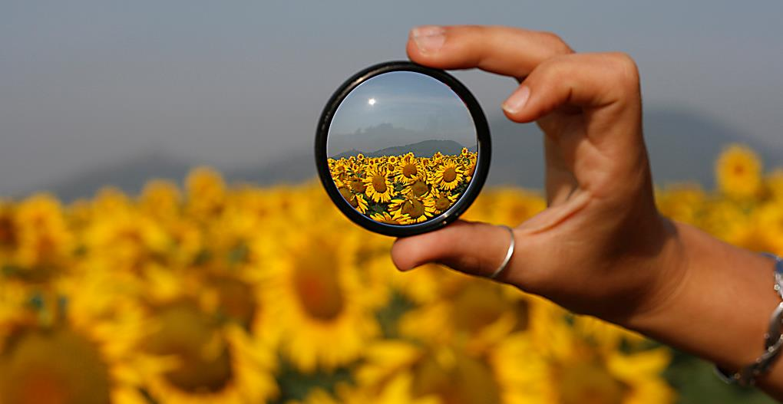
“By focusing on relationship building instead of service excellence, organizations can uncover new needs and be in position to make a stronger impact.”
(Mathews, 2012)
Notes:
Image: https://www.flickr.com/photos/marcomagrini/698692268/ by marco magrini / CC BY-NC-ND 2.0
Mathews, Brian. 2012. Think Like a Startup: A White Paper to Inspire Library Entrepreneurialism. http://chronicle.com/blognetwork/theubiquitouslibrarian/2012/04/04/think-like-a-startup-a-white-paper/.

Slide 54
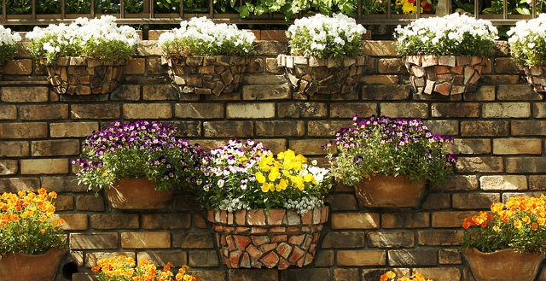
Embedded librarianship
…be where our users need us
“Our experience with a proactive chat model… showed us that there is indeed a ready-made market for our services right on our own library pages...”
(Zhang and Mayer 2014, 205)
Notes:
Image: https://www.flickr.com/photos/28481088@N00/8703727704 by tanakawho / CC BY-NC 2.0
“We need to be where our users need us, when they need us. If the majority of our users prefer to communicate via mobile phone texting, chat, or IM; to learn through gaming; by accessing the library’s unique collections and materials via social media, such as Facebook2 and Wikipedia; or to meet with us FtF outside of the library, we need to be there!” (p. 203)
“Embedded librarianship also is an important aspect of public library engagement with the community. Many public libraries are providing kiosks in public spaces, such as train and bus stations and parks, for users to check-out and return print, audio, and electronic books, magazines, newspapers, and journals.” (p. 203)
“The library of 2020 will provide user-centered services and systems that will meet the expectations of the community. The library staff will need to develop relationships with their users and partner with other organizations in order to produce, store, and preserve content and data sets and to provide personalized services. Recruiting and retaining innovative, creative individuals who are willing to engage with users and to embrace new technologies and modes of communication will be imperative for the success of the library of 2020.” (p. 204)
“Our experience with a proactive chat model at John Carroll University showed us that there is indeed a ready-made market for our services right on our own library pages, and that our users will ask us questions when we approach them.” (Zhang and Mayer 2014, 205)
Zhang, Jie, and Nevin Mayer. 2014. “Proactive Chat Reference: Getting in the Users’ Space.” College & Research Libraries News 75, no. 4: 202-205.

Slide 55
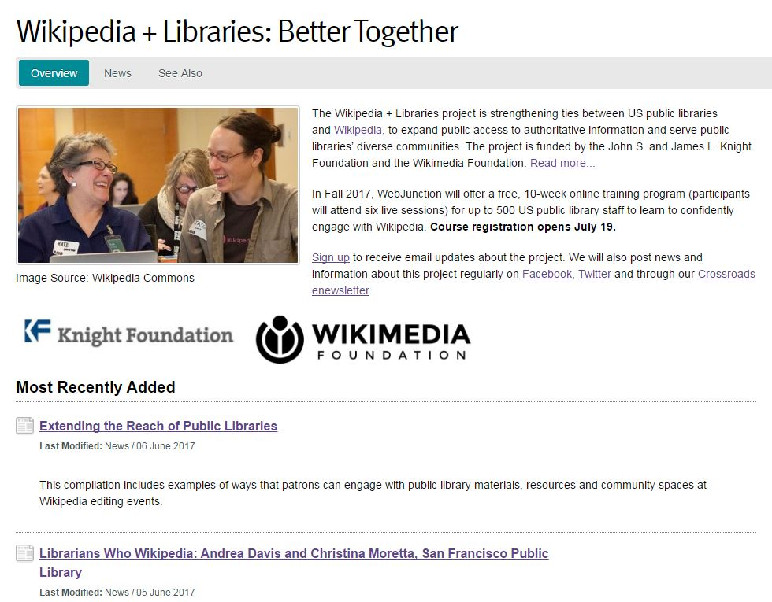
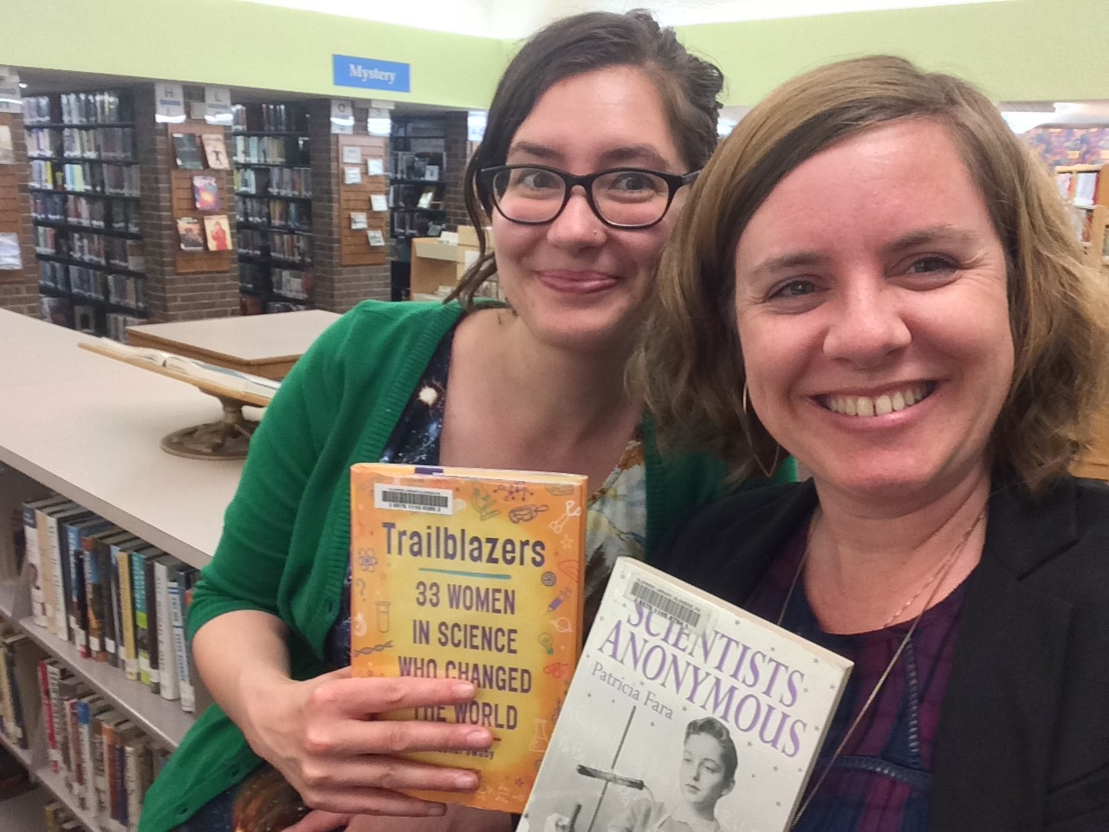
Information literacy with Wikipedia
Allison Frick, left, (Glendale Free Library in Pennsylvania) and Christina Riehman-Murphy (Penn State) organized an information literacy event focused on women and science. Photo: Courtesy Allison Frick
oc.lc/oclc-wikilib
Notes:
Slide adapted from Frick, Rachel, Sharon Streams, Monika Sengul-Jones, Kenning Arlitsch, and Jeff Mixter. 2017. OCLC Research Update. ALA Annual Conference, Chicago, Illinois, June 26, 2017.

Slide 56
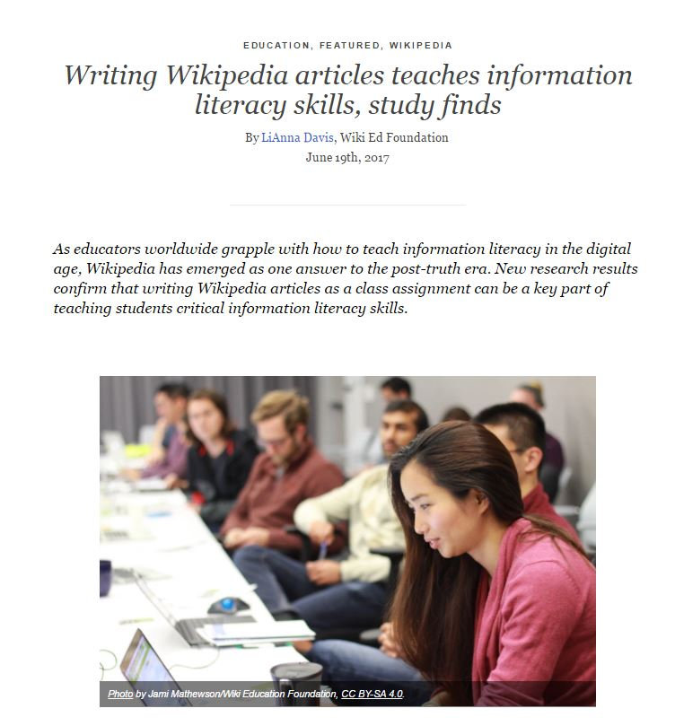
Editing Wikipedia promotes digital information literacy
96% of higher education instructors consider Wikipedia more valuable for teaching digital literacy than traditional assignments
2017 Wiki Education Foundation report
https://commons.wikimedia.org/wiki/File:Student_Learning_Outcomes_using_Wikipedia-based_Assignments_Fall_2016_Research_Report.pdf
Notes:
Slide from Frick, Rachel, Sharon Streams, Monika Sengul-Jones, Kenning Arlitsch, and Jeff Mixter. 2017. OCLC Research Update. ALA Annual Conference, Chicago, Illinois, June 26, 2017.
Wiki Education Foundation. 2016. Student Learning Outcomes using Wikipedia-based Assignments Fall 2016 Research Report. Prepared by Zachary James McDowell and Mahala Dyer Stewart. Retrieved from https://commons.wikimedia.org/w/index.php?title=File:Student_Learning_Outcomes_using_Wikipedia-based_Assignments_Fall_2016_Research_Report.pdf&page=2.

Slide 57
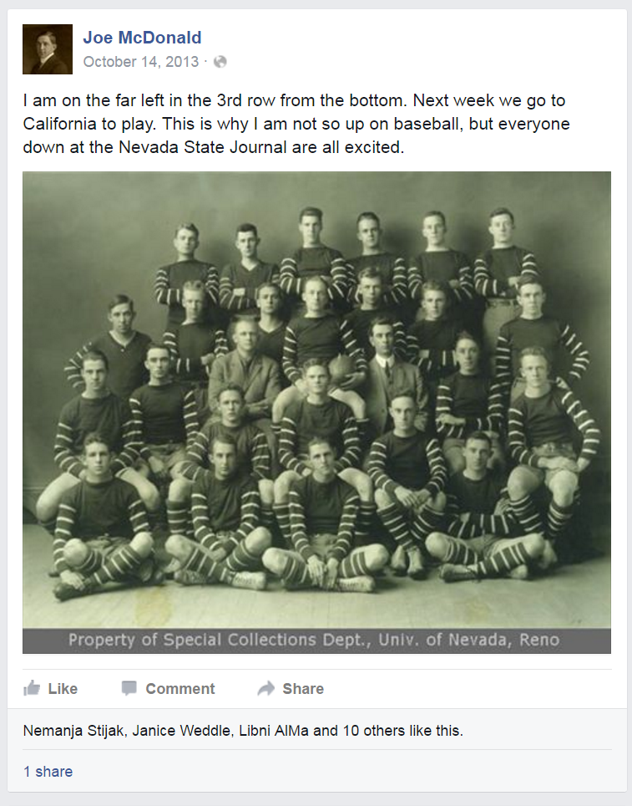
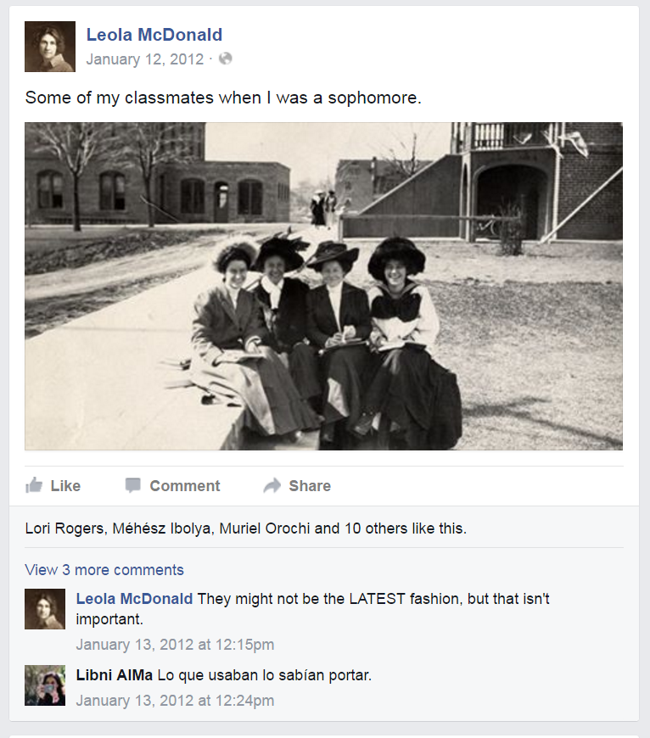
Social Media Presence
Notes:
Image: “Joe McDonald’s Facebook Page.” Facebook.com. https://www.facebook.com/Joe-McDonald-274017182657487/.
Image: “Leola McDonald’s Facebook Page.” Facebook.com. https://www.facebook.com/Leola-McDonald-128487107270652/.
DeSantis, Nick. 2012. “On Facebook, Librarian Brings 2 Students From the Early 1900s to Life.” The Chronicle of Higher Education, January 6. http://chronicle.com/blogs/wiredcampus/on-facebook-librarian-brings-two-students-from-the-early-1900s-to-life/34845.

Slide 58
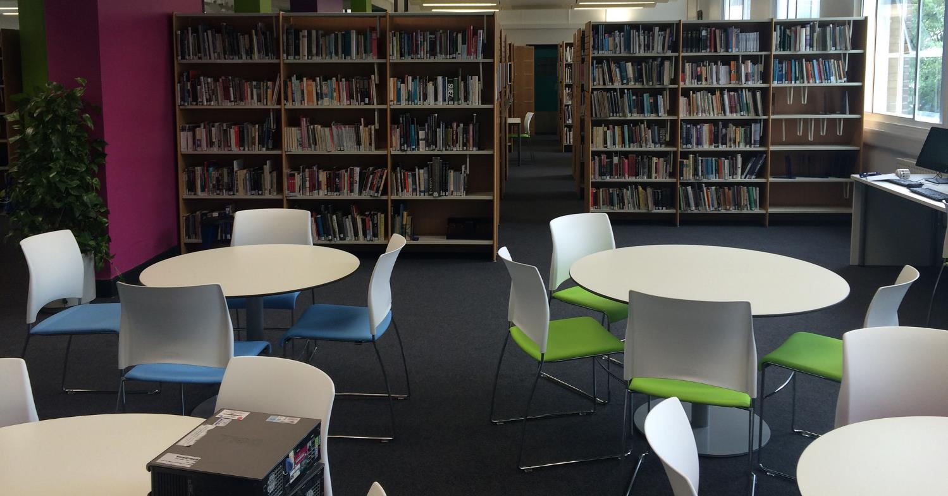
Space for socializing and group work
“We do go to the library or somewhere quiet where we can just get our work done together...”
(Digital Visitors and Residents, UKU3, Female, Age 19, French and Italian)
Notes:
Image: https://www.flickr.com/photos/jamesclay/14867901948/ by James F Clay / CC BY-NC 2.0
“When asked to describe the ideal information system, Millennials suggested that the library catalog be more like an Internet search engine or Amazon.com. They also wanted the library to provide space for them to socialize and work in groups and suggested 24/7 access to a librarian via telephone, such as a ‘lifeline” (referring to the television program, Who Wants to be a Millionaire?) Older Millennials were most interested in expediency, desiring roaming librarians, drive-up book drops, library delivery of print materials to their campus addresses, and a coffee house-like environment. The faculty (the majority were Baby Boomers) wanted a less intimidating library with better signage, and a book store like environment.” (p. 92)
Connaway, Lynn Silipigni, comp. 2015. The Library in the Life of the User: Engaging with People Where They Live and Learn. Dublin, OH: OCLC Research. http://www.oclc.org/content/dam/research/publications/2015/oclcresearch-library-in-life-of-user.pdf.
“We do go to the library or somewhere quiet where we can just get our work done together but in regards to something we need the internet for or the computer we normally do that by ourselves. For example I will write up something and send it to her or just print it out and bring it to the lesson and she will go “That’s fine.”” (Digital Visitors and Residents, UKU3, Emerging, Female, Age 19, French and Italian)
White, David S., and Lynn Silipigni Connaway. 2011-2014. Digital Visitors and Residents: What Motivates Engagement with the Digital Information Environment. Funded by JISC, OCLC, and Oxford University. http://www.oclc.org/research/activities/vandr.html.

Slide 59
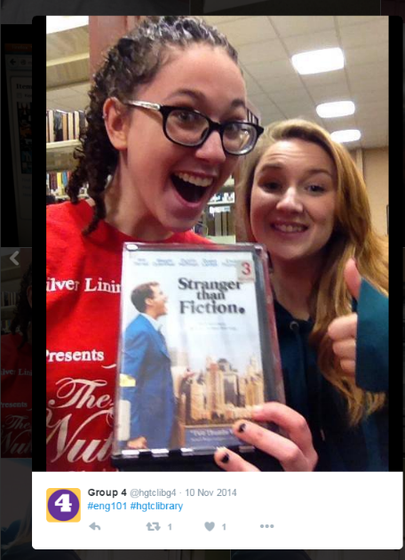
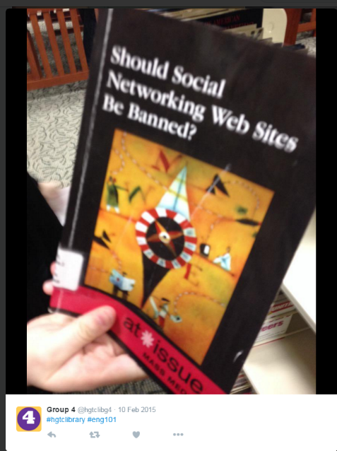
Special Events and Activities
Notes:
Images: Twitter
“The “hashtag hunt,” or Twitter-based scavenger hunt, is an activity that any librarian can complete with his or her students. Though it was originally created to help English 101 students practice finding recommended books for research assignments concerning controversial or moral issues and with the OPAC, it also allows students to explore the library as a place. The handout students receive is structured like all of the traditional library scavenger hunts of day’s past, but students are asked to take photos of the items they find and post them on Twitter with hashtags of the librarian’s choosing, usually hashtags that distinguish the library and the class (e.g., #hgtclibrary and #eng101). Students may also be awarded bonus points for #shelfie posts, which are explained to be posts of themselves in stacks, using the one of the collaborative learning units and/or print stations, or standing in a study room.” (11)
Kraft, Amanda, and Aleck F. Williams, Jr. 2016. “#Shelfies are Encouraged: Simple, Engaging Library Instruction with Hashtags.” College & Research Libraries News 77, no. 1 (2016): 10-13.

Slide 60
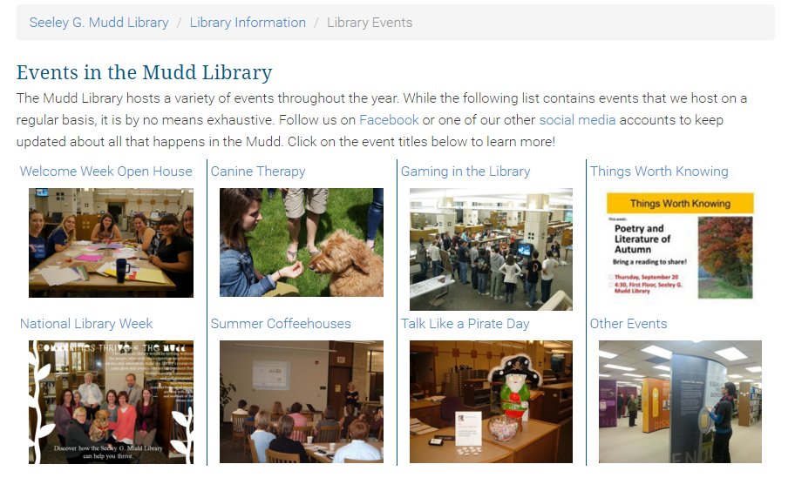
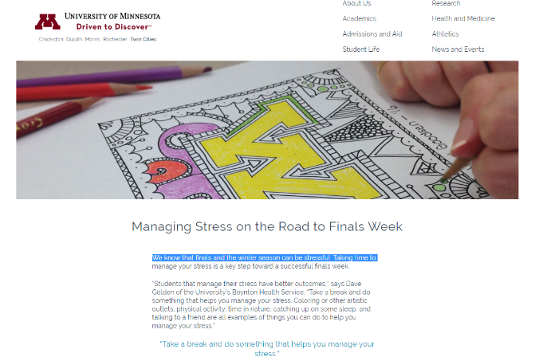
Special Events and Activities
Notes:
Image: Lawrence University. “Library Events.” https://www.lawrence.edu/library/about/events.
Image: University of Minnesota. “Managing Stress on the Road to Finals Week.” https://twin-cities.umn.edu/managing-stress-road-finals-week.

Slide 61

“Library is a growing organism.”
(Ranganathan 1931)
Use what you know.
Learn what you don’t know.
Engage in new ways.
Notes:
Image: http://www.flickr.com/photos/96043955@N05/15190222775 by Ryan Hickox / CC BY-SA 2.0
Ranganathan, S. R. 1931. The Five Laws of Library Science. London: Edward Goldston, Ltd.

Slide 62
Additional V&R Materials

Slide 63
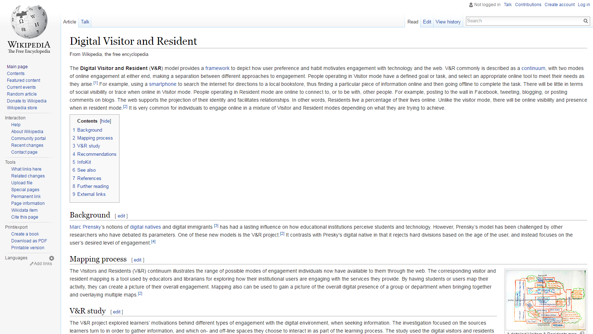
Notes:
Image: Wikipedia contributors. "Digital Visitor and Resident." Wikipedia, The Free Encyclopedia. https://en.wikipedia.org/wiki/Digital_Visitor_and_Resident.

Slide 64
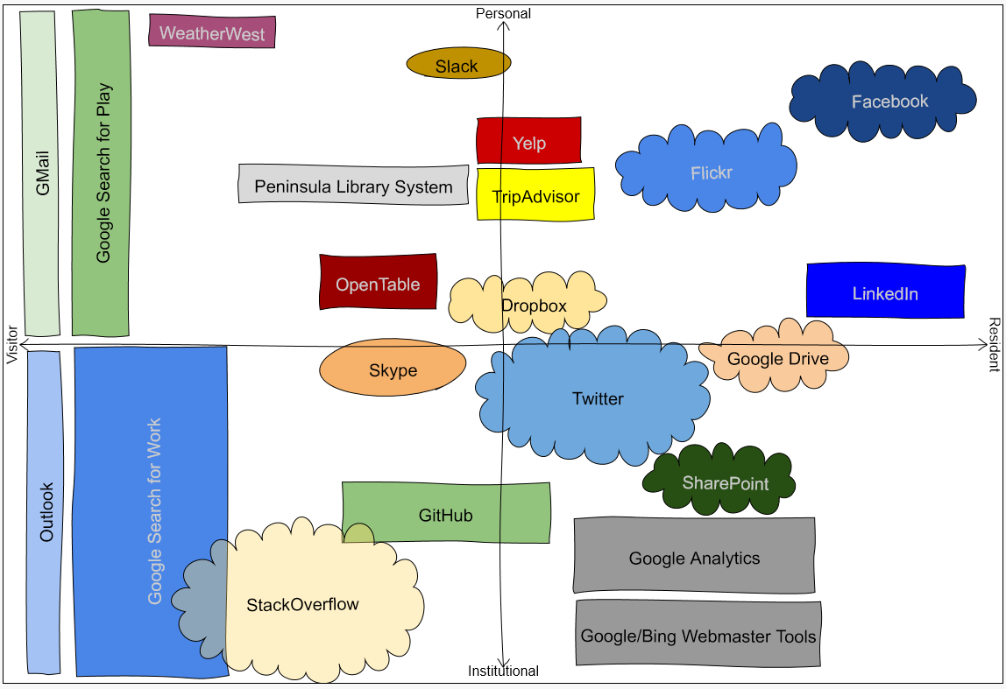

http://oc.lc/vrmap
Notes:
1. To use the app, go to “http://oc.lc/vrmap” – you can do it on paper
If you like it, share it!

Slide 65
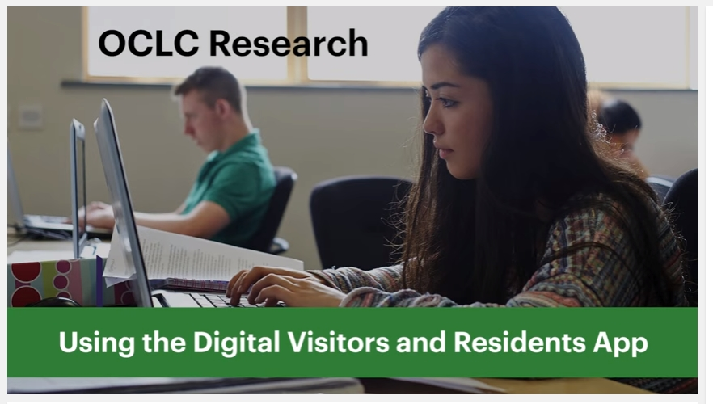
Play
https://www.youtube.com/watch?v=6ai0ZO3lDR4
Notes:
Here’s a demonstration of the app.
OCLC Research. 2016. Using the Digital Visitors and Residents App. YouTube video. May 5. https://www.youtube.com/watch?v=6ai0ZO3lDR4.

Slide 66
Future research

Slide 67
Discovery and Access
OCLC User Research Committee and University of Illinois
Goal: To understand how individuals search for known and unknown items and how they gain access to these items after discovering them
Sample Research Questions:
How do users navigate the path from discovery to access?
What do academic users do when searches don’t result in access?
What differentiates searches that lead to access from searches that don’t lead to access?

Slide 68
Data Collection and Analysis
Server log analysis: WorldCat Discovery
User interviews
10 academic libraries including University of Illinois
Pre-screen surveys with access/fulfillment data
Individual semi-structured interviews based on log data

Slide 69

The Many Faces of Digital Visitors & Residents: Facets of Online Engagement
OCLC Report authored by:
Lynn Silipigni Connaway
Vanessa Kitzie
Erin M. Hood
William Harvey
Notes:
Image: https://www.flickr.com/photos/eltpics/9674285302 by eltpics / CC BY-NC 2.0 https://creativecommons.org/licenses/by-nc/2.0/

Slide 70
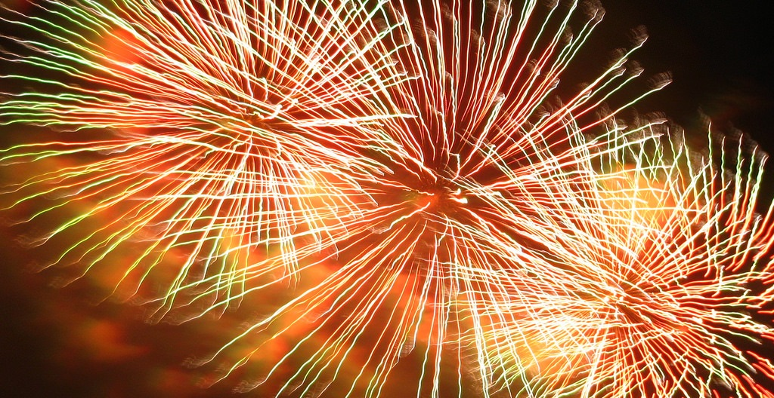
With contributions from:
Allison Benedetti
Agustí Canals
Liliana Gregori
Eva Ortoll Espinet
Daniel Lozano
Melissa Man
Josep Cobarsí Morales
Sara Giuliana Ricetto
Riccardo Melgrati
Eva M. Méndez Rodríguez
Andrea Sada
Peter Sidorko
Paolo Sirito
Virginia Steel
Titia van der Werf
Esther Woo
Notes:
Image: https://www.flickr.com/photos/littlestar19/4086086968 by littlestar19 / CC BY-NC 2.0

Slide 71
Acknowledgements
I would like to thank Brittany Brannon for her assistance in preparing this presentation.

Slide 72
References
Barthel, Michael. 2016. “Around Half of Newspaper Readers Rely Only on Print Edition.” Pew Research Center, January 6, www.pewresearch.org/fact-tank/2016/01/06/around-half-of-newspaper-readers-rely-only-on-print-edition.
Connaway, Lynn Silipigni, comp. 2015. The Library in the Life of the User: Engaging with People Where They Live and Learn. Dublin, OH: OCLC Research. http://www.oclc.org/content/dam/research/publications/2015/oclcresearch-library-in-life-of-user.pdf.
Connaway, Lynn Silipigni, Vanessa Kitzie, Erin M. Hood and William Harvey. 2017. The Many Faces of Digital Visitors & Residents: Facets of Online Engagement. With contributions from Allison Benedetti, Agustí Canals, Liliana Gregori, Eva Ortoll Espinet, Daniel Lozano, Melissa Man, Josep Cobarsí Morales, Sara Giuliana Ricetto, Riccardo Melgrati, Eva M. Méndez Rodríguez, Andrea Sada, Peter Sidorko, Paolo Sirito, Virginia Steel, Titia van der Werf, and Esther Woo. Dublin, OH: OCLC Research. doi:10.25333/C3V63F
https://www.oclc.org/content/dam/research/publications/2017/oclcresearch-many-faces-digital-vandr-a4.pdf.
DeSantis, Nick. 2012. “On Facebook, Librarian Brings 2 Students From the Early 1900s to Life.” The Chronicle of Higher Education, January 6. http://chronicle.com/blogs/wiredcampus/on-facebook-librarian-brings-two-students-from-the-early-1900s-to-life/34845.

Slide 73
References
Frick, Rachel, Sharon Streams, Monika Sengul-Jones, Kenning Arlitsch, and Jeff Mixter. 2017. OCLC Research Update. ALA Annual Conference, Chicago, Illinois, June 26, 2017.
Kraft, Amanda, and Aleck F. Williams, Jr. 2016. “#Shelfies are Encouraged: Simple, Engaging Library Instruction with Hashtags.” College & Research Libraries News 77, no. 1 (2016): 10-13.
Mathews, Brian. 2012. Think Like a Startup: A White Paper to Inspire Library Entrepreneurialism. http://chronicle.com/blognetwork/theubiquitouslibrarian/2012/04/04/think-like-a-startup-a-white-paper/.
Ranganathan, S. R. 1931. The Five Laws of Library Science. London: Edward Goldston, Ltd.
Shearer, Elisa, and Jeffrey Gottfried. 2017. “News Use Across Social Media Platforms 2017.” Pew Research Center, September 7. http://www.journalism.org/2017/09/07/news-use-across-social-media-platforms-2017/.
Statista. (2018). Number of internet users worldwide from 2005 to 2017 (in millions). https://www.statista.com/statistics/273018/number-of-internet-users-worldwide/.
Statista. (2018). Number of internet users worldwide from 2009 to 2017, by region (in millions). https://www.statista.com/statistics/265147/number-of-worldwide-internet-users-by-region/.

Slide 74
References
White, David S., and Alison Le Cornu. 2011. "Visitors and Residents: A New Typology for Online Engagement." First Monday 16,9 (5 September). Available online at: http://firstmonday.org/htbin/cgiwrap/bin/ojs/index.php/fm/article/view/3171/3049.
White, David S., and Lynn Silipigni Connaway. 2011-2014. Visitors & Residents: What Motivates Engagement with the Digital Information Environment. Funded by JISC, OCLC, and Oxford University. http://www.oclc.org/research/activities/vandr/.
Wiki Education Foundation. 2016. Student Learning Outcomes using Wikipedia-based Assignments Fall 2016 Research Report. Prepared by Zachary James McDowell and Mahala Dyer Stewart. https://commons.wikimedia.org/w/index.php?title=File:Student_Learning_Outcomes_using_Wikipedia-based_Assignments_Fall_2016_Research_Report.pdf&page=2.
World Bank. 2016. “World Development Report 2016: Digital Dividends.” Washington, D.C.: World Bank. www.worldbank.org/en/publication/wdr2016. Quoted in Gary Pattillo. 2016. “Fast Facts.” College & Research Libraries News 77, no. 3: 164.
Zhang, Jie, and Nevin Mayer. 2014. “Proactive Chat Reference: Getting in the Users’ Space.” College & Research Libraries News 75, no. 4: 202-205.

Slide 75
Image Attributions
Slide 3: https://www.flickr.com/photos/stewart/99129170/ by Stewart Butterfield / CC BY 2.0
Slide 4: https://www.flickr.com/photos/esthervargasc/9775119174/ by Esther Vargas / CC BY-SA 2.0
Slide 6: https://www.flickr.com/photos/27805557@N08/5088872975 by JoesSistah / CC BY-NC 2.0
Slide 9: https://www.flickr.com/photos/28481088@N00/11186264874 by tanakawho / CC BY 2.0
Slide 10: http://www.flickr.com/photos/15216811@N06/8521338394 by N i c o l a / CC BY 2.0
Slide 13: https://www.flickr.com/photos/vamapaull/3775032790 by Paul Istoan / CC BY-NC 2.0
Slide 14: https://www.flickr.com/photos/elena_87/2567662128/ by Elena / CC BY-NC-ND 2.0
Slide 16: https://www.flickr.com/photos/dancingpapa2007/3674686528 by Naoki Tomeno / CC BY 2.0
Slide 19: https://www.flickr.com/photos/deathtogutenberg/798918705/ by Austin Kleon / CC BY-NC-ND 2.0
Slide 20: https://www.flickr.com/photos/mrsdkrebs/11625280293 by Denise Krebs / CC BY 2.0
Slide 21: https://www.flickr.com/photos/mayopants/4021073588/ by stateofplace / CC BY-NC 2.0
Slide 22: http://www.flickr.com/photos/20452143@N08/3841271286 by Adam DeClercq / CC BY-NC-SA 2.0
Slide 23: http://www.flickr.com/photos/95792332@N00/3226023555 by Jacob Davies / CC BY-SA 2.0
Slide 24: https://www.flickr.com/photos/124705972@N06/14597368868/ by Steve Larkin / CC BY-NC 2.0
Slide 25: https://www.flickr.com/photos/caseyann/1250856017/ by Casey Smith / CC BY-NC-ND 2.0

Slide 76
Image Attributions
Slide 26: https://www.flickr.com/photos/tormentmoon/285212694 by Jinny / CC BY-NC-ND 2.0
Slide 27, 28, 35, 49: https://www.flickr.com/photos/kgregory/4675828550/ by Katie Mollon / CC BY-NC-ND 2.0
Slide 30: http://www.flickr.com/photos/113026679@N03/15646186494 by David Mulder / CC BY-SA 2.0
Slide 31: https://www.flickr.com/photos/jasonahowie/8583949219 by Jason Howie / CC BY 2.0
Slide 32: https://www.flickr.com/photos/veganfeast/4915226686 by Vegan Feast Catering / CC BY 2.0
Slide 33: https://www.flickr.com/photos/vladimir04/4438286546 by vl04 / CC BY 2.0
Slide 34: https://www.flickr.com/photos/34547181@N00/15031497490 by Philippe Put / CC BY 2.0
Slide 38: http://www.flickr.com/photos/79743208@N05/10229498105 by Matthew Matheson / CC BY-NC-ND 2.0
Slide 39: https://www.flickr.com/photos/jakerust/16226034713/ by GotCredit / CC BY 2.0
Slide 40: https://www.flickr.com/photos/bern4dette/15817093566/ by Bernadette van Hellenberg Hubar / CC BY-NC 2.0
Slide 41: https://www.flickr.com/photos/peter-trimming/9566245040/ by Peter Trimming / CC BY 2.0
Slide 42: https://www.flickr.com/photos/kgregory/4675828550/ by Katie Mollon / CC BY-NC-ND 2.0
Slide 45: https://www.flickr.com/photos/edgarpierce/5601664933/ by Edgar Pierce / CC BY 2.0
Slide 46: https://www.flickr.com/photos/12905355@N05/4293966039/ by Photo Giddy / CC BY-NC 2.0
Slide 47: https://www.flickr.com/photos/draconianrain/3982985600/ by Meghana Kulkarni / CC BY-NC 2.0

Slide 77
Image Attributions
Slide 48: https://www.flickr.com/photos/bonitoclub/9910937863/ by Tony & Wayne / CC BY-NC 2.0
Slide 51: https://www.flickr.com/photos/68532869@N08/17470913285/ by Japanexperterna.se / CC BY-SA 2.0
Slide 52: https://www.flickr.com/photos/backgroundsetc/3424524913 by Backgrounds Etc / CC BY 2.0
Slide 53: https://www.flickr.com/photos/marcomagrini/698692268/ by marco magrini / CC BY-NC-ND 2.0
Slide 54: https://www.flickr.com/photos/28481088@N00/8703727704 by tanakawho / CC BY-NC 2.0
Slide 57: “Joe McDonald’s Facebook Page.” Facebook.com. https://www.facebook.com/Joe-McDonald-274017182657487/; “Leola McDonald’s Facebook Page.” Facebook.com. https://www.facebook.com/Leola-McDonald-128487107270652
Slide 58: https://www.flickr.com/photos/jamesclay/14867901948/ by James F Clay / CC BY-NC 2.0
Slide 60: Lawrence University. “Library Events.” https://www.lawrence.edu/library/about/events; University of Minnesota. “Managing Stress on the Road to Finals Week.” https://twin-cities.umn.edu/managing-stress-road-finals-week
Slide 61: http://www.flickr.com/photos/96043955@N05/15190222775 by Ryan Hickox / CC BY-SA 2.0
Slide 69: https://www.flickr.com/photos/eltpics/9674285302 by eltpics / CC BY-NC 2.0 https://creativecommons.org/licenses/by-nc/2.0/
Slide 70: https://www.flickr.com/photos/littlestar19/4086086968 by littlestar19 / CC BY-NC 2.0
Slide 79: https://www.flickr.com/photos/scatteredashes/5844154762/ by Scipio / CC BY-NC 2.0
Creative Commons licenses: https://creativecommons.org/licenses/

Slide 78
Thank You!
Lynn Silipigni Connaway, PhD
Senior Research Scientist and Director of User Research
connawal@oclc.org
@LynnConnaway

Slide 79

Questions & Discussion
Notes:
Image: https://www.flickr.com/photos/scatteredashes/5844154762/ by Scipio / CC BY-NC 2.0

