Slide 1
Hong Kong March 28, 2017
Qualitative Research Methods in LIS
Lynn Silipigni Connaway, PhD
Senior Research Scientist & Director of User Research, OCLC
connawal@oclc.org
@LynnConnaway

Slide 2
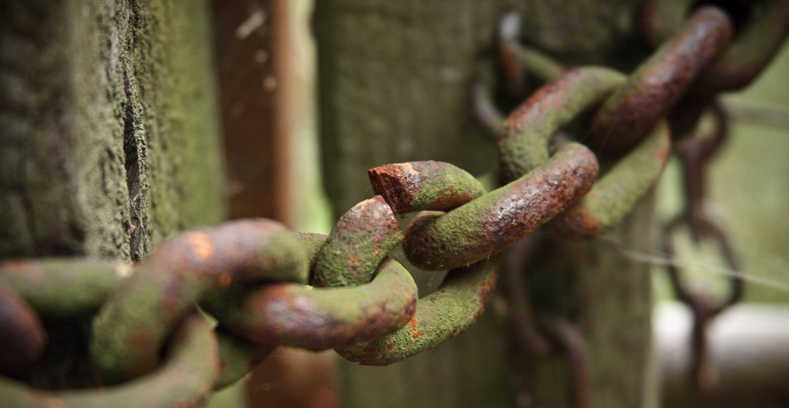
Challenges: Research Environment
Reduced funding opportunities
Scholarly value
Practical implications
Weak relationships with other disciplines
Limited communication of research & outputs
Inconsistent quality
Notes:
Image: https://www.flickr.com/photos/smithser/3870653508/ by Brian Smithson / CC BY 2.0
Reduced Funds
Scholarly Value
Theoretical framework
Practical Implications
Link between research and practice
Weak relationships between LIS and other research communities
Communicating research and outputs
Besides traditional dissemination by presentation and publication we should consider
Blogs
Social media
Conferences
Webinars
Quality
Research methods

Slide 3
Overview of LIS Published Research

Slide 4
Research Papers by Methodology and Year (Powell 1999)
Methodology | 1950 | 1960 | 1965 | 1970 | 1975 | Total* | %*
Theoretical-analytical | 11 | 17 | 11 | 36 | 52 | 127 | 14
Information system design | 7 | 16 | 21 | 57 | 49 | 150 | 17
Surveys on the public | 3 | 2 | 9 | 20 | 19 | 53 | 3
Survey or experiment on libraries, etc. | 22 | 15 | 45 | 89 | 113 | 284 | 32
Bibliometric and similar studies | 0 | 1 | 7 | 14 | 16 | 38 | 4
Content analysis | 0 | 1 | 2 | 1 | 3 | 7 | 1
Secondary analysis | 6 | 15 | 15 | 13 | 27 | 76 | 8
Historical methodologies | 21 | 26 | 25 | 49 | 42 | 163 | 18
Descriptive bibliography | 7 | 4 | 6 | 4 | 9 | 30 | 3
Comparative studies | 0 | 2 | 6 | 4 | 7 | 19 | 2
Other and multiple | 3 | 1 | 7 | 9 | 10 | 30 | 3
All papers* | 76 | 96 | 139 | 274 | 315 | 900 | 100
Notes:
*Note: The figures add to more than the total number of papers (and the percentages add to more than 100), since a paper may have more than one methodology
Table (2) from Powell, 1999
Powell, Ronald R. 1999. “Recent Trends in Research: A Methodological Essay.” Library & Information Science Research 21, no. 1: 91-119.

Slide 5
Research Methods: JDoc 2001-2010
N=367
Theoretical approach, 38%
Content analysis, 14%
Questionnaire, 13.8%
Experiment, 13.4%
Interview, 13.4%
(Chu 2015)
Notes:
Image: https://flic.kr/p/brnnFP (https://www.flickr.com/photos/64763706@N08/6850650385/) by LaTransfo / CC BY-SA 2.0
“The LIS field is maturing in terms of research method selection and application in that a greater number and wider variety of research methods are used in all the research publications this study examines. All the methods reported in the 1162 scholarly publications in a sense constitute a toolbox of research methods. Scholars are no longer limited to the research methods traditionally applied in LIS explorations (e.g., questionnaire and historical method). Researchers can instead choose research methods from this expanded toolbox according to their study objectives” (Chu 2015, 40).
Chu, Heting. 2015. “Research Methods in Library and Information Science: A Content Analysis.” Library & Information Science Research 37, no. 1: 36-41. http://dx.doi.org/10.1016/j.lisr.2014.09.003.

Slide 6
Research Methods: JASIS&T 2001-2010
N=554
Experiment, 31%
Bibliometrics, 23%
Questionnaire, 14%
Content analysis, 13%
Theoretical approach, 12%
(Chu 2015)
Notes:
Image: https://flic.kr/p/8bdX7z (https://www.flickr.com/photos/jeffanddayna/4710189081/) by Jeff Golden / CC BY-SA 2.0
Chu, Heting. 2015. “Research Methods in Library and Information Science: A Content Analysis.” Library & Information Science Research 37, no. 1: 36-41. http://dx.doi.org/10.1016/j.lisr.2014.09.003.

Slide 7
Research Methods: LISR 2001-2010
N=241
Content analysis, 30%
Questionnaire, 28%
Interview, 20%
Theoretical approach, 15%
Experiment, 9%
(Chu 2015)
Notes:
Image: https://flic.kr/p/8HwEak (https://www.flickr.com/photos/vofan/5064455445/) by VOFAN / CC BY-NC-ND 2.0
Chu, Heting. 2015. “Research Methods in Library and Information Science: A Content Analysis.” Library & Information Science Research 37, no. 1: 36-41. http://dx.doi.org/10.1016/j.lisr.2014.09.003.

Slide 8
Research Methods: JAL 2004-2013 (N=346)
METHOD | PERCENTAGE
Questionnaire | 47.6
Test or Quiz | 2.6
Diary | 0.6
Content Analysis | 27.2
Semi-structured Interviews | 14.0
Analysis of existing statistics | 6.6
Citation Analysis | 6.3
Focus Group Interview | 5.7
Observation | 4.3
Log Analysis | 3.4
Task Analysis | 2.9
(Luo and McKinney 2015)
Notes:
**used in primary research articles
Questionnaire: a standard survey questionnaire, 47.6
A test or quiz in the questionnaire format, usually used in experimental or quasi-experimental deign, 2.6
Diary, a type of self-administered questionnaire often used to record frequent or contemporaneous events or experiences, 0.6
Content analysis, 27.2
Semi-structured or in-depth interview, 14.0
Analysis of existing statistics (e.g. results from previous surveys, or circulation statistics), 6.6
Citation analysis, 6.3
Focus group interview, 5.7
Observation, including both quantitative and qualitative observation, 4.3
Log analysis, 3.4
Task analysis — the analysis of the completion of search tasks, 2.9
Luo, Lili, and Margaret McKinney. 2015. “JAL in the Past Decade: A Comprehensive Analysis of Academic Library Research.” The Journal of Academic Librarianship 41, no. 2: 123-129. http://dx.doi.org/10.1016/j.acalib.2015.01.003.

Slide 9
Definition of Qualitative Research

Slide 10
Definition
Qualitative Research:
A type of scientific research that:
Seeks answers to a question
Systematically uses predefined set of procedures to answer question
Collects evidence
Produces findings that:
Are not determined in advance
Apply beyond immediate boundaries of study
Notes:
Image: https://www.flickr.com/photos/katesheets/5772901616/ by katesheets / CC BY-NC 2.0

Slide 11
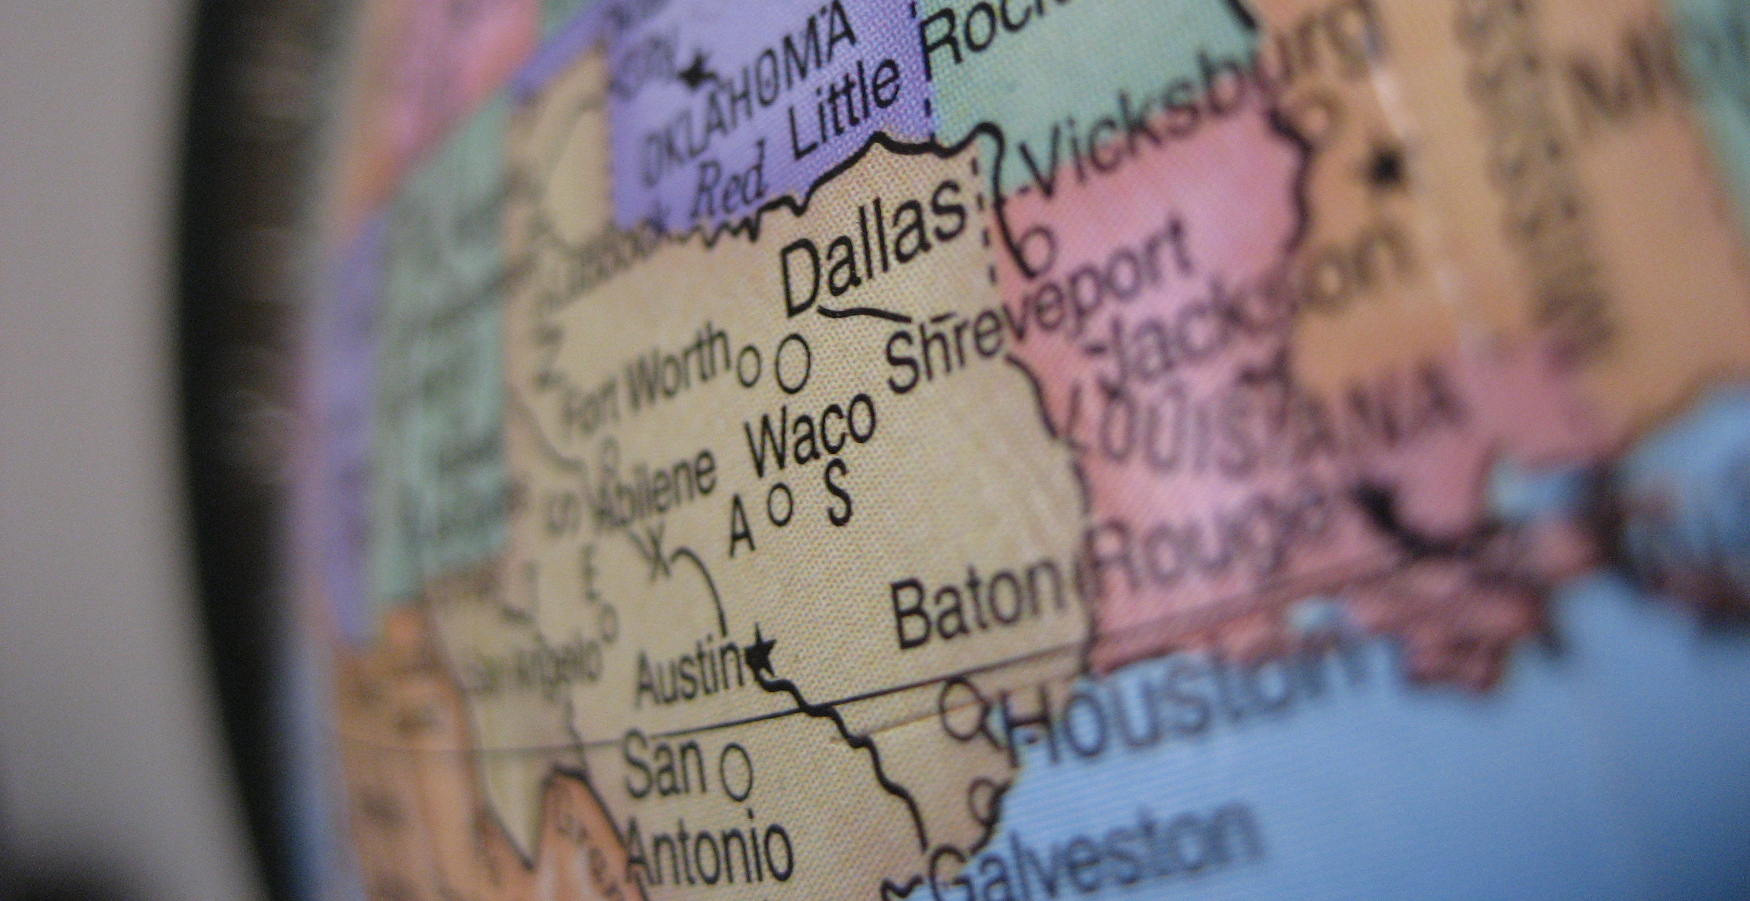
What is Qualitative Research?
“…a situated activity that locates the observer in the world. It consists of a set of interpretive, material practices that make the world visible. These practices transform the world. They turn the world into a series of representations, including field notes, interviews, conversations, photographs, recordings, & memos to the self.
At this level, qualitative research involves an interpretive, naturalistic approach to the world. This means that qualitative researchers study things in their natural settings, attempting to make sense of, or to interpret, phenomena in terms of the meanings people bring to them.”
(Denzin and Lincoln 2005)
Notes:
Image: https://www.flickr.com/photos/ddrmaxgt37/387453140/ by Arun Venkatesan / CC BY-NC 2.0
The content for this slide is from Marie L. Radford, Ph.D. qualitative research methods lecture notes.
Denzin, Norman K., and Yvonna S. Lincoln. 2005. The Sage Handbook of Qualitative Research, 4th ed. Thousand Oaks, CA: Sage Publications.

Slide 12
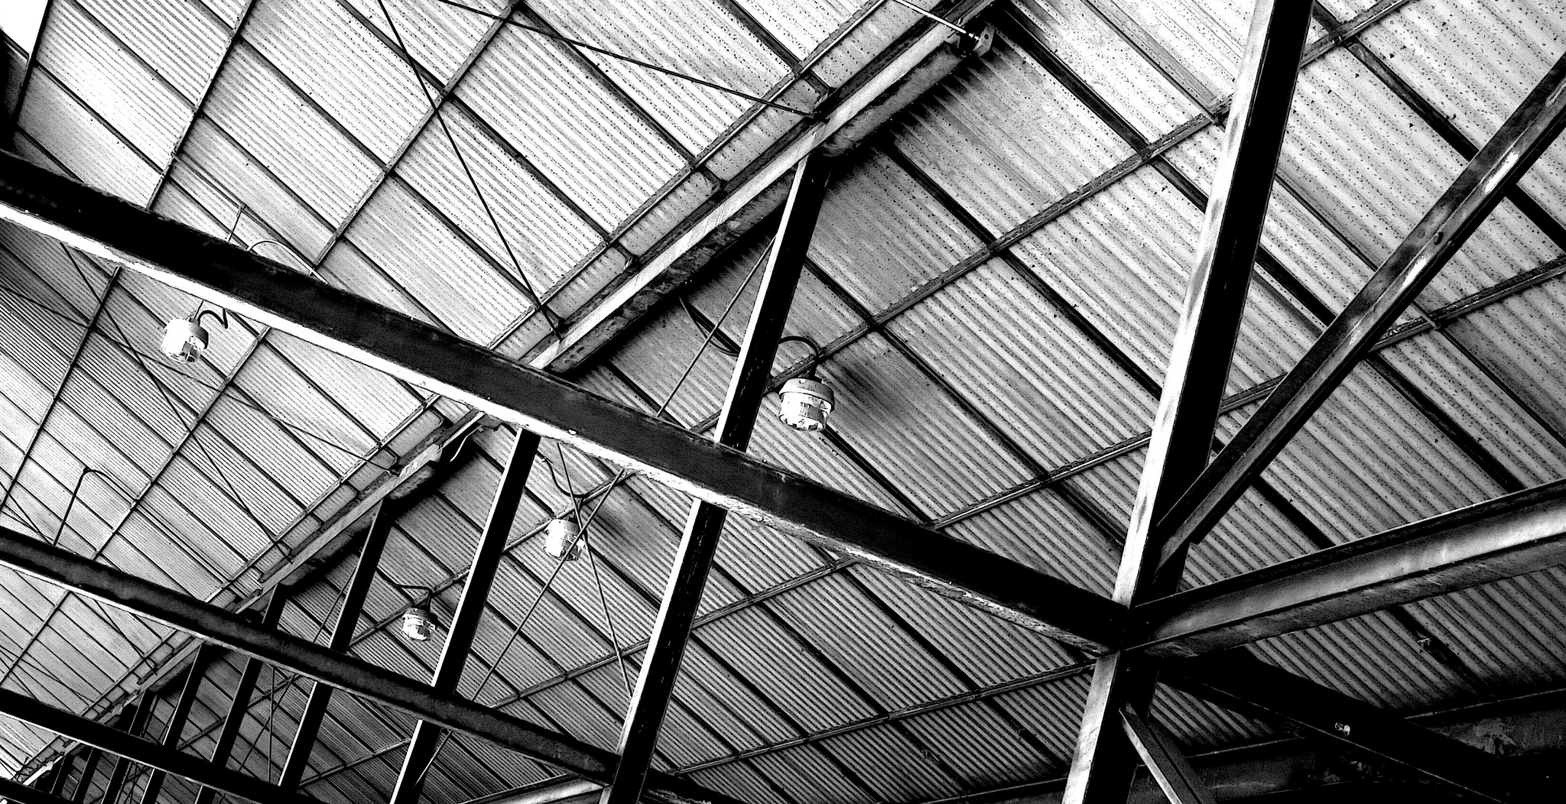
What is Qualitative Research?
DISCOVERY: discovering concepts & their relationships in raw, contextualized & situated data & then organizing these into some theoretical, explanatory scheme
UNDERSTANDING: A broad term that describes research that focuses on how individuals & groups view & understand the world & construct meaning out of their experiences
Notes:
Image: https://www.flickr.com/photos/davidjoyner/14622758882/ by David / CC BY-SA 2.0
The content for this slide is from Marie L. Radford, Ph.D. qualitative research methods lecture notes.

Slide 13
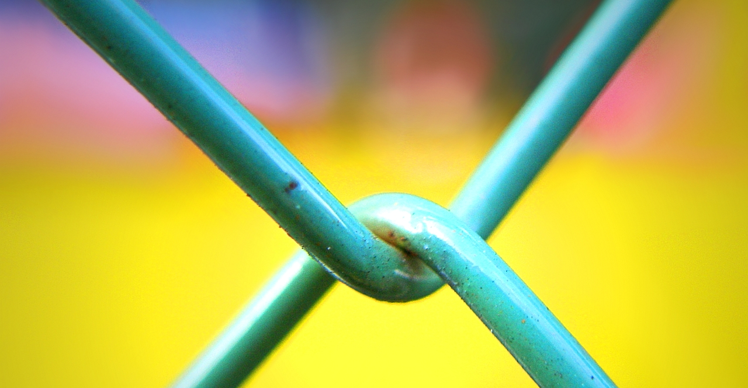
What is Qualitative Research?
Set of systematic, empirically-based approaches for investigating events in natural settings & situations
Use people’s perceptions of what is important in the situations/context
Uses inductive reasoning "from particular instances to general principles…
One starts from observed data & develops a generalization which explains the relationship between the objects observed” (Schriver 2001)
Broad term for wide range of techniques concerned more with interpretation & meaning of responses rather than their frequency or correlation
Underlying ideology is behavior can be explained only by the perspectives & highly subjective constructions of a respondent or participant, & not by any "objective truth"
Notes:
Image: https://www.flickr.com/photos/28481088@N00/3091698923/ by tanakawho / CC BY-NC 2.0
The content for this slide is from Marie L. Radford, Ph.D. qualitative research methods lecture notes.
Schriver, Joe M. 2001. Human Behavior in the Social Environment: Shifting Paradigms in Essential Knowledge for Social Work Practice, 3rd ed. Boston: Allyn & Bacon.

Slide 14
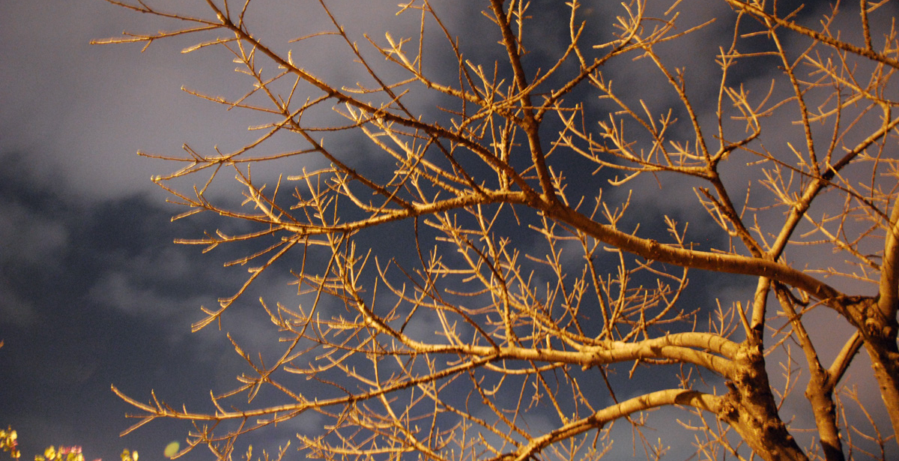
Philosophical Assumptions
Epistemology
Branch of philosophy centered on nature & origin of knowledge
Asks: “How do we know what we know?”
Ontology
Study of the nature of being.
How to represent objects, concepts & other entities assumed to exist in area of interest & relationships among them.
Hierarchical structuring of knowledge about things by subcategorizing them by essential (or relevant &/or cognitive) qualities.
Qualitative as much a PERSPECTIVE as it is a METHOD: way of thinking about & seeing social reality
Notes:
Image: https://www.flickr.com/photos/faykwong/3311629798/ by FEI KUANG / CC BY-NC 2.0
The content for this slide is from Marie L. Radford, Ph.D. qualitative research methods lecture notes.

Slide 15
Qualitative Data collection tools and methods

Slide 16
Interviews
Individual interviews
Face-to-face
Phone
Virtual
Focus group interviews
(Connaway and Radford 2017)
Notes:
Image: https://www.flickr.com/photos/nordforsk/32225539214/ by NordForsk / CC BY-NC-ND 2.0
Connaway, Lynn Silipigni, and Marie L. Radford. 2017. Research Methods for Library and Information Science, 6th ed. Westport, CT: Libraries Unlimited.

Slide 17
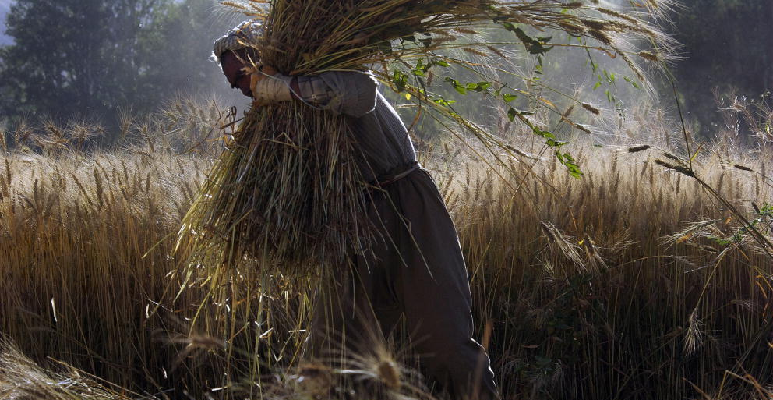
Purposes of Individual Interviews
Understanding participants’ experiences & perspectives
Discovering participants’ language forms
Gathering information about things or processes that cannot be observed easily.
Finding out about the past.
Validating & verifying information
Attaining efficient data collection
(Connaway and Radford 2017, 239-240)
Notes:
Image: https://www.flickr.com/photos/un_photo/4910848840 by United Nations Photo / CC BY-NC-ND 2.0
“Understanding participants’ experiences and perspectives via stories, accounts, and explanations.
Discovering participants’ language forms (How do they talk about things? What words and expressions are used?).
Gathering information about things or processes that cannot be observed easily.
Finding out about the past.
Validating and verifying information obtained from other sources.
Attaining efficient data collection.” (Connaway and Radford 2017, 239-240)
Connaway, Lynn Silipigni, and Marie L. Radford. 2017. Research Methods for Library and Information Science, 6th ed. Westport, CT: Libraries Unlimited.

Slide 18
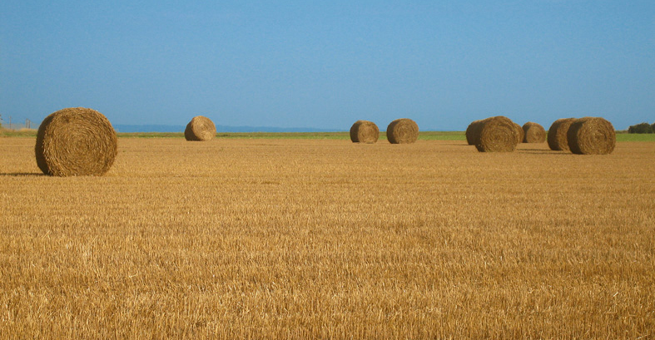
Conducting the Individual Interview
Thematizing: Clarifying the interview’s purpose
Designing: Defining the interview’s purpose
Interviewing: Conducting the interview
Transcribing: Creating a written verbatim text of the interview
Analyzing: Figuring out the meaning of data
Verifying: Determining the reliability & validity of the data
Reporting: Telling others about the findings
(Connaway and Radford 2017, 244)
Notes:
Image: https://www.flickr.com/photos/meanestindian/903380690/ by Meena Kadri / CC BY 2.0
“Thematizing: Clarifying the interview’s purpose and the concepts to be explored.
Designing: Defining the interview’s purpose and the concepts to be considerations.
Interviewing: Conducting the interview.
Transcribing: Creating a written verbatim text of the interview.
Analyzing: Figuring out the meaning of data in relation to the study’s research questions.
Verifying: Determining the reliability and validity of the data.
Reporting: Telling others about the findings.” (Connaway and Radford 2017, 244)
Connaway, Lynn Silipigni, and Marie L. Radford. 2017. Research Methods for Library and Information Science, 6th ed. Westport, CT: Libraries Unlimited.

Slide 19
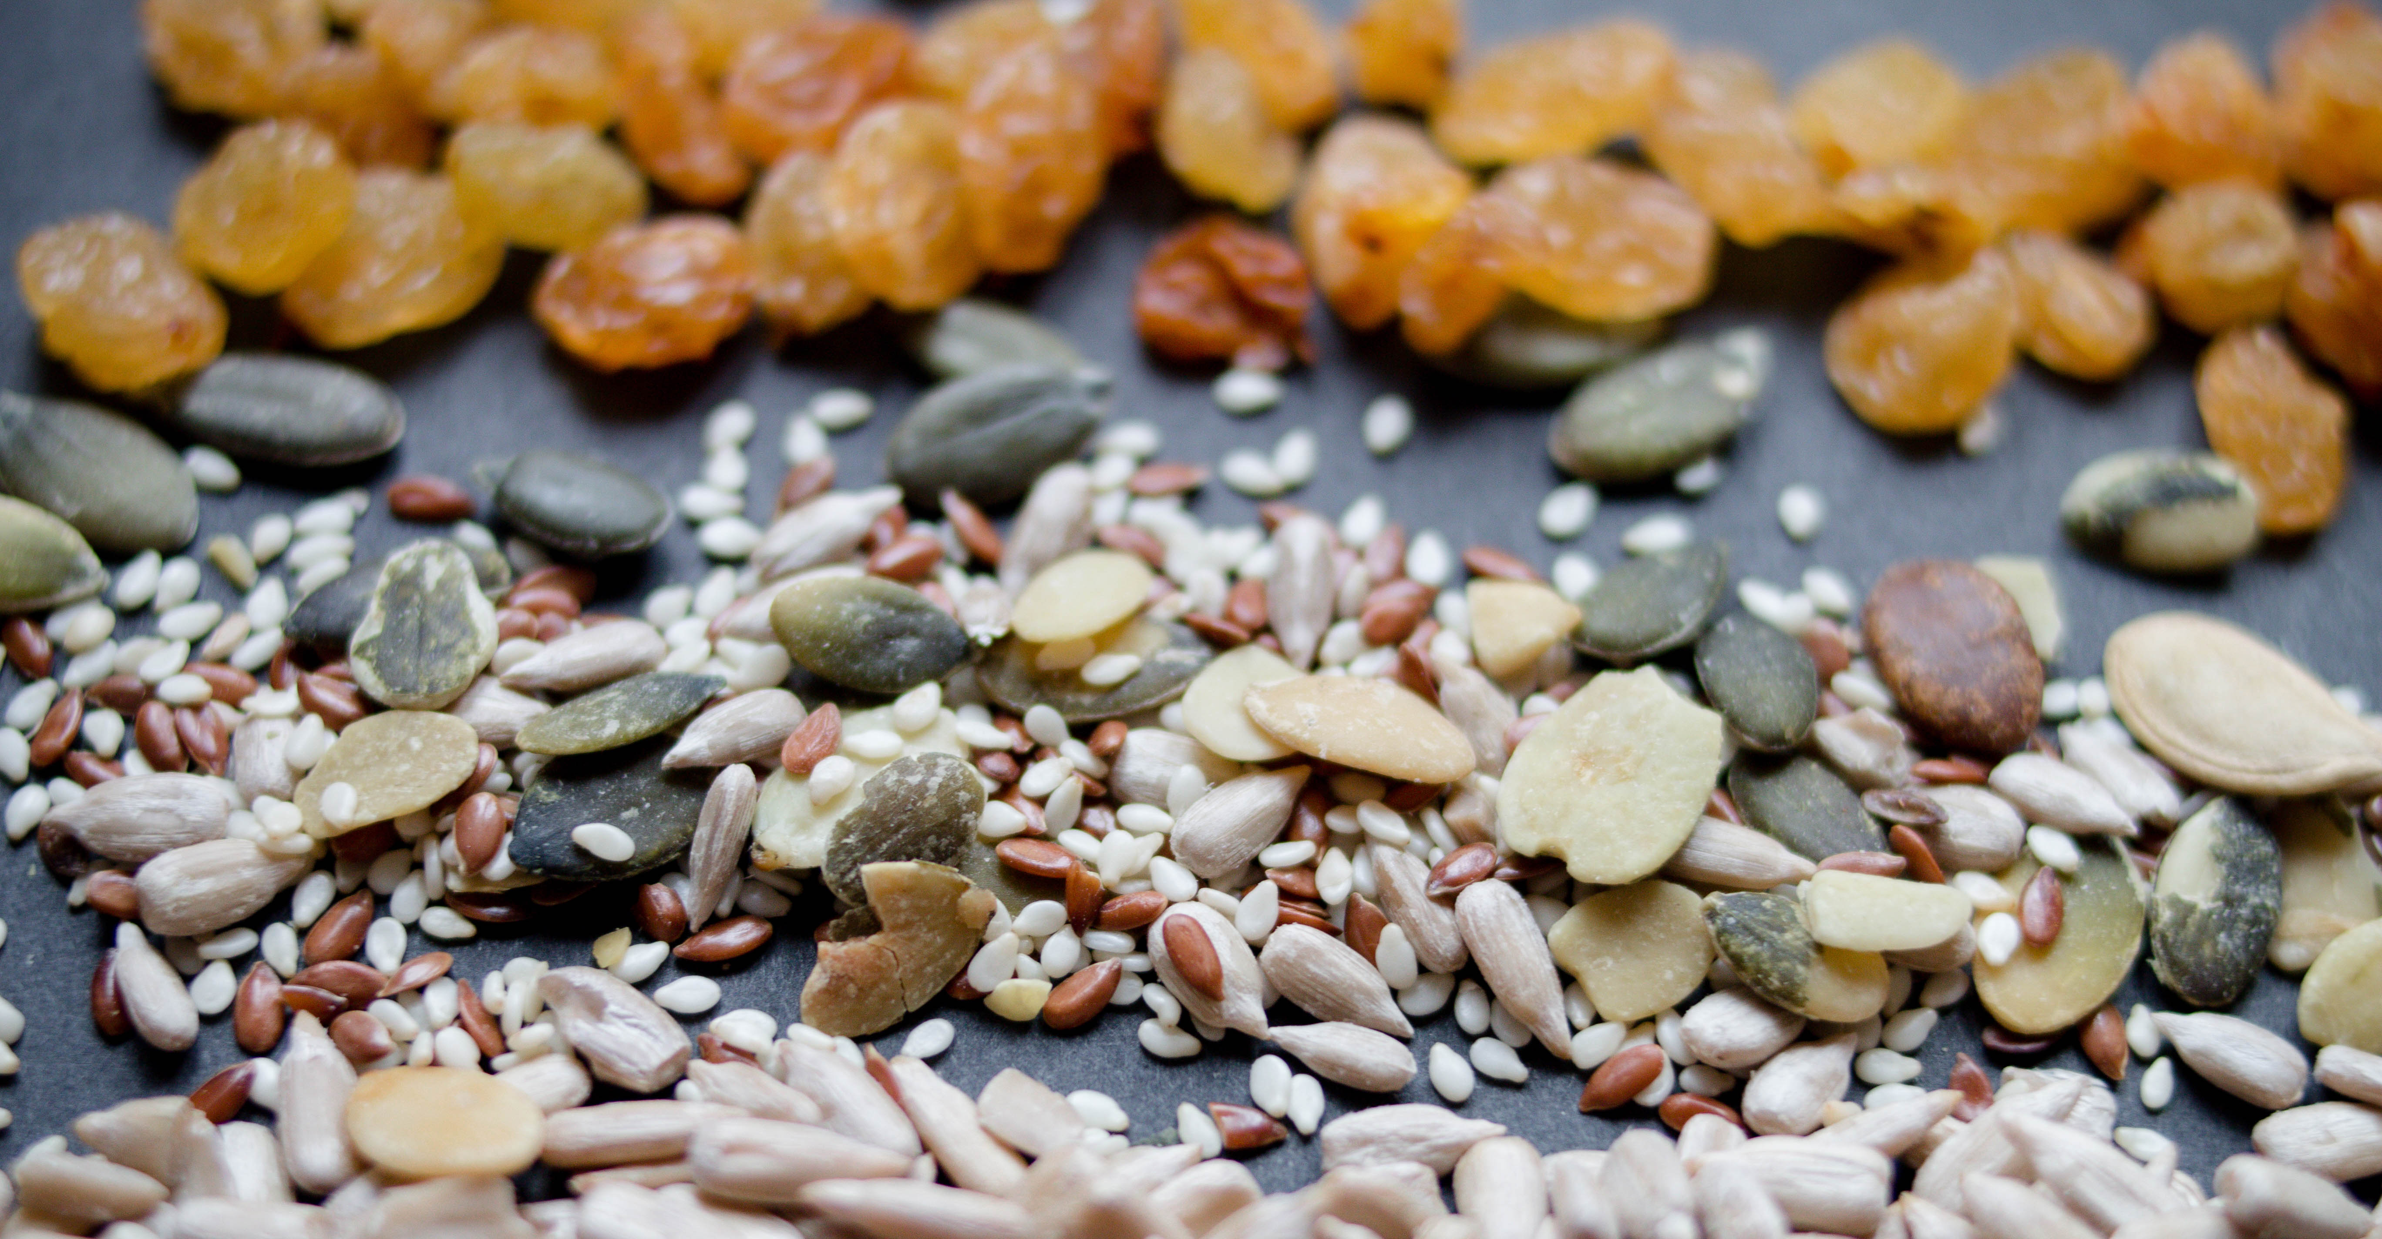
“The focus group interview technique can be used as a self-contained research method or in combination with other quantitative and qualitative research methods.”
(Connaway and Radford 2017, 250)
Notes:
Image: https://www.flickr.com/photos/30478819@N08/32624505933/ by Marco Verch / CC BY 2.0
“The focus group interview technique can be used as a self-contained research method or in combination with other quantitative and qualitative research methods. Focus groups are useful for orientating oneself to a new field; developing ideas and concepts or even generating hypotheses based on informants’ insights; evaluating different research sites or study populations; developing and refining research instruments, such as interview schedules and questionnaires; and getting participants’ interpretations of results from earlier studies.” (Connaway and Radford 2017, 250)
Connaway, Lynn Silipigni, and Marie L. Radford. 2017. Research Methods for Library and Information Science, 6th ed. Westport, CT: Libraries Unlimited.

Slide 20
Focus Group Guidelines
Open, safe, and secure forum
Confidentiality
All suggestions are acceptable
No interruptions
Active listening
Ask questions
(Connaway and Radford 2017, 252-253)
Notes:
Image: https://www.flickr.com/photos/lifeofrobert/3894022267/ by Robert Yocum / CC BY-SA 2.0
“Suggested guidelines include the following:
This is an open, safe, and secure forum.
Confidentiality of others should be respected.
All suggestions are acceptable.
Be patient with fellow group members (speak one at a time, no interruptions).
Be an active listener and participant.
Ask questions if necessary.” (Connaway and Radford 2017, 252-253)
Connaway, Lynn Silipigni, and Marie L. Radford. 2017. Research Methods for Library and Information Science, 6th ed. Westport, CT: Libraries Unlimited.

Slide 21
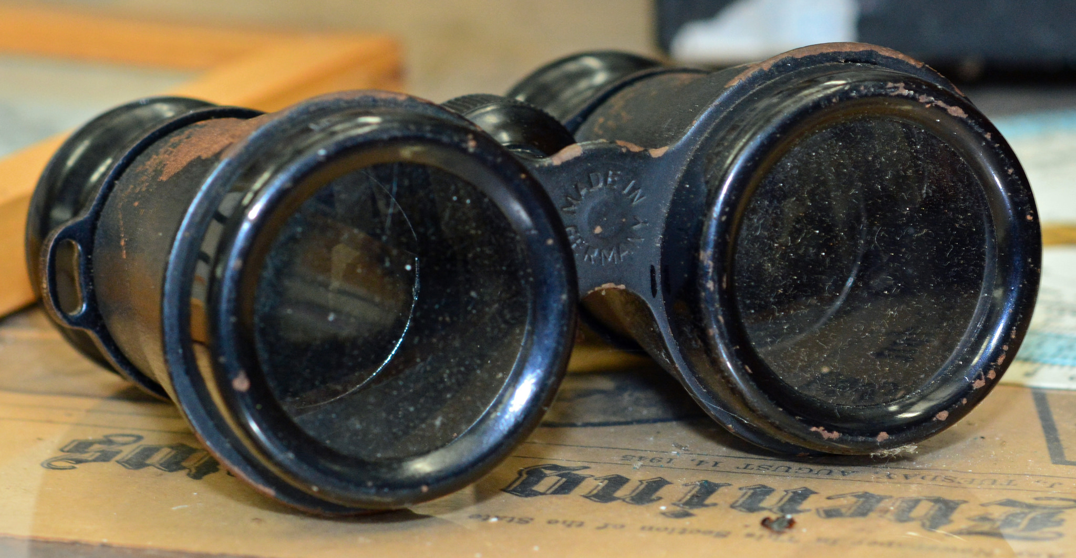
Ethnographic Research
“…a way of seeing how individuals interact and behave in situations by utilizing different qualitative data collection and analysis methods.”
(Connaway and Radford 2017, 263)
Notes:
Image: https://www.flickr.com/photos/pmillera4/13570027834/ by Peter Miller / CC BY-NC-ND 2.0
“The study of the culture and social organisation of a particular group, as well as the published result of such study” (Khoo, Rozaklis, and Hall 2012, 83).
Because ethnographic methods focus on directly observing, recording, and explaining what people are doing in practice, they are a particularly good strategy for approaching difficult and complex questions like understanding the myriad ways people approach searching for information (Asher 2017, 264).
Asher, Andrew. 2017. “On Ethnographic Research: How do Students Find the Information They Need?” In Research Methods for Library and Information Science, 6th ed., edited by Lynn Silipigni Connaway and Marie L. Radford, 264. Westport, CT: Libraries Unlimited.
Connaway, Lynn Silipigni, and Marie L. Radford. 2017. Research Methods for Library and Information Science, 6th ed. Westport, CT: Libraries Unlimited.
Khoo, Michael, Lily Rozaklis, and Catherine Hall. 2012. “A Survey of the Use of Ethnographic Methods in the Study of Libraries and Library Users.” Library and Information Science Research 34, no. 2: 82-91.

Slide 22
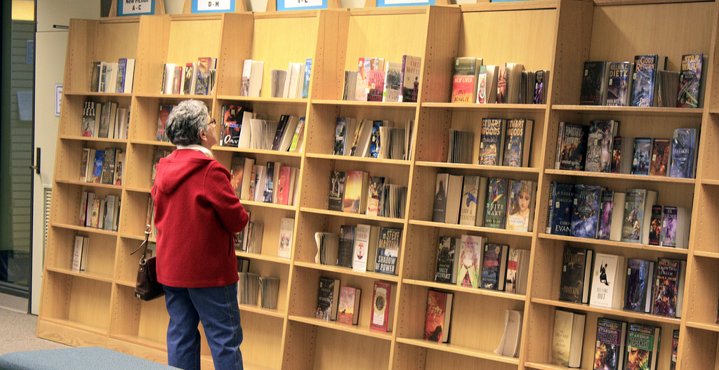
Participant/Immersive Observations
Move into the setting as deeply as possible
Disturb participants as little as possible
Participant observation
Open, direct interaction & observation as part of the group
(Connaway and Radford 2017)
Notes:
Image: https://www.flickr.com/photos/njla/3306454031/ by NJLA: New Jersey Library Association / CC BY-NC-ND 2.0
Example of participant observation: researcher appears to reference librarians as a patron.
Connaway, Lynn Silipigni, and Marie L. Radford. 2017. Research Methods for Library and Information Science, 6th ed. Westport, CT: Libraries Unlimited.

Slide 23
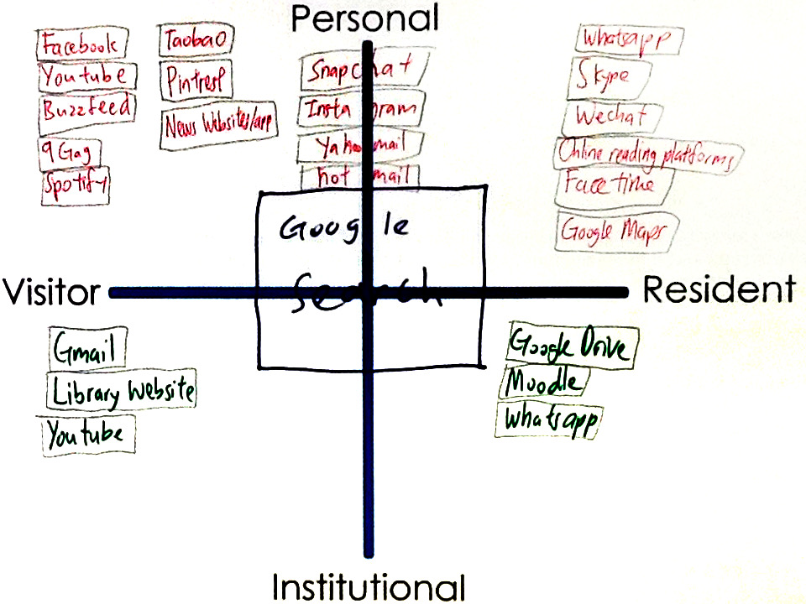
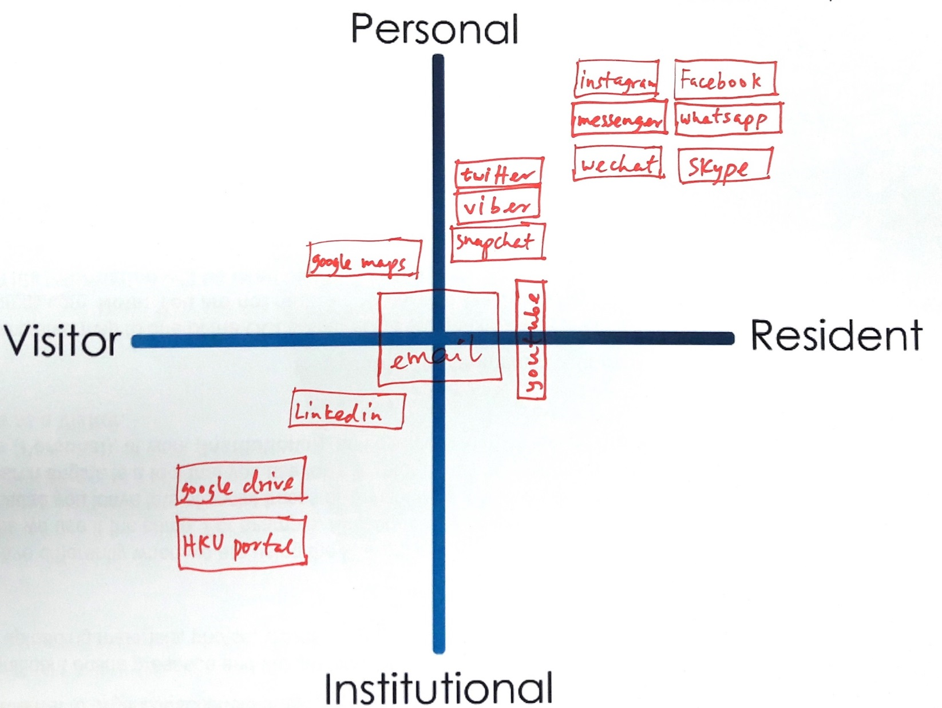
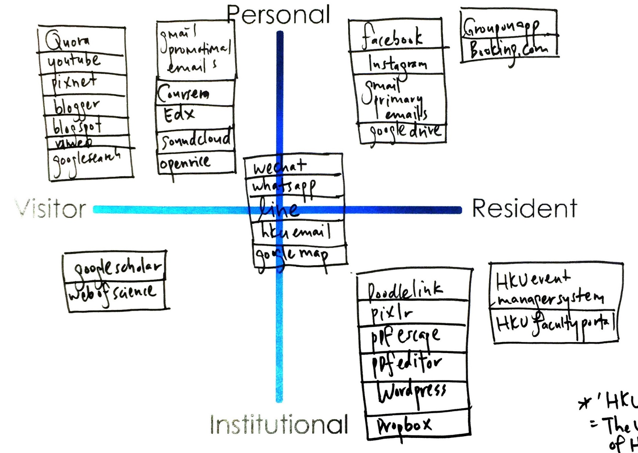
Mapping
Notes:
Quadrant 1:
HKU, 1st year undergrad
Realized I am not that hard working
In desperation when I have to directly go to library website
Google search: usually don’t login, just search, more on visitor side
Snapchat …Hotmail : Not too often do sharing
A way to release my burden
FB try not to post/share, look at what my friends share
Quadrant 2:
HKU, upper undergrad
Library- Borrow book for personal
Google drive – only for group project (visitor)
Social media apps make us anti – social
Quadrant 3:
HKU, faculty researcher and/or scholar
Research assistant
Least Digital footprint as possible, substantial, good thing to live (the left side of the map)
Middle – use a lot in work, create contacts
Use HKU specific apps for work, wordpress, create webpage
Learn about yourself: need to learn more & contribute more in digital footprint (at work and in personal)

Slide 24
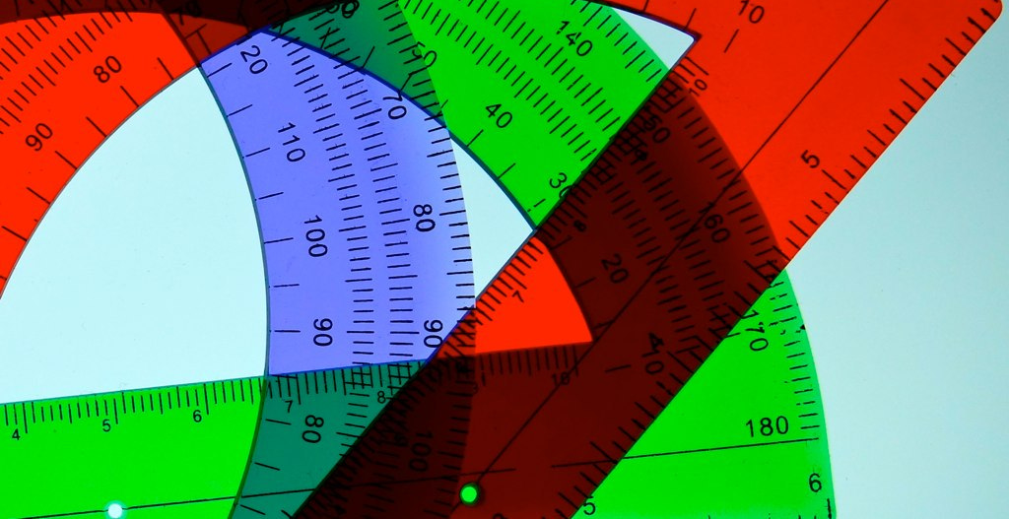
Usability Testing: Definition
Degree to which a user can successfully learn & use a product to achieve a goal
Evaluation research methodology
Observation & analysis of user behavior while users use a product or product prototype to achieve a goal
(Dumas and Redish 1993, 22)
Notes:
Image: https://www.flickr.com/photos/deanhochman/14481958642/ by Dean Hochman / CC BY 2.0
Dumas, Joseph S., and Janice C. Redish. 1993. A Practical Guide to Usability Testing. Portland, OR: Intellect Books.

Slide 25
Comprised of three parts:
Pre-session interview
Scenario and task structured test
Post-session survey
(Tang 2017, 278)
Usability Testing: Components
Notes:
Image: https://www.flickr.com/photos/78428166@N00/8120708019/ by Tony Alter / CC BY 2.0
Tang, Rong. 2017. “Usability Research.” In Research Methods for Library and Information Science, 6th ed., edited by Lynn Silipigni Connaway and Marie L. Radford, 277-278. Westport, CT: Libraries Unlimited.

Slide 26
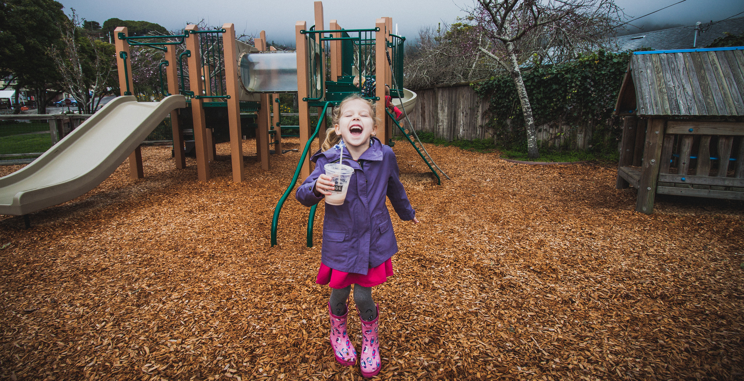
Usability Testing: Methodology
Artificial environment (laboratory)
Maintain more control
May provide more specific data on a particular feature
Natural environment
Better holistic representation of real people doing real work
(Tang 2017, 278)
Notes:
Image: https://www.flickr.com/photos/carnesaurus/32160924864/ by James Carnes / CC BY-NC-ND 2.0
Key tip: A major lesson I learned over the years of conducting usability research is that in addition to producing results and recommendations that are practical for stakeholders, it is necessary to pay attention to the scholarly value of your work. Relevant theoretical frameworks might be applied to guide you through analyzing the interplay among behavior variables and interaction patterns (Tang 2017, 278).
Tang, Rong. 2017. “Usability Research.” In Research Methods for Library and Information Science, 6th ed., edited by Lynn Silipigni Connaway and Marie L. Radford, 277-278. Westport, CT: Libraries Unlimited.

Slide 27
Qualitative Data Analysis Tools and Methods

Slide 28
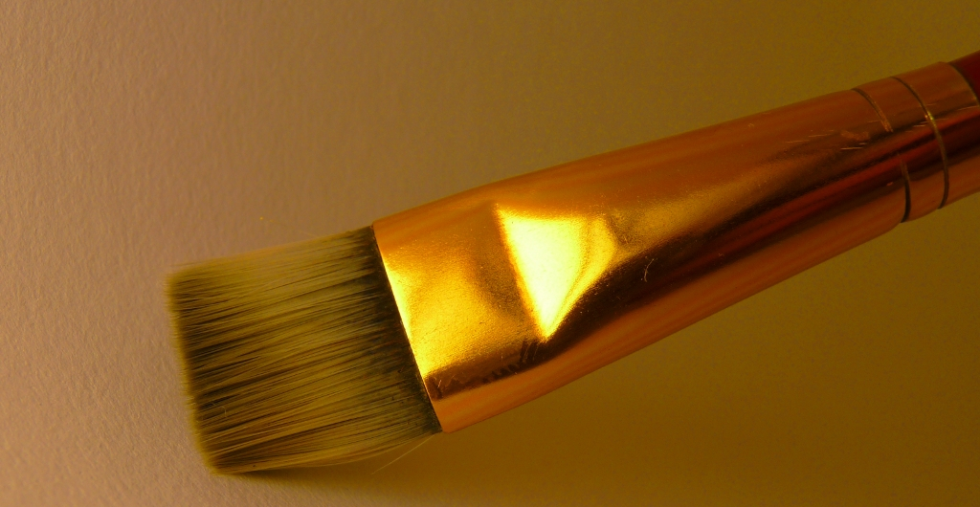
Computer-Assisted Qualitative Data Analysis Software (CAQDAS)
Contain all data sources
Creating & applying codes
Queries
Visualizations
Reports
(Connaway and Radford 2017)
Notes:
Image: https://www.flickr.com/photos/flakepardigm/4687752030/ by Tyler Nienhouse / CC BY 2.0
“The CAQDAS packages help to provide a place to contain all data sources and have multiple affordances, especially for large data sets common in qualitative projects. There is a growing number of these products available, in both proprietary and open source versions. Proprietary products include ATLAS.ti, Dedoose, HyperRESEARCH, MAXQDA, Nvivo, QDA Minder Qiqqa, and Xsight. Open source software includes Aquad, Coding Analysis Toolkit, Compendium, and RQDA.” (Connaway and Radford 2017, 290)
“Common features of all these packages include creating and applying codes. Some...have advanced features that support such enhancements as enabling queries (to explore data to discover patterns, connections, etc.), supporting visualizations (to create charts, models, maps, and cluster analyses), and delivering reports (to document and export findings).” (Connaway and Radford 2017, 290)
Connaway, Lynn Silipigni, and Marie L. Radford. 2017. Research Methods for Library and Information Science, 6th ed. Westport, CT: Libraries Unlimited.

Slide 29
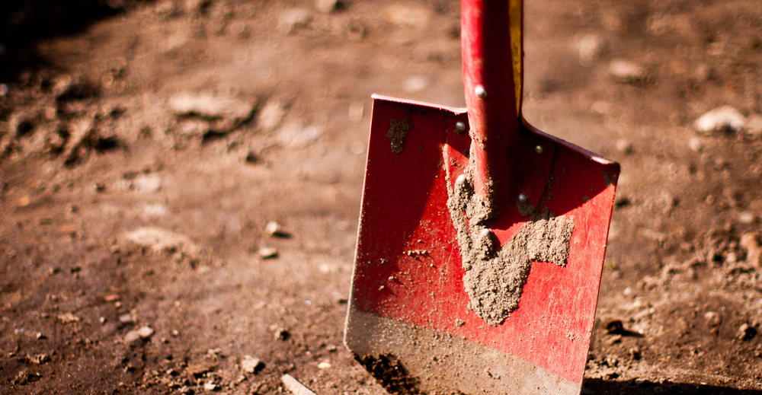
Draw on data...in service of developing new conceptual categories
Develop inductive abstract analytic categories through systematic data analysis
Emphasize theory construction rather than description or application of current theories
(Connaway and Radford 2017)
Grounded Theory
Notes:
Image: https://www.flickr.com/photos/adambindslev/4727853016/ by Adam Bindslev / CC BY-NC 2.0
“1. Conduct data collection and analysis simultaneously in an iterative process.
2. Analyze actions and processes rather than themes and structure.
3. Use comparative methods.
4. Draw on data (e.g., narratives and descriptions) in service of developing new conceptual categories.
5. Develop inductive abstract analytic categories through systematic data analysis.
6. Emphasize theory construction rather than description or application of current theories.
7. Engage in theoretical sampling.
8. Search for variation in the studied categories or process.
9. Pursue developing a category rather than covering a specific empirical topic.” (Connaway and Radford 2017, 297)
Connaway, Lynn Silipigni, and Marie L. Radford. 2017. Research Methods for Library and Information Science, 6th ed. Westport, CT: Libraries Unlimited.

Slide 30
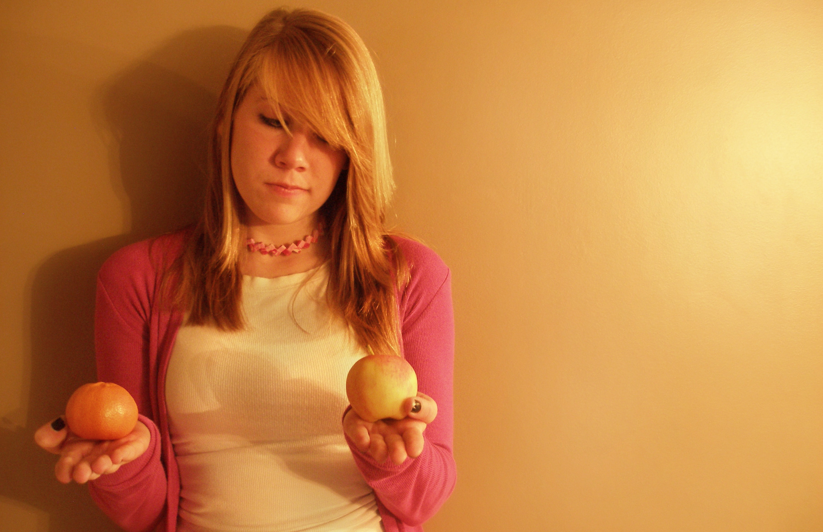
“A major strategy for analysis of qualitative data is the use of the constant comparative method, which embraces ‘constant comparisons’ defined as ‘the analytic process of comparing different pieces of data against each other for similarities and differences.’”
(Connaway and Radford 2017, 298)
Notes:
Image: https://www.flickr.com/photos/carleycomartin/4030726428/ by Carley Comartin / CC BY-NC 2.0
“A major strategy for analysis of qualitative data is the use of the constant comparative method, which embraces “constant comparisons” defined as “the analytic process of comparing different pieces of data against each other for similarities and differences.” It requires the researcher to ask continually: “What is this piece of data saying?” “Is this different from or similar to the next segment?” This involves comparing and aggregating pieces of data on the basis of similar characteristics and beginning the process of sorting these into interim groups or emerging themes.” (Connaway and Radford 2017, 298)
Connaway, Lynn Silipigni, and Marie L. Radford. 2017. Research Methods for Library and Information Science, 6th ed. Westport, CT: Libraries Unlimited.

Slide 31
Conversation Analysis
Context & social conduct
Discourse Analysis
The library within a larger social & cultural context
(Connaway and Radford 2017)
Notes:
Image: https://www.flickr.com/photos/juanillooo/1231088474/ by Juan Salmoral / CC BY-NC-ND 2.0
“Conversation analysis (CA) is an approach to analyzing talk that is captured in natural settings and has become well established in the disciplines of communication, sociology, linguistics, ethnomethodology, ethnography, and social psychology....It highlights the importance of context and revealing regularities of social conduct through examining particular episodic interactions.” (Connaway and Radford 2017, 312)
“Budd had divided discourse analysis (DA) into two different approaches: CA in the form of “linguistic-based analysis,” which is discussed above, and “culturally or socially based discursive practices,” such as those that Foucault has developed...The overarching premise of DA is to question and explore the relationship of the library as an institution and/or LIS as a field of research within a larger social and cultural context.” (Connaway and Radford 2017, 312-313)
Connaway, Lynn Silipigni, and Marie L. Radford. 2017. Research Methods for Library and Information Science, 6th ed. Westport, CT: Libraries Unlimited.
Budd, John M. 2006. “Discourse Analysis and the Study of Communication in LIS.” Library Trends 55, no. 1: 65-82.

Slide 32
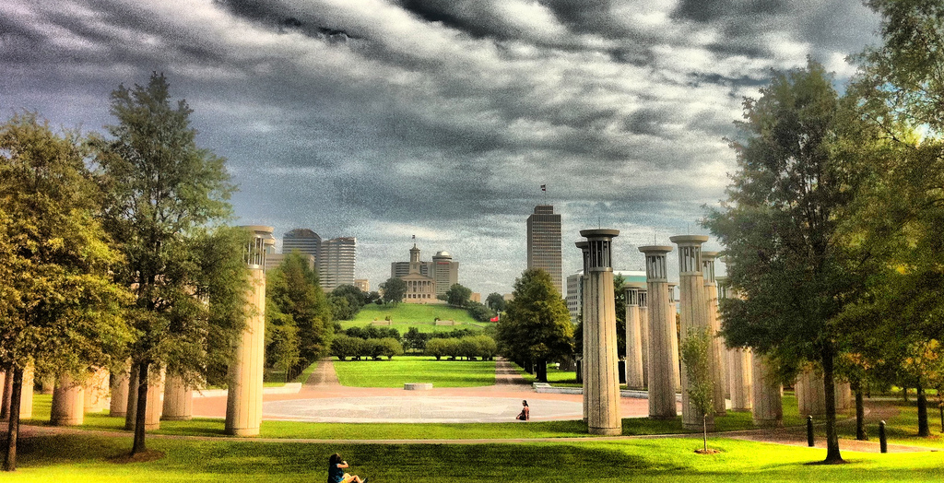
Ethnographic Analysis
Use people’s own categories
Avoid assuming what one will find
Complementary to quantitative methods
Retain ‘richness’/’thick description’
Numerous compatibility
(Asher 2017, 264)
(Connaway and Radford 2017, 282)
Notes:
Image: https://www.flickr.com/photos/respres/6041698098/ by Jeff Turner / CC BY 2.0
Ethnographic research methods seek to use people’s own categories of analysis as a way of understanding social and cultural processes on their own terms. Researchers using ethnographic approaches must be careful to avoid making assumptions about what they will find, to suspend judgment about people’s actions, and to attend to both people’s own explanations of the processes being studied as well as analytical or theoretical explanations. While ethnographic methods usually emphasize qualitative data, they should not be seen as opposed to quantitative approaches to research, but instead as a different, and often complementary, way of gathering evidence and discovering meaning within the complexities of human behavior (Asher 2017, 264).
Asher, Andrew. 2017. “On Ethnographic Research: How do Students Find the Information They Need?” In Research Methods for Library and Information Science, 6th ed., edited by Lynn Silipigni Connaway and Marie L. Radford, 264. Westport, CT: Libraries Unlimited.
“The data collection methods discussed above are used in ethnographic research studies. The data analysis methods used for the qualitative data collected in diaries, journals, interviews, and mapping are the same as those discussed in chapters 7 and 8. The data must be interpreted in a manner that retains their richness. This “thick description,” including group interactions, is one of their advantages of the ethnographic approach. The ethnographic summary and the content analysis approach of open and thematic coding are not conflicting means of analysis. If quantitative data are collected in the interviews and FtF survey questions, the data analysis methods should be compatible. The analyses most likely will include descriptive statistics but may include inferential statistics, which are discussed in chapter 6.” (Connaway and Radford 2017, 282)
Connaway, Lynn Silipigni, and Marie L. Radford. 2017. Research Methods for Library and Information Science, 6th ed. Westport, CT: Libraries Unlimited.

Slide 33
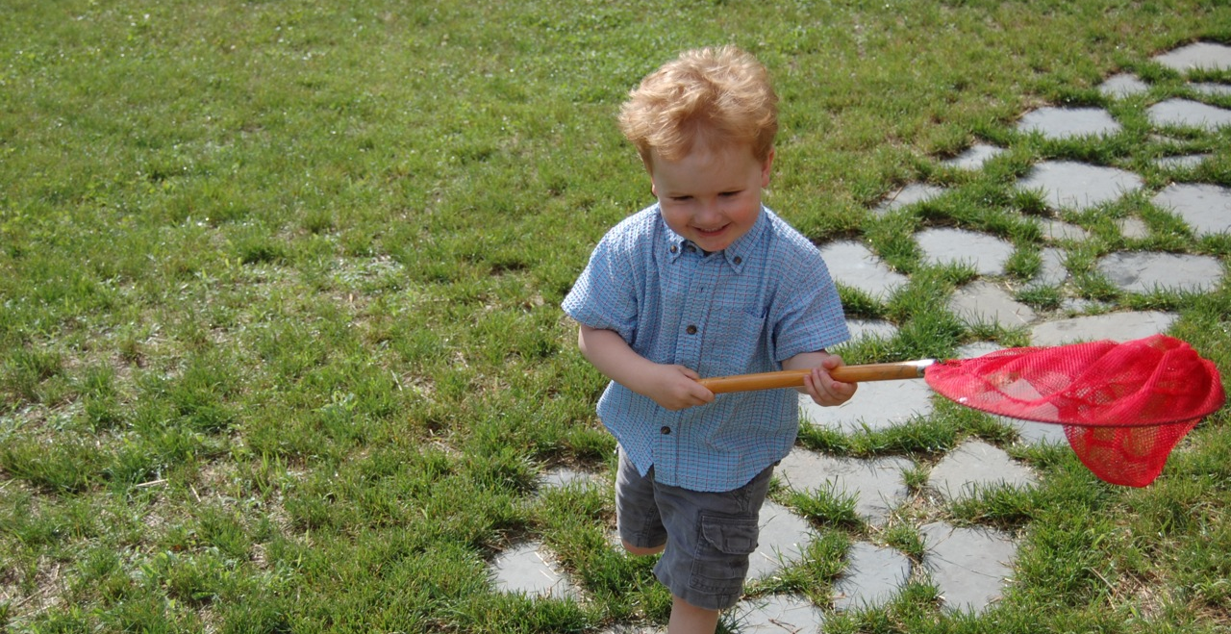
Challenges: Qualitative Research Methods
Data collection & analysis
Costs
Bias
Inaccurate & incomplete
Sampling
Massive amounts of data
Evolving technologies
Notes:
Image: https://www.flickr.com/photos/therichbrooks/2600080329/ by Rich Brooks / CC BY 2.0
Bias presents a threat to validity , particularly the interviewer because of over-reacting to responses, etc.
Massive amounts of data
Interviews
Evolving Technology
Data on Wiki’s that is no longer available
Switching data platforms

Slide 34
Mixed Methods Research

Slide 35
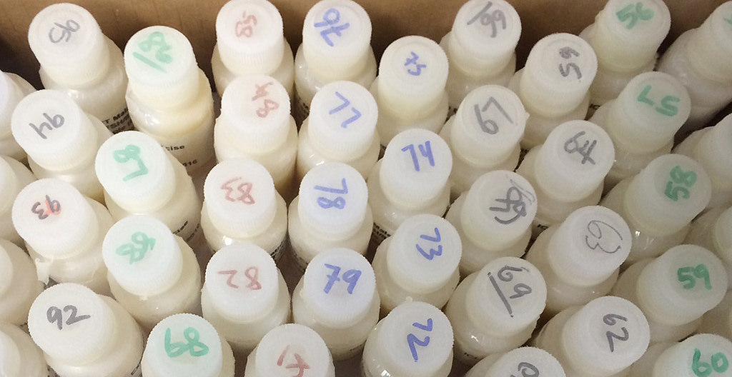
Mixed Methods Research
Any combination of research methods
Qualitative
Quantitative
Participatory
Action
Design
Equal attention to all stages of research process
Findings should be iterative & informative
(Kazmer 2017, 232-233)
Notes:
Image: https://www.flickr.com/photos/edgewoodchembiocenter/32447188374/ by U.S. Army Edgewood Chemical Biological Center / CC BY 2.0
“Mixed methods research is often thought of as quantitative/qualitative, but other approaches are important to consider: participatory, action, design, etc. Don't think of mixed methods as "survey plus interview" (or worse, "survey with open-ended questions tacked onto the end").
Mixed methods should be deeply integrated, and not parallel tracks that don't intersect. Mixing methods effectively means equal attention to all stages of the research process, from problem statement or hypothesis through analysis; don't focus on the data collection methods to the detriment of the other phases.
And rather than quantitative findings followed by a few attractive quotes from the qualitative data organized according to "themes," the findings from mixed methods should be iterative and mutually-informing.
Very few people can do mixed methods research alone, so embrace cooperative research. Each person needs to understand all the methods being used, but it's natural that each person will have more expertise in one area. Find research partners who have a deep and true appreciation for your contributions; mixed methods research just to satisfy a funding agency is never as fulfilling or productive as it could be. Work closely together so that the overall research design doesn't privilege one method over another just for the sake of method, but so that the combined approach will answer the research questions and allow you to effect change in the world.”
Kazmer, Michelle. 2017. “Mixed Methods.” In Research Methods for Library and Information Science, 6th ed., edited by Lynn Silipigni Connaway and Marie L. Radford, 232-233. Westport, CT: Libraries Unlimited.

Slide 36
Triangulation
Term coined by Webb et al. (1966)
Multiple methods of data collection (e.g., interviews – individual & group, observation, literature, archives)
Agree, or at least don’t contradict (Miles and Huberman 1994, 266)
Multiple investigators
Multiple contexts/situations
Notes:
Image: https://www.flickr.com/photos/wandrus/8434921527/ by William Andrus / CC BY 2.0
Adapted from slides by Ellen Olshansky
Miles, Matthew B., and A. Michael Huberman. 1994. Qualitative Data Analysis: A Sourcebook. Beverly Hills: Sage Publications.
Webb, Eugene J., Donald T. Campbell, Richard D. Schwartz, and Lee Sechrest. 1966. Unobtrusive Measures: Nonreactive Research in the Social Sciences, Vol. 111. Chicago: Rand McNally.

Slide 37
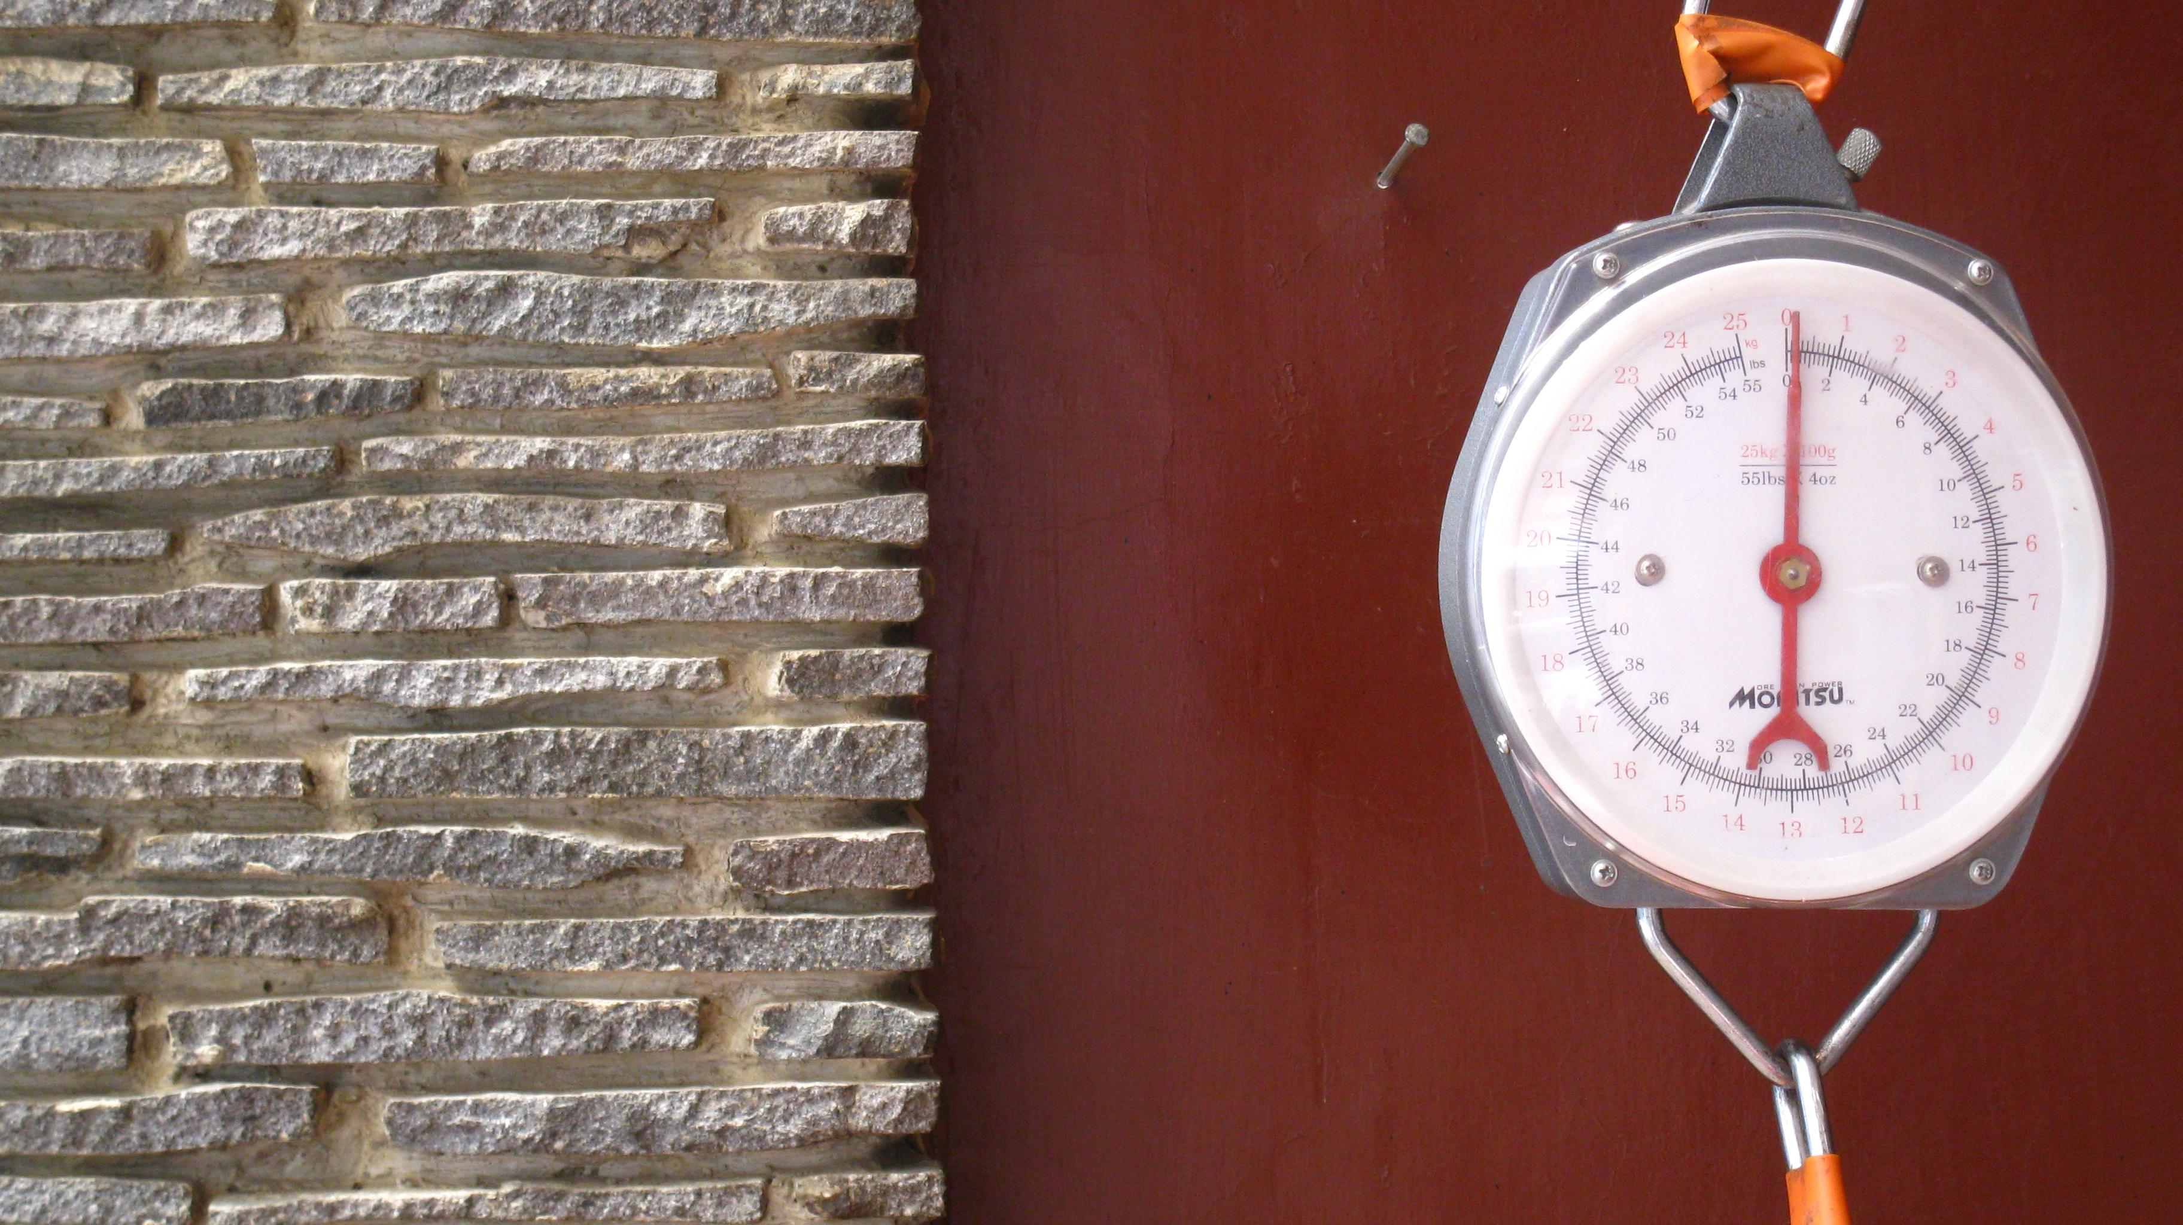
Mixed Methods
“Miles, Huberman, and Saldaña also pointed out that although designing and conducting a mixed method research project involves careful planning and more effort in execution, the benefits greatly outweigh the difficulties (including philosophical ones).”
(Connaway and Radford 2017, 229)
Notes:
Image: https://www.flickr.com/photos/ikhlasulamal/4538617347/ by Ikhlasul Amal / CC BY-NC 2.0
“Miles, Huberman, and Saldaña also pointed out that although designing and conducting a mixed method research project involves careful planning and more effort in execution, the benefits greatly outweigh the difficulties (including philosophical ones).” (Connaway and Radford 2017, 229)
Connaway, Lynn Silipigni, and Marie L. Radford. 2017. Research Methods for Library and Information Science, 6th ed. Westport, CT: Libraries Unlimited.
Miles, Matthew B., Michael Huberman, and Johnny Saldaña, eds. 2014. Qualitative Data Analysis: A Methods Sourcebook, 3rd ed. Thousand Oaks, CA: Sage.

Slide 38
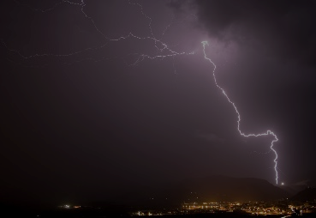
“The creative process is not like a situation where you get struck by a single lightning bolt. You have ongoing discoveries, and there are ongoing creative revelations. Yes, it's really helpful to be marching toward a specific destination, but, along the way, you must allow yourself room for your ideas to blossom, take root, and grow.”
–Carlton Cuse
Notes:
Image: https://flic.kr/p/AuDyn (https://www.flickr.com/photos/hunty66/390350345/) by Pete Hunt / CC BY-NC 2.0
https://www.brainyquote.com/quotes/quotes/c/carltoncus644835.html

Slide 39
References
Asher, Andrew. 2017. “On Ethnographic Research: How do Students Find the Information They Need?” In Research Methods for Library and Information Science, 6th ed., edited by Lynn Silipigni Connaway and Marie L. Radford, 264. Westport, CT: Libraries Unlimited.
Association of College and Research Libraries, The. (2001). Standards for Libraries in Higher Education. Chicago: ACRL. http://www.ala.org/acrl/sites/ala.org.acrl/files/content/standards/slhe.pdf.
Chu, Heting. 2015. “Research Methods in Library and Information Science: A Content Analysis.” Library & Information Science Research 37, no. 1: 36-41.
Connaway, Lynn Silipigni, and Marie L. Radford. 2017. Research Methods for Library and Information Science, 6th ed. Westport, CT: Libraries Unlimited.
Denzin, Norman K., and Yvonna S. Lincoln. 2005. The Sage Handbook of Qualitative Research, 4th ed. Thousand Oaks, CA: Sage Publications.

Slide 40
References
Dumas, Joseph S., and Janice C. Redish. 1993. A Practical Guide to Usability Testing. Portland, OR: Intellect Books.
Jansen, Bernard J. 2017. “Log Analysis.” In Research Methods for Library and Information Science, 6th ed., edited by Lynn Silipigni Connaway and Marie L. Radford, 348-349. Westport, CT: Libraries Unlimited.
Kaufman, P., & Barbara Watstein, S. (2008). Library Value (Return on Investment, ROI) and the Challenge of Placing a Value on Public Services. Reference Services Review 36(3), 226-231.
Kazmer, Michelle. 2017. “Mixed Methods.” In Research Methods for Library and Information Science, 6th ed., edited by Lynn Silipigni Connaway and Marie L. Radford, 232-233. Westport, CT: Libraries Unlimited.
Khoo, Michael, Lily Rozaklis, and Catherine Hall. 2012. “A Survey of the Use of Ethnographic Methods in the Study of Libraries and Library Users.” Library and Information Science Research 34, no. 2: 82-91.

Slide 41
References
Luo, Lili, and Margaret McKinney. 2015. “JAL in the Past Decade: A Comprehensive Analysis of Academic Library Research.” The Journal of Academic Librarianship 41, no. 2: 123-129. http://dx.doi.org/10.1016/j.acalib.2015.01.003.
Miles, Matthew B., and A. Michael Huberman. 1994. Qualitative Data Analysis: A Sourcebook. Beverly Hills: Sage Publications.
Miles, Matthew B., Michael Huberman, and Johnny Saldaña, eds. 2014. Qualitative Data Analysis: A Methods Sourcebook, 3rd ed. Thousand Oaks, CA: Sage.
Powell, Ronald R. 1999. “Recent Trends in Research: A Methodological Essay.” Library & Information Science Research 21, no. 1: 91-119.
Schriver, Joe M. 2001. Human Behavior in the Social Environment: Shifting Paradigms in Essential Knowledge for Social Work Practice, 3rd ed. Boston: Allyn & Bacon.

Slide 42
References
Seadle, Michael. 2017. “Text Mining.” In Research Methods for Library and Information Science, 6th ed., edited by Lynn Silipigni Connaway and Marie L. Radford, 350. Westport, CT: Libraries Unlimited.
Singh, Vivek. 2017. “Behavioral Analytics of Socio-Mobile Data.” In Research Methods for Library and Information Science, 6th ed., edited by Lynn Silipigni Connaway and Marie L. Radford, 90-91. Westport, CT: Libraries Unlimited.
Tang, Rong. 2017. “Usability Research.” In Research Methods for Library and Information Science, 6th ed., edited by Lynn Silipigni Connaway and Marie L. Radford, 277-278. Westport, CT: Libraries Unlimited.
Webb, Eugene J., Donald T. Campbell, Richard D. Schwartz, and Lee Sechrest. 1966. Unobtrusive Measures: Nonreactive Research in the Social Sciences, Vol. 111. Chicago: Rand McNally.

Slide 43
Image Attribution
Slide 2: Image: https://www.flickr.com/photos/smithser/3870653508/ by Brian Smithson / CC BY 2.0
Slide 5: Image: https://flic.kr/p/brnnFP (https://www.flickr.com/photos/64763706@N08/6850650385/) by LaTransfo / CC BY-SA 2.0
Slide 6: Image: https://flic.kr/p/8bdX7z (https://www.flickr.com/photos/jeffanddayna/4710189081/) by Jeff Golden / CC BY-SA 2.0
Slide 7: Image: https://flic.kr/p/8HwEak (https://www.flickr.com/photos/vofan/5064455445/) by VOFAN / CC BY-NC-ND 2.0
Slide 10: Image: https://www.flickr.com/photos/katesheets/5772901616/ by katesheets / CC BY-NC 2.0
Slide 11: Image: https://www.flickr.com/photos/ddrmaxgt37/387453140/ by Arun Venkatesan / CC BY-NC 2.0
Slide 12: Image: https://www.flickr.com/photos/davidjoyner/14622758882/ by David / CC BY-SA 2.0
Slide 13: Image: https://www.flickr.com/photos/28481088@N00/3091698923/ by tanakawho / CC BY-NC 2.0
Slide 14: Image: https://www.flickr.com/photos/faykwong/3311629798/ by FEI KUANG / CC BY-NC 2.0
Slide 16: Image: https://www.flickr.com/photos/nordforsk/32225539214/ by NordForsk / CC BY-NC-ND 2.0
Slide 17: Image: https://www.flickr.com/photos/un_photo/4910848840 by United Nations Photo / CC BY-NC-ND 2.0
Slide 18: Image: https://www.flickr.com/photos/meanestindian/903380690/ by Meena Kadri / CC BY 2.0
Slide 19: Image: https://www.flickr.com/photos/30478819@N08/32624505933/ by Marco Verch / CC BY 2.0
Slide 20: Image: https://www.flickr.com/photos/lifeofrobert/3894022267/ by Robert Yocum / CC BY-SA 2.0

Slide 44
Image Attribution
Slide 21: Image: https://www.flickr.com/photos/pmillera4/13570027834/ by Peter Miller / CC BY-NC-ND 2.0
Slide 22: Image: https://www.flickr.com/photos/njla/3306454031/ by NJLA: New Jersey Library Association / CC BY-NC-ND 2.0
Slide 24: Image: https://www.flickr.com/photos/deanhochman/14481958642/ by Dean Hochman / CC BY 2.0
Slide 25: Image: https://www.flickr.com/photos/78428166@N00/8120708019/ by Tony Alter / CC BY 2.0
Slide 26: Image: https://www.flickr.com/photos/carnesaurus/32160924864/ by James Carnes / CC BY-NC-ND 2.0
Slide 28: Image: https://www.flickr.com/photos/flakepardigm/4687752030/ by Tyler Nienhouse / CC BY 2.0
Slide 29: Image: https://www.flickr.com/photos/adambindslev/4727853016/ by Adam Bindslev / CC BY-NC 2.0
Slide 30: Image: https://www.flickr.com/photos/carleycomartin/4030726428/ by Carley Comartin / CC BY-NC 2.0
Slide 31: Image: https://www.flickr.com/photos/juanillooo/1231088474/ by Juan Salmoral / CC BY-NC-ND 2.0
Slide 32: Image: https://www.flickr.com/photos/respres/6041698098/ by Jeff Turner / CC BY 2.0
Slide 33: Image: https://www.flickr.com/photos/therichbrooks/2600080329/ by Rich Brooks / CC BY 2.0
Slide 35: Image: https://www.flickr.com/photos/edgewoodchembiocenter/32447188374/ by U.S. Army Edgewood Chemical Biological Center / CC BY 2.0
Slide 36: Image: https://www.flickr.com/photos/wandrus/8434921527/ by William Andrus / CC BY 2.0
Slide 37: Image: https://www.flickr.com/photos/ikhlasulamal/4538617347/ by Ikhlasul Amal / CC BY-NC 2.0
Slide 38: Image: https://flic.kr/p/AuDyn (https://www.flickr.com/photos/hunty66/390350345/) by Pete Hunt / CC BY-NC 2.0

Slide 45
Questions & Discussion
Lynn Silipigni Connaway, PhD
Senior Research Scientist & Director of User Research
connawal@oclc.org
@LynnConnaway

