Slide 1
Integrating Library Services into Individual Workflows
Open Lecture
Universitat Oberta de Catalunya
InfoCom UOC, iSchool
Barcelona, Spain
4 June 2014
Lynn Silipigni Connaway, Ph.D.
Senior Research Scientist
OCLC
Chair of Excellence
Departmento de Biblioteconomía y Documentación Universidad Carlos III de Madrid
@LynnConnaway
connawal@oclc.org
Notes:
Buenas Tardes!
Estoy muy contenta de estar aqui.
Y, ahora, en ingles.
"I don't remember what it was, but I remember doing it for WikiAnswers. I think I was just really confident on the information soI just wanted to help the person out.“ Demographic Information: (Cyber Synergy, V S17, Student, Social Work/Spanish).
Radford, M. L., Connaway, L. S., & Shah, C. (2011-2013). Cyber Synergy: Seeking Sustainability through Collaboration between Virtual Reference and Social Q&A Sites. Funded by the Institute of Museum and Library Services (IMLS), Rutgers University, and OCLC. Retrieved from http://www.oclc.org/research/activities/synergy/default.htm

Slide 2
84%
of users began information search with a search engine
How many began their search on a library website?
1%
(Centre for Information Behaviour and the Evaluation of Research, 2008)
(De Rosa, 2010)
This work is licensed under a Creative Commons Attribution 3.0 Unported License. http://creativecommons.org/licenses/by/3.0/
Notes:
The majority of British Library web site visits were from search engine (p. 14)
84% of users began an information search with search engine (p. 1-17)
1% began information search on library website (p.1-17)
Centre for Information Behaviour and the Evaluation of Research. (2008). Information behaviour of the researcher of the future: A CIBER briefing paper. London: CIBER (p. 14).
De Rosa, C. (2010). Perceptions of libraries: A report to the OCLC membership. Dublin, OH: OCLC Online Computer Library Center (p.32).

Slide 3
Americans who have visited a library website (past 12 months)
30%
13%
Those who used a handheld device to access library website
(Zickuhr, Rainie, & Purcell, 2013)
(Raine, 2014)
This work is licensed under a Creative Commons Attribution 3.0 Unported License. http://creativecommons.org/licenses/by/3.0/
Notes:
In the past 12 months, 30% of Americans (16 and older) visited a library website (Rainie, 2014) 13% used a handheld device to access a library website (Zickuhr, Rainie & Purcell, 2013).
Rainie, L. (2014). Libraries in communities. Washington, DC: Pew Research Center’s Internet & American Life Project.
Zickuhr, K., Rainie, L., & Purcell, K. (2013). Library services in the digital age. Washington, DC: Pew Research Center’s Internet & American Life Project.

Slide 4
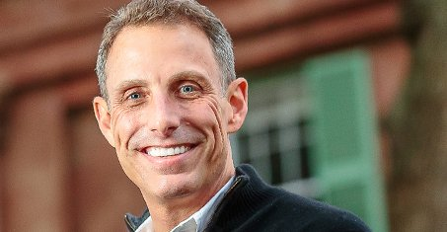
“95% of the population values libraries while only 52% are using them.”
( Roskill, 2014)
Notes:
Image from: http://tedxcharleston.org/speakers-2014/
95% of the population values libraries, only 52% are using them. -Andrew Roskill, CEO of BiblioLabs
A serial entrepreneur and a digital community advocate, who is founder and CEO of BiblioLabs, a software and media company focused on helping libraries provide cool and engaging digital products.
Roskill, A. (2014 May). Get a Read on This: Libraries Bridging the Digital Divide: Andrew Roskill at TEDxCharleston. YouTube. Retrieved May 22, 2014, from http://www.youtube.com/watch?v=J198u5HK0pY

Slide 5
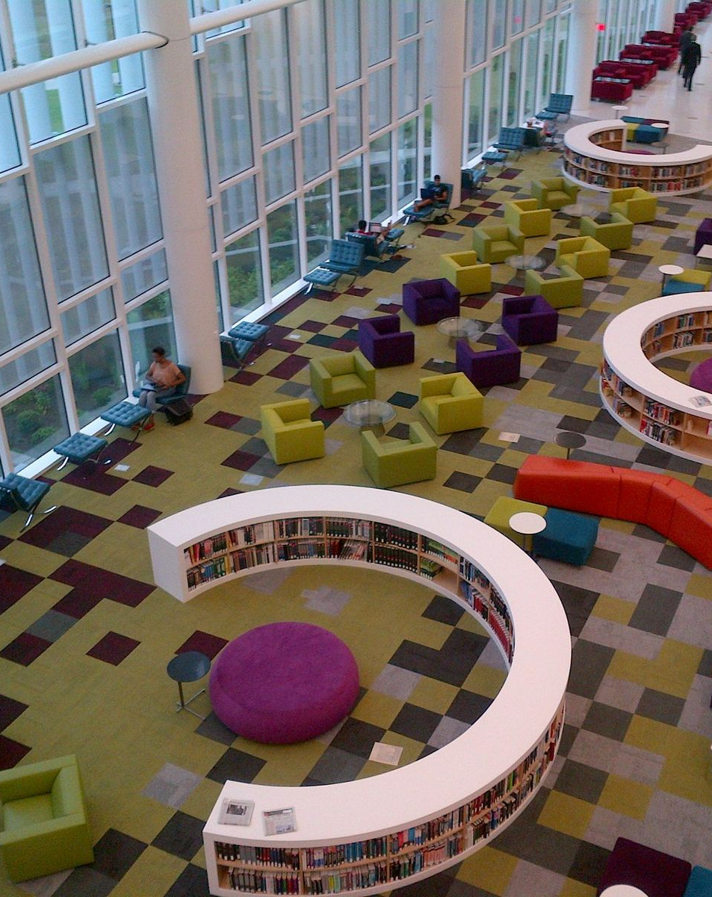
Then & Now
Then: The user built workflow around the library
Now: The library must build its services around user workflow
Then: Resources scarce, attention abundant
Now: Attention scarce, resources abundant
(Dempsey, 2008)
Notes:
Image: Connaway, L.S. (2013) NC State Library.
The need for local infrastructure or local assembly of materials has declined (Dempsey, Inside Out).
The library is institution scale where many of its users operate at network scale
The inside out library …the library as an actor in research and learning environments of its users
The catalog emerged at a time when information resources were scarce and attention was abundant. Scarce because there were relatively few sources for particular documents or research materials: they were distributed in print, collected in libraries and were locally available. If you wanted to consult books or journal or research reports or maps or government documents you went to the library. However, the situation is now reversed: information resources are abundant and attention is scarce. The network user has many information resources available to him or her on the network. Research and learning materials may be available through many services, and there is no need for physical proximity. Furthermore, users often turn first to the major network level hubs which scale to provide access to what is visible across the whole network (think, for example, of Google, Wikipedia, Amazon, and PubMed Central). This is natural as interest gravitates to the more complete resource rather than a local selection which seems increasingly partial. Studies show the high value placed on convenience and the importance of satisficing: users do not want to spend a long time prospecting for information resources (Dempsey, 2012).
Dempsey, L. (2008). Always on: Libraries in a world of permanent connectivity. First Monday, 14(1). Retrieved from http://www.firstmonday.org/htbin/cgiwrap/bin/ojs/index.php/fm/article/view/2291/207
Dempsey, L. (2013, January 23). The inside out library: Scale, learning, engagement. Presented at Hacettepe University, Beytepe, Ankara (Turkey).
Dempsey, L. (2012). Thirteen ways of looking at libraries, discovery, and the catalog: Scale, workflow, attention. EDUCAUSE Review Online. Retrieved from http://www.educause.edu/ero/article/thirteen-ways-looking-libraries-discovery-and-catalog-scale-workflow-attention
Today, more than 1.7 billion people, or almost one out of every four humans on the planet, are online (Wasserman, 2012).
Wasserman, S. (2012, June 18). The Amazon effect. The Nation. Retrieved from http://www.thenation.com/article/168125/amazon-effect

Slide 6

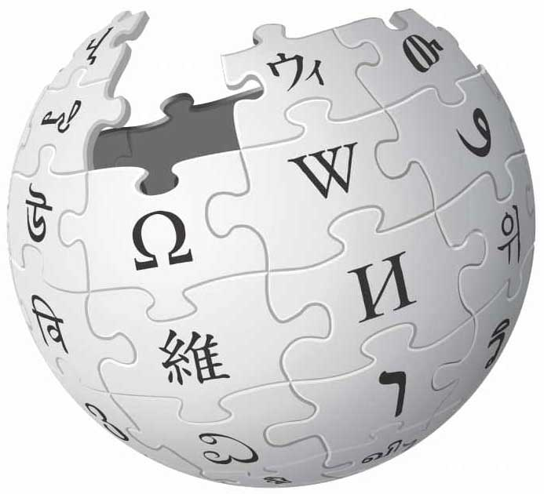




Why?
Notes:
Image
Facebook: https://encrypted-tbn2.gstatic.com/images?q=tbn:ANd9GcSW_YQ0SQXbuERWgHjsRXl9OSEcJKKTNF1tPOLMm831NuhqLpDzdi2ys4eV
Wikipedia: http://www.better-ears.com/de/images/iphone/retina/wikipedia-icon.jpg
Google: http://www.conceptcupboard.com/blog/wp-content/uploads/2013/09/google.jpg
Amazon: http://launchdfw.com/wp-content/uploads/2014/05/amazon-1.png
Apple: https://encrypted-tbn0.gstatic.com/images?q=tbn:ANd9GcTvMHlAbrfxFfaPaA-pvPxMeQ8a2s_rTVafQq-cVh7pFyS8f_Y13m9W2hZo
Twitter: https://pbs.twimg.com/profile_images/2284174758/v65oai7fxn47qv9nectx.png

Slide 7

Current Library Environment
Challenges
Budget cuts
Competition
Hiring freezes
Opportunity
Best value for most use
Understand how, why, & under what circumstances individuals use systems & services
Notes:
Image: http://markitectureconsulting.com/wp-content/uploads/2013/04/budget_cuts.jpg
“A diamond is a chunk of coal made good under pressure.” –Henry Kissinger

Slide 8
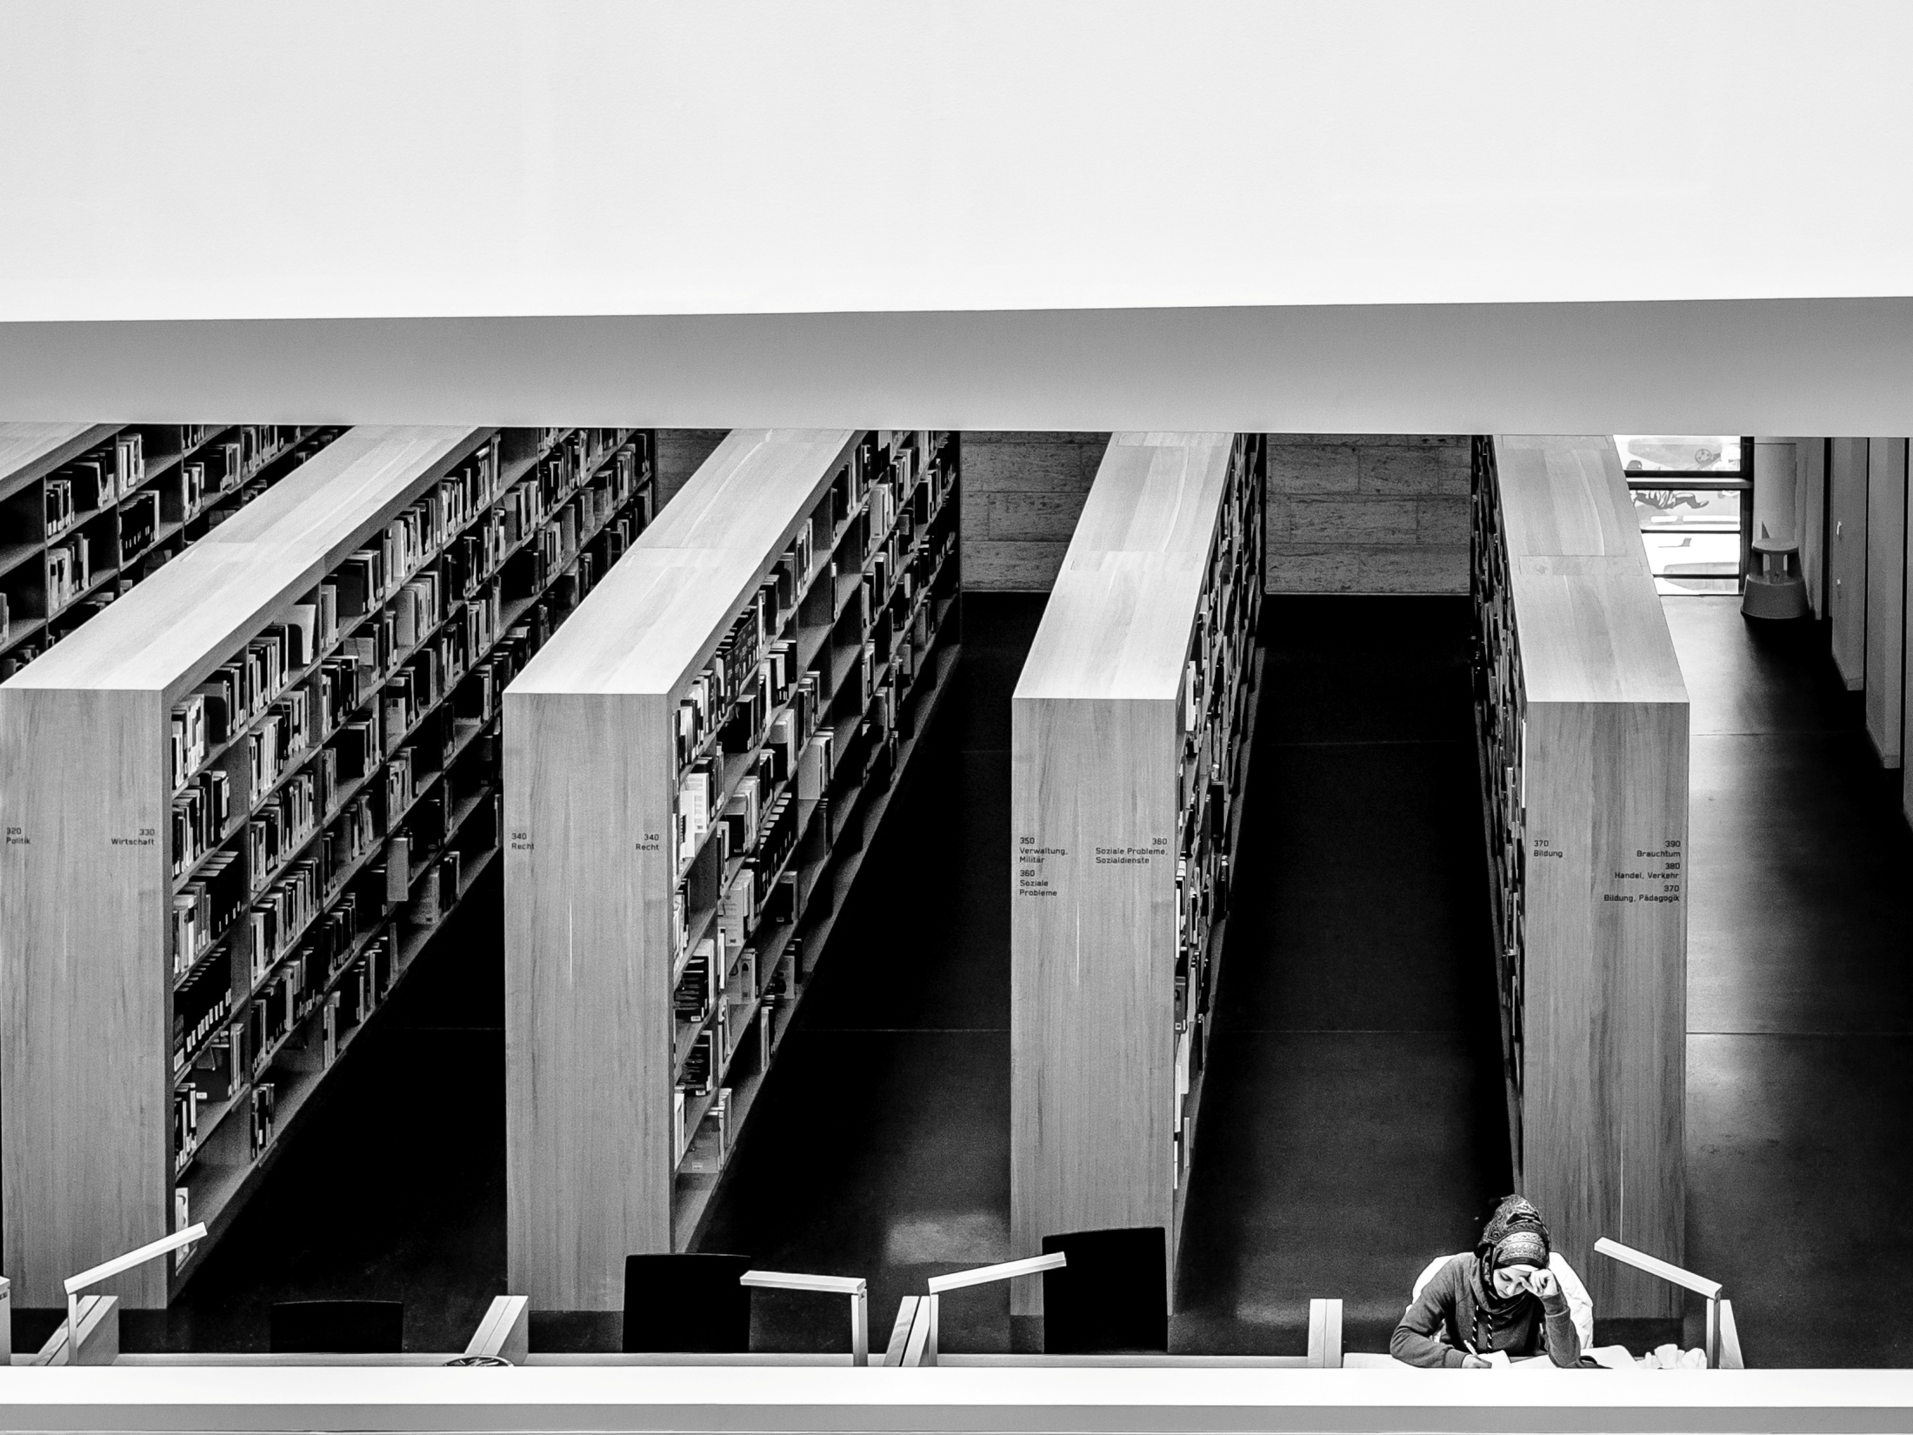
“Librarians are increasingly called upon to document and articulate the value of academic and research libraries and their contribution to institutional mission and goals.”
(ACRL, 2010, p. 6)
Notes:
Image: photo credit: <a href="http://www.flickr.com/photos/ch-weidinger/12703837055/">ch.weidinger</a> via <a href="http://photopin.com">photopin</a> <a href="http://creativecommons.org/licenses/by-nc-sa/2.0/">cc</a>
Importance of Assessment
ACRL. (2010). Value of academic libraries: A comprehensive research review and report. Chicago: Association of College and Research Libraries.
University officials & funders demand accountability
Survival in lean budget times

Slide 9
Assessment Defined
Interpreting
Analyzing
Collecting
Process of…
Defining
Selecting
Designing
Collecting
Analyzing
Interpreting
Using information to increase service/program effectiveness
Notes:
Image: Microsoft Clip Art

Slide 10

Why Assessment?
Answers questions:
What do users/stakeholders want & need?
How can services/programs better meet needs?
Is what we do working?
Could we do better?
What are problem areas?
Traditional stats don’t tell whole story
Notes:
Image: http://www.flickr.com/photos/moriza/96724309/
Traditional stats don’t describe performance
Training in assessment has not kept pace with needs.
Big time, effort, planning & $$ investment in formal evaluation.
Support & buy in from all.

Slide 11
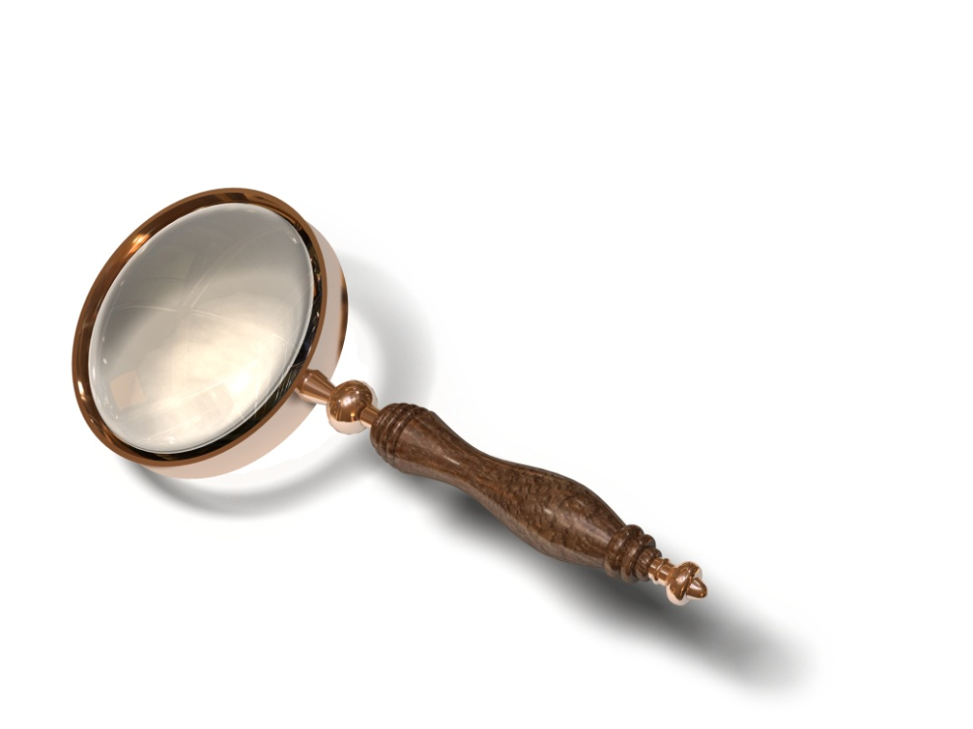
Formal vs. Informal Assessment
Formal Assessment
Data driven
Evidence-based
Accepted methods
Recognized as rigorous
Informal Assessment
Anecdotes & casual observation
Used to be norm
No longer acceptable
Notes:
Image: Microsoft Clip Art

Slide 12

Outcomes Assessment Basics
Outcomes: “The ways in which library users are changed as a result of their contact with the library’s resources and programs” (ALA, 1998).
“Libraries cannot demonstrate institutional value to maximum effect until they define outcomes of institutional relevance and then measure the degree to which they attain them” (Kaufman & Watstein, 2008, p. 227).
Notes:
Image: http://www.calledtoyouthministry.com/sites/default/files/cck/resource_images/outcomes.jpg
ALA/ACRL. (1998). Task force on academic library outcomes assessment report. Available: http://www.ala.org/Content/NavigationMenu/ACRL/Publications/White_Papers_and_Reports/Task_Force_on_Academic_Library_Outcomes_Assessment_Report.htm
Kaufman, P., & Watstein, S. B. (2008). Library value (Return on Investment, ROI) and the challenge of placing a value on public services. Reference Services Review, 36(3), 226-231.
Cited in the Values Report (2010)
Satisfaction is an outcome.
So is dissatisfaction.
Satisfaction is complex. The example that Roskill gave on previous slide demonstrates this. 95% of the population value libraries but only 52% use them.
Specific service goals should be set.

Slide 13
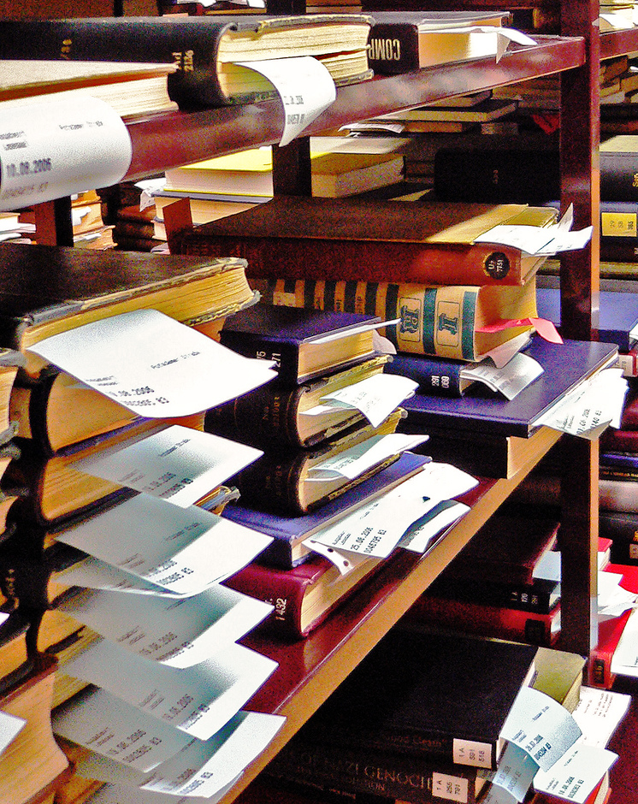
Outputs & Inputs
Outputs
Quantify the work done
Don’t relate factors to overall effectiveness
Inputs
Raw materials
Measured against standards
Insufficient for overall assessment
Notes:
Image: photo credit: <a href="http://www.flickr.com/photos/svenwerk/228203325/">svenwerk</a> via <a href="http://photopin.com">photopin</a> <a href="http://creativecommons.org/licenses/by-nc-nd/2.0/">cc</a>
Outputs
Quantify the work done:
# books circulated
# reference questions answered
Library Use Instruction attendance
Inputs
$, space, collection, equipment, & staff

Slide 14
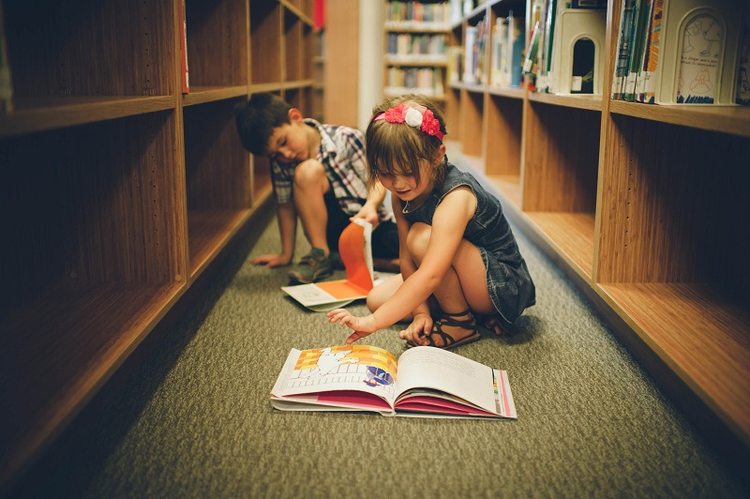
Examples of Outcomes
User matches information need to information resources
User can organize an effective search strategy
User effectively searches online catalog & retrieves relevant resources
User can find appropriate resources
Notes:
Image: photo credit: <a href="http://www.flickr.com/photos/demandaj/9035431576/">demandaj</a> via <a href="http://photopin.com">photopin</a> <a href="http://creativecommons.org/licenses/by-nc-nd/2.0/">cc</a>

Slide 15

Steps in Assessment Process
Why? Identify purpose
Who? Identify team
How? Choose model/approach/method
Commit
Training/planning
Notes:
Image: Microsoft Clip Art
Identify purpose & role of assessment
What do we want to know?
What are we going to do with results?
What outcomes do we want to assess?

Slide 16
infoKit
What is it?
Contains advice on evaluating digital/online services within the broader context of traditional services.
Why did we create it?
To understand the contexts surrounding individual engagement with digital resources, spaces and tools.
Who will use it?
Librarians and information technology staff
(White, Connaway, Lanclos, Hood & Vass, 2014)
Notes:
Image: Microsoft Clip Art
The infoKit contains advice on evaluating the services offered. The focus primarily is on digital/online services but set within the broader context of more traditional services, exploring the relationship between the two. Much of the information presented is derived from a longitudinal research project, the Digital Visitors & Residents project, which explored how individuals at various educational stages (emerging, establishing, embedding, and experiencing) engage with the digital environment for learning.
Paying attention to which services people adopt can lead to more effective engagement between individuals and institutions, and the resources/services therein. It’s not just about identifying how individuals engage with technology and how they acquire their information but also why they make the choices that they do. We need to understand the larger, more complex contexts that surround individual engagement with digital resources, spaces, and tools before we can think constructively about how to (if, indeed in some cases, we should) provide institutionally-based digital resources and services. This is also important when considering how institutional systems interface, or overlap, with the environment and culture of the wider web.
The infoKit is designed to help practitioners generate their own qualitative inquiries, to inform their own policy needs and to frame the organisation (corporate, department, faculty) and its services within the institutional agendas surrounding student experience and engagement.
White, D., Connaway, L. S., Lanclos, D., Hood, E. M., & Vass, C. (2014). Evaluating digital services: A Visitors and Residents approach. Retrieved from http://www.jiscinfonet.ac.uk/infokits/evaluating-services/

Slide 17
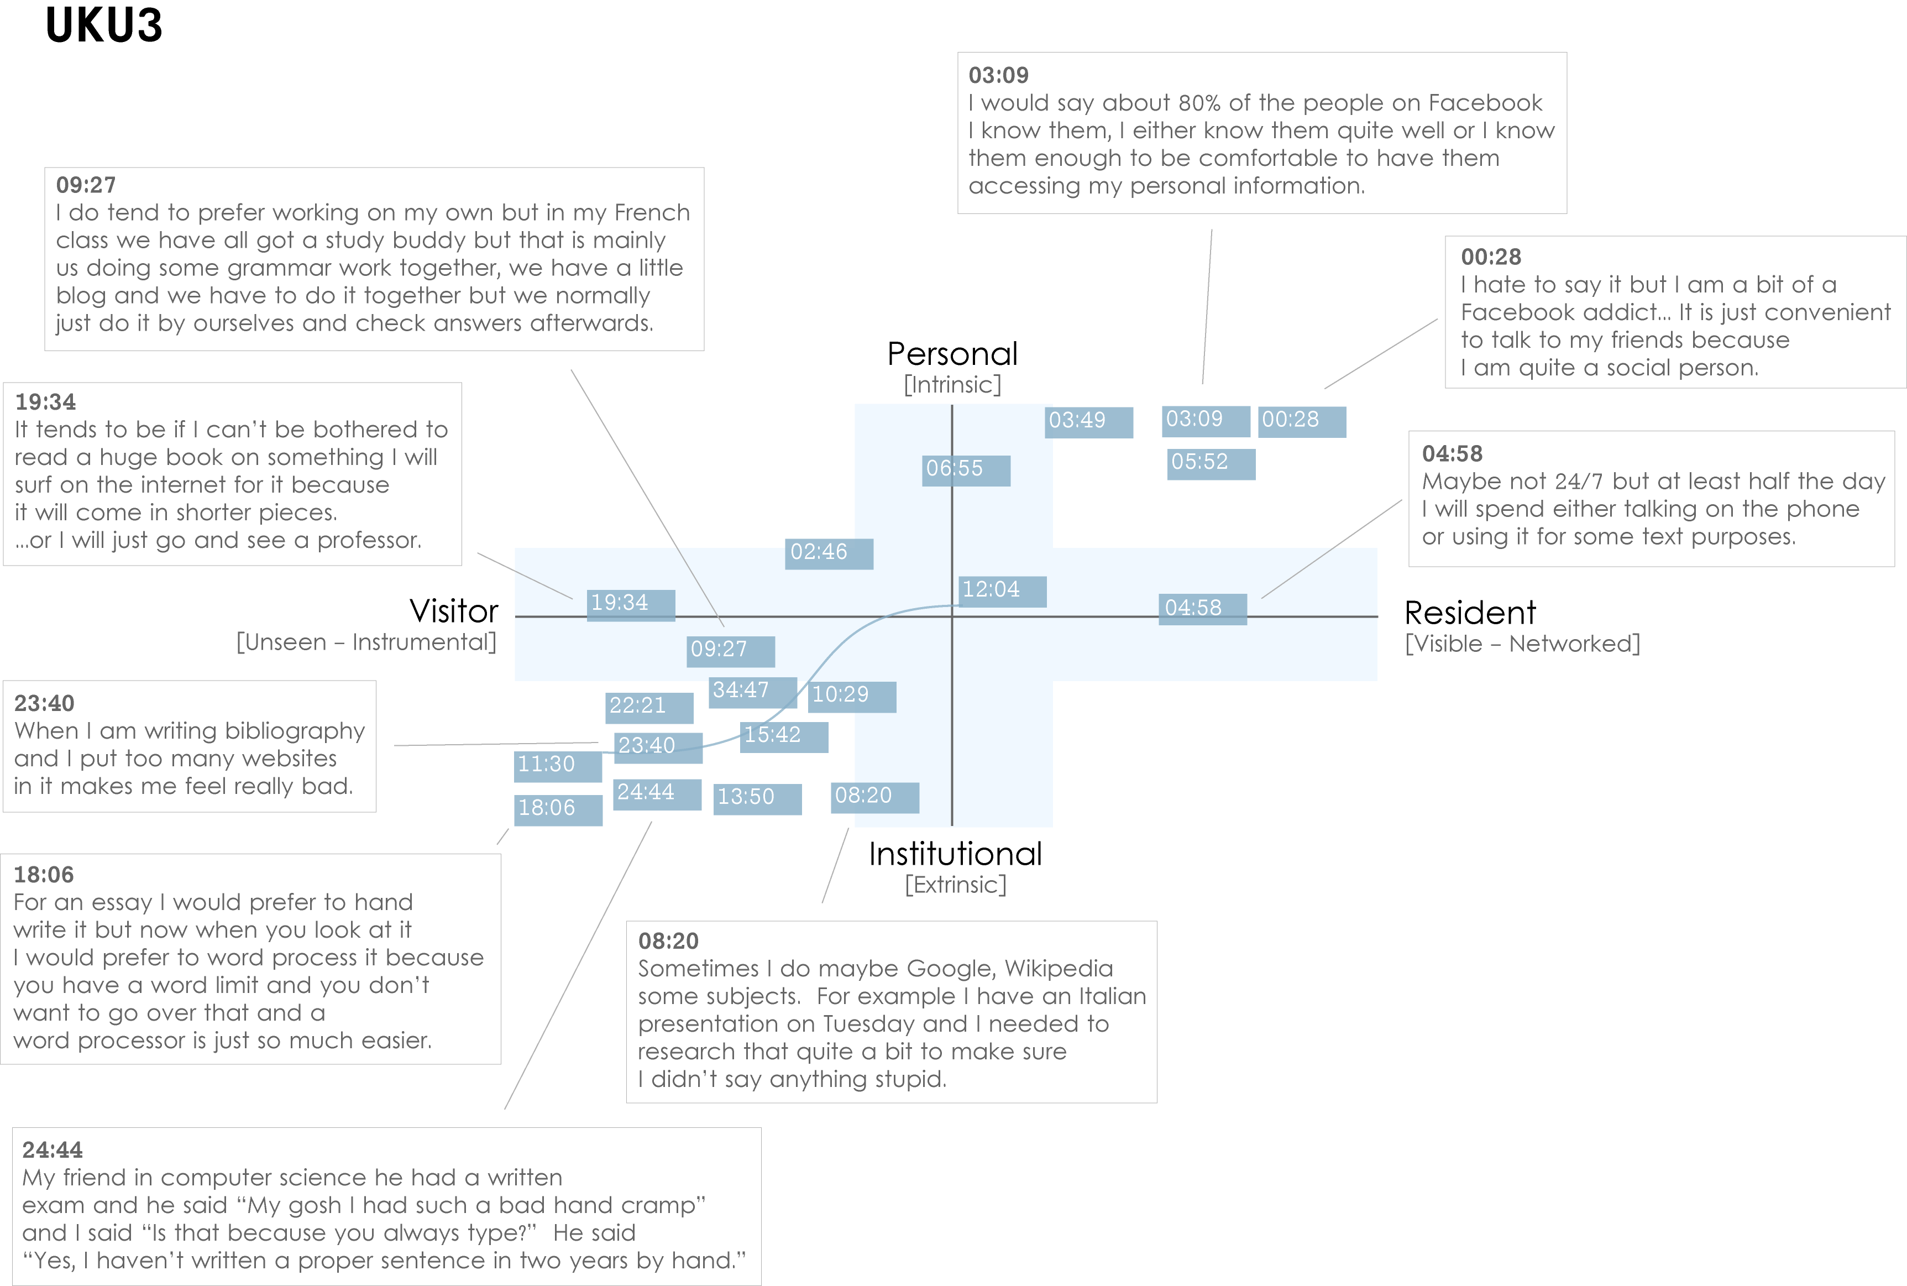
UKU3
Notes:
Images created by David White, Co-manager, Technology Assisted Lifelong Learning, University of Oxford
Institutional Resident Gap
UKU3 (Digital Visitors and Residents, UKU3, Emerging, 0:19:34, Female, Age 19, French and Italian)
This participant has a clear demarcation between Resident modes of engagement in her personal life and Visitor modes of engagement for study.
The map is a mode of engagement landscape onto which individuals can be plotted. The limits of the map have been defined by the four major framing concepts of the project: V&R – Personal and Institutional. The Personal end of the axis encompasses an individual’s private life, and the Institutional is their professional and/or academic life.
The data from the Emerging educational stage seem to suggest that individuals were engaging with systems and materials not provided by their institutions to do institutional work (e.g., consulting Wikipedia to write an essay). Such user-owned literacies, when mapped like this, take a prominent role in the academic work of many of our research subjects. Given the effect that the internet is having on collapsing the relationship between certain modes of activity and specific physical spaces, it is important not to tie notions of the institutional and the personal to ideas of “school/university/library” and “home” as buildings.
White, D., & Connaway, L.S. Visitors & Residents: What Motivates Engagement with the Digital Information Environment. 2011-2012. Funded by JISC, OCLC, and Oxford University. http://www.oclc.org/research/activities/vandr/.
17

Slide 18
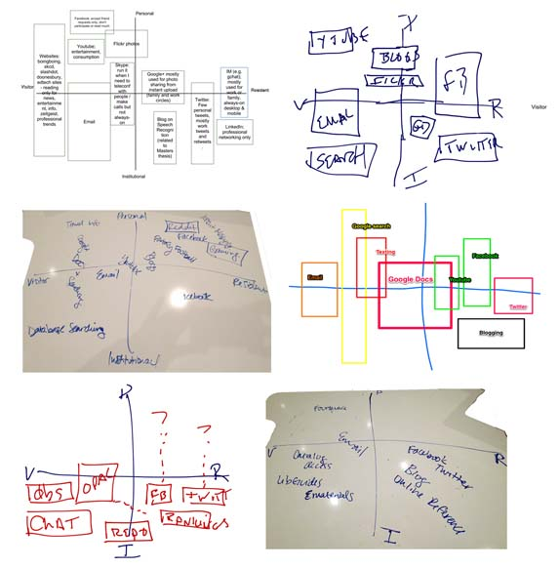
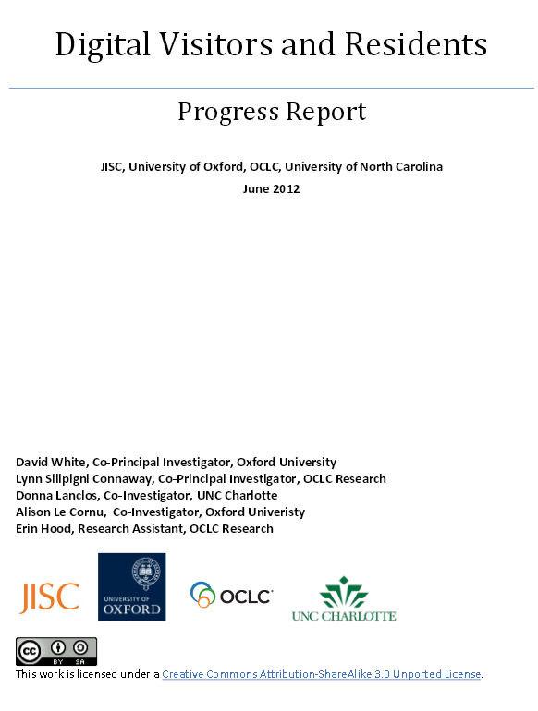
Understanding how learners are engaging and learning with technology can influence improvements in supporting and delivering …
- digital literacy
- content and infrastructure
usability
Pole-charts by participants at a V&R event at the 2012 EDUCAUSE conference
http://atkinsanthro.blogspot.com/2012/11/educause-2012-part-second.html
p. 3

Slide 19
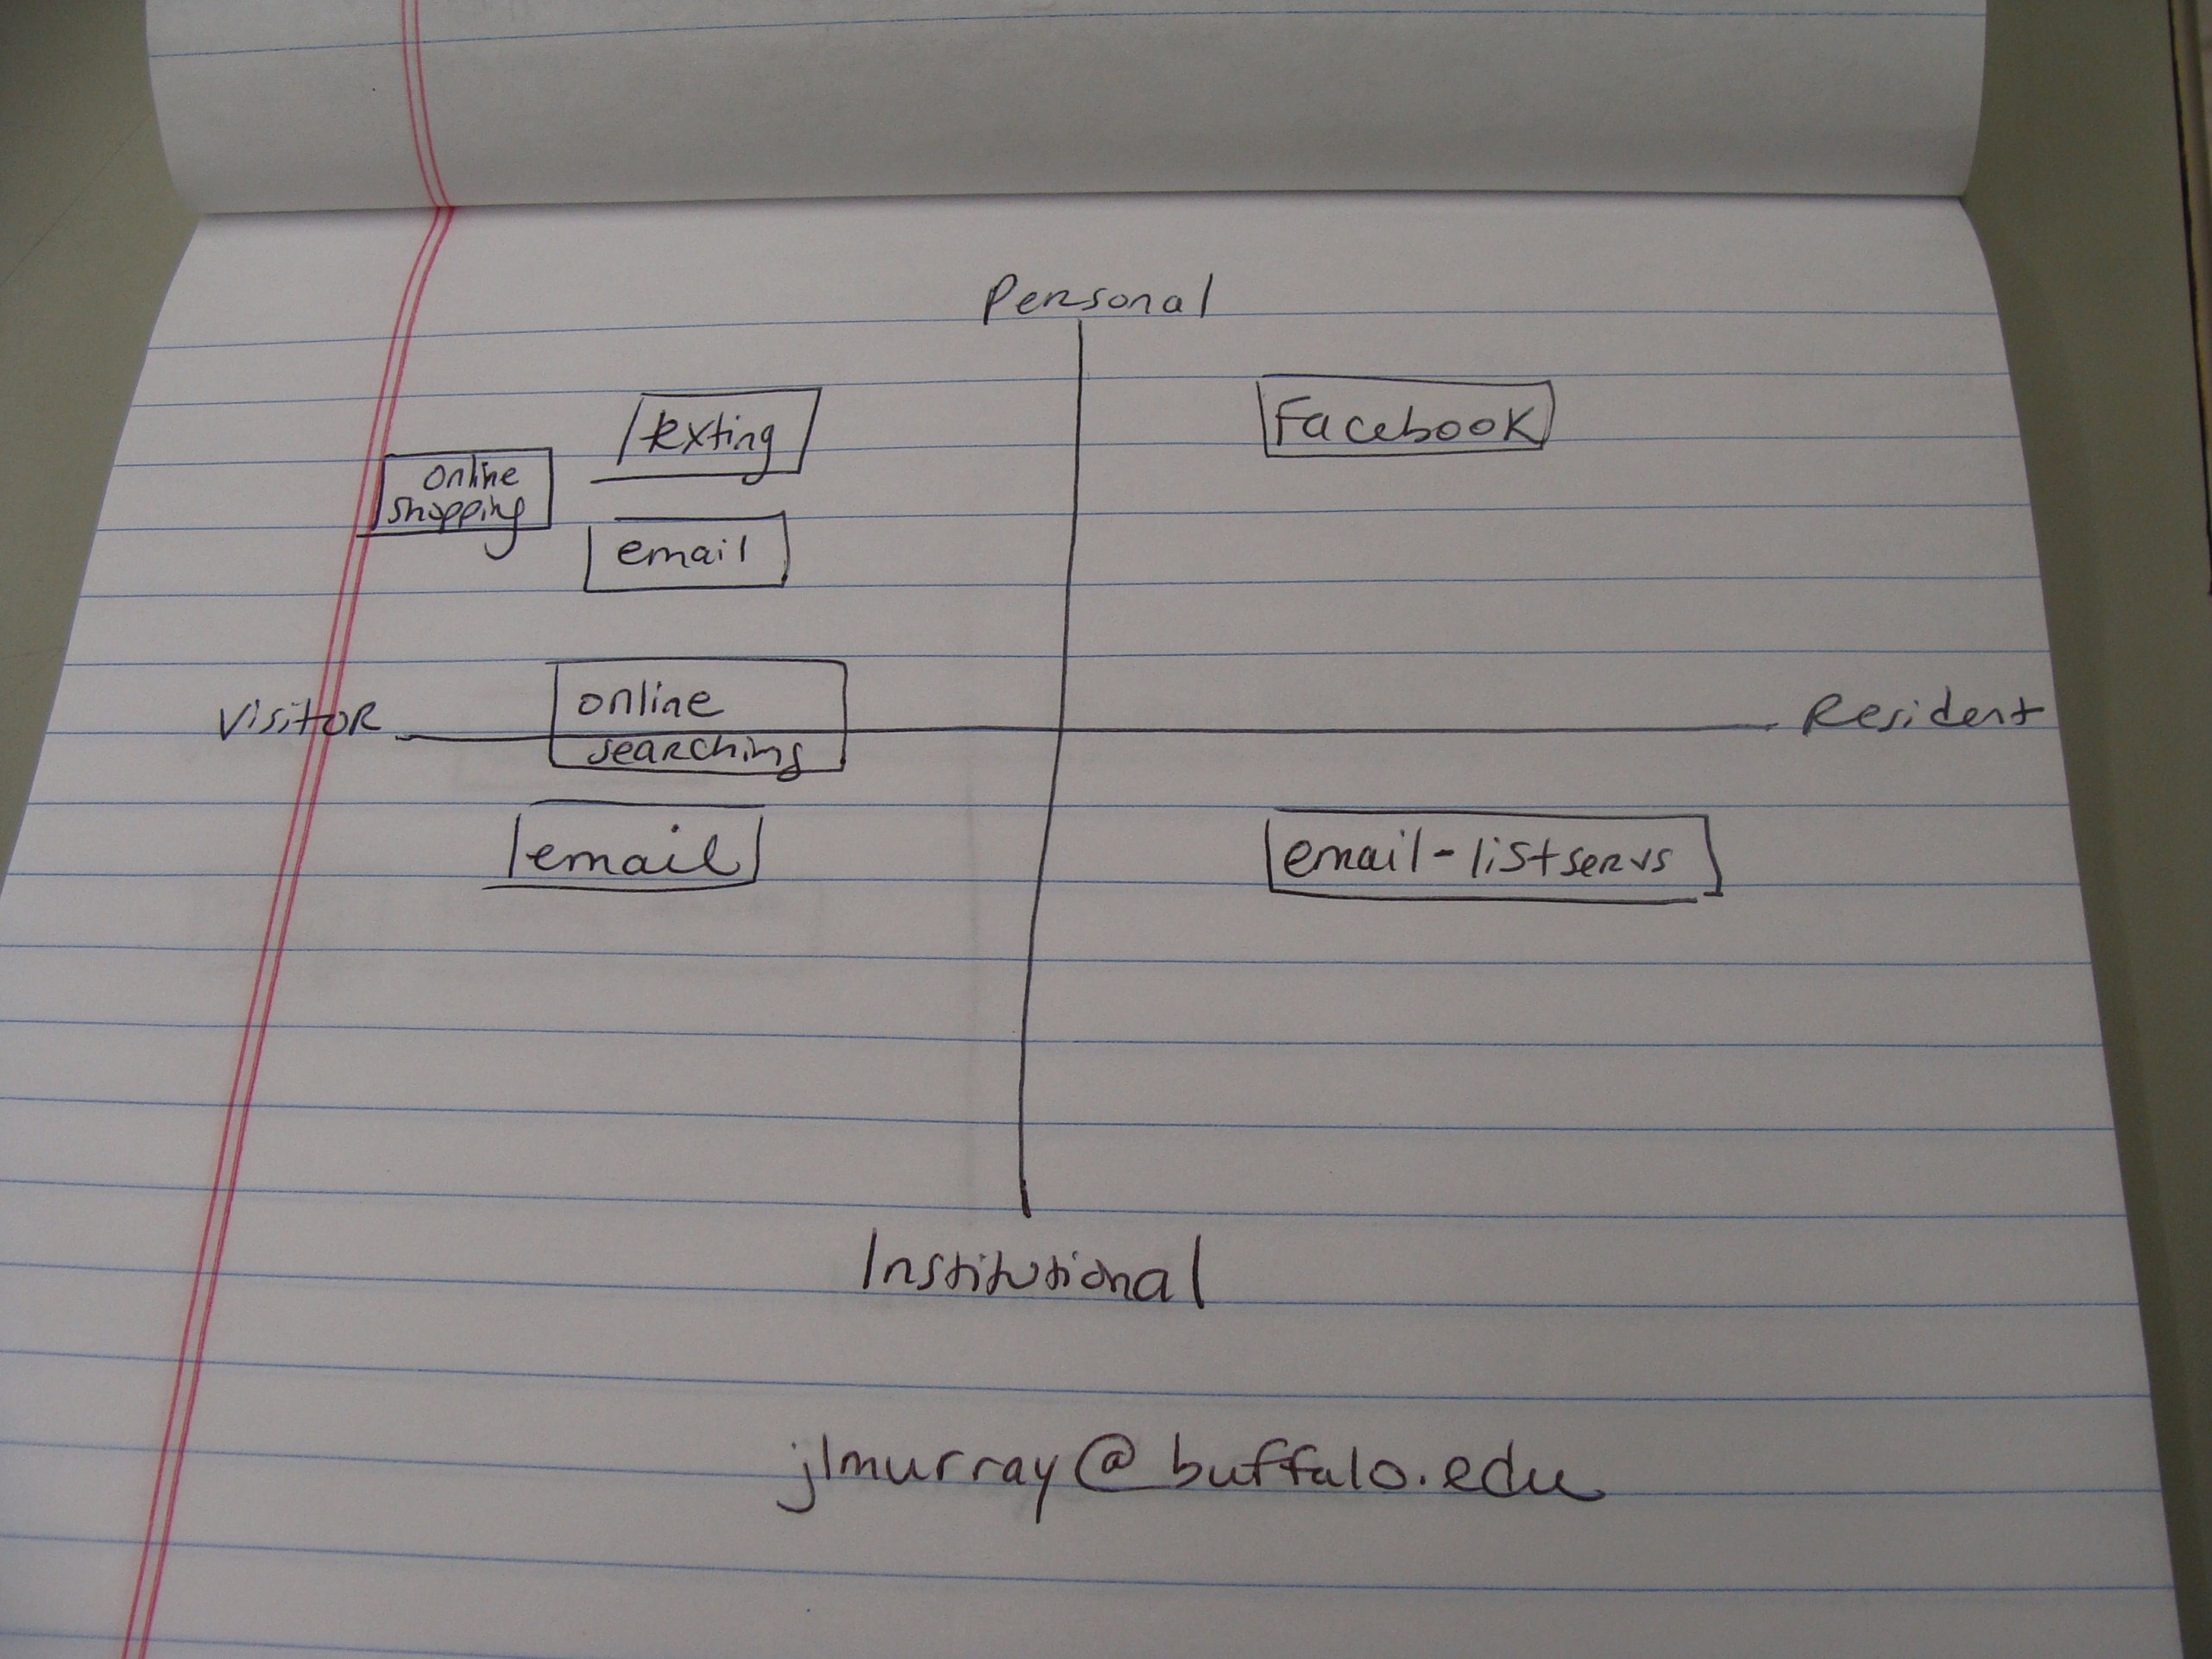
Notes:
Personal Map from participant at SUNYLA in Buffalo, NY, 2013.

Slide 20

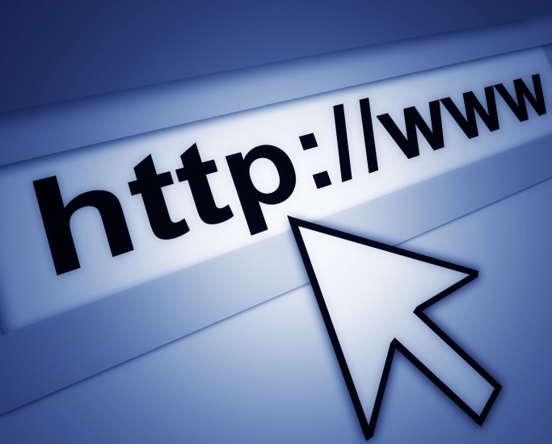
The library? What’s that?
Website hard to navigate
Inconvenient
Limited hours
Distance to library
Physical materials
Don’t think electronic resources are library resources
Associate with books
(Connaway & Dickey, 2010)
Notes:
Image: http://cdncambridge.tab.co.uk/wp-content/blogs.dir/7/files/2013/11/internet.jpg
Image (top): http://wallpaper.pickywallpapers.com/samsung-galaxy-tab/closed-sign.jpg
Connaway, L.S., & Dickey, T.J. (2010). Digital information seekers: Report of findings from selected OCLC, RIN, and JISC user behavior projects. http://www.jisc.ac.uk/media/documents/publications/reports/2010/digitalinformationseekerreport.pdf (p.4).
Connaway, L. S. & Radford, M. L. (2011). Seeking Synchronicity: Revelations and recommendations for virtual reference. Dublin, OH: OCLC Research. Retrieved from http://www.oclc.org/reports/synchronicity/full.pdf
“Yes, yes, like yes. Because I mean the thing that annoys me most is when these things [online library catalogues] are online, unlike library catalogues that’s supposed to be a really good way for looking for books but usually they are so bad that you are sort of stuck between the two worlds of you can’t go and ask someone for anything. You’re supposed to use the internet but they’re not very well developed” (Digital Visitors and Residents, UKG5, Embedding, 0:34:36, Female, Early Modern History, Age 25).
In the above quote, UKG5 is responding to the magic wand question. They state: “I’d really; I’d like sort of the archives that I have to use to have like amazing online catalogues so I know exactly what they’ve got and where it is” (Digital Visitors and Residents, UKG5, Embedding, 0:34:36, Female, Early Modern History, Age 25).
White, D., & Connaway, L. S. (2011-2014). Visitors and Residents: What motivates engagement with the digital information environment. Funded by JISC, OCLC, and Oxford University. Retrieved from http://www.oclc.org/research/activities/vandr/

Slide 21
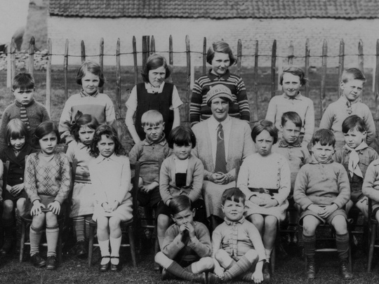
“And so like my parents will always go, ‘Well look it up in a book, go to the library.’ And I’ll go, ‘Well there’s the internet just there.’”
(Digital Visitors and Residents, UKU5, Emerging, Female, Age 19, Chemistry)
Notes:
Image: http://www.flickr.com/photos/22326055@N06/6732616879/

Slide 22
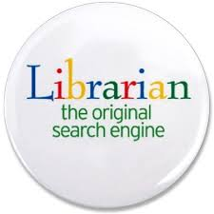
The word “librarian” only mentioned once in original interviews by Emerging Stage participants as a source of information
One participant referred to “a lady in the library who helps you find things”
(Digital Visitors and Residents, USU5, Emerging, Male, Age 19, Systems Engineering)
Notes:
Image: https://encrypted-tbn3.gstatic.com/images?q=tbn:ANd9GcQDPv9qq7lICairSWM2AYRuTpt49NvwWZoL76DSDb6vty_ZRdWH
“– there’s a lady in the library who helps you find things.” (Digital Visitors and Residents USU5, Emerging, Male, Age 19, Systems Engineering)
Americans see and appreciate the value of librarians. The vast majority (83%) of Americans who have used a librarian agree librarians add value to the search process (2010), even more so than in 2005 (76%). Respondents who had experienced a negative job impact rate librarians even higher, with 88% indicating the librarian adds value to the search process. Information consumers continue to be highly satisfied with the library and librarian experience (2010). Survey results show a growth in the number of respondents who agree libraries provide the personnel, technology, information resources and physical environment that meet their needs. In fact, we see a 25% increase in those who indicated that they are very satisfied with the overall search experience with the librarian (De Rosa, 2010, p.42).
De Rosa, C. (2010). Perceptions of libraries: A report to the OCLC membership. Dublin, OH: OCLC Online Computer Library Center.

Slide 23
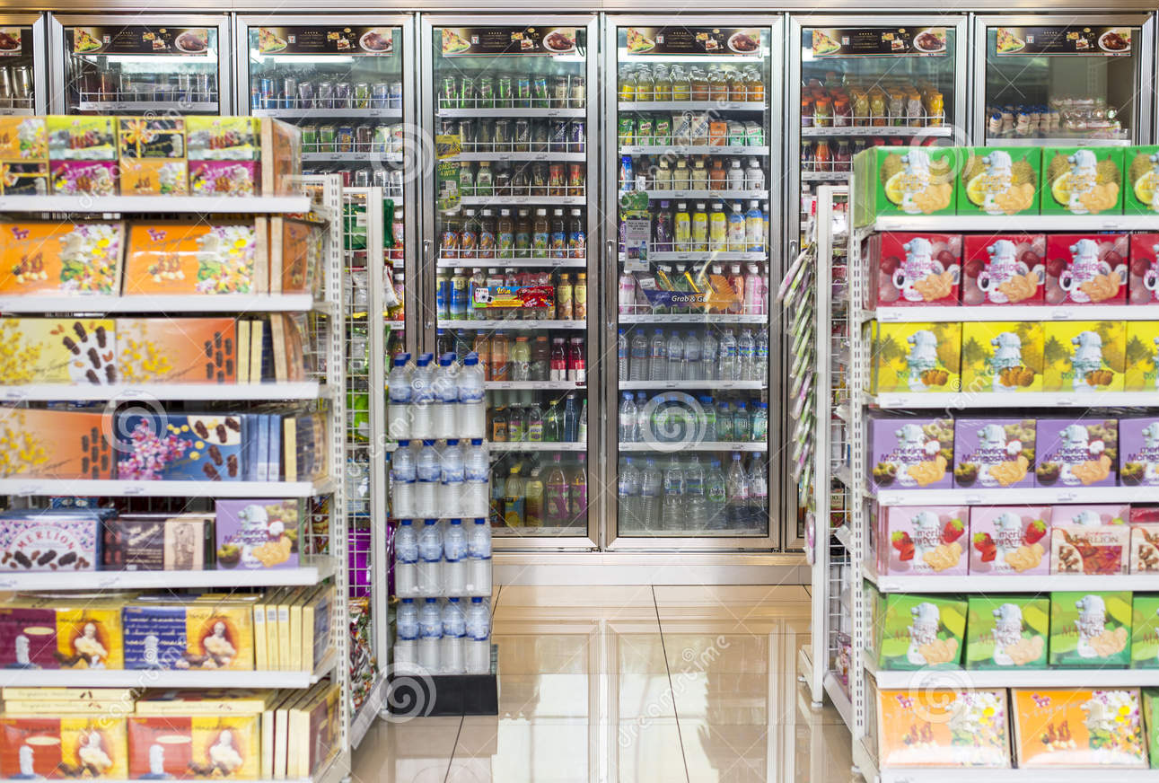
How Individuals Work
Convenience
Value human resources
Contextually based rational decisions
Situational needs determine search
Satisfice
(Connaway & Radford, 2011)
Notes:
Image: http://thumbs.dreamstime.com/z/convenience-store-26964752.jpg
Convenience often dictates choices between physical and virtual library and is based on context and situation.
Connaway, L. S., Dickey, T. J., & Radford, M. L. (2011). “If it is too inconvenient I’m not going after it:” Convenience as a critical factor in information-seeking behaviors. Library & Information Science Research, 33(3), 179-190. (Selected for inclusion in the ALA Reference Research Review: 2011)
Connaway, L. S., & Radford, M. L. (2011). Seeking synchronicity: Revelations and recommendations for virtual reference. Dublin, OH: OCLC Research. Retrieved from http://www.oclc.org/reports/synchronicity/full.pdf

Slide 24
Digital Visitors & Residents: Time, Convenience, Ease of Use
Notes:
Decision Choice AND Educational Stages: Interviews
Available Time: Emerging 40%, Establishing 40%, Embedding 50%, Experiencing 40%
Convenience: Emerging 91%, Establishing 100%, Embedding 100%, Experiencing 90%
White, D., & Connaway, L. S. (2011-2014). Visitors and residents: What motivates engagement with the digital information environment. Funded by JISC, OCLC, and Oxford University. Retrieved from http://www.oclc.org/research/activities/vandr/

Slide 25
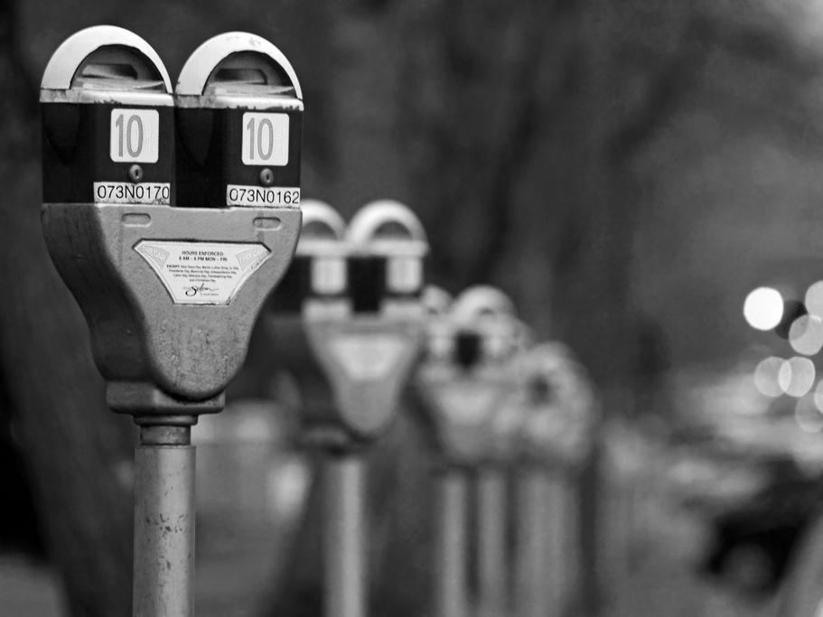
“Last semester I was writing a paper on Brazil and there was a book in the library that I just did not want to leave my house to go to. It is a 50 minute drive, I didn’t want to do that, but I was writing my paper and so I used Google books instead and really they only had a section of the book available but that was the section I used.”
(Digital Visitors and Residents, USG4, Embedding, Female, Age 23, Latin American Studies)
Notes:
Image: http://www.flickr.com/photos/31246066@N04/5261957053/
Lazy (No Motivation) OR Satisficing
Laziness levels appear to not be a true indicator of actual laziness, but perception. Not surprisingly Emerging participants indicated higher levels of laziness as they are unmotivated by their work at this stage. Considering how many required core classes are required along with high school classes, they have lower levels of interest in their classes at this point. Establishing and Embedding participants spoke of laziness as being that they don’t want to travel all the way back to campus to the library, especially late at night, and not going above and beyond in their work. These students are not necessarily lazy, though they speak of themselves that way, rather most of us would speak of these participants as busy and trying to manage their time.
Emerging: Participants do not want to take the time to do the actual task. Want to find shortcuts/quickest way to complete the task or how to avoid doing it at all. Often do not want to leave their computer. Recognize laziness in themselves/find themselves to not be motivated. I don’t see a response difference between First Round and Second Round.
Establishing: Only two participants, one speaking of professors, not themselves. The other speaks of not going above and beyond, just doing the minimum.
Embedding participants: Do not live on campus and do not want to travel just to go to the library.
Experiencing: One participant, teacher discussing student’s laziness versus their own. They would not be as lazy, but understand that the students are overwhelmed.
“I mean may be sometimes when I have to do research like I guess with the assignment last night once I’d found that website I didn’t continue to see what else I could find. So it’s kind of I guess a lazy approach to it – not going above and beyond, once I get there I just kind of stop.” (Digital Visitors and Residents, USU9, Female, Age 21, Sociology/Gerontology) Establishing
“I live about two miles away from here on bike, which is not that far, but when you’re writing a paper and don’t feel like getting out of your pajamas… Frequently when I’m working from home, it does feel a bit onerous to come all the way, which is about two miles away on bike, to use the library when I’m immediately probably going to go home afterwards. I find working from home very comfortable. I’d like – it feels also very private, it’s easy for me to concentrate without other people within the library space. So all of those reasons influenced my decision to take the easier route rather than physically having to move to get information.” (Digital Visitors and Residents, UKG2, Female, Age 22, Learning and Technology) Embedding

Slide 26
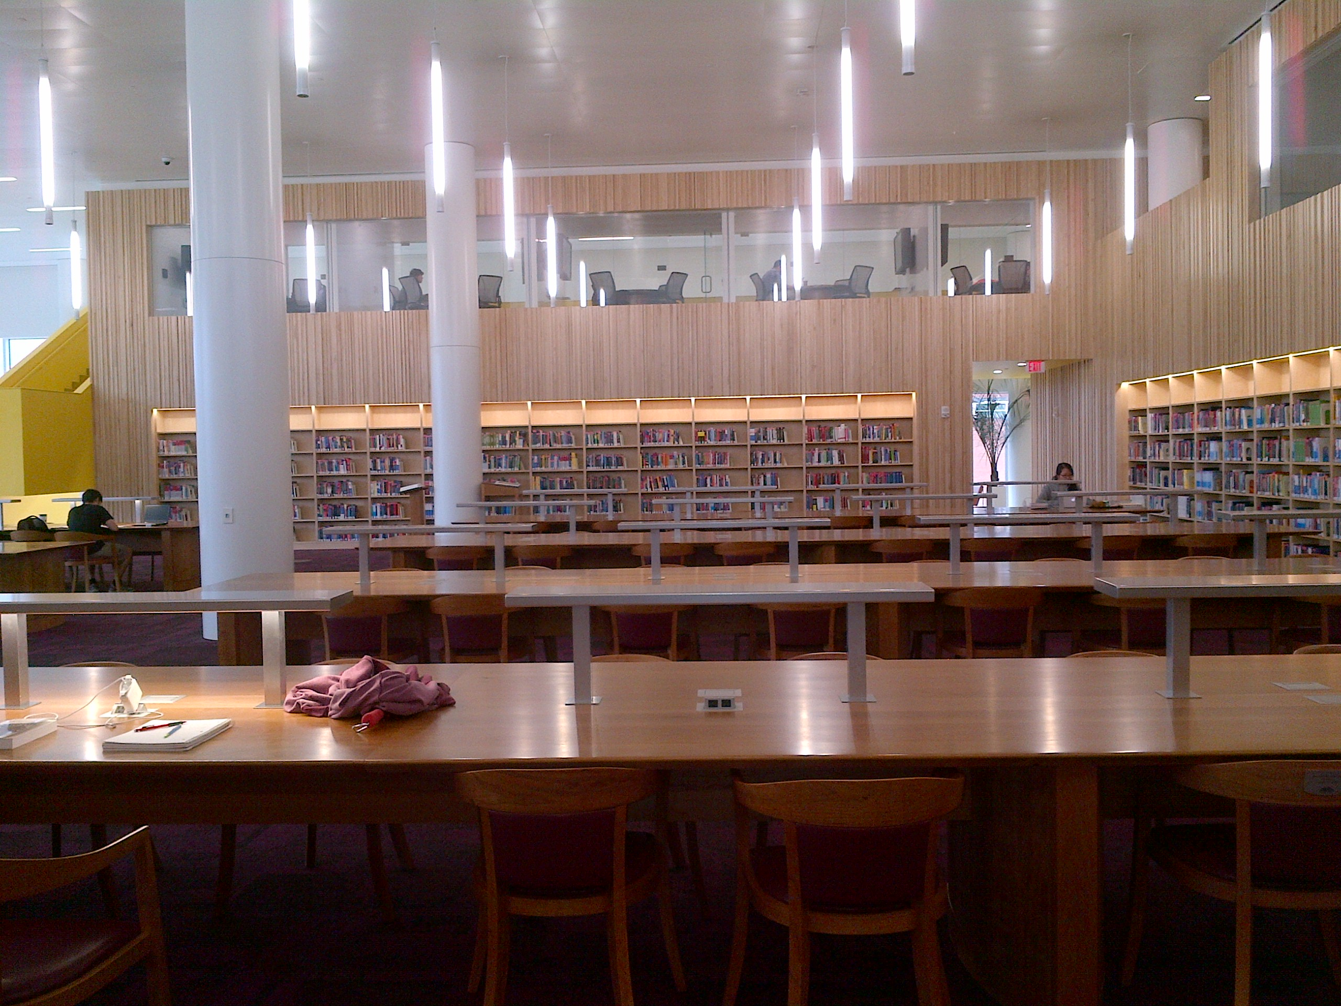
“She [professor] was very direct about certain stuff and wanted me to go to the library...But the research I needed wasn’t showing up ... And I had to find quotes from books, so I just like was able to go on Google, Google book search, and find the quote I needed. And I didn’t write down it was from the internet .... So she doesn’t really know (Laughter) that it’s from the internet.”
(Digital Visitors and Residents, USU2, Emerging, Female, Age 19, Electrical Engineering)
Notes:
Image: Connaway, L.S. (2013) NC State Library.
“I don’t use the library. Most students really don’t anymore, I know a couple of people that live here but they don’t actually use it for books, they use it as a quiet place to study.” (Digital Visitors and Residents ,USU4 0:36:27, Emerging, Male, Age 19, Double Major in Mechanical Engineering and Physics).
“[Academic library named] was really not bringing up anything. I did not have much luck. Maybe I’m not used to it. They probably had a lot but it’s a big library and I’m not patient” (Digital Visitors and Residents, USU2, Emerging Diary, Female, Age 19, Electrical Engineering)
“It can be difficult for a UK professional who does not speak foreign languages to get a good academic translation. Would like a very good translation service specifically geared for academics,” (Physical Sciences Researcher, Research Information Network. 2006. Researchers and discovery services: Behaviour, perceptions and needs. London: Research Information Network.)
Research Information Network. (2006). Researchers and discovery services: Behaviour, perceptions and needs. London: Research Information Network.
Connaway, L. S. & Dickey, T.J. (2010). The digital information seeker: Report of the findings from selected OCLC, RIN, and JISC user behaviour projects. http://www.jisc.ac.uk/media/documents/publications/reports/2010/digitalinformationseekerreport.pdf.
White, D. & Connaway, L.S. (2011). Visitors and residents: What motivates engagement with the digital information environment. Funded by JISC, OCLC, and Oxford University. http://www.oclc.org/research/activities/vandr/.

Slide 27


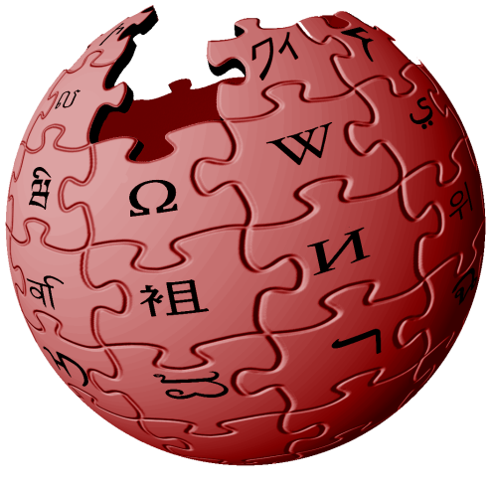
Tools Used: Students
Undergraduate Students
Google, Wikipedia
Also use library website &
e-journals
Human resources
Other students/classmates
Family & relatives
Friends
Graduate students
Professors, advisors, mentors
Electronic databases
(Connaway & Dickey, 2010)
(De Rosa, 2010)
Notes:
Image: http://shockerdaily.com/wp-content/uploads/2013/08/13-Interesting-Things-to-Know-That-will-Impress-Your-Friends.jpg
“One of my favourite ways of getting information is by asking people. Instead of Googling the whole time I mostly have faith in the fact that people are actually learning, if I can go to a tutor and ask them something.” (Digital Visitors and Residents, UKU3, Emerging, 0:19:34, Female, Age 19, French and Italian)
“Like usually with homework I usually can do it myself. But like, like sometimes I will just like IM my friend on Facebook and will be like, “Hey do you know how to do this?” That is usually how I will do it or I will text somebody but for the most part if I can’t figure it out then I just kind of star that question because there is usually just one or two questions. Or I will just go to my parents or my Grandma or something.” (Digital Visitors and Residents, USS6, Emerging, 0:17:08, Female, Age 17, High School Student)
“And then if I’m requiring more information I’ll go over to the library website and use the JSTOR. And what I find easier for me to look for the JSTOR link is actually going through what I used as an undergraduate and going into the anthropology field, because I know that they have the JSTOR and Project MUSE and all of these search engines that I already see if I click on that.” (Digital Visitors and Residents, USG5, Embedding, 0:01:10, Female, Age 30, Latin American Studies).
Information studies students: (Bertot, et al., 2012, p. 213), 28% use OPAC daily or weekly, 86% use Google daily or weekly
Bertot, J. C., Berube, K., Devereaux, P., Dhakal, K., Powers, S., & Ray, J. (2012). Assessing the usability of WorldCat Local: Findings and considerations. The Library Quarterly, 82(2), 207-221.
Connaway, L.S., & Dickey, T.J. (2010). Digital information seekers: Report of findings from selected OCLC, RIN, and JISC user behavior projects. http://www.jisc.ac.uk/media/documents/publications/reports/2010/digitalinformationseekerreport.pdf (p. 39).
De Rosa, C. (2010). Perceptions of libraries: A report to the OCLC membership. Dublin, OH: OCLC Online Computer Library Center.
White, D., & Connaway, L. S. (2011-2014). Visitors and residents: What motivates engagement with the digital information environment. Funded by JISC, OCLC, and Oxford University. Retrieved from http://www.oclc.org/research/activities/vandr/

Slide 28

Tools Used: Researchers
Online resources
99.5% use journals as primary resource
Google, Web of Science, PubMed, Science Direct, JSTOR
Human resources
90% mention expertise of individuals as important resource
Coworkers
Colleagues
Other professionals
(Research Information Network, 2006) (Connaway & Dickey, 2010)
Notes:
Image: http://libraryrgnul.weebly.com/uploads/1/2/0/4/12044417/7354339.jpg?402
Google, Web of Science, PubMed, Science Direct, JSTOR (p.27)
Increasingly important to research process at all levels (p.4)
Articles are central type of resource for researchers (p.34-35)
99.5% say journals are primary resource (p. 34-35)
71% rank journals in their top three resources (p. 34-35)
90% mention expertise of individuals as important resource (pp.7, 34-35)
Connaway, L.S., & Dickey, T.J. (2010). Digital information seekers: Report of findings from selected OCLC, RIN, and JISC user behavior projects. http://www.jisc.ac.uk/media/documents/publications/reports/2010/digitalinformationseekerreport.pdf (p.4).
Research Information Network. (2006). Researchers and discovery services: Behaviour, perceptions and needs. London: Research Information Network (p. 27, p. 34-35).

Slide 29
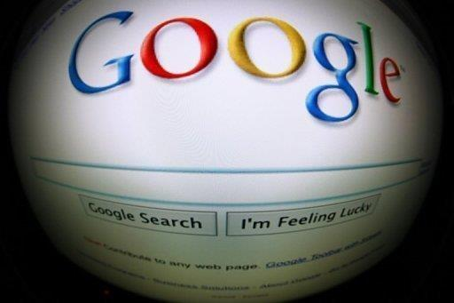
“I find Google a lot easier [than library catalog]…so many journals come up and when you look at the first ten and they just don’t make any sense. I, kind of, give up.”
(Digital Visitors and Residents, USU7, Emerging, Female, Age 19, Political Science)
Notes:
Image: http://cdn.phys.org/newman/gfx/news/hires/googleappsin.jpg
White, D., & Connaway, L. S. (2011). Visitors and residents: What motivates engagement with the digital information environment. Funded by JISC, OCLC, and Oxford University. Retrieved from http://www.oclc.org/research/activities/vandr/

Slide 30
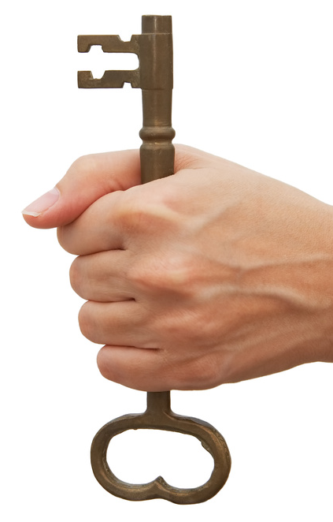
Journals & Databases
Journals
Access more important than discovery
Want full text, online versions
Expect seamless Discovery-to-Delivery
Backfiles difficult to access
Content often discovered through Google
Visit only a few minutes
Databases
Electronic databases not perceived as library sources
Frustration locating & accessing full-text copies
(Research Information Network, 2006)
Notes:
Image: Microsoft Clip Art
Logins, password, and authentication interferes with access to sources
“…the first thing I did was, before I came to the library to use the MLA database, I did a Google search and it turns out that there is a professor at Berkeley who keeps a really, really nice and fully updated [unclear – words] page with bibliographic references, all kinds of links, you know, it's just awfully good, and I mean it just gets you really off and running on a lot his information and more novels. And I used it quite a bit, and then I did finally come up with and supplement that with an MLA search, which yielded some articles that were not on that page.” (Focus Group Interview 01, Faculty, Sense-making the Information Confluence)
Connaway, L. S., & Dickey, T. J. (2010). Digital information seekers: Report of findings from selected OCLC, RIN, and JISC user behavior projects. http://www.jisc.ac.uk/media/documents/publications/reports/2010/digitalinformationseekerreport.pdf (p.4).
Dervin, B., Connaway, L. S., & Prabha, C. (2003-2006). Sense-making the information confluence: The whys and hows of college and university user satisficing of information needs. Funded by the Institute of Museum and Library Services (IMLS). Retrieved from http://imlsosuoclcproject.jcomm.ohio-state.edu/
Research Information Network. (2006). Researchers and discovery services: Behaviour, perceptions and needs. London: Research Information Network
Backfiles difficult to access
Wong, W., Stelmaszewska, H., Bhimani, N., Barn, S., & Barn, B. (2009). User behaviour in resource discovery: Final report. Retrieved from http://www.jisc.ac.uk/whatwedo/programmes/inf11/userbehaviourbusandecon.aspx
“And have all the breakdowns, because the database, although you would assume that it would be easier for me to go through the database mode it’s actually even worse because you’ve got to filter through all these other like alphabetical… Well I mean they’re in alphabetical order so… And so for me that’s not… I just go ahead and I stick to what I know. [Google] I like the layout of that and I just go bing, bing, and then I go and look into articles.” (Digital Visitors and Residents, USG5, Embedding, 0:02:58, Female, Age 30, Latin American Studies).
White, D., & Connaway, L. S. (2011-2014). Visitors and residents: What motivates engagement with the digital information environment. Funded by JISC, OCLC, and Oxford University. Retrieved from http://www.oclc.org/research/activities/vandr/

Slide 31
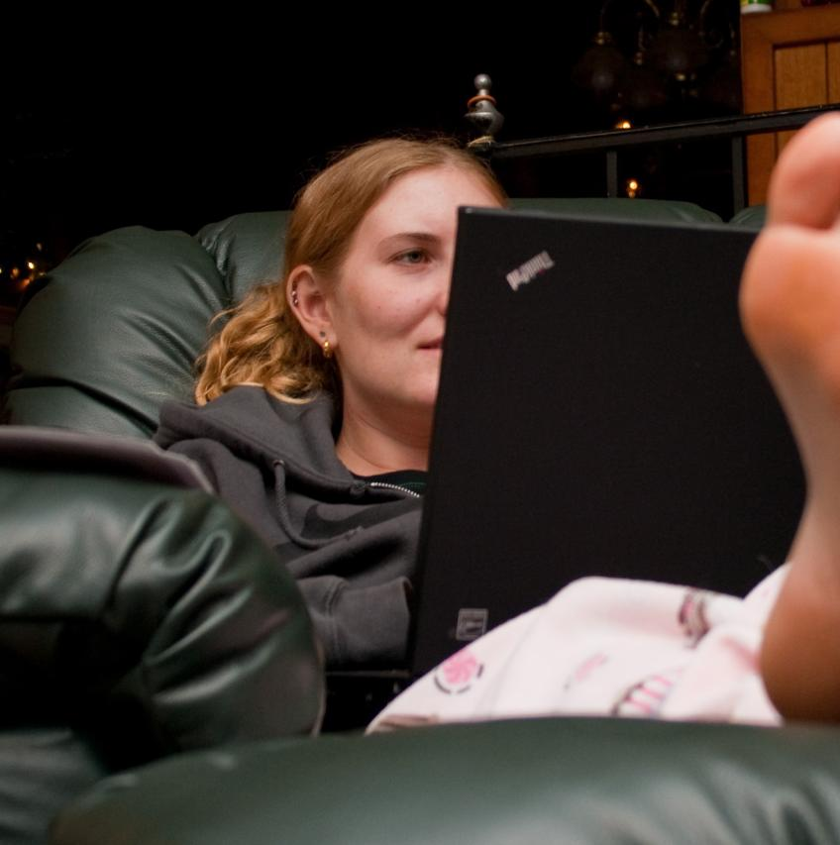
Mean Frequencies
7.81 Facebook
7.41 Internet
5.68 Email
5.51 Google
2.86 Wikipedia
1.88 Academic Library
1.34 Twitter
0.75 Libraries and Books
N=73, All Interview Participants
Notes:
Image: http://www.flickr.com/photos/colorblindpicaso/3399410617/
Mean frequency calculations from Interviews only, all educational levels combined. The mean (or average) was calculated by the sum of the total participant mentions divided by the number (or count) of participants.
Mean Frequencies for “place”: Facebook, Internet, Academic Library, Twitter, Google
Mean Frequencies for “contact”: Email
Mean Frequencies for “digital source”: Wikipedia
Libraries and Books is Nvivo query of Libraries (any) AND Books.

Slide 32
Place and Educational Stages
Notes:
Place AND Educational Stages: Interviews
Facebook: Emerging 95%, Establishing 100%, Embedding 100%, Experiencing 90%
Twitter: Emerging 21%, Establishing 50%, Embedding 50%, Experiencing 70%
YouTube: Emerging 33%, Establishing 50%, Embedding 30%, Experiencing 40%
Wikipedia: Emerging 81%, Establishing 90%, Embedding 70%, Experiencing 50%
White, D., & Connaway, L. S. (2011-2014). Visitors and Residents: What motivates engagement with the digital information environment. Funded by JISC, OCLC, and Oxford University. Retrieved from http://www.oclc.org/research/activities/vandr/

Slide 33
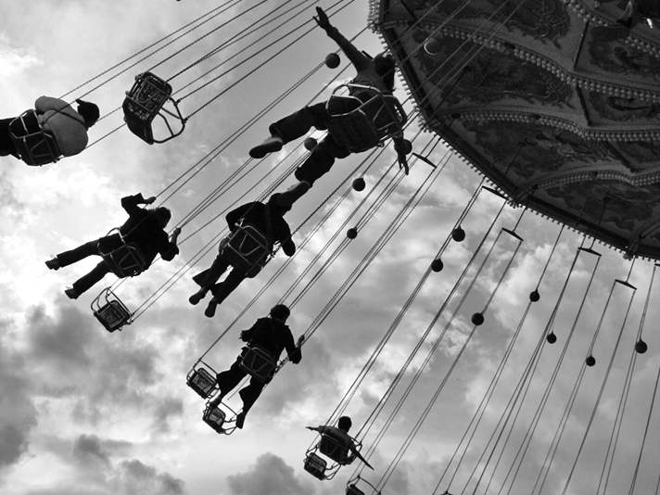
“I get on Twitter a whole bunch. It’s Twitter or Facebook are what I usually use the most to talk to my friends.”
(Digital Visitors and Residents, USS1, Emerging, Female, Age 17, High School Student)
Notes:
Image: http://www.flickr.com/photos/auro/230377281/

Slide 34
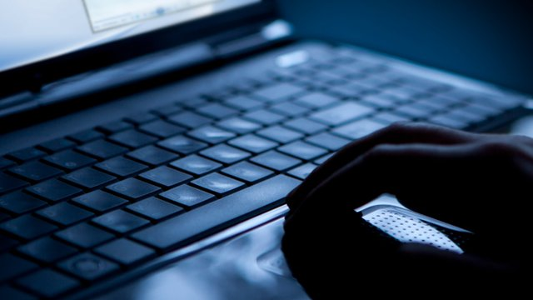
The Learning Black Market
“It’s like a taboo I guess with all teachers, they just all say – you know, when they explain the paper they always say, “Don’t use Wikipedia.”
(Digital Visitors and Residents, USU7, Emerging, Female, Age 19, Political Science)
Notes:
Image: http://news.bbcimg.co.uk/media/images/58277000/jpg/_58277172_138045933.jpg
Covert online study habits
Wikipedia
Don’t cite
Widely used
Guilt
Students & teachers disagree
Quality sources
“When Wikipedia was mentioned many of the Emerging stage participants believe that teachers, professors, and tutors do not accept Wikipedia as a legitimate source. However, the students admit to using Wikipedia and citing the references included in the Wikipedia articles but not formally acknowledging the use of Wikipedia; therefore, creating a covert, underground Learning Black Market. Perhaps, as students gain more confidence in their ability to tell whether the information on Wikipedia is reliable or not, they are more confident in revealing their uses of it as a resource.” (Connaway, Lanclos, and Hood, 2013)
Students’ Perceptions of Teachers’ opinions of Wikipedia:
“Avoid it.” (Digital Visitors and Residents, UKS8, Emerging, 0:28:28.3, Female, Age 16, Undeclared Major)
“I mean if teachers don’t like using Wikipedia they don’t want you to use Wikipedia. A lot of students will still use Wikipedia and then cite another source. As long as it has the same information and it is not word for word or anything they’ll use Wikipedia because it is the easiest thing to go look up on Wikipedia. It will give you a full in-depth detailed thing about the information. Teachers don’t just like it because it’s not the most reliable source since anyone can post something on there even though the site is monitored, it’s because it’s too easy.” (Digital Visitors and Residents, USU3, Emerging, 0:30:59, Male, Age 19, Mechanical Engineering)
“They [professors] say it’s because anyone can make up – I mean, anyone can add information on there but I mean when I’ve actually looked into information it seemed the same as any information I find anywhere else. I mean, it’s not like if you look up fourth of July, it’s not like it gives you like some weird explanation of aliens or something.” (Digital Visitors and Residents, USU7, Emerging, 0:33:14, Female ,Age 19, Political Science)
Students’ on Wikipedia:
“I use it, kind of like, I won't cite it on my papers but I, kind of, use it as a like, as a start off line. I go there and look up the general information, kind of, read through it so I get a general idea what it is. Then I start going through my research.” (Digital Visitors and Residents, USU7, Emerging, 0:33:49, Female, Age 19, Political Science)
“Everyone knows that you try not to use Wikipedia as a source because it is a cardinal sin.” (Digital Visitors and Residents, UKU3, Emerging, 0:31:03, Female, Age 19, French and Italian)
White, D. S., & Le Cornu, A. (2011). Visitors and Residents: A new typology for online engagement. First Monday, 16(9). Retrieved from http://firstmonday.org/htbin/cgiwrap/bin/ojs/index.php/fm/article/viewArticle/3171/3049
Connaway, L. S., Lanclos, D., & Hood, E. M. (2013). “I find Google a lot easier than going to the library website.” Imagine ways to innovate and inspire students to use the academic library. Proceedings of the Association of College & Research Libraries (ACRL) 2013 conference, April 10-13, 2013, Indianapolis, IN. Retrieved from http://www.ala.org/acrl/sites/ala.org.acrl/files/content/conferences/confsandpreconfs/2013/papers/Connaway_Google.pdf
Connaway, L. S., Lanclos, D., White, D., Le Cornu, A., & Hood, E. M. (2013). User-centered decision making: A new model for developing academic library services and systems. IFLA Journal, 39(1), 30-36.
Connaway, L. S., White, D., Lanclos, D., & Le Cornu, A. (2013). Visitors and Residents: What motivates engagement with the digital information environment? Information Research, 18(1). [Available:http://informationr.net/ir/18-1/infres181.html]

Slide 35


“A lot of students will still use Wikipedia and then cite another source. As long as it has the same information and it is not word for word or anything they’ll use Wikipedia because it is the easiest thing to go look up on Wikipedia.”
(Digital Visitors and Residents, USU3, Emerging, Male, Age 19, Mechanical Engineering)
Notes:
Wikipedia Image: http://en.wikipedia.org/wiki/Wikipedia:Wikipedia_logos
Laptop/Woman Image: Microsoft Clip Art
“Because Google is reliable. And fast.” (Digital Visitors and Residents, UKG1, Embedding, 0:29:14, Female Age 23)
White, D., & Connaway, L. S. (2011). Visitors and residents: What motivates engagement with the digital information environment. Funded by JISC, OCLC, and Oxford University. http://www.oclc.org/research/activities/vandr/

Slide 36

Human Sources Mean Frequency
3.53 Teachers, Professors
3.07 Friends, Colleagues
1.36 Mother
1.23 Peers
1.22 Extended Family
1.10 Father
1.08 Other Human Source
0.59 Experts, Professionals
0.22 Librarians
N=73, All Interview Participants
Notes:
Image: http://www.flickr.com/photos/cybrarian77/6284181389/
Mean calculations of Human Sources from Interviews only, all educational levels combined. The mean (or average) was calculated by the sum of the total participant mentions divided by the number (or count) of participants.

Slide 37
Digital Visitors & Residents: Means of Contact
Notes:
As shown, Email was mentioned at a much higher rate than other means of contact.
Contact and Educational Stages: Interviews
Email: Emerging 60%, Establishing 100%, Embedding 100%, Experiencing 100%
Texting: Emerging 84%, Establishing 80%, Embedding 70%, Experiencing 50%
Phone Calls: Emerging 77%, Establishing 90%, Embedding 70%, Experiencing 70%
Face-to-Face: Emerging 60%, Establishing 60%, Embedding 40%, Experiencing 70%
White, D., & Connaway, L. S. (2011-2014). Visitors and residents: What motivates engagement with the digital information environment. Funded by JISC, OCLC, and Oxford University. Retrieved from http://www.oclc.org/research/activities/vandr/

Slide 38
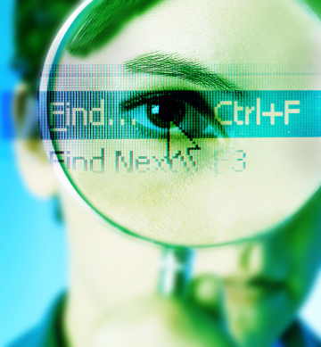
Information-Seeking Behavior
Power browsing
Scan small chunks of information
View first few pages
No real reading
Squirreling
Short basic searches
Download content for later use
Differ with discipline
(Research Information Network, 2006)
(Consortium of University Research Libraries, and Research Information Network, 2007)
(Connaway & Dickey, 2010)
Notes:
Image: http://ccistudentcenterblog.files.wordpress.com/2013/09/mageye.jpg?w=360&h=388
User behaviors in this electronic environment tend toward quick views of a few pages, and “bouncing” between resources. This seems to contradict the notion of the hard-core researcher but supports the need for more user behavior research addressing situation and context. DIS, p. 34.
Researchers in the sciences are most satisfied, Arts and Humanities researchers indicated serious problems (CURL, p. 75)
“Satisficing” (CURL, p. 31)
Awareness of open access is low (CURL, p. 64).
Lack of Understanding of copyright and publisher agreements (Connaway & Dickey, 2010, Towards a Profile of the Researcher of Today)
Consortium of University Research Libraries, and Research Information Network. (2007). Researchers’ use of academic libraries and their services: A report. London: Research Information Network and Consortium of University Research Libraries (CURL) (p. 31, p.64).
Research Information Network. (2006). Researchers and discovery services: Behaviour, perceptions and needs. London: Research Information Network (p. 75).
Connaway, L. S., & Dickey, T. J. (2010). Towards a profile of the researcher of today: What can we learn from JISC projects? Common themes identified in an analysis of JISC Virtual Research Environment and Digital Repository Projects. http://ie-repository.jisc.ac.uk/418/2/VirtualScholar_themesFromProjects_revised.pdf

Slide 39
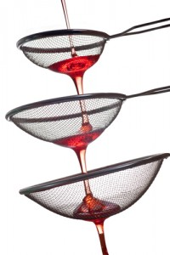
Skills for Finding Information/Sources and Criteria for Selecting Them
Students
Determine credibility by:
Common sense (77%)
Cross-checking (69%)
Reputation of company/organization (67%)
Credible recommendations (48%)
Researchers
Self-taught in discovery services
No formal training (62%)
Doctoral students learn from dissertation professor
(Research Information Network, 2006) (De Rosa, 2010)
Notes:
Image: http://www.gfi.com/blog/wp-content/uploads/2011/07/web-content-filtering-200x300.jpg
“So, I usually check. I try to test the information, if it’s- my judgment, or also my knowledge in the subject or- or I will read more to see if the information is right or not. I don’t trust it, like from the first second” (Digital Visitors and Residents, USG1, Embedding, 0:35:15, Female, Age 45, Bio-informatics and genomics).
“It is kind of like a guess and check to see which one works best or which one gives you the most information. It is not necessarily to see which one is more credible because if you want credibility you are not necessarily going to look online for it.” (Digital Visitors and Residents, USU3, Emerging, 0:18:31, Male, Age 19, Mechanical Engineering)
“You know, let’s say it’s not even in an academic context. I have to see the same conclusion reached by lots of different people in different contexts. Like I need to see the same answer again and again and again. And maybe at some point that’s enough time where it starts to gel to me that this probably is a good approximation of the truth. It might not be the truth but this seems to be what a lot of people perceive as the truth. So that would be the simplest way to do it.” (Digital Visitors and Residents, USF3, Experienced, 0:29:48, Male, Age 40, Biology)
“That’s the only problem, just knowing what information to use and why.” (Digital Visitors and Residents, UKS1, Emerging, 00:24:05, Male, Age 18, Film)
De Rosa, C. (2010). Perceptions of libraries: A report to the OCLC membership. Dublin, OH: OCLC Online Computer Library Center.
White, D., & Connaway, L. S. (2011-2014). Visitors and residents: What motivates engagement with the digital information environment. Funded by JISC, OCLC, and Oxford University. Retrieved from http://www.oclc.org/research/activities/vandr/
Most researchers self-taught in discovery services, 62% report no formal training (p.64), Confident in their skills (p.9)
Research Information Network. (2006). Researchers and discovery services: Behaviour, perceptions and needs. London: Research Information Network.
Discuss New Zealand computer science faculty projects, 1996 and 2011.
Self –taught, Depend on graduate students to tell them how to get sources and information
Cunningham, S. J., & Connaway, L. S. (1996). Information searching preferences and practices of computer science researchers. In J. Grundy (Ed.), Proceedings: Sixth Australian conference on computer-human interaction, November 24-27, 1996, Hamilton, New Zealand (pp. 294-299). Los Alamitos, CA: IEEE Computer Society Press.

Slide 40
Decision, Choice and Educational Stages
Notes:
Decision, Choice AND Educational Stages: Interviews
Currency: Emerging 12%, Establishing 40%, Embedding 70%, Experiencing 40%
Relevance: Emerging 60%, Establishing 80%, Embedding 50%, Experiencing 60%
Reliability: Emerging 47%, Establishing 50%, Embedding 70%, Experiencing 40%
Authority, Legitimacy: Emerging 79%, Establishing 50%, Embedding 90%, Experiencing 70%
White, D., & Connaway, L. S. (2011-2014). Visitors and residents: What motivates engagement with the digital information environment. Funded by JISC, OCLC, and Oxford University. Retrieved from http://www.oclc.org/research/activities/vandr/

Slide 41
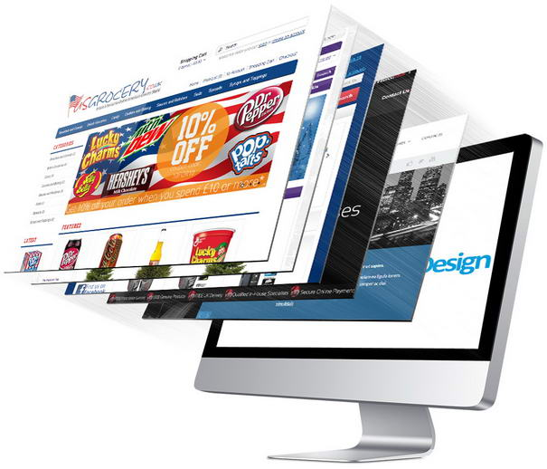
“It depends, it depends who’s made the website or what I have been told about the website or whether I know about it at all. But it sounds silly but sometimes you can just tell whether a website looks reliable or not depending on how professional that looks and who’s written it.”
(Digital Visitors and Residents, UKU6, Emerging, Female, Age 19, History)
#InsightSeries
Notes:
Image: http://www.themost10.com/common-mistakes-in-e-commerce-websites/

Slide 42
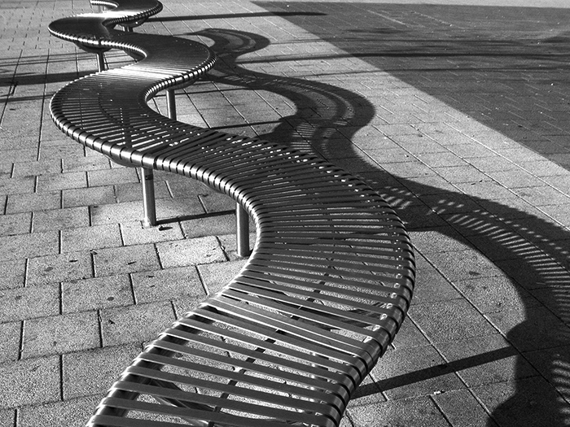
“Like, if two of them say the same thing then that must be right.”
(Digital Visitors and Residents, USS4, Emerging, Male, Age 17, High School Student)
Notes:
Image: http://www.flickr.com/photos/nikonvscanon/1750671901/
“Well I don’t like pick the first one I see. I try to evaluate two or three and see if there’s some common things between them. Like if two of them say the same thing then that must be right. Rather than like one [??] versus two consistent things” (Digital Visitors and Residents, USS4, Emerging, 00:10:01, Male, Age 17, Planned Major: Mechanical Engineering).

Slide 43
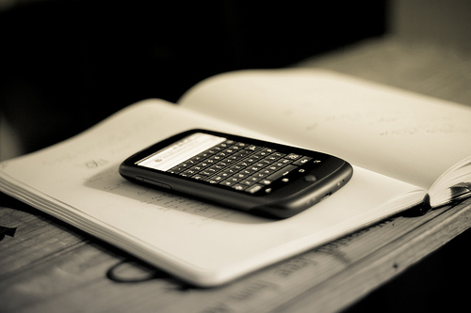
What can we change?
Improve OPACs
Community as content
Full text, online accessible
Seamless discovery to delivery
Access more important than discovery
Mobile access
Presence in social networks
Facebook
Twitter
Notes:
Image: http://www.flickr.com/photos/johanl/5131980180/
Three issues with catalog being in multiple places (Facebook, widgetes, apps, etc.)
1. Divorce between discovery and delivery
2. Reconfiguration of functions in app/mobile environments
3. Attention is shifting to the full collection and the discovery layers that make them available
Dempsey, L. (2012). Thirteen ways of looking at libraries, discovery, and the catalog: Scale, workflow, attention. EDUCAUSE Review Online. Retrieved from http://www.educause.edu/ero/article/thirteen-ways-looking-libraries-discovery-and-catalog-scale-workflow-attention
Overall, 63% of respondents say they would be likely to use library if there was a cell phone app that would allow them to access and use library services from their phone; some 35% say they would be “very likely” to use such an app, including 45% of smartphone owners and 41% of tablet owners. (Zickuhr, Rainie, & Purcell, 2013, p.62).
Zickuhr, K., Rainie, L., & Purcell, K. (2013). Library services in the digital age. Washington, DC: Pew Research Center’s Internet & American Life Project.
VRS meets users where they are
Text, e-mail, chat
Facebook
Face-to-face – still preference
Librarians’ expertise can deliver quality sources to users through VRS that they cannot find with a Google search
Link users to special collections
Facebook (“On Facebook, Librarian Brings 2 Students From the Early 1900s to Life,” January 6, 2012, Nick DeSantis, Chronicle of Higher Education. http://chronicle.com/blogs/wiredcampus/on-facebook-librarian-brings-two-students-from-the-early-1900s-to-life/34845
Joe McDonald, sophomore at University of Nevada, Reno in 1913, and girlfriend and future wife, Leola Lewis
University of Washington includes its special collections in the references in Wikipedia
De Santis, N. (2012, January 6). On Facebook, librarian brings 2 students from the early 1900s to life. Chronicle of Higher Education. Retrieved from http://chronicle.com/blogs/wiredcampus/on-facebook-librarian-brings-two-students-from-the-early-1900s-to-life/34845

Slide 44
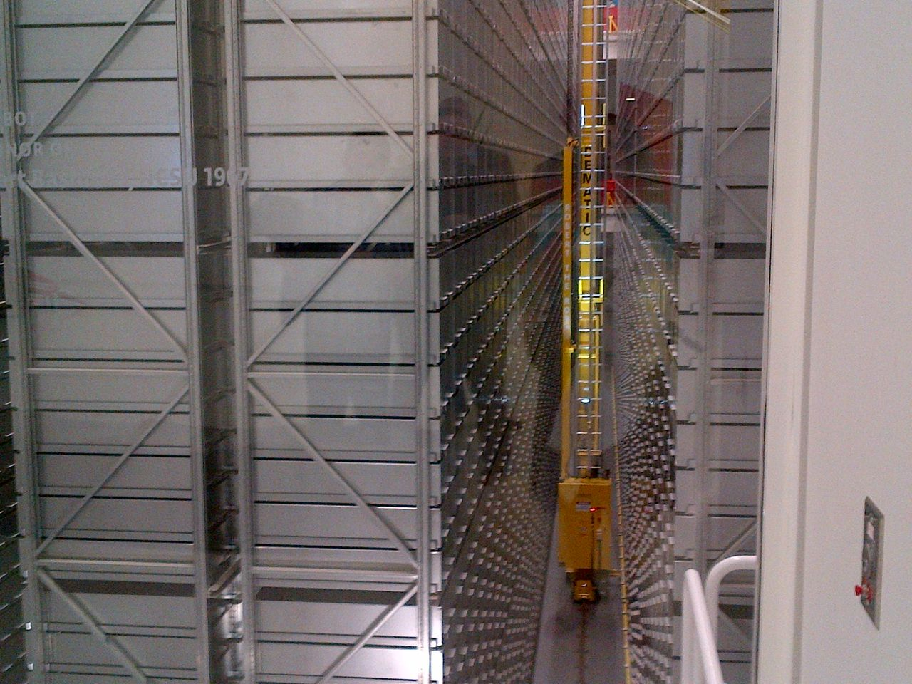
Outside-In and Inside-Out: Discovery and Discoverability
Outside-in
Acquired books, journals, databases from external systems
Provided discovery systems for local constituency
Inside-out
Now a producer of a range of resources
Digitized images, special collections, learning and research materials, research data, administrative records
Promote discoverability of institutional resources
North Carolina State University, Hunt Library bookBot
(Dempsey, 2012)
Notes:
Image: Connaway, L.S. (2013) NC State University, Hunt Library.
Dempsey, L. (2012). Thirteen ways of looking at libraries, discovery, and the catalog: Scale, workflow, attention. Educause Review Online. Retrieved from http://www.educause.edu/ero/article/thirteen-ways-looking-libraries-discovery-and-catalog-scale-workflow-attention
Throughout much of their recent existence, libraries have managed an "outside-in range" of resources: they have acquired books, journals, databases, and other materials from external sources and provided discovery systems for their local constituency over what they own or license.
The institution is also a producer of a range of information resources: digitized images or special collections, learning and research materials, research data, administrative records (website, prospectuses, etc.), and so on. And how effectively to disclose this material is of growing interest across libraries or across the institutions of which the library is a part. This presents an "inside-out" challenge, as here the library wants the material to be discovered by their own constituency but often also by a general web population.
In the outside-in case, the goal is to help researchers and students at the home institution to find resources of interest to them across the broad output of available research and learning materials. In the inside-out case, the goal is to help researchers and students at any institution to find resources of interest to them across the output of the institution itself. In other words, the goal in the inside-out case is to promote discoverability of institutional resources, or to have them discovered.
Wikipedian in Residence program
With the Wipedian in Residence Program, Wikipedia's GLAM (Galleries, Libraries, Archives and Museums) WikiProject, enables editors who work in libraries and other cultural institutions to add entries to Wikipedia for the institutions’ resources, services, etc. (http://en.wikipedia.org/wiki/Wikipedian_in_residence). This is a great way to not only promote resources and services that are not used because people do not know about their existence, but also to market libraries within individuals’ routine work practices and daily activities.
Wikipedian in residence. (2014, May 21). Wikipedia. Retrieved May 22, 2014, from http://en.wikipedia.org/wiki/Wikipedian_in_residence

Slide 45
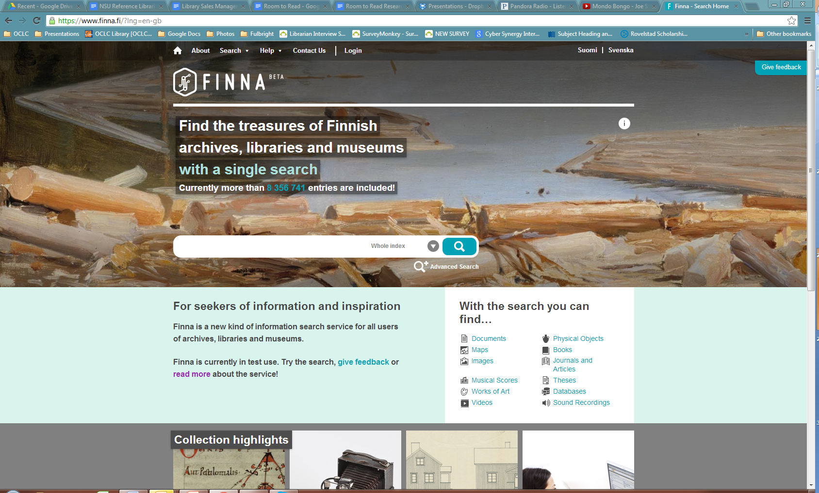
The Simple Search Bar
Notes:
Finna (The National Library of Finland): https://www.finna.fi/?lng=en-gb
Dempsey, L. (2012). Thirteen ways of looking at libraries, discovery, and the catalog: Scale, workflow, attention. EDUCAUSE Review Online. Retrieved from http://www.educause.edu/ero/article/thirteen-ways-looking-libraries-discovery-and-catalog-scale-workflow-attention
We can see this emerge as a pattern: a simple entry point opens into a richer navigation and suggestion space. In this way, the user is not asked to make choices up front by closely specifying a query. Rather they refine a result by limiting by facets (e.g., format, language, subject, date of publication, etc.), or they branch out in other directions by following suggestions. This is also emerging in our library discovery environments which are moving to think about how to better exploit the structure of the data to create navigable relations (faceted browsing, work clusters). We are making our data work harder to support interesting and useful experiences.
When we asked users how their ideal information seeking site would look, several responded with variations of having a simple entry point:
“I like the simplicity of Google, and the origin search box. I do think that my ideal situation would be more qualified people answering.” (Cyber Synergy, VS4, Female, Age 26-34)
“It’d probably look very similar to Google, like a mass search engine with so many topics.” (Cyber Synergy, VS17, Female, Age 19-25, Social Work).
Radford, M. L., Connaway, L. S., & Shah, C. (2011-2013). Cyber Synergy: Seeking sustainability through collaboration between virtual reference and social Q&A sites. Funded by the Institute of Museum and Library Services (IMLS), Rutgers University, and OCLC. http://www.oclc.org/research/activities/synergy/default.htm

Slide 46
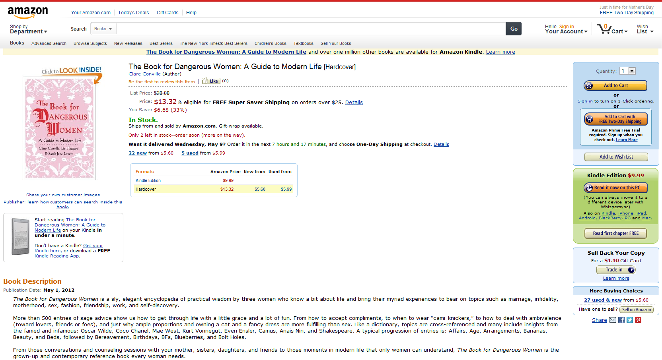
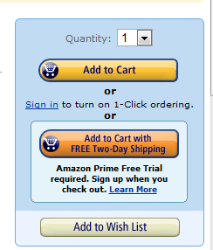
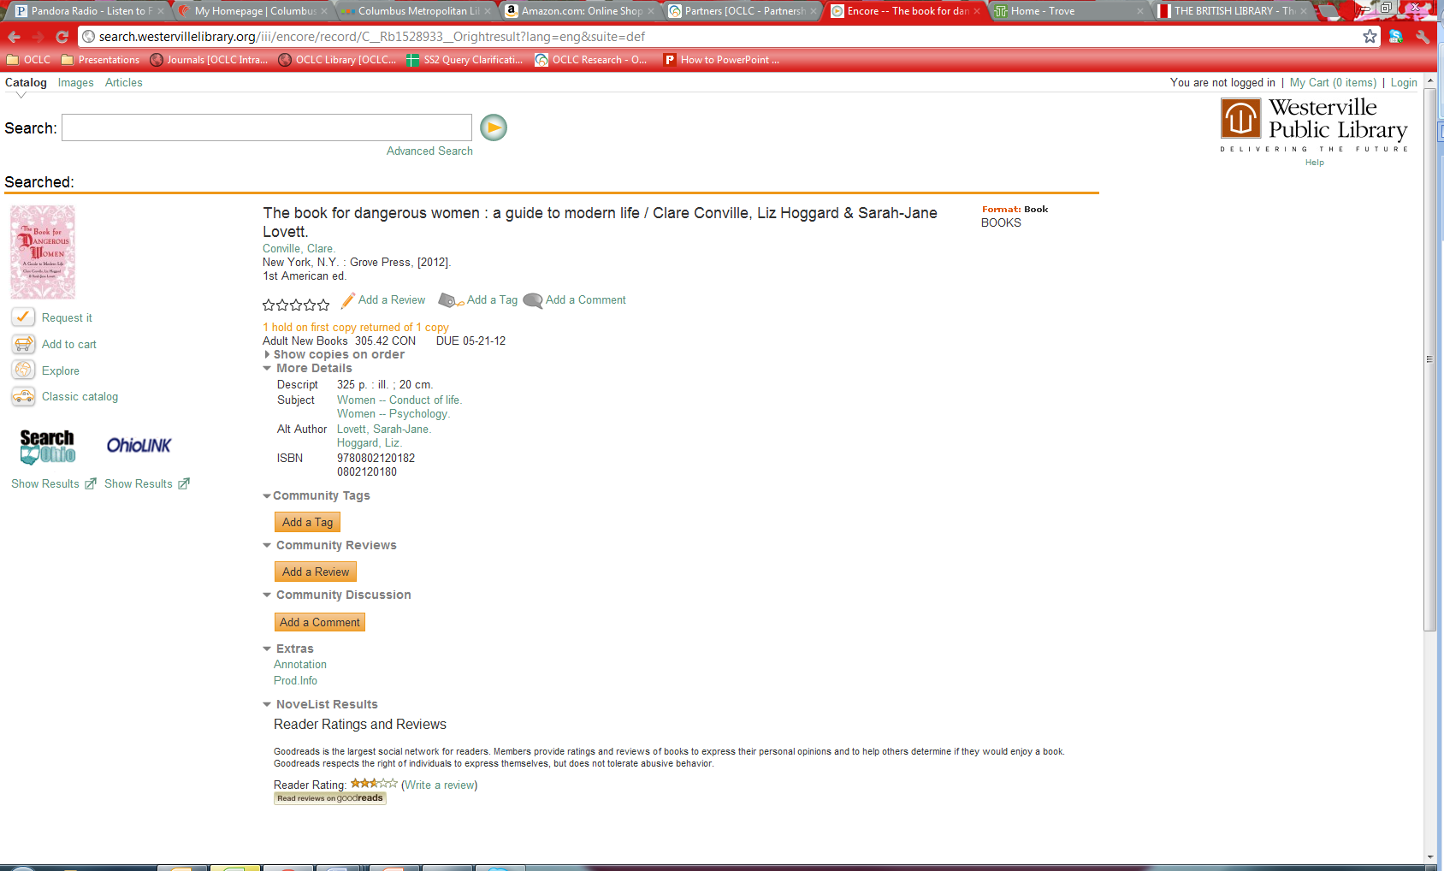
Familiar Formats
Amazon.com
Westerville Public Library
Notes:
Adding tags, reviews, and comments are also options
Interviewer: “Right, so you kind of trust the crowd at a certain level.”
Respondent: “At a certain level, yes. I’m also wary but I also trust the crowd, especially for like tying a tie video. There are 10 million views for this tying a tie video, it probably is pretty good.” (Digital Visitors and Residents, USG2, Embedding, 0:41:09, Male, Age 25, Biology)
Westerville Public Library: http://www.westervillelibrary.org/
Amazon: amazon.com

Slide 47
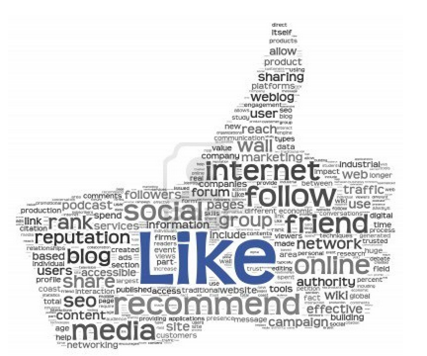
Community is Content
Social networks formed around social objects
Music, photos, videos, links
Reviewing
Tagging
Commenting
Rating
Refines interaction with resources
(Dempsey, 2012)
Notes:
Image: http://www.123rf.com/photo_13212915_like-concept-as-social-media-symbol-in-tag-cloud-of-thumb-up-shape-isolated-on-white-background.html
Dempsey, L. (2012). Thirteen ways of looking at libraries, discovery, and the catalog: Scale, workflow, attention. EDUCAUSE Review Online. Retrieved from http://www.educause.edu/ero/article/thirteen-ways-looking-libraries-discovery-and-catalog-scale-workflow-attention
The interaction of community and resources — in terms of discussion, recommendation, reviews, ratings and so on — is evident in some form in most of the major network services we use (Amazon, iTunes, Netflix, Flickr). Indeed, this is now so much a part of our experience that sites without this experience can seem bleached somehow, like black and white television in a color world.
What about the catalog in this context? Some catalogs have experimented with collecting tags and reviews but it does not seem that the catalog has the centrality, scale, or personal connection to crystallize social activity on its own. There is some activity at the aggregate level (e.g., Worldcat, BiblioCommons) and there is some syndication of social data from commercial social collecting/reading sites (e.g., LibraryThing). Similarly, catalogs have not generally mobilized usage data to rank, relate or recommend, and again this seems like something that might best be done at the aggregate level, and syndicated locally (as with the Bx service from Ex Libris, for example).
There are some places where catalog data gets used — reading lists and resource guides, for example — which seem to be especially appropriate for such attention. The choices involved in this additional layer of curation could be aggregated to provide useful intelligence. What items occur frequently on reading lists, for example? Would it be useful to provide an environment where students rate, review or comment on assigned readings? Is there enough commonality across institutions to make it useful to aggregate this data?
Our web experiences are now actively shaped by ranking, relating and recommending approaches based on social and usage data. For library services this is a major organizational challenge, as supra-institutional approaches may be required to generate appropriate scale (Dempsey, 2012).

Slide 48

Know Your Community
Mobile
Easy, Elegant, & Engaging
Content
Curation
Physical Presence
( Roskill, 2014)
Notes:
Image: http://www.winxnetcommunity.com/portals/2/images/community-people.jpg
o Mobile
o Easy, Elegant, & Engaging
§ Like Amazon, Google, and Apple
o Content
o Curation
o Physical Presence
§ Special events to promote services
o Become Whole Foods – Know and cater to your community – offer what they want in inviting environment (both physical and online)
Roskill, A. (2014 May). Get a Read on This: Libraries Bridging the Digital Divide: Andrew Roskill at TEDxCharleston. YouTube. Retrieved May 22, 2014, from http://www.youtube.com/watch?v=J198u5HK0pY

Slide 49
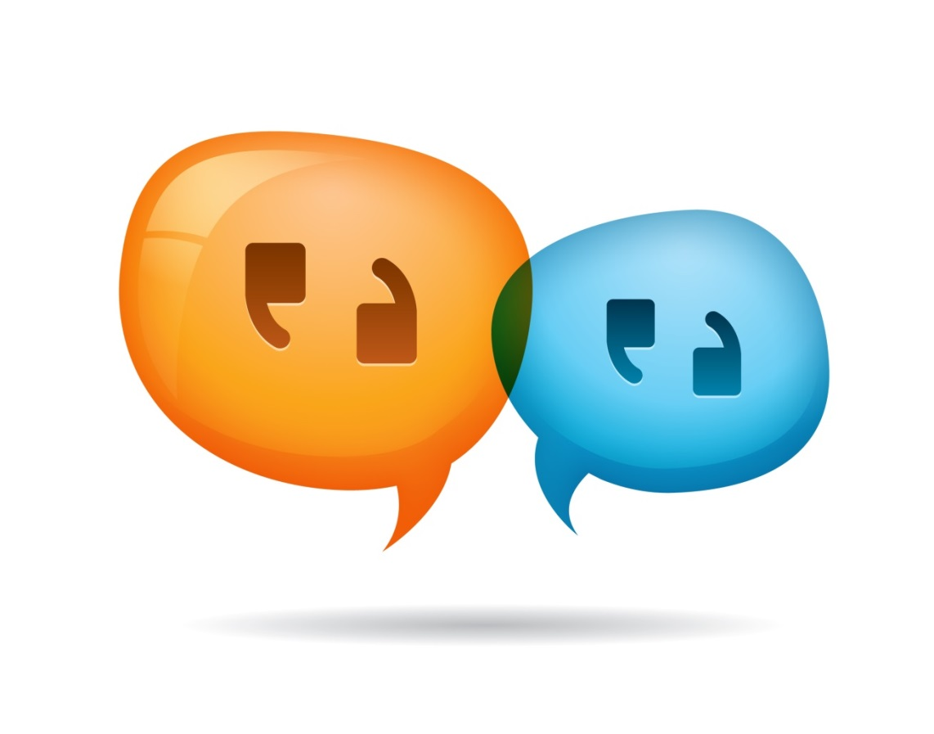
What can we do?
Advertise resources, brand, and value
Provide search help at time of need
Chat & IM
Mobile technology
Design user-centered systems
Familiar formats
Model library services on popular services
Build relationships
Notes:
Image: http://www.info.insitesoft.com/Portals/53472/images/Live-Chat-for-B2B-E-Commerce.jpg
Zickuhr, K., Rainie, L., & Purcell, K. (2013). Library services in the digital age. Washington, DC: Pew Research Center’s Internet & American Life Project.
Advertise resources, brand, value: One aspect mentioned very often, both in focus groups and in qualitative work from previous research, is that people wish they were more aware of the full range of services offered by their libraries. One focus group member loved her local library and rated it highly in all areas—except communication; “there’s so much good stuff going on but no one tells anybody.” Another said, “they do so many fabulous things, [but] they have horrible marketing” (Zickuhr, Rainie, & Purcell, p. 38)
However, focus group members say that having resources and events listed on their library’s website wasn’t enough—as several participants pointed out, they probably weren’t going to go to the website to look for events (or even to sign up for email newsletters) unless they already knew that the library had those events (Zickuhr, Rainie, & Purcell, p. 38)
Help at time of need: When asked, “What do you value in VRS?”, one participant said “Instantaneous help. Sometimes if you're looking for something and you can't find it, it takes forever. Since you have someone there that can respond to you live, you have the comfort that someone is there” (Cyber Synergy, VS47, Male, Age 26-34, Sales Account Manager)
Another was able to receive searching help in a database, “I would say it was my freshman year and I was doing an English paper for my expository writing class and I was looking for something in JSTOR and I used the "Ask a Librarian" to do more advanced searches in JSTOR as to what keywords to put in, and it really helped me. One, her quickness and response, and two, the simplicity of her instructions as to the key title words to put in really helped me and made it successful” (Cyber Synergy, VS17, Female, Age 19-25, Social Work)
St. Louis University library provided pop-up help when OPAC displayed 0 retrievals. Within the first hour, 20 individuals used the pop-up, chat help.
Users in Mind: One size fits none – design services for those who use them – Boutique libraries (Priestner, A., & Tilley, E. (2012). Personalising library services in higher education: The boutique approach. Farnham, Surrey, England: Ashgate).
Embedded librarians
Familiar formats
Something clean, simple, streamlined and user friendly, but also credible sources (Cyber Synergy, VS 23, Female, Age 26-34, Stay-at-Home-Mom).
“In college, and especially grad school, I’m not afraid to go to the library anymore because we have a very good [assist 0:45:56] and we have a very good website.” (Digital Visitors and Residents, USG2, 0:45:28, Male, Age 25, Biology)

Slide 50
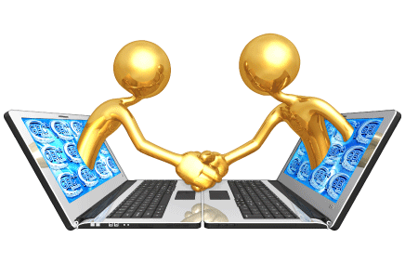
“By focusing on relationship building instead of service excellence, organizations can uncover new needs and be in position to make a stronger impact.”
(Matthews, 2012)
Notes:
Image: http://www.gbcrouting.com/GoldGuys/LaptopShakingHands-.gif
Mathews, B. (2012). Think like a startup: A white paper to inspire library entrepreneurialism [White paper]. Retrieved from http://chronicle.com/blognetwork/theubiquitouslibrarian/2012/04/04/think-like-a-startup-a-white-paper/
Users do not know they can ask librarians (Kolowich, Seeking synchronicity: Revelations and recommendations for virtual reference)
Example: Seeking Synchronicity
Librarians identified successful VR encounters as those where they were able to offer instruction and specialized knowledge, the user had a positive attitude
Users identified successful VR encounters as those providing convenience, an accurate answer, and they were comfortable with the service
Connaway, L. S., & Radford, M. L. (2011). Seeking synchronicity: Revelations and recommendations for virtual reference. Dublin, OH: OCLC Research. Retrieved from http://www.oclc.org/reports/synchronicity/full.pdf
Kolowich, S. (2011, August 22). Study: College students rarely use librarians’ expertise. USA Today. Retrieved from http://www.usatoday.com/news/education/story/2011-08-22/Study-College-students-rarely-use-librarians-expertise/50094086/1

Slide 51
Funding
Cyber Synergy: Seeking Sustainability through Collaboration between Virtual Reference and Social Q&A Sites project is funded by IMLS, OCLC, & Rutgers http://www.oclc.org/research/activities/synergy.html
The Digital Visitors and Residents project is funded by JISC, Oxford University, and OCLC, in partnership with the University of North Carolina, Charlotte
http://www.oclc.org/research/activities/vandr.html
Seeking Synchronicity: Evaluating Virtual Reference Services from User, Non-User and Librarian Perspectives is an IMLS-funded project
http://oclc.org/research/activities/synchronicity.html
Sense-making the Information Confluence: The Hows and the Whys of College and University User Satisficing of Information Needs, Institute for Museums and Library Services Research Grant, 2003-2005, Ohio State University & OCLC Research http://www.oclc.org/research/activities/imls.html

Slide 52
References
ACRL. (2010). Value of academic libraries: A comprehensive research review and report. Chicago: Association of College and Research Libraries.
ALA/ACRL. (1998). Task force on academic library outcomes assessment report. Retrieved from http://www.ala.org/acrl/publications/whitepapers/taskforceacademic
Bertot, J. C., Berube, K., Devereaux, P., Dhakal, K., Powers, S., & Ray, J. (2012). Assessing the usability of WorldCat Local: Findings and considerations. The Library Quarterly, 82(2), 207-221.
Centre for Information Behaviour and the Evaluation of Research. (2008). Information behaviour of the researcher of the future: A CIBER briefing paper. London: CIBER.
Connaway, L. S., & Dickey, T. J. (2010). Digital information seekers: Report of findings from selected OCLC, RIN, and JISC user behavior projects. Retrieved from http://www.jisc.ac.uk/media/documents/publications/reports/2010/digitalinformationseekerreport.pdf
Connaway, L. S., & Dickey, T. J. (2010). Towards a profile of the researcher of today: What can we learn from JISC projects? Common themes identified in an analysis of JISC Virtual Research Environment and Digital Repository Projects. Retrieved from http://ie-repository.jisc.ac.uk/418/2/VirtualScholar_themesFromProjects_revised.pdf
Connaway, L. S., Dickey, T. J., & Radford, M. L. (2011). “If it is too inconvenient I’m not going after it:” Convenience as a critical factor in information-seeking behaviors. Library & Information Science Research, 33(3), 179-190. (Selected for inclusion in the ALA Reference Research Review: 2011)
Connaway, L. S., Lanclos, D., & Hood, E. M. (2013). “I find Google a lot easier than going to the library website.” Imagine ways to innovate and inspire students to use the academic library. Proceedings of the Association of College & Research Libraries (ACRL) 2013 conference, April 10-13, 2013, Indianapolis, IN. Retrieved from http://www.ala.org/acrl/sites/ala.org.acrl/files/content/conferences/confsandpreconfs/2013/papers/Connaway_Google.pdf
Connaway, L. S., Lanclos, D., White, D., Le Cornu, A., & Hood, E. M. (2013). User-centered decision making: A new model for developing academic library services and systems. IFLA Journal, 39(1), 30-36.

Slide 53
References
Connaway, L. S. & Radford, M. L. (2011). Seeking Synchronicity: Revelations and recommendations for virtual reference. Dublin, OH: OCLC Research. Retrieved from http://www.oclc.org/reports/synchronicity/full.pdf
Connaway, L. S., White, D., Lanclos, D., & Le Cornu, A. (2013). Visitors and Residents: What motivates engagement with the digital information environment? Information Research, 18(1). Retrieved from http://informationr.net/ir/18-1/infres181.html
Consortium of University Research Libraries and Research Information Network. (2007). Researchers’ use of academic libraries and their services: A report. London: Research Information Network and Consortium of University Research Libraries (CURL).
Centre for Information Behaviour and the Evaluation of Research. (2008). Information behaviour of the researcher of the future: A CIBER briefing paper. London: CIBER.
Cunningham, S. J., & Connaway, L. S. (1996). Information searching preferences and practices of computer science researchers. In J. Grundy (Ed.), Proceedings: Sixth Australian conference on computer-human interaction, November 24-27, 1996, Hamilton, New Zealand (pp. 294-299). Los Alamitos, CA: IEEE Computer Society Press.
Dempsey, L. (2008). Always on: Libraries in a world of permanent connectivity. First Monday, 14(1). Retrieved from http://www.firstmonday.org/htbin/cgiwrap/bin/ojs/index.php/fm/article/view/2291/207
Dempsey, L. (2012). Thirteen ways of looking at libraries, discovery, and the catalog: Scale, workflow, attention. Educause Review Online. Retrieved from http://www.educause.edu/ero/article/thirteen-ways-looking-libraries-discovery-and-catalog-scale-workflow-attention
Dempsey, L. (2013, January 23). The inside out library: Scale, learning, engagement. Presented at Hacettepe University, Beytepe, Ankara (Turkey).
De Rosa, C. (2005). Perceptions of libraries and information resources: A report to the OCLC membership. Dublin, OH: OCLC Online Computer Library Center.

Slide 54
References
De Rosa, C. (2006). College students' perceptions of libraries and information resources: A report to the OCLC membership. Dublin, OH: OCLC Online Computer Library Center. Retrieved from: http://www.oclc.org/us/en/reports/perceptionscollege.htm (p.3-3-4).
De Rosa, C. (2010). Perceptions of libraries: A report to the OCLC membership. Dublin, OH: OCLC Online Computer Library Center.
Dervin, B., Connaway, L. S., & Prabha, C. (2003-2006). Sense-making the information confluence: The whys and hows of college and university user satisficing of information needs. Funded by the Institute of Museum and Library Services (IMLS). Retrieved from http://www.oclc.org/research/activities/imls.html
De Santis, N. (2012, January 6). On Facebook, librarian brings 2 students from the early 1900s to life. Chronicle of Higher Education. Retrieved from http://chronicle.com/blogs/wiredcampus/on-facebook-librarian-brings-two-students-from-the-early-1900s-to-life/34845
Kaufman, P., & Watstein, S. B. (2008). Library value (Return on Investment, ROI) and the challenge of placing a value on public services. Reference Services Review, 36(3), 226-231.
Kolowich, S. (2011, August 22). Study: College students rarely use librarians’ expertise. USA Today. Retrieved from http://www.usatoday.com/news/education/story/2011-08-22/Study-College-students-rarely-use-librarians-expertise/50094086/1
Mathews, B. (2012). Think like a startup: A white paper to inspire library entrepreneurialism [White paper]. Retrieved from http://chronicle.com/blognetwork/theubiquitouslibrarian/2012/04/04/think-like-a-startup-a-white-paper/
Priestner, A., & Tilley, E. (2012). Personalising library services in higher education: The boutique approach. Farnham: Ashgate.
Radford, M. L., & Connaway, L. S. (2005-2007). Seeking Synchronicity: Evaluating virtual reference services from user, non-user, and librarian perspectives. Funded by the Institute for Museums and Library Services (IMLS). Retrieved from http://www.oclc.org/research/activities/synchronicity/default.htm

Slide 55
References
Radford, M. L., Connaway, L. S., & Shah, C. (2011-2013). Cyber Synergy: Seeking Sustainability through Collaboration between Virtual Reference and Social Q&A Sites. Funded by the Institute of Museum and Library Services (IMLS), Rutgers University, and OCLC. Retrieved from http://www.oclc.org/research/activities/synergy/default.htm
Rainie, L. (2014). Libraries in communities. Washington, DC: Pew Research Center’s Internet & American Life Project.
Research Information Network. (2006). Researchers and discovery services: Behaviour, perceptions and needs. London: Research Information Network.
Research Information Network. (2009). E-journals: Their use, value and impact. London: Research Information Network.
Roskill, A. (2014 May). Get a Read on This: Libraries Bridging the Digital Divide: Andrew Roskill at TEDxCharleston. YouTube. Retrieved May 22, 2014, from http://www.youtube.com/watch?v=J198u5HK0pY
Wasserman, S. (2012, June 18). The Amazon effect. The Nation. Retrieved from http://www.thenation.com/article/168125/amazon-effect
White, D., & Connaway, L. S. (2011-2014). Visitors and Residents: What motivates engagement with the digital information environment. Funded by JISC, OCLC, and Oxford University. Retrieved from http://www.oclc.org/research/activities/vandr/
White, D., Connaway, L. S., Lanclos, D., Hood, E. M., & Vass, C. (2014). Evaluating digital services: A Visitors and Residents approach. Retrieved from http://www.jiscinfonet.ac.uk/infokits/evaluating-services/
White, D. S., & Le Cornu, A. (2011). Visitors and Residents: A new typology for online engagement. First Monday, 16(9). Retrieved from http://firstmonday.org/htbin/cgiwrap/bin/ojs/index.php/fm/article/viewArticle/3171/3049
Wikipedian in residence. (2014, May 21). Wikipedia. Retrieved May 22, 2014, from http://en.wikipedia.org/wiki/Wikipedian_in_residence
Wong, W., Stelmaszewska, H., Bhimani, N., Barn, S., & Barn, B. (2009). User behaviour in resource discovery: Final report. Retrieved from http://www.jisc.ac.uk/whatwedo/programmes/inf11/userbehaviourbusandecon.aspx
Zickuhr, K., Rainie, L., & Purcell, K. (2013). Library services in the digital age. Washington, DC: Pew Research Center’s Internet & American Life Project.

Slide 56
¡Gracias
Lynn Silipigni Connaway, Ph.D.
connawal@oclc.org
@LynnConnaway

