Slide 1


“Is it a journal title, or what?” Mitigating Microaggressions in Virtual Reference
The 23rd Annual Reference Research Forum
ALA Annual Conference, Chicago, IL, June 22-27, 2017
Marie L. Radford, Ph.D. | Rutgers | @MarieLRadford
Vanessa Kitzie, Ph.D. | University of South Carolina | @vkitzie
Lynn Silipigni Connaway, Ph.D. | OCLC | @LynnConnaway
Diana Floegel, Ph.D. Student | Rutgers | @floeginator
Notes:
Slide 1: Image: http://bit.ly/2qcD4ij (https://www.pexels.com/photo/above-background-blank-business-317420/) by Lukas / Creative Commons Zero (CC0)
Radford, M. L., Kitzie, V., Connaway, L. S., & Floegel, D. (2017). “Is it a journal title, or what?” Mitigating microaggressions in virtual reference. Accepted for presentation at ALA/RUSA’s New Discoveries in Reference: The 23rd Annual Reference Research Forum, ALA Annual Conference, Chicago, IL, June 22-27, 2017.

Slide 2
Genesis of Project
Based on previous research
Seeking Synchronicity: Evaluating Virtual Reference Services from User, Non-User, and Librarian Perspectives (Radford & Connaway, 2005-2008) http://www.oclc.org/research/activities/synchronicity
Cyber Synergy: Seeking Sustainability through Collaboration between Virtual Reference and Social Q&A Sites (Radford, Connaway, & Shah, 2011-2014) http://www.oclc.org/research/activities/synergy/default.htm
Funded by IMLS, Rutgers University, OCLC
Notes:
ALL SLIDES AVAILABLE IN RUSA
--Studied VR transcripts and conducted interviews/FG
--FOUND relational facilitators and barriers for success in VR
--We argue here that microaggressions are a type of barrier falling under the theoretical framework of Face Threats (Goffman, 1967)

Slide 3

Defining & Identifying Microaggressions
Notes:
Image: http://bit.ly/2r9yPsQ (https://www.flickr.com/photos/squirmy21/8316599080/) by SquirmyBeluga / CC BY 2.0
Nod to Vanessa Kitzie and Diana Floegel’s work and research intents on microaggressions and service to marginalized populations, which led to this research endeavor.
Microaggressions:
Literature defines microaggressions as intentional or non-intentional verbal, behavioral and environmental indignities towards marginalized groups (Sue et al., 2007; Belluomini, 2014; Kerr, 2014).
Damaging effects have been observed, but microaggressions are subtle and therefore difficult to identify and address.
Studies of microaggressive behavior in libraries are limited, and studies of micoraggressions’ presence in virtual library reference service are nonexistent as far as we found. However, research on online environments suggests that the anonymity of a virtual presence can heighten micoraggressive behavior.
This study seeks to develop an approach to detect microaggressions perpetuated by librarians towards patrons within virtual reference services (VRS), and to identify a typology and guidelines to mitigate them. In this time of heightened online conflict, VRS librarians are compelled to recognize microaggressions and seek to minimize/eliminate them to provide service excellence to marginalized groups.

Slide 4

Theoretical Framework
Types (Sue et al., 2007):
Microassaults
Microinsults
Microinvalidations
Communications (Kerr, 2014):
Verbal
Nonverbal
Environmental
Notes:
Image: http://bit.ly/2sKKmvY (https://www.flickr.com/photos/23680544@N07/2455142171/) by Sarah Ross / CC BY-NC 2.0
Three types of microaggressions identified by Sue et al. (2007)
-Microassaults: explicitly discriminatory and easily identifiable as prejudiced
---ex: racial epithets
-Microinsults: rude or insensitive behavior that demeans a person’s identity
----ex: turn away from LGBTQ+ displays of affection
--Microinvalidations: communications or actions that exclude or nullify the experiences, thoughts, and feelings of minority individuals
-----ex: statements such as “Rosa Parks ended racism”
Other literature (e.g., Kerr, 2014) discussed types of microaggressive communications:
-Verbal: said aloud
-----ex: Racial epithets
-Nonverbal: physical and/or affective
------ex: Dismissive body language like an eye roll or a shrug
-Environmental: no related to surroundings rather than behavior
------ex: Displaying offensive symbols, like a swastika

Slide 5
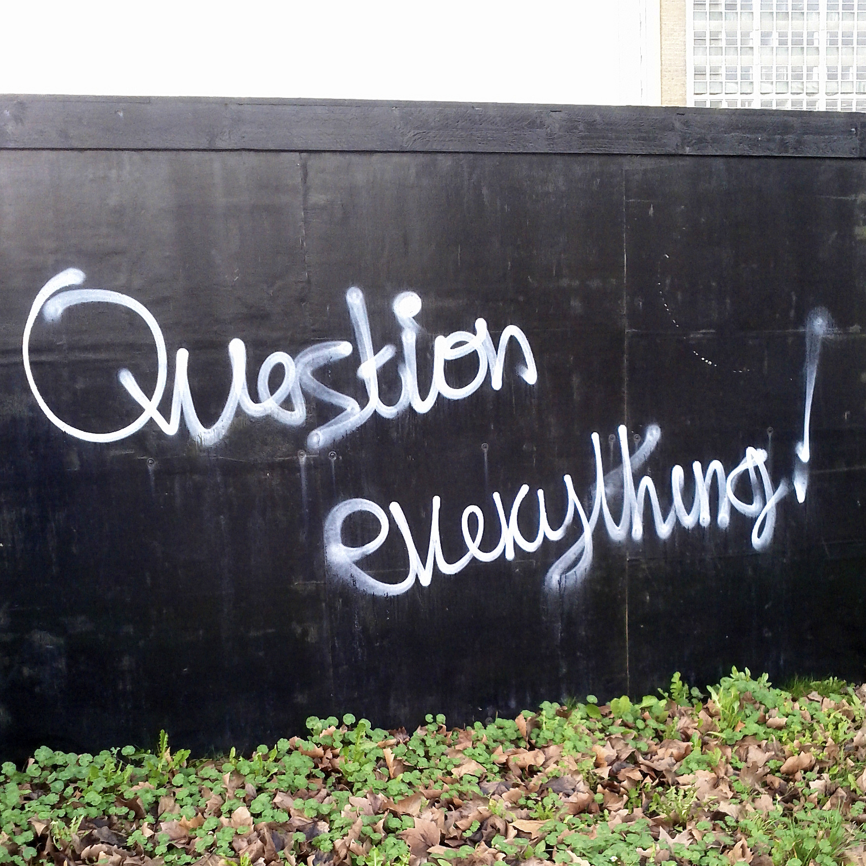
Research Questions
RQ1. Do VR librarians commit microaggressions?
RQ2. What types of microaggressions do VR librarians commit?
RQ3. How can VR librarians avoid microaggressions?
Notes:
Image: http://bit.ly/2rdhBWI (https://www.flickr.com/photos/henrybloomfield/12680815144/) by henry… / CC BY-NC-ND 2.0
--Do VRS librarians exhibit microaggressive behavior?
--What types of microaggressions are present in VR and how do they manifest?
--How can librarians avoid microaggressions to best serve their patrons? What considerations must they put into effect?

Slide 6

Methods
Longitudinal data
Large pool of randomly selected QuestionPoint transcripts (2006, 2010, 2016)
Emic/etic coding
Etic: Types, Communications
Emic: Emerged in analysis
3 coders
99% ICR
Notes:
Image: http://bit.ly/2r9oEVm (https://www.flickr.com/photos/59489479@N08/9519713874/) by Siaron James / CC BY 2.0
Three sets of transcripts were coded for microaggressions using Nvivo software and pre-established typologies and patterns discerned by our research team. 2006 and 2010 transcripts had already been coded for relational barriers from a previous study; 2016 transcripts were first coded as problematic, and that subset was then examined for microaggressions.
Of an original 1,710 transcripts, 148 had relational barriers and were coded for microaggressions. 3 coders achieved an ICR of 99% when determining which transcripts held microaggressions. Due to microaggressions’ contextual nature, we used the whole transcript as a unit of observation.
We engage in emic/etic coding (Miles & Huberman 1994). This type of coding uses an existing theoretical framework (microaggression types and microaggressive communications) from which to generate codes (etic), or labels to describe sections of transcript text, as well as allows for the inductive generation of codes to emerge from the data.
Must note: mostly white women worked on this project, and thus brought their own privileged perspective to the coding process, particularly in terms of race. This reflects a wider concept in librarianship, as most professionals are white and from middle to upper-middle socioeconomic backgrounds. This makes a study and acknowledgement of microaggressions all the more urgent.

Slide 7

Major Findings
97% of transcripts free of microaggressions!!!
3% of transcripts display microaggressive behaviors
Subtle & difficult to identify
Coding dependent on context of full transcripts
Notes:
Image: http://bit.ly/2mKI9Ow (https://www.flickr.com/photos/plymouth-district-library/5244742145/) by Plymouth District Library / CC BY-NC 2.0
A major finding is that you all are awesome! You’re doing great work. Consistent over time from 2006-2016, 97% of transcripts were free of microaggressions.
However, microaggressive behavior did exist in 3% of transcripts. These were difficult to identify due to microaggressions’ subtle nature. Additionally, microaggressions tend to be very personal, and this also makes them difficult to pinpoint. In order to determine whether a microaggressive actions were present in a transcript, the research team had to consider the context of the entire exchange. We call these “microaggressive behaviors” because it is possible that a specific user did not actually have their identity insulted or invalidated by the librarian’s actions; this is particularly possible given the relative anonymity of a VR environment. HOWEVER, it is still paramount for librarians to avoid micoraggressive statements and behaviors to be more inclusive in their practices and safeguard against subtle discrimination.

Slide 8
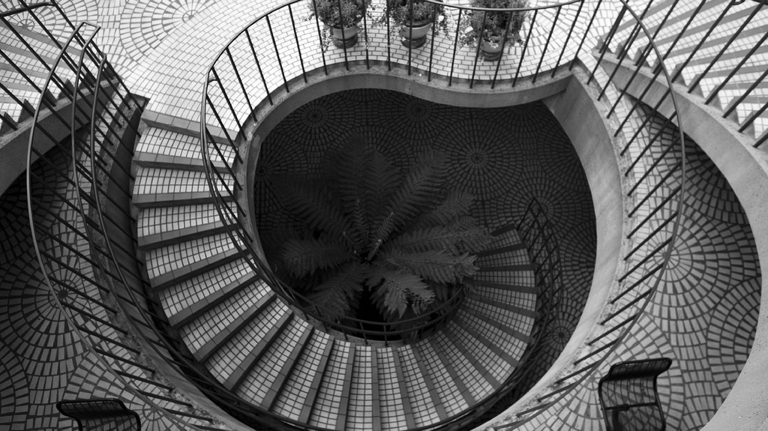
Findings: Etic Codes
Microaggressive behavior coded in:
3% of transcripts
56% of relational barrier transcripts
Total = 55 of 1710 transcripts
Code | % of Transcripts (N=55)
Verbal | 95%
Microinvalidation | 85%
Nonverbal | 18%
Notes:
Image: http://bit.ly/2s4N2ql (https://www.flickr.com/photos/thomashawk/93020443/) by Thomas Hawk / CC BY-NC 2.0
Etic = top-down from theoretical framework
Microaggressive behavior was found in 3% of all transcripts and 56% of transcripts coded for relational barriers. A total of 55 transcripts were coded as microaggressive. Transcripts were often assigned multiple codes (e.g., verbal and microinvalidation). Thus, our percentages do not add up to 100%.
The largest percentage of transcripts coded contained verbal microaggressions. 18% were nonverbal, and few were environmental. Nonverbal microaggressiions included behaviors such as hanging up abruptly, while environmental microaggressions typically occurred when librarians created a hostile environment by, for example, ignoring a user’s question or confusion over technical instructions.
85% of instances of microaggressive behavior displayed microinvalidations. A smaller percentage were microinsults, while none contained microassaults. This is excellent, as no librarians demonstrated overtly discriminatory behavior.

Slide 9
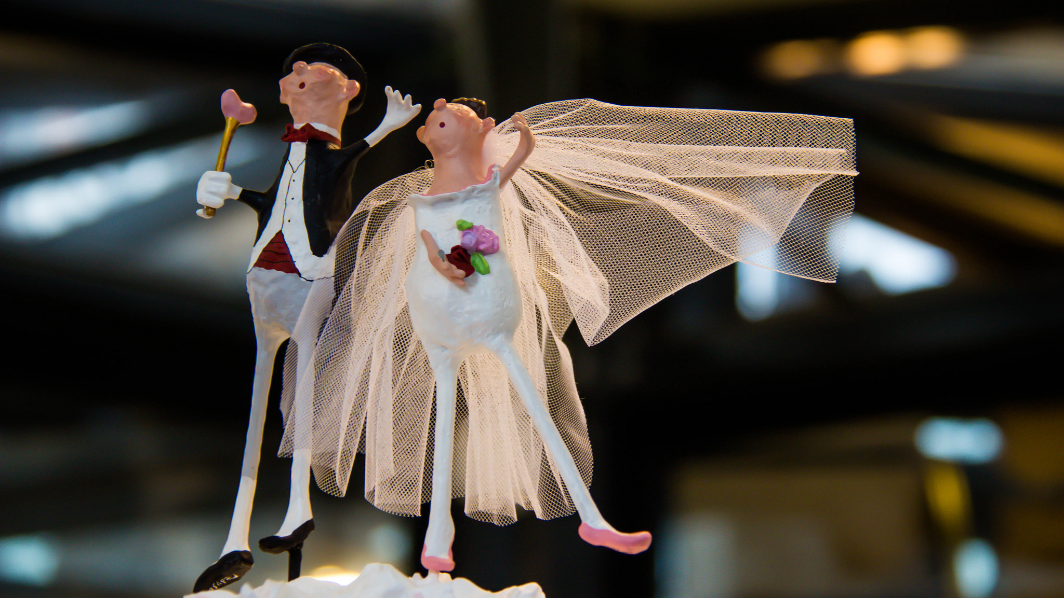
Example:
Verbal & Microinvalidation
“Also keep in mind that California is a community property state so most property and debts acquired during marriage needs to be divided up between you and your husband” (2016).
Notes:
Image: http://bit.ly/2r9tgLh (https://www.flickr.com/photos/infomastern/16574653686/) by Susanne Nilsson / CC BY-SA 2.0
Example: “Also keep in mind that California is a community property state so most property and debts acquired during marriage needs to be divided up between you and your husband” (2016_152, 2016)
This occurred in context of a conversation in which a user—whose gender was not identified—asked about legal resources for divorce in California in 2015. At this time in that state, marriage equality was legal. The librarian made a number of heteronormative assumptions. A) They believed they were talking to a woman who B) had to be married to a man. Thus, a microinvalidation occurred in terms of gender (a woman must need help navigating a divorce) and sexuality (the divorcing couple must be heterosexual). In addition, the librarian committed a socioeconomic microaggression by assuming the couple had a certain level of economic means that included property ownership and debts. However, couples may not have the economic means to own property, and thus a microinvalidation against individuals with lower incomes was perpetuated. Now, you may all be wondering… “What if the person asking the question is female, and is marreid to a man?” The point is that the librarian has no way of knowing that information, but proceeded with misogynistic and heteronormative assumptions regardless. Such microaggressive behavior must be avoided to provide quality inclusive service.

Slide 10
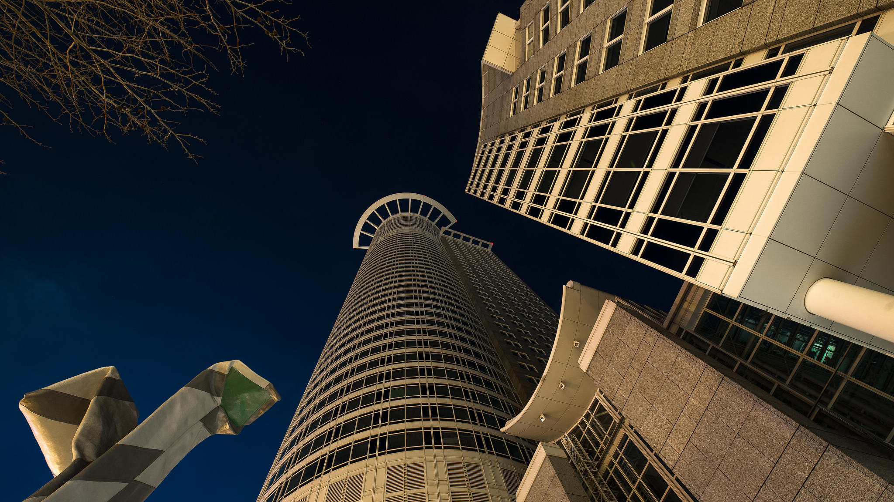
Findings: Emic Codes
Emic Code | % of Transcripts (N=55)
Assume user’s search Independence | 55%
Call user out | 33%
Assume user’s technical literacy | 27%
Assume user’s information need | 25%
Most often manifested as verbal, nonverbal, environmental, & microinvalidations, consistent with etic codes.
Notes:
Image: http://bit.ly/2rUelBL (https://www.flickr.com/photos/aldusrietveld/16589315129/) by Aldus Rietveld / CC BY-ND 2.0
Emic = bottom-up emerged during coding
We identified a number of distinct types of microaggressions found in VRS transcripts. The four most prominent are assuming a user’s ability to search independently (55% of transcripts), calling a user out for making a mistake or misrepresenting their information need (33% of transcripts), making assumptions about a user’s technical literacy (27%), and making assumptions about a user’s information need (25%).
Typically these behaviors manifested as verbal, nonverbal, and environmental microinvalidations, consistent with our other findings.
We found smaller percentages of other microaggressive behaviors. These include acts of ageism towards older or younger users, marginalizing a user’s information need, not listening to a user, making assumptions about a user’s socioeconomic independence, and making microaggressive statements that are not directed at the user, but still discriminate against certain groups and identities.

Slide 11

Example:
Call Out User
L: Can you please be more specific about what you are looking for? Is it a journal title, or what?
U: I would like to access the American Journal of Evaluations. Their journals are published by Sage (available online withan Athens account[)]
L: Okay.
L: that is much clearer (2010)
Notes:
Image: http://bit.ly/2r9yN4p (https://www.flickr.com/photos/sunsetnoir/29643575992/) by Lei Han / CC BY-NC-ND 2.0
Call user out:
Example: Here, the librarian initially sounds impatient. In the context of the exchange, the first comment occured after the user asked for a resource, and the questions asked make it seem as if the user did something wrong and/or behaved insufficiently. The librarian seems to make an assumption that the user does not know and/or care enough to find their needed material. When the user responds with more detail, the librarian’s curt “that is much clearer” maintains a scolding tone and continues the transcript’s overarching condescention. A verbal microinvalidation occurs in terms of condescention, while an environmental microinvalidation occurs in terms of creating a setting in which the user is implied to be insuffient and ill-prepared.

Slide 12
Example:
Assume User’s Search Independence
“Hi [User First Name], I have just Googled it and there is lots of information there. You shouldn’t have any trouble finding it. Otherwise there are lots of books in any library which explain the conditions … Your doctor can explain it also” (2010).
Notes:
Image: http://bit.ly/2r9yN4p (https://www.flickr.com/photos/sunsetnoir/29643575992/) by Lei Han / CC BY-NC-ND 2.0
Assuming searching independence
Example: “Hi [User First Name], i have just Googled it and there is lots of information there. You shouldn’t have any trouble finding it. Otherwise there are lots of books in any library which explain the conditions … Your doctor can explain it also” (QP2-008), assumes that the ability to use an IM client implies the ability to use a search engine, which is not always true. A double-whammy, given that the user may not have the resources to ask a medical professional. Thus, a two-fold verbal microinvalidation occurs in which the user’s potentially low technical skills and unknown access to resources are erased. Even if this specific users does not have a problem with statements such as this, they should still be avoided to keep invalidating behavior out of VR service.

Slide 13

Our Guidelines for Mitigating Microaggressions
Respond with open questions when unsure
Avoid wording implying identity assumptions
Suggest specific alternative resource (not just “look elsewhere”)
Allow time for user reply
Listen to feedback on info need & heed calls for help
Provide needed info w/o implying that doing so is a hassle
Send generalized resources for broad questions
Guidelines from Literature
Present resources from various perspectives (Sue, 2010; Ettarh, 2014)
Avoid assumptions of identity or ability (Sue, 2010; Ettarh, 2014)
Be aware that NV invalidations transfer to VR (Belluomini, 2014)
Notes:
Image: http://bit.ly/2s4qq9w (https://www.flickr.com/photos/fredcintra/2671822805/) by Frederico Cintra / CC BY 2.0
Based on the microaggressions we found, we deduced the following implications for library service:
--When unsure of a user’s intent or unable to locate what they are looking for, respond with an open question rather than an assumptive statement (e.g., ask if they would be interested in purchasing a CD, do not merely send a link to Amazon, QP2-003)
--Be careful with wording that can make assumptions about a user’s identity and/or border on condescension (e.g., do not tell a patron information may be “too simple” or “too complex,” QP2-016; gender and sexuality assumptions)
--Direct a user on how to use another resource as opposed to telling them they need to look elsewhere to solve their problem. That way, they’re less likely to feel bothersome and/or shafted.
--Allow time for a user to reply, particularly when conducting a reference interview and when reviewing potentially unfamiliar technical processes
--Listen to the user’s actual information need and calls for help (particularly in terms of technology)
--Provide needed information without implying (or outright stating) that doing so is a hassle (particularly in terms of technology)
--Send more generalized resources (e.g., if a user who has not identified their age asks for information about sexual education, do not automatically send a teen health website, as said user could be any age and of any orientation, TS059)
--Strive to represent various perspectives when providing resources (e.g., authors of all genders) (Sue, 2010; Ettarh, 2014)
--Avoid assumptions based on identity and ability, whether directed at the user or involved in an answer (Sue, 2010; Ettarh, 2014)
--Be aware that invalidating nonverbal behavior can transfer to digital encounters (Belluomini, 2014)

Slide 14
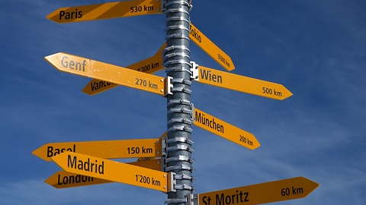
Future Directions
Notes:
Image: http://bit.ly/2qcvdkH (http://maxpixel.freegreatpicture.com/Direction-Arrow-Pizol-Shield-Signposts-Directions-999685) by Max Pixel / CC0 Public Domain
--Continue to develop a set of instructional guidelines to implement in libraries
--Extend the study of virtual microaggressions to cover users’ behavior towards librarians as well as librarians’ behavior towards users
--Expand the study beyond VRS to face-to-face encounters through interviews and focus groups

Slide 15
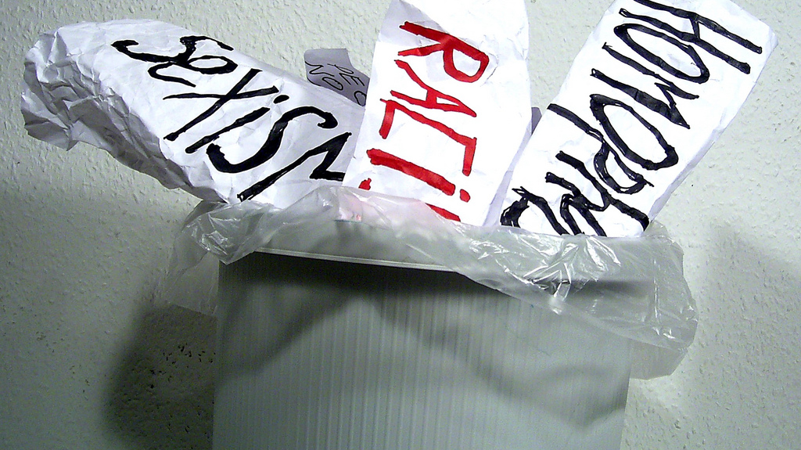
Slides available at:
Conclusion
Notes:
Image: http://bit.ly/2qMXQZF By Kurt Löwenstein Educational Center International Team from Germany (ws'08 (21)) [CC BY 2.0 (http://creativecommons.org/licenses/by/2.0)], via Wikimedia Commons
Given the relatively homogenous nature of librarianship, it is imperative that professionals acknowledge the conscious and unconscious biases, preconceived notions, and invalidating behaviors that potentially further marginalize library patrons with various minority identities. In doing so, librarians will be better equipped to service a divers array of patrons in an equitable and effective way. Additionally, patrons themselves may feel more welcome in library spaces and thus more inclined to utilize library services.
In fact, perhaps we should reconsider the term “user.” Such a term may actually lead to microaggressions, as it places all library patrons on the same neutral playing field rife with assumptions that they interact with information in a standardized way. Another term could act as a similar identifier without implying that all who frequent libraries “use” materials in a similar fashion.

Slide 16
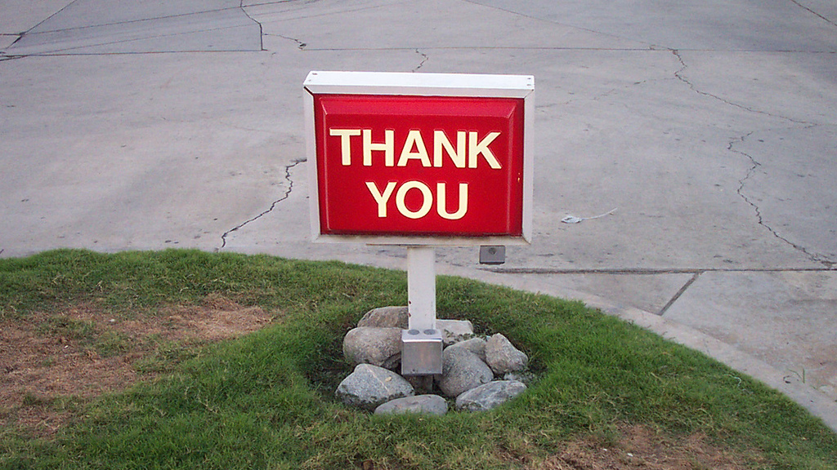
Acknowledgements
Institute of Museum & Library Services
QuestionPoint
Erin Hood, OCLC
Stephanie Mikitish, Ph.D. Rutgers
Notes:
Image: http://bit.ly/2rIKIoC (https://www.flickr.com/photos/orinrobertjohn/239595034/) by Orin Zebest / CC BY 2.0

Slide 17
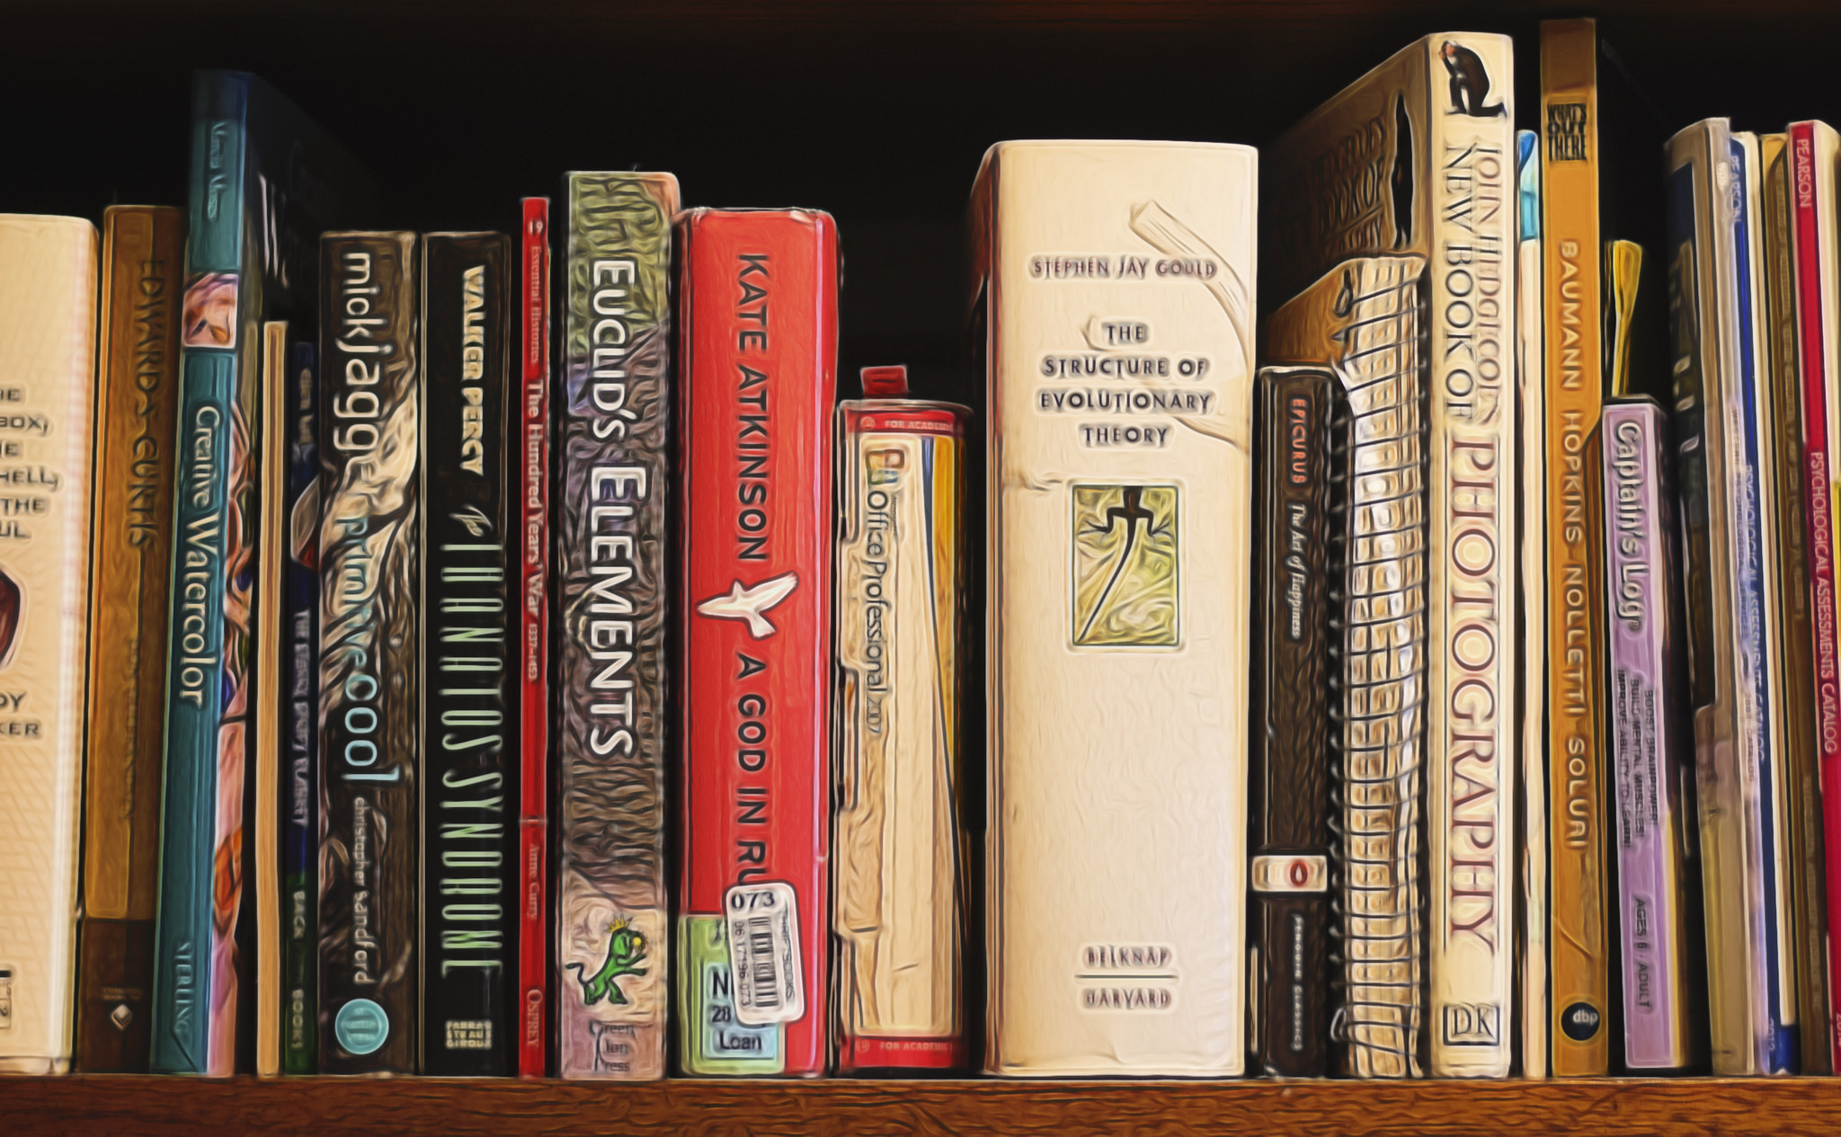
References
References
Belluomini, E. (2014). Microaggressions and the Internet. New Social Worker, 21(2), 30-31.
Ettarh, F. (2014). Making a new table: Intersectional librarianship. In the Library With the Lead Pipe: An Open Access, Open Peer Reviewed Journal. Retrieved from http://www.inthelibrarywiththeleadpipe.org/2014/making-a-new-table-intersectional-librarianship-3/
Goffman, E. (1967). Interaction ritual: Essays in face-to-face behavior. Chicago, IL: Aldine Publishing Company
Kerr, A.G. (2014, June 19). 6 things to learn about microaggressions. The Huffington Post. Retrieved from http://www.huffingtonpost.com/anna-giraldo-kerr/six-things-to-learn-about_b_5512057
Notes:
Image: http://bit.ly/2s4ROEf (https://www.flickr.com/photos/clarkzip/33650374554/) by Peter Clark / CC BY-NC 2.0

Slide 18
References
References
Lester, J., Yamanaka, A., & Struthers, B. (2016). Gender microaggressions and learning environments: The role of physical space in teaching pedagogy and communication. Community College Journal of Research and Practice, 40(11), 909-926.
Miles, M. B., & Huberman, A. M. (1994). Quantitative data analysis: A sourcebook. Beverley Hills: Sage Publications.
Nadal, K.L. (2013). That’s so gay!: Microaggressions and the lesbian, gay, bisexual, and transgender community. Washington, D.C.: American Psychological Association.
Radford, M.L., Radford, G.P., Connaway, L.S., & DeAngelis, J.A. (2011). On virtual face-work: An ethnography of communication approach to a live chat reference interaction. Library Quartlery, 81(4), 431-453.
Notes:
Image: http://bit.ly/2s4ROEf (https://www.flickr.com/photos/clarkzip/33650374554/) by Peter Clark / CC BY-NC 2.0

Slide 19
References
References
Radford, M. L., & Connaway, L. S. (2005-2008). Seeking Synchronicity: Evaluating Virtual Reference Services from User, Non-User, and Librarian Perspectives. http://www.oclc.org/research/activities/synchronicity
Radford, M. L., & Connaway, L. S., & Shah, C. (2011-2014). Cyber Synergy: Seeking Sustainability through Collaboration between Virtual Reference and Social Q&A Sites. http://www.oclc.org/research/activities/synergy/default.htm
Sue, D. W. (2010). Microaggressions in everyday life: Race, gender, and sexual orientation. Hoboken, NJ: John Wiley & Sons, Inc.
Sue, D. W., Capodilupo, C.M., Torino, G.C., et al. (2007). Racial microaggressions in everyday life: Implications for clinical practice. American Psychologist, 62(4), 271-286.
Young, K., Anderson, M., & Stewart, S. (2015). Hierarchical microaggressions in higher education. Journal of Diversity in Higher Education, 8(1), 61-71.
Notes:
Image: http://bit.ly/2s4ROEf (https://www.flickr.com/photos/clarkzip/33650374554/) by Peter Clark / CC BY-NC 2.0

Slide 20
Image Attributions
Slide 1: Image: http://bit.ly/2qcD4ij (https://www.pexels.com/photo/above-background-blank-business-317420/) by Lukas / Creative Commons Zero (CC0)
Slide 3: Image: http://bit.ly/2r9yPsQ (https://www.flickr.com/photos/squirmy21/8316599080/) by SquirmyBeluga / CC BY 2.0
Slide 4: Image: http://bit.ly/2sKKmvY (https://www.flickr.com/photos/23680544@N07/2455142171/) by Sarah Ross / CC BY-NC 2.0
Slide 5: Image: http://bit.ly/2rdhBWI (https://www.flickr.com/photos/henrybloomfield/12680815144/) by henry… / CC BY-NC-ND 2.0
Slide 6: Image: http://bit.ly/2r9oEVm (https://www.flickr.com/photos/59489479@N08/9519713874/) by Siaron James / CC BY 2.0
Slide 7: Image: http://bit.ly/2mKI9Ow (https://www.flickr.com/photos/plymouth-district-library/5244742145/) by Plymouth District Library / CC BY-NC 2.0
Slide 8: Image: http://bit.ly/2s4N2ql (https://www.flickr.com/photos/thomashawk/93020443/) by Thomas Hawk / CC BY-NC 2.0
Slide 9: Image: http://bit.ly/2r9tgLh (https://www.flickr.com/photos/infomastern/16574653686/) by Susanne Nilsson / CC BY-SA 2.0
Slide 10: Image: http://bit.ly/2rUelBL (https://www.flickr.com/photos/aldusrietveld/16589315129/) by Aldus Rietveld / CC BY-ND 2.0

Slide 21
Image Attributions
Slide 11: Image: http://bit.ly/2r9yN4p (https://www.flickr.com/photos/sunsetnoir/29643575992/) by Lei Han / CC BY-NC-ND 2.0
Slide 12: Image: http://bit.ly/2r9yN4p (https://www.flickr.com/photos/sunsetnoir/29643575992/) by Lei Han / CC BY-NC-ND 2.0
Slide 13: Image: http://bit.ly/2s4qq9w (https://www.flickr.com/photos/fredcintra/2671822805/) by Frederico Cintra / CC BY 2.0
Slide 14: Image: http://bit.ly/2qcvdkH (http://maxpixel.freegreatpicture.com/Direction-Arrow-Pizol-Shield-Signposts-Directions-999685) by Max Pixel / CC0 Public Domain
Slide 15: Image: http://bit.ly/2qMXQZF By Kurt Löwenstein Educational Center International Team from Germany (ws'08 (21)) [CC BY 2.0 (http://creativecommons.org/licenses/by/2.0)], via Wikimedia Commons
Slide 16: Image: http://bit.ly/2rIKIoC (https://www.flickr.com/photos/orinrobertjohn/239595034/) by Orin Zebest / CC BY 2.0
Slide 17: Image: http://bit.ly/2s4ROEf (https://www.flickr.com/photos/clarkzip/33650374554/) by Peter Clark / CC BY-NC 2.0
Slide 18: Image: http://bit.ly/2s4ROEf (https://www.flickr.com/photos/clarkzip/33650374554/) by Peter Clark / CC BY-NC 2.0
Slide 19: Image: http://bit.ly/2s4ROEf (https://www.flickr.com/photos/clarkzip/33650374554/) by Peter Clark / CC BY-NC 2.0
Slide 20: Image: http://bit.ly/2kuHPFS By Apple Inc. (Unknown) [Public domain or CC BY-SA 4.0 (https://creativecommons.org/licenses/by-sa/4.0)], via Wikimedia Commons

Slide 22

Contact Info
Marie L. Radford, mradford@rutgers.edu
Vanessa Kitzie, vkitzie@gmail.com
Lynn Silipigni Connaway, connawal@oclc.org
@LynnConnaway
Diana Floegel, djfloegel@gmail.com
Notes:
Image: http://bit.ly/2kuHPFS By Apple Inc. (Unknown) [Public domain or CC BY-SA 4.0 (https://creativecommons.org/licenses/by-sa/4.0)], via Wikimedia Commons

