Slide 1
LIDA 14 June 2016
Using Qualitative Methods for Library Evaluation:
An Interactive Workshop
Lynn Silipigni Connaway, Ph.D.
Senior Research Scientist, OCLC Research
Marie Radford, Ph.D.
Ph.D. Director & Professor, School of Communication & Information, Rutgers University, NJ

Slide 2
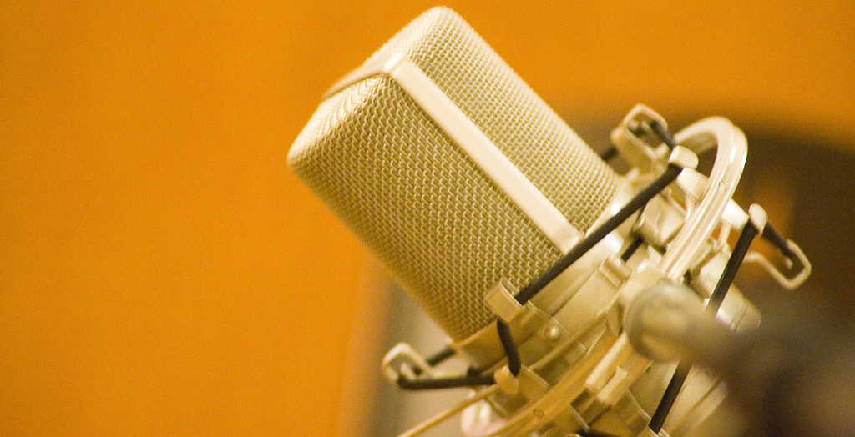
Some Initial Questions
What is your definition of library evaluation?
What comes to mind when you hear the term “assessment”?
What benefits do you see for evaluation?
What methods do you use in your library for evaluation?
How can qualitative methods help in evaluation?
Notes:
Image: https://www.flickr.com/photos/lostvegas/433710146/ by pEtE / CC BY-NC-ND 2.0
How did you come to have this definition, concern or benefits?

Slide 3
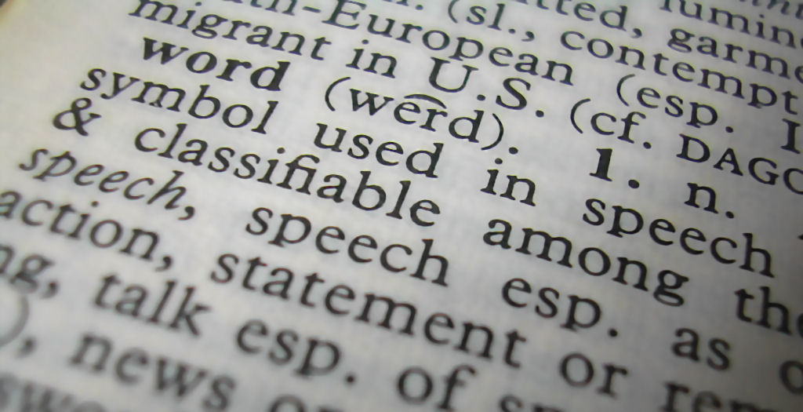
Assessment Defined
Process of…
Defining
Selecting
Designing
Collecting
Analyzing
Interpreting
Using information to increase service/program effectiveness
Notes:
Image: https://www.flickr.com/photos/wiccked/57466134/ by melanie cook / CC BY-NC-ND 2.0

Slide 4
Importance of Assessment
“Librarians are increasingly called upon to document and articulate the value of academic and research libraries and their contribution to institutional mission and goals.”
(ACRL Value of Academic Libraries, 2010, p. 6)
Notes:
Image: https://www.flickr.com/photos/nicholasjon/4101203095/ by Nick Olejniczak / CC BY-NC 2.0
Association of College and Research Libraries. (2010). Value of academic libraries: A comprehensive research review and report. Researched by Megan Oakleaf. Chicago: Association of College and Research Libraries.
University officials & funders demand accountability
Survival in lean budget times

Slide 5
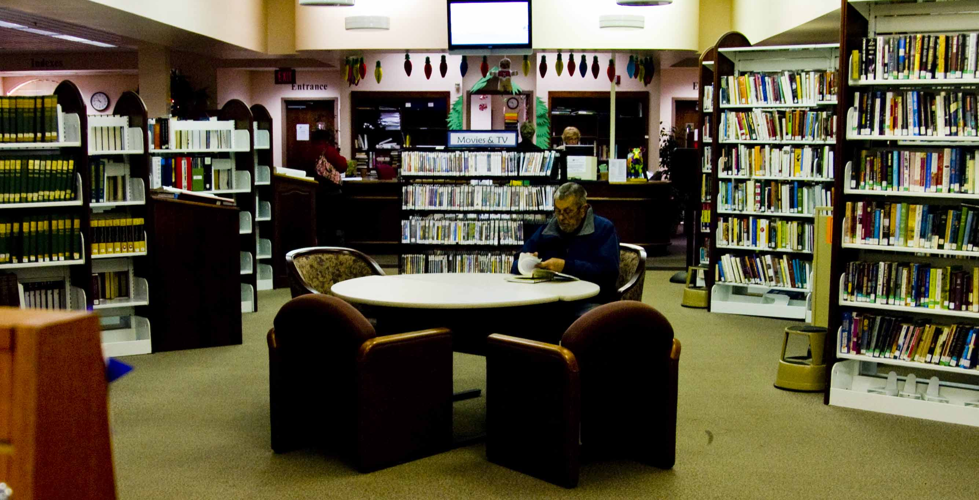
Why Evaluate?
Answers questions:
What do users/stakeholders want & need?
How can services/programs better meet needs?
Is what we do working?
Could we do better?
What are problem areas?
Traditional stats don’t tell whole story
Notes:
Image: https://www.flickr.com/photos/khawkins04/5262741640/ by Ken Hawkins / CC BY 2.0
Traditional stats don’t describe performance
Training in assessment has not kept pace with needs.
Big time, effort, planning & $$ investment in formal evaluation.
Support & buy in from all.

Slide 6
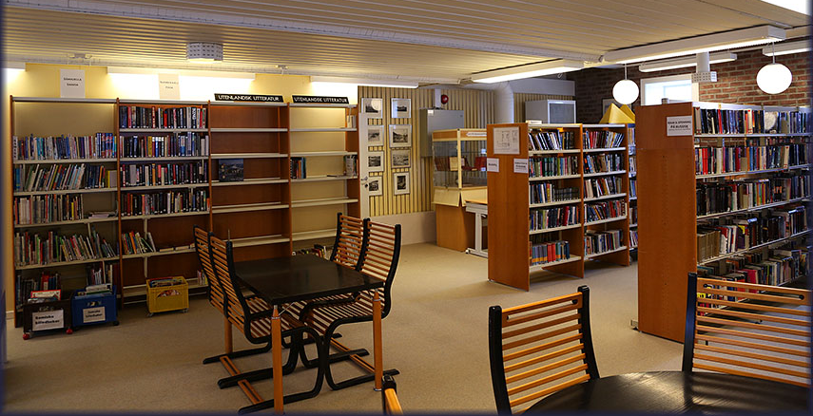
This Workshop
Will introduce you to a range of qualitative methods to assist you in evaluating/assessing your library!
Notes:
Image: https://www.flickr.com/photos/dutchsimba/13628401284/ by Dutch Simba / CC BY-NC-ND 2.0

Slide 7
Outcomes Exercise Part 1

Slide 8
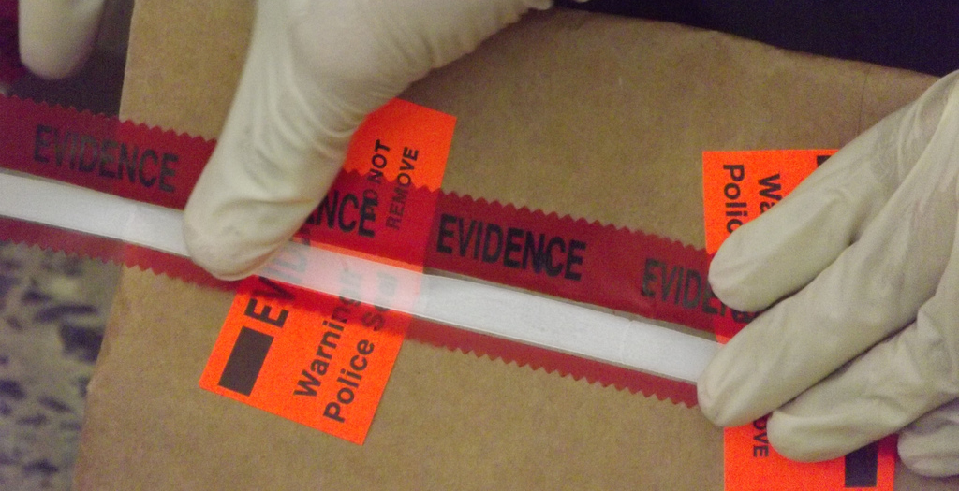
Qualitative Research Definition
Type of scientific research that:
Seeks answers to a question
Systematically uses predefined set of procedures to answer question
Collects evidence
Produces findings that:
Are not determined in advance
Apply beyond immediate boundaries of study
Notes:
Image: https://www.flickr.com/photos/1-25_sbct/6357990295/ by Arctic Wolves / CC BY 2.0

Slide 9
What is Qualitative Research?
“...a situated activity that locates the observer in the world. It consists of a set of interpretive, material practices that make the world visible. These practices transform the world. They turn the world into a series of representations, including field notes, interviews, conversations, photographs, recordings, & memos to the self.
At this level, qualitative research involves an interpretive, naturalistic approach to the world. This means that qualitative researchers study things in their natural settings, attempting to make sense of, or to interpret, phenomena in terms of the meanings people bring to them.”
(Denzin & Lincoln, 2005)
Notes:
Image: https://www.flickr.com/photos/acriley/5203916631/ by A. Charlotte Riley / CC BY-NC-ND 2.0
The content for this slide is from Marie L. Radford, Ph.D. qualitative research methods lecture notes.
Denzin, N. K., & Lincoln, Y. S. (2005). The Sage handbook of qualitative research. Thousand Oaks, CA: Sage Publications.

Slide 10
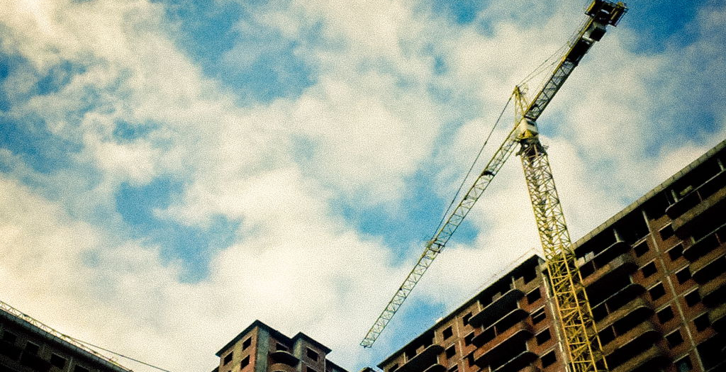
What is Qualitative Research?
DISCOVERY: discovering concepts & their relationships in raw, contextualized & situated data & then organizing these into some theoretical, explanatory scheme
UNDERSTANDING: A broad term that describes research that focuses on how individuals & groups view & understand the world & construct meaning out of their experiences.
Notes:
Image: https://www.flickr.com/photos/r_stephen/6906698996/ by Stephen Rush / CC BY-SA 2.0
The content for this slide is from Marie L. Radford, Ph.D. qualitative research methods lecture notes.

Slide 11
Survey Research
(Connaway & Powell, 2010, p. 182)
Notes:
Connaway, L. S., & Powell, R. R. (2010). Basic research methods for librarians. Santa Barbara: Libraries Unlimited.

Slide 12
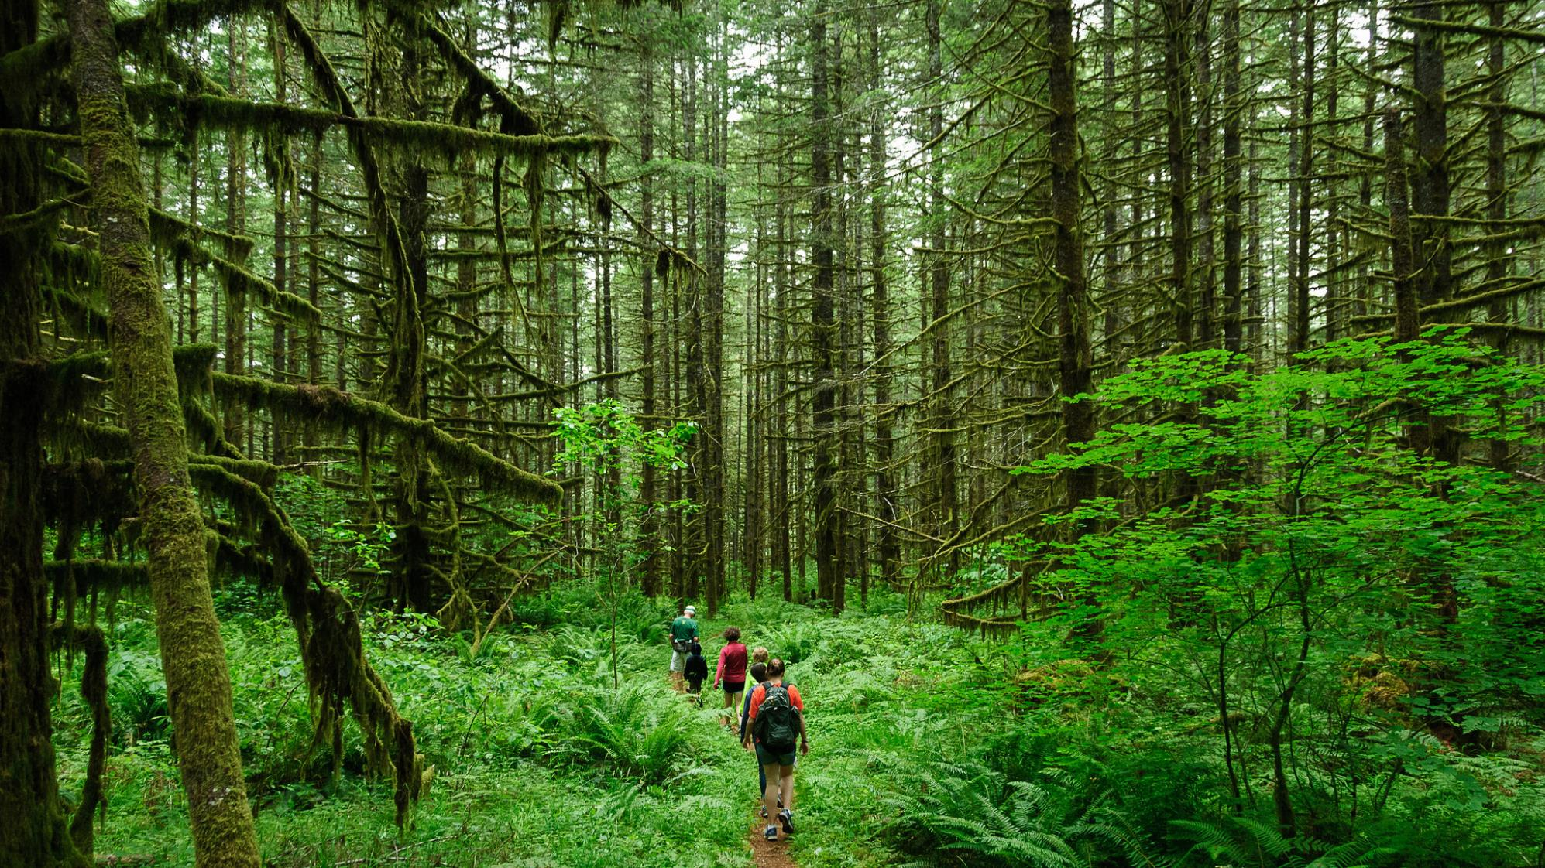
Survey Research Advantages
Explores many aspects of service
Demographic information
Controlled sampling
High response rates possible
Data reflect characteristics & opinions of respondents
Cost effective
Can be self-administered
Survey large numbers
Online surveys (e.g., Survey Monkey) provide statistical analysis
Notes:
Image: https://www.flickr.com/photos/lorenkerns/14544328432/ by Loren Kerns / CC BY 2.0
Adapted from Hernon & Altman, 1998
Hernon, P., & Altman, E. (1998). Assessing service quality: Satisfying the expectations of library customers. Chicago: ALA.

Slide 13
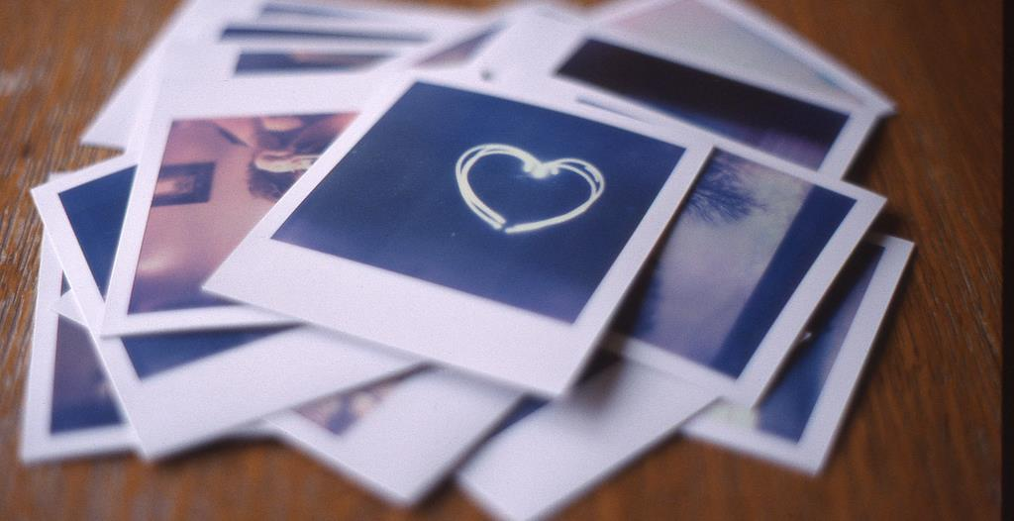
Survey Research Disadvantages
Produces a snapshot of situation
May be time consuming to analyze & interpret results
Produces self-reported data
Data lack depth of interviewing
High return rate can be difficult
Notes:
Image: https://www.flickr.com/photos/bennyseidelman/5893495655/ by Ben Seidelman / CC BY 2.0
Adapted from Hernon & Altman, 1998
Hernon, P., & Altman, E. (1998). Assessing service quality: Satisfying the expectations of library customers. Chicago: ALA.

Slide 14
Checklist for Designing Surveys
Good questions are:
Related to problem at hand
Multiple choice
Open-ended
Likert Scale
Clear, unambiguous, precise
Able to be answered by subjects
Not double-barreled (“and”)
Short
Not Negative
Unbiased
(Janes 1999)
Notes:
Image: https://www.flickr.com/photos/didmyself/6530389351/ by Daniel Kulinski / CC BY-NC-SA 2.0
Janes, J. (1999). On research survey construction. Library Hi Tech, 17(3), 321-325.

Slide 15
Design Issues
Paper or Online (e.g., Survey Monkey)
Consider order of questions
Demographic q’s first
Instructions
Be specific
Introduce sections
Keep it simple
Pre-test!
Notes:
Image: https://www.flickr.com/photos/catzrule/8381068183/ by Rick Payette / CC BY-NC-ND 2.0

Slide 16
Survey Research Interpreting Results
Objectively analyze all data
Interpret results with appropriate level of precision
Express proper degree of caution about conclusions
Use data as input in outcome measures
Consider longitudinal study, compare results over time
Qualitative data requires special attention
Notes:
Image: https://www.flickr.com/photos/-krieg-/6387036687/ by Torus Mastaz / CC BY-NC-ND 2.0

Slide 17
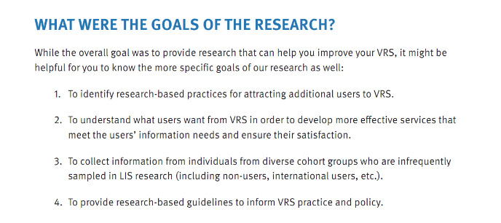
Example: Seeking Synchronicity Formatting Objectives
Review the literature
Focus group interviews with VRS librarians, users & non-users
Analyze VR transcripts
VRS librarian, user, & non-user interviews & online surveys
Notes:
Connaway, L. S., & Radford, M. L. (2011). Seeking synchronicity: Revelations and recommendations for virtual reference. Dublin, OH: OCLC Research. Retrieved from http://www.oclc.org/reports/synchronicity/full.pdf

Slide 18
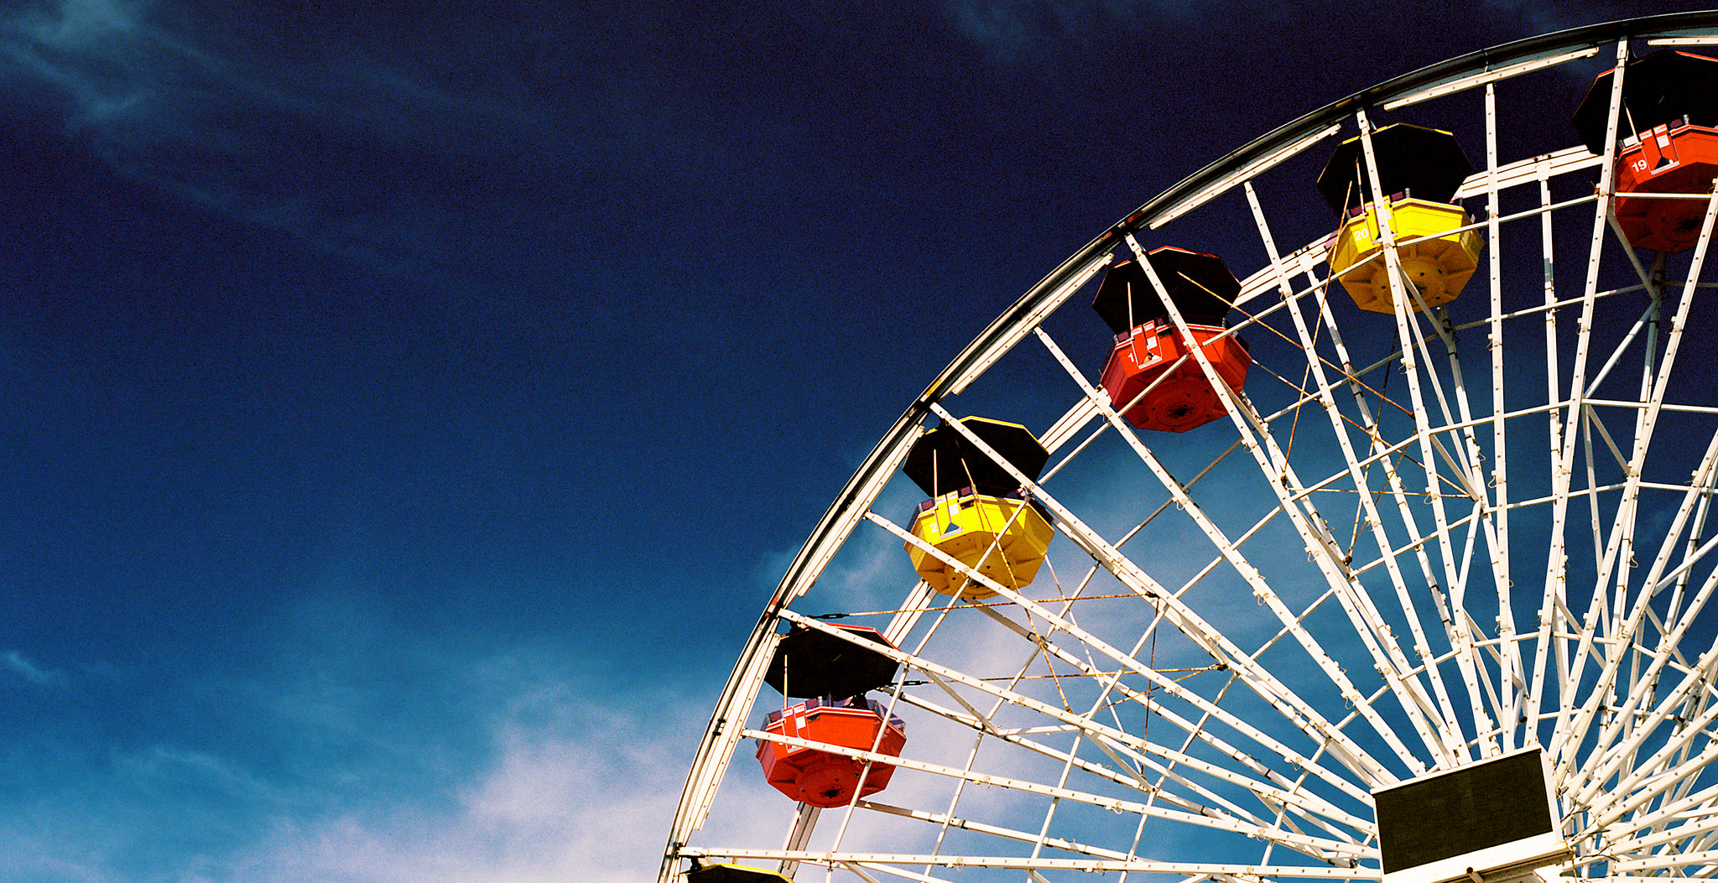
Critical Incident Technique (CIT)
Flanagan (1954)
Qualitative technique
Focuses on most memorable event/experience
Allows categories or themes to emerge rather than be imposed
(Flanagan, 1954)
Notes:
Image: https://www.flickr.com/photos/bendisinger/13857481123/ by Benjamin Disinger / CC BY-NC-ND 2.0
Flanagan, J. C. (1954). The critical incident technique. Psychological Bulletin, 51(4), 327-358.

Slide 19
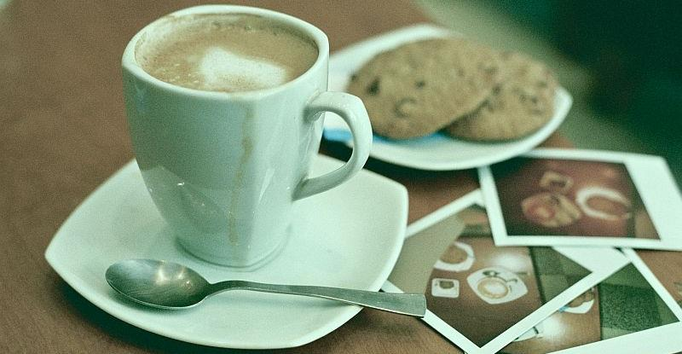
Example: Seeking Synchronicity CIT: VRS User Online Survey Questions
Think about one experience using VRS in which you felt achieved (or did not achieve) a positive result
a. Please describe the circumstances and nature of your question.
b. Describe why you felt the encounter was successful (or unsuccessful).
c. Did the chat format help your experience to be successful (or unsuccessful)? If yes, how?
Notes:
Image: https://www.flickr.com/photos/silkegb/3110013305/ by Silke Gerstenkorn / CC BY-NC 2.0
Connaway, L. S., & Radford, M. L. (2011). Seeking synchronicity: Revelations and recommendations for virtual reference. Dublin, OH: OCLC Research. Retrieved from http://www.oclc.org/reports/synchronicity/full.pdf

Slide 20
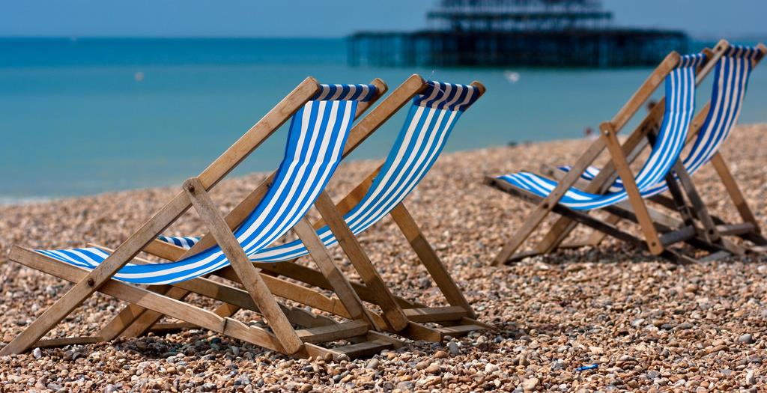
Example: Seeking Synchronicity CIT: VRS Non-User Online Survey Questions
Think about one experience in which you felt you achieved (or did not achieve) a positive result after seeking library reference services in any format.
a. Think about one experience in which you felt you did (or did not) achieve a positive result after seeking library reference services in any format.
b. Describe each interaction.
c. Identify the factors that made these interactions
positive or negative.
Notes:
Image: https://www.flickr.com/photos/25228175@N08/3689046537/ by Elvin / CC BY-NC 2.0
Connaway, L. S., & Radford, M. L. (2011). Seeking synchronicity: Revelations and recommendations for virtual reference. Dublin, OH: OCLC Research. Retrieved from http://www.oclc.org/reports/synchronicity/full.pdf

Slide 21
Example: Seeking Synchronicity CIT: VRS User Result
“The librarian threw in a cordial sign-off and encouraged me to pursue the reading. It was like talking to a friendly librarian in person.”
–VRS User (online survey)
Notes:
Image: https://www.flickr.com/photos/jantruter/8609970752/ by Jan Truter / CC BY-NC-ND 2.0
Connaway, L. S., & Radford, M. L. (2011). Seeking synchronicity: Revelations and recommendations for virtual reference. Dublin, OH: OCLC Research. Retrieved from http://www.oclc.org/reports/synchronicity/full.pdf

Slide 22
Interviews Conversation involving two or more people guided by a predetermined purpose.
Notes:
Adapted from
Lederman, L. C. (1996). Asking questions and listening to answers: A guide to using individual, focus group, and debriefing interviews. Dubuque, IA: Kendall/Hunt.

Slide 23
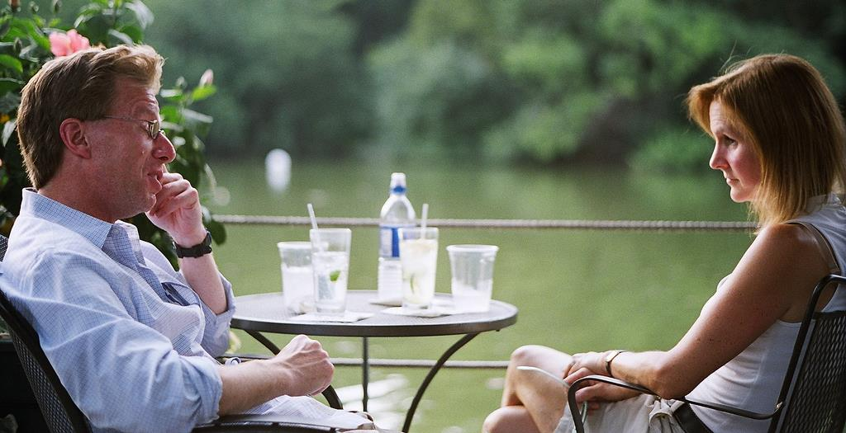
Types of Interviews
Structured
Semi-structured
Formats
Individual
Face-to-face
Telephone
Skype
Focus group interviews
Notes:
Image: https://www.flickr.com/photos/allkindsofnew/9500650217/ by Harold Navarro / CC BY-ND 2.0

Slide 24
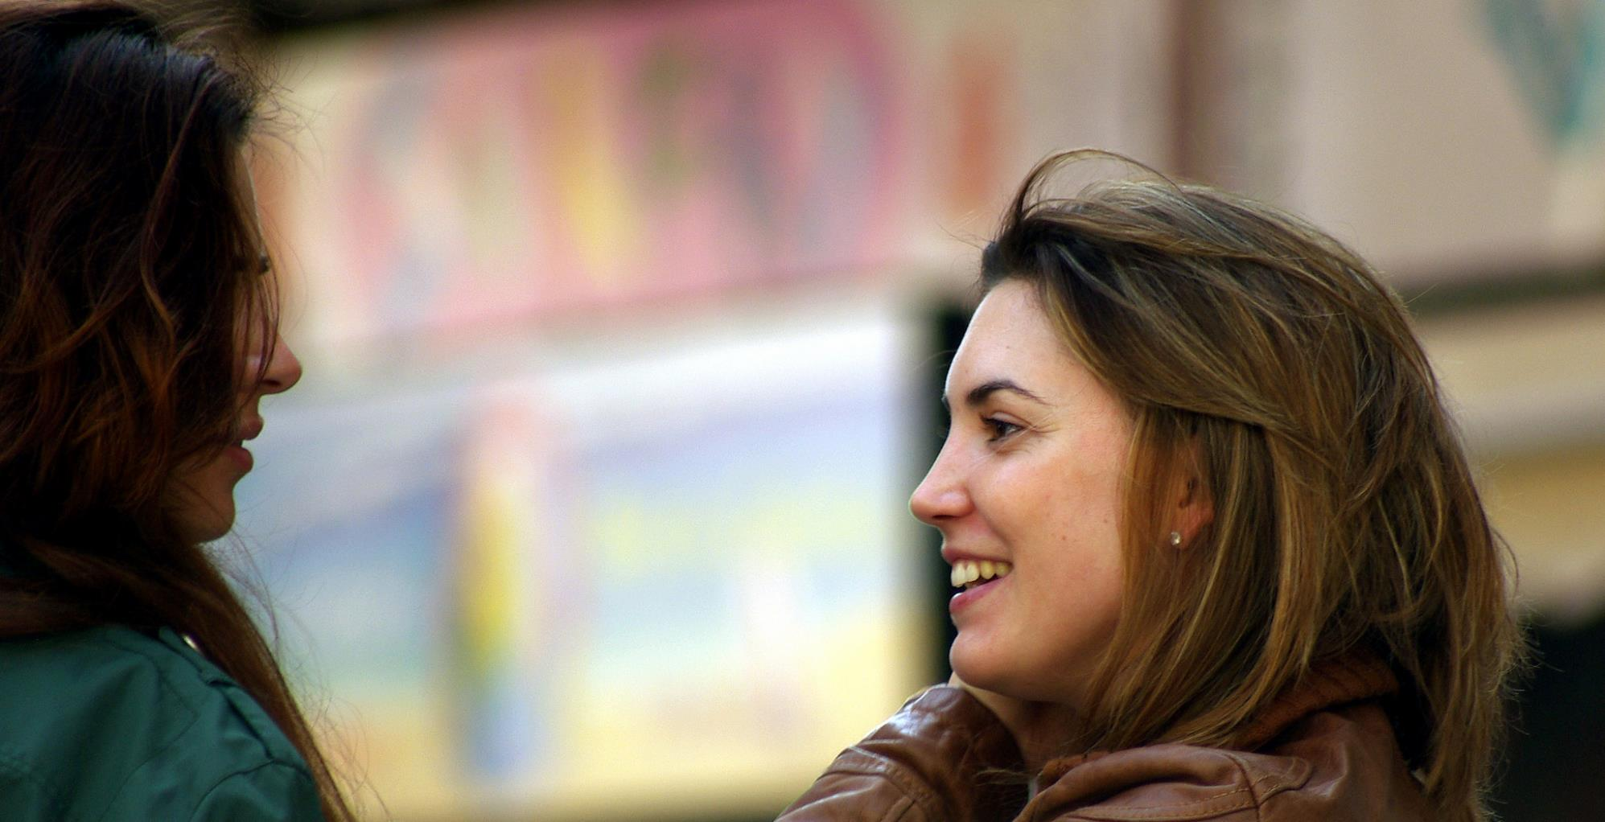
Key components
Good questions
Good listening skills
Good interpersonal skills
Notes:
Image: https://www.flickr.com/photos/10332960@N03/13305699454/ by John Blower / CC BY-NC-ND 2.0

Slide 25
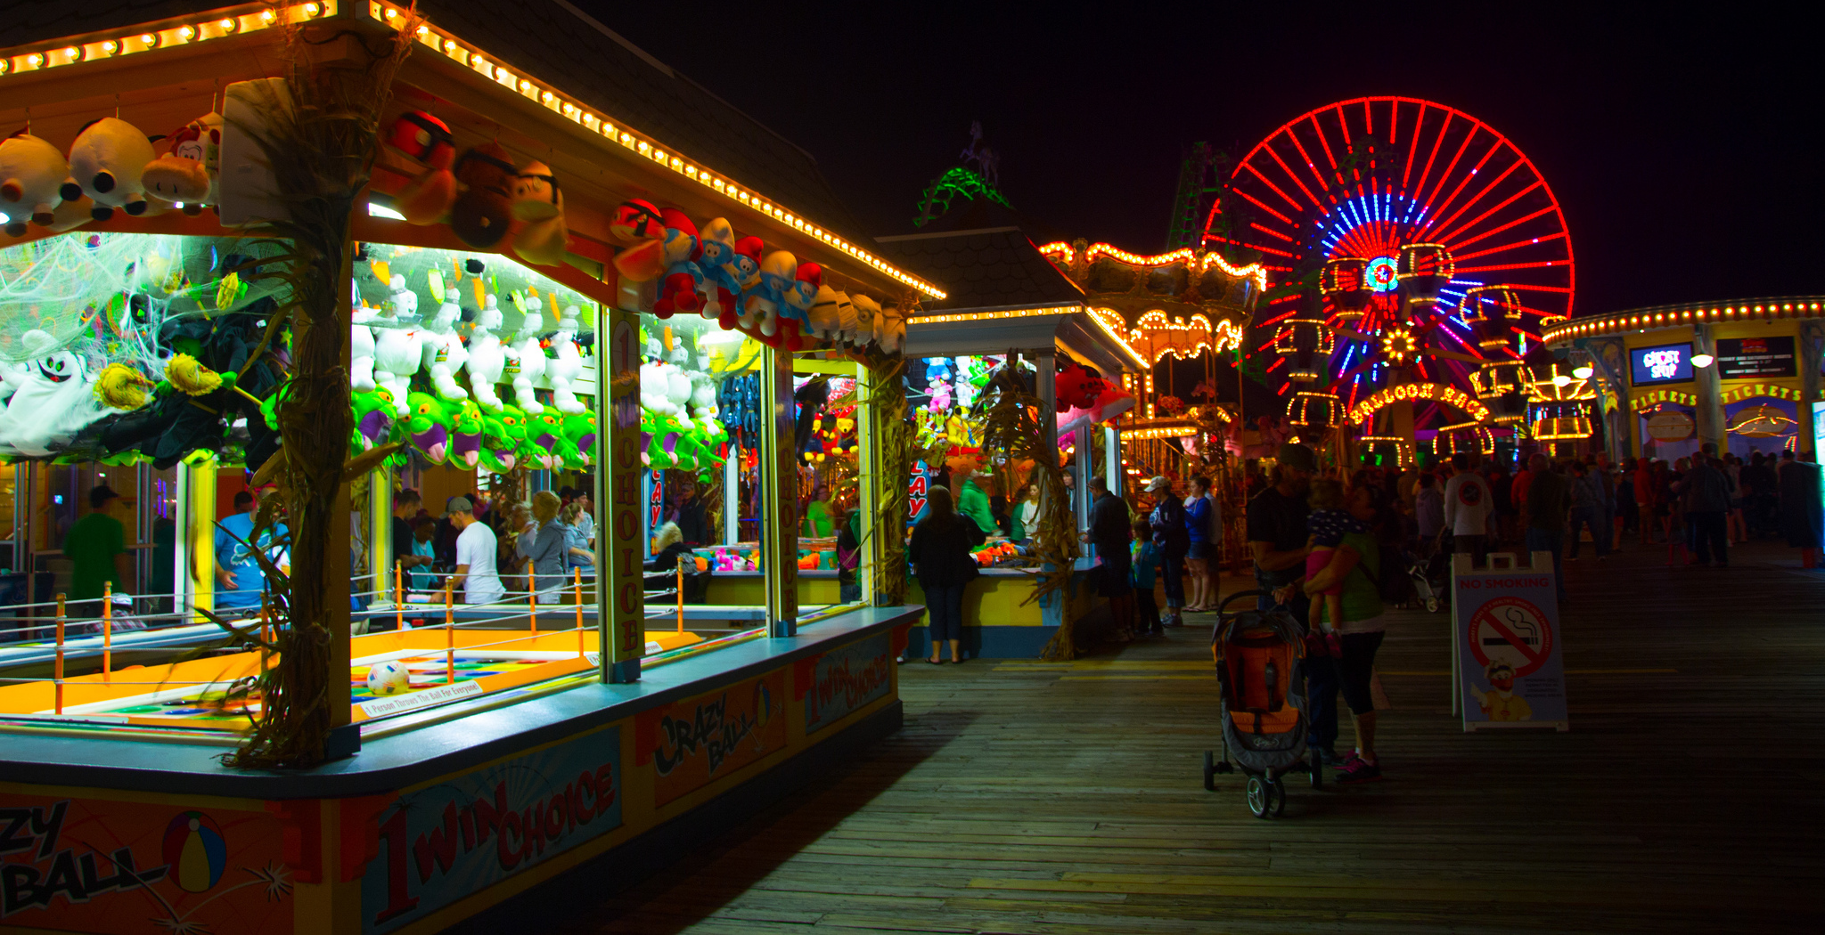
Purpose of Interviews
Gain deep understanding of organization or event, rather than surface description of large sample of population.
Understand how participants derive meaning from surroundings, & how their meaning influences behavior.
Provide explicit rendering of structure, order, & broad patterns among participants (theorizing: knowledge claims)
Notes:
Image: https://www.flickr.com/photos/kjarrett/8014985968/ by Kevin Jarrett / CC BY 2.0
Important to understand what is going on to derive meaning/information from it.
Researchers can get a view of how subjects view and interact with the world around them.

Slide 26
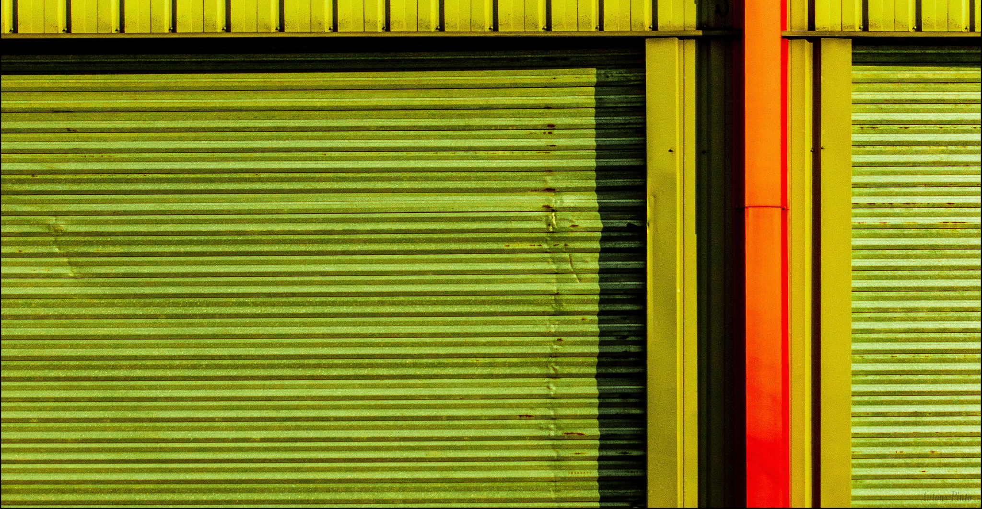
Planning the Interview
Thematizing: clarifying the purpose of the interviews and the concepts to be explored
Designing: outlining the process through which you’ll accomplish your purpose, including a consideration of the ethical dimension
Interviewing: conducting the actual interview
Transcribing: creating a written text of the interview
Analyzing: determining the meaning of gathered materials in relation to the purpose of the study
Verifying: checking the reliability and validity of the materials
Reporting: telling others what you have learned
(Kvale, 1996)
Notes:
Image: https://www.flickr.com/photos/iaourtofrez/14656421640/ by Ynot-Na / CC BY-NC-ND 2.0
The content for this slide is from Presentation 603: Qualitative Approaches Seminar Asking Questions • The Interview, by Eun Baik, Seol Ki, Alexander E. Pichugin, and Si Sun.
Kvale, S. (1996). Interviews: An introduction to qualitative research interviewing. Thousand Oaks, CA: Sage Publications.

Slide 27
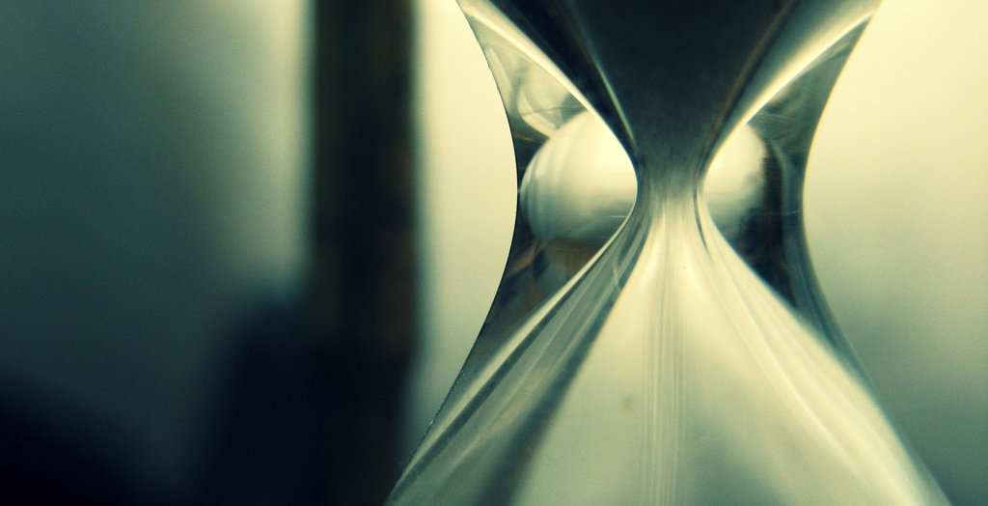
Ethnographic Interview
Incredibly detailed data
Time consuming
Establishing rapport
Selecting research participants
Transcribing observations & conversations
Keeping diaries
Notes:
Image: https://www.flickr.com/photos/ed10vi/5786763218/ by Eduardo Diez Viñuela / CC BY-SA 2.0
Ethnographic interviews are immersive. Generally the interviewee is in their natural habitat. The interviewer is observing them in this habitat. The interviewer is asking pointed questions about what the respondent is doing and feeling. These are typically conducted one on one.
Connaway, L. S., & Powell, R. R. (2010). Basic research methods for librarians. Santa Barbara: Libraries Unlimited.
Khoo, M., Rozaklis, L., & Hall, C. (2012). A survey of the use of ethnographic methods in the study of libraries and library users. Library and Information Science Research, 34(2), 82-91.

Slide 28
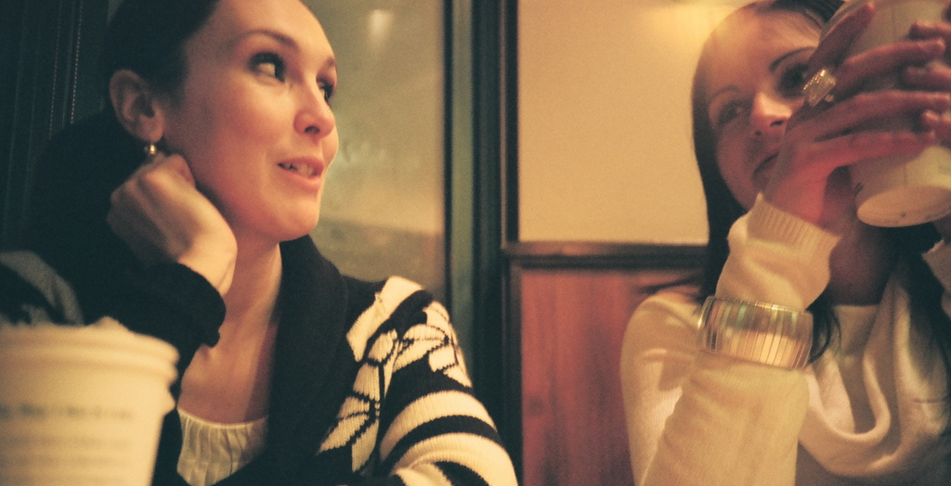
Respondent Interviews
In-depth
Social relationship/rapport between interviewee & interviewer
Rapport/relationship key element
Notes:
Image: https://www.flickr.com/photos/anyalogic/2315310261/ by Anna Levinzon / CC BY 2.0
This type of interview is in-depth.
The interview centers around the interviewer and interviewee building a rapport.
This rapport allows the interviewee to feel comfortable and relaxed in the environment. This is key as it allows the interviewer to ask questions that may be considered personal.

Slide 29
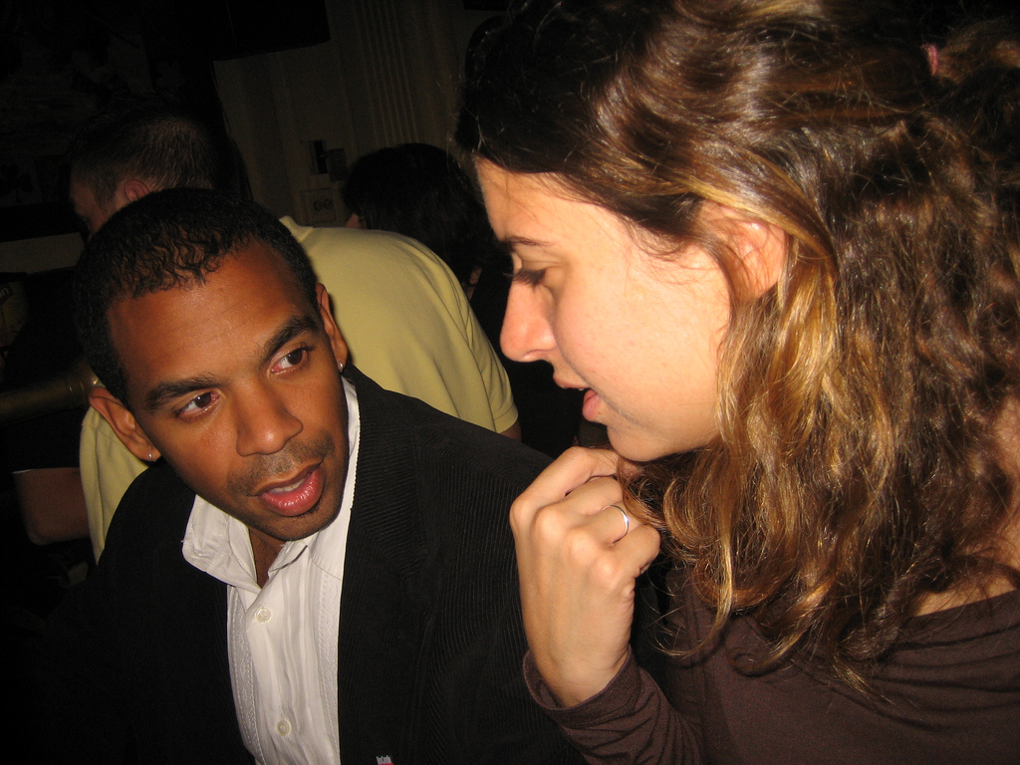
Narrative interviews
One-on-One environment
Unstructured
Interviewees are telling a story
Interviewer questions are minimal
Notes:
Image: https://www.flickr.com/photos/beglendc/293075039/ by David Boyle / CC BY-SA 2.0
This type of interview is about letting the respondent tell a story. They are narrating the interview and there is not lot of input from the interviewer.
Interviewers keep their questions to a minimum so as not to lead the respondent.
It is unstructured.
These interviews are conducted one-on-one.

Slide 30
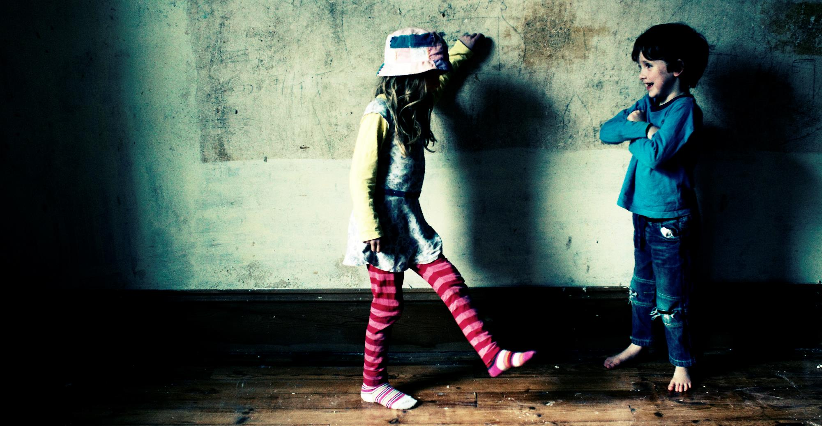
Types of Questions
OPEN
“What is it like when you visit the library?”
DIRECTIVE
“What happened when you asked for help at the reference desk?”
REFLECTIVE
“It sounds like you had trouble with the mobile app?”
CLOSED
“Have I covered everything you wanted to say?”
Notes:
Image: https://www.flickr.com/photos/horrigans/5617092052/ by Sarah Horrigan / CC BY-NC 2.0

Slide 31
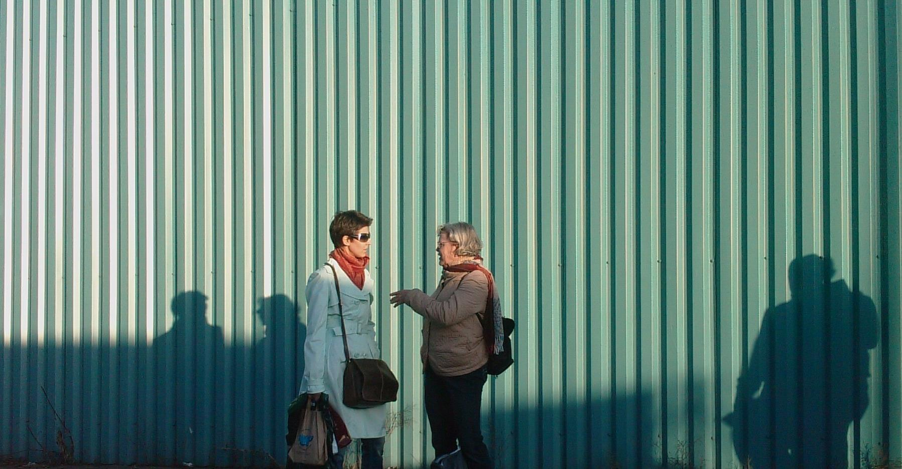
Neutral
“What are your impressions of Raynor Memorial Libraries?”
Leading
“You don’t like the librarians at Raynor Memorial Libraries, do you?”
Loaded
“How many other unreasonable requests have you made to our librarians?”
Neutral, Leading, & Loaded Questions
Notes:
Image: https://www.flickr.com/photos/robwatling/5089229734/ by Rob Watling / CC BY-NC-ND 2.0

Slide 32
Interviewing Exercise

Slide 33
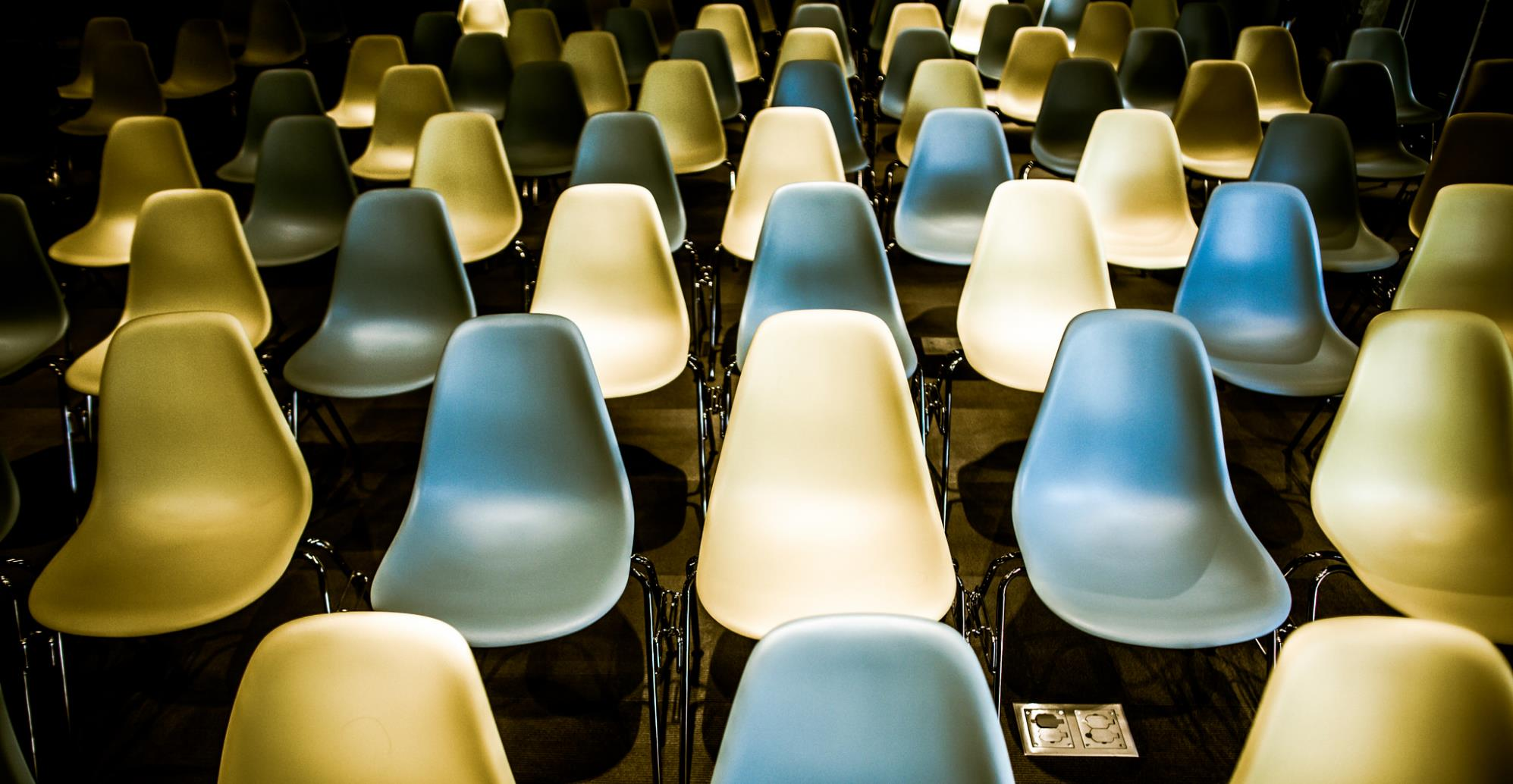
Interviews: Advantages
Face-2-face interaction
In-depth information
Understand experiences & meanings
Highlight individual’s voice
Preliminary information to “triangulate”
Control sampling
Include underrepresented groups
Greater range of topics
Notes:
Image: https://www.flickr.com/photos/thomashawk/12012985364/ by Thomas Hawk / CC BY-NC 2.0

Slide 34
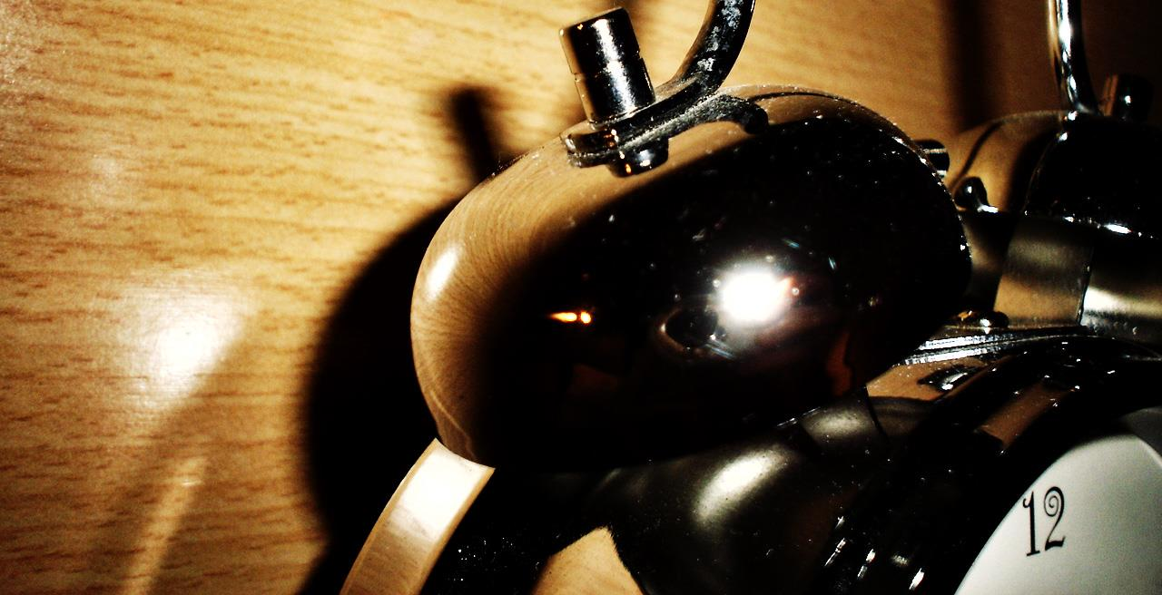
Interviews: Disadvantages
Time Factors
Varies by # & depth
Staff intensive
Cost Factors
Higher the #, higher the cost
Additional Factors
Self-reported data
Errors in note taking possible
Notes:
Image: https://www.flickr.com/photos/29668365@N08/2777606227/ by Dánae / CC BY 2.0

Slide 35
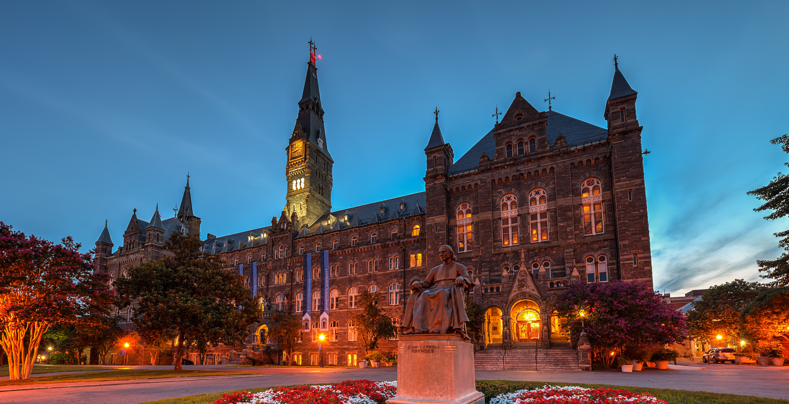
Example:
Digital Visitors & Residents Informant Questions
1. Describe the things you enjoy doing with technology and the web each week.
2. Think of the ways you have used technology and the web for your studies. Describe a typical week.
3. Think about the next stage of your education. Tell me what you think this will be like.
(White & Connaway, 2011)
Notes:
Image: https://www.flickr.com/photos/sillymonkeyphoto/15462537274/ by D L / CC BY-NC-ND 2.0
The content for this slide is from Marquette Workshop Presentation
White, D. S., & Connaway, L. S. (2011-2014). Digital visitors and residents: What motivates engagement with the digital information environment. Funded by JISC, OCLC, and Oxford University. http://www.oclc.org/research/activities/vandr.html

Slide 36
Informant
“A native speaker engaged to repeat words, phrases, and sentences in his own language or dialect as a model for imitation and a source of information”
Research Subjects ≠ Respondents ≠ Informants
Requirements for selecting a good informant
Enculturation
Current involvement
Unfamiliar cultural scene
Adequate time
Nonanalytic
(Spradley, 1979)
Sampling for the Interview
Notes:
The content for this slide is from Presentation 603: Qualitative Approaches Seminar Asking Questions • The Interview, by Eun Baik, Seol Ki, Alexander E. Pichugin, and Si Sun.
Spradley, J. (1979). The ethnographic interview. Belmont, CA: Wadsworth.

Slide 37
Sampling for the Interview
Key features of qualitative sampling
Work with small samples of people nested in their context
Tend to be purposive rather than random
Often theory-driven
Actions involving the sampling for interview
Setting boundaries
Creation of a sampling frame
(Miles & Huberman, 1994)
Notes:
Image: https://www.flickr.com/photos/khouri/6793949601/ by Michael Cory / CC BY-NC 2.0
The content for this slide is from Presentation 603: Qualitative Approaches Seminar Asking Questions • The Interview, by Eun Baik, Seol Ki, Alexander E. Pichugin, and Si Sun.
Miles, M., & Huberman, A. M. (1994). Qualitative data analysis: An expanded sourcebook (2nd ed.). Thousand Oaks, CA: Sage Publications.

Slide 38
Sampling for the Interview
Theoretical Sampling
“A method of data collection based on concepts or themes derived from data”
How does theoretical sampling differ from traditional forms of sampling in quantitative research?
Seeking pertinent data to develop your emerging theory
To elaborate & refine the categories constituting the theory
Move back and forth between category and data
→ More about “concepts” & “variation” not representativeness
(Charmaz, 2006)
(Strauss & Corbin, 1990)
Notes:
The content for this slide is from Presentation 603: Qualitative Approaches Seminar Asking Questions • The Interview, by Eun Baik, Seol Ki, Alexander E. Pichugin, and Si Sun.
Theoretical sampling refers to the process of choosing new research sites, cases, or individuals to compare with ones that have already been studied. It is one of the tools of qualitative research. The term was coined by Barney Glaser and Anselm Strauss in 1967. The goal of theoretical sampling is not the same as with the probabilistic sampling; the researcher's goal is not the representative capture of all possible variations, but to gain a deeper understanding of analysed cases and facilitate the development of analytic frame and concepts used in their research. Theoretical sampling can be viewed as a technique of data triangulation: using independent pieces of information to get a better fix on something that is only partially known or understood.
Charles C. Ragin, 'Constructing Social Research: The Unity and Diversity of Method', Pine Forge Press, 1994.
Barney G. Glaser & Anselm L. Strauss, 'The Discovery of Grounded Theory: Strategies for Qualitative Research', Chicago, Aldine Publishing Company, 1967.
Charmaz, K. (2006). Constructing grounded theory: A practical guide through qualitative analysis. Thousand Oaks, CA: Sage.
Strauss, A., & Corbin, J. (1990). Basics of qualitative research: Grounded theory procedures and techniques. Newbury Park, CA: Sage Publications.

Slide 39
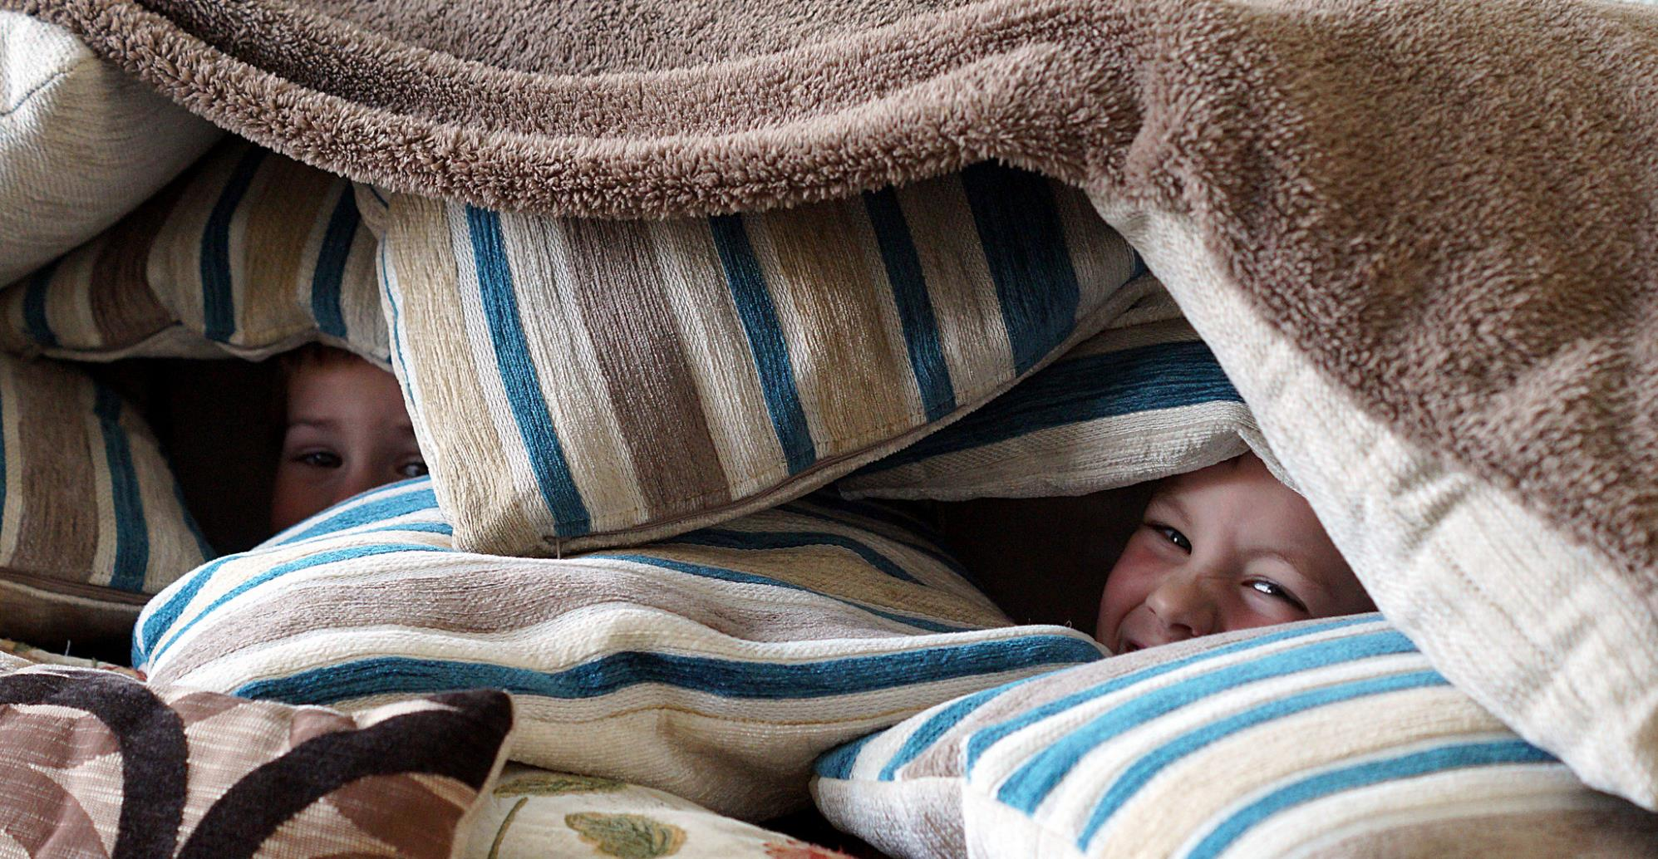
Conducting Interviews
Obtain permission to use information
Report and/or publication
Create safe climate, assure confidentiality
Be prepared, flexible, & stay on task
Listen & know when to probe
Accept that some interviews won’t go well
Thank them!
Notes:
Image: https://www.flickr.com/photos/62833283@N00/17217078330/ by Seamus McCauley / CC BY 2.0

Slide 40
Conducting the Interview
Ethical Considerations
Informed consent
Secure storage of transcribed materials and participant data
Ethical Principles
(Principles of Professional Responsibility by the Council of the American Anthropological Association, 1971)
Consider informants’ interest first
Safeguard informants’ rights, interests, and sensitivities
Communicate research objectives clearly
Protect the privacy of informants (a right to remain anonymous)
Don’t exploit informants
Provide participants with opportunity to read and review the initial report
(Spradley, 1979)
(Kvale, 1996)
Notes:
The content for this slide is from Presentation 603: Qualitative Approaches Seminar Asking Questions • The Interview, by Eun Baik, Seol Ki, Alexander E. Pichugin, and Si Sun.
Spradley, J. (1979). The ethnographic interview. Belmont, CA: Wadsworth.
Kvale, S. (1996). Interviews: An introduction to qualitative research interviewing. Thousand Oaks, CA: Sage Publications.

Slide 41
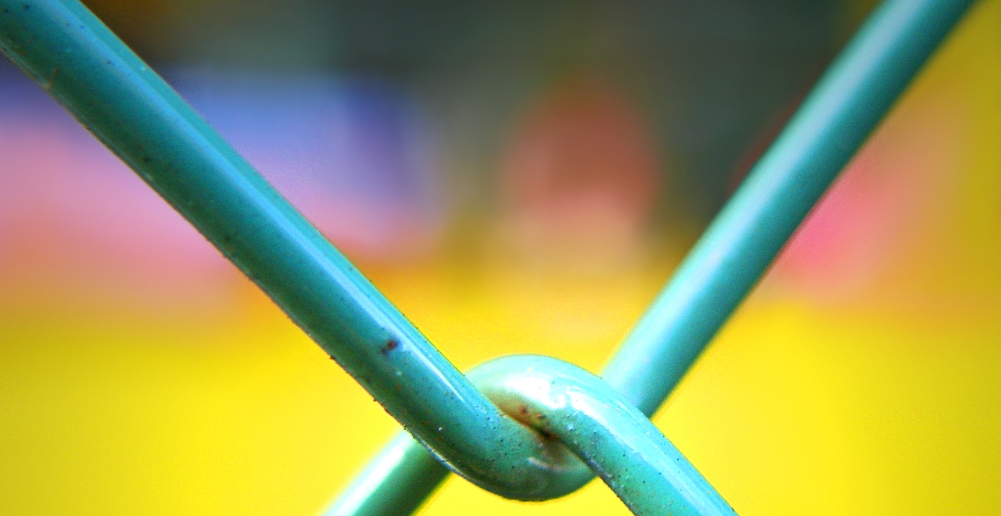
Conducting the Interview
The Interview Process
Interviewing is a skill, developed with experience
Researchers’ obligation:
Listen attentively and allow the conversation to lead new discoveries
Yield some control over the interview
More likely to be achieved if the interview if both the researcher and the participant are mutually invested (try to foster a frame of serious play)
Qualities of good interviewer: sensitivity, authenticity, credibility, intuitiveness, receptivity, and reciprocity
(Corbin & Morse, 2003)
(Lindlof & Taylor, 2010)
Notes:
Image: https://www.flickr.com/photos/28481088@N00/3091698923/ by tanakawho / CC BY-NC 2.0
The content for this slide is from Presentation 603: Qualitative Approaches Seminar Asking Questions • The Interview, by Eun Baik, Seol Ki, Alexander E. Pichugin, and Si Sun.
Corbin J., & Morse, J. M. (2003). The unstructured interactive interview: Issues of reciprocity and risks when dealing with sensitive topics. Qualitative Inquiry, 9(3), 335–354. doi:10.1177/1077800403009003001
Lindlof, T., & Taylor, B. (2010). Qualitative communication research methods (3rd ed.). Thousand Oaks, CA: Sage Publications.

Slide 42
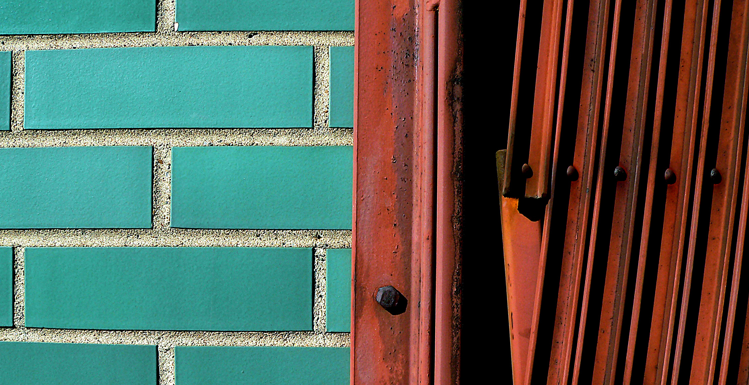
Conducting the Interview
The Interview Context
Time. Find a protected time, if not a good time: reschedule or dismiss
Location. Protected place (comfortable and confidential place), if noisy: better to defer
Reducing the location effects:
Phone interview/online interview (e.g. chat, email)
Bring distant parties together at times of mutual convenience, at a physical location known to both of them, within their respective zones of privacy
(Lindlof & Taylor, 2010)
(Spradley, 1979)
Notes:
Image: https://www.flickr.com/photos/niemster/93602172/ by Matt Niemi / CC BY-NC-ND 2.0
The content for this slide is from Presentation 603: Qualitative Approaches Seminar Asking Questions • The Interview, by Eun Baik, Seol Ki, Alexander E. Pichugin, and Si Sun.
Lindlof, T., & Taylor, B. (2010). Qualitative communication research methods (3rd ed.). Thousand Oaks, CA: Sage Publications.
Spradley, J. (1979). The ethnographic interview. Belmont, CA: Wadsworth.

Slide 43
Conducting the Interview
Recording the Interview
Note Taking can be done anywhere/ not depending on devices/ avoiding mechanical failure/ but a deterrent to mind wandering and distractions/ limitation on loss of data (can’t write down everything)
Audio Recording is capturing and preserving all interview discourses with little effort by the researcher/ engage in more fully in the conversation/ peruse the content of the talk and its paralinguistic aspects
(Lindlof & Taylor)
Notes:
The content for this slide is from Presentation 603: Qualitative Approaches Seminar Asking Questions • The Interview, by Eun Baik, Seol Ki, Alexander E. Pichugin, and Si Sun.
Lindlof, T., & Taylor, B. (2010). Qualitative communication research methods (3rd ed.). Thousand Oaks, CA: Sage Publications.

Slide 44
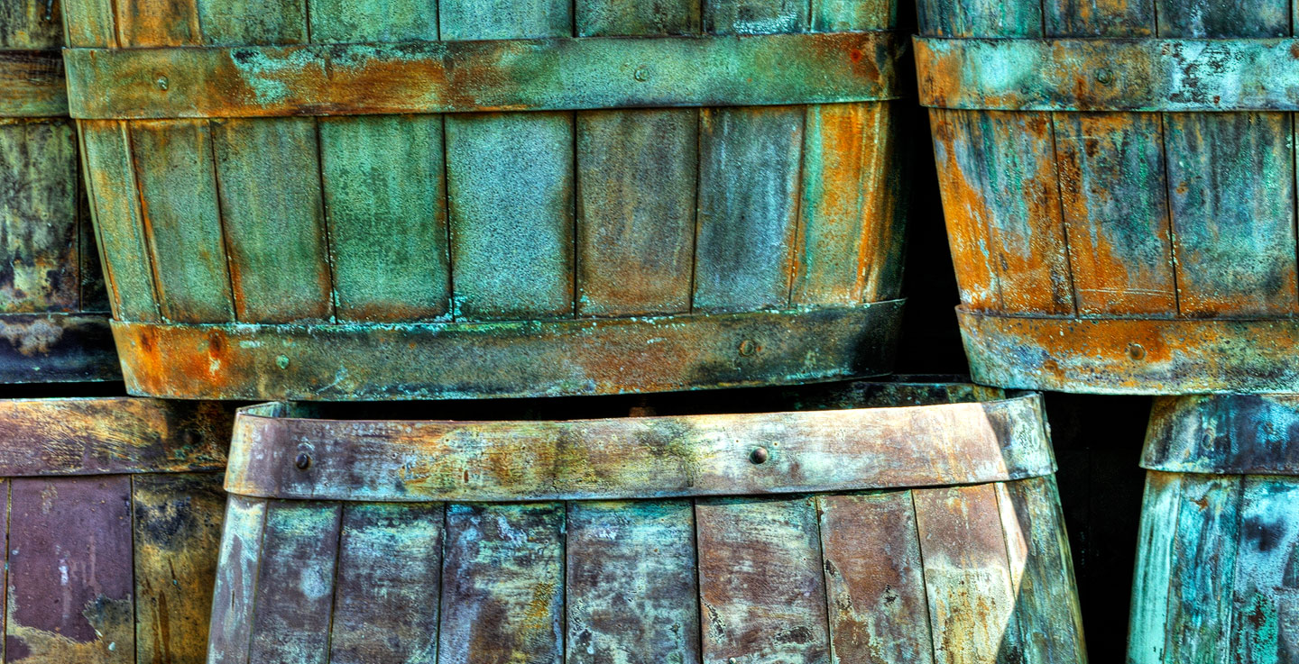
Conducting the Interview
Developing Rapport
Apprehension: to reduce an informant’s apprehension: listen, show interest, and respond in a nonjudgmental fashion. Keep informants talking
Exploration
- Repeat explanations
- Restate what informants say
- Don’t ask for meaning, ask for use
Cooperation: based on mutual trust.
Participation: heightened sense of cooperation and full participation in the research
(Spradley, 1979)
Notes:
Image: https://www.flickr.com/photos/fotoremy/6768379679/ by Remy Remmerswaal / CC BY 2.0
The content for this slide is from Presentation 603: Qualitative Approaches Seminar Asking Questions • The Interview, by Eun Baik, Seol Ki, Alexander E. Pichugin, and Si Sun.
Cooperation: involvement of more complete cooperation based on mutual trust.
Both know the goal is to discover the culture of the informant in the language of the informant.
Spradley, J. (1979). The ethnographic interview. Belmont, CA: Wadsworth.

Slide 45
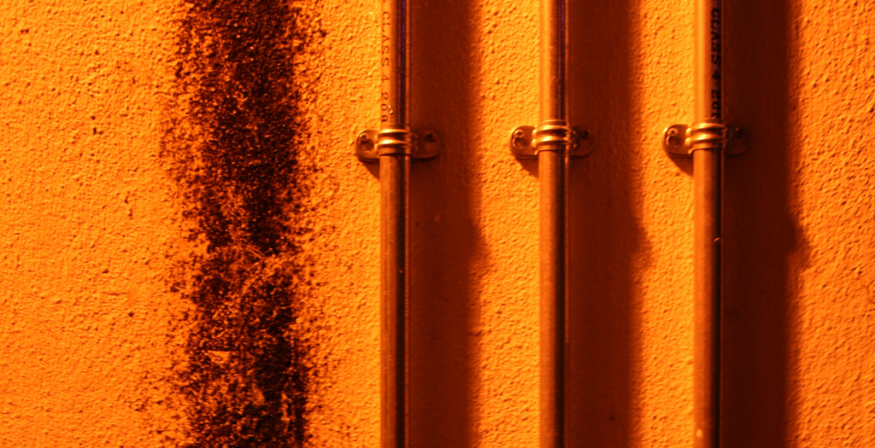
Conducting the Interview
Listening
Listening = the most crucial way to build rapport after an interview has started
Listening = paying attention
Active listening
as the conversation unfolds, you monitor your own understandings in relation to the possible meanings of what the person is saying
suggest questions that are urgent enough to warrant breaking into the subject’s talk
not being a caretaker for the audio recorder
(Lindlof & Taylor, 2010)
Notes:
Image: https://www.flickr.com/photos/108404544@N07/12941711194/ by Chris Searle / CC BY-NC-ND 2.0
The content for this slide is from Presentation 603: Qualitative Approaches Seminar Asking Questions • The Interview, by Eun Baik, Seol Ki, Alexander E. Pichugin, and Si Sun.
Lindlof, T., & Taylor, B. (2010). Qualitative communication research methods (3rd ed.). Thousand Oaks, CA: Sage Publications.

Slide 46
Listening Behaviors Exercise

Slide 47
Break Time!

Slide 48
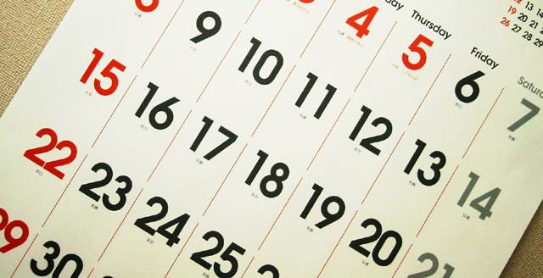
Example:
Digital Visitors & Residents Participant Questions
1. Describe the things you enjoy doing with technology and the web each week.
2. Think of the ways you have used technology and the web for your studies. Describe a typical week.
3. Think about the next stage of your education. Tell me what you think this will be like.
(Connaway & Radford, 2005-2007)
(Dervin, Connaway, & Prabha, 2003-2005)
Notes:
Image: https://www.flickr.com/photos/studiocurve/13080208/ by studio curve / CC BY-NC-ND 2.0
Describe the things you enjoy doing with technology and the web each week.
2. Think of the ways you have used technology and the web for your studies. Describe a typical week.
3. Think about the next stage of your education. Tell me what you think this will be like.
White, D. S., & Connaway, L. S. (2011-2014). Digital visitors and residents: What motivates engagement with the digital information environment. Funded by JISC, OCLC, and Oxford University. http://www.oclc.org/research/activities/vandr.html

Slide 49
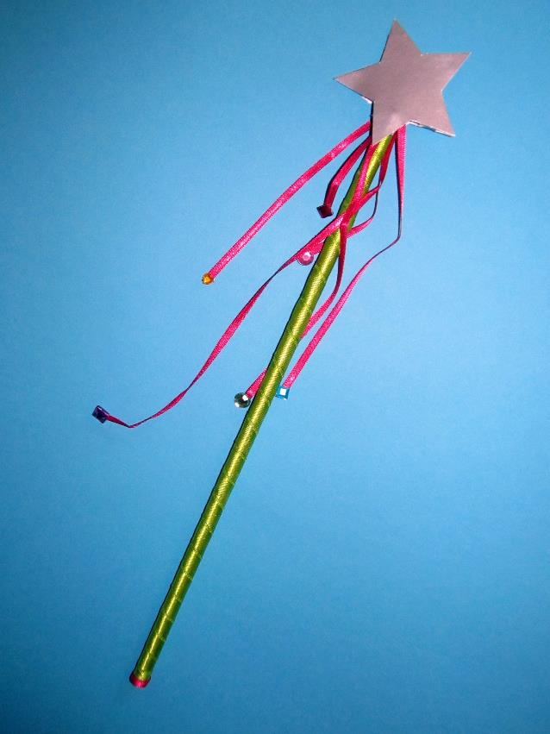
Example:
Digital Visitors & Residents Participant Questions
4. Think of a time when you had a situation where you needed answers or solutions and you did a quick search and made do with it. You knew there were other sources but you decided not to use them.
5. Have there been times when you were told to use a library or virtual learning environment (or learning platform), and used other source(s) instead?
6. If you had a magic wand, what would your ideal way of getting information be? How would you go about using the systems and services? When? Where? How?
(Connaway & Radford, 2005-2007)
(Dervin, Connaway, & Prabha, 2003-2005)
Notes:
Image: https://www.flickr.com/photos/seelensturm/8447829919/ by F_A / CC BY 2.0
4. Think of a time when you had a situation where you needed answers or solutions and you did a quick search and made do with it. You knew there were other sources but you decided not to use them. Please include sources such as friends, family, teachers, coaches, etc.
5. Have there been times when you were told to use a library or virtual learning environment (or learning platform), and used other source(s) instead?
6. If you had a magic wand, what would your ideal way of getting information be? How would you go about using the systems and services? When? Where? How?
These questions come from previous research
Dervin, B., Connaway, L. S., & Prabha, C. (2003-2005). Sense-making the information confluence: The hows and the whys of college and university user satisficing of information needs. Funded by the Institute for Museums and Library Services (IMLS). Retrieved from http://www.oclc.org/research/activities/past/orprojects/imls/default.htm
Connaway, L. S., & Radford, M. L. (2011). Seeking synchronicity: Revelations and recommendations for virtual reference. Dublin, OH: OCLC Research. Retrieved from http://www.oclc.org/reports/synchronicity/full.pdf
White, D. S., & Connaway, L. S. (2011-2014). Digital visitors and residents: What motivates engagement with the digital information environment. Funded by JISC, OCLC, and Oxford University. http://www.oclc.org/research/activities/vandr.html

Slide 50
“…interview of a group of 8 to 12 people representing some target group and centered on a single topic.”
Focus Group Interviews
(Zweizig, Johnson, Robbins, & Besant, 1996)
Notes:
Zweizig, Johnson, Robbins, & Besant, 1996
Zweizig, D., Johnson, D. W., Robbins, J., & Besant, M. (1996). The tell it! manual. Chicago: ALA.

Slide 51
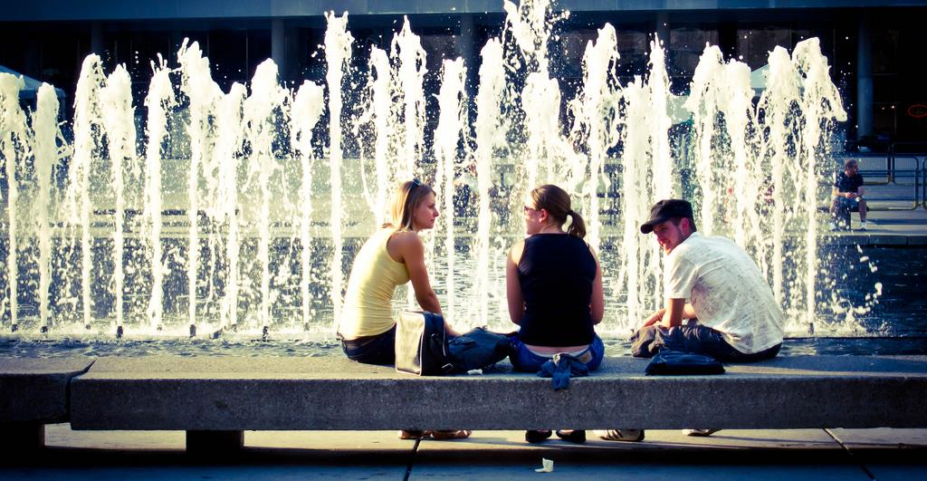
Focus Group Interviews: Advantages
Advantages of individual interviews plus…
Take less time.
Create synergy
Comments stimulate others
Unexpected insight
Access needs of under-served or underrepresented groups
Notes:
Image: https://www.flickr.com/photos/bensonkua/4839019821/ by Benson Kua / CC BY-SA 2.0
Create synergy
Comments stimulate others
Unexpected insight
More complete information
Elicit strong & common opinions
Less inhibiting, less formal

Slide 52
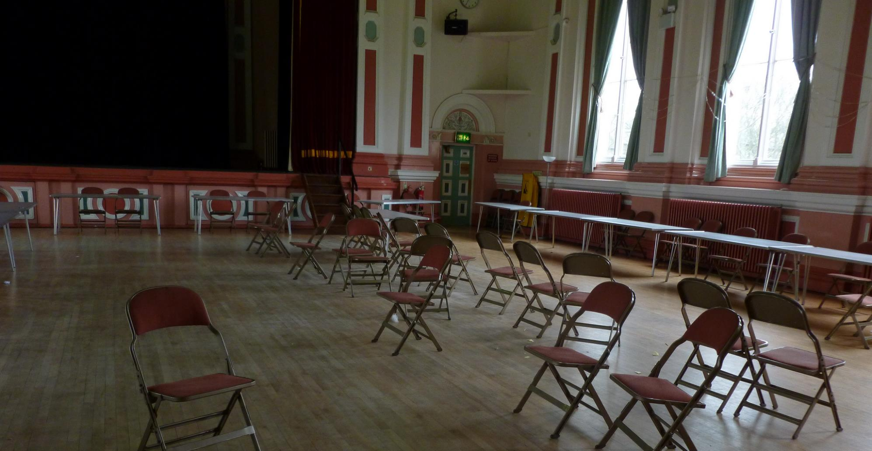
Focus Group Interviews: Disadvantages
Planning & administrative time
Experienced moderator required
See handout
Participants may be too quiet or too outspoken
Participants may not have sufficient time
Analysis, summarization & interpretation of responses difficult
Notes:
Image: https://www.flickr.com/photos/17989497@N00/8651401959/ by Monika / CC BY-SA 2.0

Slide 53
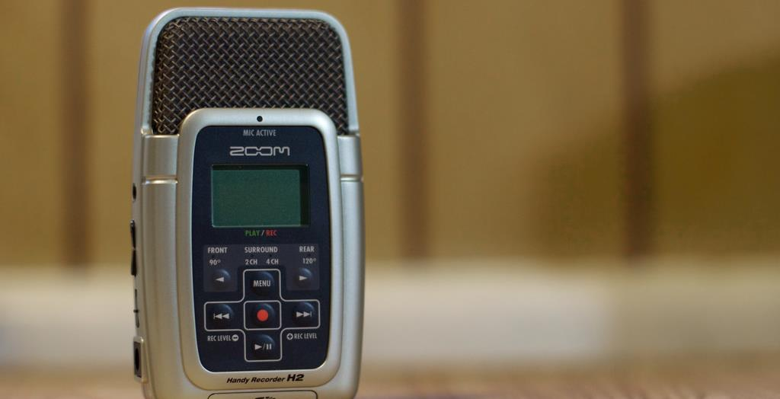
Conducting Focus Group Interviews
Obtain permission to use information & if taping
Report and/or publication
Enlist note-taker or, if recording, check equipment, bring back-up
Begin by creating safe climate
Notes:
Image: https://www.flickr.com/photos/cogdog/5841058123/ by Alan Levine / CC BY 2.0

Slide 54
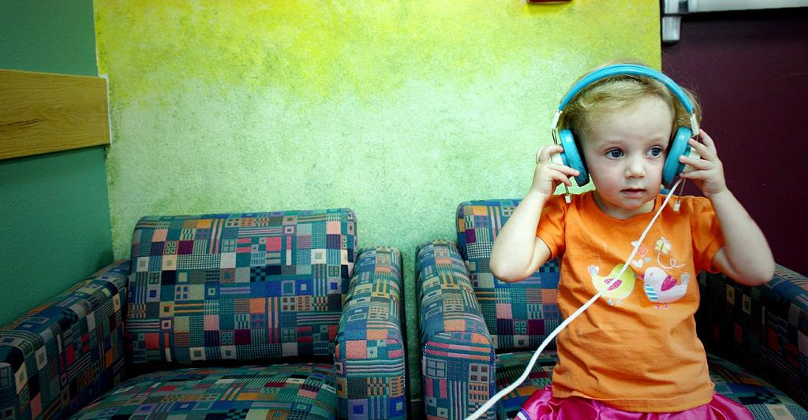
Conducting Focus Group Interviews
Help quiet people talk, limit talkative people
Design well constructed guide, including:
Introduction (purpose, ground rules)
Small set of questions (4 or 5 tops!)
Relevant major/probe questions
Effective listening essential
Notes:
Image: https://www.flickr.com/photos/gozalewis/4776747298/ by timlewisnm / CC BY-NC-ND 2.0

Slide 55
WorldCat.org Study Recruitment
Difficult
Little data of user-base
Participants across 3 continents
Hard-to-reach populations
Historians
Antiquarian booksellers
Non-probabilistic methods
Convenience sampling
Snowball sampling
(Connaway & Wakeling, 2012)
Notes:
Image: https://www.flickr.com/photos/markomikkonen/8578620969/ by Marko Mikkonen / CC BY 2.0
Connaway, L. S., & Wakeling, S. (2012). To use or not to use Worldcat.org: An international perspective from different user groups. OCLC Internal Report.
To recruit the librarians, key contacts at participating institutions provided email addresses for suitable staff members, or distributed the invitations themselves. In both cases a standard email was used that informed potential participants of the focus group interview details, explained the aims of the research, and specified what would be required of participants.
Library contacts were used to identify the subject liaison librarian for History departments, which resulted in a limited number of introductions to historians. Invitation emails were sent to interested parties, but overall recruitment numbers were low. Antiquarian Booksellers required a different approach, since in most cases our library contacts were unable to help with this group. Booksellers were identified through their membership of professional bodies (the Australian & New Zealand Association of Antiquarian Booksellers, the Antiquarian Booksellers Association (UK), and the Antiquarian Booksellers' Association of America), whose websites include contact details for members. Emails were sent to all booksellers included in the online membership directories, explaining the research and inviting them to attend a session. While this approach was unsuccessful in Australia and the US, we were able to recruit enough UK-based booksellers to conduct a focus group interview session.
Students were recruited with fliers distributed around libraries, academic departments, and student library assistants.

Slide 56
Example:
WorldCat.org Focus Group Interview Questions
Tell us about your experiences with WorldCat.org
Broad introductory question to reveal the extent to which users have engaged with WorldCat.org, and the information-seeking contexts within which they use the system.
Purpose
(Connaway & Powell, 2010, p. 184)
Notes:
Connaway, L. S., & Powell, R. R. (2010). Basic research methods for librarians. Santa Barbara: Libraries Unlimited.
Connaway, L. S., & Wakeling, S. (2012). To use or not to use Worldcat.org: An international perspective from different user groups. OCLC Internal Report.
Flanagan, J. C. (1954). The critical incident technique. Psychological Bulletin, 51(4), 327-358.
1. Tell us about your experiences with WorldCat.org
A broad introductory question intended to reveal the extent to which users have engaged with WorldCat.org, and the information-seeking contexts within which they use the system.
2. Describe a time when you used WorldCat.org that you considered a success.
Explores the features and functions of WorldCat.org that participants view positively. Requiring participants to discuss a particular instance provides richer data about the range of uses of the system.
3. Describe a time when using WorldCat.org was unsuccessful – i.e., you did not get what you wanted.
Explores the features and functions (or lack thereof) of WorldCat.org that participants view negatively.
4. Think of a time when you did not find what you were looking for, but did find something else of interest or useful to your work?
Intended to encourage discussion about the role of serendipity in information seeking, and the extent to which WorldCat.org facilitates resource discovery .
5. If you had a magic wand, what would your ideal WorldCat.org provide?
Encourages participants to discuss potential improvements to WorldCat.org. The use of the phrase “magic wand” ensures that participants are not restricted by what they believe to be practical or realistic.
*Questions 2-4 employ the Critical Incident Technique

Slide 57
Example:
WorldCat.org Focus Group Interview Questions
If you had a magic wand, what would your ideal WorldCat.org provide?
Encourages participants to discuss potential improvements to WorldCat.org.
Purpose
(Connaway & Powell, 2010, p. 184)
Notes:
Connaway, L. S., & Powell, R. R. (2010). Basic research methods for librarians. Santa Barbara: Libraries Unlimited.
Connaway, L. S., & Wakeling, S. (2012). To use or not to use Worldcat.org: An international perspective from different user groups. OCLC Internal Report.
Flanagan, J. C. (1954). The critical incident technique. Psychological Bulletin, 51(4), 327-358.
The use of the phrase “magic wand” ensures that participants are not restricted by what they believe to be practical or realistic.

Slide 58
Individual Interviews & Focus Group Interviews Analysis
Review notes/transcribe tapes
Ways to analyze:
Code data into pre-determined categories
Use data to identify categories
Use data for summary statements “capture the essence”
Compare all groups
Compile & summarize
Look for trends/patterns
Don’t overgeneralize from results
Notes:
Image: https://www.flickr.com/photos/arwilkinson/10830400356/ by Andy Wilkinson / CC BY-SA 2.0

Slide 59
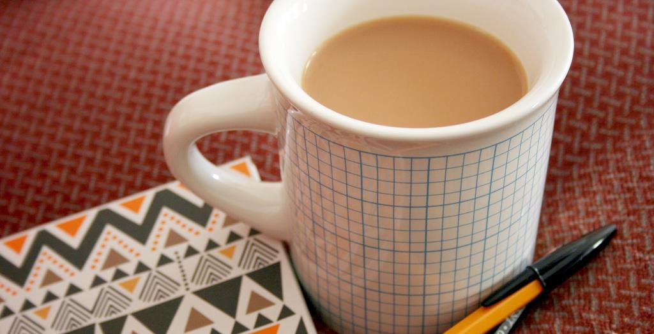
Individual Interviews & Focus Group Interviews Reporting Results
Parts of Report
List of issues
Explain how data collected/analyzed
Summary of findings: What was said on each issue?
Sample quotes (anonymous)
Interviewer’s impressions
Recommendations:
Short term (low hanging fruit)
Long term
Notes:
Image: https://www.flickr.com/photos/jenosaur/4731463366/ by jen Collins / CC BY-NC-ND 2.0

Slide 60
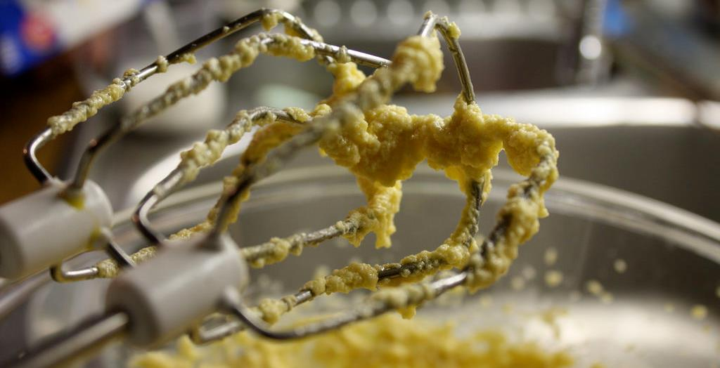
Individual Interviews & Focus Group Interviews Limitations
Difficult to generalize
May not be representative
Analyzes perceptions, not facts
Subjective analysis (reliability)
Raw data could be misleading
Results can be limited by:
Poor/inexperienced moderator/ interviewer
Poorly constructed discussion guide/interview questions
Compensate by combining methods
Notes:
Image: https://www.flickr.com/photos/furibond/3267102279/ by jim / CC BY-SA 2.0

Slide 61
Systematic description focusing on designated aspects of behavior to test causal hypotheses.
Structured observations:
(Connaway & Powell, 2010, p. 182)
Notes:
Connaway, L. S., & Powell, R. R. (2010). Basic research methods for librarians. Santa Barbara: Libraries Unlimited.

Slide 62
Structured Observations: A Guide
Develop observational categories
Define appropriate, measurable acts
Establish time length of observation
Anticipate patterns of phenomena
Decide on frame of reference
(Connaway & Powell, 2010, p. 182)
Notes:
Connaway, L. S., & Powell, R. R. (2010). Basic research methods for librarians. Santa Barbara: Libraries Unlimited.

Slide 63
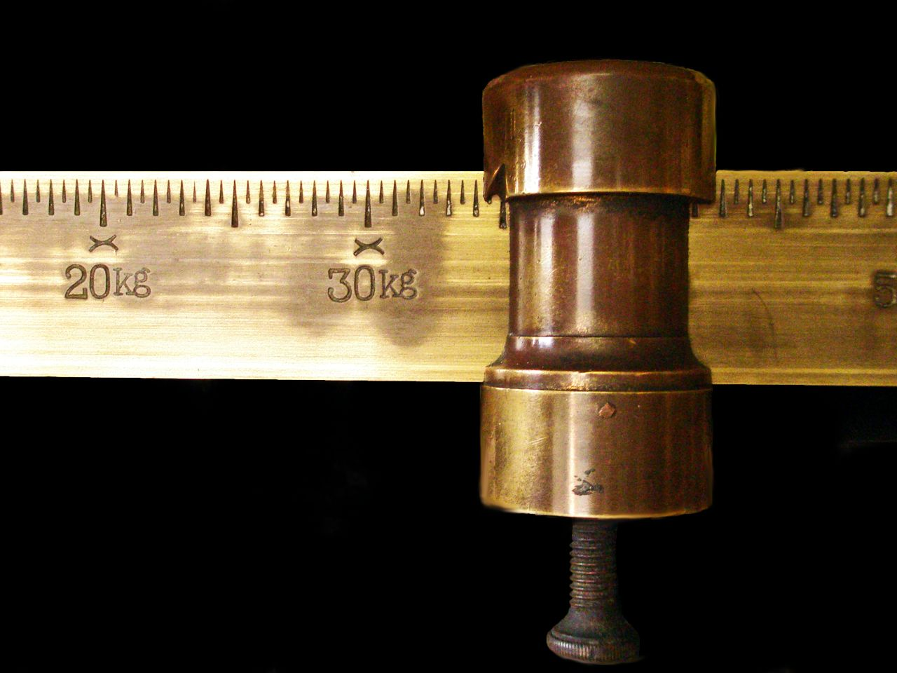
Rating scales
“All-or-none” categories
Checklists of categories
Audiovisual equipment
Useful for overall view of behavior
Analyze closely later
(Connaway & Powell, 2010, p. 182)
Recording Observations
Notes:
Image: https://www.flickr.com/photos/28481088@N00/2957770391/ by tanakawho / CC BY-NC 2.0
Connaway, L. S., & Powell, R. R. (2010). Basic research methods for librarians. Santa Barbara: Libraries Unlimited.

Slide 64
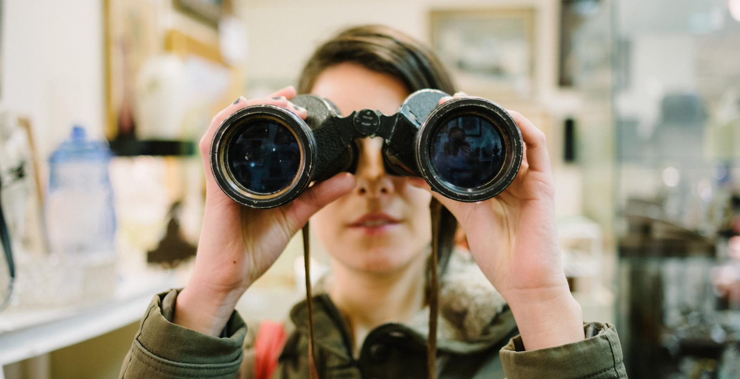
Increase Observation Reliability
Develop definitions of behavior
Train observers
Avoid observer bias
Take behaviors at face value
(Connaway & Powell, 2010, p. 182)
Notes:
Image: https://www.flickr.com/photos/chasblackman/8502151556/ by Chase Elliott Clark / CC BY 2.0
Connaway, L. S., & Powell, R. R. (2010). Basic research methods for librarians. Santa Barbara: Libraries Unlimited.

Slide 65
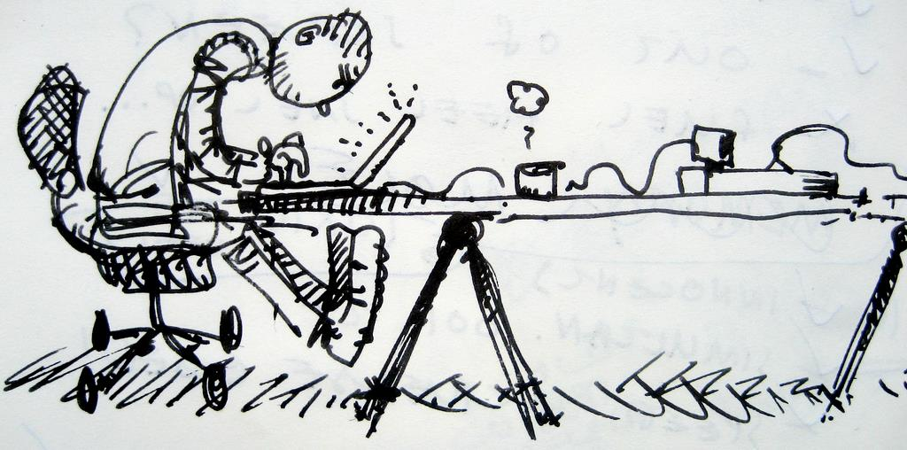
Usability Testing History
Human ethnographic observation
Ergonomics
Cognitive psychology
Became popular in 1980s
(Connaway & Powell, 2010, p. 183)
Notes:
Image: https://www.flickr.com/photos/kaeru/1599676842/ by Kars Alfrink / CC BY 2.0
Connaway, L. S., & Powell, R. R. (2010). Basic research methods for librarians. Santa Barbara: Libraries Unlimited.

Slide 66
User-Centered Design of a Recommender System for a "Universal" Library Catalogue
Joint research project
OCLC Research & the Information School, University of Sheffield
Investigate development of recommender systems for retrieval in WorldCat.org
WorldCat.org has recommender system
Basic functionality
User-centered design and empirical evaluation of a prototype system would provide invaluable data for OCLC in assessing the value of recommender services for WorldCat.org.
Notes:
Connaway, L. S., & Wakeling, S. (2012). To use or not to use Worldcat.org: An international perspective from different user groups. OCLC Internal Report.

Slide 67
Usability Questions
Basic
Which online fonts are the best?
Can users easily customize and manage discipline-specific content available in an open-source library portal?
Complex
(Connaway & Powell, 2010, p. 184)
Notes:
Connaway, L. S., & Powell, R. R. (2010). Basic research methods for librarians. Santa Barbara: Libraries Unlimited.

Slide 68
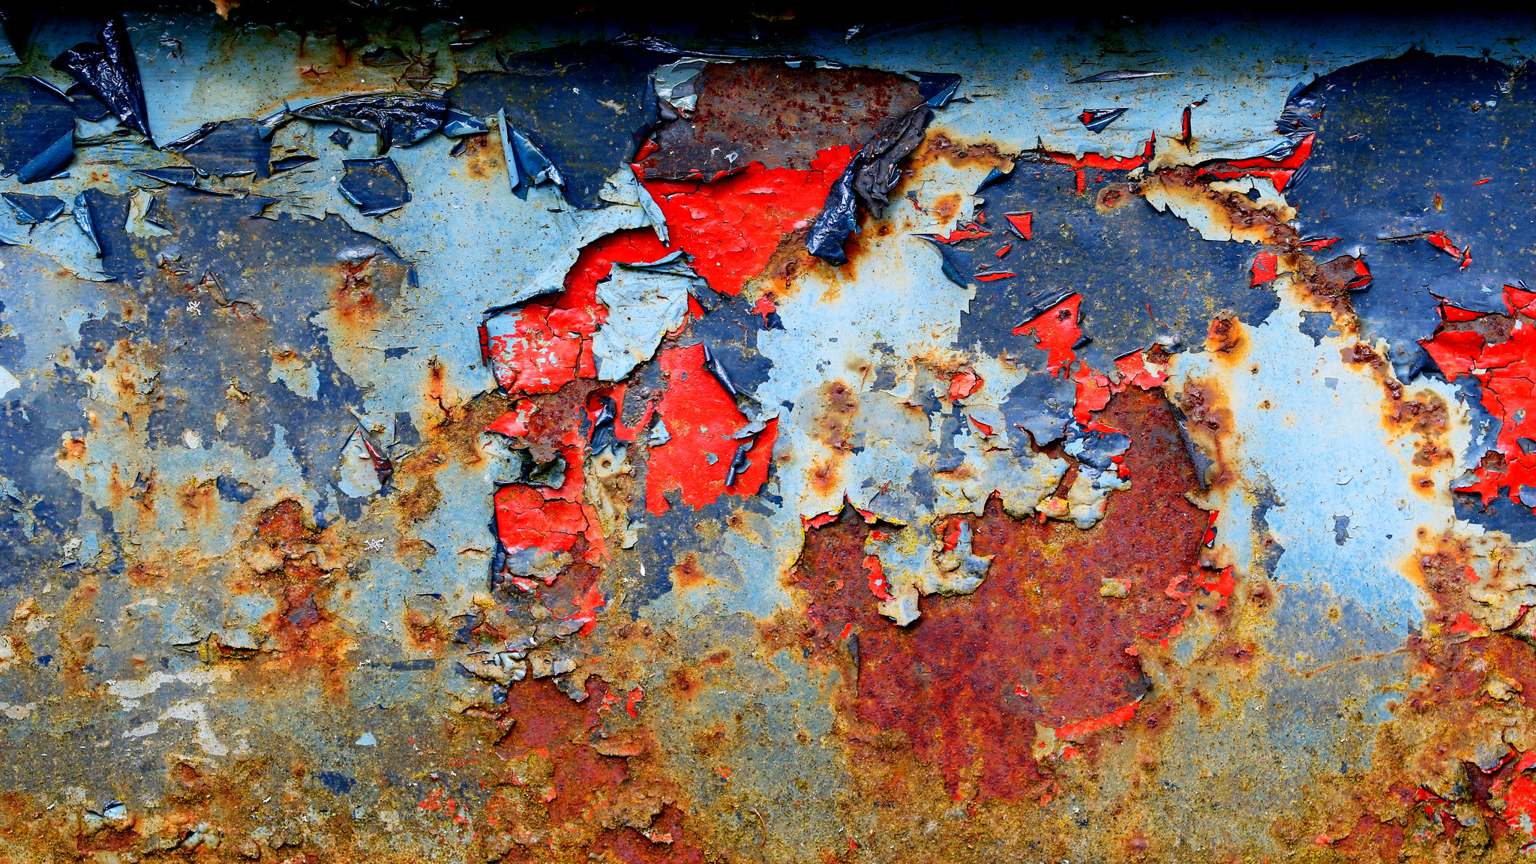
V&R Mapping App Usability Study Questions
Why did you select the shapes you did?
Why did you place them in these locations?
Were the tasks fun to do? Discuss your answer.
What would make it more fun?
What devices do you use to access the web?
If you could change this product in any way, what would you do?
Notes:
Image: https://www.flickr.com/photos/glassholic/16948415183/ by Etienne / CC BY-NC-ND 2.0
Some additional questions that are a little less generic:
Would it have been helpful to have a list of online services, apps, resources to use as examples or prompts?
Besides those you already mentioned or used in the app evaluation, what other sources, sites, apps, etc. do you use for academics, career, and professional interests?
What do you think about having access to a YouTube video instead of, or in addition to, the printed help we sent you?

Slide 69
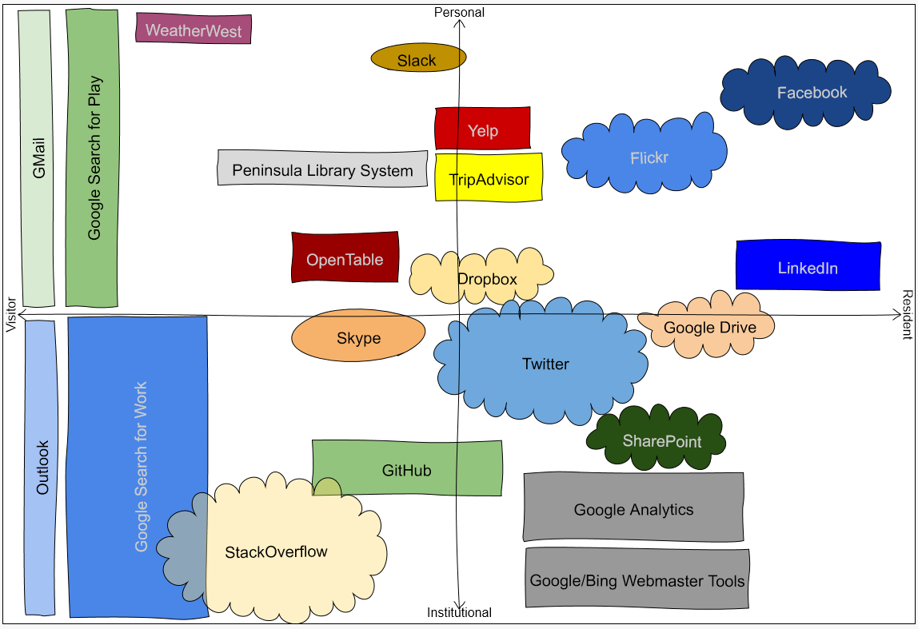
The App:
http://oc.lc/vrmap
Use It Now!
The Video:
https://youtu.be/6ai0ZO3lDR4
Play It Now!
Notes:
OCLC Research. (2016, May 5). Using the Digital Visitors and Residents app. [YouTube video]. [Available: https://www.youtube.com/watch?v=6ai0ZO3lDR4].
The app is available at http://oc.lc/vrmap.

Slide 70
Ethnographic research:
rich description
(Connaway & Powell, 2010, p. 262)
Notes:
Connaway, L. S., & Powell, R. R. (2010). Basic research methods for librarians. Santa Barbara: Libraries Unlimited.
“The study of the culture and social organisation of a particular group, as well as the published result of such study” (Khoo, Rozaklis & Hall, 2012, p. 83).
Khoo, M., Rozaklis, L., & Hall, C. (2012). A survey of the use of ethnographic methods in the study of libraries and library users. Library and Information Science Research, 34(2), 82-91.

Slide 71
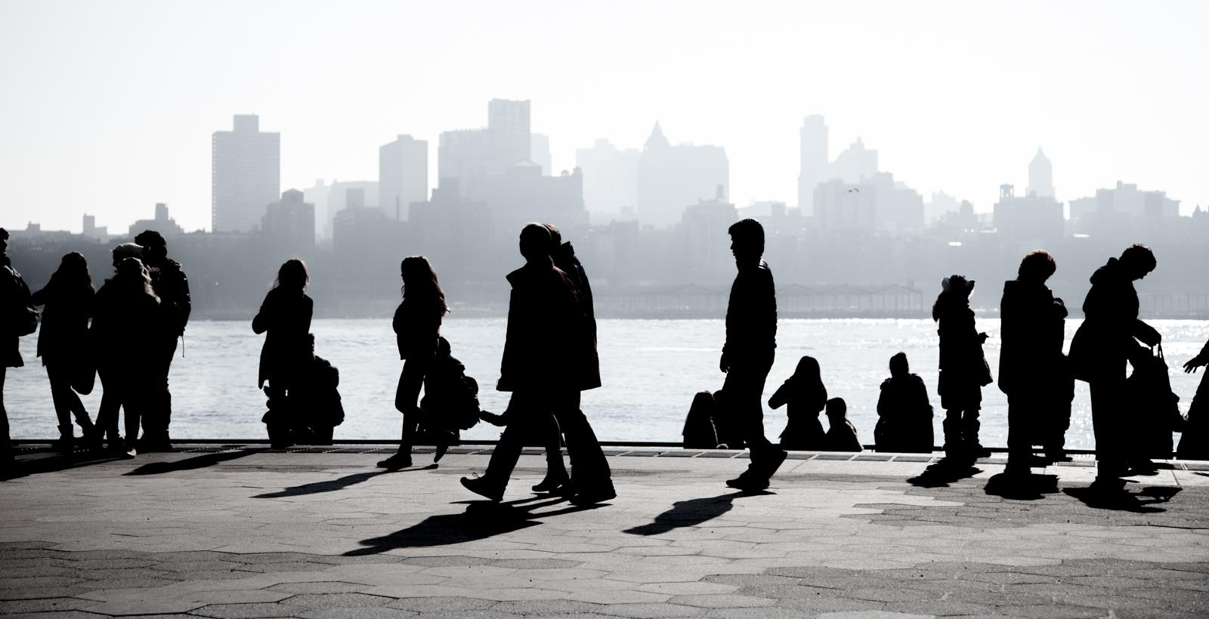
Ethnographic research
Incredibly detailed data
Time consuming
Establishing rapport
Selecting research participants
Transcribing observations & conversations
Keeping diaries
(Connaway & Powell, 2010, p. 175)
(Khoo, Rozaklis, & Hall, 2012, p.83)
Notes:
Image: https://www.flickr.com/photos/severalseconds/8476908394/ by Several seconds / CC BY-NC-ND 2.0
Connaway, L. S., & Powell, R. R. (2010). Basic research methods for librarians. Santa Barbara: Libraries Unlimited.
Khoo, M., Rozaklis, L., & Hall, C. (2012). A survey of the use of ethnographic methods in the study of libraries and library users. Library and Information Science Research, 34(2), 82-91.

Slide 72
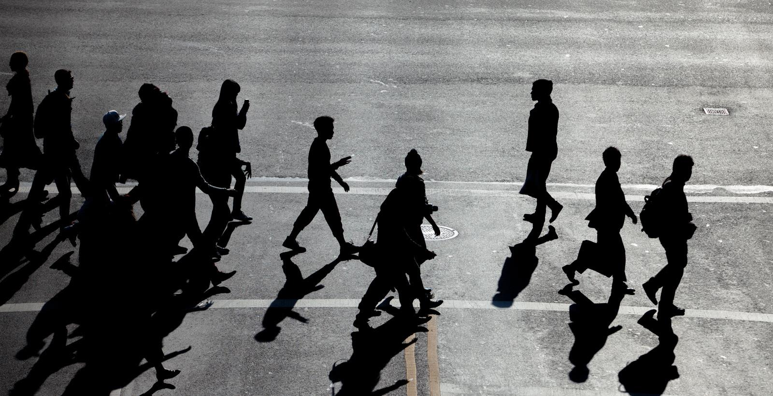
Participant/Immersive Observations
Move into the setting as deeply as possible
Disturb participants as little as possible
Participant observation
Open, direct interaction and observation as part of the group
(Connaway & Powell, 2010, p. 218)
Notes:
Image: https://www.flickr.com/photos/severalseconds/10296876914/ by Several seconds / CC BY-NC-ND 2.0
Connaway, L. S., & Powell, R. R. (2010). Basic research methods for librarians. Santa Barbara: Libraries Unlimited.
Example of participant observation: researcher appears to reference librarians as a patron.

Slide 73
Continuum of Participation
None
Active membership
Complete participation
Passive
Observation-focused
Moderate membership
Complete membership
(Connaway & Powell, 2010, p. 218)
Notes:
Connaway, L. S., & Powell, R. R. (2010). Basic research methods for librarians. Santa Barbara: Libraries Unlimited.

Slide 74
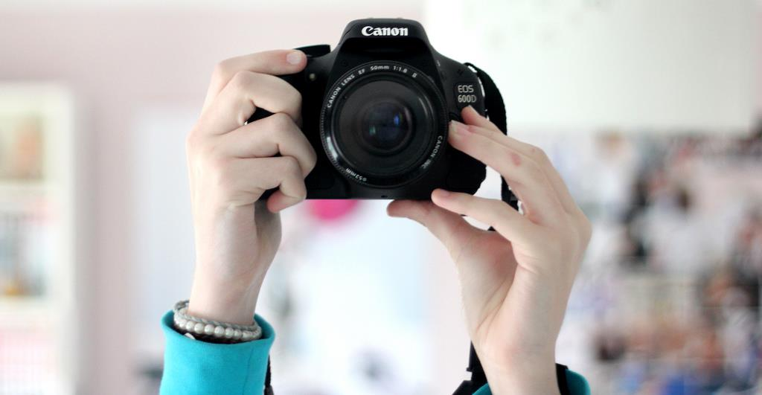
Photo diaries
Elicitation tool
Jog interviewees’ memory of detail about a person, place or event
Ask participants to take a short set of photos
List of things you want them to photograph
Conduct follow-up interviews for context of photo
(THE ERIAL Project, 2011, p.13)
(Foster & Gibbons, 2007, p. 40)
Notes:
Image: https://www.flickr.com/photos/sophielovescute/6883522255/ by Sophie / CC BY-NC-ND 2.0
Asher, A., & Miller, S. (2011). A practical guide to ethnographic research in academic libraries. http://www.erialproject.org/wp-content/uploads/2011/03/Toolkit-3.22.11.pdf
Foster, N. F., & Gibbons, S. (2007). Studying students: The undergraduate research project at the University of Rochester. Chicago: Association of College and Research Libraries.

Slide 75
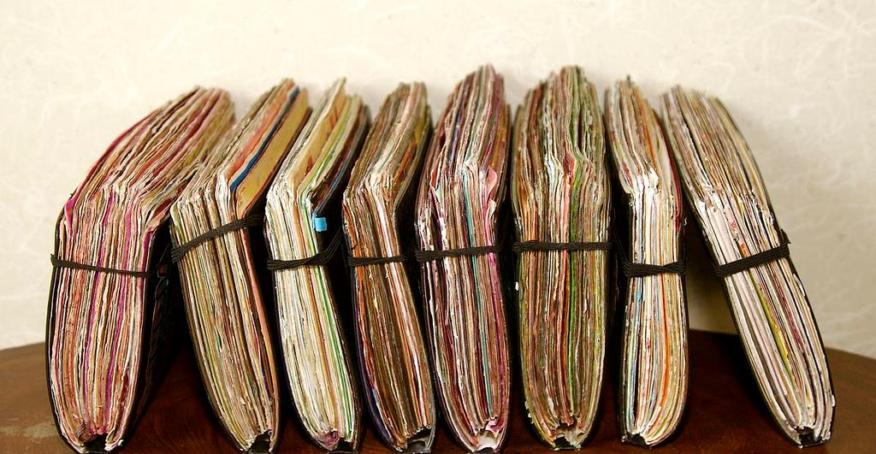
Diaries
Ethnographic data collection technique
Get people to describe what has happened
Center on defined events or moments
(Connaway & Powell, 2010)
Notes:
Image: https://www.flickr.com/photos/gbsk/4980421657/ by Barry Silver / CC BY 2.0
The diaries are an ethnographic data collection technique and a form of event sampling, which can focus participant attention on those areas which most interest researchers. Connaway and Powell (2010) point out that instruments (like diaries) that are intended to get people to describe what has just happened to them may be affected by distortions of memory and retrospection. They recommend that the question under review “center on discrete, defined events or moments so that such recording effort becomes reasonable and recall efforts are relatively straightforward” (Connaway and Powell 2010, 222).
Ethnography
(From Basic Research Methods 5th Edition, p. 175-176)
Ethnography involves establishing rapport, selecting research participants, transcribing observations and conversations, and keeping diaries, although Geertz believes that none of these techniques or procedures adequately defines the venture. He believes ethnography is defined by the kind of intellectual effort it is, “an elaborate venture in ‘thick description.’ ”
Reality, as perceived by the observer, is described in such detail that the reader can experience the total event as if he or she had actually been involved in it.
The goal of ethnography is to establish rapport with target communities, via a flexible toolkit of methods including participant observation, structured and unstructured interviews, reliance on selected research participants as “key informants,” and keeping diaries. The analytical intellectual work of ethnography involves being able to engage in a particular way of seeing (Wolcott 2008) that is informed by the ethnographer’s immersion in the reality of other people’s existence. Such qualitative data must be approached and interpreted in a way that recognizes and retains this richness (Connaway and Powell 2010).
Geertz, C. (1973). The interpretation of cultures: Selected essays. New York: Basic Books.
Connaway, L. S., & Powell, R. R. (2010). Basic research methods for librarians. Santa Barbara: Libraries Unlimited.

Slide 76
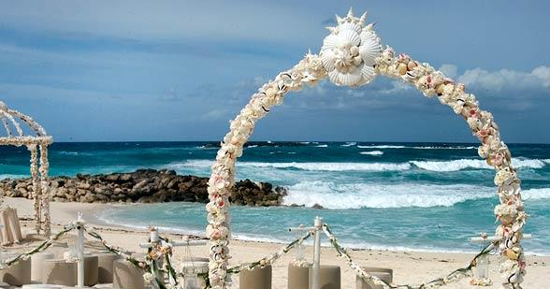
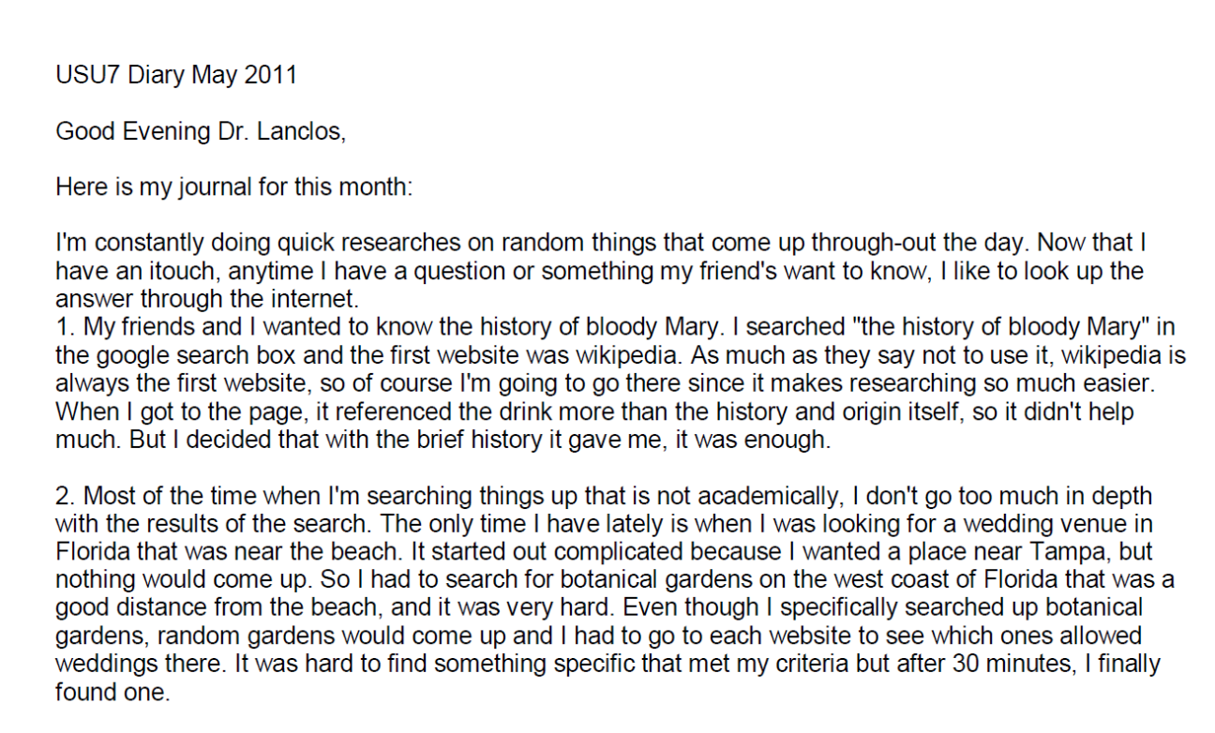
Example:
Digital Visitors and Residents Diaries
Notes:
Image: https://www.flickr.com/photos/xubangwen/9922453463/ by Mathilda Samuelsson / CC BY-SA 2.0
Screenshot: USU7 Emg Dry1 Ph1 (Digital Visitors and Residents, USU7, Female, Age 19)
“March was a little more serious. We’re nearing election time and all that jazz, and this is the first election I’ll be able to vote in, so I’ve been doing a bit of reading on a few of the candidates (not much, mind you). As a side note, I’m kind of debating whether or not I should actually vote in this election since I have such little knowledge on the candidates.” (Digital Visitors and Residents, USU12, Male, Age 19) USU12 Est Dry2 Ph2
“Um they do have a search box but I didn’t—I didn’t use that. Um I pretty much just, I pretty much just clicked links.” (Digital Visitors and Residents, USU12, Male, Age 19, 30:37) USU12 Est Follup Int1 Ph3

Slide 77
summary of observations or data in such a manner that they provide answers to the hypothesis or research questions
Analysis:
(Connaway & Powell, 2010, p. 262)
Notes:
Connaway, L. S., & Powell, R. R. (2010). Basic research methods for librarians. Santa Barbara: Libraries Unlimited.

Slide 78
Analysis
Collection of data affects analysis of data
Ongoing process
Feeds back into research design
Theory, model, or hypothesis must grow from data analysis
Notes:
Image: https://www.flickr.com/photos/creatocrat/4423113441/ by creatocrat / CC BY-NC-ND 2.0

Slide 79
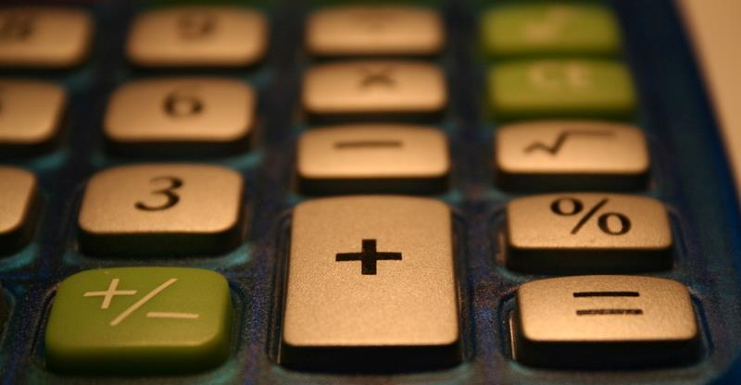
Analyzing Data
Two approaches
Ethnographic summary
Qualitative
Direct quotations
“Thick description”
(Geertz, 1973, p.6)
Content analysis approach
Numerical descriptions of data
Tallying of mentions of specific factors
Can be combined
(Connaway & Powell, 2010. p.175)
(Connaway, Johnson, & Searing, 1997, p. 409)
(Geertz,1973. p.6)
Notes:
Image: https://www.flickr.com/photos/bamroberts/2230902429/ by Ben Roberts / CC BY-NC-ND 2.0
Connaway, L. S., Johnson, D. W., & Searing, S. (1997). Online catalogs from the users’ perspective: The use of focus group interviews. College and Research Libraries, 58(5), 403-420.
Geertz, C. (1973). The interpretation of cultures: Selected essays. New York: Basic Books.
Connaway, L. S., & Powell, R. R. (2010). Basic research methods for librarians. Santa Barbara: Libraries Unlimited.
Stability
Same data coded more than once by same coder with same results
Accuracy
Extent to which the classification of text corresponds to a standard
Reproducibility
Intercoder reliability
Same data coded with same results by more than one coder
Connaway, L. S., & Powell, R. R. (2010). Basic research methods for librarians. Santa Barbara: Libraries Unlimited.
Sense-Making the Information Confluence, Dervin, B., Connaway, L.S., & Prabha, C. 2003-2006 Sense-making the information confluence: The whys and hows of college and university user satisficing of information needs. Funded by the Institute of Museum and Library
Ethnographic & content analysis approach
Collated & ranked by frequency of response
Themes within each situation & type of user group
Quotations used
WorldCat.org.
Connaway, L. S., & Wakeling, S. (2012). To use or not to use Worldcat.org: An international perspective from different user groups. OCLC Internal Report.
Code-book
Findings divided by
Use
Strengths
Challenges & weaknesses
Suggestions for improvement

Slide 80
Codebook
I. Place
A. Internet
1. Search engine
a. Google
b. Yahoo
2. Social Media
a. FaceBook
b. Twitter
c. You Tube
d. Flickr/image sharing
e. Blogging
B. Library
1. Academic
2. Public
3. School (K-12)
C. Home
D. School, classroom, computer lab
E. Other
(White & Connaway, 2011-2012)
Notes:
Image: https://www.flickr.com/photos/matt_molina/2815688603/ by Matt Molina / CC BY-SA 2.0
How we used the codebook:
First: the 3 researchers and research assistant coded the same two transcripts, one US and one UK (both secondary school).
We met and re-met and coded and re-coded until there was agreement.
THEN we went our separate ways to code. BUT we still communicate with each other in our coding processes, because of the remote nature of our collaboration.
Coding is done on paper, for the most part, and then the codes are entered into word, or scanned and sent to research assistants, who enter the coding into NVivo9. When the research assistants are entering the coding, they notice discrepancies, document them, and generate a discussion about what was intended, and what should the final coding be.
This continuous communication provides more consistency in coding across the researchers.
When Inter-coder Reliability was calculated between all five coders it was found to be an average of 0.6380 for Kappa and an Agreement Percentage of 98%.
White, D. S., & Connaway, L. S. (2011-2014). Digital visitors and residents: What motivates engagement with the digital information environment. Funded by JISC, OCLC, and Oxford University. http://www.oclc.org/research/activities/vandr.html

Slide 81
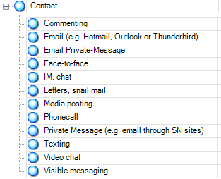
NVivo 10
Qualitative research software
Upload documents, PDFs, & videos
Create nodes & code transcripts
Merge files
Queries
Reports
Models
(QSR International, 2011)
Notes:
Image: https://www.flickr.com/photos/mervynchua/5441109097/ by Mervyn Chua / CC BY-NC 2.0
QSR International. (2011). NVivo 9: Getting started. Retrieved from http://download.qsrinternational.com/Document/NVivo9/NVivo9-Getting-Started-Guide.pdf
Screenshot of our codebook in Nvivo 9

Slide 82
Example:
Direct Quotations Digital Visitors and Residents
“It’s like a taboo I guess with all teachers, they just all say – you know, when they explain the paper they always say, “Don’t use Wikipedia.”
(USU7, Female, Age 19)
Notes:
Image: https://www.flickr.com/photos/derekbruff/11302153574/ by Derek Bruff / CC BY-NC 2.0
Covert online study habits
Wikipedia
Don’t cite
Widely used
Guilt
Students & teachers disagree
Quality sources
There is a “Learning Black Market”: learners use non-traditional sources but feel they cannot talk about them in an institutional context. Wikipedia usage is an example of this. (White & Connaway, 2011)
“I mean if teachers don’t like using Wikipedia they don’t want you to use Wikipedia. A lot of students will still use Wikipedia and then cite another source. As long as it has the same information and it is not word for word or anything they’ll use Wikipedia because it is the easiest thing to go look up on Wikipedia. It will give you a full in-depth detailed thing about the information. Teachers don’t just like it because it’s not the most reliable source since anyone can post something on there even though the site is monitored, it’s because it’s too easy.” (Digital Visitors and Residents, USU3 0:30:59, Male Age 19)
Students’ Perceptions of Teachers’ opinions of Wikipedia:
“Avoid it.” (Digital Visitors and Residents, UKS8 0:28:28.3, Female Age 16)
“They say it’s because anyone can make up – I mean, anyone can add information on there but I mean when I’ve actually looked into information it seemed the same as any information I find anywhere else. I mean, it’s not like if you look up fourth of July, it’s not like it gives you like some weird explanation of aliens or something.” (Digital Visitors and Residents, USU7 0:33:14, Female Age 19)
Students’ on Wikipedia:
“I use it, kind of like, I won't cite it on my papers but I, kind of, use it as a like, as a start off line. I go there and look up the general information, kind of, read through it so I get a general idea what it is. Then I start going through my research.” (Digital Visitors and Residents, USU7, 0:33:49, Female, Age 19)
“Everyone knows that you try not to use Wikipedia as a source because it is a cardinal sin.” (Digital Visitors and Residents, UKU3, 0:31:03, Female Age 19)
Student: “Ha ha.” I realised that there were some undergraduates that had some papers due yesterday because they were like “Oh, Wikipedia was down! Now where am I going to get my information?”
Interviewer: I know, now it’s not going to happen. But that’s not your problem because you don’t do that.
Student: Exactly. No. I like going to Wikipedia and going “Ha ha ha ha ha.” (Digital Visitors and Residents, USG5 , 0:57:26, Female, Age 30)
White, D. S., & Connaway, L. S. (2011-2014). Digital visitors and residents: What motivates engagement with the digital information environment. Funded by JISC, OCLC, and Oxford University. http://www.oclc.org/research/activities/vandr.html
Connaway, L. S., Lanclos, D., & Hood, E. M. (2013). “I find Google a lot easier than going to the library website.” Imagine ways to innovate and inspire students to use the academic library. In Proceedings of the Association of College & Research Libraries (ACRL) 2013 conference, 289-300. Retrieved from http://www.ala.org/acrl/sites/ala.org.acrl/files/content/conferences/confsandpreconfs/2013/papers/Connaway_Google.pdf
Connaway, L. S., Lanclos, D., White, D., Le Cornu, A., & Hood, E. M. (2013). User-centered decision making: A new model for developing academic library services and systems. IFLA Journal, 39(1), 30-36.
Connaway, L. S., White, D., Lanclos, D., & Le Cornu, A. (2013). Visitors and residents: What motivates engagement with the digital information environment? Information Research, 18(1). Retrieved from http://informationr.net/ir/18-1/infres181.html

Slide 83
Participant/Immersive Observations
Unobtrusive observation
Disguised
Field-based
Indirect
Reactive
(Connaway & Powell, 2010, p. 218)
Obtrusive observation
Build rapport with participants
Informal for conversation
Formal to reinforce nonjudgmental interaction
(Connaway & Powell, 2010, p. 218)
Notes:
Image: https://www.flickr.com/photos/fotostalker/15198686245/ by MFer Photography / CC BY-ND 2.0
Connaway, L. S., & Powell, R. R. (2010). Basic research methods for librarians. Santa Barbara: Libraries Unlimited.
Example of participant observation: researcher appears to reference librarians as a patron.
Unobtrusive observation
Disguised
Researcher becomes part of the community while hiding the research
Field-based
Researcher manipulates a setting or situation in order to observe behaviors
Indirect
Researcher “observes” the artifacts or traces of behavior
Reactive
Direct or structured

Slide 84
Research Design
(Connaway & Powell, 2010, p. 262)
Notes:
Connaway, L. S., & Powell, R. R. (2010). Basic research methods for librarians. Santa Barbara: Libraries Unlimited.

Slide 85
Mixed Methods & Triangulation
Triangulation
Multiple methods of data collection (e.g., interviews (individual & group), observation, survey)
Benefits of Mixed Methods
Convergence, corroboration, correspondence, complementarity of results from 1 method with results from another
Development - Use results from 1 method to help develop or inform another
Initiation - Recasting of questions or results from 1 method to another
Expansion - Extend breadth & range of enquiry by using different methods
Notes:
Image: https://www.flickr.com/photos/ehktang/6833896689/ by H. K. Tang / CC BY-NC-ND 2.0

Slide 86
Example:
Digital Visitors and Residents Triangulation of Data
Several methods:
Semi-structured interviews (qualitative)
Diaries (qualitative)
Online survey (quantitative)
Enables triangulation of data
(Connaway et al., 2012)
Notes:
Image: https://www.flickr.com/photos/jbeuh/3368656628/ by Jean-Baptiste / CC BY-NC 2.0
“Several methods of data collection are being utilized in this study: semi-structured interviews, diaries, and an online survey. The multi-method design enables triangulation, which provides a cross examination of the data analysis and results. The quantitative and qualitative methods, including ethnographic methods that devote individual attention to the subjects, yield a very rich data set enabling multiple methods of analysis.”
Connaway, L. S., Lanclos, D., White, D. S., Le Cornu, A., & Hood, E. M. (2012). User-centered decision making: A new model for developing academic library services and systems. IFLA 2012 Conference Proceedings, August 11-17, Helsinki, Finland.
White, D. S., & Connaway, L. S. (2011-2014). Digital visitors and residents: What motivates engagement with the digital information environment. Funded by JISC, OCLC, and Oxford University. http://www.oclc.org/research/activities/vandr.html

Slide 87
Key Questions for Mixed Methods
Use methods simultaneously or sequentially?
Which method, if any, has priority? Why?
Why mixing? E.g., triangulation, explanation, or exploration?
How do mixed methods impact data analysis?
Analyzed sequentially, integrated analysis, cross-method analysis?
Notes:
Image: https://www.flickr.com/photos/wandrus/8434921527/ by William Andrus / CC BY 2.0

Slide 88
Outcomes of Mixed Methods
Validity - enhanced
Offset - weaknesses & draw on strengths
Completeness- more comprehensive account
Explanation - one method helps explain findings of another.
Unexpected results - surprising, intriguing, add to richness of findings
Notes:
Image: https://www.flickr.com/photos/artcriminal/15788410874/ by Art Crimes / CC BY-NC-ND 2.0

Slide 89
Outcomes Exercise Part 2

Slide 90
Pilot Study Activity

Slide 91
Questions?

Slide 92
Thank You
Lynn Silipigni Connaway, Ph.D.
Senior Research Scientist
OCLC Research
connawal@oclc.org
Marie L. Radford, Ph.D.
Ph.D. Director & Professor,
School of Communication & Information
Rutgers University
mradford@rutgers.edu
Notes:
92
92
92

Slide 93
References
Asher, A., & Miller, S. (2011). A practical guide to ethnographic research in academic libraries. http://www.erialproject.org/wp-content/uploads/2011/03/Toolkit-3.22.11.pdf
Association of College and Research Libraries. (2010). Value of academic libraries: A comprehensive research review and report. Researched by Megan Oakleaf. Chicago: Association of College and Research Libraries.
Charmaz, K. (2006). Constructing grounded theory: A practical guide through qualitative analysis. Thousand Oaks, CA: Sage.
Connaway, L. S., Johnson, D. W., & Searing, S. (1997). Online catalogs from the users’ perspective: The use of focus group interviews. College and Research Libraries, 58(5), 403-420.
Connaway, L. S., Lanclos, D., & Hood, E. M. (2013). “I find Google a lot easier than going to the library website.” Imagine ways to innovate and inspire students to use the academic library. In Proceedings of the Association of College & Research Libraries (ACRL) 2013 conference, 289-300. Retrieved from http://www.ala.org/acrl/sites/ala.org.acrl/files/content/conferences/confsandpreconfs/2013/papers/Connaway_Google.pdf
Connaway, L. S., Lanclos, D., White, D. S., Le Cornu, A., & Hood, E. M. (2012). User-centered decision making: A new model for developing academic library services and systems. IFLA 2012 Conference Proceedings, August 11-17, Helsinki, Finland.
Connaway, L. S., Lanclos, D., White, D., Le Cornu, A., & Hood, E. M. (2013). User-centered decision making: A new model for developing academic library services and systems. IFLA Journal, 39(1), 30-36.
Connaway, L. S., & Powell, R. R. (2010). Basic research methods for librarians. Santa Barbara: Libraries Unlimited.
Connaway, L. S., & Radford, M. L. (2011). Seeking synchronicity: Revelations and recommendations for virtual reference. Dublin, OH: OCLC Research. Retrieved from http://www.oclc.org/reports/synchronicity/full.pdf

Slide 94
References
Connaway, L. S., & Wakeling, S. (2012). To use or not to use Worldcat.org: An international perspective from different user groups. OCLC Internal Report.
Connaway, L. S., White, D., Lanclos, D., & Le Cornu, A. (2013). Visitors and residents: What motivates engagement with the digital information environment? Information Research, 18(1). Retrieved from http://informationr.net/ir/18-1/infres181.html
Corbin J., & Morse, J. M. (2003). The unstructured interactive interview: Issues of reciprocity and risks when dealing with sensitive topics. Qualitative Inquiry, 9(3), 335–354. doi:10.1177/1077800403009003001
Denzin, N. K., & Lincoln, Y. S. (2005). The Sage handbook of qualitative research. Thousand Oaks, CA: Sage Publications.
Dervin, B., Connaway, L. S., & Prabha, C. (2003-2005). Sense-making the information confluence: The hows and the whys of college and university user satisficing of information needs. Funded by the Institute for Museums and Library Services (IMLS). Retrieved from http://www.oclc.org/research/activities/past/orprojects/imls/default.htm
Flanagan, J. C. (1954). The critical incident technique. Psychological Bulletin, 51(4), 327-358.
Foster, N. F., & Gibbons, S. (2007). Studying students: The undergraduate research project at the University of Rochester. Chicago: Association of College and Research Libraries.
Geertz, C. (1973). The interpretation of cultures: Selected essays. New York: Basic Books.
Hernon, P., & Altman, E. (1998). Assessing service quality: Satisfying the expectations of library customers. Chicago: ALA.

Slide 95
References
Janes, J. (1999). On research survey construction. Library Hi Tech, 17(3), 321-325.
Khoo, M., Rozaklis, L., & Hall, C. (2012). A survey of the use of ethnographic methods in the study of libraries and library users. Library and Information Science Research, 34(2), 82-91.
Kvale, S. (1996). Interviews: An introduction to qualitative research interviewing. Thousand Oaks, CA: Sage Publications.
Lederman, L. C. (1996). Asking questions and listening to answers: A guide to using individual, focus group, and debriefing interviews. Dubuque, IA: Kendall/Hunt.
Lindlof, T., & Taylor, B. (2010). Qualitative communication research methods (3rd ed.). Thousand Oaks, CA: Sage Publications.
Miles, M., & Huberman, A. M. (1994). Qualitative data analysis: An expanded sourcebook (2nd ed.). Thousand Oaks, CA: Sage Publications.
QSR International. (2011). NVivo 9: Getting started. Retrieved from http://download.qsrinternational.com/Document/NVivo9/NVivo9-Getting-Started-Guide.pdf
Spradley, J. (1979). The ethnographic interview. Belmont, CA: Wadsworth.
Strauss, A., & Corbin, J. (1990). Basics of qualitative research: Grounded theory procedures and techniques. Newbury Park, CA: Sage Publications.
White, D. S., & Connaway, L. S. (2011-2014). Digital visitors and residents: What motivates engagement with the digital information environment. Funded by JISC, OCLC, and Oxford University. http://www.oclc.org/research/activities/vandr.html
Zweizig, D., Johnson, D. W., Robbins, J., & Besant, M. (1996). The tell it! manual. Chicago: ALA.

Slide 96
Recommended Readings
Besara, R. (2013). See results: Tips and tools for visualizing library data. Presented at the Qualitative and Quantitative Methods in Libraries International Conference (QQML 2013), June 4, 2013.
Connaway, L. S. (1996). Focus group interviews: A data collection methodology. Library Administration & Management, 10(4), 231-239.
Connaway, L. S., Johnson, D. W., & Searing, S. (1997). Online catalogs from the users’ perspective: The use of focus group interviews. College and Research Libraries, 58(5), 403-420. Retrieved from http://crl.acrl.org/content/58/5/403.full.pdf+html?sid=a644ac52-8b04-4a87-806a-652f69ebd4bb
Connaway, L. S., & Powell, R. R. (2010). Basic research methods for librarians (5th ed.). Santa Barbara: Libraries Unlimited.
Connaway, L. S., & Radford, M. L. (Forthcoming). Basic research methods in library and information science (6th ed.). Littleton, CO: Libraries Unlimited.
Connaway, L. S., & Radford, M. L. (2011). Seeking Synchronicity: Revelations and recommendations for virtual reference. Dublin, OH: OCLC Research. Retrieved from http://www.oclc.org/reports/synchronicity/full.pdf
Connaway, L. S., & Wakeling, S. (2012). To use or not to use Worldcat.org: An international perspective from different user groups. OCLC Internal Report.
Consiglio, D., Furlong, K., & Holbert, G. (2012). Setting the state for success: A discussion of insights from the MISO survey. Presentation at the ELI Annual Meeting, February 2012, Austin, TX.

Slide 97
Recommended Readings
Consiglio, D. M., Furlong, K. & Holbert, G. (2013). Assessing the quality & effectiveness of library services using the MISO survey. Presented at the Qualitative and Quantitative Methods in Libraries International Conference (QQML 2013), June 6, 2013.
Dervin, B., Connaway, L. S., & Prabha, C. (2003-2006). Sense-making the information confluence: The whys and hows of college and university user satisficing of information needs. Funded by the Institute of Museum and Library Services (IMLS). Retrieved from http://www.oclc.org/research/activities/past/orprojects/imls/default.htm
Kaufman, P., & Watstein, S. B. (2008). Library value (Return on Investment, ROI) and the challenge of placing a value on public services. Reference Services Review, 36(3), 226-231.
Maciel, M. L. (2013). Identifying our customers’ needs and expectations: A data driven approach and analysis through the use of LibQUAL+TM (using five years’ data from LibQUAL+TM in Europe). Presented at the Qualitative and Quantitative Methods in Libraries International Conference (QQML 2013), June 4, 2013.
Oliver, D. G., Serovich, J. M., & Mason, T. L. (2005). Constraints and opportunities with interview transcription: Towards reflection in qualitative research. Social Forces, 84(2), 1273-1289.
Radford, M. L. (2006). The critical incident technique and the qualitative evaluation of the Connecting Libraries and Schools Project. Library Trends, 54(1), 46-64.
Radford, M. L. (1999). The reference encounter: Interpersonal communication in the academic library. Chicago: Association of College & Research Libraries.

Slide 98
Recommended Readings
Radford, M. L. (1996). Communication theory applied to the reference encounter: An analysis of critical incidents. The Library Quarterly, 66(2), 123-137.
Radford, M. L., Radford, G. P., Connaway, L. S., & DeAngelis, J. A. (2011). On virtual face-work: An ethnography of communication approach to a live chat reference interaction. The Library Quarterly, 81(4), 431-453.
Radford, M. L. (2008). How to conduct a focus group. Marketing Library Services, 22(1), 1-3.
Rodriguez, D. A., & Norberg, L. R. (2013). Assessing library impact on student learning outcomes: A case study using the Understanding Library Impacts protocol. Presented at the Qualitative and Quantitative Methods in Libraries International Conference (QQML 2013), June 7, 2013.
Taylor, M. (2013). Academic library use and undergraduate engagement and persistence at a large public research university. Presented at the Qualitative and Quantitative Methods in Libraries International Conference (QQML 2013), June 4, 2013.
Zweizig, D., Johnson, D. W., Robbins, J., & Bewsant, M. (1996). The tell it! manual. Chicago: ALA.

Slide 99
Image Attributions
Slide 2: Image: https://www.flickr.com/photos/lostvegas/433710146/ by pEtE / CC BY-NC-ND 2.0
Slide 3: Image: https://www.flickr.com/photos/wiccked/57466134/ by melanie cook / CC BY-NC-ND 2.0
Slide 4: Image: https://www.flickr.com/photos/nicholasjon/4101203095/ by Nick Olejniczak / CC BY-NC 2.0
Slide 5: Image: https://www.flickr.com/photos/khawkins04/5262741640/ by Ken Hawkins / CC BY 2.0
Slide 6: Image: https://www.flickr.com/photos/dutchsimba/13628401284/ by Dutch Simba / CC BY-NC-ND 2.0
Slide 8: Image: https://www.flickr.com/photos/1-25_sbct/6357990295/ by Arctic Wolves / CC BY 2.0
Slide 9: Image: https://www.flickr.com/photos/acriley/5203916631/ by A. Charlotte Riley / CC BY-NC-ND 2.0
Slide 10: Image: https://www.flickr.com/photos/r_stephen/6906698996/ by Stephen Rush / CC BY-SA 2.0
Slide 12: Image: https://www.flickr.com/photos/lorenkerns/14544328432/ by Loren Kerns / CC BY 2.0
Slide 13: Image: https://www.flickr.com/photos/bennyseidelman/5893495655/ by Ben Seidelman / CC BY 2.0
Slide 14: Image: https://www.flickr.com/photos/didmyself/6530389351/ by Daniel Kulinski / CC BY-NC-SA 2.0
Slide 15: Image: https://www.flickr.com/photos/catzrule/8381068183/ by Rick Payette / CC BY-NC-ND 2.0
Slide 16: Image: https://www.flickr.com/photos/-krieg-/6387036687/ by Torus Mastaz / CC BY-NC-ND 2.0
Slide 18: Image: https://www.flickr.com/photos/bendisinger/13857481123/ by Benjamin Disinger / CC BY-NC-ND 2.0

Slide 100
Image Attributions
Slide 19: Image: https://www.flickr.com/photos/silkegb/3110013305/ by Silke Gerstenkorn / CC BY-NC 2.0
Slide 20: Image: https://www.flickr.com/photos/25228175@N08/3689046537/ by Elvin / CC BY-NC 2.0
Slide 21: Image: https://www.flickr.com/photos/jantruter/8609970752/ by Jan Truter / CC BY-NC-ND 2.0
Slide 23: Image: https://www.flickr.com/photos/allkindsofnew/9500650217/ by Harold Navarro / CC BY-ND 2.0
Slide 24: Image: https://www.flickr.com/photos/10332960@N03/13305699454/ by John Blower / CC BY-NC-ND 2.0
Slide 25: Image: https://www.flickr.com/photos/kjarrett/8014985968/ by Kevin Jarrett / CC BY 2.0
Slide 26: Image: https://www.flickr.com/photos/iaourtofrez/14656421640/ by Ynot-Na / CC BY-NC-ND 2.0
Slide 27: Image: https://www.flickr.com/photos/ed10vi/5786763218/ by Eduardo Diez Viñuela / CC BY-SA 2.0
Slide 28: Image: https://www.flickr.com/photos/anyalogic/2315310261/ by Anna Levinzon / CC BY 2.0
Slide 29: Image: https://www.flickr.com/photos/beglendc/293075039/ by David Boyle / CC BY-SA 2.0
Slide 30: Image: https://www.flickr.com/photos/horrigans/5617092052/ by Sarah Horrigan / CC BY-NC 2.0
Slide 31: Image: https://www.flickr.com/photos/robwatling/5089229734/ by Rob Watling / CC BY-NC-ND 2.0
Slide 33: Image: https://www.flickr.com/photos/thomashawk/12012985364/ by Thomas Hawk / CC BY-NC 2.0
Slide 34: Image: https://www.flickr.com/photos/29668365@N08/2777606227/ by Dánae / CC BY 2.0

Slide 101
Image Attributions
Slide 35: Image: https://www.flickr.com/photos/sillymonkeyphoto/15462537274/ by D L / CC BY-NC-ND 2.0
Slide 37: Image: https://www.flickr.com/photos/khouri/6793949601/ by Michael Cory / CC BY-NC 2.0
Slide 39: Image: https://www.flickr.com/photos/62833283@N00/17217078330/ by Seamus McCauley / CC BY 2.0
Slide 41: Image: https://www.flickr.com/photos/28481088@N00/3091698923/ by tanakawho / CC BY-NC 2.0
Slide 42: Image: https://www.flickr.com/photos/niemster/93602172/ by Matt Niemi / CC BY-NC-ND 2.0
Slide 44: Image: https://www.flickr.com/photos/fotoremy/6768379679/ by Remy Remmerswaal / CC BY 2.0
Slide 45: Image: https://www.flickr.com/photos/108404544@N07/12941711194/ by Chris Searle / CC BY-NC-ND 2.0
Slide 48: Image: https://www.flickr.com/photos/studiocurve/13080208/ by studio curve / CC BY-NC-ND 2.0
Slide 49: Image: https://www.flickr.com/photos/seelensturm/8447829919/ by F_A / CC BY 2.0
Slide 51: Image: https://www.flickr.com/photos/bensonkua/4839019821/ by Benson Kua / CC BY-SA 2.0
Slide 52: Image: https://www.flickr.com/photos/17989497@N00/8651401959/ by Monika / CC BY-SA 2.0
Slide 53: Image: https://www.flickr.com/photos/cogdog/5841058123/ by Alan Levine / CC BY 2.0
Slide 54: Image: https://www.flickr.com/photos/gozalewis/4776747298/ by timlewisnm / CC BY-NC-ND 2.0
Slide 55: Image: https://www.flickr.com/photos/markomikkonen/8578620969/ by Marko Mikkonen / CC BY 2.0

Slide 102
Image Attributions
Slide 58: Image: https://www.flickr.com/photos/arwilkinson/10830400356/ by Andy Wilkinson / CC BY-SA 2.0
Slide 59: Image: https://www.flickr.com/photos/jenosaur/4731463366/ by jen Collins / CC BY-NC-ND 2.0
Slide 60: Image: https://www.flickr.com/photos/furibond/3267102279/ by jim / CC BY-SA 2.0
Slide 63: Image: https://www.flickr.com/photos/28481088@N00/2957770391/ by tanakawho / CC BY-NC 2.0
Slide 64: Image: https://www.flickr.com/photos/chasblackman/8502151556/ by Chase Elliott Clark / CC BY 2.0
Slide 65: Image: https://www.flickr.com/photos/kaeru/1599676842/ by Kars Alfrink / CC BY 2.0
Slide 68: Image: https://www.flickr.com/photos/glassholic/16948415183/ by Etienne / CC BY-NC-ND 2.0
Slide 71: Image: https://www.flickr.com/photos/severalseconds/8476908394/ by Several seconds / CC BY-NC-ND 2.0
Slide 72: Image: https://www.flickr.com/photos/severalseconds/10296876914/ by Several seconds / CC BY-NC-ND 2.0
Slide 74: Image: https://www.flickr.com/photos/sophielovescute/6883522255/ by Sophie / CC BY-NC-ND 2.0
Slide 75: Image: https://www.flickr.com/photos/gbsk/4980421657/ by Barry Silver / CC BY 2.0
Slide 76: Image: https://www.flickr.com/photos/xubangwen/9922453463/ by Mathilda Samuelsson / CC BY-SA 2.0

Slide 103
Image Attributions
Slide 78: Image: https://www.flickr.com/photos/creatocrat/4423113441/ by creatocrat / CC BY-NC-ND 2.0
Slide 79: Image: https://www.flickr.com/photos/bamroberts/2230902429/ by Ben Roberts / CC BY-NC-ND 2.0
Slide 80: Image: https://www.flickr.com/photos/matt_molina/2815688603/ by Matt Molina / CC BY-SA 2.0
Slide 81: Image: https://www.flickr.com/photos/mervynchua/5441109097/ by Mervyn Chua / CC BY-NC 2.0
Slide 82: Image: https://www.flickr.com/photos/derekbruff/11302153574/ by Derek Bruff / CC BY-NC 2.0
Slide 83: Image: https://www.flickr.com/photos/fotostalker/15198686245/ by MFer Photography / CC BY-ND 2.0
Slide 85: Image: https://www.flickr.com/photos/ehktang/6833896689/ by H. K. Tang / CC BY-NC-ND 2.0
Slide 86: Image: https://www.flickr.com/photos/jbeuh/3368656628/ by Jean-Baptiste / CC BY-NC 2.0
Slide 87: Image: https://www.flickr.com/photos/wandrus/8434921527/ by William Andrus / CC BY 2.0
Slide 88: Image: https://www.flickr.com/photos/artcriminal/15788410874/ by Art Crimes / CC BY-NC-ND 2.0

