Slide 1
ASIS&T Regional Meeting Dublin, OH
March 3, 2017
The Library in the Life of the User
Lynn Silipigni Connaway, PhD
Senior Research Scientist

Slide 2
Our traditional model was one in which we thought of the user in the life of the library
… but we are now increasingly thinking about the library
in the life of the user
(Connaway 2015)
(Dempsey 2015)
Notes:
Image: https://www.flickr.com/photos/91600944@N06/10572419153/ by Lorenzo Scheda / CC BY-NC-ND 2.0
Connaway, Lynn Silipigni, comp. 2015. The Library in the Life of the User: Engaging with People Where They Live and Learn. Dublin, OH: OCLC Research. http://www.oclc.org/content/dam/research/publications/2015/oclcresearch-library-in-life-of-user.pdf.
Dempsey, Lorcan. 2015. “Environmental Trends and OCLC Research.” Presented at the University of Notre Dame, Notre Dame, Indiana, September 28. http://www.oclc.org/content/dam/research/presentations/dempsey/dempsey-notre-dame-oclc-research-2015.pptx.

Slide 3
Need to provide services for what people actually do, not what they say they do
The workflow context
Convenience & context switching
Fragmentation is a deterrent
(Dempsey 2015)
Notes:
Image: https://www.flickr.com/photos/thyagohills/5009884654/ by Thyago - SORG|FX / CC BY 2.0
Dempsey, Lorcan. 2015. “Environmental Trends and OCLC Research.” Presented at the University of Notre Dame, Notre Dame, Indiana, September 28. http://www.oclc.org/content/dam/research/presentations/dempsey/dempsey-notre-dame-oclc-research-2015.pptx.

Slide 4
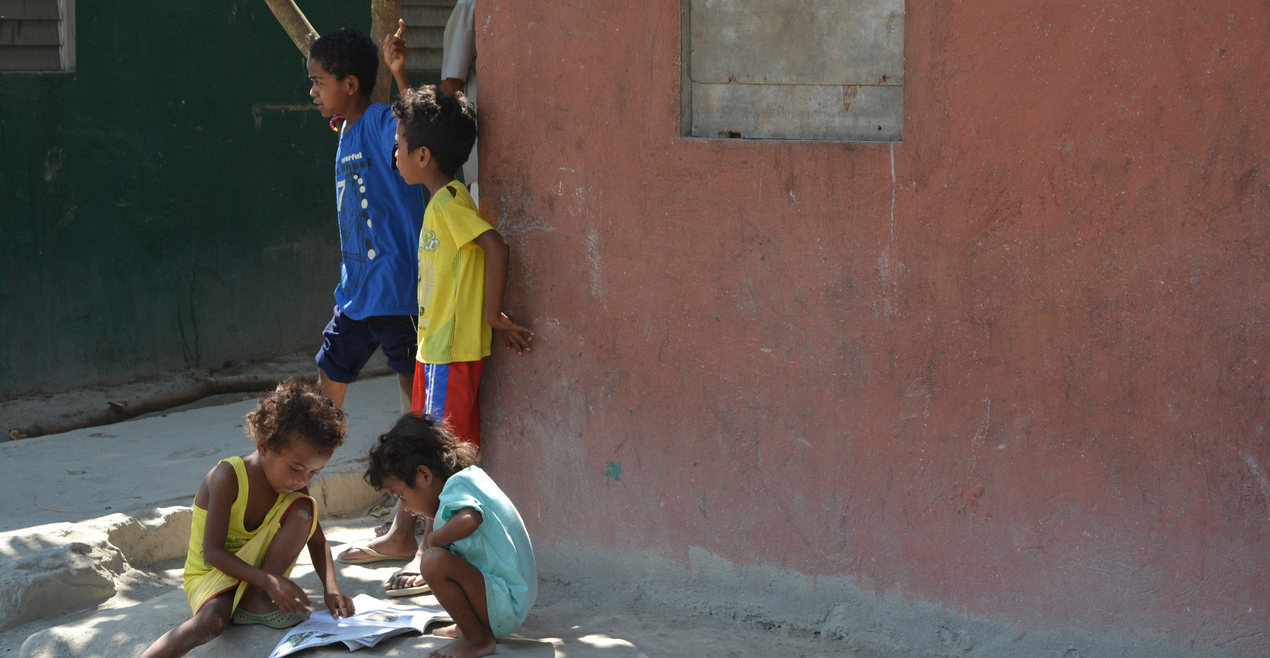
“Nearly 60 percent of the world’s people are still offline.”
(Pattillo 2016, 164)
Notes:
Image: https://www.flickr.com/photos/134037448@N03/26365644111/ by WorldRemit Comms / CC BY-SA 2.0
“Digital technologies have spread rapidly in much of the world, but the broader development benefits from using these technologies have lagged behind. While more than 40 percent of the world’s population has access to the Internet, nearly 6 billion people do not have high-speed Internet, making them unable to fully participate in the digital economy. Nearly 60 percent of the world’s people are still offline. The less educated and the bottom 40 percent of the welfare distribution worldwide are most vulnerable to technological changes in the labor market.”
World Bank. 2016. World Development Report 2016: Digital Dividends. Washington, DC: World Bank. www.worldbank.org/en/publication/wdr2016.
Quoted in Gary Pattillo. 2016. “Fast Facts.” College & Research Libraries News 77, no. 3: 164.

Slide 5
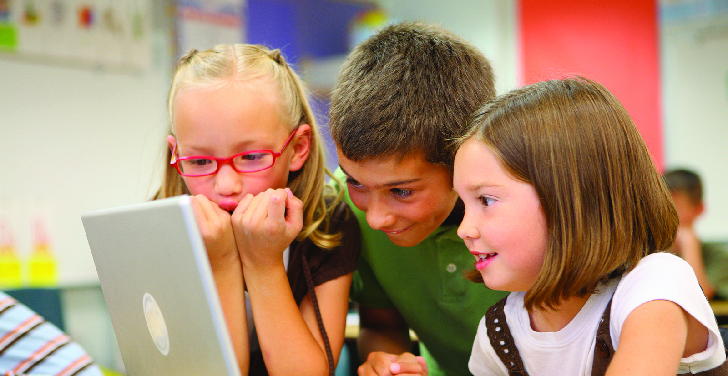
“Young people’s ability to reason about the information on the Internet can be summed up in one word: bleak.”
(Stanford History Education Group 2016, 4)
Notes:
Image: https://www.flickr.com/photos/lupuca/8720604364/ by Lucélia Ribeiro / CC BY-SA 2.0
““Young people’s ability to reason about the information on the Internet can be summed up in one word: bleak,” concluded a recent study by the Stanford History Education Group. The research studied responses from online evaluative tasks of students ranging from middle school to college. For example, more than 80 percent of middle-schoolers believed that a web ad, identified with the words “sponsored content,” was a real news story. Similarly, more than 80 percent of high school students had difficulty telling the difference between faked photos and real ones. “Despite their fluency with social media, many students are unaware of basic conventions for indicating verified digital information . . . in every case and at every level, we were taken aback by students’ lack of preparation.””
Stanford History Education Group. 2016. “Evaluating Information: The Cornerstone of Civic Online Reasoning.” November 22. https://sheg.stanford.edu/upload/V3LessonPlans/Executive%20Summary%2011.21.16.pdf.
Quoted in Gary Pattillo. 2017. “Fast Facts.” College & Research Libraries News 78, no. 1: 56.

Slide 6
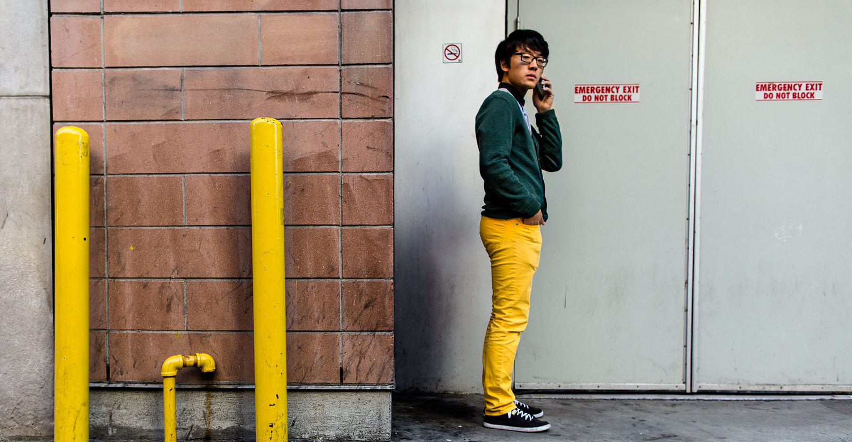
“…Americans indicate that they could make it a week or less without Internet access (67%)…”
(Birth 2015)
Notes:
Image: https://www.flickr.com/photos/orangegreenblue/10862779413/ by Kat Northern Lights Man / CC BY-NC 2.0
“A majority of Americans believe that technology has improved the overall quality of their lives (71 percent) and encourages people to be more creative (68 percent). At the same time, strong majorities also believe technology is creating a lazy society (73 percent), has become too distracting (73 percent), is corrupting interpersonal communications (69 percent), and is having a negative impact on literacy (59 percent).” “When faced with a list of technological devices and general life staples and asked how long they could live without each, majorities of Americans indicate that they could make it a week or less without Internet access (67%), a computer/laptop (60%), mobile phone (59%), or television (55%), with over two in ten going so far as to state that they simply could not live without them (27%, 22%, 26% and 21%, respectively).”
Birth, Allyssa. 2015. “More Than 7 in 10 Americans Think Technology has Become Too Distracting and is Creating a Lazy Society.” The Harris Poll 68. www.theharrispoll.com/health-and-life/Technology-Too-Distracting-Lazy-Society.html.

Slide 7
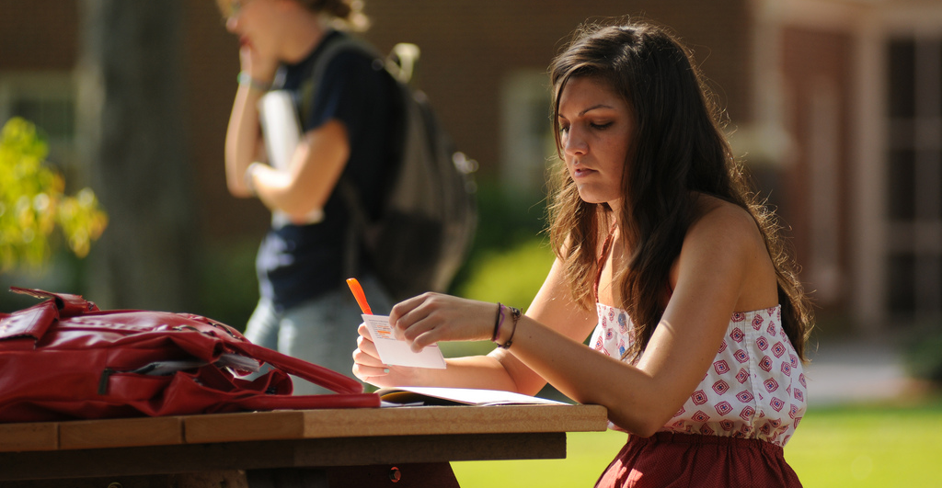
“Freshman and sophomore students using the university library as a place to study are more likely to have positive outcomes as measured by retention, graduation, and grade point average.”
(Pattillo 2015, 650)
Notes:
Image: https://www.flickr.com/photos/ucentralarkansas/5050793935/ by University of Central Arkansas Follow / CC BY-NC-ND 2.0
“Freshman and sophomore students using the university library as a place to study are more likely to have positive outcomes as measured by retention, graduation, and grade point average. Junior and senior undergraduates see positive outcomes when using the library as an information resource, rather than only as a place to study.”
Stemmer, John K., and David M. Mahan. 2016. “Investigating the Relationship of Library Usage to Student Outcomes.” College & Research Libraries 77, no. 3. http://crl.acrl.org/content/77/3/359.full.pdf+html.
Quoted in Gary Pattillo. 2015. “Fast Facts.” College & Research Libraries News 76, no. 11: 650.

Slide 8
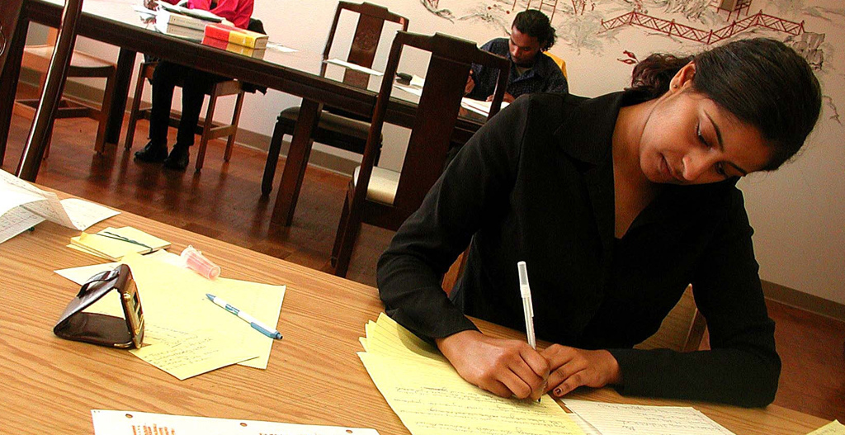
“A four-year longitudinal study of a freshman cohort at a large public university found that, as students matured, they used library resources more frequently for their research.”
(Pattillo 2016, 524)
Notes:
Image: https://www.flickr.com/photos/cunycommons/6561935761/ by CUNY Academic Commons / CC BY 2.0
“A four-year longitudinal study of a freshman cohort at a large public university found that, as students matured, they used library resources more frequently for their research. In their first semester, 69 percent of students said they started with Google while only 30 percent started with library resources. After four years, the percentage of participants starting their research with library resources rose to 45 percent. Librarian instruction and faculty source requirements both were associated with increased use of library resources.”
Perruso, Carol. 2016. “Undergraduates’ Use of Google vs. Library Resources: A Four-Year Cohort Study.” College & Research Libraries 77, no. 5: 614-630.
Quoted in Gary Pattillo. 2016. “Fast Facts.” College & Research Libraries News 77, no. 10: 524.

Slide 9
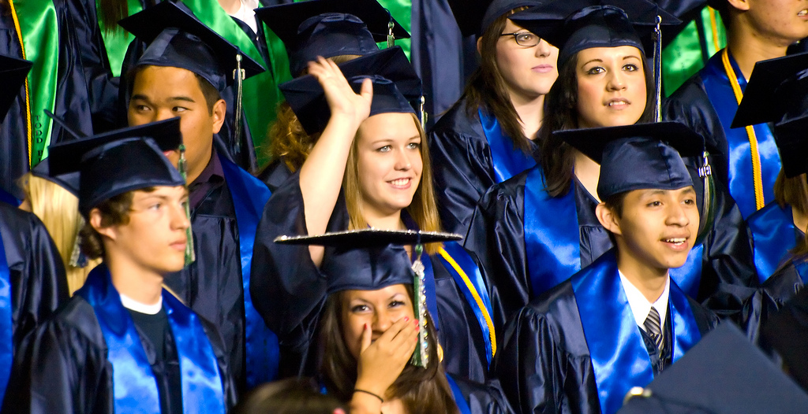
“The national graduation rate for public high school students rose to a new high…However, graduation rate gaps persist among the racial and ethnic subgroups.”
(Patillo 2016, 616)
Notes:
Image: https://www.flickr.com/photos/aboyandhisbike/3606916280/ by Michael B. / CC BY-NC-ND 2.0
“The national graduation rate for public high school students rose to a new high of 83.2 percent in 2014-15. Graduation rates increased for all reported groups of students, including all racial and ethnic subgroups, low-income students, English learners, and students with disabilities. However, graduation rate gaps persist among the racial and ethnic subgroups.”
National Center for Education Statistics. “Public High School 4-Year Adjusted Cohort Graduation Rate (ACGR), By Race/Ethnicity and Selected Demographics for the United States, the 50 states, and the District of Columbia: School Year 2014–15.” Common Core of Data, National Center for Education Statistics. http://nces.ed.gov/ccd/tables/ACGR_RE_and_characteristics_2014-15.asp.
Quoted in Gary Pattillo. 2016. “Fast Facts.” College & Research Libraries News 77, no. 11: 616.

Slide 10
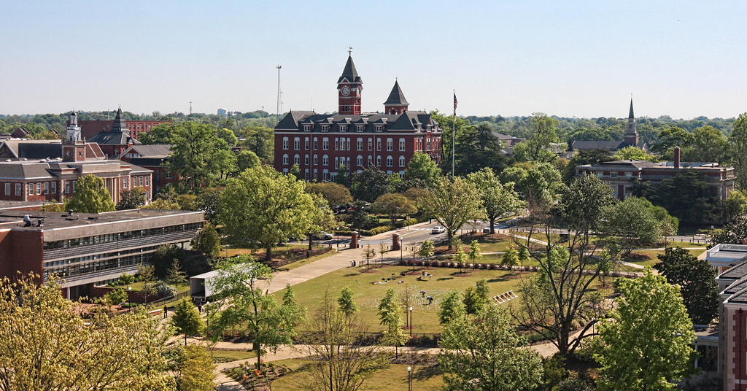
“The location of the library link on doctorate-granting institution websites correlates with research output.” (Simpson 2016)
Notes:
Image: https://www.flickr.com/photos/australianshepherds/4515927995/ by S. Carter / CC BY-SA 2.0
““The location of the library link on doctorate-granting institution websites correlates with research output. Doctoral granting institutions with higher research output put the hyperlink to their library on more prominent positions on the university website.”
Simpson, Jessica. “The Heart of the University: Library Link Location on Doctoral Granting Institutions Webpages and Correlation with Research Output.” Journal of Academic Librarianship 42, no. 5 (2016): 503–508.
Quoted in Gary Pattillo. 2016. “Fast Facts.” College & Research Libraries News 77, no. 10: 524.

Slide 11
E-reader device sales have been declining and traditional print publishing have remained stable.
(Alter 2015)
Notes:
Image: https://www.flickr.com/photos/eekim/15657137102/ by Eugene Kim / CC BY 2.0
“In the traditional publishing arena, “e-book sales fell by 10 percent in the first five months of this year. Digital books accounted last year for around 20 percent of the market, roughly the same as they did a few years ago.” Dedicated e-reader device sales are also declining. Traditional print publishing remained relatively stable during the same period. “The American Booksellers Association counted 1,712 member stores in 2,227 locations in 2015, up from 1,410 in 1,660 locations five years ago.””
Alter, Alexandra. 2015. “The Plot Twist: E-Book Sales Slip, and Print Is Far From Dead.” The New York Times, September 22. http://nyti.ms/1OPYEly.
Quoted in Gary Pattillo. 2015. “Fast Facts.” College & Research Libraries News 76, no. 10: 568.

Slide 12
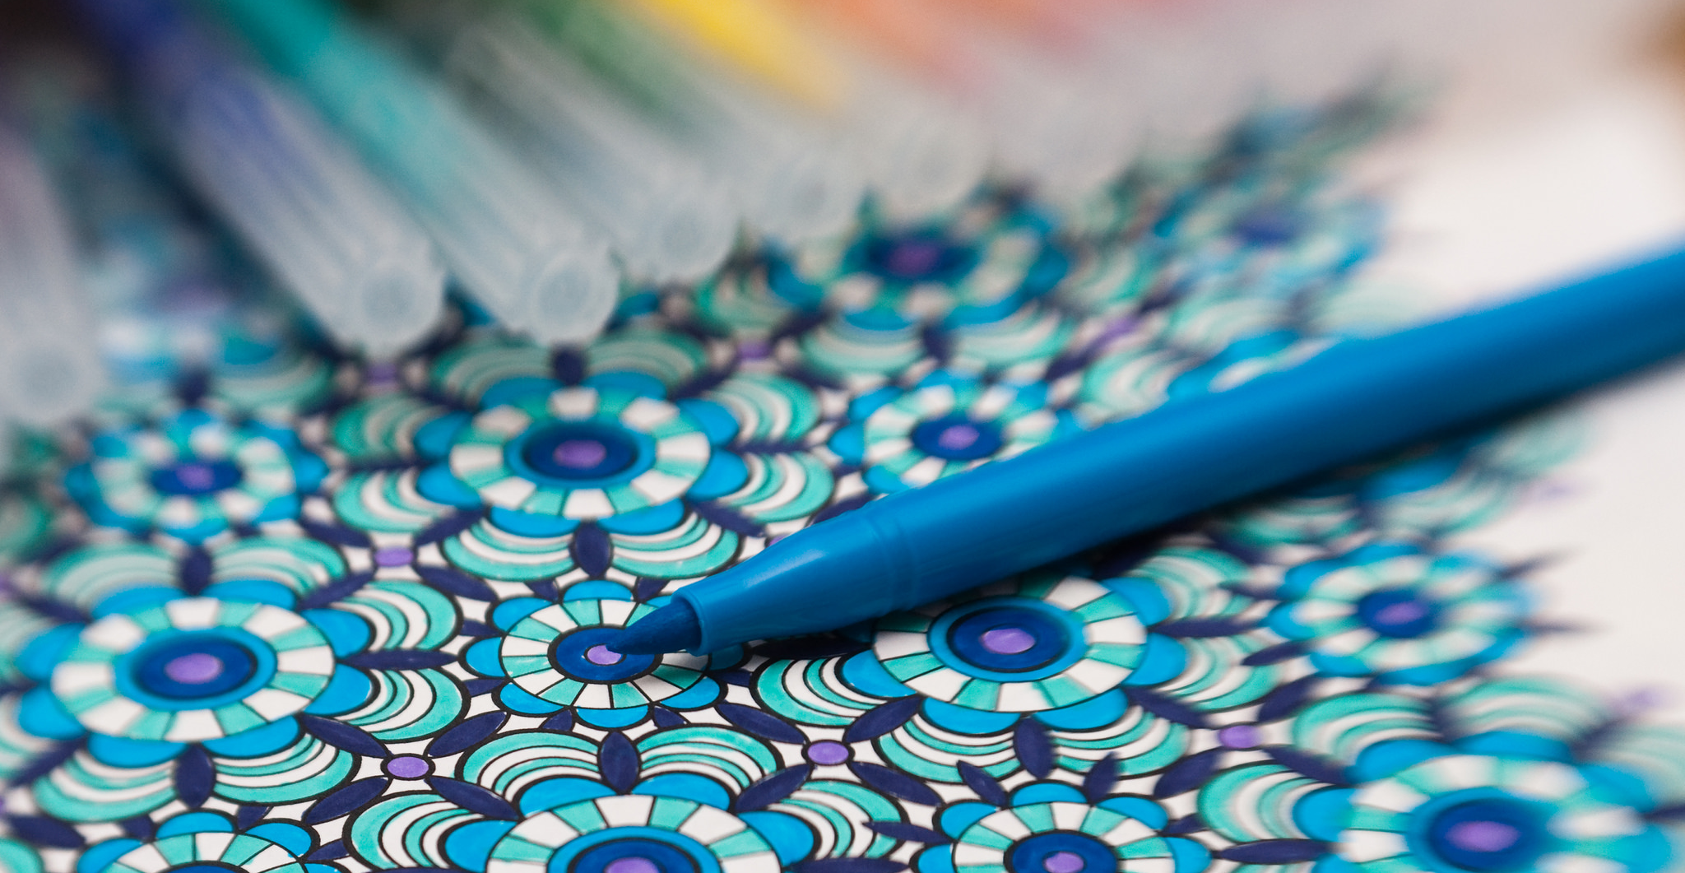
“Print books continue to be more popular than e-books or audio books.”
(Perrin 2016, 2)
“…sales of printed books have grown for the first time in four years, lifted by the adult colouring book craze and 150th anniversary of Alice in Wonderland.”
(Sweney 2016)
Notes:
Image: https://www.flickr.com/photos/fmckinlay/16255732772/ by Fiona Shields / CC BY-NC-ND 2.0
““Print books continue to be more popular than e-books or audio books. Fully 65 percent of Americans have read a print book in the last year, more than double the share that has read an e-book (28 percent) and more than four times the share that has consumed book content via audio book (14 percent). Some 73 percent of Americans report that they have read at least one book (in any format) in the last year.” When reading e-books, more Americans are reading them on tablets and cellphones rather than dedicated e-readers.”
Perrin, Andrew. 2016. “Book Reading 2016.” Pew Research Center, September 1. http://www.pewinternet.org/2016/09/01/book-reading-2016/.
Quoted in Gary Pattillo. 2016. “Fast Facts.” College & Research Libraries News 77, no. 9: 472.
“In the United Kingdom, “sales of printed books have grown for the first time in four years, lifted by the adult colouring book craze and 150th anniversary of Alice in Wonderland, as e-books suffered their first ever decline.” E-book sales fell by 1.6 percent in 2015—the first drop recorded in seven years—while sales of printed books grew by 0.4 percent in the United Kingdom.”
Sweney, Mark. 2016. “Printed book sales rise for first time in four years as ebooks decline.” The Guardian, May 13. www.theguardian.com/media/2016/may/13/printed-book-sales-ebooks-decline.

Slide 13
“A University of Washington pilot study of digital textbooks found that a quarter of students still bought print versions of e-textbooks that they were given for free.”
(Rosenwald 2015)
Notes:
Image: https://www.flickr.com/photos/18406928@N00/394745454/ by Darkangels / CC BY 2.0
“A fall 2014 “survey found students spent an average of $320 to get 5.3 textbooks. Eighty-seven percent of these were print books. A University of Washington pilot study of digital textbooks found that a quarter of students still bought print versions of e-textbooks that they were given for free.””
Rosenwald, Michael S. 2015. “Why Digital Natives Prefer Reading in Print. Yes, You Read that Right.” The Washington Post, February 22. www.washingtonpost.com/local/why-digital-natives-prefer-reading-in-print-yes-you-read-that-right/2015/02/22/8596ca86-b871-11e4-9423-f3d0a1ec335c_story.html.
Quoted in Gary Pattillo. 2015. “Fast Facts.” College & Research Libraries News 76, no. 4: 232.

Slide 14
“On average, faculty preference for using scholarly monographs for reading in depth remains high for print format rather than digital format.”
(Pattillo 2016, 264)
Notes:
“On average, faculty preference for using scholarly monographs for reading in depth remains high for print format rather than digital format. For exploring references or searching for a particular topic, faculty find electronic formats easier.”
Wolff, Christine, Alisa B. Rod, and Roger C. Schonfeld. 2016. “Ithaka S+R US Faculty Survey 2015.” Ithaka S+R, http://sr.ithaka.org?p=277685.
Quoted in Gary Pattillo. 2016. “Fast Facts.” College & Research Libraries News 77, no. 5: 264.

Slide 15
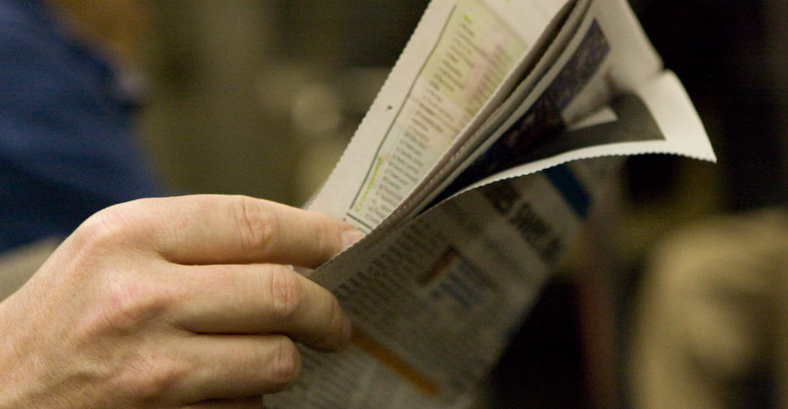
“…around half of newspaper readers consume newspapers only in their printed form. They are more likely to often watch local TV news than those newspaper readers who access the paper online instead of or in addition to the print edition.”
(Barthel 2016)
Notes:
Image: https://www.flickr.com/photos/jcolivera/2732136711/ by Jc Olivera / CC BY-NC-ND 2.0
“Data from Pew Research Center and other sources show that around half of newspaper readers consume newspapers only in their printed form. They are more likely to often watch local TV news than those newspaper readers who access the paper online instead of or in addition to the print edition. This difference persists even when controlling for age.”
Barthel, Michael. 2016. “Around Half of Newspaper Readers Rely Only on Print Edition.” Pew Research Center, January 6, www.pewresearch.org/fact-tank/2016/01/06/around-half-of-newspaper-readers-rely-only-on-print-edition.

Slide 16
“I love…to read the newspaper. I love the hard copy, the physical one.”
(Digital Visitors and Residents, UOCFI3, Male, Age 48, Information Science and Communication Studies)
Notes:
Image: https://www.flickr.com/photos/lichtempfindlich/8216960166/ by ++ lichtempfindlich / CC BY-NC-ND 2.0
“I love, for instance, to read the newspaper. I love the hard copy, the physical one. But in a lot of occasions I don’t have the time to dedicate to read the newspaper. So at the end the most normal thing is enter to the web of the newspaper, the online edition of the newspaper, and have a look at the most important things that are happening. Because I love reading the newspaper. For me it’s one of the most wonderful pleasures I can have in my life. But I don’t have time to do that, and it is very disappointing. At last, I have accepted that it is the reality I can’t fight against that.” (UOCFI3, Male, Age 48, Information Science and Communication Studies)
White, David S., and Lynn Silipigni Connaway. 2011-2014. Digital Visitors and Residents: What Motivates Engagement with the Digital Information Environment. Funded by JISC, OCLC, and Oxford University. http://www.oclc.org/research/activities/vandr.html.

Slide 17
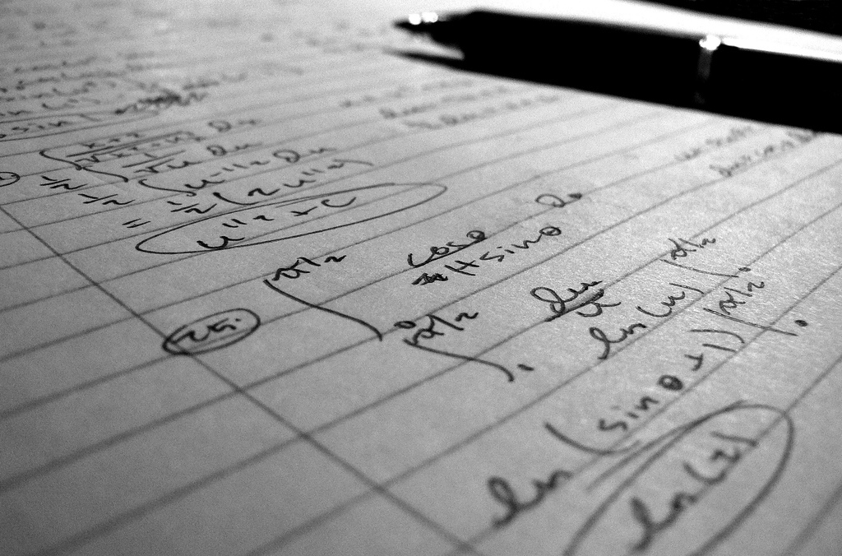
Satisficing…What is enough information?
“…I needed the answer, my maths, I was doing an exercise, I got stuck on a question, I still had the rest of the exercise to go and I had like an hour to do it and I just wanted the formula and the quickest way to do it was to type it into Google and it came up.”
(Digital Visitors and Residents, UKS2, Female, Age 17, Secondary School Student)
Notes:
Image: https://www.flickr.com/photos/akash_k/125489887/ by Akash Kataruka / CC BY-ND 2.0
Prabha, Chandra, Lynn Silipigni Connaway, Lawrence Olszewski, and Lillie Jenkins. 2007. “What is enough? Satisficing information needs.” Journal of Documentation 63, no. 1: 74–89. http://www.oclc.org/content/dam/research/publications/newsletters/prabha-satisficing.pdf.
“The foregoing examples suggest that users may satisfice their need for information based on what they are able to find and thus stop looking for more information. Users may also stop looking for information prematurely if the information systems are difficult or unusable. The very abundance of information makes it crucial for information seekers to decide what information is enough to meet their objectives.” (p. 38) “Undergraduate and graduate students tend to stop looking for information when they find the required number of sources for an assignment.” (p. 48) “Faculty as well as undergraduate and graduate students indicate that time constraints influence when they stop looking for information.” (p. 48) “In describing their information seeking and searching, participants mentioned their rationale for choosing specific strategies and sources. The situational contexts of the participants’ information-seeking experiences affect every stage of their search—from the choice of their first source (Google in many cases, or human resources such as family, friends, and colleagues)—to ongoing strategies (depth of search, value judgments on resource authority, browsing and searching) and then decisions on how much information is enough.” (p. 48)
Connaway, Lynn Silipigni, comp. 2015. The Library in the Life of the User: Engaging with People Where They Live and Learn. Dublin, OH: OCLC Research. http://www.oclc.org/content/dam/research/publications/2015/oclcresearch-library-in-life-of-user.pdf.
“But, yes, convenience, I needed the answer, my maths, I was doing an exercise, I got stuck on a question, I still had the rest of the exercise to go and I had like an hour to do it and I just wanted the formula and the quickest way to do it was to type it into Google and it came up. So, yes, it’s definitely a convenience thing I think.” (Digital Visitors and Residents, UKS2, Emerging, Female, Age 17, Secondary School Student)
White, David S., and Lynn Silipigni Connaway. 2011-2014. Digital Visitors and Residents: What Motivates Engagement with the Digital Information Environment. Funded by JISC, OCLC, and Oxford University. http://www.oclc.org/research/activities/vandr.html.

Slide 18
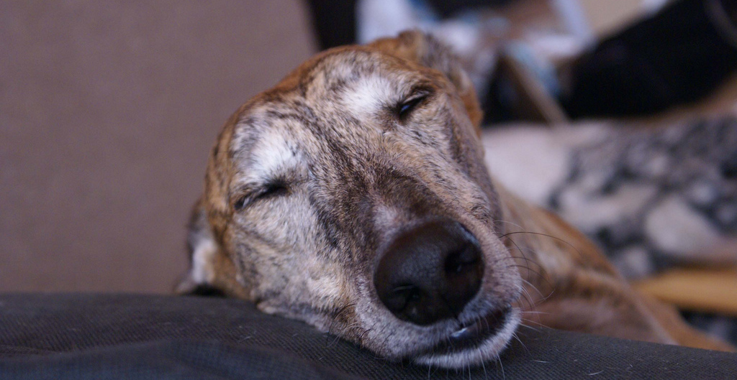
“[When you search information] you notice that new information arrives every moment ...Until you are tired and then you stop searching.”
(Digital Visitors and Residents, UOCG4, Male, Age 41, Health Sciences)
Notes:
Image: https://www.flickr.com/photos/lucathegalga/3803107791/ by Josie / CC BY-NC-ND 2.0
“[When you search information] you notice that new information arrives every moment, and a lot of information is circulating about the same question. Until you are tired and then you stop searching.” (UOCG4, Male, Age 41, Health Sciences)
White, David S., and Lynn Silipigni Connaway. 2011-2014. Digital Visitors and Residents: What Motivates Engagement with the Digital Information Environment. Funded by JISC, OCLC, and Oxford University. http://www.oclc.org/research/activities/vandr.html.

Slide 19
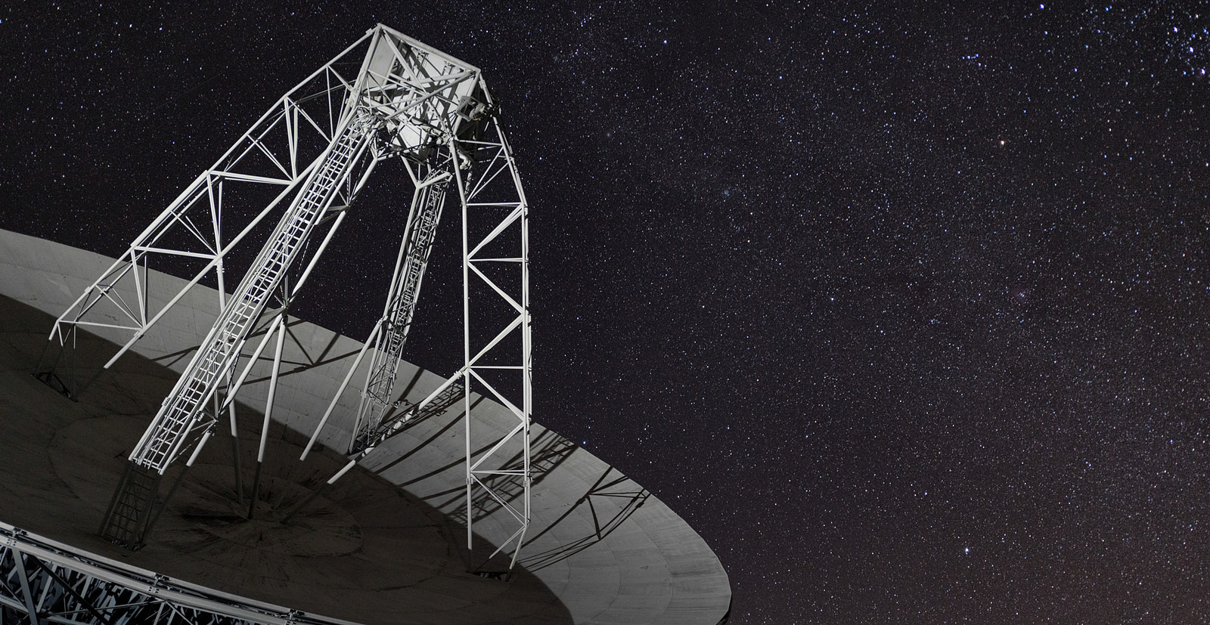
“Google now handles at least 2 trillion searches per year.”
(Sullivan 2016)
Notes:
Image: https://www.flickr.com/photos/freeside/16005615981/ by .freeside. / CC BY-NC-ND 2.0
“There are now more than 2 trillion searches per year (at a minimum) via Google. That works out to a minimum of 63,000 searches per second. In 1999, there were 1 billion searches per year.”
Sullivan, Danny. 2016. “Google Now Handles at Least 2 Trillion Searches Per Year.” Search Engine Land, May 24. http://searchengineland.com/google-now-handles-2-999-trillion-searches-per-year-250247.
Quoted in Gary Pattillo. 2016. “Fast Facts.” College & Research Libraries News 77, no. 11: 616.
“Google now handles at least 2 trillion searches per year. The search giant won’t say exactly how many trillions of queries it processes, other than it’s now two or more. It last claimed 1.2 trillion in 2012.” (Sullivan 2016).

Slide 20
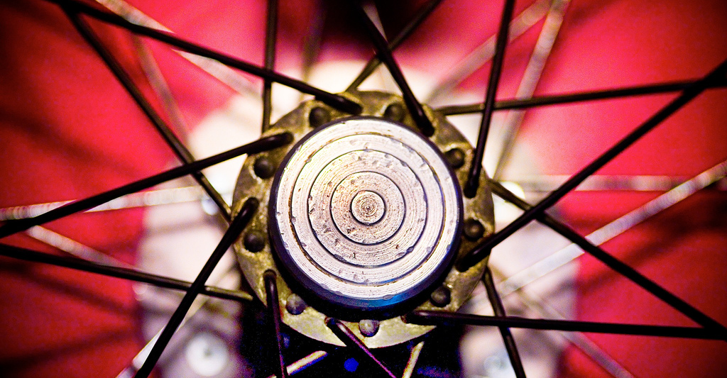
Centrality of Google & search engines
“…I just think it’s [VLE web site] too complicated and it’s limited, that I just carried on going on Google.”
(Digital Visitors and Residents, UKS6, Emerging, Female, Age 16, Secondary School Student)
Notes:
Image: https://www.flickr.com/photos/thomashawk/307750722/ by Thomas Hawk / CC BY-NC 2.0
Connaway, Lynn Silipigni, and Timothy J. Dickey. 2010. The Digital Information Seeker: Report of Findings from Selected OCLC, RIN, and JISC User Behavior Projects. http://www.jisc.ac.uk/media/documents/publications/reports/2010/digitalinformationseekerreport.pdf.
“Among the central findings are the following: • Disciplinary differences do exist in researcher behaviours, both professional researchers and students. • E-journals are increasingly very important to the process of research at all levels. • The evidence provided by the results of the studies supports the centrality of Google and search engines. — Google is often used to locate and access e-journal content. • At the same time, the entire discovery-to-delivery process needs to be supported by information systems, including increased access to resources.” (p. 105) “•Journal backfiles are particularly problematic in terms of access.” “The realities of the online environment observed above led several studies to some common conclusions about changing user behaviours: • Regardless of age or experience, academic discipline, or context of the information need, speed and convenience are important to users. — Researchers particularly appreciate desktop access to scholarly content. — Users also appreciate the convenience of electronic access over the physical library. • Users are beginning to desire enhanced functionality in library systems. • They also desire enhanced content to assist them in evaluating resources. • They seem generally confident in their own ability to use information discovery tools. • However, it seems that information literacy has not necessarily improved. — High-quality metadata is thus becoming even more important for the discovery process.” (p. 106)
Connaway, Lynn Silipigni, comp. 2015. The Library in the Life of the User: Engaging with People Where They Live and Learn. Dublin, OH: OCLC Research. http://www.oclc.org/content/dam/research/publications/2015/oclcresearch-library-in-life-of-user.pdf.
“Yes. It’s like for our extended project we have like tutorial sessions, and they gave us this website that you go on to like try and find useful resources, but I just think it’s too complicated and it’s limited, that I just carried on going on Google.” (Digital Visitors and Residents, UKS6, Emerging, Female, Age 16, Secondary School Student)
White, David S., and Lynn Silipigni Connaway. 2011-2014. Digital Visitors and Residents: What Motivates Engagement with the Digital Information Environment. Funded by JISC, OCLC, and Oxford University. http://www.oclc.org/research/activities/vandr.html.

Slide 21
“Yes, it [Matrix film plug-in to brain] - sort of makes information gathering effortless and without having to sort of manually go through and separate the chaff from the wheat.”
(Digital Visitors and Residents, UKU10, Male, Age 20, Law)
“People lack patience to wade through content silos…”
(Connaway 2015, 134)
Notes:
Image: https://www.flickr.com/photos/davebass5/14680844817/ by Dave Pearce / CC BY-NC-ND 2.0
Connaway, Lynn Silipigni, Timothy J. Dickey, and Marie L. Radford. 2011. “‘If It Is too inconvenient I’m not going after it:’ Convenience as a Critical Factor in Information-Seeking Behaviors.” Library & Information Science Research 33, no. 3: 179–190.
“The image of libraries as a quiet place to access books, rather than to access electronic sources still is prevalent today (Connaway, & Dickey, 2010, p. 39). In order to entice people to use libraries and to change their perceptions of libraries, the library experience needs to become more like that available on the web (e.g., Google, Amazon.com, iTunes, etc.) and to be embedded in individual workflows. The web environment is familiar to users; therefore, they are comfortable and confident choosing to search for information there.” (p. 133) “Access to sources, not the discovery of sources, is the concern of information-seekers. People lack patience to wade through content silos and indexing and abstracting databases. They expect seamless access to resources such as full text e-journals, online foreign-language materials, ebooks, a variety of electronic publishers’ platforms, and virtual reference desk services (Connaway & Dickey, 2010, p. 46–47).” (p. 134) “Librarians also must advertise the library brand and its resources better to academics, researchers, students, and the general public...One size does not fit all for library services, which need to be offered in multiple delivery modes to meet the different information needs of users in different situations.” (p. 134) “As seen above, in some situations information seekers will readily sacrifice content for convenience. Convenience is thus one of the primary criteria used for making choices during the information-seeking process. Convenience includes the choice of the information source (is it readily available online or in print), the satisfaction with the source (does it contain the needed information and is it easy to use), and the time it will take to access and use the information source (how long will it take to access).” (p. 134)
Connaway, Lynn Silipigni, comp. 2015. The Library in the Life of the User: Engaging with People Where They Live and Learn. Dublin, OH: OCLC Research. http://www.oclc.org/content/dam/research/publications/2015/oclcresearch-library-in-life-of-user.pdf.
UKU10: “I don’t know. Fantasy aside, probably like the Matrix, just have the plug-ins at the back of your head, I imagine.”
Interviewer: “Okay, yes. Okay, that’s fine. I mean that’s what we’re sort of wanting to know what people would actually like best.”
UKU10: “Yes, I suppose I only say that because of out of laziness and that I don’t want to have to go through reading books and searching web pages and…”
Interviewer: “So what would you want this little plug in in your head to give you?”
UKU10: “I don’t know sort of just tell me what I want to know without me having to do anything (Laughter) in essence but…”
Interviewer: “Okay, so you just – would it be able to read your mind and give you information?”
UKU10: “Yes, it - sort of make information gathering effortless and without having to sort of manually go through and separate the chaff from the wheat.”
Interviewer: “Yes. And you’d like that done for you sort of all of the relevant stuff.”
UKU10: “That’s sort of – I find that’s the biggest time consumer and obviously the most like taxing part of it.”
Interviewer: Do you think it’s where you learn most though?”
UKU10: “Oh I don’t know, that’s quite a good question, potentially – I don’t know, I’m not sure.” (Digital Visitors and Residents, UKU10, Establishing, Male, Age 20, Law)
White, David S., and Lynn Silipigni Connaway. 2011-2014. Digital Visitors and Residents: What Motivates Engagement with the Digital Information Environment. Funded by JISC, OCLC, and Oxford University. http://www.oclc.org/research/activities/vandr.html.

Slide 22
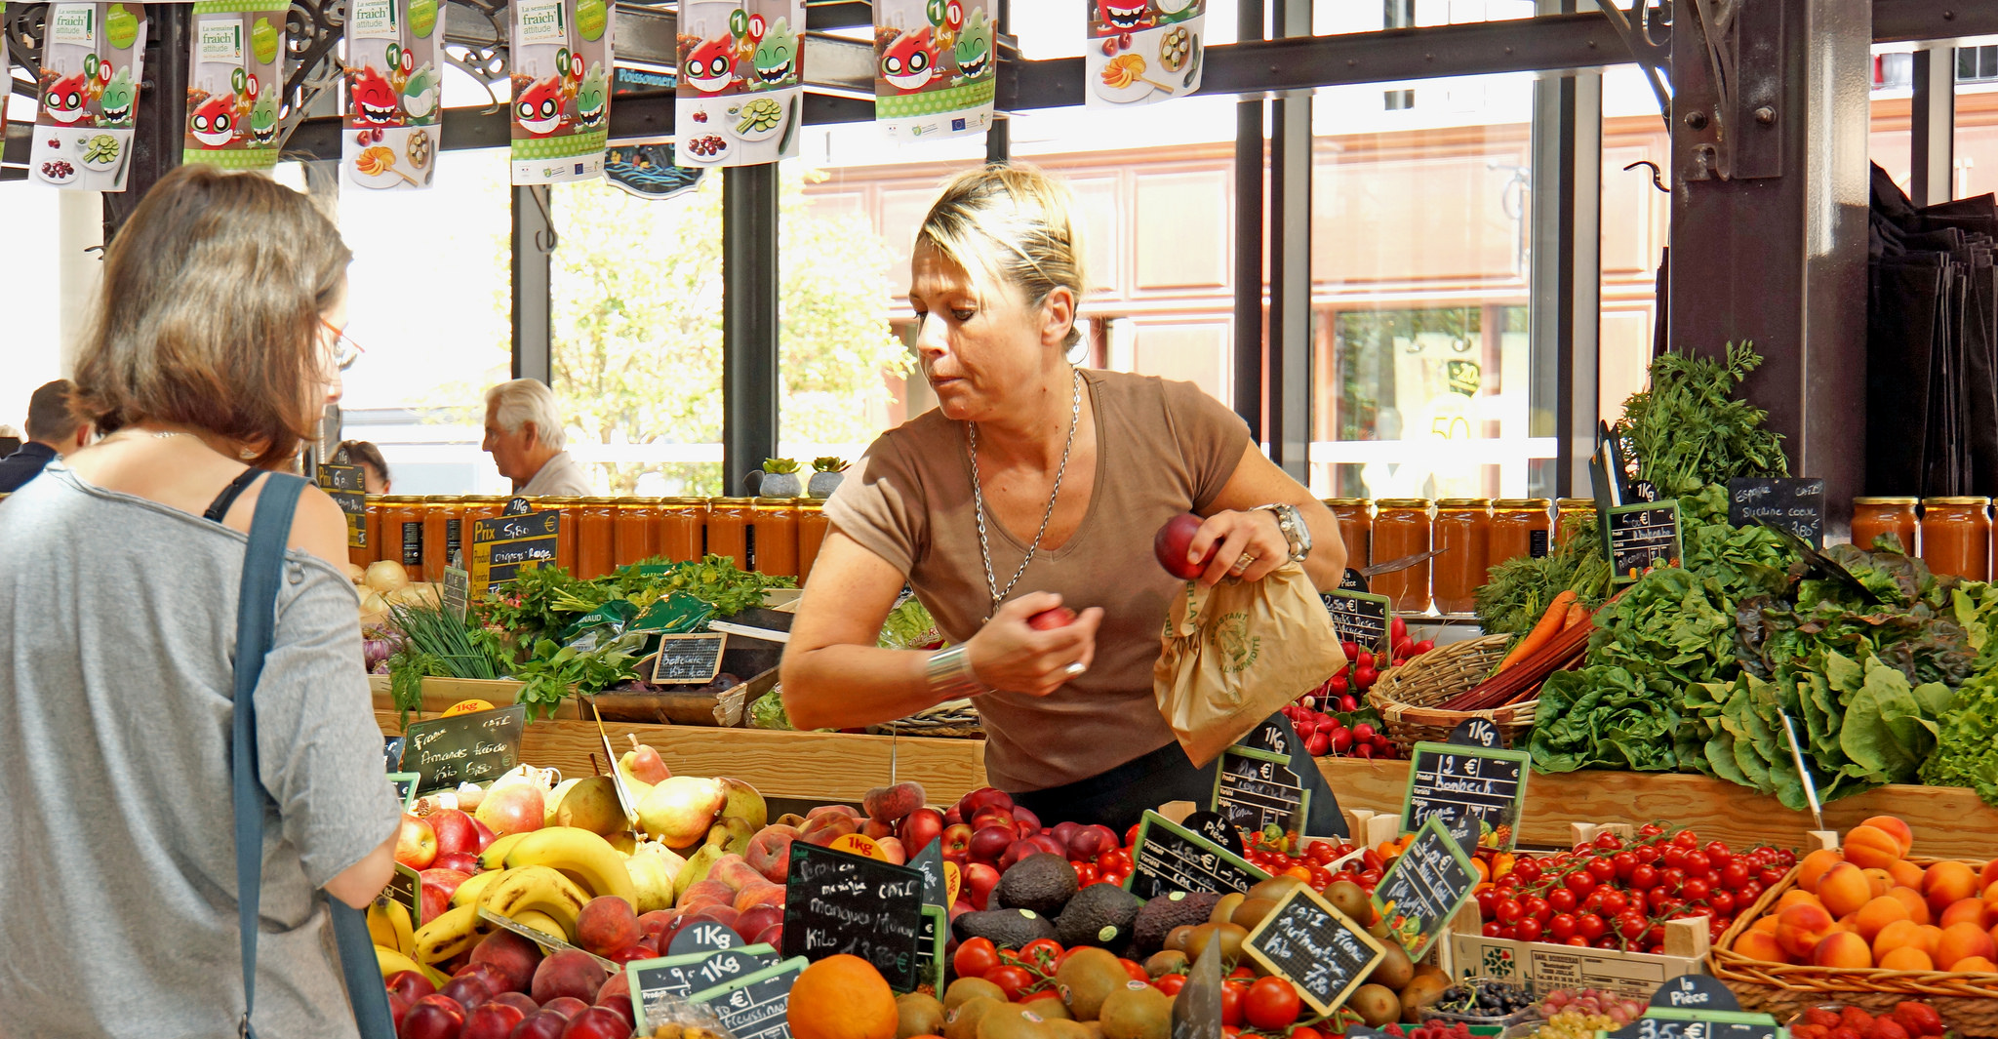
The Learning Black Market
“It’s like a taboo I guess with all teachers, they just all say – you know, when they explain the paper they always say, ‘Don’t use Wikipedia.’”
(Digital Visitors and Residents, USU7, Female, Age 19, Political Science)
Notes:
Image: https://www.flickr.com/photos/archer10/15686974001/ by Dennis Jarvis / CC BY-SA 2.0
I go to Wikipedia, scroll down to the bottom, and there’s like references that Wikipedia used and I click on those references and like check those links. Cause I’m like ‘that’s the fastest way to find a good link.’ Cause like if I’m gonna search like, I don’t know heart attack cases or something. Like that’s gonna take me forever to find like, a good website, or book to talk about what I’m looking for when I can just type in Wikipedia like, heart attacks or something, scroll to the bottom, there’s already books and websites there for me.” (Digital Visitors and Residents, 2USU1, Emerging, Male, Age 18, Engineering)
White, David S., and Lynn Silipigni Connaway. 2011-2014. Digital Visitors and Residents: What Motivates Engagement with the Digital Information Environment. Funded by JISC, OCLC, and Oxford University. http://www.oclc.org/research/activities/vandr.html.

Slide 23
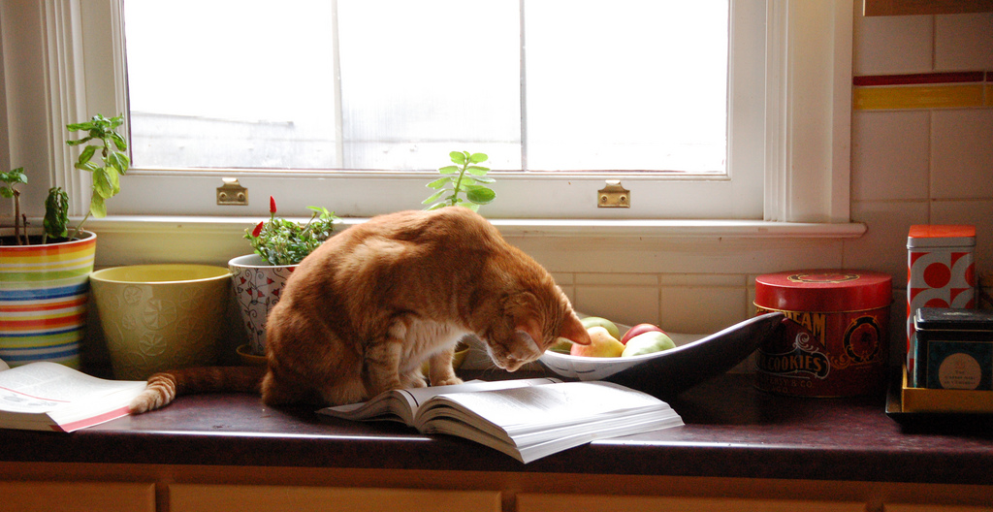
Motivation & behaviors change based on context & situation
“At first I started looking online, and it was a little bit overwhelming…I ended up reaching into my mom’s cupboard and using a recipe that I found in one of her old cookbooks. The recipe was just what I was looking for...”
(Digital Visitors and Residents, USS3, Emerging, Female, Age 17, High School Student)
Notes:
Image: http://www.flickr.com/photos/95792332@N00/3226023555 by Jacob Davies / CC BY-SA 2.0
“Residents: significant online presence and usage; high level of collaborative activity online; contributions to the online environment in the form of uploading materials, photos, videos; high dependence on a mobile device (smart phone, laptop, etc.); more than 10 hours a week spent online.”
Visitors: functional use of technology, often linked to formal need (such as use of software for specific coursework, or organising meetings through email contact); less visible/more passive online presence, more likely to favour face-to-face interactions (even as they use the Internet to organize/ schedule those interactions); fewer than 6 hours spent online a week.” (p. 145) “There are a number of “covert” online study habits. For example, Wikipedia is widely used but almost always with a sense of guilt or an eagerness to convey awareness of its “unreliability;” there is an assumption by students that teachers and lecturers value the authenticity of paperbased books rather than information found online through a browser, such as Google. The data also indicate that this assumption is unfounded.” (p. 145) “Some changes are made when transitioning from one stage of academic life to another. For example, one interviewee cleared his Facebook site of his previous high school friends when he went to University, where he replaced them with new contacts.” (p. 145) “A number of interviewees spoke about the way they evaluated information and sites from the Internet. A typical way of doing this was to judge sites by their popularity (as shown by their placement in the Google results list), i.e., popular = correct.” (p. 145) “Instead of reporting general information-seeking habits and technology use, this study explores how the subjects get their information based on the context and situation of their needs during an extended period of time, identifying if and how their behaviors change.” (p. 151)
Connaway, Lynn Silipigni, comp. 2015. The Library in the Life of the User: Engaging with People Where They Live and Learn. Dublin, OH: OCLC Research. http://www.oclc.org/content/dam/research/publications/2015/oclcresearch-library-in-life-of-user.pdf.
“This morning I was looking for a homemade bread recipe that I could use to bake and then blog about. (I just started my own food blog: gritsgonegreen.wordpress.com). At first I started looking online, and it was a little bit overwhelming. There were so many different recipes with different flavors and crazy combinations. The one thing that was good about looking at the online recipes was viewing the user comments and seeing how people liked or disliked each recipe. I ended up reaching into my mom’s cupboard and using a recipe that I found in one of her old cookbooks. The recipe was just what I was looking for: it was a simple homemade white bread. I was about to search on the internet how to knead and punch bread, but I flipped the page, and there was a whole glossary of bread making terms. I must admit, I was a little bit surprised by the amount of information and instruction found in the cookbook. I thought I was going to have to look up an instructional video online.” (Digital Visitors and Residents, USS3, Emerging, Female, Age 17, High School Student)
White, David S., and Lynn Silipigni Connaway. 2011-2014. Digital Visitors and Residents: What Motivates Engagement with the Digital Information Environment. Funded by JISC, OCLC, and Oxford University. http://www.oclc.org/research/activities/vandr.html.
Connaway, Lynn Silipigni, Donna Lanclos, David White, Alison Le Cornu, and Erin M. Hood. 2012. “User-centered Decision Making: A New Model for Developing Academic Library Services and Systems.” IFLA World Library and Information Congress 2012 Helsinki Proceedings: Libraries Now! Inspiring, Surprising, Empowering. http://conference.ifla.org/sites/default/files/files/papers/wlic2012/76-connaway-en.pdf.

Slide 24
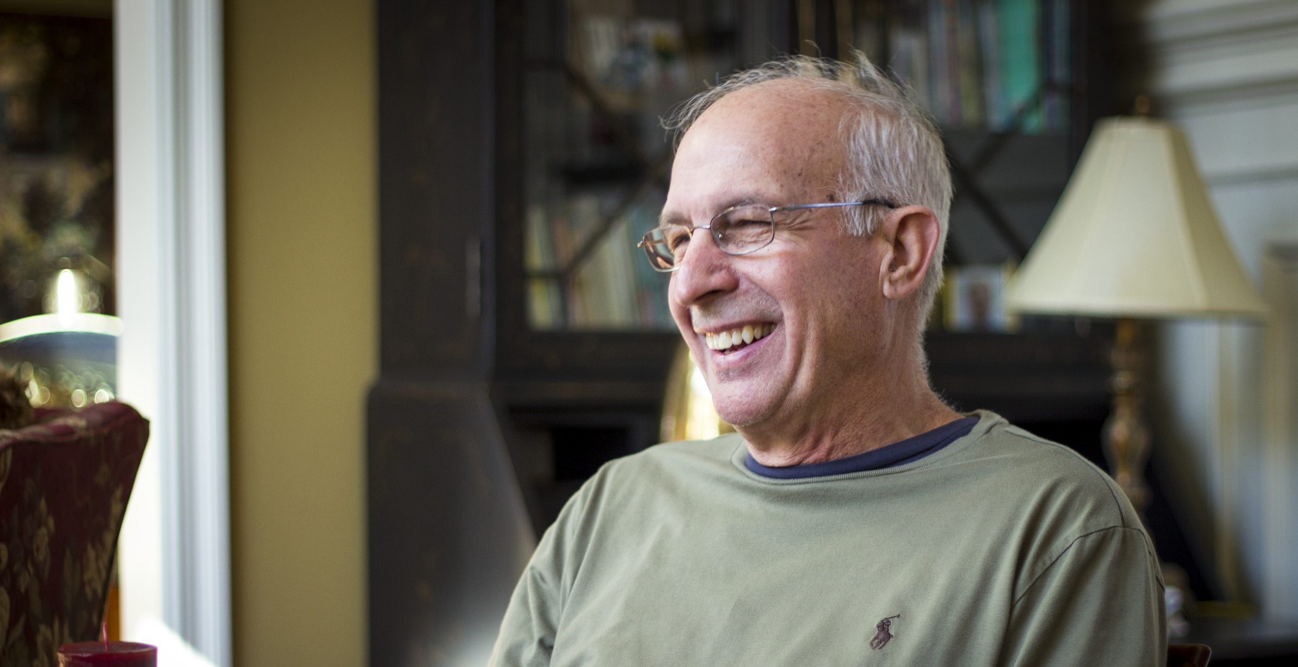
“...my father knows a lot...I trust him.... If he tells me to look at this page, or he shows me one of his books, even if they are old-fashioned.”
(Digital Visitors and Residents, UOCU2, Female, Age 28, Information Sciences)
Notes:
Image: https://www.flickr.com/photos/tychosnose/12017536084/ by Joel Tonyan / CC BY-NC-ND 2.0
“...my father knows a lot (...). I trust him (...). If he says me look at this page, or he shows me one of his books, even they are oldfashion”
(UOCU2, Female, Aged 28, Information Sciences)
“A wise person (to look for information). I like books, but I prefer people.”
(UOCU1, Female, Aged 22, Information Sciences)
White, David S., and Lynn Silipigni Connaway. 2011-2014. Visitors & Residents: What Motivates Engagement with the Digital Information Environment. Funded by JISC, OCLC, and Oxford University. http://www.oclc.org/research/activities/vandr.html.

Slide 25
Multi-tasking
“So, I’ll be like looking over at that and then like either Facebook or my email will beep at me and I’ll click on that, see who sent me something and then go back to working. So, it’s always, kind of, open and there.”
(Digital Visitors and Residents, USU4, Male, Age 19, Engineering)
Notes:
Image: https://www.flickr.com/photos/vonderauvisuals/8719186156/ by Bob Vonderau / CC BY-NC-ND 2.0
Connaway, Lynn Silipigni, David White, Donna Lanclos, and Alison Le Cornu. 2013. “Visitors and Residents: What Motivates Engagement with the Digital Information Environment?” Information Research 18, no. 1, http://informationr.net/ir/18-1/infres181.html.
“The practice of citing the references attached to a Wikipedia article but not the article itself to avoid potential ridicule from tutors and peers.” (p. 162) “The basic methods employed by students when assessing the validity of a source returned by a Google search.” (p. 163) “The manner in which emerging stage students rely on the residency of their peers in social media, allowing them to discuss assignments the night before they are due. Participants in the emerging educational stage often wanted to talk to a fellow student about an assignment using Facebook. If the person they were hoping to connect with in Facebook was not online then some participants would text the person in question to request that they login. This level of Residency meant that students could discuss an assignment at a time that was convenient to them. At the emerging stage that was often the night before a deadline. All the participants who talked about this claimed that they did not ‘do’ the assignments in this manner but merely confirmed exactly what was required from them or sought specific information such as a maths formula or a reference.” (p. 163) “The importance of convenience and how the Web often will be chosen as an information source by students even when they know higher quality sources are available elsewhere. For example, the information is available in text books or by asking a tutor or parent, yet Google is used instead. We suspect that convenience is a large part of why our data indicate that Google and Wikipedia are the most popular search engine and information source respectively…Many go no further and it was not uncommon for interviewees simply to accept the first Google site listed.” (p. 163) “A portion of the emerging educational stage participants were uncomfortable about the addictive nature of social media and the extent to which it wasted their time.” (p. 163) “The multi-tab environment that students have on screen represents a convergence of the social and the academic. In this context, the mode of an activity is no longer based on the physical space in which it occurs since any access to a network provided almost every aspect of life to those with a Resident approach to the Web.” (p. 163)
Connaway, Lynn Silipigni, comp. 2015. The Library in the Life of the User: Engaging with People Where They Live and Learn. Dublin, OH: OCLC Research. http://www.oclc.org/content/dam/research/publications/2015/oclcresearch-library-in-life-of-user.pdf.
“So, I’ll be like looking over at that and then like either Facebook or my email will beep at me and I’ll click on that, see who sent me something and then go back to working. So, it’s always, kind of, open and there.” (Digital Visitors and Residents, USU4, Emerging, Male, Age 19, Engineering)
White, David S., and Lynn Silipigni Connaway. 2011-2014. Digital Visitors and Residents: What Motivates Engagement with the Digital Information Environment. Funded by JISC, OCLC, and Oxford University. http://www.oclc.org/research/activities/vandr.html.

Slide 26
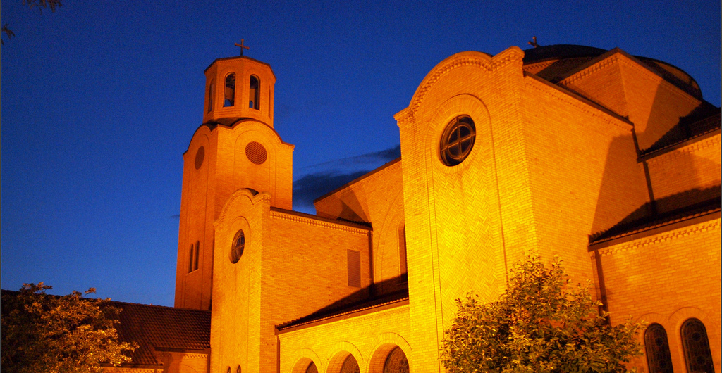
“You spend many hours, with Saint Google. We entrust ourselves to Saint Google, and that solves it for us.”
(Digital Visitors and Residents, UOCFI6, Male, Age 53, Arts & Humanities)
Notes:
Image: https://www.flickr.com/photos/theeerin/3746390760/ by Erin Nekervis / CC BY-SA 2.0
“You spend many hours, with Saint Google. We entrust ourselves to Saint Google, and that solves it for us.”
(UOCFI6, Male, Age 53, Arts and Humanities)
White, David S., and Lynn Silipigni Connaway. 2011-2014. Visitors & Residents: What Motivates Engagement with the Digital Information Environment. Funded by JISC, OCLC, and Oxford University. http://www.oclc.org/research/activities/vandr.html.

Slide 27
Need to provide services for what people actually do, not what they say they do
The workflow context
Convenience & context switching
Fragmentation is a deterrent
The personal context
Relationship – sharing – engagement
(Dempsey 2015)
Notes:
Image: https://www.flickr.com/photos/thyagohills/5009884654/ by Thyago - SORG|FX / CC BY 2.0
Dempsey, Lorcan. 2015. “Environmental Trends and OCLC Research.” Presented at the University of Notre Dame, Notre Dame, Indiana, September 28. http://www.oclc.org/content/dam/research/presentations/dempsey/dempsey-notre-dame-oclc-research-2015.pptx.

Slide 28
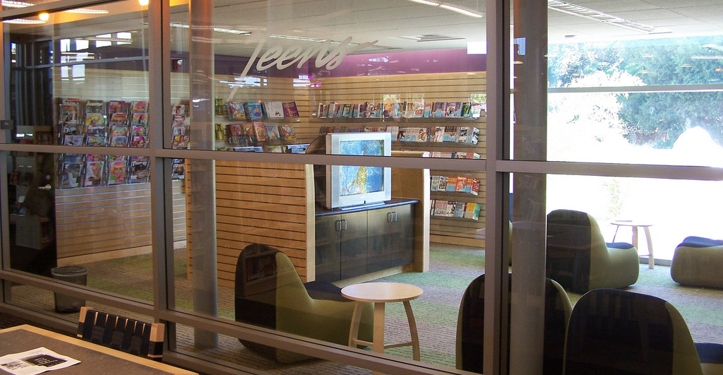
“…youth ages 14-24 make up 25% of all public library users.”
(Braun, Hartman, Hughes-Hassell, and Kumasi 2014, 1)
Notes:
Image: https://www.flickr.com/photos/sanjoselibrary/2849158124/ by San José Public Library / CC BY-SA 2.0
“The Opportunity for All study reported that youth ages 14–24 make up 25% of all public library users.”
Becker, Samantha, Michael D. Crandall, Karen E. Fisher, Rebecca Blakewood, Bo Kinney, and Cadi Russell-Sauvé. 2011. Opportunity for All: How Library Policies and Practices Impact Public Internet Access. IMLS-2011-RES-01. Institute of Museum and Library Services. Washington, DC. https://www.imls.gov/assets/1/AssetManager/OppForAll2.pdf.
Quoted in Braun, Linda W., Maureen L. Hartman, Sandra Hughes-Hassell, and Kafi Kumasi. 2014. The Future of Library Services for and with Teens: A Call to Action. With contributions by Beth Yoke. www.ala.org/yaforum/project-report.
“A 2013 Pew survey found that 72% of 16- to 17-year-olds had used a public library in 2012.”
Zickuhr, Kathryn, Lee Rainie, and Kristen Purcell. 2013. Younger Americans’ Library Habits and Expectations. http://libraries.pewinternet.org/2013/06/25/younger-americans-library-services/.
Quoted in Braun, Linda W., Maureen L. Hartman, Sandra Hughes-Hassell, and Kafi Kumasi. 2014. The Future of Library Services for and with Teens: A Call to Action. With contributions by Beth Yoke. www.ala.org/yaforum/project-report.

Slide 29
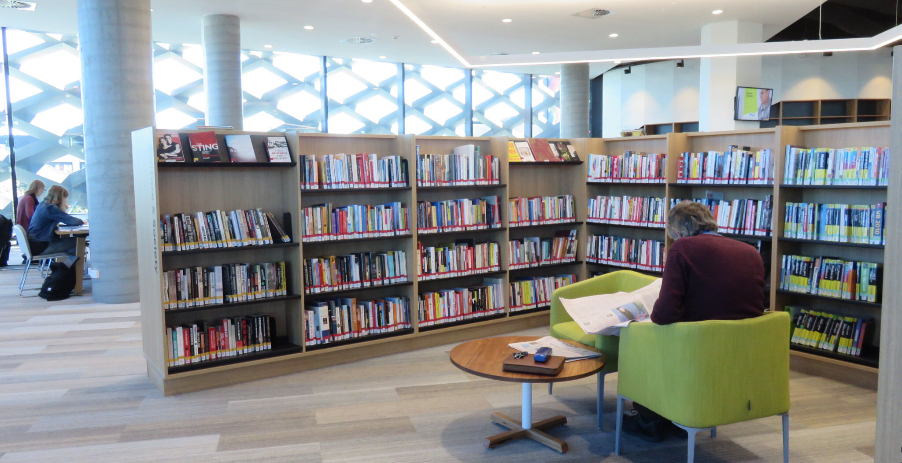
“In the public library there are two or three people. I know the staff… Once I participated in a civil servant open examination and they helped me a lot.”
(Digital Visitors and Residents, UOCU1, Female, Age 22, Information Science and Communication Studies)
Build relationships
Notes:
Image: https://www.flickr.com/photos/helenk/29826982796/ by Helen K / CC BY-NC-ND 2.0
“My town is small. Few people live there. In the public library there are two or three people. I know the staff […] Once I participated in a civil servant open examination and they helped me a lot. […] Yes, I go there [to the library] every afternoon. Because I teach children, and I do it there. The public library has a pleasant atmosphere. I prefer doing it there. [...] [I have] Not [asked them for help for my studies] until now.” (UOCU1, Female, Age 22, Information Science and Communication Studies)
White, David S., and Lynn Silipigni Connaway. 2011-2014. Digital Visitors and Residents: What Motivates Engagement with the Digital Information Environment. Funded by JISC, OCLC, and Oxford University. http://www.oclc.org/research/activities/vandr.html.

Slide 30
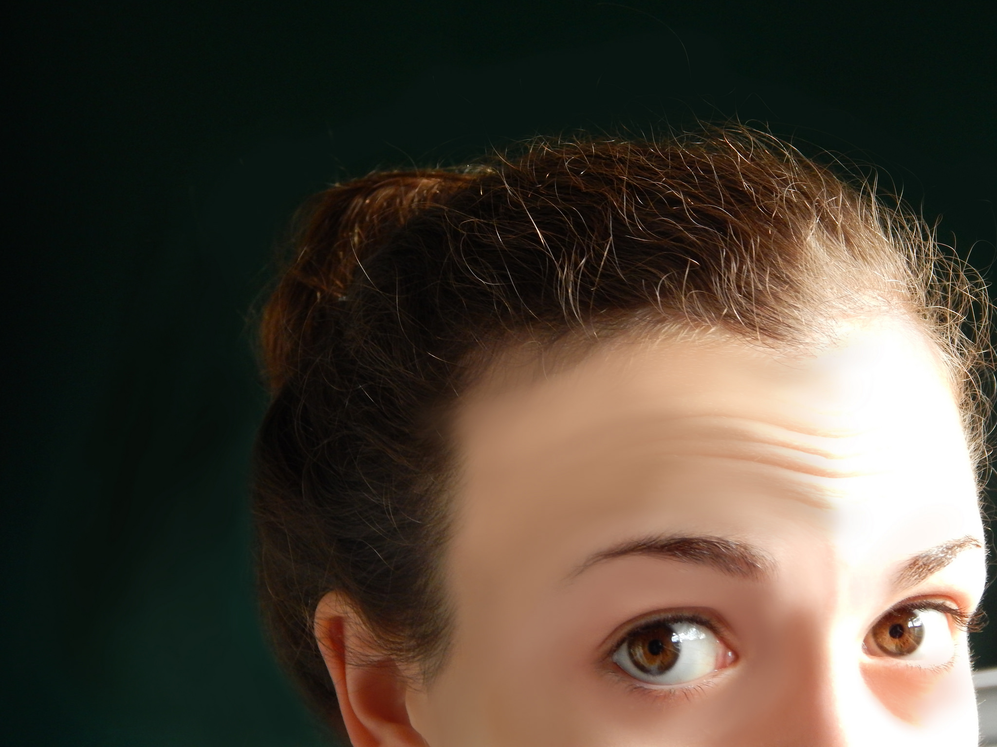
“When I need a quick answer my preferred source is a person, because a person would interpret your need quickly and better than Internet.”
(Digital Visitors and Residents, UOCU5, Female, Age 30, Education)
Notes:
Image: https://www.flickr.com/photos/emmabird8/13878757353/ by Emma M. / CC BY 2.0
“When I need a quick answer my preferred source is a person, because a person would interpret your need quickly and better than Internet. […] But when I don’t know anything about a subject, first I do a search on my own and then I asked an expert…but before I ask a person, I want to know a little about the subject…not to say the person “illuminate me, please”…if you have some basic knowledge you could to take more advantage of your contact.” (UOCU5, Female, Age 30, Education)
White, David S., and Lynn Silipigni Connaway. 2011-2014. Digital Visitors and Residents: What Motivates Engagement with the Digital Information Environment. Funded by JISC, OCLC, and Oxford University. http://www.oclc.org/research/activities/vandr.html.

Slide 31
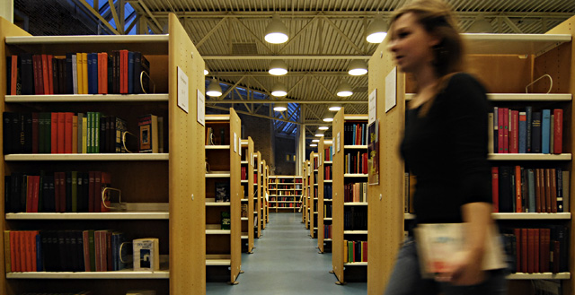
“If my other friends recommended it to me and used chat reference services themselves I might be convinced to try them...”
(Seeking Synchronicity, NOS-94938, Female, Age 15-18)
Notes:
Image: https://www.flickr.com/photos/marcin_b/2076003471/ by Marcin Biodrowski / CC BY-NC-ND 2.0
“If my other friends recommended it to me and used chat reference services themselves I might be convinced to try them because I usually learn about all sorts of computer and technology-based things from my friends because I'm so inept in that area myself. Without them, I would have never gotten iTunes, AIM, Facebook and other items that I couldn't imagine living without now that I have them.” (Seeking Synchronicity, NOS-94938, Non-user Online Survey, Female, Age 15-18)
“I am sure there must be benefits from utilizing chat reference - but talking to strangers just seems risky, are you required to give them personal information? And how are you assured that information can not be abused in any way?” (Seeking Synchronicity, NOS-69925, Non-user Online Survey, Female, Age 36-45)
“I think chatting is a great way to get reference help. Its all a matter of how user friendly the whole set up is.” (Seeking Synchronicity, NOS-67135, Non-user Online Survey, Female, Age 19-28)
“If it was more safe. If there weren't any internet hunter or dangerous people on there.” (Seeking Synchronicity, NOS-33482, Non-user Online Survey, Female, Age 15-18)
“If i trusted the librarian enough to chat with me on the web.” (Seeking Synchronicity, NOS-89558, Non-user Online Survey, Female, Age 12-14)
“If I knew or had heard of the person on the other end.” (Seeking Synchronicity, NOS-95620, Non-user Online Survey, Female, Age 12-14)
Connaway, Lynn Silipigni, and Marie L. Radford. 2005-2007. Seeking Synchronicity: Evaluating Virtual Reference Services from User, Non-User, and Librarian Perspectives. Funded by Institute for Museums and Library Services Research Grant. http://www.oclc.org/research/activities/synchronicity/default.htm.

Slide 32
Promote resources available to users
“Sometimes libraries are closed and i need help so this [VRS] would be a great alternative. This method should me advertised more.”
(Seeking Synchronicity, NOS-36503, Female, Age 15-18)
Notes:
Image: https://www.flickr.com/photos/thomashawk/149497554/ by Thomas Hawk / CC BY-NC 2.0
Prabha, Chandra, Lynn Silipigni Connaway, Lawrence Olszewski, and Lillie Jenkins. 2007. “What is Enough? Satisficing Information Needs.” Journal of Documentation 63, no. 1: 74–89. http://www.oclc.org/content/dam/research/publications/newsletters/prabha-satisficing.pdf.
“In order for libraries to stay relevant, their systems need to emulate Internet search engines. Such features as simplified searching and the collocation of all types of information (e.g., books, journals, articles, web pages, etc.) facilitate users’ search experience which obviates the need to understand the complexity of library systems.” (p. 49)
“The findings of the focus group interviews also indicate that libraries need to promote the library resources that are available to users…Those who are aware of them tend to find them difficult to use because of the need to know specific subject coverage of databases, a knowledge that is often difficult to comprehend when doing interdisciplinary research. In addition, participants indicate that the inconsistent search protocols of library web sites and online catalogs discourage effective use.” (p. 49)
Connaway, Lynn Silipigni, comp. 2015. The Library in the Life of the User: Engaging with People Where They Live and Learn. Dublin, OH: OCLC Research. http://www.oclc.org/content/dam/research/publications/2015/oclcresearch-library-in-life-of-user.pdf.
“Sometimes libraries are closed and i need help so this would be a great alternative. This method should me advertised more.” (Seeking Synchronicity, NOS-36503, Non-user Online Survey, Female, Age 15-18)
Connaway, Lynn Silipigni, and Marie L. Radford. 2005-2007. Seeking Synchronicity: Evaluating Virtual Reference Services from User, Non-User, and Librarian Perspectives. Funded by Institute for Museums and Library Services Research Grant. http://www.oclc.org/research/activities/synchronicity/default.htm.
White, David S., and Lynn Silipigni Connaway. 2011-2014. Digital Visitors and Residents: What Motivates Engagement with the Digital Information Environment. Funded by JISC, OCLC, and Oxford University. http://www.oclc.org/research/activities/vandr.html.

Slide 33
Librarians and services within the workflow
“I haven’t called them, I don’t think I’ve ever talked to the librarians here since I’m not in the building much.”
(Digital Visitors and Residents, USU4, Emerging, Male, Age 19, Engineering)
Notes:
Image: https://www.flickr.com/photos/artlung/1625328/ by Joe Crawford / CC BY 2.0
Connaway, Lynn Silipigni, Donna M. Lanclos, and Erin M. Hood. 2013. “‘I always stick with the first thing that comes up on Google…’ Where People Go for Information, What They Use, and Why.” EDUCAUSE Review Online, December 6. http://www.educause.edu/ero/article/ialways-stick-first-thing-comes-google-where-people-go-information-what-they-use-and-why.
“Institutional services and systems must be embedded within the academic community’s workflow so that individuals are able to use critical skills for inquiry wherever they land in the information landscape.” (p. 185) “Rather than perpetuating this “black market” traffic in resources, institutions should use individual Internet practices as a guide to linking institutional resources to those on the open web. Individuals use a broad range of tools to get information, and they engage with technology in multiple ways. It is therefore imperative to provide a broad range of tools and services in different media.” (p. 188) “Institutions should consider digital and face-to-face community building as a cornerstone of their enterprise-wide policies. Individuals will turn to libraries or librarians for resources only if they are a part of the individuals’ networks.” (p. 193)
Connaway, Lynn Silipigni, comp. 2015. The Library in the Life of the User: Engaging with People Where They Live and Learn. Dublin, OH: OCLC Research. http://www.oclc.org/content/dam/research/publications/2015/oclcresearch-library-in-life-of-user.pdf.
“I haven’t called them, I don’t think I’ve ever talked to the librarians here since I’m not in the building much.” (Digital Visitors and Residents, USU4, Emerging, Male, Age 19, Engineering)
White, David S., and Lynn Silipigni Connaway. 2011-2014. Digital Visitors and Residents: What Motivates Engagement with the Digital Information Environment. Funded by JISC, OCLC, and Oxford University. http://www.oclc.org/research/activities/vandr.html.

Slide 34
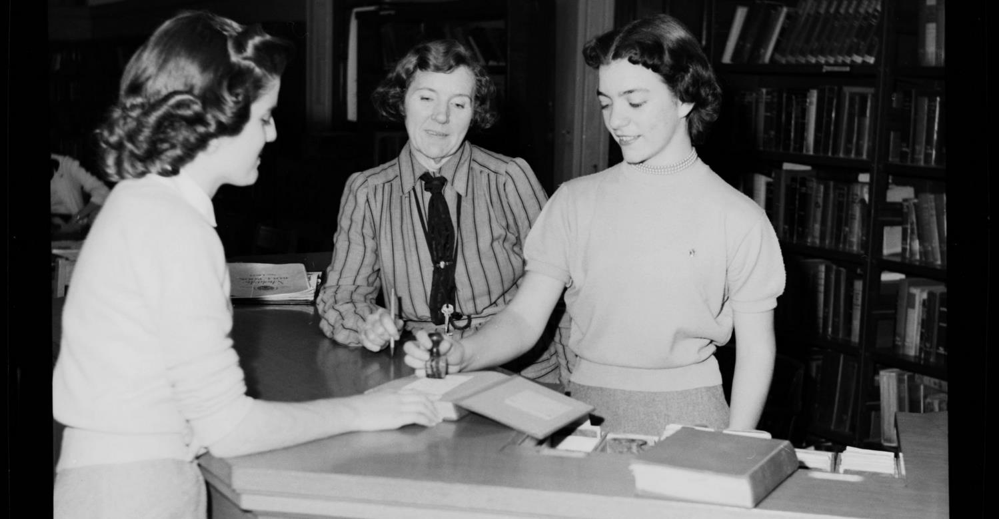
Screenagers have a traditional view of librarians
“It’s like, it’s like, you don’t want to go “So which shelf are you pointing at?” Because, I mean, once they do their famous point, it’s just like…”
(Seeking Synchronicity, Focus Group 6 participant, Female, High School Student)
Notes:
Image: https://www.flickr.com/photos/digitalnc/8263677993/ by North Carolina Digital Heritage Center / CC BY-NC-ND 2.0
Radford, Marie L., and Lynn Silipigni Connaway. 2007. “‘Screenagers’ and Live Chat Reference: Living up to the Promise.” Scan 26, no. 1: 31–39. http://www.oclc.org/content/dam/research/publications/newsletters/connaway-scan.pdf.
“Results clearly indicate that screenagers have different communication and information behaviors than those of previous generations. The teens’ traditional views of librarians carry over into their decision-making process for choosing VRS. They do not think of chat as a possible venue for homework help, worry about chat conversations with strangers, and have been told to avoid potentially dangerous situations online, so they need to be reassured by trusted adults or friends before they will try VRS.” (p. 65)
Connaway, Lynn Silipigni, comp. 2015. The Library in the Life of the User: Engaging with People Where They Live and Learn. Dublin, OH: OCLC Research. http://www.oclc.org/content/dam/research/publications/2015/oclcresearch-library-in-life-of-user.pdf.
“And then cause you’ve already asked them, you don’t want to feel like you’re pestering them too much so you don’t go and ask them again. It’s like, it’s like, you don’t want to go “So which shelf are you pointing at?” Because, I mean, once they do their famous point, it’s just like…(laughs)” (Seeking Synchronicity, Focus Group 6 participant, Female, High School Student)
Connaway, Lynn Silipigni, and Marie L. Radford. 2005-2007. Seeking Synchronicity: Evaluating Virtual Reference Services from User, Non-User, and Librarian Perspectives. Funded by Institute for Museums and Library Services Research Grant. http://www.oclc.org/research/activities/synchronicity/default.htm.
Rushkoff, Douglas. 1996. Playing the Future: How Kids’ Culture Can Each Us to Thrive in an Age of Chaos. New York: HarperCollins.

Slide 35
Need to provide services for what people actually do, not what they say they do
The workflow context
Convenience & context switching
Fragmentation is a deterrent
The personal context
Relationship – sharing – engagement
The environmental context
Spaces and places
(Dempsey 2015)
Notes:
Image: https://www.flickr.com/photos/thyagohills/5009884654/ Thyago - SORG|FX / CC BY 2.0
Dempsey, Lorcan. 2015. “Environmental Trends and OCLC Research.” Presented at the University of Notre Dame, Notre Dame, Indiana, September 28. http://www.oclc.org/content/dam/research/presentations/dempsey/dempsey-notre-dame-oclc-research-2015.pptx.

Slide 36
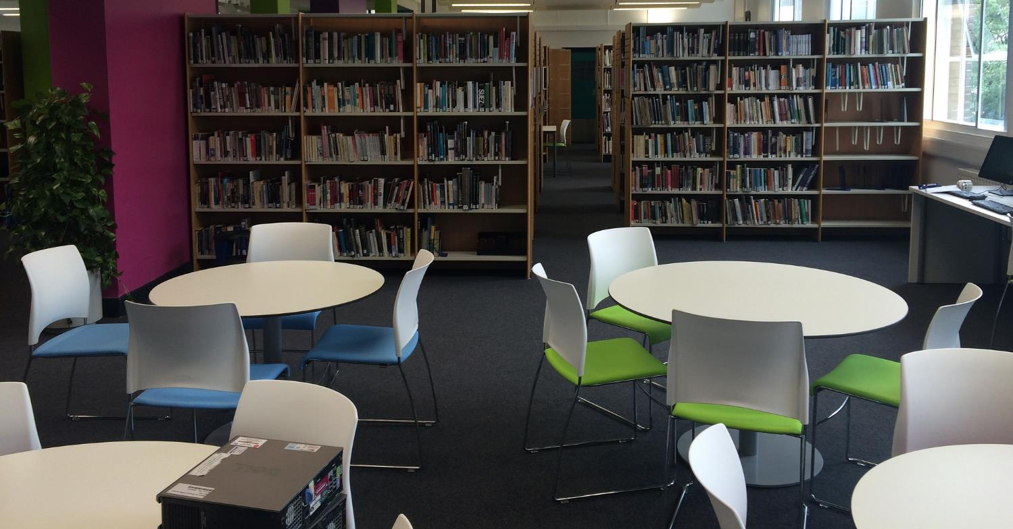
Space for socializing & work groups
“We do go to the library or somewhere quiet where we can just get our work done together...”
(Digital Visitors and Residents, UKU3, Female, Age 19, French and Italian)
Notes:
Image: https://www.flickr.com/photos/jamesclay/14867901948/ by James F Clay / CC BY-NC 2.0
Connaway, Lynn Silipigni, Marie L. Radford, Timothy J. Dickey, Jocelyn De Angelis Williams, and Patrick Confer. 2008. “Sense-making and Synchronicity: Information-Seeking Behaviors of Millennials and Baby Boomers.” Libri 58, no. 2: 123–135. http://www.oclc.org/content/dam/research/publications/library/2008/connaway-libri.pdf.
“When asked to describe the ideal information system, Millennials suggested that the library catalog be more like an Internet search engine or Amazon.com. They also wanted the library to provide space for them to socialize and work in groups and suggested 24/7 access to a librarian via telephone, such as a ‘lifeline” (referring to the television program, Who Wants to be a Millionaire?) Older Millennials were most interested in expediency, desiring roaming librarians, drive-up book drops, library delivery of print materials to their campus addresses, and a coffee house-like environment. The faculty (the majority were Baby Boomers) wanted a less intimidating library with better signage, and a book store like environment.” (p. 92)
Connaway, Lynn Silipigni, comp. 2015. The Library in the Life of the User: Engaging with People Where They Live and Learn. Dublin, OH: OCLC Research. http://www.oclc.org/content/dam/research/publications/2015/oclcresearch-library-in-life-of-user.pdf.
“We do go to the library or somewhere quiet where we can just get our work done together but in regards to something we need the internet for or the computer we normally do that by ourselves. For example I will write up something and send it to her or just print it out and bring it to the lesson and she will go “That’s fine.”” (Digital Visitors and Residents, UKU3, Emerging, Female, Age 19, French and Italian)
White, David S., and Lynn Silipigni Connaway. 2011-2014. Digital Visitors and Residents: What Motivates Engagement with the Digital Information Environment. Funded by JISC, OCLC, and Oxford University. http://www.oclc.org/research/activities/vandr.html.

Slide 37
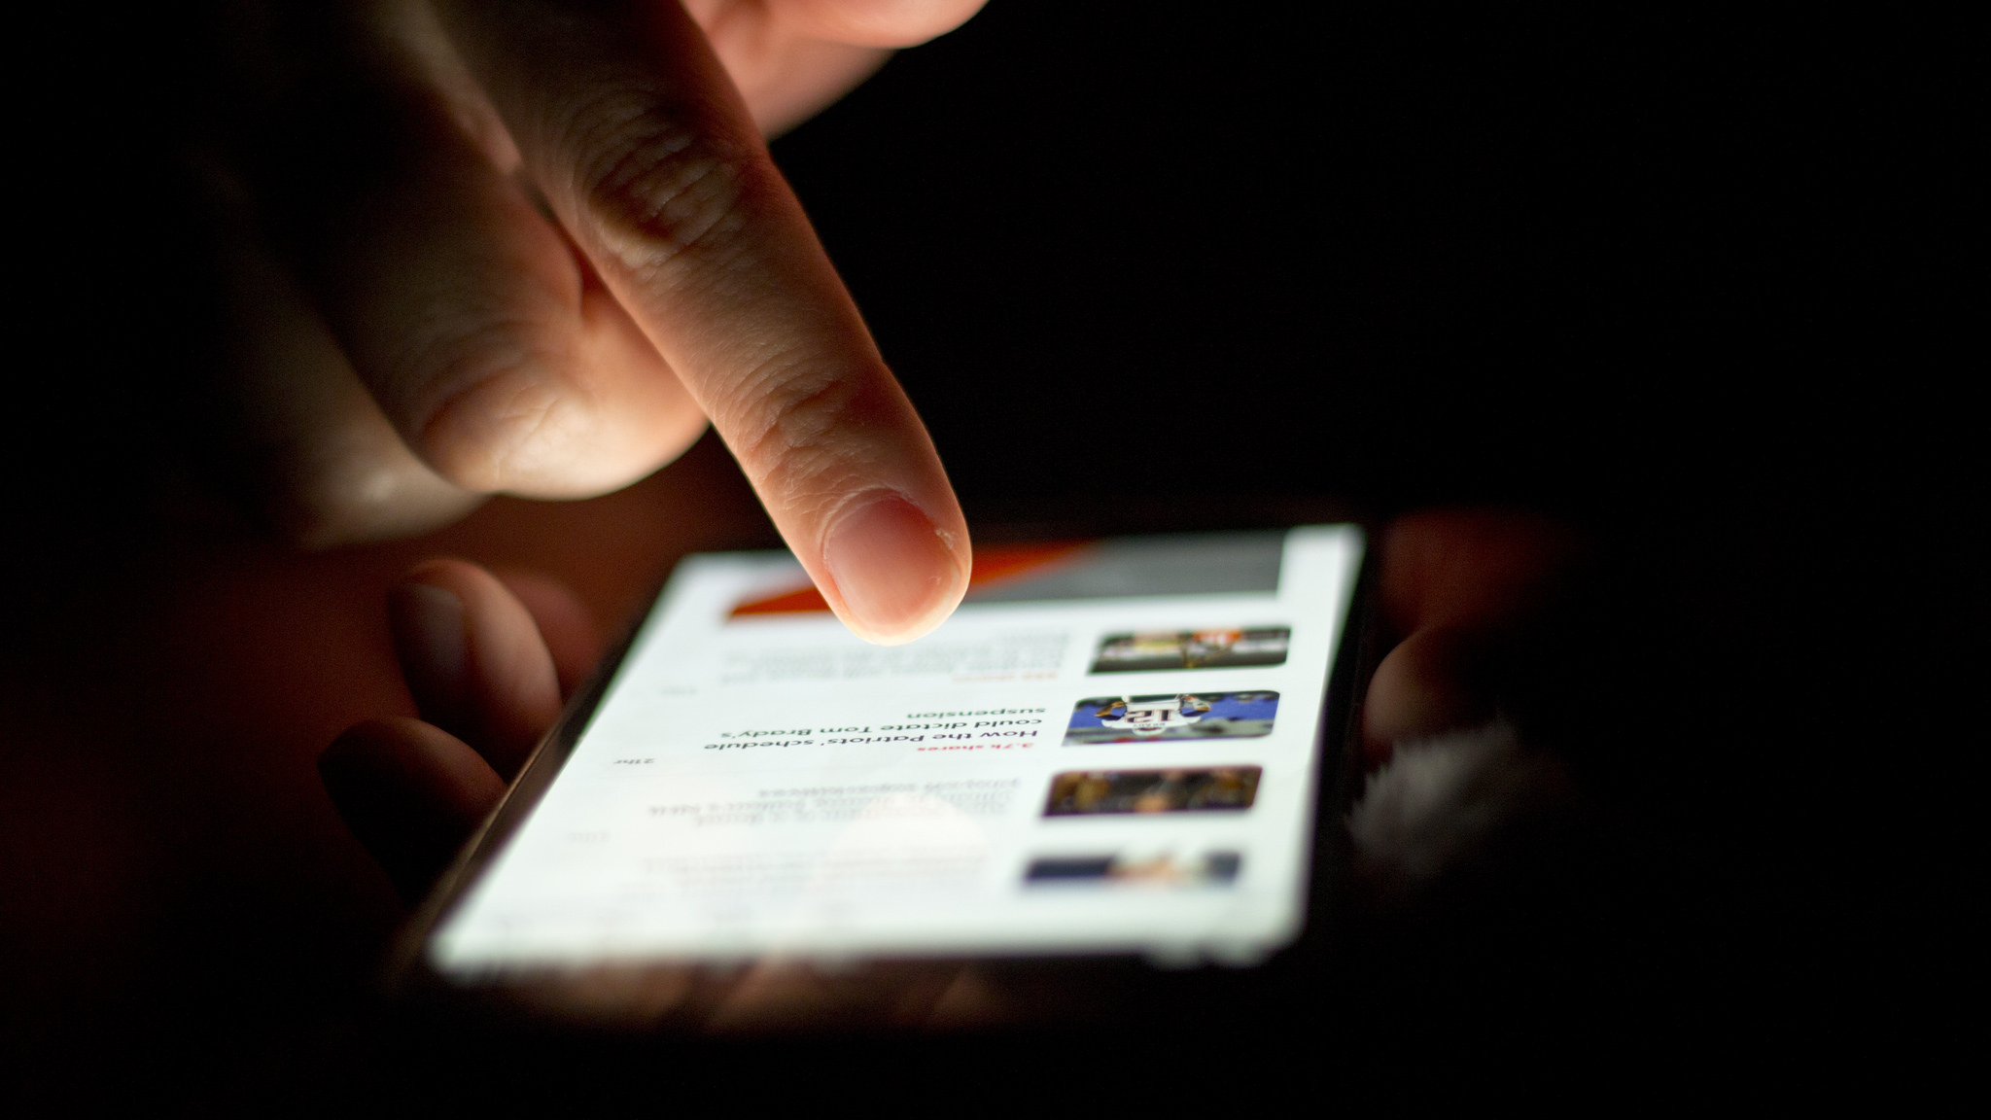
It’s time for a change
“Librarians have an opportunity to become part of users’ social networks and to put resources in the context of users’ information needs.”
(Connaway 2015, 23)
Notes:
Image: https://www.flickr.com/photos/68532869@N08/17470913285/ by Japanexperterna.se / CC BY-SA 2.0
Connaway, Lynn Silipigni, and Ixchel M. Faniel. 2015. “Reordering Ranganathan: Shifting User Behaviours, Shifting Priorities.” SRELS Journal of Information Management 52, no. 1: 3–23.
http://i-scholar.in/index.php/sjim/article/view/60392/51360.
“The following sections will look at what today’s librarians, library researchers and information scientists have said about the changing roles of the five laws and also review relevant literature to show how the five laws still apply, but where, we believe, it’s time for a change in focus and emphasis.” (p. 3) “Librarians have an opportunity to become part of users’ social networks and to put resources in the context of users’ information needs.” (p. 23)
Connaway, Lynn Silipigni, comp. 2015. The Library in the Life of the User: Engaging with People Where They Live and Learn. Dublin, OH: OCLC Research. http://www.oclc.org/content/dam/research/publications/2015/oclcresearch-library-in-life-of-user.pdf.

Slide 38
What Can we do?

Slide 39
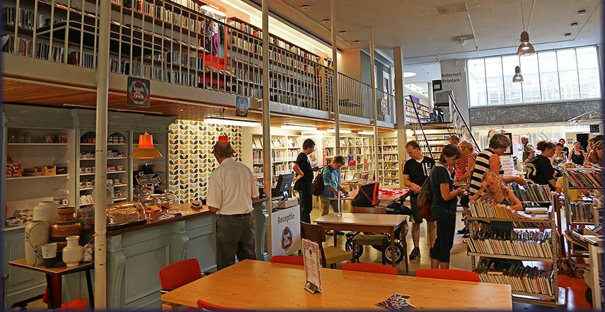
“Our experience with a proactive chat model… showed us that there is indeed a ready-made market for our services right on our own library pages...”
(Zhang and Mayer 2014, 205)
Embedded librarianship
…be where our users need us
Notes:
Image: https://www.flickr.com/photos/dutchsimba/14826733771/ by Dutch Simba / CC BY-NC-ND 2.0
Connaway, Lynn Silipigni. 2013. “Meeting the Expectations of the Community: The Engagement-centered Library.” Library 2020: Today’s Leading Visionaries Describe Tomorrow’s Library, edited by J. Janes, 83–88. Lanham, MD: Scarecrow Press.
“We need to be where our users need us, when they need us. If the majority of our users prefer to communicate via mobile phone texting, chat, or IM; to learn through gaming; by accessing the library’s unique collections and materials via social media, such as Facebook2 and Wikipedia; or to meet with us FtF outside of the library, we need to be there!” (p. 203)
“Embedded librarianship also is an important aspect of public library engagement with the community. Many public libraries are providing kiosks in public spaces, such as train and bus stations and parks, for users to check-out and return print, audio, and electronic books, magazines, newspapers, and journals.” (p. 203)
“The library of 2020 will provide user-centered services and systems that will meet the expectations of the community. The library staff will need to develop relationships with their users and partner with other organizations in order to produce, store, and preserve content and data sets and to provide personalized services. Recruiting and retaining innovative, creative individuals who are willing to engage with users and to embrace new technologies and modes of communication will be imperative for the success of the library of 2020.” (p. 204)
Connaway, Lynn Silipigni, comp. 2015. The Library in the Life of the User: Engaging with People Where They Live and Learn. Dublin, OH: OCLC Research. http://www.oclc.org/content/dam/research/publications/2015/oclcresearch-library-in-life-of-user.pdf.
“Our experience with a proactive chat model at John Carroll University showed us that there is indeed a ready-made market for our services right on our own library pages, and that our users will ask us questions when we approach them.” (Zhang and Mayer 2014, 205)
Zhang, Jie, and Nevin Mayer. 2014. “Proactive Chat Reference: Getting in the Users’ Space.” College & Research Libraries News 75, no. 4: 202-205.

Slide 40
Social Media Presence
Notes:
Image: “Joe McDonald’s Facebook Page.” Facebook.com. https://www.facebook.com/Joe-McDonald-274017182657487/.
Image: “Leola McDonad’s Facebook Page.” Facebook.com. https://www.facebook.com/Leola-McDonald-128487107270652/.
DeSantis, Nick. 2012. “On Facebook, Librarian Brings 2 Students From the Early 1900s to Life.” The Chronicle of Higher Education, January 6. http://chronicle.com/blogs/wiredcampus/on-facebook-librarian-brings-two-students-from-the-early-1900s-to-life/34845.

Slide 41
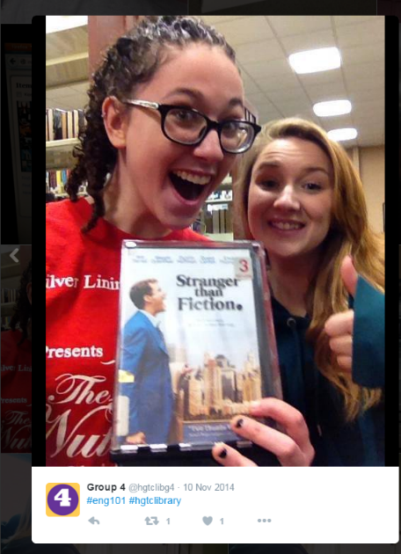
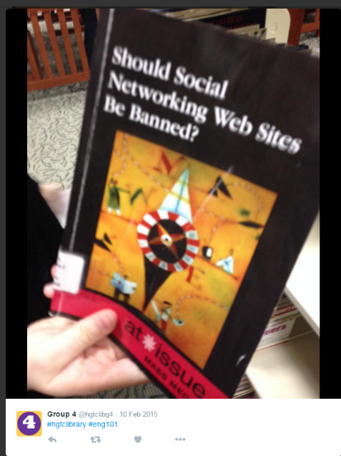
Special Events & Activities
Notes:
Images: Twitter
“The “hashtag hunt,” or Twitter-based scavenger hunt, is an activity that any librarian can complete with his or her students. Though it was originally created to help English 101 students practice finding recommended books for research assignments concerning controversial or moral issues and with the OPAC, it also allows students to explore the library as a place. The handout students receive is structured like all of the traditional library scavenger hunts of day’s past, but students are asked to take photos of the items they find and post them on Twitter with hashtags of the librarian’s choosing, usually hashtags that distinguish the library and the class (e.g., #hgtclibrary and #eng101). Students may also be awarded bonus points for #shelfie posts, which are explained to be posts of themselves in stacks, using the one of the collaborative learning units and/or print stations, or standing in a study room.” (11)
Kraft, Amanda, and Aleck F. Williams, Jr. 2016. “#Shelfies are Encouraged: Simple, Engaging Library Instruction with Hashtags.” College & Research Libraries News 77, no. 1: 10-13.

Slide 42
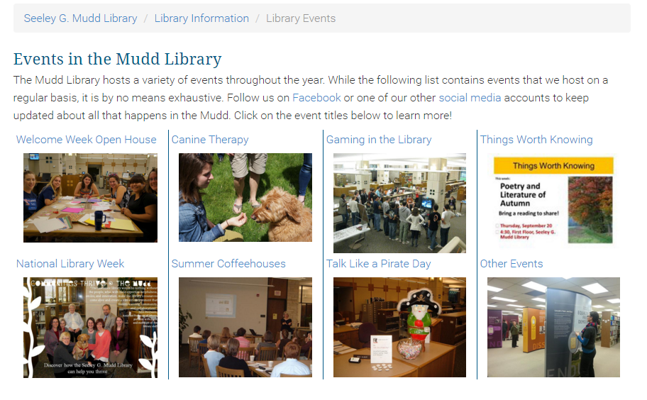
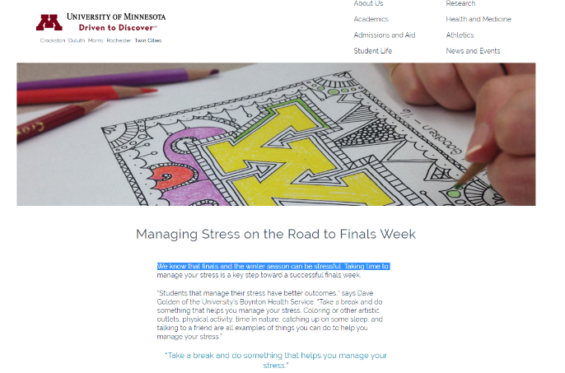
Special Events & Activities
Notes:
Image: Lawrence University. “Library Events.” https://www.lawrence.edu/library/about/events.
Image: University of Minnesota. “Managing Stress on the Road to Finals Week.” https://twin-cities.umn.edu/managing-stress-road-finals-week.

Slide 43
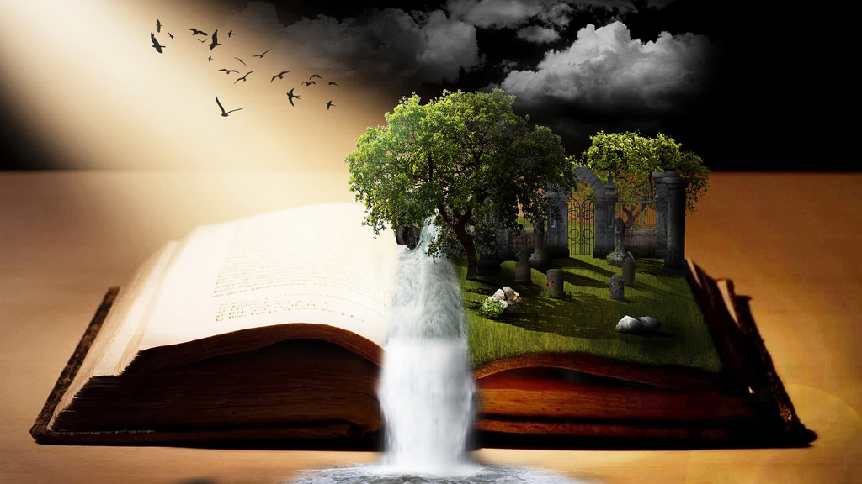
“Library is a growing organism.”
(Ranganathan 1931)
Use what you know
Learn what you don’t know
Engage in new ways
Notes:
Image: http://www.flickr.com/photos/96043955@N05/15190222775 by Ryan Hickox / CC BY-SA 2.0
Ranganathan, S. R. 1931. The Five Laws of Library Science. London: Edward Goldston, Ltd.

Slide 44
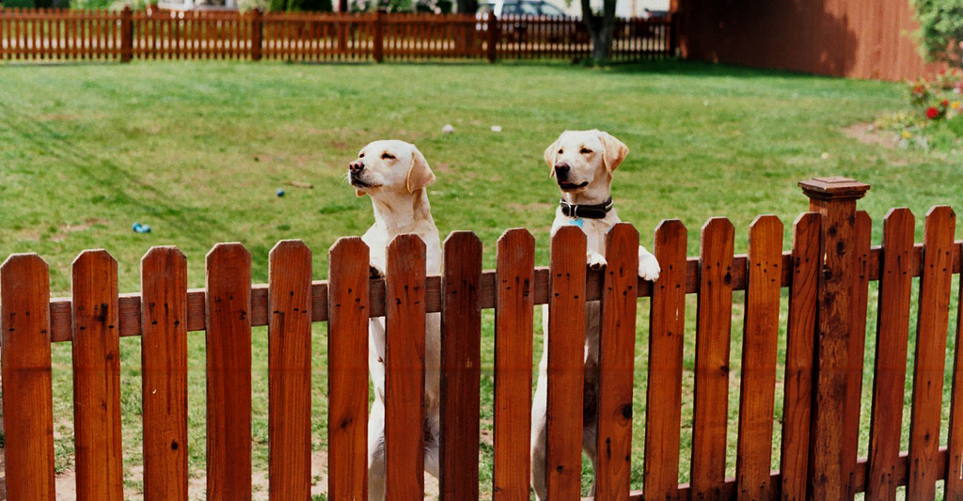
Questions & Discussion
Notes:
Image: https://www.flickr.com/photos/zabowski/4623196333/ by Erica Zabowski / CC BY-ND 2.0

Slide 45
Thank You!
Lynn Silipigni Connaway, PhD
Senior Research Scientist
connawal@oclc.org
@LynnConnaway

Slide 46
References
Alter, Alexandra. 2015. “The Plot Twist: E-Book Sales Slip, and Print Is Far From Dead.” The New York Times, September 22, http://nyti.ms/1OPYEly.
Barthel, Michael. 2016. “Around Half of Newspaper Readers Rely Only on Print Edition.” Pew Research Center, January 6, www.pewresearch.org/fact-tank/2016/01/06/around-half-of-newspaper-readers-rely-only-on-print-edition.
Birth, Allyssa. 2015. “More Than 7 in 10 Americans Think Technology has Become Too Distracting and is Creating a Lazy Society.” The Harris Poll 68, www.theharrispoll.com/health-and-life/Technology-Too-Distracting-Lazy-Society.html.
Becker, Samantha, Michael D. Crandall, Karen E. Fisher, Rebecca Blakewood, Bo Kinney, and Cadi Russell-Sauvé. 2011. Opportunity for All: How Library Policies and Practices Impact Public Internet Access. IMLS-2011-RES-01. Institute of Museum and Library Services. Washington, DC. https://www.imls.gov/assets/1/AssetManager/OppForAll2.pdf.
Braun, Linda W., Maureen L. Hartman, Sandra Hughes-Hassell, and Kafi Kumasi. 2014. The Future of Library Services for and with Teens: A Call to Action. With contributions by Beth Yoke. www.ala.org/yaforum/project-report.

Slide 47
References
Connaway, Lynn Silipigni. 2013. “Meeting the Expectations of the Community: The Engagement-centered Library.” Library 2020: Today’s Leading Visionaries Describe Tomorrow’s Library, edited by J. Janes, 83–88. Lanham, MD: Scarecrow Press.
Connaway, Lynn Silipigni, comp. 2015. The Library in the Life of the User: Engaging with People Where They Live and Learn. Dublin, OH: OCLC Research. http://www.oclc.org/content/dam/research/publications/2015/oclcresearch-library-in-life-of-user.pdf.
Connaway, Lynn Silipigni, and Timothy J. Dickey. 2010. The Digital Information Seeker: Report of Findings from Selected OCLC, RIN, and JISC User Behavior Projects. http://www.jisc.ac.uk/media/documents/publications/reports/2010/digitalinformationseekerreport.pdf.
Connaway, Lynn Silipigni, Timothy J. Dickey, and Marie L. Radford. 2011. “‘If It Is too inconvenient I’m not going after it:’ Convenience as a Critical Factor in Information-Seeking Behaviors.” Library & Information Science Research 33, no. 3: 179–190.
Connaway, Lynn Silipigni, and Ixchel M. Faniel. 2015. “Reordering Ranganathan: Shifting User Behaviours, Shifting Priorities.” SRELS Journal of Information Management 52, no. 1: 3–23. http://i-scholar.in/index.php/sjim/article/view/60392/51360.

Slide 48
References
Connaway, Lynn Silipigni, Donna M. Lanclos, and Erin M. Hood. 2013. “‘I always stick with the first thing that comes up on Google…’ Where People Go for Information, What They Use, and Why.” EDUCAUSE Review Online, December 6, http://www.educause.edu/ero/article/ialways-stick-first-thing-comes-google-where-people-go-information-what-they-use-and-why.
Connaway, Lynn Silipigni, and Marie L. Radford. 2005-2007. Seeking Synchronicity: Evaluating Virtual Reference Services from User, Non-User, and Librarian Perspectives. Funded by Institute for Museums and Library Services Research Grant. http://www.oclc.org/research/activities/synchronicity/default.htm.
Connaway, Lynn Silipigni, Marie L. Radford, Timothy J. Dickey, Jocelyn De Angelis Williams, and Patrick Confer. 2008. “Sense-making and Synchronicity: Information-Seeking Behaviors of Millennials and Baby Boomers.” Libri 58, no. 2: 123–135. http://www.oclc.org/content/dam/research/publications/library/2008/connaway-libri.pdf.
Connaway, Lynn Silipigni, David White, Donna Lanclos, and Alison Le Cornu. 2013. “Visitors and Residents: What Motivates Engagement with the Digital Information Environment?” Information Research 18, no. 1, http://informationr.net/ir/18-1/infres181.html.
Dempsey, Lorcan. 2015. “Environmental Trends and OCLC Research.” Presented at the University of Notre Dame, Notre Dame, Indiana, September 28, http://www.oclc.org/content/dam/research/presentations/dempsey/dempsey-notre-dame-oclc-research-2015.pptx.

Slide 49
References
DeSantis, Nick. 2012. “On Facebook, Librarian Brings 2 Students from the Early 1900s to Life.” The Chronicle of Higher Education, January 6, http://chronicle.com/blogs/wiredcampus/on-facebook-librarian-brings-two-students-from-the-early-1900s-to-life/34845.
Kraft, Amanda, and Aleck F. Williams, Jr. 2016. “#Shelfies are Encouraged: Simple, Engaging Library Instruction with Hashtags.” College & Research Libraries News 77, no. 1: 10-13.
Mudd Library. “Library Events.” Lawrence University. https://www.lawrence.edu/library/about/events.
National Center for Education Statistics. “Public High School 4-Year Adjusted Cohort Graduation Rate (ACGR), By Race/Ethnicity and Selected Demographics for the United States, the 50 states, and the District of Columbia: School Year 2014–15.” Common Core of Data, National Center for Education Statistics. http://nces.ed.gov/ccd/tables/ACGR_RE_and_characteristics_2014-15.asp.
Pattillo, Gary. 2015. “Fast Facts.” College & Research Libraries News 76, no. 4: 232.
Pattillo, Gary. 2015. “Fast Facts.” College & Research Libraries News 76, no. 10: 568.

Slide 50
References
Pattillo, Gary. 2015. “Fast Facts.” College & Research Libraries News 76, no. 11: 650.
Pattillo, Gary. 2016. “Fast Facts.” College & Research Libraries News 77, no. 3: 164.
Pattillo, Gary. 2016. “Fast Facts.” College & Research Libraries News 77, no. 5: 264.
Pattillo, Gary. 2016. “Fast Facts.” College & Research Libraries News 77, no. 9: 472.
Pattillo, Gary. 2016. “Fast Facts.” College & Research Libraries News 77, no. 10: 524.
Pattillo, Gary. 2016. “Fast Facts.” College & Research Libraries News 77, no. 11: 616.
Pattillo, Gary. 2017. “Fast Facts.” College & Research Libraries News 78, no. 1: 56.
Perrin, Andrew. 2016. “Book Reading 2016.” Pew Research Center, September 1, http://www.pewinternet.org/2016/09/01/book-reading-2016/.

Slide 51
References
Perruso, Carol. 2016. “Undergraduates’ Use of Google vs. Library Resources: A Four-Year Cohort Study.” College & Research Libraries 77, no. 5: 614-630.
Prabha, Chandra, Lynn Silipigni Connaway, Lawrence Olszewski, and Lillie Jenkins. 2007. “What is Enough? Satisficing Information Needs.” Journal of Documentation 63, no. 1: 74–89. http://www.oclc.org/content/dam/research/publications/newsletters/prabha-satisficing.pdf.
Radford, Marie L., and Lynn Silipigni Connaway. 2007. “‘Screenagers’ and Live Chat Reference: Living up to the Promise.” Scan 26, no. 1: 31–39. http://www.oclc.org/content/dam/research/publications/newsletters/connaway-scan.pdf.
Ranganathan, S. R. 1931. The Five Laws of Library Science. London: Edward Goldston, Ltd.
Rosenwald, Michael S. 2015. “Why Digital Natives Prefer Reading in Print. Yes, You Read that Right.” The Washington Post, February 22, www.washingtonpost.com/local/why-digital-natives-prefer-reading-in-print-yes-you-read-that-right/2015/02/22/8596ca86-b871-11e4-9423-f3d0a1ec335c_story.html.

Slide 52
References
Rushkoff, Douglas. 1996. Playing the Future: How Kids’ Culture Can Each Us to Thrive in an Age of Chaos. New York: HarperCollins.
Stanford History Education Group. 2016. “Evaluating Information: The Cornerstone of Civic Online Reasoning.” November 22, https://sheg.stanford.edu/upload/V3LessonPlans/Executive%20Summary%2011.21.16.pdf.
Stemmer, John K., and David M. Mahan. 2016. “Investigating the Relationship of Library Usage to Student Outcomes.” College & Research Libraries 77, no. 3. http://crl.acrl.org/content/77/3/359.full.pdf+html.
Simpson, Jessica. “The Heart of the University: Library Link Location on Doctoral Granting Institutions Webpages and Correlation with Research Output.” Journal of Academic Librarianship 42, no. 5 (2016): 503–508.
Sullivan, Danny. 2016. “Google Now Handles at Least 2 Trillion Searches Per Year.” Search Engine Land, May 24, http://searchengineland.com/google-now-handles-2-999-trillion-searches-per-year-250247.
University of Minnesota. “Managing Stress on the Road to Finals Week.” https://twin-cities.umn.edu/managing-stress-road-finals-week.

Slide 53
References
White, David S., and Lynn Silipigni Connaway. 2011-2014. Digital Visitors and Residents: What Motivates Engagement with the Digital Information Environment. Funded by JISC, OCLC, and Oxford University. http://www.oclc.org/research/activities/vandr.html.
Wolff, Christine, Alisa B. Rod, and Roger C. Schonfeld. 2016. “Ithaka S+R US Faculty Survey 2015.” Ithaka S+R, http://sr.ithaka.org?p=277685.
World Bank. 2016. World Development Report 2016: Digital Dividends. Washington, DC: World Bank. www.worldbank.org/en/publication/wdr2016.
Sweney, Mark. 2016. “Printed Book Sales Rise for First Time in Four Years as eBooks Decline.” The Guardian, May 13, www.theguardian.com/media/2016/may/13/printed-book-sales-ebooks-decline.
Zhang, Jie, and Nevin Mayer. 2014. “Proactive Chat Reference: Getting in the Users’ Space.” College & Research Libraries News 75, no. 4: 202-205.
Zickuhr, Kathryn, Lee Rainie, and Kristen Purcell. 2013. Younger Americans’ Library Habits and Expectations. http://libraries.pewinternet.org/2013/06/25/younger-americans-library-services/.

Slide 54
Image Attribution
Slide 2: Image: https://www.flickr.com/photos/91600944@N06/10572419153/ by Lorenzo Scheda / CC BY-NC-ND 2.0
Slide 3: Image: https://www.flickr.com/photos/thyagohills/5009884654/ by Thyago - SORG|FX / CC BY 2.0
Slide 4: Image: https://www.flickr.com/photos/134037448@N03/26365644111/ by WorldRemit Comms / CC BY-SA 2.0
Slide 5: Image: https://www.flickr.com/photos/lupuca/8720604364/ by Lucélia Ribeiro / CC BY-SA 2.0
Slide 6: Image: https://www.flickr.com/photos/orangegreenblue/10862779413/ by Kat Northern Lights Man / CC BY-NC 2.0
Slide 7: Image: https://www.flickr.com/photos/ucentralarkansas/5050793935/ by University of Central Arkansas Follow / CC BY-NC-ND 2.0
Slide 8: Image: https://www.flickr.com/photos/cunycommons/6561935761/ by CUNY Academic Commons / CC BY 2.0
Slide 9: Image: https://www.flickr.com/photos/aboyandhisbike/3606916280/ by Michael B. / CC BY-NC-ND 2.0
Slide 10: Image: https://www.flickr.com/photos/australianshepherds/4515927995/ by S. Carter / CC BY-SA 2.0
Slide 11: Image: https://www.flickr.com/photos/eekim/15657137102/ by Eugene Kim / CC BY 2.0

Slide 55
Image Attribution
Slide 12: Image: https://www.flickr.com/photos/fmckinlay/16255732772/ by Fiona Shields / CC BY-NC-ND 2.0
Slide 13: Image: https://www.flickr.com/photos/18406928@N00/394745454/ by Darkangels / CC BY 2.0
Slide 15: Image: https://www.flickr.com/photos/jcolivera/2732136711/ by Jc Olivera / CC BY-NC-ND 2.0
Slide 16: Image: https://www.flickr.com/photos/lichtempfindlich/8216960166/ by ++ lichtempfindlich / CC BY-NC-ND 2.0
Slide 17: Image: https://www.flickr.com/photos/akash_k/125489887/ by Akash Kataruka / CC BY-ND 2.0
Slide 18: Image: https://www.flickr.com/photos/lucathegalga/3803107791/ by Josie / CC BY-NC-ND 2.0
Slide 19: Image: https://www.flickr.com/photos/freeside/16005615981/ by .freeside. / CC BY-NC-ND 2.0
Slide 20: Image: https://www.flickr.com/photos/thomashawk/307750722/ by Thomas Hawk / CC BY-NC 2.0
Slide 21: Image: https://www.flickr.com/photos/davebass5/14680844817/ by Dave Pearce / CC BY-NC-ND 2.0
Slide 22: Image: https://www.flickr.com/photos/archer10/15686974001/ by Dennis Jarvis / CC BY-SA 2.0
Slide 23: Image: http://www.flickr.com/photos/95792332@N00/3226023555 by Jacob Davies / CC BY-SA 2.0
Slide 24: Image: https://www.flickr.com/photos/tychosnose/12017536084/ by Joel Tonyan / CC BY-NC-ND 2.0
Slide 25: Image: https://www.flickr.com/photos/vonderauvisuals/8719186156/ by Bob Vonderau / CC BY-NC-ND 2.0

Slide 56
Image Attribution
Slide 26: Image: https://www.flickr.com/photos/theeerin/3746390760/ by Erin Nekervis / CC BY-SA 2.0
Slide 27: Image: https://www.flickr.com/photos/thyagohills/5009884654/ by Thyago - SORG|FX / CC BY 2.0
Slide 28: Image: https://www.flickr.com/photos/sanjoselibrary/2849158124/ by San José Public Library / CC BY-SA 2.0
Slide 29: Image: https://www.flickr.com/photos/helenk/29826982796/ by Helen K / CC BY-NC-ND 2.0
Slide 30: Image: https://www.flickr.com/photos/emmabird8/13878757353/ by Emma M. / CC BY 2.0
Slide 31: Image: https://www.flickr.com/photos/marcin_b/2076003471/ by Marcin Biodrowski / CC BY-NC-ND 2.0
Slide 32: Image: https://www.flickr.com/photos/thomashawk/149497554/ by Thomas Hawk / CC BY-NC 2.0
Slide 33: Image: https://www.flickr.com/photos/artlung/1625328/ by Joe Crawford / CC BY 2.0
Slide 34: Image: https://www.flickr.com/photos/digitalnc/8263677993/ by North Carolina Digital Heritage Center / CC BY-NC-ND 2.0
Slide 35: Image: https://www.flickr.com/photos/thyagohills/5009884654/ Thyago - SORG|FX / CC BY 2.0
Slide 36: Image: https://www.flickr.com/photos/jamesclay/14867901948/ by James F Clay / CC BY-NC 2.0
Slide 37: Image: https://www.flickr.com/photos/68532869@N08/17470913285/ by Japanexperterna.se / CC BY-SA 2.0

Slide 57
Image Attributions
Slide 39: Image: https://www.flickr.com/photos/dutchsimba/14826733771/ by Dutch Simba / CC BY-NC-ND 2.0
Slide 40a: Image: “Joe McDonald’s Facebook Page.” Facebook.com. https://www.facebook.com/Joe-McDonald-274017182657487/.
Slide 40b: Image: “Leola McDonad’s Facebook Page.” Facebook.com. https://www.facebook.com/Leola-McDonald-128487107270652/.
Slide 41: Images: Twitter
Slide 42a: Image: Lawrence University. “Library Events.” https://www.lawrence.edu/library/about/events.
Slide 42b: Image: University of Minnesota. “Managing Stress on the Road to Finals Week.” https://twin-cities.umn.edu/managing-stress-road-finals-week.
Slide 43: Image: http://www.flickr.com/photos/96043955@N05/15190222775 by Ryan Hickox / CC BY-SA 2.0
Slide 44: Image: https://www.flickr.com/photos/zabowski/4623196333/ by Erica Zabowski / CC BY-ND 2.0

