Slide 1
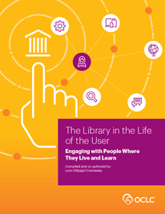
Digital Era Librarians Conference
March 17, 2016
“I go to Google first.”
Integrating the Library into the Life of the User
Lynn Silipigni Connaway, PhD
Senior Research Scientist
Notes:
Connaway, Lynn Silipigni, comp. 2015. The Library in the Life of the User: Engaging with People Where They Live and Learn. Dublin, OH: OCLC Research. http://www.oclc.org/content/dam/research/publications/2015/oclcresearch-library-in-life-of-user.pdf.

Slide 2
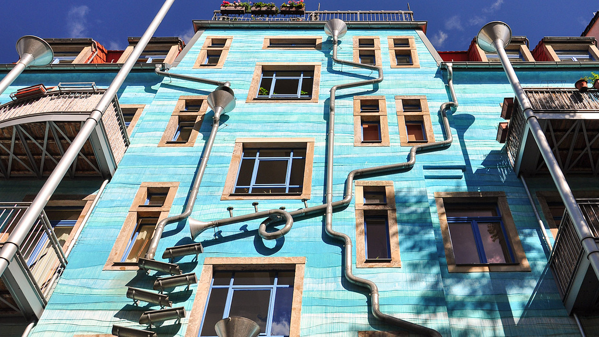
Our traditional model was
one in which we thought of
the user in the life of the library
… but we are now increasingly
thinking about the library
in the life of the user
(Connaway 2015)
(Dempsey 2015)
Notes:
Image: http://www.flickr.com/photos/8129923@N05/7402193042
Connaway, Lynn Silipigni, comp. 2015. The Library in the Life of the User: Engaging with People Where They Live and Learn. Dublin, OH: OCLC Research. http://www.oclc.org/content/dam/research/publications/2015/oclcresearch-library-in-life-of-user.pdf.
Dempsey, Lorcan. 2015. “Environmental Trends and OCLC Research.” Presented at the University of Notre Dame, Notre Dame, Indiana, September 28. http://www.oclc.org/content/dam/research/presentations/dempsey/dempsey-notre-dame-oclc-research-2015.pptx.

Slide 3

Need to provide services for what people actually do, not what they say they do
The workflow context
Convenience and context switching
Fragmentation is a deterrent
(Dempsey 2015)
Notes:
Image: http://www.flickr.com/photos/14853721@N00/6926490142
Dempsey, Lorcan. 2015. “Environmental Trends and OCLC Research.” Presented at the University of Notre Dame, Notre Dame, Indiana, September 28. http://www.oclc.org/content/dam/research/presentations/dempsey/dempsey-notre-dame-oclc-research-2015.pptx.

Slide 4
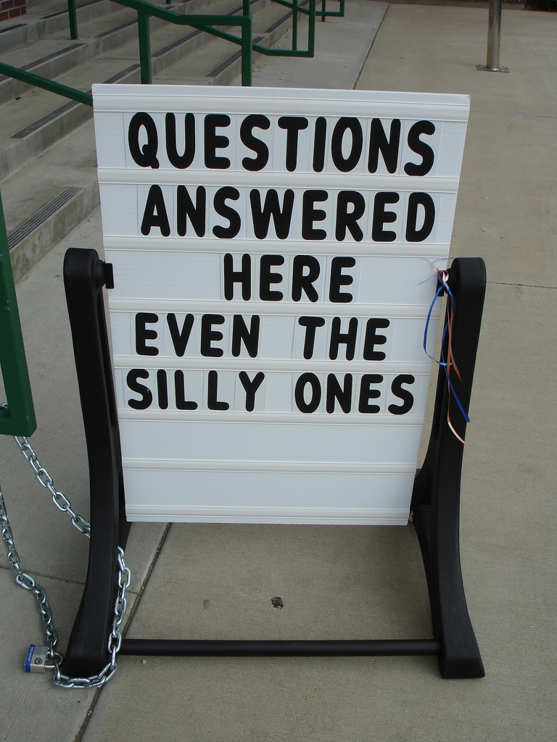
Prabha, Chandra, Lynn Silipigni Connaway, Lawrence Olszewski, and Lillie Jenkins. 2007. “What is enough? Satisficing information needs.” Journal of Documentation 63, no. 1: 74–89. http://www.oclc.org/content/dam/research/publications/newsletters/prabha-satisficing.pdf.
“Sometimes libraries are closed and i need help so this [VRS] would be a great alternative. This method should me advertised more.”
(Seeking Synchronicity, NOS-36503, Non-user Online Survey, Female, Age 15-18)
Promote resources available to users
Notes:
Image: http://www.flickr.com/photos/45082883@N00/223839049
“In order for libraries to stay relevant, their systems need to emulate Internet search engines. Such features as simplified searching and the collocation of all types of information (e.g., books, journals, articles, web pages, etc.) facilitate users’ search experience which obviates the need to understand the complexity of library systems.” (p. 49)
“The findings of the focus group interviews also indicate that libraries need to promote the library resources that are available to users…Those who are aware of them tend to find them difficult to use because of the need to know specific subject coverage of databases, a knowledge that is often difficult to comprehend when doing interdisciplinary research. In addition, participants indicate that the inconsistent search protocols of library web sites and online catalogs discourage effective use.” (p. 49)
Connaway, Lynn Silipigni, comp. 2015. The Library in the Life of the User: Engaging with People Where They Live and Learn. Dublin, OH: OCLC Research. http://www.oclc.org/content/dam/research/publications/2015/oclcresearch-library-in-life-of-user.pdf.
“Sometimes libraries are closed and i need help so this would be a great alternative. This method should me advertised more.” (Seeking Synchronicity, NOS-36503, Non-user Online Survey, Female, Age 15-18)
Connaway, Lynn Silipigni, and Marie L. Radford. 2005-2007. Seeking Synchronicity: Evaluating Virtual Reference Services from User, Non-User, and Librarian Perspectives. Funded by Institute for Museums and Library Services Research Grant. http://www.oclc.org/research/activities/synchronicity/default.htm.

Slide 5

Prabha, Chandra, Lynn Silipigni Connaway, Lawrence Olszewski, and Lillie Jenkins. 2007. “What is enough? Satisficing information needs.” Journal of Documentation 63, no. 1: 74–89. http://www.oclc.org/content/dam/research/publications/newsletters/prabha-satisficing.pdf.
“…I needed the answer, my maths, I was doing an exercise, I got stuck on a question, I still had the rest of the exercise to go and I had like an hour to do it and I just wanted the formula and the quickest way to do it was to type it into Google and it came up.”
(Digital Visitors and Residents, UKS2, Emerging, Female, Age 17, Secondary School Student)
Satisficing…What is enough information?
Notes:
Image: http://www.flickr.com/photos/33089302@N05/9211451757
“The foregoing examples suggest that users may satisfice their need for information based on what they are able to find and thus stop looking for more information. Users may also stop looking for information prematurely if the information systems are difficult or unusable. The very abundance of information makes it crucial for information seekers to decide what information is enough to meet their objectives.” (p. 38)
“Undergraduate and graduate students tend to stop looking for information when they find the required number of sources for an assignment.” (p. 48)
“Faculty as well as undergraduate and graduate students indicate that time constraints influence when they stop looking for information.” (p. 48)
“In describing their information seeking and searching, participants mentioned their rationale for choosing specific strategies and sources. The situational contexts of the participants’ information-seeking experiences affect every stage of their search—from the choice of their first source (Google in many cases, or human resources such as family, friends, and colleagues)—to ongoing strategies (depth of search, value judgments on resource authority, browsing and searching) and then decisions on how much information is enough.” (p. 48)
Connaway, Lynn Silipigni, comp. 2015. The Library in the Life of the User: Engaging with People Where They Live and Learn. Dublin, OH: OCLC Research. http://www.oclc.org/content/dam/research/publications/2015/oclcresearch-library-in-life-of-user.pdf.
“But, yes, convenience, I needed the answer, my maths, I was doing an exercise, I got stuck on a question, I still had the rest of the exercise to go and I had like an hour to do it and I just wanted the formula and the quickest way to do it was to type it into Google and it came up. So, yes, it’s definitely a convenience thing I think.” (Digital Visitors and Residents, UKS2, Emerging, Female, Age 17, Secondary School Student)
“[When you search information] you notice that new information arrives every moment, and a lot of information is circulating about the same question. Until you are tired and then you stop searching.” (Digital Visitors and Residets, UOC, UOCG4, Male, 41, Postgraduate Student, Health Sciences)
White, David S., and Lynn Silipigni Connaway. 2011-2014. Digital Visitors and Residents: What Motivates Engagement with the Digital Information Environment. Funded by JISC, OCLC, and Oxford University. http://www.oclc.org/research/activities/vandr.html.

Slide 6
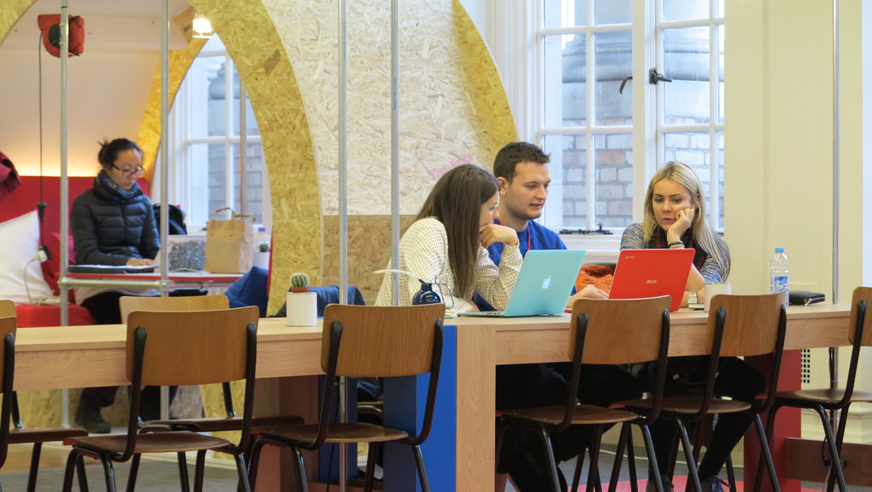
Connaway, Lynn Silipigni, and Timothy J. Dickey. 2010. The digital information seeker: Report of findings from selected OCLC, RIN, and JISC User Behavior Projects. http://www.jisc.ac.uk/media/documents/publications/reports/2010/digitalinformationseekerreport.pdf.
“…I just think it’s [their website’s] too complicated and it’s limited, that I just carried on going on Google.”
(Digital Visitors and Residents, UKS6, Emerging, Female, Age 16, Secondary School Student)
Centrality of Google and search engines
Notes:
Image: http://www.flickr.com/photos/14092627@N06/23281501139
“Among the central findings are the following: • Disciplinary differences do exist in researcher behaviours, both professional researchers and students. • E-journals are increasingly very important to the process of research at all levels. • The evidence provided by the results of the studies supports the centrality of Google and search engines. — Google is often used to locate and access e-journal content. • At the same time, the entire discovery-to-delivery process needs to be supported by information systems, including increased access to resources.” (p. 105) “•Journal backfiles are particularly problematic in terms of access.”
“The realities of the online environment observed above led several studies to some common conclusions about changing user behaviours: • Regardless of age or experience, academic discipline, or context of the information need, speed and convenience are important to users. — Researchers particularly appreciate desktop access to scholarly content. — Users also appreciate the convenience of electronic access over the physical library. • Users are beginning to desire enhanced functionality in library systems. • They also desire enhanced content to assist them in evaluating resources. • They seem generally confident in their own ability to use information discovery tools. • However, it seems that information literacy has not necessarily improved. — High-quality metadata is thus becoming even more important for the discovery process.” (p. 106)
Connaway, Lynn Silipigni, comp. 2015. The Library in the Life of the User: Engaging with People Where They Live and Learn. Dublin, OH: OCLC Research. http://www.oclc.org/content/dam/research/publications/2015/oclcresearch-library-in-life-of-user.pdf.
“Yes. It’s like for our extended project we have like tutorial sessions, and they gave us this website that you go on to like try and find useful resources, but I just think it’s too complicated and it’s limited, that I just carried on going on Google.” (Digital Visitors and Residents, UKS6, Emerging, Female, Age 16, Secondary School Student)
White, David S., and Lynn Silipigni Connaway. 2011-2014. Digital Visitors and Residents: What Motivates Engagement with the Digital Information Environment. Funded by JISC, OCLC, and Oxford University. http://www.oclc.org/research/activities/vandr.html.

Slide 7
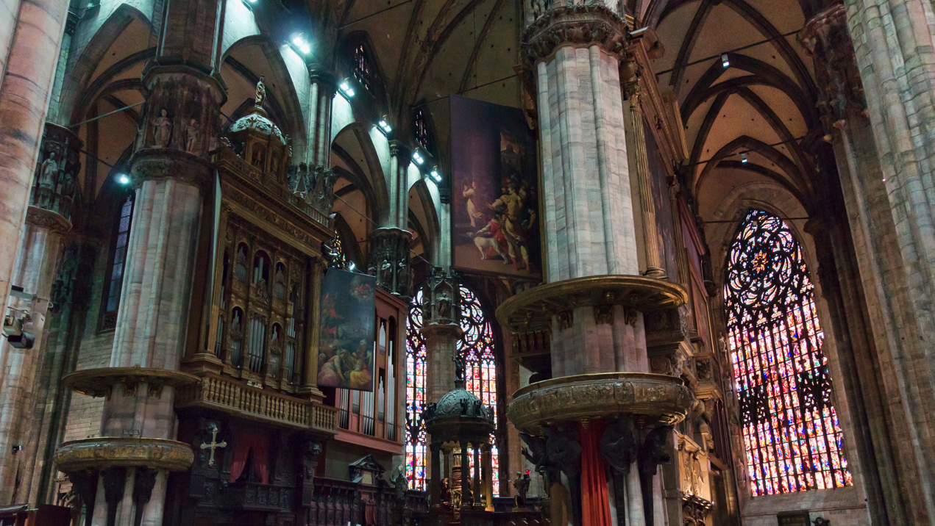
“You spend many hours, with Saint Google. We entrust ourselves to Saint Google, and that solves it for us.” (UOCFI6, Male, Age 53, Arts & Humanities)
Notes:
Image: http://theredlist.com/media/database/architecture/history/architecture-europeene/art-gothique/duomo-milan/009_duomo-milan_theredlist.png

Slide 8

Connaway, Lynn Silipigni, Timothy J. Dickey, and Marie L. Radford. 2011. “‘If It Is too inconvenient I’m not going after it:’ Convenience as a critical factor in information-seeking behaviors.” Library & Information Science Research 33, no. 3: 179–190.
“People lack patience to wade through content silos…”
(Connaway 2015, 134)
“Yes, it - sort of make information gathering effortless and without having to sort of manually go through and separate the chaff from the wheat.”
(Digital Visitors and Residents, UKU10, Establishing, Male, Age 20, Law)
Notes:
Image: http://www.flickr.com/photos/47011911@N05/5512131223
“The image of libraries as a quiet place to access books, rather than to access electronic sources still is prevalent today (Connaway, & Dickey, 2010, p. 39). In order to entice people to use libraries and to change their perceptions of libraries, the library experience needs to become more like that available on the web (e.g., Google, Amazon.com, iTunes, etc.) and to be embedded in individual workflows. The web environment is familiar to users; therefore, they are comfortable and confident choosing to search for information there.” (p. 133) “Access to sources, not the discovery of sources, is the concern of information-seekers. People lack patience to wade through content silos and indexing and abstracting databases. They expect seamless access to resources such as full text e-journals, online foreign-language materials, ebooks, a variety of electronic publishers’ platforms, and virtual reference desk services (Connaway & Dickey, 2010, p. 46–47).” (p. 134) “Librarians also must advertise the library brand and its resources better to academics, researchers, students, and the general public...One size does not fit all for library services, which need to be offered in multiple delivery modes to meet the different information needs of users in different situations.” (p. 134) “As seen above, in some situations information seekers will readily sacrifice content for convenience. Convenience is thus one of the primary criteria used for making choices during the information-seeking process. Convenience includes the choice of the information source (is it readily available online or in print), the satisfaction with the source (does it contain the needed information and is it easy to use), and the time it will take to access and use the information source (how long will it take to access).” (p. 134)
Connaway, Lynn Silipigni, comp. 2015. The Library in the Life of the User: Engaging with People Where They Live and Learn. Dublin, OH: OCLC Research. http://www.oclc.org/content/dam/research/publications/2015/oclcresearch-library-in-life-of-user.pdf.
“I go to Wikipedia, scroll down to the bottom, and there’s like references that Wikipedia used and I click on those references and like check those links. Cause I’m like ‘that’s the fastest way to find a good link.’ Cause like if I’m gonna search like, I don’t know heart attack cases or something. Like that’s gonna take me forever to find like, a good website, or book to talk about what I’m looking for when I can just type in Wikipedia like, heart attacks or something, scroll to the bottom, there’s already books and websites there for me.” (Digital Visitors and Residents, 2USU1, Emerging, Male, Age 18, Engineering)
UKU10: “I don’t know. Fantasy aside, probably like the Matrix, just have the plug-ins at the back of your head, I imagine.”
Int.: “Okay, yes. Okay, that’s fine. I mean that’s what we’re sort of wanting to know what people would actually like best.”
UKU10: “Yes, I suppose I only say that because of out of laziness and that I don’t want to have to go through reading books and searching web pages and…”
Int.: “So what would you want this little plug in in your head to give you?”
UKU10: “I don’t know sort of just tell me what I want to know without me having to do anything (Laughter) in essence but…”
Int.: “Okay, so you just – would it be able to read your mind and give you information?”
UKU10: “Yes, it - sort of make information gathering effortless and without having to sort of manually go through and separate the chaff from the wheat.”
Int.: “Yes. And you’d like that done for you sort of all of the relevant stuff.”
UKU10: “That’s sort of – I find that’s the biggest time consumer and obviously the most like taxing part of it.”
Int.: Do you think it’s where you learn most though?”
UKU10: “Oh I don’t know, that’s quite a good question, potentially – I don’t know, I’m not sure.” (Digital Visitors and Residents, UKU10, Establishing, Male, Age 20, Law)
“You spend may hours, with Saint Google. We entrust ourselves to Saint Google, and that solves it for us.” (Digital Visitors and Residents, UOC, UOCFI6, Male, Age 45-54, Faculty, Arts and Humanities)
White, David S., and Lynn Silipigni Connaway. 2011-2014. Digital Visitors and Residents: What Motivates Engagement with the Digital Information Environment. Funded by JISC, OCLC, and Oxford University. http://www.oclc.org/research/activities/vandr.html.

Slide 9
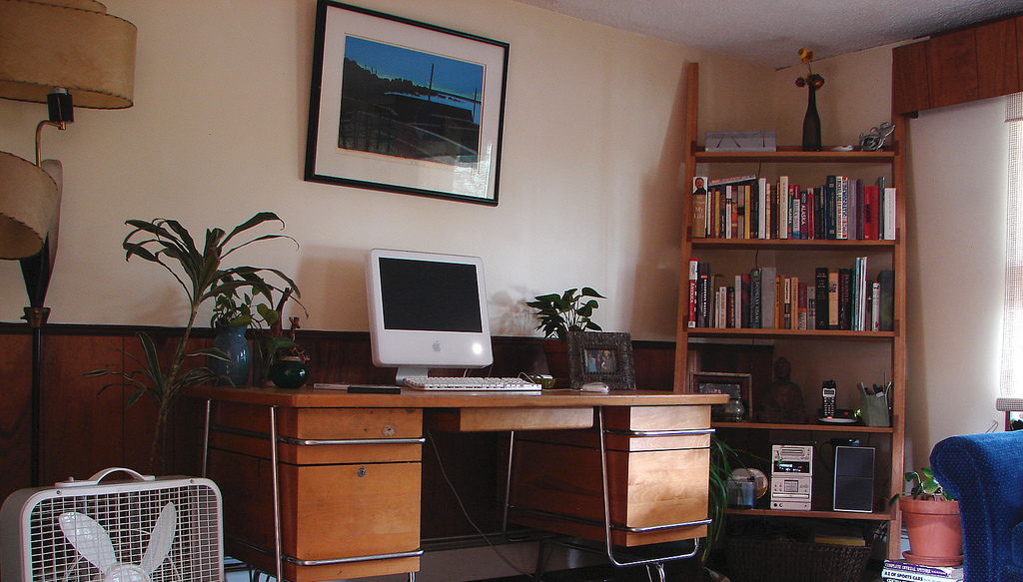
Connaway, Lynn Silipigni, Donna Lanclos, David White, Alison Le Cornu, and Erin M. Hood. 2012. “User-centered decision making: A new model for developing academic library services and systems.” IFLA World Library and Information Congress 2012 Helsinki Proceedings: Libraries Now! Inspiring, Surprising, Empowering. http://conference.ifla.org/sites/default/files/files/papers/wlic2012/76-connaway-en.pdf.
“And that’s [meeting face-to face] more helpful than the online emails or what we used to have is list serves that are still around a little bit. I used to use those a lot more.”
(Digital Visitors and Residents, USF5, Experiencing, Male, Age 51, Theatre)
Motivation and behaviors change based on context and situation
Notes:
Image: http://www.flickr.com/photos/51556967@N00/898332532
“Residents: significant online presence and usage; high level of collaborative activity online; contributions to the online environment in the form of uploading materials, photos, videos; high dependence on a mobile device (smart phone, laptop, etc.); more than 10 hours a week spent online.”
Visitors: functional use of technology, often linked to formal need (such as use of software for specific coursework, or organising meetings through email contact); less visible/more passive online presence, more likely to favour face-to-face interactions (even as they use the Internet to organize/ schedule those interactions); fewer than 6 hours spent online a week.” (p. 145) “There are a number of “covert” online study habits. For example, Wikipedia is widely used but almost always with a sense of guilt or an eagerness to convey awareness of its “unreliability;” there is an assumption by students that teachers and lecturers value the authenticity of paperbased books rather than information found online through a browser, such as Google. The data also indicate that this assumption is unfounded.” (p. 145) “Some changes are made when transitioning from one stage of academic life to another. For example, one interviewee cleared his Facebook site of his previous high school friends when he went to University, where he replaced them with new contacts.” (p. 145) “A number of interviewees spoke about the way they evaluated information and sites from the Internet. A typical way of doing this was to judge sites by their popularity (as shown by their placement in the Google results list), i.e., popular = correct.” (p. 145) “Instead of reporting general information-seeking habits and technology use, this study explores how the subjects get their information based on the context and situation of their needs during an extended period of time, identifying if and how their behaviors change.” (p. 151)
Connaway, Lynn Silipigni, comp. 2015. The Library in the Life of the User: Engaging with People Where They Live and Learn. Dublin, OH: OCLC Research. http://www.oclc.org/content/dam/research/publications/2015/oclcresearch-library-in-life-of-user.pdf.
“This morning I was looking for a homemade bread recipe that I could use to bake and then blog about. (I just started my own food blog: gritsgonegreen.wordpress.com). At first I started looking online, and it was a little bit overwhelming. There were so many different recipes with different flavors and crazy combinations. The one thing that was good about looking at the online recipes was viewing the user comments and seeing how people liked or disliked each recipe. I ended up reaching into my mom’s cupboard and using a recipe that I found in one of her old cookbooks. The recipe was just what I was looking for: it was a simple homemade white bread. I was about to search on the internet how to knead and punch bread, but I flipped the page, and there was a whole glossary of bread making terms. I must admit, I was a little bit surprised by the amount of information and instruction found in the cookbook. I thought I was going to have to look up an instructional video online.” (Digital Visitors and Residents, USS3, Emerging, Female, Age 17, High School Student)
“Well I was going to say mostly it’s face to face communities that give me the enthusiasm, or help with my enthusiasm, to write and research. So it’s regular students, it’s going to conferences, it’s meeting with colleagues at a place like this. And that’s more helpful than the online emails or what we used to have is list serves that are still around a little bit. I used to use those a lot more.” (Digital Visitors and Residents, USF5, Experiencing, Male, Age 51, Theatre).
White, David S., and Lynn Silipigni Connaway. 2011-2014. Digital Visitors and Residents: What Motivates Engagement with the Digital Information Environment. Funded by JISC, OCLC, and Oxford University. http://www.oclc.org/research/activities/vandr.html.

Slide 10

Università Cattolica del Sacro Cuore: Home
Email mentioned by 100% of upper level undergraduate & graduate students & faculty.
Università Cattolica del Sacro Cuore: Home
Last year high school & first year undergraduate students did not mention email as much as others. As they progressed through their academic studies, 100% of them mentioned email for “official academic things”.
Undergraduate student referred to “Jurassic email”.
Universita Cattolica del Sacre Cuore, 1st year undergraduate, Female, Age 19
Notes:
Image: https://d3rnbxvnd0hlox.cloudfront.net/images/channels/6/icons/large.png
Last year of secondary school and first year undergraduate students did not mention email as much as others. However, as they progressed through their academic studies (in their second year of undergraduate studies), they, too, mentioned email 100% of the time. That’s how they communicated in the academic environment with administrative issues at the university.

Slide 11
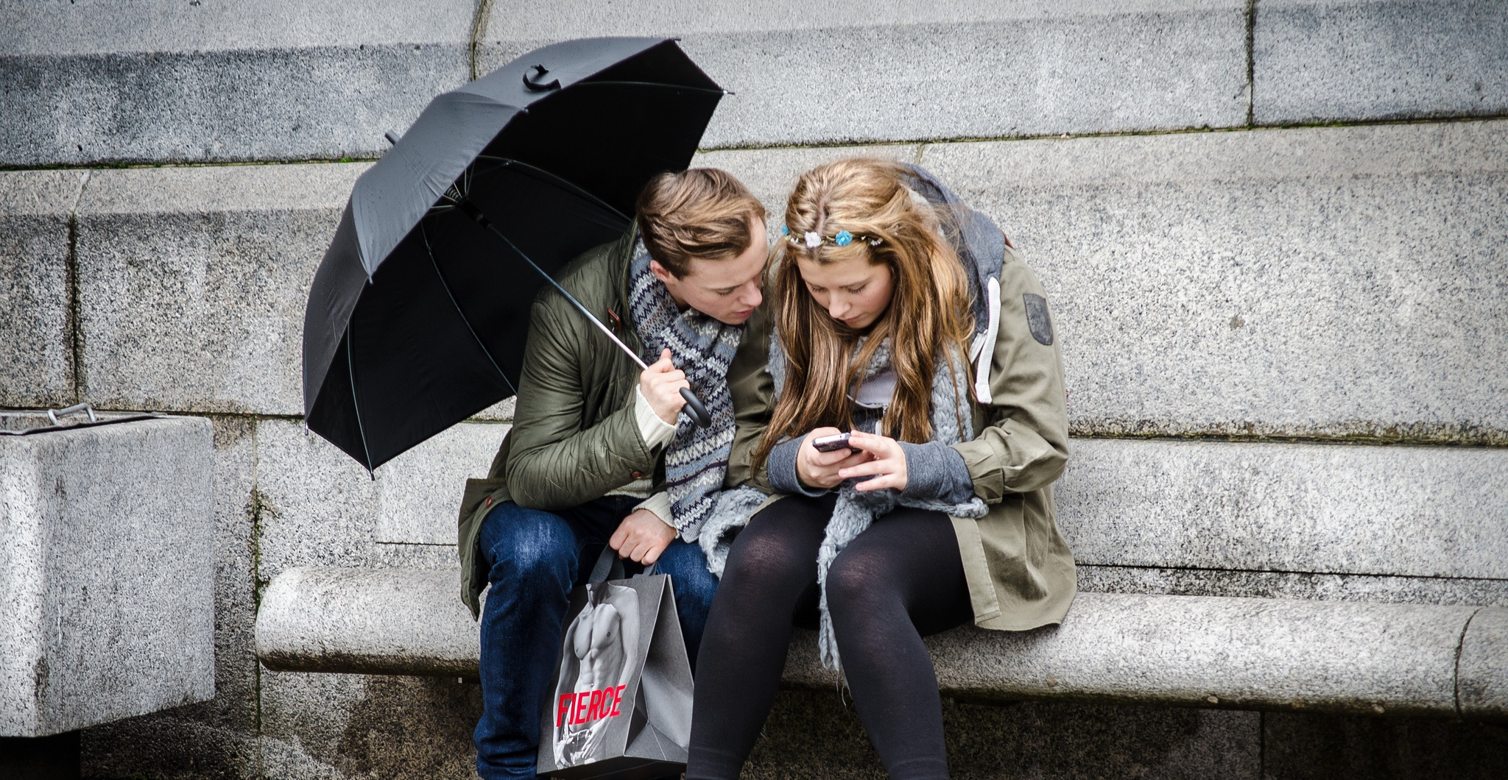
WhatsApp was discussed by the majority of interviewees in Spain & Italy but rarely mentioned by US or UK.

Slide 12
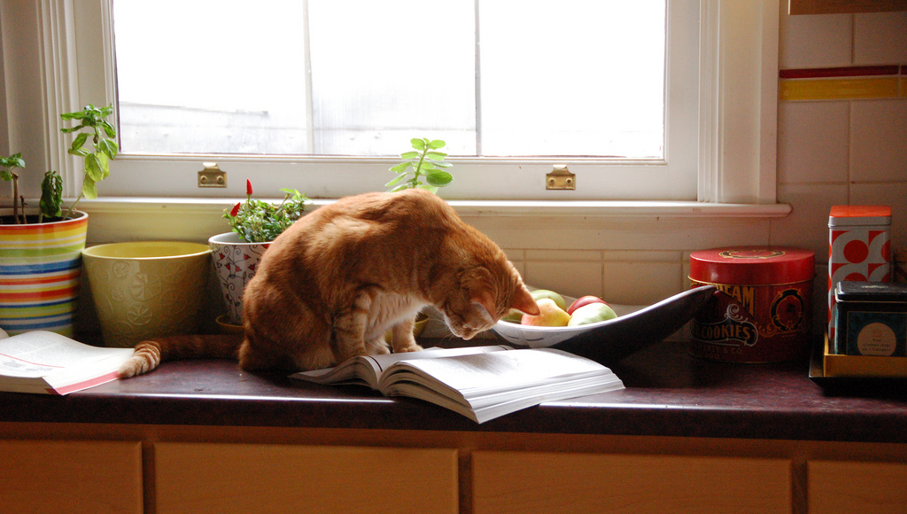
Connaway, Lynn Silipigni, Donna Lanclos, David White, Alison Le Cornu, and Erin M. Hood. 2012. “User-centered decision making: A new model for developing academic library services and systems.” IFLA World Library and Information Congress 2012 Helsinki Proceedings: Libraries Now! Inspiring, Surprising, Empowering. http://conference.ifla.org/sites/default/files/files/papers/wlic2012/76-connaway-en.pdf.
“At first I started looking online, and it was a little bit overwhelming…I ended up reaching into my mom’s cupboard and using a recipe that I found in one of her old cookbooks. The recipe was just what I was looking for...”
(Digital Visitors and Residents, USS3, Emerging, Female, Age 17, High School Student)
Motivation and behaviors change based on context and situation
Notes:
Image: http://www.flickr.com/photos/95792332@N00/3226023555
“Residents: significant online presence and usage; high level of collaborative activity online; contributions to the online environment in the form of uploading materials, photos, videos; high dependence on a mobile device (smart phone, laptop, etc.); more than 10 hours a week spent online.”
Visitors: functional use of technology, often linked to formal need (such as use of software for specific coursework, or organising meetings through email contact); less visible/more passive online presence, more likely to favour face-to-face interactions (even as they use the Internet to organize/ schedule those interactions); fewer than 6 hours spent online a week.” (p. 145) “There are a number of “covert” online study habits. For example, Wikipedia is widely used but almost always with a sense of guilt or an eagerness to convey awareness of its “unreliability;” there is an assumption by students that teachers and lecturers value the authenticity of paperbased books rather than information found online through a browser, such as Google. The data also indicate that this assumption is unfounded.” (p. 145)
“Some changes are made when transitioning from one stage of academic life to another. For example, one interviewee cleared his Facebook site of his previous high school friends when he went to University, where he replaced them with new contacts.” (p. 145) “A number of interviewees spoke about the way they evaluated information and sites from the Internet. A typical way of doing this was to judge sites by their popularity (as shown by their placement in the Google results list), i.e., popular = correct.” (p. 145)
“Instead of reporting general information-seeking habits and technology use, this study explores how the subjects get their information based on the context and situation of their needs during an extended period of time, identifying if and how their behaviors change.” (p. 151)
Connaway, Lynn Silipigni, comp. 2015. The Library in the Life of the User: Engaging with People Where They Live and Learn. Dublin, Ohio: OCLC Research. http://www.oclc.org/content/dam/research/publications/2015/oclcresearch-library-in-life-of-user.pdf.
“This morning I was looking for a homemade bread recipe that I could use to bake and then blog about. (I just started my own food blog: gritsgonegreen.wordpress.com). At first I started looking online, and it was a little bit overwhelming. There were so many different recipes with different flavors and crazy combinations. The one thing that was good about looking at the online recipes was viewing the user comments and seeing how people liked or disliked each recipe. I ended up reaching into my mom’s cupboard and using a recipe that I found in one of her old cookbooks. The recipe was just what I was looking for: it was a simple homemade white bread. I was about to search on the internet how to knead and punch bread, but I flipped the page, and there was a whole glossary of bread making terms. I must admit, I was a little bit surprised by the amount of information and instruction found in the cookbook. I thought I was going to have to look up an instructional video online.” (Digital Visitors and Residents, USS3, Emerging, Female, Age 17, High School Student)
White, David S., and Lynn Silipigni Connaway. 2011-2014. Digital Visitors and Residents: What Motivates Engagement with the Digital Information Environment. Funded by JISC, OCLC, and Oxford University. http://www.oclc.org/research/activities/vandr.html.

Slide 13
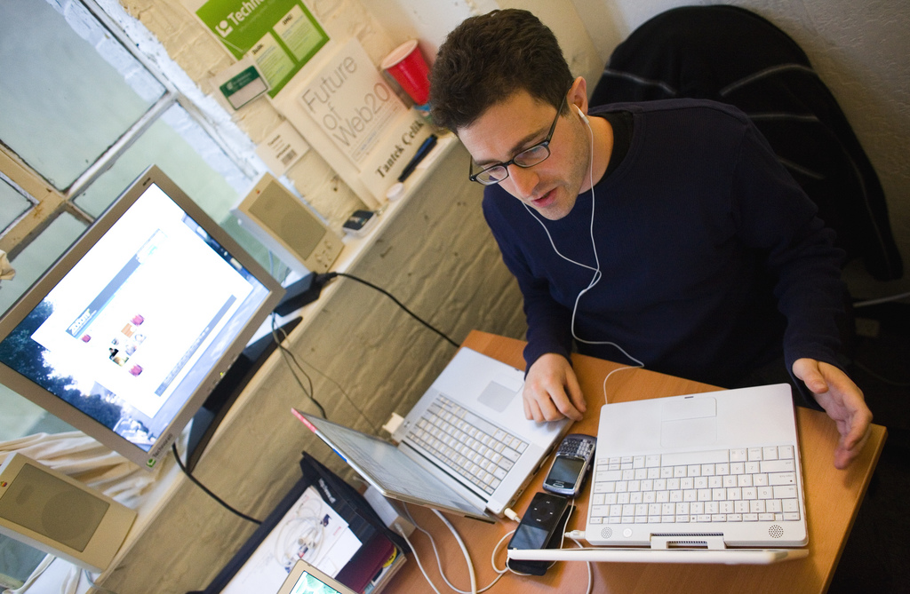
Connaway, Lynn Silipigni, David White, Donna Lanclos, and Alison Le Cornu. 2013. “Visitors and Residents: What motivates engagement with the digital information environment?” Information Research 18, no. 1, http://informationr.net/ir/18-1/infres181.html.
“So, I’ll be like looking over at that and then like either Facebook or my email will beep at me and I’ll click on that, see who sent me something and then go back to working. So, it’s always, kind of, open and there.”
(Digital Visitors and Residents, USU4, Emerging, Male, Age 19, Engineering)
Multi-tasking
Notes:
Image: http://www.flickr.com/photos/51035555243@N01/3071055422
“The practice of citing the references attached to a Wikipedia article but not the article itself to avoid potential ridicule from tutors and peers.” (p. 162)
“The basic methods employed by students when assessing the validity of a source returned by a Google search.” (p. 163) “The manner in which emerging stage students rely on the residency of their peers in social media, allowing them to discuss assignments the night before they are due. Participants in the emerging educational stage often wanted to talk to a fellow student about an assignment using Facebook. If the person they were hoping to connect with in Facebook was not online then some participants would text the person in question to request that they login. This level of Residency meant that students could discuss an assignment at a time that was convenient to them. At the emerging stage that was often the night before a deadline. All the participants who talked about this claimed that they did not ‘do’ the assignments in this manner but merely confirmed exactly what was required from them or sought specific information such as a maths formula or a reference.” (p. 163) “The importance of convenience and how the Web often will be chosen as an information source by students even when they know higher quality sources are available elsewhere. For example, the information is available in text books or by asking a tutor or parent, yet Google is used instead. We suspect that convenience is a large part of why our data indicate that Google and Wikipedia are the most popular search engine and information source respectively…Many go no further and it was not uncommon for interviewees simply to accept the first Google site listed.” (p. 163) “A portion of the emerging educational stage participants were uncomfortable about the addictive nature of social media and the extent to which it wasted their time.” (p. 163) “The multi-tab environment that students have on screen represents a convergence of the social and the academic. In this context, the mode of an activity is no longer based on the physical space in which it occurs since any access to a network provided almost every aspect of life to those with a Resident approach to the Web.” (p. 163)
Connaway, Lynn Silipigni, comp. 2015. The Library in the Life of the User: Engaging with People Where They Live and Learn. Dublin, OH: OCLC Research. http://www.oclc.org/content/dam/research/publications/2015/oclcresearch-library-in-life-of-user.pdf.
“So, I’ll be like looking over at that and then like either Facebook or my email will beep at me and I’ll click on that, see who sent me something and then go back to working. So, it’s always, kind of, open and there.” (Digital Visitors and Residents, USU4, Emerging, Male, Age 19, Engineering)
White, David S., and Lynn Silipigni Connaway. 2011-2014. Digital Visitors and Residents: What Motivates Engagement with the Digital Information Environment. Funded by JISC, OCLC, and Oxford University. http://www.oclc.org/research/activities/vandr.html.

Slide 14
Need to provide services for what people actually do, not what they say they do
The workflow context
Convenience and context switching
Fragmentation is a deterrent
The personal context
Relationship – sharing – engagement
(Dempsey 2015)
Notes:
Image: http://www.flickr.com/photos/14853721@N00/6926490142
Dempsey, Lorcan. 2015. “Environmental Trends and OCLC Research.” Presented at the University of Notre Dame, Notre Dame, Indiana, September 28. http://www.oclc.org/content/dam/research/presentations/dempsey/dempsey-notre-dame-oclc-research-2015.pptx.

Slide 15

“If my other friends recommended it to me and used chat reference services themselves I might be convinced to try them...”
(Seeking Synchronicity, NOS-94938, Non-user Online Survey, Female, Age 15-18)
Build relationships
Notes:
Image: http://www.flickr.com/photos/33073140@N06/4316687895
“If my other friends recommended it to me and used chat reference services themselves I might be convinced to try them because I usually learn about all sorts of computer and technology-based things from my friends because I'm so inept in that area myself. Without them, I would have never gotten iTunes, AIM, Facebook and other items that I couldn't imagine living without now that I have them.” (Seeking Synchronicity, NOS-94938, Non-user Online Survey, Female, Age 15-18)
“I am sure there must be benefits from utilizing chat reference - but talking to strangers just seems risky, are you required to give them personal information? And how are you assured that information can not be abused in any way?” (Seeking Synchronicity, NOS-69925, Non-user Online Survey, Female, Age 36-45)
“I think chatting is a great way to get reference help. Its all a matter of how user friendly the whole set up is.” (Seeking Synchronicity, NOS-67135, Non-user Online Survey, Female, Age 19-28)
“If it was more safe. If there weren't any internet hunter or dangerous people on there.” (Seeking Synchronicity, NOS-33482, Non-user Online Survey, Female, Age 15-18)
“If i trusted the librarian enough to chat with me on the web.” (Seeking Synchronicity, NOS-89558, Non-user Online Survey, Female, Age 12-14)
“If I knew or had heard of the person on the other end.” (Seeking Synchronicity, NOS-95620, Non-user Online Survey, Female, Age 12-14)
Connaway, Lynn Silipigni, and Marie L. Radford. 2005-2007. Seeking Synchronicity: Evaluating Virtual Reference Services from User, Non-User, and Librarian Perspectives. Funded by Institute for Museums and Library Services Research Grant. http://www.oclc.org/research/activities/synchronicity/default.htm.
“When I need a quick answer my preferred source is a person, because a person would interpret your need quickly and better than Internet. […] But when I don’t know anything about a subject, first I do a search on my own and then I asked an expert…but before I ask a person, I want to know a little about the subject…not to say the person “illuminate me, please”…if you have some basic knowledge you could to take more advantage of your contact.” (Digital Visitors and Residents, UOC, UOCU5, Female, Age 26-34, First-semester Student, Education)
White, David S., and Lynn Silipigni Connaway. 2011-2014. Digital Visitors and Residents: What Motivates Engagement with the Digital Information Environment. Funded by JISC, OCLC, and Oxford University. http://www.oclc.org/research/activities/vandr.html.

Slide 16
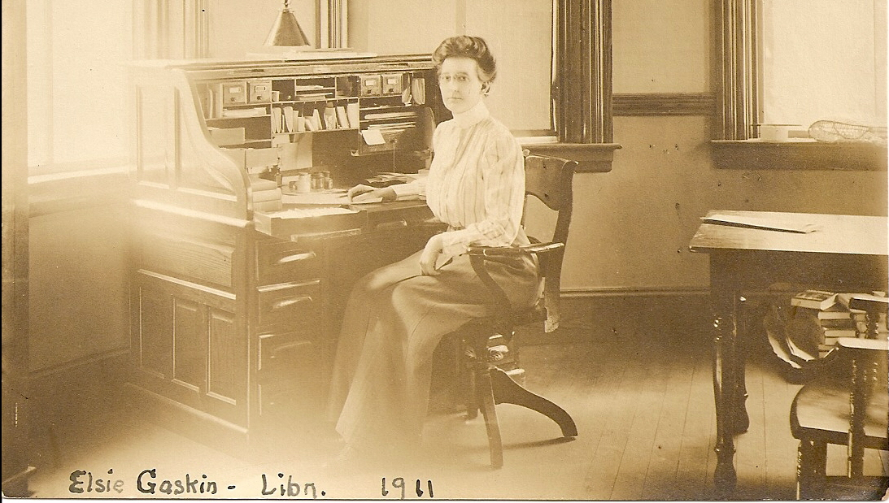
Radford, Marie L., and Lynn Silipigni Connaway. 2007. “‘Screenagers’ and live chat reference: Living up to the promise.” Scan 26, no. 1: 31–39. http://www.oclc.org/content/dam/research/publications/newsletters/connaway-scan.pdf.
“It’s like, it’s like, you don’t want to go “So which shelf are you pointing at?” Because, I mean, once they do their famous point, it’s just like…”
(Seeking Synchronicity, Focus Group 6 participant, Female, High School Student)
Screenagers have a traditional view of librarians
Notes:
Image: https://flic.kr/p/6JswcQ
“Results clearly indicate that screenagers have different communication and information behaviors than those of previous generations. The teens’ traditional views of librarians carry over into their decision-making process for choosing VRS. They do not think of chat as a possible venue for homework help, worry about chat conversations with strangers, and have been told to avoid potentially dangerous situations online, so they need to be reassured by trusted adults or friends before they will try VRS.” (p. 65)
Connaway, Lynn Silipigni, comp. 2015. The Library in the Life of the User: Engaging with People Where They Live and Learn. Dublin, OH: OCLC Research. http://www.oclc.org/content/dam/research/publications/2015/oclcresearch-library-in-life-of-user.pdf.
“And then cause you’ve already asked them, you don’t want to feel like you’re pestering them too much so you don’t go and ask them again. It’s like, it’s like, you don’t want to go “So which shelf are you pointing at?” Because, I mean, once they do their famous point, it’s just like…(laughs)” (Seeking Synchronicity, Focus Group 6 participant, Female, High School Student)
Connaway, Lynn Silipigni, and Marie L. Radford. 2005-2007. Seeking Synchronicity: Evaluating Virtual Reference Services from User, Non-User, and Librarian Perspectives. Funded by Institute for Museums and Library Services Research Grant. http://www.oclc.org/research/activities/synchronicity/default.htm.
Radford, Marie L., and Lynn Silipigni Connaway. “‘Screenagers’ and Live Chat Reference: Living Up to the Promise.” Scan 26, no. 1 (2007): 31–39. http://www.oclc.org/research/publications/archive/2007/connaway-scan.pdf.
Rushkoff, Douglas. 1996. Playing the Future: How Kids’ Culture Can Each Us to Thrive in an Age of Chaos. New York: HarperCollins.

Slide 17
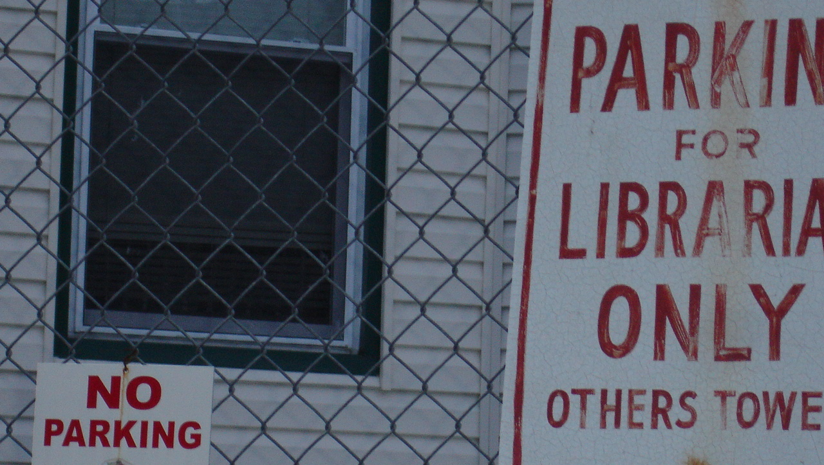
Connaway, Lynn Silipigni, Donna M. Lanclos, and Erin M. Hood. 2013. “‘I always stick with the first thing that comes up on Google…’ Where people go for information, what they use, and why.” EDUCAUSE Review Online (6 December), http://www.educause.edu/ero/article/ialways-stick-first-thing-comes-google-where-people-go-information-what-they-use-and-why.
Librarians and services within the workflow
“I haven’t called them, I don’t think I’ve ever talked to the librarians here since I’m not in the building much.”
(Digital Visitors and Residents, USU4, Emerging, Male, Age 19, Engineering)
Notes:
Image: https://www.flickr.com/photos/78779687@N00/108993035
“Institutional services and systems must be embedded within the academic community’s workflow so that individuals are able to use critical skills for inquiry wherever they land in the information landscape.” (p. 185)
“Rather than perpetuating this “black market” traffic in resources, institutions should use individual Internet practices as a guide to linking institutional resources to those on the open web. Individuals use a broad range of tools to get information, and they engage with technology in multiple ways. It is therefore imperative to provide a broad range of tools and services in different media.” (p. 188)
“Institutions should consider digital and face-to-face community building as a cornerstone of their enterprise-wide policies. Individuals will turn to libraries or librarians for resources only if they are a part of the individuals’ networks.” (p. 193)
Connaway, Lynn Silipigni, comp. 2015. The Library in the Life of the User: Engaging with People Where They Live and Learn. Dublin, OH: OCLC Research. http://www.oclc.org/content/dam/research/publications/2015/oclcresearch-library-in-life-of-user.pdf.
“I haven’t called them, I don’t think I’ve ever talked to the librarians here since I’m not in the building much.” (Digital Visitors and Residents, USU4, Emerging, Male, Age 19, Engineering)
“Because we think we have a very good service in our library and I think that the service and the functions of our library have been really improved in the last years. I remember, perhaps, five or eight years ago… when you had to enter the library it was like… “it takes some time to get that, going there…” It was not very intuitive, it was not very practical, it was very difficult really to get the information you needed unless you knew perfectly the path you should follow to get that information. It was quite disappointing. But recently, perhaps in the last two or three years the improvement has been enormous, enormous, and now when you have a requirement of information in a very easy way you can get the information, and if you don’t get it you can ask for help to the people working in the library service and they help you very effectively and very quickly. And for me that makes a difference.” (Digital Visitors and Residents, UOC, UOCFI3, 48, Male, Age 45-54, Faculty, Information Science and Communication Studies)
White, David S., and Lynn Silipigni Connaway. 2011-2014. Digital Visitors and Residents: What Motivates Engagement with the Digital Information Environment. Funded by JISC, OCLC, and Oxford University. http://www.oclc.org/research/activities/vandr.html.

Slide 18
Need to provide services for what people actually do, not what they say they do
The workflow context
Convenience and context switching
Fragmentation is a deterrent
The personal context
Relationship – sharing – engagement
The environmental context
Spaces and places
(Dempsey 2015)
Notes:
Image: http://www.flickr.com/photos/14853721@N00/6926490142
Dempsey, Lorcan. 2015. “Environmental Trends and OCLC Research.” Presented at the University of Notre Dame, Notre Dame, Indiana, September 28. http://www.oclc.org/content/dam/research/presentations/dempsey/dempsey-notre-dame-oclc-research-2015.pptx.

Slide 19
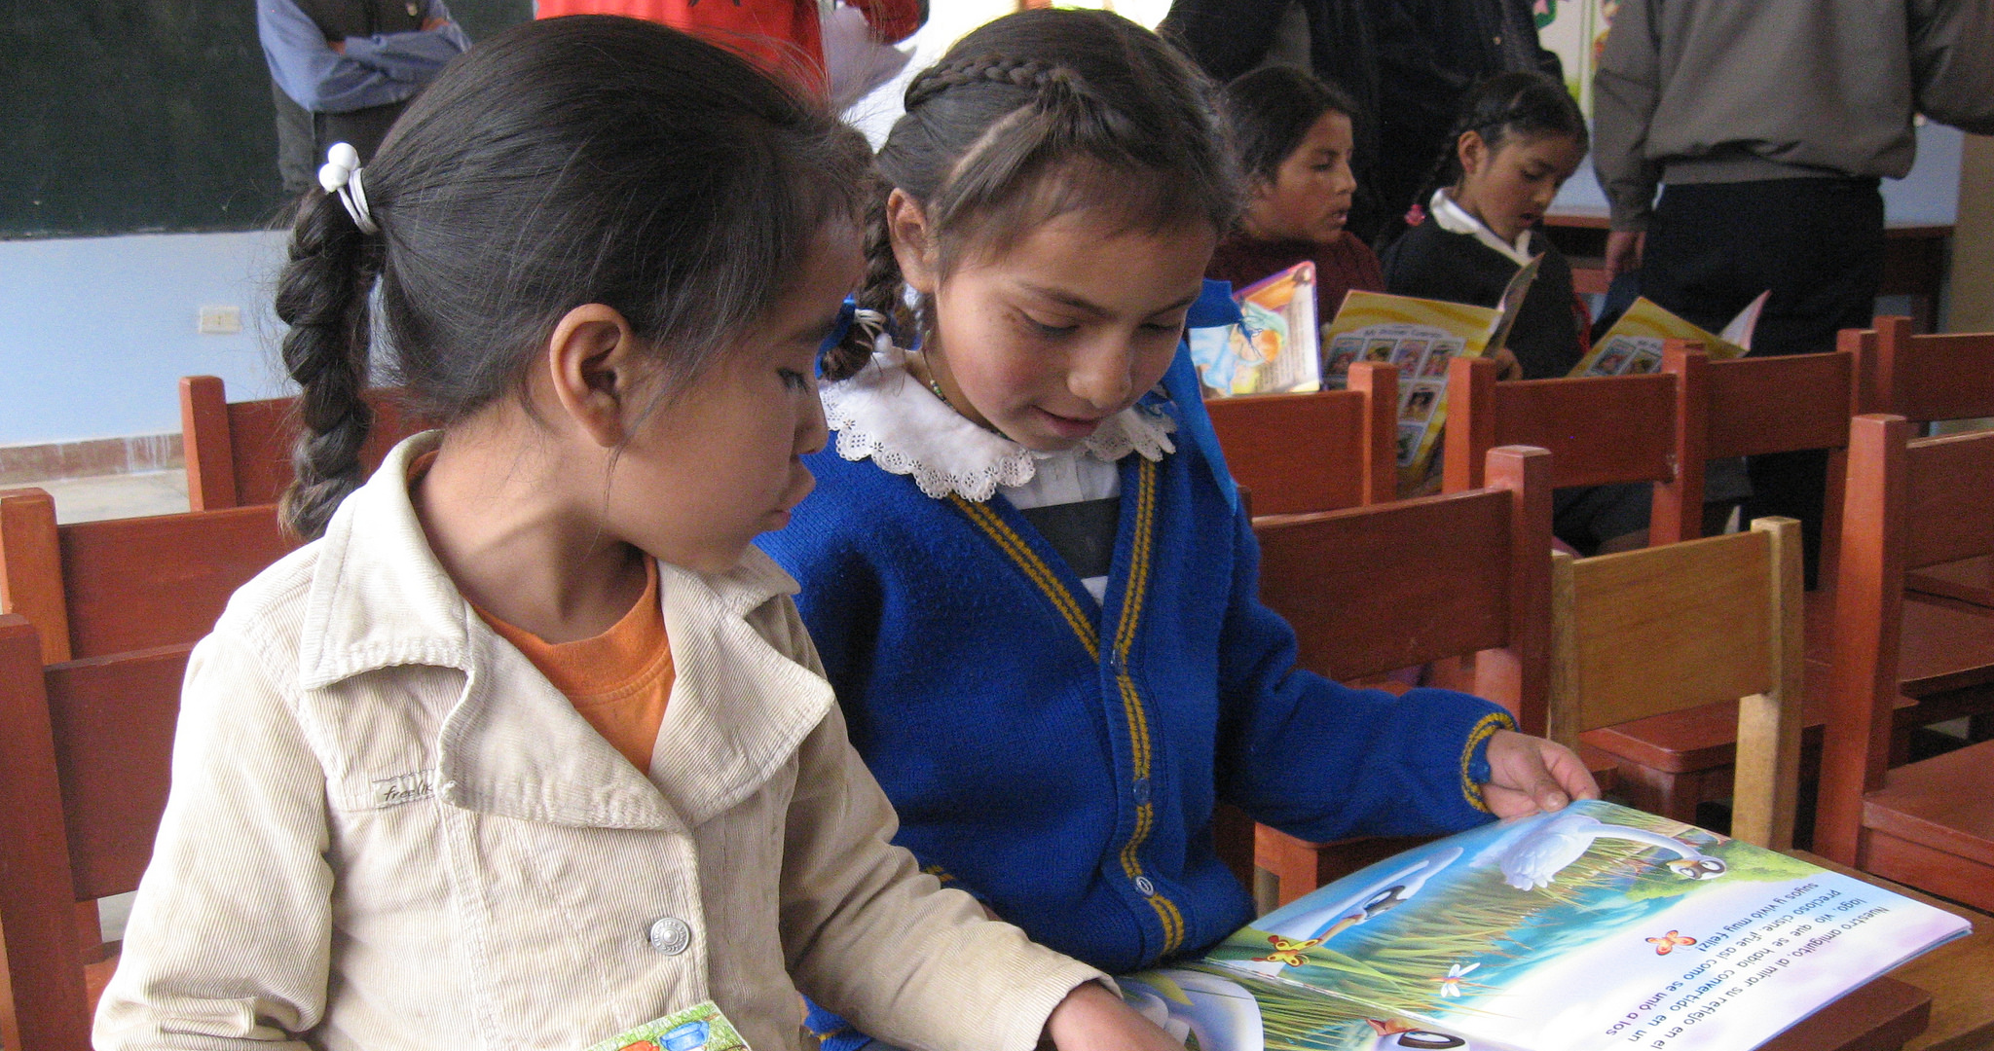
“Nearly 60% of the world’s people are still offline.”
(Pattillo 2016)
Notes:
Image: https://www.flickr.com/photos/beyondaccessinitiative/14007524987/
“Digital technologies have spread rapidly in much of the world, but the broader development benefits from using these technologies have lagged behind. While more than 40 percent of the world’s population has access to the Internet, nearly 6 billion people do not have high-speed Internet, making them unable to fully participate in the digital economy. Nearly 60 percent of the world’s people are still offline. The less educated and the bottom 40 percent of the welfare distribution worldwide are most vulnerable to technological changes in the labor market.”
World Bank. 2016. “World Development Report 2016: Digital Dividends.” Washington, D.C.: World Bank. www.worldbank.org/en/publication/wdr2016. Quoted in Gary Pattillo. 2016. “Fast Facts.” College & Research Libraries News 77, no. 3: 164.

Slide 20
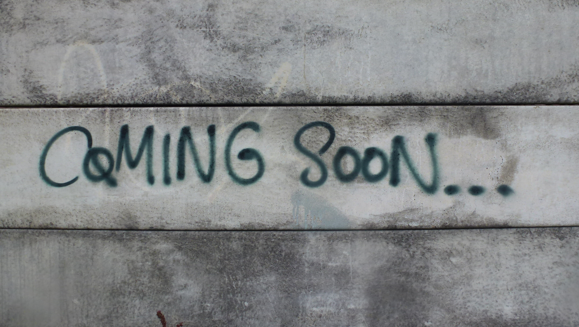
Connaway, Lynn Silipigni, and Ixchel M. Faniel. 2015. “Reordering Ranganathan: Shifting user behaviours, shifting priorities.” SRELS Journal of Information Management 52, no. 1: 3–23. http://i-scholar.in/index.php/sjim/article/view/60392/51360.
“Librarians have an opportunity to become part of users’ social networks and to put resources in the context of users’ information needs.”
(Connaway 2015, 23)
It’s time for a change
Notes:
Image: https://flic.kr/p/oTbXwD
“The following sections will look at what today’s librarians, library researchers and information scientists have said about the changing roles of the five laws and also review relevant literature to show how the five laws still apply, but where, we believe, it’s time for a change in focus and emphasis.” (p. 3)
“Librarians have an opportunity to become part of users’ social networks and to put resources in the context of users’ information needs.” (p. 23)
Connaway, Lynn Silipigni, comp. 2015. The Library in the Life of the User: Engaging with People Where They Live and Learn. Dublin, OH: OCLC Research. http://www.oclc.org/content/dam/research/publications/2015/oclcresearch-library-in-life-of-user.pdf.
“I don’t know how Digital Library of my university works, but I suppose Google is better [to search].” (Digital Visitors and Residents, UOC, UOCG3, Male, 28, Doctoral Student, Computer Science)

Slide 21

Connaway, Lynn Silipigni, Marie L. Radford, Timothy J. Dickey, Jocelyn De Angelis Williams, and Patrick Confer. 2008. “Sense-making and synchronicity: Information-seeking behaviors of Millennials and Baby Boomers.” Libri 58, no. 2: 123–135. http://www.oclc.org/content/dam/research/publications/library/2008/connaway-libri.pdf.
“We do go to the library or somewhere quiet where we can just get our work done together...”
(Digital Visitors and Residents, UKU3, Emerging, Female, Age 19, French and Italian)
Space for socializing and work groups
Notes:
Image: http://www.flickr.com/photos/32170112@N03/23657031265
“When asked to describe the ideal information system, Millennials suggested that the library catalog be more like an Internet search engine or Amazon.com. They also wanted the library to provide space for them to socialize and work in groups and suggested 24/7 access to a librarian via telephone, such as a ‘lifeline” (referring to the television program, Who Wants to be a Millionaire?) Older Millennials were most interested in expediency, desiring roaming librarians, drive-up book drops, library delivery of print materials to their campus addresses, and a coffee house-like environment. The faculty (the majority were Baby Boomers) wanted a less intimidating library with better signage, and a book store like environment.” (p. 92)
Connaway, Lynn Silipigni, comp. 2015. The Library in the Life of the User: Engaging with People Where They Live and Learn. Dublin, OH: OCLC Research. http://www.oclc.org/content/dam/research/publications/2015/oclcresearch-library-in-life-of-user.pdf.
“We do go to the library or somewhere quiet where we can just get our work done together but in regards to something we need the internet for or the computer we normally do that by ourselves. For example I will write up something and send it to her or just print it out and bring it to the lesson and she will go “That’s fine.”” (Digital Visitors and Residents, UKU3, Emerging, Female, Age 19, French and Italian)
White, David S., and Lynn Silipigni Connaway. 2011-2014. Digital Visitors and Residents: What Motivates Engagement with the Digital Information Environment. Funded by JISC, OCLC, and Oxford University. http://www.oclc.org/research/activities/vandr.html.

Slide 22
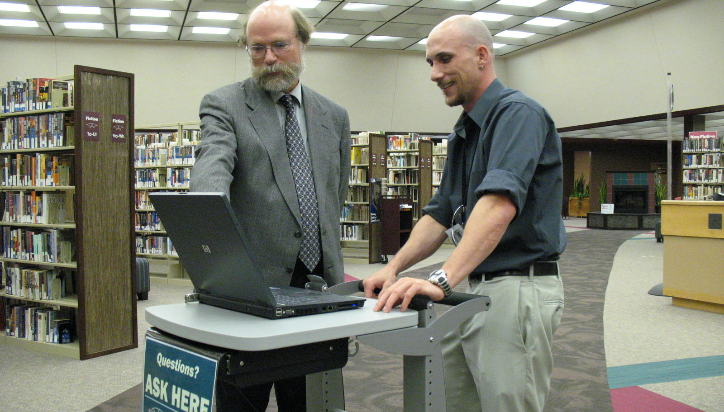
Connaway, Lynn Silipigni. 2013. “Meeting the expectations of the community: The engagement-centered library.” Library 2020: Today’s Leading Visionaries Describe Tomorrow’s Library, edited by J. Janes, 83–88. Lanham, MD: Scarecrow Press.
“Our experience with a proactive chat model… showed us that there is indeed a ready-made market for our services right on our own library pages...”
(Zhang and Mayer 2014, 205)
Embedded librarianship
…be where our users need us
Notes:
Image: https://flic.kr/p/4XerD9
“We need to be where our users need us, when they need us. If the majority of our users prefer to communicate via mobile phone texting, chat, or IM; to learn through gaming; by accessing the library’s unique collections and materials via social media, such as Facebook2 and Wikipedia; or to meet with us FtF outside of the library, we need to be there!” (p. 203)
“Embedded librarianship also is an important aspect of public library engagement with the community. Many public libraries are providing kiosks in public spaces, such as train and bus stations and parks, for users to check-out and return print, audio, and electronic books, magazines, newspapers, and journals.” (p. 203)
“The library of 2020 will provide user-centered services and systems that will meet the expectations of the community. The library staff will need to develop relationships with their users and partner with other organizations in order to produce, store, and preserve content and data sets and to provide personalized services. Recruiting and retaining innovative, creative individuals who are willing to engage with users and to embrace new technologies and modes of communication will be imperative for the success of the library of 2020.” (p. 204)
Connaway, Lynn Silipigni, comp. 2015. The Library in the Life of the User: Engaging with People Where They Live and Learn. Dublin, OH: OCLC Research. http://www.oclc.org/content/dam/research/publications/2015/oclcresearch-library-in-life-of-user.pdf.
“Our experience with a proactive chat model at John Carroll University showed us that there is indeed a ready-made market for our services right on our own library pages, and that our users will ask us questions when we approach them.” (Zhang and Mayer 2014, 205)
Zhang, Jie, and Nevin Mayer. 2014. “Proactive Chat Reference: Getting in the Users’ Space.” College & Research Libraries News 75, no. 4: 202-205.

Slide 23

“Oh my goodness when I was starting my academic life everything was in the library and you could go in to these libraries at your university which were such fascinating places. …So I miss that – the old fashioned library.”
(Digital Visitors and Residents, UKF2, Female, Age 51, Marketing)
Notes:
Image: http://www.flickr.com/photos/99532761@N00/14154338759
“There’s been some times where it’s not available online but I can walk up to the library and get a photocopy or take the book itself or something.” (Digital Visitors and Residents, USG2, Male, Age 25, Biology) (Embedding)
“I think I probably have to come to the library more as a college student as opposed to when I was in high school I probably just looked something up offline. There are more restrictions now, at least for me, with the sort of resources that you can use as far as internet sources and things like that. In high school it was generally if you had a project they kind of just, I guess, expected that you’d go online. So I didn’t have any book requirements or things like that.” (Digital Visitors and Residents, USG3, Female, Age 23, History) (Embedding)
White, David S., and Lynn Silipigni Connaway. 2011-2014. Digital Visitors and Residents: What Motivates Engagement with the Digital Information Environment. Funded by JISC, OCLC, and Oxford University. http://www.oclc.org/research/activities/vandr.html.

Slide 24

“Library is a growing organism.”
(Ranganathan 1931)
Use what you know
Learn what you don’t know
Engage in new ways
Notes:
Image: http://www.flickr.com/photos/96043955@N05/15190222775
Ranganathan, S. R. 1931. The Five Laws of Library Science. London: Edward Goldston, Ltd.

Slide 25
References
Connaway, Lynn Silipigni, comp. 2015. The Library in the Life of the User: Engaging with People Where They Live and Learn. Dublin, OH: OCLC Research. http://www.oclc.org/content/dam/research/publications/2015/oclcresearch-library-in-life-of-user.pdf.
Connaway, Lynn Silipigni, and Marie L. Radford. 2005-2007. Seeking Synchronicity: Evaluating Virtual Reference Services from User, Non-User, and Librarian Perspectives. Funded by Institute for Museums and Library Services Research Grant. http://www.oclc.org/research/activities/synchronicity/default.htm.
Dempsey, Lorcan. 2015. “Environmental Trends and OCLC Research.” Presented at the University of Notre Dame, Notre Dame, Indiana, September 28. http://www.oclc.org/content/dam/research/presentations/dempsey/dempsey-notre-dame-oclc-research-2015.pptx.
Radford, Marie L., and Lynn Silipigni Connaway. “‘Screenagers’ and Live Chat Reference: Living Up to the Promise.” Scan 26, no. 1 (2007): 31–39. http://www.oclc.org/research/publications/archive/2007/connaway-scan.pdf.
Ranganathan, S. R. 1931. The Five Laws of Library Science. London: Edward Goldston, Ltd.
Rushkoff, Douglas. 1996. Playing the Future: How Kids’ Culture Can Each Us to Thrive in an Age of Chaos. New York: HarperCollins.
    White, David S., and Lynn Silipigni Connaway. 2011-2014. Digital Visitors and Residents: What Motivates Engagement with the Digital Information Environment. Funded by JISC, OCLC, and Oxford University. http://www.oclc.org/research/activities/vandr.html.
Zhang, Jie, and Nevin Mayer. 2014. “Proactive Chat Reference: Getting in the Users’ Space.” College & Research Libraries News 75, no. 4: 202-205.

Slide 26
I would like to thank Dr. Josep Cobarsi, Dr. Agustí Canals, & Dr. Eva Ortoll, Universitat Oberta de Catalunya; Titia van der Werf & Erin Hood, OCLC Membership and Research; and Elise Sada, Paolo Sirito, Liliana Gregori, Sara Ricetto, & Andrea Sada, Universita Cattolica del Sacre Cuore for all of their work and assistance with this project.

Slide 27
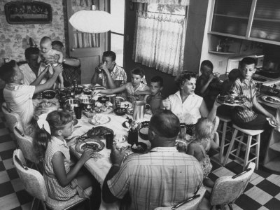

D
I
S
C
U
S
S
I
O
N
G
R
A
Z
I
E
© 2016 OCLC . This work is licensed under a Creative Commons Attribution 4.0 International License. Suggested attribution: “This work uses content from ‘I go to Google first.’
Integrating the Library into the Life of the User.’ © OCLC, used under a Creative Commons Attribution 4.0 International License: http://creativecommons.org/licenses/by/4.0/.”
Notes:
Image: https://lucasconfectionery.files.wordpress.com/2014/10/paul-horsch-and-his-family-during-their-sunday-dinner.jpg

