Slide 1
What Motivates Engagement with the Digital Information Environment?
ISIC, Tokyo, 5 September 2012
Visitors and Residents:
Lynn Silipigni Connaway, Ph. D.
David White
Senior Research Scientist
OCLC
connawal@oclc.org
Donna Lanclos, Ph. D.
Associate Professor for Anthropological Research
University of North Carolina, Charlotte
Co-manager, Technology Assisted Lifelong Learning
University of Oxford
david.white@conted.ox.ac.uk
@daveowhite
Alison Le Cornu, Ph. D.
Independent Consultant
University of Oxford

Slide 2
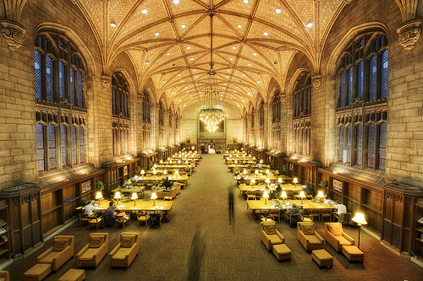
Then & Now
Then: The user built workflow around the library
Now: The library must build its services around user workflow
Then: Resources scarce, attention abundant
Now: Attention scarce, resources abundant
School and university resources often not first choice
(Dempsey, 2008)
Notes:
LSC
Image: http://www.flickr.com/photos/aramisfirefly/3580397954/
Dempsey, L. (2008). Always on: Libraries in a world of permanent connectivity. First Monday, 14(1). Retrieved from http://www.firstmonday.org/htbin/cgiwrap/bin/ojs/index.php/fm/article/view/2291/207
Today, more than 1.7 billion people, or almost one out of every four humans on the planet, are online (Wasserman, 2012).
Wasserman, S. (2012, June 18). The Amazon effect. The Nation. Retrieved from http://www.thenation.com/article/168125/amazon-effect

Slide 3


The Study
Digital Visitors and Residents
Digital Visitors & Residents
Notes:
LSC
Image: Microsoft Clip Art

Slide 4
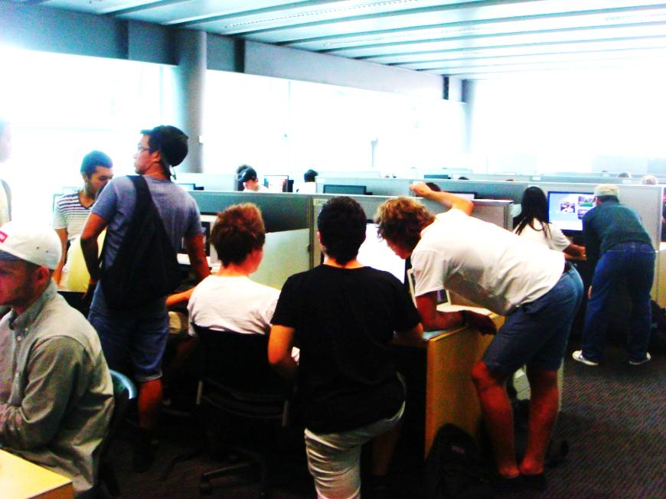
Visitors and Residents:
What motivates engagement with the digital information environment?
Partners
  JISC (UK funding body)
  OCLC
    Lynn Silipigni Connaway, Ph.D.
  Oxford University
    David White
    Alison Le Cornu, Ph.D
  University of North Carolina, Charlotte
    Donna Lanclos, Ph.D.
Notes:
LSC

Slide 5
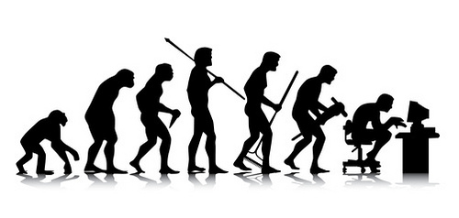
Why Visitors & Residents Project?
Shifting changes in engagement with information environment
Gap in user behavior studies
Understand motivations & expectations for using technologies
Track shifts in motivation and engagement as they transition between educational stages
(White & Connaway, 2011-2012)
(Connaway & Dickey, 2010)
(Cool & Spink, 2002)
Notes:
LSC
Image: http://www.flickr.com/photos/55524309@N05/5377715421/
White, D. S., & Connaway, L. S. (2011-2012). Visitors and residents: What motivates engagement with the digital information environment. Funded by JISC, OCLC, and Oxford University. Retrieved from http://www.oclc.org/research/activities/vandr/
Connaway, L. S., & Dickey, T. J. (2010). The digital information seeker: Report of the findings from selected OCLC, RIN, and JISC user behaviour projects. Retrieved from http://www.jisc.ac.uk/media/documents/publications/reports/2010/digitalinformationseekerreport.pdf
Cool, C., & Spink, A. (2002). Issues of context in information retrieval (IR): An introduction to the special issue. Information Processing and Management: An International Journal, 38(5), 605-611.

Slide 6

Research Questions
What are the most significant factors for novice & experienced researchers in choosing their modes of engagement with the information environment?
Do individuals develop personal engagement strategies which evolve over time & for specific needs & goals, or are the educational contexts (or, in the context of this study, “educational stages”) the primary influence on their engagement strategies?
Are modes of engagement shifting over the course of time, influenced by emergent web culture & the availability of “new” ways to engage, or are the underlying trends & motivations relatively static within particular educational stages?
?
?
education
?
?
engage
stages
?
?
?
strategies
web
?
Notes:
LSC
Image: Microsoft Clip Art

Slide 7
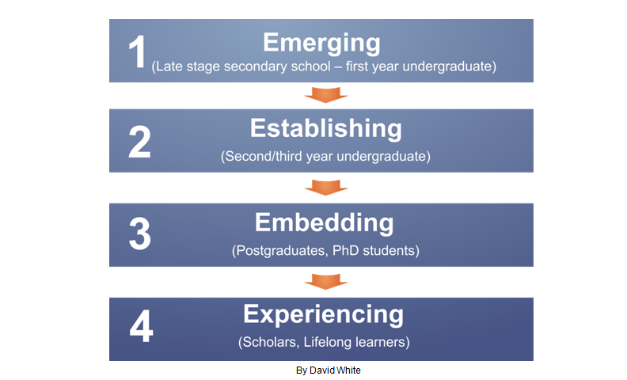
Visitors & Residents
(White & Connaway, 2011-2012)
Notes:
LSC
White, D. S., & Connaway, L. S. (2011-2012). Visitors & residents: What motivates engagement with the digital information environment. Funded by JISC, OCLC, and Oxford University. Retrieved from http://www.oclc.org/research/activities/vandr/

Slide 8
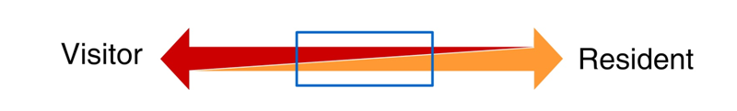
Video: http://is.gd/vandrvideo
First Monday Paper: http://is.gd/vandrpaper
Connaway & White for OCLC Research. 2012.
Notes:
DW
Discuss Prensky and how this is an attempt to move away from Native/Immigrant metaphor:
“‘The digital natives/digital immigrants distinction is dead or at least dying’. So proclaims Doug Holton in his blogpost. He continues: ‘Unfortunately, the idea is still uncritically accepted even in some journal articles, and perhaps used as an excuse or crutch too often for poor or ineffective teaching practices’. Holton is not alone in his criticism. McKenzie (2007) writes strongly against Prensky’s (2001a, b) typology identifying a number of ‘thinly supported claims’, while Kennedy, et al. (2010) demonstrate through an empirical research project that Prensky’s age–related hypothesis is very much less clear–cut than the Natives and Immigrants dichotomy implies. Our intention is to propose an alternative, which we have termed ‘Visitors and Residents’.”
Holton, D. (2010, March 19). The digital natives/digital immigrants distinction is dead or at least dying. [Web log comment]. EdTechDev . Retrieved from http://edtechdev.wordpress.com/2010/03/19/the-digital-natives-digital-immigrants-distinction-is-dead-or-at-least-dying/
Kennedy, G., Judd, T. & Dalgarno, B. (2010). “Beyond natives and immigrants: Exploring types of net generation students,” Journal of Computer Assisted Learning, 26(5), 332–343.
McKenzie, J. (2007). Digital nativism, digital delusions, and digital deprivation. From Now On: The Educational Technology Journal, 17 (2). Retrieved from http://www.fno.org/nov07/nativism.html
Prensky, M. (2001a). Digital natives, digital immigrants. On the Horizon, 9(5). Retrieved from http://www.marcprensky.com/writing/Prensky%20-%20Digital%20Natives,%20Digital%20Immigrants%20-%20Part1.pdf
Prensky, M. (2001b). “Do they really think differently?” On the Horizon, 9(5). Retrieved from http://www.marcprensky.com/writing/Prensky%20-%20Digital%20Natives,%20Digital%20Immigrants%20-%20Part2.pdf
White, D. S., & Le Cornu, A. (2011). Visitors and Residents: A new typology for online engagement. First Monday, 16(9). Retrieved from http://firstmonday.org/htbin/cgiwrap/bin/ojs/index.php/fm/article/viewArticle/3171/3049

Slide 9
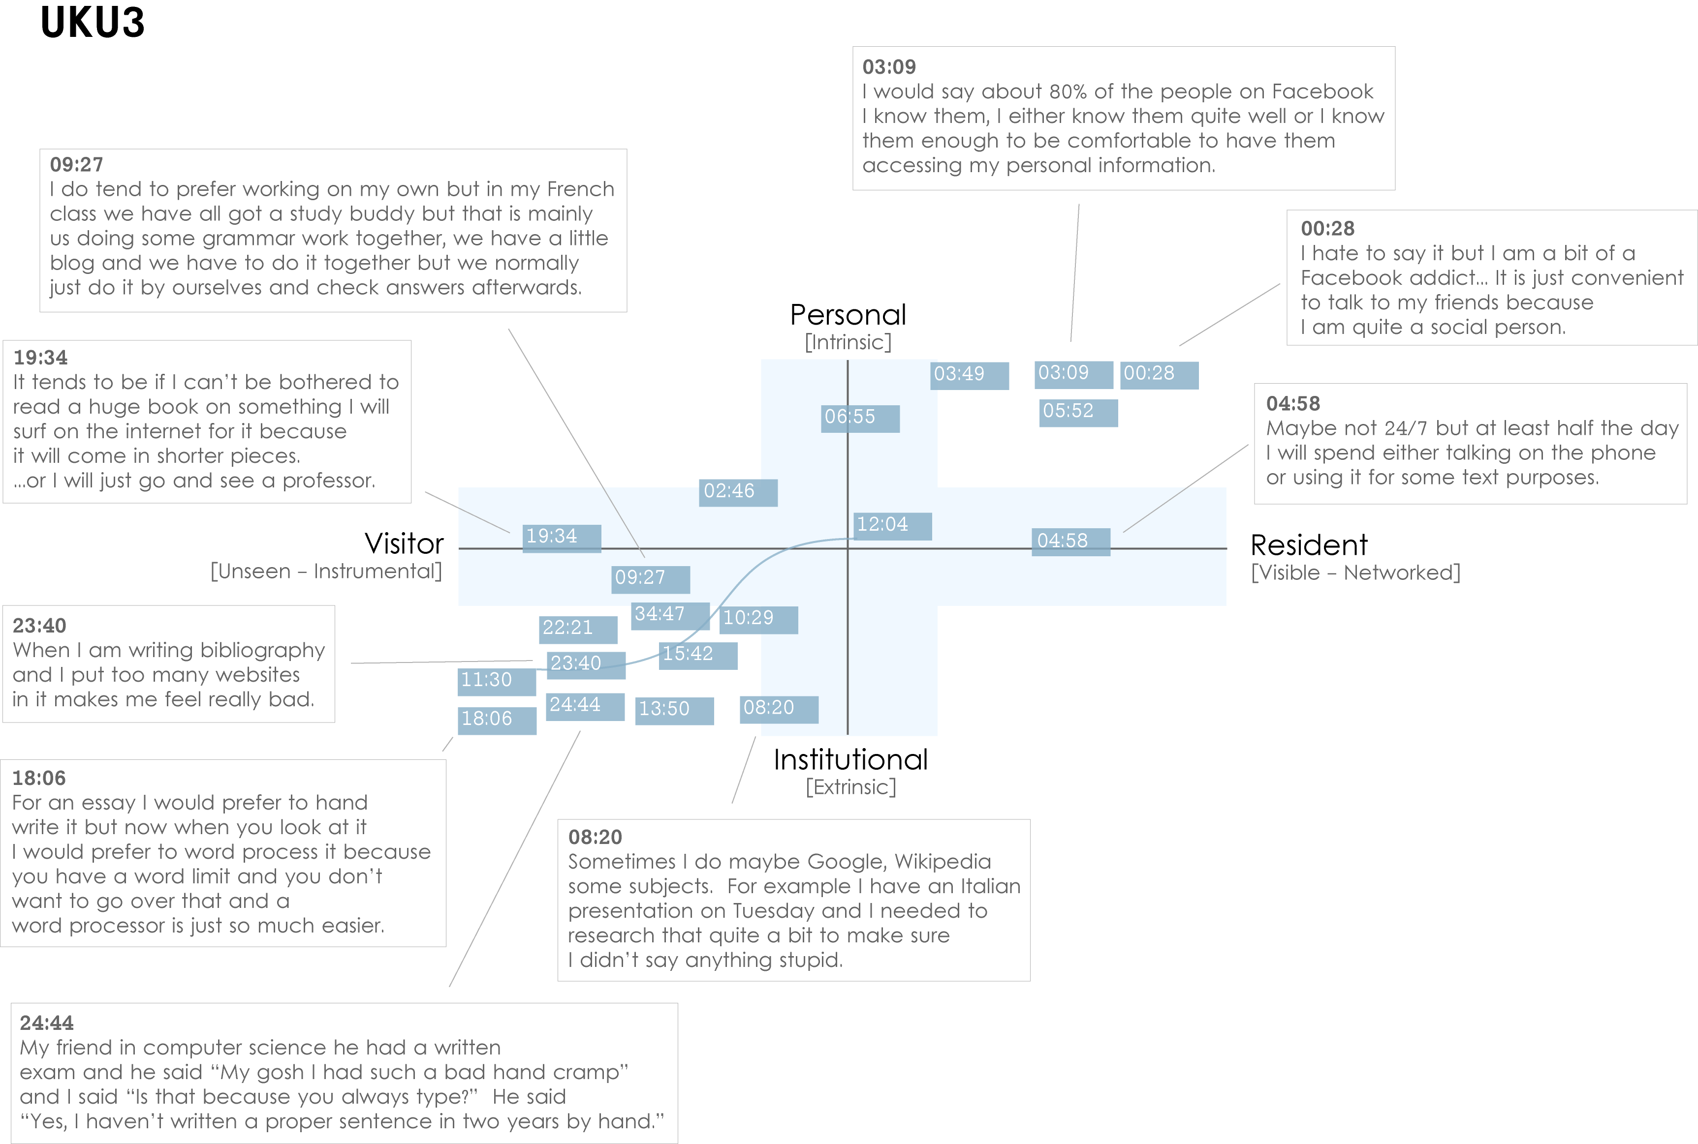
Connaway & White for OCLC Research. 2012.
Notes:
DW
UKU3 (UK 1st year undergraduate)
This participant has a clear demarcation between Resident modes of engagement in her personal life and Visitor modes of engagement for study.
The map is a mode of engagement landscape onto which individuals can be plotted. The limits of the map have been defined by the four major framing concepts of the project: V&R – Personal and Institutional. The Personal end of the axis encompasses an individual’s private life, and the Institutional is their professional and/or academic life.
The data from the Emerging educational stage seem to suggest that individuals were engaging with systems and materials not provided by their institutions to do institutional work (e.g., consulting Wikipedia to write an essay). Such user-owned literacies, when mapped like this, take a prominent role in the academic work of many of our research subjects. Given the effect that the internet is having on collapsing the relationship between certain modes of activity and specific physical spaces, it is important not to tie notions of the intuitional and the personal to ideas of “school/university/library” and “home” as buildings.
White, D. S., & Connaway, L. S. (2011-2012). Visitors and residents: What motivates engagement with the digital information environment. Funded by JISC, OCLC, and Oxford University. Retrieved from http://www.oclc.org/research/activities/vandr/

Slide 10
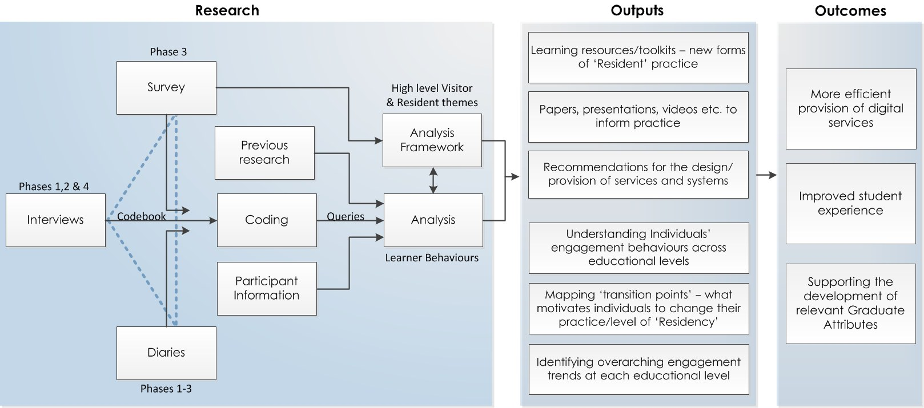
Triangulation of Data
Connaway & White for OCLC Research. 2012.
Notes:
DW
“Several methods of data collection are being utilized in this study: semi-structured interviews, diaries, and an online survey. The multi-method design enables triangulation, which provides a cross examination of the data analysis and results. The quantitative and qualitative methods, including ethnographic methods that devote individual attention to the subjects, yield a very rich data set enabling multiple methods of analysis.”
Connaway, L. S., Lanclos, D., White, D. S., Le Cornu, A., & Hood, E. M. (2012). User-centered decision making: A new model for developing academic library services and systems. IFLA 2012 Conference Proceedings, August 11-17, Helsinki, Finland.

Slide 11

Phase I & 2: Participant Demographics
61 participants
  15 secondary students
  46 university students & faculty
  34 females
  27 males
  38 Caucasian
  5 African-American
  2 Multi-racial
  1 Asian
  2 Hispanic
  13 Unidentified
(White & Connaway, 2011-2012)
Notes:
DW
Image: http://www.flickr.com/photos/doug88888/4570566630/in/set-72157606920303752/
Phase I and 2: Participant Demographics (All Stages)
15 Secondary students, 46 University students and faculty
Ethnicities (All)
5 African-American, 38 Caucasian, 2 Multi-racial, 1 Asian, 2 Hispanic, 13 Unidentified
Genders (All)
34 females, 27 males
Economic class:
We recorded the residential post-code/zipcodes for the participants as a way to identify broad socio-economic categories (given what we knew about socio-economic homogeneity in the cities in which we were working).
Attempts were made to recruit secondary students from schools with a wide range of socio-economic backgrounds. This is basically a convenience sample of students—those who were willing to be interviewed by us, in institutions that allowed us entry.
We also asked questions about parents’ educational backgrounds, and current/past vocations, to enrich our picture of interviewee backgrounds.
White, D. S., & Connaway, L. S. (2011-2012). Visitors and residents: What motivates engagement with the digital information environment. Funded by JISC, OCLC, and Oxford University. Retrieved from http://www.oclc.org/research/activities/vandr/

Slide 12

Codebook
Place
Sources
Tools
Agency
Situation/context
Quotes
Contact
Technology Ownership
Network used
(White & Connaway, 2011-2012)
Notes:
DW
The codebook was created with a grounded analysis of the interviews of the Emerging group, and is to date one of our most significant research findings.
There was significant discussion among researchers about the content of the codebook, via emails and Skype conversations. We started writing the codebook in May, and the final version came about in mid-September.
The content of the codebook reveals the priorities and practices of the Emerging group, but can also be used to analyze the remaining groups we have yet to interview. (for instance, we can use the codebook to analyze faculty interviews even if we don’t have a code for LinkedIn)
Discuss the content of the codebook.
White, D. S., & Connaway, L. S. (2011-2012). Visitors and residents: What motivates engagement with the digital information environment. Funded by JISC, OCLC, and Oxford University. Retrieved from http://www.oclc.org/research/activities/vandr/
Microsoft Clip Art

Slide 13

The Findings
Digital Visitors and Residents
Notes:
LSC
Image: Microsoft Clip Art

Slide 14
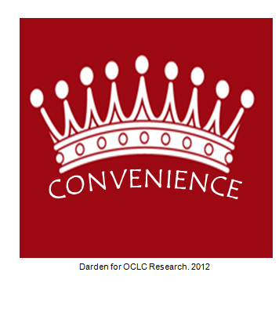
Convenience is King
Convenience dictates choices
  Is it readily accessible online?
  Does it contain the needed information & is it easy to use?
  How much time will it take to access & use the source?
  Is it a familiar interface and easily navigable interface?
    Google
    Wikipedia
CONVENIENCE
Notes:
LSC
Image: Microsoft Clip Art
“They do often advise that we go to the library and look for books but I would normally go to the internet and go to the library as my last sort of option really. (Laughter) It just takes me – I don’t really know how to use the library, I’ve got to be honest, but I know how to use the internet. Yes, I would normally use the internet or sort of word of mouth if someone else knows how to do it – that kind of thing – first.” Digital Visitors and Residents, (UKU5 0:14:19, Female Age 19)
“I find Google a lot easier than going to the library website because I don’t know, it’s just like sometimes so many journals come up and when you look at the first ten and they just don’t make any sense I, kind of, give up. Google, I don’t know. It’s just Google it’s – I find it easier just to look through anything.” Digital Visitors and residents, (USU7 0:34:11, Female Age 19)
“I could easily have found the information she found for me, but the fact that I could just ask her question and have them look up the reference and read through articles instead of me having to look through like a million Googled articles…it was definitely a nice convenience and would definitely make it more likely for me to go to them and actually ask a librarian a question or figure it out on my own.” –Seeking Synchronicity, User (Focus Group, Rutgers University, July 11, 2006)
Although campus Information Commons, with cafes and 24/7 access to the facilities and resources, are still popular with students and faculty, convenient access to resources, whether human, print, or electronic is the most critical factor. After all, “If it is too inconvenient I’m not going after it.”
Connaway, L. S., Dickey, T. J., & Radford, M. L. (2011). "If it is too inconvenient I'm not going after it": Convenience as a critical factor in information-seeking behaviors. Library & Information Science Research, 33 (3) 188.

Slide 15
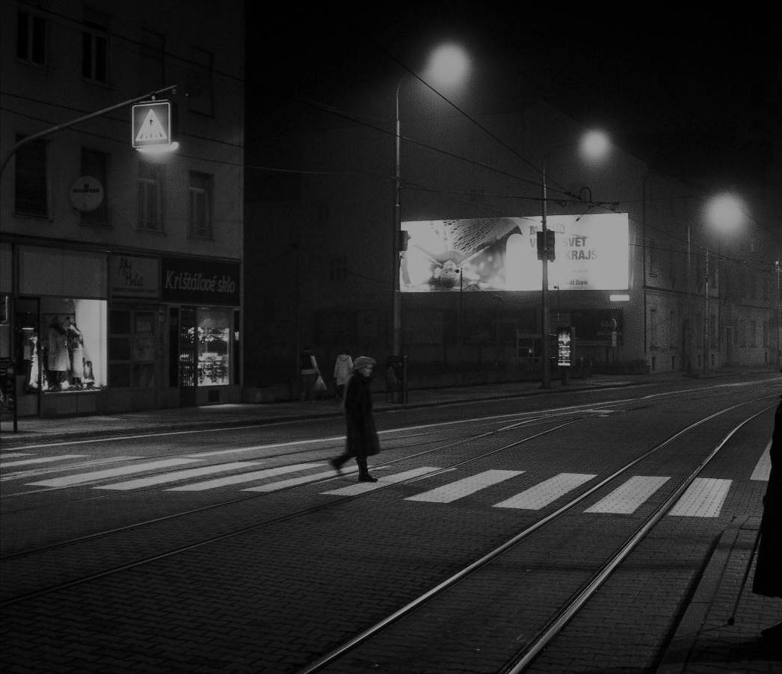
The Learning Black Market
Covert online study habits
  Wikipedia
  Don’t cite
  Widely used
  Guilt
Perception that students & teachers disagree
  Quality sources
Notes:
DW
Image CC: http://wp.me/pLtlj-fH
There is a Learning Black Market”: learners use non-traditional sources but feel they cannot talk about them in an institutional context. Wikipedia usage is an example of this. (White & Connaway, 2011)
White, D. S., & Le Cornu, A. (2011). Visitors and Residents: A new typology for online engagement. First Monday, 16(9). Retrieved from http://firstmonday.org/htbin/cgiwrap/bin/ojs/index.php/fm/article/viewArticle/3171/3049
This is the updated Sources Tree map. (All stages, Phase 1 and 2)
Students’ Perceptions of Teachers’ opinions of Wikipedia:
“Avoid it.” (UKS8, 0:28:28, Female, Age 16, Digital Visitors and Residents) (Emerging)
“They used to tell us in high school not to use Wikipedia.” (USU1, 0:34:59, Female, Age 19, Digital Visitors and Residents)
“It’s like a taboo I guess with all teachers, they just all say – you know, when they explain the paper they always say, “Don’t use Wikipedia.”” (USU7, 0:33:05, Female, Age 19, Digital Visitors and Residents) (Emerging)
Students’ on Wikipedia:
“I use it, kind of like, I won't cite it on my papers but I, kind of, use it as a like, as a start off line. I go there and look up the general information, kind of, read through it so I get a general idea what it is. Then I start going through my research.” (USU7, 0:33:49, Female, Age 19, Digital Visitors and Residents) (Emerging)
“…I would actually use my phone to Wiki or to use Wikipedia to look up something and then I would just be like “Okay” and keep to that. Just because it’s there and it’s easy and it’s just kind of getting this first point of call and maybe a better understanding.” (UKU9, 0:27:59, Male, age unidentified, Digital Visitors and Residents) (Establishing)
“I think academia does not like Wikipedia just for the fact it can be edited, but I really think that Wikipedia is in some ways better than other sources and some ways not as good because one thing is like the kind of go to place just like if you want to read about something and you know it’s on Wikipedia you can just go there and quickly read about it. And also there’s so many people that can edit and modify Wikipedia pages so you can have a less biased and more standardized information.” (USU14, 0:02:03, Male, Age 18, Digital Visitors and Residents) (Establishing)
White, D. S., & Connaway, L. S. (2011-2012). Visitors and residents: What motivates engagement with the digital information environment. Funded by JISC, OCLC, and Oxford University. Retrieved from http://www.oclc.org/research/activities/vandr/

Slide 16
Examples of boxes
“Cognitive authority is clearly related to credibility. The authority’s influence on us is thought proper because he is thought credible, worthy of belief. The notion of credibility has two main components: competence and trustworthiness.”
(Wilson, 1983)
Notes:
DW
“A person is competent in some area of observation or investigation if he is able to observe accurately or investigate successfully.” (Wilson, 1983, p. 15).
Wilson, P. (1983). Second-hand knowledge: An inquiry into cognitive authority. Westport, Connecticut: Greenwood Press.

Slide 17
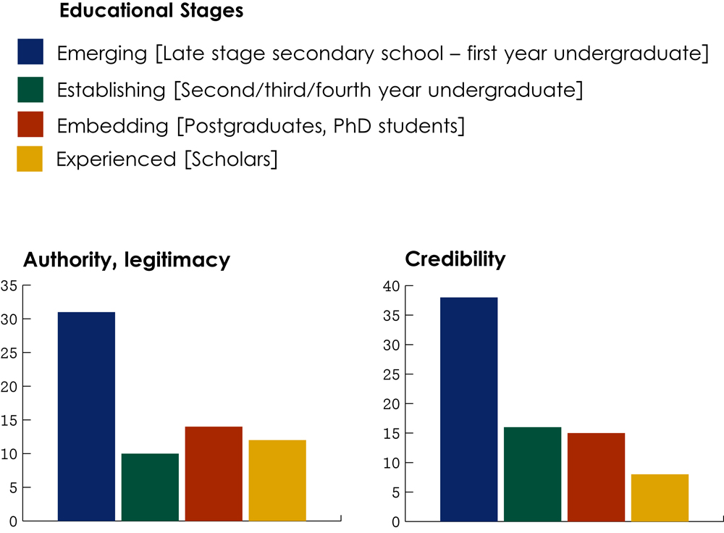
Credibility across stages
Connaway & White for OCLC Research. 2012.
Notes:
DW
Issues of authority/legitimacy (from the codebook) and credibility (from the analysis framework) are significantly more prevalent in the Emerging education stage as the less experienced students negotiate these issues in the context of the web. This is a huge change from a few years ago when the Emerging stage students would have been predominantly engaging with curated/’ratified’ resources from the library.
“Yes, there is that kind of sense that books are better than the internet and I don’t really know why. But it’s just because people always say anyone can put anything on the internet, that kind of thing. But to be fair it is usually right what’s on the internet.”
UKU5

Slide 18
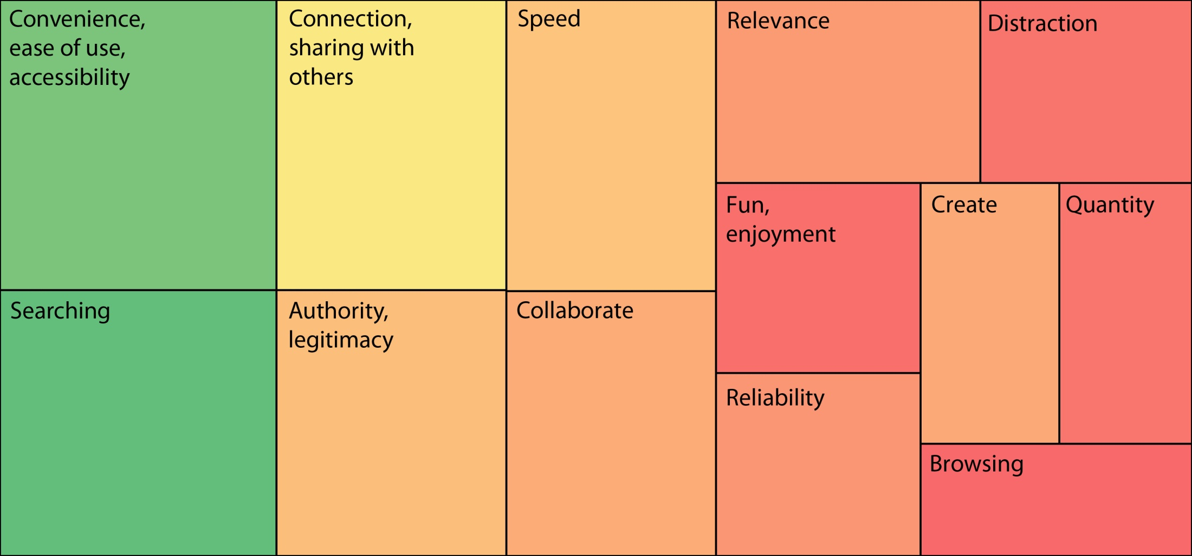
Agency
Connaway & White for OCLC Research. 2012.
(White & Connaway, 2011-2012)
Notes:
LSC
(All stages, Phases 1 and 2)
Ease/Convenience
“Well I probably actually use these things on emails because it’s an incredibly easy and quick way of getting information.” (UKS8, 0:04:36, Female, Age 16, Digital Visitors and Residents) (Emerging)
Ease/Convenience: Wikipedia
“I just thought, because it was the easiest thing to do there and then, and I didn’t have a lot of time and I just thought Wikipedia would be the best option.” (UKS1, 0:16:49, Male, Age 18, Digital Visitors and Residents) (Emerging)
“Probably not the best, but I think it’s the simplest and easiest way to get going. So if I needed to produce a much more detailed and developed essay I would probably explore further on the internet.” (UKS1, 0:17:52, Male, Age 18, Digital Visitors and Residents) (Emerging)
Reliable
“But I try to find one source that looks like its reliable, not biased and applicable and then look at the references it cites.” (USU10, 0:46:55, Male, Age 28, Digital Visitors and Residents) (Establishing)
White, D. S., & Connaway, L. S. (2011-2012). Visitors and residents: What motivates engagement with the digital information environment. Funded by JISC, OCLC, and Oxford University. Retrieved from http://www.oclc.org/research/activities/vandr/
Distraction
“Being online is a little unproductive sometimes. Sometimes I will actually turn off my internet if I want to be more productive, and that’s because in an environment where I almost subconsciously check Facebook or check my email, it tends to be very distracting while I’m trying to read an in-depth text.” (UKG2, 0:19:18, Female, age unidentified, Digital Visitors and Residents) (Embedding)

Slide 19

The word “librarian” never mentioned by Emerging Stage participants as a source of information
One participant referred to “a lady in the library who helps you find things” (USU5)
Notes:
LSC
Image: http://www.flickr.com/photos/domesticat/2438570563/

Slide 20
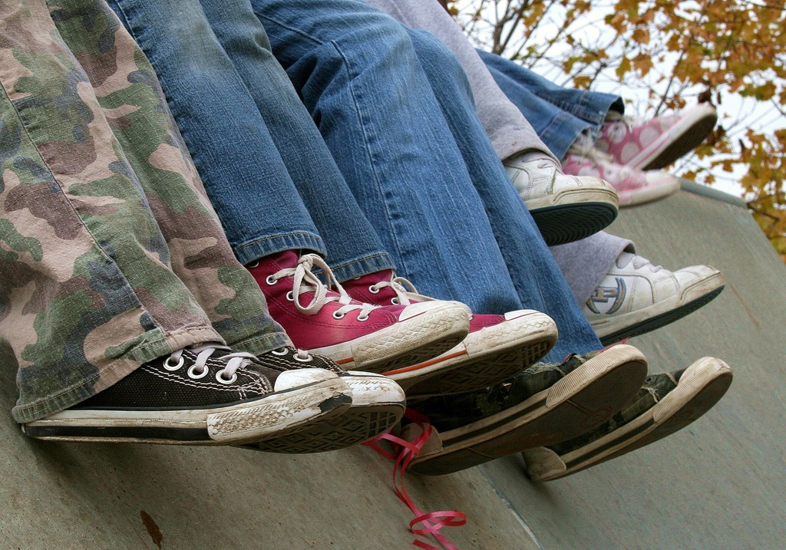
“I always stick with the first thing that comes up on Google because I think that’s the most popular site which means that’s the most correct.” (USS1)
Notes:
LSC
Image: http://www.flickr.com/photos/pinksherbet/2001899627/

Slide 21
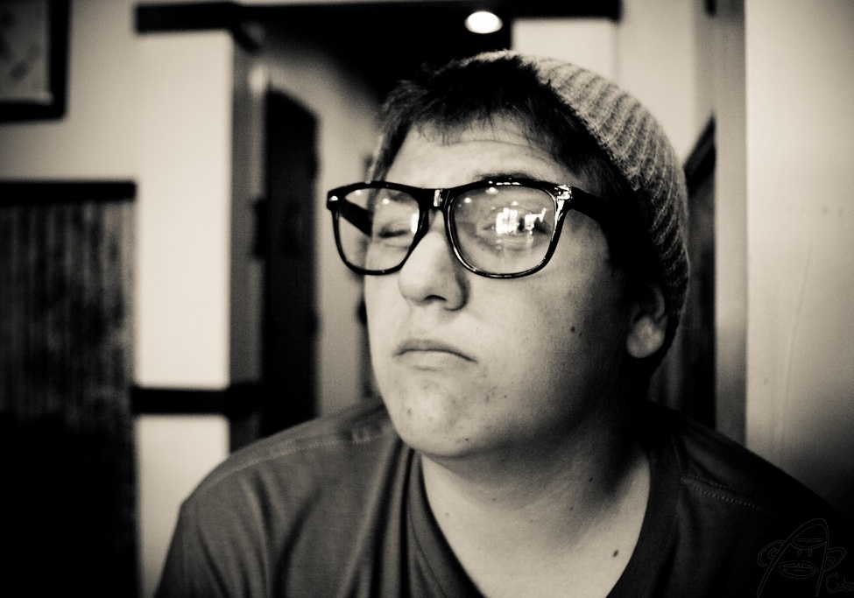
“Google doesn’t judge me” (UKF3)
Notes:
LSC
Image: http://www.flickr.com/photos/cubmundo/6184306158/

Slide 22
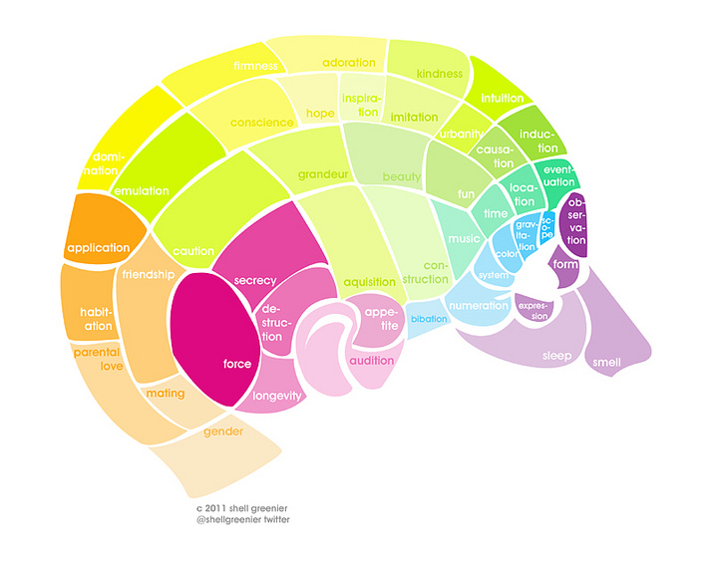
Moving Forward
Digital Visitors and Residents
Notes:
DW
Image: Microsoft Clip Art (plant), http://www.flickr.com/photos/shellberry/5683934976/in/faves-37635807@N08/ (brain diagram)

Slide 23
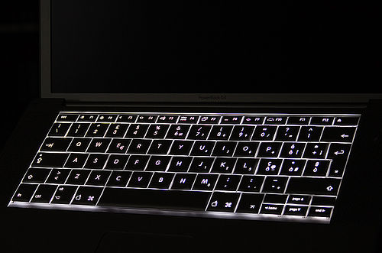
User-centered
‘Resident’ modes of engaging users (on and off-line)
Countering the perception of the library as only a physical space.
Understand user behavior out on the web. (Learning black market etc.)
Activity engaging in the digital spaces users inhabit.
Advertise resources, brand & value
Need help?
Notes:
DW
Image: http://www.flickr.com/photos/flod/26083507/
Mention learning resource/toolkit as well.
Libraries and librarians need to work to counter the notion of the library as only a physical space. There should be more ‘Resident’ practice both on and off line e.g. Posting information experts in departments, placing collection links on Wikipedia, providing links to expertise and services via social media etc.
Library systems need to look and function more like search engines, e.g., Google and Yahoo, and services, e.g., Amazon.com since these are familiar to users who are comfortable and confident in using them (p.5).
36% of respondents reported being extremely familiar with search engines while only 26% reported being very familiar with libraries (p. 1-8)
VRS meets users where they are
Text, e-mail, chat
Facebook (“On Facebook, Librarian Brings 2 Students From the Early 1900s to Life,” January 6, 2012, Nick DeSantis, Chronicle of Higher Education. http://chronicle.com/blogs/wiredcampus/on-facebook-librarian-brings-two-students-from-the-early-1900s-to-life/34845
Joe McDonald, sophomore at University of Nevada, Reno in 1913, and girlfriend and future wife, Leola Lewis
Librarians’ expertise can deliver quality sources to users through VRS that they cannot find with a Google search
Connaway, L.S., & Dickey, T.J. (2010). Digital information seekers: Report of findings from selected OCLC, RIN, and JISC user behavior projects. http://www.jisc.ac.uk/media/documents/publications/reports/2010/digitalinformationseekerreport.pdf (p. 5).
De Rosa, C. (2005). Perceptions of libraries and information resources: A report to the OCLC membership. Dublin, Ohio: OCLC Online Computer Library Center (p.1-8).
“However, I would have used Google if I had had internet connection, because if you spell something incorrectly, there is a notice saying “did you mean to spell ____?” with the correct spelling of the word. So that would have been my first choice of thing to do in this situation, but the dictionary application worked fine since I did not have internet connection.” (USS3 Emg Diary 2 / 5/15/2011, Female Age 19)
“She was very direct about certain stuff and wanted me to go to the library. Of course like the library’s like a second home for me, so that’s fine. But the research I needed wasn’t showing up. So I was like okay, I’m going to the internet. And I had to find quotes from books, so I just like was able to go on Google, Google book search, and find the quote I needed. And I didn’t write down it was from the internet .... So she doesn’t really know (Laughter) that it’s from the internet.” (USU2 0:31:50, Female Age 19)
“Being at University allows you membership of a large and well respected library on campus. There are librarians and other staff who can help you if you need advice, whereas searching online you can’t ask anyone for help.” (Undergraduate, Age 18)

Slide 24
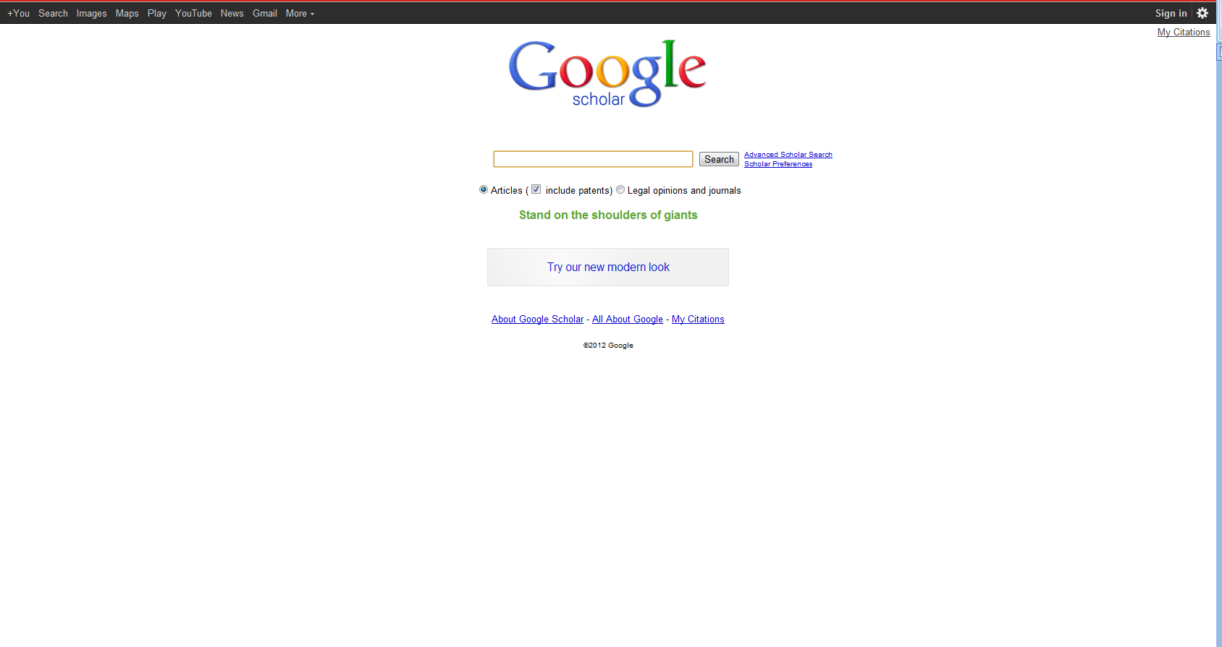
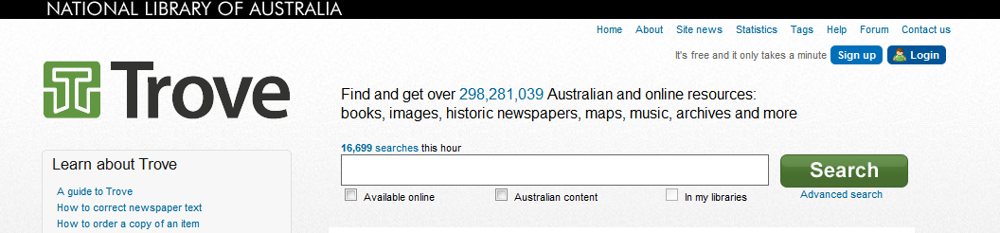
Notes:
LSC
“Yes, I’m sure, because, you know, going to the library was a task. And part of, I’m sure, a lot of people, and as far as me is concerned from laziness, it was much easier to just scrap around. It’s so much easier to just strain to find something on the internet than to, like, drive to the library. But that was in high school. In college, and especially grad school, I’m not afraid to go to the library anymore because we have a very good [assist 0:45:56] and we have a very good website.” (USG2 0:45:28, Male Age 25, Digital Visitors and Residents)
Trove (National Library of Australia): http://trove.nla.gov.au/

Slide 25
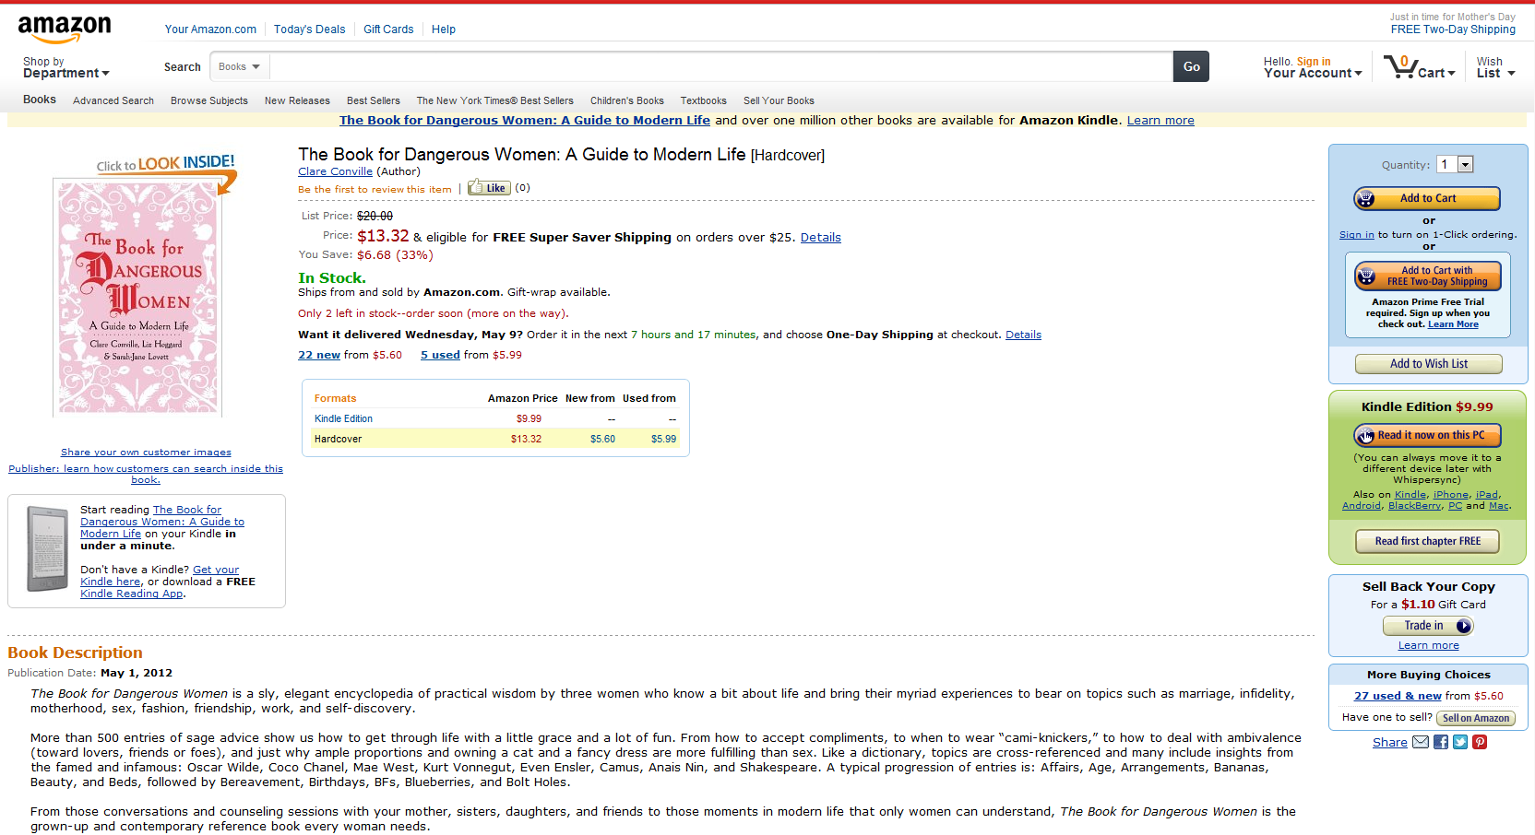
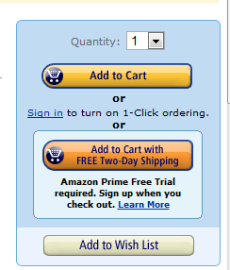
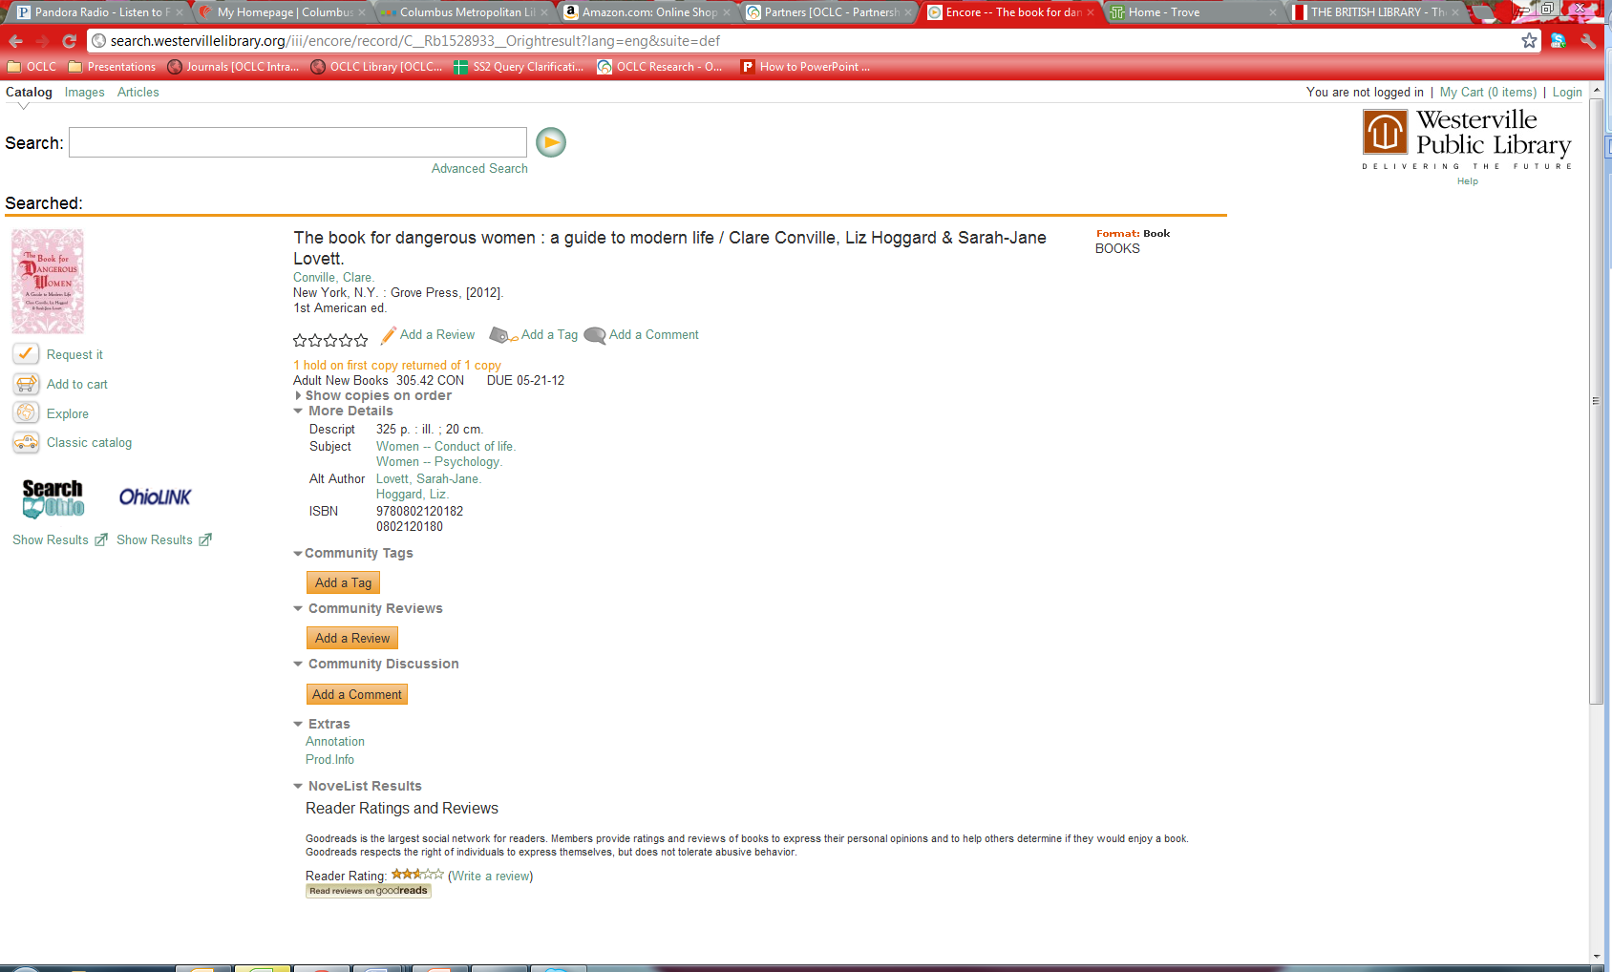
Amazon.com
Westerville Public Library
Notes:
LSC
Addings tags, reviews, and comments are also options
Interviewer: “Right, so you kind of trust the crowd at a certain level.”
Respondent: “At a certain level, yes. I’m also wary but I also trust the crowd, especially for like tying a tie video. There are 10 million views for this tying a tie video, it probably is pretty good.” (USG2 0:41:09, Male Age 25, Digital Visitors and Residents)
Westerville Public Library: http://www.westervillelibrary.org/
Amazon: amazon.com

Slide 26
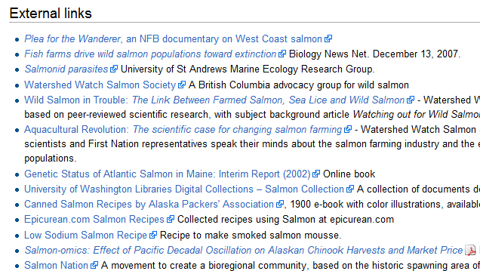
http://en.wikipedia.org/wiki/Salmon
Notes:
LSC
University of Washington actively link their collections to relevant Wikipedia articles.

Slide 27
Selected Bibliography
Centre for Information Behaviour and the Evaluation of Research. (2008). Information behaviour of the researcher of the future: A CIBER briefing paper. London: CIBER.
Connaway, L. S., & Dickey, T. J. (2010). The digital information seeker: Report of the findings from selected OCLC, RIN, and JISC user behaviour projects. Retrieved from http://www.jisc.ac.uk/media/documents/publications/reports/2010/digitalinformationseekerreport.pdf
Connaway, L. S., Dickey, T. J., & Radford, M. L. (2011). "If it is too inconvenient I'm not going after it": Convenience as a critical factor in information-seeking behaviors. Library & Information Science Research, 33(3) 179-190.
Connaway, L. S., Lanclos, D., White, D. S., Le Cornu, A., & Hood, E. M. (2012). User-centered decision making: A new model for developing academic library services and systems. IFLA 2012 Conference Proceedings, August 11-17, Helsinki, Finland.
Connaway, L. S., & Powell, R. R. (2010). Basic research methods for librarians. Santa Barbara, CA: Libraries Unlimited.
Connaway, L. S., Radford, M. L., & OCLC Research. (2011). Seeking synchronicity: Revelations and recommendations for virtual reference. Dublin, Ohio: OCLC Research. http://www.oclc.org/research/activities/synchronicity/default.htm
Connaway, L.S., White, D., & Lanclos, D. (2011). Proceedings of the 74th ASIS&T Annual Meeting, 48. “Visitors and residents: What motivates engagement with the digital environment?” Silver Spring, MD: Richard B. Hill.
Cool, C., & Spink, A. (2002). Issues of context in information retrieval (IR): An introduction to the special issue. Information Processing and Management: An International Journal, 38(5), 605-611.
Dempsey, L. (2008). Always on: Libraries in a world of permanent connectivity. First Monday, 14(1). Retrieved from http://www.firstmonday.org/htbin/cgiwrap/bin/ojs/index.php/fm/article/view/2291/207
De Rosa, C. (2005). Perceptions of libraries and information resources: A report to the OCLC membership. Dublin, Ohio: OCLC Online Computer Library Center (p.1-8).
Notes:
LSC

Slide 28
Selected Bibliography
Dervin, B., Connaway, L. S., & Prabha, C. (2003-2005). Sense-making the information confluence: The hows and the whys of college and university user satisficing of information needs. Funded by the Institute for Museums and Library Services (IMLS). Retrieved from http://www.oclc.org/research/activities/past/orprojects/imls/default.htm
DeSantis, N. (2012, January 6, ). On Facebook, librarian brings 2 students from the early 1900s to life. Chronicle of Higher Education. Retrieved from http://chronicle.com/blogs/wiredcampus/on-facebook-librarian-brings-two-students-from-the-early-1900s-to-life/34845
Geertz, C. (1973). The interpretation of cultures: Selected essays. New York: Basic Books.
Gilster, P. (1997). Digital literacy. New York: Wiley.
Glaser, B. G. , & Strauss, A.L. (1967). The discovery of grounded theory; strategies for qualitative research. Chicago: Aldine Pub. Co.
Helsper, E. J. & Eynon, R. (2009). Digital natives: Where is the evidence? British Educational Research Journal, 36(3), 503–520.
Holton, D. (2010, March 19). The digital natives/digital immigrants distinction is dead or at least dying. [Web log comment]. EdTechDev . Retrieved from http://edtechdev.wordpress.com/2010/03/19/the-digital-natives-digital-immigrants-distinction-is-dead-or-at-least-dying/
    Kennedy, G., Judd, T., & Dalgarno, B. (2010). Beyond natives and immigrants: Exploring types of net generation students. Journal of Computer Assisted Learning, 26(5), 332–343.
Kvale, S. (1996). InterViews: An introduction to qualitative research interviewing. Thousand Oaks, Calif: Sage Publications, 133-135.
Lankshear, C. & Knobel, M. (Eds.) (2008). Digital literacies: Concepts, policies and practices. New York: Peter Lang.
Notes:
LSC

Slide 29
Selected Bibliography
Margaryan, A. & Littlejohn, A. (2008). Are digital natives a myth or reality?: Students’ use of technologies for learning. Retrieved from http://www.academy.gcal.ac.uk/anoush/documents/DigitalNativesMythOrReality-MargaryanAndLittlejohn-draft-111208.pdf
McKenzie, J. (2007). Digital nativism, digital delusions, and digital deprivation. From Now On: The Educational Technology Journal, 17(2). Retrieved from http://www.fno.org/nov07/nativism.html
Prensky, M. (2001a). Digital natives, digital immigrants. On the Horizon, 9(5). Retrieved from http://www.marcprensky.com/writing/Prensky%20-%20Digital%20Natives,%20Digital%20Immigrants%20-%20Part1.pdf
Prensky, M. (2001b). “Do they really think differently?” On the Horizon, 9(5). Retrieved from http://www.marcprensky.com/writing/Prensky%20-%20Digital%20Natives,%20Digital%20Immigrants%20-%20Part2.pdf
Radford, M. L., & Connaway, L. S. (2005-2007). Seeking synchronicity: Evaluating virtual reference services from user, non-user, and librarian perspectives. Funded by the Institute for Museums and Library Services (IMLS). Retrieved from http://www.oclc.org/research/activities/synchronicity/default.htm
    Radford, M. L., & Connaway, L. S. (2010). “I stay away from the unknown, I guess.” Measuring impact and understanding critical factors for millennial generation and adult non-users of virtual reference services. In online proceedings of the Fifth Annual iConference. University of Illinois at Urbana-Champaign, February 3-6, 2010. http://nora.lis.uiuc.edu/images/iConferences/2010papers2_Page-Zhang.pff
Stoerger, S. (2009). The digital melting pot: Bridging the digital native–immigrant divide. First Monday, 14(7). Retrieved from http://firstmonday.org/htbin/cgiwrap/bin/ojs/index.php/fm/article/view/2474/2243
    Wasserman, S. (2012, June 18). The Amazon effect. The Nation. Retrieved from http://www.thenation.com/article/168125/amazon-effect
    White, D. S., & Connaway, L. S. (2011-2012). Visitors and residents: What motivates engagement with the digital information environment. Funded by JISC, OCLC, and Oxford University. Retrieved from http://www.oclc.org/research/activities/vandr/
    White, D. S., & Le Cornu, A. (2011). Visitors and Residents: A new typology for online engagement. First Monday, 16(9). Retrieved from http://firstmonday.org/htbin/cgiwrap/bin/ojs/index.php/fm/article/viewArticle/3171/3049

Slide 30
Selected Bibliography
    White, D. (2008, April 23). Not ‘natives’ & ‘immigrants’ but ‘visitors’ & ‘residents’. [Web log comment]. TALL Blog: Online Education with the University of Oxford. Retrieved from http://tallblog.conted.ox.ac.uk/index.php/2008/07/23/not-natives-immigrants-but-visitors-residents/
    Whyte, W. F. (1979). On making the most of participant observation. The American Sociologist,14, 56-66.
    Wilson, P. (1983). Second-hand knowledge: An inquiry into cognitive authority. Westport, Connecticut: Greenwood Press.
Notes:
LSC

Slide 31
The researchers would like to thank Alyssa Darden for her assistance in preparing this presentation and Erin Hood for her assistance in keeping the team organized, analyzing the data, and disseminating the results.
Notes:
LSC

Slide 32
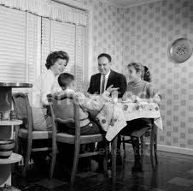
Questions and Discussion
Lynn Silipigni Connaway
connawal@oclc.org
David White
david.white@conted.ox.ac.uk@daveowhite
Notes:
32
32
32
LSC

