Slide 1
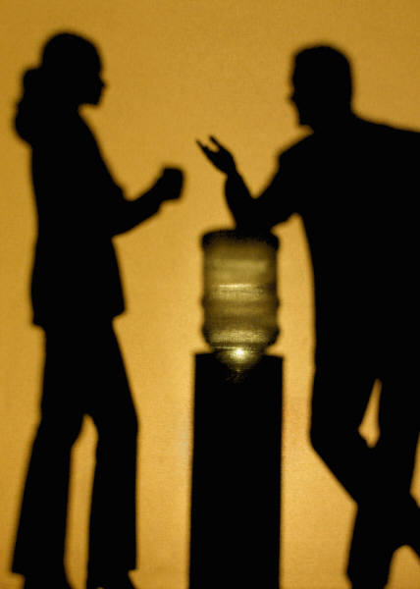
“I knew that the internet wouldn’t give me a wrong answer.” Identifying Changing Information Behaviours
Dr. Lynn Silipigni Connaway
Senior Research Scientist
OCLC Research
EDINA
3 June 2011
Edinburgh, UK

Slide 2
Towards a Profile of the Researcher of Today: What Can We Learn from JISC Projects?
Digital Information Seekers: Report of findings from selected OCLC, JISC & RIN User Behaviour Projec
Funded by JISC
Analysis of 12 user behaviour studies
Conducted in US and UK
Published within last 5 years
Synthesis
Better understand user information-seeking behaviour
Identify issues for development of user-focused services and systems
Notes:
Joint Information Systems Committee.
De Rosa, Cathy. 2005. Perceptions of libraries and information resources: A report to the OCLC membership. Dublin, Ohio: OCLC Online Computer Library Center.
De Rosa, Cathy. 2006. College students' perceptions of libraries and information resources: A report to the OCLC membership. Dublin, Ohio: OCLC Online Computer Library Center.
Dervin, Brenda, CarrieLynn D. Reinhard, Zack Y. Kerr, Mei Song, and Fei C. Shen, eds. 2006. Sense-making the information confluence: The whys and hows of college and university user satisficing of information needs. Phase II: Sense-making online survey and phone interview study. Report on National Leadership Grant LG-02-03-0062-03 to Institute of Museum and Library Services, Washington, D.C. Columbus, Ohio: School of
Communication, Ohio State University.
Connaway, Lynn Silipigni, Chandra Prabha, and Timothy J. Dickey. 2006. Sense-making the information confluence: The whys and hows of college and university user satisficing of information needs. Phase III: Focus group interview study. Report on National Leadership Grant LG-02-03-0062-03, to Institute of Museum and Library Services, Washington, D.C. Columbus, Ohio: School of Communication, The Ohio State University.
Prabha, Chandra, Lynn Silipigni Connaway, and Timothy J. Dickey. 2006. Sense-making the information confluence: The whys and hows of college and university user satisficing of information needs. Phase IV: Semi-structured interview study. Report on National Leadership Grant LG-02-03-0062-03, to Institute of Museum and Library Services, Washington, D.C. Columbus, Ohio: School of Communication, The Ohio State University.
Research Information Network. 2006. Researchers and discovery services: Behaviour, perceptions and needs. London: Research Information Network.
Consortium of University Research Libraries, and Research Information Network. 2007. Researchers' use of academic libraries and their services: A report. London: Research Information Network and Consortium of University Research Libraries (CURL).
Centre for Information Behaviour and the Evaluation of Research. 2008. Information behaviour of the researcher of the future: A CIBER briefing paper. London: CIBER.
Radford, Marie L., and Lynn Silipigni Connaway. 2008. Seeking synchronicity: Evaluating virtual reference services from user, non-user, and librarian perspectives: IMLS final performance report. Report on Grant LG-06-05-0109-05, to Institute of Museum and Library Services, Washington, D.C. Dublin, Ohio: OCLC Online Computer Library Center.
Calhoun, Karen, et al. 2009. Online catalogs: What users and librarians want: An OCLC report. Dublin, Ohio: OCLC.
Research Information Network. 2009. E-journals: Their use, value and impact. London: Research Information Network.
JISC and UCL. 2009. JISC national e-books observatory project: Key findings and recommendations: Final report.
Hampton-Reeves, Stuart, Claire Mashiter, Jonathan Westaway, Peter Lumsden, Helen Day, Helen Hewerston, and Anna Hart. 2009. Students’ use of research content in teaching and learning: A report of the Joint Information Systems Council (JISC).
Wong, William, Hanna Stelmaszewska, Nazlin Bhimani, Sukhbinder Barn, and Balbir Barn. 2009. User behaviour in resource discovery: Final report.

Slide 3
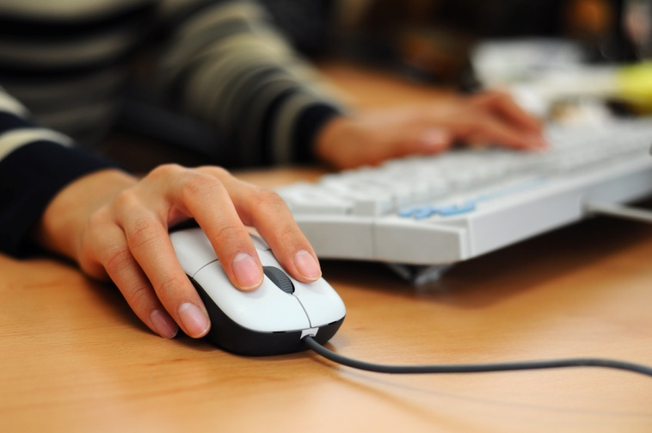
Common Findings: User Behaviors
“The majority of researchers in all disciplines have adapted readily to the widespread availability of digital content, accessible directly from their desktops.”
(Consortium of University Research Libraries, and Research Information Network. 2007. Researchers' use of academic libraries and their services: A report. London: Research Information Network and Consortium of University Research Libraries (CURL), p. 23)
Notes:
Researchers particularly appreciate desktop access to scholarly content, from e-journals to VRS (DIS, p. 33).
Researchers and discovery services, 2006
Valuation of the convenience of desktop access
Researchers' use of academic libraries, 2007
Immediate access from desktop computer is taken for granted
Seeking synchronicity, 2008
VRS' convenience is from home computer
Students' use of research content, 2009
Home computer is main way they gain access
Consortium of University Research Libraries, and Research Information Network. 2007. Researchers' use of academic libraries and their services: A report. London: Research Information Network and Consortium of University Research Libraries (CURL).
“The majority of researchers in all disciplines have adapted readily to the widespread availability of digital content, accessible directly from their desktops” (Consortium of University Research Libraries, and Research Information Network 2007, p. 23).

Slide 4
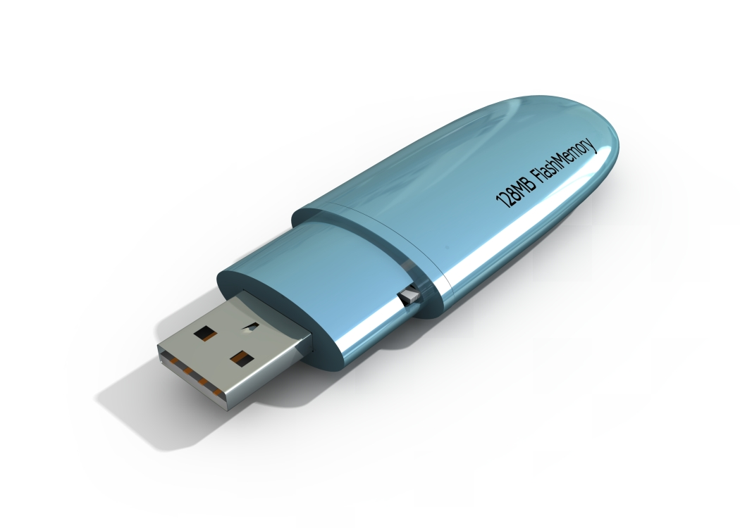
Common Findings: User Behaviors
Convenience dictates choice between physical & virtual library
Very little time using content
“Squirreling” of downloads
Prefer quick chunks of information
Visit only a few minutes
Use basic search
Notes:
User behaviours in this electronic environment tend toward quick views of a few pages, and “bouncing” between resources. This seems to contradict the notion of the hard-core researcher but supports the need for more user behaviour research addressing situation and context. DIS, p. 34.
Seeking Synchronicity, 2008
Convenience often dictates choices between physical and virtual library
Researcher of the future, 2008
Very little time using content, “squirreling” of downloads by academic users
All users preferring quick chunks of information
E-journals, 2009
Users are visiting only a few minutes
User behaviours vary but demonstrate shorter sessions, using basic search, and viewing fewer pages

Slide 5
Common Findings: User Behaviors
Use snippets from e-books
View only a few pages
Short visits
Simple searching of Google-like interfaces
Power browsing
Value human resources
Notes:
Calhoun, Karen, et al. 2009. Online catalogs: What users and librarians want: An OCLC report. Dublin, Ohio: OCLC. DIS, p. 18.
“Make it as easy as a Google Book Search,” one survey respondent requested when discussing the catalog. (Calhoun et al. 2009, p. 14)
JISC national e-books, 2009
Users tend to use e-books quickly, viewing only a few pages
User behaviour in resource discovery, 2009
Users make short visits, with simple searching of Google-like interfaces; power browsing for snippets of information
Researchers also value human resources such as colleagues, peers, family, friends, and teachers in their information seeking. DIS, p. 39.

Slide 6
Common Findings: The Library
= Collections of books
Desire Selective Dissemination of Information (SDI)
More digital content = Better
Use for research
Use less since Internet available
Notes:
Digital Information Seeker, pg. 4.
In addition, some common findings regarding content and resources arise:
More digital content of all kinds and formats is almost uniformly seen as better.
People still tend to think of libraries as collections of books.
Despite this, researchers also value human resources in their information-seeking.
Sense-making the information confluence: Phases 1-4 and Final Report. DIS, p. 9.
Participants also discussed enhancements and changes to the library’s electronic resources (Connaway, Prabha, and Dickey 2006, p. 16). These include Selective Dissemination of Information (SDI) [although the participants did not use this term, this is the service they described], 24/7 reference, and expanded online sources, including all print and other physical materials available online (Connaway, Prabha, and Dickey 2006, p. 16-17).
College students’ perceptions, 2006
Students trust library, but are visiting less since they began using Internet

Slide 7
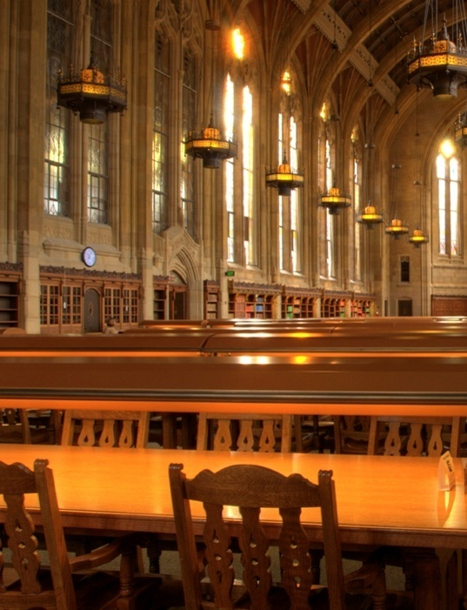
Common Findings: The Library
Criticize physical library & traditional services
Faculty praise physical collection
Electronic databases not perceived as library sources
Frustration with locating and accessing full-text copies
Notes:
Connaway, Lynn Silipigni. 2007. “Mountains, valleys, and pathways: Serials users’ needs and steps to meet them. Part I: Identifying Serials Users’ Needs: Preliminary Analysis of Focus Group Interviews and Semi-structured Observations at Colleges and Universities.” Serials Librarian 52(1/2): 223-236.
However, these respondents also offer frequent criticisms of traditional library services. (p. 3-4).
In this situation, both undergraduate and graduate students offer a high concentration of responses in three categories: positive comments on the ease of the web as an information source, some positive commentary on library resources (though their use of library resources were very frequently through electronic intervention), and criticism of the physical library. …However, the faculty provide a variety of data which uniquely praise the virtues of the physical library collection, and which consider credibility, authority, and trustworthiness as criteria for judging an information source. (p.5).
However, the respondents do not perceive these databases as “library sources” and express frustration with their inability to locate or access full-text copies of journals and books. They suggest the library provide recommender and discovery services like those available through Amazon. (p. 10).

Slide 8
Common Findings: User Literacy Skills
Information literacy skills
Lacking
Not kept pace with digital literacy
Researchers self-taught & confident
Notes:
Wong, William, Hanna Stelmaszewska, Nazlin Bhimani, Sukhbinder Barn, and Balbir Barn. 2009. User behaviour in resource discovery: Final report. DIS, p. 23.
Information literacy skills are generally lacking; they have not necessarily kept pace with digital literacy (Wong et al. 2009, p. 6).
Research Information Network . Researchers and discovery services. DIS, p. 11.
Most researchers are self-taught in the use of discovery services with 62% of the researchers reporting they had no formal training (ibid, p. 64). However, they are relatively confident in their own skills (Research Information Network 2006, p. 9).

Slide 9
Common Findings: The Web
Search engine first choice
Starting point
Easy and convenient to use
Quick searches to become familiar with subjects
Rate search engines better lifestyle fit than libraries
Trust Google to understand
Notes:
Even more evidence exists for the increasing centrality of Google and other search engines in researchers’ behaviours. DIS, p. 27.
Perceptions of libraries, 2005
Search engines dominant place to begin
Search engine as lifestyle fit
Search engines are preferred over libraries
College students’ perceptions, 2006
Search engines overwhelming first choice for an information search
94% lifestyle fit
Researcher of the future, 2008
Prefer natural language searching and trust Google to understand them
Connaway, Lynn Silipigni. 2007. “Mountains, valleys, and pathways: Serials users’ needs and steps to meet them. Part I: Identifying Serials Users’ Needs: Preliminary Analysis of Focus Group Interviews and Semi-structured Observations at Colleges and Universities.” Serials Librarian 52(1/2): 223-236.
The focus group interview data indicate a heavy reliance upon Google and other web browsers and sources. (p. 3-4).
Graduate students also rank Google as the first source for quick searches. (p. 3-4).
The preliminary analysis of the focus group interviews and semi-structured observations suggests that college and university information seekers use Google and other web sources and browsers for quick searches and to familiarize themselves with subjects. (p.11).
In this situation, both undergraduate and graduate students offer a high concentration of responses in three categories: positive comments on the ease of the web as an information source,…(p.5).

Slide 10
Common Findings: The Search
Search strategies differ by context
Database interfaces hinder access
Desire enhanced functionality & content to evaluate resources
Prefer natural language
Notes:
Wong, William, Hanna Stelmaszewska, Nazlin Bhimani, Sukhbinder Barn, and Balbir Barn. 2009. User behaviour in resource discovery: Final report. DIS, p. 23.
Search strategies change by context, during the course of the process (Wong et al. 2009, p. 7).
Users found access hindered by the difficulty of using database interfaces (Wong et al. 2009, p. 7).
Digital Information Seeker, pg. 4.
The realities of the online environment observed above led several studies to some common conclusions about changing user behaviours:
Users are beginning to desire enhanced functionality in library systems.
They also desire enhanced content to assist them in evaluating resources.
Centre for Information Behaviour and the Evaluation of Research. 2008. Information behaviour of the researcher of the future: A CIBER briefing paper. DIS, p. 15.
Younger people tended to spend little time, and with little effectiveness in evaluating search results. They preferred natural-language searching and trusted Google to understand them. Many do not find library resources intuitive (CIBER 2008, p. 12).

Slide 11
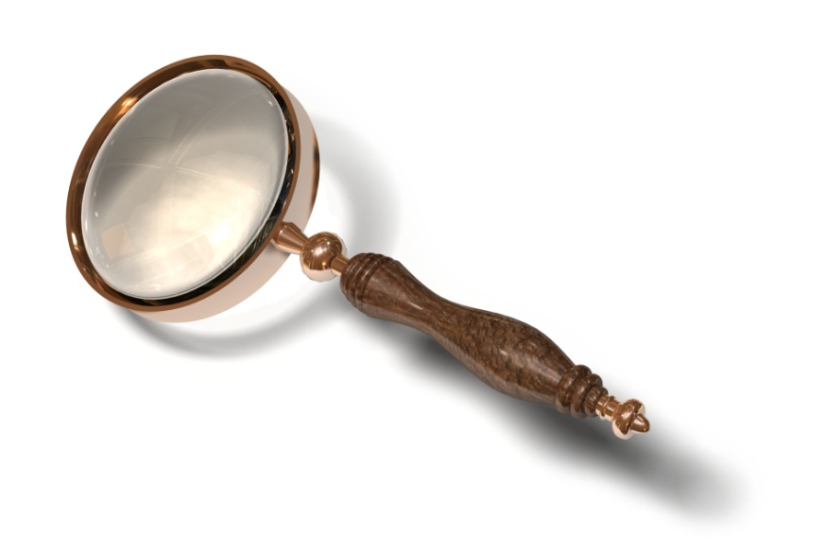
Common Findings: The Catalog
“It is very clear that Google has emerged as a real force in the accessing and discovery of research content which is rivalling university library catalogues.”
(Hampton-Reeves, Stuart, Claire Mashiter, Jonathan Westaway, Peter Lumsden, Helen Day, Helen Hewerston, and Anna Hart. 2009. Students’ use of research content in teaching and learning: A report of the Joint Information Systems Council (JISC), p. 30)
Notes:
Hampton-Reeves, Stuart, Claire Mashiter, Jonathan Westaway, Peter Lumsden, Helen Day, Helen Hewerston, and Anna Hart. 2009. Students’ use of research content in teaching and learning: A report of the Joint Information Systems Council (JISC). DIS, p. 22.
In situations of formal research for these students, this leads them to the library catalogue first and to use it more (32%, n=137, N=428; Hampton-Reeves et al. 2009, p. 24). However, the researchers stated, “it is very clear that Google has emerged as a real force in the accessing and discovery of research content which is rivalling university library catalogues” (Hampton-Reeves et al. 2009, p. 30).

Slide 12
Common Findings: The Catalog
Value databases & other online sources
Do not understand what resources available in libraries
Cannot distinguish between databases held by a library & other online sources
Library OPACs difficult to use
Notes:
Sense-making the information confluences: Phases 1-4 and Final Report. DIS, p. 9.
Faculty response in a focus group interview, “I do use Google, but …[I also] use two different library homepages” (Connaway, Prabha, and Dickey 2006, p. 12).
The participants acknowledged the value of databases and other online sources to both academic and personal information needs.
Some users did not understand what resources were actually available in libraries nor could they distinguish between databases held by a library and sources merely available online (Connaway, Prabha, and Dickey 2006, p. 13-14).
Library OPACs difficult to use
“I wish the results page would list a short blurb (one line) about the book similar to the way Google shows you a tiny bit about what a site link is about.” (Calhoun, Karen, et al. 2009. Online catalogs: What users and librarians want: An OCLC report. Dublin, Ohio: OCLC, p. 17
One survey respondent suggested, “I wish the results page would list a short blurb (one line) about the book similar to the way Google shows you a tiny bit about what a site link is about” (Calhoun et al. 2009, p. 17).
Sense-making the information confluence: Phases 1-4 and Final Report. DIS, p. 9.
Participants also stated that library OPACs are difficult to use; this belief is held by all types of participants (Connaway, Prabha, and Dickey 2006, p. 11-14).
Participants also discussed enhancements and changes to the library’s electronic resources and suggestions to “make the library catalog more like search engines” (Connaway, Prabha, and Dickey 2006, p. 16). These include Selective Dissemination of Information (SDI) [although the participants did not use this term, this is the service they described], 24/7 reference, and expanded online sources, including all print and other physical materials available online (Connaway, Prabha, and Dickey 2006, p. 16-17).

Slide 13
Common Findings: The Catalog
Search behaviors vary by discipline
Desire seamless process from D2D
Sciences most satisfied
Social Sciences & Arts & Humanities have serious gaps
Foreign language materials
Multi-author collections
Journal back files
Lack of specialist search engines
Notes:
Research Information Network. 2006. Researchers and discovery services: Behaviour, perceptions and needs. London: Research Information Network. DIS, p. 11.
“Increasingly, the boundary between resources themselves and discovery services is a permeable one” (Research Information Network 2006, p. 5). There is a need for a seamless process from discovery-to-delivery (D2D).
Some disciplinary differences exist in the researchers’ satisfaction with D2D services. Researchers in the sciences are most satisfied. Arts and Humanities researchers indicated serious problems in unavailable content, irrelevant information in result lists, and in the discovery of non-English content (Research Information Network 2006, p. 75).
Other specific gaps in D2D provision included foreign language materials (especially for social sciences and Arts and Humanities researchers; Research Information Network 2006, p. 75), chapters in multiauthor collections, short journal back files, and lack of specialist search engines (Research Information Network 2006, p. 67).

Slide 14
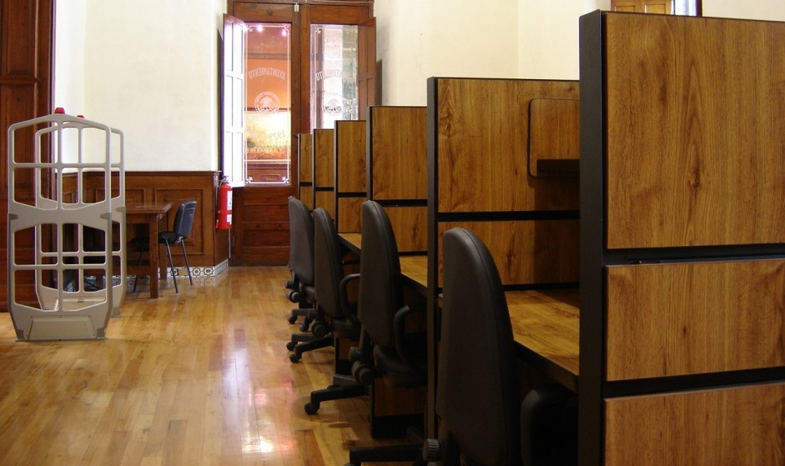
Common Findings: Metadata
Inadequately cataloged resources result in underuse
Library ownership of sources essential data element
Differences exist between the catalog data quality priorities of users & librarians
Notes:
Calhoun, Karen, et al. 2009. Online catalogs: What users and librarians want: An OCLC report. Dublin, Ohio: OCLC. DIS, p. 18.
“Important differences exist between the catalog data quality priorities of end users and those who work in libraries.” Fifty-two percent of the librarians indicated that the most desired data enhancement was to “Merge duplicate records” (Calhoun et al. 2009, p. 25). This enhancement might improve users’ searching tasks and their retrieved results. However, users necessarily would not understand the implications of duplicate records on searching and retrieval; therefore, they probably would not mention this.

Slide 15
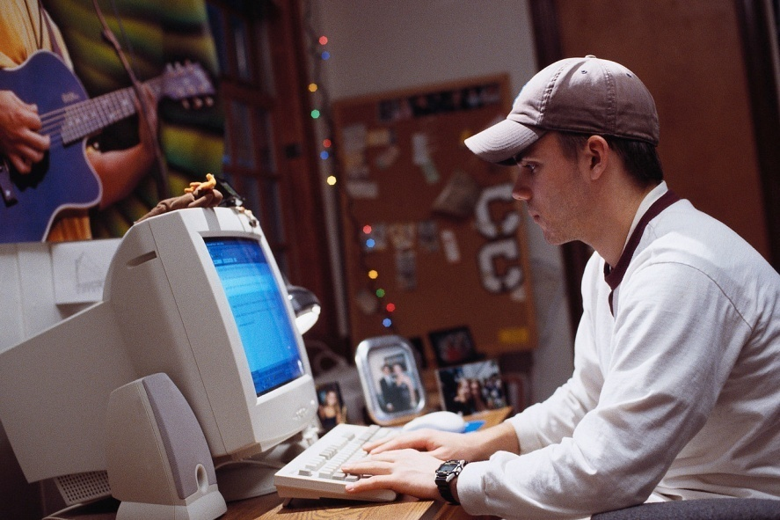
Contradictory Findings
“Google generation”
Search engine speed
Support for library OPAC advanced search options & social features
Notes:
Digital Information Seeker, pg. 4-5.
In a few cases, the above findings from the studies under review offered evidence that runs counter to popular perceptions of the current information scene.
Many popular media claims about the “Google generation” may not be supported by all the evidence.
In choosing among search engines, some evidence indicates that speed may not be the most important evaluative factor.
The studies that addressed library OPACs provide little support for the advanced search options which are still popular in these systems.

Slide 16
Conclusions
Simple searches & power browsing
“Squirreling” of downloads
Natural language
Convenience very important
Human resources valued
D2D of full-text digital content desired
Transparency of ranking results
Evaluative information included in catalog
More robust metadata

Slide 17
Conclusions
Information literacy skills lacking
Information literacy not kept pace with digital literacy
Researchers self-taught & confident
Notes:
“Digital literacies and information literacies do not go hand in hand” (ibid, p. 20).
Centre for Information Behaviour and the Evaluation of Research. 2008. Information
behaviour of the researcher of the future: A CIBER briefing paper. London: CIBER.

Slide 18
Implications
Build on & integrate search engine features
Market services
Provide search help at time of need
Chat & IM help during search
Adopt user-centered development approach
Longitudinal data
Talk to and listen to users

Slide 19
Why Visitors and Residents Project?
“If we build it, they will come.” NOT
Shifting changes in engagement with information environment
Effect of larger cultural changes influenced by Web?
New attitudes towards education?
Gap in user behaviour studies – need for longitudinal studies
Understanding of motivations for using and expectations of technologies & spaces in information environment
Inform projects & service design to improve engagement & uptake
http://www.oclc.org/research/activities/vandr/

Slide 20
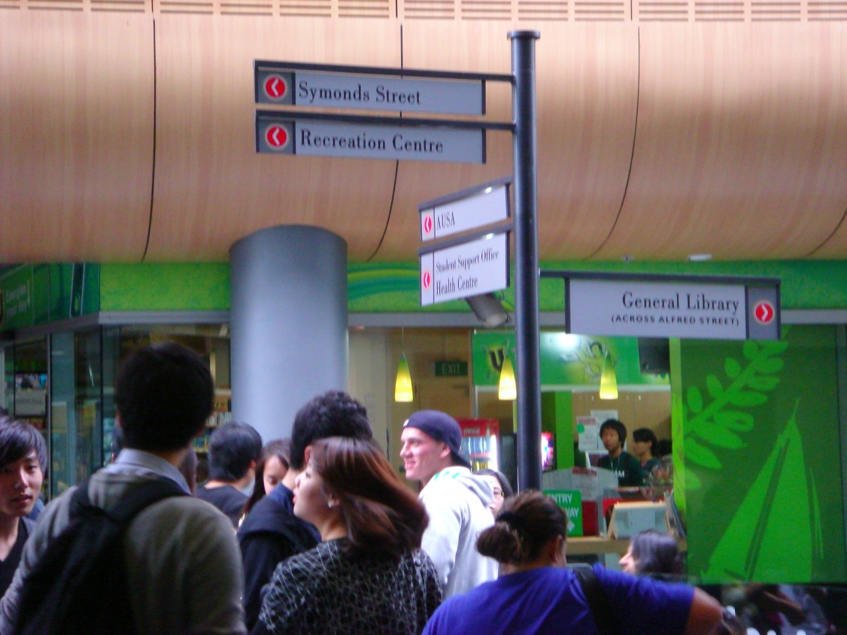
Digital Natives and Digital Immigrants

Slide 21
Old people just don’t get this stuff

Slide 22
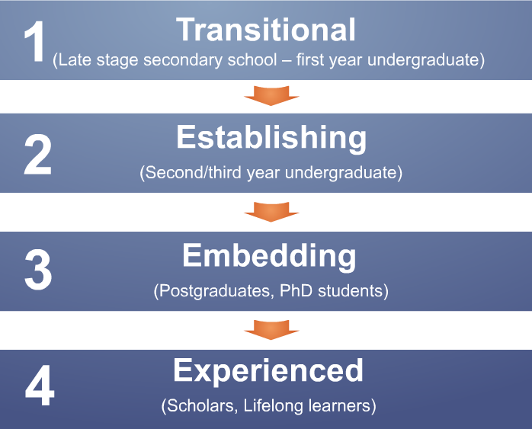
Visitors and Residents Study

Slide 23
Notes:
“I just type it into Google and see what comes-up…” (UKS2 00:16:21)
“I simply just type it into Google and just see what comes up” (UK4 00:13:36)
I always stick with the first thing that comes up on Google because I think that’s the most popular site which means that’s the most correct. (USS1 0:21:57)
“I knew that the internet wouldn’t give me a wrong answer.” (UKS4 00:24:10)
“That’s the only problem, just knowing what information to use and why.” (UKS1 00:24:05)
“Perfect thing, I think it would be that all the useful, accurate, reliable information would like glow a different colour or something so I could tell without wasting my time going through all of them.” (UKS2 00:37:09)

Slide 24
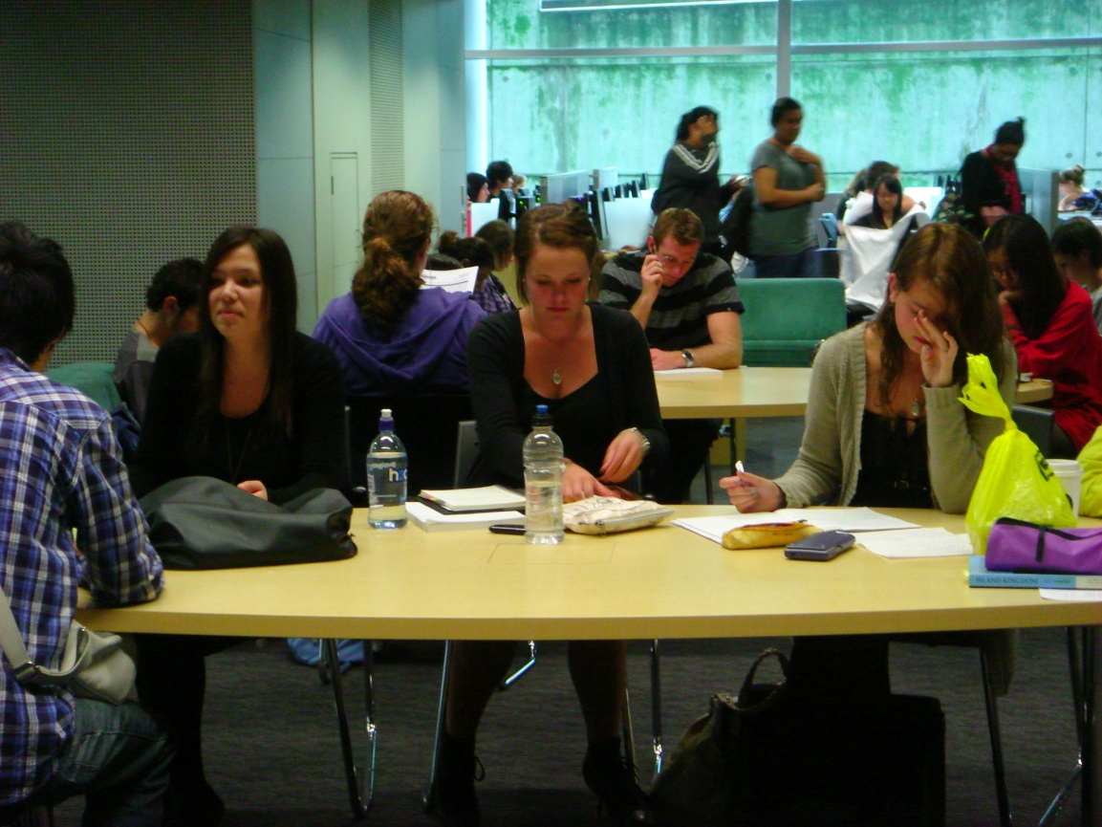
“…our generation isn’t technology orientated. I think it’s always a stereotype.”
(Participant UKS4)

Slide 25
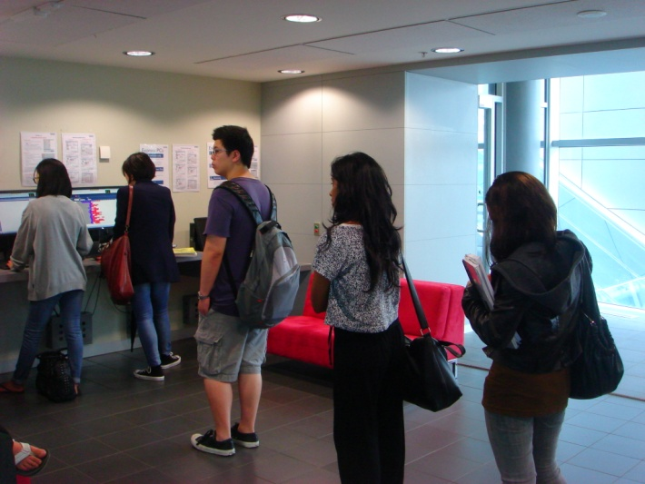
“I think that lots of like companies and people away from my generation think that we rely and we’re obsessed with gadgets and gizmos and everybody has to buy the newest iPhone and iPad and newest everything. At the end of the day, as a student, are you really know is that is what the internet is for. How you get to it – it doesn’t matter if you don’t own a computer and you have to come to the library to use it. Um…like it’s available to you and you don’t care like how you get it.”
(WorldCat.org Focus Group Interview UKU4th year Participant)

Slide 26
=
Notes:
Screenagers in focus group interviews in 2008 said that “email is for old people.”
In interviews with last year secondary school/first year university students we are told that email is for “formal communication.”

Slide 27
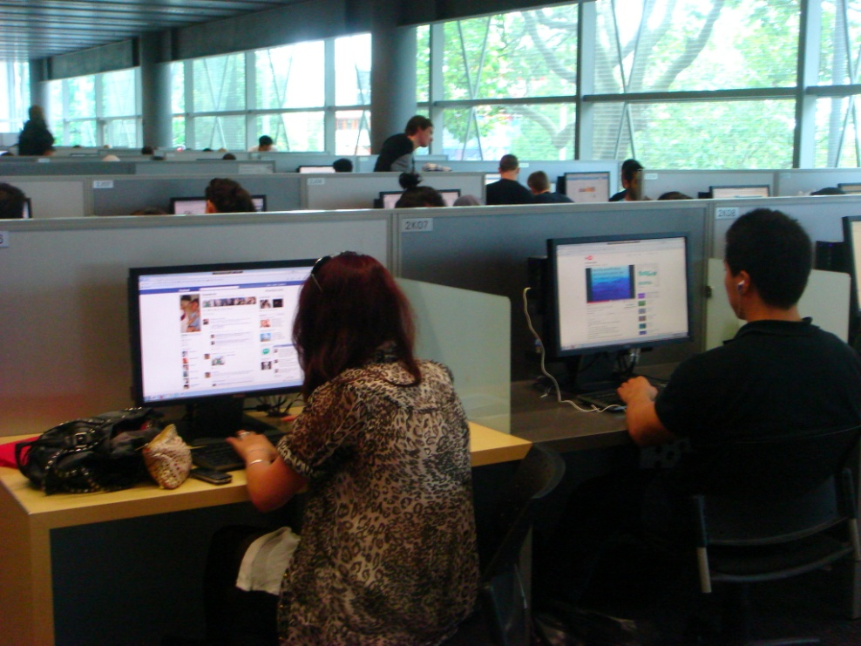
Facebook is for administration & social communication
Notes:
“…he was the only one who received it and the teacher told him to pass it on. And he sent a message to everyone in the calls on Facebook, so that helped.” (UKS1 00:12:22)

Slide 28
Don’t mention Wikipedia!
English The Free Encyclopedia 3 642 000+ articles
日本語 フリー百科事典 750 000+ 記事
Deutsch Die freie Enzyklopädie 1 233 000+ Artikel
Español La enciclopedia libre 761 000+ artículos
Français L’encyclopédie libre 1 106 000+ articles
Русский Свободная энциклопедия 714 000+ статей
Italiano L’enciclopedia libera 803 000+ voci
Português A enciclopédia livre 685 000+ artigos
Polski Wolna encyklopedia 802 000+ haseł
Nederlands De vrije encyclopedie 688 000+ artikelen
Notes:
Interviewer: ‘Do they actually fail you?’
‘They don’t fail you but you get ridiculed in front of everyone for sourcing Wikipedia.’ (USS3)

Slide 29
Notes
Connaway, Lynn Silipigni, and Timothy J. Dickey. The Digital Information Seeker: Report of the Findings from Selected OCLC, RIN, and JISC User Behaviour Projects. 2010. Funded by JISC and OCLC.
http://www.jisc.ac.uk/media/documents/publications/reports/2010/digitalinformationseekerreport.pdf.
White, David , and Lynn Silipigni Connaway. Visitors and Residents: What Motivates Engagement with the Digital Information Environment. 2011. Funded by JISC, OCLC, and Oxford University. http://www.oclc.org/research/activities/vandr/.

Slide 30
Image Credit
Slide 18: Conclusions: C Peter Nijenhuis: http://www.flickr.com/photos/peternijenhuis/199686509/

Slide 31
The researchers would like to thank Alison LeCornu for her assistance in keeping the Visitors and Residents team organized, scheduling and conducting interviews, analyzing the data, and disseminating the results.

Slide 32
Questions & Comments
Lynn Silipigni Connaway
connawal@oclc.org
Notes:
32

