Slide 1
ALA Annual 2014
Las Vegas, NV
June 30, 2014
Reordering Ranganathan:
Shifting User Behaviors, Shifting Priorities
Lynn Silipigni Connaway, Ph.D.
Ixchel M. Faniel, Ph.D.
Senior Research Scientist
OCLC Research
connawal@oclc.org
@LynnConnaway
Associate Research Scientist
OCLC Research
fanieli@oclc.org
Notes:
Connaway, Lynn Silipigni, and Ixchel M. Faniel. 2014. Reordering Ranganathan: Shifting User Behaviors, Shifting Priorities. Dublin, OH: OCLC Research. http://www.oclc.org/content/dam/research/publications/library/2014/oclcresearch-reordering-ranganathan-2014.pdf.

Slide 2

Moved from an era of content scarcity to one of incredible abundance and diversity
(Connaway and Faniel 2014, 4)
Notes:
Image from http://photos.pcpro.co.uk/images/front_picture_library_PC_Pro/dir_370/it_photo_185113_52.gif

Slide 3

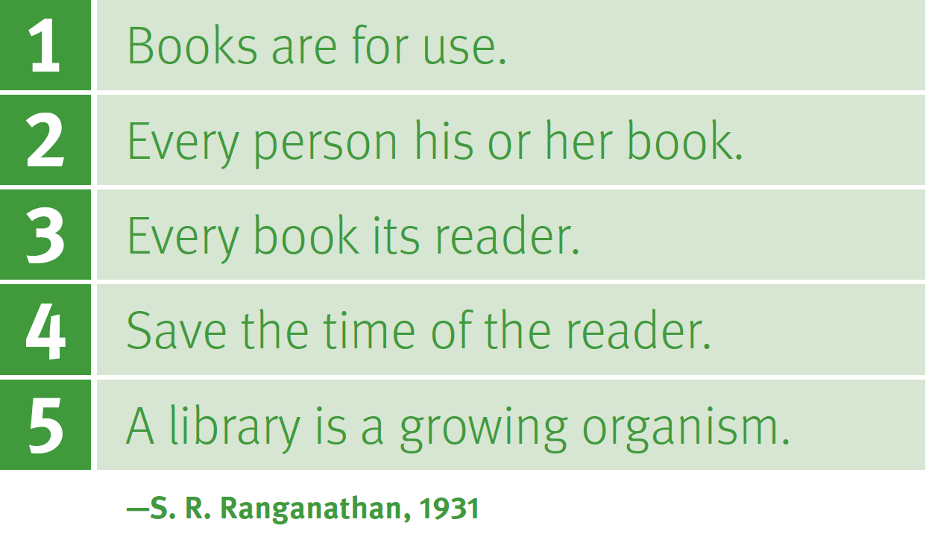
Ranganathan’s Original Laws
Notes:
Image from Connaway and Faniel 2014, 2

Slide 4
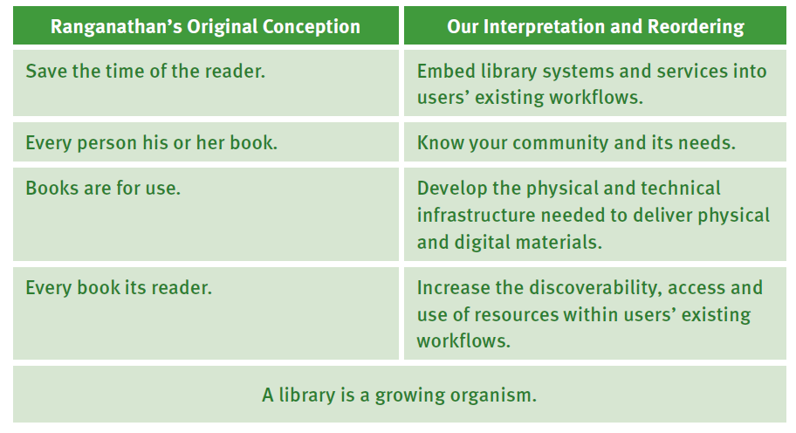
Our Interpretation and Reordering
Notes:
Image from Connaway and Faniel 2014, 105

Slide 5
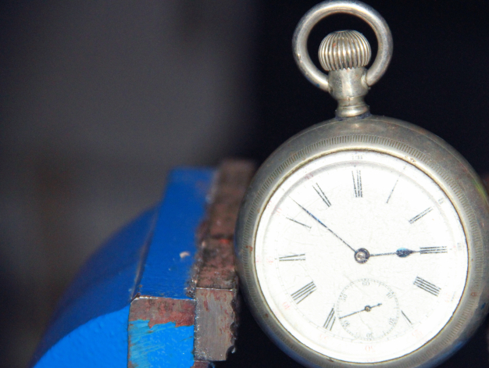
Embed library systems and services into users’ existing workflows
(Connaway and Faniel 2014, 15)
Notes:
Image from https://www.collaborativedrug.com/wp-content/uploads/2013/07/clock_in_a_vise.jpg

Slide 6
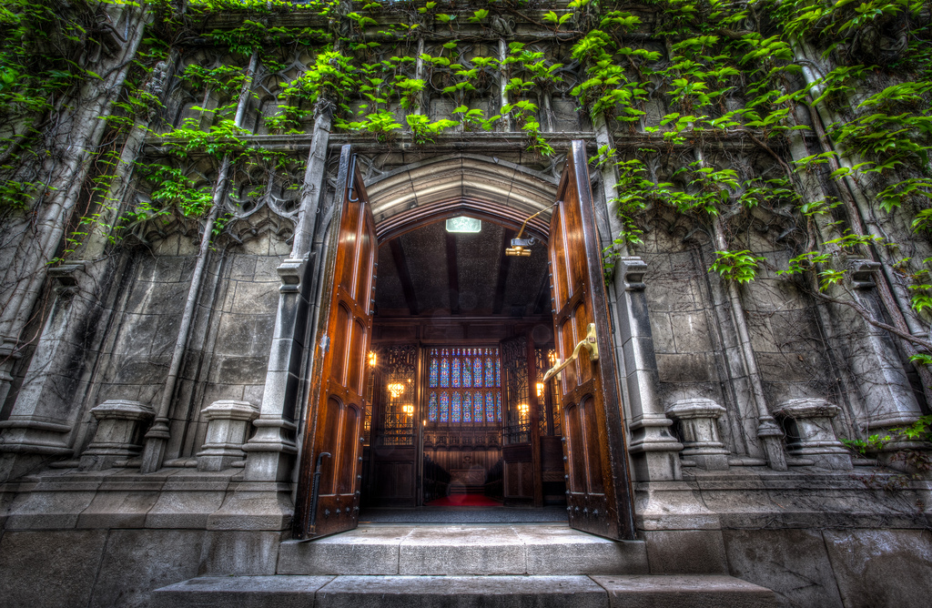
Know your community
and its needs
(Connaway and Faniel 2014, 32)
Notes:
Image from http://www.flickr.com/photos/cjsmithphotography/7081787019/

Slide 7
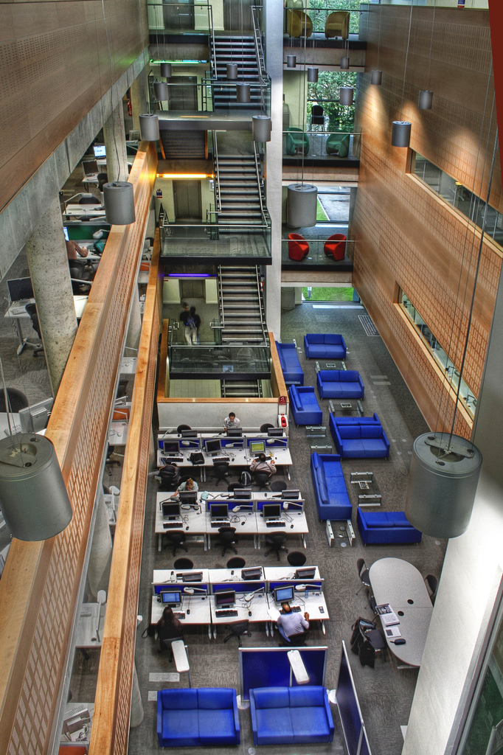
Develop the physical and technical infrastructure to deliver materials
(Connaway and Faniel 2014, 51)
Notes:
Image from http://www.flickr.com/photos/paolomargari/786017449/

Slide 8
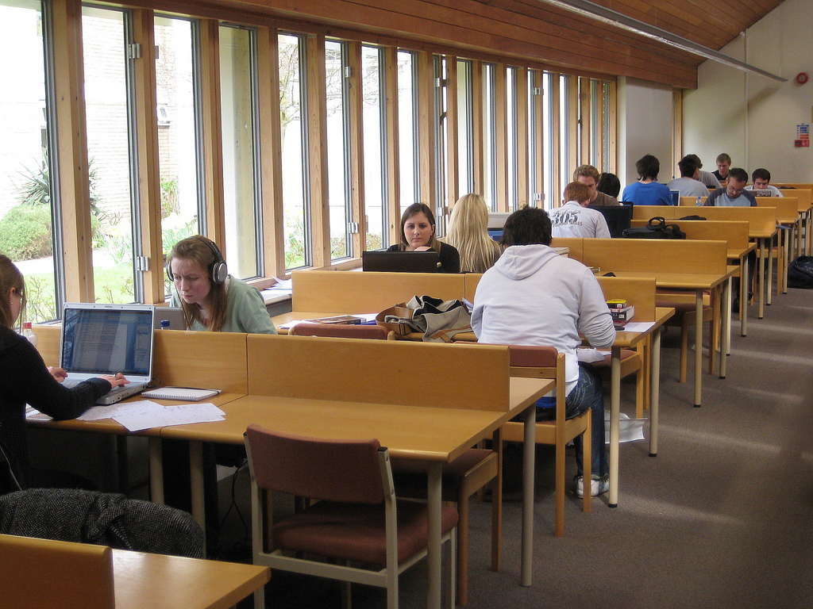
Increase the discoverability, access and use of resources within users’ existing workflows
(Connaway and Faniel 2014, 74)
Notes:
Image from http://www.flickr.com/photos/heywayne/4167403158/

Slide 9
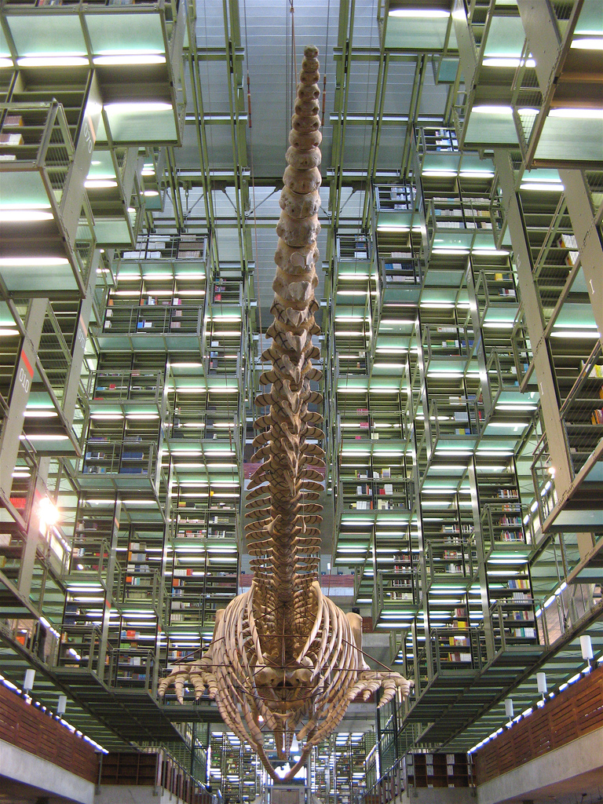
A library is a growing organism
(Connaway and Faniel 2014, 92)
Notes:
Image from http://www.flickr.com/photos/ionushi/380747945/

Slide 10
References
Connaway, Lynn Silipigni, and Ixchel M. Faniel. 2014. Reordering Ranganathan: Shifting user behaviors, shifting priorities. Dublin, OH: OCLC Research. http://www.oclc.org/content/dam/research/publications/library/2014/oclcresearch-reordering-ranganathan-2014.pdf.
Dempsey, Lorcan. 2012. Thirteen ways of looking at libraries, discovery, and the catalog: Scale, workflow, attention. EDUCAUSE Review Online (December 10, 2012), http://www.educause.edu/ero/article/thirteen-ways-looking-libraries-discovery-and-catalog-scale-workflow-attention.
Ranganathan, Shiyali Ramamrita. 1931. The five laws of library science. London: Edward Goldston, Ltd.

Slide 11
Acknowledgements
Without the help of Andy Havens, Brad Gauder and Tom Storey for their insightful contributions and valuable feedback; Julianna Barrera-Gomez, Alyssa Darden, Erin M. Hood and Carrie Vass for their dedicated research support; Tam Dalrymple, Larry Olszewski and Jennifer Smither for their thoughtful comments; and Renee Page for her talented design and layout expertise, it would have been difficult to make this report a reality.

Slide 12
Funding
A Cyberinfrastructure Evaluation of the George E. Brown, Jr. Network for Earthquake Engineering Simulation (NEES), funded by the National Science Foundation (CMMI-0714116)
The Cyber Synergy: Seeking Sustainability through Collaboration between Virtual Reference and Social Q&A Sites, funded by the Institution of Museum and Library Services (LG-06-11-0342-11) in collaboration with OCLC Research, and Rutgers, The State University of New Jersey
The Digital Information Seeker Report, jointly sponsored by Jisc and OCLC Research
The Digital Visitors and Residents: What Motivates Engagement with the Digital Information Environment? project, funded by Jisc in collaboration with the University of Oxford, OCLC Research, and the University of North Carolina
The Dissemination Information Packages for Information Reuse (DIPIR) project, funded by the Institute for Museum and Library Services (LG-06-10-0140-10) in collaboration with the University of Michigan
The Seeking Synchronicity: Evaluating Virtual Reference Services from User, Non-user and Librarian Perspectives, funded by the Institution of Museum and Library Services (LG-06-05-0109-05) in collaboration with OCLC Research, and Rutgers, The State University of New Jersey
The Virtual Research Environment (VRE) Study, which was a collaborative project between Jisc and OCLC Research

Slide 13
Lynn Silipigni Connaway, Ph.D.
Senior Research Scientist
connawal@oclc.org
@LynnConnaway
Ixchel M. Faniel, Ph.D.
Associate Research Scientist
fanieli@oclc.org
Reordering Ranganathan: Shifting User Behaviors, Shifting Priorities Webinar with Lynn Silipigni Connaway and Ixchel Faniel
Tuesday, 8 July 11am-12pm EDT

