Slide 1

Changing User Patterns for Information Discovery
Lynn Silipigni Connaway, Ph.D.
Senior Research Scientist
OCLC Research
Te Puna Libraries Forum
1 April 2011
Wellington, New Zealand

Slide 2

Libraries Today
Vying for information seekers’ attention
Must re-engineer to accommodate users’ workflows and habits
Notes:
2
Libraries vying for information seekers’ attention in today’s increasingly crowded digital environment
To remain viable, today’s librarians must re-engineer to accommodate users’ workflows and habits.

Slide 3

Why Not Libraries?
Then: The user built workflow around the library
Now: The library must build its services around user workflow
Get into the flow
Disclose into other environments

Slide 4

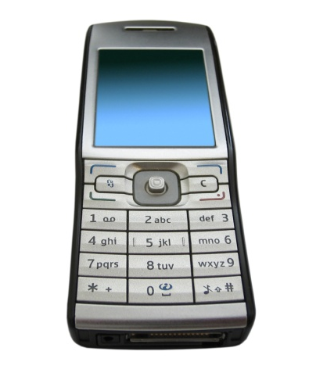
Why Not Libraries?
Then: Resources scarce, attention abundant
Now: Attention scarce, resources abundant
Competition for attention
Notes:
Smartphone usage in the US has increased 1,050% since 2005
Twitter has experienced a 1,100% increase in US visitors since 2007
Perceptions of Libraries, 2010, p.12

Slide 5

The Digital Information Seeker:
Report of findings from selected OCLC, RIN and JISC User Behaviour Projects
Funded by JISC
Analysis of 12 user behaviour studies
  Conducted in US and UK
  Published within last 5 years
  Synthesis
    Better understand user information-seeking behaviour
    Identify issues for development of user-focused services and systems

Slide 6

Common Findings:
The Catalogue
Value databases & other online sources
Do not understand what resources available in libraries
Cannot distinguish between databases held by a library & other online sources
Notes:
Sense-making the information confluences: Phases 1-4 and Final Report. DIS, p. 9.
Faculty response in a focus group interview, “I do use Google, but …[I also] use two different library homepages” (Connaway, Prabha, and Dickey 2006, p. 12).
The participants acknowledged the value of databases and other online sources to both academic and personal information needs.
Some users did not understand what resources were actually available in libraries nor could they distinguish between databases held by a library and sources merely available online (Connaway, Prabha, and Dickey 2006, p. 13-14).

Slide 7
Common Findings:
The Catalogue
Library OPACs difficult to use
“I wish the results page would list a short blurb (one line) about the book similar to the way Google shows you a tiny bit about what a site link is about.”
(Calhoun, Karen, et al. 2009. Online catalogs: What users and librarians want: An OCLC report. Dublin, Ohio: OCLC, p. 17)
  “Make the library catalog more like search engines.”
(Connaway, Lynn Silipigni, Chandra Prabha, and Timothy J. Dickey. 2006. Sense-making the information confluence: The whys and hows of college and university user satisficing of information needs. Phase III: Focus group interview study. Report on National Leadership Grant LG-02-03-0062-03, to Institute of Museum and Library Services, Washington, D.C. Columbus, Ohio: School of Communication, The Ohio State University, p. 16)
Notes:
Calhoun, Karen, et al. 2009. Online catalogs: What users and librarians want: An OCLC report. Dublin, Ohio: OCLC. DIS, p. 18.
“Make it as easy as a Google Book Search,” one survey respondent requested when discussing the catalog (Calhoun et al. 2009, p. 14).
One survey respondent suggested, “I wish the results page would list a short blurb (one line) about the book similar to the way Google shows you a tiny bit about what a site link is about” (Calhoun et al. 2009, p. 17).
Sense-making the information confluence: Phases 1-4 and Final Report. DIS, p. 9.
Participants also stated that library OPACs are difficult to use; this belief is held by all types of participants (Connaway, Prabha, and Dickey 2006, p. 11-14).
Participants also discussed enhancements and changes to the library’s electronic resources and suggestions to “make the library catalog more like search engines” (Connaway, Prabha, and Dickey 2006, p. 16). These include Selective Dissemination of Information (SDI) [although the participants did not use this term, this is the service they described], 24/7 reference, and expanded online sources, including all print and other physical materials available online (Connaway, Prabha, and Dickey 2006, p. 16-17).

Slide 8

Common Findings:
The Catalogue
“The end user’s experience of the delivery of wanted items is as important, if not more important, than his or her discovery experience.”
(Calhoun, Karen, et al. 2009. Online catalogs: What users and librarians want: An OCLC report. Dublin, Ohio: OCLC p. v)
Notes:
Calhoun, Karen, et al. 2009. Online catalogs: What users and librarians want: An OCLC report. Dublin, Ohio: OCLC. DIS, p. 18.
“The end user’s experience of the delivery of wanted items is as important, if not more important, than his or her discovery experience” (Calhoun et al. 2009, p. v).
Fifty-five percent of survey respondents stated they would immediately try to obtain a copy of the item based on information they discover, 30% would “Request the item from a library,” 21% would “Visit a library listed here,” and 4% would “Purchase the item;” (Calhoun et al. 2009, p. 20).
Twenty-four percent of the respondents indicated that a “list of libraries that own the item” is the most essential data element for them while 14% cited “the ability to see what is immediately available” as essential to them (Calhoun et al. 2009, p. 12).
Thirty-six percent of survey respondents believed that “more links to online content/full text” was the “most helpful” change to identify a needed item in the catalog (ibid, p. 13). However, this enhancement was in the bottom third of librarians’ desired changes (Calhoun et al. 2009, p. 44).

Slide 9

Common Findings:
The Catalogue
Search behaviors vary by discipline
Desire seamless process from D2D
  Sciences most satisfied
  Social Sciences & Arts & Humanities have serious gaps
    Foreign language materials
    Multi-author collections
    Journal back files
    Lack of specialist search engines
Notes:
Research Information Network. 2006. Researchers and discovery services: Behaviour, perceptions and needs. London: Research Information Network. DIS, p. 11.
“Increasingly, the boundary between resources themselves and discovery services is a permeable one” (Research Information Network 2006, p. 5). There is a need for a seamless process from discovery-to-delivery (D2D).
Some disciplinary differences exist in the researchers’ satisfaction with D2D services. Researchers in the sciences are most satisfied. Arts and Humanities researchers indicated serious problems in unavailable content, irrelevant information in result lists, and in the discovery of non-English content (Research Information Network 2006, p. 75).
Other specific gaps in D2D provision included foreign language materials (especially for social sciences and Arts and Humanities researchers; Research Information Network 2006, p. 75), chapters in multiauthor collections, short journal back files, and lack of specialist search engines (Research Information Network 2006, p. 67).

Slide 10
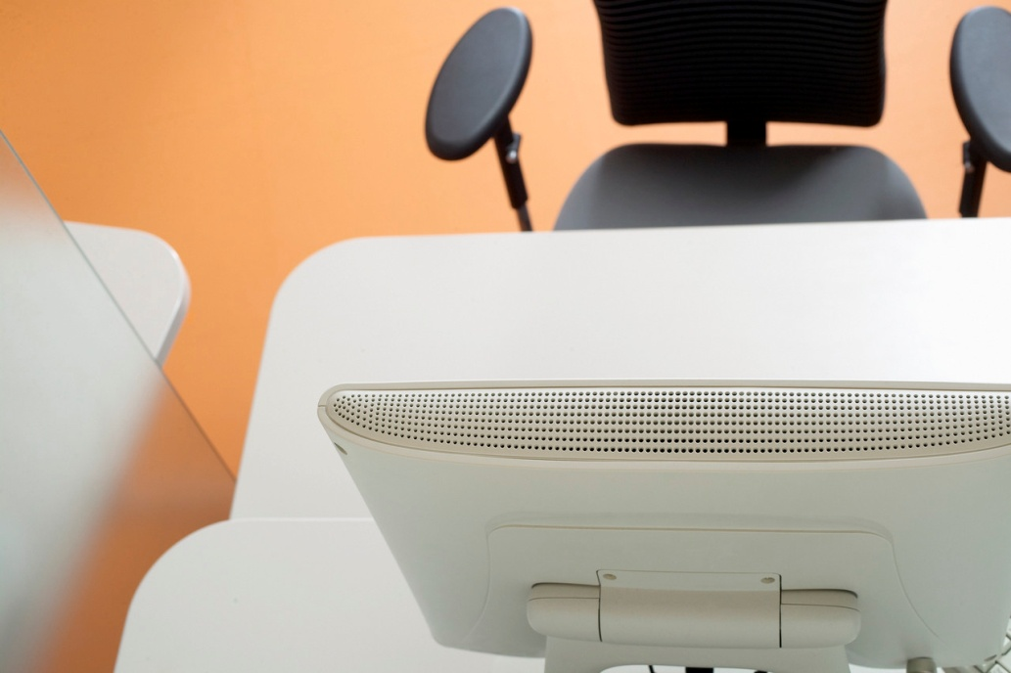
Common Findings:
The Catalogue
“Refine down” from large result lists
More full-text digital content
Notes:
Research Information Network. 2006. Researchers and discovery services: Behaviour, perceptions and needs. London: Research Information Network. DIS, p. 11.
Fifty-nine percent of the researchers identified “refining down from a large list of results” as their most common search strategy (Research Information Network 2006, p. 59). This leads to a key problem of irrelevant results and the fear of missing significant items (see quotes from survey respondents; Research Information Network 2006, p.60).
Researchers want access to more digital content. (Research Information Network 2006, p. 11).

Slide 11

Common Findings:
The Catalogue
Make results obviously relevant
Catalog should contain helps for navigation & evaluation of sources
“Use weighting in the search algorithm.”
(Calhoun, Karen, et al. 2009. Online catalogs: What users and librarians want: An OCLC report. Dublin, Ohio: OCLC, p. 14)
Expect enhanced content
Provide advanced search option & facets
Mixed reaction of social features
Notes:
De Rosa, Cathy. 2005. Perceptions of libraries and information resources: A report to the OCLC membership. Dublin, Ohio: OCLC Online Computer Library Center. DIS, p. 6.
“Make a way to search through all the databases with one search engine, instead of having to search each database individually,” stated a 21-year-old from the United States (De Rosa 2005, p. 1-19).
Calhoun, Karen, et al. 2009. Online catalogs: What users and librarians want: An OCLC report. Dublin, Ohio: OCLC. DIS, p. 18.
End users who participated in the focus group interviews indicated that they wanted the retrieved results to be obviously relevant and suggested that catalogs “use weighting in the search algorithm” (Calhoun et al. 2009, p. 14). They also suggested the catalog contain helps to the user for navigation within the catalog and evaluation of sources.
“End users rely on and expect enhanced content.” Thirty-two percent of survey respondents’ preferred more subject information and 18% indicated a preference for summaries, abstracts, and tables of content (Calhoun et al. 2009, p. 13).
“An advanced search option and facets help end users refine searches, navigate, browse and manage large result sets” (Calhoun et al. 2009, p. 15-16).
“The focus group interview participants offered a mixed reaction to social features” in the catalog (Calhoun et al. 2009, p. 18-19).

Slide 12

Common Findings:
The Catalogue
“It is very clear that Google has emerged as a real force in the accessing and discovery of research content which is rivalling university library catalogues.”
(Hampton-Reeves, Stuart, Claire Mashiter, Jonathan Westaway, Peter Lumsden, Helen Day, Helen Hewerston, and Anna Hart. 2009. Students’ use of research content in teaching and learning: A report of the Joint Information Systems Council (JISC), p. 30)
Notes:
Hampton-Reeves, Stuart, Claire Mashiter, Jonathan Westaway, Peter Lumsden, Helen Day, Helen Hewerston, and Anna Hart. 2009. Students’ use of research content in teaching and learning: A report of the Joint Information Systems Council (JISC). DIS, p. 22.
In situations of formal research for these students, this leads them to the library catalogue first and to use it more (32%, n=137, N=428; Hampton-Reeves et al. 2009, p. 24). However, the researchers stated, “it is very clear that Google has emerged as a real force in the accessing and discovery of research content which is rivalling university library catalogues” (Hampton-Reeves et al. 2009, p. 30).

Slide 13

Common Findings:
Google
Search engines
  Dominant place to begin
  Preferred over libraries
Search engines first choice
Rate search engines better lifestyle fit than libraries
Heavy reliance on Google & other web sources
Notes:
Even more evidence exists for the increasing centrality of Google and other search engines in researchers’ behaviours
Perceptions of libraries, 2005
Search engines dominant place to begin
Search engine as lifestyle fit
Search engines are preferred over libraries
College students’ perceptions, 2006
Search engines overwhelming first choice for an information search
94% lifestyle fit
Sense-making, 2006
Heavy reliance on Google and other web information sources
E-Journals, 2009
Behaviours vary by discipline
Historians more likely to use Google & publisher platform search tools than life sciences
Perceptions of libraries, 2010, p.12
Facebook surpassed Google as the most-visited site in the US in March 2010

Slide 14

Common Findings:
Google, cont.
Simple tasks with other sources
Majority British Library visits from search engines
  40% school-age visits via image search
Prefer natural-language searching
Trust Google to understand
Notes:
A 71-year old from the United States, stated, “…also, the internet as now put all the librarys of the world [at] your fingertips.” (De Rosa 2005, p. 1-13)
Researchers and discovery services, 2006
Common tools include general search engines, specialist search engines
Google is often used for relatively simple tasks in conjunction with other sources
Researcher of the future, 2008
Majority of BL visits were from search engine
Prefer natural-language searching and trust Google to understand them
40% of school-age visits to the BL visits were via an image search
Perceptions of libraries, 2010, 40
Americans consider search engines to be more convenient, faster, more reliable, and easier-to-use than libraries
Americans consider libraries to be more trustworthy and more accurate
Not so when asked about the information provided by search engines
69% believe information found using search engines is just as trustworthy as they would find from their library

Slide 15
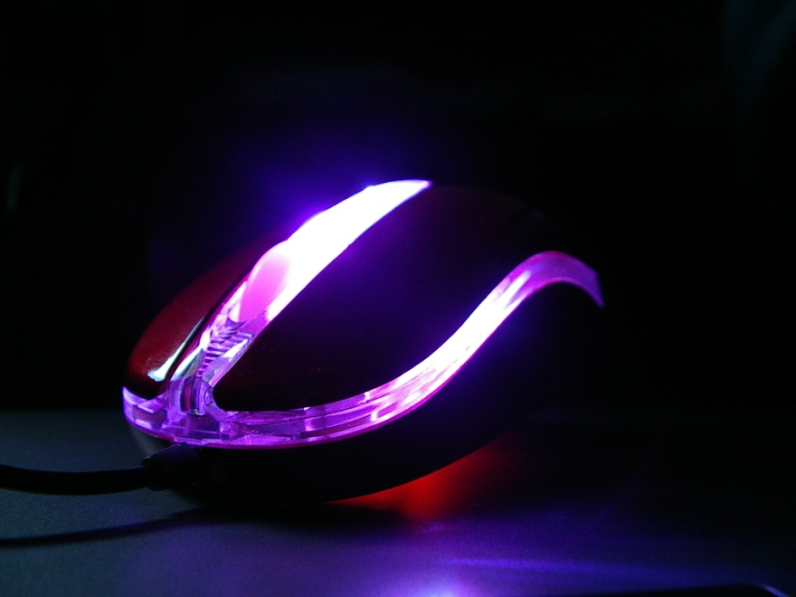
Common Findings:
Locate and Access E-Journals Via Google
Ignore publishers’ platforms
1/3 traffic via Google
Notes:
A graduate student focus group interview participant, “Google, I don’t have to know, I go to one spot.” (Connaway, Prabha, and Dickey, p. 11)
Google is often used to locate and access e-journal content, and other library resources, both by students and by professional researchers.
Sense-making, 2006
Some evidence for use of Google in this way
E-journals, 2009
Users are tending to ignore publishers’ platforms
A third of the traffic to this content now is via Google

Slide 16

Common Findings:
Discovery to Delivery
Permeable boundary between resources & discovery services
Satisfaction with availability of discovery services
Delivery as important as discovery
Notes:
A life science researcher with 5-10 years experience stated, “The most irritating thing is to eventually find the right paper and then find you need to have a subscription to read it.” (Research Information Network, p. 71)
The entire Discovery-to-Delivery process needs to be supported by information systems, including increased access to resources; a large number of studies identified particular problems with platforms, and noted that the boundary between discovery and actual access to resources is increasingly permeable.
Researchers and discovery services, 2006
Boundary between resources and discovery services is permeable
General satisfaction with the availability of discovery services
Online catalogs, 2009
User’s experience of delivery is as important, if not more important, than discovery experience

Slide 17

Common Findings:
Discovery to Delivery, cont.
Confused by variety of platforms
Student complaints about unavailable print resources decreasing
Database interfaces difficult
E-book access a problem
Notes:
“I don’t always know which is the most appropriate [database].” (Wong et al., p. 63)
JISC national e-books, 2009
Users do tend to be confused by a variety of platforms for discovery and delivery
Level of student complaints about print resources being unavailable is dropping
E-book use varies by discipline
Higher use in business than engineering
Students’ use of research content, 2009
Accessibility is seen as a secondary (but still important) criterion
User behaviour in resource discovery, 2009
Users are finding access hindered by the difficulty of using database interfaces
Access is a problem, both for e-books and for moving from e-books to locating print volumes

Slide 18

Common Findings:
E-Journals
Journal articles central type of resource
High value placed on e-journals
Powerful part of academic libraries
Article downloads have doubled
ROI considered very good for e-journals
E-journal use strongly correlated with
  Publications
  PhDs awarded
  Grants
  Contracts
Notes:
The evidence suggests the increasing importance of e-journals to researchers.
Researchers and discovery services, 2006
Journal articles central type of resources
Researchers use of academic libraries, 2007
Researchers place a very high value on electronic journals
E-journals, 2009
E-journals are a powerful part of academic libraries
Article downloads have nearly doubled
ROI considered very good for e-journals
User downloads 47 articles a year
Strongly correlated with papers published, number of PhD awards, research grants, contracts income

Slide 19

Common Findings:
Journal Access
“The main problem is access to free journal articles once I have discovered they exist. Our library does not subscribe (electronically or in print) to all the journals I consult.” (Research Information Network, p. 11)
Notes:
Life sciences researcher with 10-20 years experience stated, “The main problem is access to free journal articles once I have discovered they exist. Our library does not subscribe (electronically or in print) to all the journals I consult.” (Research Information Network, p. 11)
One area of special concern arose: journal backfiles are particularly and routinely problematic in terms of access.
Researchers and discovery services, 2006
Problems arise when it comes to accessing identified materials
Gaps in access included journal backfiles
User behaviour in resource discovery, 2009
Journal backfiles are a frustration in terms of access

Slide 20

Common Findings:
Speed and Convenience
Search engines preferred over libraries for speed, convenience
Fast is key criteria in choices
Value convenience
Once taught to use database,
always use
– Familiar & convenient
Notes:
It is clear that regardless of age or experience, academic discipline, or context of the information need, speed and convenience are important to users are factors when selecting discovery tools and resources.
Perceptions of libraries, 2005
Search engines preferred over libraries for speed, convenience
Key criteria in choices include fast
Sense-making, 2006
User value convenience

Slide 21

Common Findings:
Speed and Convenience, cont.
Convenience
Little time to locate item
Immediate answer preference not unique to their generation
Notes:
“Looking and reading an entire book takes too long when the specific information can be gained online in a matter of minutes,” stated a 38-year-old from the United States (De Rosa 2005, p. 3-14).
Researchers’ use of academic libraries, 2007
Convenience is a major factor
Users expect not to spend much time locating the actual item
Researcher of the future, 2008
Preferences for immediate answer may not be unique to their generation
Users demand 24/7 access, instant gratification, and “the answer”

Slide 22

Common Findings:
Speed and Convenience, cont.
Users demand
  24/7 access
  Instant gratification
  “The answer”
Convenience major factor for choosing VRS and e-books
Notes:
“E-books are now part of the academic mainstream.” (JISC and UCL, p. 5)
21-year old from the United States explained, “My schedule rarely fits their [libraries] schedule.” (De Rosa, p. 3-29)
Seeking synchronicity, 2008
Convenience is the most important factor for choosing virtual reference services
JISC national e-books, 2009
Convenience is a major factor in e-book usage
Researcher of the future, 2008
Preferences for immediate answer may not be unique to their generation
Users demand 24/7 access, instant gratification, and “the answer”

Slide 23
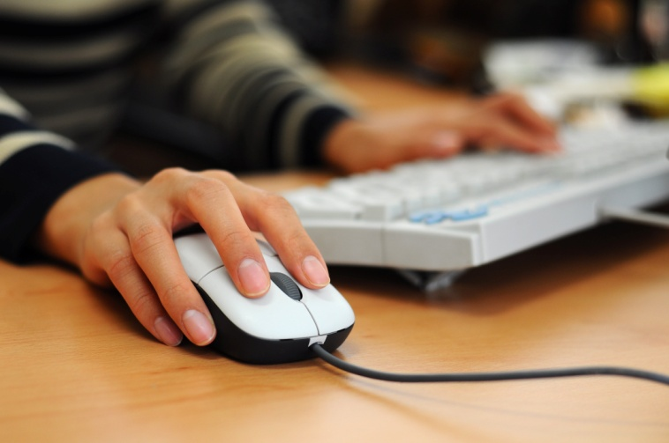
Common Findings:
Desktop Access
“The majority of researchers in all disciplines have adapted readily to the widespread availability of digital content, accessible directly from their desktops.” (CURL, p. 23)
Notes:
Researchers particularly appreciate desktop access to scholarly content, from e-journals to VRS
Researchers and discovery services, 2006
Valuation of the convenience of desktop access
Researchers' use of academic libraries, 2007
Immediate access from desktop computer is taken for granted
Seeking synchronicity, 2008
VRS' convenience is from home computer
Students' use of research content, 2009
Home computer is main way they gain access

Slide 24
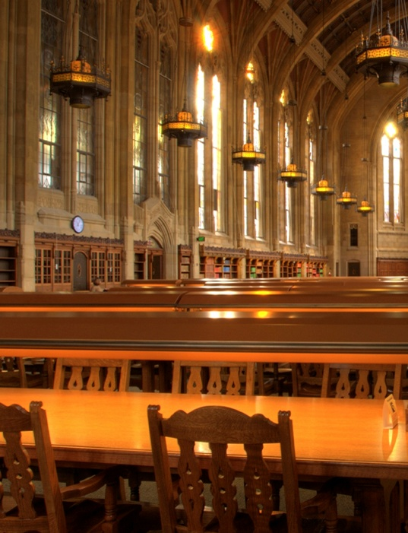
Common Findings:
Convenience
Use library less since began using Internet
Sharp fall in institution’s library visitation
Convenience dictates choice between physical and virtual library
Notes:
Users also appreciate the convenience of electronic access over the physical library, with several studies marking decreased visitation of the library.
College students' perceptions, 2006
Use the library less since they began using the Internet
Researchers' use of academic libraries, 2007
Sharp fall in the number of researchers who visit their institution’s library
Seeking synchronicity, 2008
Convenience often dictates choices between physical and virtual library

Slide 25
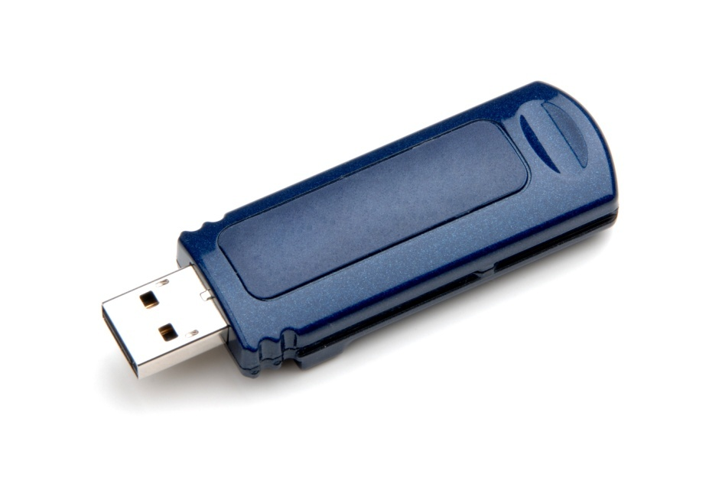
Common Findings:
User Behaviours
Begin with search engines
Very little time using content
“Squirreling” of downloads
Prefer quick chunks of information
Visit only a few minutes
Use basic search
Notes:
User behaviours in this electronic environment tend toward quick views of a few pages, and “bouncing” between resources. This seems to contradict the notion of the hard-core researcher but supports the need for more user behaviour research addressing situation and context.
Researcher of the future, 2008
Very little time using content, “squirreling” of downloads by academic users
All users preferring quick chunks of information
E-journals, 2009
Users are visiting only a few minutes
User behaviours vary but demonstrate shorter sessions, using basic search, and viewing fewer pages
Perceptions of libraries, 2010, p.54
College students search for information
Search engines, 83%
Wikipedia, 7%
Social networking site, 2%
Email, 1%
Online database, 1%
Ask-an-expert site, 0%
Library web site, 0% - libraries add value to the search process – 78%, 2010; 74%, 2005

Slide 26
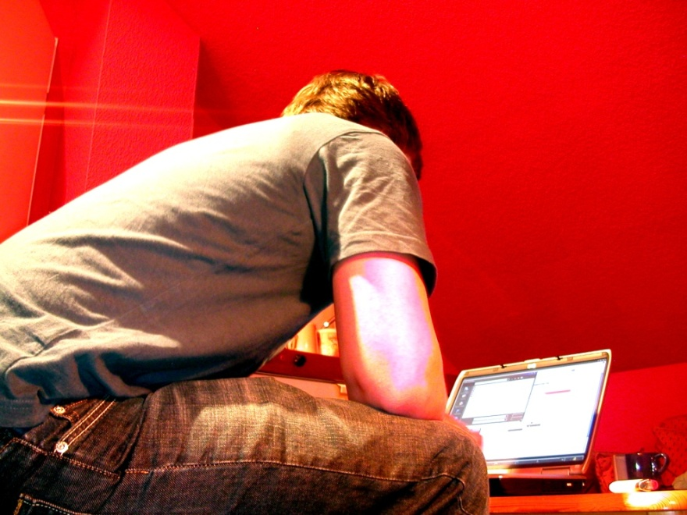
Common Findings:
User Behaviours, cont.
Use snippets from e-books
View only a few pages
Short visits
Simple searching of Google-like interfaces
Power browsing
Notes:
“Make it as easy as a Google Book Search,” one survey respondent requested when discussing the catalogue. (Calhoun et al., p. 14)
JISC national e-books, 2009
Users tend to use e-books quickly, viewing only a few pages
User behaviour in resource discovery, 2009
Users make short visits, with simple searching of Google-like interfaces; power browsing for snippets of information

Slide 27
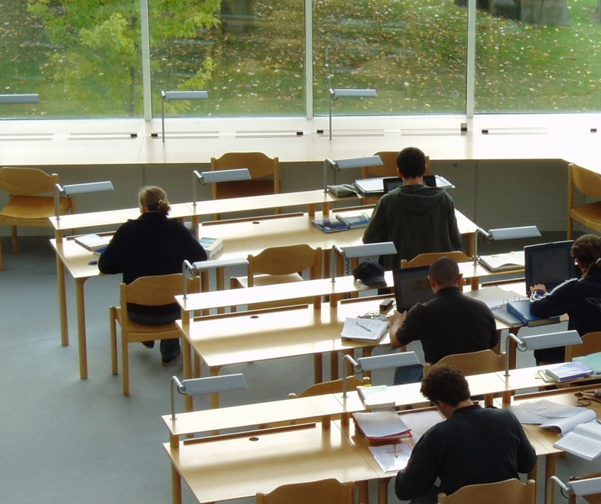
Common Findings:
Enhanced Functionality
Re-envisioning library services and spaces
Irrelevant results
Fear of missing items
Improve usability
Notes:
“Have to actually go to the library Takes a lot of time to search through all the books,” stated an 18-year-old undergraduate from the UK (De Rosa 2006, p. 2-9).
One survey respondent suggested, “I wish the results page would list a short blurb (one line) about the book similar to the way Google shows you a tiny bit about what a site link is about.” (Calhoun et al., p. 17)
Users are beginning to desire enhanced functionality in library systems, to assist in managing large result sets.
Sense-making, 2006
Users re-envision library services and spaces
Researchers and discovery services, 2006
Key problem of irrelevant results and the fear of missing items
User behaviour in resource discovery, 2009
Improve usability of library and publisher systems

Slide 28
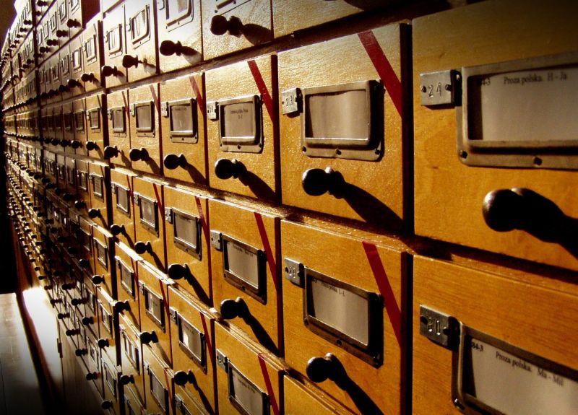
Common Findings:
Enhanced Functionality, cont.
Search results
  Must be obviously relevant
  Must contain helps
Advanced search options help refine searches and manage large results
Mixed reaction to social features
Notes:
Online catalogs, 2009
List of libraries that own the item is essential
Search results must be obviously relevant and contain helps to the user for navigation/evaluation
Advanced search option and facets help end users refine searches and manage large results
Participants offered mixed reaction to social features

Slide 29

Common Findings:
Enhanced Content
Links to online content/full text helpful
Rely on and expect enhanced content
Notes:
Users also desire enhanced content to assist them in evaluating resources.
Online catalogs, 2009
Links to online content/full text was helpful change
End users rely on and expect enhanced content

Slide 30
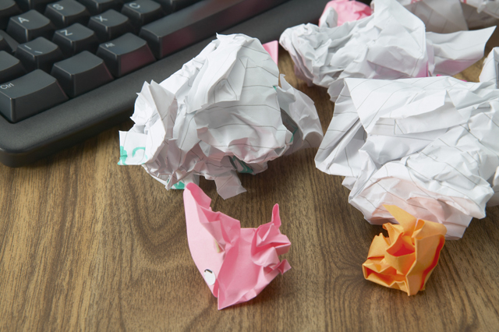
Common Findings:
User Confidence
Satisfied with their search
Trust results the same as results from libraries
Adept at doing searches for personal needs
Self-taught but confident
Notes:
Both professional researchers and younger people do seem generally confident in their own ability to use information discovery tools.
Perceptions of libraries, 2005
Respondents are satisfied with their search; tend to trust results the same as results from libraries
College students’ perceptions, 2006
Students are satisfied with their search
In determining quality, users judge based upon their own knowledge or common sense
Sense-making, 2006
Users are adept at doing searches for personal needs
Researchers and discovery services, 2006
Researchers are self-taught but remain confident in their own skills

Slide 31

Common Findings:
User Confidence, cont.
Big gap between performance and self-estimates
Virtual Reference Services
  Getting answer was cited most often for success
  Relational and content facilitators contributing to perceptions of success
Notes:
Researcher of the future, 2008
Big gap between performance and self-estimates
Seeking synchronicity, 2008
Getting an answer was cited most often for success
A mixture of relational and content facilitators contributing to perceptions of success

Slide 32

Common Findings:
Information Literacy
Estimate quality based on
  Own knowledge
  Common sense
  Institutional reputation
  Cross-checking with other websites
Acknowledge value of databases and other online sources
Notes:
A Social Sciences student, “Some of it [internet information] is interesting but some is waffle.” (Hampton-Reeves et al., p. 39)
Information literacy has not necessarily improved with users’ digital literacy.
Perceptions of libraries, 2005
College students' perceptions, 2006
In determining quality, users judge based upon their own knowledge or common sense, institutional reputation, cross-checking, and recommendations
Cross-checking most often involves other websites
Sense-making, 2006
Participants acknowledge the value of databases and other online sources

Slide 33
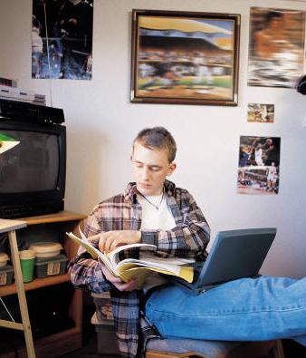
Common Findings:
Information Literacy, cont.
Refine large result list
Low awareness of OA issues
Not expert searchers
Spend little time evaluating search results
Do not find library resources intuitive
Teachers not passing literacy skills to pupils
Notes:
“Digital literacies and information literacies do not go hand in hand.” (CIBER, p. 20)
Researchers and discovery services, 2006
Most common search strategy is refining down from a large list of results
Researchers' use of academic libraries, 2007
Researchers’ awareness of OA issues is low
Researcher of the future, 2008
They are not expert searchers
Tend to spend little time, little effectiveness in evaluating search results; prefer natural-language searching and trust Google; do not find library resources intuitive
Teachers not passing literacy on to the pupils

Slide 34

Common Findings:
Information Literacy, cont.
Assess content based on relevance to assignment
Aware of difference between formal research & basic internet content
Lack information literacy skills
  Not kept pace with digital literacy
Increased use of quality resources with higher level information literacy & domain knowledge
Notes:
Student said, “You can’t trust everything on the internet, anyone can publish something.” (Hampton-Reeves et al., p. 39)
Students’ use of research content, 2009
Users assess content based on its relevance to their assignment
Students are aware of difference between formal research and basic internet content
User behaviour in resource discovery, 2009
Information literacy skills are lacking; they have not kept pace with digital literacy
When level of information literacy and domain knowledge increases, increased use of quality resources

Slide 35
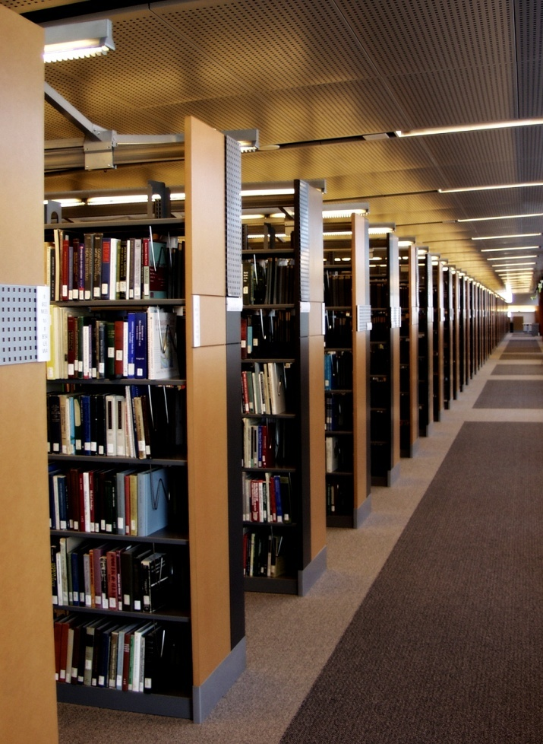
Common Findings:
Metadata
Satisfactory information search
  Quality of information
  “Worthwhile” information
Quality metadata essential for discovery
Inadequately catalogued resources result in underuse
Notes:
One important finding related to this is that high-quality metadata is becoming even more important for discovery of appropriate resources.
Perceptions of libraries, 2005
Quality of information a determinant of satisfactory information search
Other key criteria determining satisfaction include “worthwhile” information
Researchers' use of academic libraries, 2007
Need to provide good metadata
Many resources under-used because inadequately catalogued

Slide 36
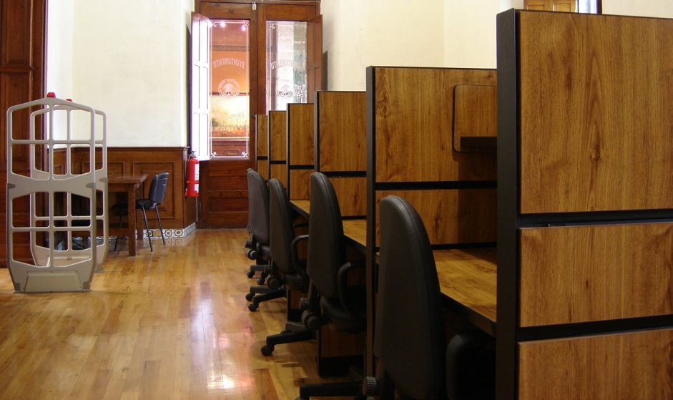
Common Findings:
Metadata, cont.
Library ownership of sources essential data element
Differences exist between the catalogue data quality priorities of users and librarians
Notes:
Online catalogs, 2009
List of libraries that own the item is essential data element
Differences exist between the catalogue data quality priorities of users and librarians

Slide 37
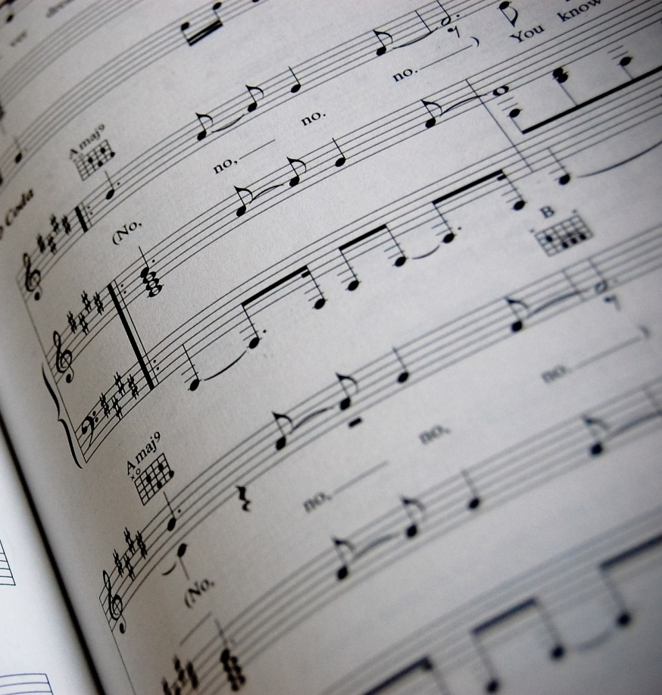
Common Finding:
Digital Content
Desire more digitized sources, including older literature, sheet music, art images
Prefer to have everything available in digital form
Libraries key player in e-book market
Notes:
In several studies, more digital content of all kinds and formats is almost uniformly seen as better.
Sense-making, 2006
Desire more digitized sources, including digitization of older literature, sheet music, art images
Researchers' use of academic libraries, 2007
Respondents would prefer to have everything available in digital form
JISC national e-books, 2009
Libraries are a key player in the market for e-books

Slide 38

Common Finding:
Library as Place
Libraries = Books
Value library as space
  Browsing
  Physical space
Homework/study most common library activity
  Group interaction
  Quiet space
Notes:
A 41-year-old Canadian respondent said, “Books, books, books, rows and rows of books, stacks of books, tables filled with books, people holding books, people checking out books. Libraries are all about books.” (De Rosa 2005, p. 3-31)
People still tend to think of libraries as collections of books; this is evident in several OCLC-sponsored studies of larger populations. They do not think of libraries as providing electronic resources.
Perceptions of libraries, 2005
Libraries viewed as being about books
College students' perceptions, 2006
Most common activity in the physical library is do homework/study
Sense-making, 2006
Users value traditional browsing, praise library as space for information
Perceptions of libraries, 2010
Even stronger than in 2005 69% said books in 2005 compared to 75% in 2010

Slide 39

Common Findings:
Library as Place, cont.
Researchers stress importance of library
Satisfied when visit library
Notes:
Researchers' use of academic libraries, 2007
Researchers retain a sense of the importance of the library
Seeking synchronicity, 2008
Those who visit the library continue to experience satisfaction
Perceptions of libraries, 2010, p.54
College students
32% believe library’s value has increased for them personally during the recession, p 58
31% believe library’s value has increased for their community during the recession, p.58

Slide 40

Common Findings:
Human Resources
Human resources important
  Family
  Friends
  Colleagues
  Teachers/Professors
Notes:
In addition, several studies indicated that despite the increasing prominence of digital research and electronic resources, researchers also value human resources such as colleagues, peers, family, friends, and teachers, in their information-seeking.
Researchers and discovery services, 2006
Colleagues and peers are an important resource
Sense-making, 2006
Human resources (family, friends, colleagues, teachers) very common

Slide 41

Common Preconceptions Exposed
Media claims about “Google generation” may not be supported
Speed may not be the most important factor
Little support for advanced search options in OPACs
Notes:
In a few cases, the above findings from the studies under review offered evidence that runs counter to popular perceptions of the current information scene.
Many popular media claims about the “Google generation” may not be supported by all the evidence.
In choosing among search engines, some evidence indicates that speed may not be the most important evaluative factor.
The studies that addressed library OPACs provide little support for the advanced search options which are still popular in these systems.

Slide 42

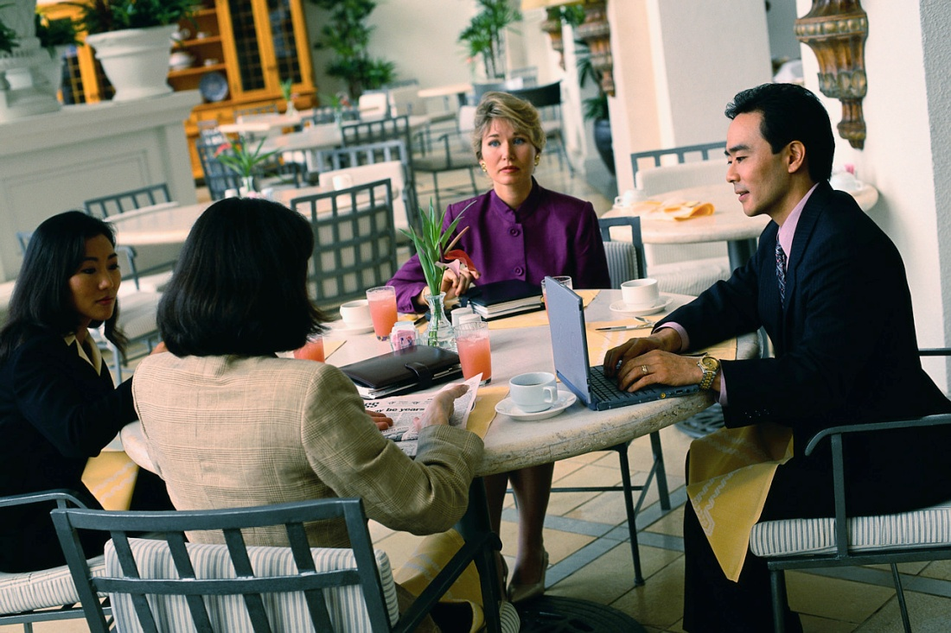
Implications for Librarians
Different constituencies =
  Different needs and behaviors
Notes:
Implication: Different Constituencies
The library serves many constituencies, with different needs and behaviours.
Researchers and discovery services, 2006
Some disciplinary differences exist
E-journals, 2009
Behaviours vary by discipline
JISC national e-books, 2009
Students’ use varied by discipline
Students’ use of research content, 2009
Students need “more guidance and clarity on how to find research content and on how to assess its worth as well as its relevance.”
User behaviour in resource discovery, 2009
Increase information literacy instruction for users

Slide 43

Implications for Library Systems
Build on & integrate search engine features
Provide search help at time of need
  Chat & IM help during search
Adopt user-centered development approach
  Smartphones
Notes:
Library systems need to look and function more like search engines, e.g., Google and Yahoo, and services, e.g., Amazon.com since these are familiar to users who are comfortable and confident in using them.

Slide 44
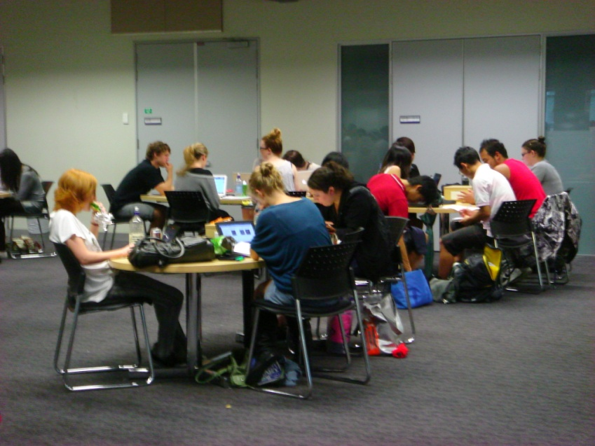
How Can Librarians Meet User Needs?
Offer different formats and content
Increase digital collections
  Build e-journal collections - good investment
  Provide more e-book content
Enhance electronic resources
Build virtual research and learning environments
Notes:
“Get more copies of current and classic bestsellers, then sell off the books to reduce inventory when they are no longer in as high demand.” (De Rosa 2005, p. 4-7)
Implication: Variety of Resources
Librarians must increasingly consider a greater variety of digital formats and content.
Perceptions of libraries, 2005
Libraries can offer different formats and content
Libraries advised to increase their collections
Sense-making, 2006
Users speak of enhancements and changes to electronic resources
Users blamed the lack of sources
Researchers' use of academic libraries, 2007
Growth in VREs and digital research must be met by librarians

Slide 45
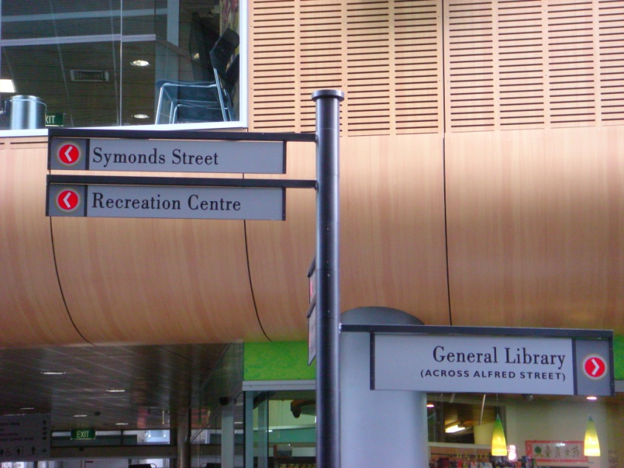
How Can Librarians Meet User Needs?
Improve access to
  Open source materials
  Journal backfiles
  Repositories
Provide seamless access to resources
More direct links
Look/function like search engines/popular web services
  One stop searching – mash up
Notes:
Digital Information Seekers Briefing Paper
Library systems must do better at providing seamless access to resources such as pull text e-journals, online foreign-language materials, e-books, a variety of electronic publishers’ platforms, and virtual reference desk services.
Library catalogues need to include more direct links to resources and more online content.
Libraries should provide more digital resources of all kinds, from e-journals to curated data sets, as well as emerging services such as virtual research environments (VREs), open source materials, non-text-based and multimedia object, and blogs.
Library systems need to look and function more like search engines (eg., Google) and popular web services (eg. Amazon.com) as these familiar to users who are comfortable and confident in using them.

Slide 46
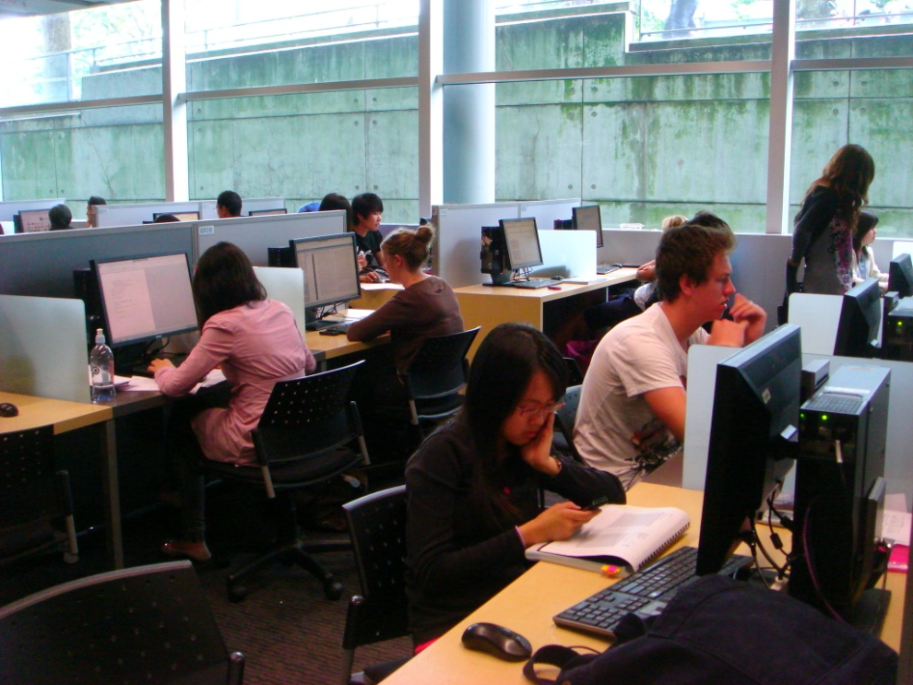
How Can Librarians Meet User Needs?
Adapt to changing user behaviours
  Allow users to contribute to catalog
Provide high-quality metadata
  Accurate data
Enable power browsing
Offer guidance & clarity for researchers
Advertise library brand
Notes:
Digital Information Seekers Briefing Paper
Library systems must be prepared for changing user behaviours, which include advanced search options, demands for immediate access, and quick perusal of resources.
High-quality metadata is becoming more important for discovery of appropriate resources.
TOCs
Authoritative reviews
Book Summaries
Author videos
Librarians must now consider the implications of power browsing behaviours.
Students need more guidance and clarity on how to find content and how to assess its worth as well as its relevance.
The library must advertise its brand and its resources better to academics, researchers and students, demonstrating its value clearly and unambiguously.

Slide 47

What Can Librarians Do to
Encourage Use of Library Services?
Emphasize personal service
  Build positive relationships FtF, phone, or online
  Become more e-consumer-friendly
Notes:
Vital if we are going to remain relevant in their universe.
Need to ensure that we have a wide range of options – email, chat, IM, text, ftf, phone, etc.
Dwell on positive – what we CAN do rather than what we CAN’T do

Slide 48
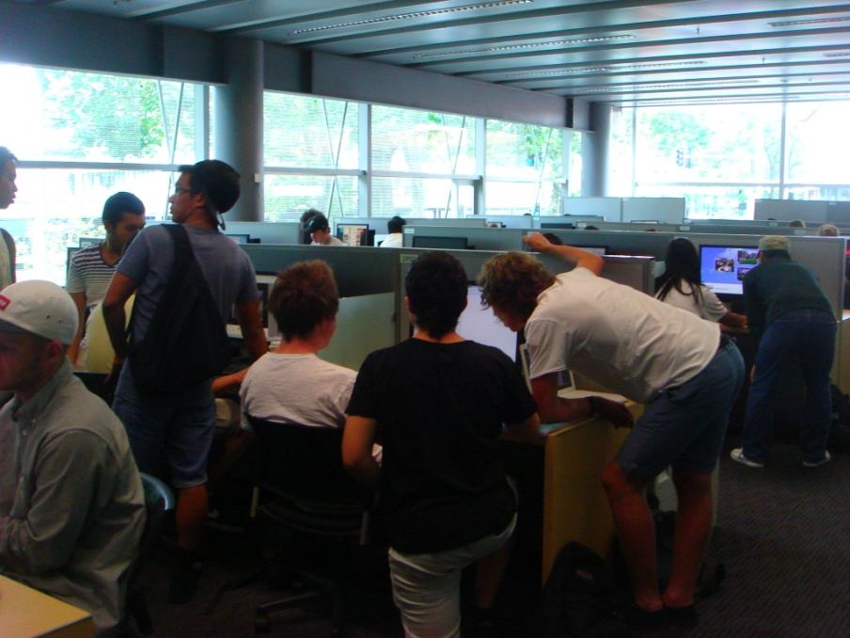
Future Research
Development of a physical/virtual resource allocation model
  Roles of social networking, mobile technology, & texting
Longitudinal user behavior study
  How individuals
    engage in both virtual and physical worlds
    navigate in multiple information environments
    adopt and use information technology
  Why people make their information choices
Notes:
Digital Information Seeker, pg. 52.
Many of the findings presented in this meta-analysis could be used as hypotheses for subsequent testing and generalization; therefore, the next logical step is to further explore and quantify these findings by conducting large, random-sample online and interview surveys.
A large, random sample of specific demographic groups of information seekers should be identified in order to conduct a wide-ranging user behaviour study to address how people find information in different contexts and situations. It would be optimal to conduct a longitudinal study. However, the cost of such an intensive study involving a large, random sample could be prohibitive. Regardless, a study that includes a large, random sample to identify how individuals engage in both the virtual and physical worlds to get information for different situations could be conducted. Such an investigation would contribute to a better understanding of how individuals navigate in multiple information environments and could influence the design and integration of systems and services for devices and applications, as well as cloud computing. Such a study, undertaken at this pivotal moment in both library funding and explosion of information resources, could provide invaluable guidance for both libraries and the field of information science by possibly contributing to the development of a physical/virtual resource allocation model for libraries.

Slide 49

“Who has the most scientific knowledge of large-scale organization, collection, and access to information? Librarians! A librarian can take a book, put it somewhere, and then guarantee to find it again.”
Peter Bol, Carswell Professor of East Asian Languages & Civilization
(Shaw, Jonathan. 2010. Gutenberg: Harvard’s libraries deal with disruptive change. Harvard Magazine, May-June, p. 36.)

Slide 50
End Notes
Connaway, L.S., & Dickey, T.J. (2010). Towards a profile of the researcher of today: The digital information seeker: Report of findings from selected OCLC, RIN, and JISC user behavior projects. [Available: http://www.jisc.ac.uk/media/documents/publications/reports/2010/digitalinformationseekerreport.pdf]
Funded by JISC and OCLC
Project Web Site URL:
  http://www.jisc.ac.uk/publications/reports/2010/digitalinformationseekers.aspx

Slide 51
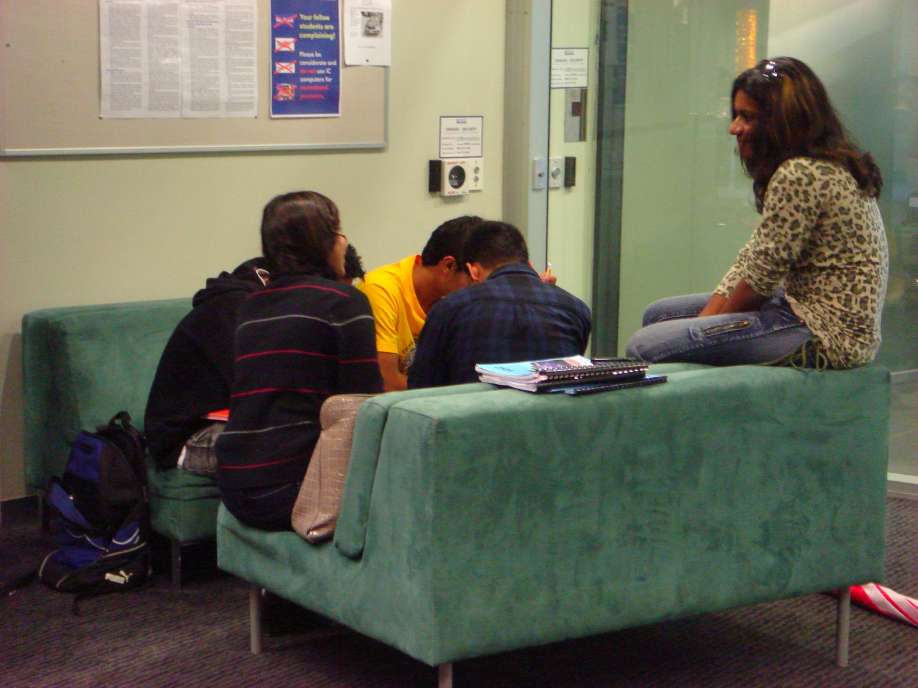
Questions & Discussion
Dr.Lynn Silipigni Connaway
connawal@oclc.org

