Slide 1
Bibliostar Conference Milan, Italy March 15, 2018
Online Engagement and Information Literacy:
The Many Faces of Digital Visitors & Residents
Lynn Silipigni Connaway, PhD
Senior Research Scientist & Director of User Research, OCLC
connawal@oclc.org
@LynnConnaway

Slide 2
Global internet usage
Region | Number of internet users (in millions)
Middle East | 146.97
North America | 320.06
Europe | 659.63
Asia | 1,938.08
Statista 2018
Notes:
Statista. (2018). Number of internet users worldwide from 2009 to 2017, by region (in millions). https://www.statista.com/statistics/265147/number-of-worldwide-internet-users-by-region/.
“Social networking is one of the most popular online activities and Facebook is the most popular online network based on active usage. As of the fourth quarter of 2016, there were a total of roughly 1.86 billion monthly active Facebook users, accounting for almost half of internet users worldwide. Connecting with family and friends, expressing opinions, entertainment and online shopping are amongst the most popular reasons for internet usage.”
Statista. (2018). Number of internet users worldwide from 2005 to 2017 (in millions). https://www.statista.com/statistics/273018/number-of-internet-users-worldwide/.

Slide 3
Connaway, Lynn Silipigni, Vanessa Kitzie, Erin M. Hood and William Harvey. 2017. The Many Faces of Digital Visitors & Residents: Facets of Online Engagement. With contributions from Allison Benedetti, Agustí Canals, Liliana Gregori, Eva Ortoll Espinet, Daniel Lozano, Melissa Man, Josep Cobarsí Morales, Sara Giuliana Ricetto, Riccardo Melgrati, Eva M. Méndez Rodríguez, Andrea Sada, Peter Sidorko, Paolo Sirito, Virginia Steel, Titia van der Werf, and Esther Woo. Dublin, OH: OCLC Research. doi:10.25333/C3V63F
https://www.oclc.org/content/dam/research/publications/2017/oclcresearch-many-faces-digital-vandr-a4.pdf.
Notes:
Connaway, Lynn Silipigni, Vanessa Kitzie, Erin M. Hood and William Harvey. 2017. The Many Faces of Digital Visitors & Residents: Facets of Online Engagement. With contributions from Allison Benedetti, Agustí Canals, Liliana Gregori, Eva Ortoll Espinet, Daniel Lozano, Melissa Man, Josep Cobarsí Morales, Sara Giuliana Ricetto, Riccardo Melgrati, Eva M. Méndez Rodríguez, Andrea Sada, Peter Sidorko, Paolo Sirito, Virginia Steel, Titia van der Werf, and Esther Woo. Dublin, OH: OCLC Research. doi:10.25333/C3V63F.

Slide 4
Digital visitors & residents

Slide 5

About Digital Visitors and Residents
Identify how individuals engage with technology
How they acquire their information
Why they make their choices
(White, Connaway, Lanclos, Hood, and Vass 2014)
Notes:
Image: https://www.flickr.com/photos/ameteorshower/7003279005/ by A METEOR SHOWER / CC BY-NC-ND 2.0 https://creativecommons.org/licenses/by-nc-nd/2.0/
V&R project
identify how individuals engage with technology and sources
how they acquire their information
why they make the choices that they do.
Understand the contexts that surround engagement with digital resources, spaces, and tools
(InfoKit Intro)
White, David, Lynn Silipigni Connaway, Donna Lanclos, Erin M. Hood, and Carrie Vass. 2014. Evaluating Digital Services: A Visitors and Residents Approach. http://www.jiscinfonet.ac.uk/infokits/evaluating-services/.

Slide 6
V&R Framework
#vandr
Visitors and Residents resources http://goo.gl/vxUMRD
(White and Le Cornu 2011)
Notes:
This is a continuum and individuals may be display visitor or resident characteristics in different contexts and situations.
Visitors
functional use of technology
often linked to formal need
less visible/more passive online presence
more likely to favor face- to- face interactions
Residents
significant online presence and usage
high level of collaborative activity online
contributions to the online environment in the form of uploading materials, photos, videos.
White, David S., and Lynn Silipigni Connaway. 2011-2014. Visitors & Residents: What Motivates Engagement with the Digital Information Environment. Funded by JISC, OCLC, and Oxford University. http://www.oclc.org/research/activities/vandr/.

Slide 7

Visitor Mode
Functional use of technology
Formal need
Invisible online presence
Internet is a toolbox
(White and Connaway 2011-2014)
Notes:
Image: https://www.flickr.com/photos/29233640@N07/9363159824/ by Robert Couse-Baker / CC BY 2.0 https://creativecommons.org/licenses/by/2.0/
Visitors: functional use of technology, often linked to formal need (such as use of software for specific coursework, or organizing meetings through email contact); less visible/more passive online presence, more likely to favor face-to-face interactions (even as they use the internet to organize/schedule those interactions)
White, David S., and Lynn Silipigni Connaway. 2011-2014. Visitors & Residents: What Motivates Engagement with the Digital Information Environment. Funded by JISC, OCLC, and Oxford University. http://www.oclc.org/research/activities/vandr/.

Slide 8
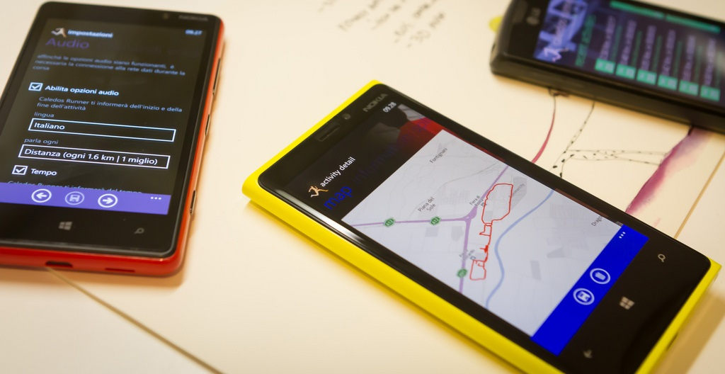
Resident Mode
Visible and persistent online presence
Collaborative activity online
Contribute online
Internet is a place
(White and Connaway 2011-2014)
Notes:
Image: https://www.flickr.com/photos/15216811@N06/8521338394 by N i c o l a / CC BY 2.0 https://creativecommons.org/licenses/by/2.0/
Residents: significant online presence and usage; high level of collaborative activity online; contributions to the online environment in the form of uploading materials, photos, videos.
White, David S., and Lynn Silipigni Connaway. 2011-2014. Visitors & Residents: What Motivates Engagement with the Digital Information Environment. Funded by JISC, OCLC, and Oxford University. http://www.oclc.org/research/activities/vandr/.

Slide 9
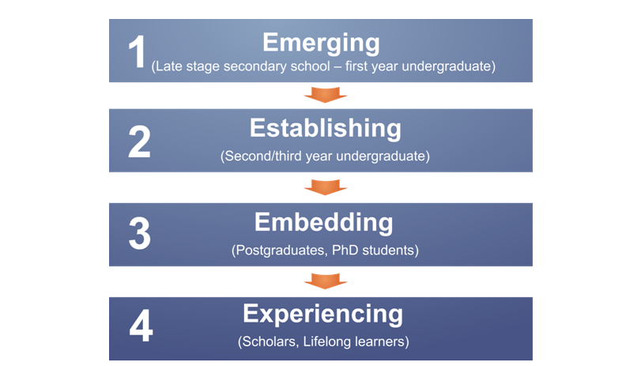
Educational Stages
(Connaway, White, and Lanclos 2011)
Notes:
1. Emerging (Late stage secondary school/First year undergraduate);
2. Establishing (Second/third or third/fourth year undergraduate);
3. Embedding (Postgraduates, PhD students);
4. Experienced (Scholars).
Connaway, Lynn S., David White, and Donna Lanclos. 2011. “Visitors and Residents: What motivates engagement with the digital information environment?” Proceedings of the 74th ASIS&T Annual Meeting 48: 1-7.
White, David S., and Lynn Silipigni Connaway. 2011-2014. Visitors & Residents: What Motivates Engagement with the Digital Information Environment. Funded by JISC, OCLC, and Oxford University. http://www.oclc.org/research/activities/vandr/.

Slide 10
Data collection & Analysis

Slide 11

Data Collection Tools
4 Project Phases
  Semi-structured interviews
  Diaries/monthly semi-structured interviews
      Written
      Video
      Skype or telephone
  Second group of semi-structured interviews
  Online survey
Notes:
Image: https://www.flickr.com/photos/vamapaull/3775032790 by Paul Istoan / CC BY-NC 2.0

Slide 12
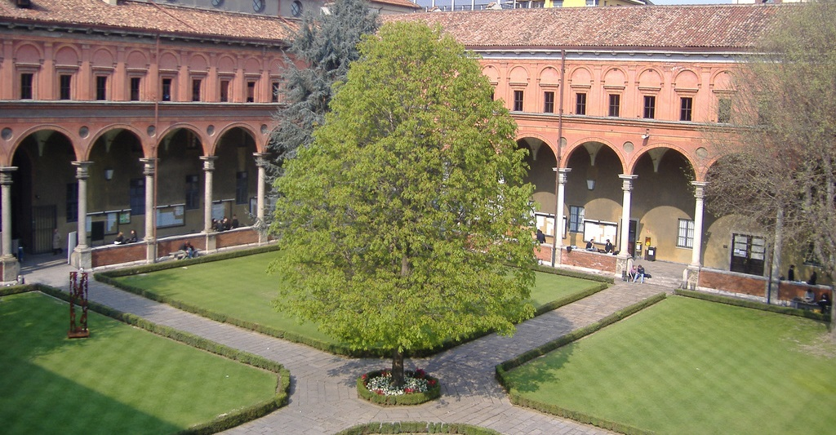
Visitors and Residents Interviews
United States
United Kingdom
Universidad Carlos III de Madrid (Madrid, Spain)
Università Cattolica del Sacro Cuore (Milan, Italy)
Universitat Oberta de Catalunya (Barcelona, Spain)
Notes:
Image: https://www.flickr.com/photos/elena_87/2567662128/ (Università Cattolica del Sacro Cuore Milano) by Elena / CC BY-NC-ND 2.0 https://creativecommons.org/licenses/by-nc-nd/2.0/
Comparisons being done across countries using the original Digital Visitors and Residents Interviews from 2011-2014. New Interviews being conducted.
We are now working on analyzing the new data and comparing them to one another.

Slide 13
Visitors and Residents Interview Demographics
Educational Stage | Universidad Carlos III de Madrid (Madrid) | United States | United Kingdom | Universitat Oberta de Catalunya (Barcelona) | Università Cattolica del Sacro Cuore (Milan)
Emerging Participants | 8 | 22 | 21 | 6 | 3
Establishing Participants | 10 | 5 | 5 | 7 | 6
Embedding Participants | 10 | 5 | 5 | 7 | 6
Experiencing Participants | 10 | 5 | 5 | 13 | 5
Total | 38 | 37 | 36 | 33 | 20
(n=164)
Notes:
We have 36 Interviews from the United Kingdom and the United States, with a higher number from Emerging participants as these were conducted as longitudinal studies. Diaries and Follow-up Interviews were conducted but for this analysis, we are only using the initial Interview. We have also pulled in 20 Interviews from Milan and 33 from Barcelona, all more equally distributed. Total = 164

Slide 14
V&R findings

Slide 15
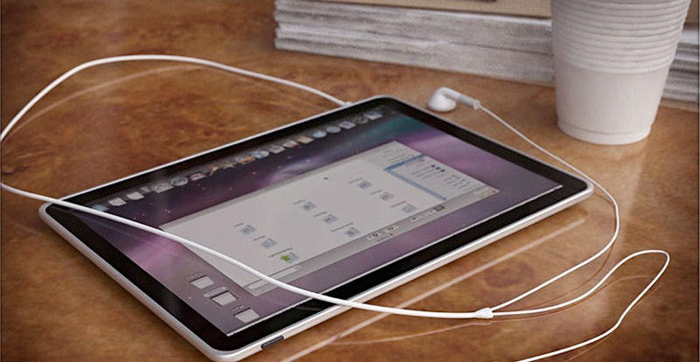
“As to the findings during the interviews, I was pleasantly surprised to note that young researchers or students were well aware of the potentialities and ‘dangers’ when using technology. They were not naïve or too enthusiastic about technology especially at personal level. It was also pleasantly surprising to see they were interested in the results and follow up of this project.”
(V&R project team member, Unicatt (Università Cattolica del Sacro Cuore))
Notes:
Image: https://www.flickr.com/photos/12905355@N05/4293966039/ by Photo Giddy / CC BY-NC 2.0 https://creativecommons.org/licenses/by-nc/2.0/
In relation to the use of tablets, it seems that in Spain and UK tablets are a family tool that is mostly used for watching TV programms, playing gammes, or reading the news….
In this sense one UOC faculty member comment us that the tablet was his favourite device to work....
“I feel guilty, but the tablet is perfect because childs can watch films and I can work…it is lovely to have it.”
(UOCFI3, Male, Age 48, Information and Communication Studies)
But even people use mostly digital devices and applications to access to information, it is interesting to note some questions in relation with printed information…
Tablets
Tools AND Educational Stage Aggregated By Sources (Tablets, iPads, Other Tablets)
Experiencing Interviews
UC3M Madrid: 8, 80%
US: 2, 40%
UK: 4, 80%
UOC Barcelona: 8, 89%
White, David S., and Lynn Silipigni Connaway. 2011-2014. Visitors & Residents: What Motivates Engagement with the Digital Information Environment. Funded by JISC, OCLC, and Oxford University. http://www.oclc.org/research/activities/vandr/.

Slide 16
Where do people expect to find information?
Notes:
Let’s talk about the information sources people use to get information…
Human
Digital, i.e., journals web sites, TV , Wikipedia, VLE
Physical

Slide 17
Sources
Notes:
Let’s talk about the information sources people use to get information…
Human
Digital, i.e., journals web sites, TV , Wikipedia, VLE
Physical

Slide 18
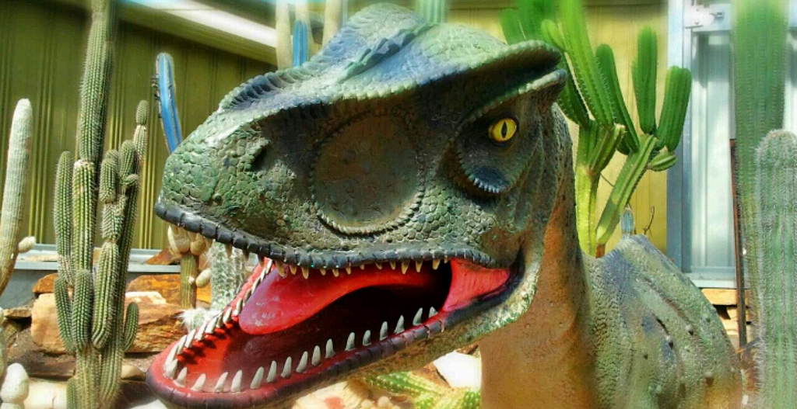
“So, it's... I mean, people who use books are dinosaurs now.”
(UCSCF2, Male, Age 39, Social Sciences)
Notes:
Image: https://www.flickr.com/photos/bonitoclub/9910937863/ by Tony & Wayne / CC BY-NC 2.0 https://creativecommons.org/licenses/by-nc/2.0/
And again, we can see that the use of paper is a question of habits but also very related with emotional aspects…as pointed by several people interviewed
White, David S., and Lynn Silipigni Connaway. 2011-2014. Visitors & Residents: What Motivates Engagement with the Digital Information Environment. Funded by JISC, OCLC, and Oxford University. http://www.oclc.org/research/activities/vandr/.

Slide 19

“When I learned to make bechamel sauce, my mother would have taught me gladly, but she was not available, so I searched on Internet… I searched for a good video.”
(UOCG3, Male, Age 28, Computer Science)
Notes:
Image: https://www.flickr.com/photos/124705972@N06/14597368868/ by Steve Larkin / CC BY-NC 2.0 https://creativecommons.org/licenses/by-nc/2.0/
Is interesting to notice, that most interviewed people consider the use of human sources as the best way to access to information. Not being this always possible, people goes to digital information and if possible, including video, images and interactive capabilities.
White, David S., and Lynn Silipigni Connaway. 2011-2014. Visitors & Residents: What Motivates Engagement with the Digital Information Environment. Funded by JISC, OCLC, and Oxford University. http://www.oclc.org/research/activities/vandr/.

Slide 20

“Facebook from this point of view is very comfortable because you can create cultural events. For example, during the week and during the month, I see very much, expositions, and I can find these events and expositions, these events and these cultural events. For example, just some weeks ago, I went to a conference by a famous international artist, which his name is Christo, and his conference was in Bergamo. Facebook sent me this.”
(UCSCG2, Age 25, Female, Humanities)
Notes:
Image: https://www.flickr.com/photos/ligthelm/22154604304/ by Rick Ligthelm / CC BY 2.0 https://creativecommons.org/licenses/by/2.0/

Slide 21
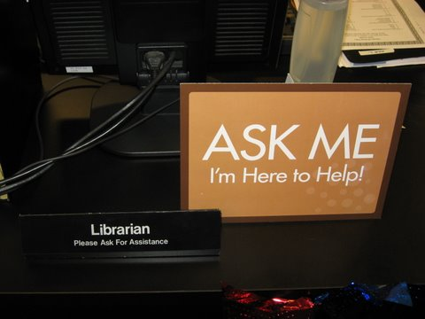
Librarians rarely were mentioned by Students of any groups. Faculty of all groups, mentioned librarians slightly more often, yet still less than half of the time.
Notes:
Image: https://www.flickr.com/photos/deathtogutenberg/798918705/ by Austin Kleon / CC BY-NC-ND 2.0 https://creativecommons.org/licenses/by-nc-nd/2.0/
A specific example of personal source is a librarian.
In this sense, faculty members mention more the librarians than students. For instance, one UOC faculty said that “librarians are nice people”
When human sources are not possible, Google and Wikipedia are the most used sources to get information.
Eva’s Original Text: Both UOC Faculty and Students mention Human Sources to find information. Experts, friends and peers are the most used by Students. In contrast Faculty use the Librarian’s advice. Family members are not a common information source.
Sources AND Edu Stage By Sources Non-Aggregated
Sources: Librarians Experiencing Interviews/”Student” Interviews (Emg, Est, Emb)
US Exp. N=5: 1, 20% / US Student N=32: 3, 9%
UK Exp. N=5: 1, 20% / UK Student N=31: 3, 10%
UOC Barcelona N=13: 4, 31% / UOC Barcelona Student N=20: 3, 15%
Unicatt Milan N=5: 0, 0% / Unicatt Milan Student N=15: 3, 20%
UC3M Madrid N=10: 1, 10% / UC3M Madrid Student N=28: 0, 0%
Sources AND Educational Stage By Sources Non-Aggregated
Sources: Experts/Professionals Experiencing Interviews/”Student” Interviews (Emg, Est, Emb)
US Exp. N=5: 1, 20% / US Students N=32: 7, 22%
UK Exp. N=5: 1, 20% / UK Students N=31: 11, 35%
UOC Barcelona Exp. N=13: 5, 38% / UOC Barcelona Students N=20: 14, 70%
Unicatt Milan Exp. N=5: 1, 20% / Unicatt Milan Students N=15: 3, 20%
UC3M Madrid Exp. N=10: 5, 50% / UC3M Madrid Students N=28: 8, 29%
Sources AND Educational Stage By Sources Non-Aggregated
Sources: Friends/Colleagues Experiencing Interviews/”Student” Interviews (Emg, Est, Emb)
US Exp. N=5: 2, 20% / US Students N=32: 22, 69%
UK Exp. N=5: 2, 20% / UK Students N=31: 22, 71%
UOC Barcelona Exp. N=13: 5, 38% / UOC Barcelona Students N=20: 13, 65%
Unicatt Milan Exp. N=5: 5, 100% / Unicatt Milan Students N=15: 12, 80%
UC3M Madrid Exp. N=10: 10, 100% / UC3M Madrid Students N=28: 12, 43%
Sources AND Educational Stage By Sources Non-Aggregated
Sources: Peers Experiencing Interviews/”Student” Interviews (Emg, Est, Emb)
US Exp. N=5: 2, 40% / US “Students” N=32: 18, 56%
UK Exp. N=5: 3, 60% / UK Students N=31: 14, 45%
UOC Barcelona Exp. N=13: 3, 23% / UOC Barcelona Students N=20: 11, 55%
Unicatt Milan Exp. N=5: 3, 60% / Unicatt Milan Students N=15: 5, 33%
UC3M Madrid Exp. N=10: 0, 0% / UC3M Madrid Students N=28: 10, 36%
White, David S., and Lynn Silipigni Connaway. 2011-2014. Visitors & Residents: What Motivates Engagement with the Digital Information Environment. Funded by JISC, OCLC, and Oxford University. http://www.oclc.org/research/activities/vandr/.

Slide 22
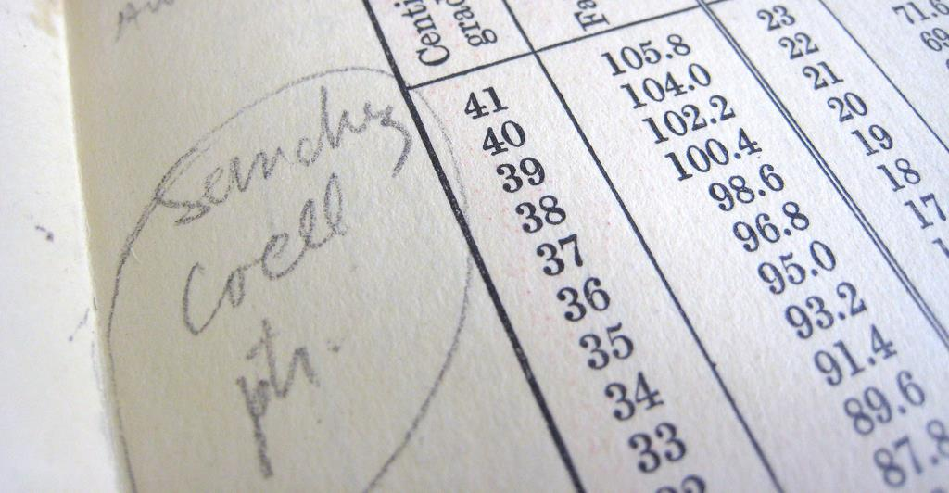
“Wikipedia it’s perfect, because it gives you the words, the things the technical words that have to look, keywords, so Wikipedia is always, always the first step.”
(UOCG1, Male, Age 35-44, Professions and Applied Sciences)
Notes:
Image: https://www.flickr.com/photos/mayopants/4021073588/ by stateofplace / CC BY-NC 2.0 https://creativecommons.org/licenses/by-nc/2.0/
In relation with Wikipedia, we have to mention the research project leaded by Eudard Aibar, a UOC researcher. In that project ……..
In our study we find that people use to consult Wikipedia when they need to be introduced in a new subject, or to find definitions or concrete concepts.
“I always read everything I am looking for and need some new to me, the first thing that I learned during my degree, the first thing you have to look always is a central or a first approach. Wikipedia it’s perfect, because it gives you the words, the things the technical words that have to look, keywords, so Wikipedia is always, always the first step.” UOC Barcelona (Universitat Oberta de Catalunya) (UOCG1, Embedding, Male, Age 35-44, Professions and Applied Sciences)
“Una informació que faig servir molt és la Wikipedia..però els meus amics diuen que hi ha coses equivocades…i la Larousse també, però està impresa I no es pot corregir…Els errors hi són, no depèn de la tecnologia, els errors dependen del creador.” (UOCFE6, Male, Age 53, Computer Science)
“I used to seek information in Wikipedia, even my colleagues said that there are wrong things on it…but I said Enciclopedia Larousse [Traditional encyclopedia] also have mistakes…the only difference is that it is printed and is impossible to correct the mistakes once you have the printed version…Mistakes are not about technology, are about people.”
Wikipedia
Sources AND Educational Stage By Sources Non-Aggregated
Experiencing Interviews
Sources: Wikipedia
UC3M Madrid: 9, 90%
US: 1, 20%
UK: 4, 80%
UOC Barcelona: 6, 67%

Slide 23
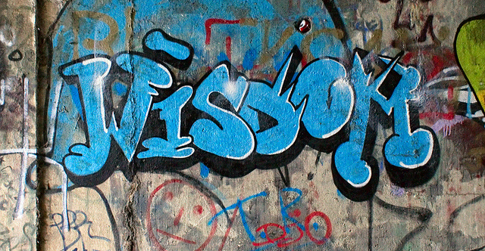
The magic future would be…
“I would like to have a library, a material library with real books. But by a platform, I would like to type some words or some contents, I would like to learn. And the platform search what you have typed in the real books, so you can take the real books, but by searching on the internet, and directly...”
(UCSCU3, Age 21, Female, Social Sciences)
Notes:
Image: https://www.flickr.com/photos/zigazou76/6086655772 by Frederic BISSON / CC BY 2.0
“Voldria tenir un xip al cap amb tota la informació. (UOCFI1)
“Having tags. If you want to upload a sound or music, tag it. Because if no, it’s impossible to share, to search…” (UOCG1)
“Una persona sàvia. M’agraden els llibres i la tecnologia, però les persones són millors que els llibres” (UOCU1)

Slide 24
place
Notes:
And where people interact mostly with information? We have a wide range of places. Let’s see some of them,
Internet
Search Engines
Social Media
Library
Home
School
Other

Slide 25
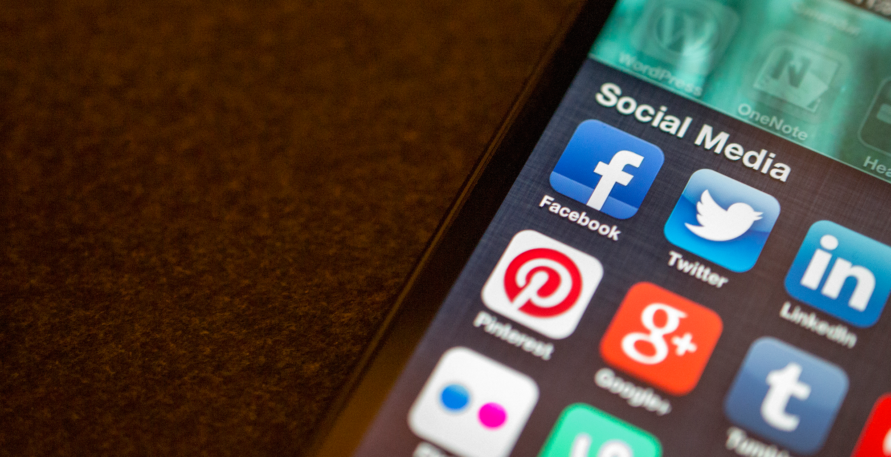
Social Media was mentioned highly across all Faculty groups, with Facebook being mentioned the most.
“Whereas I do not abuse of the internet for my social life. I don't use internet many times for my social life as I would say to you. I have a Facebook account which I access once, two in a month, so not very much. As maybe to contact friends I prefer to use either or telephone or chat applications.”
(UCSCF4, Age 39, Male, Formal Sciences)
Notes:
Image: https://www.flickr.com/photos/jasonahowie/8583949219 by Jason Howie / CC BY 2.0 https://creativecommons.org/licenses/by/2.0/
Social Media
Place AND Educational Stage By Sources Aggregated
Experiencing Interviews
Place: Social Media
UC3M Madrid: 8, 80%
US: 5, 100%
UK: 5, 100%
UOC Barcelona: 9, 100%
Place: Facebook
UC3M Madrid: 8, 80%
US: 4, 80%
UK: 5, 100%
UOC Barcelona: 8, 89%
Social Media: Twitter
UC3M Madrid: 7, 70%
US: 2, 40%
UK: 5, 100%
UOC Barcelona: 8, 89%
Social Media coded: Blogging, Facebook, Flickr, Twitter, YouTube
White, David S., and Lynn Silipigni Connaway. 2011-2014. Visitors & Residents: What Motivates Engagement with the Digital Information Environment. Funded by JISC, OCLC, and Oxford University. http://www.oclc.org/research/activities/vandr/.

Slide 26
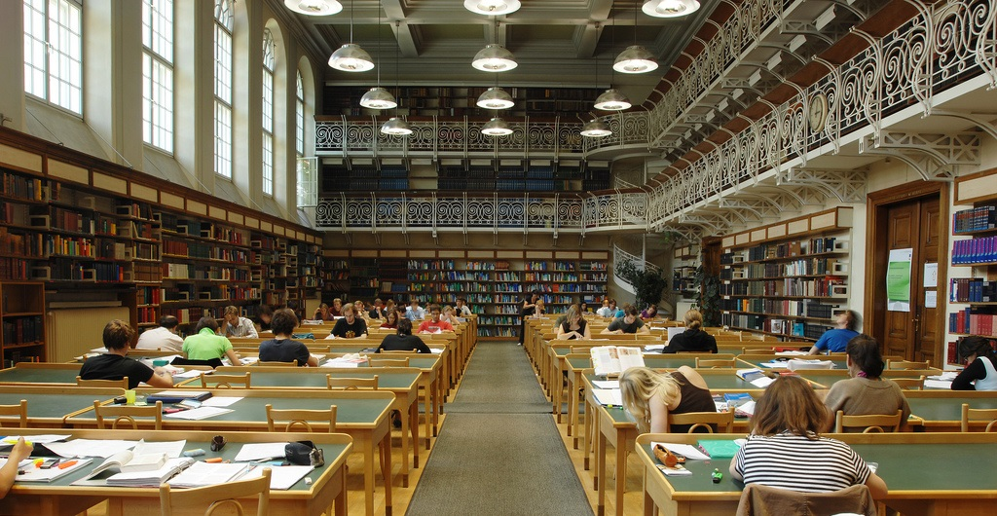
Academic Library
Barcelona: 88%
US: 70%
Milan: 65%
UK: 56%
Madrid: 26%
Notes:
Image: https://www.flickr.com/photos/uniinnsbruck/3723226694 by uniinnsbruck / CC BY-NC 2.0 https://creativecommons.org/licenses/by-nc/2.0/
In fact, the Academic library is mentioned a lot by UOC sample mainly because the Library is Virtual and is embedded in the clasroom. But the awareness and use of the library is not always…
Place AND Educational Stage By Sources Non-Aggregated
Place: Academic Library All Interviews/ All Levels
US N=37: 26, 70%
UK N=36: 20, 56%
UOC Barcelona N=33: 29, 88%
Unicatt Milan N=20: 13, 65%
UC3M Madrid N=38: 10, 26%
White, David S., and Lynn Silipigni Connaway. 2011-2014. Visitors & Residents: What Motivates Engagement with the Digital Information Environment. Funded by JISC, OCLC, and Oxford University. http://www.oclc.org/research/activities/vandr/.

Slide 27
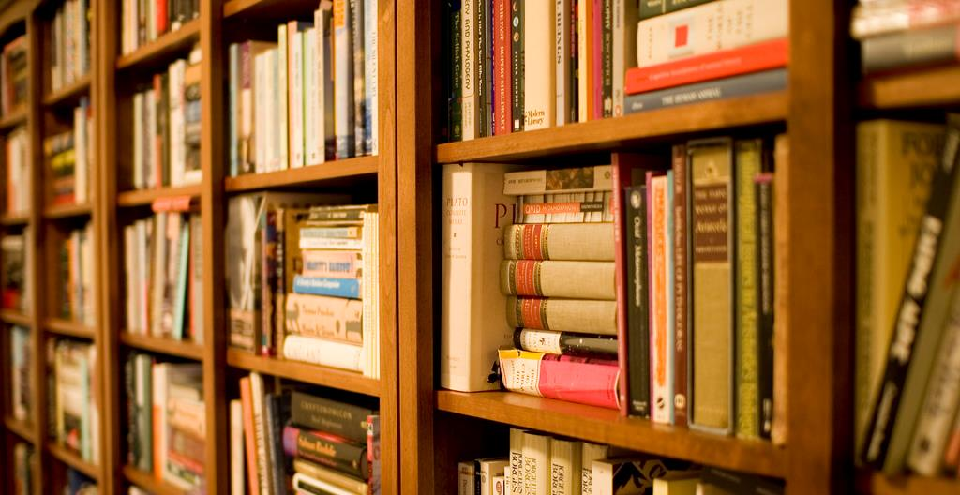
“I start Googling something, then I see which are the path that I needed to follow at the given moment. You have to use formal repositories, but generally, I start with the Google search and then I go into scholarly repositories.”
(UCSCF2, Age 39, Male, Social Sciences)
Notes:
Image: https://www.flickr.com/photos/stewart/99129170/ by Stewart Butterfield / CC BY 2.0 https://creativecommons.org/licenses/by/2.0/
….related with their perceveid value in comparasion with other information sites, like Google. Although this perception about the search capability of library website, we must point that library is seen as the key text-provider for nondigital resources or digital resources not free available in other places.
“Si aquest llibre no està digitalitzat per Google, l’he d’anar a buscar a la Biblioteca.” (UOCU7, Male, Aged 31, Computer Science)
“If this book is not digitalized by Google, then I must go to the Library.” (UOCU7, Male, Aged 31, Computer Science)
“The students don’t have to go to the library to find knowledge, they have Knowledge in Internet.” (UOCFI1, Male, Aged 43, Computer Science)
White, David S., and Lynn Silipigni Connaway. 2011-2014. Visitors & Residents: What Motivates Engagement with the Digital Information Environment. Funded by JISC, OCLC, and Oxford University. http://www.oclc.org/research/activities/vandr/.

Slide 28
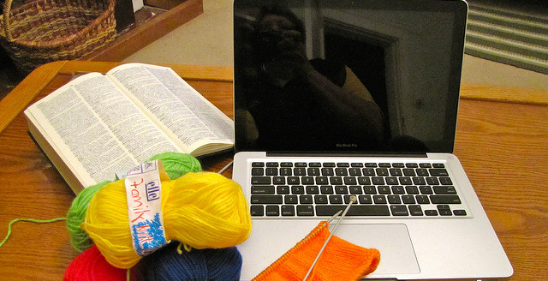
The magic future would be…
“An online database of ancient book and manuscript with deeper descriptions of books. For instance, watermark, engravers, the name of printers. For instance also a database of characters of poems.”
(UCSC04, Age 26, Male, Humanities)
Notes:
Image: https://www.flickr.com/photos/11115086@N00/4276498711 by Brenda / CC BY 2.0
“Voldria tenir un xip al cap amb tota la informació. (UOCFI1)
“Molt fàcil, només parlant. Que jo li digui a l’ordinador “mira necessito això” i que l’ordinador m’ho donés. (...) (UOCG6)
“Tenir la informació als ulls, per telepatia. Sense emprar cap estrí” (UOCU8)

Slide 29
Why do people make the choices they do for getting information?
Notes:
Well, once we have seen the sources people use to access to information, let’s to know a little more about the criteria they apply to make decisions about the information they find. For example,
Convenience
Repetition
Relevancy
Authority
Available Time
Speed

Slide 30
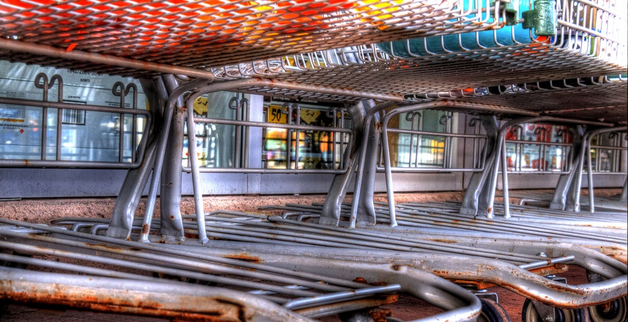
Convenience/Ease of Use/Accessibility as reasons for selecting a source were mentioned often by all groups.
Notes:
Image: http://www.flickr.com/photos/79743208@N05/10229498105 by Matthew Matheson / CC BY-NC-ND 2.0 https://creativecommons.org/licenses/by-nc-nd/2.0/
It seems that a convenience is a predominant factor to select both the source and the information. But convenience is a complex concept, ant it changes highly depending on the situation and the context.
If we look at the reasons people use to select information…
Convenience
Decision/Choice AND Educational Stage By Sources Non-Aggregated
All Interviews/All Levels
Decision/Choice: Convenience/Ease of Use/Accessibility
US N=37: 33, 89%
UK N=36: 30, 83%
UOC Barcelona N=33: 30, 91%
Unicatt Milan N=20: 19, 95%
UC3M Madrid N=38: 35, 92%
White, David S., and Lynn Silipigni Connaway. 2011-2014. Visitors & Residents: What Motivates Engagement with the Digital Information Environment. Funded by JISC, OCLC, and Oxford University. http://www.oclc.org/research/activities/vandr/.

Slide 31
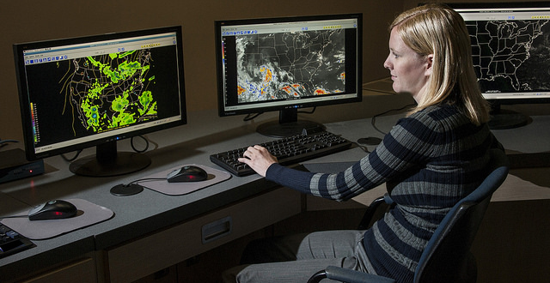
“So I check three, or four websites and if is more or less the same, so ok, I am confident.”
(ESG01, Female, Age 26-34, Formal Sciences)
Notes:
Image: https://www.flickr.com/photos/51009184@N06/12326453255 by Savannah River Site / CC BY 2.0
….we can see that REPETITION is a usual criteria. In fact, people stop looking for information when they realise that the results are more or less the same all the time.
Other criteria to selecte information is….
“So I check three, or four websites and if is more or less the same, so ok, I am confident.” UC3M Madrid (Universidad Carlos III de Madrid) (ESG01, Embedding, Female, Age 26-34, Formal Sciences)
“Cuando veo que está todo repetido, que no sale nada. Que no hay cosas nuevas, es cuando paro” (UOCU2, Female, Aged 28, Information Sciences)
“When I see that everything is the same, that nothing new appears. That there’s nothing new, then i stop looking for information.”(UOCU2, Female, Aged 28, Information Sciences)
“Miro dos o tres recursos. Si hi ha coincidència entre les dos o tres primeres pàgines, aleshores paro” (UOCFE1, Male, Aged 43, Information Sciences)
“I look for two or three resources. If there’s a repetition between the two or three first pages, then I stop.” (UOCFE1, Male, Aged 43, Information Sciences)
White, David S., and Lynn Silipigni Connaway. 2011-2014. Visitors & Residents: What Motivates Engagement with the Digital Information Environment. Funded by JISC, OCLC, and Oxford University. http://www.oclc.org/research/activities/vandr/.

Slide 32
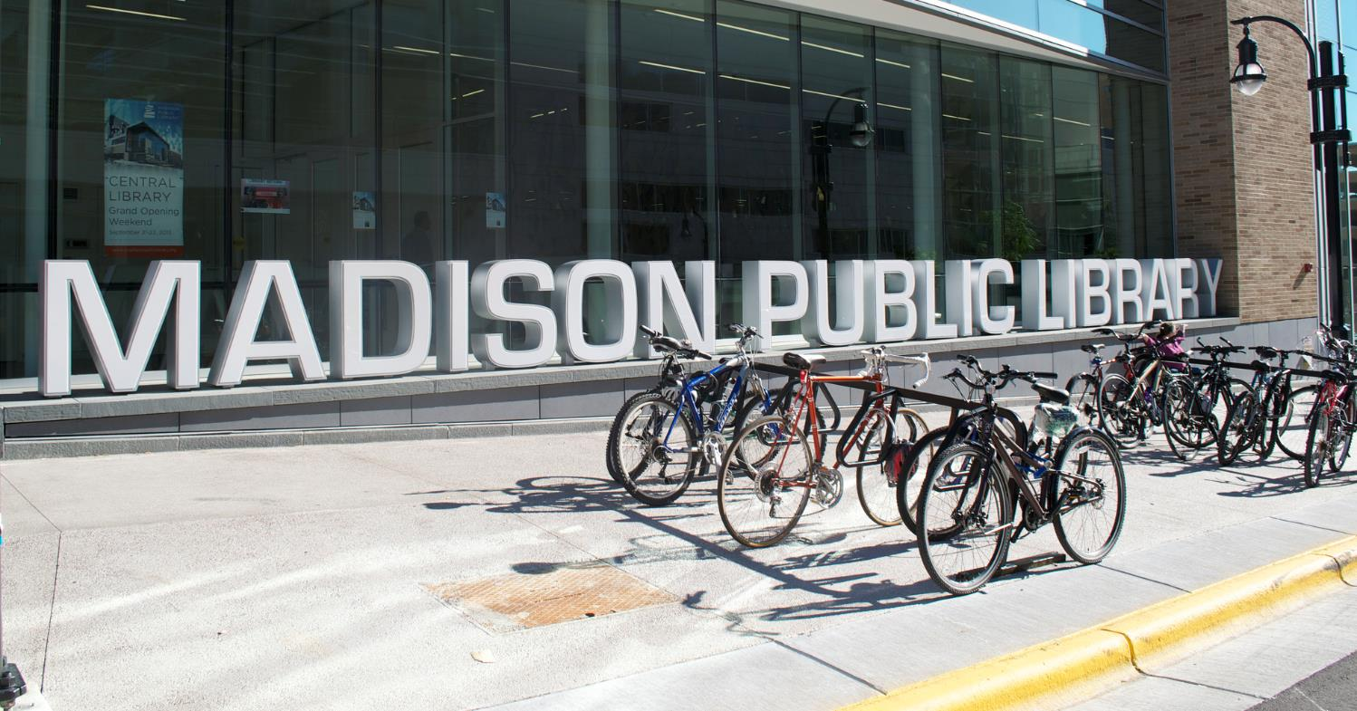
“So maybe now, because at the beginning of my research, I think like this. Maybe in the end, I want to find everything, probably. But my goal is to find the answer, precise answer without finding too many of them.”
(UCSCU5, Age 23, Female, Professions & Applied Sciences)
Notes:
Image: https://www.flickr.com/photos/96684011@N05/9902436694/ by Erik Lorenzsonn / CC BY 2.0 https://creativecommons.org/licenses/by/2.0/
…the realibility of information. This is highly priorized against the quantity of information, that is not always perceived as a value in itself.
“A banda de les referències, el fet que aquella persona tingui presència a les xarxes socials et dona confiança.” (UOCU5, Female, Aged 30, Education and Psychology)
“A part from the references, the fact that those person have a social media presnece, provides you some kind of reliability.” (UOCU5, Female, Aged 30, Education and Psychology)
“Prefereixo tenir menys informació, però estar quasi al 90% segur que aquella informació és certa.” (UOCU7, Male, Aged 31, Computer Science)
“I prefer to have less information, but to be sure about 90% that the information is true.” (UOCU7, Male, Aged 31, Computer Science)
White, David S., and Lynn Silipigni Connaway. 2011-2014. Visitors & Residents: What Motivates Engagement with the Digital Information Environment. Funded by JISC, OCLC, and Oxford University. http://www.oclc.org/research/activities/vandr/.

Slide 33
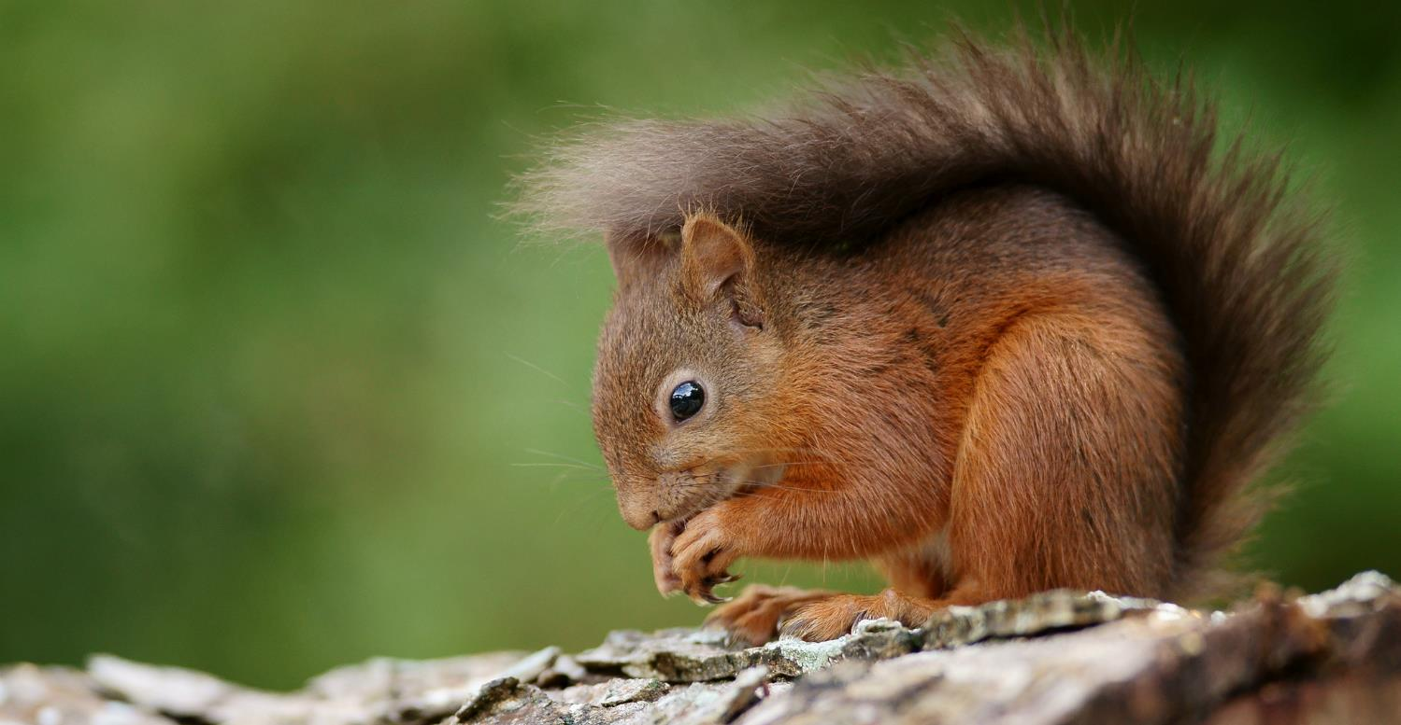
“My capacity to process information is overloaded. I’m just accumulating information as a hamster.”
(UOCFE1, Male, Age 43, Information Sciences)
Notes:
Image: https://www.flickr.com/photos/peter-trimming/9566245040/ by Peter Trimming / CC BY 2.0 https://creativecommons.org/licenses/by/2.0/
The literature refers to the fact to keep all the information you find as a “squirreling away” information.
In these sense, the interviewed people keep information in their computer “in case they need in the future” but in fact, they confessed us that when they need it they repeat the search, because they forget that they already have the information or they don’t remember where they information is stored.
“…ara està tot allí (Internet). Qualsevol afició, per rara que sigui, sempre trobes alguna cosa.” (UOCFE6, Male, Age 53, Computer Sciences)
White, David S., and Lynn Silipigni Connaway. 2011-2014. Visitors & Residents: What Motivates Engagement with the Digital Information Environment. Funded by JISC, OCLC, and Oxford University. http://www.oclc.org/research/activities/vandr/.

Slide 34
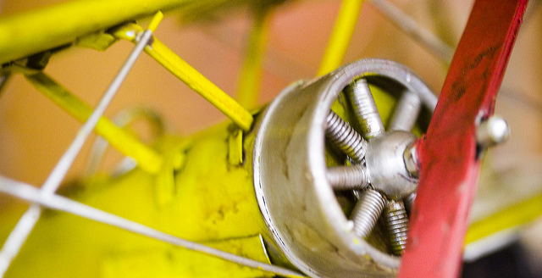
The magic future would be…
“I must say that I'm quite satisfied at the moment, because from my computer I have access to all the journals but I think that many of my school friends that don't have access, they have to go the library to look for the information. So, that means you can't do it from home and sometimes for people, it's not that easy to get to the library. So, I think the most important thing is that everyone from home could be able to consult the university's library.”
(UCSCU5, Age 23, Female, Professions & Applied Sciences)
Notes:
Image: https://www.flickr.com/photos/thomashawk/2383336375 by Thomas Hawk / CC BY-NC 2.0

Slide 35
How do people want to communicate?
Notes:
Let’s see examples of different situations about how people perceive contact and communication.

Slide 36
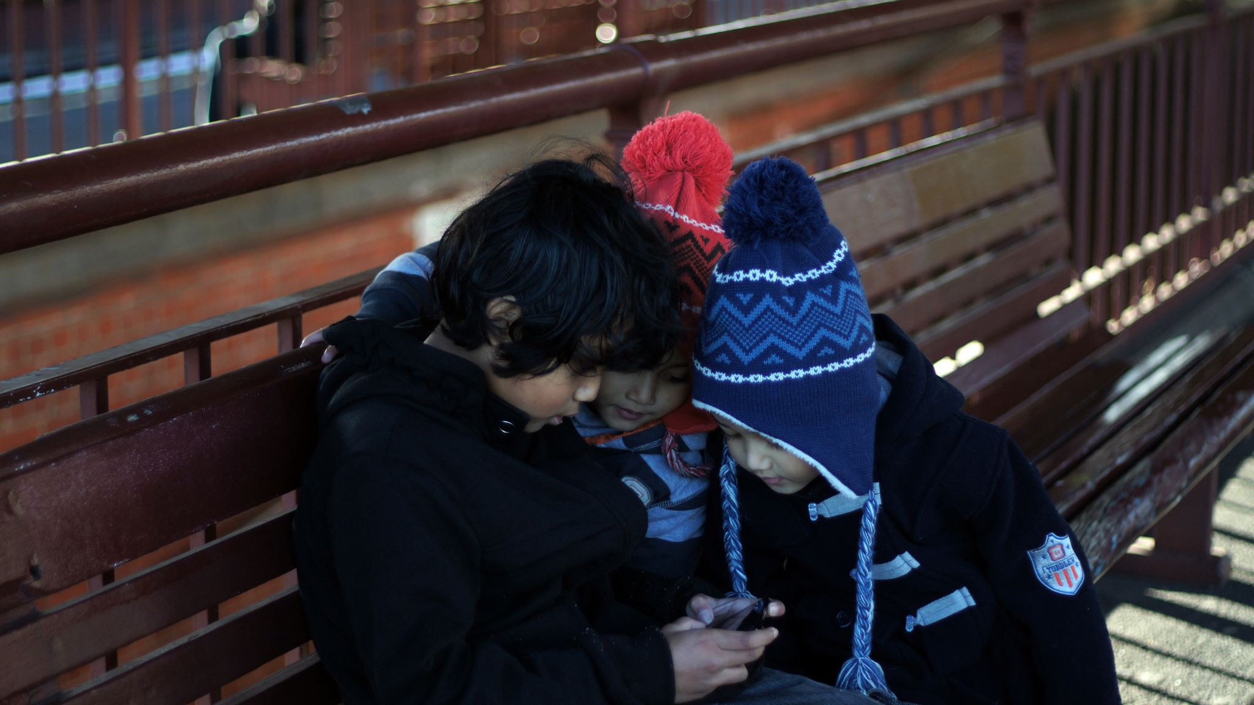
“And in everyday social life, technological tools, as I said before, I use, I have Facebook, I have WhatsApp as you said.”
(UCSCF4, Age 39, Male, Formal Sciences)
Notes:
Image: https://www.flickr.com/photos/wrachmanto/7566846468/ by Widhi Rachmanto / CC BY 2.0 https://creativecommons.org/licenses/by/2.0/
….a faculty explain us that his main way of communication was whatsapp, he said “sometimes I send a whatsapp just to advice the person that I’ve send an email that I want him to read”. There are different combinations of use of whatsapp and email.
““But human minds are plug-and-play devices; they’re not meant to be used alone. They’re meant to be used in networks.” Games allow us to do that – they allow us to use what Gee calls “collective intelligence.” Collectively, we’re not so stupid. Further, games help us develop non-cognitive skills that the panelists agreed are as fundamental as cognitive skills in explaining how we learn and if we succeed. According to Gee, skills such as patience and discipline, which one should acquire as a child but often does not, correlate with success better than IQ scores do. And those non-cognitive skills – that is, not what you know but how you behave – are far better suited to a game context than to a traditional classroom and textbook context.”
MacKay, R. F. (2013). “Playing to Learn: Panelists at Stanford Discussion Say Using Games as an Educational Tool Provides Opportunities for Deeper Learning.” Stanford News, March 1, http://news.stanford.edu/2013/03/01/games-education-tool-030113/.

Slide 37
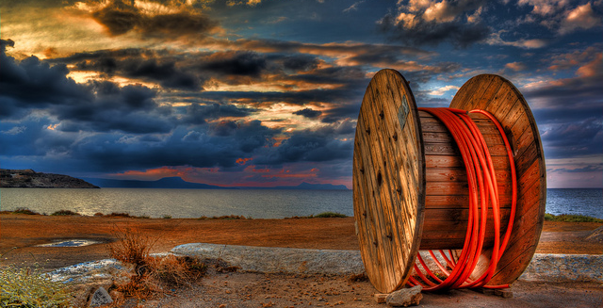
Faculty mentioned Email as a means of Contact.
US: 100%
UK: 100%
Madrid: 100%
Barcelona: 92%
Milan: 80%
Notes:
Image: https://www.flickr.com/photos/theo_reth/5577311905 by Tehophilos Papadopoulos / CC BY-NC-ND 2.0
…is a way of contact and communication highly mentioned in all the countries involved in the study. But in ous particular study at UOC, the email is mainly used for professional reasons.
Even some people interviewed embedded the personal communication in the corporative email.
“Well, my first tool to communicate with them is email, the corporate email. My wife, my sisters, closest friends , closest friends , can use the mail to contact me if they need to do that. So, it is the first way, And it’s not a very intrusive way to connect. Because the phone you must stop whatever you are doing at that time to answer. And the email you are checking it when you can.” (UOCFI3, Male, Age 48, Information Science and Communication Studies)

Slide 38
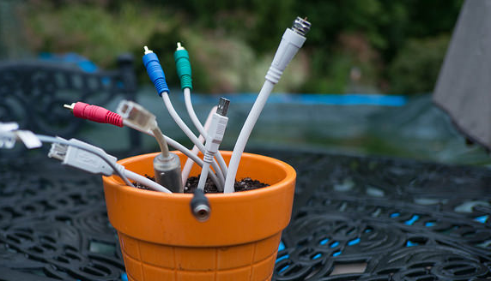
“One of the first things I do in the morning is check my telephone to see if anyone tried to contact me during the night and also to check maybe my emails or social networks.”
(UCSC02, Emerging, Age 19, Female, Humanities)
Notes:
Image: https://www.flickr.com/photos/121483302@N02/16270228508 by Global Panorama / CC BY-SA 2.0

Slide 39
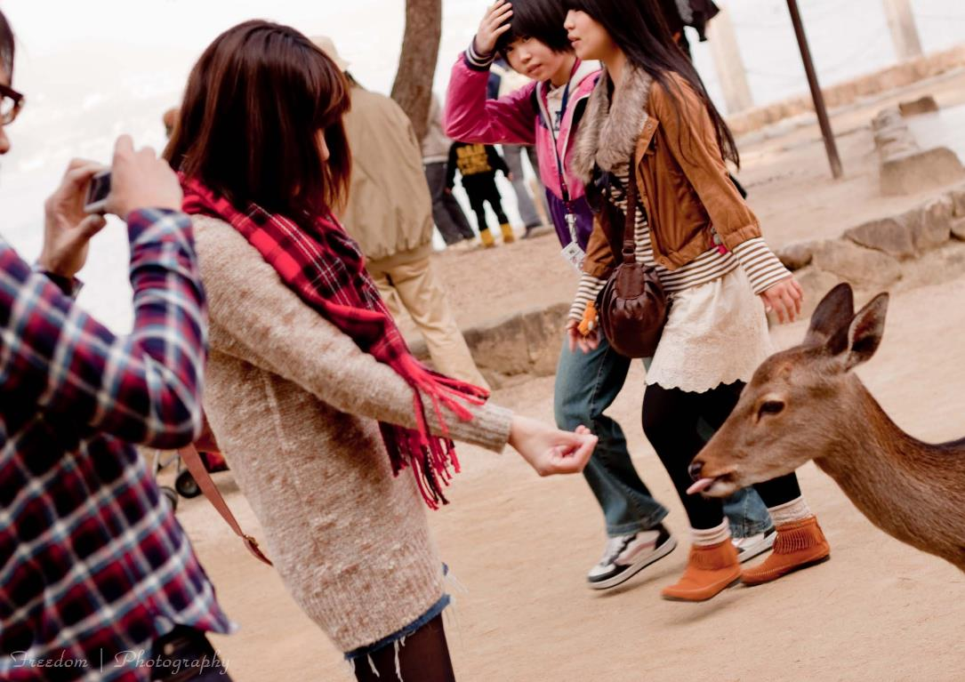
“It's difficult because without a smartphone, I could live. But my friends will be rather upset because I won't be there all the time. When I didn't have WhatsApp, it was a tragedy because I couldn't understand. I said, ‘Well, you could text me. We have Messenger.’ But it wasn't the same for them. ‘You don't have WhatsApp?’”
(UCSCU8, Age 23, Female, Social Sciences)
Notes:
Image: https://www.flickr.com/photos/freedomiiphotography/5181103215/ by Freedom II Andres / CC BY 2.0 https://creativecommons.org/licenses/by/2.0/
….In this sense, people recognize the importance of having some kind of context in relation with the digital information landscape, so to enrich the meaning of this information.
Place AND Educational Stage By Sources Non-Aggregated
Place: Home All Interviews/All Levels
US N=37: 7, 19%
UK N=36: 23, 64%
UOC Barcelona N=33: 15, 45%
Unicatt Milan N=20: 8, 40%
UC3M Madrid N=38: 9, 24%
White, David S., and Lynn Silipigni Connaway. 2011-2014. Visitors & Residents: What Motivates Engagement with the Digital Information Environment. Funded by JISC, OCLC, and Oxford University. http://www.oclc.org/research/activities/vandr/.

Slide 40
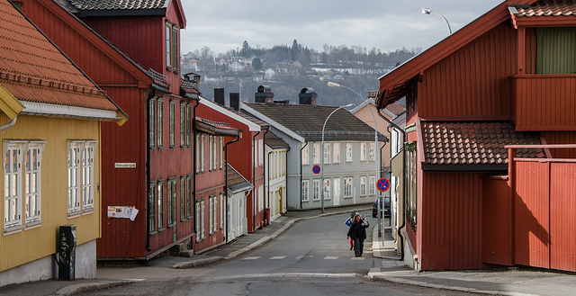
The magic future would be…
“If I could do whatever I want, I think I would invent an instrument which could bring in your head the information you need.”
(UCSCU6, Emerging, Age 20, Male, Professions & Applied Sciences)
Notes:
Image: https://www.flickr.com/photos/astrid/26199740886 by astrid westvang / CC BY-NC-ND 2.0

Slide 41
V&R Mapping

Slide 42
V&R Mapping

Slide 43
Why Mapping Exercise?
Learn about how we engage
  Personally
  Professionally
  Individually
  Collectively
Identify and better understand our identity and dynamics
Better understand users to better understand their workflows and engagement
  Modify and change library offerings, modes of interaction, and communication
It is fun and interesting
Data and Discovery
Notes:
Here are some of the reasons why we do the mapping exercise. In what follows, I will give you an example of the kinds of analysis that we can do and what we can learn from it.

Slide 44
Personal
Visitor
Resident
Institutional
Notes:
Here is a quick example of the mapping exercise. Resident services are ones where you leave purposeful traces of yourself with an expectation of being involved with others there. Visitor services are ones we use to accomplish a task… and then we move on.

Slide 45
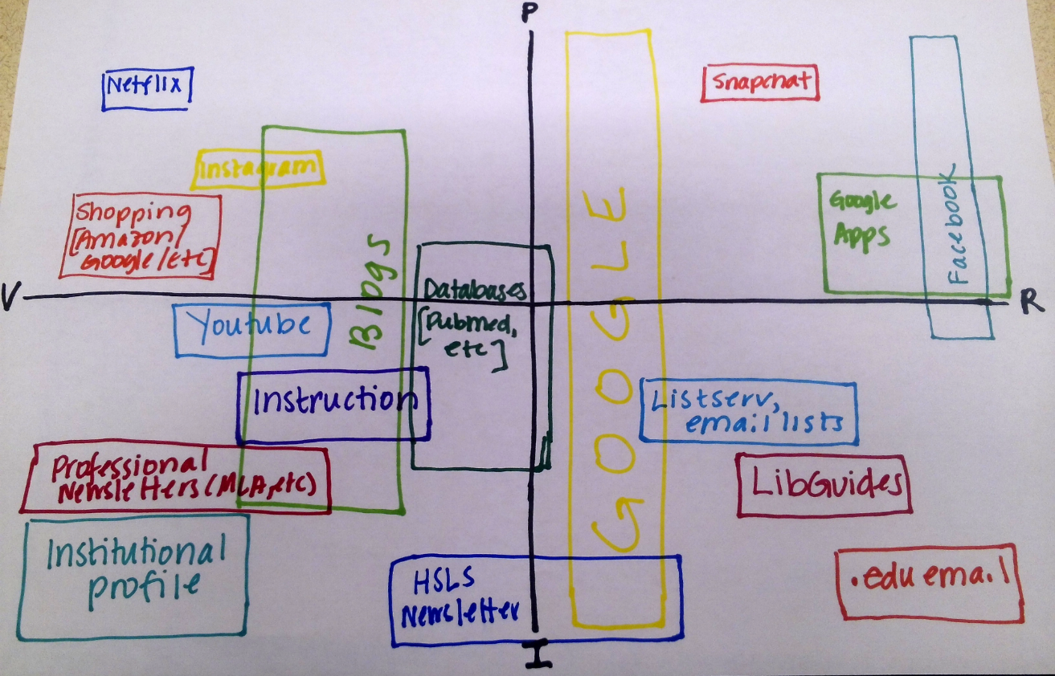
Notes:
Pitt librarian. Residential use of LibGuides. Uses Google and Facebook as a Resident.

Slide 46
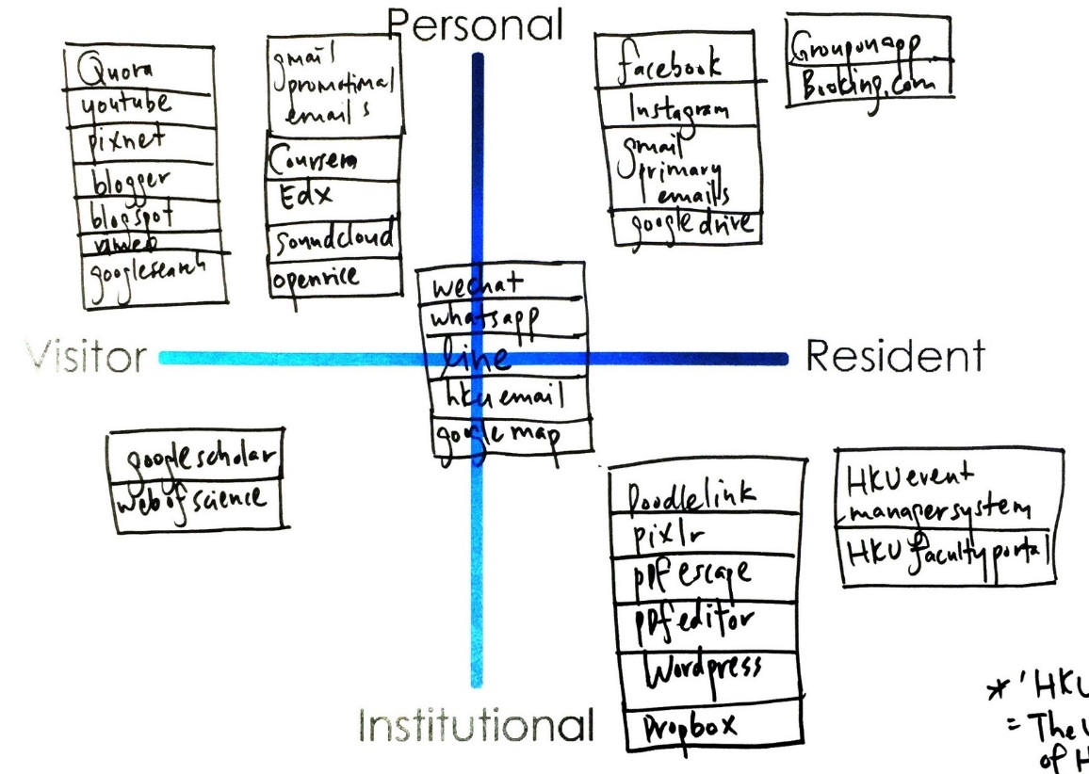
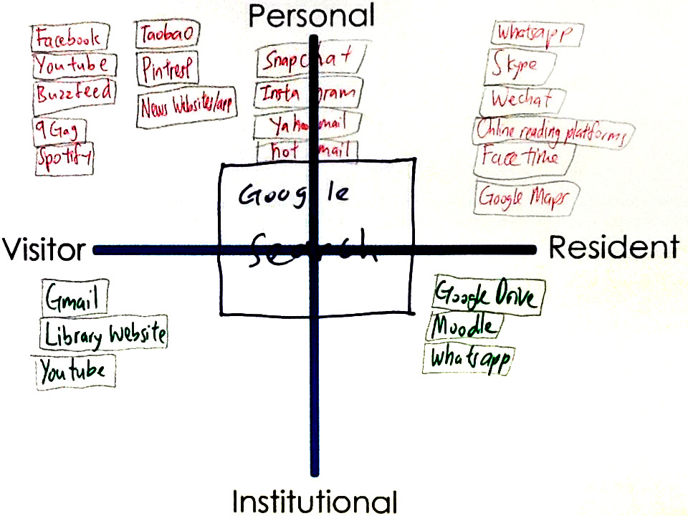
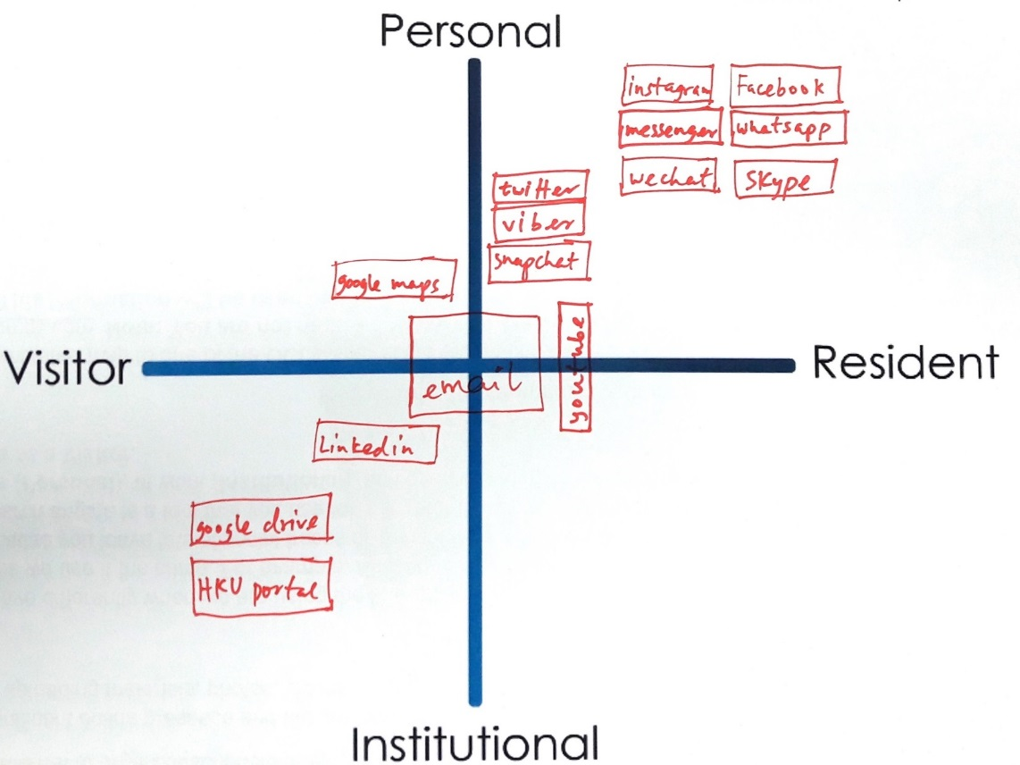
Mapping
Visitors and Residents Sample Maps
Notes:
Quadrant 1:
HKU, 1st year undergrad
Realized I am not that hard working
In desperation when I have to directly go to library website
Google search: usually don’t login, just search, more on visitor side
Snapchat …Hotmail : Not too often do sharing
A way to release my burden
FB try not to post/share, look at what my friends share
Quadrant 2:
HKU, upper undergrad
Library- Borrow book for personal
Google drive – only for group project (visitor)
Social media apps make us anti – social
Quadrant 3:
HKU, faculty researcher and/or scholar
Research assistant
Least Digital footprint as possible, substantial, good thing to live (the left side of the map)
Middle – use a lot in work, create contacts
Use HKU specific apps for work, wordpress, create webpage
Learn about yourself: need to learn more & contribute more in digital footprint (at work and in personal)
White, David S., and Lynn Silipigni Connaway. 2011-2014. Visitors & Residents: What Motivates Engagement with the Digital Information Environment. Funded by JISC, OCLC, and Oxford University. http://www.oclc.org/research/activities/vandr/.

Slide 47
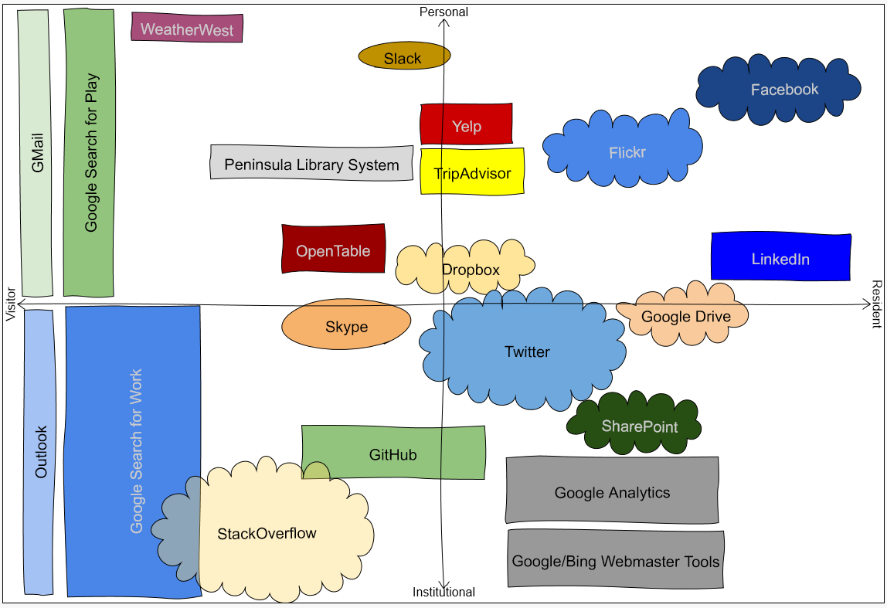

http://oc.lc/vrmap

Slide 48
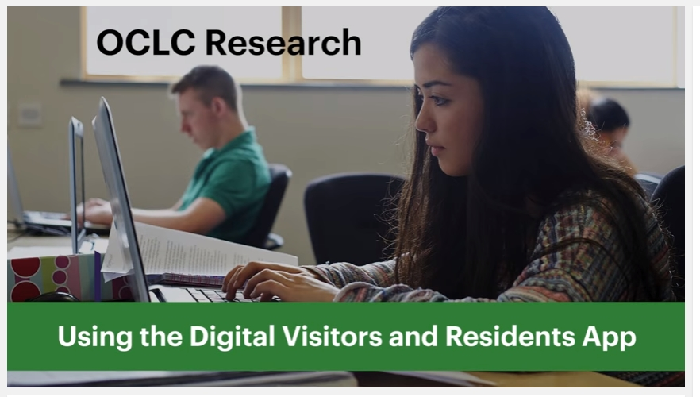
Play
https://www.youtube.com/watch?v=6ai0ZO3lDR4
Notes:
Here’s a demonstration of the app.
OCLC Research. 2016. Using the Digital Visitors and Residents App. YouTube video. May 5. https://www.youtube.com/watch?v=6ai0ZO3lDR4.

Slide 49
Recommendations: Information literacy

Slide 50
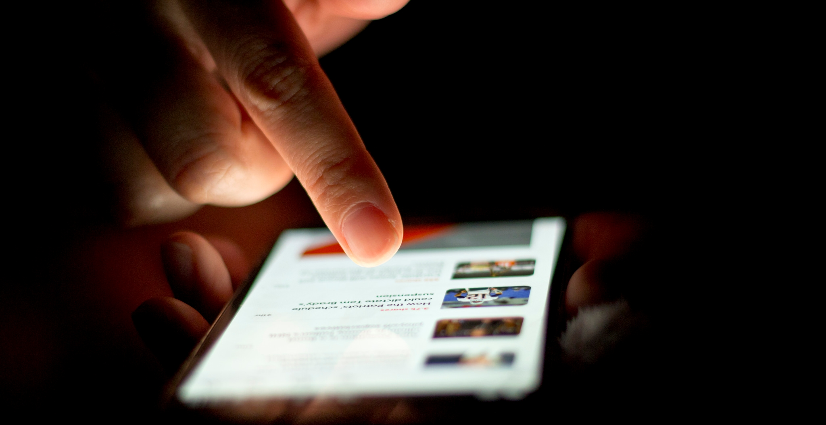
It’s time for a change
“Librarians have an opportunity to become part of users’ social networks and to put resources in the context of users’ information needs.”
(Connaway 2015, 23)
Notes:
Image: https://www.flickr.com/photos/68532869@N08/17470913285/ by Japanexperterna.se / CC BY-SA 2.0
“Librarians have an opportunity to become part of users’ social networks and to put resources in the context of users’ information needs.” (p. 23)
Connaway, Lynn Silipigni, comp. 2015. The Library in the Life of the User: Engaging with People Where They Live and Learn. Dublin, OH: OCLC Research. http://www.oclc.org/content/dam/research/publications/2015/oclcresearch-library-in-life-of-user.pdf.

Slide 51

“Nearly 60 percent of the world’s people are still offline.”
(Pattillo 2016)
Notes:
Image: https://www.flickr.com/photos/backgroundsetc/3424524913 by Backgrounds Etc / CC BY 2.0
“Digital technologies have spread rapidly in much of the world, but the broader development benefits from using these technologies have lagged behind. While more than 40 percent of the world’s population has access to the Internet, nearly 6 billion people do not have high-speed Internet, making them unable to fully participate in the digital economy. Nearly 60 percent of the world’s people are still offline. The less educated and the bottom 40 percent of the welfare distribution worldwide are most vulnerable to technological changes in the labor market.”
World Bank. 2016. “World Development Report 2016: Digital Dividends.” Washington, D.C.: World Bank. www.worldbank.org/en/publication/wdr2016. Quoted in Gary Pattillo. 2016. “Fast Facts.” College & Research Libraries News 77, no. 3: 164.

Slide 52
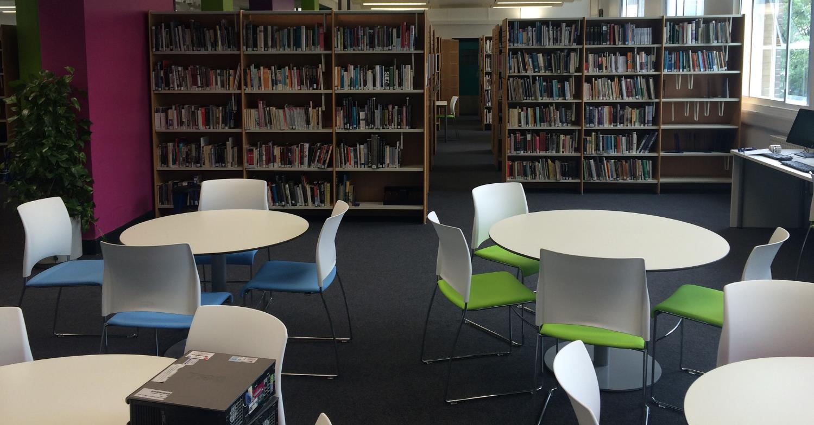
Space for socializing and group work
“We do go to the library or somewhere quiet where we can just get our work done together...”
(UKU3, Female, Age 19, French and Italian)
Notes:
Image: https://www.flickr.com/photos/jamesclay/14867901948/ by James F Clay / CC BY-NC 2.0
“When asked to describe the ideal information system, Millennials suggested that the library catalog be more like an Internet search engine or Amazon.com. They also wanted the library to provide space for them to socialize and work in groups and suggested 24/7 access to a librarian via telephone, such as a ‘lifeline” (referring to the television program, Who Wants to be a Millionaire?) Older Millennials were most interested in expediency, desiring roaming librarians, drive-up book drops, library delivery of print materials to their campus addresses, and a coffee house-like environment. The faculty (the majority were Baby Boomers) wanted a less intimidating library with better signage, and a book store like environment.” (p. 92)
Connaway, Lynn Silipigni, comp. 2015. The Library in the Life of the User: Engaging with People Where They Live and Learn. Dublin, OH: OCLC Research. http://www.oclc.org/content/dam/research/publications/2015/oclcresearch-library-in-life-of-user.pdf.
“We do go to the library or somewhere quiet where we can just get our work done together but in regards to something we need the internet for or the computer we normally do that by ourselves. For example I will write up something and send it to her or just print it out and bring it to the lesson and she will go “That’s fine.”” (Digital Visitors and Residents, UKU3, Emerging, Female, Age 19, French and Italian)
White, David S., and Lynn Silipigni Connaway. 2011-2014. Digital Visitors and Residents: What Motivates Engagement with the Digital Information Environment. Funded by JISC, OCLC, and Oxford University. http://www.oclc.org/research/activities/vandr.html.

Slide 53
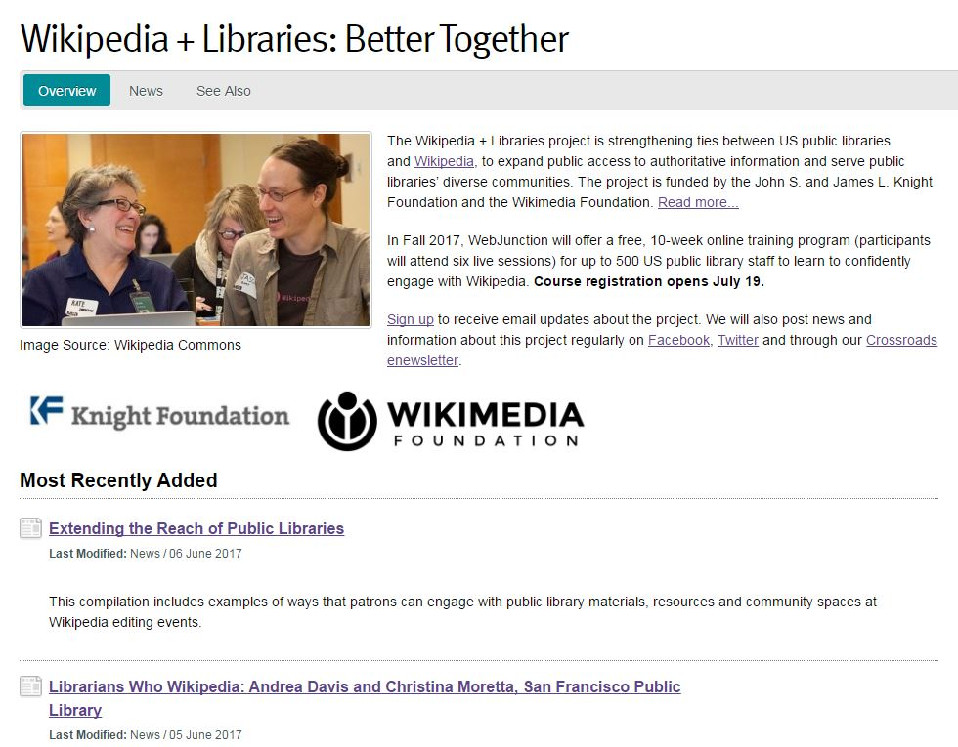
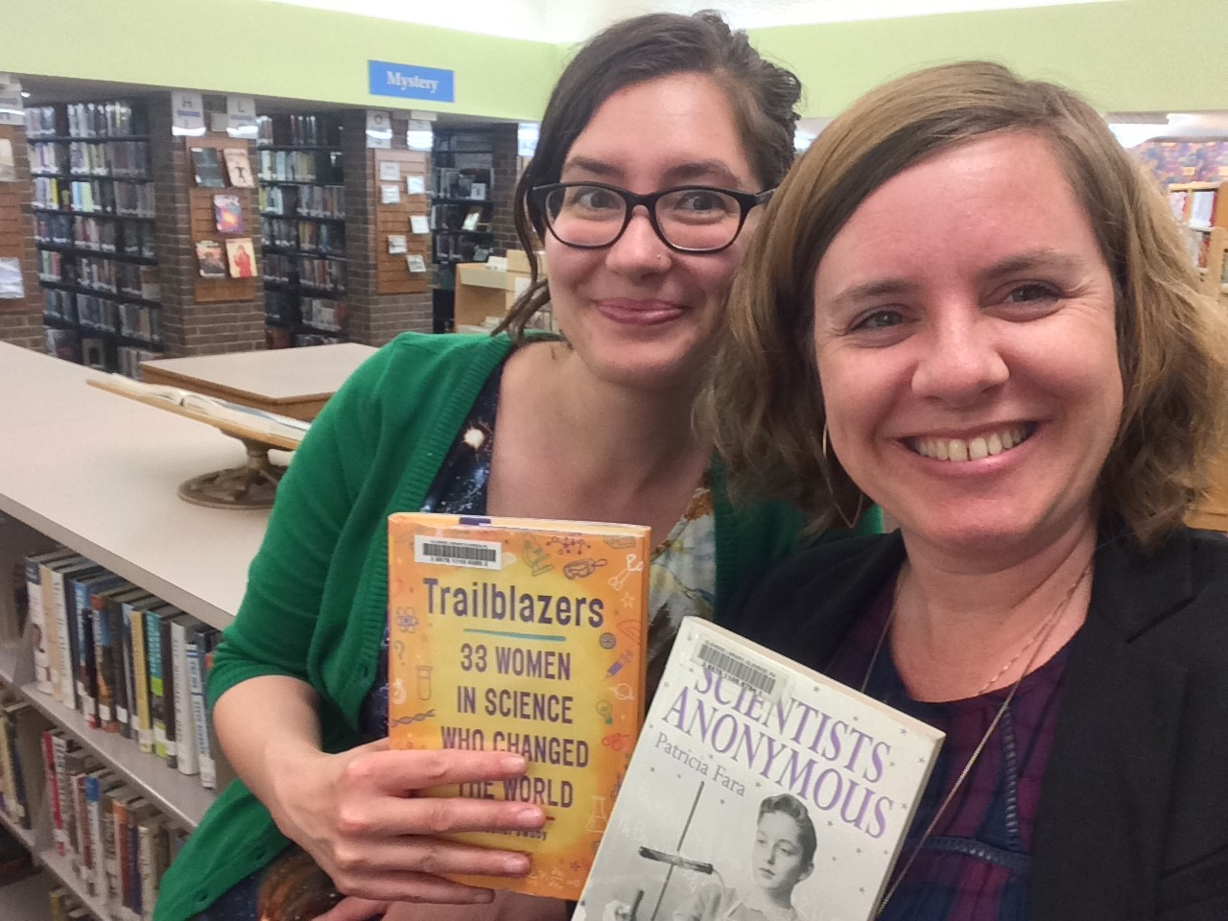
Information literacy with Wikipedia
Allison Frick, left, (Glendale Free Library in Pennsylvania) and Christina Riehman-Murphy (Penn State) organized an information literacy event focused on women and science. Photo: Courtesy Allison Frick
oc.lc/oclc-wikilib
Notes:
Slide adapted from Frick, Rachel, Sharon Streams, Monika Sengul-Jones, Kenning Arlitsch, and Jeff Mixter. 2017. OCLC Research Update. ALA Annual Conference, Chicago, Illinois, June 26, 2017.

Slide 54
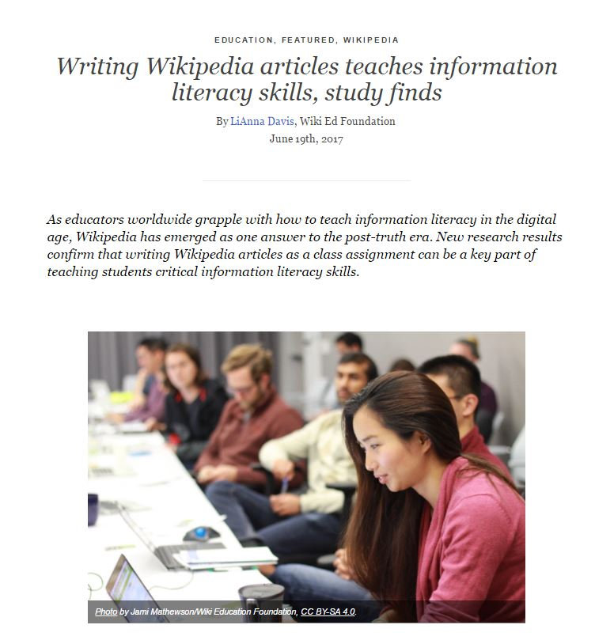
Editing Wikipedia promotes digital information literacy
96% of higher education instructors consider Wikipedia more valuable for teaching digital literacy than traditional assignments
    2017 Wiki Education Foundation report
    https://commons.wikimedia.org/wiki/File:Student_Learning_Outcomes_using_Wikipedia-based_Assignments_Fall_2016_Research_Report.pdf
Notes:
Slide from Frick, Rachel, Sharon Streams, Monika Sengul-Jones, Kenning Arlitsch, and Jeff Mixter. 2017. OCLC Research Update. ALA Annual Conference, Chicago, Illinois, June 26, 2017.
Wiki Education Foundation. 2016. Student Learning Outcomes using Wikipedia-based Assignments Fall 2016 Research Report. Prepared by Zachary James McDowell and Mahala Dyer Stewart. Retrieved from https://commons.wikimedia.org/w/index.php?title=File:Student_Learning_Outcomes_using_Wikipedia-based_Assignments_Fall_2016_Research_Report.pdf&page=2.

Slide 55
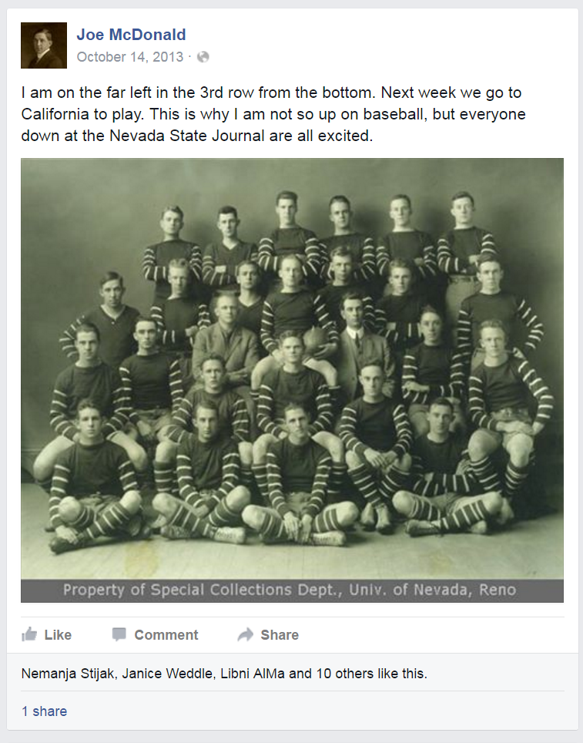
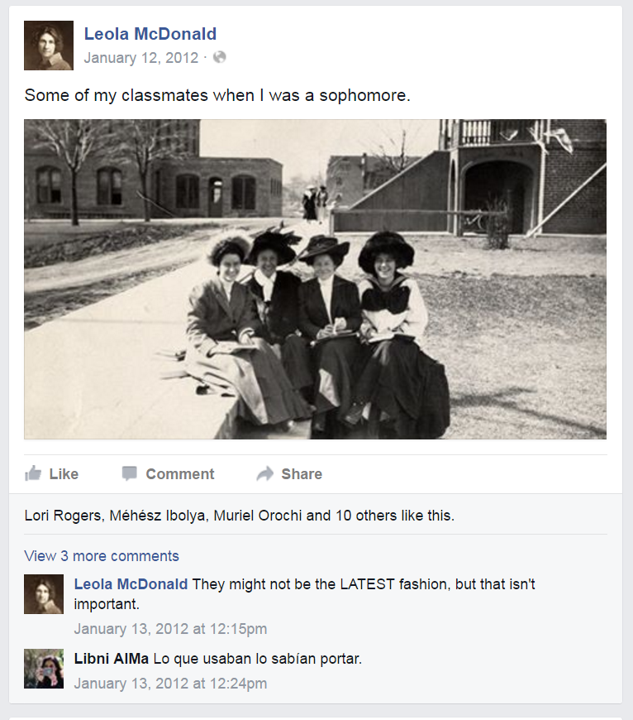
Social Media Presence
Notes:
Image: “Joe McDonald’s Facebook Page.” Facebook.com. https://www.facebook.com/Joe-McDonald-274017182657487/.
Image: “Leola McDonald’s Facebook Page.” Facebook.com. https://www.facebook.com/Leola-McDonald-128487107270652/.
DeSantis, Nick. 2012. “On Facebook, Librarian Brings 2 Students From the Early 1900s to Life.” The Chronicle of Higher Education, January 6. http://chronicle.com/blogs/wiredcampus/on-facebook-librarian-brings-two-students-from-the-early-1900s-to-life/34845.

Slide 56
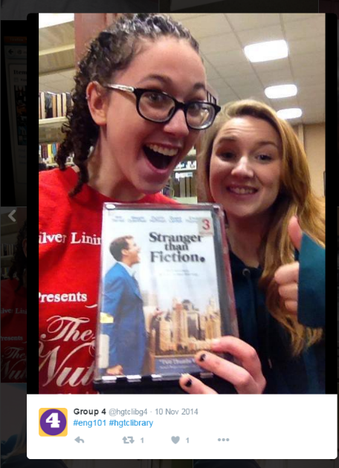
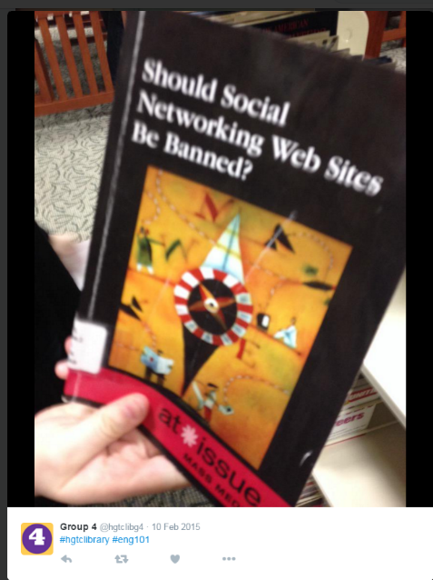
Special Events & Activities
Notes:
Images: Twitter
“The “hashtag hunt,” or Twitter-based scavenger hunt, is an activity that any librarian can complete with his or her students. Though it was originally created to help English 101 students practice finding recommended books for research assignments concerning controversial or moral issues and with the OPAC, it also allows students to explore the library as a place. The handout students receive is structured like all of the traditional library scavenger hunts of day’s past, but students are asked to take photos of the items they find and post them on Twitter with hashtags of the librarian’s choosing, usually hashtags that distinguish the library and the class (e.g., #hgtclibrary and #eng101). Students may also be awarded bonus points for #shelfie posts, which are explained to be posts of themselves in stacks, using the one of the collaborative learning units and/or print stations, or standing in a study room.” (11)
Kraft, Amanda, and Aleck F. Williams, Jr. 2016. “#Shelfies are Encouraged: Simple, Engaging Library Instruction with Hashtags.” College & Research Libraries News 77, no. 1 (2016): 10-13.

Slide 57
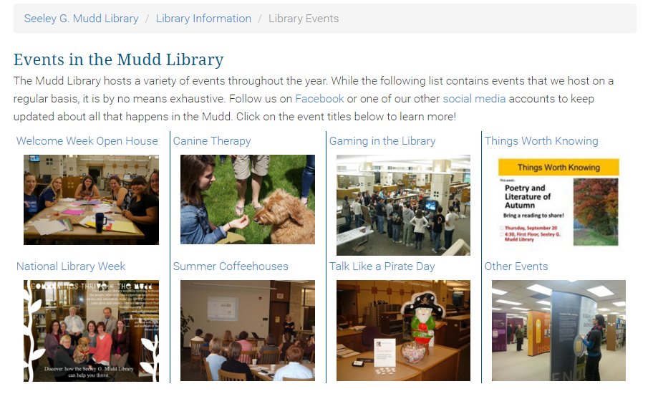
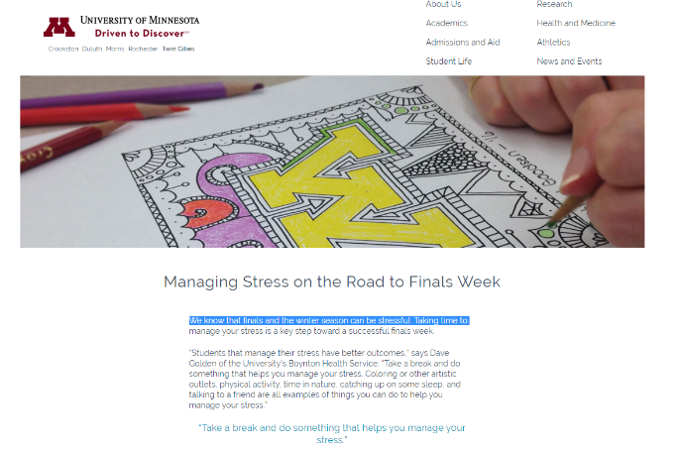
Special Events & Activities
Notes:
Image: Lawrence University. “Library Events.” https://www.lawrence.edu/library/about/events.
Image: University of Minnesota. “Managing Stress on the Road to Finals Week.” https://twin-cities.umn.edu/managing-stress-road-finals-week.

Slide 58
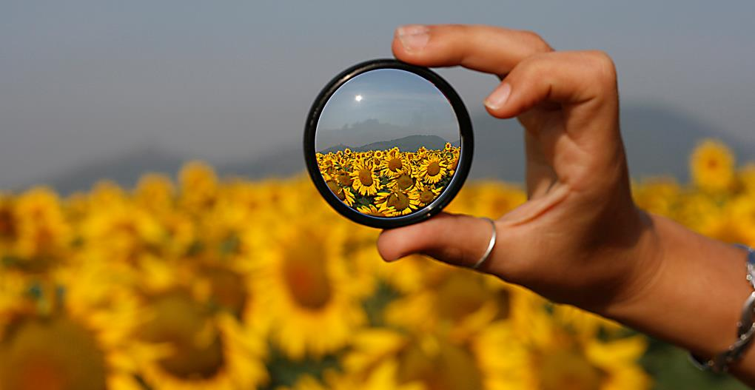
“By focusing on relationship building instead of service excellence, organizations can uncover new needs and be in position to make a stronger impact.”
(Mathews 2012)
Notes:
Image: https://www.flickr.com/photos/marcomagrini/698692268/ by marco magrini / CC BY-NC-ND 2.0
Mathews, Brian. 2012. Think Like a Startup: A White Paper to Inspire Library Entrepreneurialism. http://chronicle.com/blognetwork/theubiquitouslibrarian/2012/04/04/think-like-a-startup-a-white-paper/.

Slide 59

“Library is a growing organism.”
(Ranganathan 1931)
Use what you know.
Learn what you don’t know.
Engage in new ways.
Notes:
Image: http://www.flickr.com/photos/96043955@N05/15190222775 by Ryan Hickox / CC BY-SA 2.0
Ranganathan, S. R. 1931. The Five Laws of Library Science. London: Edward Goldston, Ltd.

Slide 60
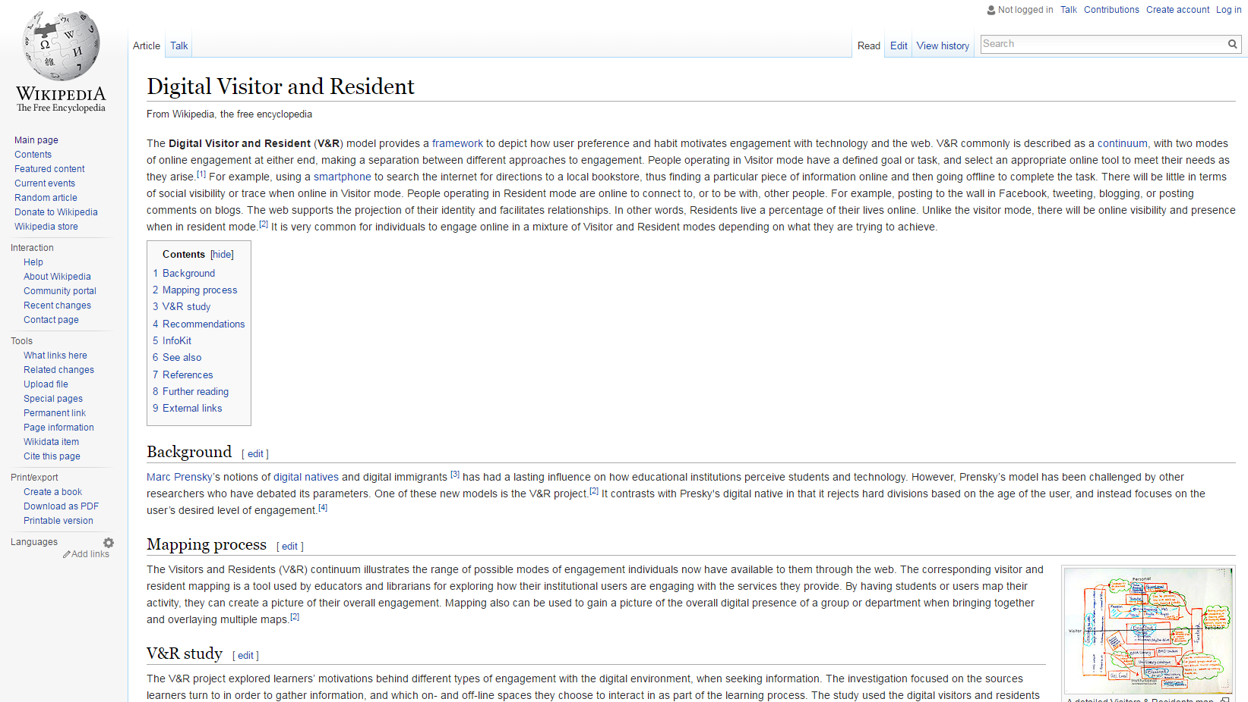
Notes:
Image: Wikipedia contributors. "Digital Visitor and Resident." Wikipedia, The Free Encyclopedia. https://en.wikipedia.org/wiki/Digital_Visitor_and_Resident.

Slide 61

The Many Faces of Digital Visitors & Residents:
Facets of Online Engagement
OCLC Report authored by:
Lynn Silipigni Connaway
Vanessa Kitzie
Erin M. Hood
William Harvey
Notes:
Image: https://www.flickr.com/photos/eltpics/9674285302 by eltpics / CC BY-NC 2.0 https://creativecommons.org/licenses/by-nc/2.0/

Slide 62

With contributions from:
Allison Benedetti
Agustí Canals
Liliana Gregori
Eva Ortoll Espinet
Daniel Lozano
Melissa Man
Josep Cobarsí Morales
Sara Giuliana Ricetto
Riccardo Melgrati
Eva M. Méndez Rodríguez
Andrea Sada
Peter Sidorko
Paolo Sirito
Virginia Steel
Titia van der Werf
Esther Woo
Notes:
Image: https://www.flickr.com/photos/littlestar19/4086086968 by littlestar19 / CC BY-NC 2.0 https://creativecommons.org/licenses/by-nc/2.0/

Slide 63
Acknowledgements
I would like to thank Erin M. Hood and Brittany Brannon for their assistance in preparing this presentation.

Slide 64
References
Connaway, Lynn S., David White, and Donna Lanclos. 2011. “Visitors and Residents: What motivates engagement with the digital information environment?” Proceedings of the 74th ASIS&T Annual Meeting 48: 1-7.
Connaway, Lynn Silipigni, comp. 2015. The Library in the Life of the User: Engaging with People Where They Live and Learn. Dublin, OH: OCLC Research. http://www.oclc.org/content/dam/research/publications/2015/oclcresearch-library-in-life-of-user.pdf.
DeSantis, Nick. 2012. “On Facebook, Librarian Brings 2 Students From the Early 1900s to Life.” The Chronicle of Higher Education, January 6. http://chronicle.com/blogs/wiredcampus/on-facebook-librarian-brings-two-students-from-the-early-1900s-to-life/34845.
Frick, Rachel, Sharon Streams, Monika Sengul-Jones, Kenning Arlitsch, and Jeff Mixter. 2017. OCLC Research Update. ALA Annual Conference, Chicago, Illinois, June 26, 2017.
Kraft, Amanda, and Aleck F. Williams, Jr. 2016. “#Shelfies are Encouraged: Simple, Engaging Library Instruction with Hashtags.” College & Research Libraries News 77, no. 1 (2016): 10-13.
MacKay, R. F. (2013). “Playing to Learn: Panelists at Stanford Discussion Say Using Games as an Educational Tool Provides Opportunities for Deeper Learning.” Stanford News, March 1, http://news.stanford.edu/2013/03/01/games-education-tool-030113/.

Slide 65
References
Mathews, Brian. 2012. Think Like a Startup: A White Paper to Inspire Library Entrepreneurialism. http://chronicle.com/blognetwork/theubiquitouslibrarian/2012/04/04/think-like-a-startup-a-white-paper/.
OCLC Research. 2016. Using the Digital Visitors and Residents App. YouTube video. May 5. https://www.youtube.com/watch?v=6ai0ZO3lDR4.
Ranganathan, S. R. 1931. The Five Laws of Library Science. London: Edward Goldston, Ltd.
White, David, Lynn Silipigni Connaway, Donna Lanclos, Erin M. Hood, and Carrie Vass. 2014. Evaluating Digital Services: A Visitors and Residents Approach. http://www.jiscinfonet.ac.uk/infokits/evaluating-services/.
Wiki Education Foundation. 2016. Student Learning Outcomes using Wikipedia-based Assignments Fall 2016 Research Report. Prepared by Zachary James McDowell and Mahala Dyer Stewart. Retrieved from https://commons.wikimedia.org/w/index.php?title=File:Student_Learning_Outcomes_using_Wikipedia-based_Assignments_Fall_2016_Research_Report.pdf&page=2.
World Bank. 2016. “World Development Report 2016: Digital Dividends.” Washington, D.C.: World Bank. www.worldbank.org/en/publication/wdr2016. Quoted in Gary Pattillo. 2016. “Fast Facts.” College & Research Libraries News 77, no. 3: 164.
Zhang, Jie, and Nevin Mayer. 2014. “Proactive Chat Reference: Getting in the Users’ Space.” College & Research Libraries News 75, no. 4: 202-205.

Slide 66
Image Attributions
Slide 5: https://www.flickr.com/photos/ameteorshower/7003279005/ by A METEOR SHOWER / CC BY-NC-ND 2.0
Slide 7: https://www.flickr.com/photos/29233640@N07/9363159824/ by Robert Couse-Baker / CC BY 2.0
Slide 8: https://www.flickr.com/photos/15216811@N06/8521338394 by N i c o l a / CC BY 2.0
Slide 11: https://www.flickr.com/photos/vamapaull/3775032790 by Paul Istoan / CC BY-NC 2.0
Slide 12: https://www.flickr.com/photos/elena_87/2567662128/ (Università Cattolica del Sacro Cuore Milano) by Elena / CC BY-NC-ND 2.0
Slide 14: https://www.flickr.com/photos/vek/4785218372/ by Kevin Spencer / CC BY-NC 2.0
Slide 15: https://www.flickr.com/photos/bull3t/3271752011 by Bull3t Hughes / CC BY-SA 2.0
Slide 17: https://www.flickr.com/photos/12905355@N05/4293966039/ by Photo Giddy / CC BY-NC 2.0
Slide 20: https://www.flickr.com/photos/bonitoclub/9910937863/ by Tony & Wayne / CC BY-NC 2.0
Slide 21: https://www.flickr.com/photos/124705972@N06/14597368868/ by Steve Larkin / CC BY-NC 2.0
Slide 22: Image: https://www.flickr.com/photos/ligthelm/22154604304/ by Rick Ligthelm / CC BY 2.0
Slide 24: https://www.flickr.com/photos/mayopants/4021073588/ by stateofplace / CC BY-NC
Slide 25: https://www.flickr.com/photos/zigazou76/6086655772 by Frederic BISSON / CC BY 2.0

Slide 67
Image Attributions
Slide 27: https://www.flickr.com/photos/jasonahowie/8583949219 by Jason Howie / CC BY 2.0
Slide 28: https://www.flickr.com/photos/uniinnsbruck/3723226694 by uniinnsbruck / CC BY-NC 2.0
Slide 29: https://www.flickr.com/photos/stewart/99129170/ by Stewart Butterfield / CC BY 2.0
Slide 30: https://www.flickr.com/photos/11115086@N00/4276498711 by Brenda / CC BY 2.0
Slide 32: http://www.flickr.com/photos/79743208@N05/10229498105 by Matthew Matheson / CC BY-NC-ND 2.0
Slide 33: https://www.flickr.com/photos/51009184@N06/12326453255 by Savannah River Site / CC BY 2.0
Slide 34: https://www.flickr.com/photos/96684011@N05/9902436694/ by Erik Lorenzsonn / CC BY 2.0
Slide 35: https://www.flickr.com/photos/peter-trimming/9566245040/ by Peter Trimming / CC BY 2.0
Slide 36: https://www.flickr.com/photos/thomashawk/2383336375 by Thomas Hawk / CC BY-NC 2.0
Slide 38: https://www.flickr.com/photos/wrachmanto/7566846468/ by Widhi Rachmanto / CC BY 2.0
Slide 39: https://www.flickr.com/photos/theo_reth/5577311905 by Tehophilos Papadopoulos / CC BY-NC-ND 2.0
Slide 40: https://www.flickr.com/photos/121483302@N02/16270228508 by Global Panorama / CC BY-SA 2.0
Slide 41: https://www.flickr.com/photos/freedomiiphotography/5181103215/ by Freedom II Andres / CC BY 2.0

Slide 68
Image Attributions
Slide 42: https://www.flickr.com/photos/astrid/26199740886 by astrid westvang / CC BY-NC-ND 2.0
Slide 51: https://www.flickr.com/photos/68532869@N08/17470913285/ by Japanexperterna.se / CC BY-SA 2.0
Slide 52: https://www.flickr.com/photos/backgroundsetc/3424524913 by Backgrounds Etc / CC BY 2.0
Slide 53: https://www.flickr.com/photos/28481088@N00/8703727704 by tanakawho / CC BY-NC 2.0
Slide 54: https://www.flickr.com/photos/jamesclay/14867901948/ by James F Clay / CC BY-NC 2.0
Slide 57: “Joe McDonald’s Facebook Page.” Facebook.com. https://www.facebook.com/Joe-McDonald-274017182657487/; “Leola McDonald’s Facebook Page.” Facebook.com. https://www.facebook.com/Leola-McDonald-128487107270652/
Slide 59: Lawrence University. “Library Events.” https://www.lawrence.edu/library/about/events; University of Minnesota. “Managing Stress on the Road to Finals Week.” https://twin-cities.umn.edu/managing-stress-road-finals-week
Slide 60: https://www.flickr.com/photos/marcomagrini/698692268/ by marco magrini / CC BY-NC-ND 2.0
Slide 61: http://www.flickr.com/photos/96043955@N05/15190222775 by Ryan Hickox / CC BY-SA 2.0
Slide 63: https://www.flickr.com/photos/eltpics/9674285302 by eltpics / CC BY-NC 2.0
Slide 64: https://www.flickr.com/photos/littlestar19/4086086968 by littlestar19 / CC BY-NC 2.0
Creative Commons licenses: https://creativecommons.org/licenses/

Slide 69
Questions & Discussion
Lynn Silipigni Connaway, PhD
Senior Research Scientist & Director of User Research
connawal@oclc.org
@LynnConnaway

