Slide 1
ASIS&T Annual Meeting | October 31, 2017
On Shapes and Sizes:
Measuring Diversity of Technological Engagement Through Digital Visitors and Residents Maps
William Harvey, PhD
Consulting Software Engineer, OCLC
Erin M. Hood, MLIS
Research Support Specialist, OCLC
Lynn Silipigni Connaway, PhD
Senior Research Scientist and Director of User Research, OCLC

Slide 2

About Digital Visitors and Residents
Identify how individuals engage with technology
How they acquire their information
Why they make their choices
(White, Connaway, Lanclos, Hood, and Vass 2014)
Notes:
Image: https://www.flickr.com/photos/ameteorshower/7003279005/ by A METEOR SHOWER / CC BY-NC-ND 2.0
V&R project
identify how individuals engage with technology and sources
how they acquire their information
why they make the choices that they do.
Understand the contexts that surround engagement with digital resources, spaces, and tools
(InfoKit Intro)

Slide 3
V&R Framework
#vandr
Visitors and Residents resources http://www.oclc.org/research/themes/user-studies/vandr.html
(White and Le Cornu 2011)
Notes:
This is a continuum and individuals may display visitor or resident characteristics in different contexts and situations.

Slide 4
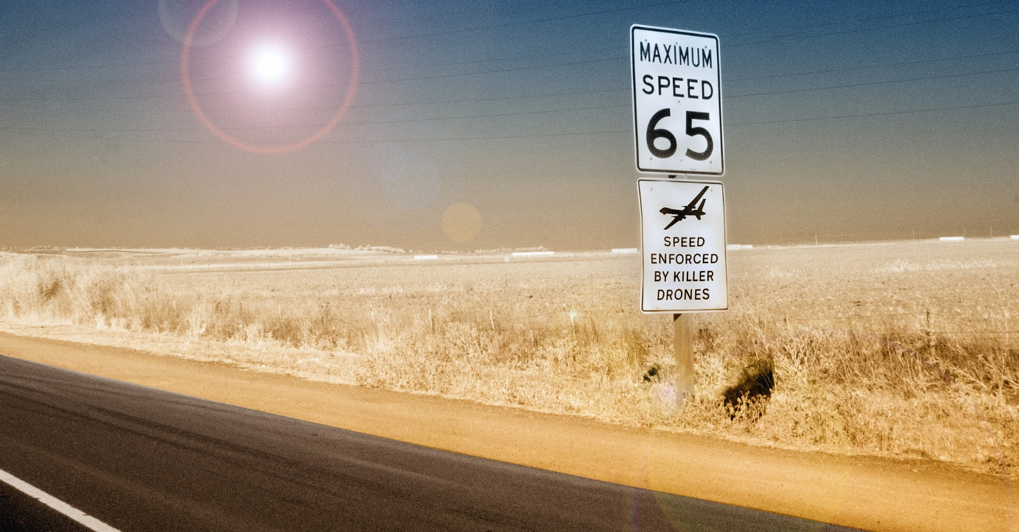
Visitor Mode
Functional use of technology
Formal need
Invisible online presence
Internet is a toolbox
(White and Connaway 2011-2014)
Notes:
Image: https://www.flickr.com/photos/29233640@N07/9363159824/ by Robert Couse-Baker / CC BY 2.0
Visitors: functional use of technology, often linked to formal need (such as use of software for specific coursework, or organizing meetings through email contact); less visible/more passive online presence, more likely to favor face-to-face interactions (even as they use the internet to organize/schedule those interactions)

Slide 5
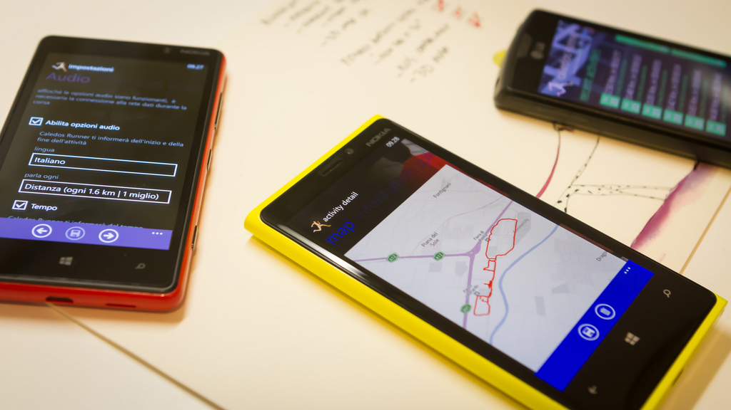
Resident Mode
Visible and persistent online presence
Collaborative activity online
Contribute online
Internet is a place
(White and Connaway 2011-2014)
Notes:
Image: http://www.flickr.com/photos/15216811@N06/8521338394 by N i c o l a / CC BY 2.0
Residents: significant online presence and usage; high level of collaborative activity online; contributions to the online environment in the form of uploading materials, photos, videos.

Slide 6
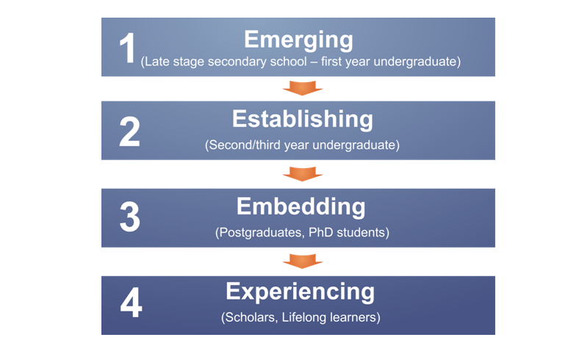
Educational Stages
(Connaway, White, and Lanclos 2011)
Notes:
1. Emerging (Late stage secondary school/First year undergraduate);
2. Establishing (Second/third or third/fourth year undergraduate);
3. Embedding (Postgraduates, PhD students);
4. Experienced (Faculty, Researchers, Scholars Lifelong Learners).

Slide 7
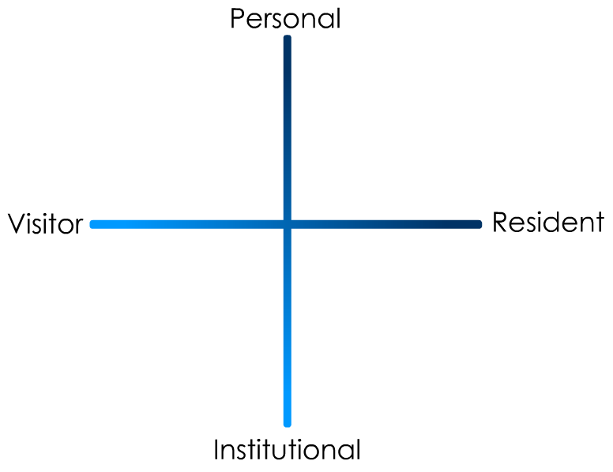
(Connaway and White for OCLC Research 2012)
Notes:
“In simple terms the Visitors see the web as a series of tools. They decide what they want to achieve, chose an appropriate online tool to do the job, then log-off. They leave no social trace of themselves online. The Residents live a proportion of their lives online. They see the web as a place where they can express themselves and spend time with people. Residents will have a profile on a social networking platform and aspects of their persona, or digital identity, maintaining presence even when they are not online. The premise of V&R is presented as a continuum whereby individuals’ modes of engagement will be more Visitor or Resident depending on their personal motivations and the context and situation at the time.” (Connaway, Lanclos, and Hood 2013)
First Monday Paper: http://is.gd/vandrpaper
Video: http://is.gd/vandrvideo

Slide 8
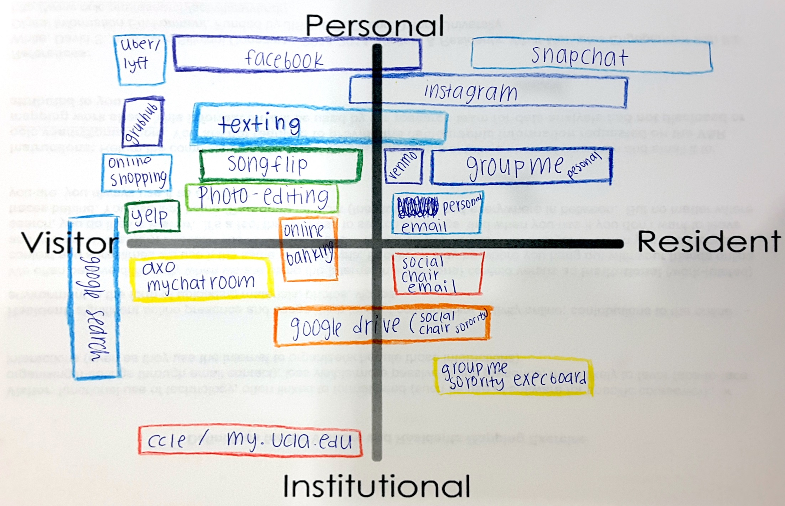
Notes:
Here is an example map drawn by a UCLA 2nd year undergrad student. [Point out a few of the activities, such as Uber, and explain/speculate why they were drawn in those locations.]

Slide 9
The Big Question
We have hundreds of these maps
Can we process them quantitatively?
Yes!

Slide 10
Workflow
Registration
Vectorization
Analysis
  Bag-Of-Words
  Set-Of-Words
  Shape Similarity

Slide 11
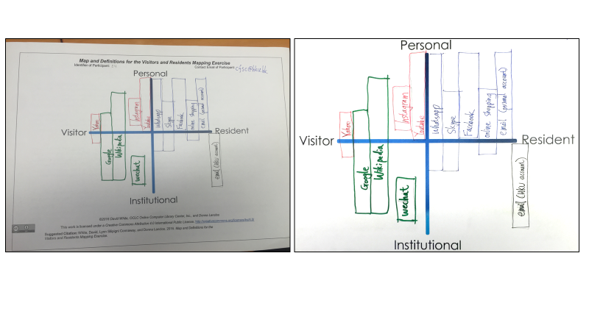
Image Normalization
Notes:
This is a raw map image acquired with a cell phone camera. The human visual system is very advanced, so most of us do not even notice that the camera is not squared up with the paper. We also do not notice the barrel distortion around the edges of the image.

Slide 12
Image Normalization
Notes:
Here is the same map image after registration and cleanup.
In Registration, we align each acquired image with a canonical Cartesian coordinate system (the X- and Y- axes you see here). By doing so, we can effectively overlay all map images and analyze their shapes in a common coordinate system. We cannot in general account for lens distortion in the images, however.
In Cleanup, we remove shadows, apply color contrast enhancement, and occasionally remove other irrelevant image artifacts.
We call the finished product a Normalized image.

Slide 13
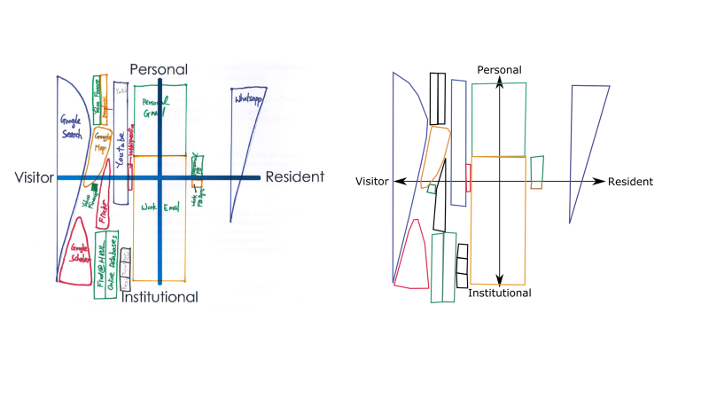
Image Vectorization
Notes:
The next step is to Vectorize each image. This is a simple, but manual, process. Each shape is traced using a graphics editing program. The outlined shapes are then saved as an SVG file.
Here is a normalized map image.

Slide 14
Image Vectorization
Notes:
…and here is its vectorized counterpart. While the shapes’ labels are not rendered over the shapes here, they are in fact recorded within the SVG file so that our software can use them for analysis.

Slide 15
Bag-Of-Words Analysis
Extract the bag of labels from each map
Each map becomes a bag-of-words

Slide 16
Bag-Of-Words
Which activities appear multiple times in a map?

Slide 17
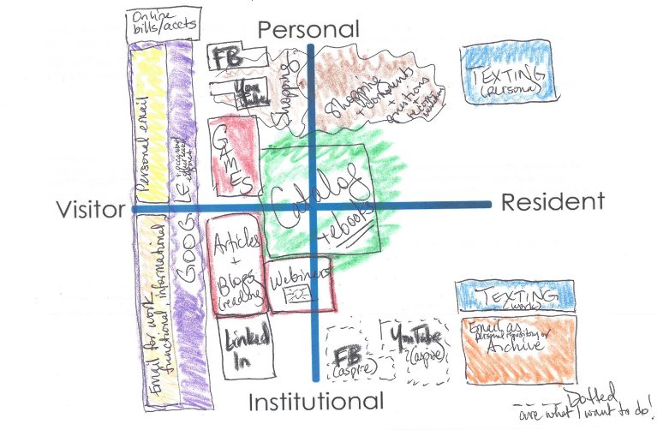
Notes:
Here is an example map with several instances of “multiple modes of engagement”. In particular, Facebook, YouTube, Texting, Email.

Slide 18

Notes:
Facebook

Slide 19

Notes:
YouTube

Slide 20

Notes:
Texting

Slide 21

Notes:
Email

Slide 22
UCLA: Top 10 Activities
Notes:
Now, for each map, we can just count the number of occurrences of each activity and build a histogram.
These are the top 10 most frequently reported websites/activities for UCLA.
The height of each bar is the percentage of people in the dataset who reported the activity on their map. The dark blue caps at the top of each bar represent the percentage of people who reported multiple modes of engagement for a given activity.
Notice how each activity has some map in the dataset where it was drawn using multiple shapes (modes of engagement). However, note that Google Search, Facebook, Email, and Gmail have somewhat elevated occurrence of multiple modes of engagement.

Slide 23
HKU: Top 10 Activities
Notes:
These are the top 10 most frequently reported websites/activities for HKU.
The height of each bar is the percentage of people in the dataset who reported the activity on their map. The dark blue caps at the top of each bar represent the percentage of people who reported multiple modes of engagement for a given activity.
Note that WhatsApp, Facebook, Google Search, and WeChat tend to have higher incidence of “multiple modes of engagement” than the other websites/activities.

Slide 24
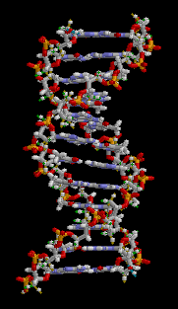
Bag-Of-Words Analysis
Which activities differentiate a set of maps from another?
  Treat activities as genes
  Measure differences in gene expression using SVMs
Notes:
We can measure which activities differentiate one set of maps from another using support-vector machines. While it sounds really exciting, it is just a natural thing to do with bag-of-words data.

Slide 25
Notes:
These websites/activities represent the “dominant genes” of the two groups. Note the institution-specific items (“HKU Portal”, “MyUCLA”, “CCLE”) and region-specific items (“Taobao”).

Slide 26
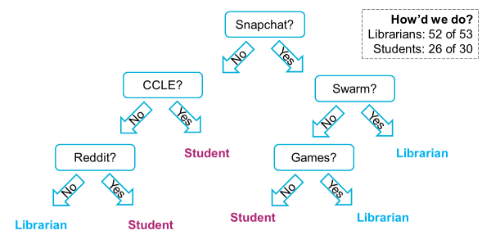
Bag-Of-Words: Decision Tree
Decision trees can also differentiate between two groups of maps
Notes:
Using the Bag-Of-Words representation, we ran an experiment to differentiate between librarians and UCLA students. Snapchat turned out to be the most important feature! Also, why are librarians playing games?

Slide 27
Bag-Of-Words: Geometric Means
Enough about differences!
What do two groups have in common?
  Geometric means of activity frequencies
Notes:
The geometric mean of two numbers, a and b, is the length of one side of a square whose area is equal to the area of a rectangle with sides of lengths a and b.

Slide 28
Notes:
Here, we take the geometric mean of the percentages of UCLA/HKU maps reporting each activity, and grab the top ten. These activities can be thought of as the activities most in common between the two groups. Note that some of these features (Linkedin, Amazon) appeared as discriminative activities in previous slides – still, they occur with non-negligible frequency in both groups.

Slide 29
Set-Of-Words
How do the individuals within a group relate to each other?
Set-Of-Words can help!
  Hamming distance
  Dice’s coefficient
  Tversky index
  …etc…

Slide 30
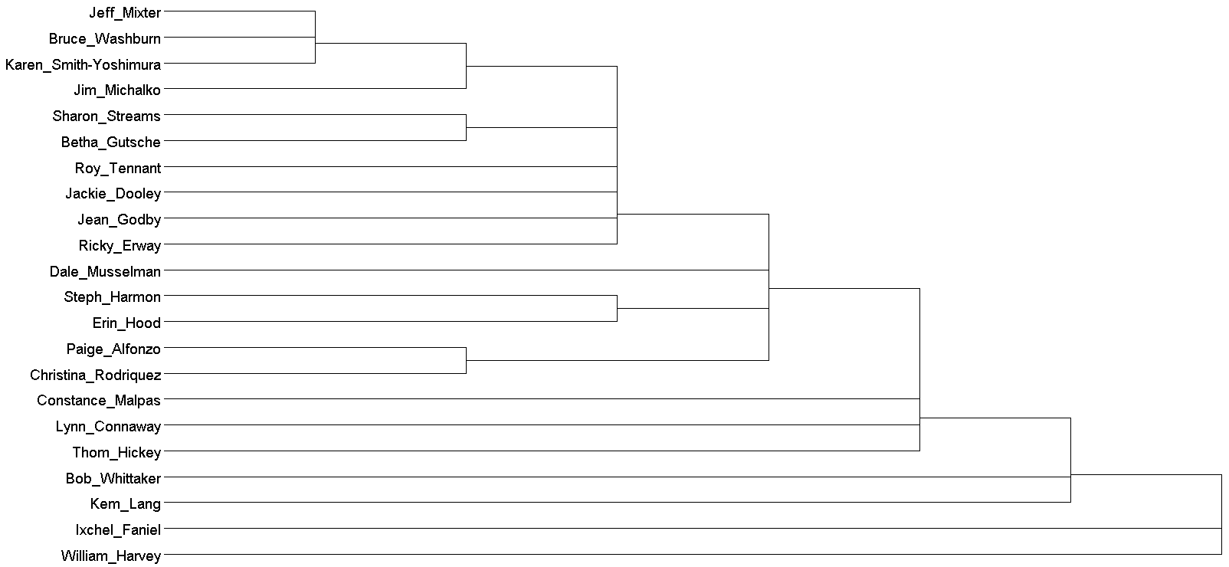
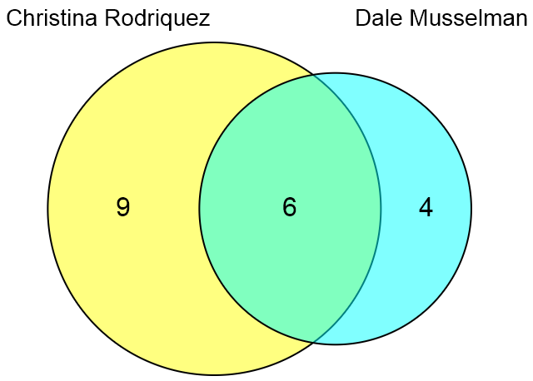
Alpha
Goodreads
Instagram
Pinterest
Reddit
Snapchat
Twitter
WebEx
CQ Web Content
iTunes
Bravo
Charlie
Oscar
Kilo
Delta
Echo
Foxtrot
Flickr
Moodle
Netflix
Yahoo
Golf
Hotel
India
Juliet
Kilo
Lima
Mike
November
Oscar
Email
Facebook
Google Search
Linkedin
Skype
Youtube
Papa
Quebec
Romeo
Sierra
Tango
Uniform
Victor
Notes:
Here we built a dendrogram of OCLC staff maps, using agglomerative clustering under set intersection cardinality. (The names of the staff were replaced with NATO alphabet codenames for anonymity.)
At a glance, you can see commonalities of engagement among subgroups of people (e.g., Alpha, Bravo, and Charlie). Victor is a complete outlier.

Slide 31
(Very) Basic Shape-Aware Analysis
Overlay the maps!

Slide 32
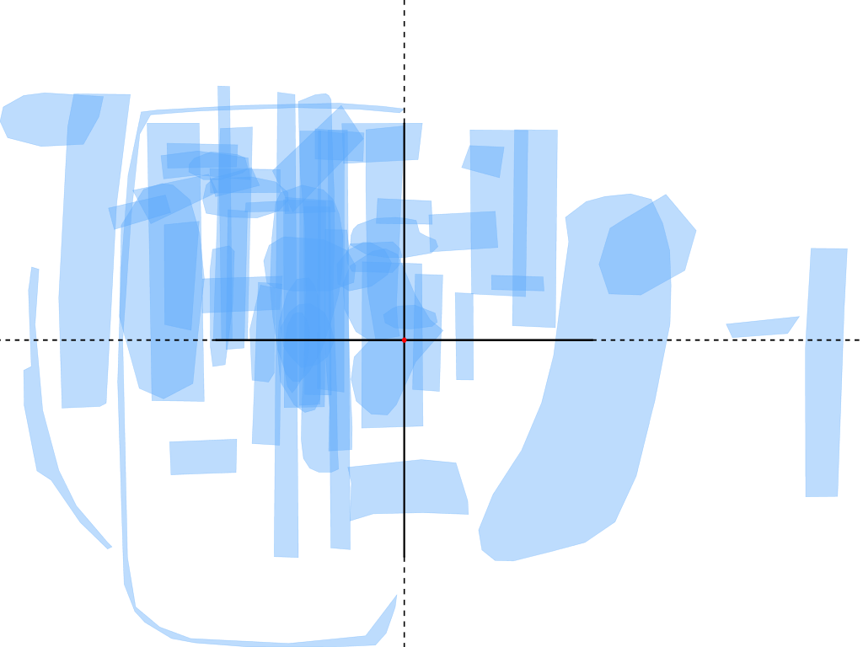
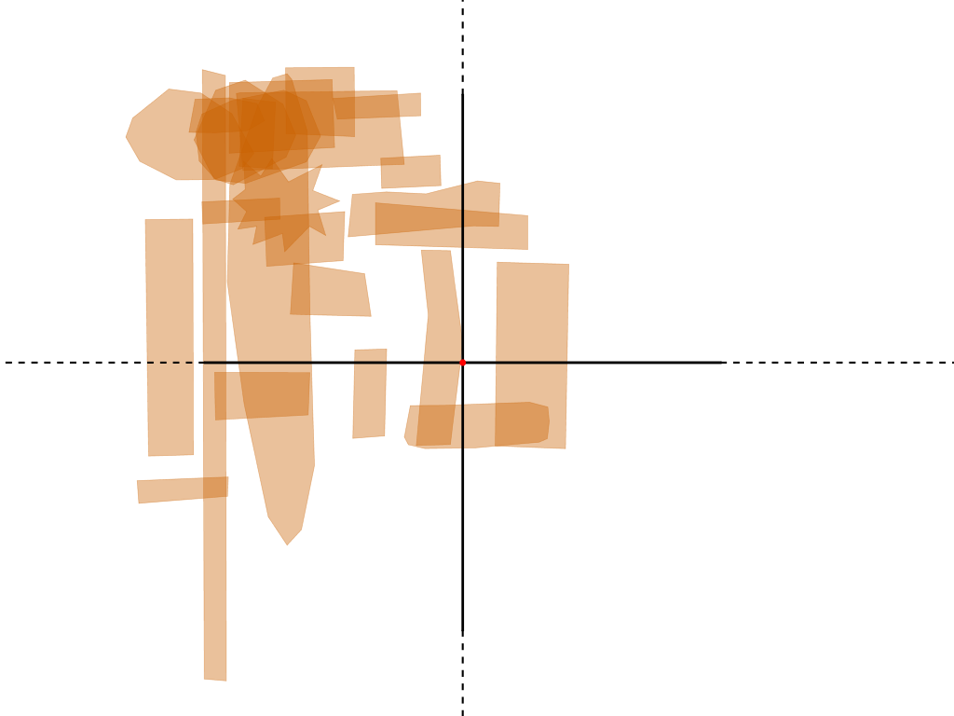
Personal
YouTube
Personal
Visitor
Resident
Visitor
Resident
Institutional
Institutional
HKU
UCLA
Notes:
YouTube use tends to cluster in the Visitor/Personal quadrant with some Institutional use in both cases. HKU participants tend to engage as a Resident more frequently than UCLA participants.

Slide 33
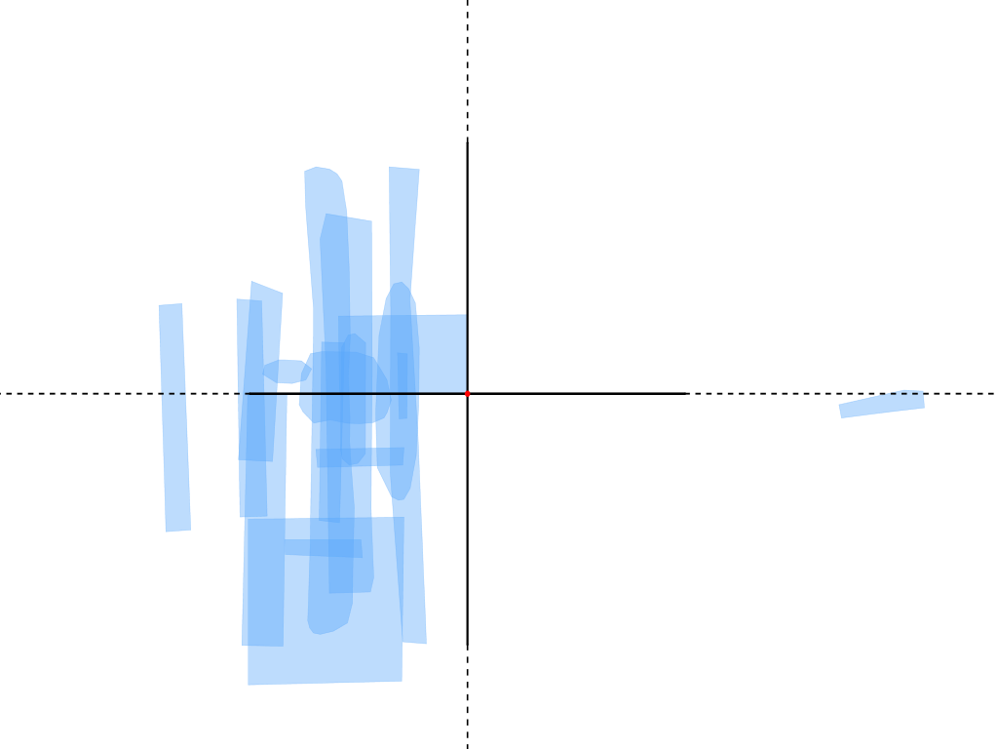
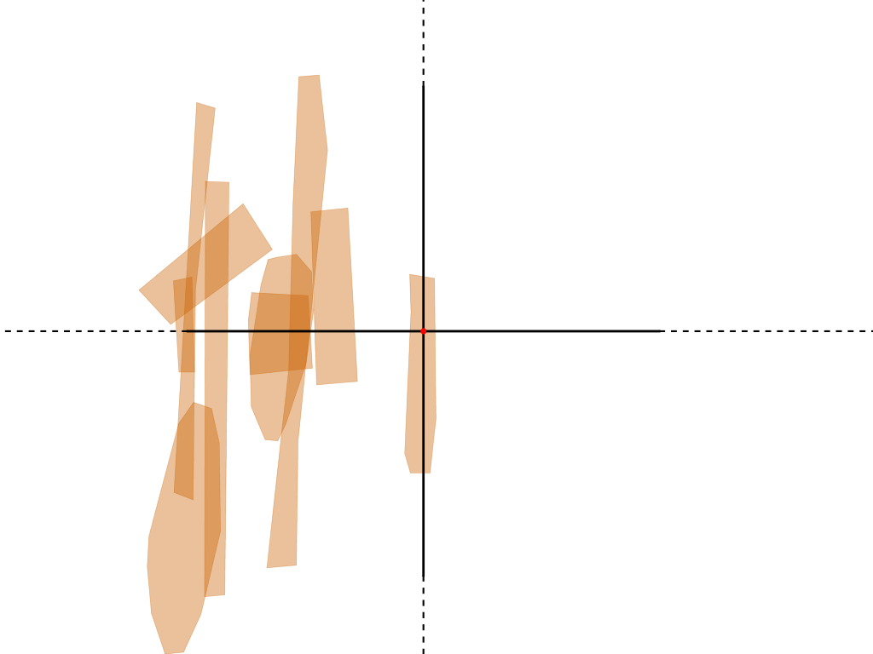
Personal
Wikipedia
Personal
Visitor
Resident
Visitor
Resident
Institutional
Institutional
HKU
UCLA
Notes:
Wikipedia usage is similar. Can anyone spot the “Wikipedia Editor”?

Slide 34
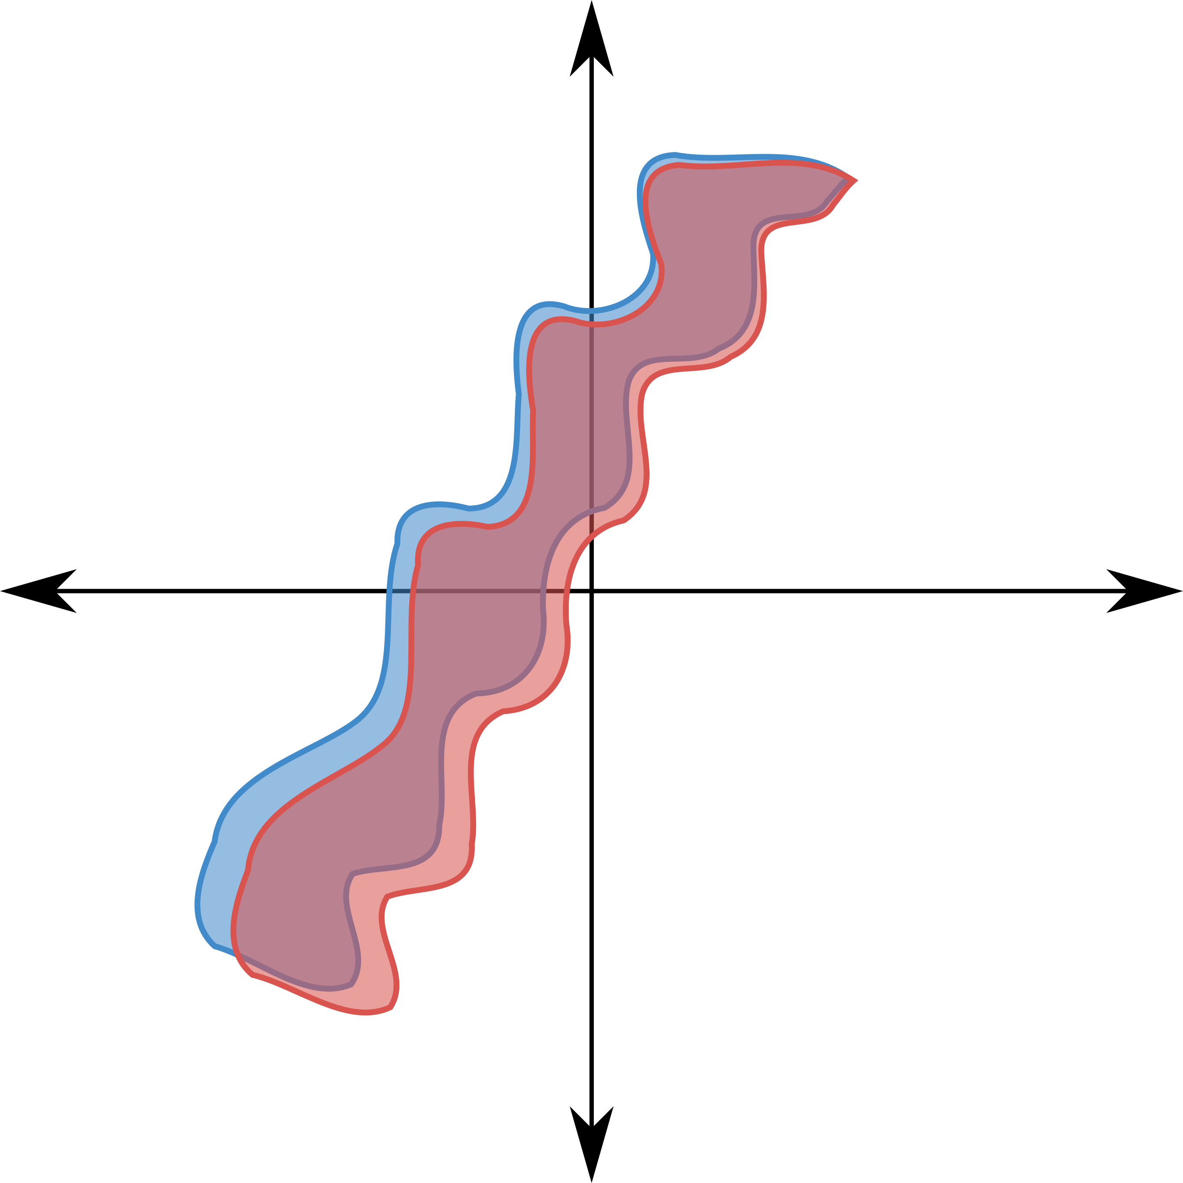
Shape Similarity?
Notes:
What if we want to compare a shape in one map with a shape in another? Can we overlay the two shapes and take their intersection area?
Maybe.

Slide 35
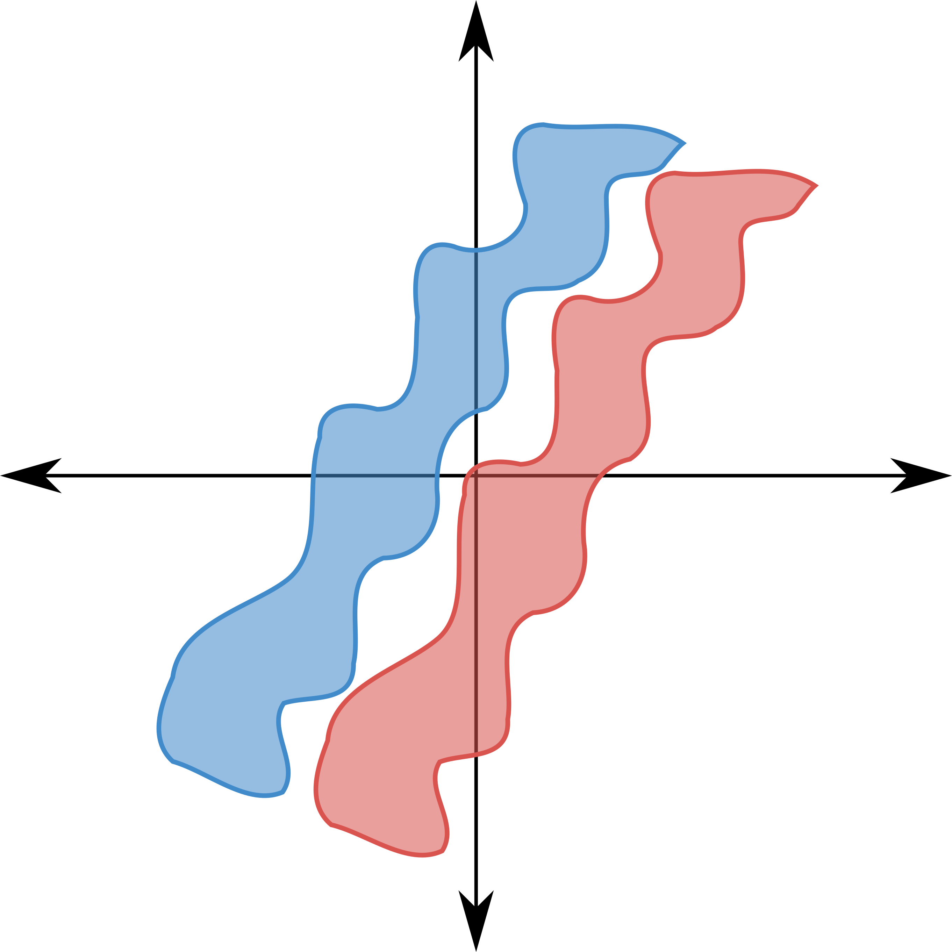
Shape Similarity?
Notes:
Or, maybe not. These two shapes look similar, but they don’t happen to overlap at all. So, if we use shape intersection area, their similarity is zero!
What else can be done?

Slide 36

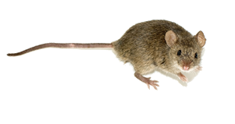
Wasserstein Distance
Notes:
Imagine I have overlaid two shapes, and I want to measure how geometrically similar they are. They don’t overlap, so I can’t use overlap area.

Slide 37
Wasserstein Distance
Notes:
Image: https://en.wikipedia.org/wiki/Mouse#/media/File:%D0%9C%D1%8B%D1%88%D1%8C_2.jpg by George Shuklin / CC BY-SA 1.0
Image: https://s0.wp.com/wp-content/mu-plugins/wpcom-smileys/twemoji/2/svg/1f9c0.svg Twitter [CC BY 4.0 (http://creativecommons.org/licenses/by/4.0)], via Wikimedia Commons
We can use the “Wasserstein Distance” (also known as the Earth Mover’s Distance) to measure the (dis)similarity of the two shapes.
Imagine that one shape is uniformly covered with N hungry mice, and the other shape is uniformly covered with N irresistible cheese wedges.

Slide 38
Wasserstein Distance
Notes:
The Wasserstein finds an assignment between mice and cheese wedges that minimizes the total distance traveled by the mice.
We could have called this the “cheese mover’s distance” if we imagine the cheese gravitating toward the mice.

Slide 39
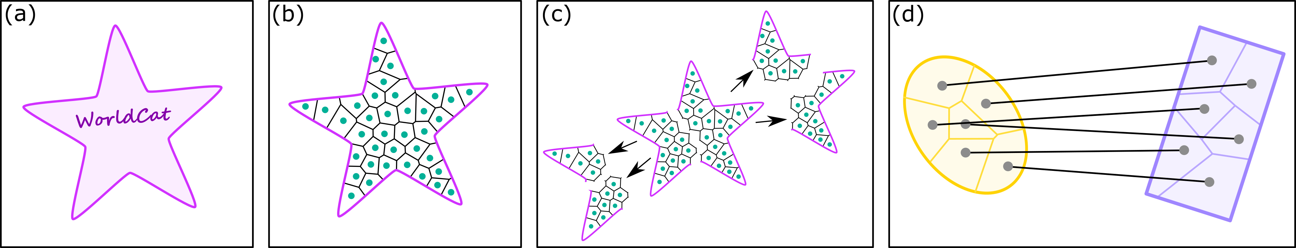
Wasserstein Distance
Notes:
Here is an example of how we use it to find correspondences between two shapes, and from those the Wasserstein Distance.
An input shape,
A shape shattered into N pieces
A hierarchical decomposition of each shape encourages nearby mice to forage in a group
An optimal correspondence found between two shapes.

Slide 40
Wasserstein Distance
Notes:
Here is an example of how we use it to find correspondences between two shapes, and from those the Wasserstein Distance.
An input shape,
A shape shattered into N pieces
A hierarchical decomposition of each shape encourages nearby mice to forage in a group
An optimal correspondence found between two shapes.

Slide 41
Wasserstein Distance
Notes:
Here is an example of how we use it to find correspondences between two shapes, and from those the Wasserstein Distance.
An input shape,
A shape shattered into N pieces
A hierarchical decomposition of each shape encourages nearby mice to forage in a group
An optimal correspondence found between two shapes.

Slide 42
Wasserstein Distance
Notes:
Here is an example of how we use it to find correspondences between two shapes, and from those the Wasserstein Distance.
An input shape,
A shape shattered into N pieces
A hierarchical decomposition of each shape encourages nearby mice to forage in a group
An optimal correspondence found between two shapes.

Slide 43

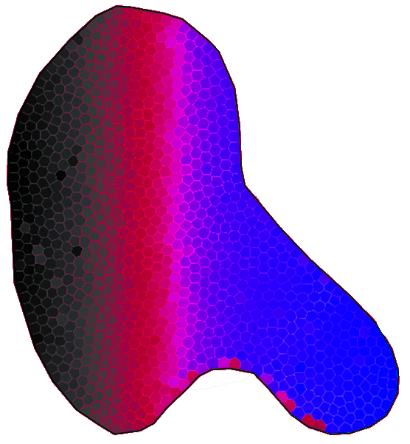
Notes:
Correspondences recovered using the Wasserstein distance. Note the red dots in the lower-right part of the right shape – neighboring mice are encouraged to forage together, but they don’t have to if it serves the greater good!

Slide 44
Wasserstein and Shape Distances
Find an “average” user (medoids)
Find outliers (e.g., Wikipedia editors)
Test statistical hypotheses
Cluster shapes
“A V&R map is a set of Bayesian probability distributions corresponding to quantifications of a user’s belief of how they engage with technologies.”

Slide 45
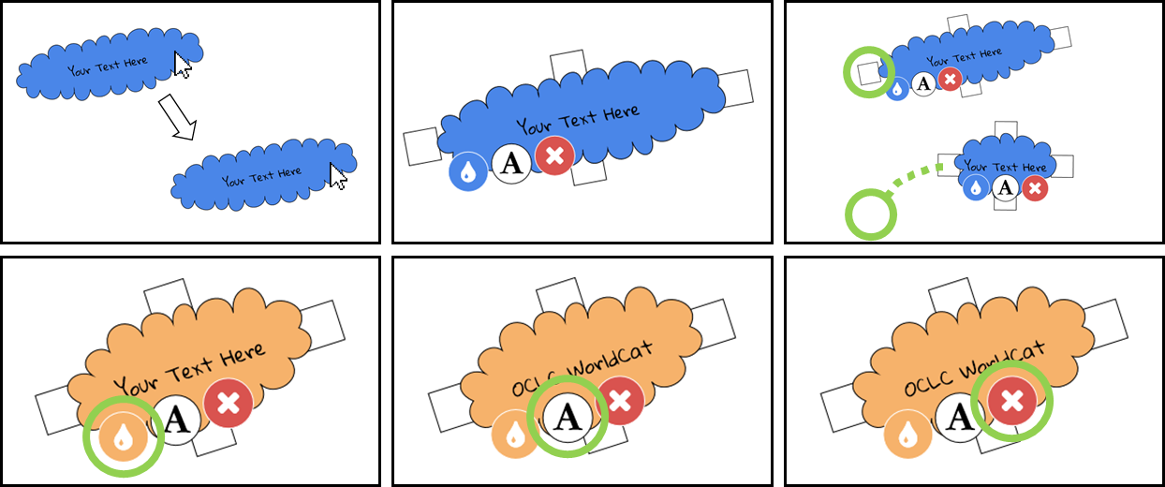
Try Our App! http://oc.lc/vrmap
Notes:
We put together an app that you can use to create and share your own map! It features a “stretchy scrapbooking” interface. It is fun to use, and it helps us to collect more data that we can process more easily than taking photos. Give it a try!

Slide 46
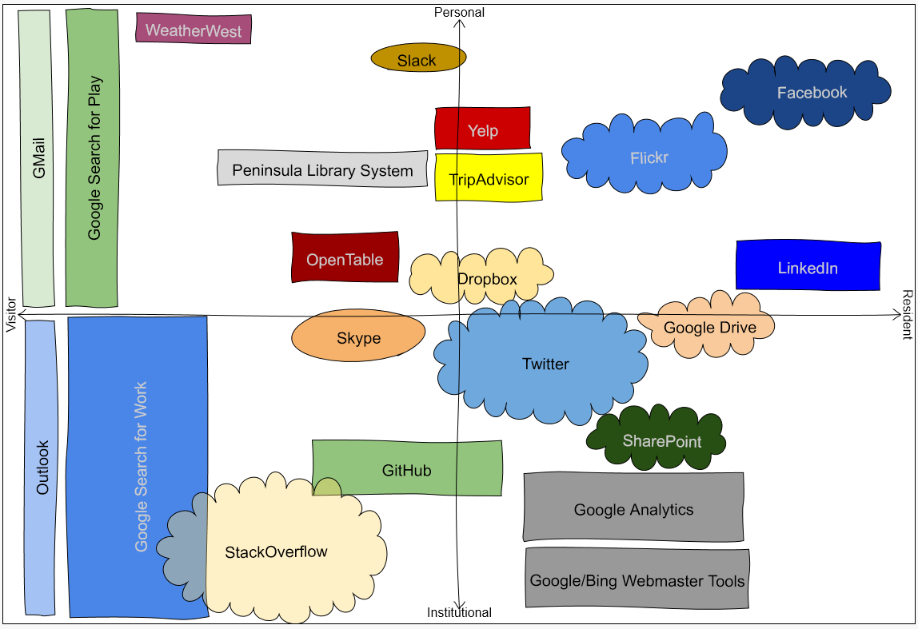

http://oc.lc/vrmap
Notes:
We made an app so that we can get more data!
1. To use the app, go to “http://oc.lc/vrmap”.
If you like it, share it!

Slide 47
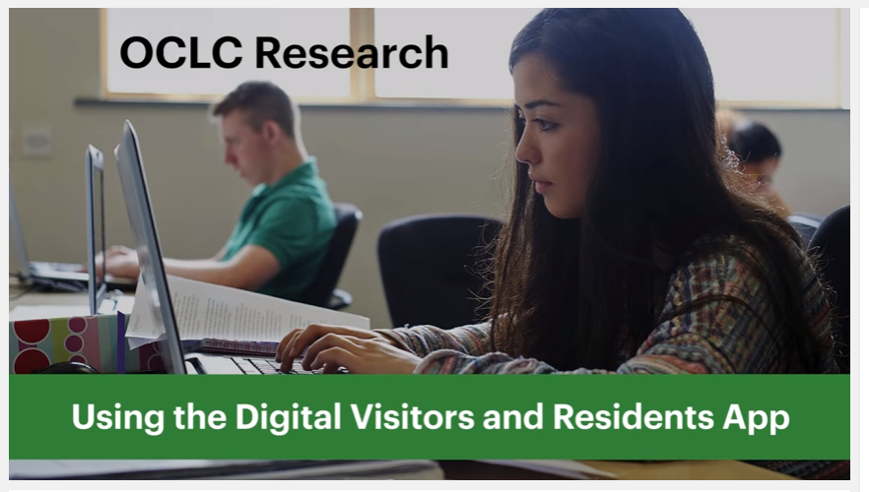
Play
Notes:
OCLC Research. 2016. Using the Digital Visitors and Residents App. YouTube video. May 5. https://www.youtube.com/watch?v=6ai0ZO3lDR4.

Slide 48
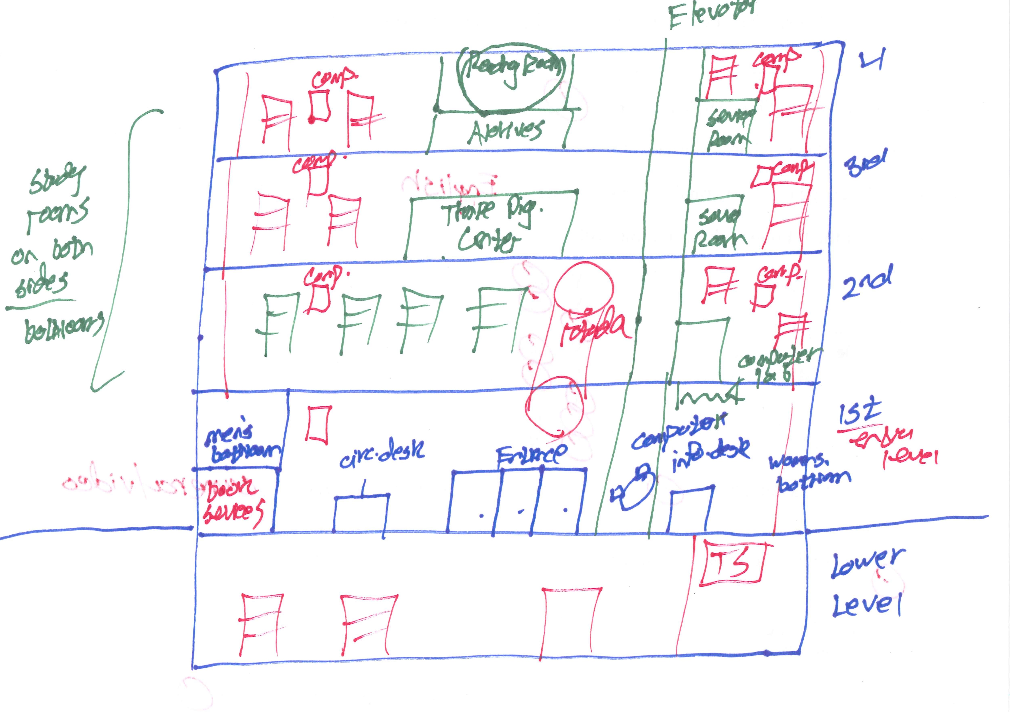
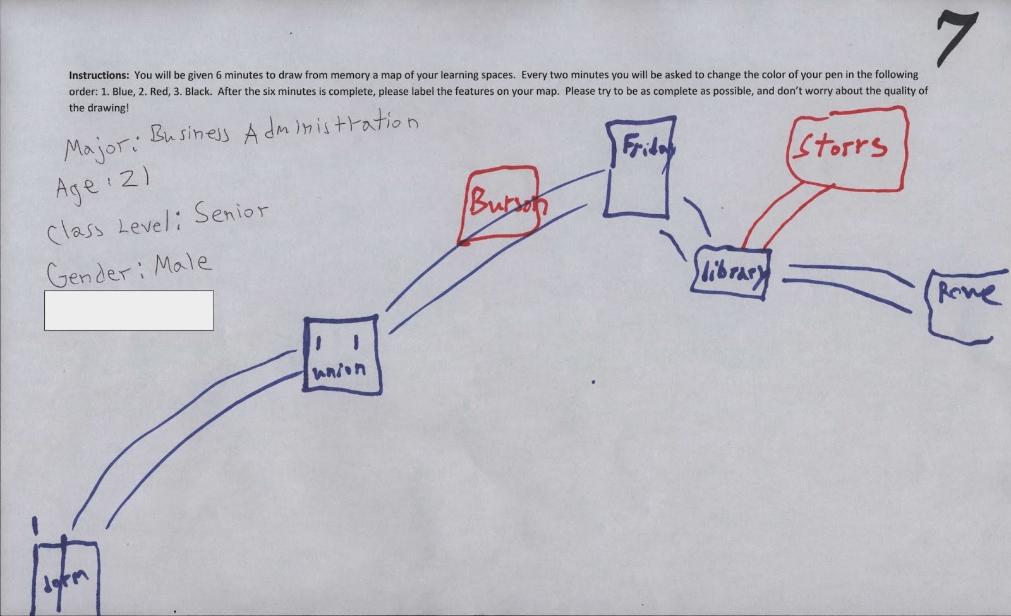
Now Analyze Your Data!
Notes:
Many research projects collect interesting pictorial data. Bring it to life using shape analysis techniques!
Left image:
Image: Donna Lanclos, “Playing with Cognitive Mapping,” The Anthropologist in the Stacks, November 19, 2013, http://atkinsanthro.blogspot.com/2013/11/playing-with-cognitive-mapping.html and http://4.bp.blogspot.com/-ovQmL8OAWtE/UouwsrtOvfI/AAAAAAAAA9g/d2xyJ-nXgD8/s1600/Map+7.jpg.
Right image:
Image: Andrew Asher, “Coding Library Cognitive Maps,” Biblio|Ethno|Historio|Graphy, December 9, 2013, http://www.andrewasher.net/BiblioEthnoHistorioGraphy/coding-library-cognitive-maps/ and http://www.andrewasher.net/BiblioEthnoHistorioGraphy/wp-content/uploads/2013/12/map41.jpg (CC BY 4.0).

Slide 49
Image Attributions
Slide 2: Image: https://www.flickr.com/photos/ameteorshower/7003279005/ by A METEOR SHOWER / CC BY-NC-ND 2.0
Slide 4: Image: https://www.flickr.com/photos/29233640@N07/9363159824/ by Robert Couse-Baker / CC BY 2.0
Slide 5: Image: http://www.flickr.com/photos/15216811@N06/8521338394 by N i c o l a / CC BY 2.0
Slide 37a: Image: https://en.wikipedia.org/wiki/Mouse#/media/File:%D0%9C%D1%8B%D1%88%D1%8C_2.jpg by George Shuklin / CC BY-SA 1.0
Slide 37b: Image: https://s0.wp.com/wp-content/mu-plugins/wpcom-smileys/twemoji/2/svg/1f9c0.svg Twitter [CC BY 4.0 (http://creativecommons.org/licenses/by/4.0)], via Wikimedia Commons
Slide 48a: Image: Donna Lanclos, “Playing with Cognitive Mapping,” The Anthropologist in the Stacks, November 19, 2013, http://atkinsanthro.blogspot.com/2013/11/playing-with-cognitive-mapping.html and http://4.bp.blogspot.com/-ovQmL8OAWtE/UouwsrtOvfI/AAAAAAAAA9g/d2xyJ-nXgD8/s1600/Map+7.jpg.
Slide 48b: Image: Andrew Asher, “Coding Library Cognitive Maps,” Biblio|Ethno|Historio|Graphy, December 9, 2013, http://www.andrewasher.net/BiblioEthnoHistorioGraphy/coding-library-cognitive-maps/ and http://www.andrewasher.net/BiblioEthnoHistorioGraphy/wp-content/uploads/2013/12/map41.jpg (CC BY 4.0).
Slide 50: Image: https://www.flickr.com/photos/scatteredashes/5844154762/ by Scipio / CC BY-NC 2.0

Slide 50
Thank You!
William Harvey, PhD
Consulting Software Engineer
harveyw@oclc.org
Lynn Silipigni Connaway, PhD
Senior Research Scientist and Director of User Research
connawal@oclc.org
@LynnConnaway

Slide 51
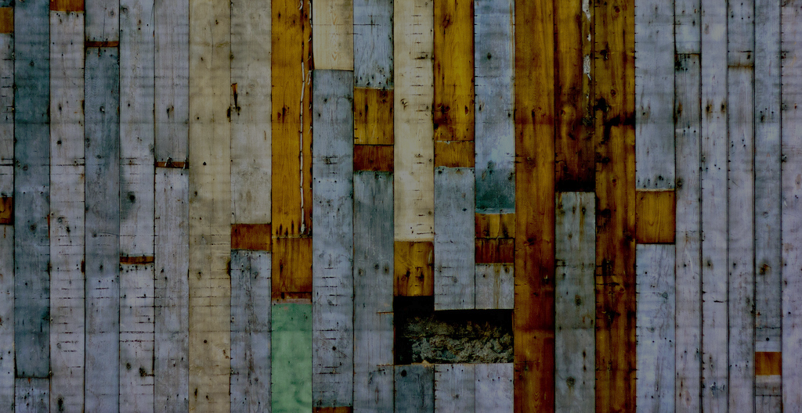
Questions & Discussions
Notes:
Image: Image: https://www.flickr.com/photos/scatteredashes/5844154762/ by Scipio / CC BY-NC 2.0

