Slide 1
Teaching Research Methods in LIS Programs
ALISE 2018 Panel Session

Slide 2
Agenda
Welcome and Introduction of Panel Members
Rationale for Teaching Research Methods
Competencies and Guidelines of Research
ALA, ASIS&T, SAA & MLA: Educational Guidelines & Professional Competencies
Research Methods in LIS Pedagogy
Role, purpose, and course learning objectives.
Course assignments.
Tools and resources, and depth of knowledge covered.
Challenges and innovative strategies.
Ways in which research methods courses contribute to students career preparation.
Discussion and Knowledge Sharing with Audience
Notes:
Lynn

Slide 3
Panelists
Moderator:
Lynn Silipigni Connaway, OCLC Research.
Panelists:
Timothy J. Dickey, Kent State University.
Jenna Hartel, University of Toronto (Content presented by other panelists).
Kristen Rebmann, San Jose State University.
Rong Tang, Simmons College.
Elaine Yontz, East Carolina University.
Notes:
Lynn
Timothy J. Dickey is a public service librarian and library science educator, with a current repertoire of courses in Library technology, Research methods, Reference, and Humanities librarianship, for the library science programs at Kent State University and San José State University. Prior to that worked with me at the OCLC Office of Research, with research in data mining, user studies, and an IMLS grant project evaluating virtual reference services. He holds a Ph.D. from Duke University, and the M.L.I.S. from Kent State University. Dr. Dickey's publications have appeared in numerous LIS and music history journals He currently works face-to-face at the Columbus Metropolitan Libraries. He has served on ALISE and ASIS&T Committees.
Jenna Hartel is an associate professor at the Faculty of Information, University of Toronto. Her research examines the nature of information in the pleasures of life. She is the creator of the iSquare Research Program, an arts-informed, visual study of information.
Kristen Rebmann is an Associate Professor at San Jose State University's School of Information. She joined SJSU in 2007 after completing a PhD in Communication at the University of California, San Diego. Kristen is interested in activities and research in the areas of access and inclusion, learning design, virtual field methods, and new literacies.
Rong Tang is an Associate Professor and founding and current Director of Simmons Usability Lab at the School of Library and Information Science, Simmons College. Her research interests center on user behavior research, including cognitive styles and user experience, usability evaluation, collaborative user behavior, and mobile user research. Published in top-ranked journals, Rong Tang teaches primarily in areas of usability, digital information searching, evaluation of information services, theories of information science, and research methods.
Professionally, Rong has served and chaired or co-chaired numerous ASIS&T and ALISE Committees.
Elaine Yontz is professor in the Master of Library Science Program at East Carolina University in Greenville, North Carolina. She previously served on the faculties of Valdosta State University and the University of South Florida. She holds degrees from Florida State University and the University of Florida.

Slide 4
Why Teach Research Methods?
Build confidence
Develop informed consumers of research
Critically evaluate research
Discuss and share research findings
Greater understanding of scholars’ needs when working with researchers
Ability to make informed decisions (evidence-based decision making)
Mentor and develop new researchers
Introduction to methods and theoretical foundations
Ability to conduct research
Contribute to quality and rigor of research environment
"Need for more and better basic and applied research" (Connaway & Radford, 2016, p. 5)
Assessment research
Notes:
Lynn
"Need for more and better basic and applied research" (Connaway & Radford, 2016, p. 5)
Crucial for continued growth, especially in the current climate of budget tightening and the need for libraries to prove their worth.
Connaway, L. S., & Radford, M. L. (2017). Research methods for library and information science (6th ed.). Westport, CT: Libraries Unlimited.

Slide 5
Most Widely Used LIS Research Methods
Notes:
Lynn

Slide 6
Research Papers by Methodology & Year
Methodology | 1950 | 1960 | 1965 | 1970 | 1975 | Total* | %*
Theoretical-analytical | 11 | 17 | 11 | 36 | 52 | 127 | 14
Information system design | 7 | 16 | 21 | 57 | 49 | 150 | 17
Surveys on the public | 3 | 2 | 9 | 20 | 19 | 53 | 3
Survey or experiment on libraries, etc. | 22 | 15 | 45 | 89 | 113 | 284 | 32
Bibliometric and similar studies | 0 | 1 | 7 | 14 | 16 | 38 | 4
Content analysis | 0 | 1 | 2 | 1 | 3 | 7 | 1
Secondary analysis | 6 | 15 | 15 | 13 | 27 | 76 | 8
Historical methodologies | 21 | 26 | 25 | 49 | 42 | 163 | 18
Descriptive bibliography | 7 | 4 | 6 | 4 | 9 | 30 | 3
Comparative studies | 0 | 2 | 6 | 4 | 7 | 19 | 2
Other and multiple | 3 | 1 | 7 | 9 | 10 | 30 | 3
All papers* | 76 | 96 | 139 | 274 | 315 | 900 | 100
(Powell, 1999)
Notes:
Lynn
*Note: The figures add to more than the total number of papers (and the percentages add to more than 100), since a paper may have more than one methodology
Table (2) from Powell, 1999
Powell, R. (1999). Recent Trends in Research: A Methodological Essay. Library & Information Science Research 21(1), 91-119.

Slide 7
Research Methods: JDoc 2001-2010
N=367
Theoretical approach, 38%
Content analysis, 14%
Questionnaire, 13.8%
Experiment, 13.4%
Interview, 13.4%
(Chu, 2015)
Notes:
Lynn
“The LIS field is maturing in terms of research method selection and application in that a greater number and wider variety of research methods are used in all the research publications this study examines. All the methods reported in the 1162 scholarly publications in a sense constitute a toolbox of research methods. Scholars are no longer limited to the research methods traditionally applied in LIS explorations (e.g., questionnaire and historical method). Researchers can instead choose research methods from this expanded toolbox according to their study objectives” (Chu, 2015, p. 40).
Chu, H. (2015). Research Methods in Library and Information Science: A Content Analysis. Library & Information Science Research 37(1), 36-41.

Slide 8
Research Methods: JASIS&T 2001-2010
N=554
Experiment, 31%
Bibliometrics, 23%
Questionnaire, 14%
Content analysis, 13%
Theoretical approach, 12%
(Chu, 2015)
Notes:
Lynn
Chu, H. (2015). Research Methods in Library and Information Science: A Content Analysis. Library & Information Science Research 37(1), 36-41.

Slide 9
Research Methods: LISR 2001-2010
N=241
Content analysis, 30%
Questionnaire, 28%
Interview, 20%
Theoretical approach, 15%
Experiment, 9%
(Chu, 2015)
Notes:
Lynn
Chu, H. (2015). Research Methods in Library and Information Science: A Content Analysis. Library & Information Science Research 37(1), 36-41.

Slide 10
Research Methods: JAL 2004-2013
Method | Percentage (n=346)
Questionnaire | 47.6
Test or Quiz | 2.6
Diary | 0.6
Content Analysis | 27.2
Semi-structured Interviews | 14.0
Analysis of existing statistics | 6.6
Citation Analysis | 6.3
Focus Group Interview | 5.7
Observation | 4.3
Log Analysis | 3.4
Task Analysis | 2.9
(Luo & McKinney, 2015)
Notes:
Lynn
**used in primary research articles
Questionnaire: a standard survey questionnaire, 47.6
A test or quiz in the questionnaire format, usually used in experimental or quasi-experimental deign, 2.6
Diary, a type of self-administered questionnaire often used to record frequent or contemporaneous events or experiences, 0.6
Content analysis, 27.2
Semi-structured or in-depth interview, 14.0
Analysis of existing statistics (e.g. results from previous surveys, or circulation statistics), 6.6
Citation analysis, 6.3
Focus group interview, 5.7
Observation, including both quantitative and qualitative observation, 4.3
Log analysis, 3.4
Task analysis — the analysis of the completion of search tasks, 2.9
Luo, L., & McKinney, M. (2015). JAL in the Past Decade: A Comprehensive Analysis of Academic Library Research. The Journal of Academic Librarianship 41(2),123-129.

Slide 11
Questions and Discussion
Research methods are certainly essential for LIS publications. How does this translate into the focus of research method education at the Master’s level?
Should Master’s students only learn about being a researcher consumer or they need to learn to be a research producer?
Notes:
Lynn

Slide 12
Core Competencies of Librarianship (ALA, 2009)
Foundations of the Profession.
Information Resources.
Organization of Recorded Knowledge and Information.
Technological Knowledge and Skills.
Reference and User Services.
Research.
Continuing Education and Lifelong Learning.
Notes:
Rong

Slide 13
Research Competencies (ALA, 2009)
The fundamentals of quantitative and qualitative research methods.
The central research findings and research literature of the field.
The principles and methods used to assess the actual and potential value of new research.
Notes:
Rong

Slide 14
ASIS&T Education Guidelines (ASIS&T, 2001)
1. Foundations of Information Science.
2. Information Use and Users.
3. Methods of Inquiry.
4. Information Processing.
5. Information Technology.
6. Information Service Provision and Management.
Notes:
Rong

Slide 15
Methods of Inquiry (ASIS&T, 2001)
This category includes methodologies which explore and facilitate investigations of information science in a variety of contexts. These include:
Basic Research Methods.
Measurement and Evaluation.
Assessment Technologies.
Critical Thinking and Problem Solving.
Notes:
Rong

Slide 16
SAA: Guidelines for a Graduate Program In Archival Studies (2016)
Understanding multiple methods of research design and execution
Knowledge of and experience with research also
Knowledge of research may allow archivists to
allows graduates to assess the status of research in their own discipline, to undertake new research, and to blend theoretical and empirical aspects of archival studies into scholarly investigations.
use their repositories' collections to advance their own scholarship and provide enhanced reference and access.
is important to enable graduates to provide effective service to a wide variety of researchers and to evaluate archival operations from the perspective of users.
Notes:
Rong

Slide 17
MLA: Professional Competencies (Medical Library Association, 2017)
Competency 5.
Evidence-Based Practice & Research​
Finds and evaluates evidence to support decision making​.
Evaluates activities, programs, collections, and services using evidence-based methodologies.
Conducts research.
Interprets data and presents statistical and data analyses.
Communicates research results.
Notes:
Rong

Slide 18
Questions and Discussion
With a variety of LIS professional associations listing research as a core competency, do you think that research is valued appropriately in your program’s curriculum?
Should MSLIS programs teach their students to be research consumers instead of research executers?
Notes:
Lynn

Slide 19
Titles of Research Methods Courses
Institution | Course Number/Title
Simmons | MSLIS: LIS 403: Evaluation of Information Services; LIS 532O Planning and Evaluation. PhD: LIS 621: Conducting Research: Methods and Design.
Kent State | LIS 60050: Research and Assessment in LIS.
Toronto | MI in the LIS concentration: INF1240H Research Methods; INF2330H Information Ethnography; INF2110H Design and Evaluation of Information Literacy Programs. PhD: INF3003H Research in Information, Frameworks and Methods
San Jose State | INFO 285: Applied Research Methods [Topic: Doing Research Online]. INFO 285: Applied Research Methods [Topic: Historical Research and Writing].
East Carolina | LIBS 6019: Research Literacy in Library Science. LIBS 6872: Research Methods in Library & Information Studies.
Notes:
Kristin

Slide 20
Role of Research Methods Courses
Institution | Roles
Simmons | MSLIS: Elective, but strongly recommended for Independent Study course and Usability and UX Research course. PhD: Required as the second semester course.
Kent State | MLIS: Required, core course. Especially helpful for those taking thesis option for culminating experience. PhD: 2 required methods courses in Communication dept.
Toronto | MI in the LIS concentration: Until 2016 required, 2017 and elective and required for a thesis. PhD: Required.
San Jose State | MLIS and MARA: Required, core course. Gateway PhD Program: Optional.
East Carolina | MLS: Research Literacy course is required of all MLS students. Research Methods course: Required of Academic Librarianship concentration, transitioning to elective for all students, recommended for Academic Librarianship and for future graduate study.
Notes:
Kristin

Slide 21
Purpose of Research Methods Courses
Institution | Purposes
Simmons | MSLIS: Focus on evaluation research practice in the context of LIS. PhD: Standard research method course.
Kent State | Focuses on quantitative and qualitative research methods applicable to information settings and environments. Explores research design, data analysis, proposal development, and ethical issues.
Toronto | MI in the LIS concentration: Provides an overview of qualitative and quantitative research methods. PhD: Focuses on the development of methodology and research design for the dissertation.
San Jose State | Covers fundamental principles, processes, values, and roles of research for professional application. Ties to our Program-level learning outcomes (core competencies).
East Carolina | Required course: Effective consumers of others’ research; ability to apply research results to professional problems. Second course: More specific understanding of methodologies; relationship to assessment of library services.
Notes:
Anh

Slide 22
Course Learning Objectives
Institution | Learning Objectives
Simmons (MSLIS, LIS403) | To study the domain and purpose of evaluation, and the principles, design, and framework of evaluation research To apply evaluation research method to investigate contemporary library issues, and solve practical problems relevant to the field of library and information science To acquire the knowledge and skills necessary to evaluate LIS research papers and conduct usability evaluations To become familiar with the evaluation research process by designing a survey instrument and preparing a professional quality evaluation research proposal To acquire a basic understanding of descriptive and inferential statistics, and the ability to select and use appropriate statistical methods for evaluation research
Notes:
Rong
[Simmons]
To study the domain and purpose of evaluation, and the principles, design, and framework of evaluation research
To apply evaluation research method to investigate contemporary library issues, and solve practical problems relevant to the field of library and information science
To acquire the knowledge and skills necessary to evaluate LIS research papers and conduct usability evaluations
To become familiar with the evaluation research process by designing a survey instrument and preparing a professional quality evaluation research proposal
To acquire a basic understanding of descriptive and inferential statistics, and the ability to select and use appropriate statistical methods for evaluation research

Slide 23
Course Learning Objectives
Institution | Learning Objectives
Simmons (PhD., LIS621) | To understand the nature of scientific methods and reflective inquiry, the conduct and process of research, the design frameworks, and methods of collecting, managing, and analyzing data; To master key research methods and design traditions in the LIS field and beyond, especially to familiar with the quantitative, qualitative, and mixed methods and their corresponding research designs; To develop viable research plan, acquire skills in developing problem statement and research questions, and designing appropriate empirical methods and approaches for the research questions; To obtain practical experience in applying for IRB approval for research protocols involving human participants, writing of research proposal, and conducting data collection; To develop critical reading/thinking skills, obtain an understanding of the writing requirements of scholarly communication, and build a sense of scholarship and academic life in the information field.
Notes:
Rong
[Simmons]
To study the domain and purpose of evaluation, and the principles, design, and framework of evaluation research
To apply evaluation research method to investigate contemporary library issues, and solve practical problems relevant to the field of library and information science
To acquire the knowledge and skills necessary to evaluate LIS research papers and conduct usability evaluations
To become familiar with the evaluation research process by designing a survey instrument and preparing a professional quality evaluation research proposal
To acquire a basic understanding of descriptive and inferential statistics, and the ability to select and use appropriate statistical methods for evaluation research

Slide 24
Course Learning Objectives
Institution | Learning Objectives
Kent State | To describe a range of research methods, quantitative and qualitative; To evaluate examples of LIS research in terms of reliability, validity, and significance; To articulate and apply steps in the research process to identify a research problem, formulate a question, choose an appropriate method; To demonstrate knowledge and application of basic concepts, and techniques in the analysis of quantitative and qualitative data; To create an effective research proposal for conducting some form of guided research and/or for a financial grant application.
Notes:
Rong

Slide 25
Course Learning Objectives
Institution | Learning Objectives
Toronto | (INF1240 Research Methods) The objectives of the course are to provide students with the tools and skills required to understand research terminology and assess published research, identify the types of methods best suited for investigating different types of problems and questions, develop research questions that are based on and build upon a critical appraisal of existing research, design a research proposal, and begin initial preparations for embarking on a new research project.
Notes:
Rong

Slide 26
Course Learning Objectives
Institution | Learning Objectives
San Jose State | Understand the difference between primary and secondary research. Demonstrate knowledge of fundamental principles and processes of conducting research. Articulate the research method(s) covered in the course, appropriately apply them, and understand their strengths and liabilities. Understand appropriate data collection/analysis tools, and ethical concerns related to research.
Notes:
Rong

Slide 27
Course Learning Objectives
Institution | Learning Objectives
East Carolina | Required course: Recognize and apply the fundamentals of social research methods in library science; Retrieve, interpret, evaluate and analyze research literature of the field; Apply the principles and methods used to assess the actual and potential value of new research; Analyze and apply research to investigate professional problems and design a research project; Recognize and apply ethical principles in research involving human subjects; Employ the mechanics of APA Style; Second course: Apply research designs, including research instruments and data coding methods; Discuss possible research methods to employ to assess various library services; Assess the strengths and limitations of particular research tools and methodologies; Connect evaluation of services with service improvement, best practices, and accountability of libraries.
Notes:
Rong

Slide 28
Common Learning Objectives
Common Learning Objectives | Institutions
Develop proficiency with the foundations of LIS research | All
Develop proficiency with the research process | All
Develop proficiency with research design, methods, and methodology | All
Develop proficiency with evaluating relevant LIS research articles and resources | All
Design some kind of research product (e.g. a research proposal, research plan, or grant application) | Simmons, Kent State, Toronto, ECU
Develop proficiency with creating LIS evaluation research questions | Simmons Kent State, Toronto
Notes:
Rong
[Simmons]
To study the domain and purpose of evaluation, and the principles, design, and framework of evaluation research
To apply evaluation research method to investigate contemporary library issues, and solve practical problems relevant to the field of library and information science
To acquire the knowledge and skills necessary to evaluate LIS research papers and conduct usability evaluations
To become familiar with the evaluation research process by designing a survey instrument and preparing a professional quality evaluation research proposal
To acquire a basic understanding of descriptive and inferential statistics, and the ability to select and use appropriate statistical methods for evaluation research

Slide 29
Unique Learning Objectives
Unique Learning Objectives (two or one programs) | Institutions
Develop proficiency with specific evaluation research techniques and tools (e.g. statistics and/or data coding) | Simmons, Kent State
Gain practical experience | Simmons, ECU
Develop proficiency with LIS evaluation research ethics | SJSU, ECU
Develop proficiency with the APA citation style | ECU
Build a sense of scholarship and academic life in the information field | Simmons
Notes:
Rong
[Simmons]
To study the domain and purpose of evaluation, and the principles, design, and framework of evaluation research
To apply evaluation research method to investigate contemporary library issues, and solve practical problems relevant to the field of library and information science
To acquire the knowledge and skills necessary to evaluate LIS research papers and conduct usability evaluations
To become familiar with the evaluation research process by designing a survey instrument and preparing a professional quality evaluation research proposal
To acquire a basic understanding of descriptive and inferential statistics, and the ability to select and use appropriate statistical methods for evaluation research

Slide 30
Questions and Discussion
What do you think are the purposes of a research methods course in your MLIS curriculum?
What do you think students want to learn from the course?
What other courses in your curriculum cover research methods?
Notes:
Lynn

Slide 31
Tools and Resources Covered
Institution | Tools and Resources
Simmons | Online survey tools (google form, survey monkey, etc.); Morae software (for extra credit students); Tools for randomization, sample size, etc.; Introduction to SPSS.
Kent State | Online survey tools (survey monkey); Coding and categorization of data; Introduction to statistics (Excel); Concept mapping in literature reviews.
Toronto | Varies per instructor. General qualitative and quantitative research methods (INF1240 Research Methods); Ethnographic data gathering methods, analysis, and writing (INF2330 Information Ethnography).
San Jose State | General research methods. Other topics include: Historical Research and Writing; Action Research; Evaluating Programs and Services; Doing Research Online.
East Carolina | Open source tools such as PSPR, Random.org, Google Scholar; Databases provided by university library, with emphasis on Library Lit & Info Science Full Text.
Notes:
Timothy

Slide 32
Depth of Knowledge Covered
Institution | Depth of Knowledge
Simmons | Components of problem statement; Development of research questions; Probability and non-probability Sampling; Questionnaire and interview instrumentation; Data analysis and statistical methods.
Kent State | Phases of the research process: Question formulation; Literature review; Design; Data collection; Data analysis. Students also practice evaluation of published research.
Toronto | Students are introduced to a variety of research designs and experience the complete research process.
San Jose State | Students learn basic skills of evaluating, planning, designing, executing, and applying research.
East Carolina | Required course: Question formation; Literature review; Study design; Evaluation of others’ research; Ethics. Second course: Methodologies; Relationship to assessment of library services.
Notes:
Timothy

Slide 33
Course Assignments
Institution | Course Assignments
Simmons | MSLIS: Assignment 1 - Research scenario and problem statement; Assignment 2 - Evaluation of a research paper; Assignment 3 - Questionnaire development; Final Project - Evaluation research proposal; Extra-Credit Project - Usability evaluation of an LIS site/tool. PhD: CITI ethics training; Review of a research design; Various segments of the research paper; final research paper.
Kent State | Complete research proposal, in stages. Research paper evaluations and practical exercises. CITI ethics (IRB training).
Toronto | Major assignment: Development of a research proposal (INF1240 Research Methods); Exploratory ethnographic study (INF2330 Information Ethnography).
San Jose State | Varies by section. Research manuscript or proposal. CITI ethics (IRB) training.
East Carolina | Research proposal. Exercises and discussion posts. CITI ethics training.
Notes:
Timothy

Slide 34
Questions and Discussion
How much focus--in terms of coverage and emphasis--should be placed on instrumentation skills in the research methods course?
Does the one research methods course per program model work well? What are alternative ways to deliver knowledge and skills (e.g., embed research methods content in a variety of courses without one dedicated course)?
Notes:
Lynn

Slide 35
Challenges and Gaps in Teaching Research Methods Courses
Institution | Challenges and Gaps
Simmons | Not a core course means limited enrollment. Recommended for some advanced research course, but not everyone takes it so advanced research courses need to fill the gap of basic research notions.
Kent State | Balance across a wide spectrum of student backgrounds, preparation, interests, and goals.
Toronto | Placing research methods into the context of information institutions. Convincing students of the value of research methods.
San Jose State | Must appeal to broad range of interests, abilities, and goals due to being a required course. Tension between preparation of manuscripts vs. proposals.
East Carolina | Wide variations in student knowledge, based on presence or absence of previous graduate study. All-online delivery complicates use of proprietary tools.
Notes:
Elaine

Slide 36
Strengths in Teaching Research Methods Courses
Institution | Strengths
Simmons | Focus on applied research process means course is helpful for future work involving research, evaluation, assessment, etc. Prepares students to consume research literature, develop instruments, and develop proposals.
Kent State | Focus on practical assessment of research papers and professionally practical applications of research. Students appreciate depth and rigor of critical thinking.
Toronto | Creative and critical perspectives of the instructors.
San Jose State | Theory/research dimension balances applied practice. Supports competencies relating to LIS scholarly communication, research practices, and ethics.
East Carolina | Focus on preparing consumers makes the required course comprehensible for students in their first graduate degree. Availability of second course prepares students for academic employment and further graduate study.
Notes:
Elaine

Slide 37
Innovative Strategies in Teaching Research Methods Courses
Institution | Strengths
Simmons | Tie the course into real life scenarios. Invite assessment librarians to discussion their research or assessment projects (e.g., using Tableau for visualization).
Kent State | Work through the complete research proposal in stages, with plenty of personalized feedback. Guide students toward diverse areas of personal research interest. Encourage vibrant peer review and feedback.
Toronto | Students conduct an exploratory, ethnographic study upon a topic/population of their choice (in INF2330 Information Ethnography).
San Jose State | Hold synchronous sessions to workshop student projects. Help students develop relevant research questions. Use online surveys process datasets and consents. Plan ahead so that course activities are covered by IRB.
East Carolina | Individual choice of course project topic to fit students’ current workplaces or future professional goals. Assignments throughout the semester complete portions of the final course project. Use of MediaSite for AV online content delivery.
Notes:
Elaine

Slide 38
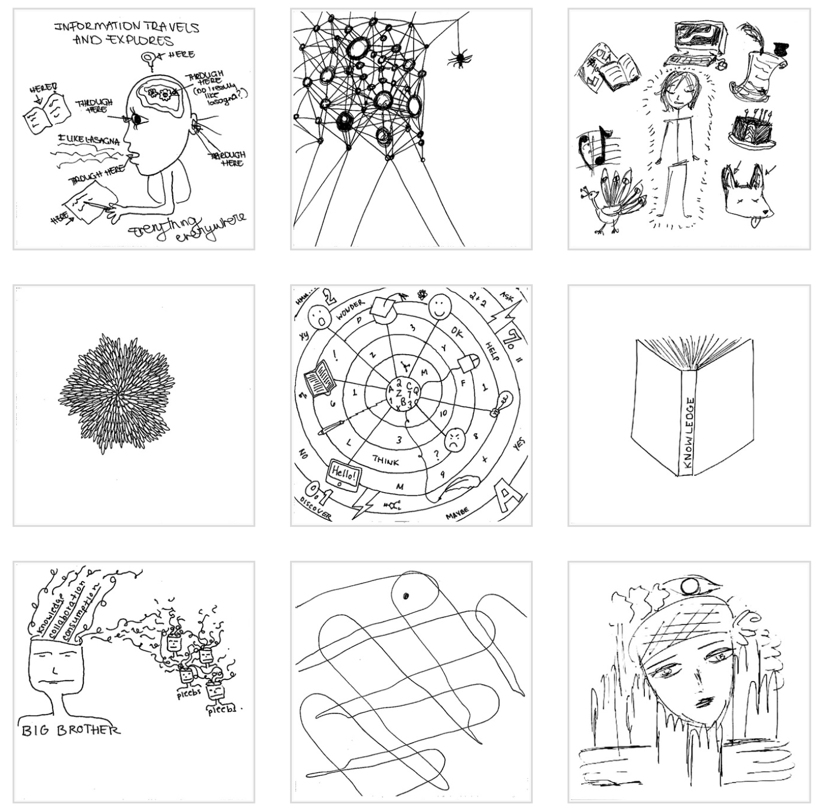
Innovative Strategies Example
The Visual Research Project with the Draw-and-Write Technique
Notes:
Elaine; Anh Thu

Slide 39
Student Career Preparation
Master’s
Assessment Librarian
Research Librarian
UX Librarian
Data Science Librarian
PhD
Researcher
Faculty
Notes:
Elaine

Slide 40
Questions and Discussion
Are there differences between the online delivery of a research methods course and a face-to-face one?
What differences, if any, are there between a master’s level research methods course and a doctoral level research methods course?
Notes:
Lynn

Slide 41
Final Question and Discussion
How can we make research methods courses timely, relevant, and practically useful?
Notes:
Lynn

Slide 42
Thank you very much!

