Slide 1


Action-oriented Research Agenda on Library Contributions to Student Learning and Success
ACRL VAL Update Session
January 22, 2017
Lynn Silipigni Connaway, PhD, OCLC
William Harvey, PhD, OCLC
Vanessa Kitzie, Rutgers University
Stephanie Mikitish, Rutgers University
Notes:
We will present on the progress we have made on the research agenda, specifically in the following five areas:
Content analysis of the literature
Since our last report we have added 178 AiA studies to our literature review bringing our total number of documents to 535 documents
Results of focus group interviews with Advisory Group members
Results of provost interviews from Advisory Group member institutions
Recommendations for librarians, students, and researchers based on analysis of these three data sources
Identification of priority areas for future research
We will spend the most time focusing in on the priority areas and eliciting your feedback.

Slide 2
The Value of Academic Libraries
ACRL Goal-area committee
  Part of Plan for Excellence
Goal: Academic libraries demonstrate alignment with and impact on institutional outcomes
  Promote impact & value of libraries to higher ed. community
Notes:
This project relates to ACRL’s Plan for Excellence.
A major goal for this plan is to help academic libraries demonstrate their value to their parent institutions through their impact on institutional outcomes.
A major institutional outcome is to promote student learning and success.

Slide 3
Research Agenda
Action-oriented Research Agenda on Library Contributions to Student Learning & Success
  Update progress since 2010 VAL Report
  Identify research needs in higher ed. sector
  Focus on institutional priorities for student learning & success (i.e., retention, persistence, degree completion)
Notes:
Agenda builds on Values of Academic Libraries Report commissioned by ACRL and published in 2010
Report argued that libraries need to demonstrate value by measuring contribution to institutionally defined outcomes
Our research agenda is an update and extension to VAL report focusing on student learning and success
Defining and measuring learning and success can be difficult, as reflected in higher education and library and information science literature.
Some would define student success as including satisfaction, persistence, and high levels of learning and personal development (Kuh, Kinzie, Schuh, and Whitt)
One of our advisory group members explained that for those in student affairs, student learning is associated with attaining learning goals and objectives, while student success is associated with programs that support those goals.
However, the definition that the team defined the terms based on their measurability.
Success in college: An outcome focused on the more objective indicators of learning, or “quantifiable student attainment indicators, such as enrollment in postsecondary education, grades, persistence to the sophomore year, length of time to degree, and graduation.” These tend to be linked to a specific assignment/semester, such as grades/GPA. It could also be related to whether the student re-enrolled or graduated. . Kuh, Kinzie, Buckley, Bridges, and Hayek, "What Matters to Student Success,” 5; Venezia, Callan, Finney, Kirst, and Usdan, "The Governance Divide.”
Learning in college: An outcome focused on the less objective concepts of learning, such as critical thinking. These encompass the outcomes not covered by the Success in college theme, which are “quantifiable student attainment indicators, such as enrollment in postsecondary education, grades, persistence to the sophomore year, length of time to degree, and graduation.” Usually not tied to a specific graded assignment or graduation. . Kuh, Kinzie, Buckley, Bridges, and Hayek, "What Matters to Student Success,” 5; Venezia, Callan, Finney, Kirst, and Usdan, "The Governance Divide.”
Our research agenda:
First part: Analyze the current state of the research of how the library impacts student learning and success
Next part: Suggest directions for future research
Team will develop a data visualization piece that will allow librarians, researchers, and students to search for documents and studies based on certain criteria, such as themes addressed and methodological aspects that were informed by content analysis of the selected literature
The visualization piece currently is being developed and will undergo usability testing in March

Slide 4
Report Timeline
Item Due | Due Date
Submit Second Draft to Task Force/ACRL, Report Available Online | January 2017
Develop Visualization Component | March 2017
Conduct Usability Testing | March 2017
Present at ACRL Conference 2017 | March 2017
Submit Final Report to Task Force/ACRL Board | May 2017
Public Release of the Final Report | May 2017
Reports available at:
http://www.oclc.org/research/themes/user-studies/acrl-agenda.html
Please submit input by February 17, 2017 at: http://www.oclc.org/research/forms/feedback-acrl-agenda.html
Notes:
This slide depicts the report timeline and process by which it is being written. The next deadline for public feedback is February 17, 2017 and the final version of the report will be submitted May, 2017.
Report URL: http://www.oclc.org/research/themes/user-studies/acrl-agenda.html
Please submit input by February 17, 2017
http://www.oclc.org/research/forms/feedback-acrl-agenda.html

Slide 5
Data Collection
Individual Interviews with Provosts
Selected Literature
Focus Group Interview & Feedback from Advisory Group
Notes:
This slide depicts three data sources:
Selected literature on student learning and success identified in the RFP and documents found in LIS and higher education databases
Selection criteria are: 1) indexed by LIS and/or higher education databases or identified by the project team or ACRL (e.g., ACRL Assessment in Action (AiA) studies, Ithaka S+R surveys, see Relevant ACRL Documents section), 2) published between 2010-2016, 3) contained themes identified in the 2010 VAL Report, and 4) published in the US, except for studies outside the US deemed relevant by the project team
Focus group with Advisory Group Members
Consist of library administrators from a variety of community colleges, 4 year colleges and universities around the country
Members provide us feedback throughout the process and put us in touch with provosts or similarly high level academic administrators in their institutions
Individual, semi-structured interviews with provosts from each Advisory Group member’s institution
Process of data collection is iterative, with findings from each source informing the other
E.g., focus group and provost interview protocol was based on the themes that we identified in the initial database searches

Slide 6
Coding – Themes
Higher education trend | Trend defined | Example of library responses to trend
Learning in college (and beyond) | Less objective concepts of learning. Usually not tied to a specific graded assignment or graduation. | Space: Collaborative working space for students
Research support | Outcome tied to research outside of a class. | Service: Teach data management
Teaching support | Outcome viewed from an instructor perspective and deals with a specific course. | Collection: Online repository of syllabi
Response to Students
Response to Students/Faculty
Response to Faculty
Notes:
The team developed an initial codebook using ACRL publications specified for review. This slide depicts an excerpt from one of two codebooks created. These two codebooks are: 1) theoretical codes, which indicate higher education trends to which libraries are responding and 2) study demographics.
Areas informing the codebook include:
Student enrollment, retention, and graduation; success; achievement; learning; and support of faculty teaching
Effectiveness of library assessment when libraries collaborate with other campus units, assessment aligns with institutional goals, and mixed methods approaches are employed
Contribution of library instruction and spaces, and collaborative instructional activities, instructional games, and multiple instruction sessions, to student outcome measures
Research data services, discovery services, and the library as a place for student success
Information literacy assessment

Slide 7
Coding – Study Demographics
Code name | Code definition | Values
Year | Year study was published. | 2010-2016
Type | Type of institution where the study was performed; Do not code if multiple institution types were studied. | College; Community college; University
Quantitative analysis method | The method used if numeric data was analyzed | ANOVA; Regression; X2; Descriptive statistics; Correlation; Other
Notes:
The second codebook pictured here is 2) study demographics.
Only coded for documents labeled as research documents (n=369, 69% of all selected documents)
Documents involve some type of data collection and analysis for measuring outcomes or answering practical or empirical questions and identify a higher education trend or a library response to that trend
Will be used to inform visualization tool
Remaining (n=166, 31%) documents labeled as theoretical documents
Include literature reviews, discussions of a theoretical model or framework, or thought pieces that identify a higher education trend or a library response to that trend on specific library collections, spaces, and services or a combination of these
Represent what LIS and higher education professionals addressed as emerging and/or important areas to examine

Slide 8
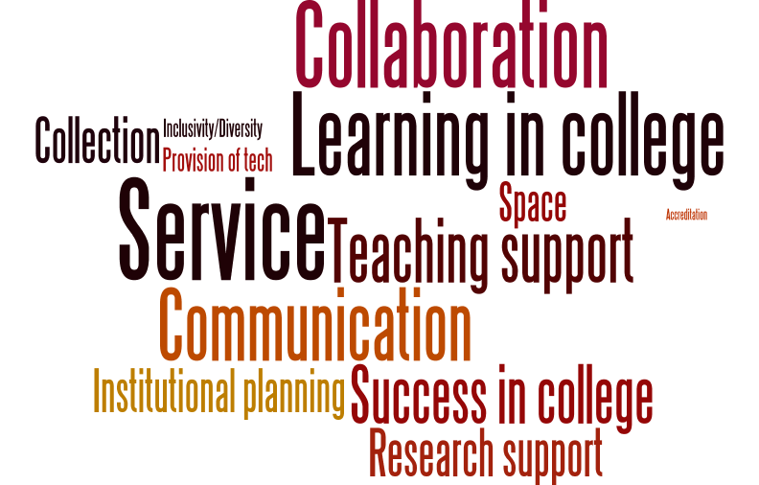
Notes:
Here’s a word cloud of the themes by frequency of documents they were present in. The larger the word, the more documents that included the theme.
To reiterate:
The selection criteria for LIS and higher education documents reviewed are: 1) indexed by LIS and/or higher education databases or identified by the project team or ACRL (e.g., ACRL Assessment in Action (AiA) studies, Ithaka S+R surveys, see Relevant ACRL Documents section), 2) published between 2010-2016, 3) contained themes identified in the 2010 VAL Report, and 4) published in the US, except for studies outside the US deemed relevant by the project team
Selected higher education databases were:
Academic Search Premier
Education Resources Information Center (ERIC)
ProQuest Education Journals, and Teacher Reference Center
Selected LIS databases were:
Library and Information Science Abstracts (LISA)
Library Literature & Information Science Full Text (H.W. Wilson)
Library, Information Science & Technology Abstracts (LISTA)

Slide 9
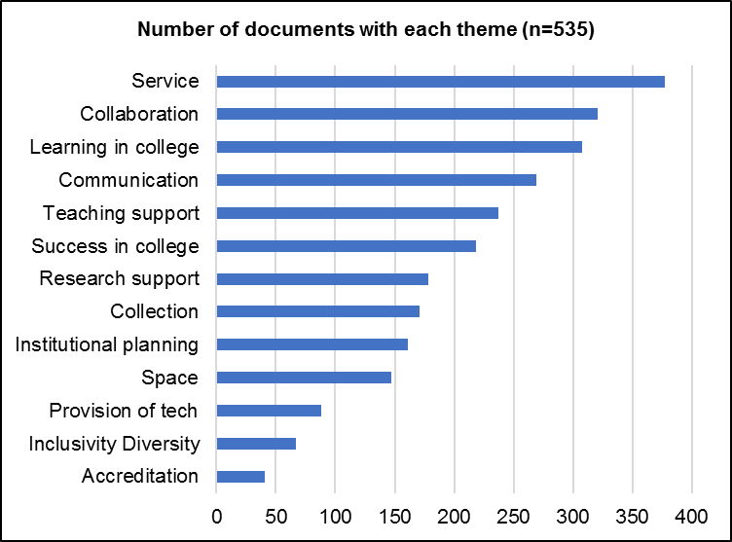
Content Analysis of Literature
Other study
n=153
Key thematic
n=53
Other thematic
n=113
Key study
n=38
Notes:
Here are is the figure visualized in another way.
Themes most discussed in the selected documents are:
Service (n=377, 70%)
Collaboration (n=321, 60%)
Learning in college (n=308, 58%)
Those least discussed are:
Provision of technology (n=88, 16%)
Inclusivity/diversity (n=67, 13%)
Accreditation (n=41, 8%)

Slide 10
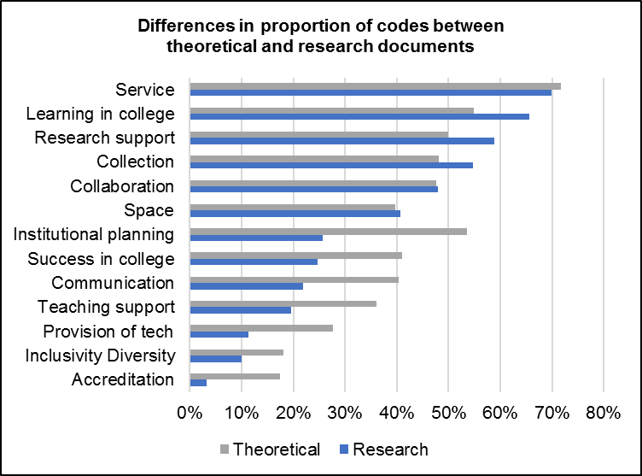
Notes:
Theoretical documents have more thematic codes than research documents– approximately 7% more codes.
A likely explanation for this observation is that theoretical documents include genres such as literature reviews and lists, whereas research documents empirically ground a phenomenon or phenomena observed among one or two themes
The largest difference between proportion of times a code was applied between theoretical and research documents is Institutional planning discussed 28% more in theoretical documents than in research documents
This finding suggests that institutional planning, or assessment, is more often discussed in the context of what libraries should be focusing on, rather than what libraries actually focus on when demonstrating their value

Slide 11
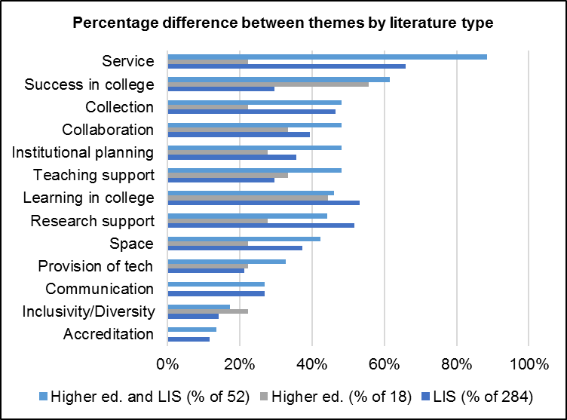
Notes:
The team compared the differences in proportion of themes discussed in documents from the higher education literature versus the LIS literature.
Search terms used for the database searches included the word “Library” and its derivatives.
For this reason, this comparison is only able to inform of differences in the proportion of themes between what is being said about student learning outcomes as related to libraries within the higher education literature versus the LIS literature, not student learning outcomes in general.
We are going to conduct a search more broadly to identify trends in higher education related to outcomes that advance the mission and goals of the university, including student outcomes
Results of this literature review will be contained in the final version of the report
Documents labeled as higher education literature were those retrieved from higher education databases that were not indexed by LIS databases and reports from Ithaka S+R. Therefore a total of 354 documents of the total 535 documents (66%) were reviewed when making this comparison given that the team retrieved documents for review that were not indexed by databases (e.g., AiA studies). There were:
n=18 documents designated as higher education literature (about 5% of the total documents)
n=52 documents (15%) designated as both higher education and LIS literature since they were indexed by both databases
n=284 documents (80%) were from LIS literature.
This figure illustrates the percent difference between thematic code by whether a document is from the higher education literature, LIS literature, or higher education and LIS literature.
Which themes vary most by the proportion of documents to which they are applied?
LIS literature and higher ed. and LIS literature combined discuss service more than higher education literature
LIS literature discusses service and success in college more than in higher education and LIS literature

Slide 12
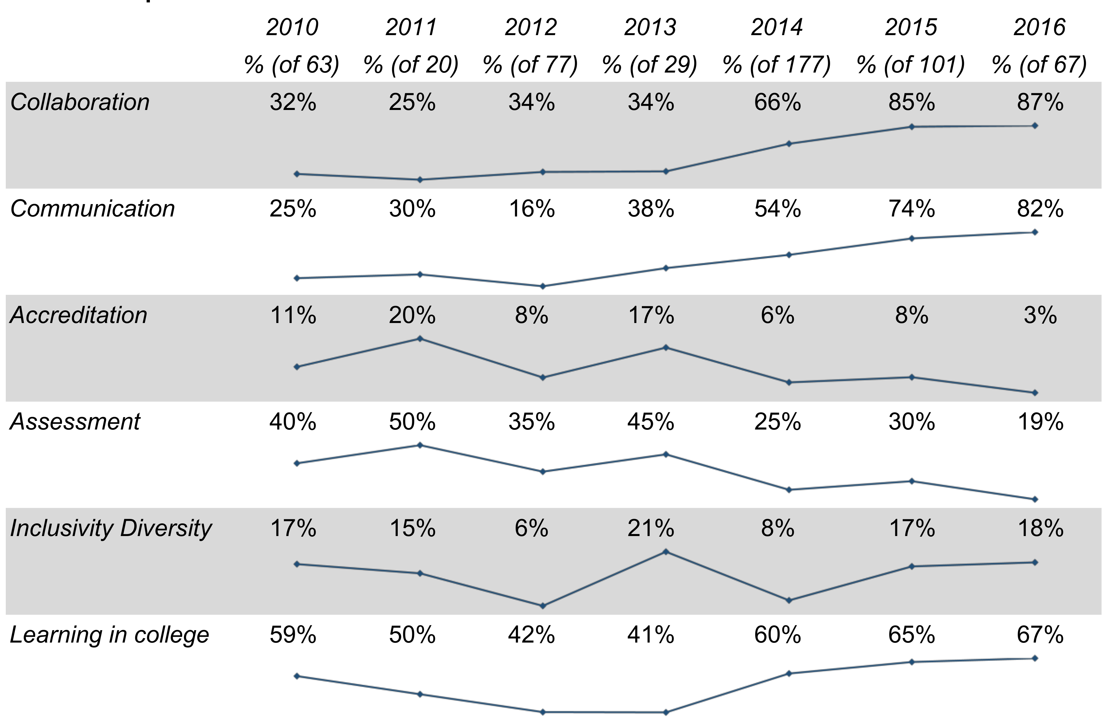
Theme Changes Over Time
Notes:
How did thematic codes change over time?
Themes discussed more over time are:
Collaboration
Communication
Teaching support
Themes that appeared to decrease over time are:
Institutional planning
Research support
Collection
It should be noted that these results differ from those presented in first report draft where any trends observed were relatively minor and not statistically significant. In comparison, all of the trends reviewed are statistically significant. The change in these results is likely due to the incorporation of the 178 AiA studies into the analysis, which were not included in the first report draft.

Slide 13
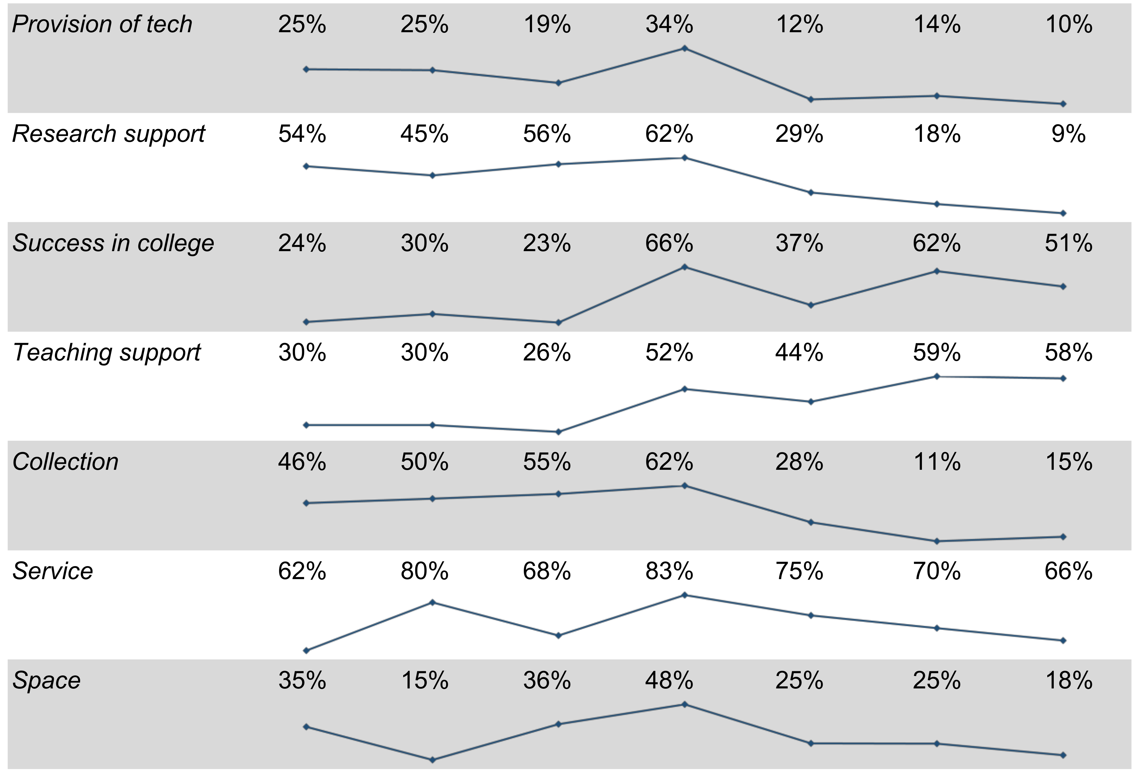
Theme Changes Over Time
Notes:
How did thematic codes change over time?
Themes discussed more over time are:
Collaboration
Communication
Teaching support
Themes that appeared to decrease over time are:
Institutional planning
Research support
Collection
It should be noted that these results differ from those presented in first report draft where any trends observed were relatively minor and not statistically significant. In comparison, all of the trends reviewed are statistically significant. The change in these results is likely due to the incorporation of the 178 AiA studies into the analysis, which were not included in the first report draft.

Slide 14
AiA vs Non-AiA studies
Distributed throughout the US
Focus more on community colleges & colleges
Equal study of graduates, undergraduates, & other populations
Themes: communication, collaboration
  Less examination of space & research support
Focus on instruction
More mixed &/or multiple methods
Heightened use of correlations
(Association of College & Research Libraries)
Notes:
The addition of the AiA studies was a major update to this report.
The information was taken from the posters themselves, and included 178 completed projects.
Conducted throughout the US. AiA studies are more evenly dispersed throughout the four regions of the US (Northeast, 25%, n=43; West, 20%, n=34; Midwest, 28%, n=48; South, 26%, n=45) as compared to non-AiA studies, which are less representative of the Northeast (9%, n=19).
Focus more on community colleges and colleges. In terms of the populations studied, by both institution type and group focused on within the institution (e.g., undergraduates), AiA studies focus more on community colleges (6%, n=22) and colleges (8%, n=31) than non-AiA studies (1%, n=5; 2%, n=8, respectively). AiA studies also focus more on private institutions (18%, n=67) than non-AiA studies (8%, n=30). Both study types primarily examine universities (non-AiA, 38%, n=141; AiA, 34%, n=125).
Equal study of graduates, undergraduates, & other populations. Regarding the groups studied, AiA studies focus less on undergraduates. Thirty-three percent (n=120) of non-AiA studies examine undergraduates, while six percent (n=23) of AiA studies do. Instead, AiA studies have a more evenly dispersed focus in the study of graduates, undergraduates, and other populations.
Themes: communication, collaboration. In the analysis of theme coding, AiA studies focus more on communication (48%, n=178) and collaboration (48%, n=178) than non-AiA studies (25%, n=91; 39%, n=143).
Less examination of space & research support. On the other hand, AiA studies focus less on space (4%, n=13) and research support (1%, n=2) than non-AiA studies (36%, n=134; 48%, n=176). Since all AiA studies were conducted between 2014 and 2016, AiA studies likely account for the observed increase in the focus on communication and collaboration, and the decrease of focus on research support over time.
Focus on instruction. In terms of types of library responses studied, AiA studies focus much more on instruction as a library service (37%, n=135) than non-AiA studies (17%, n=64). This observation plays out when examining quantitative data collection methods used, with AiA studies more often employing rubrics (22%, n=82) to assess instructional effectiveness than non-AiA studies (5%, n=20).
More mixed and/or multiple methods. AiA studies also demonstrate a heightened use of mixed methods (45%, n=166) as compared to non-AiA studies (22%, n=80).
Heightened use of correlations. 45% (n=166) of AiA studies employ correlations whereas 7% (n=25) of non-AiA studies do.
As previously discussed, the themes of collaboration and communication were addressed more frequently in the AiA studies than in the non-AiA studies. These themes also were addressed by the focus group participants in this project.
Association of College & Research Libraries, “Assessment in Action: Academic Libraries and Student Success,” accessed January 17, 2017, http://www.ala.org/acrl/AiA.

Slide 15
Focus Group Interview
N =14 (of 14)
90 minutes
Transcribed
NVivo for analysis
Thematic coding scheme
  One team member coded, another checked
Notes:
Next, we will examine which findings from the content analysis resonate with practicing librarians in higher education
Based on focus group interviews with 11 advisory group members; the other three were unable to meet and were sent focus group questions that they completed. The responses to these questions were included in analysis
Coded transcripts in Nvivo using thematic coding scheme, allowing for inductive categories to be pulled from the data
Another team member checked the codes

Slide 16
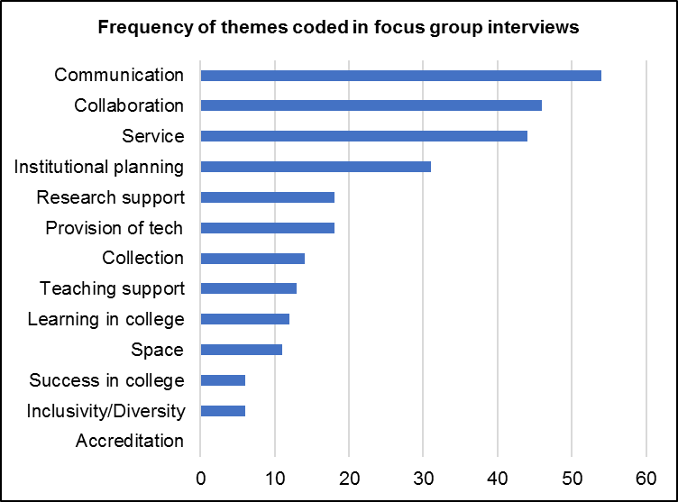
Notes:
Focus group interview participants most often discussed:
Communication (20%, n=54)
Collaboration (17%, n=46)
Service (16%, n=44)
They less frequently mentioned the themes of:
Accreditation (n=0, 0%)
If you’re wondering how these frequencies compared to our other two sources of data, the relevant literature and the provost interviews, don’t worry, we’ll have a slide for that later on.

Slide 17
Focus Group Interview
“Each of us would have some example of our shared strategic initiatives around enhancing students' success. I think what's underlying all of this is that all of us see our work as directly tied to the mission of the university. And it is what makes academic libraries unique in some ways, but also so successful that academic libraries, in my personal opinion, are those that are directly connected to the mission of their unique institution.” (Advisory Group Member LM13, Research University, Non-Secular, Private)
Notes:
May be surprising that the focus group interview participants did not discuss Student learning and Success, when two themes so frequently mentioned in the literature. However, as explained by one participant…
Full quote: “I think probably each of us would have some example of our shared strategic initiatives around enhancing students' success. And promoting innovation and teaching and learning. I think those are probably common across all of our institutions. I think what's underlying all of this is that all of us see our work as directly tied to the mission of the university. And it is what makes academic libraries unique in some ways, but also so successful that academic libraries, in my personal opinion, are those that are directly connected to the mission of their unique institution” (Advisory Group Member LM13, Research University, Non-Secular, Private).
Enhancing student learning and success inherent to library mission
Fulfilling library-oriented goals detracts from impact at university level
Observation may be explained by participants being administrators in their academic libraries,
Focus is to be strategic and targeted on high-level library goals.
Accounts for why themes that implied making connections and establishing relationships outside of the library – Assessment, Collaboration, and Communication – were among those most frequently discussed.

Slide 18
Focus Group Interview
“….one thing I will say is I think it needs to be sort of multi-level communication from the provost to those relationships you have with other units like the centers for teaching and learning to the academic units to the individual relationships that, that librarians and staff have with faculty and students. You know, all of those levels reinforce each other, and any alone doesn't quite work as well.” (Advisory Group Member LM03, Research University, Secular, Public)
Notes:
Making connections is not as simple as having a conversation with one specific group or implementing the same strategies to make connections across various ones.
Outreach beyond the library necessary for its success relates to recognizing and adapting to the unique “eco-system” of relationships within the specific institution (Advisory Group Member LM14, Research University, Secular, Public).
As stated by the following participant…
“There's one other thing I was uh, when I was sitting here thinking about every, a lot of what's come out is that we're not islands, not that we ever were, but I think part of our success in reaching to students and faculty is the way we collaborate with others….one thing I will say is I think it needs to be sort of multi-level communication from the provost to those relationships you have with other units like the centers for teaching and learning to the academic units to the individual relationships that, that librarians and staff have with faculty and students. You know, all of those levels reinforce each other, and any alone doesn't quite work as well” (Advisory Group Member LM03, Research University, Secular, Public).
Establishing multi-level communication requires collaboration. Librarians must have the ability to recognize how the multiple stakeholders within their specific university ecosystem interrelate and leverage their relationships to attain “shared goals,” rather than just library-oriented ones (Advisory Group Member LM07, Research University, Secular, Public).

Slide 19
Provost Individual Interviews
N = 14 provosts (of 14)
45 minute average
Transcribed (9 of 14)
Detailed interview notes (5 of 14)
NVivo for analysis
Thematic coding scheme
  One team member coded, another checked
Notes:
Three team members interviewed the provosts on the phone and recorded the interviews. Nine of the fourteen interviews were transcribed. The other five were deemed to have low sound quality, so team members took in-depth notes and recorded juicy quotes.

Slide 20
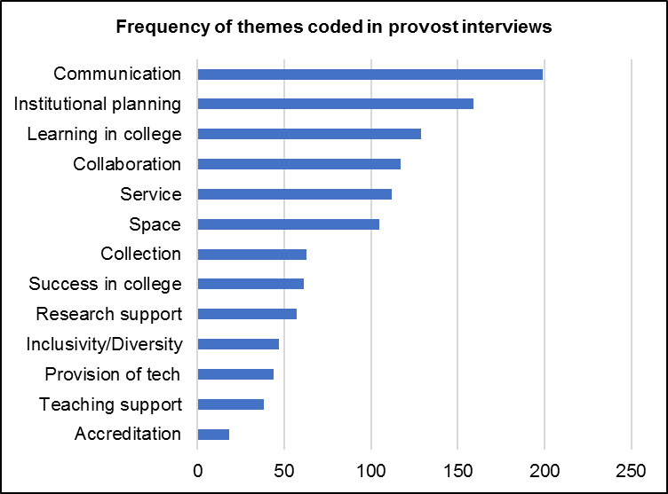
Notes:
Themes discussed most by provosts were:
Communication (17%, n=199)
Institutional planning (14%, n=159)
Themes not discussed frequently by provosts were:
Accreditation (2%, n=18)
Top themes for focus group interview with librarians were communication, collaboration, and institutional planning
The theme among the librarians was accreditation, and this was the least mentioned theme among the provosts

Slide 21
Provost Individual Interviews
“…A library has so many resources to help with the mission of the university…But you have to woo in faculty and students and staff…the space is important…”(Provost Interviewee PP04, Research University, Secular, Public)
Notes:
One key observation made by provosts is the difficulty faced by librarians in getting the attention of potential users and stakeholders. In some cases, the provosts themselves do not perceive the library as relevant to immediate needs. One provost stated, “The library is viewed as a service body. People communicate with them when they need to” (Provost Interviewee PP13, Research University, Non-Secular, Private).
To demonstrate value, this provost contended that the library needs to communicate its importance. However, communication is not viewed by the provost to be significant in and of itself. For instance, one provost stated: “…passive forms of communication are not helpful. Umm, I would say another email is not helpful. Even a newsletter that's, you know, beautiful, by email, probably not helpful” (Provost Interviewee PP04, Research University, Secular, Public)
Instead of such passive communication, librarians need to become good at “customer service” (Provost Interviewee PP07). It instills buy in from other campus stakeholders, who can become the library’s “champions,” “boosters,” and “prophets” (Provost Interviewee PP02, Research University, Non-Secular, Private Not-for-Profit).
To fulfill this role, provosts suggest the importance of collaborating with faculty and students, such as introducing a liaison program. As conveyed by one provost, it is very important for libraries to “establish themselves as a critical link or a critical piece” early on by having “intentional interventions” (e.g., in orientations, by going to classes or convincing instructors to bring classes to the libraries, online or on campus) (Provost Interviewee PP05). The goal of the library should be to go beyond its role as “a service body” and instead be integrated into the lives of its potential users (Provost Interviewee PP13, Research University, Non-Secular, Private).
One of the ways librarians can collaborate with potential users is by sharing space with them. As indicated by Figure 6, provosts discussed space often. But space cannot be limited to supporting library collections or services. Instead, provosts want librarians to collaborate with others in using space. This can be achieved in several ways, from offering space in the library to a writing center to hosting a museum with artifacts of interest to those within and outside the university. For provosts, being able to see the library space being used by those outside of the library leaves an impression of the library as “a hub of student learning” (Provost Interviewee PP03, Research University, Secular, Private Not-for-Profit).

Slide 22
Provost Individual Interviews
“One thing librarians are great at is collecting metrics on what they're doing, and who's using this and that and so forth, and then trying to get... Adjust their services to meet, umm, the development and demands and so forth. You know, the problem, of course, is that there's a lot of, uh, less tangible kinds of benefits that the library brings to a campus, in terms of being a place where people, uh, meet to exchange ideas, and to develop projects, and things like that, umm, and... And use the resources in less visible ways, umm, than can always be tracked by, umm, these kinds of use metrics.” (Provost Interviewee PP02, Research University, Non-Secular, Private Not-for-Profit).
Notes:
Communication and collaboration do not occur in a vacuum. Instead, they complement institutional planning. Namely, if the library actively is assessing services, systems, spaces, etc. participating in institutional planning, then they are naturally having to communicate and collaborate with the administrators and faculty on a regular basis. Provosts indicate that communication and collaboration-based efforts on part of the library must be tied to the larger institutional mission to sell them to higher education administrators: “…if, if it can help a university-wide initiative, that's gonna be helpful. So find out what the provost is very interested in, and then, try to, to find a way that the library can help, help support that initiative” (Provost Interviewee PP04, Research University, Secular, Public).
However, this provost’s account, especially her conclusion, should not be interpreted as provosts emphasizing direct outcomes as indicators of library value. Provosts recognized that the influence of the library often is indirect, which has been suggested in older literature, as exemplified by the following quote and supported by their discussion of learning in college (16%, n=44).
Rather than librarians concerning themselves with whether an impact is direct or indirect, they should instead connect these impacts strategically to the overarching institutional mission (Provost Interviewee PP14, Research University, Secular, Public). This finding also was reflected in the focus group interview.

Slide 23
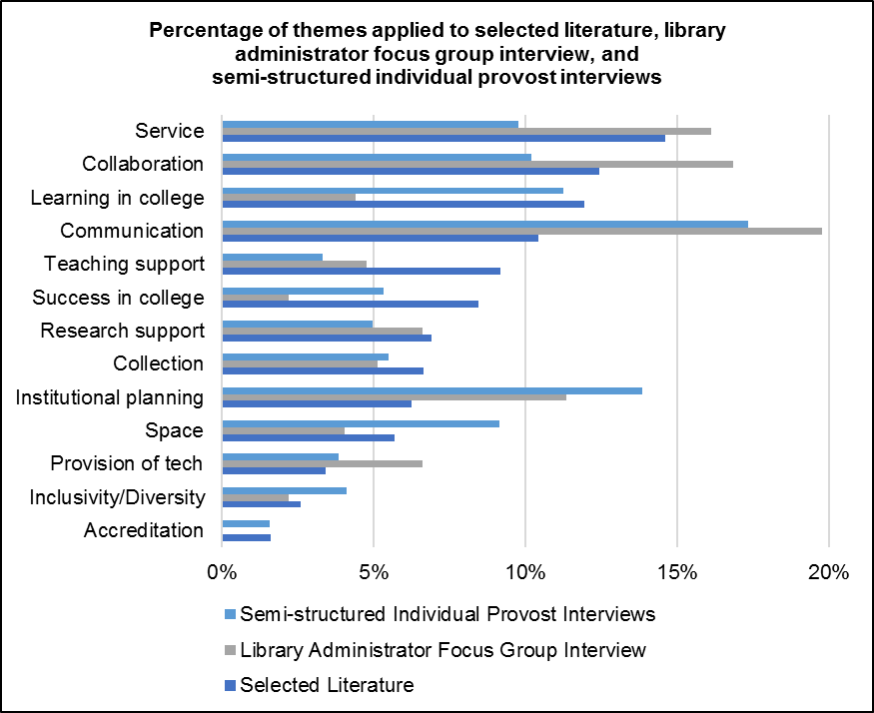
Notes:
When comparing all three data sources, some differences among the themes prevalent in each can be drawn.
Documents from the selected literature discussed success in college more than library administrator focus group interview or provost semi-structured individual interviews and communication less.
Define selected literature. The selection criteria for LIS and higher education documents reviewed are: 1) indexed by LIS and/or higher education databases or identified by the project team or ACRL (e.g., ACRL Assessment in Action (AiA) studies, Ithaka S+R surveys, see Relevant ACRL Documents section), 2) published between 2010-2016, 3) contained themes identified in the 2010 VAL Report, and 4) published in the US, except for studies outside the US deemed relevant by the project team
Documents from the selected literature discussed institutional planning less than the provosts in their individual interviews
Provosts focused less on teaching support than the selected literature.
Focus group interview participants discussed learning in college less than the selected literature documents and provost interviews.
Provosts discussed space more than the participants of the focus group interview or in the selected literature and service less.

Slide 24
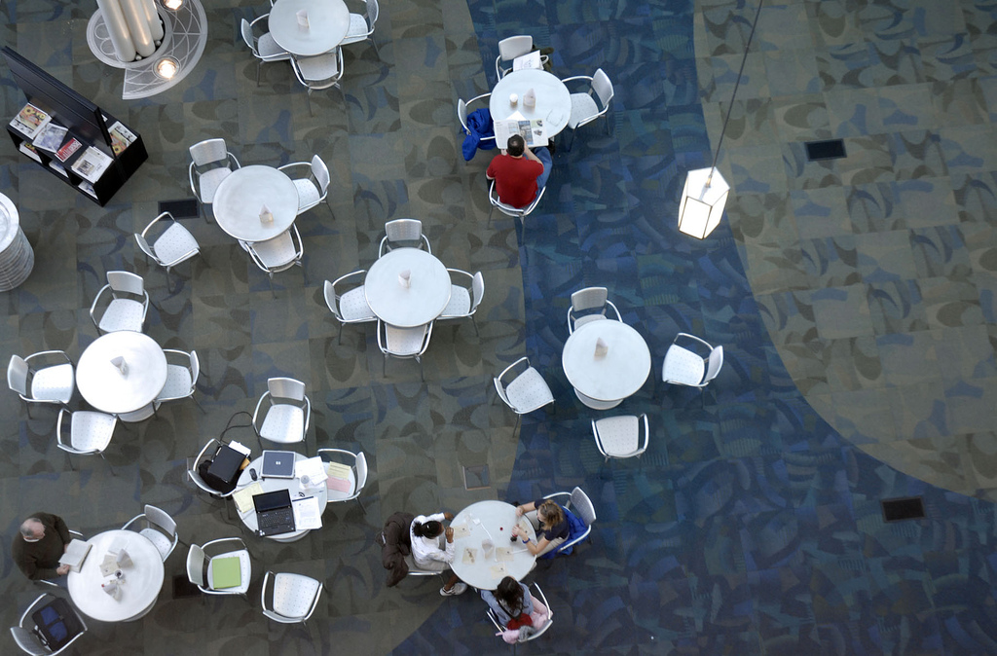
Recommendation
Identify & articulate both learning & success outcomes
  Engage students in redesigning library space to demonstrate library’s impact for learning outcome
  Library resource or service usage & its relationship to student retention exemplifies the effect of library’s service, collection, &/or space for success outcome
Notes:
Image: https://www.flickr.com/photos/kimmanleyort/2130314519/ by Kim Manley Ort / CC BY-NC-ND 2.0
Based on these initial findings, we’ve come up with the following recommendations.

Slide 25
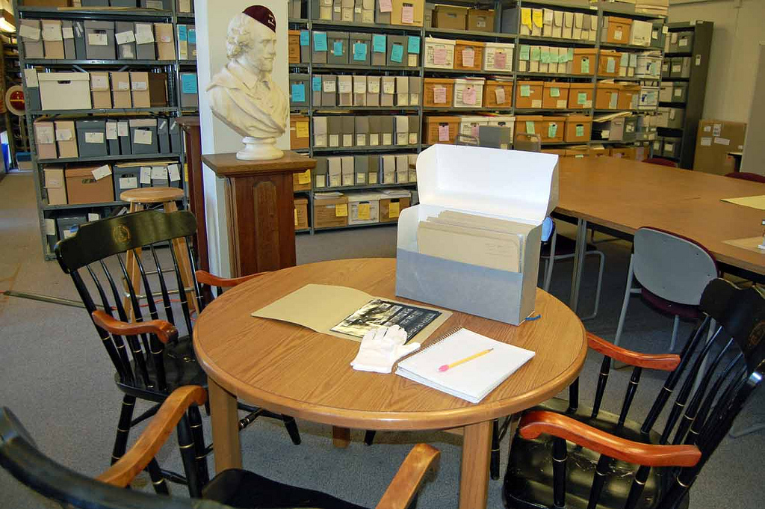
Recommendation
Focus less on service & more on sharing space & collaborative programming with groups both on & off campus
Notes:
Image: https://www.flickr.com/photos/ubarchives/4663516752/ by ubarchives / CC BY-NC-ND 2.0

Slide 26
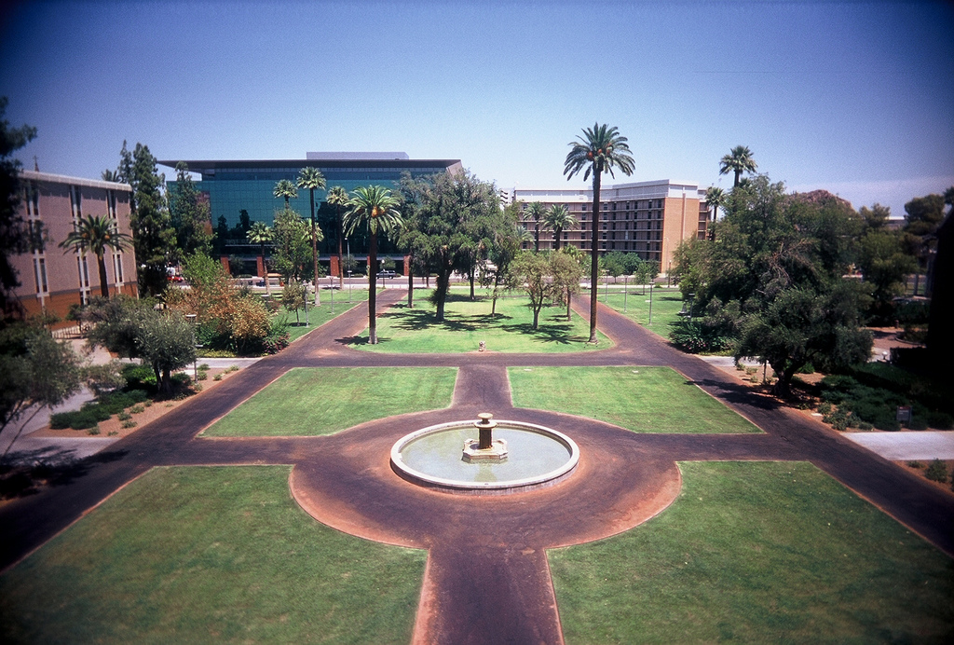
Recommendation
Bolster collaboration with other campus units or external partners, including consortia, on assessment-based efforts
Notes:
Image: https://www.flickr.com/photos/pagedooley/3887095398/ by Kevin Dooley / CC BY 2.0

Slide 27
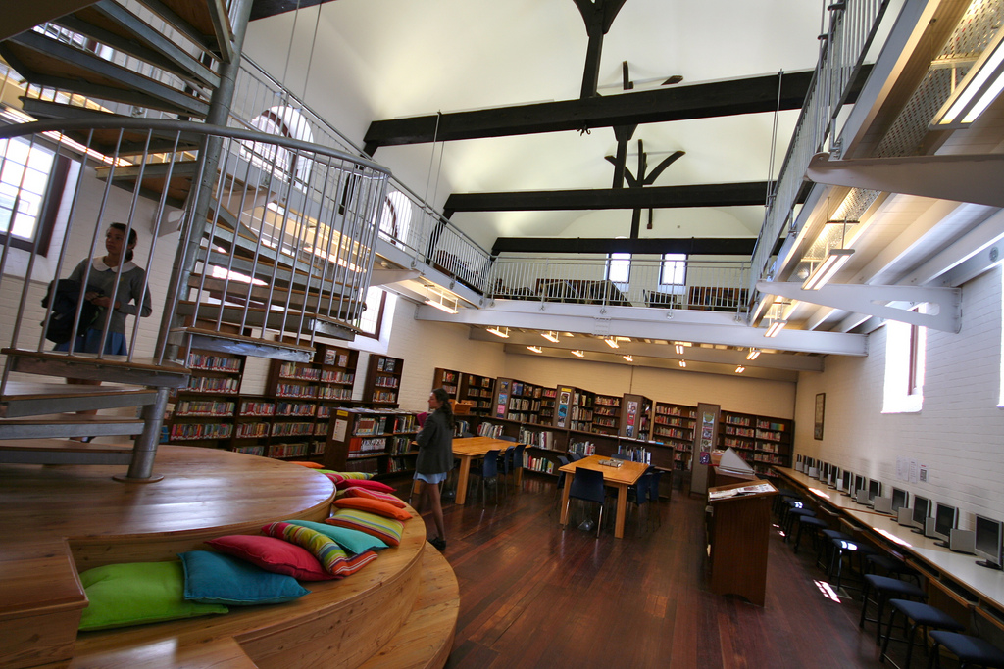
Recommendation
Communicate how library services, collections, and spaces address the larger mission of the institution by becoming better at marketing & customer service
Notes:
Image: https://www.flickr.com/photos/edublogger/5119742141/ by Ewan McIntosh / CC BY-NC 2.0
Strategically align the student success goals and metrics with the Chancellors’/Presidents’ institutional priorities on student success.

Slide 28
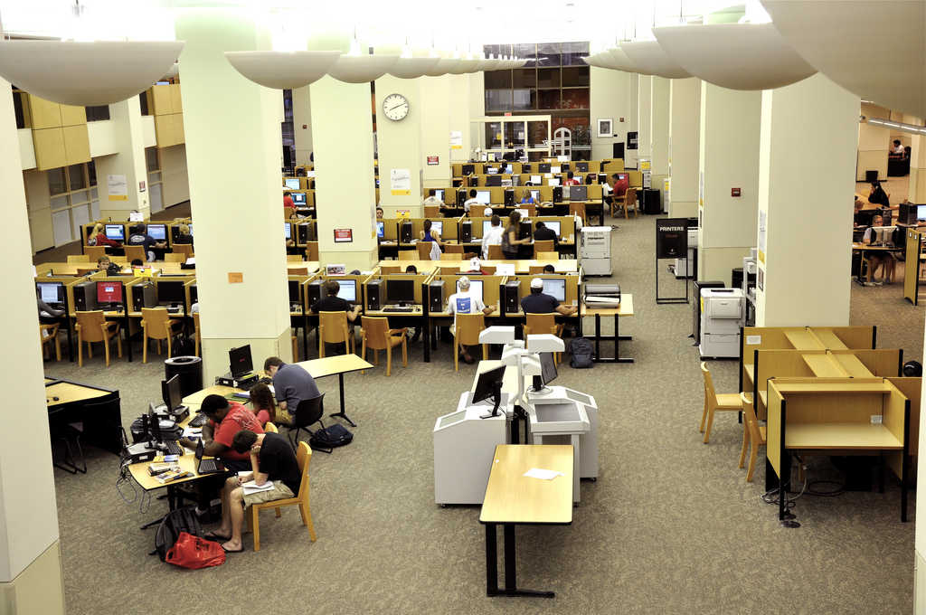
Recommendation
Study the assessment & student-centered outcomes of diverse populations across various institutions using multiple methods
Notes:
Image: https://www.flickr.com/photos/kimberlykv/4495272217/ by Kimberly Vardeman / CC BY 2.0

Slide 29
Recommendation
Develop relationships within different academic service areas, such as teaching & learning, at various levels throughout institution
Notes:
Refers back to/is part of sharing space and developing collaborative programming

Slide 30
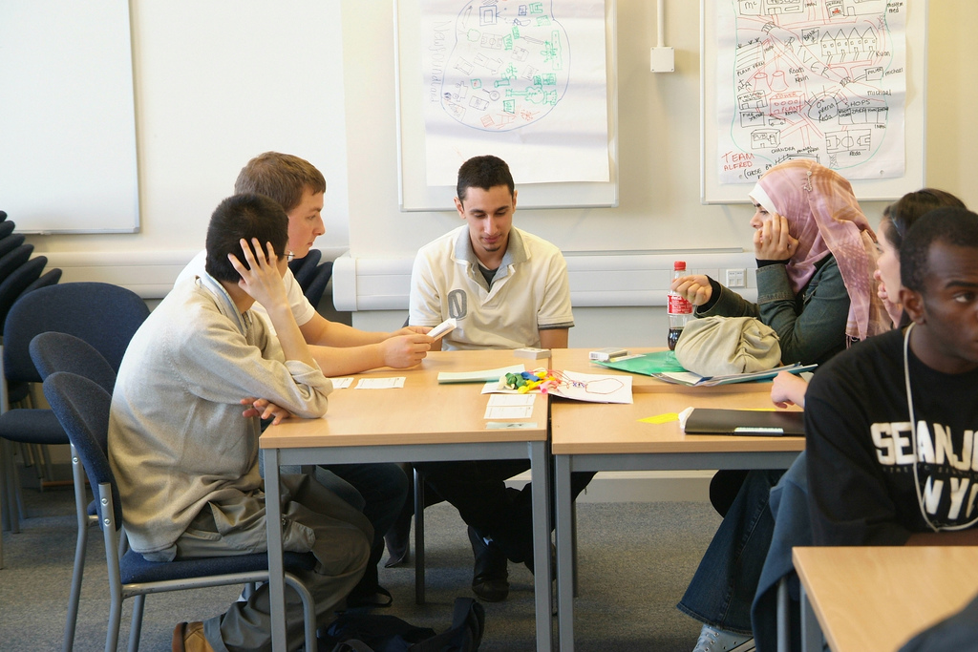
Recommendation
Continue to develop & foster relationships and engagement with academic administrators & other service providers, such as student services, offices of sponsored programs, teaching & learning, etc.
Notes:
Image: https://www.flickr.com/photos/goodimages/1448139556/ by Gianni / CC BY-NC-ND 2.0

Slide 31

Recommendation
Represent data different contexts & visualizations to make case with diverse groups of academic administrators
Notes:
Image: https://www.flickr.com/photos/skinnylawyer/6337956175/ by InSapphoWeTrust / CC BY-SA 2.0

Slide 32
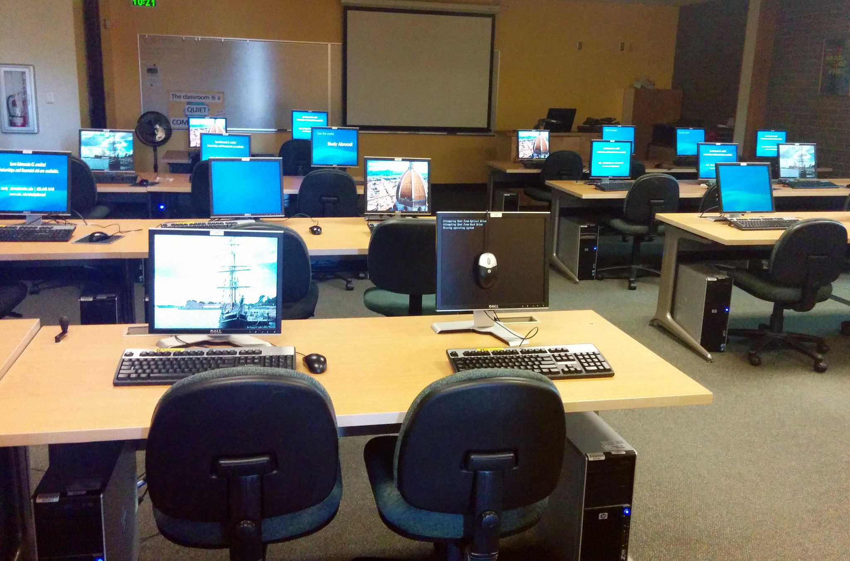
Priority Area
Communication
  Communicate with those outside of library & at different levels within the institution
    Can provide offer a bird’s eye view of what library should be doing
    Can be advocates for & supporters of library
Notes:
Image: https://www.flickr.com/photos/wsl-libdev/20313732103/ by Washington State Library / CC BY-NC 2.0
The Priority Areas for future research are based on the findings of the selected literature review, the library administrator focus group interview, and the provost semi-structured individual interviews. These Priority Areas intentionally are broad to foster discussion and input from academic librarians and to include more specific research questions within each Priority Area.
The most important factor for identifying the Priority Areas was to discover which themes occurred most frequently in each data source. This was in response to the RFP, which specifically stated that the project would “Begin with a high level look at the trends in higher education that concern academic librarians in the broader context of academia and identify current academic library responses to the trends.” Individual library responses, such as information literacy instruction and data analytics were not included in the codebook. Therefore, it should be noted that while library response (collection, service, space) was coded as a theme, these codes were not included within the count of the top five themes since each Priority Area addresses a theme across all three responses.
Per the RFP, which asked for between 5-10 priority areas, six were addressed, which will now be overviewed. We will also briefly discuss an exemplar study for each area, and identify best practices related to the area.
The importance of communication was identified in the RFP and in the project plan, and was one of the main reasons for the creation of the Advisory Group. It provided the opportunity for library administrators to connect with provosts at their institutions and provide data on how librarians can communicate the value the library brings to the academic community. As a theme, its definition was: “Librarians communicate impact or other aspects of value with stakeholders.” However, only three studies published since 2000 have looked at how administrators perceive the library and its collections, spaces, and services. An earlier study from 2007 found that according to multiple administrators at six American universities, the library’s symbolic role as the heart of the university was outweighed by its practical role, through which it needed to “connect what it does to the values and mission of the university.” A later study of nine Canadian provosts found that the participants most valued information access provided by the library and envisioned the library evolving into more of a learning space. The study the team identified as exemplar is Fister's (2010) survey of 134 administrators, which covered the highest number of themes (n=11) and received the highest score of all the studies (17 points).
Fister, Barbara. “Critical Assets: Academic Libraries, A View from the Administration Building.” Library Journal 135, no. 8 (2010): 24–27.

Slide 33
Priority Area
2. Collaboration
  Understand different types & levels of collaboration & consider reviewing literature from related fields to see what is said about libraries & common ground
    Work with academic administrators, academic services, faculty, students, alumni, & other members of regional & local communities.
Notes:
Collaboration is an important theme because of the academic library’s primary mission as a research and teaching support unit. The AiA projects also explicitly required librarians to collaborate with at least two other people outside the libraries. As a theme, its definition was: “Librarians work with other institutional departments to influence student outcomes or with other institutions.” The 2015 study by Hess, Greer, Lombardo, and Lim at Oakland University Libraries is exemplary because it documents the libraries’ efforts to collaborate with other departments in support of student success and persistence. Their documented and suggested collaborations cover a wide range of services and collections. Another notable collaboration was between Wolfe, who is an Assistant Professor in the Behavioral and Social Sciences at Hostos Community College (CUNY), who published the results of a study that incorporated information literacy into a class assignment in a higher education journal, and was one of the highest scoring research documents from the higher education databases.
Hess, Amanda Nichols. “Equipping Academic Librarians to Integrate the Framework into Instructional Practices: A Theoretical Application.” Journal of Academic Librarianship 41, no. 6 (2015): 771–76. doi:10.1016/j.acalib.2015.08.017.
Wolfe, Kate S. “Emerging Information Literacy and Research-Method Competencies in Urban Community College Psychology Students.” The Community College Enterprise 21, no. 2 (2015): 93–99.

Slide 34
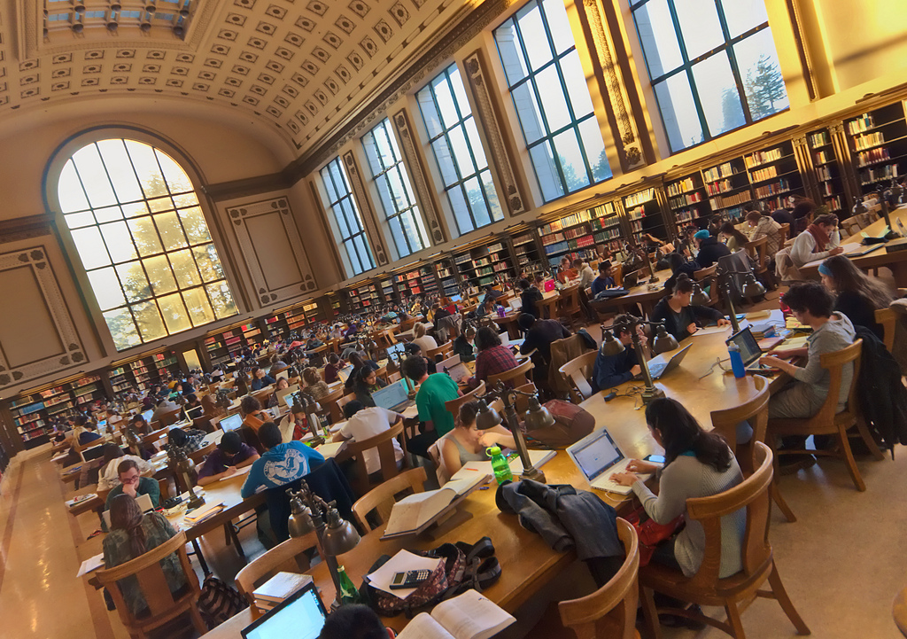
Priority Area
3. Mission Strategy & Alignment
  Go outside of library to collect data & seek possible collaborators for common issues
    Work with teaching & learning support services & directly with faculty & students to build culture of assessment
      Use both qualitative & quantitative data for collection, analysis, & reporting
Notes:
Image: https://www.flickr.com/photos/parksdh/11340519505/ by Daniel Parks / CC BY-NC 2.0
The definition for this theme was: “Institutionally-identified student outcomes (can be co-coded with learning and success).” It appeared in the top five themes in the Advisory Group’s focus group interview and the provosts’ semi-structured individual interviews, but it was the seventh most common theme in the literature. Moreover, there was a statistically significant difference in the number it was reported in theoretical documents compared to research documents, which means that it likely is being discussed more than being empirically tested. Lombard’s 2012 study at Gannon University had a short write up, but was exemplar in several ways, which led to its relatively high score. First, it looked at the library’s influence on recruitment, which has been studied in higher education research documents addressing student outcomes, but rarely appears in library research documents. The data collection method also was interesting because the survey was posted on various non-library online spaces, meaning that it may have tapped into those who do not use the library. It also collected and analyzed qualitative data from interviews with fourteen admissions professionals from various institutions and, based on survey and interview findings, makes suggestions for ways librarians can collaborate with admissions departments.
Lombard, Emmett. “The Role of the Academic Library in College Choice.” Journal of Academic Librarianship 38, no. 4 (2012): 237–41. doi:10.1016/j.acalib.2012.04.001.

Slide 35
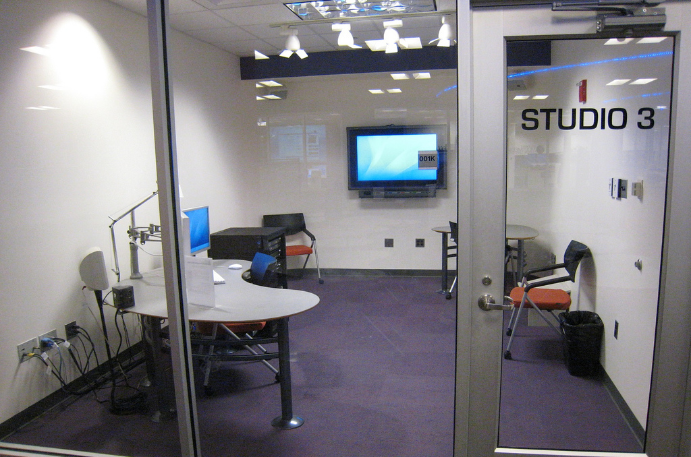
Priority Area
4. Teaching & Learning
  Engage with faculty & students for librarian inclusion in developing academic & everyday life support services for students
  Develop educated & informed citizens
Notes:
Image: https://www.flickr.com/photos/cogdog/2555280926/ by Alan Levine / CC0 1.0 Universal (CC0 1.0)
This area also builds on the first two Priority Areas, communication and collaboration.
The definition for this theme was: “Outcome was focused on the less objective concepts of learning, such as critical thinking. Usually not tied to a specific graded assignment or graduation.” In contrast with student success, the code was used for identifying the less tangible or indirect effect of the library on students. Brown-Sica's 2013 study of space redesign at Auraria Library offers one way for various groups to provide multiple types of input and otherwise engage with the library. The Auraria Library serves the University of Colorado Denver, the Metropolitan State College of Denver, and the Community College of Denver. Students were involved in all stages of the study, from formulating the questions to ask, analyzing the data, and offering suggestions based on the results. This study was a high scoring example of learning in college because although not tied to an objective outcome, such as student retention or GPA, this study gave students a voice in the project and facilitated unexpected collaborations with faculty. It also touched on library space, which was a library response that was mentioned by the provosts that was not mentioned as often by librarians.
Brown-Sica, Margaret. “Using Academic Courses to Generate Data for Use in Evidence Based Library Planning.” Journal of Academic Librarianship 39, no. 3 (2013): 275–87. doi:10.1016/j.acalib.2013.01.001.

Slide 36
Priority Area
5. Student Success
  Identify quantifiable student attainment indicators
    Enrollment in postsecondary education
    Grades
    Persistence to the sophomore year
    Length of time to degree & graduation
  Work with academic services & faculty
    Develop data collection & reporting methods that retain student privacy & confidentiality
Notes:
Success in college is defined as: “Outcome was focused on the more objective indicators of learning. These tended to be linked to a specific assignment/semester, such as grades/GPA. It could also be related to whether the student re-enrolled or graduated.” As mentioned earlier in the report, it is useful for librarians to collect individual-level data to document how the library affected student success. Soria, Fransen, and Nackerud’s 2013 study found empirical evidence that first-time, first-year undergraduate students who used the library were more likely to re-enroll for a second semester and to have higher GPAs than those who did not use the library at the thirteen library access points covered in the data collected. While this study has one of the strongest findings empirically, it was not given as many points using the scoring system explained above as compared to the other exemplar studies described in this section. This lack of points rewarded illustrates the difficulty of setting evaluative criteria and suggests that additional exemplar studies should be solicited from Advisory Group members and other relevant stakeholders.

Slide 37
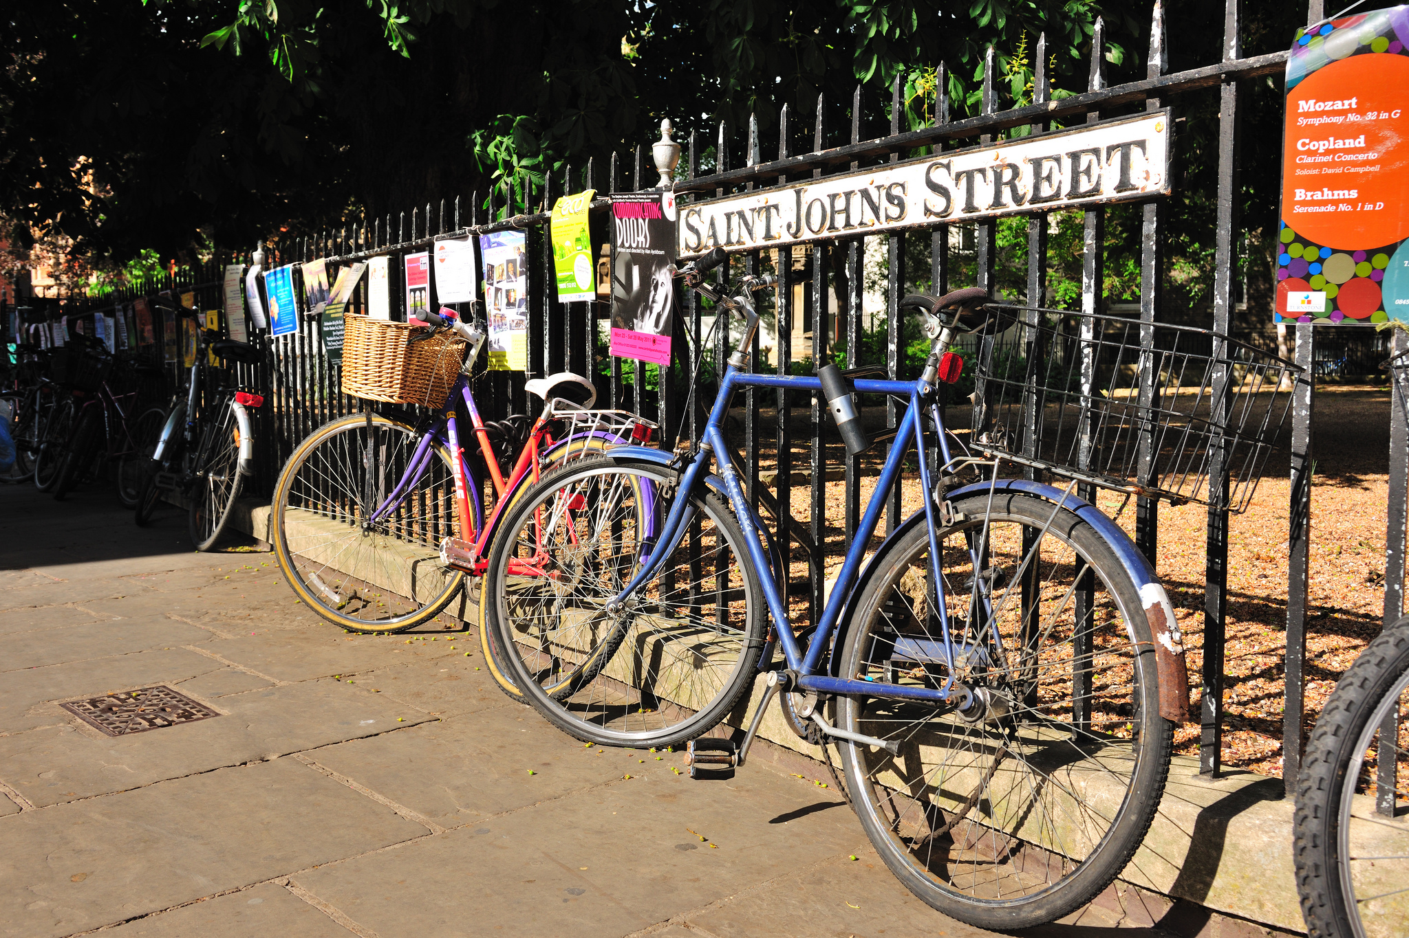
Priority Area
6. Learning analytics
  Measure, collect, analyze & report “data about learners and their contexts, for purposes of understanding and optimizing learning and the environments in which it occurs.”
  Include library data with institutionally collected data to predict student success
(Jantti and Heath 2016)
Notes:
Image: https://www.flickr.com/photos/13523064@N03/7807957322/ by llee_wu / CC BY-ND 2.0
Although learning analytics did not have its own thematic code, it was identified as being an important area in documents such as ACRL’s top trends in academic libraries and ACRL initiatives, such as the e-Learning Webcast Series on Learning Analytics. Jantti and Heath’s 2016 study describes the use of learning analytics at the University of Wollongong in Australia. In addition to collecting library related data in a repository called the Library Cube, this library collects and analyzes more sources of institutional data than any other. These data sets come from course management software called Moodle, student administration, tutorials, and student support service usage data.
Jantti, Margie, and Jennifer Heath. "What role for libraries in learning analytics?" Performance Measurement and Metrics 17, no. 2 (2016): 203-210.

Slide 38
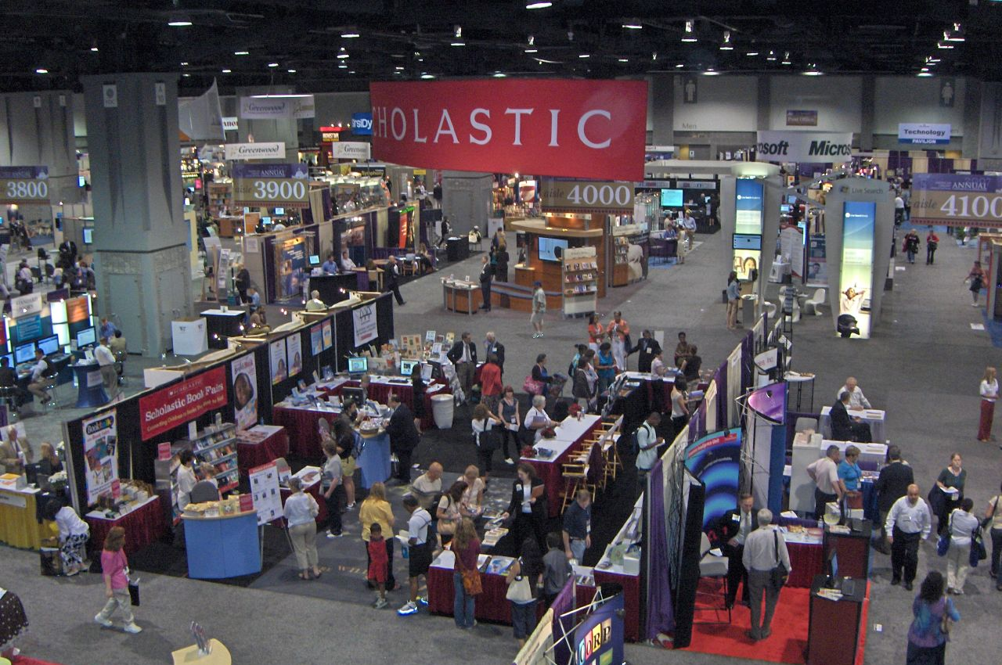
Next Steps
January 2017
  Analysis of 2 Advisory Group brainstorming sessions
  Selection & analysis of higher education literature on student learning & success that does not include libraries
February 2017
  Review & respond to comments from ACRL board, VAL committee, Advisory Group, & other librarians, researchers, and students
Notes:
Image: https://www.flickr.com/photos/minow/624854612/ by cranberries / CC BY-NC-ND 2.0

Slide 39
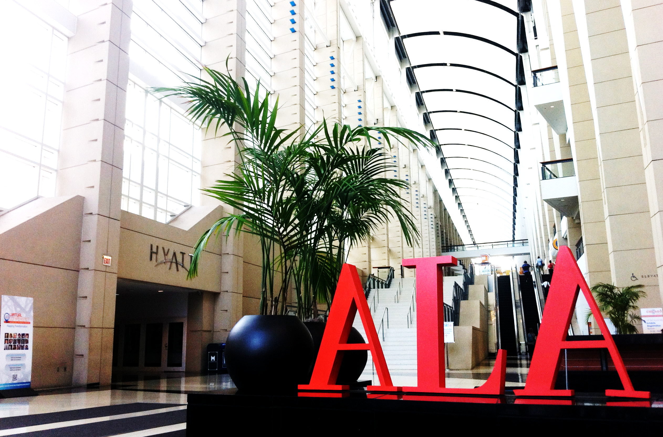
Next Steps
March 2017
  Develop visualization tool
  Conduct usability testing
May 2017
  Release full report & Research Agenda
June 2017
  ACRL Open Online Forum
  ALA 2017 Annual Conference presentation
Notes:
Image: https://www.flickr.com/photos/courtneymcgough/9211901056/ by Courtney McGough / CC BY-NC-ND 2.0

Slide 40

We thank the following people for their contributions to this project:
Erin M. Hood, OCLC
Brittany Brannon, OCLC
Marie L. Radford, Rutgers University
ACRL Board
ACRL VAL Committee
Advisory Group Members
Notes:
Image: https://www.flickr.com/photos/epicfireworks/8058678846/ by Epic Fireworks / CC BY 2.0

Slide 41

Discussion & Questions
Notes:
Image: https://www.flickr.com/photos/noarau/5540659743/ by Thomas Rusling / CC BY-NC-ND 2.0

Slide 42

Feedback
Please submit feedback and suggestions
by February 17, 2017
http://www.oclc.org/research/forms/
feedback-acrl-agenda
Notes:
Image: https://www.flickr.com/photos/fotoremy/6768379679/ by Remy Remmerswaal / CC BY 2.0

Slide 43
References
Association of College & Research Libraries, “Assessment in Action: Academic Libraries and Student Success,” accessed January 17, 2017, http://www.ala.org/acrl/AiA.
Brown-Sica, Margaret. “Using Academic Courses to Generate Data for Use in Evidence Based Library Planning.” Journal of Academic Librarianship 39, no. 3 (2013): 275–87. doi:10.1016/j.acalib.2013.01.001.
Connaway, Lynn, William Harvey, Vanessa Kitzie, and Stephanie Mikitish. Action-oriented Research Agenda on Library Contributions to Student Learning and Success (January 10, 2017), http://www.oclc.org/research/themes/user-studies/acrl-agenda.html.
Notes:
Association of College & Research Libraries, “Assessment in Action: Academic Libraries and Student Success,” accessed January 17, 2017, http://www.ala.org/acrl/AiA.
Brown-Sica, Margaret. “Using Academic Courses to Generate Data for Use in Evidence Based Library Planning.” Journal of Academic Librarianship 39, no. 3 (2013): 275–87. doi:10.1016/j.acalib.2013.01.001.
Connaway, Lynn, William Harvey, Vanessa Kitzie, and Stephanie Mikitish. Action-oriented Research Agenda on Library Contributions to Student Learning and Success (January 10, 2017), http://www.oclc.org/research/themes/user-studies/acrl-agenda.html.

Slide 44
References
Fister, Barbara. “Critical Assets: Academic Libraries, A View from the Administration Building.” Library Journal 135, no. 8 (2010): 24–27.
Hess, Amanda Nichols. “Equipping Academic Librarians to Integrate the Framework into Instructional Practices: A Theoretical Application.” Journal of Academic Librarianship 41, no. 6 (2015): 771–76. doi:10.1016/j.acalib.2015.08.017.
Jantti, Margie, and Jennifer Heath. "What Role for Libraries in Learning Analytics?" Performance Measurement and Metrics 17, no. 2 (2016): 203-210.
Notes:
Fister, Barbara. “Critical Assets: Academic Libraries, A View from the Administration Building.” Library Journal 135, no. 8 (2010): 24–27.
Hess, Amanda Nichols. “Equipping Academic Librarians to Integrate the Framework into Instructional Practices: A Theoretical Application.” Journal of Academic Librarianship 41, no. 6 (2015): 771–76. doi:10.1016/j.acalib.2015.08.017.
Jantti, Margie, and Jennifer Heath. "What Role for Libraries in Learning Analytics?" Performance Measurement and Metrics 17, no. 2 (2016): 203-210.

Slide 45
References
Lombard, Emmett. “The Role of the Academic Library in College Choice.” Journal of Academic Librarianship 38, no. 4 (2012): 237–41. doi:10.1016/j.acalib.2012.04.001.
Soria, Krista M., Jan Fransen, and Shane Nackerud. “Library Use and Undergraduate Student Outcomes: New Evidence for Students’ Retention and Academic Success.” portal: Libraries and the Academy 13, no. 2 (2013): 147–64. doi:10.1353/pla.2013.0010.
Wolfe, Kate S. “Emerging Information Literacy and Research-Method Competencies in Urban Community College Psychology Students.” The Community College Enterprise 21, no. 2 (2015): 93–99.
Notes:
Lombard, Emmett. “The Role of the Academic Library in College Choice.” Journal of Academic Librarianship 38, no. 4 (2012): 237–41. doi:10.1016/j.acalib.2012.04.001.
Soria, Krista M., Jan Fansen, and Shane Nackerud. “Library Use and Undergraduate Student Outcomes: New Evidence for Students’ Retention and Academic Success.” portal: Libraries and the Academy 13, no. 2 (2013): 147–64. doi:10.1353/pla.2013.0010.
Wolfe, Kate S. “Emerging Information Literacy and Research-Method Competencies in Urban Community College Psychology Students.” The Community College Enterprise 21, no. 2 (2015): 93–99.

Slide 46
Image Attributions
Slide 24: Image: https://www.flickr.com/photos/kimmanleyort/2130314519/ by Kim Manley Ort / CC BY-NC-ND 2.0
Slide 25: Image: https://www.flickr.com/photos/ubarchives/4663516752/ by ubarchives / CC BY-NC-ND 2.0
Slide 26: Image: https://www.flickr.com/photos/pagedooley/3887095398/ by Kevin Dooley / CC BY 2.0
Slide 27: Image: https://www.flickr.com/photos/edublogger/5119742141/ by Ewan McIntosh / CC BY-NC 2.0
Slide 28: Image: https://www.flickr.com/photos/kimberlykv/4495272217/ by Kimberly Vardeman / CC BY 2.0
Slide 30: Image: https://www.flickr.com/photos/goodimages/1448139556/ by Gianni / CC BY-NC-ND 2.0
Slide 31: Image: https://www.flickr.com/photos/skinnylawyer/6337956175/ by InSapphoWeTrust / CC BY-SA 2.0
Slide 32: Image: https://www.flickr.com/photos/wsl-libdev/20313732103/ by Washington State Library / CC BY-NC 2.0
Slide 34: Image: https://www.flickr.com/photos/parksdh/11340519505/ by Daniel Parks / CC BY-NC 2.0
Slide 35: Image: https://www.flickr.com/photos/cogdog/2555280926/ by Alan Levine / CC0 1.0 Universal (CC0 1.0)
Slide 37: Image: https://www.flickr.com/photos/13523064@N03/7807957322/ by llee_wu / CC BY-ND 2.0
Slide 38: Image: https://www.flickr.com/photos/minow/624854612/ by cranberries / CC BY-NC-ND 2.0
Slide 39: Image: https://www.flickr.com/photos/courtneymcgough/9211901056/ by Courtney McGough / CC BY-NC-ND 2.0
Slide 40: Image: https://www.flickr.com/photos/epicfireworks/8058678846/ by Epic Fireworks / CC BY 2.0
Slide 41: Image: https://www.flickr.com/photos/noarau/5540659743/ by Thomas Rusling / CC BY-NC-ND 2.0
Slide 42: Image: https://www.flickr.com/photos/fotoremy/6768379679/ by Remy Remmerswaal / CC BY 2.0

