Slide 1
ACRL | 23 March 2017
Changing Tack:
A Future-Focused ACRL Research Agenda
Lynn Silipigni Connaway, Senior Research Scientist & Director of User Research, OCLC
William Harvey, Consulting Engineer, OCLC
Vanessa Kitzie, Research Assistant, OCLC, PhD Candidate, Rutgers University
Stephanie Mikitish, PhD Candidate, Rutgers University

Slide 2
INTRODUCTION

Slide 3
The Value of Academic Libraries
ACRL Goal-area committee
Part of Plan for Excellence
Goal: Academic libraries demonstrate alignment with and impact on institutional outcomes
Promote impact & value of libraries to higher ed. community
Notes:
This project relates to ACRL’s Plan for Excellence.
A major goal for this plan is to help academic libraries demonstrate their value to their parent institutions through their impact on institutional outcomes.
A major institutional outcome is to promote student learning and success.
With decreasing support, the competition for resources becomes more intense and the need for demonstrating value becomes more critical.
Association of College and Research Libraries. (2010). Value of Academic Libraries: A Comprehensive Research Review and Report, researched by Megan Oakleaf. Chicago, IL: Association of College and Research Libraries. Retrieved from: http://www.ala.org/acrl/sites/ala.org.acrl/files/content/issues/value/val_report.pdf

Slide 4
Data Collection
Individual Interviews with Provosts
Selected Literature
Focus Group Interview & Feedback from Advisory Group
Three data sources
Iterative process
Advisory group
Literature review
Provost interviews
Notes:
This slide depicts three data sources:
Selected literature on student learning and success that met the following criteria:
Indexed by LIS and/or higher education databases or identified by the project team or ACRL (e.g., ACRL Assessment in Action (AiA) studies, Ithaka S+R surveys,
Published between 2010-2016
Contained themes identified in the 2010 Value of Academic Libraries (VAL) Report
Published in the US, except for studies outside the US deemed relevant by the project team
Focus group with Advisory Group Members
Consist of library administrators from a variety of community colleges, 4 year colleges and universities around the country
Members provide us feedback throughout the process and put us in touch with provosts or similarly high level academic administrators in their institutions
Individual, semi-structured interviews with provosts from each Advisory Group member’s institution
Process of data collection is iterative, with findings from each source informing the other
E.g., focus group and provost interview protocol was based on the themes that we identified in the initial database searches

Slide 5
Supporting Evidence for
Priority Areas &
Research Questions
Notes:
Based on our data analysis, we developed priority areas and research questions to guide future work.
We will now overview supporting evidence for the priority areas and research questions from interviews with the advisory group and provosts.
The literature review data will be discussed in terms of how it informed our visualization tool.

Slide 6
“Thinking of how these new learning environments work, and how the library would enhance students' and faculty's ability to access and process knowledge, data information, in those particular kinds of environments. That's what libraries need to do to be successful.”
(Provost Interviewee PP02, Research University, Non-Secular, Private)
Notes:
Image: http://bit.ly/2l8fAwO (https://www.flickr.com/photos/napafloma-pictures/16081970310/) by Patrick BAUDUIN / CC BY-NC-ND 2.0
“There's not one specific thing a library can do, because the environments are so different. Thinking of how these new learning environments work, and how the library would enhance students' and faculty's ability to access and process knowledge, data information, in those particular kinds of environments. That's what libraries need to do to be successful.” (Provost Interviewee PP02, Research University, Non-Secular, Private)
The way that libraries can impact learning is contextually-bound because of their dependency on the mission and goals unique to their institution. The importance of context in shaping how librarians communicate value is exemplified by the following provost account.

Slide 7
“I think each of us would have some example of our shared strategic initiatives around enhancing students' success. And promoting innovation and teaching and learning. What's underlying all of this is that all of us see our work as directly tied to the mission of the university.…Academic libraries are those directly connected to the mission of their unique institution.”
(Advisory Group Member LM13, Research University, Non-Secular, Private)
Notes:
“I think each of us would have some example of our shared strategic initiatives around enhancing students' success. And promoting innovation and teaching and learning. What's underlying all of this is that all of us see our work as directly tied to the mission of the university. And it is what makes academic libraries unique in some ways, but also so successful. Academic libraries are those directly connected to the mission of their unique institution.” (Advisory Group Member LM13, Research University, Non-Secular, Private)
On first pass, it may be surprising that the focus group interview participants did not discuss student learning (4%, n=12) and success (2%, n=6), compared to how often these themes are mentioned in the literature (learning, 58%, n=308; success, 41%, n=218). However, as explained by the quote on this slide [read quote].
As perceived by this participant, the library’s role in enhancing student learning and success is perceived by librarians to be inherent to the mission of the academic library. This participant felt that solely being concerned with fulfilling library-oriented goals would detract from the effect they would be able to have at the university level. This observation may be explained by the fact that the participants are administrators in their academic libraries, therefore their focus is to be strategic and targeted on high-level library goals. It also likely accounts for why themes that implied making connections and establishing relationships outside of the library--collaboration and communication--were among those most frequently discussed (communication, 20%, n=54; collaboration, 17%, n=46).

Slide 8
“My biggest concern is that the students aren't coming together…there's a hunger within our undergraduate student population to actually socialize. The library has always been that crossroads for campuses. It could serve in this capacity, pulling students together.”
(Provost Interviewee PP04, Research University, Secular, Public)
Notes:
Image: http://bit.ly/2lQ0XwV (https://www.flickr.com/photos/dlebech/6803716862/) by David Lebech / CC BY-NC 2.0
“My biggest concern is that the students aren't coming together. The library can be that place, that nexus where students can come to study together. Yes, everything's posted online and they know they can do this alone, but there's a hunger within our undergraduate student population to actually socialize. The library has always been that crossroads for campuses. It could serve in this capacity, pulling students together.” (Provost Interviewee PP04, Research University, Secular, Public)

Slide 9
“Only sharing space, such as with a writing or computer lab is low level. There needs to be cooperative programming and interaction.”
(Advisory Group Member LM06, Research University, Secular, Public)
Notes:
Image: http://bit.ly/2m9i39Y (http://bit.ly/2m9i39Y) by stnorbert / CC BY-NC-ND 2.0
“Only sharing space, such as with a writing or computer lab is low level. There needs to be cooperative programming and interaction.” (Advisory Group Member LM06, Research University, Secular, Public)

Slide 10
“The way many of our faculty and students research now, it’s less about going to a physical space but accessing information in their offices.…I think that that is one of the challenges of changing the paradigm.”
(Provost Interviewee PP13, Research University, Non-Secular, Private)
Notes:
Image: http://bit.ly/2m3H2uS (https://www.flickr.com/photos/rolexpv/9752688231/) by Raul Pacheco-Vega / CC BY-NC-ND 2.0
“For so long [librarians] have had a role of support rather than integration into work. Much more of a partnership rather than support as needed, so it’s proactive in its orientation rather than reactive. The way many of our faculty and students research now, it’s less about going to a physical space but accessing information in their offices. Trying to imagine a new way where it’s not just a service model, but it’s actually an integration and partnership model, I think that that is one of the challenges of changing the paradigm.” (Provost Interviewee PP13, Research University, Non-Secular, Private)
Provosts suggest the importance of collaborating with faculty and students, such as introducing a liaison program. As conveyed by one provost, it is very important for libraries to “establish themselves as a critical link or a critical piece” early on by having “intentional interventions” (e.g., in orientations, by going to classes or convincing instructors to bring classes to the libraries, online or on campus) (Provost Interviewee PP05). The goal of the library should be to go beyond its role as “a service body” and instead be integrated into the lives of its potential users (Provost Interviewee PP13).

Slide 11
“…we have to be willing to do types of data collection that libraries have shied away from in the past.…I think that we have to be able to be willing to have conversations on campus about tracking user behavior in ways that libraries just haven't done.”
(Advisory Group Member LM14, Research University, Secular, Public)
Notes:
Image: http://bit.ly/2mHdL6q (https://www.flickr.com/photos/pong/2404940312/) by Rob Pongsajapan / CC BY 2.0
“To truly be able to look at, and be able to tell those stories, and to come up with those snippets of information that will resonate with other leaders, we have to be willing to do types of data collection that libraries have shied away from in the past. That involves tracking user behavior in a way that we've seen in a couple of the different studies that have looked at retention. There are ways of extrapolating and growing that out a little bit more so that we are dealing with large datasets, and we could...We could still keep it anonymous when we look at it in aggregate, right? I think that we have to be able to be willing to have conversations on campus about tracking user behavior in ways that libraries just haven't done.” (Advisory Group Member LM14, Research University, Secular, Public)
Privacy only was mentioned once, but is an important area of exploration. This topic is particularly fraught in the areas of assessment and academic libraries since there is a lack of established best practices and standards addressing the methods and contexts that may threaten the privacy of students. For this reason, privacy, when broadly defined, can be viewed by librarians in some instances as less of an ethics issue and more of an impediment, as articulated by the following participant [read quote].

Slide 12
Priority Areas &
Research Questions

Slide 13
Priority Areas
Communication
Collaboration
Mission strategy & alignment
Teaching & learning
Student success
Learning analytics
Notes:
Image: https://www.flickr.com/photos/parksdh/11340519505/ by Daniel Parks / CC BY-NC 2.0
Analysis of all three data sources informed the identification of six priority areas for future research.
Communication: Communicate with those outside of library & at different levels within the institution
Collaboration: Understand different types & levels of collaboration & consider reviewing literature from related fields to see what is said about libraries & common ground
Mission strategy & alignment: Go outside of library to collect data & seek possible collaborators for common issues; Inform students, faculty, & administrators of how the academic library contributes to the institutional mission and goals.
Teaching & learning: Engage with faculty & students for librarian inclusion in developing academic & everyday life support services for students; Develop educated & informed citizens
Student success: Identify quantifiable student attainment indicators; Work with academic services and faculty
Learning analytics: Measure, collect, analyze & report “data about learners and their contexts, for purposes of understanding and optimizing learning and the environments in which it occurs.” ; Include library data with institutionally collected data to predict student success
Brown-Sica, Margaret. “Using Academic Courses to Generate Data for Use in Evidence Based Library Planning.” Journal of Academic Librarianship 39, no. 3 (2013): 275–87. doi:10.1016/j.acalib.2013.01.001.
Fister, Barbara. “Critical Assets: Academic Libraries, A View from the Administration Building.” Library Journal 135, no. 8 (2010): 24–27.
Hess, Amanda Nichols. “Equipping Academic Librarians to Integrate the Framework into Instructional Practices: A Theoretical Application.” Journal of Academic Librarianship 41, no. 6 (2015): 771–76. doi:10.1016/j.acalib.2015.08.017.
Jantti, M. and Heath, J. (2016). What role for libraries in learning analytics? Performance Measurement and Metrics 17(2), 203-210.
Lombard, E. (2012). The role of the academic library in college choice. Journal of Academic Librarianship 38(4), 237–41.

Slide 14
How do academic library resources or services impact success outcomes for students?
How do library collections impact student retention for undergraduate students?
How do library spaces support student enrollment?
How does library instruction affect post-graduate metrics such as job placement?
Research Questions:
Student Success
Notes:
Image: http://bit.ly/2msQ06a (https://www.flickr.com/photos/governordayton/5572098001/) by Governor Mark Dayton / CC BY 2.0
For each priority area, we are creating research questions to address each priority area. These questions are informed by our data. I will show some examples of research questions for the Student Success theme. Each high-level question is more general, while the sub-questions beneath them offer suggestions for how librarians can tailor these questions to their institutions and needs.
Italicized items signify a key high-level themes indexed by the visualization tool, while underlined words are detected by a keyword search using the tool.

Slide 15
How do academic library resources or services impact success outcomes for different students?
What difference in information literacy tests do graduate & undergraduate students exhibit?
How do military students benefit from library instruction?
Research Questions:
Student Success
Notes:
For each priority area, we are creating research questions to address each priority area. These questions are informed by our data. I will show some examples of research questions for the Student Success theme. Each high-level question is more general, while the sub-questions beneath them offer suggestions for how librarians can tailor these questions to their institutions and needs.
Italicized items signify a key high-level themes indexed by the visualization tool, while underlined words are detected by a keyword search using the tool.

Slide 16
What outcome data do other departments/units in different institution types collect?
What student persistence data do tutoring centers in 4-year colleges collect?
What student success & library instruction data do community college libraries collect?
Research Questions:
Student Success
Notes:
For each priority area, we are creating research questions to address each priority area. These questions are informed by our data. I will show some examples of research questions for the Student Success theme. Each high-level question is more general, while the sub-questions beneath them offer suggestions for how librarians can tailor these questions to their institutions and needs.
Italicized items signify a key high-level themes indexed by the visualization tool, while underlined words are detected by a keyword search using the tool.

Slide 17
Research Questions:
Student Success
How have librarians ethically collected student outcome & library resource or service data?
(Question cross listed with learning analytics)
How have librarians collected student GPA & library usage data?
Notes:
For each priority area, we are creating research questions to address each priority area. These questions are informed by our data. I will show some examples of research questions for the Student Success theme. Each high-level question is more general, while the sub-questions beneath them offer suggestions for how librarians can tailor these questions to their institutions and needs.
Italicized items signify a key high-level themes indexed by the visualization tool, while underlined words are detected by a keyword search using the tool.

Slide 18
VISUALIZATION DASHBOARD

Slide 19
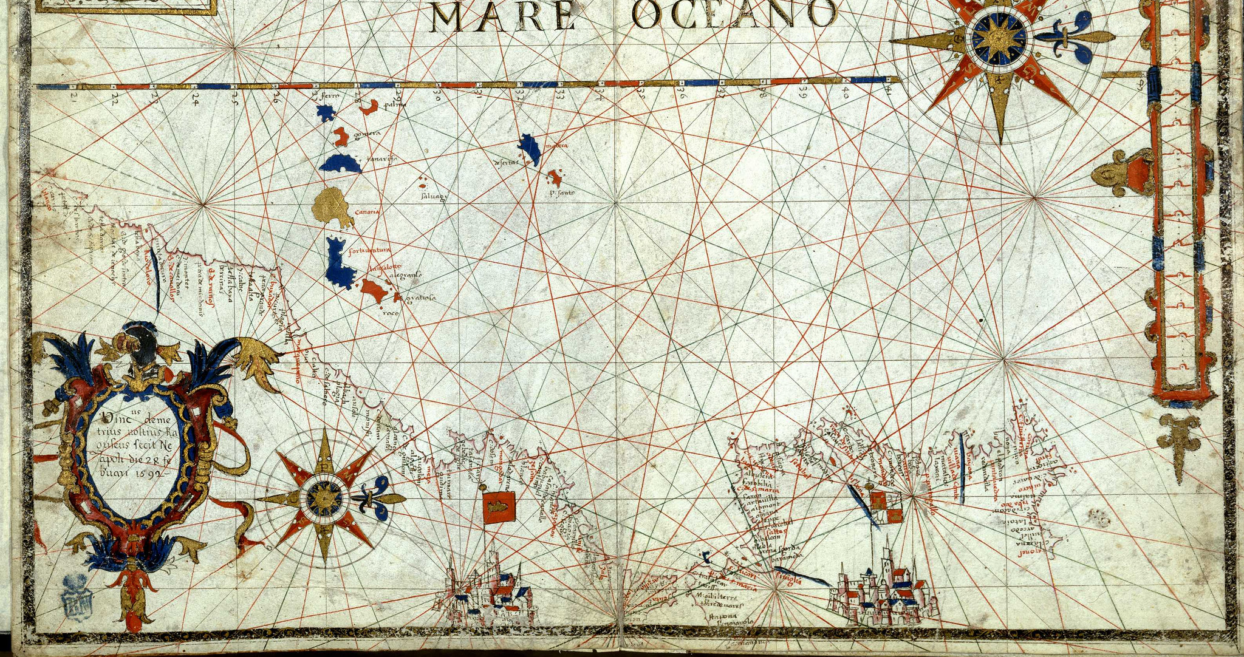
Interactive Visualization Dashboard
Overview
What it does
How it works
Engineering feats and tips
Design decision and challenges
Usability testing via OCLC Usability Lab
Upcoming features
Notes:
Image: https://www.flickr.com/photos/bibliotecabne/12185588643/ by Biblioteca Nacional de España / CC BY-NC-ND 2.0

Slide 20
About The Dashboard
Find literature relevant to your research interests
Create charts and graphs
Notes:
Image: https://www.flickr.com/photos/markleepower/7962282652/ by Mark Power / CC BY-NC-ND 2.0
We have developed an interactive visualization dashboard to help librarians filter the existing literature for studies most relevant to their research interests. A second visualization tool will help librarians communicate their value to their constituencies and may allow entry of local data to produce a graphic that could be shared with stakeholders.
The dashboard has two primary components: A literature search tool, and charts and graphs tool.

Slide 21
Literature search tool
Notes:
First I will give a quick overview of the literature search tool’s features, then we will try it out in a live demo.

Slide 22
Notes:
We have an auto-suggest search bar that indexes our articles’ titles, abstracts, and metadata.

Slide 23
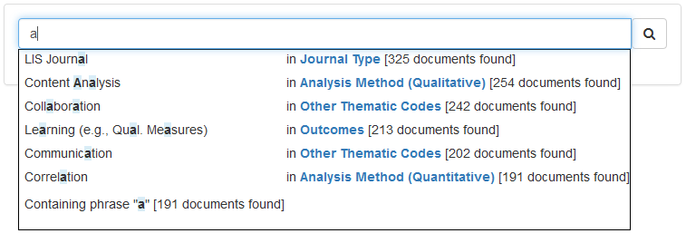
Notes:
As you type, you can quickly get a sense for the thematic codes and other categorizations of documents in the dataset.

Slide 24
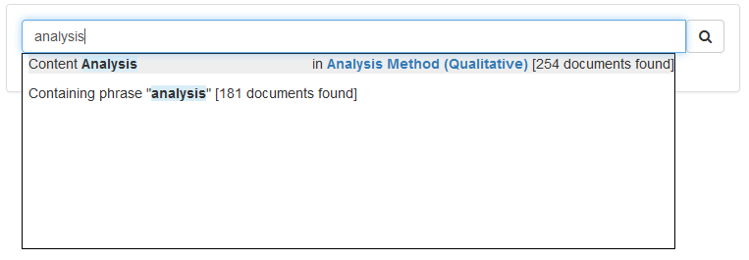
Notes:
Searches are performed in realtime, and the sizes of your results sets are shown as you type.

Slide 25
Notes:
Search works a lot like shopping for shoes at Zappos. As you search, your queries gradually refine your results, and each intermediate query is shown as a breadcrumb. You can remove any query at any time by clicking the “X” on its breadcrumb.

Slide 26
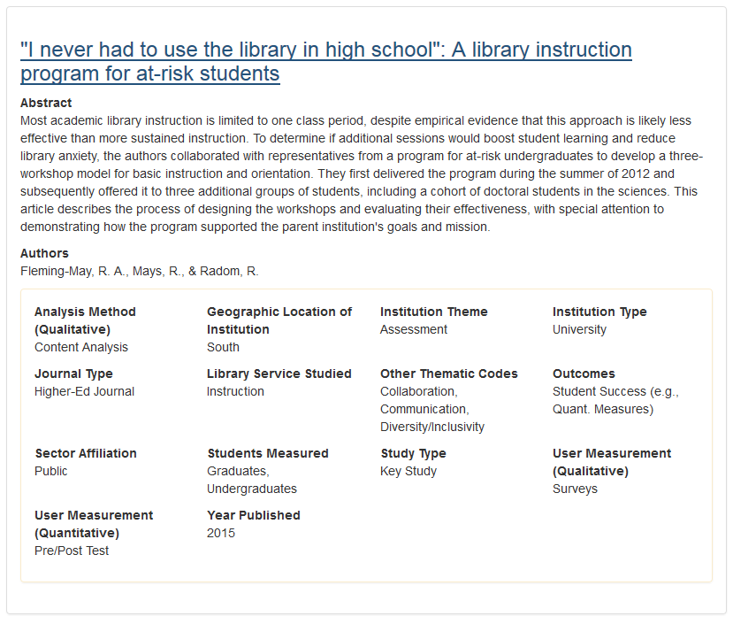
Notes:
As you search, the articles that you have found are listed in the search results.

Slide 27
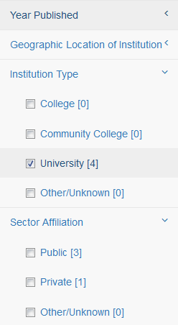
Notes:
In addition to keyword searching, you can use faceted browsing to refine your search results. The facets automatically check as they are chosen from the auto-suggest box.

Slide 28
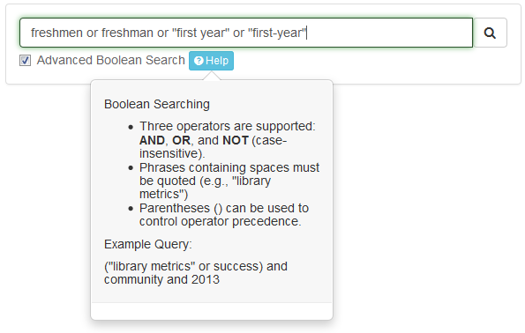
Notes:
Our search engine supports Boolean syntax with phrasing. Currently we have it as an opt-in (“advanced Boolean search”, but after discussions with our design expert, we may make it automatic and add an “Advanced Search” control panel to help people who are not familiar with Boolean searches.
Now, let’s go to a live demo.

Slide 29
Charts and graphs tool
Notes:
The “Charts and Graphs” tool allows us to visualize data. Currently it allows exploration of the document database for this project, but has been designed to support arbitrary tabular data (upcoming feature).

Slide 30
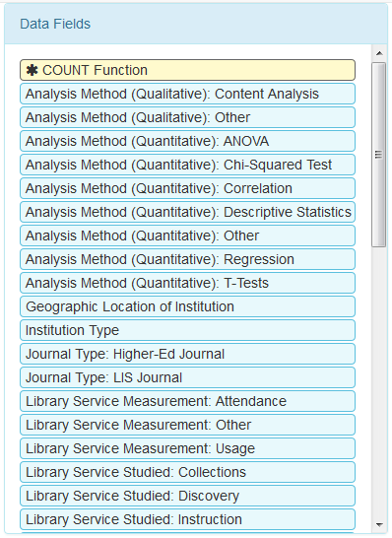
Notes:
The data fields that can be rendered inside a visualization are shown in a basket.

Slide 31
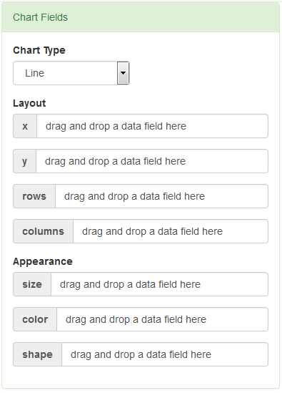
Notes:
There is another basket that represents the various visual attributes of a chart or graph. For example, a chart or graph has an X-axis, a Y-axis, and can have other visual attributes such as colors and sizes of chart elements.

Slide 32
Notes:
Drag-and-drop data fields onto the chart fields to add them to your graphic.

Slide 33
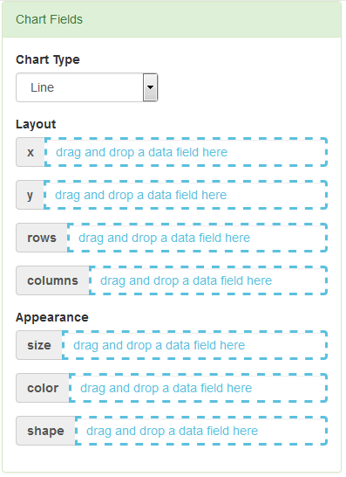
Notes:
As you drag a data field, the UI shows you where you can drop it.

Slide 34
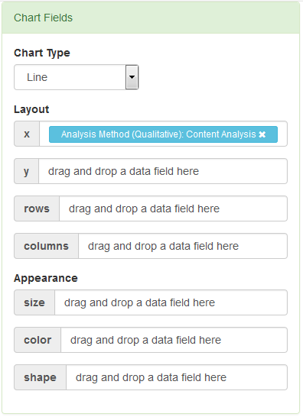

Slide 35
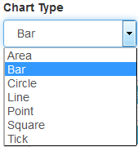
Notes:
There are seven different kinds of charts supported…

Slide 36
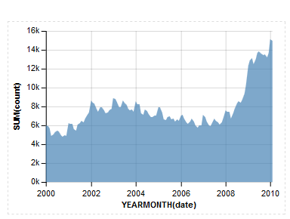
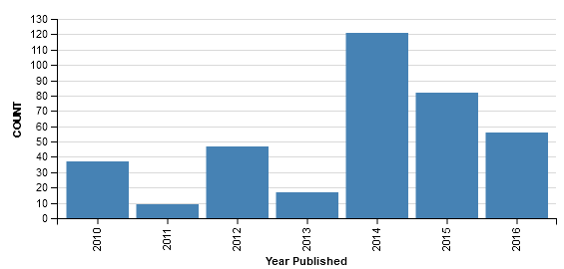
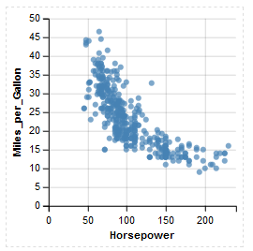
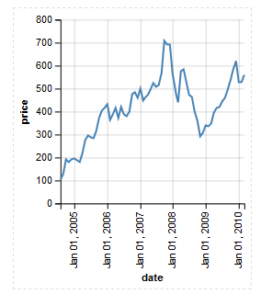
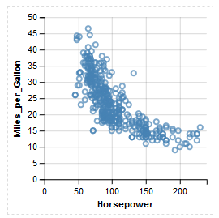
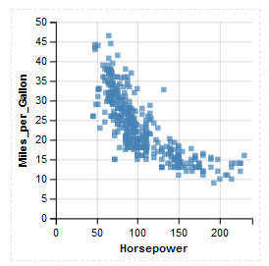
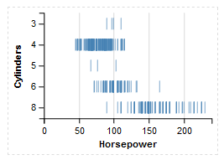
Notes:
…Area, Bar, Point, Line, Circle, Square, and Tick.

Slide 37
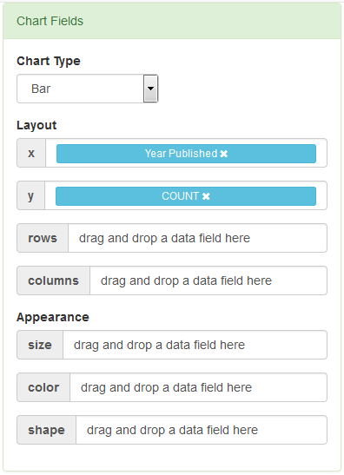
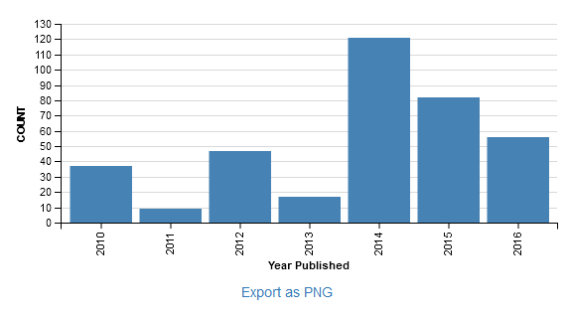
Notes:
When you have built your chart, you can use “Export as PNG” to save it as a graphic…

Slide 38
Notes:
…or you can choose the “Save My Work” button to save your chart so you can edit it later.

Slide 39
How it Works

Slide 40
Instant. Comprehensive. Exact.
Notes:
The fundamental piece of engineering behind the literature search tool is a data structure called a Suffix Array. This is actually a variant of a data structure that is used to assemble human genomes. This data structure gives us a full-text index of our entire dataset ON THE CLIENT SIDE which makes search instantaneous – no round trips to the server.
If you are the product owner of a search tool like ours, or if you need to build one someday, consider using our code! To our knowledge, as of March 2017, we are the only ones to do this in JavaScript on the client side.
(Remark: Any delays that we see in the current prototype are due to “DOM reflow”, which is a complicated way of saying that it takes the browser some time to show/hide the rendered articles after a search. The searching itself is virtually instantaneous.)
Also, our implementation of Boolean searching is small and provably complete (using formal lightweight methods).

Slide 41
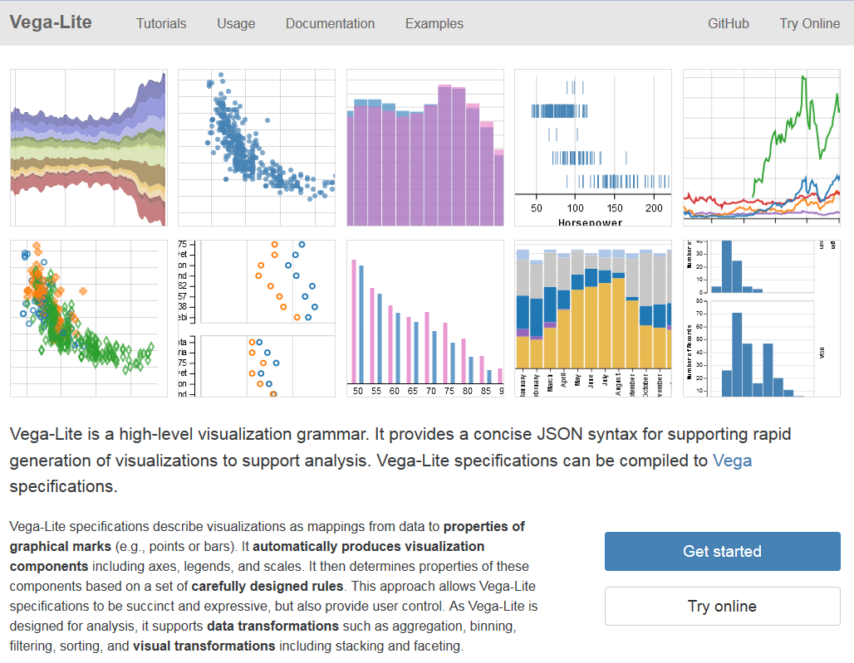
Notes:
Slide 41: Image: Vega-Lite—A Grammar of Interactive Graphics. https://vega.github.io/vega-lite/.
We use “Vega” as our chart rendering engine. Specifically, the “Vega-Lite Visualization Grammar.”

Slide 42
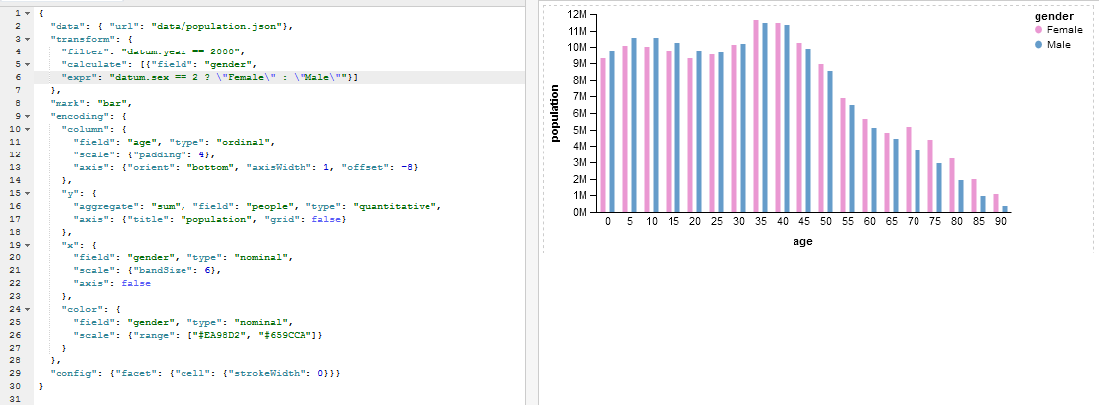
Notes:
(Image that is shown is Vega-Lite, NOT our dashboard.)
By itself, Vega-Lite is difficult to use and extremely powerful. We have built a bidirectional compiler that has allowed us to build a layer on top of it that allows us to control the ergonomics of interacting with it. The “charts and graphs” tool hides a great deal of complexity, and exposing that complexity to end users is a balancing act where we trade simplicity for expressive power.

Slide 43
Aggregation…
Notes:
Perhaps one of the biggest tradeoffs is in determining how users are allowed to transform their data before charting it.
People get very confused (in SQL, in Microsoft Excel, in Microsoft Access) when they want to do something with a table that requires an intermediate step of “aggregation” (e.g., “GROUP BY” in SQL, or using a Pivot Table in Excel).
SHOW OF HANDS: How many people out there know how to use Pivot Tables? Pivot Charts?
Our approach seems like it may be promising, but more usability testing is needed: By dragging an aggregate function onto the “Chart Fields” widget, data is automatically grouped by ANY OTHER COLUMNS that are dragged onto the table. May be the simplest way to represent this kind of transformation. (Our users say that a short YouTube video would undoubtedly help…)

Slide 44
Usability Study
Still In Progress
Findings
Positive feedback on general appearance/polish
Literature search works well
“Chart anxiety” in people who do not make many charts
A short YouTube video on the Charts and Graphs could help
Notes:
Our usability study is still in progress. In general, people are able to use the literature search tool and find it effective. The charts and graphs tool is tricky for some - especially for people who do not make charts on a regular basis. They tend to experience “chart anxiety.” However, in our latest tests, users tend to have optimism that a YouTube video providing a tutorial on how to use the charts and graphs tool would be beneficial.

Slide 45
Remaining Features
Log in with ACRL Account
Save charts/data
Edit/upload additional articles
Formulas
Visualize other data
Additional aggregate functions
Expose a few more Vega-Lite features
Notes:
Several features remain to be implemented, such as [read above].

Slide 46
Available for Use & Comment
Public Release May 23, 2017
Accessible from:
http://www.oclc.org/research/themes/user-studies/acrl-agenda.html
Notes:
When the dashboard is publicly released, you will be able to access it via this URL.

Slide 47
References
Association of College and Research Libraries. (2010). Value of Academic Libraries: A Comprehensive Research Review and Report, researched by Megan Oakleaf. Chicago, IL: Association of College and Research Libraries. Retrieved from: http://www.ala.org/acrl/sites/ala.org.acrl/files/content/issues/value/val_report.pdf
Brown-Sica, Margaret. “Using Academic Courses to Generate Data for Use in Evidence Based Library Planning.” Journal of Academic Librarianship 39, no. 3 (2013): 275–87. doi:10.1016/j.acalib.2013.01.001.
Fister, Barbara. “Critical Assets: Academic Libraries, A View from the Administration Building.” Library Journal 135, no. 8 (2010): 24–27.

Slide 48
References
Hess, Amanda Nichols. “Equipping Academic Librarians to Integrate the Framework into Instructional Practices: A Theoretical Application.” Journal of Academic Librarianship 41, no. 6 (2015): 771–76. doi:10.1016/j.acalib.2015.08.017.
Jantti, M. and Heath, J. (2016). What role for libraries in learning analytics? Performance Measurement and Metrics 17(2), 203-210.
Lombard, E. (2012). The role of the academic library in college choice. Journal of Academic Librarianship 38(4), 237–41.

Slide 49
Image Attributions
Slide 6: Image: http://bit.ly/2l8fAwO (https://www.flickr.com/photos/napafloma-pictures/16081970310/) by Patrick BAUDUIN / CC BY-NC-ND 2.0
Slide 8: Image: http://bit.ly/2lQ0XwV (https://www.flickr.com/photos/dlebech/6803716862/) by David Lebech / CC BY-NC 2.0
Slide 9: Image: http://bit.ly/2m9i39Y (http://bit.ly/2m9i39Y) by stnorbert / CC BY-NC-ND 2.0
Slide 10: Image: http://bit.ly/2m3H2uS (https://www.flickr.com/photos/rolexpv/9752688231/) by Raul Pacheco-Vega / CC BY-NC-ND 2.0
Slide 11: Image: http://bit.ly/2mHdL6q (https://www.flickr.com/photos/pong/2404940312/) by Rob Pongsajapan / CC BY 2.0
Slide 13: Image: https://www.flickr.com/photos/parksdh/11340519505/ by Daniel Parks / CC BY-NC 2.0
Slide 14: Image: http://bit.ly/2msQ06a (https://www.flickr.com/photos/governordayton/5572098001/) by Governor Mark Dayton / CC BY 2.0
Slide 19: Image: https://www.flickr.com/photos/bibliotecabne/12185588643/ by Biblioteca Nacional de España / CC BY-NC-ND 2.0
Slide 20: Image: https://www.flickr.com/photos/markleepower/7962282652/ by Mark Power / CC BY-NC-ND 2.0
Slide 41: Image: Vega-Lite—A Grammar of Interactive Graphics. https://vega.github.io/vega-lite/.

Slide 50
Thank you!
Lynn Silipigni Connaway connawal@oclc.org
@LynnConnaway
William Harvey harveyw@oclc.org
Vanessa Kitzie kitziev@oclc.org
@vkitzie
Stephanie Mikitish mikitish@scarletmail.rutgers.edu

