Slide 1
Bar-Ilan University • 11 March 2018
Academic Library Impact:
Improving Practice and Essential Areas to Research
Lynn Silipigni Connaway, PhD
Senior Research Scientist & Director of User Research, OCLC
connawal@oclc.org
@LynnConnaway

Slide 2
The Value of Academic Libraries
ACRL Goal-area committee
  Part of Plan for Excellence
Goal: Academic libraries demonstrate alignment with and impact on institutional outcomes
  Promote impact & value of libraries to higher ed. community
Notes:
This project relates to ACRL’s Plan for Excellence.
A major goal for this plan is to help academic libraries demonstrate their value to their parent institutions through their impact on institutional outcomes.
A major institutional outcome is to promote student learning and success.
With decreasing support, the competition for resources becomes more intense and the need for demonstrating value becomes more critical.
Association of College and Research Libraries. (2010). Value of Academic Libraries: A Comprehensive Research Review and Report, researched by Megan Oakleaf. Chicago, IL: Association of College and Research Libraries. Retrieved from: http://www.ala.org/acrl/sites/ala.org.acrl/files/content/issues/value/val_report.pdf

Slide 3

The Value of Academic Libraries by Megan Oakleaf
published in 2010
PDF: acrl.org/value

Slide 4
Connect, Collaborate, and Communicate:
A Report from the Value of Academic Libraries Summits
ACRL 2012 white-paper

Slide 5
IMLS-funded 14-month professional development program that ran for 3 cycles, with over 200 library teams.
http://www.ala.org/acrl/AiA

Slide 6
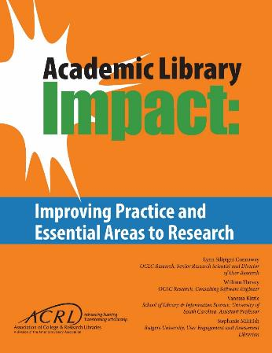
Free pdf online acrl.org/value
– or –
Purchase print from ALA Store www.alastore.ala.org
Notes:
Association of College and Research Libraries. 2017. Academic Library Impact: Improving Practice and Essential Areas to Research. Prepared by Lynn Silipigni Connaway, William Harvey, Vanessa Kitzie, and Stephanie Mikitish of OCLC Research. Chicago: Association of College and Research Libraries.

Slide 7
Data collection and analysis

Slide 8
Data Collection
Individual Interviews with Provosts
Selected Literature
Focus Group Interview & Feedback from Advisory Group
Three data sources
Iterative process
  Advisory group
  Literature review
  Provost interviews
Notes:
This slide depicts three data sources:
Selected literature on student learning and success identified in the RFP and documents found in LIS and higher education databases
Focus group with Advisory Group Members
Consist of library administrators from a variety of community colleges, 4 year colleges and universities around the country
Members provide us feedback throughout the process and put us in touch with provosts or similarly high level academic administrators in their institutions
Individual, semi-structured interviews with provosts from each Advisory Group member’s institution
Process of data collection is iterative, with findings from each source informing the other
E.g., focus group and provost interview protocol was based on the themes that we identified in the initial database searches

Slide 9

Literature Selection
Indexed by LIS &/or higher ed databases
2010-2016
Themes in 2010 VAL Report
Published in US
Notes:
Image: https://www.flickr.com/photos/benhosg/32627578042 by Benjamin Ho / CC BY-NC-ND 2.0
Selection criteria are: 1) indexed by LIS and/or higher education databases or identified by the project team or ACRL (e.g., ACRL Assessment in Action (AiA) studies, Ithaka S+R surveys, see Relevant ACRL Documents section), 2) published between 2010-2016, 3) contained themes identified in the 2010 VAL Report, and 4) published in the US, except for studies outside the US deemed relevant by the project team
Association of College and Research Libraries. (2010). Value of Academic Libraries: A Comprehensive Research Review and Report, researched by Megan Oakleaf. Chicago, IL: Association of College and Research Libraries. Retrieved from: http://www.ala.org/acrl/sites/ala.org.acrl/files/content/issues/value/val_report.pdf

Slide 10
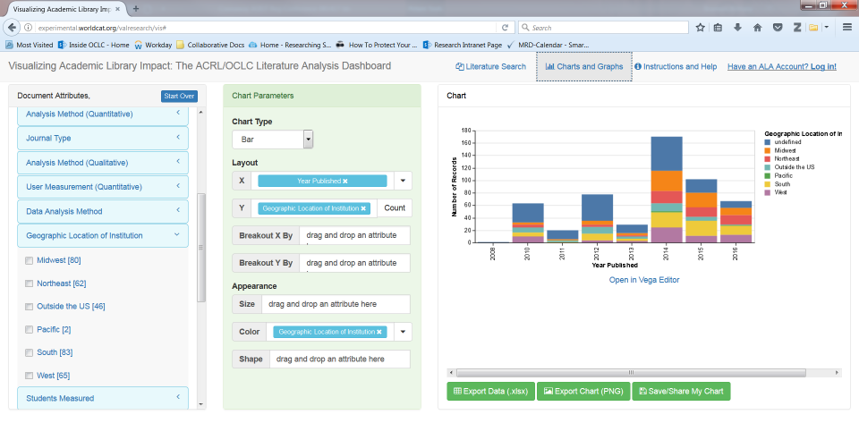
Visualization Dashboard
Notes:
Visualization tool containing all of the literature analyzed

Slide 11
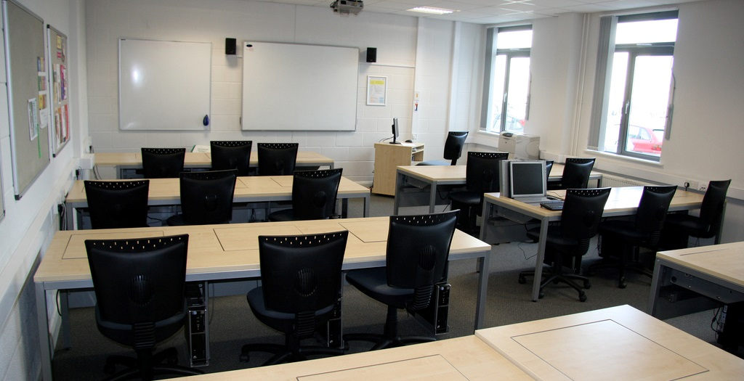
Focus group interviews
N =14 (of 14)
90 minutes
Transcribed
NVivo for analysis
Thematic coding scheme
  One team member coded, another checked
Notes:
Image: https://www.flickr.com/photos/jamesclay/3509153661 by James F Clay / CC BY-NC 2.0
Next, we will examine which findings from the content analysis resonate with practicing librarians in higher education
Based on focus group interviews with 11 advisory group members; the other three were unable to meet and were sent focus group questions that they completed. The responses to these questions were included in analysis
Coded transcripts in Nvivo using thematic coding scheme, allowing for inductive categories to be pulled from the data
Another team member checked the codes

Slide 12
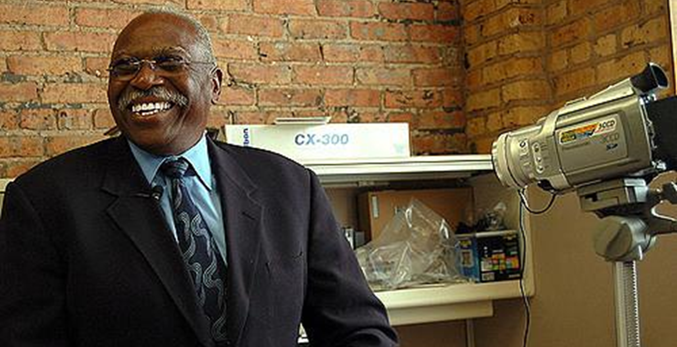
Provost individual interviews
N = 14 provosts (of 14)
45 minute average
Transcribed (9 of 14)
Detailed interview notes (5 of 14)
NVivo for analysis
Thematic coding scheme
  One team member coded, another checked
Notes:
Image: https://www.flickr.com/photos/vickiwolkinsphotography/270985453 by Vicki Wolkins, used under CC BY-NC-ND 2.0
Three team members interviewed the provosts on the phone and recorded the interviews. Nine of the fourteen interviews were transcribed. The other five were deemed to have low sound quality, so team members took in-depth notes and recorded juicy quotes.

Slide 13
Coding – Themes
Higher education trend | Trend defined | Example of library responses to trend
Learning in college (and beyond) | Less objective concepts of learning. Usually not tied to a specific graded assignment or graduation. | Space: Collaborative working space for students
Research support | Outcome tied to research outside of a class. | Service: Teach data management
Teaching support | Outcome viewed from an instructor perspective and deals with a specific course. | Collection: Online repository of syllabi
Response to Students
Response to Students/Faculty
Response to Faculty
Notes:
The team developed an initial codebook using ACRL publications specified for review. This slide depicts an excerpt from one of two codebooks created. These two codebooks are: 1) theoretical codes, which indicate higher education trends to which libraries are responding and 2) study demographics.
Areas informing the codebook include:
Student enrollment, retention, and graduation; success; achievement; learning; and support of faculty teaching
Effectiveness of library assessment when libraries collaborate with other campus units, assessment aligns with institutional goals, and mixed methods approaches are employed
Contribution of library instruction and spaces, and collaborative instructional activities, instructional games, and multiple instruction sessions, to student outcome measures
Research data services, discovery services, and the library as a place for student success
Information literacy assessment

Slide 14
findings

Slide 15
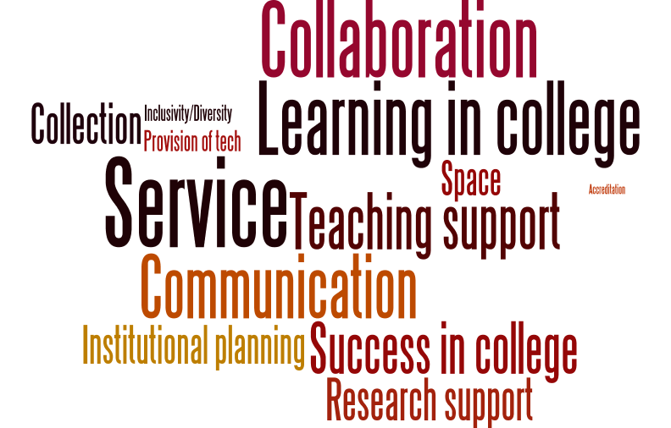
Literature
Notes:
Here’s a word cloud of the themes by frequency of documents they were present in. The larger the word, the more documents that included the theme.
To reiterate:
The selection criteria for LIS and higher education documents reviewed are: 1) indexed by LIS and/or higher education databases or identified by the project team or ACRL (e.g., ACRL Assessment in Action (AiA) studies, Ithaka S+R surveys, see Relevant ACRL Documents section), 2) published between 2010-2016, 3) contained themes identified in the 2010 VAL Report, and 4) published in the US, except for studies outside the US deemed relevant by the project team
Selected higher education databases were:
Academic Search Premier
Education Resources Information Center (ERIC)
ProQuest Education Journals, and Teacher Reference Center
Selected LIS databases were:
Library and Information Science Abstracts (LISA)
Library Literature & Information Science Full Text (H.W. Wilson)
Library, Information Science & Technology Abstracts (LISTA)

Slide 16
n=377
n=321
n=308
Key thematic
n=53
Other thematic
n=113
Other study
n=153
n=88
n=67
Key study
n=38
n=41
Notes:
Here are is the figure visualized in another way.
Themes most discussed in the selected documents are:
Service (n=377, 70%)
Collaboration (n=321, 60%)
Learning in college (n=308, 58%)
Those least discussed are:
Provision of technology (n=88, 16%)
Inclusivity/diversity (n=67, 13%)
Accreditation (n=41, 8%)

Slide 17
Notes:
Theoretical documents have more thematic codes than research documents– approximately 7% more codes.
A likely explanation for this observation is that theoretical documents include genres such as literature reviews and lists, whereas research documents empirically ground a phenomenon or phenomena observed among one or two themes
The largest difference between proportion of times a code was applied between theoretical and research documents is Institutional planning discussed 28% more in theoretical documents than in research documents
This finding suggests that institutional planning, or assessment, is more often discussed in the context of what libraries should be focusing on, rather than what libraries actually focus on when demonstrating their value

Slide 18
Notes:
The team compared the differences in proportion of themes discussed in documents from the higher education literature versus the LIS literature.
Search terms used for the database searches included the word “Library” and its derivatives.
For this reason, this comparison is only able to inform of differences in the proportion of themes between what is being said about student learning outcomes as related to libraries within the higher education literature versus the LIS literature, not student learning outcomes in general.
We are going to conduct a search more broadly to identify trends in higher education related to outcomes that advance the mission and goals of the university, including student outcomes
Results of this literature review will be contained in the final version of the report
Documents labeled as higher education literature were those retrieved from higher education databases that were not indexed by LIS databases and reports from Ithaka S+R. Therefore a total of 354 documents of the total 535 documents (66%) were reviewed when making this comparison given that the team retrieved documents for review that were not indexed by databases (e.g., AiA studies). There were:
n=18 documents designated as higher education literature (about 5% of the total documents)
n=52 documents (15%) designated as both higher education and LIS literature since they were indexed by both databases
n=284 documents (80%) were from LIS literature.
This figure illustrates the percent difference between thematic code by whether a document is from the higher education literature, LIS literature, or higher education and LIS literature.
Which themes vary most by the proportion of documents to which they are applied?
LIS literature and higher ed. and LIS literature combined discuss service more than higher education literature
LIS literature discusses service and success in college more than in higher education and LIS literature

Slide 19
n=54
n=46
n=44
Focus Groups
Notes:
Focus group interview participants most often discussed:
Communication (20%, n=54)
Collaboration (17%, n=46)
Service (16%, n=44)
They less frequently mentioned the themes of:
Accreditation (n=0, 0%)

Slide 20
n=377
n=321
n=308
n=54
n=46
n=44
n=199
n=159
n=129
Notes:
Themes most discussed in the selected documents are:
Service (n=377, 70%)
Collaboration (n=321, 60%)
Learning in college (n=308, 58%)
Focus group interview participants most often discussed:
Communication (20%, n=54)
Collaboration (17%, n=46)
Service (16%, n=44)
Themes discussed most by provosts were:
Communication (17%, n=199)
Institutional planning (14%, n=159)
Learning in college (11%, n=129)

Slide 21

“…the whole kind of conversation around fake news is this really important example of how important it is in our daily life and civic health in order to bring critical skills to bear on understanding information and being able to critically evaluate the source of that.”
(Advisory Member LM03, Research University, Secular, Private)
Notes:
Image: https://www.flickr.com/photos/mxmstryo/3507201141/ by mxmstryo / CC BY 2.0
“If I’m understanding you correctly, the whole kind of conversation around fake news is this really important example of how important it is in our daily life and civic health in order to bring critical skills to bear on understanding information and being able to critically evaluate the source of that.” (Advisory Member LM03, Research University, Secular, Private)

Slide 22
n=199
Provost Interviews
n=18
Notes:
Themes discussed most by provosts were:
Communication (17%, n=199)
Institutional planning (14%, n=159)
Themes not discussed frequently by provosts were:
Accreditation (2%, n=18)
Top themes for focus group interview with librarians were communication, collaboration, and institutional planning
The theme among the librarians was accreditation, and this was the least mentioned theme among the provosts

Slide 23

“People [are] talking about the problems of educating people to be citizens more, with this election being indicative of that. This is a hard thing to confront right now because we are going to have an administration that doesn't think that's important at all.”
(Provost Interviewee PP02, Research University, Non-Secular, Private)
Notes:
Image: https://www.flickr.com/photos/vauvau/4284175347/ by Clemens v. Vogelsang / CC BY 2.0
“People [are] talking about the problems of educating people to be citizens more, with this election being indicative of that. This is a hard thing to confront right now because we are going to have an administration that doesn't think that's important at all.” (Provost Interviewee PP02, Research University, Non-Secular, Private)

Slide 24
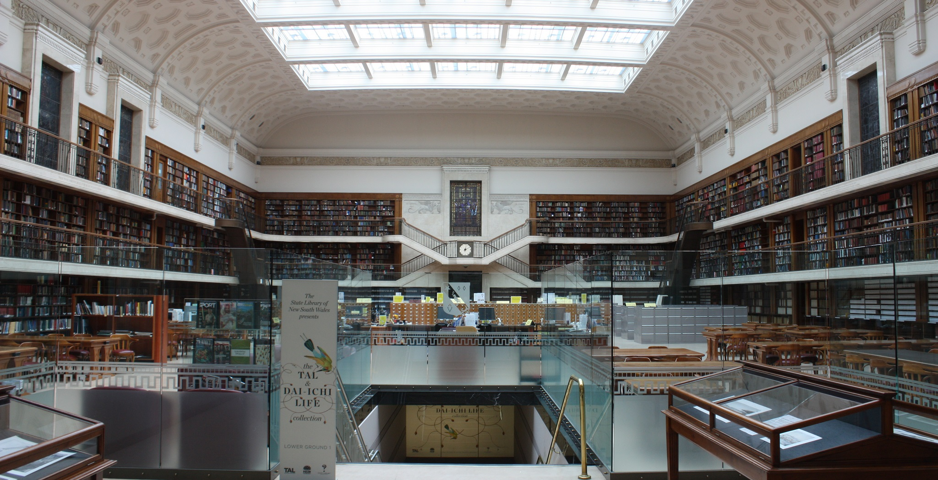
“My biggest concern is that the students aren't coming together…there's a hunger within our undergraduate student population to actually socialize. The library has always been that crossroads for campuses. It could serve in this capacity, pulling students together.”
(Provost Interviewee PP04, Research University, Secular, Public)
Notes:
Image: https://www.flickr.com/photos/dlebech/6803716862/ by David Lebech / CC BY-NC 2.0
“My biggest concern is that the students aren't coming together. The library can be that place, that nexus where students can come to study together. Yes, everything's posted online and they know they can do this alone, but there's a hunger within our undergraduate student population to actually socialize. The library has always been that crossroads for campuses. It could serve in this capacity, pulling students together.” (Provost Interviewee PP04, Research University, Secular, Public)

Slide 25
Notes:
This slide depicts key differences in themes discussed by advisory focus group members versus provosts
Not a surprise that accreditation is not discussed by either. As Krisellen (Advisory Group Member LM07, Research University, Secular, Public) says “accreditation is just a task to be done.”
Key differences are:
Provosts discussed learning in college more than advisory group members
Provosts discussed space more than advisory group members
Advisory group members focused more on service than provosts
Advisory group members focused more on collaboration than provosts

Slide 26

Language Differences
Librarians use “service”
Provosts use more specific terms
  Teaching & learning
  Customer service
  Space
Notes:
Image: https://www.flickr.com/photos/27518426@N03/3617723004 by Patrick Dalton / CC BY-NC-ND 2.0
Mikitish, Stephanie, Vanessa Kitzie, and Lynn Silipigni Connaway. (forthcoming). “Assessing for Alignment: How to Win Collaborators and Influence Stakeholders.” In Shaping the Campus Conversation on Student Learning and Experience: Activating the Results of Assessment in Action, edited by Kara Malenfant, Karen Brown, Deb Gilchrist, Lisa Hinchliffe, Chase Ollis, and Allison Payne.

Slide 27
Priority areas
Notes:
In the report, each priority area includes a general discussion, practices to implement, exemplary studies, research questions, and proposed research design.
Association of College and Research Libraries. 2017. Academic Library Impact: Improving Practice and Essential Areas to Research. Prepared by Lynn Silipigni Connaway, William Harvey, Vanessa Kitzie, and Stephanie Mikitish of OCLC Research. Chicago: Association of College and Research Libraries.

Slide 28

Priority Areas
Communication
Collaboration
Mission strategy & alignment
Teaching & learning
Student success
Learning analytics
Notes:
Image: https://www.flickr.com/photos/vizpix/8063474709 by naturalflow, used under CC BY-SA 2.0
Analysis of all three data sources informed the identification of six priority areas for future research.
Communication: Communicate with those outside of library & at different levels within the institution
Collaboration: Understand different types & levels of collaboration & consider reviewing literature from related fields to see what is said about libraries & common ground
Mission strategy & alignment: Go outside of library to collect data & seek possible collaborators for common issues; Inform students, faculty, & administrators of how the academic library contributes to the institutional mission and goals.
Teaching & learning: Engage with faculty & students for librarian inclusion in developing academic & everyday life support services for students; Develop educated & informed citizens
Student success: Identify quantifiable student attainment indicators; Work with academic services and faculty
Learning analytics: Measure, collect, analyze & report “data about learners and their contexts, for purposes of understanding and optimizing learning and the environments in which it occurs.” ; Include library data with institutionally collected data to predict student success
Brown-Sica, Margaret. “Using Academic Courses to Generate Data for Use in Evidence Based Library Planning.” Journal of Academic Librarianship 39, no. 3 (2013): 275–87. doi:10.1016/j.acalib.2013.01.001.
Fister, Barbara. “Critical Assets: Academic Libraries, A View from the Administration Building.” Library Journal 135, no. 8 (2010): 24–27.
Hess, Amanda Nichols. “Equipping Academic Librarians to Integrate the Framework into Instructional Practices: A Theoretical Application.” Journal of Academic Librarianship 41, no. 6 (2015): 771–76. doi:10.1016/j.acalib.2015.08.017.
Jantti, M. and Heath, J. (2016). What role for libraries in learning analytics? Performance Measurement and Metrics 17(2), 203-210.
Lombard, E. (2012). The role of the academic library in college choice. Journal of Academic Librarianship 38(4), 237–41.

Slide 29
Communication
Communicate with those outside of library & at different levels within the institution
  Can provide a bird’s eye view of what library should be doing
  Can be advocates for & supporters of library
Notes:
The Priority Areas for future research are based on the findings of the selected literature review, the library administrator focus group interview, and the provost semi-structured individual interviews. These Priority Areas intentionally are broad to foster discussion and input from academic librarians and to include more specific research questions within each Priority Area.
The most important factor for identifying the Priority Areas was to discover which themes occurred most frequently in each data source. This was in response to the RFP, which specifically stated that the project would “Begin with a high level look at the trends in higher education that concern academic librarians in the broader context of academia and identify current academic library responses to the trends.” Individual library responses, such as information literacy instruction and data analytics were not included in the codebook. Therefore, it should be noted that while library response (collection, service, space) was coded as a theme, these codes were not included within the count of the top five themes since each Priority Area addresses a theme across all three responses.
Per the RFP, which asked for between 5-10 priority areas, six were addressed, which will now be overviewed. We will also briefly discuss an exemplar study for each area, and identify best practices related to the area.
The importance of communication was identified in the RFP and in the project plan, and was one of the main reasons for the creation of the Advisory Group. It provided the opportunity for library administrators to connect with provosts at their institutions and provide data on how librarians can communicate the value the library brings to the academic community. As a theme, its definition was: “Librarians communicate impact or other aspects of value with stakeholders.” However, only three studies published since 2000 have looked at how administrators perceive the library and its collections, spaces, and services. An earlier study from 2007 found that according to multiple administrators at six American universities, the library’s symbolic role as the heart of the university was outweighed by its practical role, through which it needed to “connect what it does to the values and mission of the university.” A later study of nine Canadian provosts found that the participants most valued information access provided by the library and envisioned the library evolving into more of a learning space. The study the team identified as exemplar is Fister's (2010) survey of 134 administrators, which covered the highest number of themes (n=11) and received the highest score of all the studies (17 points).
Fister, Barbara. “Critical Assets: Academic Libraries, A View from the Administration Building.” Library Journal 135, no. 8 (2010): 24–27.

Slide 30

“….it needs to be sort of multi-level communication from the provost to those relationships you have with other units like the centers for teaching and learning to the academic units to the individual relationships that, that librarians and staff have with faculty and students.”
(Advisory Group Member LM03, Research University, Secular, Public)
Notes:
Image: https://www.flickr.com/photos/30003006@N00/2439637326 by urbanfeel / CC BY-ND 2.0
“There's one other thing I was uh, when I was sitting here thinking about every, a lot of what's come out is that we're not islands, not that we ever were, but I think part of our success in reaching to students and faculty is the way we collaborate with others….one thing I will say is I think it needs to be sort of multi-level communication from the provost to those relationships you have with other units like the centers for teaching and learning to the academic units to the individual relationships that, that librarians and staff have with faculty and students. You know, all of those levels reinforce each other, and any alone doesn't quite work as well.” (Advisory Group Member LM03, Research University, Secular, Public)
Making connections is not as simple as having a conversation with one specific group or implementing the same strategies to make connections across various ones.
Outreach beyond the library necessary for its success relates to recognizing and adapting to the unique “eco-system” of relationships within the specific institution (Advisory Group Member LM14, Research University, Secular, Public).
Establishing multi-level communication requires collaboration. Librarians must have the ability to recognize how the multiple stakeholders within their specific university ecosystem interrelate and leverage their relationships to attain “shared goals,” rather than just library-oriented ones (Advisory Group Member LM07, Research University, Secular, Public).

Slide 31

“[Librarians] have to be able to sell to the deans that this is something valuable that the deans want to be a part of, and the deans are going to be impacted by their faculty feeling like that this is a worthy thing because if we use money for one thing, we can’t use if for something else. I think customer service…becomes really important in this kind of environment.
(Provost Interviewee PP07, Research University, Secular, Public)
Notes:
Image: https://www.flickr.com/photos/28500561@N03/5507077908/ by Mitchel / CC BY-NC 2.0
“[Librarians] have to be able to sell to the deans that this is something valuable that the deans want to be a part of, and the deans are going to be impacted by their faculty feeling like that this is a worthy thing because if we use money for one thing, we can’t use if for something else. I think customer service…becomes really important in this kind of environment.
(Provost Interviewee PP07, Research University, Secular, Public)

Slide 32
Collaboration
Understand different types & levels of collaboration & consider reviewing literature from related fields to see what is said about libraries & common ground
  Work with academic administrators, academic services, faculty, students, alumni, & other members of regional & local communities.
Notes:
Collaboration is an important theme because of the academic library’s primary mission as a research and teaching support unit. The AiA projects also explicitly required librarians to collaborate with at least two other people outside the libraries. As a theme, its definition was: “Librarians work with other institutional departments to influence student outcomes or with other institutions.” The 2015 study by Hess, Greer, Lombardo, and Lim at Oakland University Libraries is exemplary because it documents the libraries’ efforts to collaborate with other departments in support of student success and persistence. Their documented and suggested collaborations cover a wide range of services and collections. Another notable collaboration was between Wolfe, who is an Assistant Professor in the Behavioral and Social Sciences at Hostos Community College (CUNY), who published the results of a study that incorporated information literacy into a class assignment in a higher education journal, and was one of the highest scoring research documents from the higher education databases.
Hess, Amanda Nichols. “Equipping Academic Librarians to Integrate the Framework into Instructional Practices: A Theoretical Application.” Journal of Academic Librarianship 41, no. 6 (2015): 771–76. doi:10.1016/j.acalib.2015.08.017.
Wolfe, Kate S. “Emerging Information Literacy and Research-Method Competencies in Urban Community College Psychology Students.” The Community College Enterprise 21, no. 2 (2015): 93–99.

Slide 33

Provost Perspectives
Provosts did not mention collaboration with significant frequency
Collaboration as facilitated by mission alignment & strategy
Want libraries to share space
Notes:
Image: https://www.flickr.com/photos/142500385@N08/27577398941/ by Rodney Gomez / CC BY 2.0
Mikitish, Stephanie, Vanessa Kitzie, and Lynn Silipigni Connaway. (forthcoming). “Assessing for Alignment: How to Win Collaborators and Influence Stakeholders.” In Shaping the Campus Conversation on Student Learning and Experience: Activating the Results of Assessment in Action, edited by Kara Malenfant, Karen Brown, Deb Gilchrist, Lisa Hinchliffe, Chase Ollis, and Allison Payne.

Slide 34

“I think [space] is one of the most effective ways to get the message out. That . . . might involve, as an example, making meeting rooms in the library more generally available for people to come and do projects. Creating . . . the library as this sort of center of intellectual activity.”
(Provost Interviewee PP09, Research University, Secular, Public)
Notes:
Image: https://www.flickr.com/photos/tiffany98101/15228605742 by Tiffany Von Arnim / CC BY 2.0
Mikitish, Stephanie, Vanessa Kitzie, and Lynn Silipigni Connaway. (forthcoming). “Assessing for Alignment: How to Win Collaborators and Influence Stakeholders.” In Shaping the Campus Conversation on Student Learning and Experience: Activating the Results of Assessment in Action, edited by Kara Malenfant, Karen Brown, Deb Gilchrist, Lisa Hinchliffe, Chase Ollis, and Allison Payne.

Slide 35
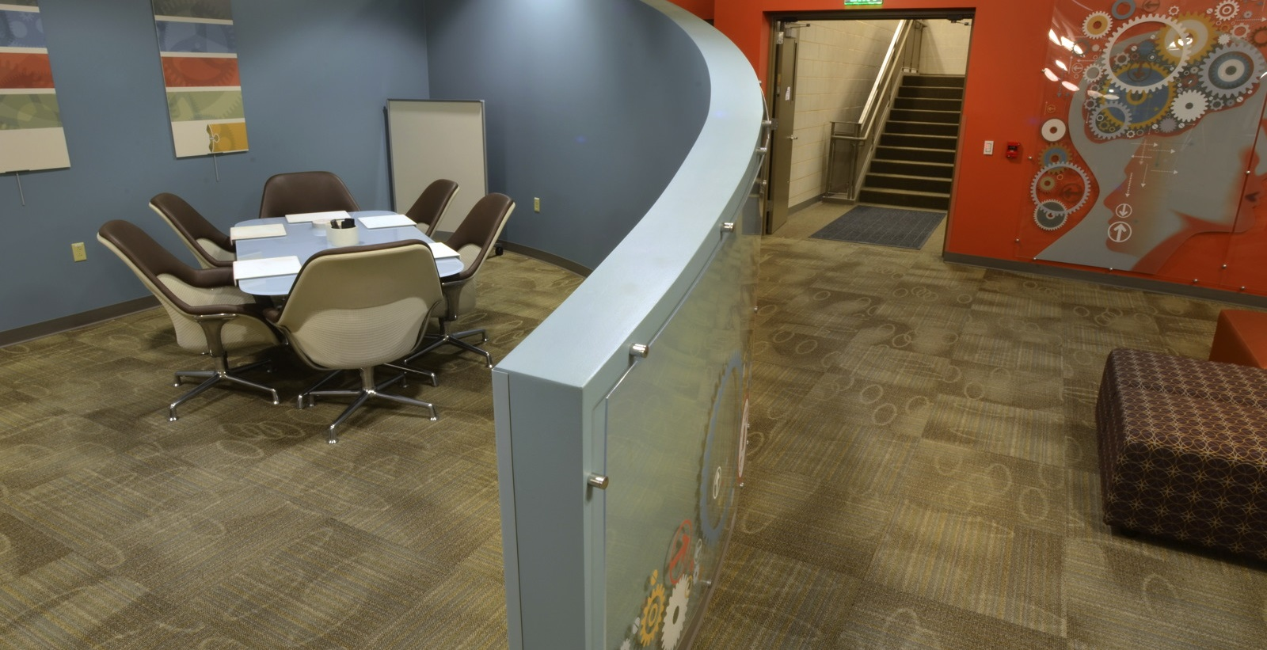
“Only sharing space, such as with a writing or computer lab is low level. There needs to be cooperative programming and interaction.”
(Advisory Group Member LM06, Research University, Secular, Public)
Notes:
Image: https://www.flickr.com/photos/stnorbertcollege/11839410166 by stnorbert / CC BY-NC-ND 2.0
“Only sharing space, such as with a writing or computer lab is low level. There needs to be cooperative programming and interaction.” (Advisory Group Member LM06, Research University, Secular, Public)

Slide 36
Mission Strategy & Alignment
Go outside of library to collect data & seek possible collaborators for common issues
Inform students, faculty, & administrators of how the academic library contributes to the institutional mission & goals.
  Achieving this connection & communicating it to academic community are critical for integrating the library into the life of the university
Notes:
The definition for this theme was: “Institutionally-identified student outcomes (can be co-coded with learning and success).” It appeared in the top five themes in the Advisory Group’s focus group interview and the provosts’ semi-structured individual interviews, but it was the seventh most common theme in the literature. Moreover, there was a statistically significant difference in the number it was reported in theoretical documents compared to research documents, which means that it likely is being discussed more than being empirically tested. Lombard’s 2012 study at Gannon University had a short write up, but was exemplar in several ways, which led to its relatively high score. First, it looked at the library’s influence on recruitment, which has been studied in higher education research documents addressing student outcomes, but rarely appears in library research documents. The data collection method also was interesting because the survey was posted on various non-library online spaces, meaning that it may have tapped into those who do not use the library. It also collected and analyzed qualitative data from interviews with fourteen admissions professionals from various institutions and, based on survey and interview findings, makes suggestions for ways librarians can collaborate with admissions departments.
Lombard, E. (2012). The role of the academic library in college choice. Journal of Academic Librarianship 38(4), 237–41.

Slide 37

Mission Alignment
Only important to provosts
Somewhat important in theoretical literature
Tied to communication & collaboration themes
Notes:
Image: https://www.flickr.com/photos/whatknot/135308732/ by Whatknot / CC BY-NC-ND 2.0
Mikitish, Stephanie, Vanessa Kitzie, and Lynn Silipigni Connaway. (forthcoming). “Assessing for Alignment: How to Win Collaborators and Influence Stakeholders.” In Shaping the Campus Conversation on Student Learning and Experience: Activating the Results of Assessment in Action, edited by Kara Malenfant, Karen Brown, Deb Gilchrist, Lisa Hinchliffe, Chase Ollis, and Allison Payne.

Slide 38

“What's underlying all of this is that all of us see our work as directly tied to the mission of the university.…Academic libraries are those directly connected to the mission of their unique institution.”
(Advisory Group Member LM13, Research University, Non-Secular, Private)
Notes:
Image: https://www.flickr.com/photos/cindyshebley/3019242323 by Cindy Shebley / CC BY-SA 2.0
“I think each of us would have some example of our shared strategic initiatives around enhancing students' success. And promoting innovation and teaching and learning. What's underlying all of this is that all of us see our work as directly tied to the mission of the university. And it is what makes academic libraries unique in some ways, but also so successful. Academic libraries are those directly connected to the mission of their unique institution.” (Advisory Group Member LM13, Research University, Non-Secular, Private)
On first pass, it may be surprising that the focus group interview participants did not discuss student learning (4%, n=12) and success (2%, n=6), compared to how often these themes are mentioned in the literature (learning, 58%, n=308; success, 41%, n=218). However, as explained by the quote on this slide [read quote].
As perceived by this participant, the library’s role in enhancing student learning and success is perceived by librarians to be inherent to the mission of the academic library. This participant felt that solely being concerned with fulfilling library-oriented goals would detract from the effect they would be able to have at the university level. This observation may be explained by the fact that the participants are administrators in their academic libraries, therefore their focus is to be strategic and targeted on high-level library goals. It also likely accounts for why themes that implied making connections and establishing relationships outside of the library--collaboration and communication--were among those most frequently discussed (communication, 20%, n=54; collaboration, 17%, n=46).

Slide 39
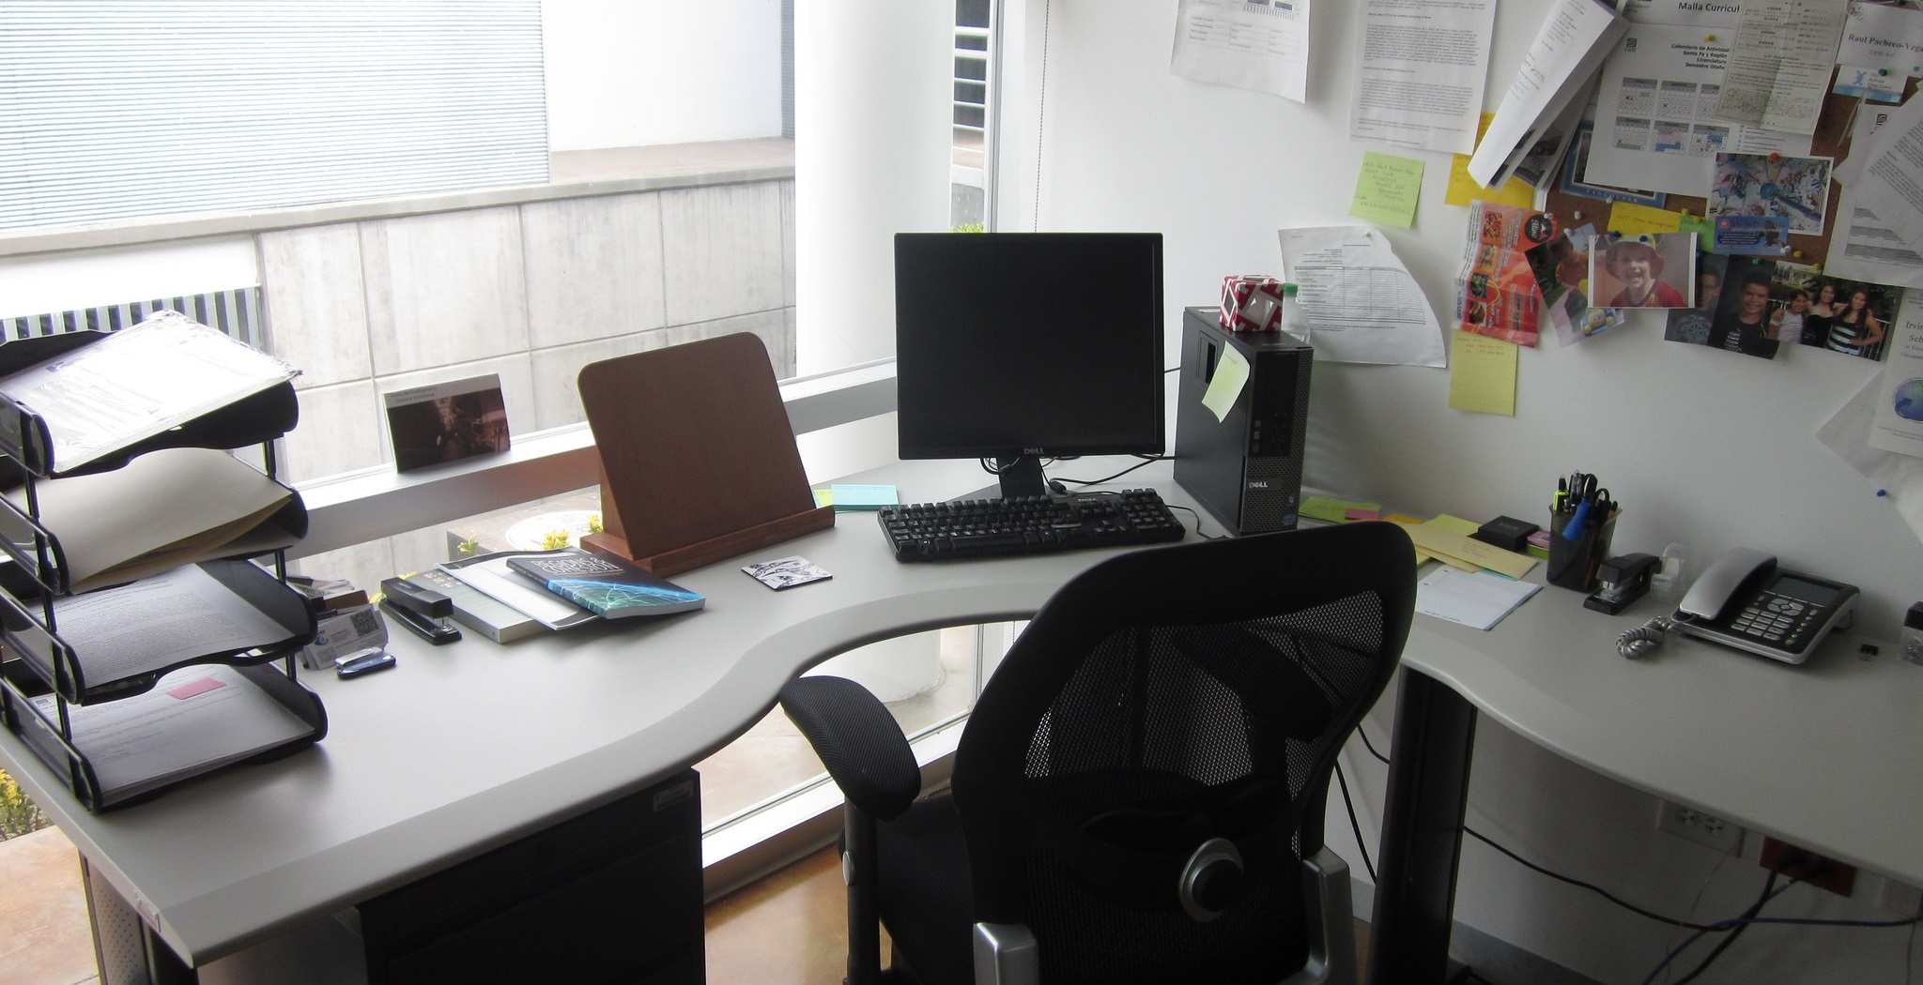
“The way many of our faculty and students research now, it’s less about going to a physical space but accessing information in their offices.…I think that that is one of the challenges of changing the paradigm.”
(Provost Interviewee PP13, Research University, Non-Secular, Private)
Notes:
Image: https://www.flickr.com/photos/rolexpv/9752688231 by Raul Pacheco-Vega / CC BY-NC-ND 2.0
“For so long [librarians] have had a role of support rather than integration into work. Much more of a partnership rather than support as needed, so it’s proactive in its orientation rather than reactive. The way many of our faculty and students research now, it’s less about going to a physical space but accessing information in their offices. Trying to imagine a new way where it’s not just a service model, but it’s actually an integration and partnership model, I think that that is one of the challenges of changing the paradigm.” (Provost Interviewee PP13, Research University, Non-Secular, Private)
Provosts suggest the importance of collaborating with faculty and students, such as introducing a liaison program. As conveyed by one provost, it is very important for libraries to “establish themselves as a critical link or a critical piece” early on by having “intentional interventions” (e.g., in orientations, by going to classes or convincing instructors to bring classes to the libraries, online or on campus) (Provost Interviewee PP05). The goal of the library should be to go beyond its role as “a service body” and instead be integrated into the lives of its potential users (Provost Interviewee PP13).

Slide 40
Teaching & Learning
  Engage with faculty & students for librarian inclusion in developing academic & everyday life support services for students
  Develop educated & informed citizens
Notes:
This area also builds on the first two Priority Areas, communication and collaboration.
The definition for this theme was: “Outcome was focused on the less objective concepts of learning, such as critical thinking. Usually not tied to a specific graded assignment or graduation.” In contrast with student success, the code was used for identifying the less tangible or indirect effect of the library on students. Brown-Sica's 2013 study of space redesign at Auraria Library offers one way for various groups to provide multiple types of input and otherwise engage with the library. The Auraria Library serves the University of Colorado Denver, the Metropolitan State College of Denver, and the Community College of Denver. Students were involved in all stages of the study, from formulating the questions to ask, analyzing the data, and offering suggestions based on the results. This study was a high scoring example of learning in college because although not tied to an objective outcome, such as student retention or GPA, this study gave students a voice in the project and facilitated unexpected collaborations with faculty. It also touched on library space, which was a library response that was mentioned by the provosts that was not mentioned as often by librarians.
Brown-Sica, Margaret. “Using Academic Courses to Generate Data for Use in Evidence Based Library Planning.” Journal of Academic Librarianship 39, no. 3 (2013): 275–87. doi:10.1016/j.acalib.2013.01.001.

Slide 41

“Thinking of how these new learning environments work, and how the library would enhance students' and faculty's ability to access and process knowledge, data information, in those particular kinds of environments. That's what libraries need to do to be successful.”
(Provost Interviewee PP02, Research University, Non-Secular, Private)
Notes:
Image: https://www.flickr.com/photos/napafloma-pictures/16081970310 by Patrick BAUDUIN / CC BY-NC-ND 2.0
“There's not one specific thing a library can do, because the environments are so different. Thinking of how these new learning environments work, and how the library would enhance students' and faculty's ability to access and process knowledge, data information, in those particular kinds of environments. That's what libraries need to do to be successful.” (Provost Interviewee PP02, Research University, Non-Secular, Private)
The way that libraries can impact learning is contextually-bound because of their dependency on the mission and goals unique to their institution. The importance of context in shaping how librarians communicate value is exemplified by the following provost account.

Slide 42

“I see that [libraries] play a role as a partner, facilitating both learning and doing in new and different ways, both helping all of us to embrace information in critical and yet meaningful ways.” (Provost Interviewee PP03, Research University, Secular, Private)
Notes:
Image: https://www.flickr.com/photos/rrenomeron/8456758333/ by Rich Renomeron / CC BY-NC-ND 2.0
“I see that [libraries] play a role as a partner, facilitating both learning and doing in new and different ways, both helping all of us to embrace information in critical and yet meaningful ways.” (Provost Interviewee PP03, Research University, Secular, Private)

Slide 43

“Thinking of how these new learning environments work, and how the library would enhance students' and faculty's ability to access and process knowledge, data information, in those particular kinds of environments. That's what libraries need to do to be successful.”
(Provost Interviewee PP02, Research University, Non-Secular, Private)
Notes:
Image: https://www.flickr.com/photos/ruthanddave/5818845187/ by Ruth Hartnup / CC BY 2.0
“There's not one specific thing a library can do, because the environments are so different. Thinking of how these new learning environments work, and how the library would enhance students' and faculty's ability to access and process knowledge, data information, in those particular kinds of environments. That's what libraries need to do to be successful.” (Provost Interviewee PP02, Research University, Non-Secular, Private)
The way that libraries can impact learning is contextually-bound because of their dependency on the mission and goals unique to their institution. The importance of context in shaping how librarians communicate value is exemplified by the following provost account.

Slide 44
“We should be helping people learn how to think, learn how to be skeptical, learn how to use critical thinking skills, learn how to be self-reflective. I think because those things are so much harder to assess and to demonstrate we have not done as good a job telling that story.”
(Provost Interviewee PP10, College, Non-secular, Private)
Notes:
Image: https://www.flickr.com/photos/deia/6461457 by Andréia Bohner / CC BY 2.0
“We should be helping people learn how to think, learn how to be skeptical, learn how to use critical thinking skills, learn how to be self-reflective. I think because those things are so much harder to assess and to demonstrate we have not done as good a job telling that story.”
(Provost Interviewee PP10, College, Non-secular, Private)

Slide 45
Student Success
Identify quantifiable student attainment indicators
  Enrollment in postsecondary education
  Grades
  Persistence to the sophomore year
  Length of time to degree & graduation
Work with academic services & faculty
  Develop data collection & reporting methods that retain student privacy & confidentiality

Slide 46

“I do not think the learning stops after [students graduate]. How do we set our students up for success? How do they reach the outcomes that we want for them? How do we have them thinking about, and in particular for libraries, how do they think about that down the road as, using public libraries and the resources we have there as well?”
(Provost Interviewee PP06, Research University, Secular, Public)
Notes:
Image: https://www.flickr.com/photos/ubarchives/4663516752/ by ubarchives / CC BY-NC-ND 2.0
“I do not think the learning stops after [students graduate]. How do we set our students up for success? How do they reach the outcomes that we want for them? How do we have them thinking about, and in particular for libraries, how do they think about that down the road as, using public libraries and the resources we have there as well?”
(Provost Interviewee PP06, Research University, Secular, Public)

Slide 47

“I think each of us would have some example of our shared strategic initiatives around enhancing students' success. And promoting innovation and teaching and learning. What's underlying all of this is that all of us see our work as directly tied to the mission of the university.…Academic libraries are those directly connected to the mission of their unique institution.”
(Advisory Group Member LM13, Research University, Non-Secular, Private)
Notes:
Image: https://www.flickr.com/photos/opacity/6819349248 by opacity / CC BY-NC-ND 2.0
“I think each of us would have some example of our shared strategic initiatives around enhancing students' success. And promoting innovation and teaching and learning. What's underlying all of this is that all of us see our work as directly tied to the mission of the university. And it is what makes academic libraries unique in some ways, but also so successful. Academic libraries are those directly connected to the mission of their unique institution.” (Advisory Group Member LM13, Research University, Non-Secular, Private)
On first pass, it may be surprising that the focus group interview participants did not discuss student learning (4%, n=12) and success (2%, n=6), compared to how often these themes are mentioned in the literature (learning, 58%, n=308; success, 41%, n=218). However, as explained by the quote on this slide [read quote].
As perceived by this participant, the library’s role in enhancing student learning and success is perceived by librarians to be inherent to the mission of the academic library. This participant felt that solely being concerned with fulfilling library-oriented goals would detract from the effect they would be able to have at the university level. This observation may be explained by the fact that the participants are administrators in their academic libraries, therefore their focus is to be strategic and targeted on high-level library goals. It also likely accounts for why themes that implied making connections and establishing relationships outside of the library--collaboration and communication--were among those most frequently discussed (communication, 20%, n=54; collaboration, 17%, n=46).

Slide 48
Learning Analytics
Measure, collect, analyze & report “data about learners and their contexts, for purposes of understanding and optimizing learning and the environments in which it occurs.”
Include library data with institutionally collected data to predict student success
(Jantti & Heath, 2016)
Notes:
Although learning analytics did not have its own thematic code, it was identified as being an important area in documents such as ACRL’s top trends in academic libraries and ACRL initiatives, such as the e-Learning Webcast Series on Learning Analytics. Jantti and Heath’s 2016 study describes the use of learning analytics at the University of Wollongong in Australia. In addition to collecting library related data in a repository called the Library Cube, this library collects and analyzes more sources of institutional data than any other. These data sets come from course management software called Moodle, student administration, tutorials, and student support service usage data.
Jantti, M. and Heath, J. (2016). What role for libraries in learning analytics? Performance Measurement and Metrics 17(2), 203-210.

Slide 49

“The drive to knowing more about what students get from a college education is not going to go away. We are going to have to continually look at, quality.…This drive towards knowing what students get from their college education, is going to continue to be important. I can't imagine that part of it would go away with the Trump Administration.”
(Provost Interviewee PP06, Research University, Secular, Public)
Notes:
Image: https://www.flickr.com/photos/dej611/9983732323 by Dej611 / CC BY-NC 2.0
“The drive to knowing more about what students get from a college education is not going to go away. We are going to have to continually look at, quality. We need to pay a lot of attention to access and affordability. Accreditation will continue to be analyzed and scrutinized in Washington. This drive towards knowing what students get from their college education, is going to continue to be important. I can't imagine that part of it would go away with the Trump Administration.” (Provost Interviewee PP06, Research University, Secular, Public)

Slide 50

Privacy
“…we have to be willing to do types of data collection that libraries have shied away from in the past.…I think that we have to be able to be willing to have conversations on campus about tracking user behavior in ways that libraries just haven't done.” (Advisory Group Member LM14, Research University, Secular, Public)
Notes:
Image: https://www.flickr.com/photos/pong/2404940312 by Rob Pongsajapan / CC BY 2.0
“To truly be able to look at, and be able to tell those stories, and to come up with those snippets of information that will resonate with other leaders, we have to be willing to do types of data collection that libraries have shied away from in the past. That involves tracking user behavior in a way that we've seen in a couple of the different studies that have looked at retention. There are ways of extrapolating and growing that out a little bit more so that we are dealing with large datasets, and we could...We could still keep it anonymous when we look at it in aggregate, right? I think that we have to be able to be willing to have conversations on campus about tracking user behavior in ways that libraries just haven't done.” (Advisory Group Member LM14, Research University, Secular, Public)
Privacy only was mentioned once, but is an important area of exploration. This topic is particularly fraught in the areas of assessment and academic libraries since there is a lack of established best practices and standards addressing the methods and contexts that may threaten the privacy of students. For this reason, privacy, when broadly defined, can be viewed by librarians in some instances as less of an ethics issue and more of an impediment, as articulated by the following participant [read quote].

Slide 51
recommendations

Slide 52

Recommendation
Identify & articulate both learning & success outcomes
Engage students in redesigning library space to demonstrate library’s impact for learning outcome
Library resource or service usage & its relationship to student retention exemplifies the effect of library’s service, collection, &/or space for success outcome
Notes:
Image: https://www.flickr.com/photos/fajalar/7129046107 by Matthew Oliphant / CC BY-ND 2.0
Based on these initial findings, we’ve come up with the following recommendations.

Slide 53

Recommendation
Focus less on service & more on sharing space & collaborative programming with groups within the institution & community
Notes:
Image: https://www.flickr.com/photos/bobx-nc/14056106583/ by Bob Muller / CC BY-NC 2.0

Slide 54

Recommendation
Bolster collaboration with other campus units or external partners, including consortia, on assessment-based efforts
Notes:
https://www.flickr.com/photos/djcurly/1444860869/ by Rachel / CC BY-NC-ND 2.0

Slide 55

Recommendation
Communicate how library services, collections, & spaces address the larger mission of the institution by becoming better at marketing & customer service
Notes:
Image: https://www.flickr.com/photos/edublogger/5119742141/ by Ewan McIntosh / CC BY-NC 2.0
Strategically align the student success goals and metrics with the Chancellors’/Presidents’ institutional priorities on student success.

Slide 56

Recommendation
Study the assessment & student-centered outcomes of diverse populations across various institutions using multiple methods
Notes:
Image: https://www.flickr.com/photos/kimberlykv/4495272217/ by Kimberly Vardeman / CC BY 2.0

Slide 57

Recommendation
Develop relationships within different academic service areas, such as teaching & learning, at various levels throughout institution & with community offices and organizations
Notes:
Image: https://www.flickr.com/photos/sleepy_sarah/15074099707/ by Sarah J. Poe / CC BY-ND 2.0
Refers back to/is part of sharing space and developing collaborative programming

Slide 58

Recommendation
Continue to develop & foster relationships & engagement with academic administrators & offices, such as student services, offices of sponsored programs, & teaching & learning & with community offices & organizations, such as tourism, voter registration, & chamber of commerce
Notes:
Image: https://www.flickr.com/photos/fajalar/6608567219 by Matthew Oliphant / CC BY-ND 2.0

Slide 59

Recommendation
Represent data in different contexts & visualizations to make case with diverse groups & administrators
Notes:
Image: https://www.flickr.com/photos/132913811@N07/17160232400 by Erin Warren / CC BY-ND 2.0

Slide 60

“By focusing on relationship building instead of service excellence, organizations can uncover new needs and be in position to make a stronger impact.”
(Mathews, 2012)
Notes:
Image: https://www.flickr.com/photos/marcomagrini/698692268/ by marco magrini / CC BY-NC-ND 2.0
Mathews, Brian. 2012. Think Like a Startup: A White Paper to Inspire Library Entrepreneurialism. http://chronicle.com/blognetwork/theubiquitouslibrarian/2012/04/04/think-like-a-startup-a-white-paper/.

Slide 61

I thank the following people for their contributions to this project:
Vanessa Kitzie, Rutgers University
Stephanie Mikitish, Rutgers University
William Harvey, OCLC
Erin M. Hood, OCLC
Brittany Brannon, OCLC
Marie L. Radford, Rutgers University
ACRL Board
ACRL VAL Committee
Advisory Group Members
Notes:
Image: https://www.flickr.com/photos/epicfireworks/8058678846/ by Epic Fireworks / CC BY 2.0

Slide 62
Acknowledgements
I would like to thank Brittany Brannon for her assistance in preparing this presentation.

Slide 63

Discussion & Questions
Notes:
Image: https://www.flickr.com/photos/noarau/5540659743/ by Thomas Rusling / CC BY-NC-ND 2.0

Slide 64
References
Association of College and Research Libraries. 2010. Value of Academic Libraries: A Comprehensive Research Review and Report, researched by Megan Oakleaf. Chicago, IL: Association of College and Research Libraries. Retrieved from: http://www.ala.org/acrl/sites/ala.org.acrl/files/content/issues/value/val_report.pdf
Association of College and Research Libraries. 2017. Academic Library Impact: Improving Practice and Essential Areas to Research. Prepared by Lynn Silipigni Connaway, William Harvey, Vanessa Kitzie, and Stephanie Mikitish of OCLC Research. Chicago: Association of College and Research Libraries.
Brown-Sica, Margaret. “Using Academic Courses to Generate Data for Use in Evidence Based Library Planning.” Journal of Academic Librarianship 39, no. 3 (2013): 275–87. doi:10.1016/j.acalib.2013.01.001.
Fister, Barbara. 2010. “Critical Assets: Academic Libraries, A View from the Administration Building.” Library Journal 135, no. 8: 24–27.
Hess, Amanda Nichols. 2015. “Equipping Academic Librarians to Integrate the Framework into Instructional Practices: A Theoretical Application.” Journal of Academic Librarianship 41, no. 6: 771–76. doi:10.1016/j.acalib.2015.08.017.

Slide 65
References
Hess, Amanda Nichols. 2015. “Equipping Academic Librarians to Integrate the Framework into Instructional Practices: A Theoretical Application.” Journal of Academic Librarianship 41, no. 6: 771–76. doi:10.1016/j.acalib.2015.08.017.
Jantti, M. and Heath, J. 2016. What role for libraries in learning analytics? Performance Measurement and Metrics 17(2), 203-210.
Lombard, E. 2012. The role of the academic library in college choice. Journal of Academic Librarianship 38(4), 237–41.
Mathews, Brian. 2012. Think Like a Startup: A White Paper to Inspire Library Entrepreneurialism. http://chronicle.com/blognetwork/theubiquitouslibrarian/2012/04/04/think-like-a-startup-a-white-paper/.
Mikitish, Stephanie, Vanessa Kitzie, and Lynn Silipigni Connaway. (forthcoming). “Assessing for Alignment: How to Win Collaborators and Influence Stakeholders.” In Shaping the Campus Conversation on Student Learning and Experience: Activating the Results of Assessment in Action, edited by Kara Malenfant, Karen Brown, Deb Gilchrist, Lisa Hinchliffe, Chase Ollis, and Allison Payne.
Wolfe, Kate S. 2015. “Emerging Information Literacy and Research-Method Competencies in Urban Community College Psychology Students.” The Community College Enterprise 21, no. 2: 93–99.

Slide 66
Image Attribution
Slide 9: https://www.flickr.com/photos/benhosg/32627578042 by Benjamin Ho / CC BY-NC-ND 2.0
Slide 11: https://www.flickr.com/photos/jamesclay/3509153661 by James F Clay / CC BY-NC 2.0
Slide 12: https://www.flickr.com/photos/vickiwolkinsphotography/270985453 by Vicki Wolkins, used under CC BY-NC-ND 2.0
Slide 21: https://www.flickr.com/photos/mxmstryo/3507201141/ by mxmstryo / CC BY 2.0
Slide 23: https://www.flickr.com/photos/vauvau/4284175347/ by Clemens v. Vogelsang / CC BY 2.0
Slide 24: https://www.flickr.com/photos/dlebech/6803716862/ by David Lebech / CC BY-NC 2.0
Slide 26: https://www.flickr.com/photos/27518426@N03/3617723004 by Patrick Dalton / CC BY-NC-ND 2.0
Slide 28: https://www.flickr.com/photos/vizpix/8063474709 by naturalflow, used under CC BY-SA 2.0
Slide 30: https://www.flickr.com/photos/30003006@N00/2439637326 by urbanfeel / CC BY-ND 2.0
Slide 31: https://www.flickr.com/photos/28500561@N03/5507077908/ by Mitchel / CC BY-NC 2.0
Slide 33: https://www.flickr.com/photos/142500385@N08/27577398941/ by Rodney Gomez / CC BY 2.0
Slide 34: https://www.flickr.com/photos/tiffany98101/15228605742 by Tiffany Von Arnim / CC BY 2.0

Slide 67
Image Attribution
Slide 35: https://www.flickr.com/photos/stnorbertcollege/11839410166 by stnorbert / CC BY-NC-ND 2.0
Slide 37: https://www.flickr.com/photos/whatknot/135308732/ by Whatknot / CC BY-NC-ND 2.0
Slide 38: https://www.flickr.com/photos/cindyshebley/3019242323 by Cindy Shebley / CC BY-SA 2.0
Slide 39: https://www.flickr.com/photos/rolexpv/9752688231 by Raul Pacheco-Vega / CC BY-NC-ND 2.0
Slide 41: https://www.flickr.com/photos/napafloma-pictures/16081970310 by Patrick BAUDUIN / CC BY-NC-ND 2.0
Slide 42: https://www.flickr.com/photos/rrenomeron/8456758333/ by Rich Renomeron / CC BY-NC-ND 2.0
Slide 43: https://www.flickr.com/photos/ruthanddave/5818845187/ by Ruth Hartnup / CC BY 2.0
Slide 44: https://www.flickr.com/photos/deia/6461457 by Andréia Bohner / CC BY 2.0
Slide 46: https://www.flickr.com/photos/ubarchives/4663516752/ by ubarchives / CC BY-NC-ND 2.0
Slide 47: https://www.flickr.com/photos/opacity/6819349248 by opacity / CC BY-NC-ND 2.0
Slide 49: https://www.flickr.com/photos/dej611/9983732323 by Dej611 / CC BY-NC 2.0
Slide 50: https://www.flickr.com/photos/pong/2404940312 by Rob Pongsajapan / CC BY 2.0

Slide 68
Image Attribution
Slide 52: https://www.flickr.com/photos/fajalar/7129046107 by Matthew Oliphant / CC BY-ND 2.0
Slide 53: https://www.flickr.com/photos/bobx-nc/14056106583/ by Bob Muller / CC BY-NC 2.0
Slide 54: https://www.flickr.com/photos/djcurly/1444860869/ by Rachel / CC BY-NC-ND 2.0
Slide 55: https://www.flickr.com/photos/edublogger/5119742141/ by Ewan McIntosh / CC BY-NC 2.0
Slide 56: https://www.flickr.com/photos/kimberlykv/4495272217/ by Kimberly Vardeman / CC BY 2.0
Slide 57: https://www.flickr.com/photos/sleepy_sarah/15074099707/ by Sarah J. Poe / CC BY-ND 2.0
Slide 58: https://www.flickr.com/photos/fajalar/6608567219 by Matthew Oliphant / CC BY-ND 2.0
Slide 59: https://www.flickr.com/photos/132913811@N07/17160232400 by Erin Warren / CC BY-ND 2.0
Slide 60: https://www.flickr.com/photos/marcomagrini/698692268/ by marco magrini / CC BY-NC-ND 2.0
Slide 61: https://www.flickr.com/photos/epicfireworks/8058678846/ by Epic Fireworks / CC BY 2.0
Slide 63: https://www.flickr.com/photos/noarau/5540659743/ by Thomas Rusling / CC BY-NC-ND 2.0
Creative Commons licenses: https://creativecommons.org/licenses/

