Slide 1
Are we getting warmer yet? Why the library still is not the first choice
Library Directors’ Meetings
May 30, 2012
Los Angeles, CA
Lynn Silipigni Connaway, Ph.D
Senior Research Scientist
OCLC Research
.

Slide 2
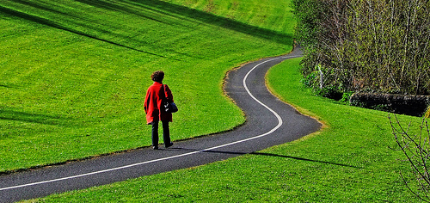
Libraries as Startups
“How can libraries support 21st century learners? Follow that thread and you’ll find transformative change.” (Mathews, 2012)
Notes:
Mathews, Brian. “Think Like a Startup: A White Paper to Inspire Library Entrepreneurialism.” VTechWorks working paper, Virginia Polytechnic Institute and State University, Blacksburg, Virginia, April 2012. http://vtechworks.lib.vt.edu/handle/10919/18649.
“How can libraries support 21st century learners? Follow that thread and you’ll find transformative change.” (pg. 1)
http://www.flickr.com/photos/sbh/3422705673/

Slide 3
Libraries as Startups
“Now is the time to ‘zoom out’ rather than ‘zoom in.’ Let’s not pigeonhole ourselves into finite roles, such as print collections, computer labs, or information literacy.” (Mathews, 2012)
Notes:
Mathews, Brian. “Think Like a Startup: A White Paper to Inspire Library Entrepreneurialism.” VTechWorks working paper, Virginia Polytechnic Institute and State University, Blacksburg, Virginia, April 2012. http://vtechworks.lib.vt.edu/handle/10919/18649.
“We have to face the future boldly. We have to peer upwards and outwards through telescopes, not downwards into microscopes.” (pg. 1)
“Now is the time to ‘zoom out’ rather than ‘zoom in.’ Let’s not pigeonhole ourselves into finite roles, such as print collections, computer labs, or information literacy.” (pg. 1)
http://www.flickr.com/photos/christopherf/6874966155/

Slide 4
Libraries as Startups
“Several years ago it was impossible to imagine a research library without a significantly massive collection in print.” (Mathews, 2012)
Notes:
Mathews, Brian. “Think Like a Startup: A White Paper to Inspire Library Entrepreneurialism.” VTechWorks working paper, Virginia Polytechnic Institute and State University, Blacksburg, Virginia, April 2012. http://vtechworks.lib.vt.edu/handle/10919/18649.
“Several years ago it was impossible to imagine a research library without a significantly massive collection in print. Now I can’t envision a future without the majority of scholarly content being digital. But it isn’t just about books; it’s about libraries redefining what a collection is.” (pg. 3)
http://www.flickr.com/photos/pocait/2274239427/

Slide 5
Then and Now
Then: The user built workflow around the library
Now: The library must build its services around user workflow
Then: Resources scarce, attention abundant
Now: Attention scarce, resources abundant
(Dempsey, 2008)
Notes:
Dempsey, L. (2008). "Always on: Libraries in a world of permanent connectivity" First Monday [Online], (14) 1. Retrieved from http://www.firstmonday.org/htbin/cgiwrap/bin/ojs/index.php/fm/article/view/2291/2070
http://www.flickr.com/photos/aramisfirefly/3580397954/

Slide 6
“I have better things to do than go drive all the way to the library when I can just sit at home and type it into my computer.”
(Digital Visitors & Residents Project, USU1, Female, Age 19)
Notes:
“I have better things to do than go drive all the way to the library when I can just sit at home and type it into my computer.” (Digital Visitors & Residents Project, USU1 0:33:12, Female, Age 19)
“It’s sometimes to do with having that security of being able to use my own laptop and knowing my way around it. Sometimes I have to use library computers, and they are just a little bit confusing, so I usually find that it’s easier to just use my own laptop.” Digital Visitors and Residents, (UKS4 00:20:26, Female Age 17)
“So if they say, you know, look at this book, go to the library and look at it, I’ll go to the library and look at it. And sometimes they are okay and I do think, oh, actually, this is a good example of what to use, so I do use it for my studying. But sometimes the case is that I think that I could probably get more from the internet or from books that I have at home, so I’ll just briefly look through it and maybe take some things down, note some things down, but usually I’ll use my own resources that I’m familiar with.” Digital Visitors and Residents, (UKS4 00:28:04, Female Age 17)
Microsoft Clip Art

Slide 7
Notes:
“…the unfortunate thing of that is that sometimes there is just an overload of information as opposed to a paragraph consistently found, is that there is just, you know, volumes upon volumes of information based upon one particular individual. And so, time to sift through which of those information who I feel I want to convey to students can be a very difficult process.” Sense-Making the Information Confluence, User (Faculty Focus Group Interview, Institution B, 2005)
Librarians are ideal “discovery experts” to help users navigate information on Internet
VRS can build up knowledge bases, adding trust and authority to their services and sources
VRS librarians can connect users with quality information not linked to a publication
Help bring open access information into research
Facilitate data reuse
OCLC QuestionPoint Knowledge Base
Replace “the vertical file”
Store, preserve, & facilitate access to reference question & answer pairs
>6 million reference transactions
Enable reference cooperatives, librarians, & users to share knowledge
Ready Reference is NOT dead!
Ready Reference questions increased from 2004-2006 (n=243, 27%) to 2010 (n=179, 31%) (Connaway & Radford 2012)
Save time of librarians & users
Decreasing budgets – share and cooperate
Saves time of librarian and the user – back to Ranganathan (1957)– save time of the reader
Books are for use.
Every reader his [or her] book.
Every book its reader.
The library is a growing organism.
Ranganathan, S.R. (1957). The Five Laws of Library Science. Madras: Madras Library Association; London: G. Blunt and Sons
http://www.flickr.com/photos/will-lion/2595497078/
Connaway, L.S., & Radford, M.L.(2012). Extending Our Virtual Reach: A Longitudinal Study of Query Type & Accuracy in Live Chat & IM Reference IM Reference [PowerPoint slides]. Retrieved from OCLC website: http://www.oclc.org/research/activities/synchronicity/ppt/alise2012.pptx (Sl. 15).
Standards could better facilitate reference cooperatives and allow users and librarians to easily search different knowledge bases

Slide 8
Road Map
Identify top trends in academic libraries
Effect of trends on future of library services
Notes:
Microsoft Clip Art

Slide 9
Communicating Value
Libraries must prove value they provide to community
Notes:
http://www.flickr.com/photos/vipulmathur/471634239

Slide 10
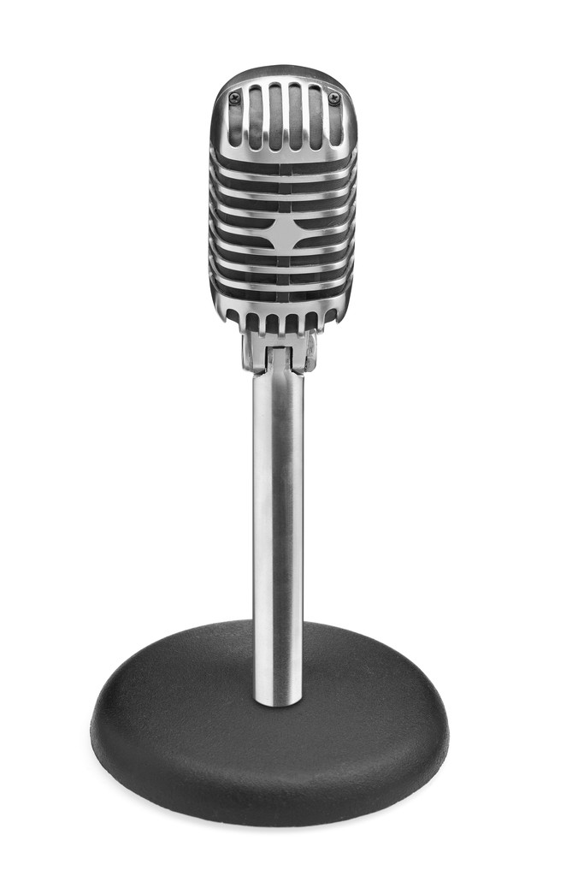
Communicating Value: Academic Libraries
Measure library contributions to
Teaching & learning
Research
Social, professional, & public engagement
Library resources contribute to student & faculty success
Correlation between library material usage & instruction with student grade-point averages
Student achievement related to library use
Impact of liaison librarians
Notes:
Newly-revised Standards for Libraries in Higher Education include an outcomes-based approach that articulates “expectations for library contributions to institutional effectiveness.”
ACRL Board of Directors. (2011). “Standards for Libraries in Higher Education,” ACRL Association of College & Research Libraries, http://www.ala.org/acrl/standards/standardslibraries
The IMLS-funded Lib-Value project is developing assessment tools that will allow libraries to show their contributions to teaching and learning; research; and social, professional, and public engagement.
“The Lib-Value Project,” LIBValue: Value, Outcomes, and Return on Investment of Academic Libraries, http://libvalue.cci.utk.edu/node/2.
Microsoft Clip Art

Slide 11
Communicating Value: Library Services
Market & publicize services
Don’t know library provides sources
Don’t know what is available
Text
Email
Chat
Phone
Face-to-face
Facebook
Skype
Notes:
“[Market] it more. Because I didn’t hear about it until I started working at this job a few months ago.” –User (Focus Group, Rutgers University, June 5, 2006) , Seeking Synchronicity
“I’ve never used this type of service and never knew it was available—that’s probably why I never tried it.” –Millenial (Non-users Online Survey) , Seeking Synchronicity
Virtual Reference Services (VRS)
Analysis of transcripts
VRS meets users where they are
Text, e-mail, chat
Facebook (“On Facebook, Librarian Brings 2 Students From the Early 1900s to Life,” January 6, 2012, Nick DeSantis, Chronicle of Higher Education. http://chronicle.com/blogs/wiredcampus/on-facebook-librarian-brings-two-students-from-the-early-1900s-to-life/34845
Joe McDonald, sophomore at University of Nevada, Reno in 1913, and girlfriend and future wife, Leola Lewis
Librarians’ expertise can deliver quality sources to users through VRS that they cannot find with a Google search
Microsoft Clip Art

Slide 12
Digital Preservation
As digital collections mature, concerns about lack of long-term planning for their preservation grow, with no strategic leadership for establishing architecture, policy, or standards for creating, accessing, and preserving digital content is likely to emerge in the near term.
Notes:
Microsoft Clip Art

Slide 13
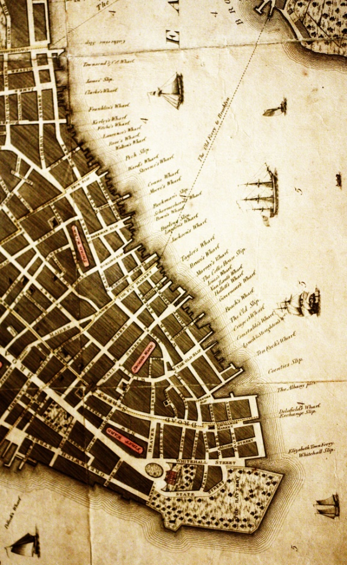
Digital Preservation: Academic Libraries
What is being digitized?
Distinctive & unique collections
Rare or unique content or institution-specific materials
University records
Grey literature
97% of 169 libraries surveyed have “completed one or more digitization projects and/or have an active program” (Dooley & Luce, 2010)
Notes:
“Well, I, the most thorough academic search I’ve done recently was on a pianist named Harold Bowers who was born in England and made most of his career in the United States. And nothing’s really been written on him and he’s been largely forgotten, although in his day he was very, very well know, very influential, so I wanted to do some research on him. I found the same single paragraph everywhere on sites about him and in Groves, which is the standard music dictionary, is the identical information. Everyone seems to know the same one paragraph about him. And, so I went to the Library of Congress, where everything he ever did is there in about 50 boxes and no one’s ever opened this stuff, you know, so you start opening it and its all his love letters to his fiancé and really his whole life is there. So then, you know you’ve gotten to the bottom of it when everyone has the same paragraph and then here’s this thing that’s never touched at the Library of Congress. Yeah, it was really very exciting, for research.” -Sense-Making the Information Confluence, (Faculty, Focus Group, Institution B, 2005)
Refer to University of Nevada, Reno example from slide 11.
Challenges of Digital Preservation
Collections are at risk when individual institutions lack a comprehensive preservation plan
Investment in creating digital collections “must be met with a commitment and infrastructure to protect this content for its lifetime”
Lack of significant and standardized architecture and policy
Collection, preservation, and management of born-digital materials are a growing concern.
Lack of funding, planning, and expertise are impediments to management and preservation of born-digital materials.
Parent institutions are not likely to see value of planning for collection and management of born-digital content and are likely to be reactive in responding to a need for preserving these materials.
Dooley, J.M. and Luce, K. (2010). Taking Our Pulse: The OCLC Research Survey of Special Collections and Archives. Dublin, OH: OCLC Research. Available: http://www.oclc.org/research/publications/library/2010/2010-11.pdf (p.54).
http://www.flickr.com/photos/mglarsen/4728823590/

Slide 14
Digital Preservation: Library Services
Reference Extract Project
“Make a more credible Web search experience” using reference librarians’ expertise (OCLC, 2008)
Primary source materials in digital format
Users enter search & receive results weighted toward sites most used by librarians
Partners libraries, technology organizations, & research institutions
Notes:
Users will enter a search term and receive results weighted toward sites most often used by librarians at institutions such as the Library of Congress, the University of Washington, the State Library of Maryland, and over 2,000 other libraries worldwide.
Baker, M. (2011, May 14). Reference Extract [Video file]. Retrieved from http://www.youtube.com/watch?v=kZUlU5uPH6A
OCLC. (2008). OCLC, Syracuse University and University of Washington to help develop a new Web search experience based on expertise from librarians [Press release]. Retrieved from http://www.oclc.org/news/releases/200842.htm
Microsoft Clip Art

Slide 15
Higher Education
Higher education institutions are entering a period of flux and turmoil
Notes:
Increased online instruction and degree programs
Globalization
Western countries expanding footprint into Middle East and Asia
China and India increasing competition for Western institutions
Increased skepticism of “return on investment”
Can’t sustain both teaching & learning with high quality research
Higher education overvalued for hefty price tag
Christensen, C. M., Horn, M. B., Caldera, L., Soares, L., Innosight Institute., & Center for American Progress. (2011). Disrupting college: How disruptive innovation can deliver quality and affordability to postsecondary education. Mountain View, Calif: Innosight Institute.
Microsoft Clip Art

Slide 16
Higher Education: Library Services
Global reach
Anytime/anywhere access
Cooperative services may reduce costs
Notes:
Shifts in the higher education surround will have an impact on libraries in terms of expectations for development of collections, delivery of collections and services for both old and new audiences, and in terms of how libraries continue to demonstrate value to parent institutions.
Microsoft Clip Art

Slide 17
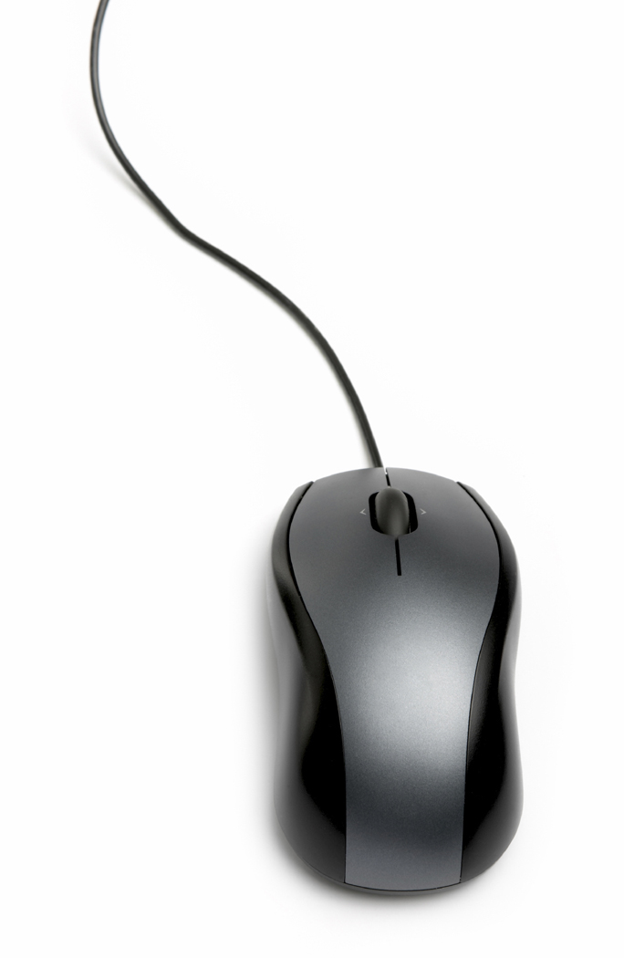
Information Technology
Technology continues to drive much of the futuristic thinking within academic libraries.
Notes:
Microsoft Clip Art

Slide 18
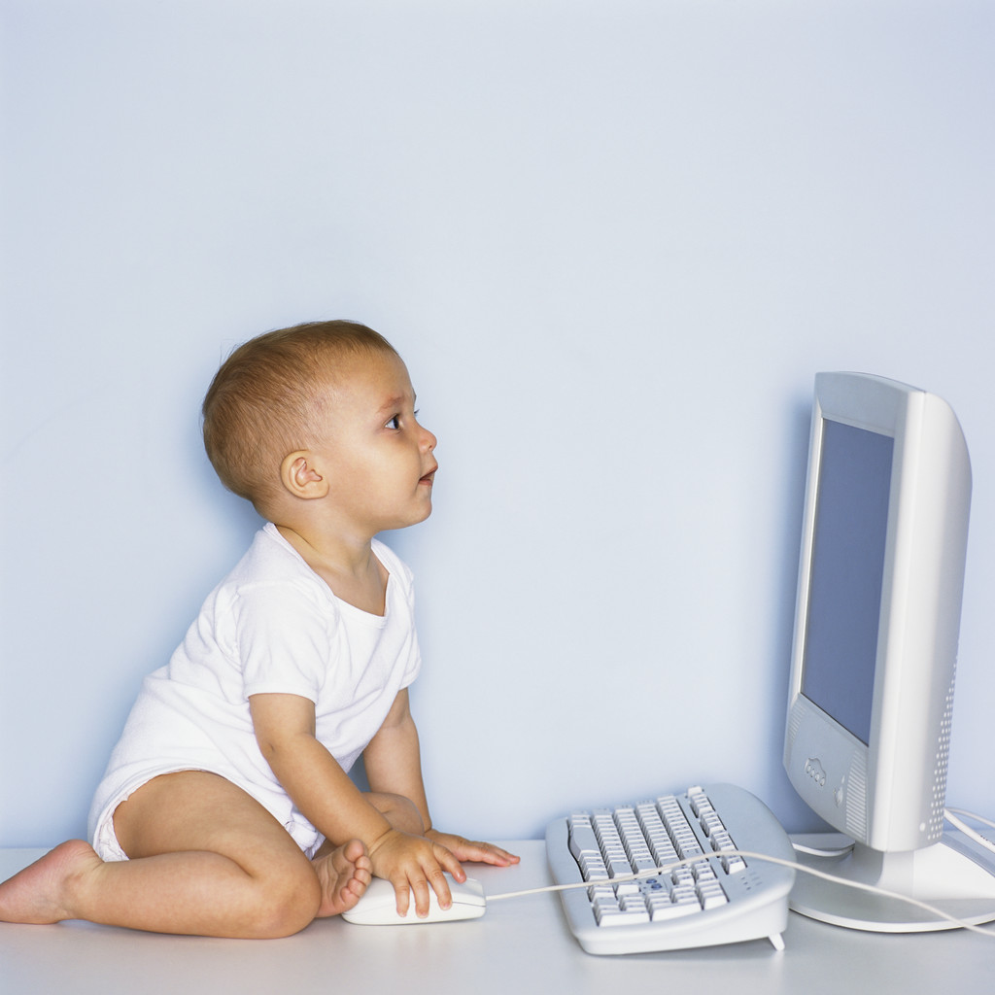
Information Technology: Academic Libraries
New education paradigms with online & hybrid learning
Challenge-based & active learning
Virtual staff
Outsourcing responsibilities
Notes:
Microsoft Clip Art

Slide 19
Information Technology: Library Services
Just-in-time model (Smith & Pickett, 2011)
Access more important than nearby inventory
Adoption of cloud-based technologies
More value on collaboration
Embed in social Q&A services & social media
Cooperative services
Help at point of need – chat pop-up help
Library web pages
Library online catalogs
Notes:
“I was on the site at 2 or 3 in the morning and it felt personalized. I don’t know, I felt like I was the only person the other person had to talk to and they took the time out.” –Seeking Synchronicity, User (Focus Group, Rutgers University, July 11, 2006)
Smith and Pickett (2011): “The new library should be based on the just-in-time model, where access is more important than vast quantities of nearby inventory.” Cloud computing provides a great opportunity for the provision of full-text electronic sources “just-in-time” (p.43).
Smith, S. & Pickett, C. (2011, September 05). Avoiding the path to obsolescence. American Libraries, 42 (9), 38-43.
Information is ubiquitous and alternate forms of credentialing are available
Microsoft Clip Art

Slide 20
Information Technology: Library Services
Help students develop digital media literacy skills
Web-scale discovery systems
Discipline-scoped searching
Create metrics for evaluating new scholarly forms of authoring, publishing, & researching
Assist new content creators
Develop customized widgets
Provide services in different formats
Be available to the users
Notes:
“I used a lot of journals, like scientific journals and stuff and then I even didn’t use a computer for some of it. Like I went to the library and found stuff there. And like we learned how to use google a little better, like fish out the .com and stuff, like you can do that. And just get the .orgs and .edu’s because they are more reliable sources.” Digital Visitors and Residents, (USS6 0:23:00, Female Age 17).
Google Search Education Hub (K-12):
Lesson plans in Google Docs
Search activities
Webinars
Visitors & Residents Project: Last year high school & first year of undergraduate studies, use FaceBook and Wikipedia (http://www.oclc.org/research/activities/vandr/)
One tool used on a large scale by Tuck School of Business, Dartmouth, is Chatter. This is an application that is very similar to Facebook, but offers users more privacy and the facility to create numerous subgroups.
However, social media can also be used to help organise the reams of data. “You can consolidate feeds into the right channel, which students can access when they want. This reduces the overload,” says Prof Johnson.
“The more information we get the better, but the way it is organised is critical.” (Clark, 2012)
Clark, C. (2012, March 12). Social media: Information networks are vital to success. Financial Times. Retrieved from http://www.ft.com/cms/s/2/0e97b7a0-6389-11e1-9686-00144feabdc0.html
http://www.flickr.com/photos/pburch_tulane/4193041009/

Slide 21
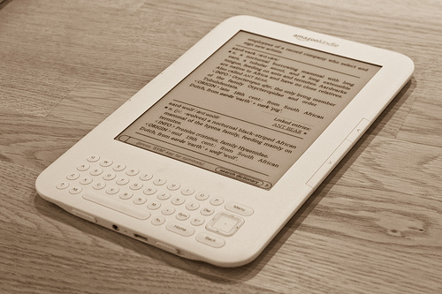
Patron Driven E-book Acquisition: Academic Libraries
Replace low circulation, physical books with e-books
Enable users to select e-books
Align library with needs of its constituencies
Notes:
Replace physical books with low circulation for licensing agreements with e-book vendors
Enable users to select e-books
Align library with needs of its constituencies
Sustainability is a core principle for e-book collections
Secure and ongoing funding
Technology solutions
Long term management capabilities
New licensing options
Standards to facilitate library lending, provide COUNTER compliant statistics, and allow for portability between devices and platforms
http://www.flickr.com/photos/holleboom/5171246269/

Slide 22
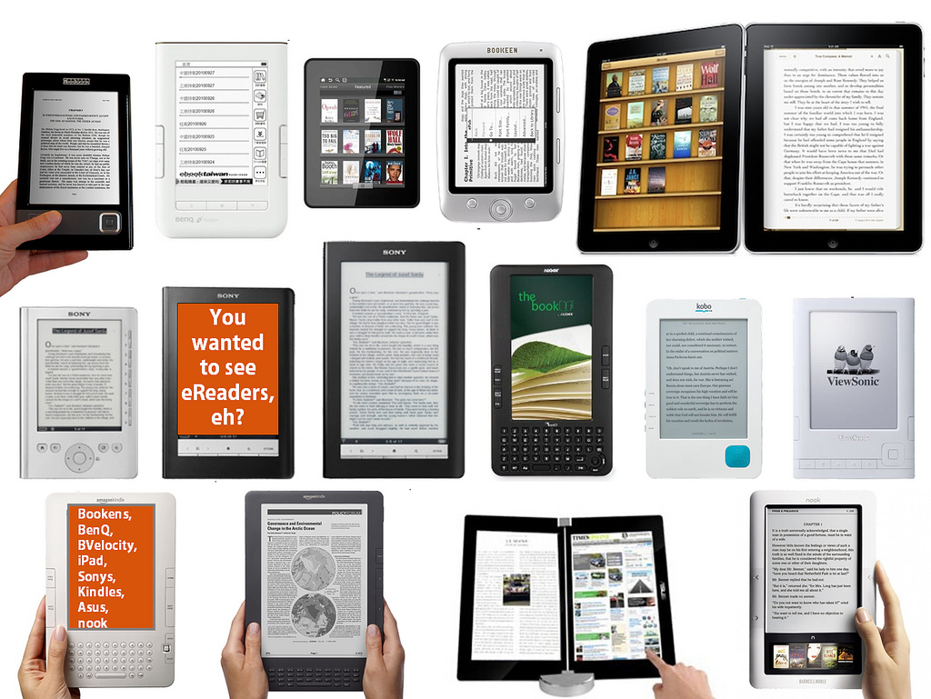
Patron Driven E-book Acquisition: Library Services
Educate users to select & use e-books
Utilize e-books to answer questions
E-book collections are full-text data bases
Immediate access to electronic sources
Notes:
http://www.flickr.com/photos/libraryman/5052936803/

Slide 23
Mobile Environments
Mobile Technology Students Own
Notes:
Data from: Dahlstrom, E., de Boor, T., Grunwald, P. & Vockley, M. (2011). The ECAR National Study of Undergraduate Students and Information Technology. Boulder, CO: EDUCAUSE Center for Applied Research. Retrieved on March 22, 2012 from http://www.educause.edu/ecar. (p. 8).
“I would use more of the iPhone than my computer because obviously this is always with me whereas my Mac Book is not with me at school or anything. Whereas my phone I bring to school and I use it, I probably use the phone more to communicate but if it is say a really long message where I just want an answer straight away, if someone is online I will then speak to them through online.” Digital Visitors and Residents, (UKS5 0:03:19, Female Age 17)
“Yes, now that I’ve got an iPhone I don’t think I could go back. It just has everything on it. It’s very much a convenience, it has my calendar, it has everything on it. If I have it with me then I can always organise things, I know what I’m doing, when I’m going. But, having said that, I can cope without it if I need to.” Digital Visitors and Residents, (UKS2, 0:09:30, Female Age 18)
My laptop and my phone, I would not be able to live without. I think more so my phone, just because with my phone I feel connected, so if I’m ever in difficulty or if I ever need to ask a question I’m always able to do that. And it’s kind of, yes, for security as well, I find I always feel secure when I have my phone with me. Digital Visitors and Residents, (UKS4 00:07:27, Female Age 17)
Mobile devices are changing the way information is delivered and accessed (Connaway & White, 2011).
Connaway, L. S., White, D., & Lanclos, D. (2011). “Visitors and residents: What motivates engagement with the digital environment?” Proceedings of the 74th ASIS&T Annual Meeting, 48: 1-7.

Slide 24
Mobile Environments
Student Use of Smartphones
59%
24%
Notes:
Data from: Dahlstrom, E., de Boor, T., Grunwald, P. & Vockley, M. (2011). The ECAR National Study of Undergraduate Students and Information Technology. Boulder, CO: EDUCAUSE Center for Applied Research. Retrieved on March 22, 2012 from http://www.educause.edu/ecar. (p. 15).
“The new Smartphones are very useful. I can’t really think of anything more accessible than having a device where you can get everything on a little tablet. There has been talk of gadgets like epaper where you can fold it out and it acts like a tablet and you can go through it. That would be quite good, it would save a lot of, this is slightly off topic, it would save a lot of trees, and you just download it. You buy a paper online then download it. But as far as information gathering now I wouldn’t change anything right now.” Digital Visitors and Residents, (UKS3 0:31:54, Male Age 17)

Slide 25
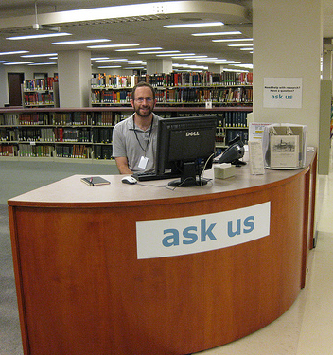
Mobile Environments: Library Services
Roving librarians
Use mobile devices
Move from behind the reference desk
Extend services to groups and/or students studying abroad
Videoconferencing via Skype, etc.
Offer reference apps as mobile interfaces develop
(Zabel, 2011)
Notes:
Zabel, D. (2011). Reference reborn: Breathing new life into public services librarianship. Santa Barbara, Calif: Libraries Unlimited. pp. 175-176.
http://www.flickr.com/photos/23618675@N05/3432181624/

Slide 26
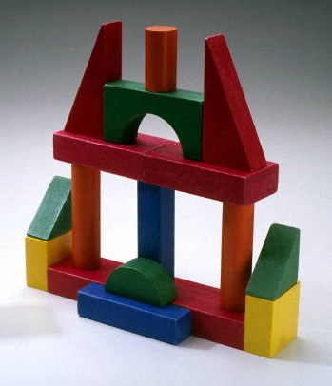
Scholarly Communication: Academic Libraries
New publishing models
Stakeholders trying to develop sustainable models
Uncertainty of Big Deals
Libraries as publishing services
~50% of libraries had or were developing library publishing services (Crow et al., 2011)
~75% published journals (Crow et al., 2011)
~50% published monographs and/or conference proceedings (Crow et al., 2011)
Notes:
“My teacher doesn’t issue text books.” Digital Visitors and Residents, (USS6 0:08:15, Female Age 17)
New scholarly communication and publishing models are developing at an ever-faster pace, requiring libraries to be actively involved or be left behind.
By 2012, digital textbooks will comprise 11% of textbook (Kelley, 2011)
“The Open Course Library” is making some high-enrollment class textbooks available through Creative Commons licenses (Kelley, 2011)
Kelley, M. (2011). Library with free online college textbooks makes debut. Retrieved from http://www.thedigitalshift.com/2011/11/ebooks/library--with-free-online-college-textbooks-makes-debut/
Crow, R., Ivins, O., Mower, A., Nesdill, D., Newton, M., Speer, J. & Watkinson, C. (2011). Library Publishing Services: Strategies for Success Research Report, Version 1.0 . Washington, DC: SPARC. Retrieved on March 22, 2012 from http://wp.sparc.arl.org/lps/. (p.4).
“And so I think that if there was that kind of system with notable published works and peer review journal type information that was searchable and organized in such a way that it could be presented comparatively then I think that that would be a very very useful tool for people to be able to access. But as I say it wouldn’t happen.” Digital Visitors and Residents, (UKU4 0:29:02, Male Age 19)
Microsoft Clip Art

Slide 27
Scholarly Communication: Library Services
Help users
Locate resources
Open access materials
Traditional publications
Navigate different interfaces
Critically evaluate sources
Notes:
“I’m suspicious of people who are publishing on-line because usually the peer review is much less rigorous.” Sense-Making the Information Confluence, (Faculty Focus Group, Institution A, 2005)
Microsoft Clip Art

Slide 28
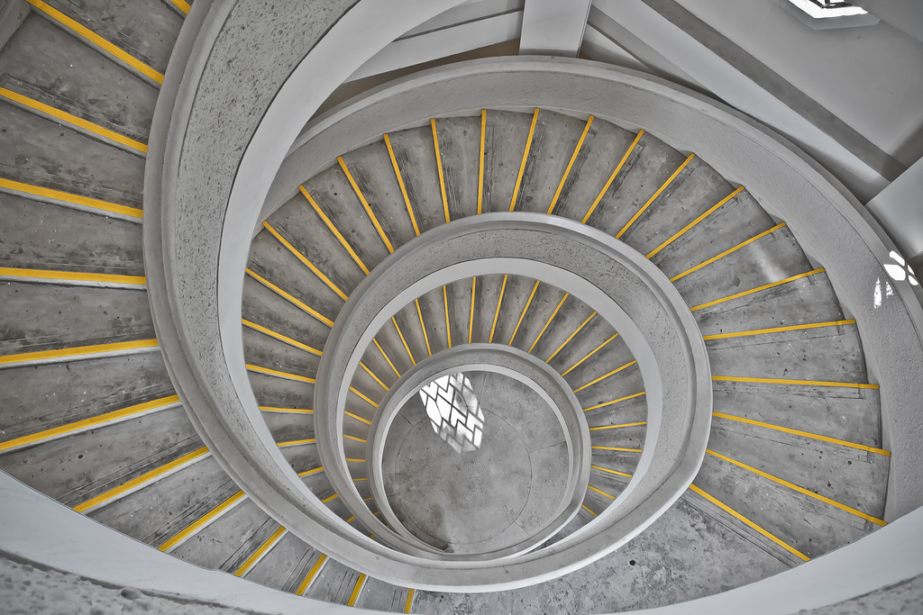
Staffing: Academic Libraries
Academic libraries, downsized through retirements, voluntary separation options, hiring freezes, and career movement, must move forward with their current staffing levels.
Notes:
http://www.flickr.com/photos/maniniyut/5912946545/

Slide 29
Staffing: Library Services
45% of current librarians turned 65 in current decade (Lynch, 2005)
Retirements peaking 2015–2019 (Lynch, 2005)
“Nothing beats experience” (Roberts, 2005)
Capture reference knowledge for knowledge base
Cooperatives can help fill gap in staff
Notes:
Cooperatives can help fill gap in staff
QuestionPoint
The Ask a Librarian services at Columbia University Libraries are staffed primarily by Columbia University librarians. Evening in Fall and Spring semesters, chat services are staffed by library school interns from accredited library science degree programs that include Queens College, the Pratt Institute, and the Palmer School at C.W. Post.
Collection Development
2CUL - http://2cul.org/progressreport122010 - Columbia and Cornell are sharing collection development librarians for research support and collection development services, manage library purchases, monitor gift offers, and provide statistics on collections access and usage for both Cornell and Columbia. The shared staffing model is organized through a cost transfer agreement between the two institutions. It is designed to result in cost savings for both schools, at the same time creating a deeper shared collection with fewer unnecessary duplicate purchases.
“I think we [VRS] get a lot of support. We are at a difficult point, we used to do consortia reference with about 7 universities and when we went to IM we all went different ways. It’s hard to staff the service for the number of hours we feel that our users would like to have with only our existing library staff.” Seeking Synchronicity (Librarian, Telephone Interview, Transcript 008).
Lynch, M., Tordella, S., & Godfrey, T. (2005). Retirement and recruitment: A deeper look. American Libraries, 36 (1), 28.
Roberts, G. (2005). Groupware as a knowledge repository. Computers in Small Libraries. 25 (4), 29-31.
Microsoft Clip Art

Slide 30
User Behaviors and Expectations
Convenience affects all aspects of information seeking - the selection, accessibility, and use of sources.
Notes:
“I guess it is just people our age is just more in our minds it is more convenient to go on the computer and get information than go through a book and try and find it and look through it. When you can just type it in, it will come up quicker on the computer.” Digital Visitors and Residents,(UKS4 0:30:04, Female Age 17)
“I mean in a way the internet is just books online somewhere. Or just bits of books online...Books and people would be my choice. But of course even like me saying that I use the internet way more than I use books because it’s just more convenient...Because they’re not doing things somewhat that may just take a little bit longer, just a little bit but turn out a lot better.” Digital Visitors and Residents (USS5 01:11:02, Male Age 18)
Microsoft Clip Art

Slide 31
User Behaviors and Expectations: Academic Libraries
Library is not the first source for finding information (sometimes it’s not even considered)
Users expect convenience!
Is it readily accessible online?
Does it contain the needed information and is it easy to use?
How much time will it take to access and use the source?
Is it a familiar interface and easily navigable interface?
Notes:
“They do often advise that we go to the library and look for books but I would normally go to the internet and go to the library as my last sort of option really. (Laughter) It just takes me – I don’t really know how to use the library, I’ve got to be honest, but I know how to use the internet. Yes, I would normally use the internet or sort of word of mouth if someone else knows how to do it – that kind of thing – first.” Digital Visitors and Residents, (UKU5 0:14:19, Female Age 19)
“I find Google a lot easier than going to the library website because I don’t know, it’s just like sometimes so many journals come up and when you look at the first ten and they just don’t make any sense I, kind of, give up. Google, I don’t know. It’s just Google it’s – I find it easier just to look through anything.” Digital Visitors and residents, (USU7 0:34:11, Female Age 19)
“I could easily have found the information she [VRS librarian] found for me, but the fact that I could just ask her question and have them look up the reference and read through articles instead of me having to look through like a million Googled articles…it was definitely a nice convenience and would definitely make it more likely for me to go to them and actually ask a librarian a question or figure it out on my own.” –Seeking Synchronicity, User (Focus Group, Rutgers University, July 11, 2006)
Information Studies students: (Bertot, et al., 2012, p. 213)
28% use OPAC daily or weekly
86% use Google daily or weekly
Bertot, J. C., Berube, K., Devereaux, P., Dhakal, K., Powers, S., & Ray, J. (2012). Assessing the usability of WorldCat Local: Findings and considerations. The Library Quarterly, 82(2), 207-221.
Although campus Information Commons, with cafes and 24/7 access to the facilities and resources, are still popular with students and faculty, convenient access to resources, whether human, print, or electronic is the most critical factor. After all, “If it is too inconvenient I’m not going after it.” Convenience is based on context and situation.
Connaway, L. S., Dickey, T. J., & Radford, M. L. (2011). "If it is too inconvenient I'm not going after it": Convenience as a critical factor in information-seeking behaviors. Library & Information Science Research, 33 (3) 188.

Slide 32
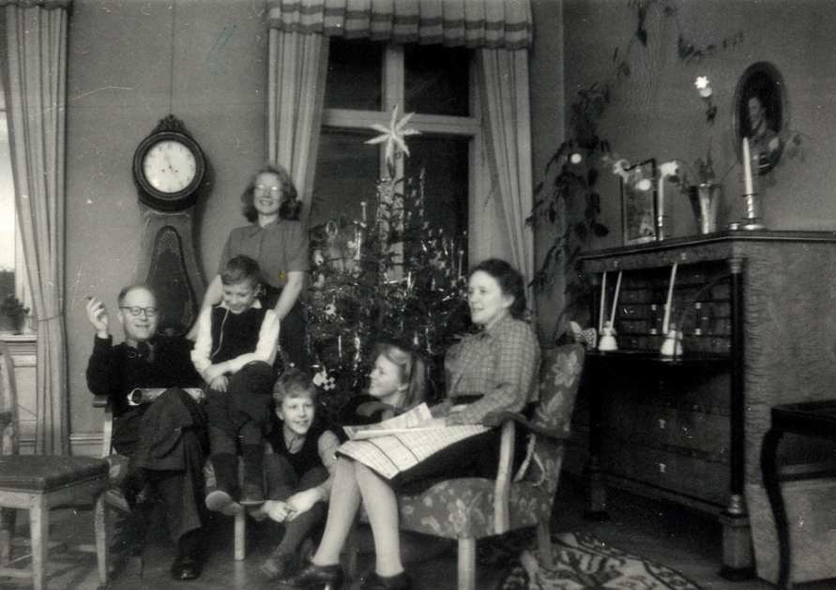
User Behaviors and Expectations: Library Services
Human sources very important (Connaway, White, & Lanclos, 2011)
Academic & personal situations
Parents
Friends
Family
Colleagues
Professors
Great opportunity for reference services
Develop relationships
Embedded librarians (Kesselman & Watstein, 2009)
William H. Welch Medical Library at Johns Hopkins University (Kelley, 2011)
Notes:
Not only is immediate access to electronic sources a critical component of meeting the information needs of students and faculty, but access to human sources is also important. When students and faculty were interviewed in 2005, 2008, 2010, 2011, and 2012 to identify how they get their information for both academic and personal situations, parents, friends, family, colleagues, and professors are often the first sources queried. Why? Convenience! These sources immediately can be reached by texting, voice calling, IMing, or emailing, with an often instantaneous response. Librarians, too, are making themselves available to students and faculty through a number of channels including social media, such as Facebook, chat, IM, and text reference, as well as making themselves physically available within the academic departments, student unions, and cafeterias. (ACRL Research Planning and Review Committee, 2012).
“One of my favourite ways of getting information is by asking people. Instead of Googling the whole time I mostly have faith in the fact that people are actually learning, if I can go to a tutor and ask them something.” Digital Visitors and Residents, (UKU3 0:19:34, Female Age 19)
“I use my friends a lot. I use people that I know know things about like if they’re, maybe not specialised but know what they are. Ask them first and then they’ll give me information. (USS5 01:01:42, Male Age 18)
ACRL Research Planning and Review Committee. (2012). ACRL Top Ten Trends. Accepted for publication in C&RL News.
Connaway, L.S., Prabha, C. & Dickey, T.J. (2003-2005). Sense-making the Information Confluence: The Whys and Hows of College and University User Satisficing of Information Needs. Phase III: Focus Group Interview Study (Columbus, OH: School of Communication, The Ohio State University). Retrieved from http://www.oclc.org/research/activities/past/orprojects/imls/default.htm
Connaway, L. S., Radford, M. L., & OCLC Research. (2011). Seeking synchronicity: Revelations and recommendations for virtual reference. Dublin, Ohio: OCLC Research.
Radford, M.L. & Connaway, L.S. (2008). Seeking Synchronicity: Evaluating Virtual Reference Service from User, Non-user, and Librarian Perspectives. IMLS Final Performance Report. Retrieved from: http://www.oclc.org/research/activities/synchronicity/reports/20080626-final.pdf
Connaway, L.S., White, D., & Lanclos, D. (2011). Proceedings of the 74th ASIS&T Annual Meeting, Volume 48. “Visitors and Residents: What Motivates Engagement with the Digital Environment?” Silver Spring, MD: Richard B. Hill.
Embedded librarians:
Librarians, too, are making themselves available to students and faculty through a number of channels including social media, such as Facebook, chat, IM, and text reference, as well as making themselves physically available within the academic departments, student unions, and cafeterias (ACRL Research Planning and Review Committee). This is referred to as embedded librarianship (Kesselman & Watstein, 2009). To be embedded is described by Kessleman and Watstein (2009): “with the dramatic increase in electronic resources and technological capabilities, bringing the library and the librarian to the user, wherever they are – office, laboratory, home, or even on their mobile deice is at the forefront of what it means to be embedded.”
A perfect example of this was the October 2011 announcement that the William H. Welch Medical Library at Johns Hopkins University in Baltimore, MD would close its physical doors to patrons on January 1, 2012 (Kelley, 2011). The library continues to provide resources, which are completely online. One of the main reasons for the closing of the library was the decreasing use and circulation of physical materials (41 checkouts a day and 106 visits a day, OCLC Distinguished Seminar Series, 2012) and the exponential increase in the use of electronic materials. The librarians have been embedded within the academic departments for the past 6 years and are available to students and faculty via email or phone.
Kesselman, M. A., & Watstein, S. B. (2009). Creating Opportunities: Embedded Librarians. Journal of Library Administration, 49, 4, 383-400.
Kelley, M. (2011, October 27). Major medical library closing its doors to patrons and moving to digital model. The Digital Shift. Retrieved from http://www.thedigitalshift.com/2011/10/research/major-medical-library-closing-its-doors-to-patrons-and-moving-to-digital-model/
OCLC Distinguished Seminar Series (Producer). (2012, January 16). From Books and Buildings to Information and Services [Video webcast]. Retrieved from http://player.multicastmedia.com/player.php?p=j1v57etx
http://www.flickr.com/photos/teotwawki/55900838/

Slide 33
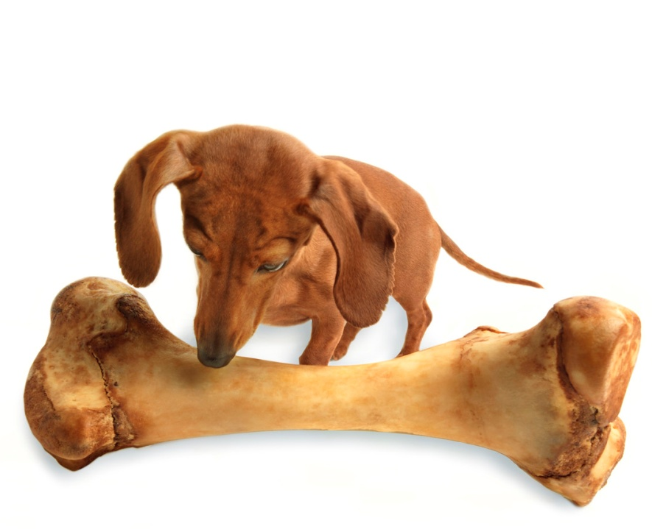
User Behaviors and Expectations: Library Services
“One size does not fit all for library services” (Connaway, Dickey, & Radford, 2011, p.187)
Reference can be offered in different modes
Utilize strengths of available staff
Meet user needs for different situations & contexts
Need for an economic model for allocation of resources for different delivery modes (Connaway, Dickey, & Radford, 2011, p.187)
Notes:
Library services should be made as convenient as possible for users, meeting them where they are
Fit into user’s workflow
One size fits no one
Connaway, L. S., Dickey, T. J., & Radford, M. L. (2011). "If it is too inconvenient I'm not going after it": Convenience as a critical factor in information-seeking behaviors. Library & Information Science Research, 33 (3) 187.
Microsoft Clip Art

Slide 34
Startup Solutions
Look to future instead of measuring past
Analyze what we do, why we do it, & how we might implement change
Discover possibilities, address needs, & propose solutions
Notes:
Mathews, B. (2012). Think like a startup: A white paper to inspire library entrepreneurialism [White paper]. Retrieved from http://chronicle.com/blognetwork/theubiquitouslibrarian/2012/04/04/think-like-a-startup-a-white-paper/
Microsoft Clip Art

Slide 35
Startup Solutions
“Fail faster, fail smarter”
Failure is part of process
“Good enough is good enough to start”
Have a raw form of concept & go with it, then build upon success
“Feed the feedback loop”
Let the users nurture the concept to build it up
Go beyond traditional library boundaries
Notes:
“Good enough is good enough to start”
Users are very adept a satisficing and survive and often excel.
Mathews, B. (2012). Think like a startup: A white paper to inspire library entrepreneurialism [White paper]. Retrieved from http://chronicle.com/blognetwork/theubiquitouslibrarian/2012/04/04/think-like-a-startup-a-white-paper/
Microsoft Clip Art

Slide 36
Startup Solutions
Plant many seeds
Try lots of decent ideas instead of one good one
See what works
Seize the white space
“Don’t limit your innovation”
Notes:
Mathews, B. (2012). Think like a startup: A white paper to inspire library entrepreneurialism [White paper]. Retrieved from http://chronicle.com/blognetwork/theubiquitouslibrarian/2012/04/04/think-like-a-startup-a-white-paper/
Microsoft Clip Art

Slide 37
Startup Solutions
Libraries Now:
Library assessment linked to satisfaction & performance
Focus on sustainability
Evaluate how we’re doing right now
Teaching information literacy
Information focused
Culture of tradition
Library’s role as providing access to information & space to study
Libraries as Startup:
Library assessment tries to anticipate unarticulated needs
Focus on revolutionary new services
Evaluate direction we’re headed
Build instructional support to address information literacy
User-focused
Culture of innovation
Expand library’s role
Notes:
Mathews, B. (2012). Think like a startup: A white paper to inspire library entrepreneurialism [White paper]. Retrieved from http://chronicle.com/blognetwork/theubiquitouslibrarian/2012/04/04/think-like-a-startup-a-white-paper/
Microsoft Clip Art

Slide 38
Startup Solutions
“By focusing on relationship building instead of service excellence, organizations can uncover new needs and be in position to make a stronger impact.”
Notes:
Mathews, B. (2012). Think like a startup: A white paper to inspire library entrepreneurialism [White paper]. Retrieved from http://chronicle.com/blognetwork/theubiquitouslibrarian/2012/04/04/think-like-a-startup-a-white-paper/
“Joseph Michelli provides insight that propelled Starbucks from turning ordinary into extraordinary experiences. His vision is based on the process of making a personal connection with people through a framework based on connecting, discovering, and responding. This transforms patrons into people and makes library usage personal. By focusing on relationship building instead of service excellence, organizations can uncover new needs and be in position to make a stronger impact.” (pg. 9)
Example: Seeking Synchronicity
Librarians identified successful VR encounters as those where they were able to offer instruction and specialized knowledge, the user had a positive attitude
Users identified successful VR encounters as those providing convenience, an accurate answer, and they were comfortable with the service
Connaway, L. S., Radford, M. L., & OCLC Research. (2011). Seeking synchronicity: Revelations and recommendations for virtual reference. Dublin, OH: OCLC Research. http://www.oclc.org/research/activities/synchronicity/default.htm
Microsoft Clip Art

Slide 39
Startup Solutions
“A strategic instructional venture isn’t about just training students how to search database interfaces, but about building their fluency with data, visual, spatial, media, information, and technology literacies…This is how we transform scholarship.”
(Mathews, 2012)
Notes:
Mathews, B. (2012). Think like a startup: A white paper to inspire library entrepreneurialism [White paper]. Retrieved from http://chronicle.com/blognetwork/theubiquitouslibrarian/2012/04/04/think-like-a-startup-a-white-paper/
“A strategic instructional venture isn’t about just training students how to search database interfaces, but about building their fluency with data, visual, spatial, media, information, and technology literacies. This is how we can advance the role of the library. This is how we transform scholarship.” (pg. 9)
Example of the teachable moment:
“Yeah, I don't step in the library anymore… better to read a 25-page article from JSTOR than 250-page book.” Undergraduate student IMLSFG_07
“Yeah, like go to, you could go to JSTOR you can look at like a journal index and it’s library, the catalog for that volume and all sorts of things. And, it’s not really, I wouldn’t think it’s the most efficient way, but sometimes it takes a lot less time than a search.” Undergraduate student IMLSFG_07
“It’s beautiful, and in the research facilities are amazing there in terms of how many databases they have, but my entire undergraduate, and the majority of my graduate, I had no idea. I probably knew about 1/100 of the information that was available in the library. Then I spent a couple hours with the main librarian there, just doing a couple of searches that I needed to do, and now I can do that as fast online, through the library’s homepage. I can do that as fast as I can going through Google and get better, more reliable information. So I use it a lot actually.” Graduate student IMLSFG_06
Dervin, B., Connaway, L. S., & Prabha, C. (2003-2005). Sense-making the information confluence: The hows and the whys of college and university user satisficing of information needs. Funded by the Institute of Museum and Library Services (IMLS). Project Website URL: http://www.oclc.org/research/activities/past/orprojects/imls/default.htm
Microsoft Clip Art

Slide 40
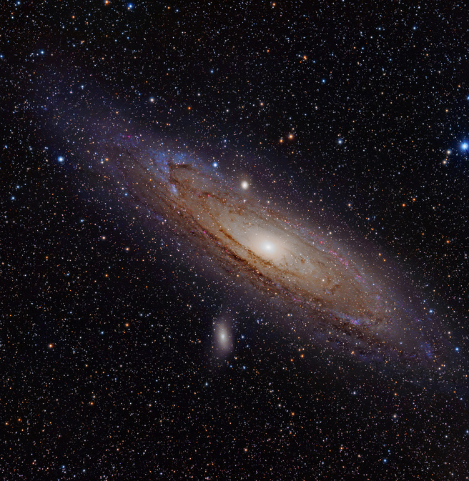
Startup Solutions
“Dent the universe”
Build the impossible
Offer “insanely great” services, products, & spaces
Notes:
Mathews, B. (2012). Think like a startup: A white paper to inspire library entrepreneurialism [White paper]. Retrieved from http://chronicle.com/blognetwork/theubiquitouslibrarian/2012/04/04/think-like-a-startup-a-white-paper/
“Or as Steve Jobs preached, we need to strive to ‘dent the universe,’ ‘build the impossible,’ and offer ‘insanely great’ services, products, and spaces.” (pg. 10)
http://www.flickr.com/photos/astroporn/4999978603/

Slide 41
Startup Solutions
Focus on revolutionary new services and models
Notes:
Mathews, B. (2012). Think like a startup: A white paper to inspire library entrepreneurialism [White paper]. Retrieved from http://chronicle.com/blognetwork/theubiquitouslibrarian/2012/04/04/think-like-a-startup-a-white-paper/
“In short: we focus on service sustainability rather than revolutionary or evolutionary new services. As we think about the direction libraries are heading, the focus can’t remain on how well we’re doing right now, but on where we should be heading. It’s not about making our services incrementally better, but about developing completely new services and service models.” (pg. 8)
Microsoft Clip Art

Slide 42
Role of Librarian
Keep talking
Keep moving
Keep the gates open
Keep it simple
Notes:
All of this will affect the role of the librarian who might increasingly have to help students clarify and interpret tasks and briefs, find the appropriate resources and run information skills sessions. Dr. Connaway identifies a few key issues for libraries to consider:
1. Keep talking: Librarians need to market and promote their services and be very transparent about what they offer, in addition to ‘books’.
2. Keep moving: Librarians need to provide a range of tools and services in different media. Some people prefer walking into a library and talking face-to-face. Some like to talk to a librarian, others to communicate virtually. While some users want to hold a book, many want electronic access. Librarians need to offer a wide range of services and resources which is difficult in the current economic environment.
3. Keep the gates open: Libraries need to remove the barriers between discovering and accessing information. Older materials need to be made available digitally as researchers perceive a wealth of digital and varied resources as ‘better’.
4. Keep it simple: Researchers are very familiar with other web-based searches like Google, Yahoo or Amazon. Library web services ought to look similar despite providing very detailed ways of searching for information. The majority of users search by keywords and library search tools must have a simple and convenient interface.
Microsoft Clip Art

Slide 43
References
ACRL Board of Directors. (2011). Standards for libraries in higher education. ACRL Association of College & Research Libraries. Retrieved from http://www.ala.org/acrl/standards/standardslibraries
ACRL Research Planning and Review Committee. (2012). ACRL top ten trends. Accepted for publication in C&RL News.
Baker, M. (2011, May 14). Reference extract [Video file]. Retrieved from http://www.youtube.com/watch?v=kZUlU5uPH6A
Bertot, J. C., Berube, K., Devereaux, P., Dhakal, K., Powers, S., & Ray, J. (2012). Assessing the usability of WorldCat Local: Findings and considerations. The Library Quarterly, 82(2), 207-221.
Christensen, C. M., Horn, M. B., Caldera, L., Soares, L. (2011). Disrupting college: How disruptive innovation can deliver quality and affordability to postsecondary education. Mountain View, CA: Innosight Institute.
Clark, C. (2012, March 12). Social media: Information networks are vital to success. Financial Times. Retrieved from http://www.ft.com/cms/s/2/0e97b7a0-6389-11e1-9686-00144feabdc0.html\
Connaway, L. S., Dickey, T. J., & Radford, M. L. (2011). "If it is too inconvenient I'm not going after it": Convenience as a critical factor in information-seeking behaviors. Library & Information Science Research, 33(3), 179-190.
Connaway, L. S., Prabha, C., & Dickey, T. J. (2003-2005). Sense-making the information confluence: The whys and hows of college and university user satisficing of information needs. Phase III: Focus group interview study. (Columbus, OH: School of Communication, The Ohio State University). Retrieved from http://www.oclc.org/research/activities/past/orprojects/imls/default.htm

Slide 44
References
Connaway, L. S., & Radford, M. L.(2012). Extending our virtual reach: A longitudinal study of query type & accuracy in live chat & IM reference. Retrieved from website: http://www.oclc.org/research/activities/synchronicity/ppt/alise2012.pptx
Connaway, L. S., Radford, M. L., & OCLC Research. (2011). Seeking synchronicity: Revelations and recommendations for virtual reference. Dublin, OH: OCLC Research. http://www.oclc.org/research/activities/synchronicity/default.htm
Connaway, L. S., White, D., & Lanclos, D. (2011). “Visitors and residents: What motivates engagement with the digital environment?” Proceedings of the 74th ASIS&T Annual Meeting, 48: 1-7.
Crow, R., Ivins, O., Mower, A., Nesdill, D., Newton, M., Speer, J., & Watkinson, C. (2011). Library publishing services: Strategies for success research report, version 1.0. Washington, DC: SPARC. Retrieved from http://wp.sparc.arl.org/lps/
Dahlstrom, E., de Boor, T., Grunwald, P., & Vockley, M. (2011). The ECAR National Study of Undergraduate Students and Information Technology. Boulder, CO: EDUCAUSE Center for Applied Research. Retrieved from http://www.educause.edu/ecar
Dempsey, L. (2008). Always on: Libraries in a world of permanent connectivity. First Monday, 14(1). Retrieved from: http://www.firstmonday.org/htbin/cgiwrap/bin/ojs/index.php/fm/article/view/2291/2070
DeSantis, N. (2012). On Facebook, librarian brings 2 students from the early 1900s to life. Wired Campus (January 6). Retrieved from http://chronicle.com/blogs/wiredcampus/on-facebook-librarian-brings-two-students-from-the-early-1900s-to-life/34845

Slide 45
References
Dooley, J. M., & Luce, K. (2010). Taking our pulse: The OCLC Research survey of special collections and archives. Dublin, OH: OCLC Research. Retrieved from http://www.oclc.org/research/publications/library/2010/2010-11.pdf
Dervin, B., Connaway, L. S., & Prabha, C. (2003-2005). Sense-making the information confluence: The hows and the whys of college and university user satisficing of information needs. Funded by the Institute of Museum and Library Services (IMLS). Project Website URL: http://www.oclc.org/research/activities/past/orprojects/imls/default.htm
Kelley, M. (2011). Library with free online college textbooks makes debut. The Digital Shift (November 1). Retrieved from http://www.thedigitalshift.com/2011/11/ebooks/library--with-free-online-college-textbooks-makes-debut/
Kelley, M. (2011. Major medical library closing its doors to patrons and moving to digital model. The Digital Shift (October 27). Retrieved from http://www.thedigitalshift.com/2011/10/research/major-medical-library-closing-its-doors-to-patrons-and-moving-to-digital-model/
Kesselman, M. A., & Watstein, S. B. (2009). Creating opportunities: Embedded librarians. Journal of Library Administration, 49(4), 383-400.
“The Lib-Value Project,” LIBValue: Value, Outcomes, and Return on Investment of Academic Libraries, http://libvalue.cci.utk.edu/node/2
Lynch, M., Tordella, S., & Godfrey, T. (2005). Retirement and recruitment: A deeper look. American Libraries, 36 (1), 28. http://www.ala.org/research/sites/ala.org.research/files/content/librarystaffstats/recruitment/recruitretire-adeeperlook.pdf

Slide 46
References
Mathews, B. (2012). Think like a startup: A white paper to inspire library entrepreneurialism. VTechWorks working paper, Virginia Polytechnic Institute and State University, Blacksburg, Virginia. http://vtechworks.lib.vt.edu/handle/10919/18649
OCLC. (2008). OCLC, Syracuse University and University of Washington to help develop a new Web search experience based on expertise from librarians [Press release]. Retrieved from http://www.oclc.org/news/releases/200842.html
OCLC Distinguished Seminar Series (Producer). (2012, January 16). From Books and Buildings to Information and Services [Video webcast]. Retrieved from http://player.multicastmedia.com/player.php?p=j1v57etx
Radford, M. L., & Connaway, L. S. (2008). Seeking Synchronicity: Evaluating virtual reference service from user, non-user, and librarian perspectives. IMLS final performance report. Retrieved from: http://www.oclc.org/research/activities/synchronicity/reports/20080626-final.pdf
Ranganathan, S. R .(1957). The five laws of library science. Madras: Madras Library Association.
Roberts, G. (2005). Groupware as a knowledge repository. Computers in Small Libraries, 25 (4), 29-31.
Smith, S., & Pickett, C. (2011). Avoiding the path to obsolescence. American Libraries, 42 (9), 38-43. http://americanlibrariesmagazine.org/features/09052011/avoiding-path-obsolence
White, D., & Connaway, L. S. (2011-2012). Visitors and Residents: What motivates engagement with the digital information environment. Funded by JISC. Project Website URL: http://www.oclc.org/research/activities/vandr/
Zabel, D. (2011). Reference reborn: Breathing new life into public services librarianship. Santa Barbara, CA: Libraries Unlimited.

Slide 47
Photo Credits
Slide 2: Path http://www.flickr.com/photos/sbh/3422705673/
Slide 3: Telescope http://www.flickr.com/photos/christopherf/6874966155/
Slide 4: Books http://www.flickr.com/photos/pocait/2274239427/
Slide 5: Waterfall http://www.flickr.com/photos/aramisfirefly/3580397954/
Slide 7: Fire Hydrant http://www.flickr.com/photos/will-lion/2595497078/
Slide 9: Heart http://www.flickr.com/photos/vipulmathur/471634239
Slide 13: Map http://www.flickr.com/photos/mglarsen/4728823590/
Slide 20: Student at Computer http://www.flickr.com/photos/pburch_tulane/4193041009/

Slide 48
Photo Credits
Slide 21: Ebook http://www.flickr.com/photos/holleboom/5171246269/
Slide 22: Ebooks http://www.flickr.com/photos/libraryman/5052936803/
Slide 25: Reference Desk http://www.flickr.com/photos/23618675@N05/3432181624/
Slide 28: Staircase http://www.flickr.com/photos/maniniyut/5912946545/
Slide 32: Family Portrait http://www.flickr.com/photos/teotwawki/55900838/
Slide 40: Universe http://www.flickr.com/photos/astroporn/4999978603/

Slide 49
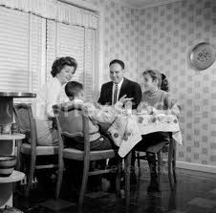
Questions and Discussion

Slide 50
Thank You!
connawal@oclc.org

