Slide 1
San Juan, Puerto Rico (21 October 2015)
VIAF Hispánica
Eric Childress
Consulting Project Manager
OCLC Membership & Research
Notes:
It is a pleasure to address you today. I am Eric Childress of OCLC Research. My background is as a cataloger, and I’ve been involved with metadata, controlled vocabularies and classification for my entire career.
Presentation to
Escuela Graduada de Ciencias y Tecnologías de la Información, Universidad de Puerto Rico (Graduate School of Information Sciences and Technologies , University of Puerto Rico)

Slide 2
Virtual International Authority File
Aggregates data from ~36 sources
Includes personal and organizational names, works and their translations
Links in Wikidata (and thus Wikipedia)
One of most frequently accessed sources consumed by linked data services

Slide 3
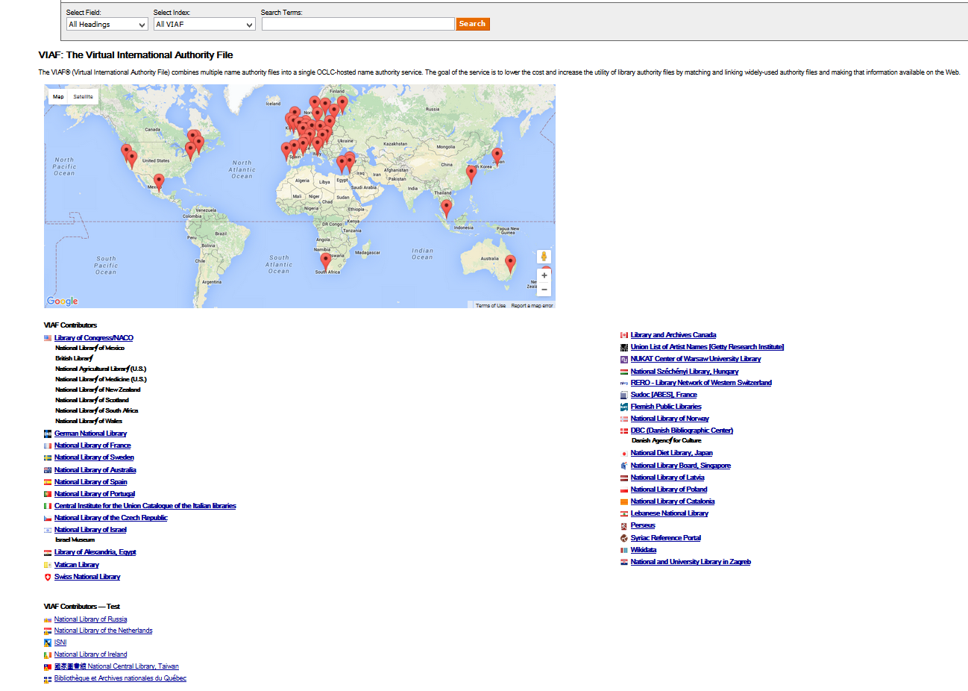
Size of VIAF
37 active participants/files
29 million VIAF clusters
53 million source authority records
39 M personal
6 M corporate/conference
4 M geographic
4 M title
54 million links
111 million bibliographic records
Notes:
Also improvements in clustering, clustering stability, matching, date recognition

Slide 4
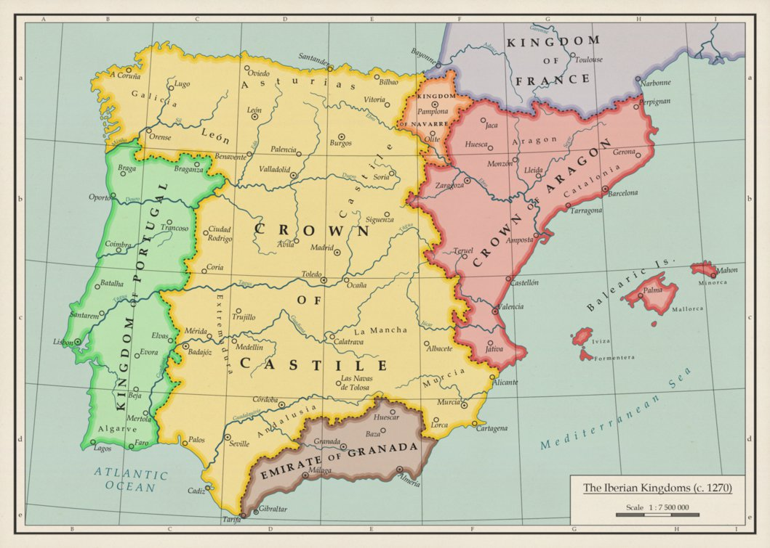
VIAF – Iberian Language sources
Notes:
Source of image: http://pre04.deviantart.net/f174/th/pre/i/2014/093/9/c/the_iberian_kingdoms__c__1270__by_undevicesimus-d697lpa.png

Slide 5
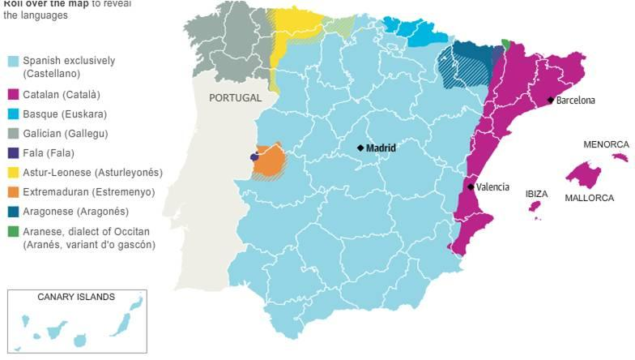
Languages of Iberia
Notes:
From https://europetravelfreak.wordpress.com/2013/02/12/multitude-of-languages-that-may-be-encountered-while-traveling-in-spain/ - Photo courtesy of guardian.co.uk

Slide 6
Iberian languages sources in VIAF
Spanish-speaking countries
LC NAF
Biblioteca Nacional de México (BNM)
Biblioteca Nacional de España (BNE)
Biblioteca de Catalunya (BC)
Portuguese-speaking countries
Biblioteca Nacional de Portugal (BNP)

Slide 7
Interface language options
español
Courtesy of the Biblioteca Nacional de España (BNE)

Slide 8
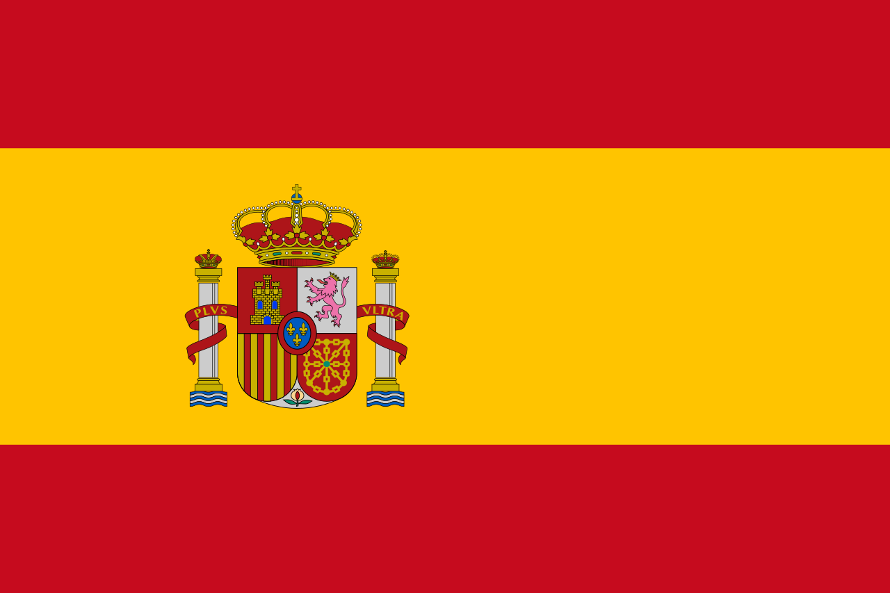
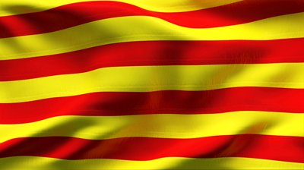
VIAF Hispánica

Slide 9
VIAF Hispánica view
Limits results to clusters that include records from
Biblioteca Nacional de España (BNE)
Biblioteca de Catalunya (BC)

Slide 10
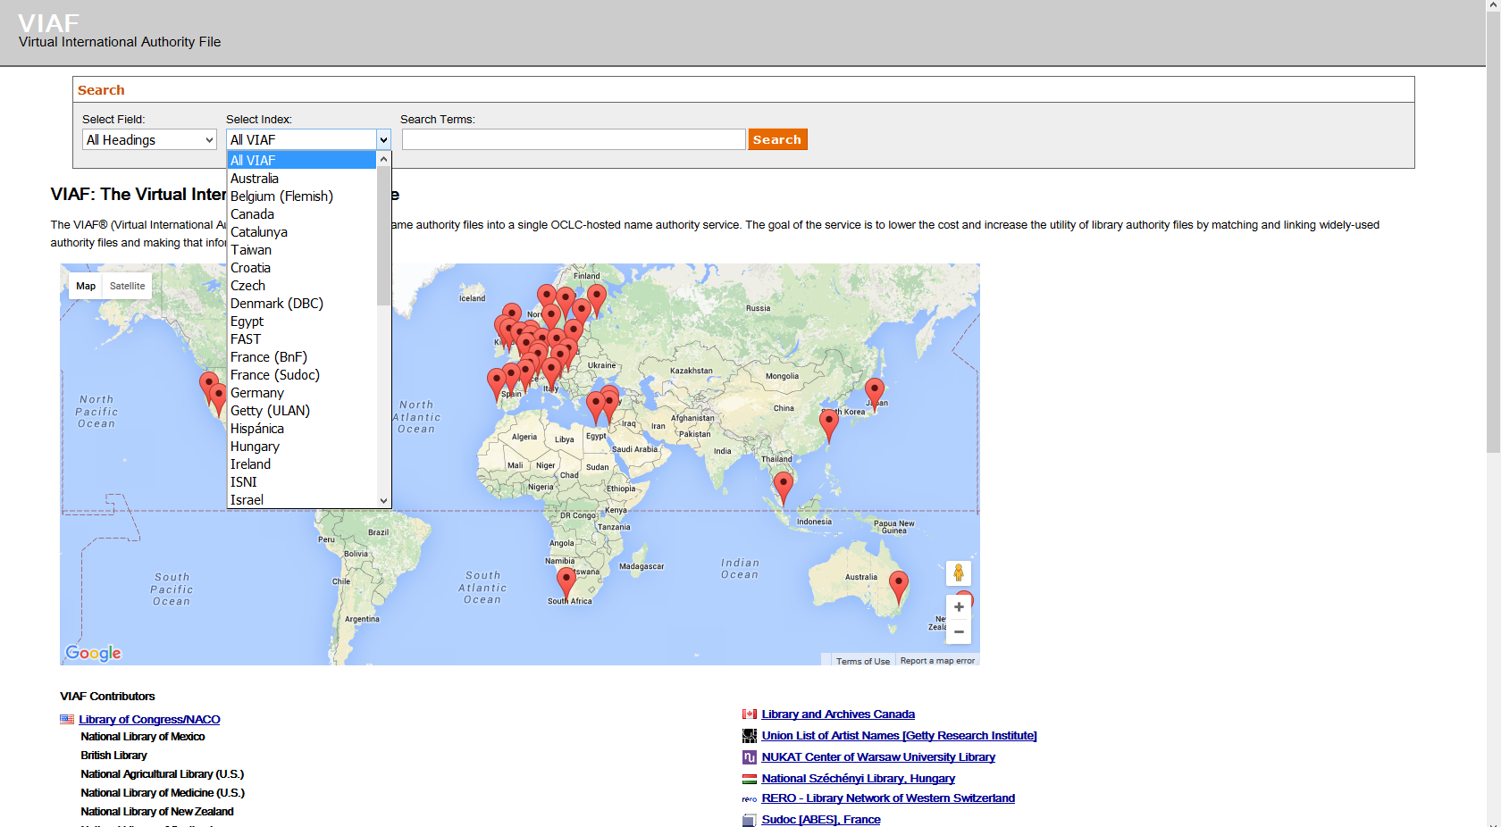

Slide 11
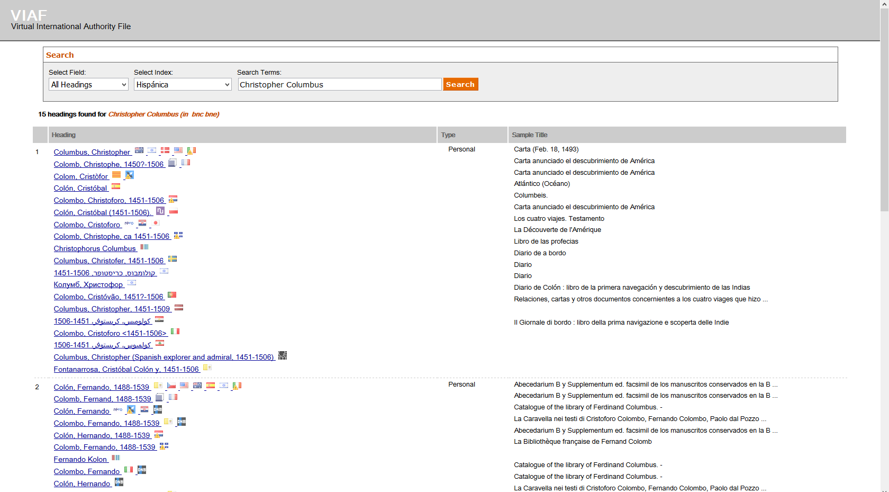
VIAF Hispánica – Sample search
Notes:
Without this restriction, 100 search results

Slide 12
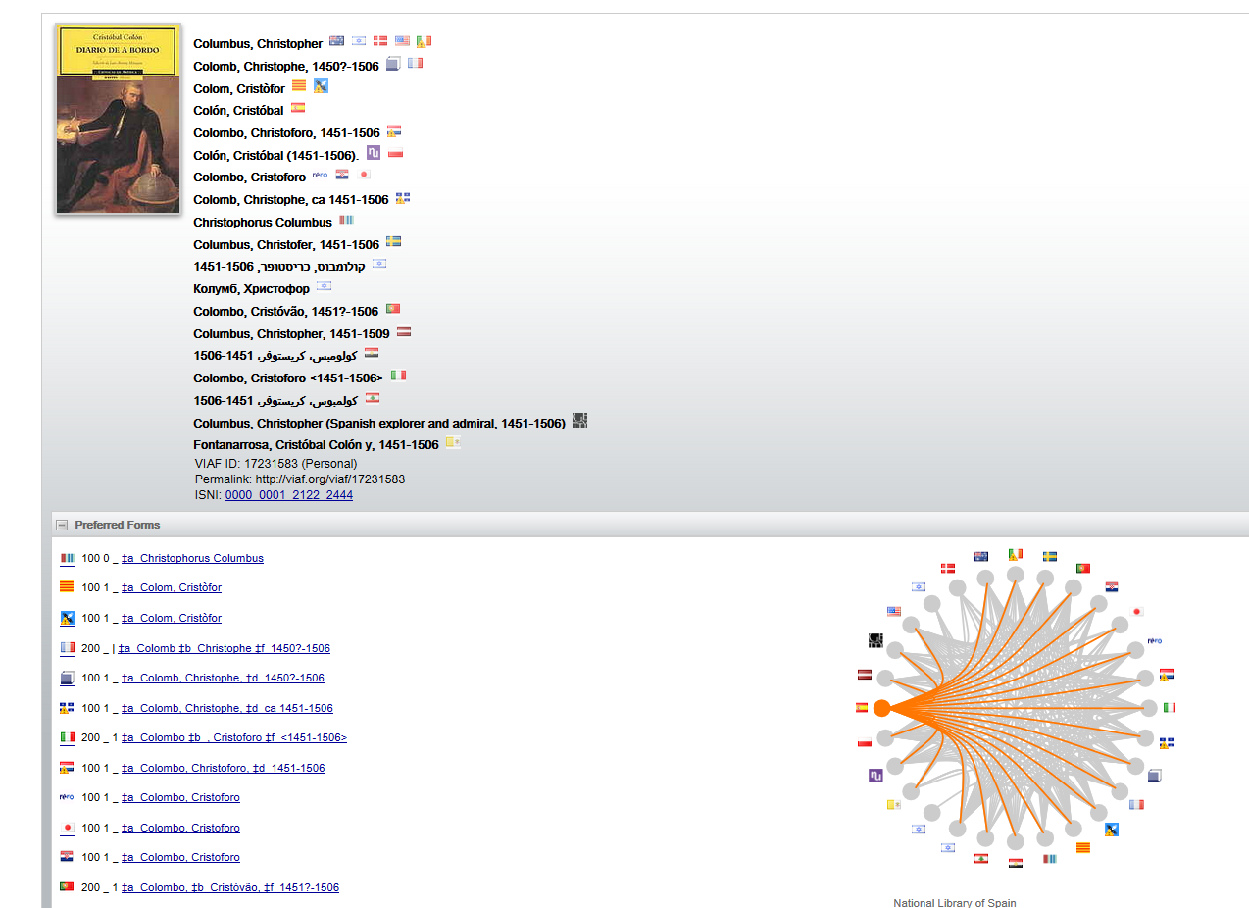
Colón, Cristóbal

Slide 13
Future?
Identify appropriate files and host agencies with names of entities associated with materials written in the following languages:
español (Spanish) {also known as castellano (Castilian)}
català (Catalan)
Euskara (Basque)
galego (Galician)
valencià (Valencian)

Slide 14
Thank you
Eric Childress
Consulting Project Manager
childree@oclc.org
@echildress
©2015 OCLC. This work is licensed under a Creative Commons Attribution 4.0 International License. Suggested attribution: This work uses content from Linked Data, RDA, BIBFRAME © OCLC, used under a Creative Commons Attribution 4.0 International License: http://creativecommons.org/licenses/by/4.0/.

