Slide 1
FAST Update
Eric Childress
Consulting Community Manager

Slide 2

FAST by the numbers
~93 Million WorldCat records have FAST headings
Personal Names | 10.6
Organization Names | 6.9
Events | 2.8
Titles of Works | 2.4
Chronological Headings | 10.8
Topical Headings | 159.1
Place Names | 49.2
Form/Genre | 49.0
Total (millions) | 290.8

Slide 3
Links in the FAST file
FAST contains links to the following data sets:
  Library of Congress Subject Headings (~303,000 links)
  VIAF & NACO (~1.2 million)
  Wikidata/Wikipedia (~237,000)
  GeoNames (~85,000)

Slide 4
FAST team activity
Continuing synchronization
Refining and simplifying processing rules and logic
Developing a prototype “import” tool (see next slides)
  In phases
  Initial release in 2017

Slide 5
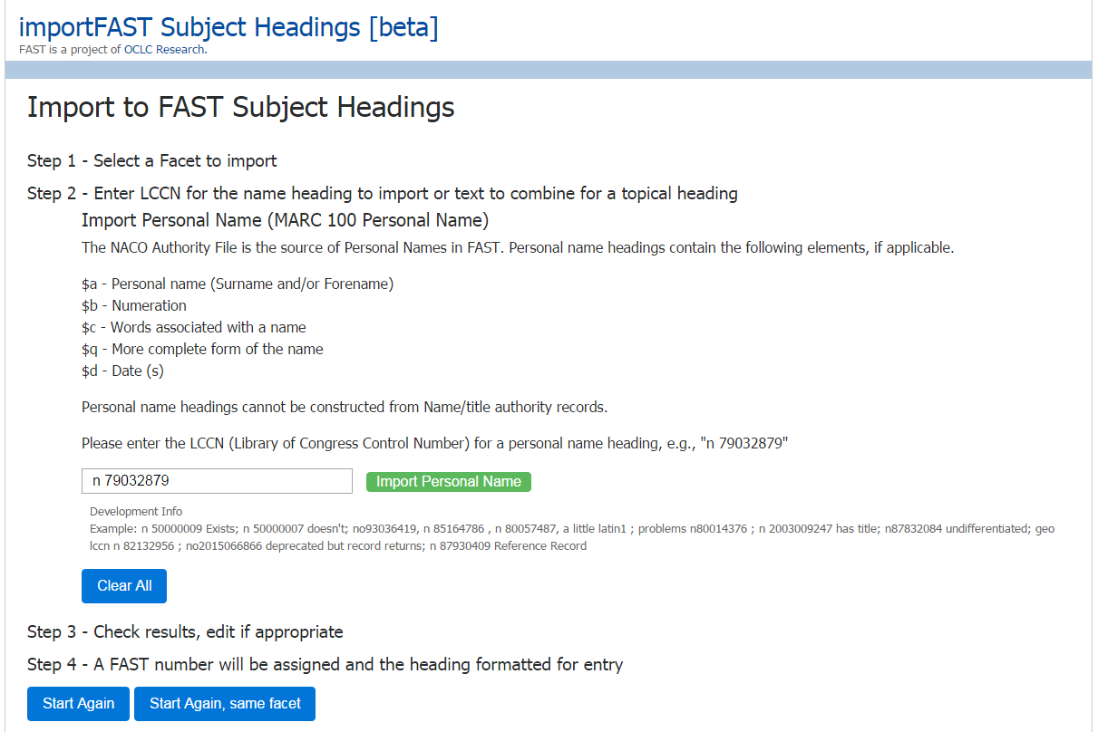

Slide 6
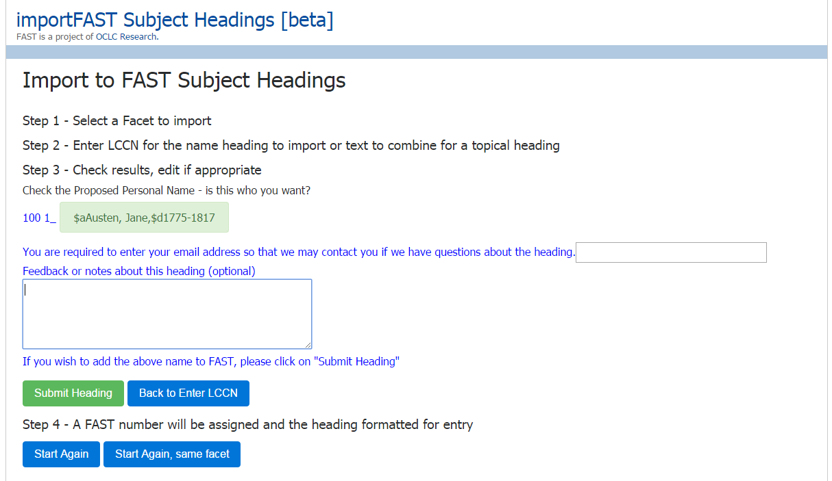

Slide 7
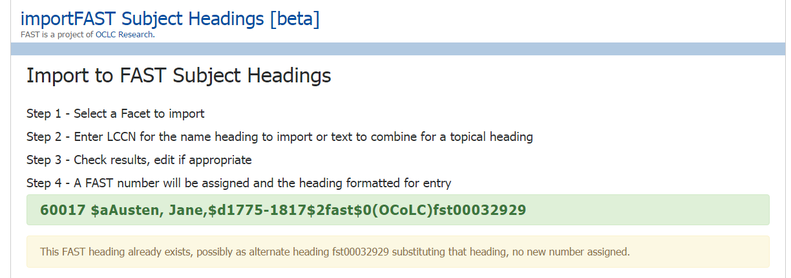

Slide 8
FACETVOC-L (Faceted Controlled Vocabularies discussion list)
Introduced August 2016
Hosted by OCLC Research,
Focused on faceted controlled vocabularies used in libraries, archives and museums.
To subscribe or unsubscribe to the list, go to http://listserv.oclclists.org/scripts/wa.exe?A0=FACETVOC-L

Slide 9
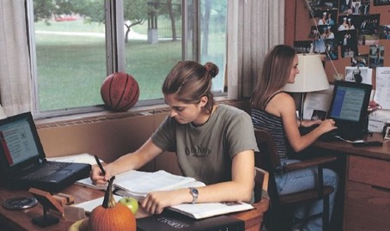
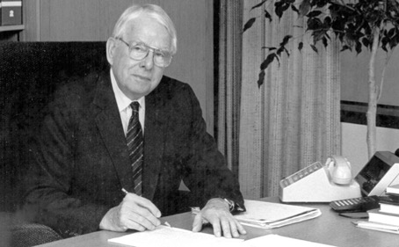
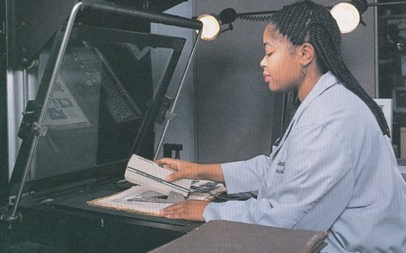

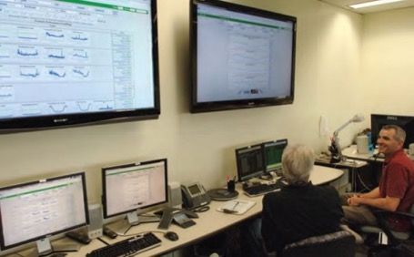
oc.lc/fifty
Notes:
On July 6, OCLC will turn fifty!
We would like to congratulate OCLC members around the world for 50 years of library collaboration, innovation and breakthroughs.
We’ll be celebrating in a variety of ways—both with staff and members, online and in-person.
Stop by booth #1824 during ALA Annual for interactive fun and giveaways in celebration of our 50th year
Visit oc.lc/fifty to see the incredible milestones we’ve achieved over the past 50 years in partnership with our amazing members
Celebrate with us on social media using the hashtag #OCLC50 as we continue our “50 years in 50 days” campaign on Facebook, Twitter and Instagram
For reference:
Photos (from top left, counter-clockwise): Students at Cornell University using the library catalog via computer (from the 1998/99 Annual Report); OCLC’s first President, Fred Kilgour; the Tuscarawas County Public Library (New Philadelphia, Ohio, USA) “Geek the Library” campaign; the OCLC Operations Center in 2010; Camera Technician working in OCLC’s Preservation Resources area (from 1994/95 Annual Report); a printed catalog card from 1996
[Notes updated: 05/17/17]

