Slide 1
1 November 2018
Findings from the euroCRIS/OCLC Research Survey of Research Information Management Practices
Rebecca Bryant, PhD, Senior Program Officer, OCLC Research
bryantr@oclc.org @RebeccaBryant18
https://orcid.org/0000-0002-2753-3881
Anna Clements, Assistant Library Director, University of St Andrews
akc@st-andrews.ac.uk @AnnaKClements
https://orcid.org/0000-0003-2895-1310
Jan Fransen, Service Lead for RIM Systems, University of Minnesota
fransen@umn.edu
https://orcid.org/0000-0002-0302-2761

Slide 2
Today’s talk
Introducing OCLC Research, euroCRIS and their collaboration
Discuss joint Survey of Research Information Management Practice: goals, scope, aims
Share and discuss survey results and findings

Slide 3
Devoted to challenges facing libraries and archives since 1978
Community resource for shared Research and Development (R&D)
Engagement with OCLC members and the community around shared concerns
Learn more
oc.lc/research
Hangingtogether.org blog

Slide 4
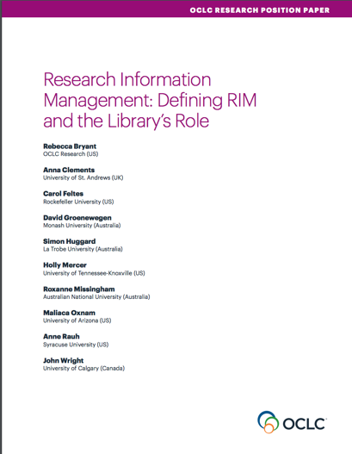
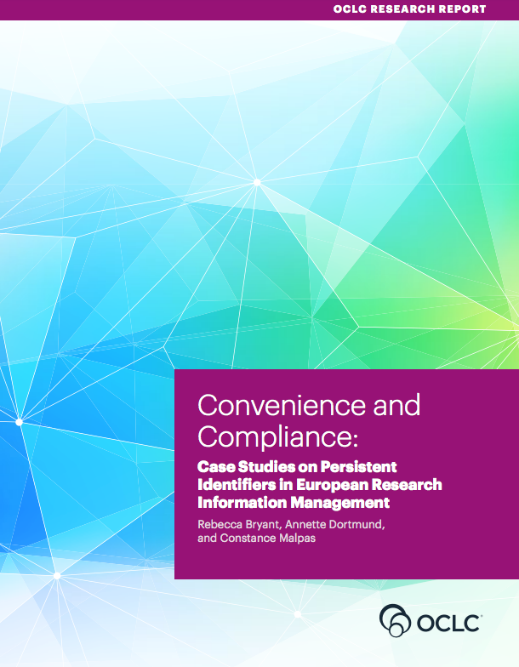
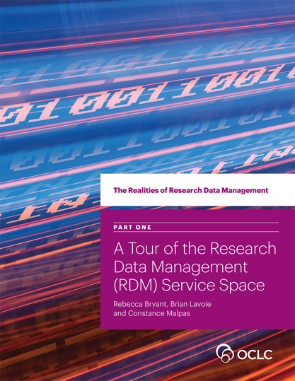
OCLC Research publications on Research Information Management
Survey of Research Information Management Practices
(report coming November 2018)
oc.lc/rim

Slide 5
An international not-for-profit association founded in 2002 to bring together experts on research information in general and research information systems (CRIS) in particular
45 Countries
>200 Members
15 Strategic Partners

Slide 6
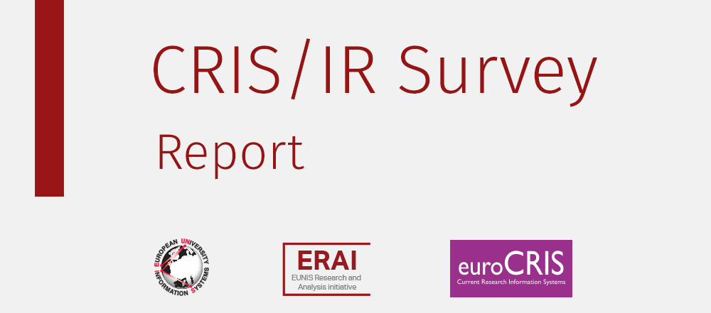
RIM Survey: building on previous work
Lígia Maria Ribeiro, lmr@fe.up.pt
Universidade do Porto – FEUP & EUNIS
Pablo de Castro, pablo.decastro@kb.nl
Stichting LIBER& euroCRIS
Michele Mennielli, m.mennielli@cineca.it
CINECA & EUNIS & euroCRIS
http://www.eunis.org/blog/2016/03/01/crisir-survey-report/
http://www.eunis.org/wp-content/uploads/2016/03/cris-report-ED.pdf

Slide 7
Survey of Research Information Management Practices
Joint project between
Report to be published in November 2018
Rebecca Bryant, PI, OCLC Research
Pablo de Castro, Strathclyde University and euroCRIS
Anna Clements, University of St. Andrews and euroCRIS
Annette Dortmund, OCLC EMEA
Jan Fransen, University of Minnesota, Twin Cities
Muhammed Javed, Cornell University Constance Malpas, OCLC Research
Michele Mennielli, DuraSpace and euroCRIS
Maliaca Oxnam, University of Arizona
Rachael Samberg, University of California-Berkeley
Julie Speer, Virginia Tech
Plus a number of valuable collaborators at OCLC
oc.lc/rim

Slide 8
Results we’ll be talking about
Incentives for RIM Adoption
Functions/Uses of RIM
Interoperability
RIM Stakeholders
Use of Persistent Identifiers

Slide 9
Methodology & promotion
Online survey data collection: Oct 2017 – Jan 2018
English and Spanish versions
Survey promotion through:
OCLC and euroCRIS communications channels and events worldwide
Communications by CRIS vendors and user communities
Listservs, social media, and announcements to research & library organizations

Slide 10
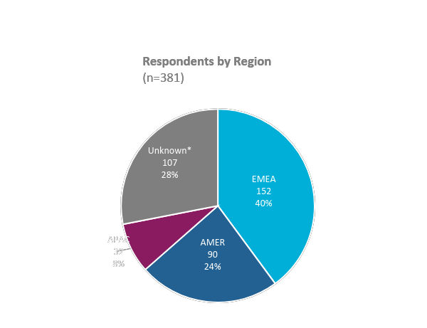
RIM Survey responses: geographic overview 381 survey respondents from 44 countries
Country | # Resp. | Country | # Resp.
United Kingdom | 39 (10%) | Canada | 4 (1%)
United States | 39 (10%) | South Africa | 4 (1%)
Peru | 39 (10%) | Andorra | 3 (1%)
Italy | 28 (7%) | Colombia | 3 (1%)
Australia | 24 (6%) | Finland | 3 (1%)
Germany | 14 (4%) | India | 3 (1%)
Netherlands | 10 (3%) | Japan | 3 (1%)
Portugal | 7 (2%) | Austria | 2 (0.5%)
Poland | 6 (2%) | Bahrain | 2 (0.5%)
Spain | 6 (2%) | China | 2 (0.5%)
Belgium | 5 (2%) | Denmark | 2 (0.5%)
Ireland | 5 (2%) | New Zealand | 2 (0.5%)
1 respondent from each of the following countries: Afghanistan, Albania, Azerbaijan, Barbados, Belize, Brazil, Hungary, Lebanon, Mexico, Namibia, Russia, Saudi Arabia, Slovakia, Sri Lanka, Sweden, Trinidad and Tobago, Turkey, Uganda, United Arab Emirates and Uruguay
by OCLC Research CC BY 4.0
Research Information Management (RIM) Systems: International Survey of Libraries, preliminary results (2018)

Slide 11
Research Information Management Systems Well over half (58%) have a live RIM System
*Note: 29 respondents did not provide their RIM system
by OCLC Research CC BY 4.0
Research Information Management (RIM) Systems: International Survey of Libraries, preliminary results (2018)

Slide 12
by OCLC Research CC BY 4.0
Research Information Management (RIM) Systems: International Survey of Libraries, preliminary results (2018)

Slide 13
by OCLC Research CC BY 4.0
Research Information Management (RIM) Systems: International Survey of Libraries, preliminary results (2018)

Slide 14
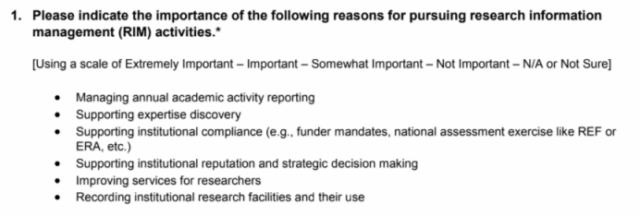
INCENTIVES FOR RIM ADOPTION

Slide 15
Reporting and compliance drive RIM adoption
by OCLC Research CC BY 4.0
Research Information Management (RIM) Systems: International Survey of Libraries, preliminary results (2018)

Slide 16
by OCLC Research CC BY 4.0
Research Information Management (RIM) Systems: International Survey of Libraries, preliminary results (2018)

Slide 17
by OCLC Research CC BY 4.0
Research Information Management (RIM) Systems: International Survey of Libraries, preliminary results (2018)

Slide 18
Summary: Incentives for Adoption
US is an outlier
No national compliance requirements
Early emphasis on Research Networking Systems (e.g., Harvard Profiles)
Action for the next survey
Different platforms emphasize different capabilities, so…
Increase promotion to Profiles RNS and VIVO communities
Research Question for the next survey
Will incentives for new adopters of RIM shift away from compliance and toward expertise discovery?
Most institutions with reporting mandates will have already implemented RIM

Slide 19
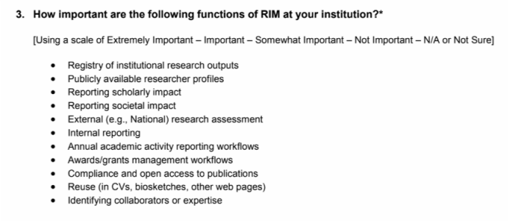
RIM functions

Slide 20
by OCLC Research CC BY 4.0
Research Information Management (RIM) Systems: International Survey of Libraries, preliminary results (2018)

Slide 21
by OCLC Research CC BY 4.0
Research Information Management (RIM) Systems: International Survey of Libraries, preliminary results (2018)

Slide 22
by OCLC Research CC BY 4.0
Research Information Management (RIM) Systems: International Survey of Libraries, preliminary results (2018)

Slide 23
by OCLC Research CC BY 4.0
Research Information Management (RIM) Systems: International Survey of Libraries, preliminary results (2018)

Slide 24
Summary: RIM uses
For most, RIM is valuable as a registry of the institution’s research outputs
RIM has multiple uses at most institutions
External & internal assessment are among the most important (and unsurprising)
Managing OA compliance is also important
Supporting the discovery of potential research collaborators is less important
As expected, some of these differences appear to vary by region

Slide 25
Interoperability

Slide 26
RIM systems interoperate with multiple internal and external systems
National publication database (n=20)
Institution's website (n=6)
Faculty activity system (n=5)
by OCLC Research CC BY 4.0
Research Information Management (RIM) Systems: International Survey of Libraries, preliminary results (2018)

Slide 27
Publication Metadata Sources that Populate
your RIM system (n=185)
Base: Institutions with a live RIM system
Note: Respondents could select more than one answer
EBSCOhost (n=4)
Mendeley (n=4)
Espacenet (n=3)
by OCLC Research CC BY 4.0
Research Information Management (RIM) Systems: International Survey of Libraries, preliminary results (2018)

Slide 28
Use of RIM Systems to support repository functions
by OCLC Research CC BY 4.0
Research Information Management (RIM) Systems: International Survey of Libraries, preliminary results (2018)

Slide 29
by OCLC Research CC BY 4.0
Research Information Management (RIM) Systems: International Survey of Libraries, preliminary results (2018)

Slide 30
by OCLC Research CC BY 4.0
Research Information Management (RIM) Systems: International Survey of Libraries, preliminary results (2018)

Slide 31
by OCLC Research CC BY 4.0
Research Information Management (RIM) Systems: International Survey of Libraries, preliminary results (2018)

Slide 32
by OCLC Research CC BY 4.0
Research Information Management (RIM) Systems: International Survey of Libraries, preliminary results (2018)

Slide 33
Some summary findings
Fairly high degree of RIM system interoperability with other institutional systems – including IRs
Significant workflows for funding information exchange both internally and externally
Institutions leverage publications metadata harvesting
OAI-PMH & CERIF-XML important standards

Slide 34
Stakeholders

Slide 35
by OCLC Research CC BY 4.0
Research Information Management (RIM) Systems: International Survey of Libraries, preliminary results (2018)

Slide 36
Stakeholders with Primary Responsibility for RIM Activities by Country
Based on # of Mentions (Decreasing Importance of Library)
Base: Institution with a Live RIM system
by OCLC Research CC BY 4.0
Research Information Management (RIM) Systems: International Survey of Libraries, preliminary results (2018)

Slide 37
Persistent identifiers

Slide 38
Researcher Identifiers Used in Your RIM system (n=182)
Base: Institutions with a live RIM system
Note: Respondents could select more than one answer
Google Scholar ID (n=4)
SSRN (n=3)
Codice fiscale (Italy) (n=19)
by OCLC Research CC BY 4.0
Research Information Management (RIM) Systems: International Survey of Libraries, preliminary results (2018)

Slide 39
Organization Identifiers Used in Your RIM system (n=162)
Base: Institutions with a live RIM system
Note: Respondents could select more than one answer
by OCLC Research CC BY 4.0
Research Information Management (RIM) Systems: International Survey of Libraries, preliminary results (2018)

Slide 40
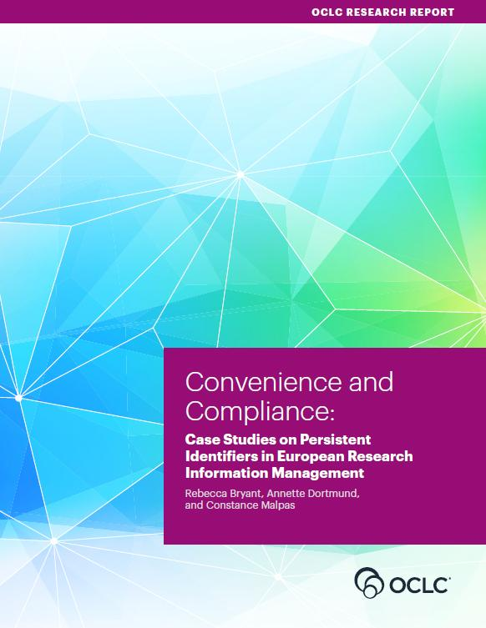
Some summary findings
Congruent with our qualitative Convenience and Compliance findings
Strong adoption of person identifiers
ORCID becoming a de facto standard in scholarly literature, but other identifiers also needed and used
Organizational identifiers largely unused
oc.lc/rim

Slide 41
Discussion
Survey results and data to be published as an OCLC Research Report in November 2018
More information at oc.lc/rim
Rebecca Bryant, PhD, Senior Program Officer, OCLC Research
bryantr@oclc.org @RebeccaBryant18
https://orcid.org/0000-0002-2753-3881
Anna Clements, Assistant Library Director, University of St Andrews; euroCRIS
akc@st-andrews.ac.uk @AnnaKClements
https://orcid.org/0000-0003-2895-1310
Jan Fransen, Service Lead for RIM Systems, University of Minnesota
fransen@umn.edu
https://orcid.org/0000-0002-0302-2761
oc.lc/rim

Slide 42
References
Bryant, Rebecca, Anna Clements, Carol Feltes, David Groenewegen, Simon Huggard, Holly Mercer, Roxanne Missingham, Maliaca Oxnam, Anne Rauh and John Wright. 2017. Research Information Management: Defining RIM and the Library’s Role. Dublin, OH: OCLC Research. doi:10.25333/C3NK88
Bryant, Rebecca, Annette Dortmund, and Constance Malpas. 2017. Convenience and Compliance: Case Studies on Persistent Identifiers in European Research Information. Dublin, Ohio: OCLC Research. doi:10.25333/C32K7M
euroCRIS & OCLC Research. International Survey on Research Information Management Practices. Publication of results as an OCLC Research report expected in 2018
Ribeiro, Lígia, Pablo De Castro, and Michele Mennielli. “EUNIS-EuroCRIS Joint Survey on CRIS and IR,” 2016. http://www.eurocris.org/news/cris-ir-survey-report.

