Slide 1
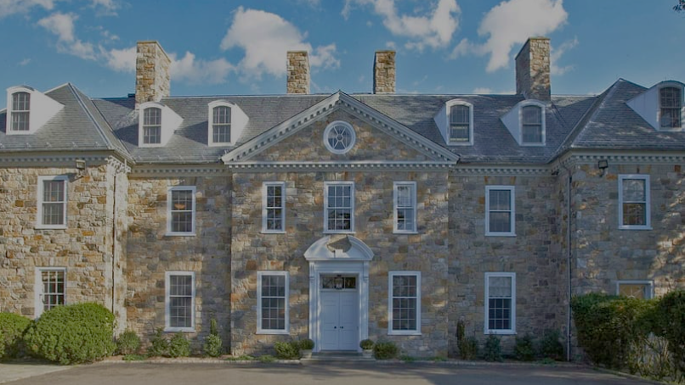
Developing and maintaining culturally conscious descriptive practices at the Rockefeller Archive Center
Amy Berish, Katie Martin, Darren Young Processing Archivists, RAC

Slide 2
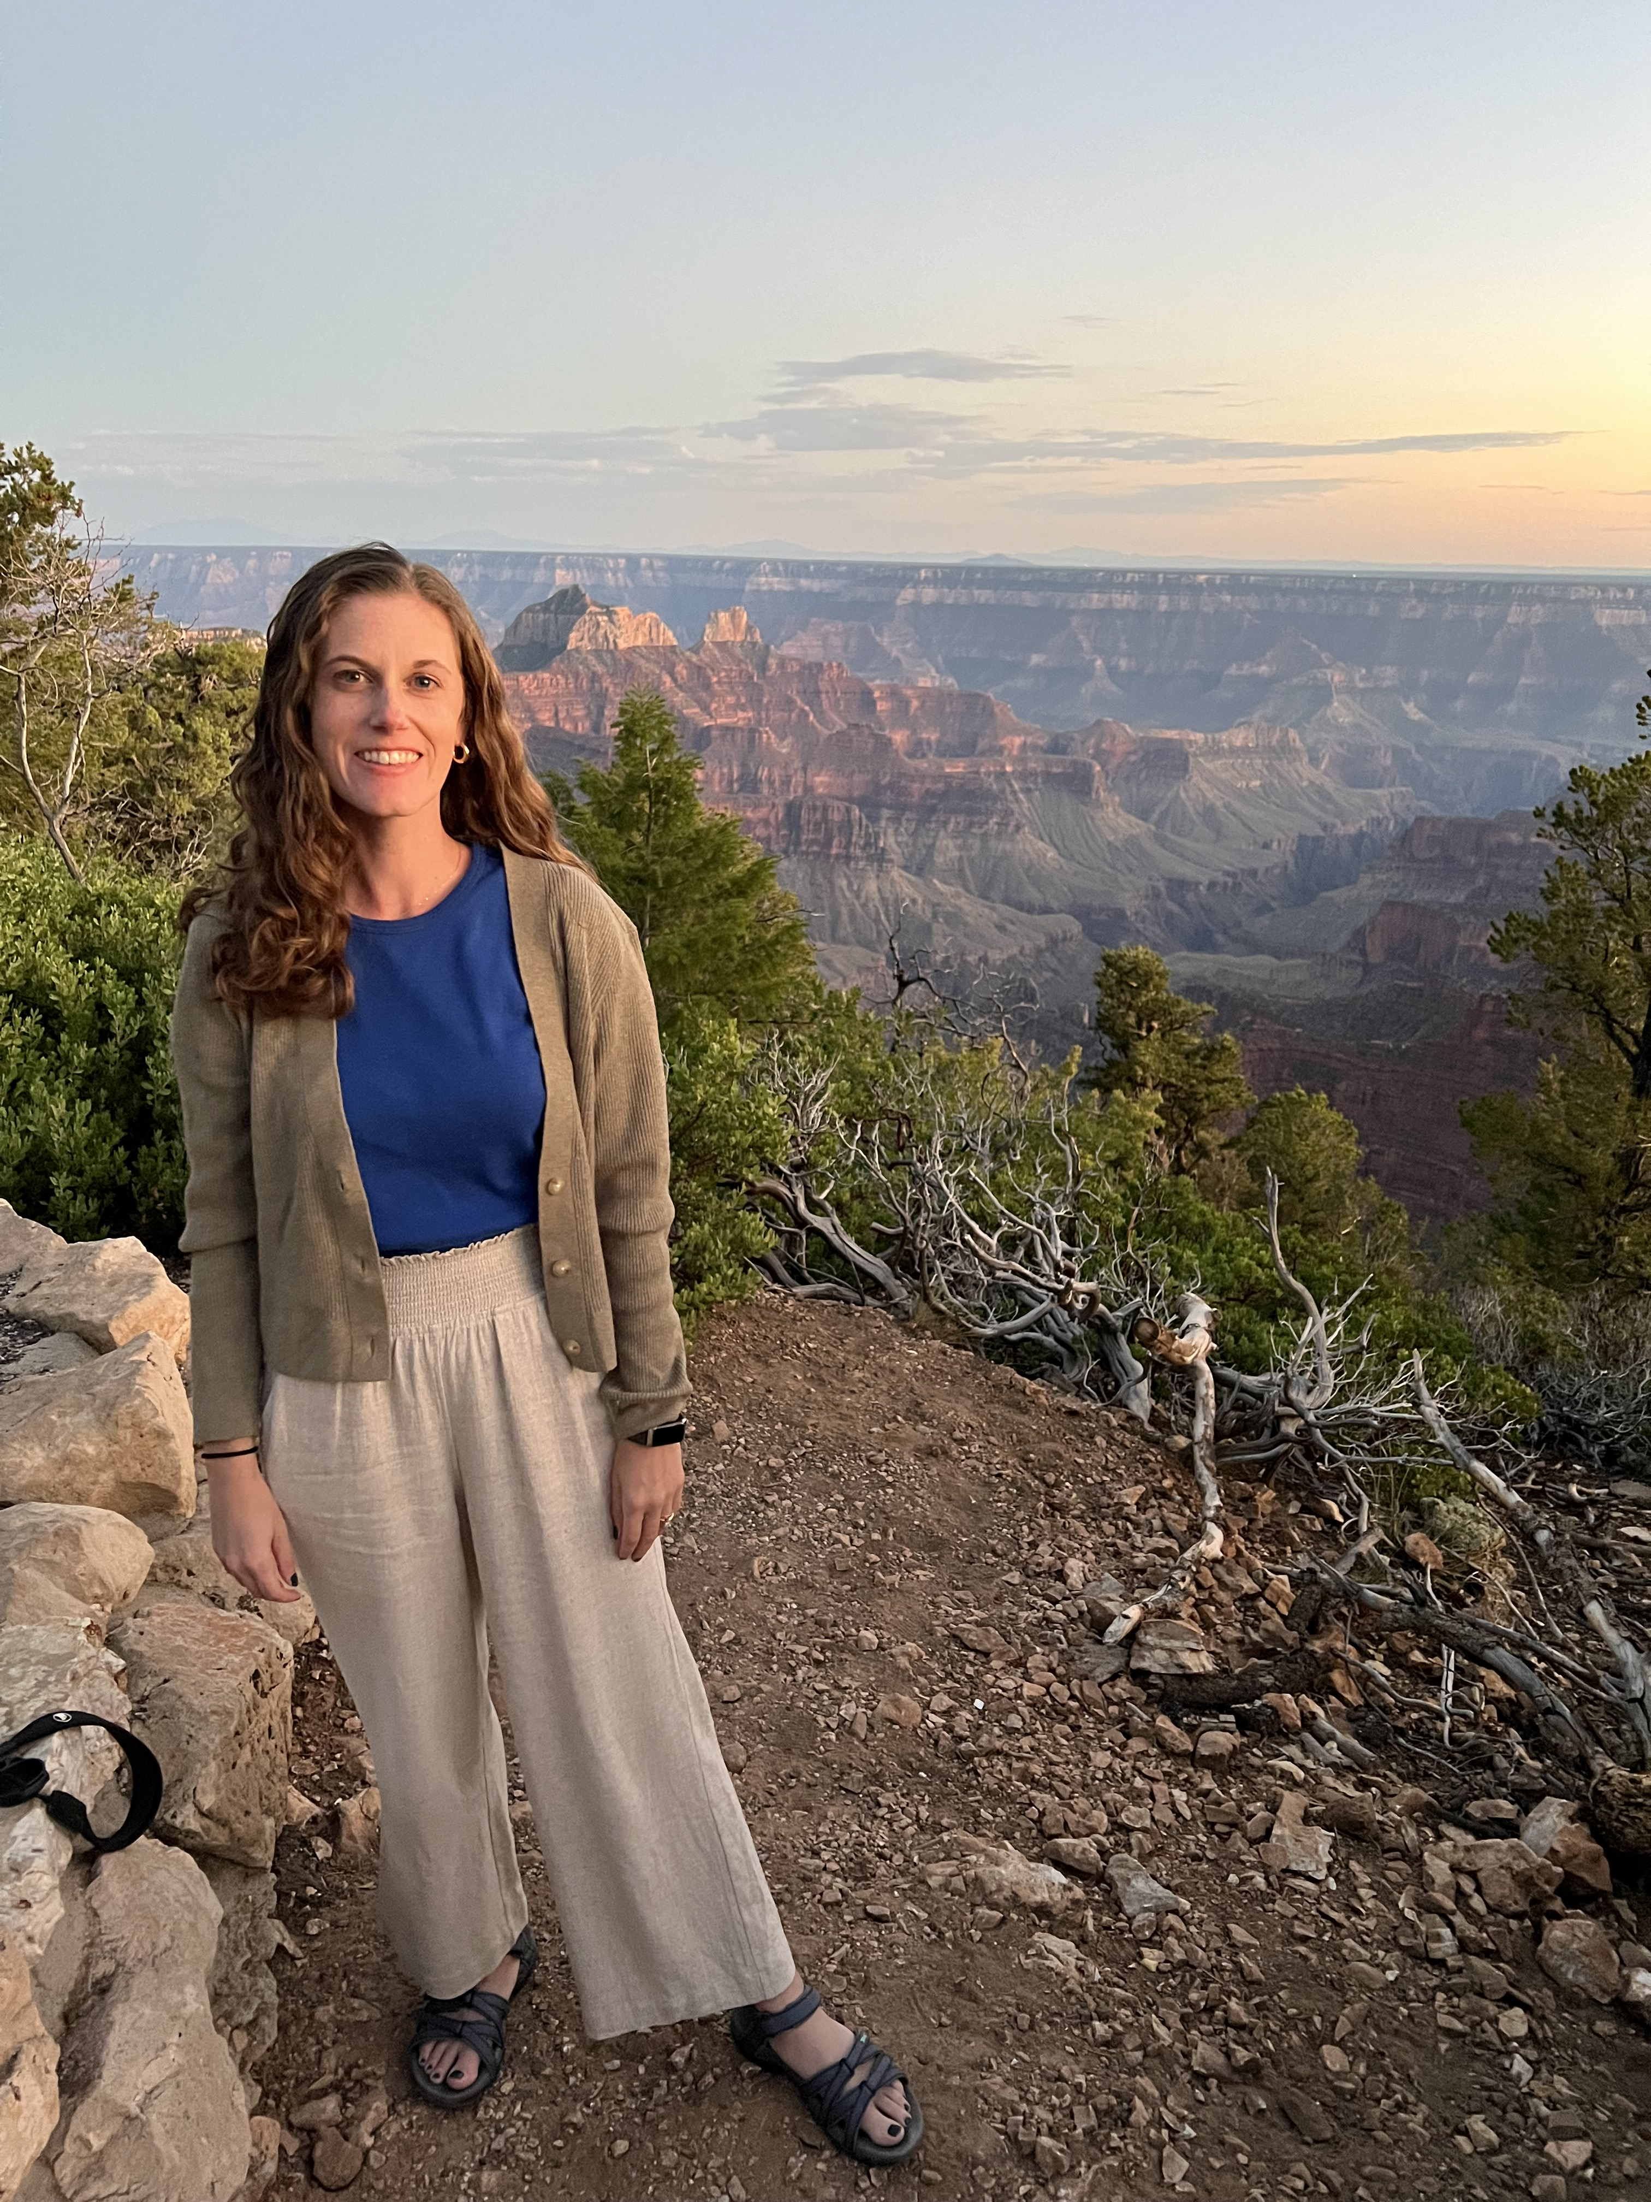
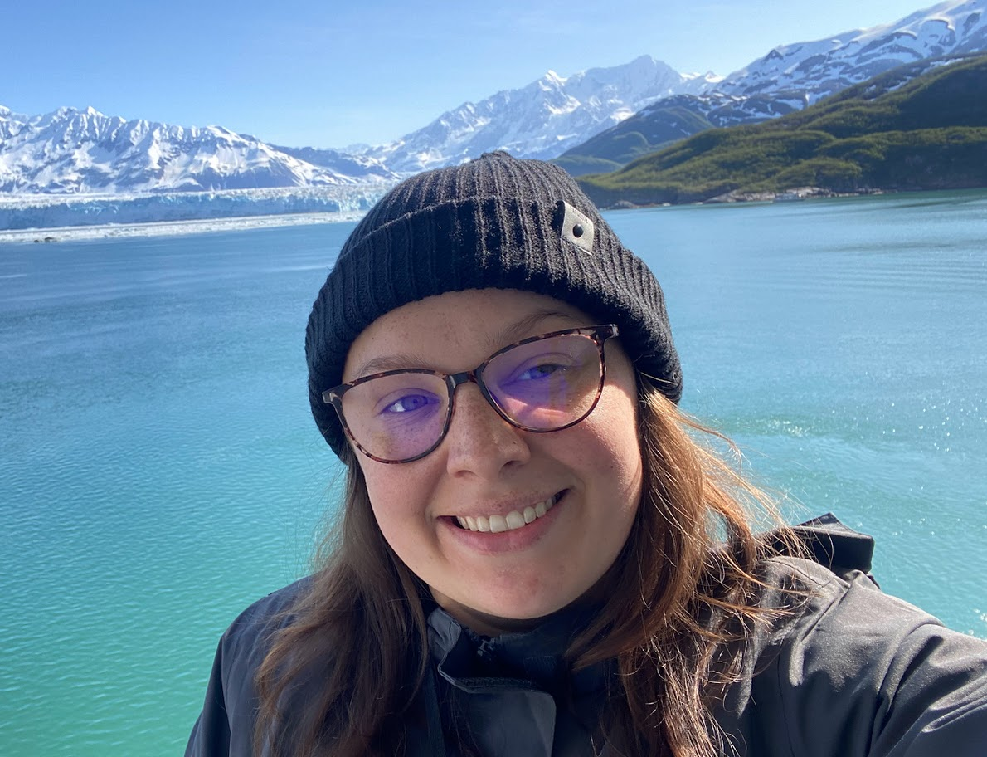
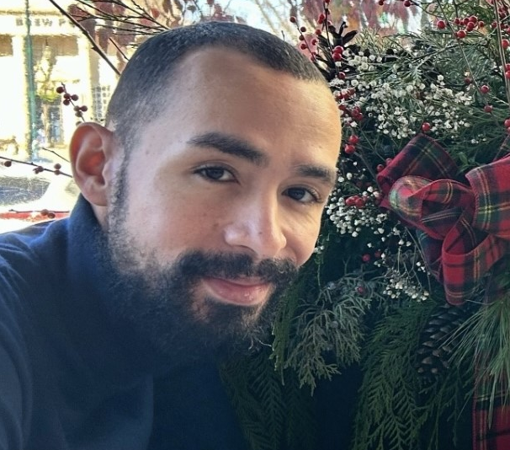
Introductions
Introductions
Amy Berish
Katie Martin
Darren Young

Slide 3
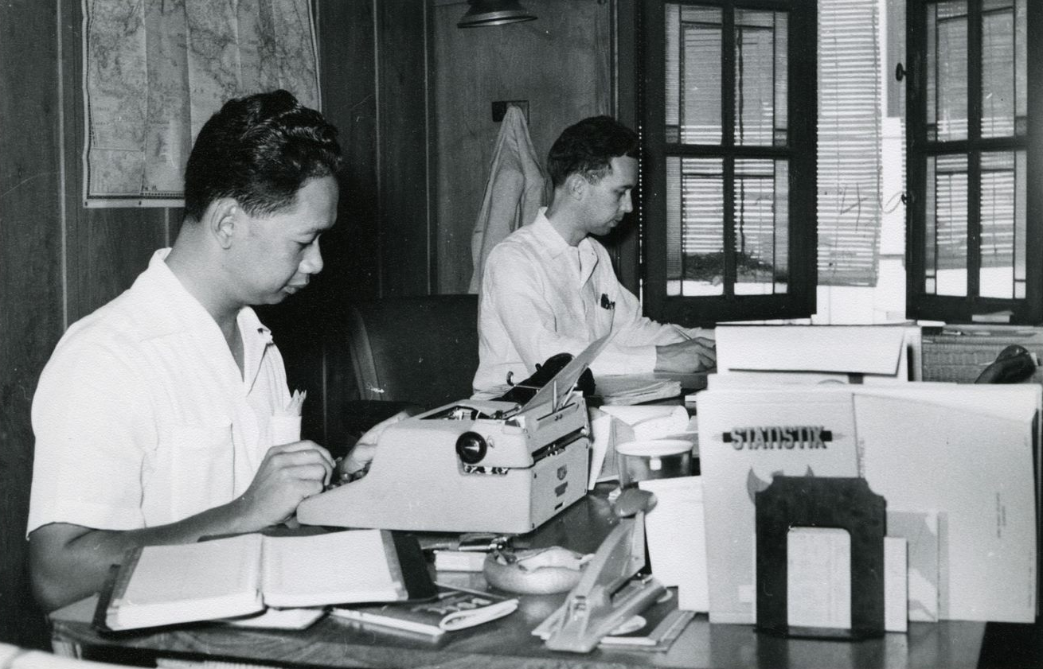
Themes
Institutional Context
Creating an environment for Culturally Competent (Re)Description (CCD) work
Sustainability of CCD
Integrating CCD into core work
Collaborative projects and sharing CCD responsibility with others
Ford Foundation records, RAC

Slide 4
About the Rockefeller Archive Center
The RAC’s collections contain the records of a wide range of institutions dedicated to the public good, as well as the papers of individuals associated with these institutions
Four archival teams: Collections Management, Processing, Access, and Digital Strategies
In addition to the Archives Program, RAC has a Research & Engagement Program and Operations and Finance Programs

Slide 5
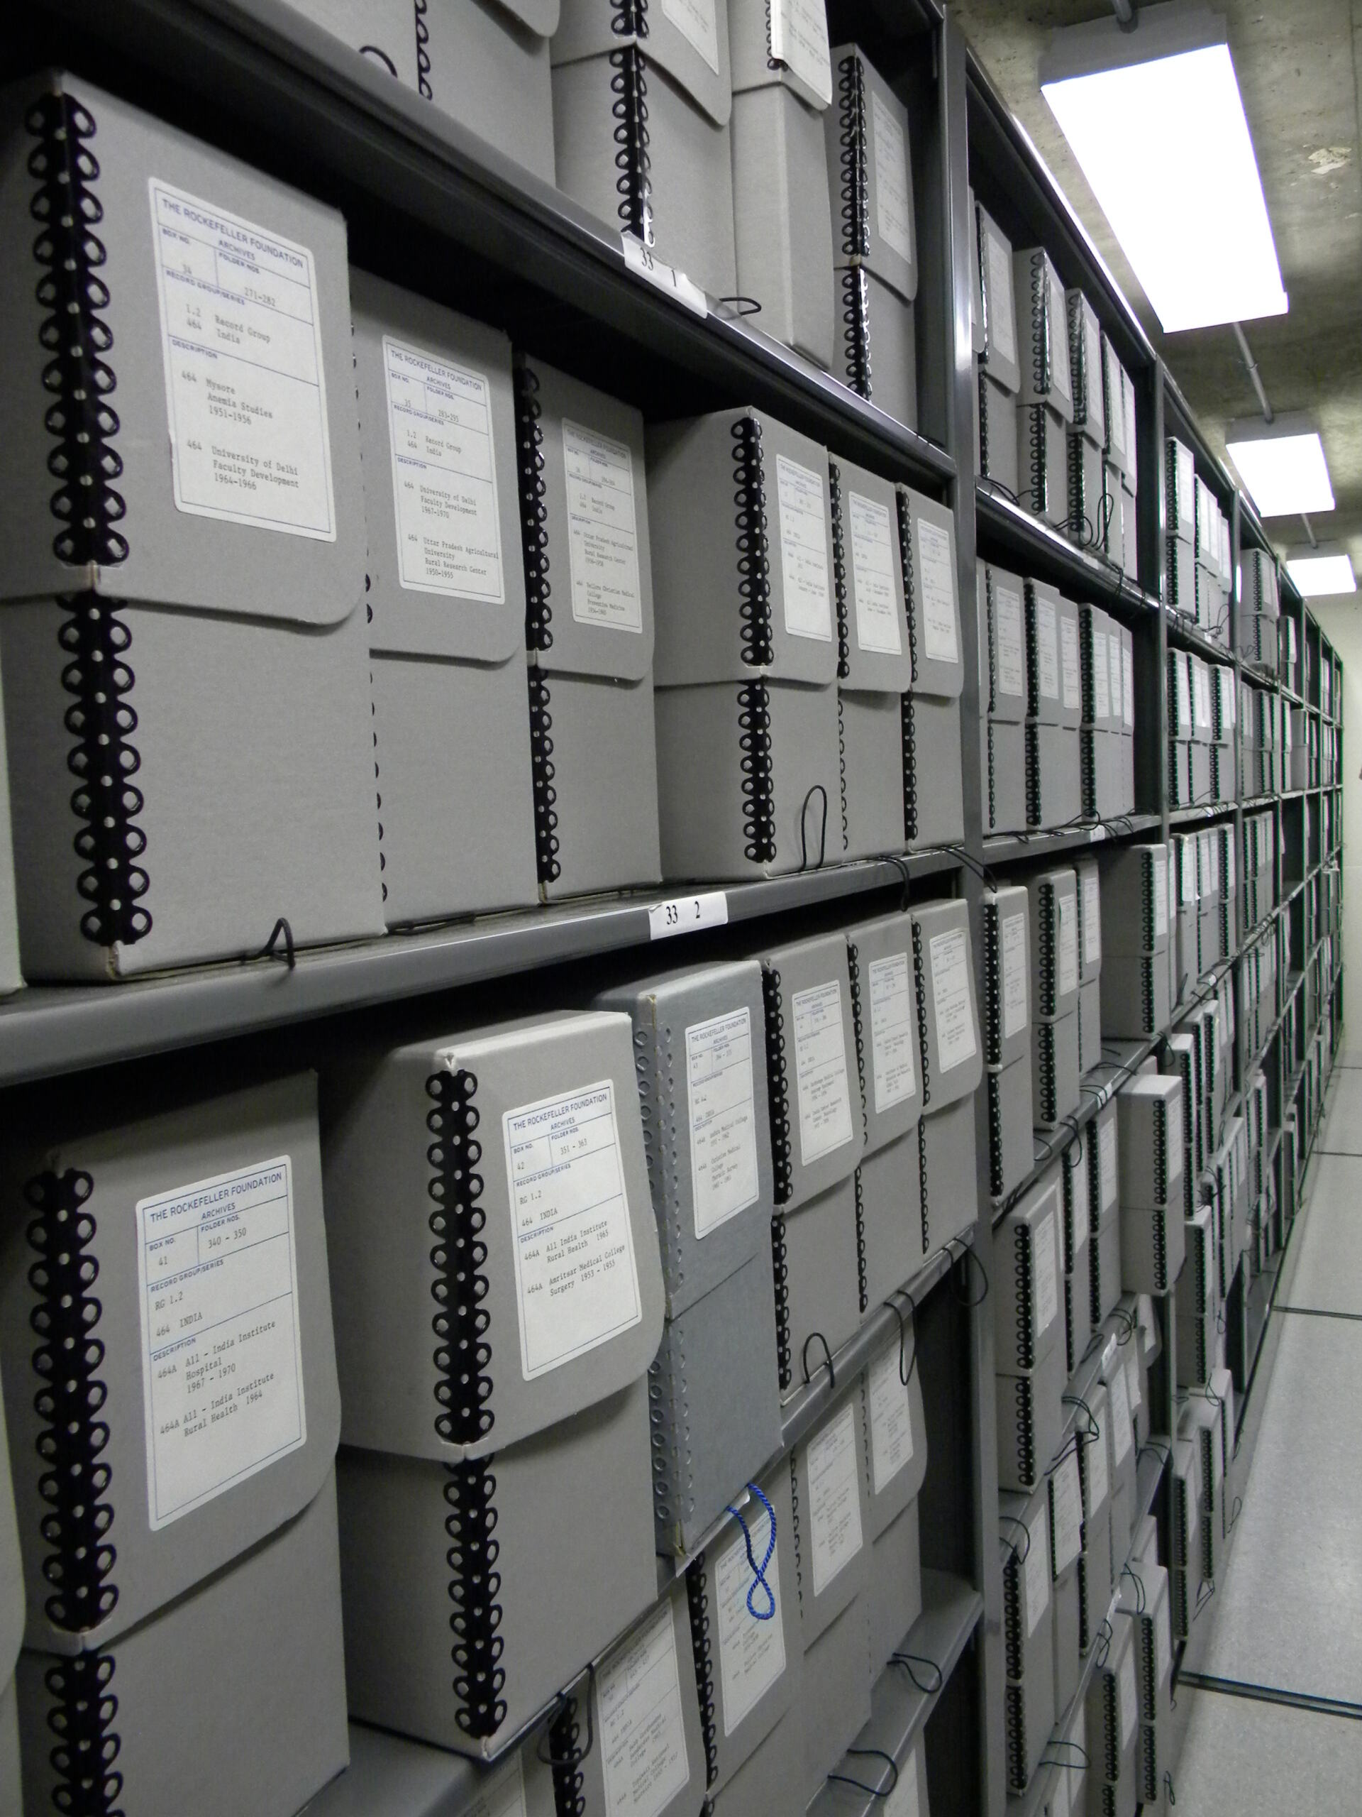
RAC Processing Team
All team members have access to create and edit description in ArchivesSpace
Archival description is iterative
Processing Manual:
Already had projects to edit existing description
Removing outdated and non-standard notes

Slide 6
Organizational Push for Cultural Competency (CCD)
RAC Statement in Solidarity
Call for projects
CCD Education Campaign
Staff DEI Committee

Slide 7
Organizational Push for Cultural Competency (Big Picture)
Staff DEI Committee
DEI consultants
Mission, Vision, and Values
Staff DEI Training

Slide 8
RAC Mission, Vision, and Values
Mission
… the Rockefeller Archive Center inspires critical analysis and contributes knowledge to diverse learning communities throughout the world.
Vision
… the Rockefeller Archive Center aspires to:
Embed the principles of equity, inclusion, diversity, and belonging in the framework of everything we do.
Values
We are Dedicated to Diversity, Equity, Accessibility, and Inclusion
We foster cultural competence among our staff and apply those standards to our collecting, archival description, access, and engagement activities.

Slide 9
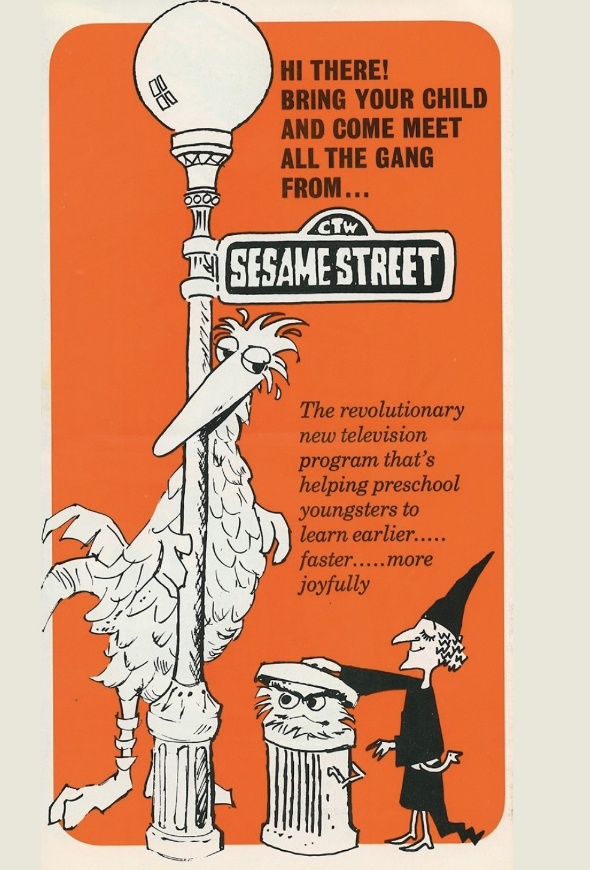
Education Campaign
Establish a baseline understanding for all staff members regarding cultural competency broadly and specifically in relationship to archives
Develop a shared language and not assume concepts are understood universally
Set ground rules to help staff feel comfortable discussing topics
Emphasize we are all learning
Employ tiered approach to work from a "big picture" understanding of cultural competency to specific application of CCD to RAC description
Phase 1: Self-Guided Remote Learning
Phase 2: Reading Group
Ford Foundation records, RAC

Slide 10
Reading Group
Session 1
Facilitator: Research & Engagement and Digital Strategies
Focus: Production of history and archival methodology
Session 2
Facilitator: Access
Focus: Inclusive archival description
Session 3
Facilitator: Collections Management and Selznick School Fellow
Focus: Specific RAC archival description
One Tenth of Our Nation, 1940, RAC YouTube thumbnail

Slide 11
Processing Manual
CCD Is Processing

Slide 12
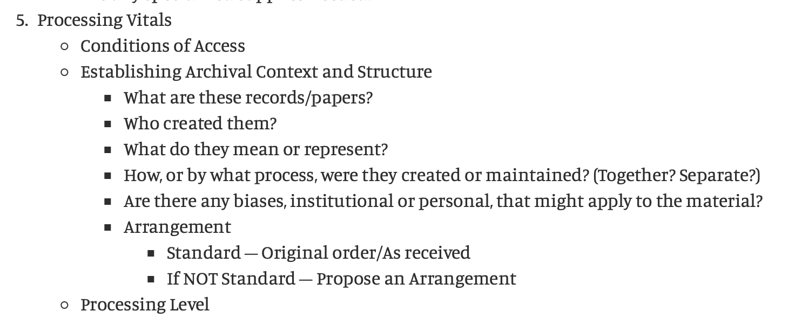
CCD in Processing Planning
Project Vitals – A simplified processing plan, focusing on the critical data necessary to visualize, plan, and execute work

Slide 13
CCD Instructions
Pre-Description Guiding Statements and Questions
Language, Naming Choices, and Power Dynamics
Redescription

Slide 14
CCD Throughout Processing
CCD integrated in:
Fundamentals of description
Arrangement
Titles
Describing AV materials
Subjects

Slide 15
Archival Description Concern Form

Slide 16
Archival Description Concern Form: Report an issue
Staff SharePoint
Processing Manual
"When staff members encounter instances of problematic archival description and/or see opportunities for reparative description within the RAC’s collections and are unsure of how to act, they should use the Archival Description Concern Request form to identify the issue and notify Processing Archivists who can help address the problem."
Reading Room Handbook
"When desk monitors or researchers encounter instances of problematic archival description and/or see opportunities for reparative description within the RAC’s collections, desk monitors should use the Archival Description Concern Request form to identify the issue and notify Processing Archivists who can help address the problem."

Slide 17
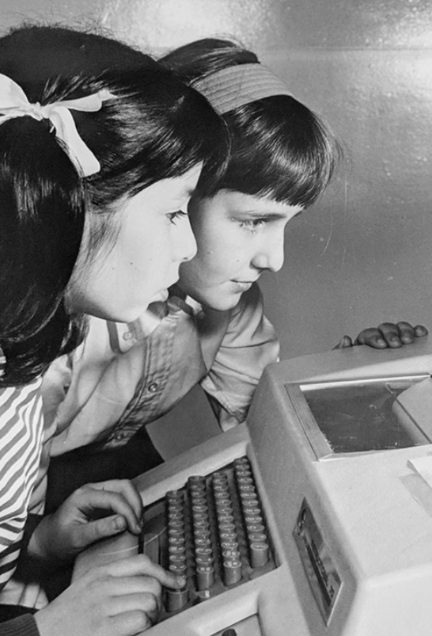
Archival Description Concern Form: Information gathered
Identify the object impacted
Title
DIMES/ArchivesSpace URL
Describe the concern
Summary
Choose type of issue
Describe the scope of the concern
Where is the issue in the object
Is there more than one instance of the issue
Computer-Assisted Instruction, 1968, Ford Foundation records, RAC

Slide 18
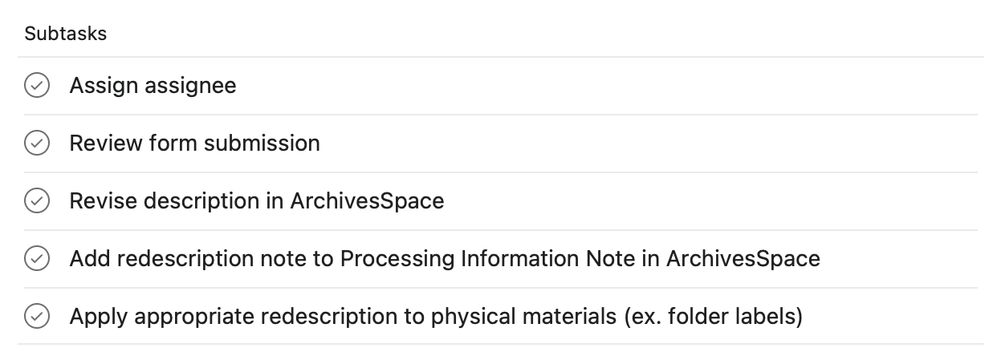
Archival Description Concern Form: Submission response

Slide 19
Working towards sustainability
Considering the types of labor involved in this work:
Time
Mental and emotional effort
Critical lens for legacy description, including your own
Sustainability:
"Forever" projects: processing manual, description concern form
Collaborations & "one-off" projects

Slide 20
RAC CCD-Related Projects
All Staff
Education Campaign
Onboarding CCD discussion with new staff
Processing
Integrate CCD as part of processing manual, annual project planning, and processing plans (project vitals)
Archival Description Concern form
Collections Management
Audiovisual contextual notes
Research & Engagement
Reading Group
Rockefeller Foundation biography project: update bios, remove peacock language
Subject records review and implementation
Intern Collaboration

Slide 21
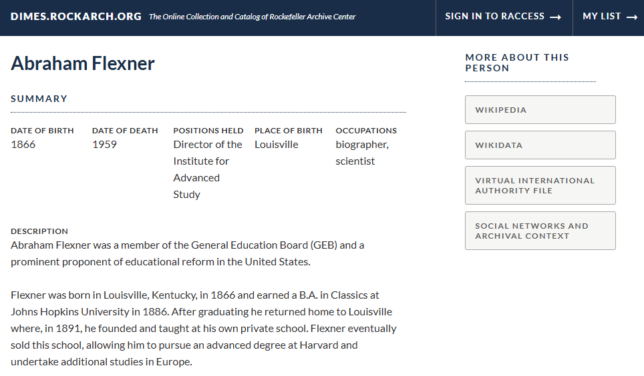
Rockefeller Foundation Biographies
Partnership with Research & Engagement team
Apply CCD to an ongoing migration project to move biographies out of a Rockefeller Foundation Centennial site and into ArchiveSpace/DIMES
Removed peacock language and assessed existing biographical notes used within collections
"iconic," "visionary," most renowned," "leading," "distinguished"

Slide 22
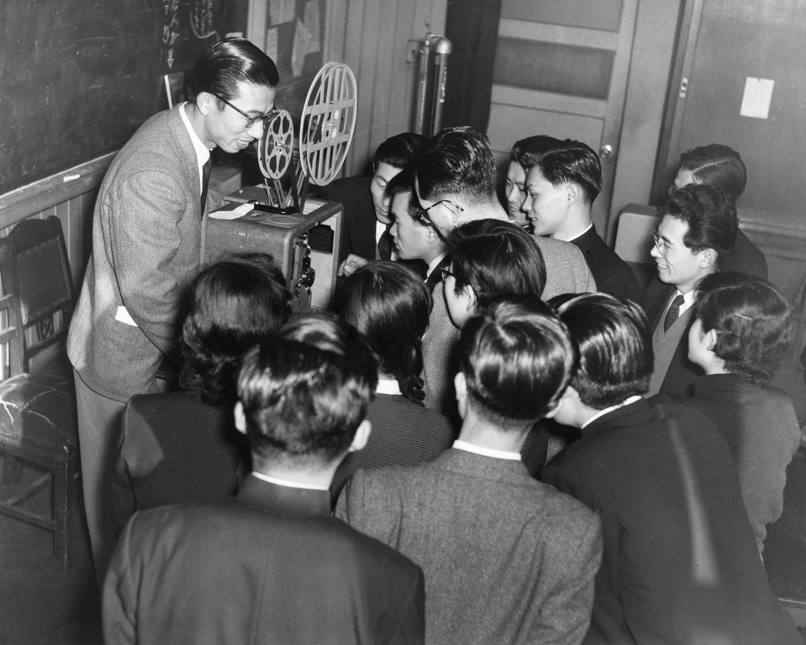
AV Contextual Notes
Based off the work of Selznick Fellow, Christian Balistreri
Reviewed examples of content warnings and contextual statements from Disney+, Drexel University, Mid-Atlantic Regional Moving Image Archive (MARMIA), Tufts Digital Library
In collaboration with Processing, created a broad generalized statement to apply at collection/series level for collections containing applicable AV material.
Keio University Library School, RAC
The Rockefeller Archive Center recognizes that our audiovisual materials may contain problematic language and/or content.
The films, videos, and/or sound in this collection have not been altered in any way. All titles and/or content are illustrative of the creator’s original vision. As such, this audiovisual collection may contain discriminatory visual and/or aural content that is representative of racial, gendered, or ableist biases.
Accompanying description, most often with creator or donor-generated language and terminology, has to this point been retained and maintained “as received” by RAC with minimal archivist intervention or augmentation.
We acknowledge these problems and aim to cultivate inclusive representation and equity by reconsidering and enhancing our description of this audiovisual material with current sensibilities.

Slide 23
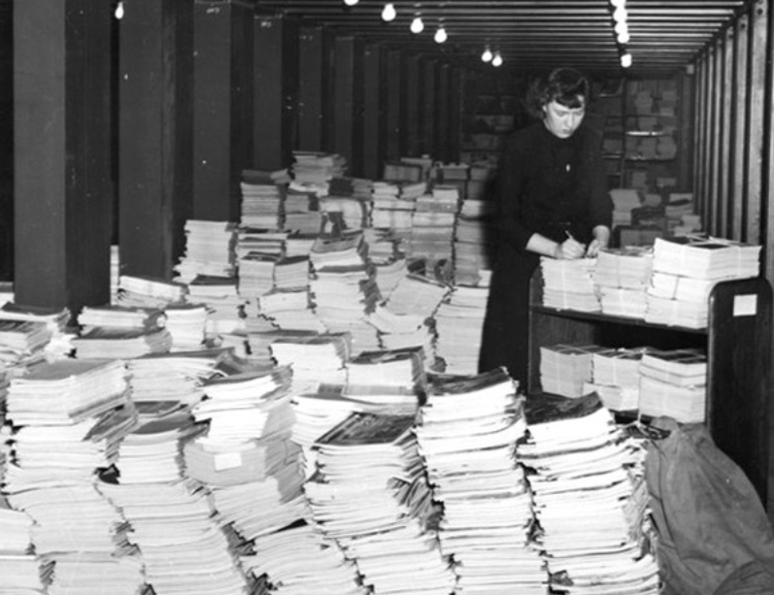
Subject Term Review
Worked with two City College of New York (CCNY) summer interns
Interns reviewed list of potentially problematic subjects we provided with helpful resources
Revised 54 subject terms
Rockefeller Foundation records, RAC

Slide 24
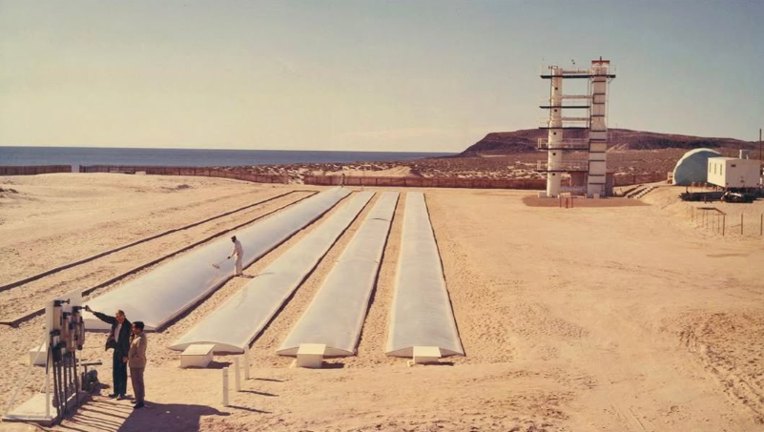
Sustaining CCD
Levelling up our collective/institutional understanding of CCD
Keeping staff involved in the process
Shared responsibility of CCD
Collaborating with teams outside of processing
Creating mini projects when we have low bandwidth
Rockefeller Foundation records, RAC

Slide 25
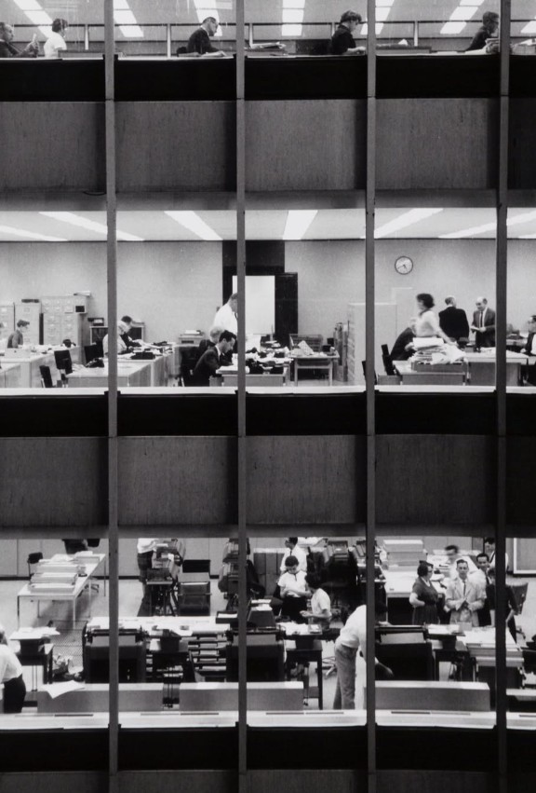
A question for you...
Do other institutions treat reparative description as a staff-wide effort?
Yes
No
Not sure
Downtown-Lower Manhattan Association, Inc. records, RAC.

Slide 26
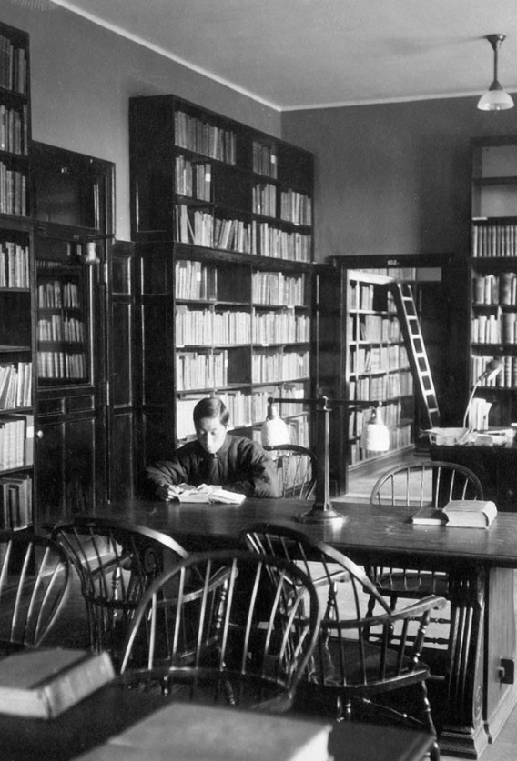
Questions to consider...
How do others make new employees aware of ongoing redescription work?
Is this work situated within known policies that someone new can see?
How do new employees find out about this work?
China Medical Board records, RAC

Slide 27
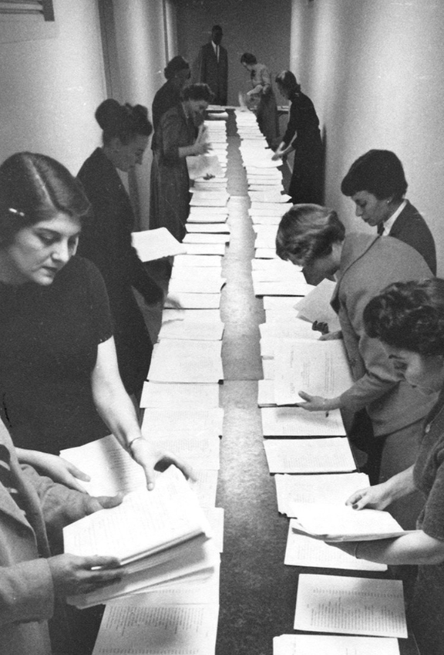
Questions to consider...
How do you keep this work going?
Ford Foundation records, RAC

Slide 28
Read more:
Education Campaign:
Culturally Competent (Re)Description Education Campaign Project Overview
Learning Together: Cultural Competency in Archives: Planning an Education Campaign
Learning Together: Cultural Competency in Archives: Phase One of the Education Campaign
Learning Together: Cultural Competency in Archives: Education Campaign Phase 2, the Reading Group
Related Projects:
Our Mission, Vision & Values
The RAC’s New Mission, Vision, and Values Statements: How We Got Here
Cultural Competency in Archives - Processing Manual Revisions
RAC Processing Manual
Learning Together: Cultural Competency in Archives: Investigating Archival Description for Audiovisual Materials
Using Wikidata Identifiers to Enhance Agent Discovery
The Hybrid Archives Internship Experience (Subject Term Review)
My Summer 2023 Internship Experience: An Introduction to Archive Work (Subject Term Review)

Slide 29
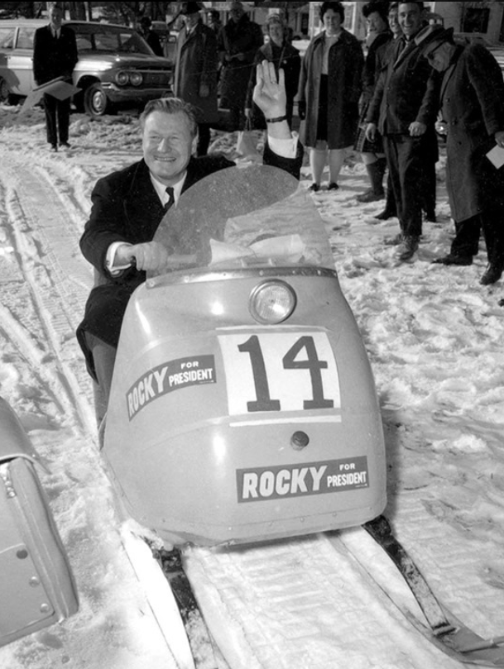
Contact us!
Amy Berish, aberish@rockarch.org
Katie Martin, k.martin@rockarch.org
Darren Young, dyoung@rockarch.org
Bits & Bytes: Perspectives on our work and how we do it.
@RockefellerArchiveCenter
Campaign Snowmobile, Nelson A. Rockefeller photographs, RAC

