Slide 1
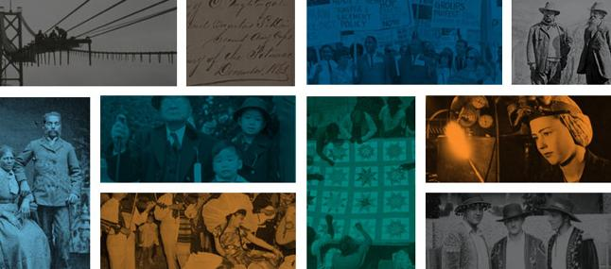
Works in Progress Webinar: Listening to community-centered archives about sharing collections online

Slide 2
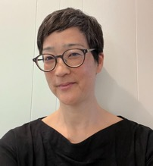
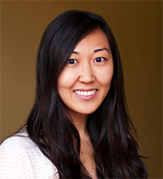
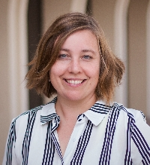
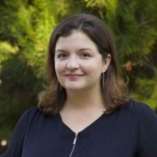
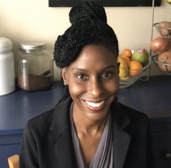
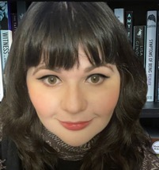
Who We Are
Sharon Mizota (she/her)
Consultant
Christine Kim (she/her) California Digital Library
Madelynn Dickerson (she/her) University of California, Irvine
Audra Eagle Yun (she/her) University of California, Irvine
Krystal Tribbett (she/her)
University of California, Irvine
Rivka Arbetter
University of California, Irvine

Slide 3
Today’s Agenda
Introducing C-CAP TEACH & The Research
Doing the Work: A Tale of Three Pivots
Pivot 1: Breaking Up With a Research Partner
Pivot 2: Re-scoping the Research Questions
Pivot 3: Different Deliverables
Reflection

Slide 4
Introducing C–CAP TEACH
& The Research

Slide 5
Community-Centered Archives in Practice Transforming Education, Archives, and Community History
C-CAP TEACH will cultivate commitment among higher education institutions to community-centered archives approaches, simultaneously solidifying the ability and responsibility of academic libraries to engage critically and contribute to social justice-focused scholarship, training, pedagogy, and partnerships in their communities.
https://sites.uci.edu/ccap/
UCI Community-Centered Archives in Practice: Transforming Education, Archives, and Community History
https://sites.uci.edu/ccap/

Slide 6
What are CCAs?
We define community-centered archives (CCAs) as organizations documenting the lives of underrepresented, marginalized, or disenfranchised people including Community-Based Archives (CBAs) with archival work as mission-centric or Community-Based Organizations (CBOs) where archival work is not mission-centric but that are doing archival projects.

Slide 7
Principles of community-centered archives partnerships
Collaborative through shared authority with community members
Attentive to inequities reflected in archives
Responsive to the community’s needs
Engaging with the divergent priorities of communities
https://ocseaa.lib.uci.edu/partnerships
Principles of community-centered archives partnerships
https://ocseaa.lib.uci.edu/partnerships

Slide 8
Research Assessment Project
Goals:
Understand the ways regional and national digital collection aggregators can work towards more representative and inclusive aggregation
Support the development of a more responsible and inclusive framework for digital exhibitions, or online storytelling

Slide 9
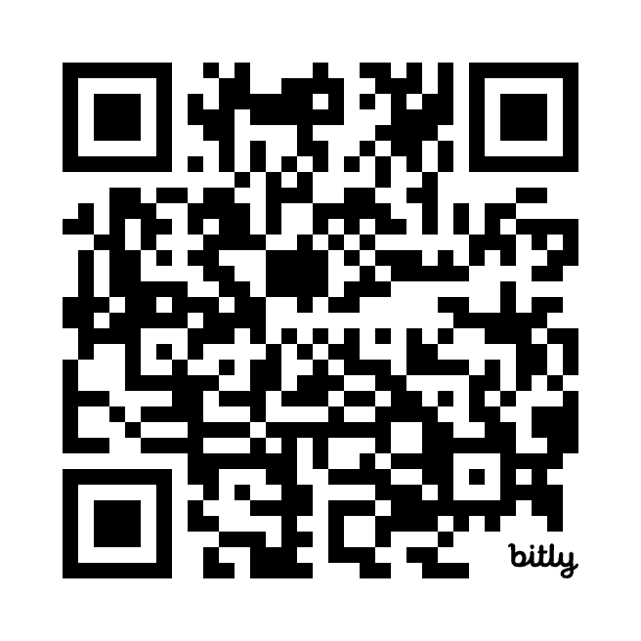
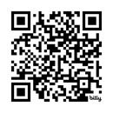
Research Methods & Outcomes
“Sharing Your Stories Online: A Guide for Community Organizations and Their Partners” https://bit.ly/3CHtWgF
Research Reports
Environmental Scan: http://bit.ly/4767IP8
DPLA Hubs & Community Archives Surveys: https://bit.ly/4hgnEDX
Community Archives & Curator Interviews: https://bit.ly/3EjaEyI
Analysis of institution “types” in the national (DPLA) aggregation [in progress]

Slide 10
Doing the Work: A Tale of Three Pivots

Slide 11
What we planned…
Grant Proposal
Results
Milestone 1
Milestone 2
Milestone 3

Slide 12
What actually happened.
Pivot 3
Grant Proposal
Results
Pivot 1
Pivot 2

Slide 13
Pivot 1: Breaking Up with a Research Partner

Slide 14
The Original Plan
Hold informational interviews with multiple potential consultants
Solicit project proposals
Select a consultant
Onboard partner as vendor with library business office
Meet with consultant to initiate project
Hold regular check-ins, be available to answer questions
Receive deliverable: a white paper or report based on research findings

Slide 15
The Pivot: Making a Difficult Decision
Relationship with original consultant was feeling strained
Misalignment of values and expectations
Bureaucracy supported status quo
Making a change felt difficult and disruptive
Ultimately decided to part ways
When parting ways, everyone seemed relieved
Now we needed a new consultant, which led to additional questions and challenges

Slide 16
Pivot 2:
Re-scoping the Research Questions

Slide 17
Original Research Questions
How can regional and national digital collection aggregators (e.g., DPLA, the DPLA Hubs Network, and other regional aggregators) work towards a more representative and inclusive aggregation?
What is a responsible and inclusive digital exhibition framework that may amplify historically marginalized narratives?

Slide 18
Re-scoped Research Question
How can institutions and community-centered archives develop reciprocal partnerships that support online storytelling through digital primary sources?

Slide 19
The Pivot: It’s Okay to Start Over
Learning is an iterative process
It’s okay to reset, re-center, and start over
Doing the work right is more important than meeting a timeline
Mapping out a strategy with your collaborator is crucial to any partnership
Look to your guiding principles often
Crucial for leadership to support an environment of adaptation
Listening - really listening - is being willing to learn, re-center, and adapt

Slide 20
Pivot 3:
Different Deliverables

Slide 21
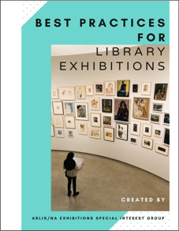
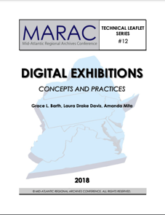
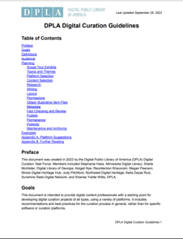
Our Original Intention
Project 1: Whitepaper on research findings
Project 2: A guide to creating ethical online exhibitions
Build on existing guides
Emphasize ethics, relationships, & responsibility
Make online exhibitions more “friendly” & accessible

Slide 22
The Pivot: Listening to Community Respondents
Lack of consensus on “online exhibitions” and “aggregators”
Most were not creating or participating in them
No bandwidth or resources
Didn’t serve their missions or audiences
Had negative experiences
Frustrations with collaborations & partners
Curators focused on relationships & support, not prescriptions or “how-to”
Community organizations don’t need help with ethics. They need resources.
Larger institutions have resources. They need help with ethics.

Slide 23
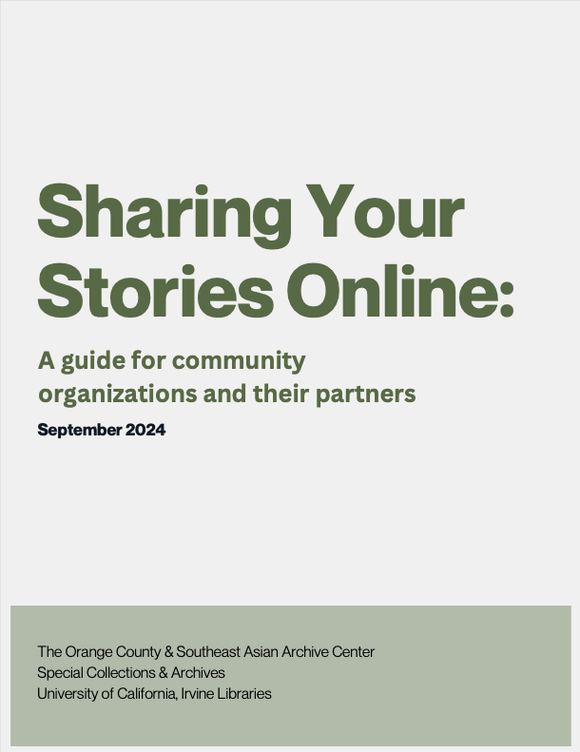
Sharing Your Stories Online:
A guide for community organizations and their partners
Concise, straightforward definitions
FAQ format
Pros, cons & considerations
Guidelines for partnerships from both sides
Resource lists

Slide 24
For institutions interested in partnering with a community organization
What are your institution’s values and principles?
How do you find a partner?
Is the partnership reciprocal?
Are you listening to the partner?
Are you communicating transparently and in a timely manner?
Do you respect the partner’s autonomy and expertise?
Are you in it for the long term?
Can you be flexible?
Do you understand that “community” is complicated?
Are you able to do what you promise?

Slide 25
Reflection

Slide 26
Reflection
Necessity of supportive leadership
Following the CCAP methodology: CARE
Ongoing questioning and reevaluation: Embracing the messiness
Collaborative
Attentive
Responsive
Engaging
Listening to CCAs
Taking to heart what they say
Giving what is needed
Accessible format & language

Slide 27
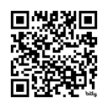
Thank you!
“Sharing Your Stories Online”: https://bit.ly/3CHtWgF
CCAP Digital Collections and Exhibitions Research Project: https://bit.ly/3Ej5hj1
CCAP TEACH Project Website: https://sites.uci.edu/ccap/
Sharon Mizota, sharon@sharonmizota.com
Christine Kim, christine.kim@ucop.edu
Madelynn Dickerson, mrosed@uci.edu

