Slide 1
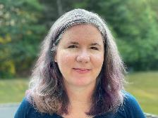
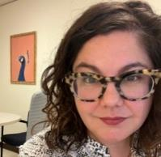
Operationalizing Open at Syracuse University Libraries
Déirdre Joyce, Head of Digital Stewardship and the Digital Library
Anne Rauh, Head of Collections and Research Services
February 13, 2024

Slide 2
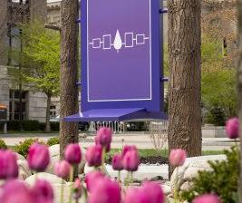
Land Acknowledgement
We acknowledge with respect the Onondaga Nation, firekeepers of the Haudenosaunee, the Indigenous people on whose ancestral lands Syracuse University now stands.
https://www.waer.org/podcast/the-land-youre-on

Slide 3
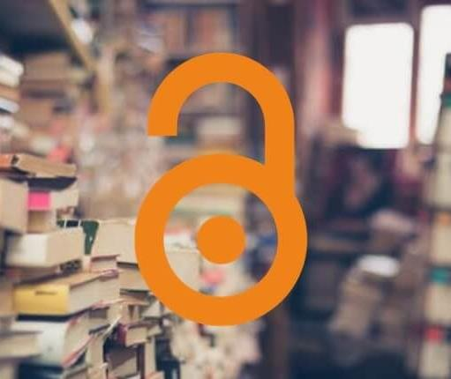
We did it! It’s working!
About us.
Why we did it.
How we did it.
Because we did it.
Some takeaways.
Questions.
This Photo by Unknown Author is licensed under CC BY-SA-NC

Slide 4
About us.

Slide 5
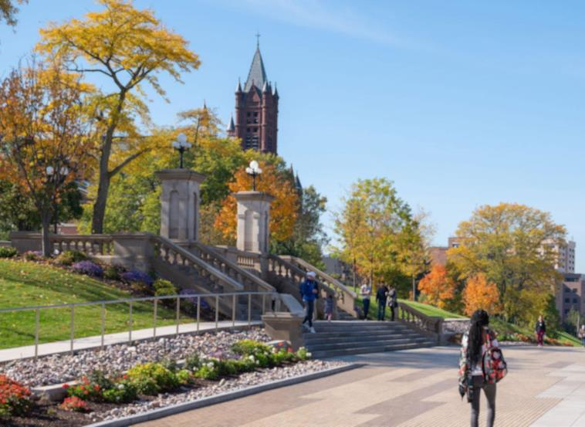
Syracuse University
Private research university
R1 (Research Intensive) Carnegie Classification of Institutions of Higher Ed (up from R2 in 2015)
14,754 undergraduates
7,944 graduate students

Slide 6
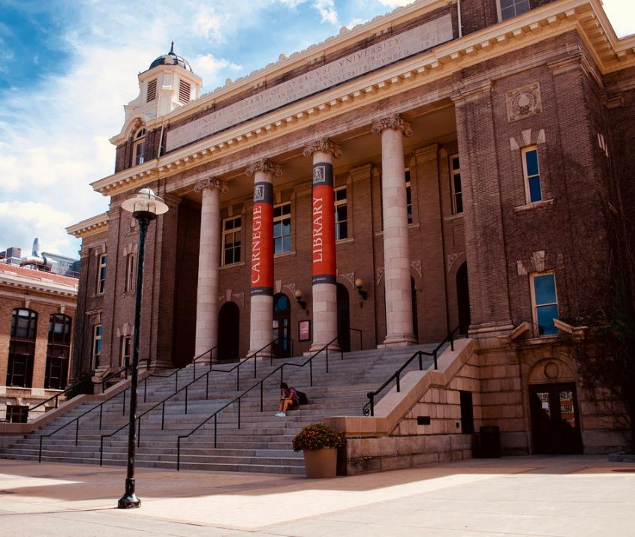
Syracuse University Libraries
Over 4.8 million volumes in the collection
Over 850,000 visits to the buildings
157 full-time library staff
60 librarians
Includes Syracuse University Press and Law Library

Slide 7
Why we did it.

Slide 8
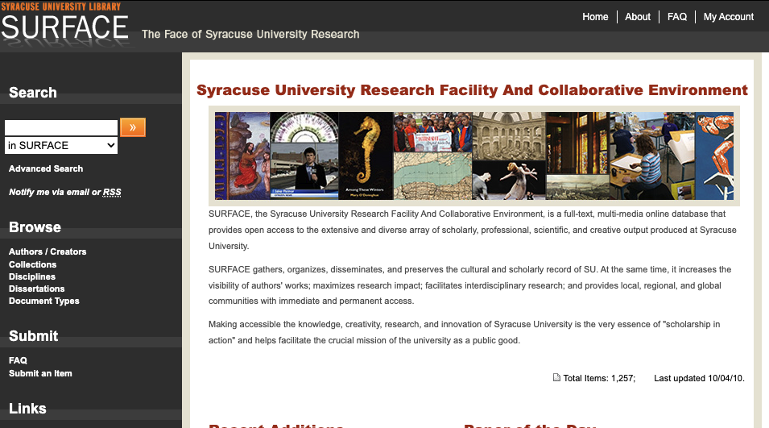

SURFACE – Then...

Slide 9
Previous IR Structure
Scholarly Communications/ Open Publishing Librarian
Metadata Librarian
Digital Humanities Librarian
Graduate Students
Digital Initiatives Librarian
Repository Coordinator
Centralized repository and collection management vested in one role
Other staff roles more loosely defined
Operates independently from other Libraries’ functions/digital infrastructure
Periodic turnover at the center

Slide 10


2020
Digital Initiatives Librarian
Digital Humanities Librarian
Graduate Students
Digital Library Program Head
This Photo by Unknown Author is licensed under CC BY-NC

Slide 11

This Photo by Unknown Author is licensed under CC BY-SA

Slide 12
Current IR Structure
Team-based repository management
Staff roles more well-defined
Balanced division of labor at the repository level
Open Scholarship Librarian
Digital Content Coordinator
Digital Projects Librarian

Slide 13
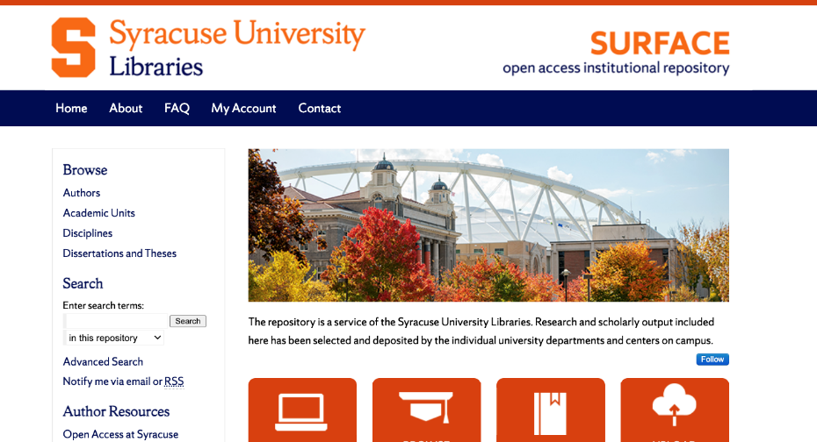
SURFACE – Now.

Slide 14
How we did it.

Slide 15
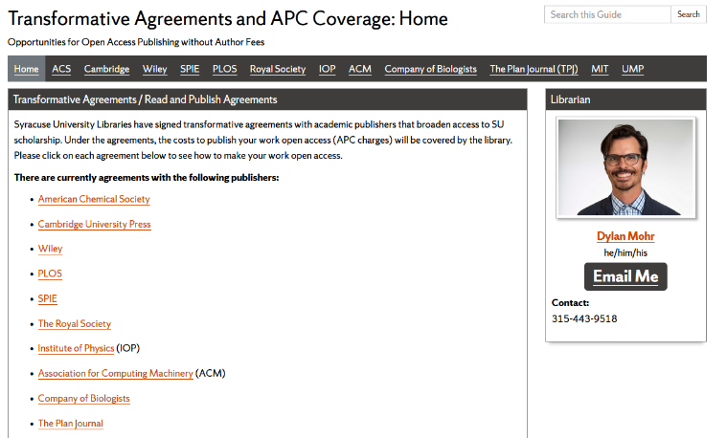
Library Strategy: Expanding Open

Slide 16
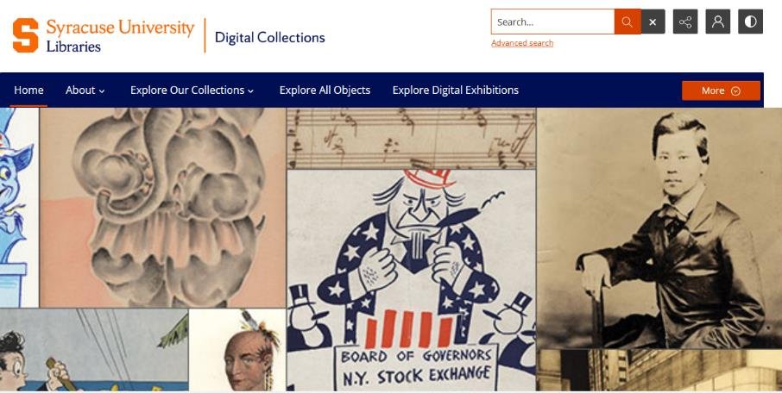
Library Strategy: Digital Collections

Slide 17
Library Strategy: SaaS
Storage
Preservation
Production
Management
Access
tools, services, platforms
tools, services, platforms
producers, location, content
tools, services, platforms
locations/destinations for end-users, UX
AWS
Preservica
Digital Production Unit, Belfer, external vendors, content stewards
Quartex
(digital collections)
SU Digital Collections, IVMF Digital Library
Stand Alone Collections and Selected Exhibits
Kaltura
(A/V)
external aggregations
LOCKSS
Digital Commons
(IR)
SURFACE
Electronic theses and dissertations pulled from
OnBase/ProQuest
Internet Archive
Archive-it
web archive files (WARCs)
Archive-it
Archive-it
KEY
Workflow needed/under development
Needed/Under Development

Slide 18
Storage
Preservation
Production
Management
Access
tools, services, platforms
tools, services, platforms
producers, location, content
tools, services, platforms
locations/destinations for end-users, UX
AWS
Preservica
Digital Production Unit, Belfer, external vendors, content stewards
Quartex
(digital collections)
SU Digital Collections, IVMF Digital Library
Stand Alone Collections and Selected Exhibits
Kaltura
(A/V)
external aggregations
LOCKSS
Digital Commons
(IR)
SURFACE
Electronic theses and dissertations pulled from
OnBase/ProQuest
Internet Archive
Archive-it
web archive files (WARCs)
Archive-it
Archive-it
KEY
Workflow needed/under development
Needed/Under Development

Slide 19

Articulating the Digital Library
Digital Scholarship
  Supporting innovation, use and reuse of and around digital objects and by-products
Digital Stewardship
  Coordinating and managing activities and infrastructure related to the production, description, maintenance, preservation, and delivery of unique resources
Digital Library
Scholarship
Stewardship

Slide 20
Role of the Middle Manager
Librarians
Libraries Administration
Department Leadership

Slide 21

Current IR Structure
Outreach
Journal Facilitation
Scholarship Focus
Collection Development
Open Scholarship Librarian
Digital Content Coordinator
Digital Projects Librarian
Content Management
Metadata
Ingest Processes
Triage
Project Support

Slide 22
Because we did it.

Slide 23
Key Accomplishments
Efficient repository management
Improved workflows
Educational collaboration
Increased visibility

Slide 24
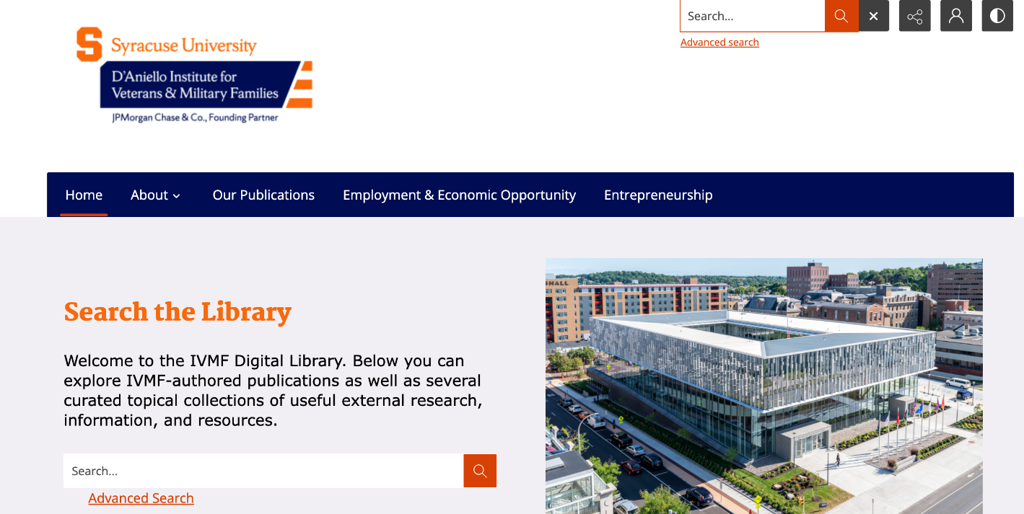
IVMF Digital Library

Slide 25
Open Journals
Peer-Reviewed Journals
  Concurrent Enrollment Review
  EnglishUSA
  Information Literacy Collab
Student/Creative Journals
  Mend
  iY-1 Perspectives
  The Crown: Syracuse Undergraduate Research Journal

Slide 26

The first independent, open access, peer reviewed journal dedicated to research in the field of dual/concurrent enrollment.

Slide 27

The EnglishUSA Journal focuses on theory and practice in the field of teaching English as a second/foreign language and serves as a medium for sharing best practices, addressing current issues and presenting research.

Slide 28
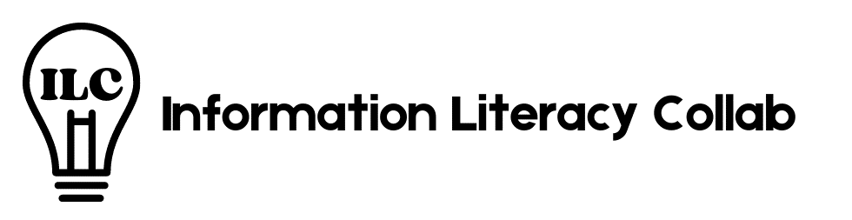
The Information Literacy Collab (ILC) is a diamond open-access publication by and for students and early career professionals that fosters critical conversations about reflective and ethical information practices within a variety of learning environments.

Slide 29

Mend celebrates the lives and creative work of incarcerated and formerly incarcerated people as well as individuals who have been impacted by the criminal justice system. This annual publication showcases writing of all types, including fiction, poetry, and nonfiction.

Slide 30
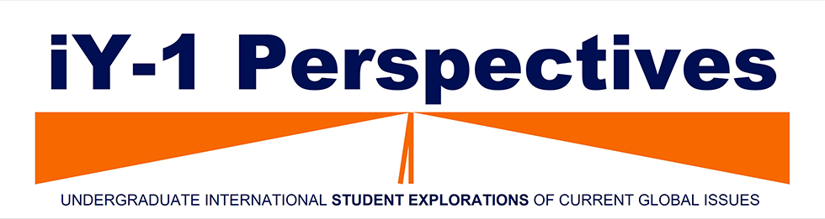
International Year-One Perspectives features a selection of work by undergraduate international students completing their first year of study in Syracuse University’s iY-1 program. Each issue contains students’ explorations of a global issue covered in the English for Academic Purposes course.

Slide 31

The Crown is a new SU undergraduate research journal, edited by and for Honors students, that was created to provide a platform for their legacy and work to live on.

Slide 32
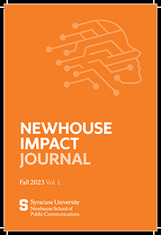
The Newhouse Impact Journal is an imprint of the S.I. Newhouse School of Public Communications at Syracuse University, is a vibrant examination of the most transformative aspects of the communications industry.

Slide 33
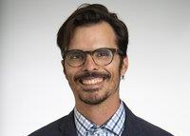
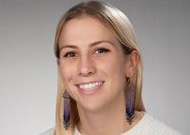
Early Career Librarian Involvement
Dylan Mohr Open Scholarship Librarian
Grace Swinnerton, IVMF Research and Digital Projects Librarian

Slide 34
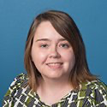
Cultivating Hidden Talent
Sarah Allis, Digital Library Content Coordinator

Slide 35
Staff Modularity
Author Outreach
Author Consultation
Open Collection Development
IVMF Digital Library
IR Platform Management
Digital Collections
Open Scholarship Librarian
Digital Content Coordinator
Digital Projects Librarian
Project Management
Knowledge Base
Digital Library

Slide 36


Future Directions
Research Data
Open Educational Resources

Slide 37
Takeaways.

Slide 38
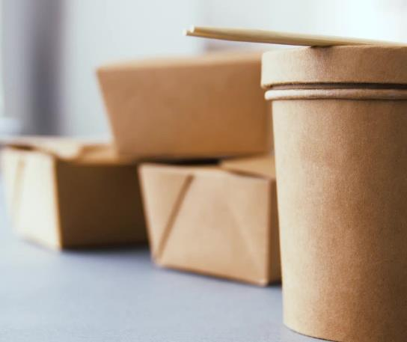
Keys to Success
Organic organization
Division of labor
Collaboration and communication
Mission driven
Thinking at scale

Slide 39
Questions
Déirdre Joyce, dfjoyce@syr.edu
Anne Rauh, aerauh@syr.edu

