Slide 1
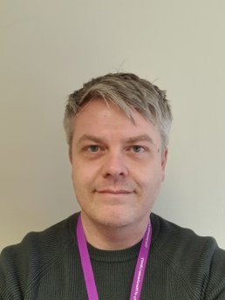
Supporting campus goals through a library-led Office for Open Research at the University of Manchester
Scott Taylor, Head of the Office for Open Research, University of Manchester
Jan 2024

Slide 2
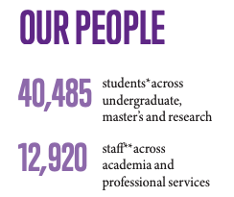

Slide 3
UNIVERSITY STRATEGY

Slide 4
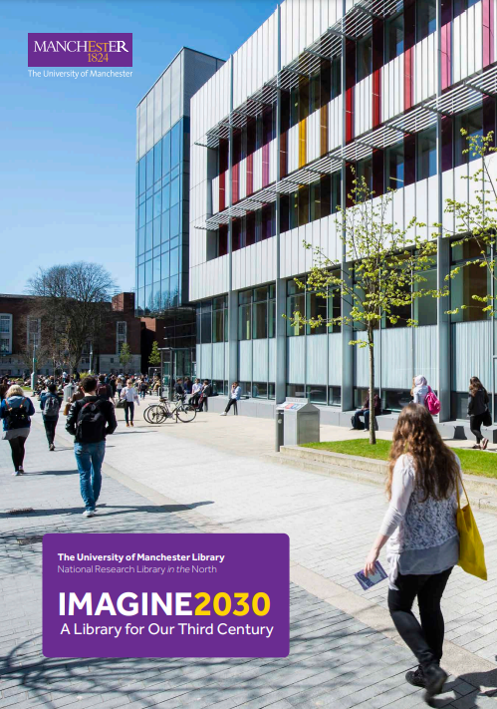
Imagine 2030
Imagine 2030 is the Library’s response and contribution to the University’s strategic plan ‘Our Future.’
The programme of work to reinvent our Open Research support is a key part of that vision.
Following wide consultation, the programme developed an Open Research Position Statement for the University, and a three year Open Research Strategic Action Plan.

Slide 5
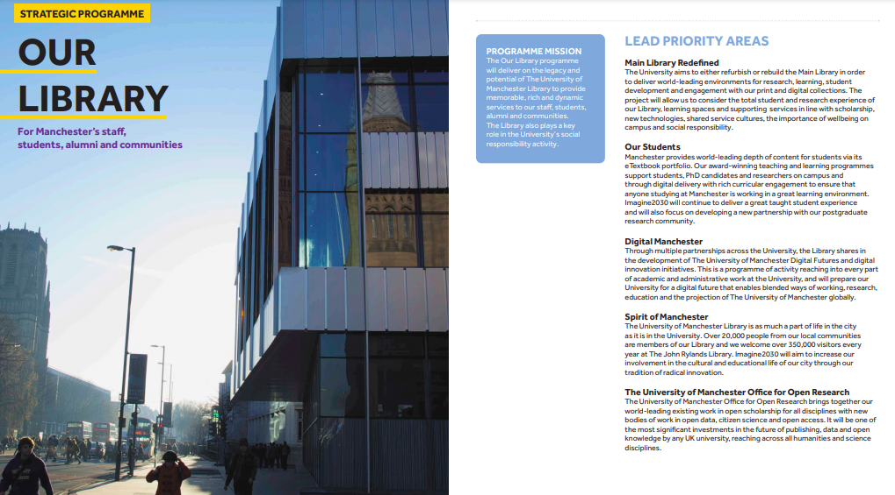
IMAGINE 2030

Slide 6
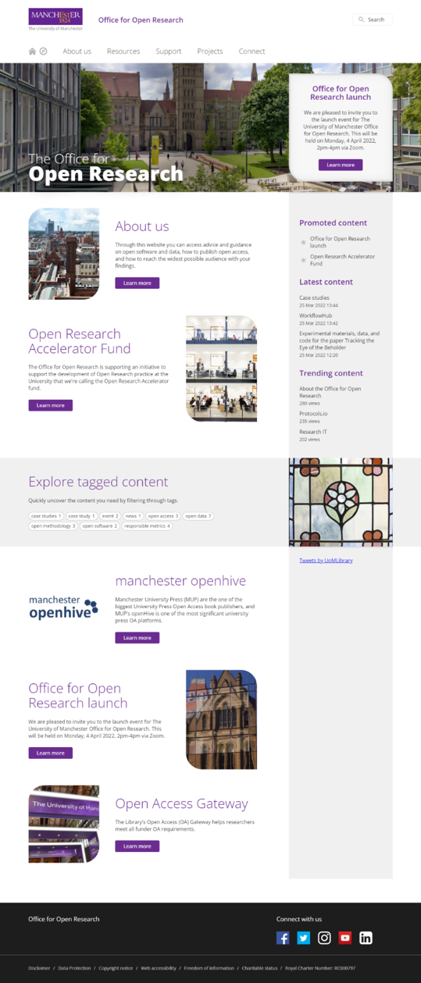
Open Research at
Manchester
The Library has supported Open Research for over ten years through our Open Access and Research Data Management services.
During that time the Open Research movement has evolved and gained momentum to include a much wider range of open research practices.
The launch of our Office for Open Research represents our response to this development and a reinvention of how we support Open Research at Manchester.
It represents a more collaborative and connected approach with the Office providing a hub for all of the University’s activities in this area.

Slide 7
Open Research Governance
Membership
Prof Colette Fagan – Vice President for Research
Prof Nigel Hooper – Associate Vice President for Research
Prof Chris Taylor – Associate Vice President for Research
Prof Richard Curry – Vice Dean for Research and Innovation (FSE)
Prof Neil Humphrey – Associate Dean for Research (HUM)
Prof Andrew Trafford – Associate Dean for Research (BMH)
Prof Andrew Stewart – Institutional Lead for Open and Reproducible Research, UKRN Institutional Lead
Prof Caroline Jay – Open Research Network Lead
Lorraine Beard – Associate Director, Research and Digital Horizons
Scott Taylor – Head of the Office for Open Research
Lucy May – Library Research Services Manager
Sarah Albutt – Head of Research Strategy
Bill Ayres – Strategic Lead for Research Data Management
Ann Fretwell – Policy, Governance and REF Manager (FSE)
Rupa Lunan – Research Policy and REF Manager (BMH)
Steve Carlton – Open Research Strategy Group Secretary
The Office for Open Research priorities are developed by academics and the Library through the Open Research Strategy Group (ORSG)

Slide 8
UK Reproducibility Network
The University is an institutional member of the UK Reproducibility Network as part of our commitment to developing an Open Research environment.
The UK Reproducibility Network (UKRN) is a national peer-led consortium that aims to ensure the UK retains its place as a centre for world-leading research by promoting initiatives to improve research rigour, reproducibility, robustness and quality at both grassroots and stakeholder levels.
University is centrally involved in a UKRN project “Growing and Embedding Open Research in Institutional Practice and Culture” worth £8.5M over five years and includes £4.5M from the Research England Development (RED) Fund.

Slide 9
The Office for Open Research has four key functions:
Strategically coordinating the University’s response to the Open Research agenda.
Creating a single point of contact with the expert open research support available across the University.
Supporting Open Research communities within the University and beyond.
Championing Open Research and sharing the latest Open Research news.

Slide 10
Strategically coordinating the University’s response to the Open Research agenda.
OR1: Open Research Skills Training Project
OR2: Research Software Project
OR3: Open Research Indicator Framework
OR4: Data Stewardship Project
OR5: Trusted OR Systems

Slide 11
OR1: Open Research Skills Training Project
Open Research Skills Framework
Open Research Skills Training Portal
Open Research Fellowship Programme

Slide 12
OR1: Open Research Skills Training Project
Open Research Skills Training Portal
Open Research Skills Framework
Open Research Fellowship Programme
Transparent Methodology: Practices like preregistration and protocol sharing, along with related training on using platforms like OSF and Protocols.io.
Community Engagement: Including citizen science and co-production, with training on public and patient involvement and public engagement.
Responsible Methods: Covering statistical literacy, awareness of questionable research practices (QRPs), and replication studies, with corresponding workshops and training sessions.
Communication and Publishing: Focused on open access publishing, recognizing authorship, and responsible use of metrics, with training on open access publishing, using CRediT taxonomy, and engaging with metrics.
Open Software and Data: Discussing FAIR research data, data management plans, and code repositories, along with training on writing data management plans and working with open datasets.

Slide 13
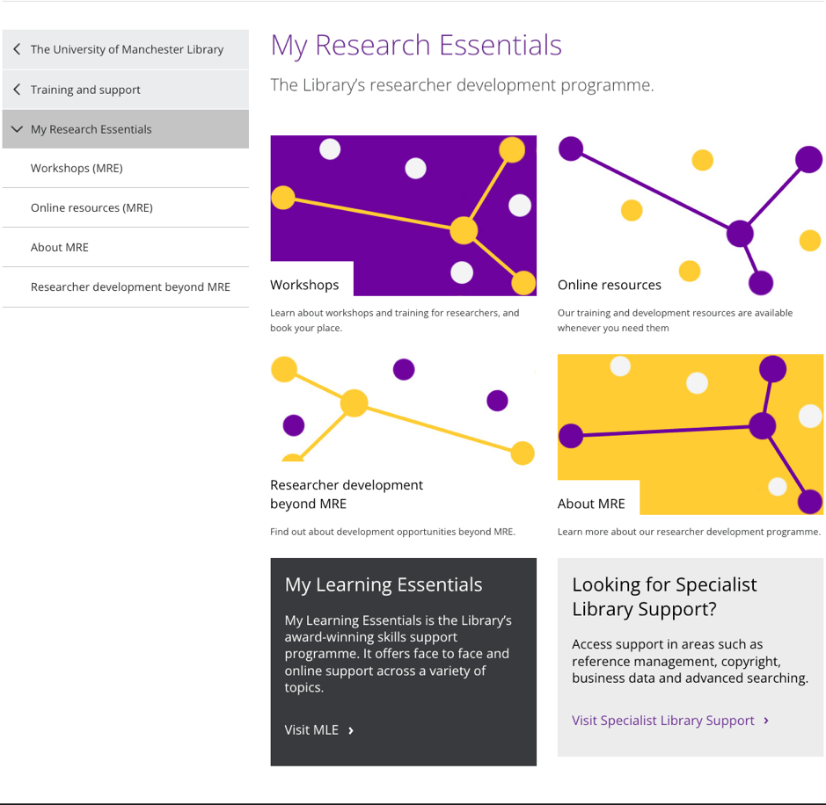
OR1: Open Research Skills Training Project
Open Research Skills Training Portal
Open Research Skills Framework
Open Research Fellowship Programme
Purpose: MRE is designed to assist researchers with resources for the research process, dissemination of research, and enhancing research profiles.
Delivery Methods:
Workshops and Information Sessions: Open to all researchers, bookable through the website.
Online Resources: Accessible to all researchers at any time.
Additional Sessions: Offered on request as part of Faculty researcher development programs, the New Academics Programme, or other School-led training activities.
Organizers: The program is delivered by the University of Manchester Library and invited speakers and is a part of the University's researcher development program.
Booking for School Training Activities: Requests for sessions can be made via email, with a recommended six weeks' notice.

Slide 14
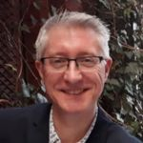
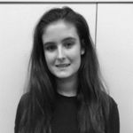
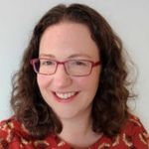
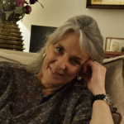
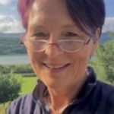
OR1: Open Research Skills Training Project
Open Research Skills Training Portal
Open Research Skills Framework
Open Research Fellowship Programme
Alex Henderson: Enhancing the FAIR publication of chemical analysis data through the development of open file formats and metadata vocabulary.
Hawys Williams and Samantha Franklin: Joint project to improve the Charter Mark tool for recognizing quality Patient and Public Involvement and Engagement in research.
Saskia Lawson-Tovey: Investigating researchers' knowledge of Research Data Management and FAIR principles in handling sensitive health data.
Anne Cotton: Creating an online resource to promote open research practices in microbiome studies, including guidance on open-source software and FAIR data and code practices.
Kay Gallacher: Contributing to the enhancement of the Charter Mark for Patient and Public Involvement and Engagement.
Luis Ospina-Forero: Integrating the University of Manchester's Research Data Repository with GitHub to facilitate dynamic open hosting of code.
Joanne Pennock: Increasing public and patient involvement by publishing lay summaries of grants and PhD theses in health research.

Slide 15
OR2: Research Software Project
Research Software Policy
Research Software Training and Support
Research Software Catalogue

Slide 16
OR3: Open Research Indicator Framework
Open Research Indicators
Open Research Tracker
Open Research Reports

Slide 17
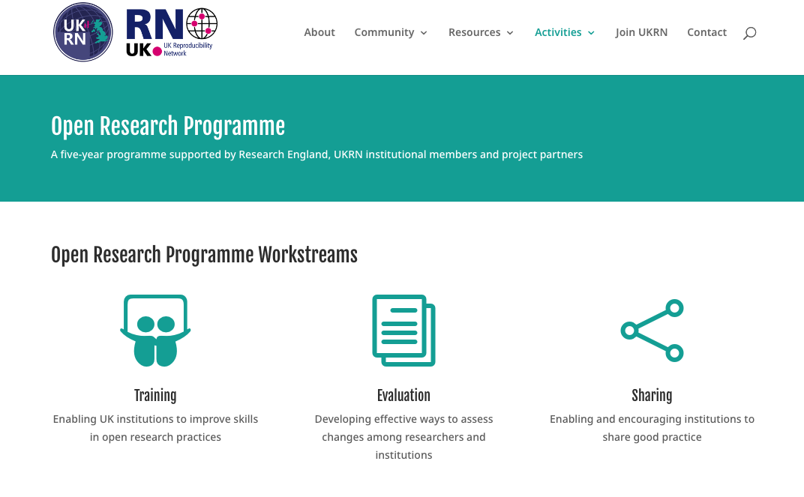
OR3: Open Research Indicator Framework
Open Research Tracker
Open Research Indicators
Open Research Reports

Slide 18
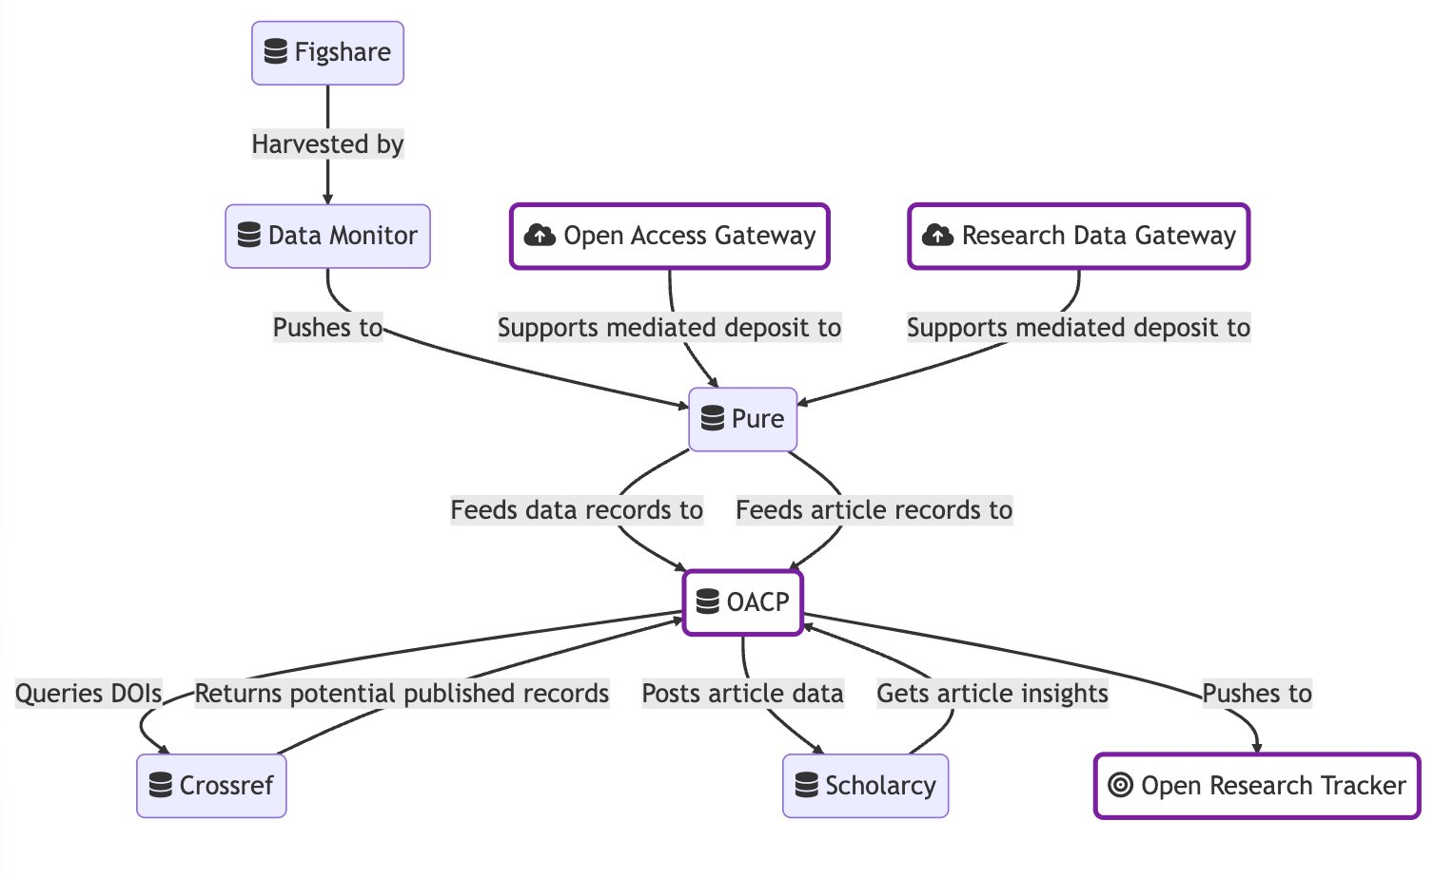
OR3: Open Research Indicator Framework
Open Research Tracker
Open Research Indicators
Open Research Reports

Slide 19
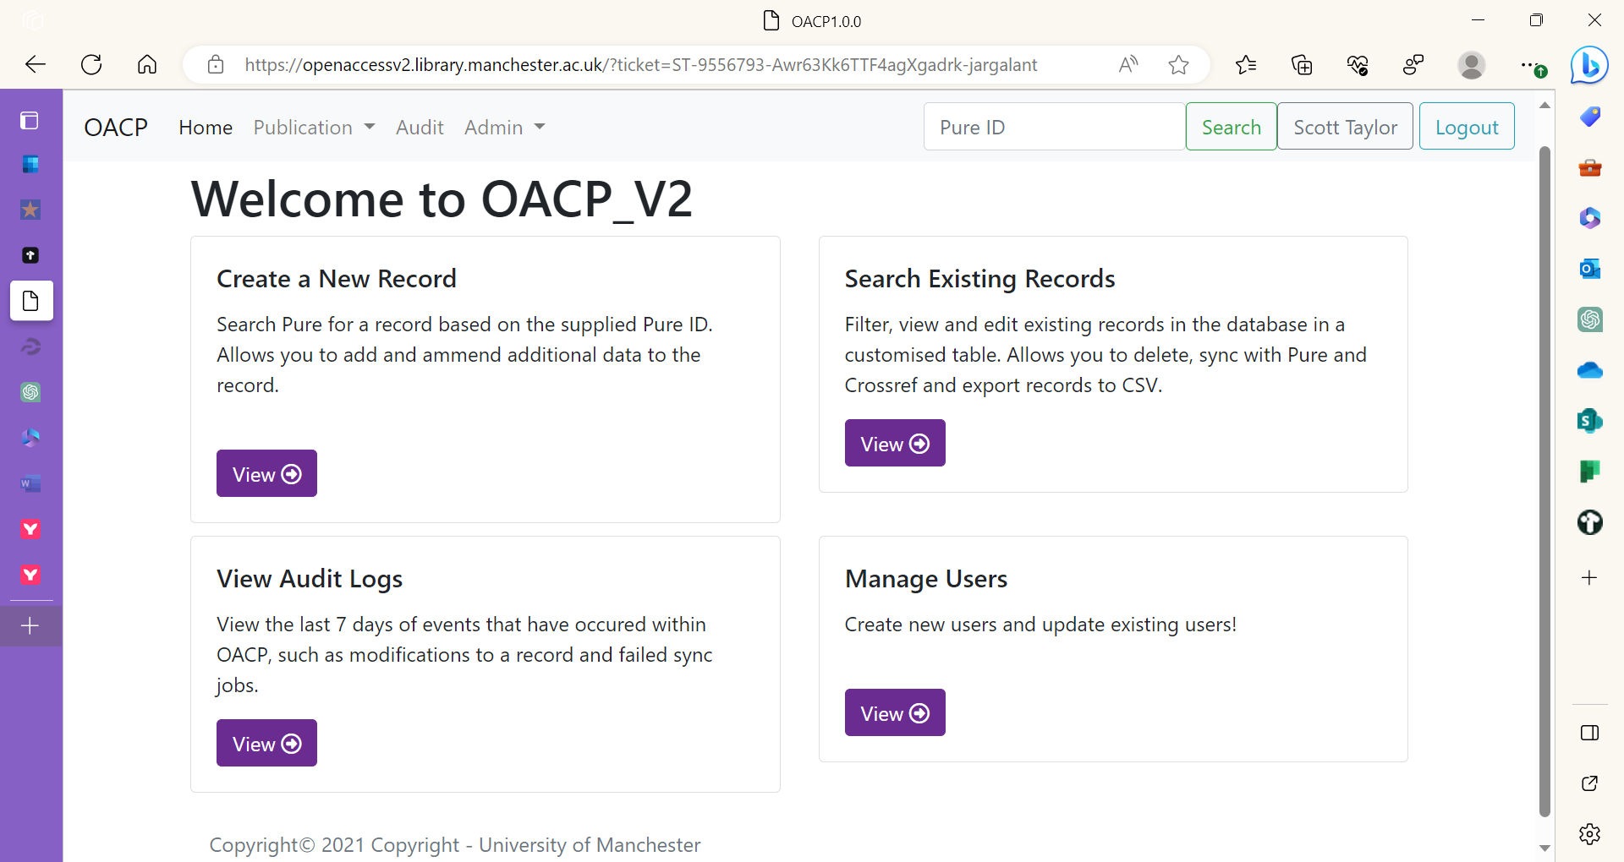

Slide 20
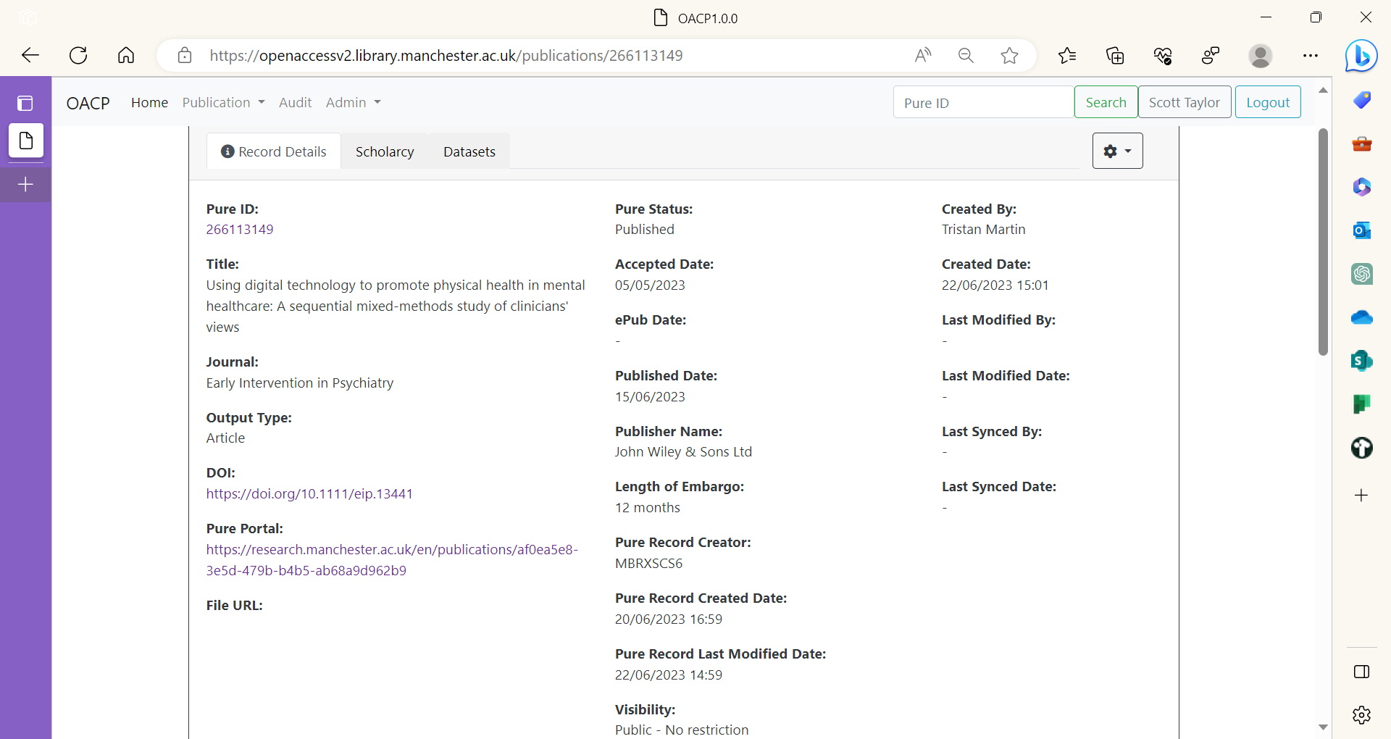

Slide 21
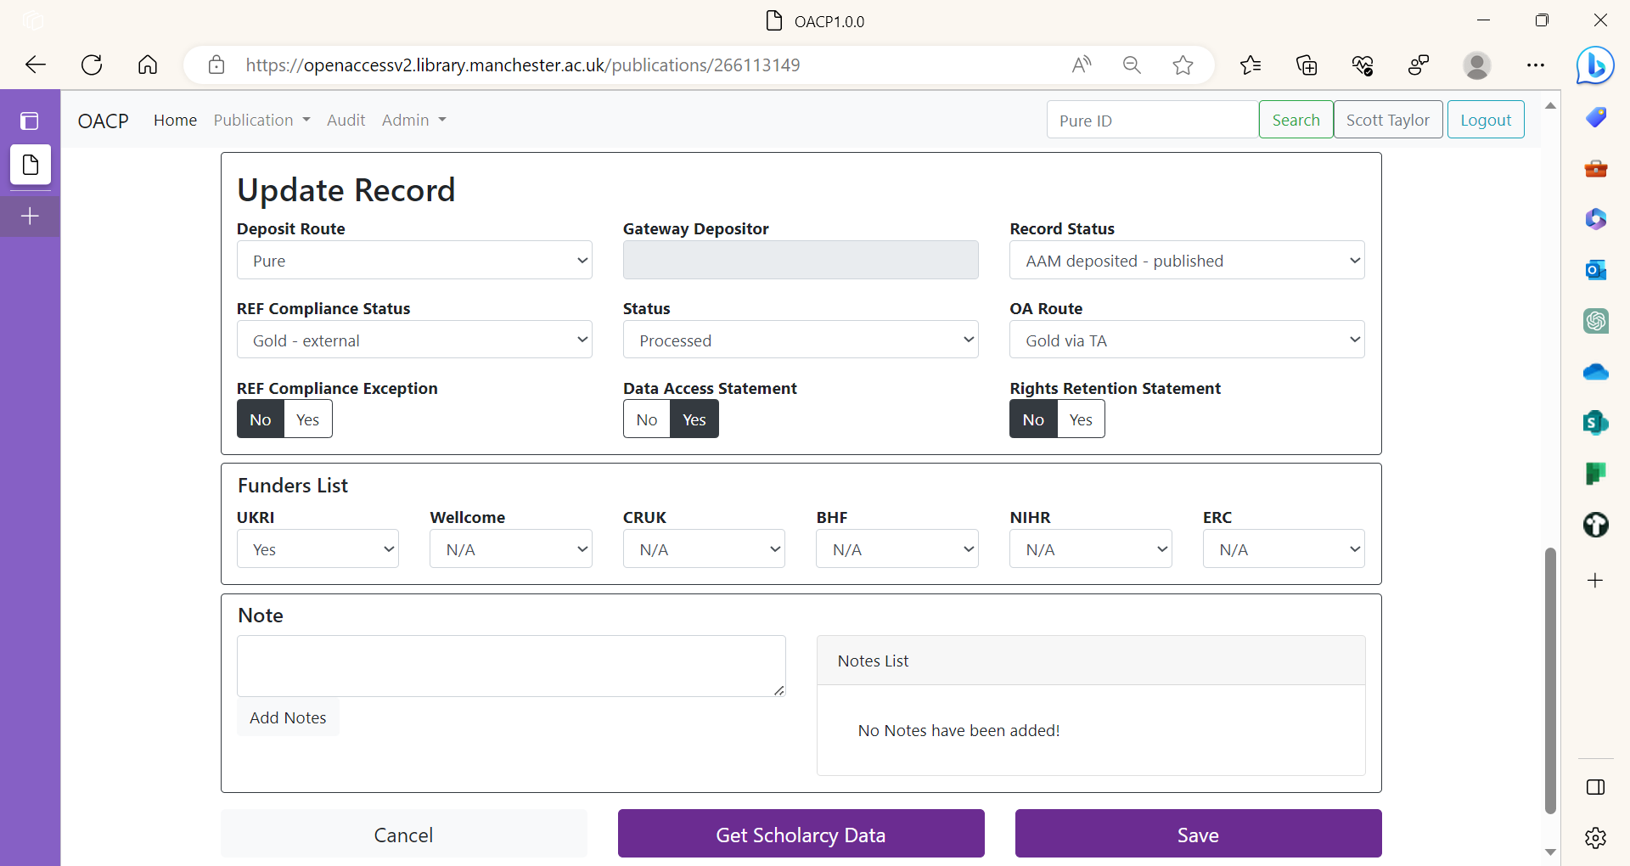

Slide 22
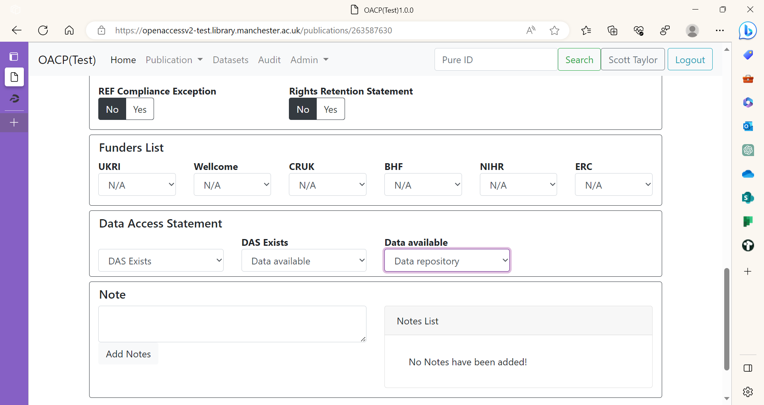

Slide 23
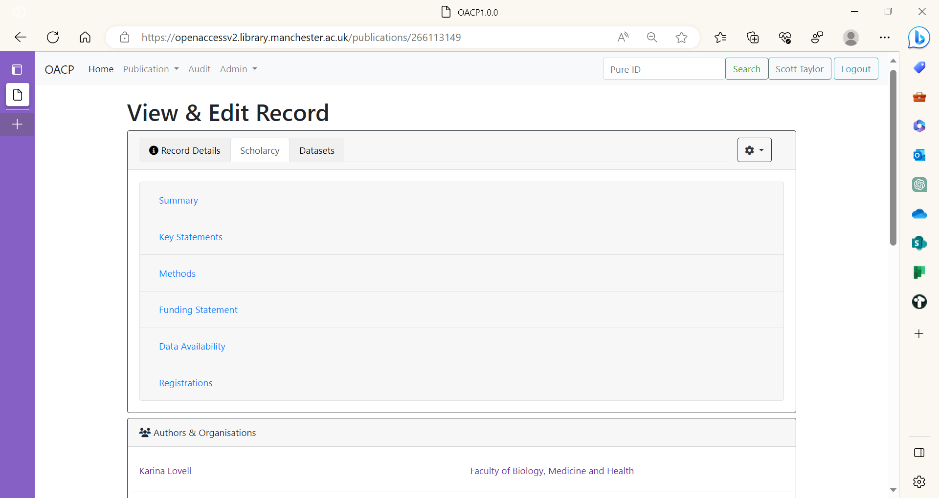

Slide 24
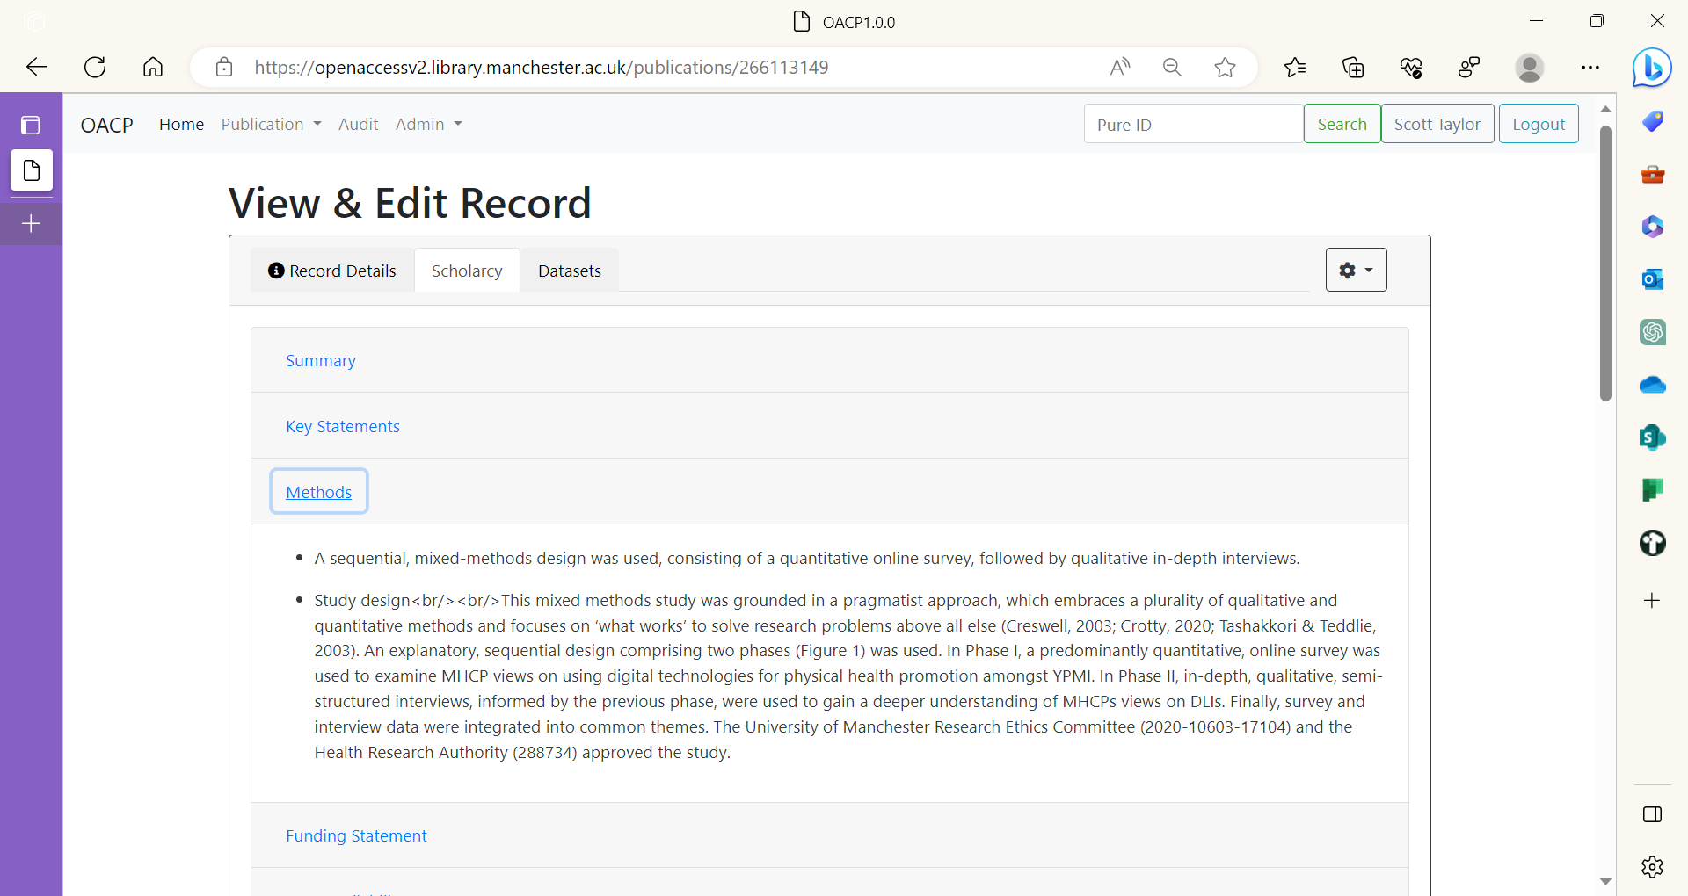

Slide 25
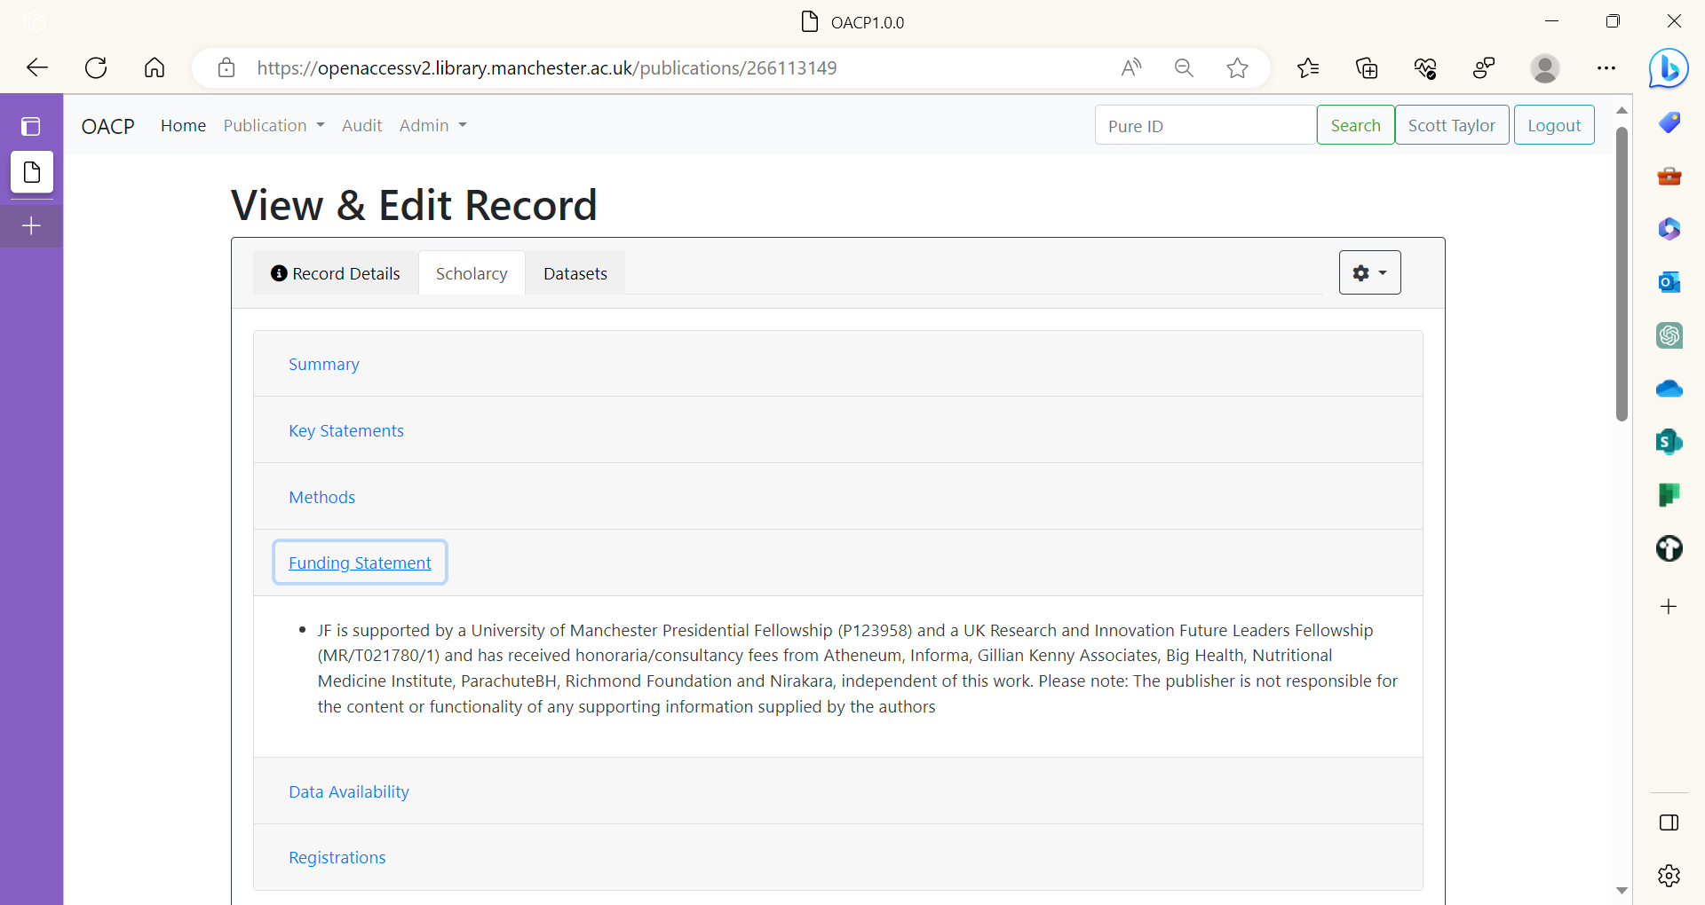

Slide 26
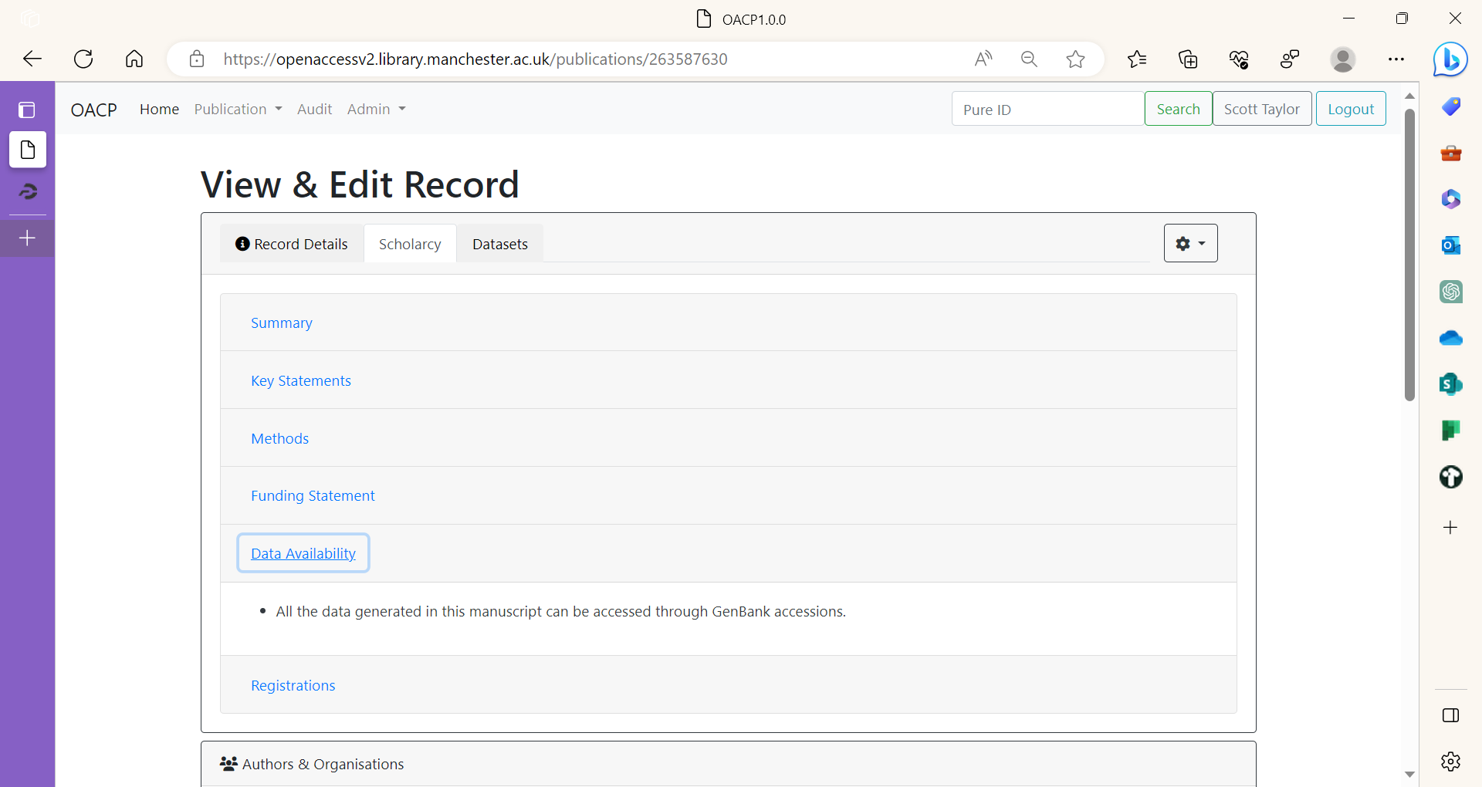

Slide 27
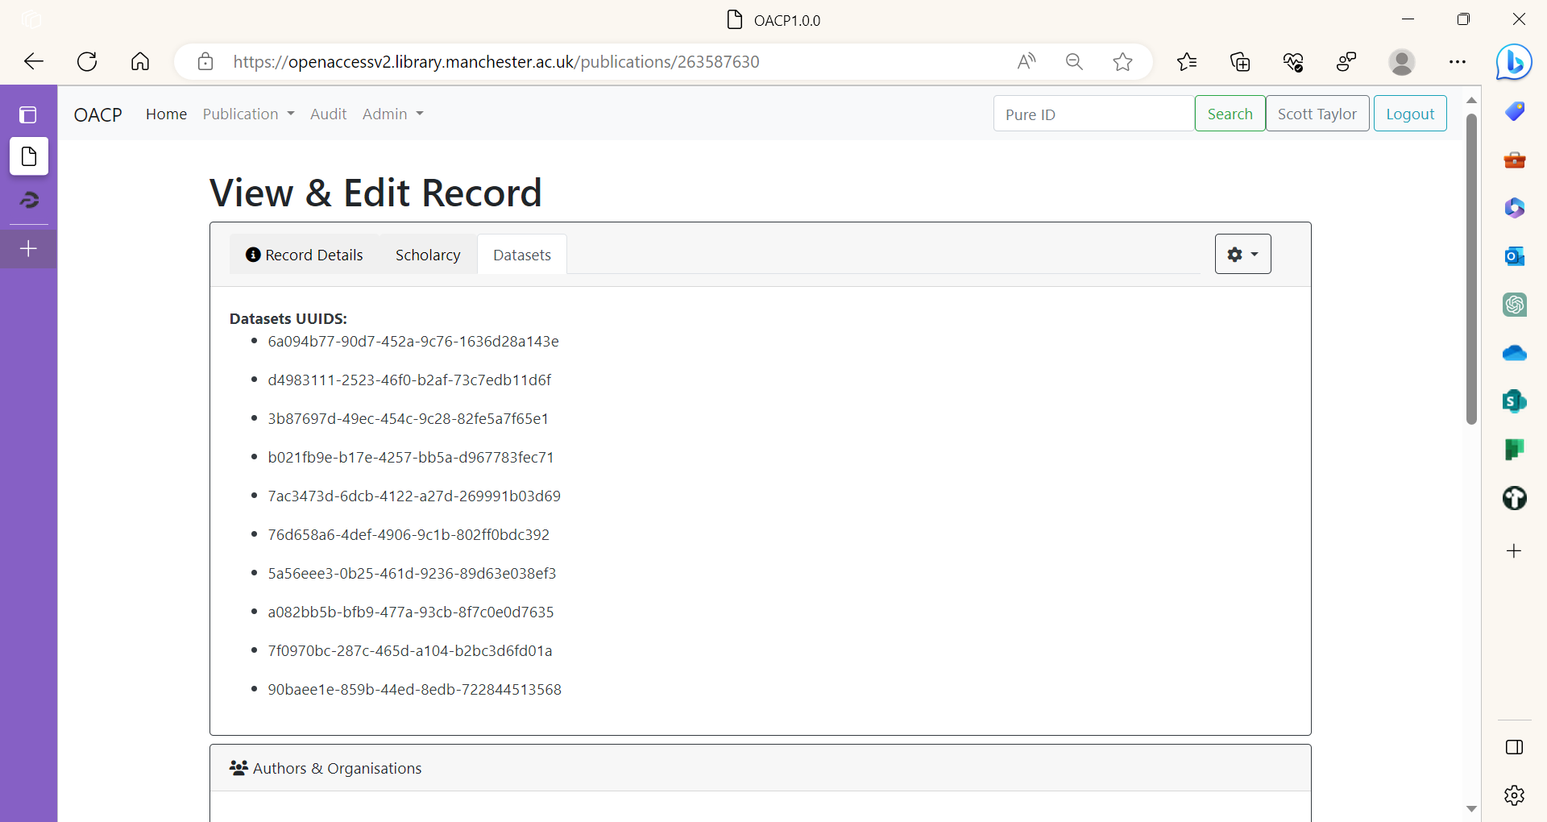

Slide 29
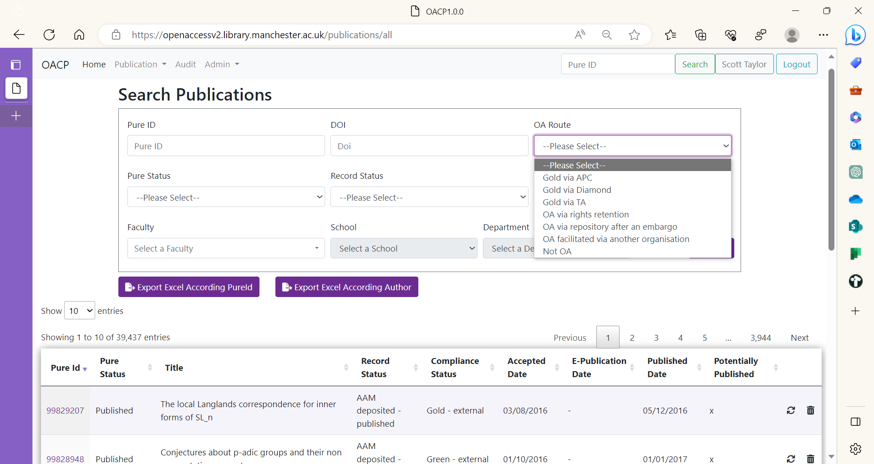

Slide 30
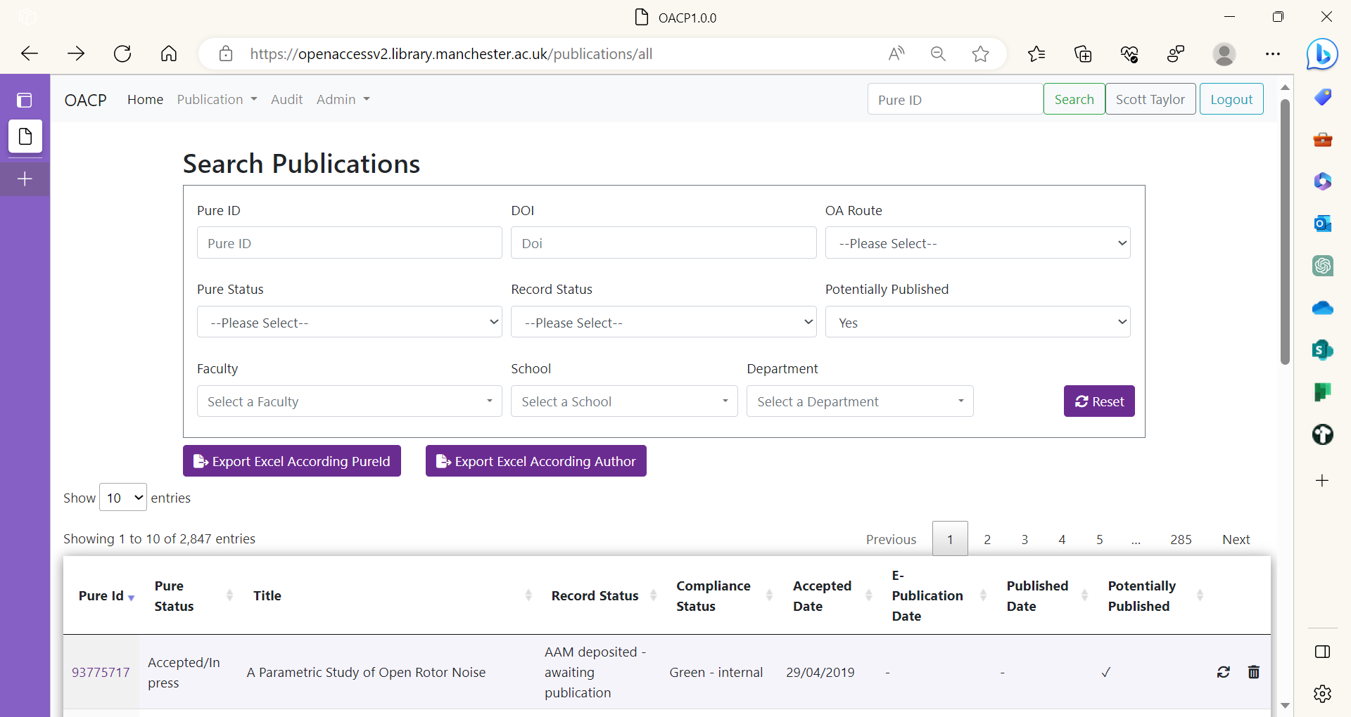

Slide 33
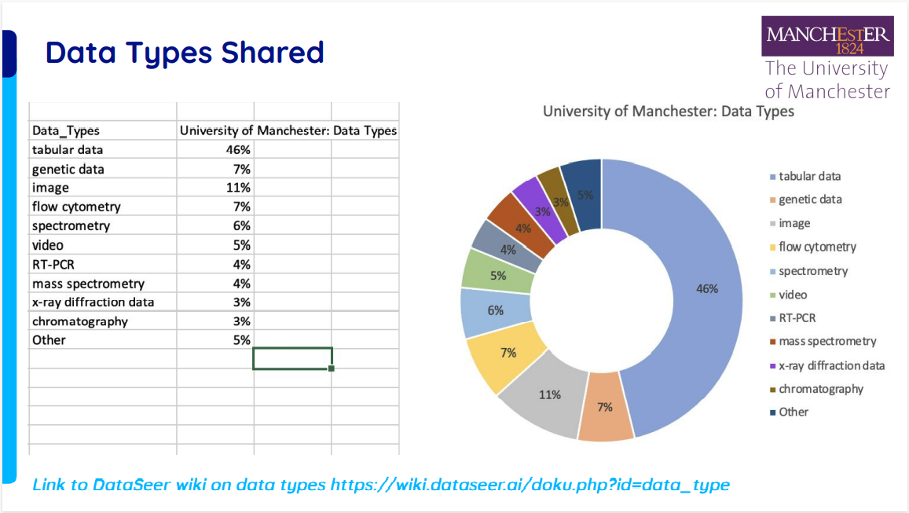
OR3: Open Research Indicator Framework
Open Research Tracker
Open Research Indicators
Open Research Reports

Slide 34
OR4: Data Stewardship Project
Establish a network across UoM
Role description templates
Provide support and training

Slide 35
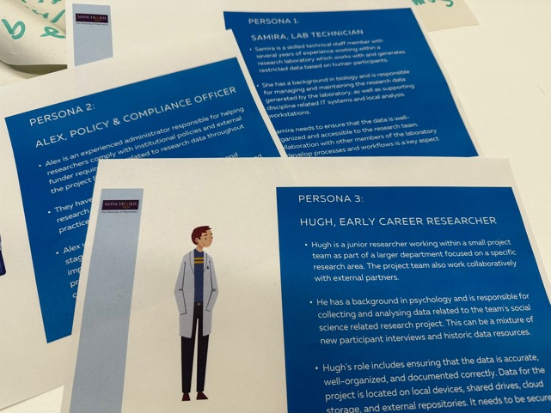
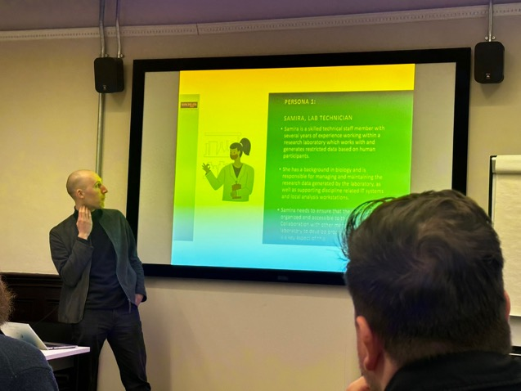
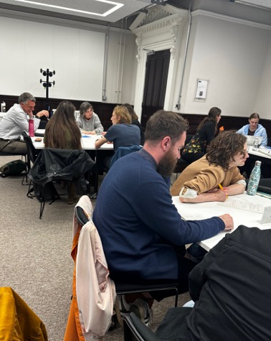
OR4: Data Stewardship Project
Role description templates
Establish a network across UoM
Provide support and training

Slide 36
OR5: Trusted OR Systems

Slide 37
Creating a single point of contact with the expert open research support available across the University.
Registered Reports
Open methodology
Open code
Responsible Metrics
Pre-prints
Open monographs
Open Access
Open data
Open research skills
Citizen Science
Co-production
Public Engagement
www.manchester.ac.uk/openresearch

Slide 38
Office for Open Research
OOR Team
Head of OOR
1x Project Manager
1x Programme Co-Ordinator
1x Programme Assistant
0.2 FTE Programme Manager
Library | Research IT | Research Strategy | Research Degrees and Researcher Development | Research Governance, Ethics and Integrity | Research Services | Information Governance | Manchester University Press | Communications and Marketing | Open Research Network

Slide 39
Open Research Service Partnership
Library | Research IT | Research Strategy | Research Degrees and Researcher Development | Research Governance, Ethics and Integrity | Research Services | Information Governance | Manchester University Press | Communications and Marketing | Open Research Network
Single access point
Triage enquiries
Project collaboration
Sharing knowledge

Slide 40
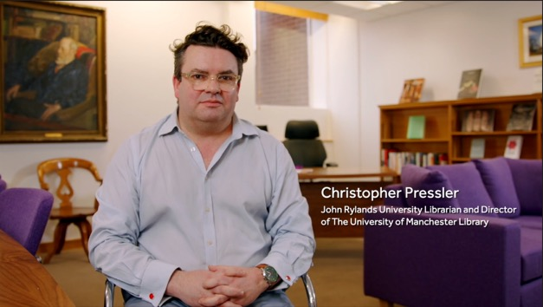
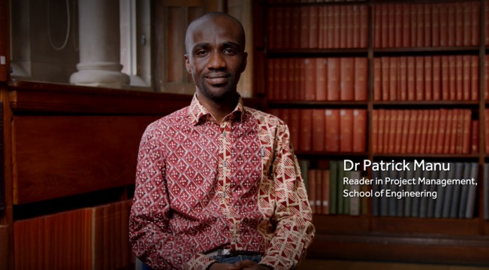
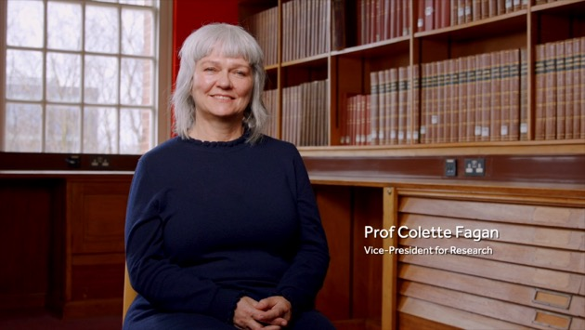
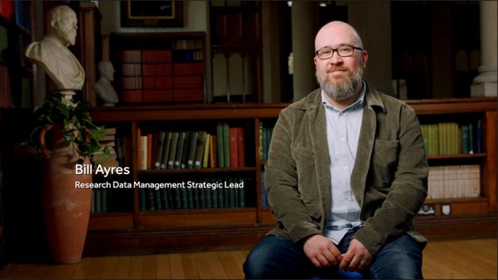
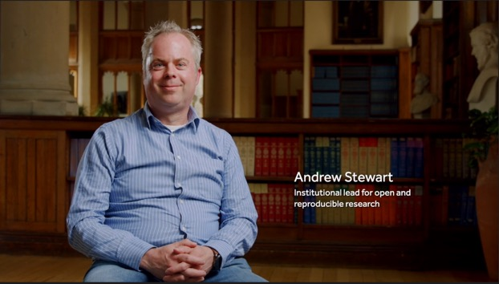
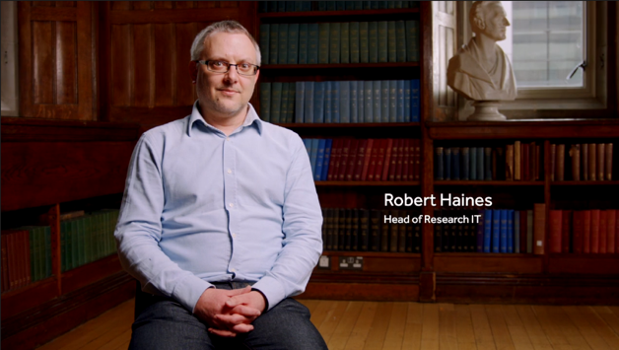
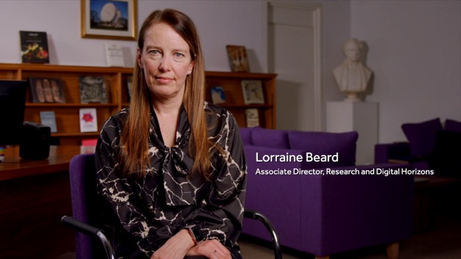
Supporting Open Research communities within the University and beyond.

Slide 41
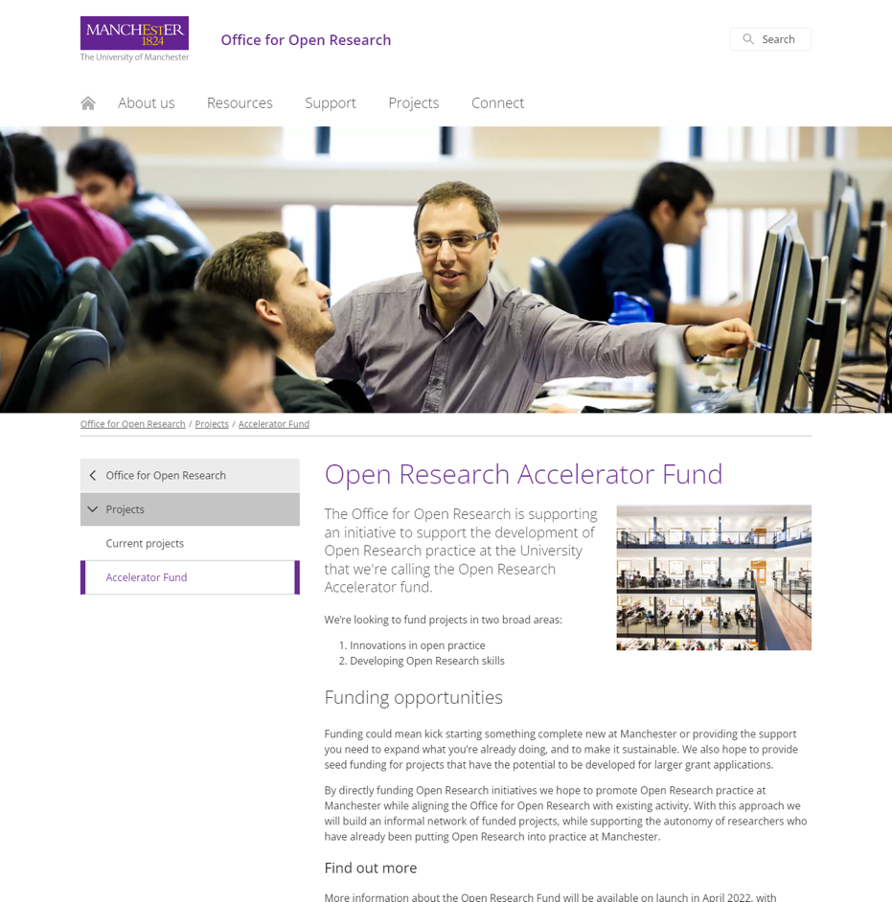
Open Research Accelerator Fund
New fund open April-June to support projects in two broad areas
Innovations in Open Research practice
Developing Open Research skills
This approach allows the Office to support an informal network of funded projects, while supporting the autonomy of researchers who have already been putting Open Research into practice at Manchester.
This year we have received over 30 applications from all parts of the University, totalling £312,000.

Slide 42
Open Research Accelerator Fund
Neil Mitchell (Faculty of Science and Engineering): Focused on improving the transparency, accessibility, and reusability of scientific ocean drilling data.
Lukas Hughes-Noehrer (Faculty of Science and Engineering): Investigating open-source software and code at the University of Manchester.
Nuno Pinto (Faculty of Humanities): Developing decision support systems for local community engagement in Moss Side.
David Buil Gil (Faculty of Humanities): Creating CrimRxiv, a global open access hub for criminology.
Cristina Temenos (Faculty of Humanities): Exploring Zotero’s capabilities as an open data interface.
Siobhan Caughey (Faculty of Humanities): Developing a psychophysiological database of emotion elicitation.
Patrick Parkinson (Faculty of Science and Engineering): Understanding open research practices in the natural sciences.
Akinloluwa Babalola (Faculty of Science and Engineering): Developing an implementation flowchart for open research awareness among engineering postgraduate students.
Francisco Espinoza (Faculty of Humanities): Sharing best practices for open research in political science.
Paul Stott (Faculty of Biology, Medicine and Health): Designing and conducting open and reproducible experiments in linguistics.

Slide 43
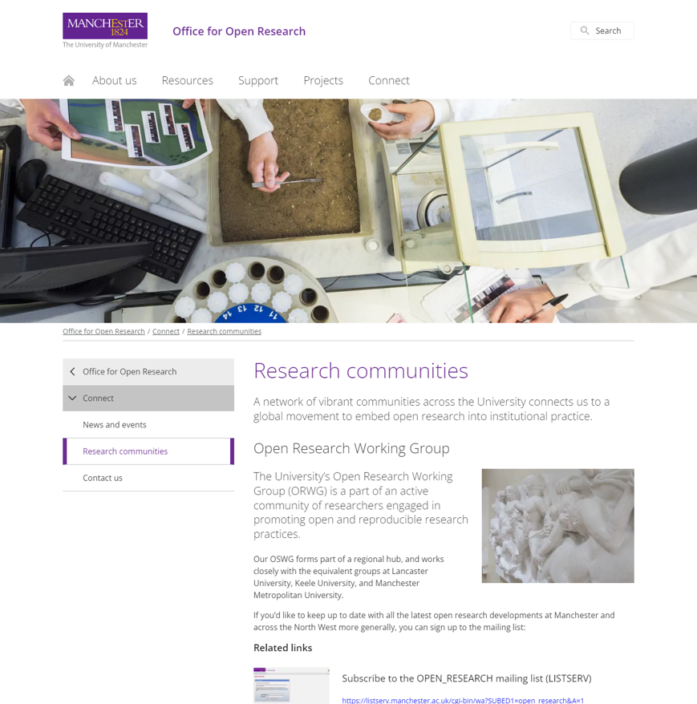
Open Research Action Group
This academic-led group’s purpose is to draft policies and recommendations for the Open Research Strategy Group to:
guide our University's approach to openness and transparency in research, and
ensure that the infrastructure is in place to support colleagues in conducting research in as open and transparent a manner as possible.

Slide 44
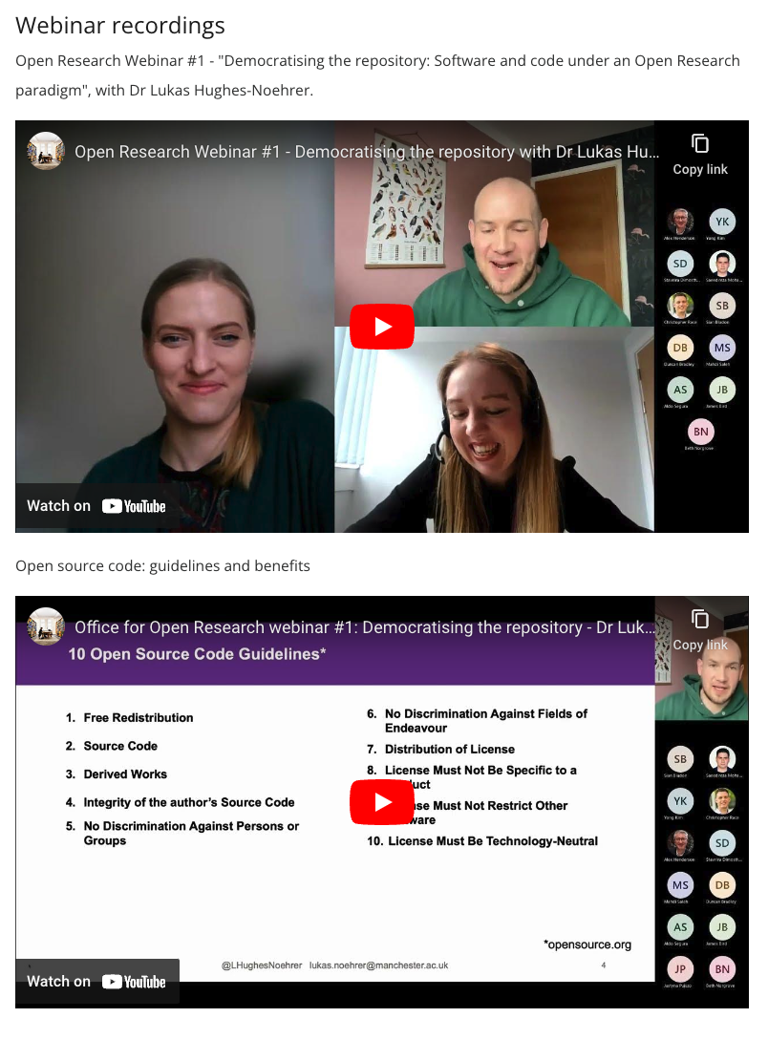
Open Research Webinar Series
Led by expert academics and research staff, these sessions discuss developments in research methods and consider practical ways towards open practice.
We invite all researchers, from Manchester and beyond, to attend an opportunity to contemplate the big questions in the open research movement, hear about exciting research and network with fellow academics.

Slide 45
Open Research Networks
An Open Research Network mailing list, a growing community of 200+ members.

Slide 46
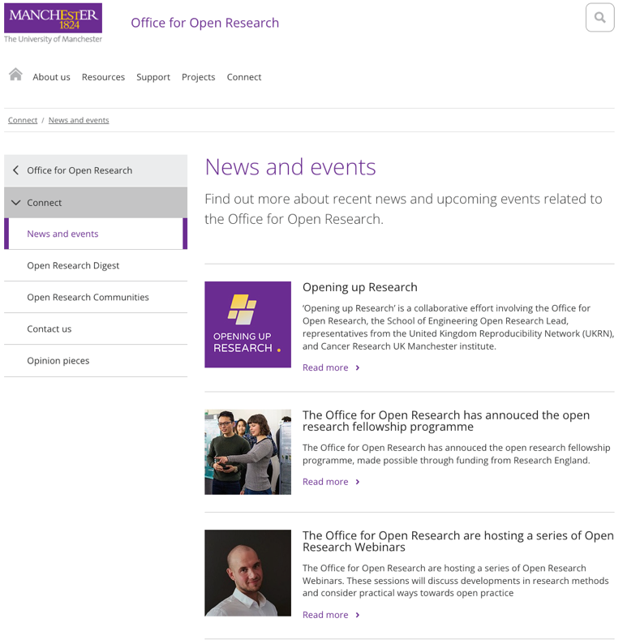
Championing Open Research and sharing the latest Open Research news.
Open Research News
Regular news items on the website
Open Research monthly digest

Slide 47
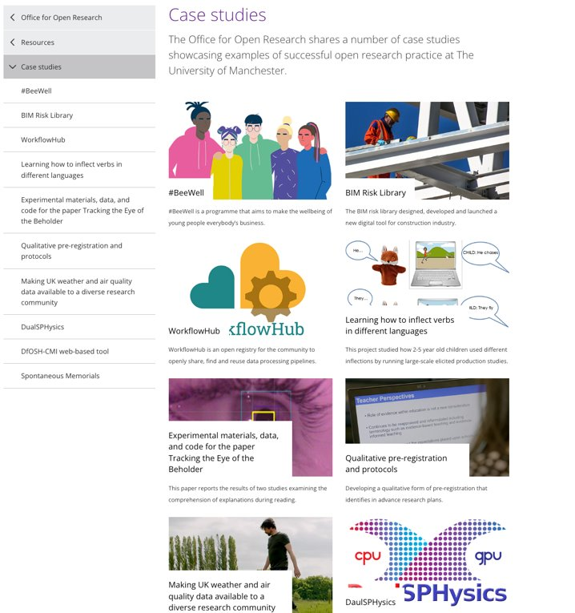
Open Research Case Studies
A wide range of open research case studies were submitted as part of a call via the Open Research Network.
Each case study has been written up and shared on the Office for Open Research website
A selection of case studies have had an accompanying video created.

Slide 48
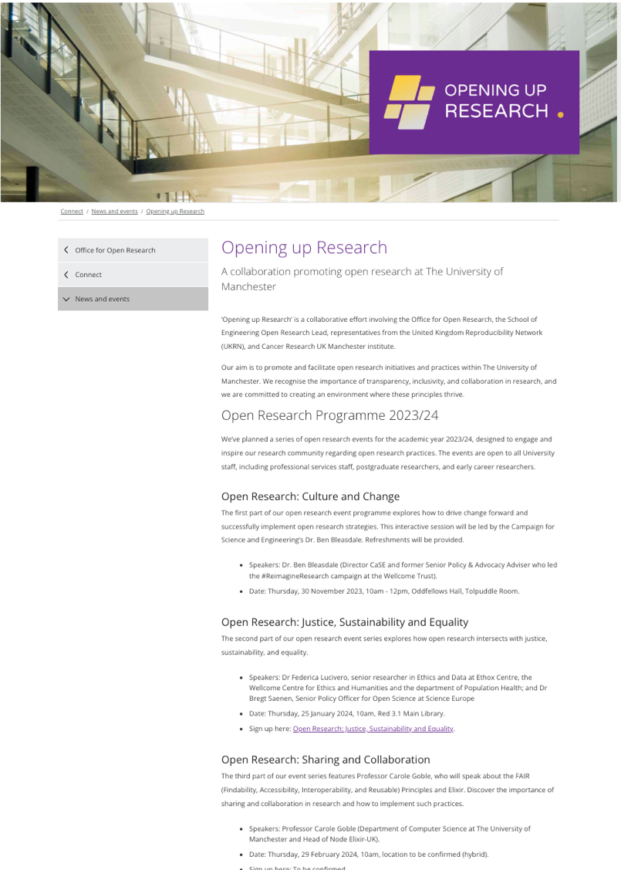
Opening up Research
A collaboration promoting open research at the University of Manchester

Slide 49
Thank you!

