Slide 1
OCLC RLP Webinar
March 12, 2024
Exploring Computational Description: LC Labs Planning Framework in Action
Caroline Saccucci & Abigail Potter
Library of Congress
Washington, D.C.

Slide 2
Elements of Machine Learning
Processes that are trained to recognize and predict patterns in data

Slide 3
LC Labs AI Planning Framework
Understand
Experiment
Implement
Governance + Policy

Slide 4
Understand
Experiment
Implement
Risks & benefits
Strategy & Roadmap
Data readiness
Skills & Capacities
Shared Quality Standards
Practices & Documentation
Collaborate & Assess
Policies & Standards

Slide 5
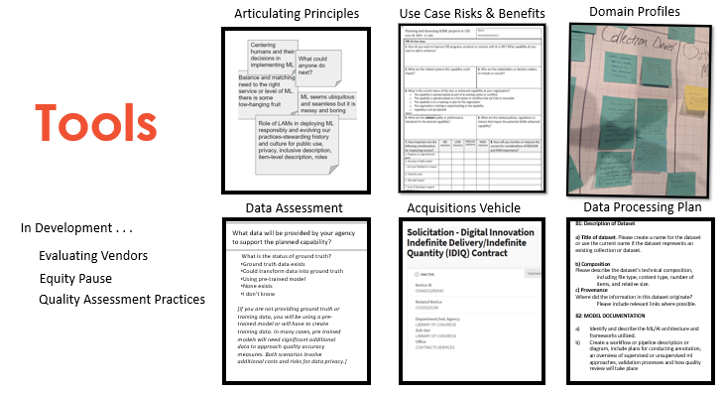

Slide 6
Executive Order 13960 – AI Principles
Principles & Values
Lawful and respectful of our National’s values. Especially those addressing privacy, civil rights, and civil liberties.
Purposeful and performance-driven. Use AI for specific use cases when the benefits outweigh risks and the risks and can be assessed and managed.
Accurate, reliable, and effective.
Safe, secure, and resilient.
Understandable by subject matter experts and users.
Regularly monitored. Periodically test AI systems for adherence to these Principles.
Transparent. Disclose the use of AI to stakeholders, including Congress and the public.
Accountable. Ensure proper use of AI and training to staff.
Executive Order 14110 – AI Policy + Principles
Be safe and secure
Promote innovation, competition and collaboration
Support American workers
Advance equity and civil rights
Protect consumers
Protect privacy and civil liberties
Train gov staff and recruit technical talent
Lead globally

Slide 7
Potential AI Principles?
Very important
D.E.I.
Leverage collections
Able to have limits
Appropriate to the problem
Most important
Sustainable
Able to have limits
Useable
Ensuring privacy when necessary
Inform users
Trustworthy
Replicable
Accessible
Traceable
Secure
Connects to all levels of expertise
Robustness / Resilient
Quality and Trust
Accountable
Responsible
Auditable
Transparent – open about who made it?
Approachable
Controllable / governable

Slide 8
Example domain profile
Local & Domain Expertise
Example domain profile for libraires, archives, museums
Discovery at scale Generating metadata for items, pages, articles, paragraphs to enhance search and discovery OCR Speech to text Named entity linking | Enabling research use Making data and guides available for researchers and other users to analyze or process Text mining Sentiment analysis Genre classification
Improving staff workflows For local content management and preservation Automatic classification and sorting Machine generated MARC records Identifying PII or other content | Augmenting user services Enhancing public-facing services Recommending systems Chat bots Voice search

Slide 9
Use Case: Risk and Benefit Analysis
https://github.com/LibraryOfCongress/labs-ai-framework/blob/main/Understand/Use_Case_Assessment_Worksheet_2023-11-15-draft.docx
Very high-risk use case. Plan for significant research, development and testing before implementation. Performance must meet the current state of the art for AI safety, trustworthiness, and quality. Quality benchmarks and controls need to be developed and thoroughly tested for even and consistent performance. ​
High risk use case. Experiment, test and pilot these solutions prior to implementation. Baseline quality metrics need to be established. ​
More information and detail are needed prior to moving forward.​
Moderate risk use case. If you want to buy or acquire AI services for this risk level, verify published performance metrics are achievable with your data and use case. ​
Low risk use case. It is likely appropriate to research and request to purchase tools or services available in the marketplace that meet quality standards.​
A mix? Where do you have the most As and Bs? That will tell you where to focus risk mitigation efforts. Your Ds and Es will point to where the conditions for risk are lowering.

Slide 11
Why This Experiment Now?
LC Labs was looking for AI/ML experiment project partners
ABA had large quantity of uncataloged ebooks from various acquisition workstreams, primarily via CIP Program
Metadata creation of born-digital content is the perfect test case
Funding provided via the National Digital Trust Fund

Slide 12
Goal for Exploring Machine Learning

Slide 15
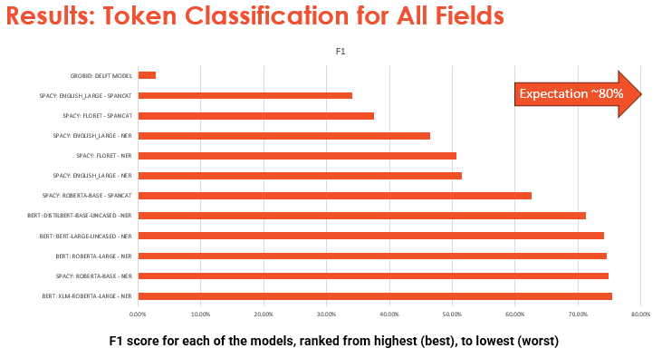

Slide 16
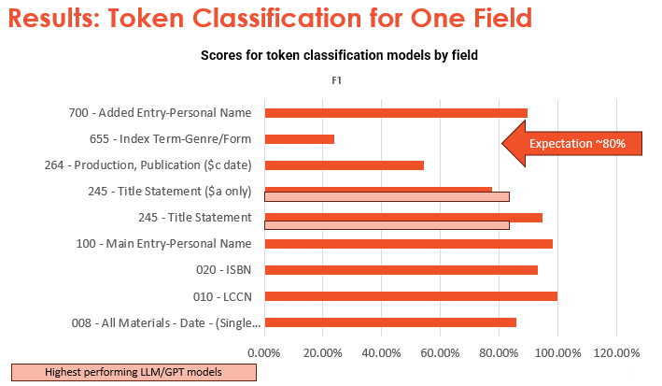
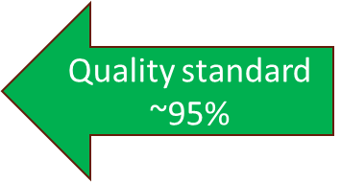

Slide 17
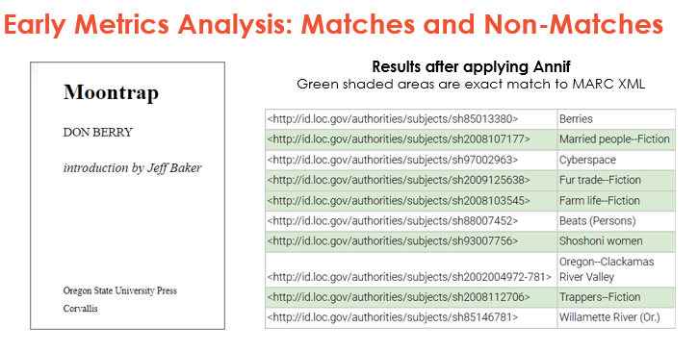

Slide 18
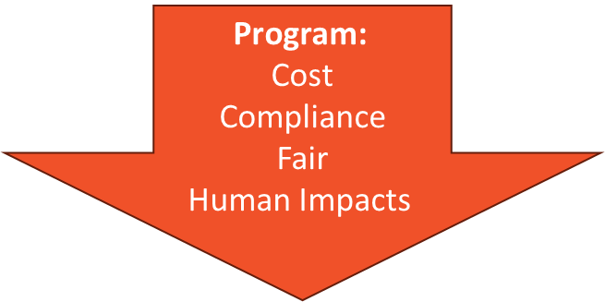

Slide 19
Assisted Cataloging HITL Prototype

Slide 21
