Slide 1
Polite, Precise, Powerful:
Building capacity and facilitating connection with a Chatbot
Leeanne Morrow, AUL – Student Learning and Engagement
Paul R. Pival, Research Librarian – Data Analytics
Kim Groome, Information Specialist – Chatbot Administrator
2024, November 20

Slide 2
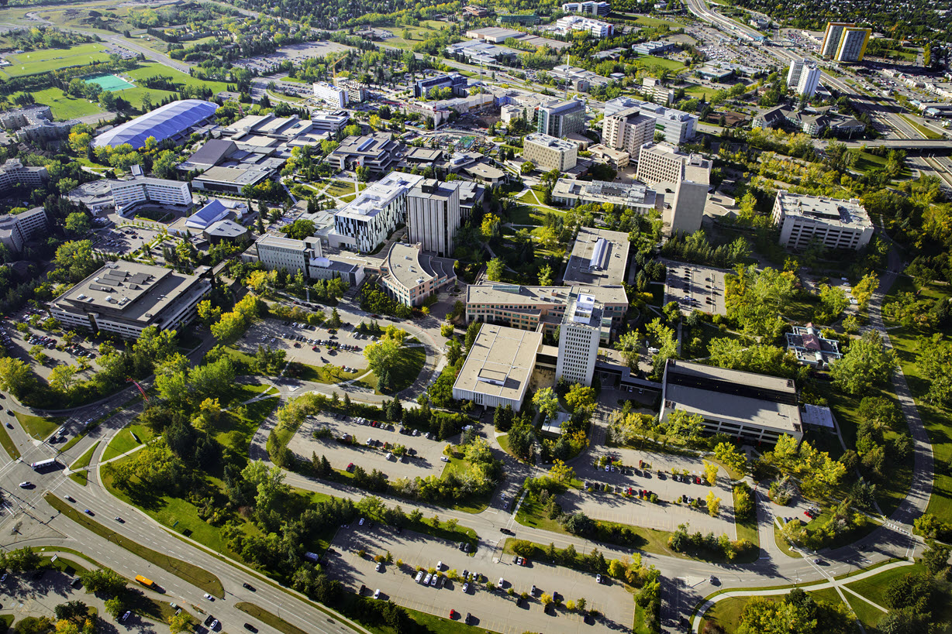

Slide 3
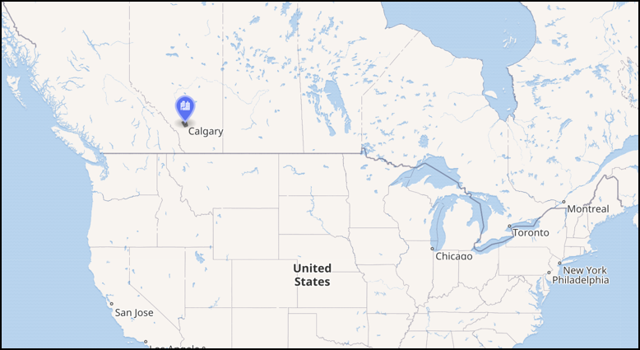
Introduction
Welcome! We are here from UCalgary Libraries & Cultural Resources to recount the tales from our T-Rex chatbot journey, stopping to reminisce about milestones such as:
Inspiration
Preparation
Implementation
Evolution
Fruition
Reflection
Recommendations
Assessment
Discussion

Slide 4
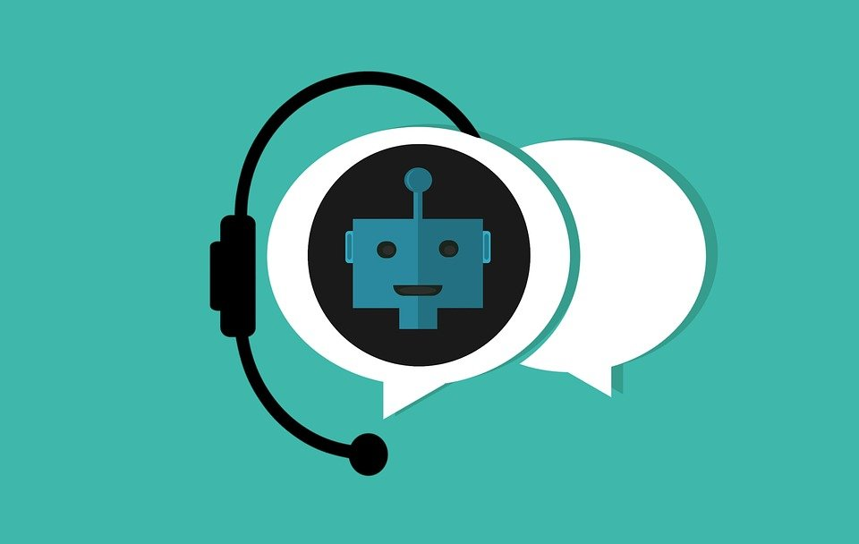
Chat Service in the Library
Chat service offered for 12+ years.
Responsive Chat implemented 5 years ago.
Heavier use of Chat during Covid and remote learning.
Staffed daytime hours 9:00 – 5:00.
Why we moved to a Bot:
Volume was high
Many directional/basic questions
Students needed help outside regular hours

Slide 5
Inspiration
Due to high use we asked, “Would a Bot help provide more service options for students?”
The Pandemic response answered, Yes!
Students are top priority for Libraries and Cultural Resources
UCalgary campus chatbot solution

Slide 6
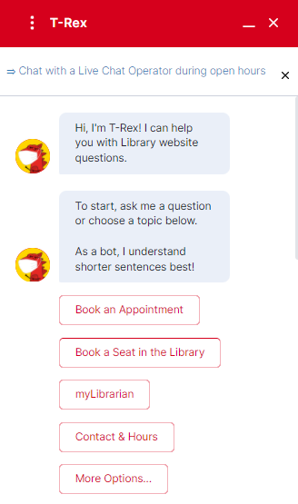
T-Rex @UCalgary
Implemented in the Library in August 2021.
Addressed the need of higher demand during remote learning.
Chose particular vendor similar to libraries in USA.
Registrar also used same Bot platform so there was a need to differentiate.
Requires a Bot Administrator.

Slide 7
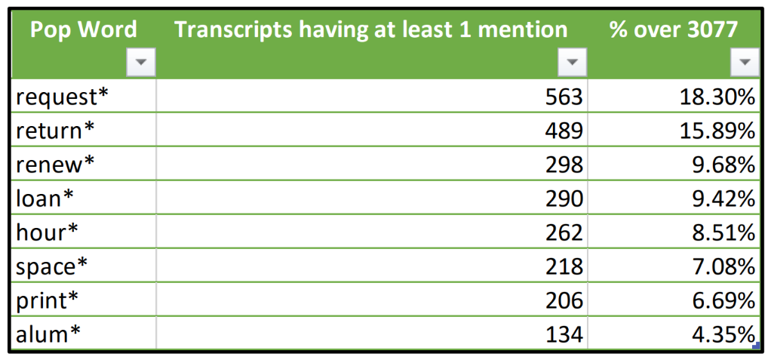
Preparation
How useful could the bot be?
Used previous live chat questions to determine the most common topics
14-24% were consistently directional questions and definitely could be answered by a chatbot

Slide 8
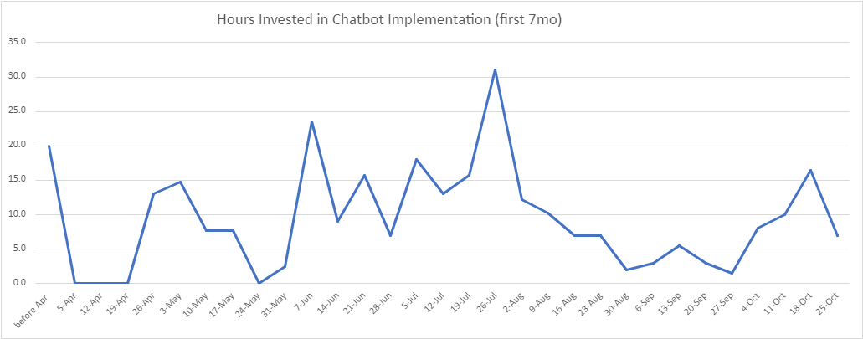
Implementation
2021 April kick-off
2021 May-June Staff Implementation Team (SIT) testing bot
2021 July all library staff testing bot and giving feedback to SIT
Focused on the top asked questions
2021 August 16th live

Slide 9
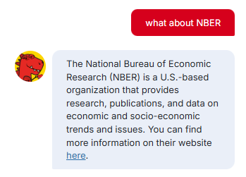
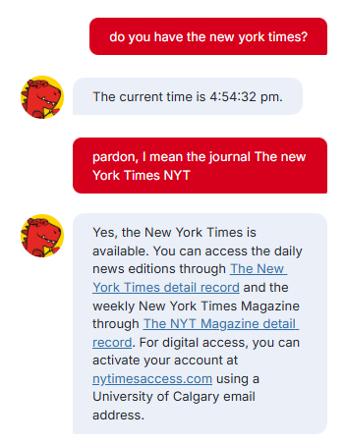
Evolution
2021 August, the Ivy.ai chatbot had a machine learning "brain bank"
Chatbot brain loaded with
Library website elements,
FAQs,
and more to feed the chatbot brain
By 2023 February, the system was updated to IvyQuantum where the tool generated its own responses to compliment the custom responses.

Slide 10
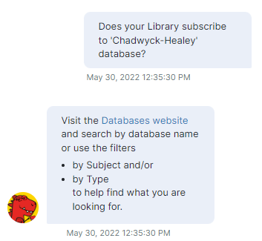
Fruition
T-Rex very accurate for directional questions
T-Rex a 3.7/5.0 for other questions, but not perfect
T-Rex is fast and consistent
T-Rex offers help with website navigation 24/7
T-Rex frees up staff time for higher-level tasks

Slide 11
Estimated v Actual topics answered by T-Rex

Slide 12
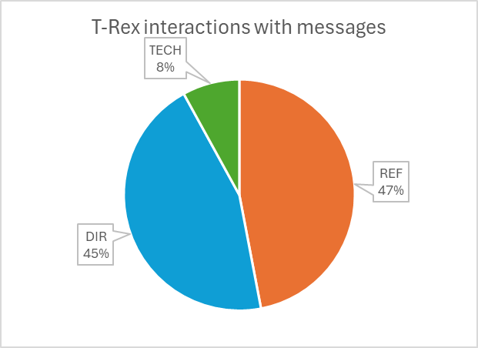
Types of questions Live Chat v T-Rex answers
Source: based on the numbers from Brosz, J., Guy, J., & Groome, K. (2022, August 23). T-Rex: Numbers, naughtiness, next steps. UCalgary Staff Training Day.

Slide 13
Reflection
Every tool has weaknesses, including T-Rex.
The biophilic nature of people – AI anxiety is a thing
People prefer a clear and direct answer now – not more links
People often ask non-library questions – which the bot is not trained on
Opportunity cost – what are the person-hours time for maintenance
Risk of incorrect information from bot – to reputation, to brand
Source: Lewis, C., Keiller, K., Bennedbaek, D., & Groome, K. (2024, May 15). Are you real? The library AI chatbot. Marigold Library Conference.

Slide 14
Recommendations
Plan on success – define what success will look like before the project starts
Build capacity, improve morale, free staff to do higher level tasks
Aimed to delegate 14-24% of questions to bot, ended up deflecting between 45-60%
Change management – invite staff into the project, even the biggest detractors can turn into project advocates.
Be ready for opportunity – shovel-ready projects in the pocket just in case.
Assessment – look at different ways to make the chatbot service better for the student experience, always room for improvement.

Slide 15
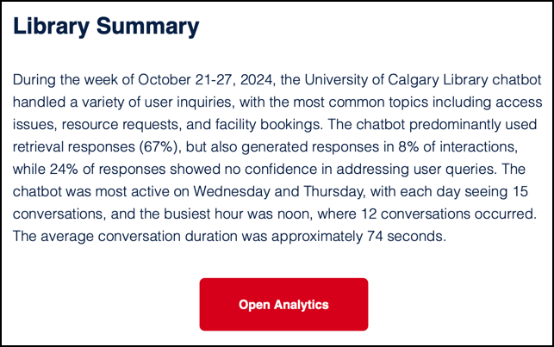
Assessment
Initial Survey
Ongoing with Weekly Insights
Administrative Dashboard

Slide 16
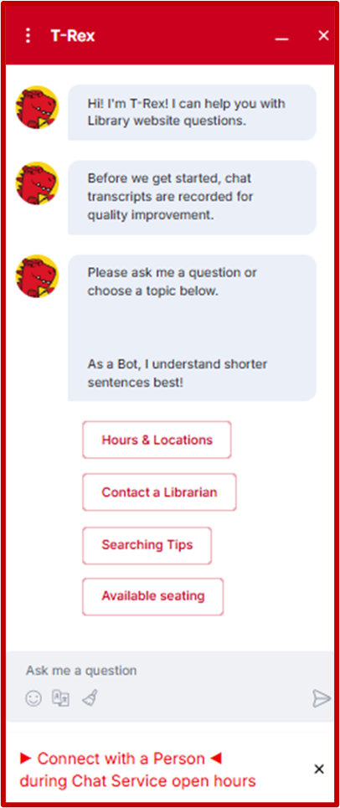
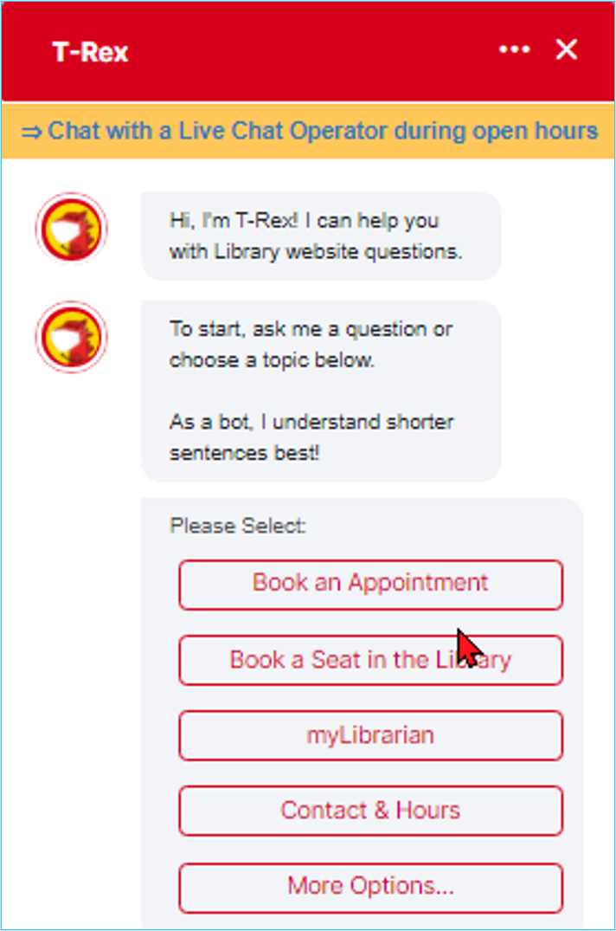
Assessment
Transparency re transcripts
Evolution of patron needs re hot buttons
"Connect with a person" using the words that patrons prefer

Slide 17
Assessment

Slide 18
Bot Data Uses - Academic Integrity Bot Project
Examine the previous data to see what students were asking
Examine how the Bot was answering current academic integrity questions (if any)
Find the gaps and design questions that the Bot should be able to answer
Fix the Bot
Test the Bot

Slide 19
Remaining questions included queries around:
copyright,
grammar checkers,
seeking writing support

Slide 20
Fixing Existing Questions

Slide 21
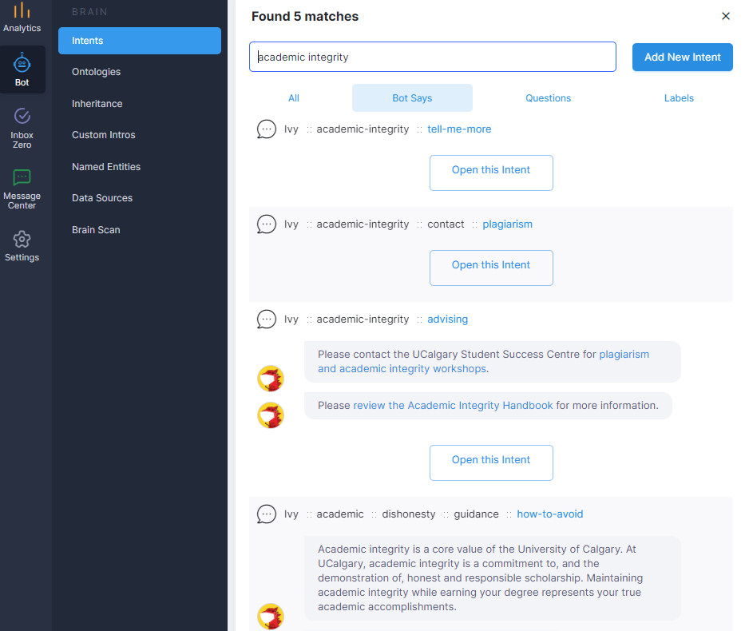
Adding New Content
Reviewing commonly asked questions from data.
Meeting with Academic Integrity Coordinator to review.
Creating “Intentions” to add to the Bot:
Adding a questions
Linking it to current content scraped from your site
Creating your own content for a response including videos, images etc.

Slide 22
AI approach @ucalgary
Chatbot service + Centre for Artificial Intelligence, Ethics, Literacy and Integrity (CAIELI)
https://library.ucalgary.ca/services/caieli
Focus on generative artificial intelligence
Responsive to student requests and current needs
Focus on supporting literacy for all of campus
Underpin it all with foundation in integrity

Slide 23
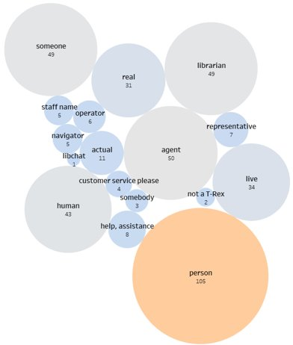
Reality
As much as T-Rex the chatbot has been helpful,
people still prefer humans.

Slide 24
Discussion

Slide 25
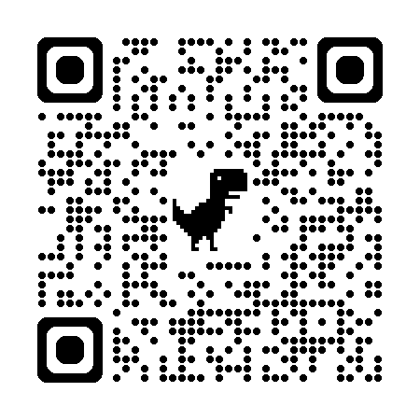
Thank you for attending!
To try T-Rex for yourself, https://library.ucalgary.ca/?chat=default
Leeanne Morrow lhlmorro@ucalgary.ca
Paul R. Pival ppival@ucalgary.ca
Kim Groome kim.groome@ucalgary.ca

Slide 26
References
Brosz, J., Guy, J., & Groome, K. (2022, August 23). T-Rex: Numbers, naughtiness, next steps. UCalgary Staff Training Day.
Guy, J., Pival, P. R., Lewis, C. J., & Groome, K. (2023). Reference Chatbots in Canadian Academic Libraries. Information Technology and Libraries, 42(4). https://doi.org/10.5860/ital.v42i4.16511
Lewis, C., Keiller, K., Bennedbaek, D., & Groome, K. (2024, May 15). Are you real? The library AI chatbot. Marigold Library Conference.
UCalgary. (2024). Facts and figures: UCalgary by the numbers. UCalgary. Facts and figures | University of Calgary
UCalgary Libraries. (2024). Staff directory. UCalgary. Staff Directory | University of Calgary Library

