Slide 1
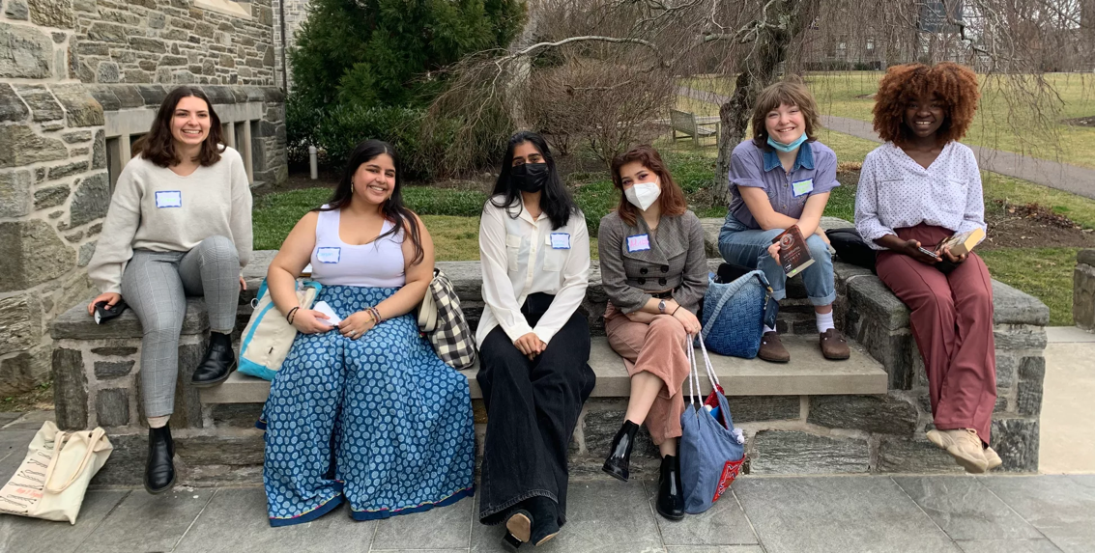
Diversifying library Collections through Student-led collection development
Bryn Mawr College

Slide 2
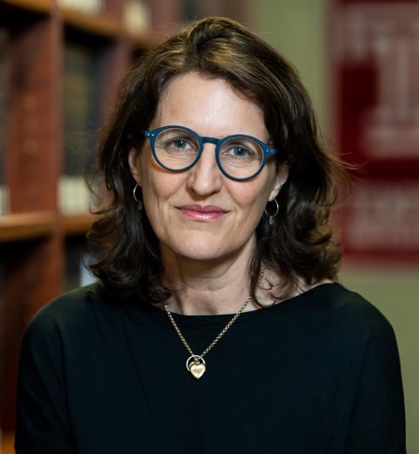
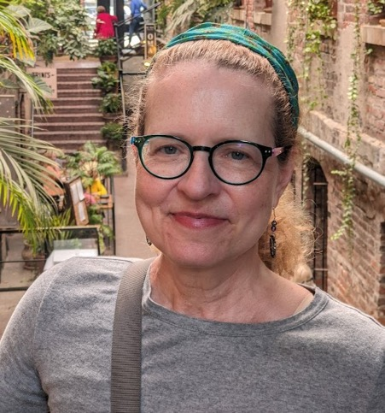
Librarians
Camilla MacKay
Director of Library Research and Instructional Services and Scholarly Communications Librarian
Library & Information Technology Services (LITS)
Arleen Zimmerle
Humanities and Media Librarian
Library & Information Technology Services (LITS)

Slide 3
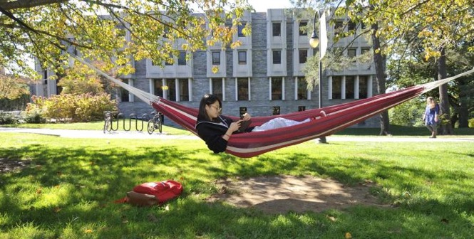
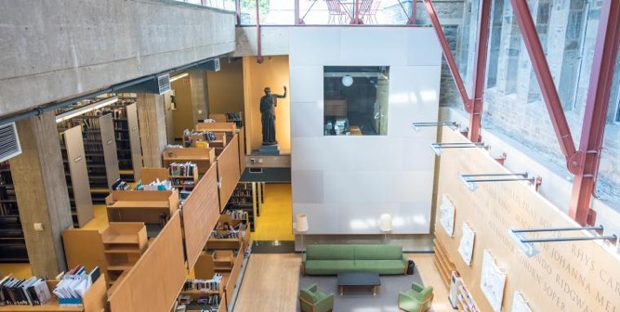
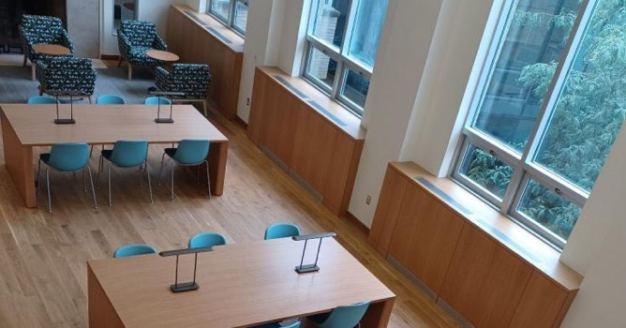
Bryn Mawr College
Liberal arts college outside Philadelphia
1,500 undergraduate women
300 graduate students (coed)
Libraries
Main and 2 branch (art & classics, science)
Share catalog and physical library collections with Haverford and Swarthmore

Slide 4
Diversity, equity, inclusion at Bryn Mawr
College mission statement
"...A across all aspects of diversity propels our students, faculty, and staff to reflect upon and work to build fair, open and welcoming institutional structures, values, and culture..."
Research & Instructional Services DEI goals
Increase diversity of authors, subjects, presses in our pleasure reading collection
Create relationships with and buy from local bookstores
Partner with acquisitions colleagues to involve students in selecting books

Slide 5
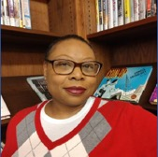
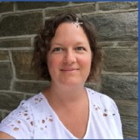
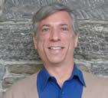
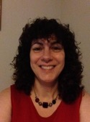
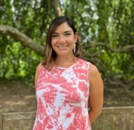
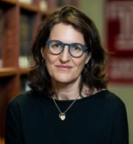
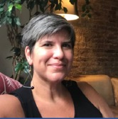
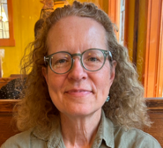
We joined forces...
Research & Instructional Services (RIS)
Joyce Bryant Angelucci, Kate Blinn, Jennifer Coval, Camilla MacKay, Laura Surtees, Arleen Zimmerle
Collection Management and Discovery (CMD)
Berry Chamness, Amy Graham
...to create Students Shape the Shelves
Goal: Promote diversity in the library collections by providing students with the knowledge and a budget to purchase popular reading material from Philadelphia independent bookstores whose collections reflect diverse voices.

Slide 6
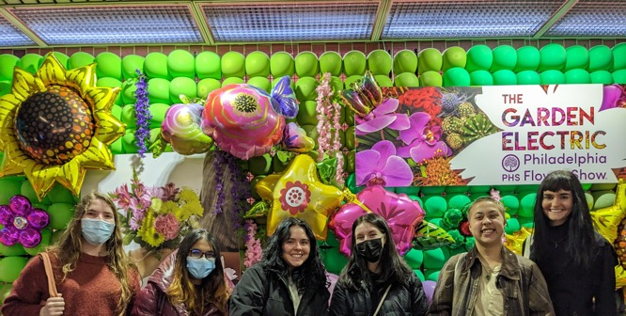
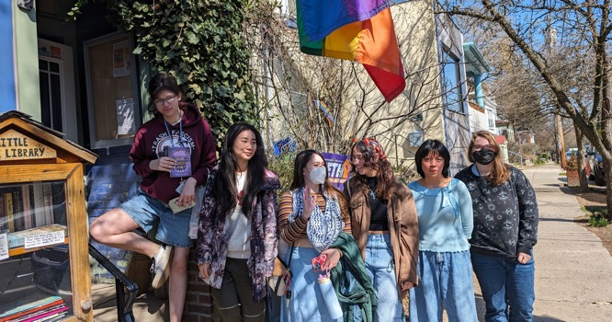
Students Shape the Shelves
Spring break
Weeklong paid internship: 6 students are hired and paid for a 40-hour week
Partner with independent bookstores in the Philadelphia area
Budget: $5,500 ($3000 books, $2500 student wages)

Slide 7
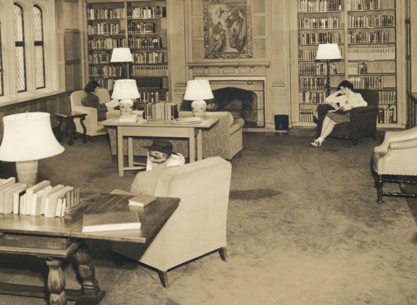
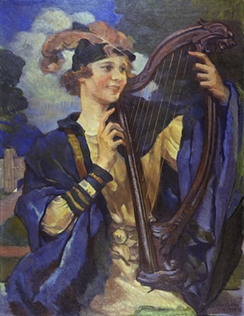
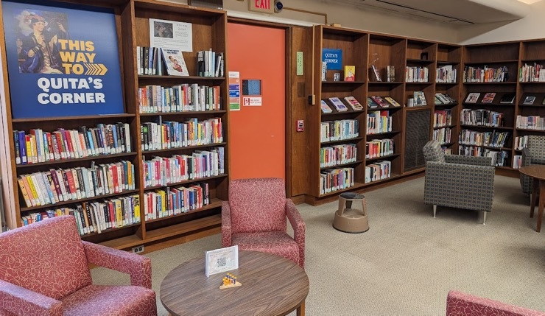
The Quita Woodward Room
Pleasure reading at Bryn Mawr
Quita Woodward ’32, died one year after graduation, her family created a space for pleasure reading in her memory
Quita’s portrait by Violet Oakley (1939)
Older books
Quita’s Corner
Started in 2006 to display new pleasure reading, graphic novels, literary fiction, etc.
About 2,000 books

Slide 8
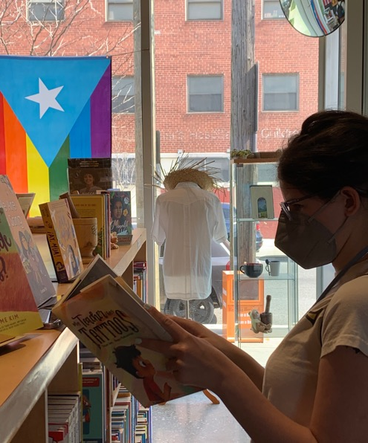
Our interns
Students apply with a resume and cover letter that states their reading interests & backgrounds
What do they really want to read? We don't have to guess; we'll just ask them!
Some of their interests:
LGBTQ+ stories from the Middle East
Modern Chinese, Japanese and Hebrew literature
Indigenous Latin American authors
BIPOC Speculative Fiction
Disabled / Neurodiverse stories/authors
Literature from small presses

Slide 9
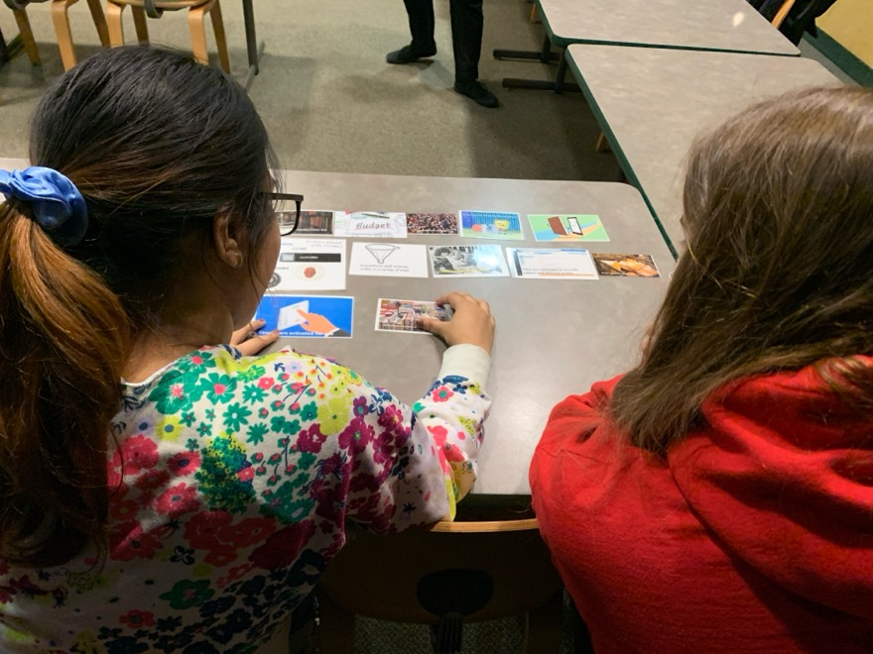
Collection development crash course
How a library book gets from selection to the shelves
How librarians discover and evaluate new titles
How libraries and bookstores select within a limited budget

Slide 10
Student Reflections

Slide 11
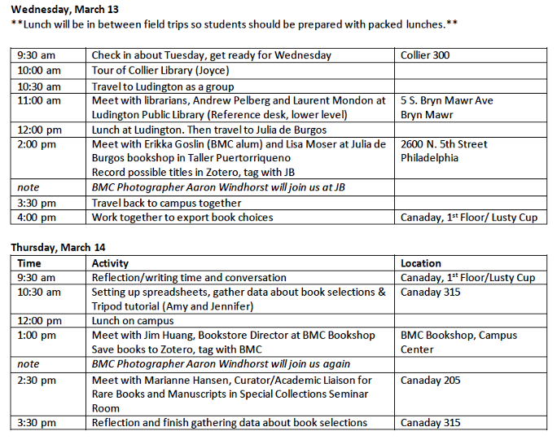
Daily Schedule

Slide 12
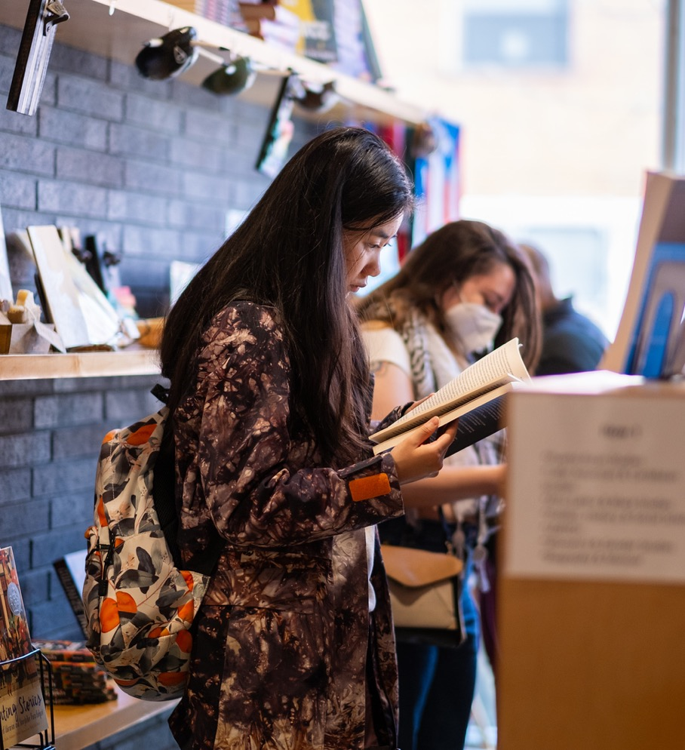
Bookstore visits
We chose independent bookstores that reflect their communities
We pre-scouted sites, arranged meetings with bookstore managers
Students interview managers
Students "shop" the store
We use Zotero app to scan ISBNs and collect titles to download later

Slide 13
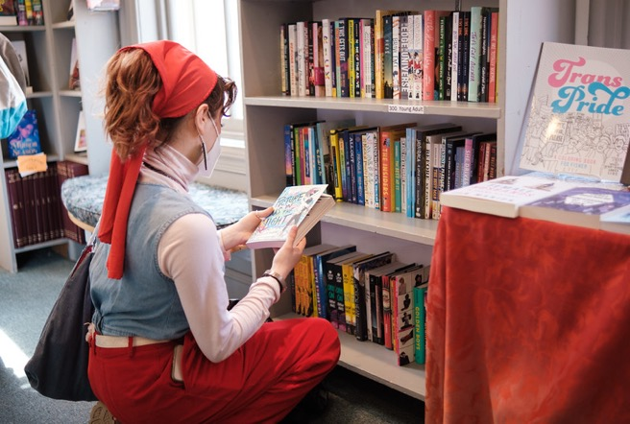
Philly AIDS Thrift @Giovanni’s Room Center City, Philadelphia
"The Oldest & Very Best LGBTQ & Feminist Bookstore in the Country"
https://www.queerbooks.com/

Slide 14
Uncle Bobbie’s Coffee and Books Germantown, Philadelphia
“Created to provide underserved communities with access to books and a space where everyone feels valued.“
unclebobbies.com

Slide 15
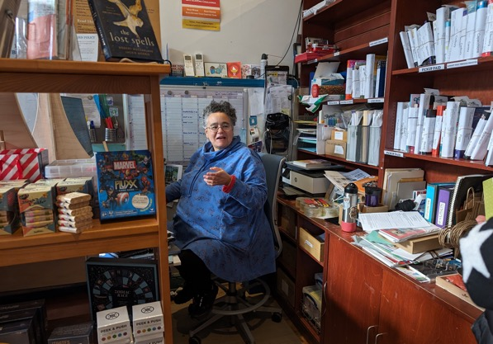
Big Blue Marble Mt. Airy, Philadelphia
"A reflection of our neighborhood—racially and economically diverse...full of parents and grandparents looking for the best children's books, LOTS of writers, and quite a large LGBTQIA community..."
bigbluemarblebooks.com

Slide 16
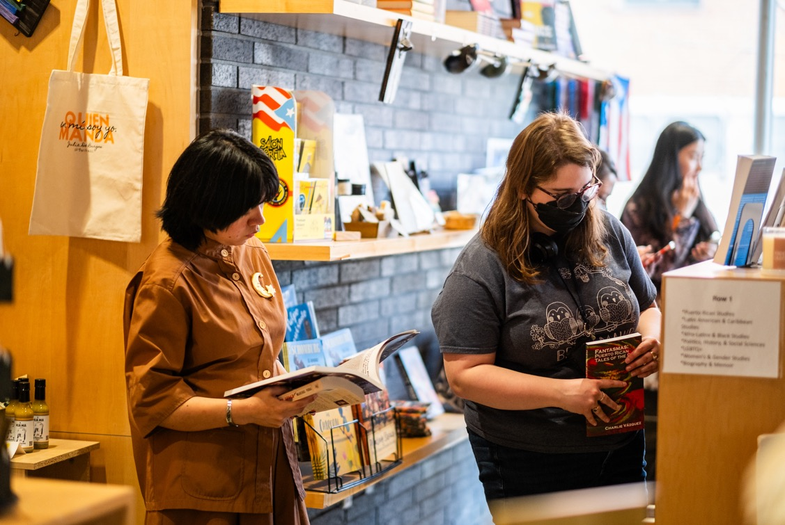
Julia de Burgos Bookstore West Kensington, Philadelphia Part of Taller Puertorriqueño, a nonprofit cultural center
"The only Spanish/English bookstore in Philadelphia... We specialize in books by Latine and Latin American authors, with a special focus on BIPOC, queer, and women writers“
shoptallerpr.org/

Slide 17
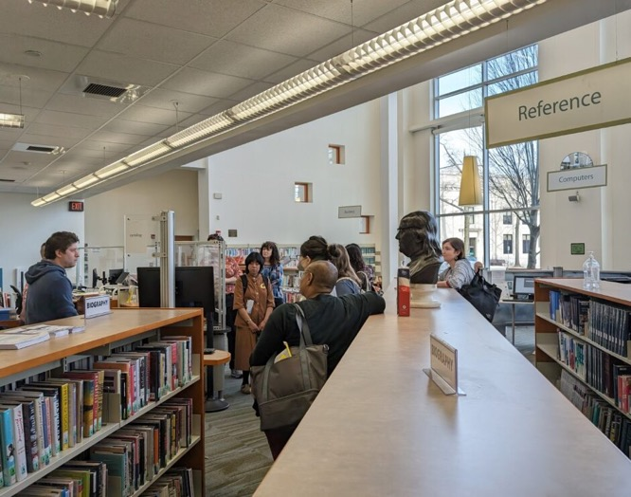
Ludington Public Library
Large and vibrant public library in Bryn Mawr, a short walk from campus
lmls.org/ludington

Slide 18
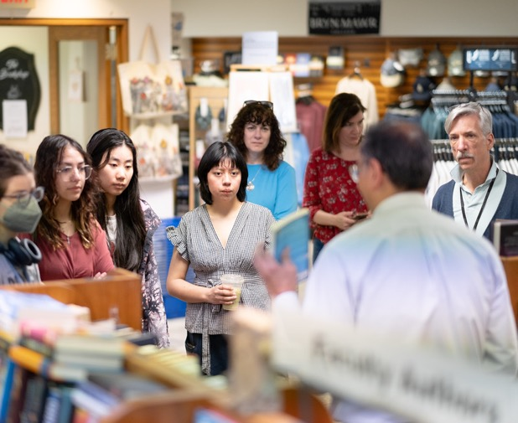
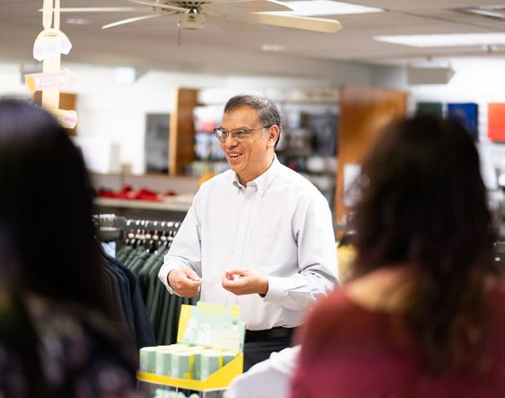
The Bryn Mawr College Bookshop
Previously run by Follett
Now independent: bookstore director with experience in college and independent bookstores and publishing

Slide 19
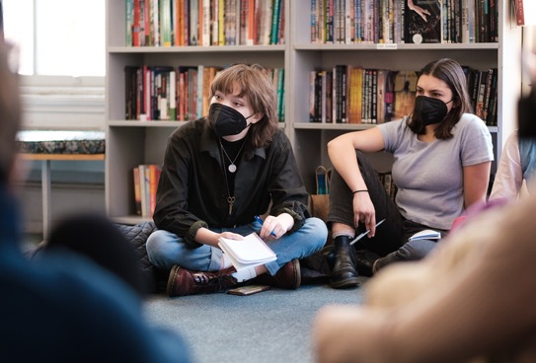
Students decide what to buy
Students
Collate book selections; check against library holdings
Review and discuss selections; decide together on final purchases
Create online presentation on Padlet to share their selections
Library Acquisitions
Checks list against library holdings again (just to make sure!)
Purchases ca. 100 student selections from the bookstores

Slide 20
Student-created Padlet

Slide 21
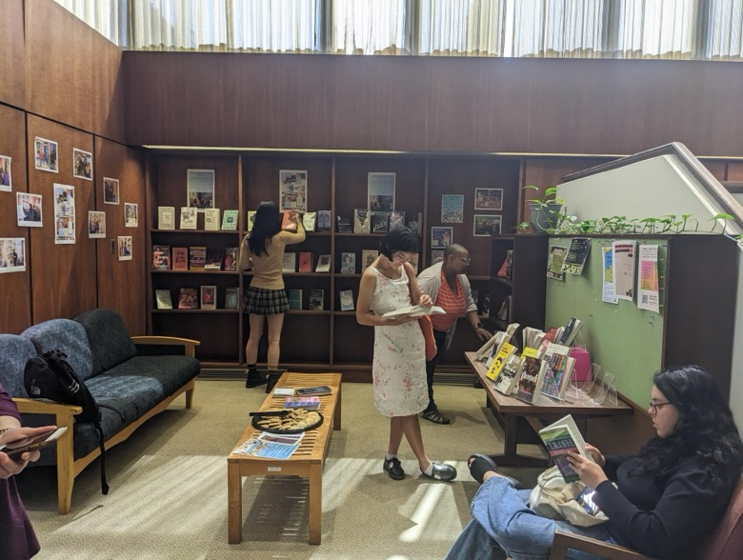
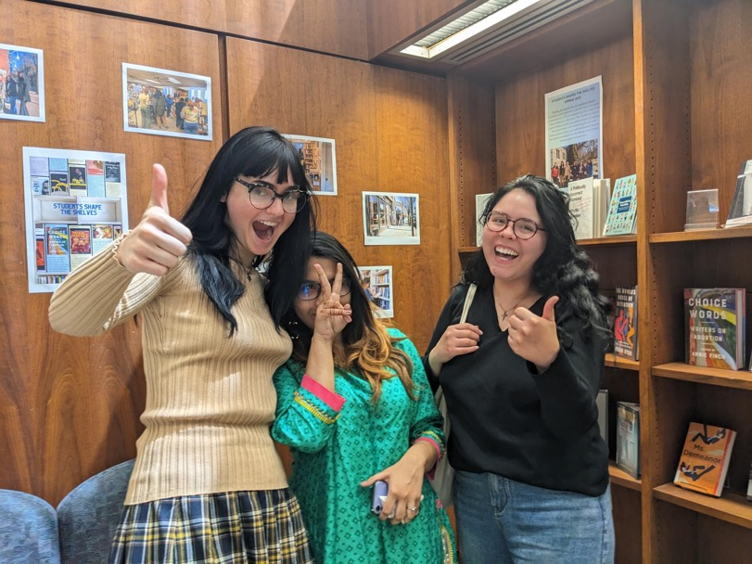
Public celebration and book display!

Slide 22
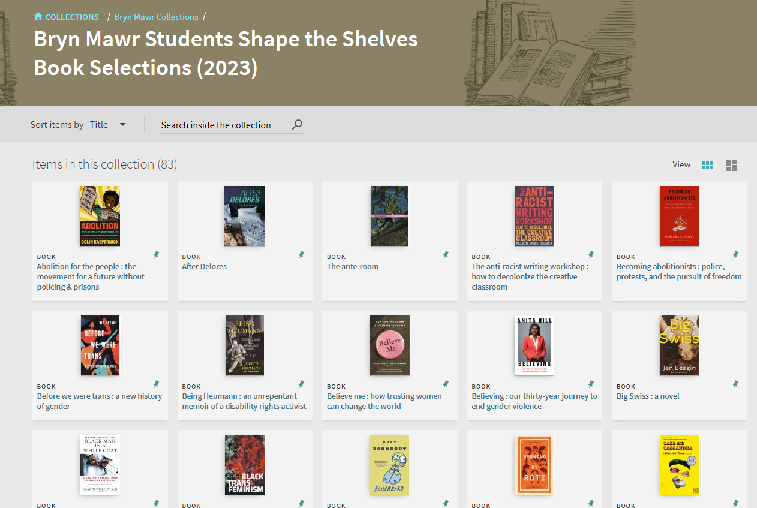
Collections
After books are off display, they are shelved in Quita's Corner.
Each year’s books are displayed through virtual collections

Slide 23
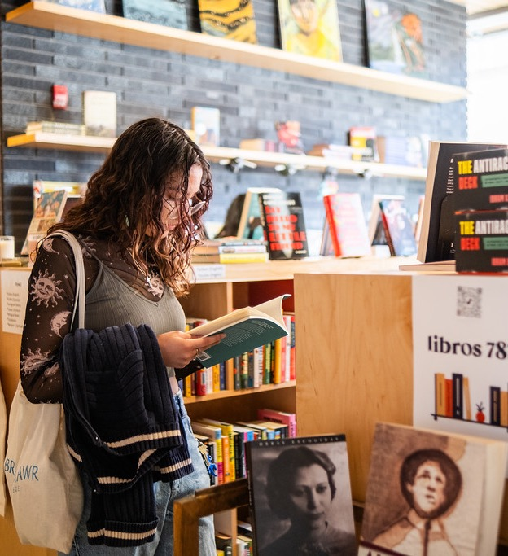
What the students learned
“Getting to see how my peers made their choices, and being able to talk openly…about what we really wanted our impact to be on this collection for our community… “
“How crucial library work is for supporting communities…There is so much to the process of acquisition and curation that goes unnoticed…”
“There is so much mentorship to be gained from librarians and bookstore sellers…
Discovery of library services!

Slide 24
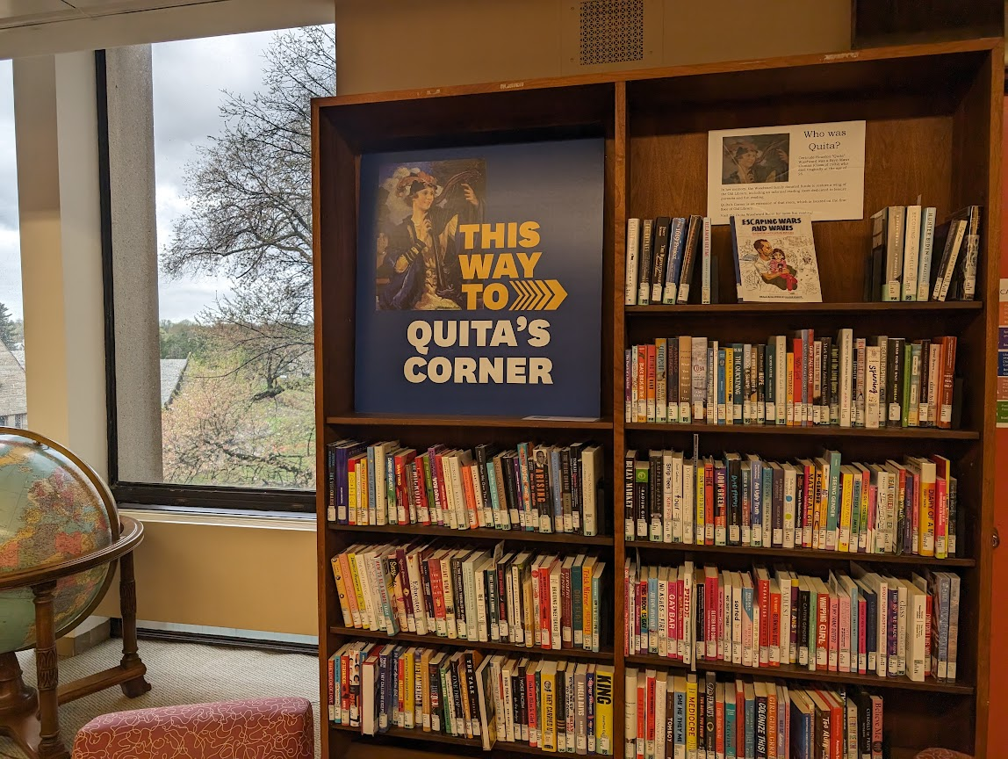
Assessing Students Shape the Shelves
What did the students choose?
Has the program had an effect on the diversity of our pleasure reading collections?

Slide 25
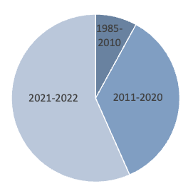
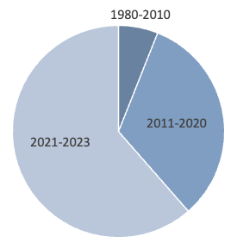
Publication dates
2022 (113 books)
2023 (83 books)

Slide 26
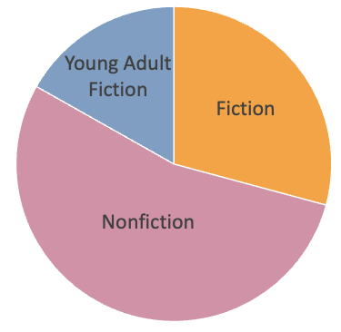
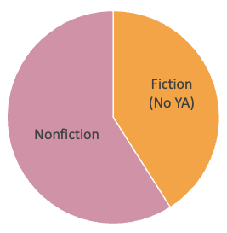
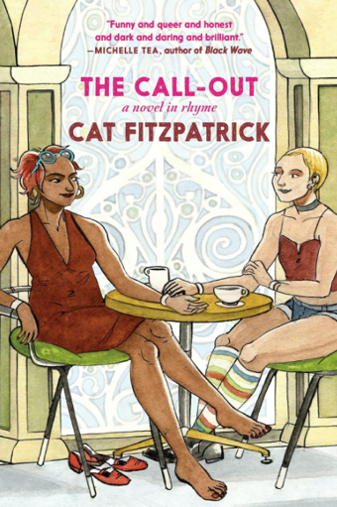
Fiction vs. nonfiction
2022 (113 books)
2023 (83 books)

Slide 27
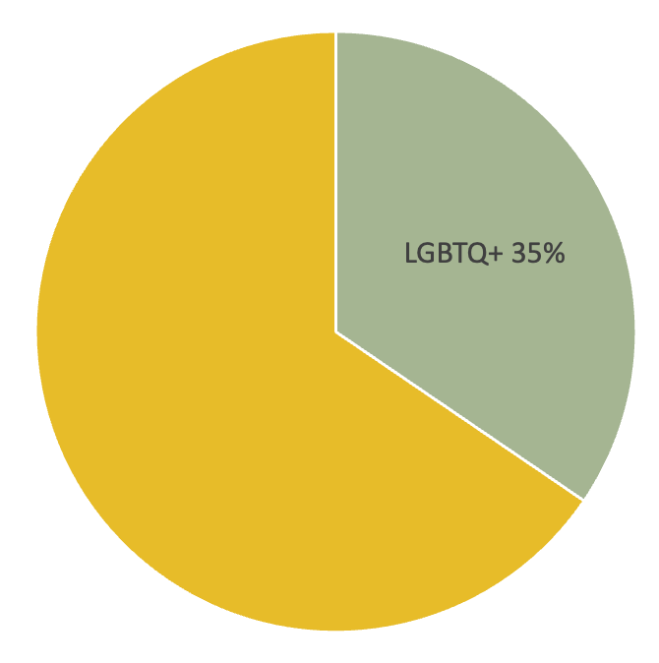
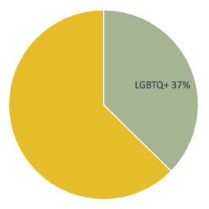
Authors & subjects
2022
2023

Slide 28
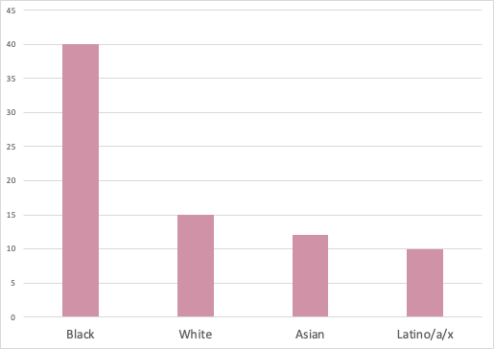
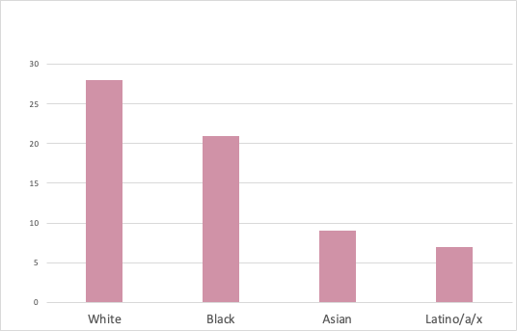
Authors & subjects continued
2022
2023

Slide 29
Drilling down
2023

Slide 30
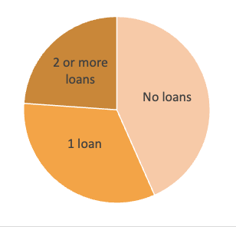
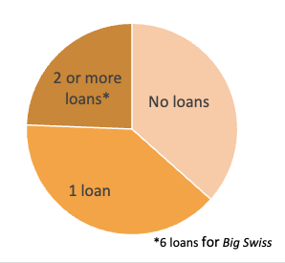
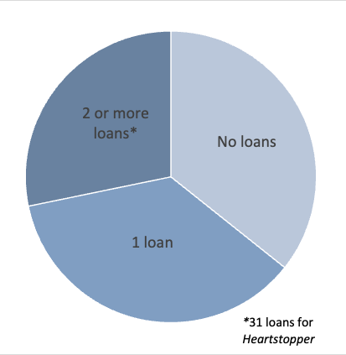
Circulation numbers
2022 selections
May '22-April '24
2023 selections
Loans May '23-April '24
Entire pleasure reading collection (ca. 2000 books)
Loans May '23-April '24

Slide 31
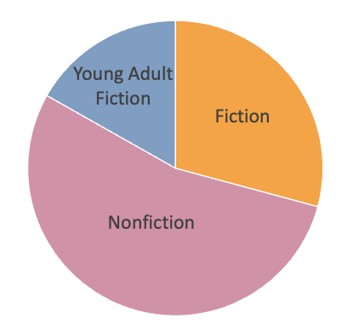
Young adult fiction
2/3 regular fiction & nonfiction circulated
2/3 YA fiction did not circulate
2022 selections
(Loans 2022-2024)
Lots of YA in 2022

Slide 32
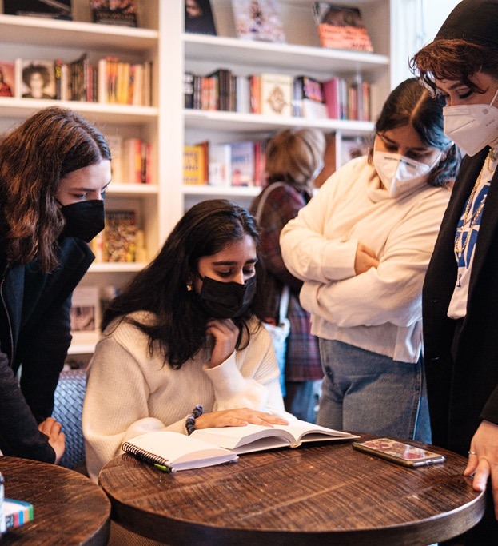
Achievements
Students' understanding of
Choosing, acquiring, and displaying books in libraries and bookstores
Themselves and libraries as consumers
How to navigate the library as more experienced users
Focused buying in diverse areas each year
Broader collection of books to share in our consortium and through ILL

Slide 33
New & enhanced relationships
Between library departments
With the Bryn Mawr Bookshop
With the local public library
With students

Slide 34
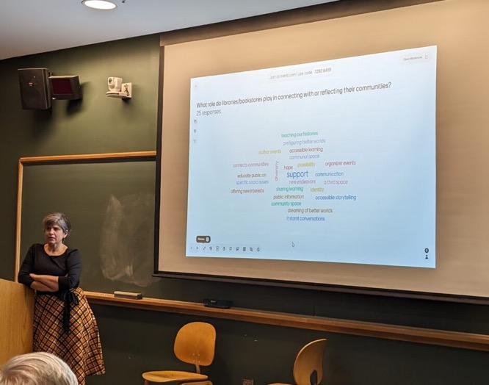
What we’ve learned
Easy to overbook the week
Don’t use library jargon & don’t assume students are library users
Running the program takes a lot of organization and staff time; best done by a group

Slide 35
What we've learned
Students select a lot of books we already own. (We've made it a “teaching moment” and have them create a display of these books.)
Students love seeing themselves represented in the collection; they tell their friends about the books they've selected and all about the library
The program seems to get better every year

Slide 36
Last slide

Slide 37
Thank you! Questions?
Students Shape the Shelves internship
https://guides.tricolib.brynmawr.edu/sss-internship
Camilla MacKay
cmackay@brynmawr.edu
Arleen Zimmerle
azimmerl@brynmawr.edu

