Slide 1
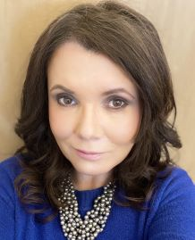
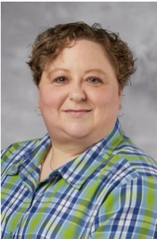
Towards Diversifying Collections: Implementing Strategies
Annette Day - Director, Collections, Discovery and Scholarly Communication
UNLV Libraries
Jen Culley - Lead Acquisitions Librarian
UNLV Libraries
OCLC Works in Progress Webinar
03/05/2024

Slide 2
INTRODUCTION
Overview
Pilot projects
Workflows/Processes
Goals
Background/Context
Next Steps
South Puget Sound Community College
Relationship to UNLV’s work

Slide 3
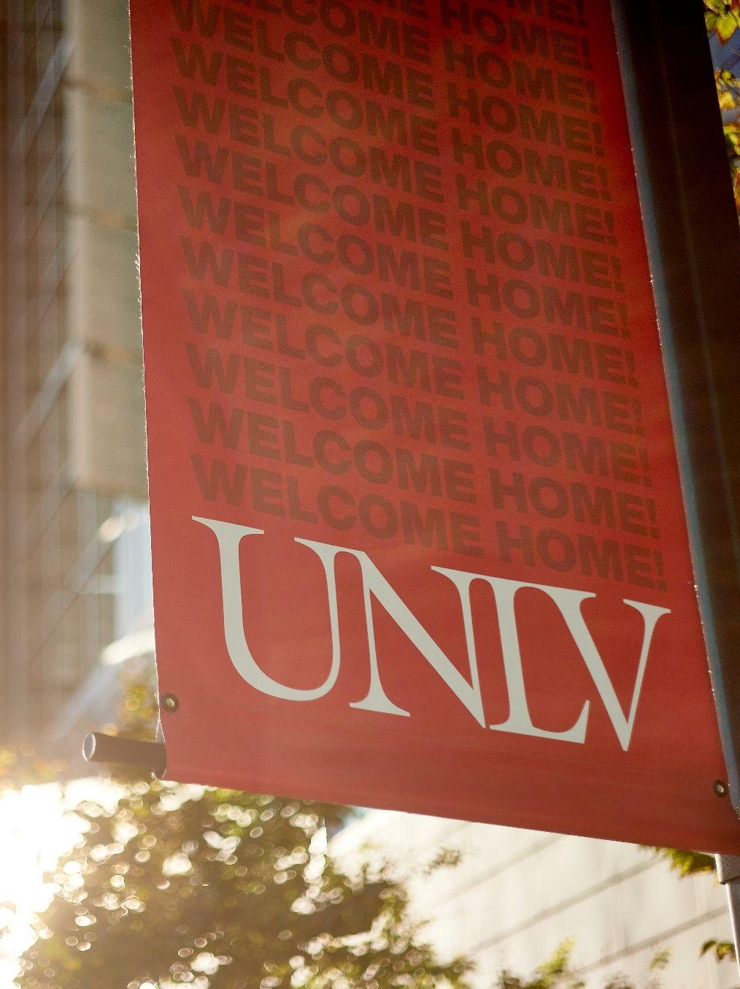
University of Nevada, Las Vegas (UNLV)
Founded in 1957
US News & World Report’s - Most Diverse Campus for Undergraduates
MSI
HSI
AANAPISI
Strategic Plan Core Area
Social Justice, Equity and Inclusion

Slide 4
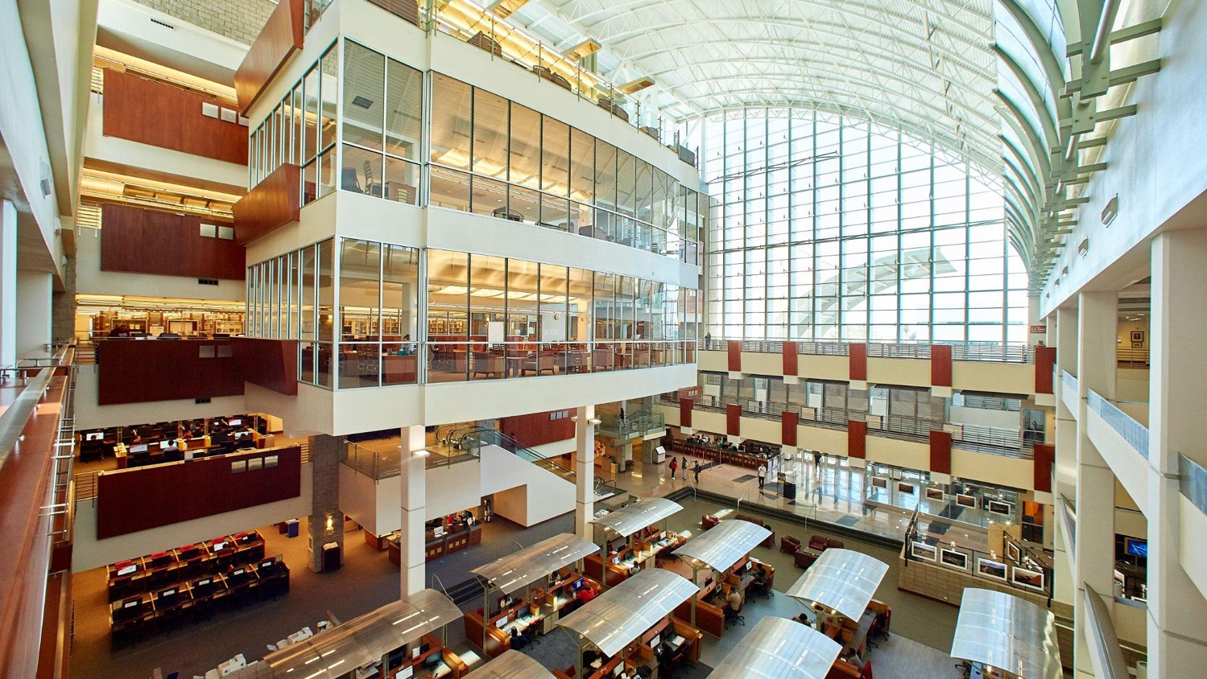
5 Libraries
One main and 4 branches
110 Staff
$10 million Collections Budget
$8.5 million - Main library
$1.5 million - School of Medicine Library
Inclusion and Equity Committee
UNLV Libraries
Libraries Strategic Themes
Cultivate a welcoming, inclusive, and accessible environment that values the diverse experiences and needs of our users and ourselves.
Acquire and showcase inclusive collections that support and document our diverse community.
Incorporate more inclusive cataloging and metadata practices.
Foster the cultural awareness of library employees through ongoing professional development focused on issues of equity, diversity, and inclusion.
Offer safe and secure library spaces that are inviting, welcoming, and supportive of all users.

Slide 5
Inclusive and Anti-Racist Collecting
Working Group
Scope/Aims/Focus Areas
Moving Forward
“as both a direct and indirect result of colonialism and white supremacy the historical and contemporary scholarly publishing market centers and prioritizes voices that are white, male, Christian, able-bodied, and heterosexual”
Clear and Achievable Action Steps
Develop Annual Goals
Provide Structure and Forward Momentum
Pilot projects
Foster a culture of collecting to support this work
Support UNLV research and programmatic needs
Provide content that reflects the diverse and constantly changing demographics of the Southern Nevada region
Acquire content from diverse and historically-excluded authors/creators in all disciplines
Utilize collection content vendors that reflect a variety of perspectives
.

Slide 6
3 Overlapping Projects
Understand Workflows, Procedures, Resources
Vendor and Content Focused
Pilot Collecting Projects Overview
BIPOC Vendors
Micro-audit
Identify
Invest
Increase ant-racist content
Prioritize BIPOC Vendors
Represent Collection
Funding
Community Selected Collection
Reflect Identities, Experiences, Interests of UNLV Students and Staff
Prioritize BIPOC Vendors
Dean’s Leadership Circle
General Collections Fund

Slide 7
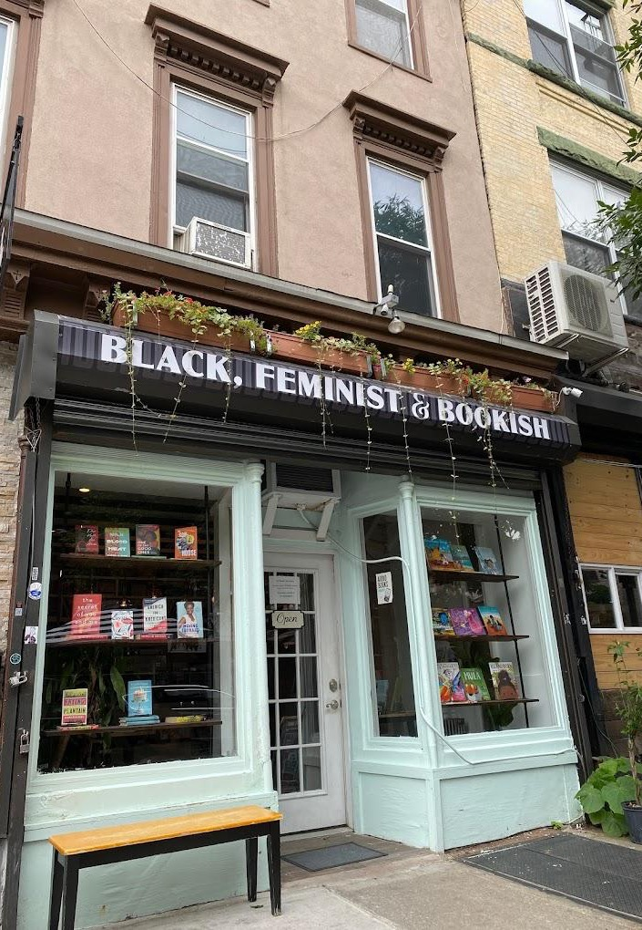
Logistics
Setting Up Vendors
Purchasing Workflows
Workday
Vendor System
Alma
BIPOC Vendors
Established Vendors
Purchase Card
Tracking Purchases
Pros
Cons
Reporting Code designation in order record
Fund Codes
Discovery Services

Slide 8
Project Outcomes
Vendors
Micro-Audit Project
Established UNLV purchasing relationship with 5 vendors
Birchbark Books
Cafe Con Libros
Sistah Scifi
Reparations Club
Red Planet Books and Comics
162 titles on list of key-anti-racist texts
42 titles purchased
Others already owned
$1,060 spent
Represent Collection
Overall
32 titles suggested
5 titles already owned
1 gifted
39 Items acquired
Multi-volume
Foreign/English Language versions
243 items purchased from BIPOC vendors totaling $5,049
274 items acquired across the pilots for a total cost of $5,754

Slide 9
What We Encountered/Learned - Logistics
Workflows
Impacts on staff and on other processes
Managing stakeholder expectations
Vendor Experience
Challenges in scaling up

Slide 10
What we Encountered/Learned - Organizational
Sustainable Path Forward
One of Many Organizational Priorities
Workload Concerns
Balance and Empathy
Acknowledge Progress May Be Slow

Slide 11
Moving Forward
Focus on sustainability and scale
Stick with a small number of vendors for BIPOC
Dollar amount limit for BIPOC
Utilize existing vendors such as YBP
Developments in their services/ how can they support our work better
Establish a new workflow to share with selectors and better aid in tracking purchases
Ask selectors to identify BIPOC vendors for content
Ask selectors to identify content as meeting the aims of Inclusive and Anti-racist collecting
Multiple Vendor elements (see diagram on next slide)
Update YBP/GOBI Tech Specs

Slide 12
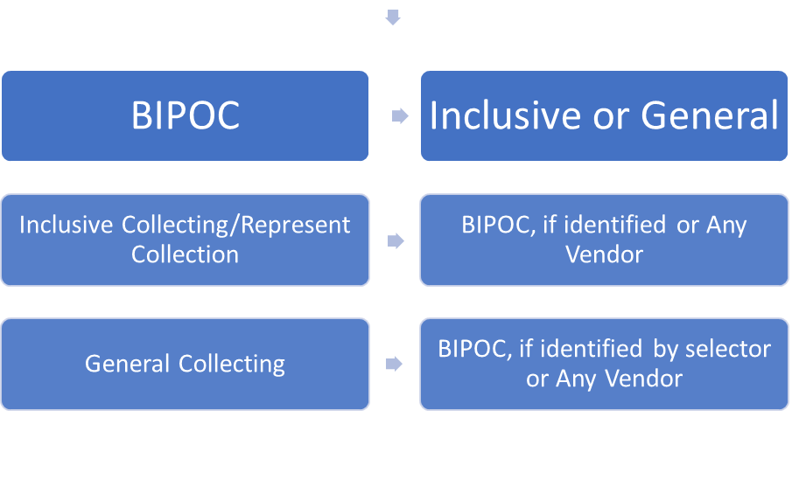
Vendor Selection Outline

Slide 13
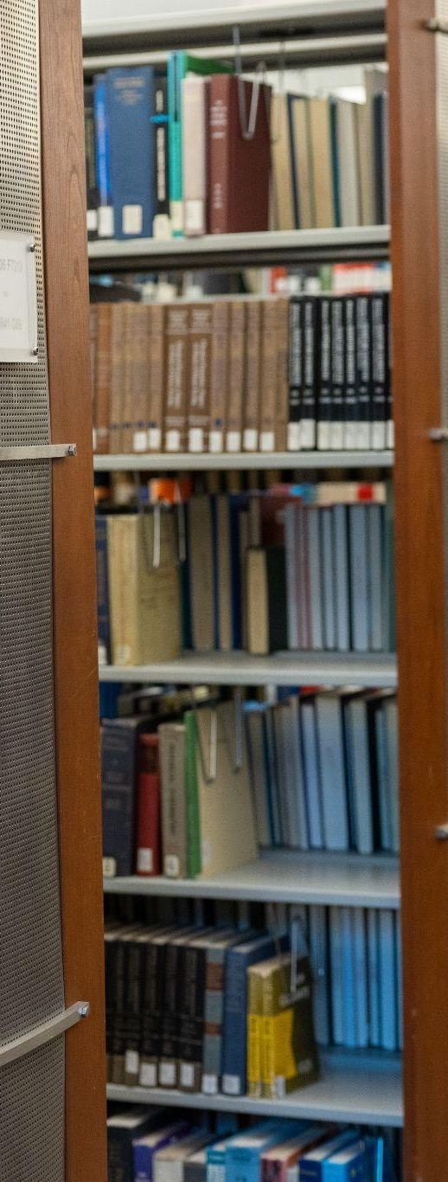
Moving Forward
Selector Community of Practice
Libraries’ Communication and Collaboration
IEC Event
Increased Outreach
Liaisons/Teaching Learning Librarians

Slide 14
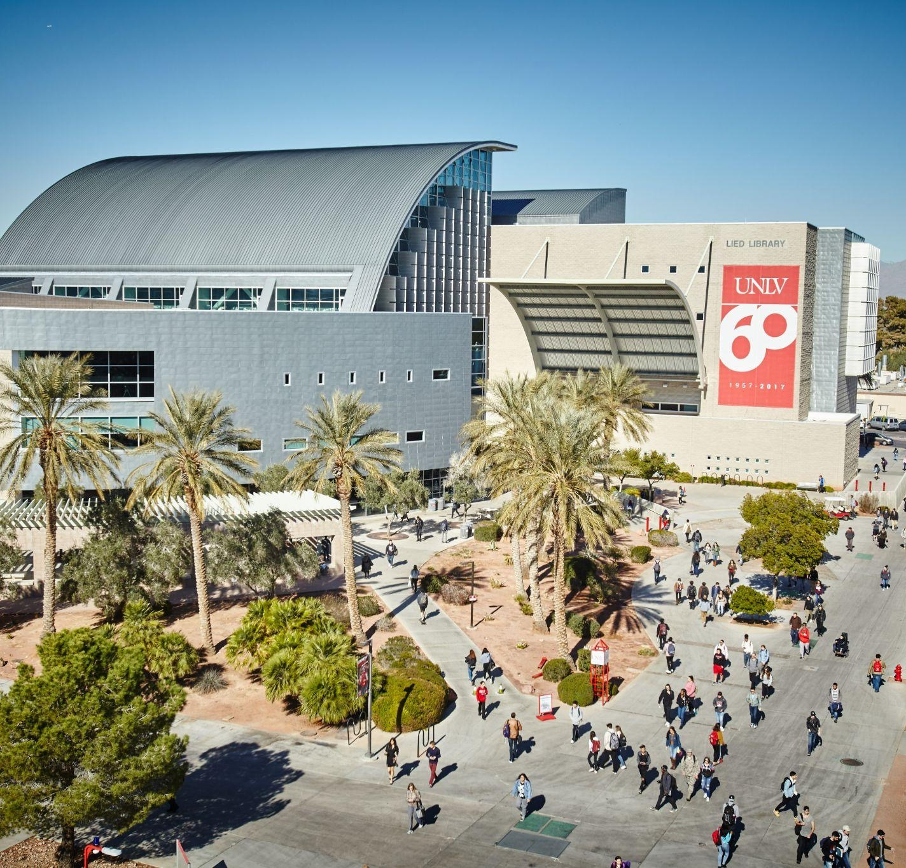
Info
Contact Details:
annette.day@unlv.edu
jennifer.culley@unlv.edu
Resources:
Inclusive and Anti-Racist Collecting at UNLV Libraries: Working Group Final Report
https://digitalscholarship.unlv.edu/libfacpresentation/213
Presentation Template:
SlidesCarnival
You can find these fonts online too. Happy designing!
Don't forget to delete this page before presenting.

Slide 15
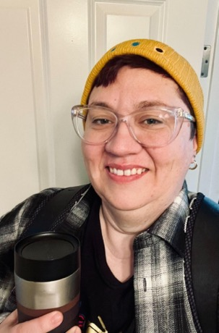
Reparations-Informed Collections Purchasing
Amy Tureen
Dean of Academic Success Programs
South Puget Sound Community College

Slide 16
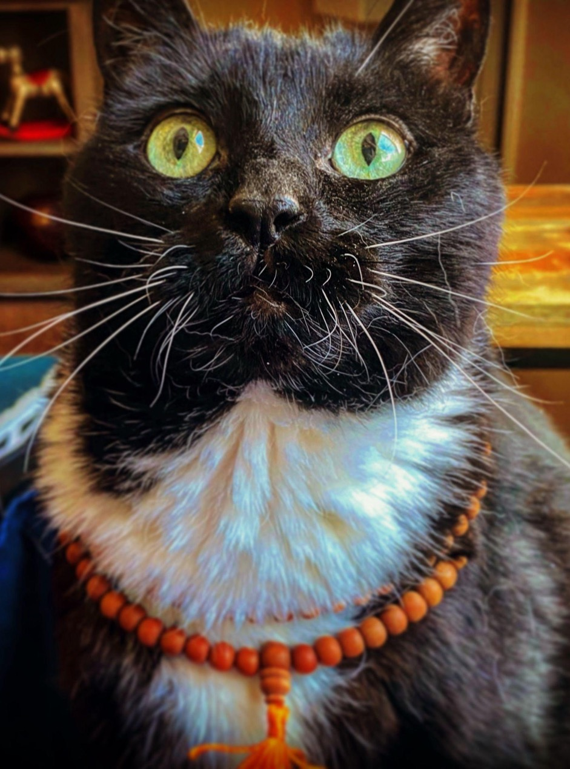
about me
I'm Amy Tureen and previously I was a department head at UNLV. Now I am the Dean of Academic Success Programs at South Puget Sound Community College (SPSCC). I wear many
hats, but my favorite is Dean of Libraries!
Time to pay the cat tax! This is Macduff!

Slide 17
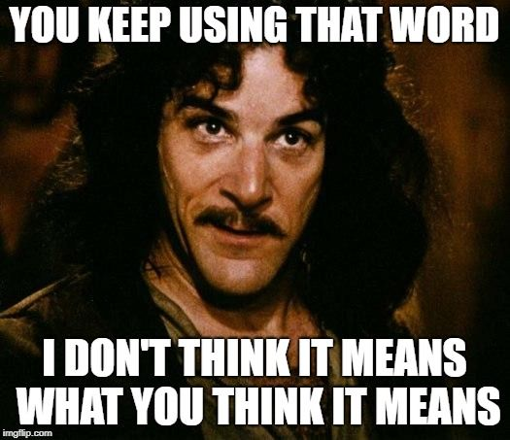
Reparations
/ˌrepəˈrāSH(ə)n/
The making of amends for a wrong one has done, by paying money to or otherwise helping those who have been wronged.

Slide 18
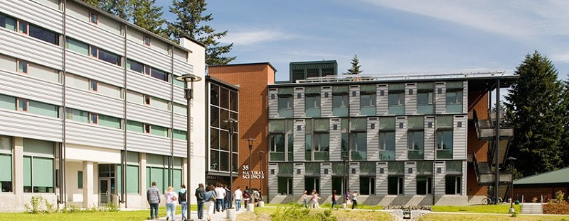
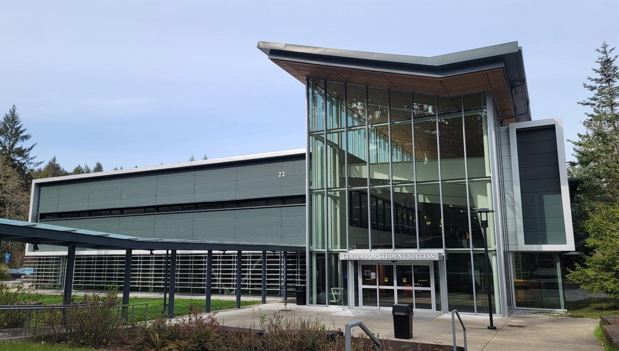
SPSCC Quick Facts
3-campuses in Olympia, Lacy, & Yelm WA (South Sound)
5,300 students (FTE, Running Start, & Part-Time)
55 Associate degrees, 19 certificates, & adult education
2 Bachelor degrees starting in 2024-25
Computer Science (BA) & Brewing/Distilling (BAS)
One library, 3 library faculty, & 2 library paraprofessionals
Sub-20K annual physical monograph budget

Slide 19
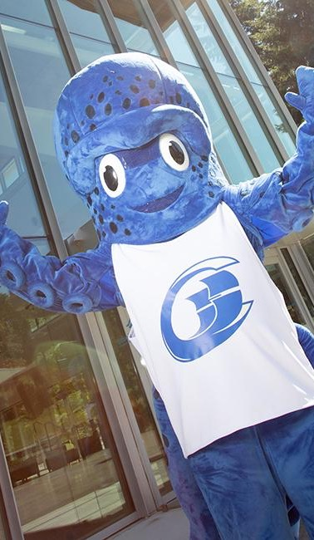
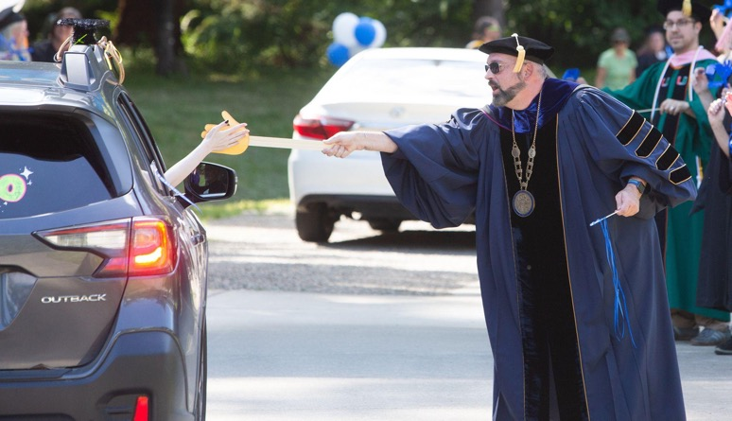
SPSCC Values
Pursues excellence.
Operates in an atmosphere of accountability and respect.
Responds to and partners with the communities we serve.
Fosters inclusiveness at our campuses.
Provides student-centered education.
values in action

Slide 20
Valuing equity is not the same thing as practicing equity.

Slide 21
Equitable practices must be systematized, or they are not equitable.

Slide 22
How do we create a system that…
is aligned with our values of inclusivity & community partnership?
meets our obligations as financial stewards of state funds?
is sustainable/does not overwhelm our cataloger?
spreads the increased labor equally across all relevant stakeholders?
is equitable and beneficial to our partner bookstores?

Slide 23
Our Workflow
Selector identifies text(s) of interest.
Selector requests book(s), indicating which partners have the item(s) in stock at time of request:
Cataloger selects an available vendor, seeking to expend a balanced amount between partners.
Some items cannot be bought through our partners. This model prioritizes reparative purchasing, but does not restrict purchasing.
Cataloger places order then catalogs and labels upon receipt.

Slide 24
Our Partner Bookstores
A vital resource!
Grants 30% of a book’s
list price to designated bookstore!

Slide 25
Strengths
Highly scalable
Places equity & reparative action at the forefront of collection processes
Supports historically-decentered & local communities
Weaknesses
strengths vs weaknesses comparison
Time-intensive
Limited automation opportunities
Requires multiple vendor authorizations
Occasional higher text prices

Slide 26
answers to common concerns
Money
Time Intensive
Employee Buy-In
Scalability - commit as much or as little money as is appropriate to your situation.
Book costs can vary, volume discounts must be individually negotiated.
If vendors have to be pre-authorized, limit the total vendors you partner with.
Change expectations re: speed and efficiency of cataloging.
Most content can be cataloged using quick or copy cataloging.
Use bookstore curation to identify titles for purchase.
Host selection parties so content selectors can efficiently review available materials from partner bookstores.
Consistently tie work to organizational values.
Start with a pilot!
Accept that this is a political act - any process that prioritizes equity, inclusion, & diversity over the hidden capitalist values of efficiency, speed, and tradition is inherently political.

Slide 27
thank you!
Want to know more? Contact me at:
atureen@spscc.edu
@atureen.bsky.social

Slide 28
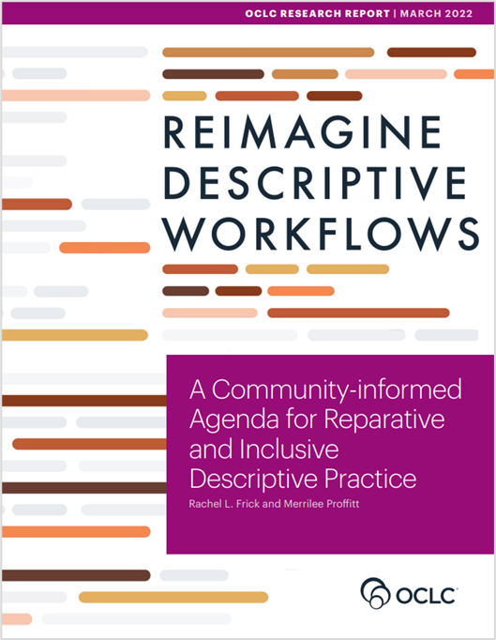
2017 – RLP EDI Survey
2021-2022 Reimagine Descriptive Workflows
2022-2023 Casting a different net: Diversifying print monograph collecting in research libraries
Notes:
oc.lc/reimagine-workflows-report
https://hangingtogether.org/casting-a-different-net-diversifying-print-monograph-collecting-in-research-libraries/

