Slide 1
Will our future selves
thank us?
Examining born-digital curation practices at UKL
OCLC Works in Progress Webinar series
April 2024

Slide 2
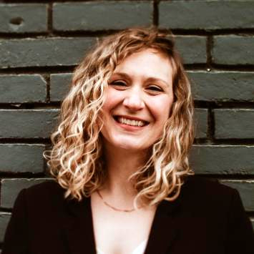
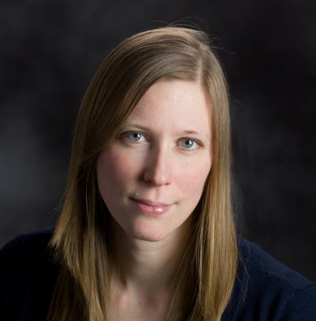
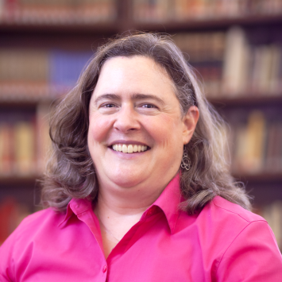
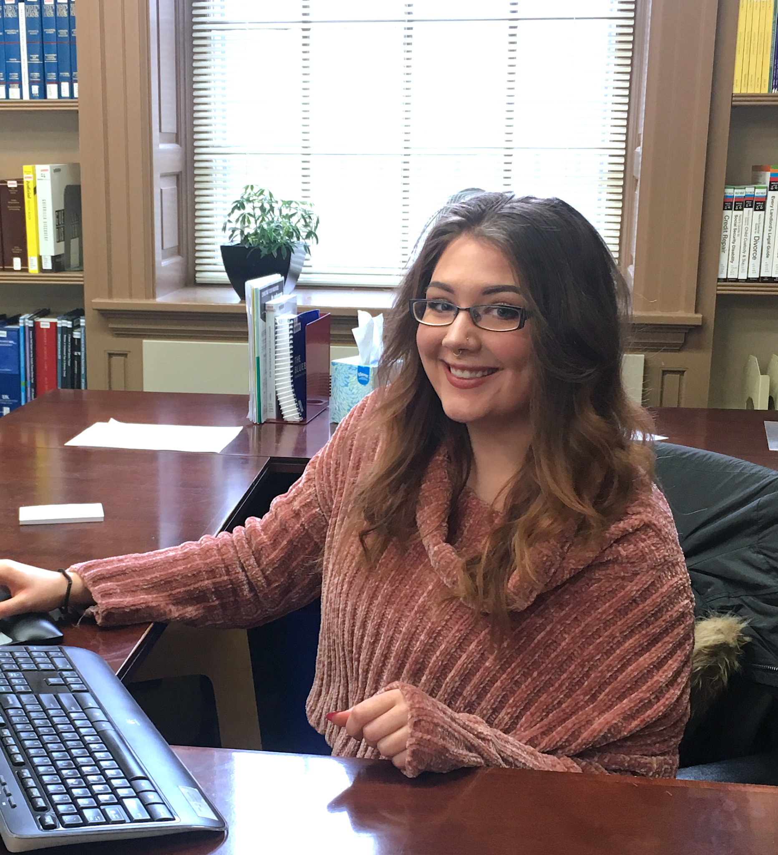
Speakers
Sarah Dorpinghaus, Director of Digital Strategies and Technology
Megan Mummey, Director of Manuscript Collections
Andrew McDonnell, Digital Archivist
Ruth E. Bryan, CA, University Archivist
Emily B. Collier, Assistant University Archivist

Slide 3
UKL Digital Preservation Infrastructure
A changing landscape, 2021-2024

Slide 4
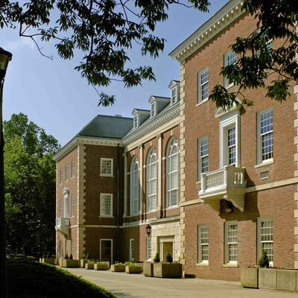
University of Kentucky Libraries
R1, land grant institution
Home-grown digital preservation repository and digital libraries
UK Libraries has engaged in born-digital archival work since 2015 and web archiving since 2018
1 FTE (100%) working with born-digital archives, 8 FTE partial (5-15%), and on average 0-3 student employees
Margaret I. King Library

Slide 5
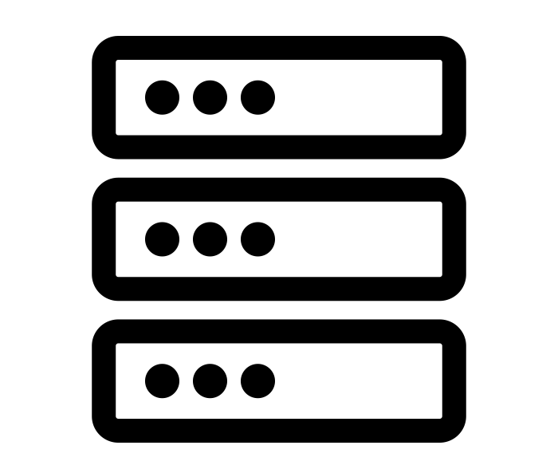
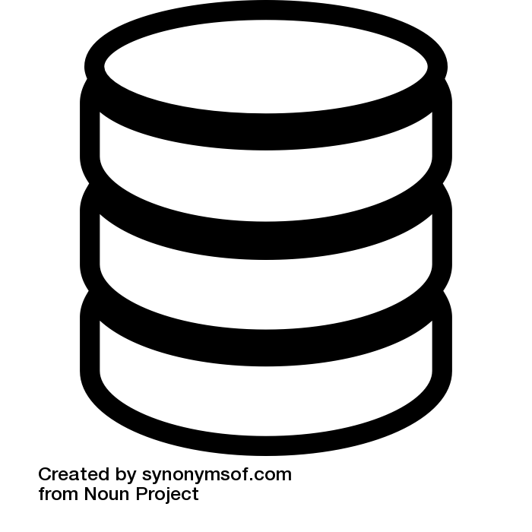
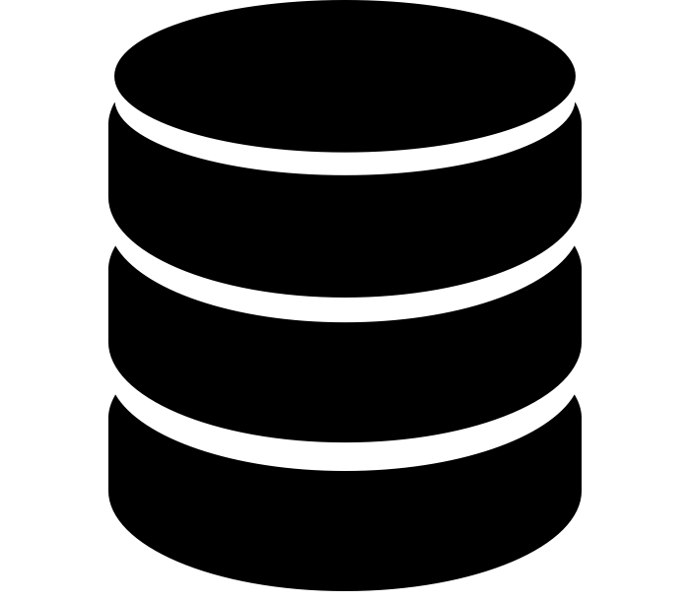
Virtual Machines & Web Servers
host applications, serve content
free
Active Storage
networked storage
DIPs
DIPs
Dark Storage & Backups
tape
AIPs
free

Slide 6
Virtual Machines & Web Servers
host applications, serve content
free
Active Storage
networked storage
DIPs
DIPs
Dark Storage & Backups
tape
AIPs
free

Slide 7
Virtual Machines & Web Servers
host applications, serve content
free
Active Storage
networked storage
DIPs
DIPs
Dark Storage & Backups
$
tape
AIPs

Slide 8
Virtual Machines & Web Servers
host applications, serve content
free
Active Storage
networked storage
DIPs
DIPs
Dark Storage & Backups
$
tape
AIPs
free

Slide 9
Virtual Machines & Web Servers
host applications, serve content
$
$
$
$
Active Storage
networked storage
DIPs
DIPs
Dark Storage & Backups
$
tape
AIPs
free?

Slide 10
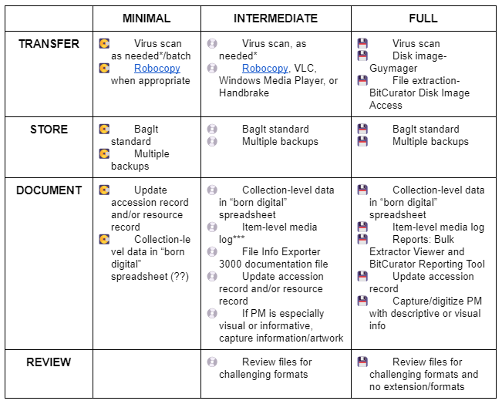
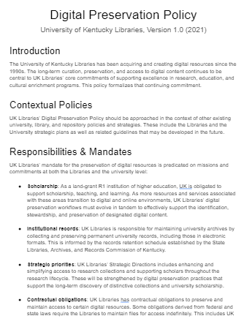
Impact on Digital Curation and Preservation
Decision tree
+
Digital preservation policy
Notes:
Link to UKL born-digital migration decision tree
Link to UKL digital preservation policy

Slide 11
Impact on Digital Curation and Preservation
Decision tree
+
Digital preservation policy
Dark Storage & Backups
tape
AIPs

Slide 12
Impact on Digital Curation and Preservation
Decision tree
+
Digital preservation policy
Dark Storage & Backups
$
tape
AIPs

Slide 13
Impact on Digital Curation and Preservation
Digital preservation cost estimate
1 TB = approx $200 / year
(up from $152 / year)
Dark Storage & Backups
tape
AIPs
$
free?

Slide 14
Impact on Digital Curation and Preservation
Funding challenges
How does this impact appraisal?
Virtual Machines & Web Servers
host applications, serve content
$
$
$
$

Slide 15
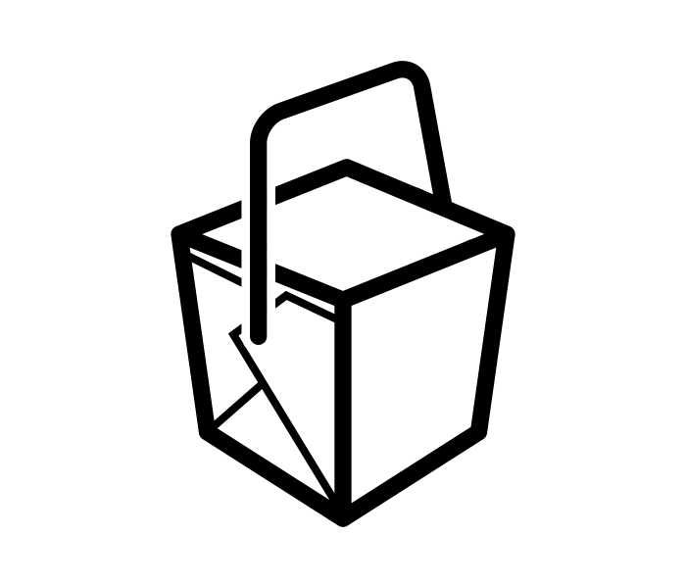
Takeaways
Be flexible and nimble.

Slide 16
Takeaways
Be flexible and nimble.
Build and maintain relationships with IT.

Slide 17
Takeaways
Be flexible and nimble.
Build and maintain relationships with IT.
Storage costs increase over time.

Slide 18
All icons from the Noun Project https://thenounproject.com/

Slide 19
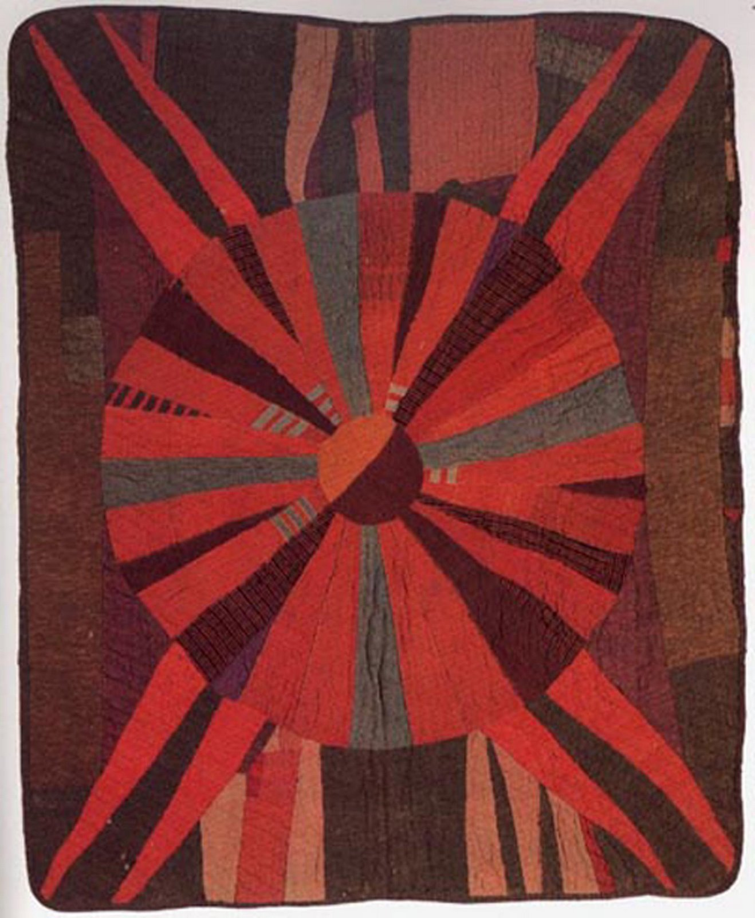
Not everything is worth saving
Digital appraisal and environmental impact
Megan Mummey
Director of Manuscript Collections
Andrew McDonnell
Digital Archivist
Image from The Kentucky Quilt Project, inc. "Why Quilts Matter: History, Art, and Politics" documentary records

Slide 20
Environmental Impact of Digital Preservation
“When [the challenges of digital preservation] are confronted in an environment where staff time is scarcer than digital storage, it can be tempting to appraise digital content in a cursory manner.”
Pendergrass, Keith L., Walker Sampson, Tim Walsh, and Laura Alagna. “Toward Environmentally Sustainable Digital Preservation.” The American Archivist 82, no. 1 (2019): 165–206. https://www.jstor.org/stable/48659833.

Slide 21
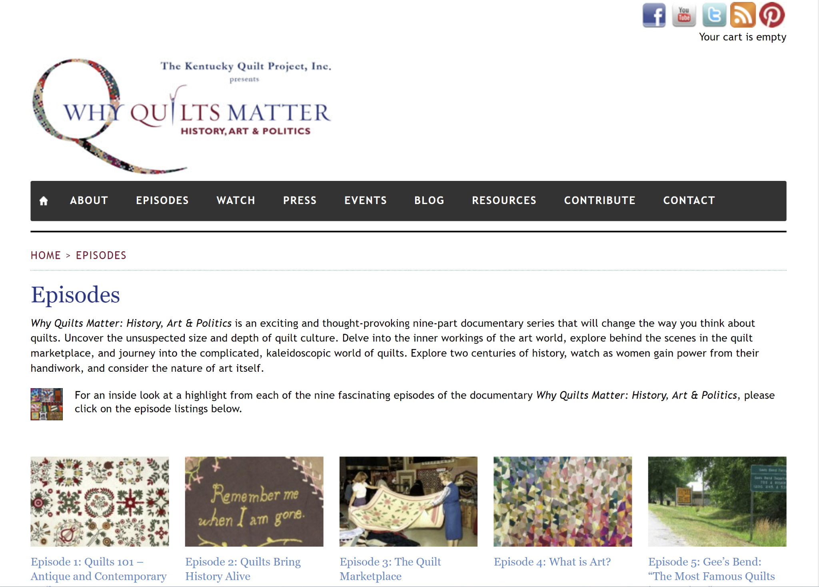

Slide 22
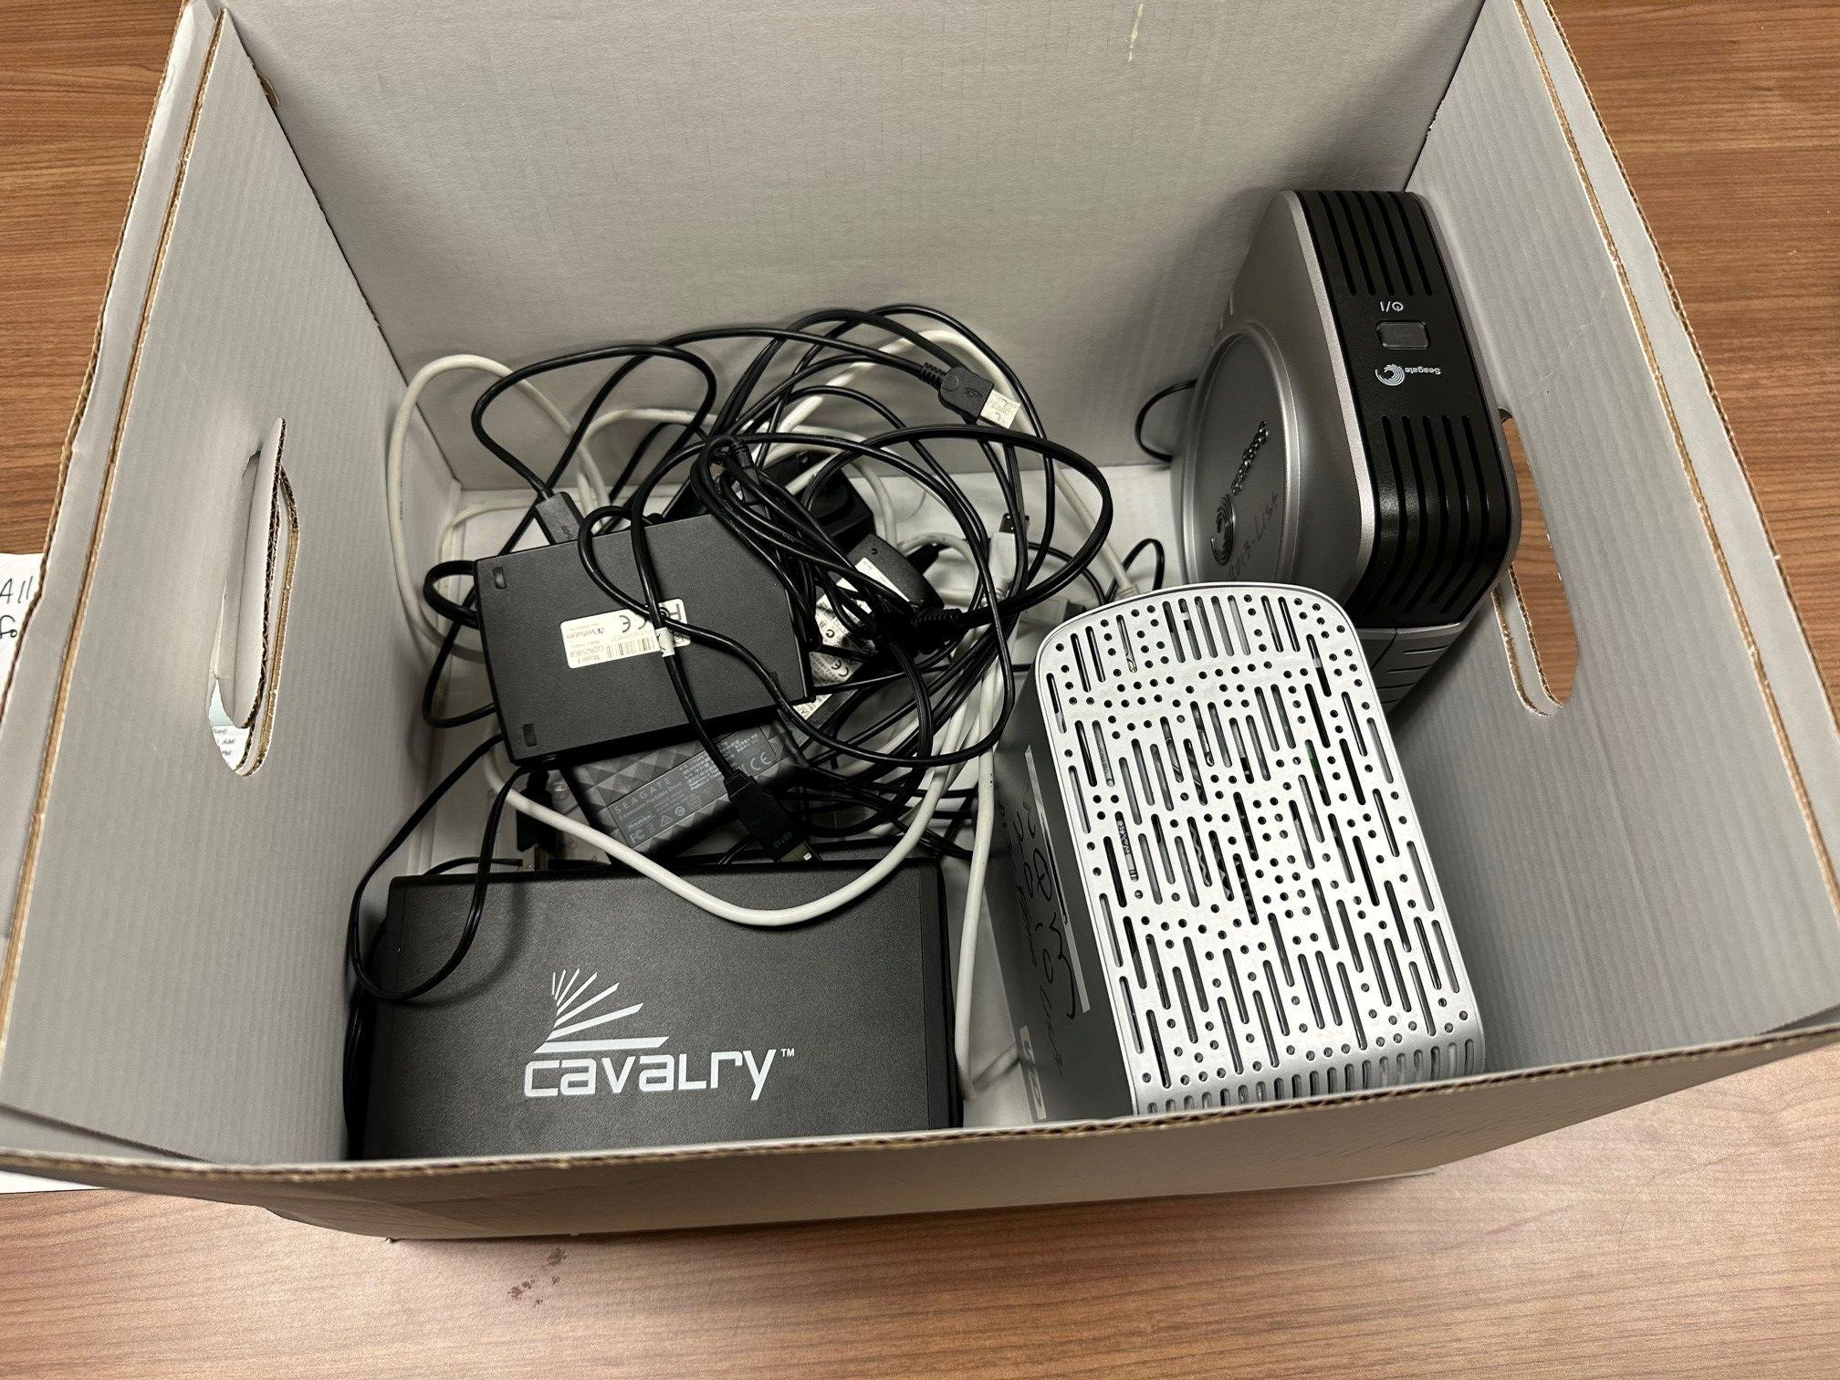

Slide 23
Appraisal questions to ask
What is the collection’s archival value?
Which records can we provide access to and approve the use of?
Which records are essential to documenting this work/subject/person?
Realistically – which records will patrons use?
Do these files contain proprietary formats?
Do we need to keep drafts of the documentaries?
What at the bare minimum (given our capacity) should we preserve?

Slide 24
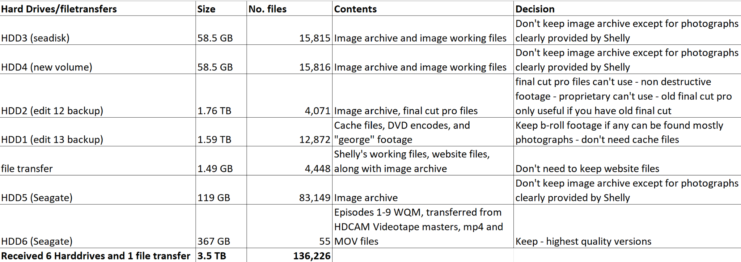

Slide 25
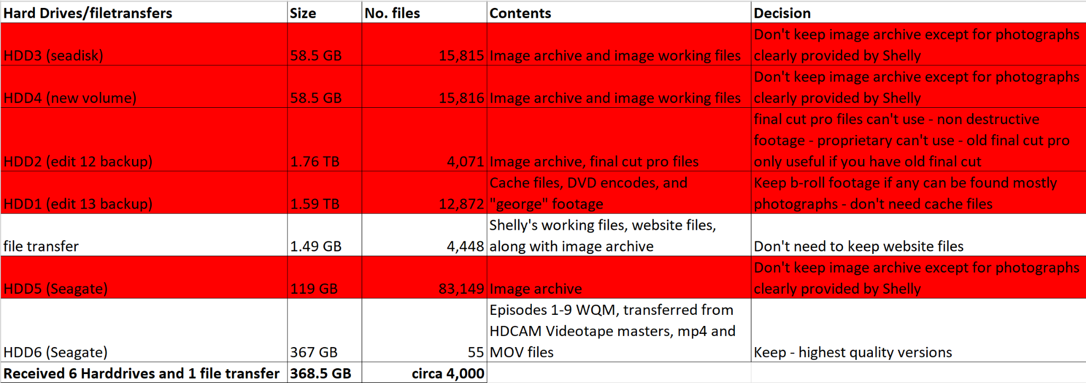

Slide 26
Deduplication: TreeSize automated + manual
~60,000 duplicates files deleted (some recurred more than 10 times across multiple directories)
Many duplicates were tiny, but in those quantities take up significant space and processing power
Duplicate video files: multiple formats for DVD, broadcast, web, and other outlets
Manually discovered, fewer files but large file sizes!

Slide 27
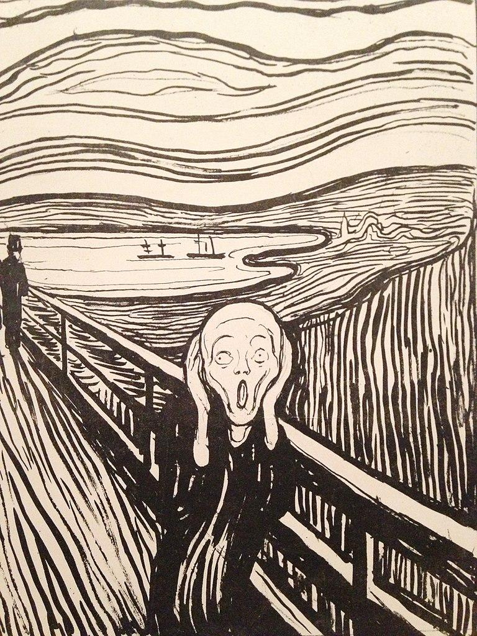
PII and Tree-size analysis
Deleted folders and files of material irrelevant to the Kentucky Quilt Project, including personal vacation photos, medical files, legal files, real estate contracts, and other materials containing significant PII.

Slide 28
The Real Savings: Scratch Disk: 2.89 TB, 8,500 files
360 MB: 1:11 silent clip from a dark room

Slide 29
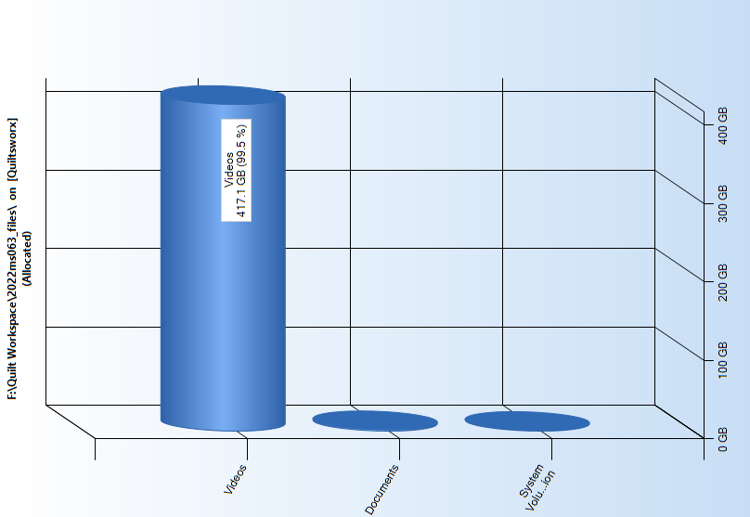
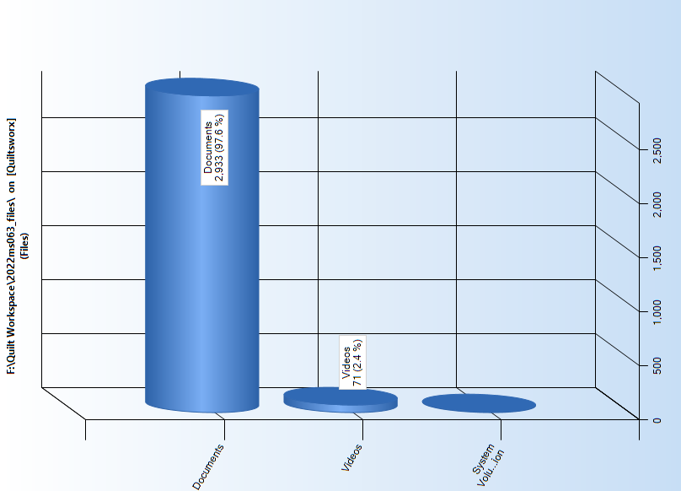
Final Tally
We started with: 146,664 files; 3.86 TB
We conclude with: 3,006 files; 418.6 GB
Cost for digital preservation: Original size= $772/year; After Cleanup=$83.60/year
Allocated space by file type
Number of Files

Slide 30
Takeaways
Added in a more rigorous appraisal section to our documentation.
Saving everything is a trap. Do not do it! It’s bad for archives and it’s bad for the environment.
Reappraise your born digital collections.

Slide 31
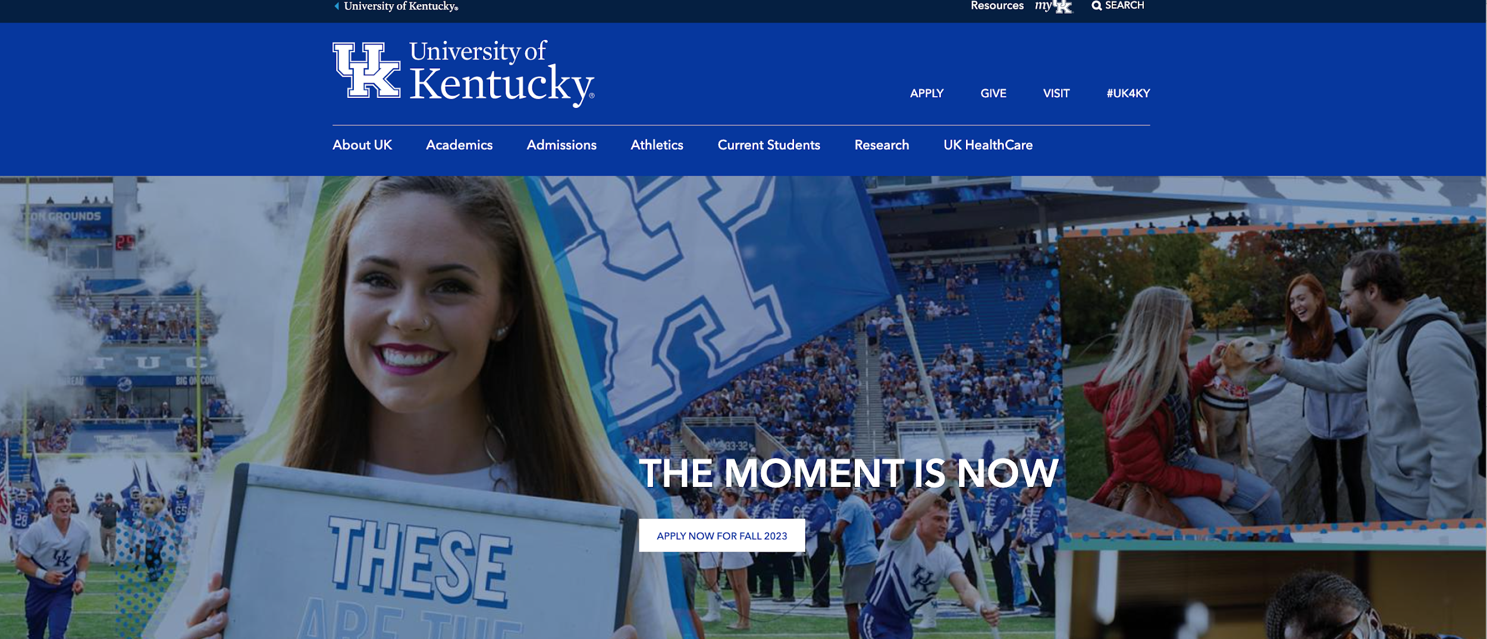
Suddenly, Everything’s Online!
What Do We Do Now?
Ruth E. Bryan, CA
University Archivist
University of Kentucky Libraries
Special Collections Research Center

Slide 32
SUDDENLY! (The Realization)
Situation:
Archive-It subscription
Started crawling UK seeds
Including yearly crawl of www.uky.edu
Successful capture threshold = 75%
=
2018

Slide 33
SUDDENLY! (The Realization)
Situation:
Key records and papers
Are distributed online only
Not transferred to Archives
Likely to be lost
Web archiving is more central than before
Preservation is complex
Is thus resource-heavy
Do we need to re-align effort?
=
2019

Slide 34
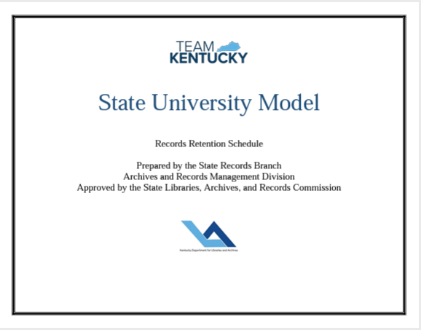
Key permanent university records:
Publications
Regulations and policies
Meeting minutes
News
Photographs and AV
Every-
thing!
=
Appraisal criteria:

Slide 35
Documents of cultural and historical importance:
--University records and personal papers
Correspondence
Diaries
Flyers and broadsides
Invitations
Every-
thing!
=
Appraisal criteria:
Cultural significance

Slide 36
Is Online!
Many are in PDF
Some PDFs on proprietary platforms with no download
Websites/blogs
Embedded video not always captured.
Some webpages not captured at all (URL changes)
Web 2.0 functions are difficult to capture
Online ≠ Archived/preserved

Slide 37
Every-
thing!
Is
Online!
What Now?
SUDDENLY!
Acknowledge the challenge and opportunity
Test/research
Advocate
Rethink appraisal criteria/resources
Re-allocate/seek available resources and partnerships

Slide 38
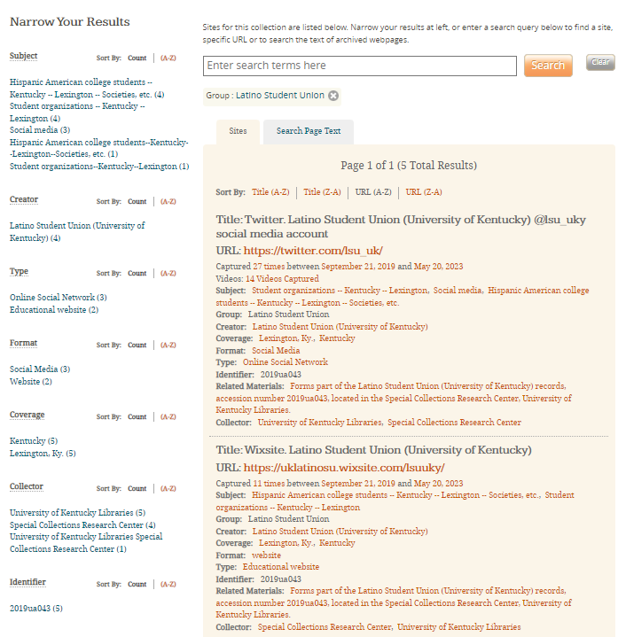
Wildcat Histories:
Preserving Activist UK Student Organization’s Legacies
Emily Collier
Assistant University Archivist
Web Archiving Specialist
Special Collections Research Center
University of Kentucky
Seeds belonging to the Latino Student Union on UK Libraries’ public Archive-It page

Slide 39
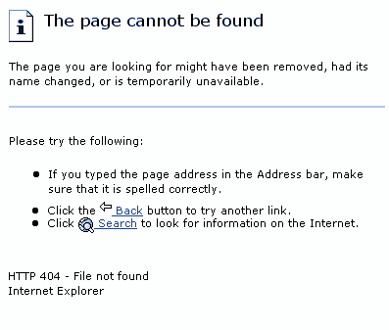
Key Problems:
Link rot
Archiving tool failures
Website upgrades
Enterprise interception

Slide 40
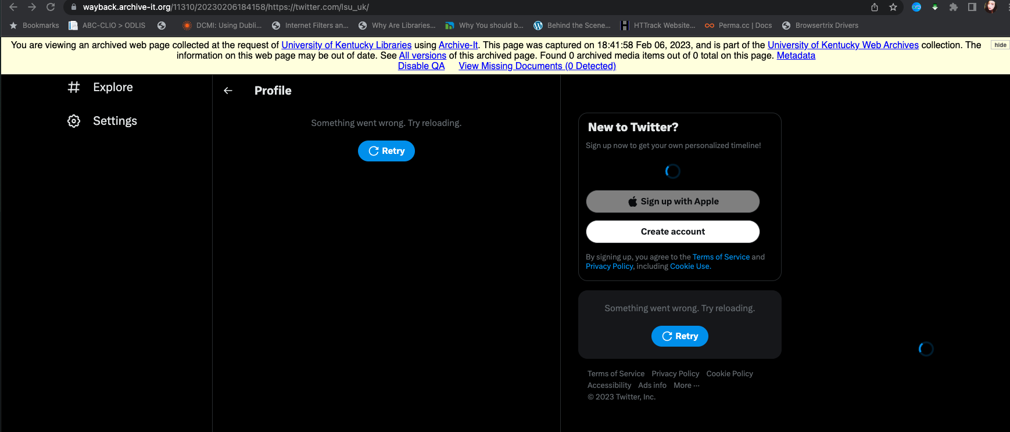
Social Media: Our Notorious Evader
WHY?
Complex, interactive scripts
Crawler traps/infinite links
Near-constant updates create an arms race with preservation technology
Crawler blockers and permissions obstacles
A failed Twitter crawl with Archive-It

Slide 41
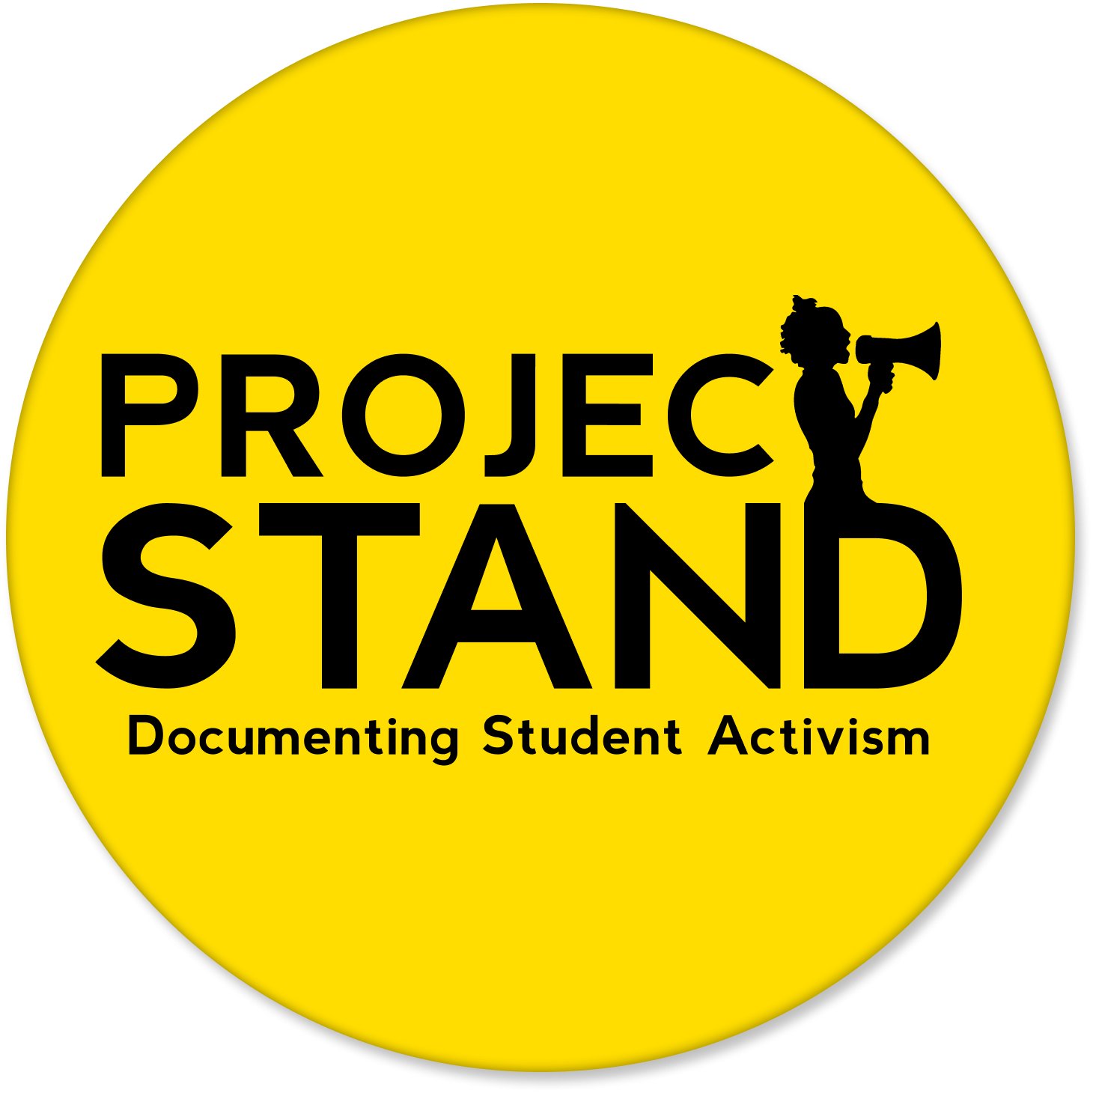
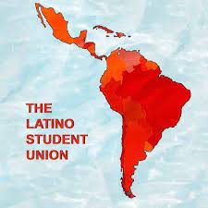
Wildcat Histories: A Flagship
A Project STAND (STudent Activism Now Documented) mini-grant
IMLS and Mellon Foundation funding
April 2022-Aug 2023
Partnered with the Latino Student Union
Use the partnership as a pilot for building procedures on archiving student organizations’ online content, specifically social media

Slide 42
Social Media Goals
Theoretical Goals
Practical Goals
Preserving Memory
Testing
Appraising platforms that appropriately capture communities’ memories
Test available tools and methods for best capture and preservation practices
Social Interactions
Documentation
Ensuring that the social interactions, ie comment sections, are preserved
Document tests and outcomes in order to keep a record of chosen methods and rational
Online Culture
Standardization
Preserve the unique qualities of online culture
Use these rationals to create a standardization of procedures and application of metadata

Slide 43
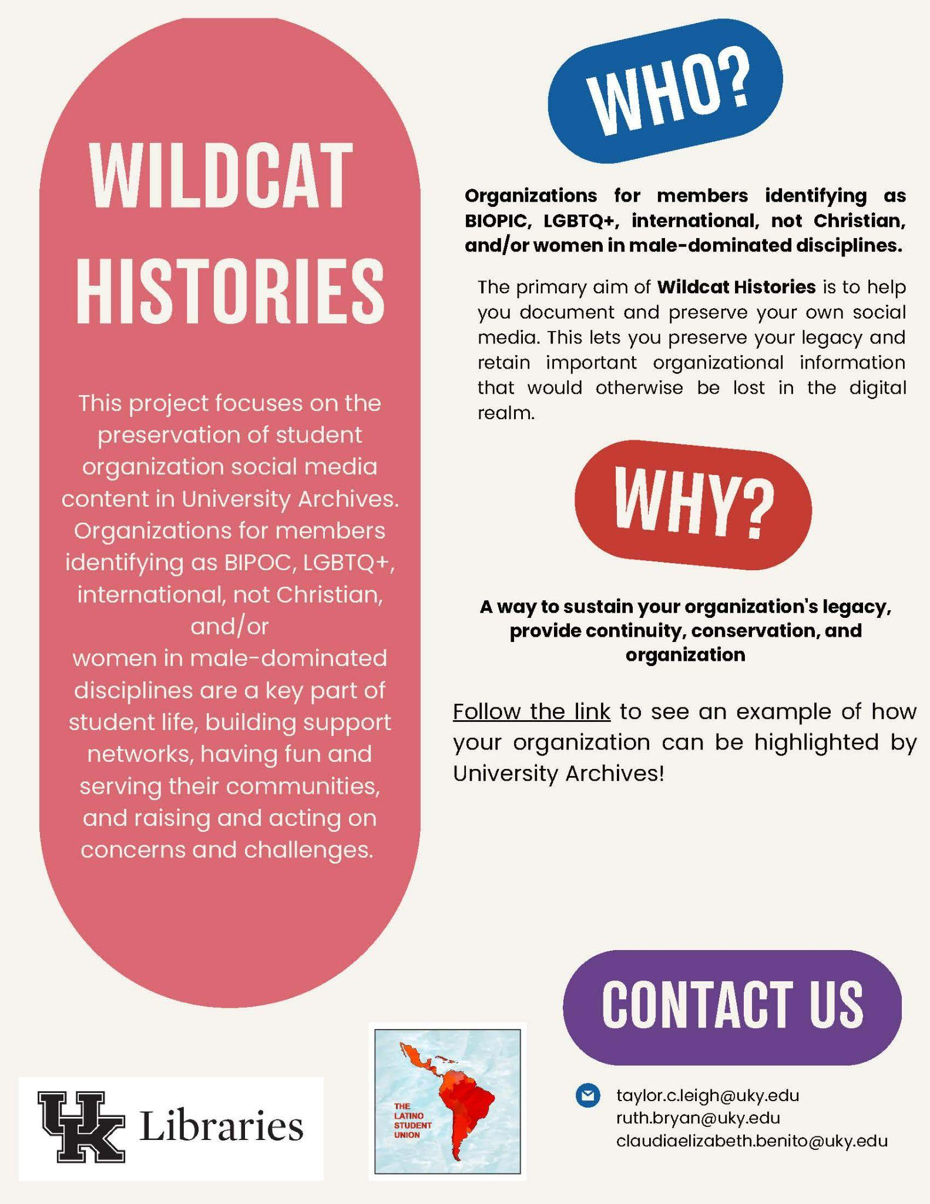
Student Archiving Goals
Empowerment: Return control to student organizations
Community: Build positive and productive relationships between students and Special Collections
Sustainability: Create solutions to integrate archiving into student organization policy
Informational flyer created by our Student Organizations Communication Assistant, Claudia Benito

Slide 44
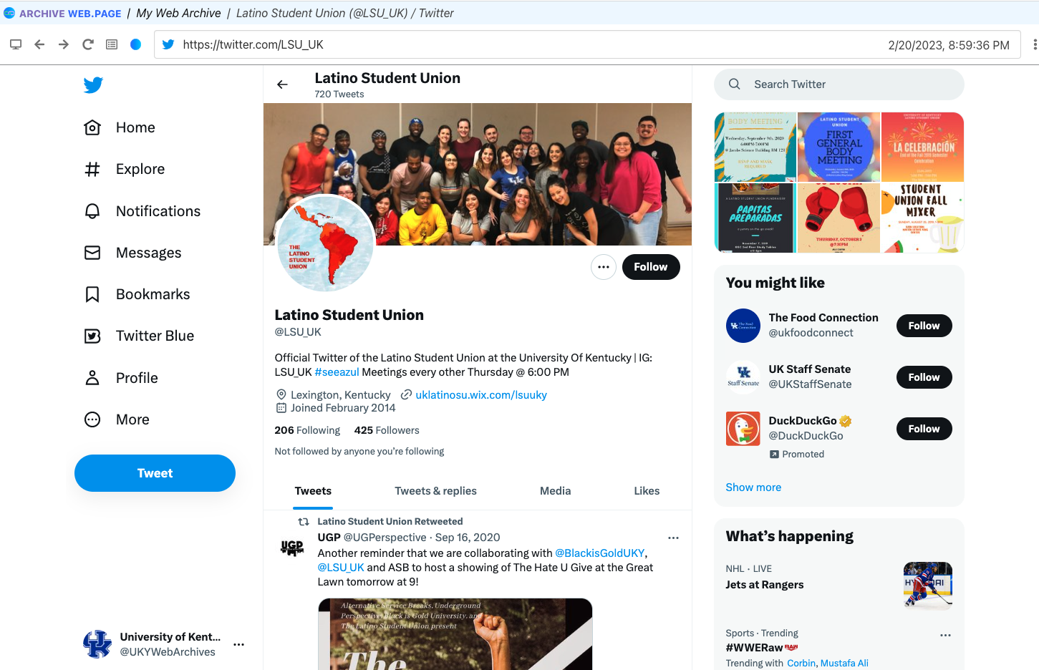
Building Forward-Thinking Practice Around Anticipating Failures
Gaps can be left in collections when crawling technologies fail.
Anticipating these failures and preparing backup tools or policy can alleviate this burden.
The same Twitter page, successfully captured with Webrecorder

Slide 45
Redundancy in Research
New technologies always coming into the field
Existing technologies typically successful may fail in the future
Old technologies once dismissed may have upgraded to better tools
TESTING
RESEARCH

Slide 46
Q
Questions Proposed
What are your tools, how do they work, and what are their products?
How is content made accessible to users?
How is your program funded/what is your long term management plan?
What are your next steps/developments?
Professional Network
Peter Chan, Stanford University Libraries
Zakiya Collier, Documenting the Now
Lynda Schmitz Fuhrig, Smithsonian Libraries and Archives
Bergis Jules, Documenting the Now
Christie Moffatt, National Library of Medicine
Jasmine Mulliken, Stanford University Press
Dolsy Smith, Social Feed Manager
Ed Sommers, Documenting the Now, Stanford University Libraries
Brian Thomas, Texas State Archives
A

Slide 47
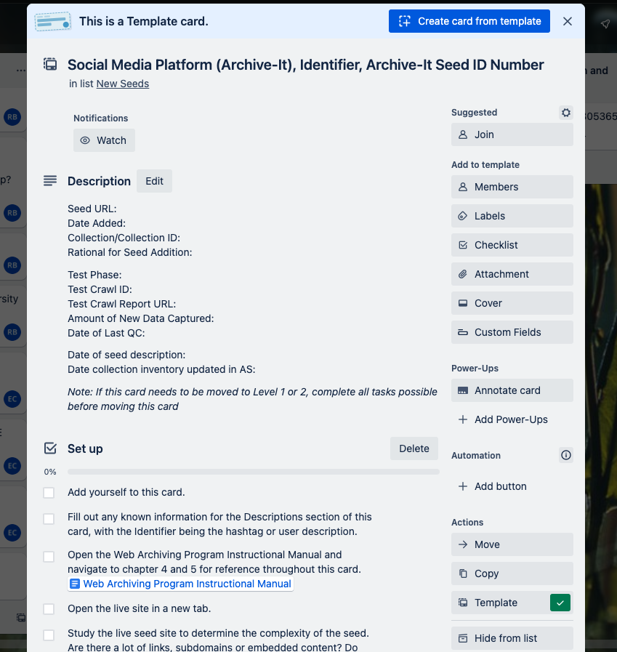
Maintaining Simplicity
Adopting complex technologies or practices makes long-term management difficult
If a staff member leaves and takes knowledge with them, how is the work maintained?
Needs to be simple for students to understand and use readily
Trello card with steps for crawling social media sites with archive-It

Slide 48
Themes
Documentation is important
Flexibility is key
Relationship building can open doors
Digital preservation requires funding and personnel
Record procedure or policy changes, with rationales
View workflows as learning-in-working or practiced-based and adaptable, rather than a set of rigid tasks
Short-term and ongoing re-appraisal and re-prioritization and re-allocation of existing funds

Slide 49
Future directions and questions
Reappraisal of born digital materials already migrated and preserved, but not processed
Access tools for web archives, including data harvesting tools
Resource allocation and workflows for description and capturing are different for web-based content vs. other born-digital content
Is appraisal criteria for permanent and culturally significant online university records different from other born-digital content?
Should we apply digital preservation criteria retroactively? This requires additional development for our tools

Slide 50
Q&A
Sarah Dorpinghaus, Director of Digital Strategies and Technology
Megan Mummey, Director of Manuscript Collections
Andrew McDonnell, Digital Archivist
Ruth E. Bryan, CA, University Archivist
Emily B. Collier, Assistant University Archivist

