Slide 1
Personal Librarians:
Audrey B. Welber
Princeton University
Building Relationships Across Campus
Notes:
Title change to include outreach
WHAT IS A PERSONAL LIBRARIAN PROGRAM? All about BRANDING. (Who here has a PL program?)
Will also talk about an event I linked to our PL program
Gorey details—pull back curtain. Hopefully spare you some PAIN
I will go in chronological order of the way things unfolded
UNEXPECTED: PL program started with just PLs→ students but then got attention of Deans etc and now has brought library staff closer
Explain that because I founded program I have the most students
Feel free to ask questions as we go along, we'll get to them at the end!
Librarians in a unique support role—we’re not grading but can help them academically

Slide 2
Time for a poll!

Slide 3
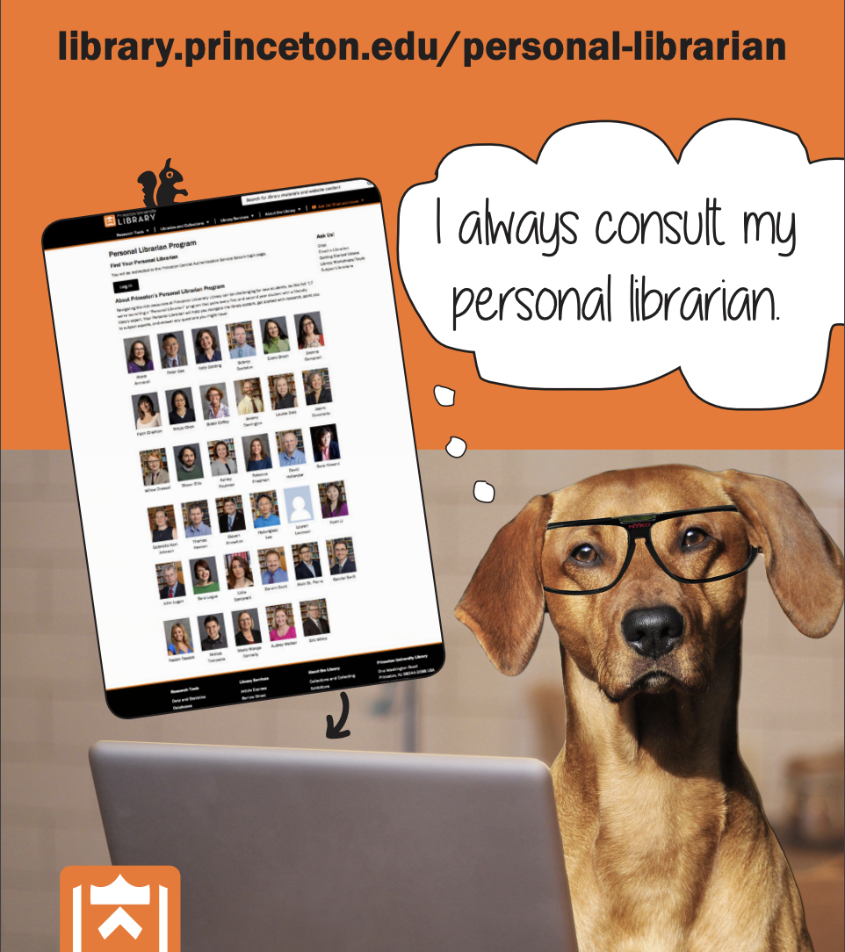
Overview of Princeton’s Personal Librarian (PL) Program
Every undergraduate is paired with a Personal Librarian (includes librarians and support staff)
While most students are paired randomly, we are increasingly pairing by groups, such as athletic teams and First Gen Low Income (our “Freshman Scholars Institute” program)
We hold in-person outreach and support events publicized via PL program
Word of mouth has contributed to success of program
Notes:
We are increasingly realizing that librarians have the superpower of “unconditional support”—we aren’t grading them but can contribute to their academic success
Thank you to PUL administration for trusting me to implement this vision
Inclusion of non-librarians has been key to success

Slide 4
Time for a poll!

Slide 5
Beginnings (Fall 2017)
Launched as a pilot in Fall 2017
Modeled after Yale’s program
Began with first/second year students, paired randomly
Envisioned as “safety net” for students
Only reference/subject librarians involved at first
Collaboration with PU registrar
Notes:
Trip to Yale and Williams. PL would fill a GAP for us. Especially SOPHOMORES (writing seminar librarians and subject specialists handle other years) and general mental health crisis (and suicides at PU)
Yale noted that they had a 10% response rate
considered pairing by STEM/non STEM or by residential college or by first year writing seminar
approval to contact entire undergraduate body
When I recruited librarians to be PL, I wasn’t clear about intention to “fold in” juniors and seniors
Many self-corrections but switching from Bcc to personalized emails was critical

Slide 6
Initial Implementation (2017-18)
Registrar sent undergraduate IDs in August
Each PL assigned a student roster of 50-100
Public-facing page so students could proactively locate their PL
Each PL downloads student roster from .csv file
PLs instructed to use Bcc for emailing

Slide 7
Early Challenges (2017-18)
Initial ambiguity regarding inclusion of juniors/seniors—overlap with subject specialists not considered
BCC emails yielded very low student response rate
Many PLs dropped out of the program
Notes:
Recruitment letter: “...The basic premise of the PL outreach is that every first- and second- year student (we’re restricting it to underclassmen for this first pilot year) will be paired with a librarian who can serve as a friendly face and starting point for general information about the library…”
During these initial bumps in the road, I had to learn to be flexible and responsive to concerns and consider every angle in order to get buy-in from staff. Taught me the need for clarity in communicating about the program.

Slide 8
Early Statistics (2017/18 and 2019/20)
Number of PLs: 2017/18: 36
2018/19: 24
Contacts for one PL with 450 students: AY2017-8: 12
AY2018-9: 79
Total PU Undergraduates: 5,353
Notes:
Yale said to expect a yield of 10%
Contact means the student responded to my email either with a question or an enthusiastic acknowledgement
12 of 450 is 2.67%
70 of 350 is 17.56%

Slide 9
% Audrey’s student responses 2017- present
Notes:
Statistics have been challenging to gather so I’m using myself as a snapshot

Slide 10
Initial Improvements (2018-2020)
Switched to Word/Outlook “mail merge”
Separate emails to first/second years and juniors/seniors (emphasizing specialists)
Confirmed commitment before re-enrolling PLs
Inclusion of non-librarians
Internal PL website with templates, documentation
PL program gained momentum during pandemic
Notes:
emphasize subject specialists for the latter (40% of inquiries necessitated referrals)
Inclusion of non-librarians was key! Learning curve necessitated training but well worth it!

Slide 11
Technical Refinements (2021-2023)
Mail merge proved cumbersome
Discovered “Campus Groups” platform and ran with it
Customized for PL Program
Centralized statistics recording (libinsight form)
Notes:
Mail merge proved cumbersome; consulted with other PL programs about email platforms
In late summer 2021 discovered “Campus Groups” platform and ran with it--Princeton was already using it as a communications tool for all students, faculty, and staff
Worked with PU computing staff customized for PL Program
Centralized statistics recording (rather than in 2 places) (libinsight form replaces google sheet)
Learning curve for non-public service librarians
mail merge was tricky esp during pandemic when people were using home computers and everyone had different OS/platforms

Slide 12
Features of new emailing platform (Campus Groups)
Ability to share email templates and images with PL colleagues
Ability to tag student netids (e.g., with PL netid, athletic teams)
Can send reminder emails to PLs
Can see student “opens” for emails we send
Can send personalized email to all undergraduates at once (e.g., for events)
Notes:
Pet emails are a hit, plus personal touches like favorite movies and restaurants
Campus Groups makes it easy to coordinate program—send reminder emails, etc

Slide 13
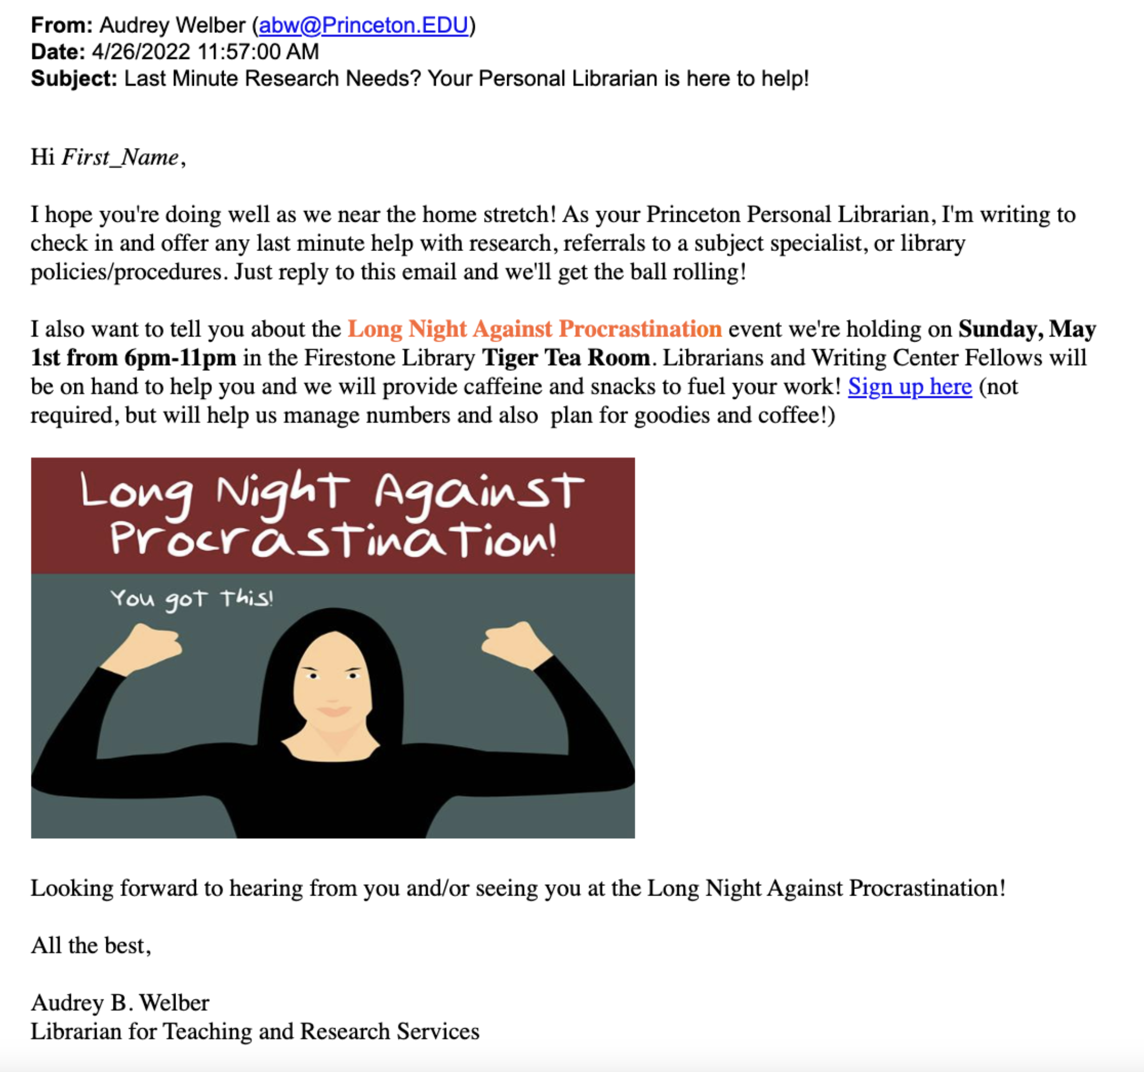
Sample Emails

Slide 14
Refinements to Vision (2021-present)
Emphasis on empathy and support
Less formal emails with graphics
Lunches for PLs in which we discuss successes, share emailing tips, etc.
Focus on underserved populations and groups with similar backgrounds/interests
Allow for possibility of in-person events
Notes:
Mention mention of Max to Max who was researching 20th century French military aviation
Emphasis on empathy and support aspect of PL program
Less formal emails with graphics
Lunches for PLs in which we discuss successes, share emailing tips, etc.
Focus on underserved populations and groups with similar backgrounds/interests (for camaraderie and word of mouth)
Allow for possibility of in-person events, e.g., LNAP, study breaks

Slide 15
First In-person LNAP (spring 2022)
Over 300 students showed up; exciting, supportive atmosphere
Advertised both by PL emails and via social media
6-11pm on a Sunday night 3 days away from Dean’s Date
Staffed by PLs and Writing Center Fellows
Ran out of food 3 times during event
Notes:
Dean’s date is when all written assignments are due
Writing center fellows were overrun with customers
Talk about writing clinics

Slide 16
Modifications to next LNAP event (Fall 2022)
We tweaked the poster to de-emphasize “procrastination”
Expanded to two campus library locations—Main library and “collaboration hub” in Science library
Science library had popcorn maker with toppings (a big hit!)
PLs sent advertisement to their rosters and Library Communications used social media

Slide 17
LNAP Led to Expansion of PL Program!
Deans of Student Services saw Instagram post about spring 2022 LNAP event—they reached out about a specialized subset of PL program for athletes
We decided to start with Football team since many were in need of extra academic support
Notes:
Jess a Princeton alumna
Deans of Student Services saw Instagram post about spring 2022 LNAP event—they reached out to me and we met about a specialized subset of PL program for athletes
We decided to start with Football team since many were in need of extra academic support

Slide 18
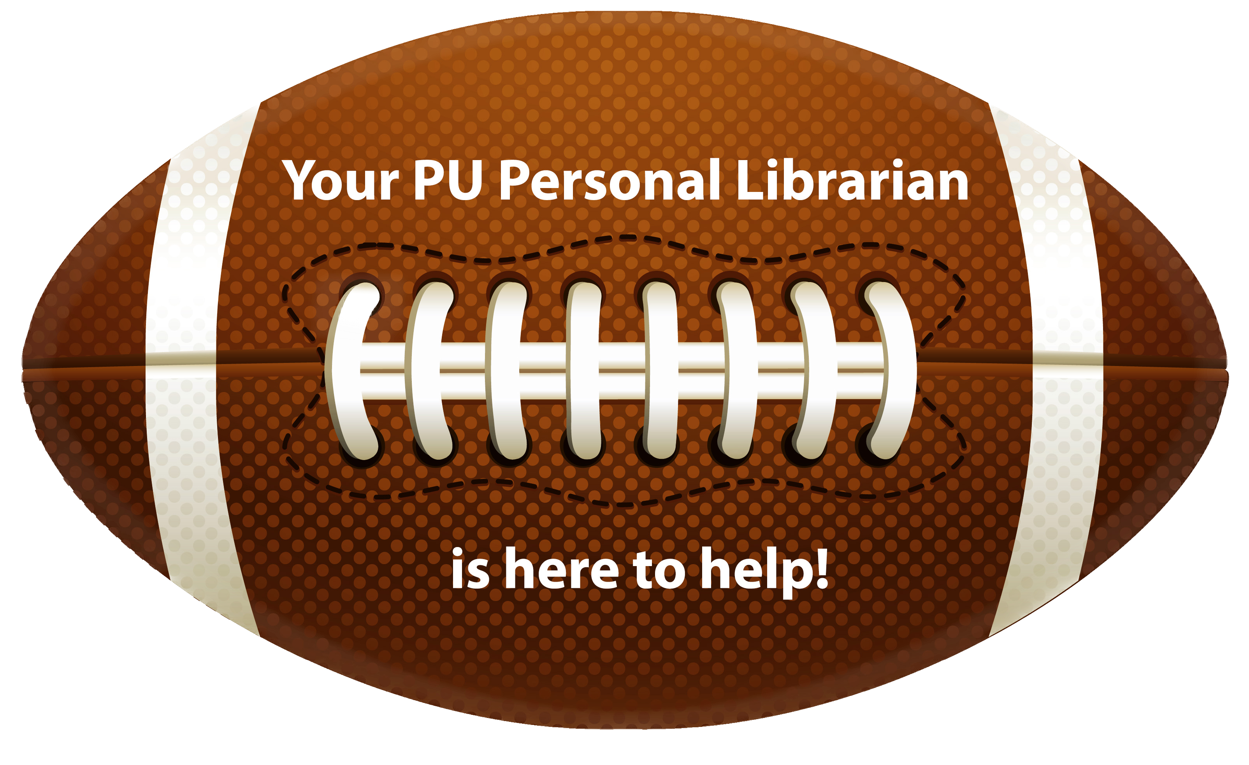
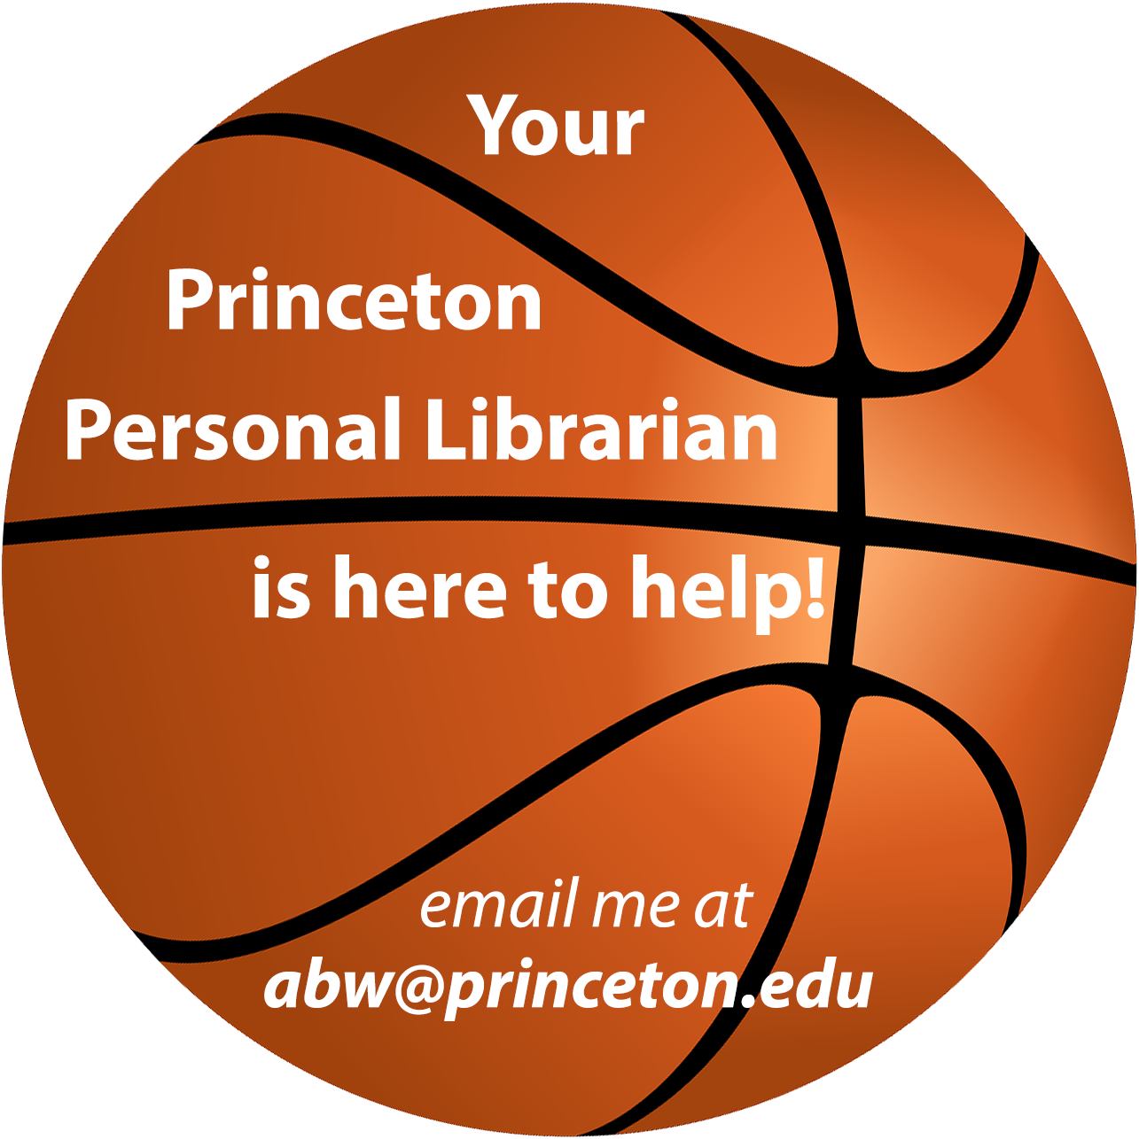
PL Football Pilot (Fall 2022)
I was invited to a panel for junior/senior football players and presented on the PL program
Men’s and Women’s basketball teams learned of the football pilot and asked for their own PL!
Notes:
Many of the football players offered to hang out with my son and teach him!
Yay MBB and WBB!!
I was invited to a panel for junior/senior football players. While presenting the PL program, I mentioned my 8-year old football-playing son and the coach invited us to a practice!
Men’s and Women’s Bball teams learned of the FB pilot and demanded their own PL!

Slide 19
Sample email to football team
Notes:
While presenting the PL program to the panel for junior/senior football players, I mentioned my 8-year old football-playing son and the coach invited us to a practice!
Many of the FB players offered to meet up with my son to work with him!!

Slide 20
Enhancements and Expansion (Fall 2023)
Athletic Teams expanded to Track & Field, Wrestling, and Hockey—PLs invited to team meetings/practices
Creation of “Freshman Scholars Institute” Cohort (First gen, low income students) at request of FSI program
I have an assistant to help with administrative tasks

Slide 21
A Few Student Testimonials
From a junior: I now realize how much time and effort I wasted in the past...all Princeton students should take full advantage of this resource.”
From a senior who had never contacted a librarian (due to fear and stress): “My personal librarian not only pointed me to resources and a subject specialist, but talking to her gave me confidence that I can do this!”
Notes:
Econ junior who confessed mental illness struggles. We talked about cats for the first 10 minutes

Slide 22
Future Refinements/Possibilities
Use of “Badges” in Campus Groups so students can proactively locate their PL, and PLs can include their bios (we lost this functionality when we moved to new interface)
Assessment using statistics gathered via Libinsight
Fine-tune the timing of emails
Popcorn maker at main library for in-person events
Include new Grad students somehow? (we’ve already had inquiries!)
Residential College pairing for possibility of in-person study breaks
Add even more athletic teams
Notes:
I worked with the Computing Center staff to modify Campus Groups for PL program

Slide 23
Final poll!

Slide 24
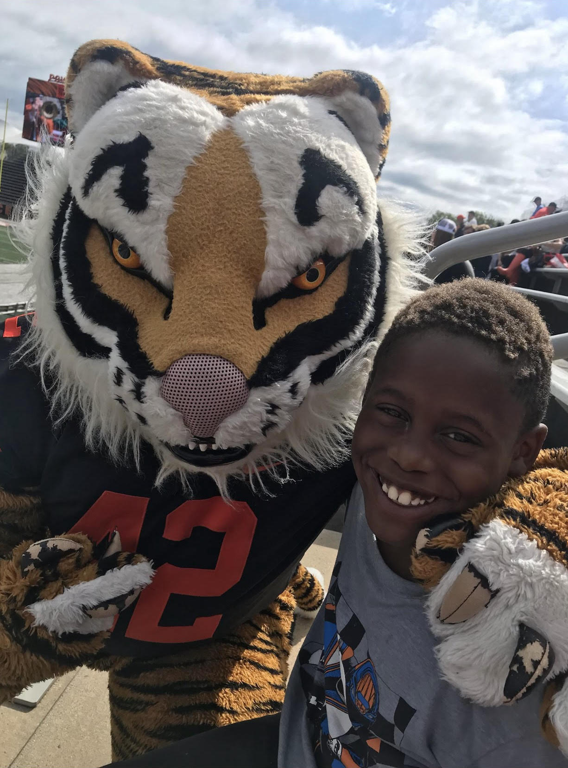
Questions?
I’d love to hear from you!
abw@princeton.edu

