Slide 1
Works In Progress | 13 June 2023
Building a National Finding Aid Network:
Research Methods & Summary Findings
Lynn Silipigni Connaway, Ph.D. (she/her/hers)
Executive Director, Research
Chela Scott Weber (she/her/hers)
Senior Program Officer, OCLC Research Library Partnership

Slide 2
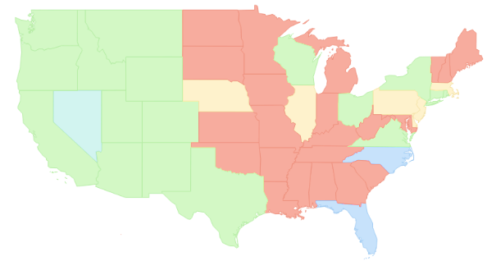
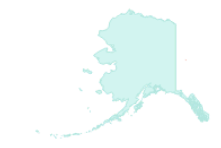
NAFAN
“A national finding aid network that is community-driven, -sustained, and -governed.”
▇ = Statewide/regional coverage
▇ = Partial coverage
▇ = Defunct aggregation
▇ = No coverage
*not to scale
Notes:
A 2 year research and development grant to explore and create the blueprint for implementing a national finding aid network that is community-driven, -sustained, and –governed
Led by CDL with partners at UVA, Shift Collective, Chain Bridge Group, and OCLC.
OCLC was tasked with leading research on end user and archives needs related to aggregation, and with an assessment of quality of archival descriptive data

Slide 3
OCLC Research Team
Chela Scott Weber (she/her)
Senior Program Officer
OCLC Research Library Partnership
Lynn Silipigni Connaway, Ph.D. (she/her)
Executive Director, Research
OCLC Research
Lesley A. Langa, Ph.D. (she/her)
Associate Research Scientist
OCLC Research
Merrilee Proffitt (she/her)
Senior Manager
OCLC Research Library Partnership
Itza A. Carbajal (she/her)
Associate Researcher
OCLC Research
Bruce Washburn (he/him) - retired
Software Engineer
OCLC Research
Brooke Doyle (she/her)
Senior Project Coordinator
OCLC Research
Brittany Brannon (she/her)
Research Support Specialist
OCLC Research
Notes:
Cross-departmental team at OCLC with expertise in qualitative and quantitative research, archival data, and archival practice

Slide 4
Research Advisory Group
Bill Stingone, New York Public Library
Derek Mosley, Auburn Avenue Research Library on African American Culture and History, Atlanta-Fulton Public Library
Hillel Arnold, Rockefeller Archives Center
Holly Mengel, University of Pennsylvania, Kislak Center (PACSCL)
Lydia Tang, Lyrasis
Molly Bruce Patterson, Rhode Island College (RIAMCO)
Rachel Walton, Rollins College
Ricky Punzalan, University of Michigan, School of Information
Notes:
Fantastic group of archivists advising our work and making it better

Slide 5
NAFAN Research Findings – Five Reports
Summary of Research
Pop-up Survey of Users
User Interviews
Focus Group Interviews
EAD Analysis
https://oc.lc/nafan-research
Notes:
Five research outputs - https://oc.lc/nafan-research
Summary of findings will be our focus today, and we will be offering two more webinars in July and August doing a deeper dive into the findings of the other reports

Slide 6
RESEARCH MetHODS

Slide 7
Mixed Methods
“Mixed methods research should be deeply integrated from the genesis of the project, and not to be conducted along parallel tracks that do not intersect…the findings from mixed methods should be iterative and mutually informing”
Kazmer, M., “Mixed Methods,” in Connaway, L.S., & Radford, M.L. (2021). Research methods in library and information science (7th ed.). Santa Barbara: Libraries Unlimited, p. 62.

Slide 8
Research Data Sources
User Survey & Individual Interviews
Archivist Focus Group Interviews
Aggregated Finding Aid Data
Notes:
From this review, we determined three main avenues of explorations or sources of data we wanted to examine: End users, archivists who might participate in aggregation, and the extant finding aid data available to us through current aggregations.

Slide 9
Mixed Methods Research Design
EAD data analysis
Pop-Up Survey
User Individual Interviews
Archivist Focus Group Interviews
Notes:
Example of the way all of the data collection and analysis efforts were used in combination – for the data analysis, we used what we learned from the other research streams to inform the specific questions we would address

Slide 10
Developing Research Questions
Understand the Landscape
Previous NAFAN project outputs
Archival literature review
Persona work
Identify Gaps and Needs – User Research
No existing work on users of aggregation
Previous user research primarily focused on scholars
Notes:
We reviewed:
Outputs from a 2018-2019 NAFAN planning grant, including a summary report of findings and an action plan outlining a concrete path toward a set of goals. We examined these outputs to identify the research questions they raised, then prioritized and narrowed the questions for inclusion in this study.
After questions were prioritized, the OCLC research team conducted a literature review to identify any existing work that addressed or would inform the research questions
Gaps
The literature review identified a significant gap in existing archival research, with no studies examining researcher needs related to aggregations of archival description that represent multiple institutions’ holdings. Most existing work focused on researcher interaction with and understanding of finding aids as a genre, or with finding aids as rendered in online interfaces of a specific institution
More recent archival user study work has broadened in scope to determine the information-seeking behaviors and research practices of scholars using primary sources, but it has focused almost entirely on historians and other academic researchers in the humanities. Archival persona work done for archival software projects focused on a broader range of users, but did not include extensive study of information seeking needs and behaviors

Slide 11
Who are the current users of aggregated archival description?
Do current user types align with the persona types and needs identified in recent archival persona work?
Why are the current users trying to discover and access archival collections via aggregation of archival description?
How are current users discovering and accessing aggregations of archival description?
What are the benefits and challenges users face when searching archival description in aggregation?
User
Research Questions
Notes:
Given the lack of understanding of archival aggregation users, and of the broad range of archival researchers generally, exploratory work was necessary to identify the needs, expectations, and behaviors of potential national aggregation users. The following research questions were developed to address this need.

Slide 12
Mixed Methods Research Design
Pop Up Survey
User Interviews
Cluster Analysis

Slide 13
Purpose
Capture data on users of online aggregators
Identify potential interviewees for qualitative analysis
Design
Hosted by 12 aggregators
Convenience sample
Opt-in
Opened March - May 2021
~3,300 responses
Pop-Up Survey
Methods
Notes:
The purpose of the survey was to capture data on users of aggregators. Previous studies of this nature generally looked at individual archives themselves, rather than across aggregators, and were generally smaller N than we wanted for this project. We designed and launched a pop-up survey for users that we placed on the websites of each extant archival aggregator. The survey was designed to do two things, first provide descriptive statistics of users, and second to identify potential interviewees.
The survey was hosted by 12 aggregators. It opened on March 18, 2021, and closed on May 31. The sample was a convenience sample, with users opting in, rather than a randomized sample. Future research could use a random sample, but given the lack of large N studies on this, we felt that a convenience sample was a good starting point. We ended up with over 3,000 responses, which as a higher number than we were even expecting.

Slide 14
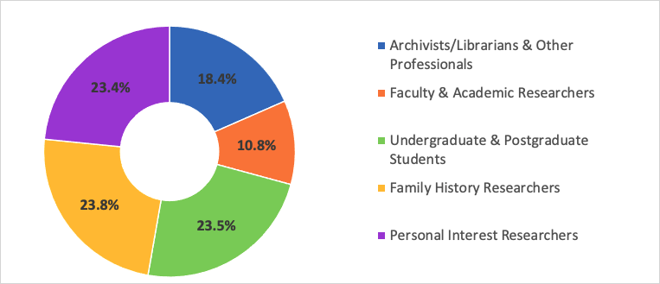
Two-Step Cluster Method
Notes:
To identify the individuals we wanted to invite for interviews, we performed further analysis on the survey data. Specifically, we wanted to categorize users into buckets that takes into account how similar they are to one another by characteristics like their project purpose and their profession.
The TwoStep Cluster Analysis procedure is an exploratory tool designed to reveal natural groupings (or clusters) within a data set that would otherwise not be apparent. The algorithm employed by this procedure has several desirable features that differentiate it from traditional clustering techniques:
The ability to create clusters based on both categorical and continuous variables.
Automatic selection of the number of clusters.
The ability to analyze large data files efficiently.
With more than 3,000 users in the survey, the cluster analysis was a suitable method. This approach provided useful cluster categories in the donut chart in the middle of the slide.
Archivist/Librarian & Other Professionals (N=559) – public and technical service archivists/librarians, journalists, writers, tradespeople
Faculty and Other Doctoral Degrees (N=328) – faculty, post-doc, independent researcher, museum professionals
Family History Researchers (N=722)– local history, professional genealogist, hobby genealogist
Personal Interest Researchers (N=711) – general search with a range of profession and education
Undergraduate and Postgraduate Students (N=712) – Indicate their profession is undergraduate/postgraduate student

Slide 15
Individual Interviews
with Users
Purpose:
Focus on why and how they are discovering and accessing archives, what they want from aggregation.
Design:
25 interviews, 5 per persona type
In-depth, 1:1, 60-minute interviews
Conducted Oct-Dec 2021
Developed code book
Coded transcripts in NVivo
Notes:
We invited 25 pop-up survey respondents to sit for a semi-structured interview from the top five professions. Questions in the interview delved further into the researcher's motivations and methods for seeking out archival materials.

Slide 16
Developing Research Questions
Understand the Landscape
Previous NAFAN project outputs
Archival literature review
Identify Gaps and Needs – Archivists & Finding Aid Data
No existing work on contribution to aggregation
Most recent data analysis from 2013 – pre- ArchivesSpace and AtoM
Notes:
we reviewed materials from the 2018-2019 planning grant and the archival literature
Gaps
There is no research specifically focused on contributing finding aids to an archival aggregator.
More broadly, there is a body of research related to the use and implementation of the EAD encoding standard. This work is relevant to NAFAN as EAD encoded finding aids comprise most data in current regional aggregators in the US and these regional aggregators are likely to play a key role in contributing data to a national aggregation platform. Most of the EAD-focused literature dates from the late 1990s and early 2000s in the nascent period of implementation of the EAD standard, and the most recent major work on EAD was from 2013

Slide 17
What are the enabling and constraining factors that influence whether institutions describe the archival collections in their care?
What are the enabling or constraining factors that influence whether institutions contribute to an aggregation?
What value does participation in an aggregation service bring to institutions?
Archivist
Research Questions
Notes:
One of the goals outlined in the 2018–2019 planning grant was to enable participation by a wider range of cultural heritage institutions and support greater variety of collection description levels and formats. So we felt it was important to develop a broader understanding of descriptive practice beyond just EAD creation. With no existing research about working with archival aggregators, it also was vital to identify and document the experiences of current and potential contributors to archival aggregations.

Slide 18
What is the structure and extent of consistency across finding aid data in
current aggregations?
Can that data support the needs to be identified in the user research phase of the study? If so, how? If not, what are the gaps?
Finding Aid Data
Research Questions
Notes:
Given the age of EAD studies, and the subsequent significant development and uptake of archival collection management systems such as ArchivesSpace and Access to Memory (AtoM), the research team felt it was necessary to develop a current understanding of EAD quality and how well it could support discovery functionality

Slide 19
Focus Group Interviews
with Archivists
Purpose:
Get in-depth information about how and why they undertake descriptive work
Identify perceptions of the value of aggregators
Design:
10 Interviews / 53 Archivists total
In-depth, 90-minute interviews
Conducted June 2021
Developed codebook based on emerging themes
Coded Transcripts using theme analysis
Notes:
Purpose:
get in-depth responses on how and why they are or are not describing the collections in their care and participating in aggregation
Identify from archivists perceptions of the value of participating in aggregation
Design:
We conducted 10 focus group interviews with a total of 53 participants, roughly half of whom worked in an archive that currently participates in an aggregation and half of whom did not.
In our participant selection, we worked hard to assemble groups representing a wide range of institution types and sizes, and people with different levels and types of responsibilities.
10 focus groups
Recruiting via email lists and Twitter
274 respondents to our participant screening survey
Organizing groups based on institution size, job responsibility, years experience, participation in aggregation
Interviews transcribed; theme analysis conducted
Conducted virtually in June 2021
53 participants total
25 participating in aggregation
28 not participating in aggregation
Representing 27 states and District of Columbia
Divided into five group types
Leadership / Administrative
Public Services & Tech Services, small institution
Public Services & Tech Services, large institution
Technical Services & Systems Responsibilities
Very Small Institution / Lone Arrangers

Slide 20
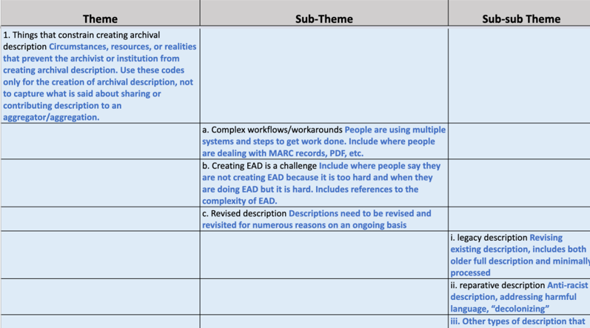
Codebook

Slide 21
Purpose:
Assess data quality and how extant data does or does not support discovery
Design:
Used representative sample of 145K EAD from multiple aggregators
First pass analysis to analyze consistency and variance in practice
Second pass analysis based on findings of the other two research categories
EAD Data Analysis
Notes:
Twelve NAFAN partners made their EAD XML finding aids available to the project for quantitative analysis, producing a total of over 145 thousand documents.

Slide 22
Mixed Methods Research Design
EAD data analysis
Pop-Up Survey
User Individual Interviews
Archivist Focus Group Interviews

Slide 23
EAD Data Quality Analysis
Tag Analysis: What is the consistency of data element usage?
Finding aid links to digital content
Specifying physical characteristics & genre
Connections to controlled vocabularies
Consistency of institutional contact information
Information about access, use and reuse of materials
Notes:
1st phase of analysis: we did a tag analysis of elements that can support typical functionality in discovery systems, looking at the absence or presence of tags in the data set, at both the collection and lower levels in the finding aid.
2nd phase of analysis: Using what we learned from our user and archivist research, we did more in depth investigations into data element content that might support user needs, such as the potential to link to digital content from these finding aids, the potential to connect to controlled vocabularies, and the consistency and completeness of institutional contact information.

Slide 24
Research Findings

Slide 25
Value Proposition for NAFAN
“A core principle guiding work on this phase of work on NAFAN is that the project team must gather evidence to better understand and articulate the value proposition that a national aggregation can provide.”
Notes:
Going into this project, there was a sense from participants and our partners at regional aggregators that aggregation was valuable, but it was a kind of hand-wavy, anecdotally driven idea of value. So a guiding principle set at the beginning of our work was that we needed to gather evidence to help us think much more carefully about the value a national archival aggregation could offer users and the archives that participate.
One way to think about value proposition is to identify the problems a system is trying to solve, and then articulate how the system will address them. Our research identified challenges faced by both researchers and archivists that a national aggregation can address, as well as alignment between the needs of these two groups.
I'll walk through the four overarching areas of need the research pointed to, that a national aggregation could address

Slide 26
Address Discovery Challenges
“It does take a lot of time…it's guessing what repository might have something, was this person based on the East Coast, or this company? It does take a lot of time and energy to try and find those archival materials.”
-- Professional Researcher
Notes:
Real challenge for users to find archives
This was across all types of users. Even the most expert still have to work very hard – they may find more than others, but it still takes lots of time
A key challenge voiced by interviewees is how difficult it is to do archival research generally, including how many places they must look and how long searching takes.
Frustration with having to use multiple systems also was an issue in using aggregators, as regional aggregators have limited scope and multiple systems must be used to approximate a nation-wide search.
Some participants voiced concern that they were not finding material held at smaller and community-based archives and missing out on the stories that those repositories documented.

Slide 27
Address Discovery Challenges
“…being indexed through ArchiveGrid is the only way that we can currently search across our finding aids.” -- Archivist, Academic Library, West
Notes:
Archivists described being challenged to make their collections visible to a broad audience of researchers.

Slide 28
Address Discovery Challenges
“[Aggregation] makes our resources more discoverable, and it also puts them in a conversation with other resources at other institutions that are similar.”
--Curator, Academic Archive, West
Notes:
Both want an easy-to-use system that provides comprehensive discovery of archival collections across many institutions. Similarly, both groups of stakeholders were concerned not just with discovering individual collections, but also surfacing connections between collections.
Archivists highlighted the importance of these connections given the deep interrelatedness of distinct archival collections held across many institutions and because the sometimes-fractured nature of archival collecting means that not all archival material by a single creator may end up in the same archive.
Users desire systems that provide connections across collections, institutions, and topics.

Slide 29
Address Discovery Challenges
"A national aggregation can provide important value by making archival collections more visible and discoverable on the web and making connections between collections much more easily visible to users."

Slide 30
Address Access Challenges
Researchers need better support to access archives
Key Challenges:
In-person research is prohibitive
Mediated access is poorly supported
Digital content delivery is clunky and confusing
Notes:
While this work was ostensibly focused on discovery, we of course heard a lot about access
In-person research is prohibitive:
Most archives are not digitized
Travel is expensive
Caretaking responsibilities limit travel
Rules & policies are unclear
Mediated access is poorly supported:
Archivists are still playing a vital intermediary role in helping people access archives, whether they are doing so in-person, through a digital surrogate, or through a researcher for hire
Researchers need to:
ask questions
make appointments
request remote research
request scans and licensing
We heard a lot of frustration from researchers about how difficult it is to get the help they need. This was exacerbated in aggregation settings.
Digital content delivery is clunky and confusing:
Most archives aren't digitized
Hard to connect to digital content
Hard to request digital content

Slide 31
“intuitive to use”
Delivery Desires
Easy to tell which repository has a collection
Easy to find contact information or access policies
Easy connection to digital content
…and more digital content
“information so I can contact that archive”
“if everything was online, that would be my perfect world”
Notes:
We asked user – If you had a magic wand, what kind of a system would you create to access archives?
Researchers have already done the labor of finding the collections – finding information about the repositories should not be an additional research task.

Slide 32
Address Access Challenges
The NAFAN platform can provide value by:
supporting access needs
helping researchers find collections held nearby
supporting easier access to digitized collections
Notes:
While aggregators are traditionally considered discovery systems, research findings indicate that NAFAN can create value by supporting access as well as discovery. End users described a desire to be able to access archival materials once they had discovered them and noted the ways an aggregation system can support or frustrate that process. The NAFAN platform can provide value by understanding how the system can support access needs, planning for archival research trips, and contacting individual archives. Users also noted barriers to doing in-person archival research, especially when it requires traveling to an archive. A national aggregation can provide value by helping researchers discover collections held geographically close to them that they are more likely to be able to easily access. Both pop-up survey data and interviews with users tell us that online access to digital collections is highly desired by researchers. NAFAN can provide important value to researchers by considering how digital resources will be incorporated into aggregation features and interfaces to allow researchers to access digitized collections more easily.

Slide 33
Address Archivists’ Challenges
"Archivists face significant barriers and challenges in creating and publishing archival description. Inefficiencies in participating in current archival aggregation systems can exacerbate these issues, creating additional or redundant work for archivists and preventing participation in aggregation."

Slide 34
Archivists’ Description Challenges
“we’re doing a lot of manual encoding, which means that for us, EAD encoding does not happen as a priority...I'll be honest.” -Curator, Public library archive, Northeast
Notes:
In terms of things that made it more difficult for archivists to describe the collections in their care, the top three things we heard about were:
· Complex workflows and workarounds, often involving multiple tools or systems that don’t always play well together, making do with systems that weren’t purpose built for archives, managing description in multiple formats, and creating bespoke workarounds for the limitations of systems in use. A major subset of this was complex workflows designed to produce EAD.
· Many participants described having legacy archival description in multiple non-structured or semi-structured formats, like Word, PDF, and Excel or CSV files. This finding is tightly tied to the complex workflows finding – in many cases managing and trying to migrate description in many formats necessitates keeping multiple, clunky tools and systems going.
These findings confirmed a belief the NAFAN project team had from the outset of the project – that a national aggregation would need to accept formats beyond EAD in order to meet archives where they are in their descriptive program.
Given the challenges of creating archival description broadly, along with the inconsistency of archival data we found in our EAD analysis, we identified data remediation as a potential value that an aggregator could provide.

Slide 35
Archivists’ Aggregation Challenges
“We joined the [aggregator], and I have not put anything there yet because I have to reformat and redo the data that I have done already so that their system can read it and it's so time-consuming...”
--Archivist, Museum archive, Midwest
Notes:
The primary barriers to contribution to archival aggregations are a range of difficulties in contributing and maintaining records with the aggregator. The top barrier mentioned was having to comply with the aggregator’s data requirements, especially when they created additive work. Similarly, participants described how difficult it can be to update, edit, or delete records that are represented in an aggregation, and were frustrated by the time spent dealing with cumbersome systems.
Difficulties in participating in aggregation exacerbated existing challenges in describing collections, and a national aggregation could provide important value by supporting easier creation and sharing of archival description.

Slide 36
Address Inequity in the Archival Landscape
"Our research identifies that there is significant unevenness in the resources available to both archives and archival researchers, with real impacts on the historical record, scholarship, and knowledge access and dissemination"

Slide 37
Address Inequity in the Archival Landscape
Inequity for Archives and Researchers
Key Challenges:
Visibility of collections held in small and underfunded archives
Support for participation for small institutions
Inequity in who can access archival collections

Slide 38
Potential Challenges to Sustainability
“A guiding principle for the NAFAN project has been ‘we must design our work with sustainability in mind from the outset.’”

Slide 39
Discovery Expectations & Data Realities
There is a tension between:
Archivist attitudes around aggregation data requirements
Users’ discovery desires
Archivists’ discovery expectations
Notes:
First, there is a tension between attitudes around aggregation data requirements, users’ discovery desires, and archivists’ discovery expectations. Focus group interview participants described realities related to their archival description resources and practices that do not align easily with the discovery functionality both users and archivists described as desirable. The top barrier that focus group interview participants identified to contributing to aggregations is having to comply with the aggregator’s data requirements, indicating both the data format and data structure requirements as challenges. At the same time, both archivists and end users expressed desires and expectations related to discovery that require structured data. Discovery benefits were archivists’ most-cited incentives to participate in aggregation. Primary among them was a desire to make it easier to discover connections between collections held at different repositories, based on people, organizations, places, and topical subjects. While a basic attempt at this might be accomplished with keyword searching, structured data in the form of authorities or entities would support more sophisticated and reliable functionality to illuminate connections between collections. Participants expressed a strong desire for digital objects to be seamlessly supported within the aggregation, and the utility of advanced search, filtering and faceting, and narrowing searches to specific geographic areas, all of which would rely on structured data
An aggregator discovery platform that features a simple, intuitive, and easy-to-use interface was another key expectation of both researchers and archivists, a desire archivists tied both to serving users and advocating to administrators for participating in aggregation. This functionality will be difficult to achieve with variable data structure and formats. Indexing a combination of structured and unstructured data may create challenges for search weighting and relevancy ranking. It also will create challenges for how to display search results and for creating understandable paths for users navigating from search results to finding aids and other content pages.

Slide 40
Cost Expectations & Resource Realities
There is a tension between:
Archivists’ expectations for a low- or no-cost service
Desired contributor support and aggregation features
Notes:
In the focus groups we heard an archival aggregation should support low barrier participation to a range of institutions and robust discovery features while at the same time being low- or no-cost.
The desired features and community support identified by participants would require a significant level of monetary support, and it is likely that contributors would need to bear a major portion of ongoing costs.
I should note that discussion of costs in the focus group interviews was abstract and occurred organically during the interviews; the interview protocol did not include any questions directly about cost or requests to react to examples of specific fees.
Further investigation is required to assess what costs the archival community are willing to bear to participate and how the market might be segmented to shape a fee structure that is equitable across many types and sizes of institutions.

Slide 41
“There is significant value to be drawn from a national aggregation of archival description, and there are significant challenges to overcome to build the community of participation a national finding aid aggregation will require to be sustainable.”
Notes:
OCLC’s findings point to needs for design, research and testing, and community and user support that will require a holistic conception of the NAFAN system and its resourcing. Concrete guidance can be drawn from this research for prioritization of the next phases of the NAFAN project, not just for technical requirements but also for design and usability, governance, marketing, community building, and further research.

Slide 42
Wrap Up & Questions

Slide 43
Learn More
Read the reports!
Subscribe to the NAFAN mailing list for updates
Sign up for the RLP Primary Sources list
Join us for upcoming NAFAN webinars
Join us at SAA for Session 302 - Searching for the Commons: Reflecting on Access Realities Surfaced through User Research
Notes:
NAFAN findings: https://oc.lc/nafan-research
NAFAN mailing list sign up https://confluence.ucop.edu/display/NAFAN
Primary Sources email list sign up https://www.oclc.org/research/partnership/lists.html
Upcoming NAFAN webinars https://www.oclc.org/research/events/2023/nafan.html
SAA Session description https://whova.com/embedded/session/NFdCWcgMulEQMwx9Xmlwgf4rdPHHEcJf8mkv5hKzZJ8%3D/3016046/?widget=primary

Slide 44
Discussion & Questions
Lynn Silipigni Connaway, Ph.D.
Executive Director, Research
Lynn_connaway@oclc.org
@LynnConnaway
Chela Scott Weber
Senior Program Officer,
OCLC Research Library Partnership
weberc@oclc.org
@partly_cloudy

