Slide 1
Works In Progress 1 August 2023
Building a National Finding Aid Network:
Archivist focus group interviews and EAD analysis
Lesley A. Langa, Ph.D. (she/her/hers)
Associate Research Scientist, OCLC Research
Merrilee Proffitt (she/her/hers)
Senior Manager, OCLC Research Library Partnership
Chela Scott Weber (she/her/hers)
Senior Program Officer, OCLC Research Library Partnership

Slide 2
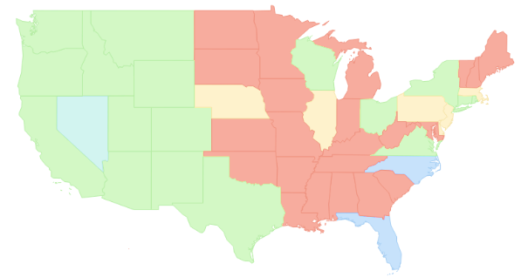
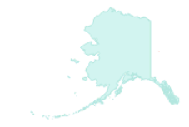
NAFAN
“A national finding aid network that is community-driven, -sustained, and -governed.”
▇ = Statewide/regional coverage
▇ = Partial coverage
▇ = Defunct aggregation
▇ = No coverage
*not to scale

Slide 3
OCLC Research Team
Chela Scott Weber (she/her)
Senior Program Officer
OCLC Research Library Partnership
Lynn Silipigni Connaway, Ph.D. (she/her)
Director of Library Trends and User Research
OCLC Research
Lesley A. Langa, Ph.D. (she/her)
Associate Research Scientist
OCLC Research
Merrilee Proffitt (she/her)
Senior Manager
OCLC Research Library Partnership
Itza A. Carbajal (she/her)
Associate Researcher
OCLC Research
Bruce Washburn (he/him) - retired
Software Engineer
OCLC Research
Brooke Doyle (she/her)
Senior Project Coordinator
OCLC Research
Brittany Brannon (she/her)
Research Support Specialist
OCLC Research

Slide 4
Research Advisory Group
Bill Stingone, New York Public Library
Derek Mosley, Auburn Avenue Research Library on African American Culture and History, Atlanta-Fulton Public Library
Hillel Arnold, Rockefeller Archives Center
Holly Mengel, University of Pennsylvania, Kislak Center (PACSCL)
Lydia Tang, Lyrasis
Molly Bruce Patterson, Rhode Island College (RIAMCO)
Rachel Walton, Rollins College
Ricky Punzalan, University of Michigan, School of Information

Slide 5
NAFAN Research Findings – Five Reports
Summary of Research
Pop-up Survey of Users
User Interviews
Focus Group Interviews
EAD Analysis
https://oc.lc/nafan-research

Slide 6
RESEARCH MetHODS

Slide 7
Mixed Methods
“Mixed methods research should be deeply integrated from the genesis of the project, and not to be conducted along parallel tracks that do not intersect…the findings from mixed methods should be iterative and mutually informing”
- Michelle Kazmer
Kazmer, M., “Mixed Methods,” in Connaway, L.S., & Radford, M.L. (2021).
Research methods in library and information science (7th ed.). Santa Barbara: Libraries Unlimited, p. 62.

Slide 8
Research Data Sources
User Survey & Individual Interviews
Archivist Focus Group Interviews
Aggregated Finding Aid Data

Slide 9
What are the enabling and constraining factors that influence whether organizations describe the archival collections in their care?
What are the enabling or constraining factors that influence whether organizations contribute to an aggregation or archival description?
What value does participation in an archival aggregation service bring to organizations?
What is the structure and extent of consistency across the body of metadata records in current aggregations of archival description? Can that body of metadata records support user needs identified in findings from the user research phase of the study? If so, how? If not what are the gaps?
Aggregation
Research Questions

Slide 10
Mixed Methods Research Design
EAD data analysis
Pop-Up Survey
User Individual Interviews
Archivist Focus Group Interviews

Slide 11
EAD Data Quality Analysis
Tag Analysis: What is the consistency of data element usage?
Finding aid links to digital content
Specifying physical characteristics & genre
Connections to controlled vocabularies
Consistency of institutional contact information
Information about access, use and reuse of materials

Slide 12
Research Findings

Slide 13
Focus Group Findings Themes
Things that constrain creating archival description
Things that enable creating archival description
Incentives to participate in aggregation (current or perceived)
Disincentives to participating in aggregation (current or perceived)

Slide 14
Contributor Focus Group Findings
Challenges and Enablers

Slide 15
Description constrainers
Complex workflows / workarounds (n=29)
Dealing with legacy description (n=19)
Lack of financial resources / staffing (n=18)
“we’re doing a lot of manual encoding, which means that for us, EAD encoding does not happen as a priority...I'll be honest.” -Curator, Public library archive, Northeast
n=number of focus group interview participants ​

Slide 16
Description enablers
Collection Management Systems (n=21)
Worksheets / templates (n=14)
Documentation / manuals (n=8)
“ArchivesSpace makes it easy for us...It's been a sea change for us in terms of time savings.”
-Supervisory Archivist, Academic archive, West
n=number of focus group interview participants ​

Slide 17
EAD Findings
Data quality

Slide 18
Focus of this work
How much consistency exists across the body of EAD encoded records found in current aggregations of archival description?
AND
How current data would support user discovery and access needs?

Slide 19
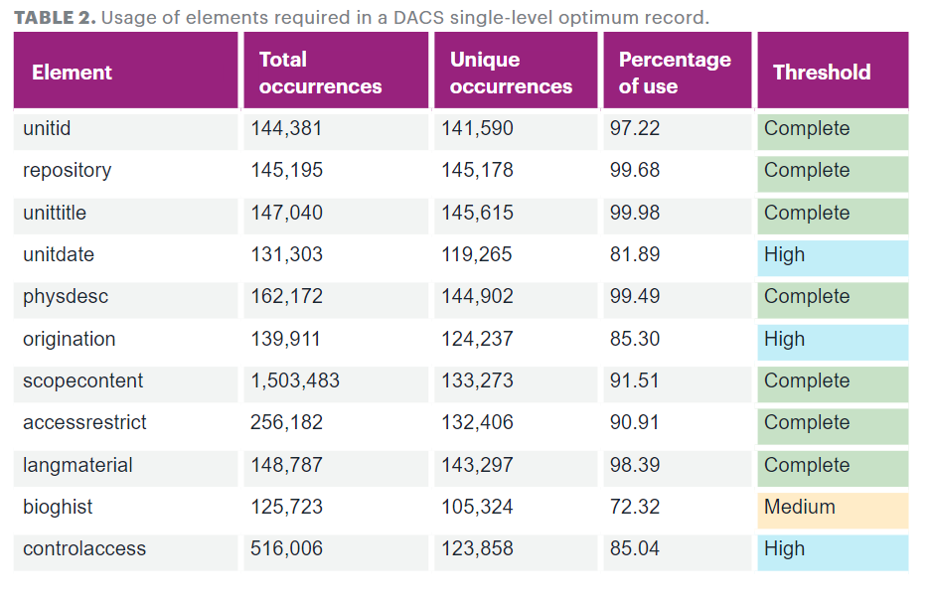
DACS compliance

Slide 20
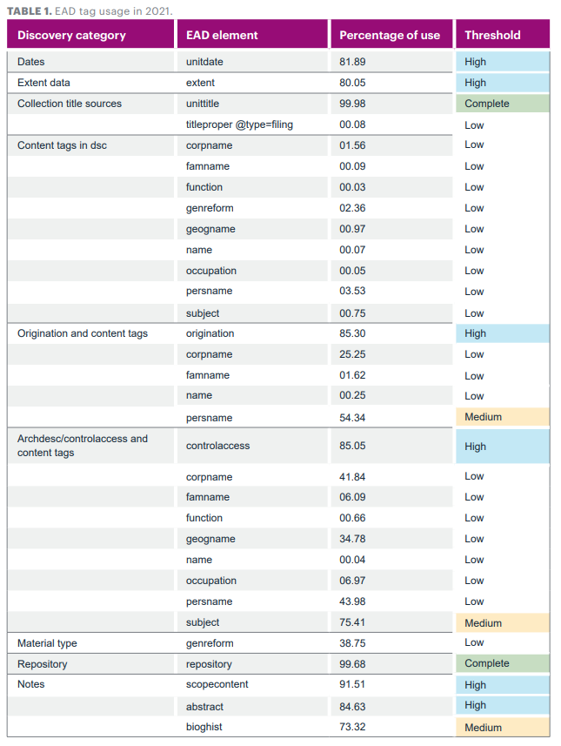
Framework for data quality
High-level features in archival discovery systems
Search
Browse
Results display
Sort
Facet

Slide 21
Contributor Focus Group Findings
Incentives and disincentives to participate in aggregation

Slide 22
Disincentives to participate
Data requirements (n=19)
Difficult to edit / update (n=14) or submit (n=8) records
Cost (n=8)
“We joined the [aggregator], and I have not put anything there yet because I have to reformat and redo the data that I have done already so that their system can read it and it's so time-consuming...” -Archivist, Museum archive, Midwest
n=number of focus group interview participants

Slide 23
Incentives to participate
Increased visibility / awareness of collections (n=25)
Uncovering connections between collections (n=22)
Ease of contributing existing records (n=21)
“For the institution, it makes our resources more discoverable, and it also puts them in a conversation with other resources in other institutions that are similar.”
- Curator, Academic archive, West
n=number of focus group interview participants

Slide 24
“a one-stop shopping place”
Discovery Desires
One place to search for archival material
Include different types and sizes of archives
Connections across collections
Easy to filter/parse large results sets
Easy connection to digital content
“a Google of the archival world”
“be WorldCat, but just for archives”

Slide 25
EAD Findings Linking potential and digital content

Slide 26
Framework for data quality
High-level features in archival discovery systems
Search
Browse
Results display
Sort
Facet

Slide 27
Address Discovery Challenges
“[Aggregation] makes our resources more discoverable, and it also puts them in a conversation with other resources at other institutions that are similar.”
--Curator, Academic Archive, West

Slide 28
Address Discovery Challenges
"A national aggregation can provide important value by making archival collections more visible and discoverable on the web and making connections between collections much more easily visible to users."

Slide 29
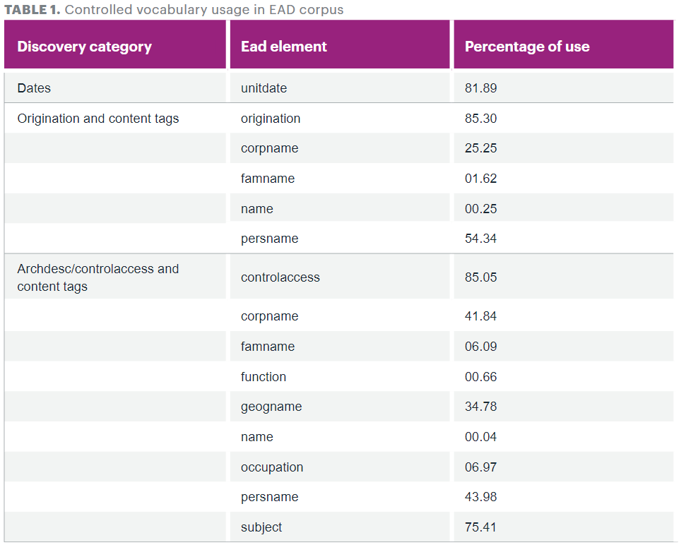
Controlled vocabulary
Overall present in 85% of data (at origination / archdesc level)
Individual elements used far less frequently

Slide 30
Linking potential: a deeper look
Within this set, the inclusion of an authority file attribute value or identifier is rare, but inclusion of a source attribute value is more common
For personal names, 8.6% included an identifier
54.6% included a source attribute value
Clustering across the aggregation may provide a path for enriching the data set with identifiers through reconciliation efforts

Slide 31
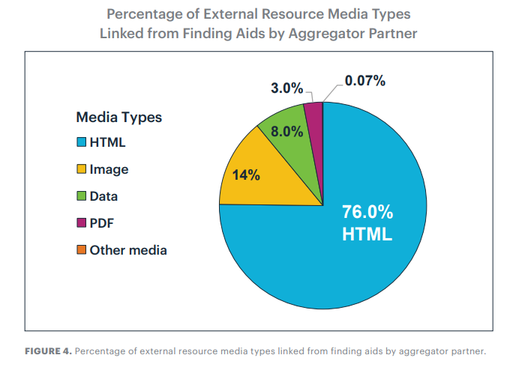
Support for digital content

Slide 32
Discovery Expectations & Data Realities
There is a tension between:
Archivist attitudes around aggregation data requirements
Users’ discovery desires
Archivists’ discovery expectations

Slide 33
Cost Expectations & Resource Realities
There is a tension between:
Archivists’ expectations for a low- or no-cost service
Desired contributor support and aggregation features

Slide 34
NAFAN Project Goals
Create a national finding aid network that is community-driven, community-sustained, and community-governed.
Scale discovery and access to a national level that is as comprehensive as possible.
Increase usable access to unique resources for the broadest possible range of users.
Support the broadest possible range of contributing institutions and minimize barriers to participation.

Slide 35
Recommendations
Develop a “minimal viable record”
Provide a light-weight authoring tool
Provide support for descriptive formats beyond EAD
Provide automated paths for record contribution
Support hosting and publishing of archival description

Slide 36
Wrap Up & Questions

Slide 37
Learn More
Read the reports!
Subscribe to the NAFAN mailing list for updates
Sign up for the RLP Primary Sources list
Watch previous NAFAN webinars

Slide 38
Discussion & Questions
Lesley A. Langa, Ph.D.
Associate Research Scientist, Research
langal@oclc.org
@LesleyLanga
Merrilee Proffitt
Senior Manager,
OCLC Research Library Partnership
proffitm@oclc.org
@MerrileeIAm
Chela Scott Weber
Senior Program Officer,
OCLC Research Library Partnership
weberc@oclc.org
@partly_cloudy

