Slide 1
Developing a Trusted Research Impact Team at Virginia Tech
An OCLC RLP Works in Progress Webinar
January 2023

Slide 2
What We Will Cover Today
1
Our Backstory
2
Grant Support
3
Competitive Intelligence
4
Collaboration Intelligence
5
Research Impact Reports
7
Reputational Support
8
Curating the Scholarly Record

Slide 3
Our Backstory
Notes:
2-3 Minutes
Connie started 2006
Rachel started 2018
Sarah started spring 2022
Next year’s position focuses on researcher profiles, Elements

Slide 4
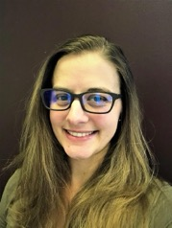
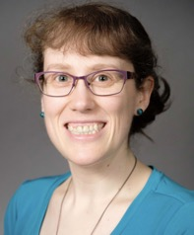
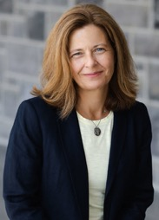
Research Impact & Intel Team
Rachel Miles, MLIS
Research Impact Coordinator
Sarah Over, Ph.D
Engineering Collections & Research Analyst
Connie Stovall, MLIS
Director for Research Impact & Intel
New Position, MLIS
Research Impact Analyst
Please Apply!
Students!
4-8

Slide 5
PRESIDENT
PROVOST
Strategic Initiatives
Communications
Chief Operating Officer
Academic Deans
Academic Vice Presidents
Exec. Vice Provost
Advancement
Government & Community Relations
Enterprise Administration & Business Services
Diversity, Inclusion & Strategic Affairs
Communications & Marketing
Agriculture & Life Sciences
Liberal Arts & Human Sciences
Arts at Virginia Tech
Health Sciences & Technology
University Legal
Human Resources
Technology-enhanced Learning & Online Strategies
Architecture, Arts & Design
Natural Resources & Environment
Innovation Campus
Outreach & International Affairs
Audit, Risk & Compliance
Campus Planning, Infrastructure and Facilities
Business
Vice Provosts
Science
Athletics
Engineering
Research & Innovation
Academic Resources Management
University Libraries
University Ombuds Office
IT & CIO
Graduate Education
Student Affairs
Veterinary Medicine
Finance
Honors College
Affiliated Corporations & Initiatives
Innovation & Partnerships (Tech Transfer)
Equity & Accessibility
Enrollment Management
Carilion School of Medicine
Faculty Affairs
Research Institutes
Sponsored Programs
Policy & Governance
Undergraduate Affairs
Strategic Research Alliances
Research Computing

Slide 6
Grant Support
Notes:
Connie: 2-3 minutes

Slide 7
Active Grant Support Engagement
NSF Regional Engine Grant Proposal
Phase II NSF Proposal: Pandemic Prediction & Prevention
NSF Cooperative Agreement Awarded Grant: 5 Universities
$160M grant requiring industry and HBCU partners
HBCU research strengths investigation
Background research for Virginia minority owned businesses
Product: Spreadsheets, slides
Proposal Role: Listed Collaborator
Recommended by: Transportation Institute based on prior intel work
Benchmark all other programs funded through Phase I
Products: Systematic or Scoping Review & Program Benchmarking in spreadsheets and slides
Proposal Role: Likely listed Collaborator
Recommended by: Provost’s Office & Office of Research based on prior work
7-year cooperative agreement
Includes use of facilities by internal & external users
Products: Dashboard with bibliography, citations, journal rank percentiles, facility user map
Grant Role: in progress
Recommended by: former AVP for Strategic Alliance and Office of Research based on prior work

Slide 8
HBCU Research Partner Justification (Just part of the equation)

Slide 9
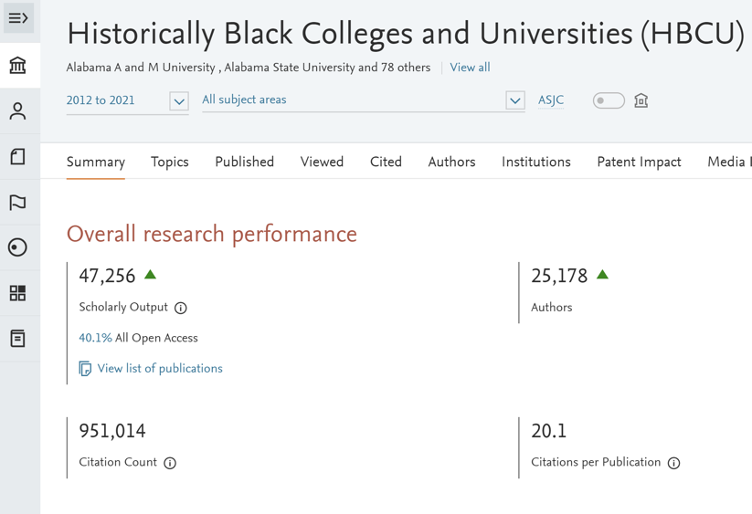
HBCU’s in Dimensions and Scival

Slide 10
Competitive Intelligence
Notes:
Sarah 2-3 minutes

Slide 11
Competitive Intel Examples
Quantum Computing Initiative
Commonwealth Cybersecurity Initiative
Funding
Program comparison
Internal and external research strengths
Collaboration evidence
Funding evidence
Strategic hiring informed in part by bibliometric and other sources
Product: Spreadsheets, slides, Tableau dashboards
Recommended by: Office of Research unit Associate Vice President
Proof of interdisciplinarity & impact
Patent and research production
Journal percentiles
Product: Spreadsheets, slides, Tableau dashboards
Recommended by: Office of Research unit Associate Vice President
NIH Reporter Data
NSF HERD Data
USASpending.gov
Product: Spreadsheets, slides, Tableau dashboards
Recommended by: Office of Research Associate Vice President

Slide 12
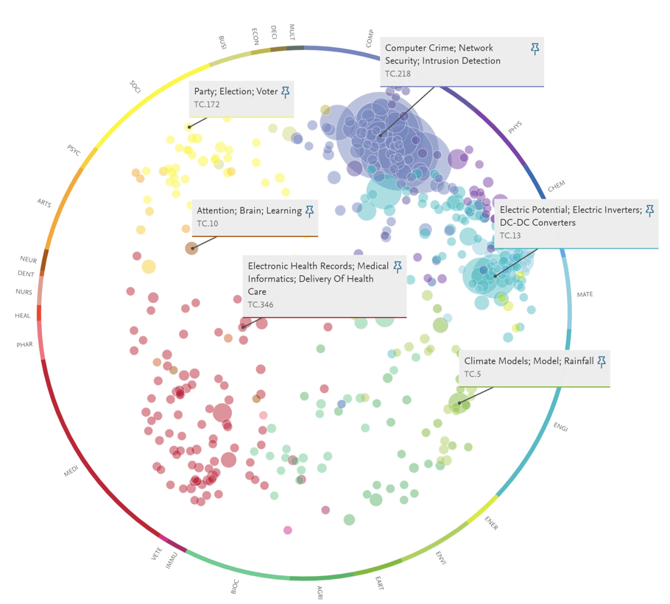
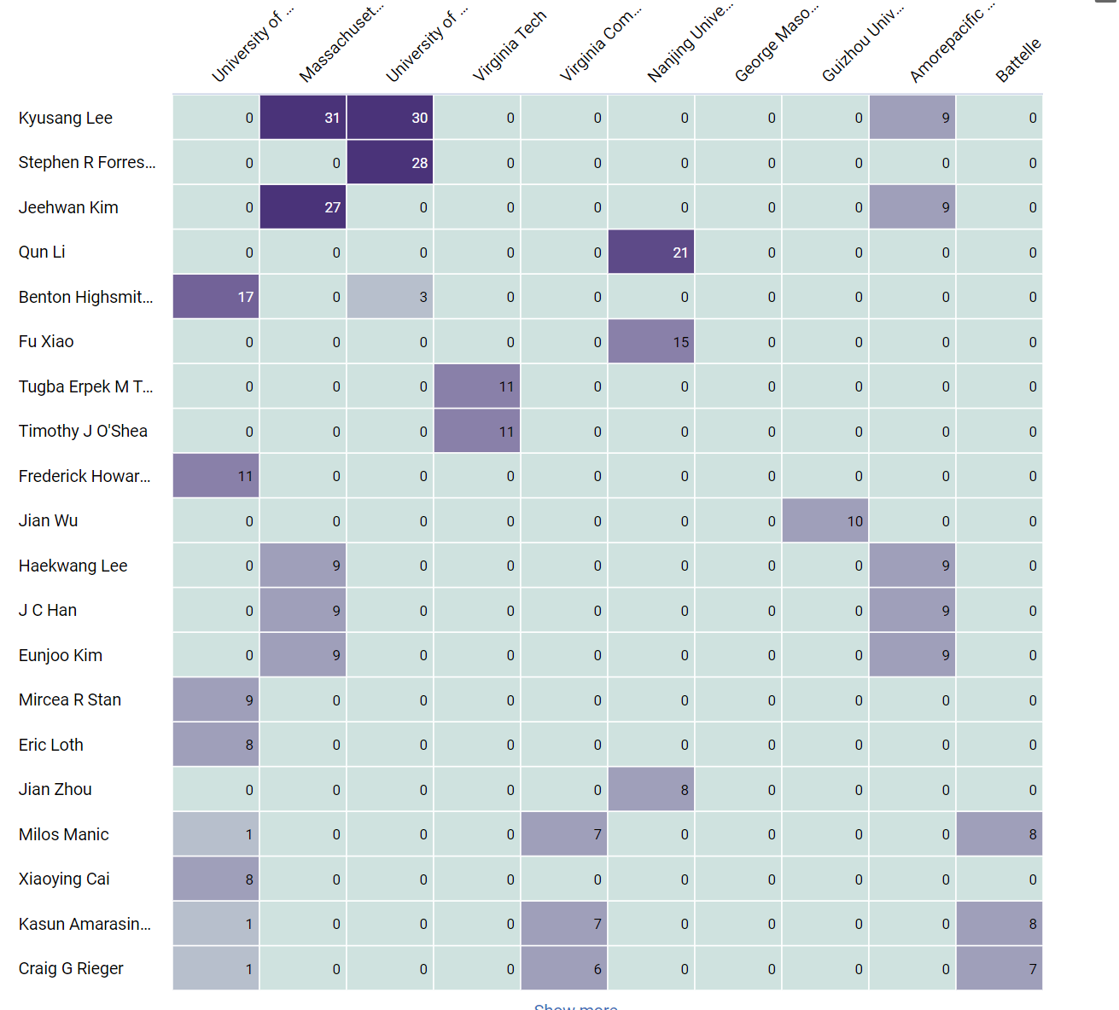
CCI Interdisciplinarity and Patents Example

Slide 13
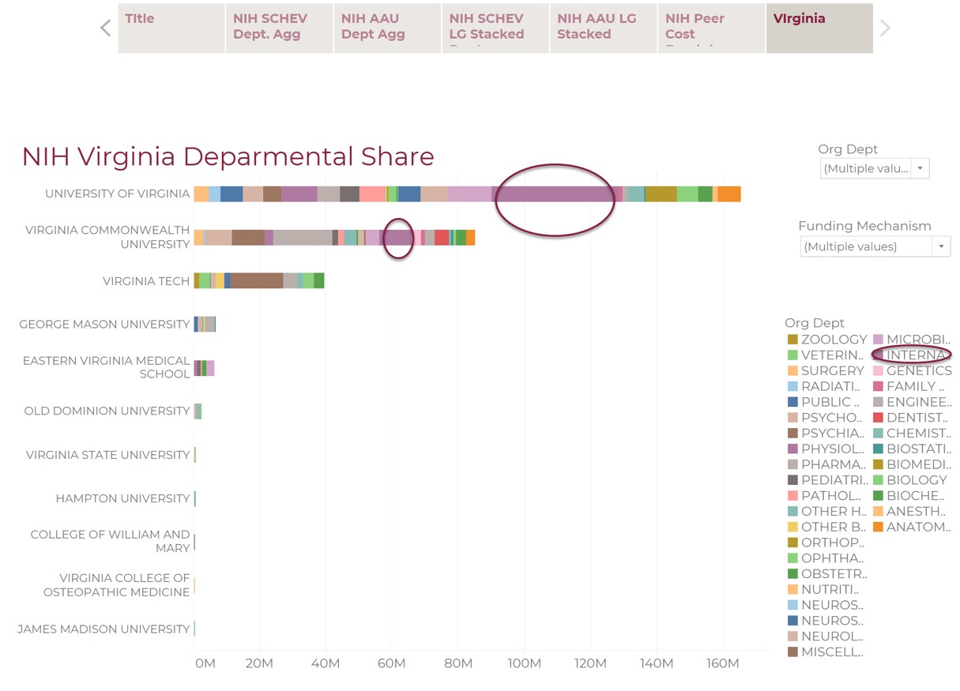
NIH Benchmarking Example

Slide 14
Collaboration Intelligence
Notes:
Sarah – 5 min
Lots of collab intel req, much related to Eng (VT large)
As eng spec and eng, well suited to work on these
Today – highlight work on HBCU’s and a company

Slide 15
Collaborations between Virginia Tech & X
University priority of building more collaborations:
Other institutions: Peer & Minority Serving
Tech Companies of All Sizes
Analyses goals include:
Research alignment
Top researchers or other people of interest
Funding information
Previous successful collaborations and partnerships
Tools: Databases, SciVal, Dimensions, VOSviewer, Tableau and more
Examples: HBCUs & Intel
Notes:
Just some of the VT priorities I have been involved with
Basically provide how do we fit and how should we start
Some free tools, some subscription

Slide 16
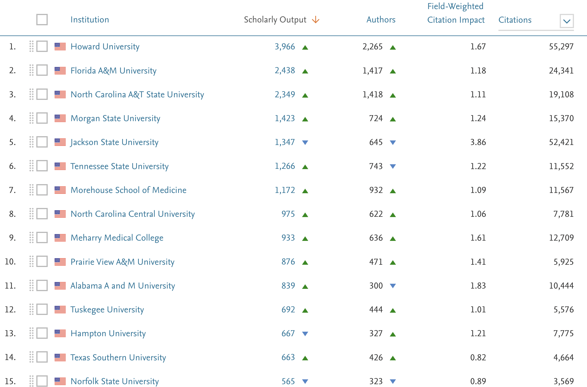
Collaborations - HBCUs
VT seeking to increase engagement with Minority Serving Institutions (MSIs) – start with HBCUs
Initial scan looked for areas of alignment in research output (publications)
(2017+ Publications top HBCUs)
Notes:
Top HBCUs – no R1, top 10 R2 and some getting close to R1
SciVal 09/2022

Slide 17
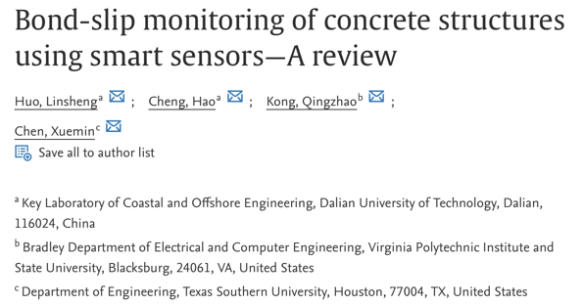
Collaborations - HBCUs
As project progressed, focused on specific areas such as transportation
Primarily utilize SciVal & (now) NSF HERD data
Texas Southern – Transportation Top Area
(Topic Clusters)
Notes:
Only 1 joint publication from 2019 found w/ Tx Southern for example – but lots of places to work together (VTTI)
SciVal 09/2022

Slide 18
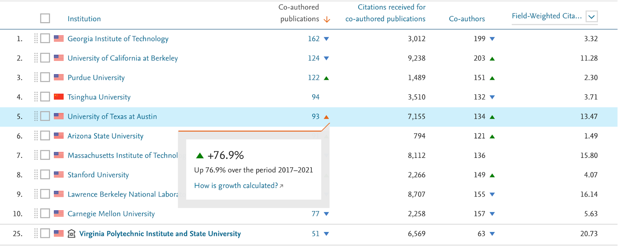
Collaborations - Intel
Tech transfer office at VT looking to increase partnerships with corporations
Intel identified as priority
UC Berkley initially identified as example for collaboration – UT also found
(2017+ Joint Publications)
Notes:
SciVal 07/2022

Slide 19
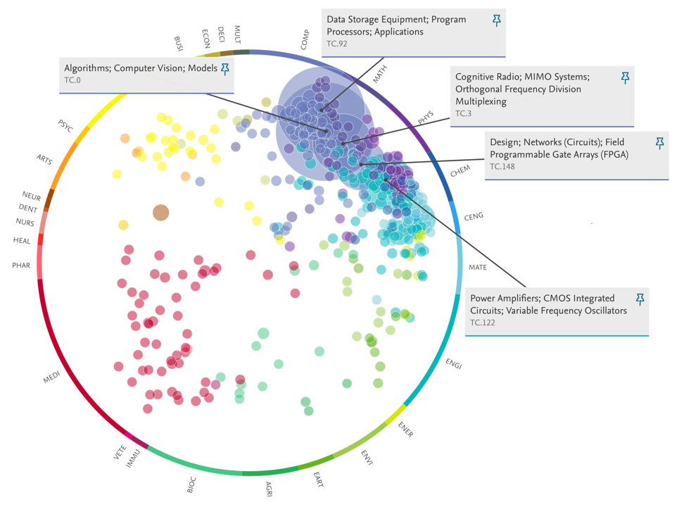
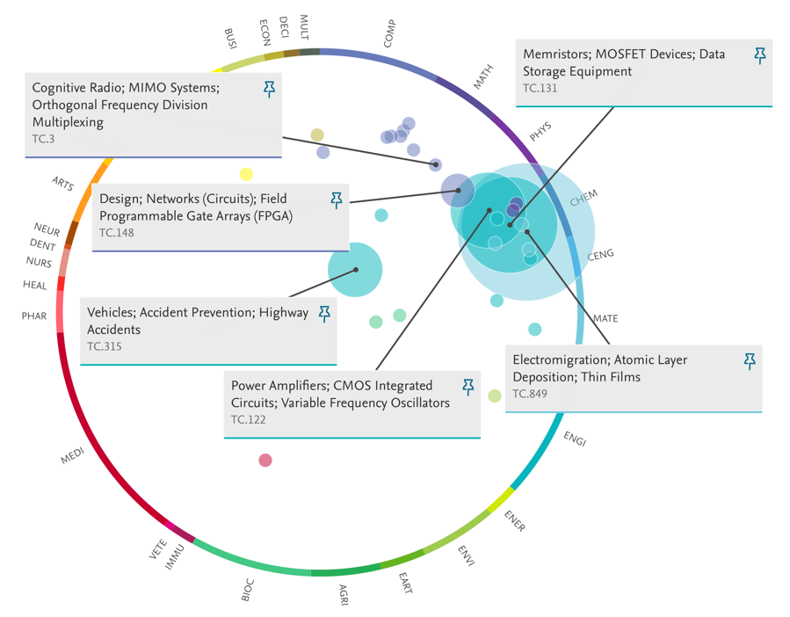
Collaborations – Intel & VT alignment by Publications
Intel – Top 5
VT – Top 5 from Joint Publications
Notes:
Then can look into faculty who authored pubs and/or others at VT in these areas to get them involved!
SciVal 07/2022

Slide 20
Research Impact Reports
Notes:
Rachel: 2-3 minutes

Slide 21
Research Impact Reports
Individual reports demonstrate:
Impact and reach of publications
Benchmarking against similar scholars in the field
Breakdown of citing authors’ demographics (e.g., country, institution, field)
Group reports demonstrate:
Publication productivity
Topical analyses
Identifying key “strengths” and “weaknesses” of areas of research
Identifying institutional collaborations & their impact
Identifying co-authorship networks & their impact
Benchmarking against similar units
Interpretation and caveats of bibliometrics & altmetrics
College
Department, Unit, Institute
Individual

Slide 22
What’s in a Report?

Slide 23
Request from an Individual
“Is there any way you could provide some of the information about international, separately for each meta-analysis [I published] using Google Scholar (e.g., % of international scholars are citing me compared to domestic scholars, % by country)?”

Slide 24
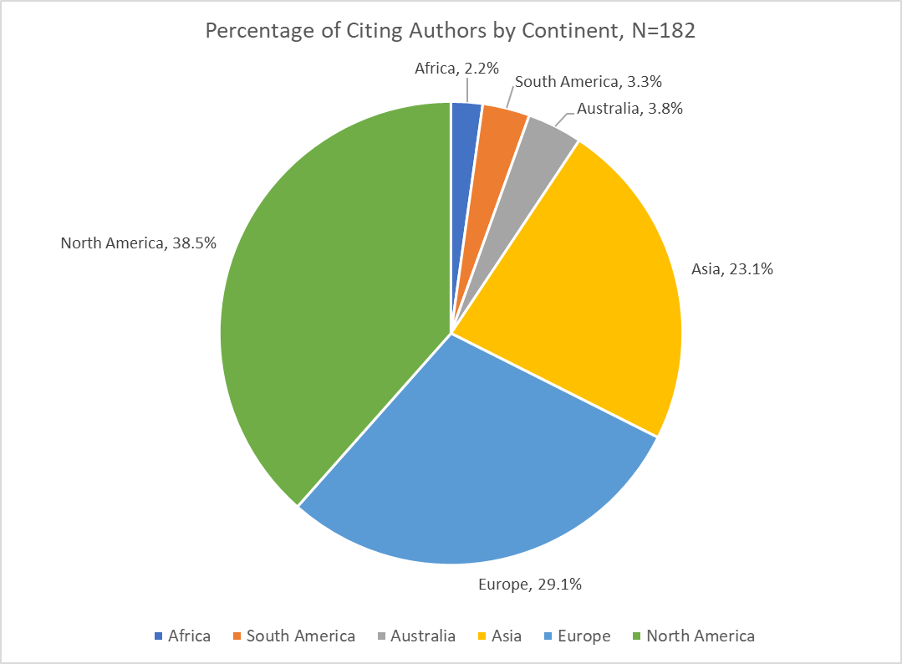
Geographic Breakdown of Citing Documents to a Meta-analysis Data sources: Scopus & Web of Science

Slide 25
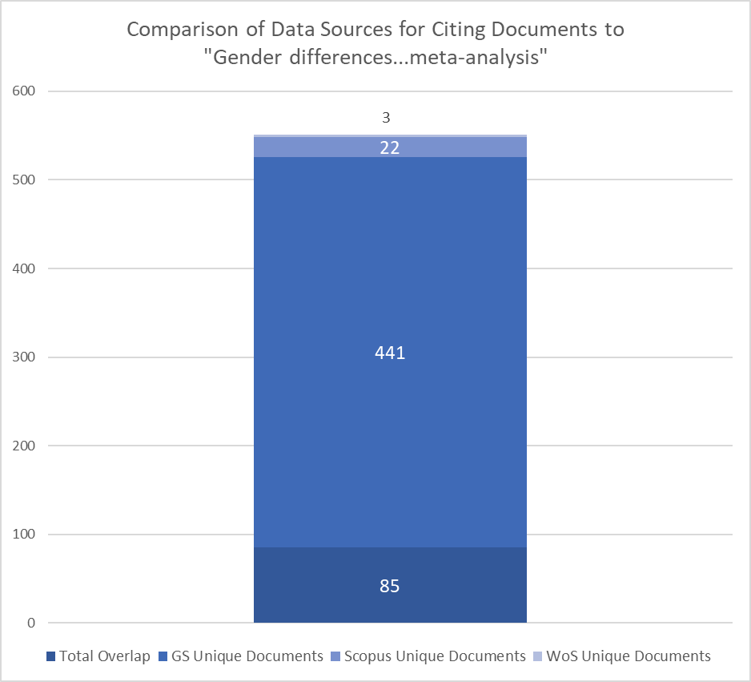
Comparison of Data Sources

Slide 26
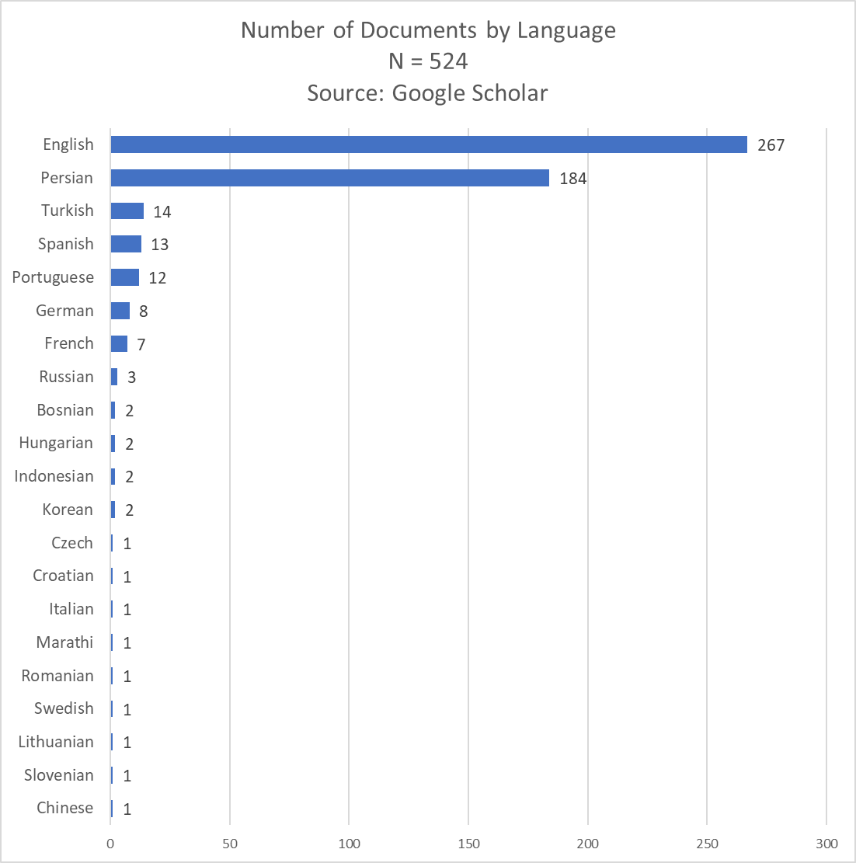
Citing Documents by Language Data source: Google Scholar

Slide 27
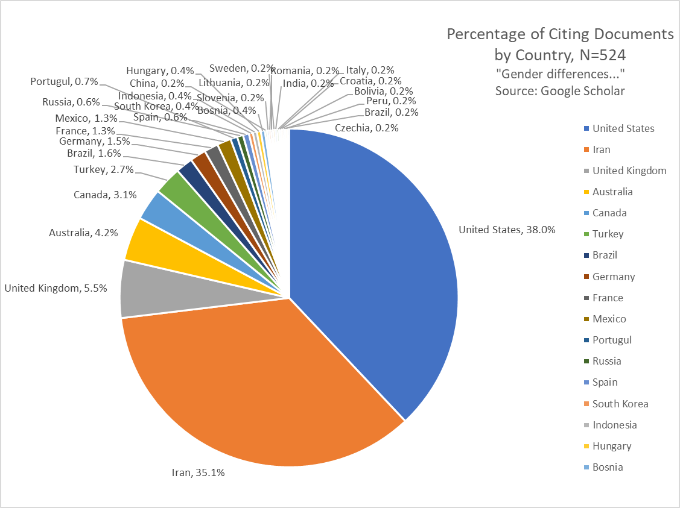

Slide 28
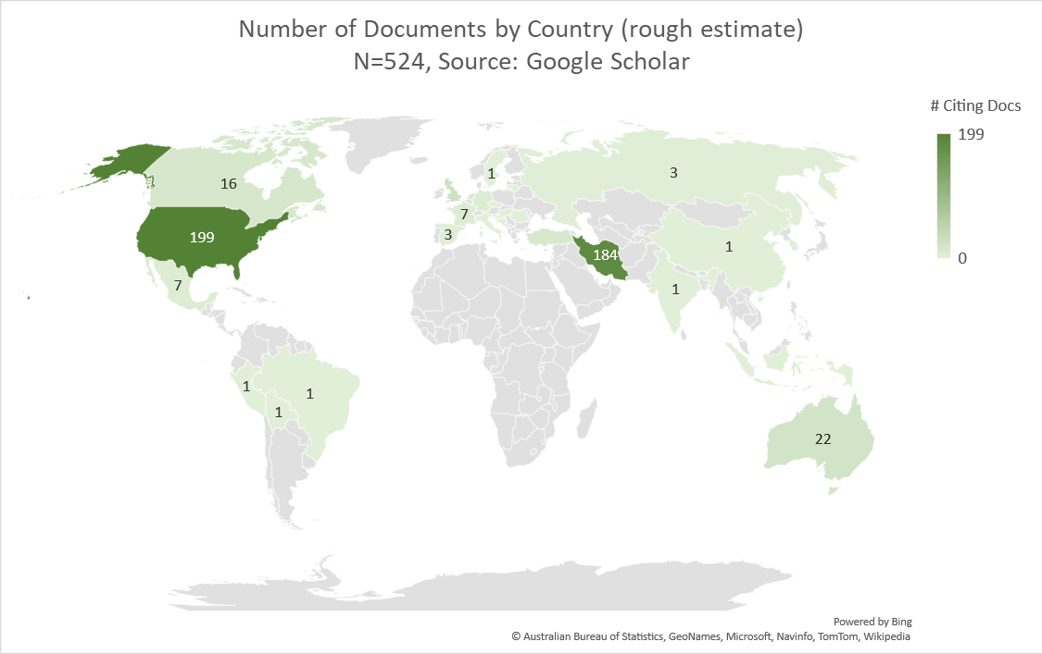
Country Affiliation of Citing Documents

Slide 29
Impact Report for a College
Consider what you want to measure:
Scientific productivity and/or contribution
Institutional trends in grant funding
Economic impact
Societal impact
Research impact
Journal publishing impact
Something else? Emerging trends
“How would you measure these?”

Slide 30
College-level Research Impact Report
Citation data from SciVal
Citation counts by author, department
Field-weighted citation impact (FWCI) from SciVal
Number of Outputs in Top 10% Citation Percentiles
Citations per publication
Collaboration data from SciVal
International
Corporate
Citation impact of these
Academic-corporate collaboration and international collaboration had the highest citation impact, while national, institutional only, and single-authored documents had lower citation impact (in descending order)
Notes:
All citation metrics included all publications and a separate count for publications with fewer than ten authors per publication (to eliminate “hyper-authored” publications and account for a rough proxy of “scientific contribution”)
FWCIs were usually lower when publications had fewer than ten authors, but other citation metrics had no significant difference

Slide 31
College-level Research Impact Report (continued)
Aggregated Data from Scopus and Web of Science
Co-authorship Networks by Department
Organizational Collaboration Networks
Term Co-Occurrence Maps by Department
First-authored publications by author
Number of first-authored publications
Number of citations to those documents
Average number of citations

Slide 32
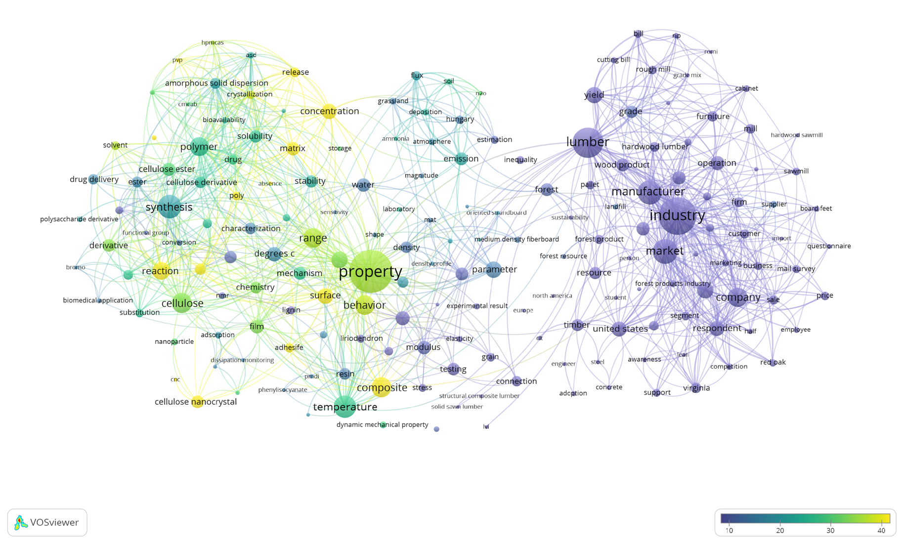
Example of Term Co-Occurrence Map (VOSviewer visualization)
Size of Node = Average number of documents that mention the term at least once in the title or abstract
Average Citation Count per Document

Slide 33
Curating the Scholarly Record
Notes:
Rachel: 2-3 minutes

Slide 34
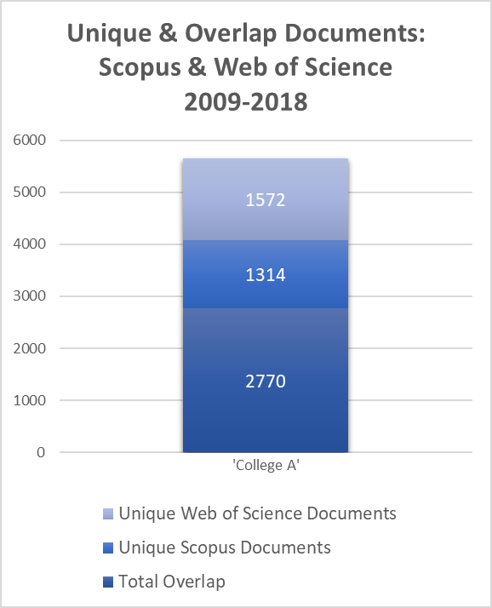
Comparison of Scopus & Web of Science
2019: research analytics completed for ‘College A’
Data sources compared for overlap and unique coverage
Overall, there were significant numbers of unique documents from both databases

Slide 35
Future Elements Work
College of Science will require Elements eFARs next fiscal year
Department of Chemistry has asked faculty to submit forms for our team to curate profiles over the next year
Transportation Institute (VTTI) expressed interest in profile curation
ORCID Write in the works
Provide services
Offer services
Promote & educate

Slide 36
Reputational Support
Notes:
Rachel: 2-3 minutes
Experts public portal

Slide 37
Virginia Tech Experts
Public profile system unique to Virginia Tech researchers
Data from Elements feeds directly into Experts
Elements users must toggle their Elements profile from “internal” to “public” for it to display on Experts
All grant data set to internal, because some of the data is sensitive or confidential, and it is not possible to filter this

Slide 38
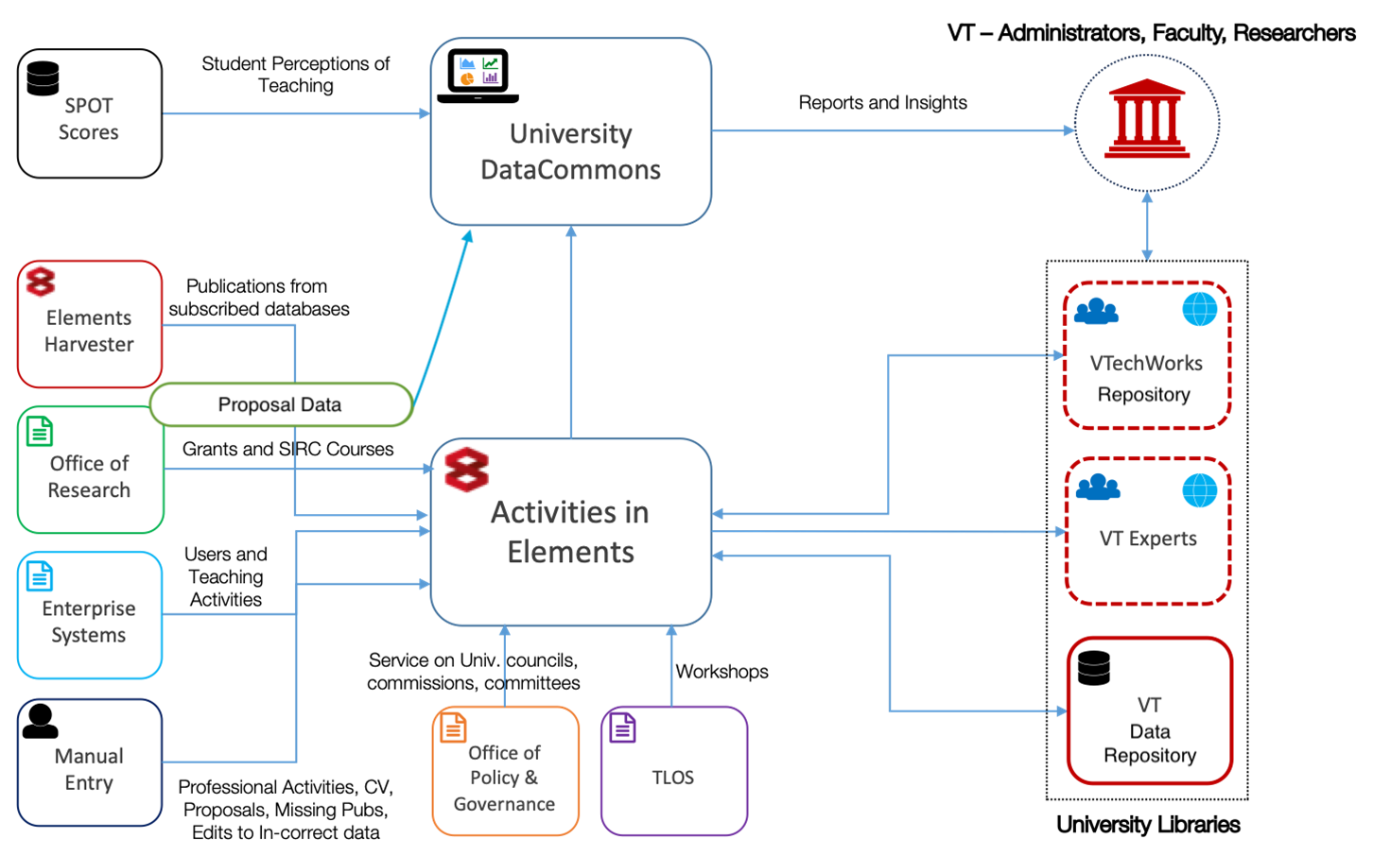
Data 🡪 Elements 🡪 Experts

Slide 39
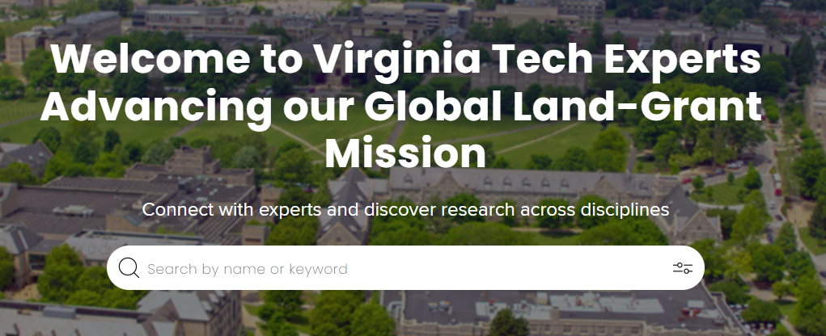
Virginia Tech Experts Webpage Landing Page

Slide 40
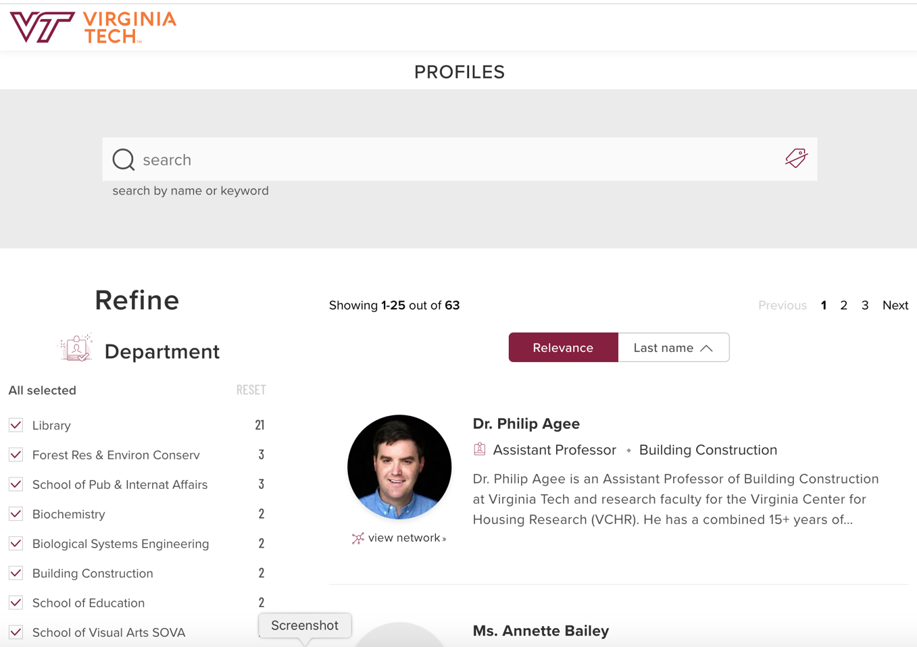
Filter by Department

Slide 41
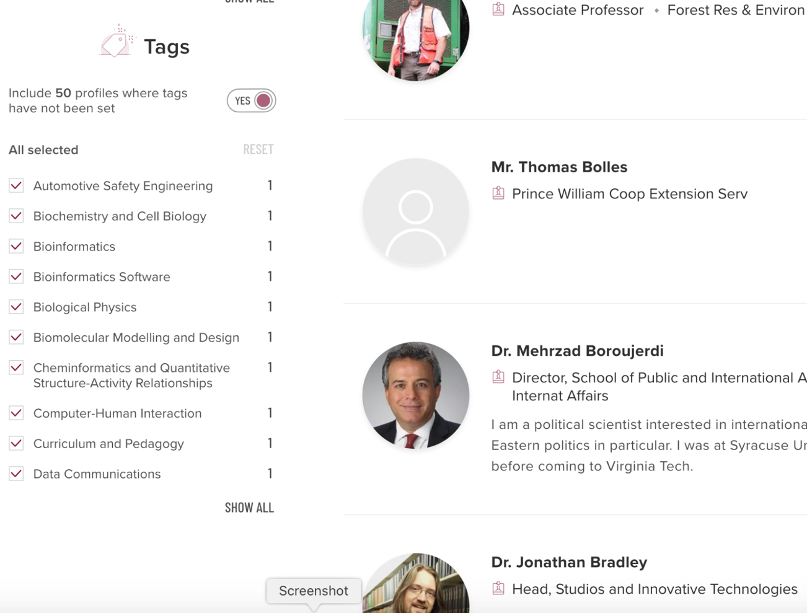
Filter by Topic Area

Slide 42
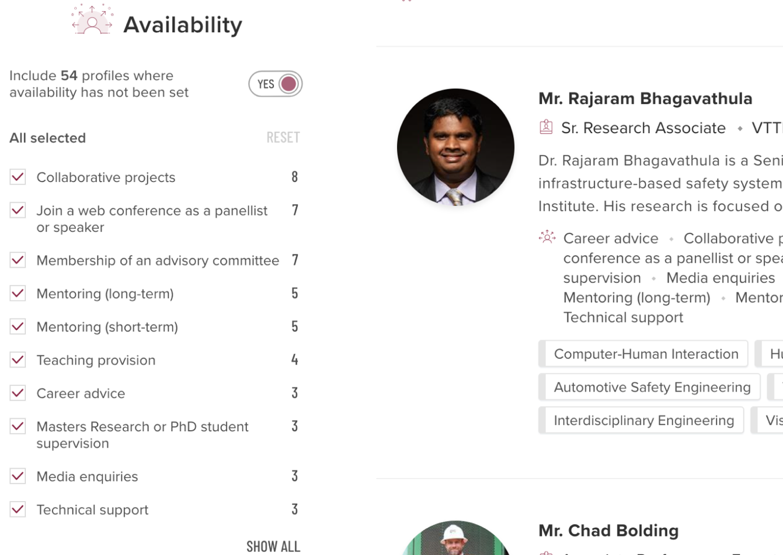
Filter by Topic Availability

Slide 43
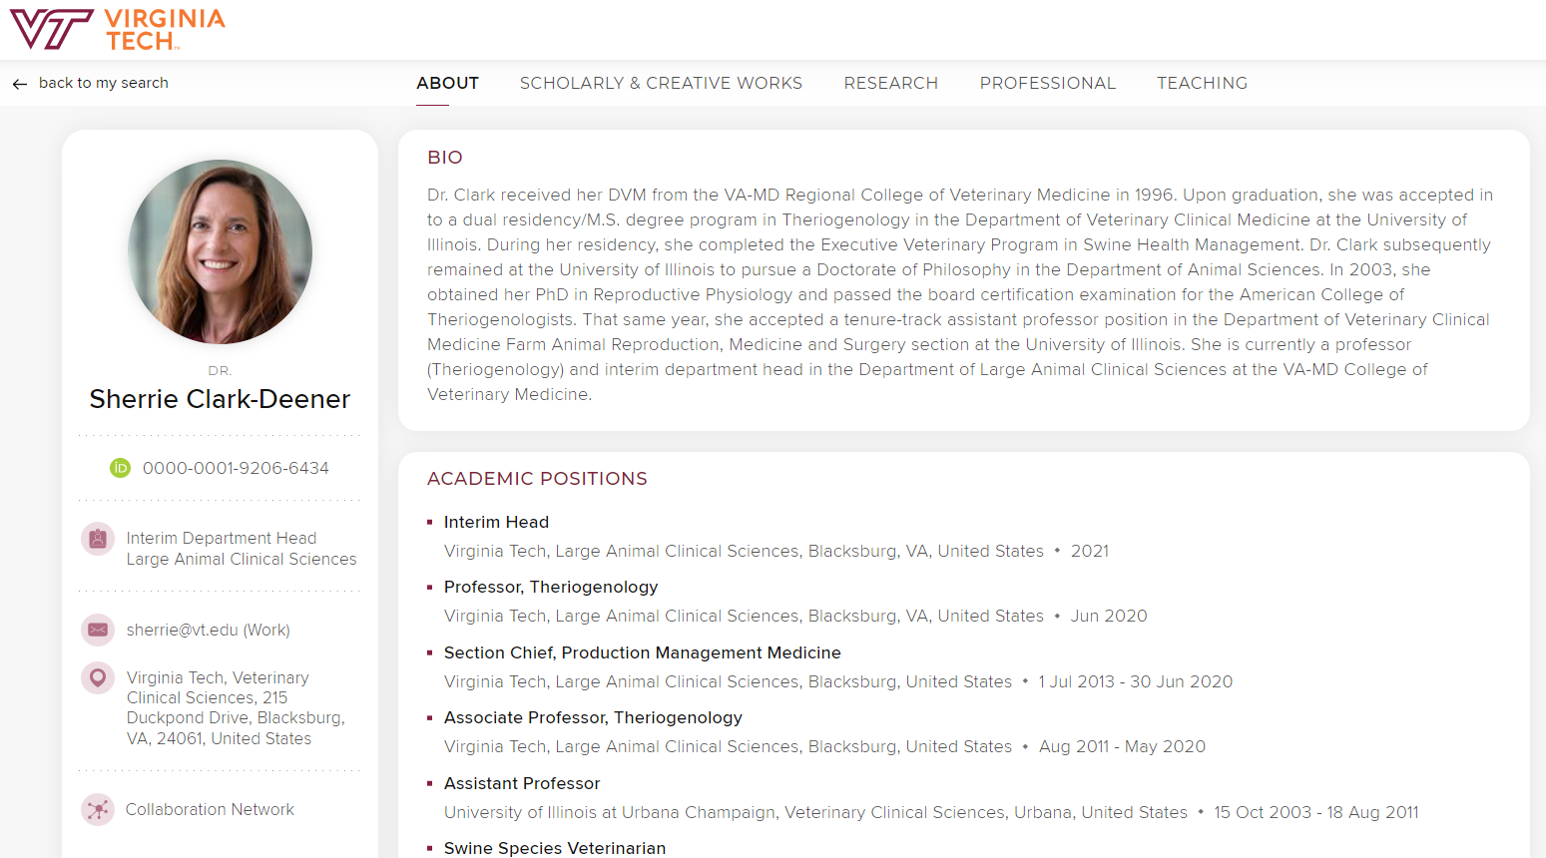
Example of an Experts Profile
Tabs correspond to Elements sections

Slide 44
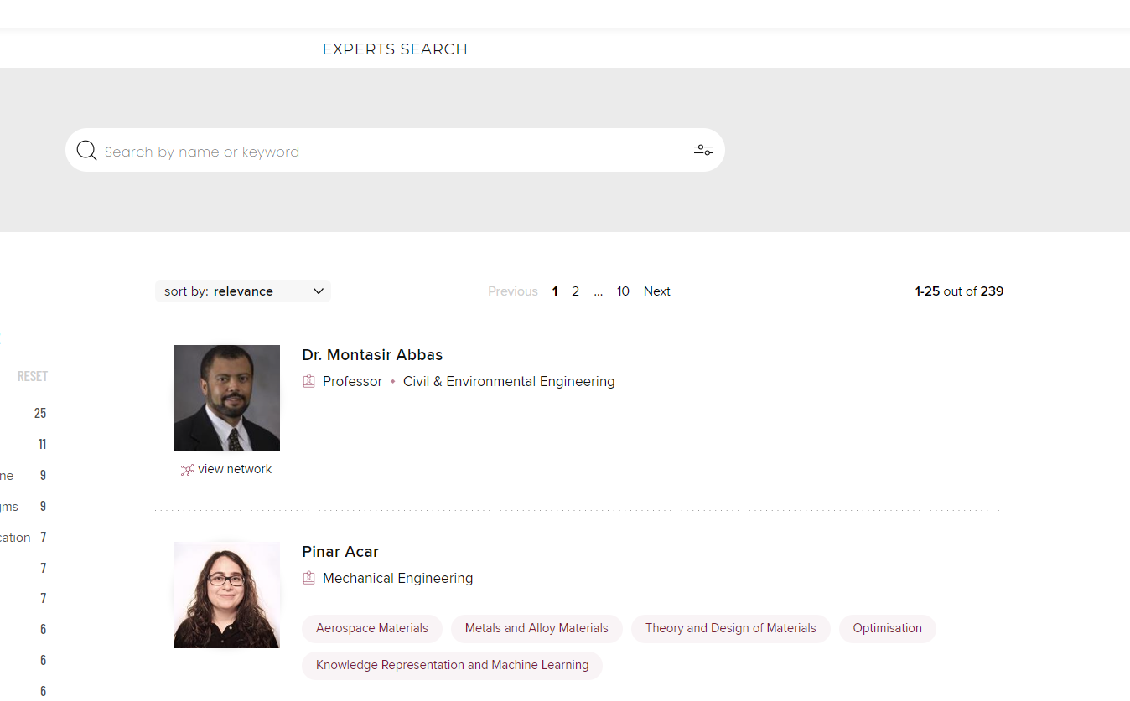
Unfortunately, adoption is slow with only 239 of 4,000+ faculty making their profiles public

Slide 45
Improving Messaging
Next steps:
Communication plan for Elements & Experts
How faculty activity data is used, by whom, and why
How activity data might be used in the future
How Experts can improve scholar visibility and boost institutional reputation

Slide 46
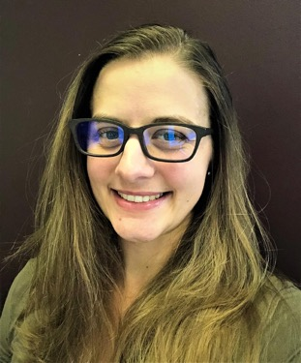
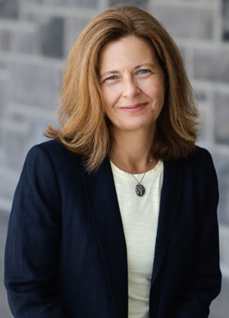
THANK YOU! QUESTIONS?
Rachel Miles, MLIS
Research Impact Coordinator
ramiles@vt.edu
Sarah Over, PhD
Engineering Collections & Research Analyst
sover05@vt.edu
Connie Stovall, MLIS
Director for Research Impact & Intel
cjstova@vt.edu

Slide 47
Supplementary Material
Our ever-evolving Libguide
External Corporate Collaborators Dashboard Example Using Scival and Tableau
HBCU Research Strengths Example
Notes:
https://guides.lib.vt.edu/research_impact_intelligence

