Slide 1
OCLC RLP Works in Progress | May 11, 2023
Sustaining art research collections:
Identifying and building strong library collaborations

Slide 2
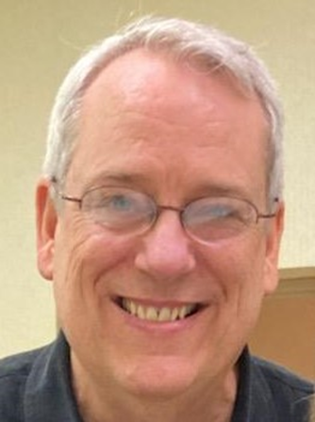

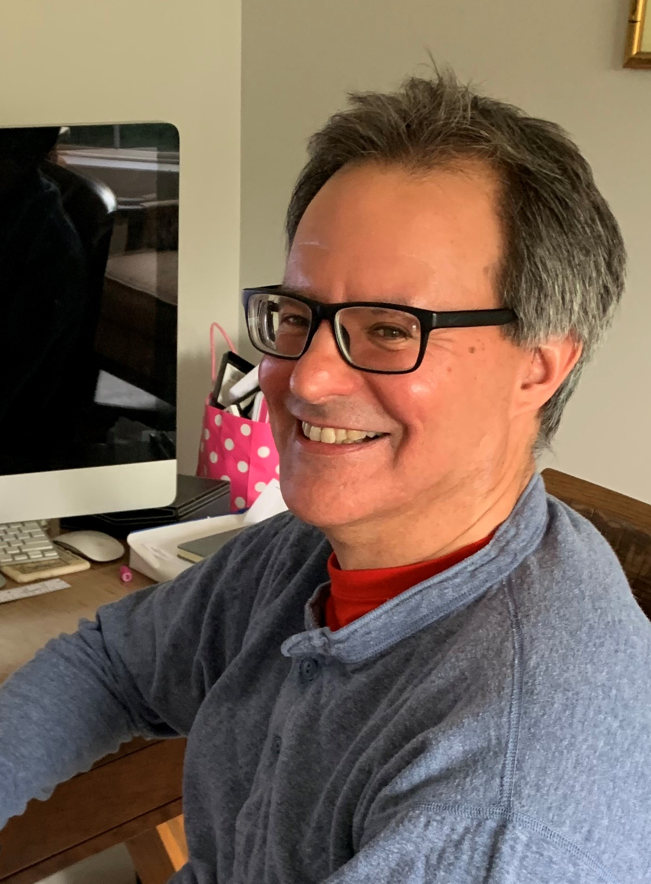
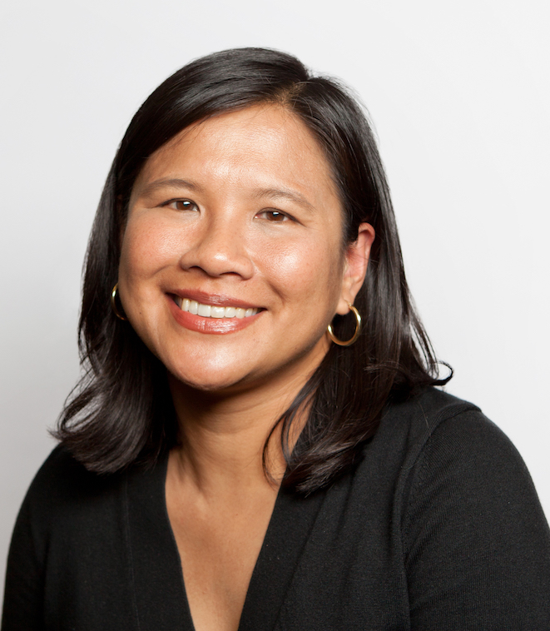
  OpArt project team
Dennis Massie
Chela Scott Weber
Senior Program Officer, Resource Sharing
Senior Program Officer, Archives and Special Collections
Brian Lavoie
Mercy Procaccini
Senior Research Scientist
Senior Program Officer,
Learning and Engagement

Slide 3
Art libraries bring great value to collaborations.

Slide 4
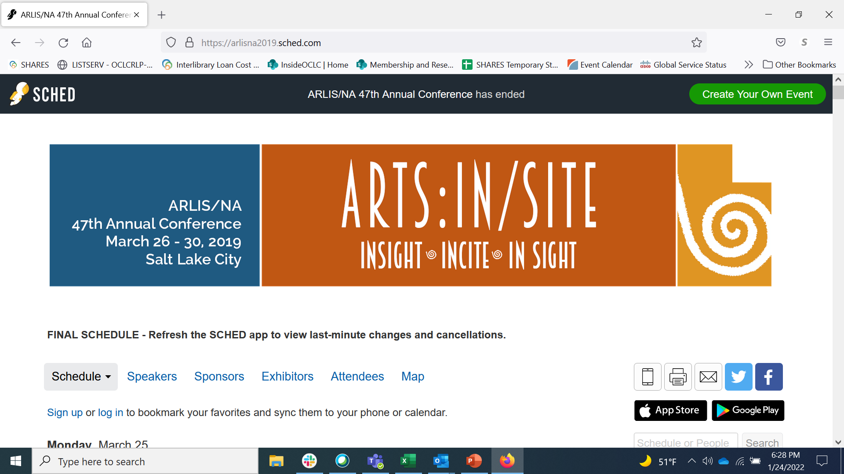
Beginnings
Attendees of OCLC session on shared print and offsite storage
Cleveland Museum of Art
Frick Art Reference Library
Getty Research Institute
Museum of Fine Arts, Houston
University of Nevada, Las Vegas
Acute lack of storage space
Gaps in shared knowledge about peers' collections
Perceived value in art libraries partnering with other libraries
Notes:
The OpArt project grew out of a conversation around a table at a session at the 2019 ARLIS conference. The themes that emerged from the conversation—acute lack of space at art research libraries, gaps in shared knowledge about the collections of peer institutions, and the belief in the value of art libraries partnering with one another and with other library types informed what eventually became this project.

Slide 5
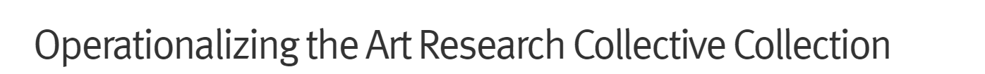


About the project
The goal of the project is to help art libraries identify potential collaborative models to address shared sustainability barriers and consider practically what institutions will need to make these models operational.
oc.lc/art-collective-collection
Notes:
https://oc.lc/art-collective-collection
Operationalizing the Art Research Collective Collection—OpArt for short-- was funded by a generous grant from Kress with co-investment by OCLC.
Launched in January 2021
The project's goal is to help art libraries identify potential collaborative models to address shared sustainability barriers and consider practically what institutions will need to make these models operational.

Slide 6
Advisory group
Jon Evans, Museum of Fine Arts, Houston
Rebecca Friedman, Marquand Library, Princeton University
Roger Lawson, National Gallery of Art
Autumn Mather, Art Institute of Chicago
Keli Rylance, Saint Louis Art Museum
Lori Salmon, Institute of Fine Arts, New York University
Kathleen Salomon, Getty Research Institute
Tony White, OCAD University
Notes:
The project has benefited from the guidance of experts from art research libraries. We're grateful that our advisory group generously contributed their time and expertise to scope and shape the work.

Slide 7
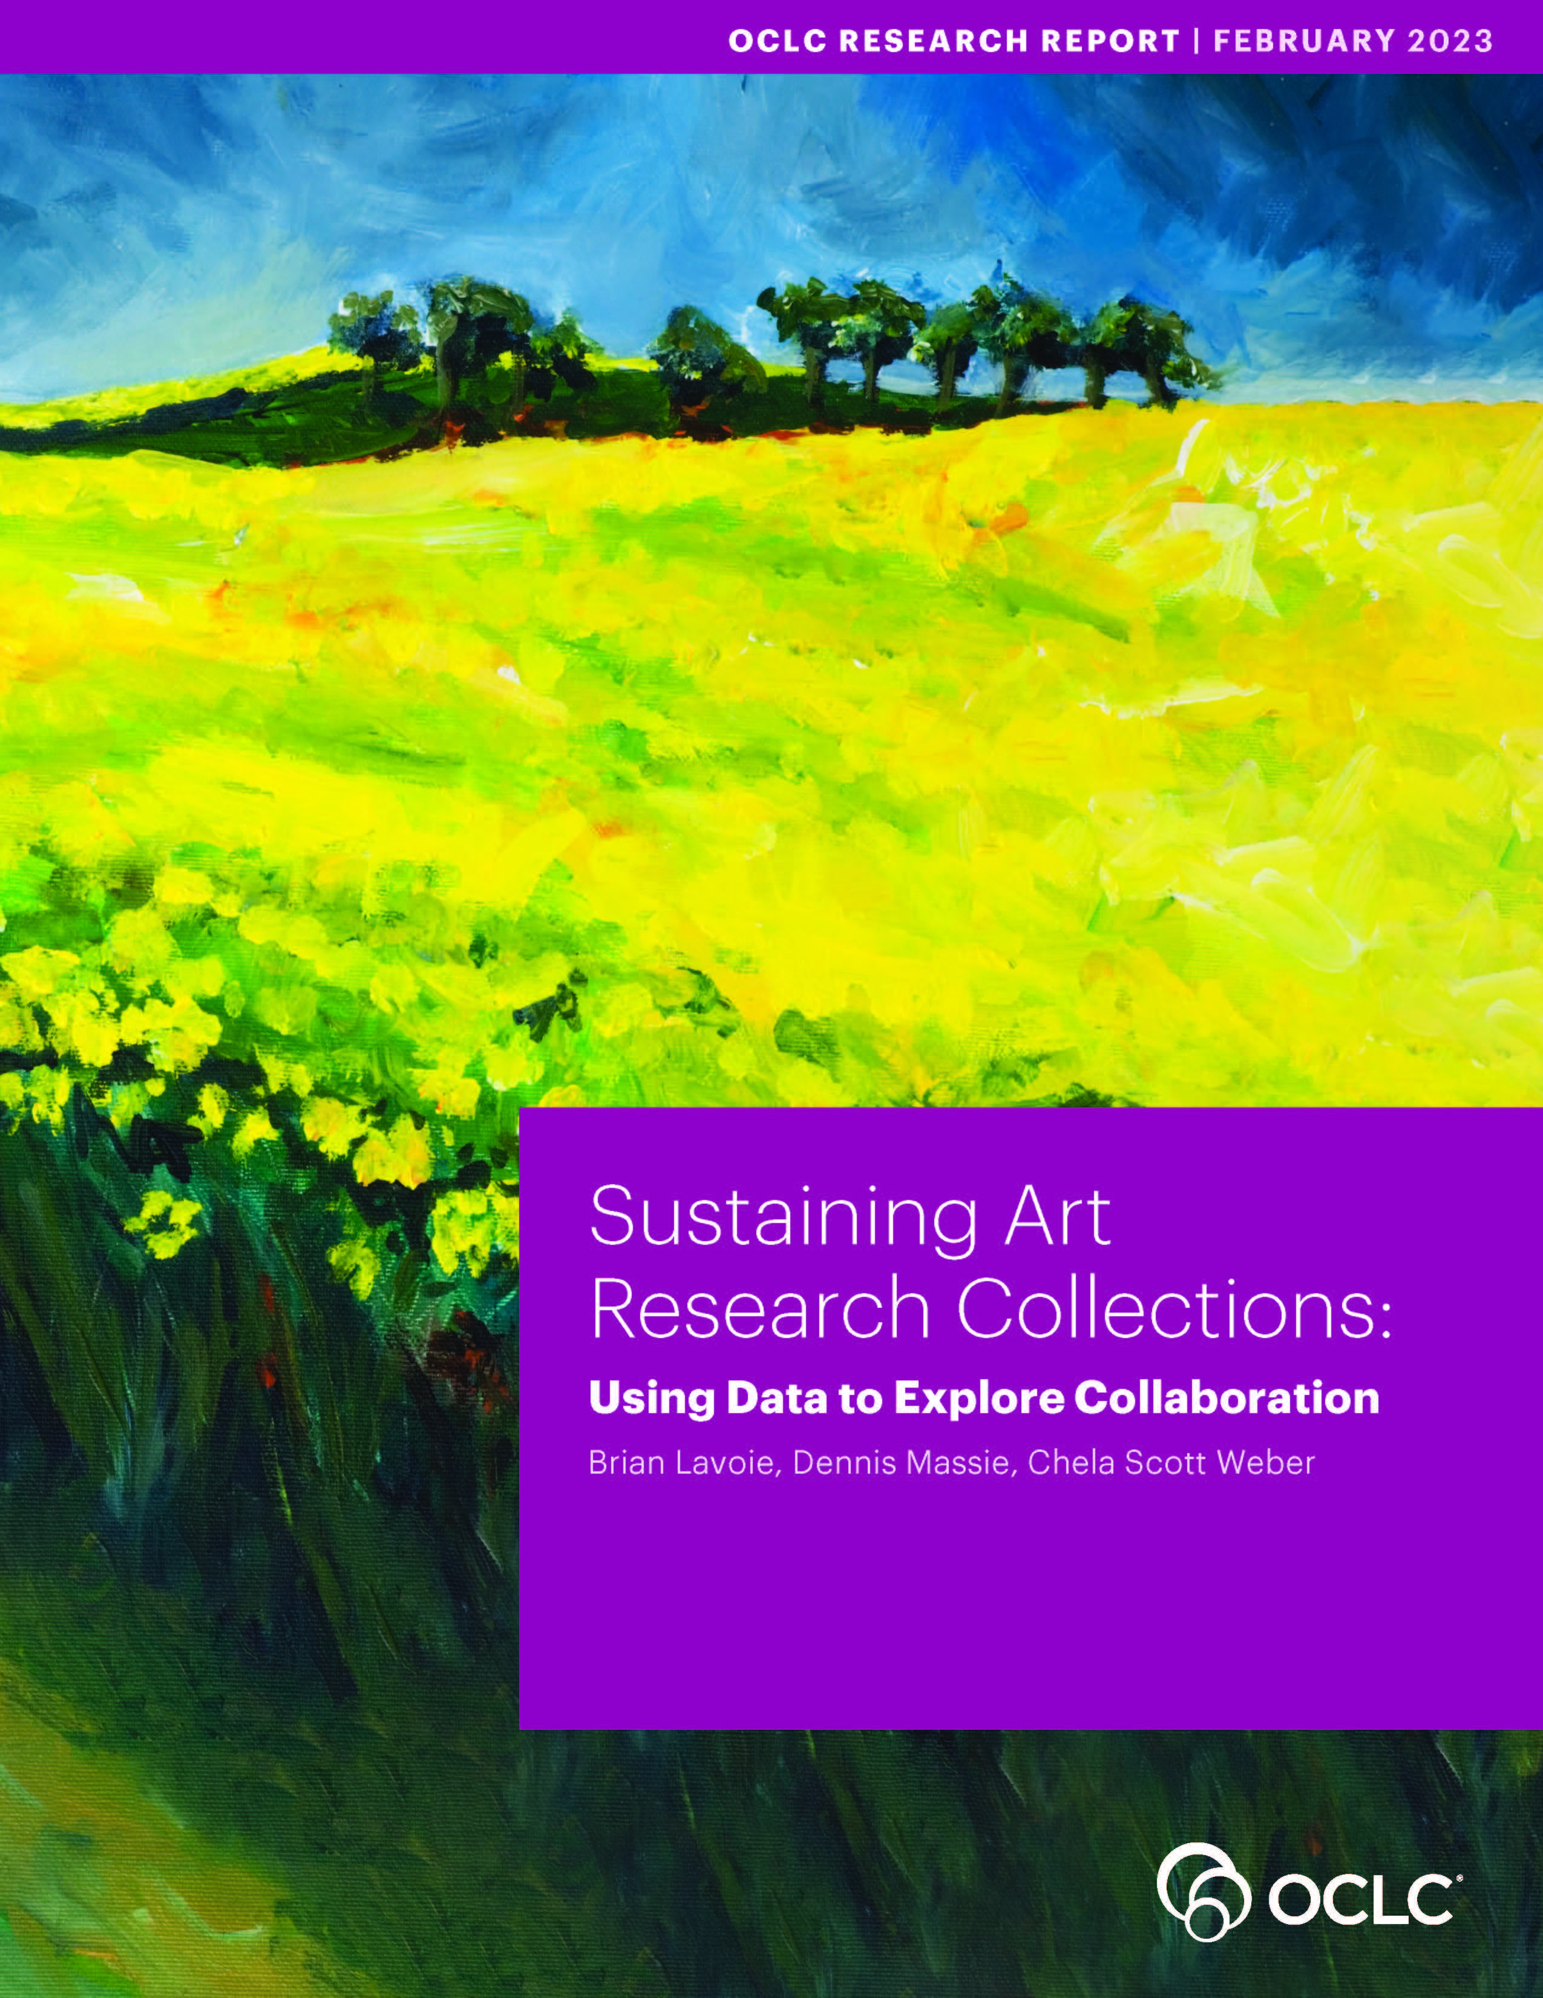
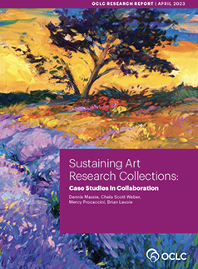

Mixed methods approach
Discovering sources of art libraries' value using data-driven analysis
Exploring how art libraries manifest value within collaborations using case studies
Both reports can be downloaded from: https://oc.lc/art-collective-collection
Notes:
We used a mixed methods approach in this research, bringing together quantitative and qualitative analyses to consider opportunities and models for collaboration.
For our first set of findings (detailed in report 1), using collective collections analysis, we discovered sources of value. What we saw in the data is the great value that art libraries bring to collaborations.
Next, we conducted case studies of real-world collaboration, and these findings (report 2) demonstrate/point to how to manifest art libraries’ value within collaborations

Slide 8
Case studies in collaboration
Museum of Fine Arts, Houston (MFAH)
Rice University
Ontario Council of University Libraries (OCUL)
OCAD University
Worcester Art Museum
(WAM)
College of the Holy Cross
Notes:
I want to introduce the three case studies—our recommendations are drawn from these.
All these feature an art library partnered with another type of library or as a member in a consortium; each offers a different model of collaboration.
We conducted structed interviews with 3-5 individuals from each partnership, asking about how it began, how it works, the challenges they face. We want to thank all the interviewees for their time, their candor, and the insights they shared.

Slide 9


Museum library partnership with neighboring university library | Houston, Texas
Rice provides offsite storage for MFAH library collections
MFAH extends borrowing privileges to Rice faculty and students
Addresses storage challenges and increases access to art research materials
Notes:
This partnership between the library at MFAH and neighboring Rice University has focused on shared access to and storage of library materials.
Increasing space pressures at MFAH’s Hirsch library led to conversations between the directors at the Hirsch and at Rice’s Fondren Library. What resulted was an agreement between the two institutions; a portion of Hirsch’s library has been transferred to an off-site storage facility at Rice. In return, Hirsch extended borrowing privileges to Rice faculty and students. The MFAH materials in Rice’s offsite storage are searchable in both MFAH and Rice catalogs. This partnership addresses the storage challenge while also increasing access to art research materials.

Slide 10
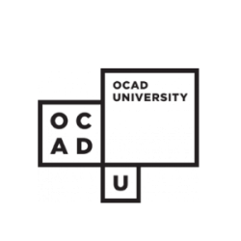

Art and design university library’s membership in regional consortium | Ontario, Canada
OCUL provides community, shared infrastructure, buying power, professional development, access to member collections
OCAD's participation includes financial obligations, governance activities, and sharing of collections
Increases access to wide range of materials and expertise that support art research
Notes:
This case study looks at OCAD University, a public art and design university, and its membership in the Ontario Council of University Libraries (OCUL), a regional academic library consortium with 20 other university libraries of various sizes and types.
Membership in OCUL provides OCAD with community, shared infrastructure, buying power, professional development opportunities, and privileged access to over 60 million items held by consortium libraries. OCAD’s participation includes financial and governance contributions, and it makes available many of its specialized art and design books for borrowing by consortium patrons.
With consortium patron access to the unique art materials in OCAD U collections, and OCAD patron access to materials in a diverse range of disciplines and formats, interconnected and interdisciplinary approaches to art research--and research generally--are robustly supported by this collaboration.

Slide 11


Museum library partnership with neighboring university library | Worcester, Massachusetts
Shared cataloging and ILL infrastructure
Collaborative staffing model
Reciprocal access to partner collections
Supports sustainability of and increased access to art research materials
Notes:
The partnership between Worcester Art Museum (WAM) and the library of nearby College of the Holy Cross involves shared infrastructure, staffing, and collections access.
Holy Cross provides cataloging and interlibrary loan (ILL) infrastructure for both collections, a cost savings for WAM.
WAM provides the funds for the librarian’s salary annually; they are formally an employee of Holy Cross, with a dual reporting line to supervisors at both institutions.
The WAM Library serves as the fine arts branch for the Holy Cross Library. Staff and researchers from both institutions have access to each other’s collections. The arts are important to the HC curriculum, so art and non-art majors alike benefit from access to the WAM Library.
This collaboration supports the sustainability of WAM library and its collections and increases access to art research materials.

Slide 12
recommendations

Slide 13
1. Identify true need, contribution, and value
Art libraries bring unique contributions to partnerships
Understand and articulate strengths and value

Slide 14
1. Identify true need, contribution, and value
Art libraries bring unique contributions to partnerships
Understand and articulate strengths and value
Unique, hyper-local, and rare collections
Specialized subject matter expertise
“What I think is really important about having this diversity of institutions is the kinds of specialized focus that they can bring into the conversation, and, really, sometimes . . . that expertise sort of takes you by surprise.”
--OCAD / OCUL interviewee

Slide 15
1. Identify true need, contribution, and value
Art libraries bring unique contributions to partnerships
Understand and articulate strengths and value
Mak[e] sure that ... the entangling alliances don't draw you down a path you don't want to go and be very honest about what those risks are … so both parties understand what the other person is risking in order to make something successful.
--WAM / CHC interviewee
Identify and communicate needs
Seek alignment of partners' strengths and needs

Slide 16
2. Embrace creative approaches to collaboration
Creative approaches can take many forms:
Choosing Partners
Structuring Partnerships
"[It’s important] to just approach the situation as a creative endeavor because the partnership really is creative."
- WAM/CHC interviewee
Interpreting Value
Notes:
Our second key takeaway is certainly appropriate to art libraries, and that is to embrace creative approaches to collaboration. And this creativity could be applied in any number of areas related to collaboration. In our case studies we saw valuable creativity in:
Choosing partners for a collaboration
The way that collaborations are structured
And the way that value brought by partners is interpreted and understood

Slide 17
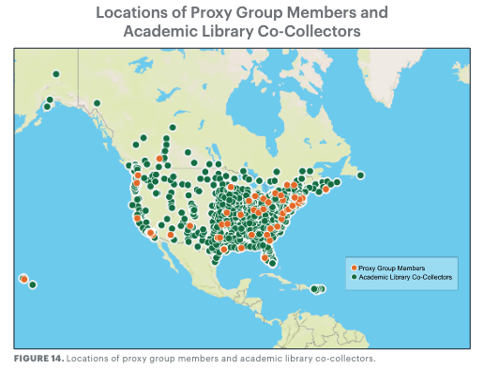
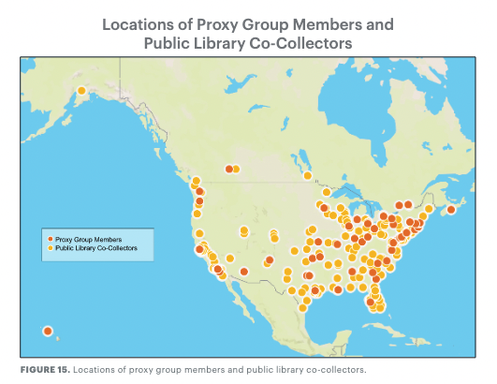
2. Embrace creative approaches to collaboration
Creative approaches can take many forms:
Choosing Partners
Notes:
Thinking broadly about potential partners may help find a great match with complementary strengths and needs, who might not be immediately obvious. In our first report we looked at the collective collections of 85 art research libraries in North America, and then looked which other libraries represented in WorldCat also had significant holdings of the titles in the art research collective collection.
These maps shows our 85 art research libraries in the dark orange dots, along with public libraries in yellow and academic libraries in green, who also have significant collections of art materials and may be valuable collaborators. While art libraries may think that partnerships need to be with other art libraries, or with big ARL research libraries, a creative approach can expand the pool of potential collaborators and bring together unlikely partners.

Slide 18
2. Embrace creative approaches to collaboration
Creative approaches can take many forms:
Choosing Partners
Structuring Partnerships
"A creative understanding of a partnership’s value can expand the benefits that a collaboration creates, and collaborators enjoy."
Interpreting Value
Notes:
Creativity in partnership structure can also yield value. We saw this in our case studies, each of which had a really different structure that worked well for their context. For example:
Partners in the OCUL consortium give significant in-kind effort to the collaboration, and in some cases formally second their own staff to the partnership for defined periods of time.
WAM/Holy Cross collaboration includes a shared staffing arrangement, with the WAM librarian having a dual reporting line into both organizations, and the position formally being an employee of Holy Cross rather than the museum.
Some institutions might hesitate to implement these kinds of models that require each partner to give up some local autonomy. But we really saw in our case studies how this can increase institutional investment in and commitment to a partnership, which in turn contributes to its success and sustainability.
And last but certainly not least, our findings encourage a creative interpretation of the value that partnerships can bring, both the value your institution might bring and the value the partnership might offer. This may require looking beyond the transactional value of a collaboration to take a more nuanced view of the intangible or less easily quantifiable benefits of working with other institutions can offer. For example, multiple case study participants discussed the chance to pool knowledge, exchange expertise, and create an informal professional network as a valuable byproduct of the overall partnership.

Slide 19
3. Form strong bonds with shared vision
Shared vision can be a powerful and valuable catalyst for collaboration
Move up from an operational to conceptual view of mutual interests
Consider partners with mutual commitments to a civic or scholarly community
Common purpose can help a partnerships weather challenge and change
Notes:
Our next major takeaway nicely complements the last one, and that is that shared vision can be a powerful and valuable catalyst for collaboration.
Again we come back to thinking creatively about value – grounding a partnership on shared vision may require moving up from thinking only about operational or transactional benefits of a collaboration, to a conceptual or strategic view of how a collaboration could help partners more effectively or impactfully serve their stated mission.
Shared commitment to a civic or scholarly community can be a strong tie. We see the commitment to the Houston community in the MFAH and Rice partnership, and to higher education in Ontario in the OCUL consortia. The WAM/Holy Cross partnership aligns closely with both institutions’ missions to be of service to the Worcester community and region. This alignment of larger purpose is an important part of the long-term success of the collaboration, and its resiliency through change and periods of challenge.

Slide 20
4. Manage change as collaborations evolve
Collaboration is an ongoing choice, not a one-time decision
Change takes many forms: staffing, scope, governance
Document the present, and plan for change
"Partners should continually and intentionally choose whether and how to collaborate."
Informal may be fine...at first
Regularly review the status of the collaboration

Slide 21
5. Rightsize the collaboration
Ambitions must be commensurate with partner resources and commitment
Starting small is fine
Staying small can also be fine
Success can breed further collaboration
"I think it would be a good thing to revisit what more we could be doing together.”
- MFAH/Rice interviewee
Balance "everyone has a say" with efficient decision-making processes

Slide 22
6. Communicate effectively to collaborate successfully
Communication is the "logistical backbone" of collaboration
Use formal and informal channels
Be in the same room together
“What keeps it going [is] definitely good communication and a constant upkeep of priorities and every year setting goals together.”
- WAM/CHC interviewee
Be open and transparent
Don't forget local colleagues

Slide 23
7. Connect personally to collaborate institutionally
Relationships between people drive collaborations
Build on familiarity and trust
Leverage personal networks of collaboratively-minded leaders
"[I]t’s always a good thing to know people at your other local institutions and have some kind of relationship with them.”
- MFAH/Rice interviewee
Be aware of the power of one (and the risks)
Manage turnover by preserving local knowledge

Slide 24
Recommendations
Identify true need, contribution, and value
Embrace creative approaches to collaboration
Form strong bonds with shared vision
Manage change as collaborations evolve
Rightsize the collaboration
Communicate effectively to collaborate successfully
Connect personally to collaborate institutionally
oc.lc/sustaining-art-research-case-studies

Slide 25
  Questions?
Dennis Massie
Chela Scott Weber
Senior Program Officer, Resource Sharing
Senior Program Officer, Archives and Special Collections
Brian Lavoie
Mercy Procaccini
Senior Research Scientist
Senior Program Officer,
Learning and Engagement

Slide 26
  Project page / download the reports: https://oc.lc/art-collective-collection
  Join our Art & Architecture Group email list https://www.oclc.org/research/partnership/lists.html
  Email Chela at weberc@oclc.org
  or Dennis at massied@oclc.org
Connect with us

