Slide 1
Understanding and Mitigating Bias and Racism across Collections at Yale University
Elizabeth Williams
Director for Cross-Collection Initiatives
Yale University
elizabeth.j.williams@yale.edu
Robert Sanderson
Director for Cultural Heritage Metadata
Yale University
robert.sanderson@yale.edu
OCLC Works in Progress Webinar, May 10th 2022

Slide 2
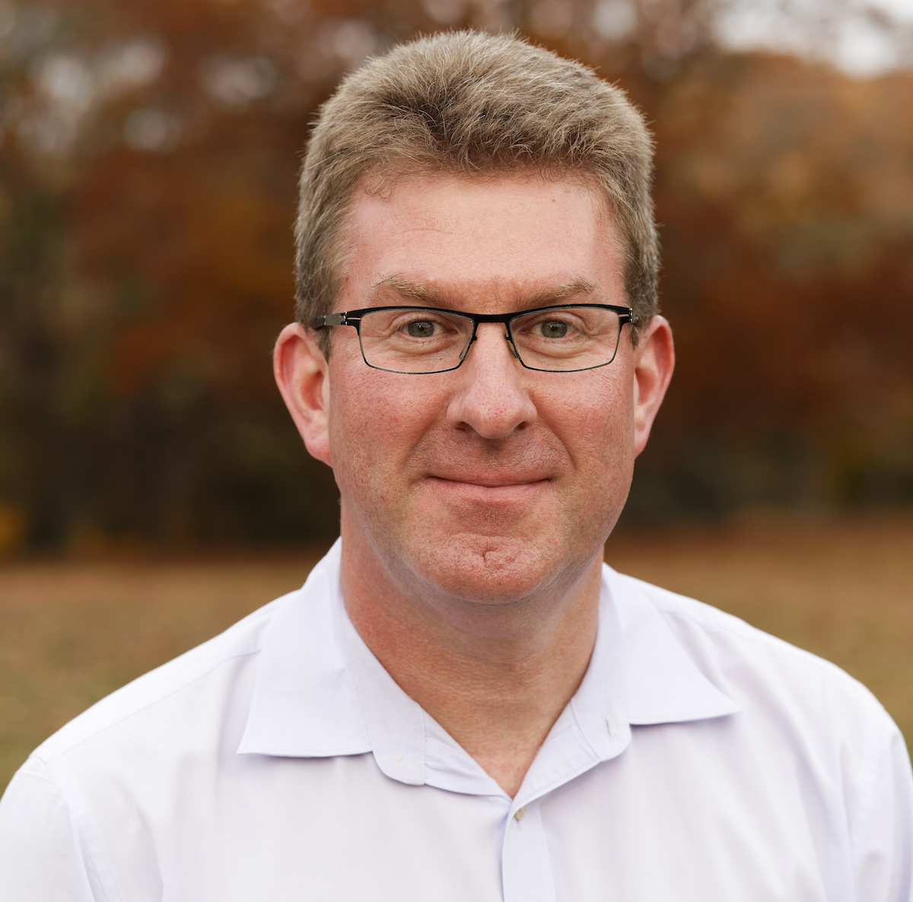
Elizabeth and Rob
Notes:
Note two change over time

Slide 3
Committee Members
Anna Arays YUL
Alison Clemens YUL
Emmanuelle Delmas-Glass YCBA
Benjamin Diebold YUAG
Erin Gredell YPM
Lindsay King YUL
Sarah Prown ITS
Gabriela Redwine YUL
Robert Sanderson OVP
Molleen Theodore YUAG
David Thompson YCBA
Timothy Thompson YUL
Edward Town YCBA
Elizabeth Williams OVP
Jessica Utrup YPM
Yer Vang-Cohen YUAG
Notes:
Note two change over time

Slide 4
Overview
Context of the Work
Statement and Recommendations
Process
Cross-Collection Challenges
Ongoing Work
Conclusions

Slide 5
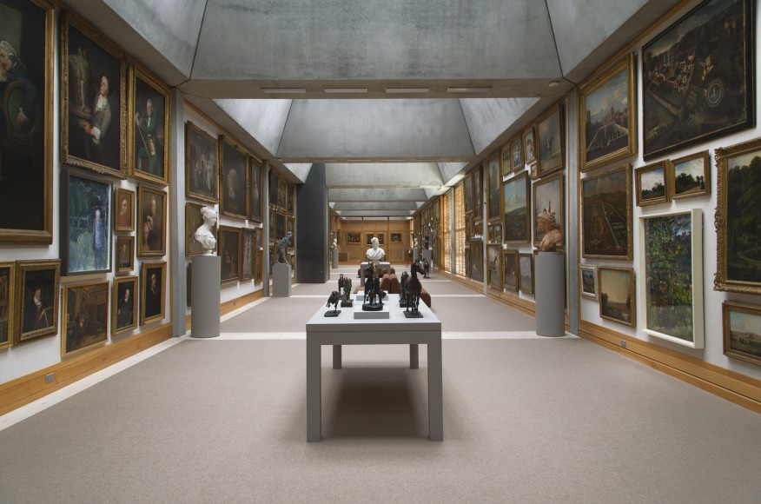
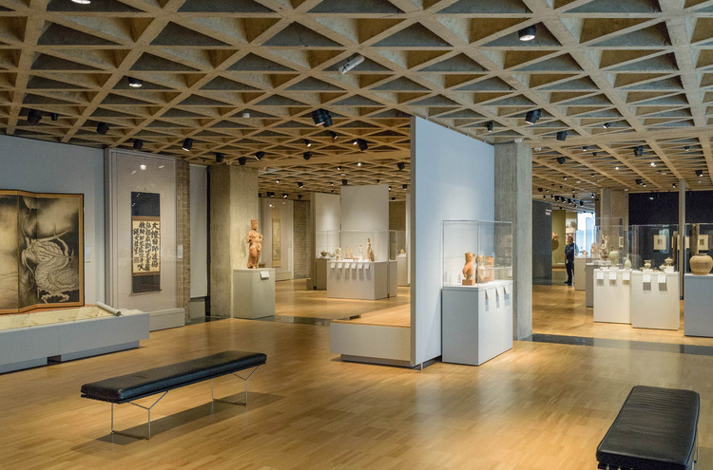
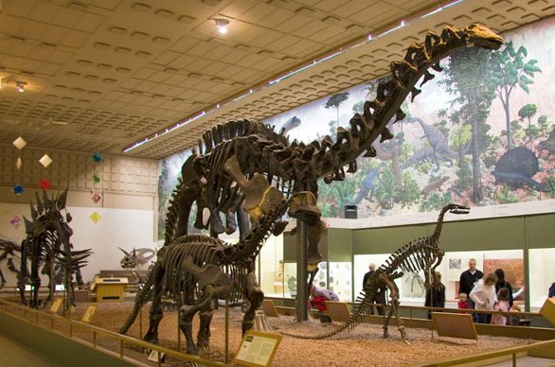
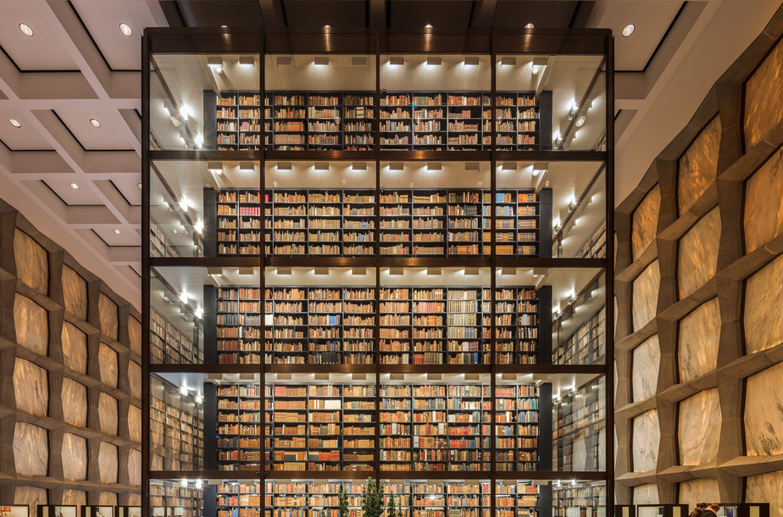
Context: Yale Collections
Yale Center for British Art
Yale University Art Gallery
Yale Peabody Museum of Natural History
Yale University Library
Notes:
Explain units and scale

Slide 6
Context: Yale Collections
Yale Center for British Art
Yale University Art Gallery
Yale Peabody Museum of Natural History
Yale University Library
Notes:
Peabody is undergoing renovations. Even more important that digital interactions are best user experience.

Slide 7
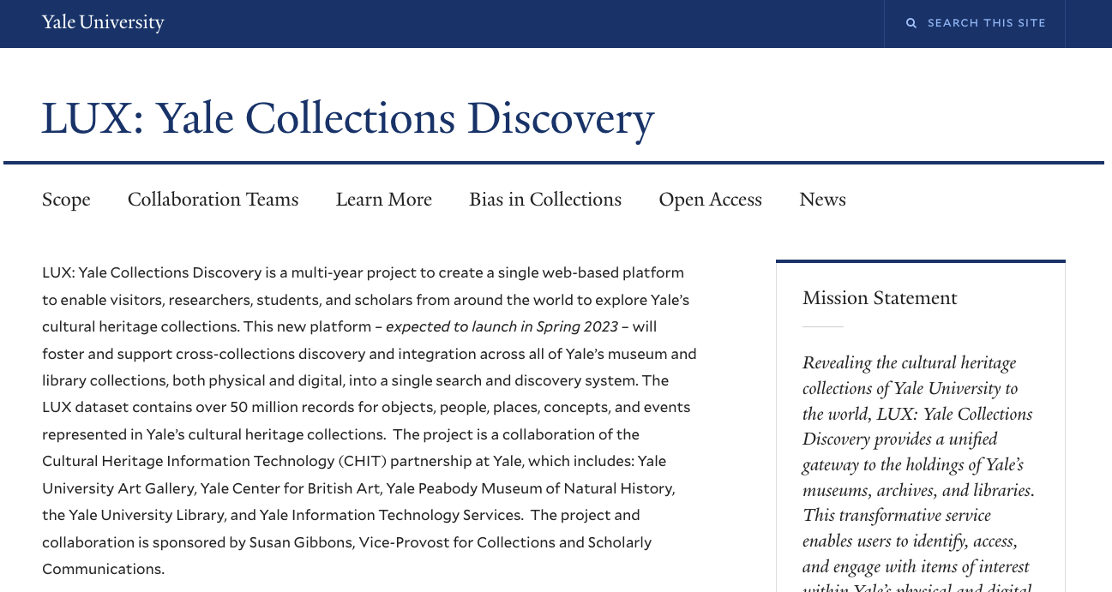
LUX - Cross-Collection Discovery
Context of the Work
Notes:
LUX brings all the content together.

Slide 8
LUX - Cross-Collection Discovery
Context of the Work
Notes:
And exposes the biases across the collections!

Slide 9
Scope of Work: Bias Awareness
The Bias Awareness and Responsibility for Cultural Heritage Committee is tasked with considering the issues of implicit and explicit bias within the knowledge systems that manage our heritage collection data, its exposure via LUX and other publication channels, and with developing a series of recommendations for addressing these concerns.
Deliverables:
Statement articulating core values and concerns
Action plan for implementing positive change

Slide 10
Statement on Core Values
Needed to understand local and global context
Lots of learning, research and building shared understanding within the committee
Useful tools:
Zotero bibliography
Trello board to manage terminology and scope
Notes:
Two tools we found helpful were Zotero for managing a bibliography of articles… and a trello board to manage terminology with definitions and notes

Slide 11
Zotero Bibliography
Books, Articles, etc.
Other institutions’ statements
Disclaimers
Responsibility and Action Statements
Stanford’s Special Collections & Archives was very clear
Committee reviewed, annotated and discussed
Examples of other institutions’ UI and processes
Notes:
Two types of statements. We wanted the action statement that takes responsibility for past action and inaction, not just a disclaimer that there might be harmful content.

Slide 12
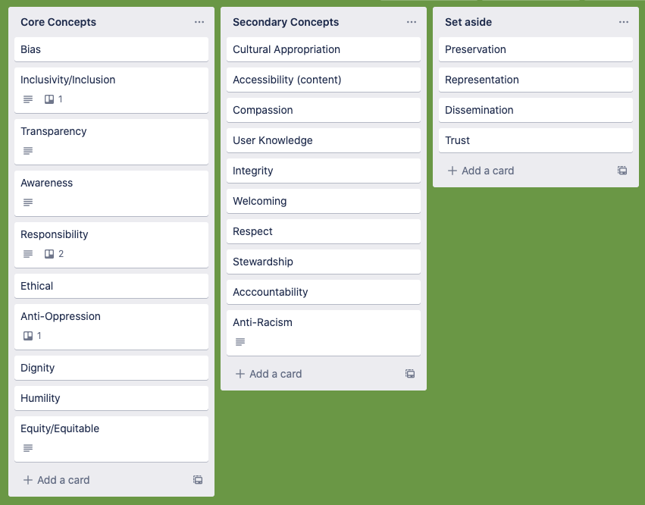
Speaking the Same Language
Notes:
Used Trello to manage core, secondary and related terminology

Slide 13
Core Terminology
Bias
Inclusivity
Transparency
Awareness
Responsibility
Ethical
Anti-Oppression
Dignity
Humility
Equitable
In particular oppressive/harmful biases
Effort to ensure diverse participation
Of processes, provenance, data
Importance of raising awareness
Accountability of intent
Changing acceptable standard of conduct
More than just racism
Dignity of individuals and cultures
Humility of description
Equitable processes and presentation

Slide 14
Secondary / Related Terminology
Cultural Appropriation
Accessibility (content)
Compassion
User Knowledge
Integrity
Welcoming
Respect
Stewardship
Accountability
Anti-Racism
Related but Set Aside
Preservation
Representation
Dissemination
Trust

Slide 15
Discursive Statement
Longer form essay
Who is making this statement, and why?
What are the challenges that we see?
Bias, Inclusion, Transparency
What are our values related to the challenges?
What actions are we taking to further those values?
Set aside as we were writing to ourselves!

Slide 16
Final Statement
LUX exposes longstanding and deep bias within our acquisition activities, collection systems and descriptive practices. Some content, and the description of that content, is outmoded, racist, and culturally insensitive. Yale’s cultural heritage institutions commit to identifying and addressing these issues, and also to being transparent about documenting such processes. Individually and collectively, the institutions seek to treat users with respect, ensuring dignity is extended to all those who created, or are represented in, Yale’s collections. This includes numerous groups who historically have been marginalized and systemically silenced, whose perspectives, expertise, and authority will contribute to the direction of LUX’s future.

Slide 17
Process
Important parts of the process:
Norms and Reflection
Collaboration and Commitment
Engagement with Colleagues

Slide 18
Explicit Norms
Consensus for useful and appropriate mode of work
“We are all learning and language is complex”
“Assume positive intent as we speak in draft”
“Reflection and brainstorming are important to the work”
“We come prepared, and allow everyone to speak”
Importance: Difficult topics to be discussed by zoom, by people from different parts of the University

Slide 19
Collaborative
All units are included, with diverse representation
Tension between size and representation
Attempt to wear multiple hats
All participants are responsible for communication within unit and with other committees
Importance: Work needs to be generally understood and changes made to practices across the organization

Slide 20
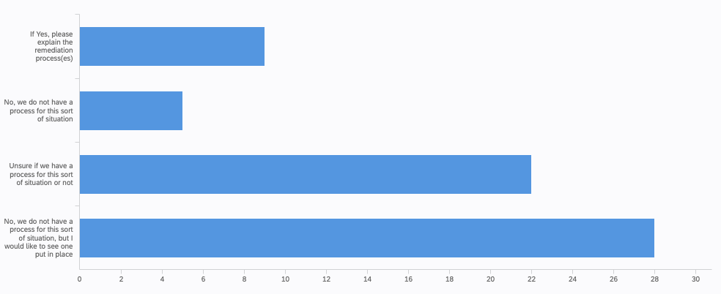
Staff Survey: Policies
Does your unit have a remediation policy in place for harmful content?
yes
no
don’t know
want one

Slide 21
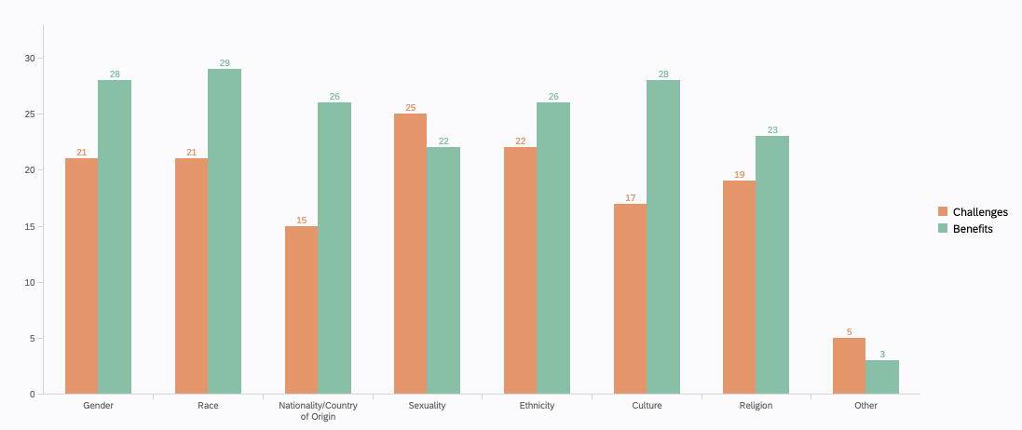
Staff Survey: Topics
Are there benefits/challenges for providing information about people?

Slide 22
Recommendations
Moved to Recommendations covering
LUX User Interactions
Unit-level Metadata
Communications and Outreach
Ongoing Work
Notes:
Transition to Rob here

Slide 23
Recommendations
LUX
Visibility of values and activities, allow for feedback and contextualization of content.
Communication
Ensure that the efforts are integrated through engagement with related and impacted workflows
Ongoing
The work is ongoing, and needs strategic consideration, venues for safe and respectful learning and discussion, and outreach for awareness

Slide 24
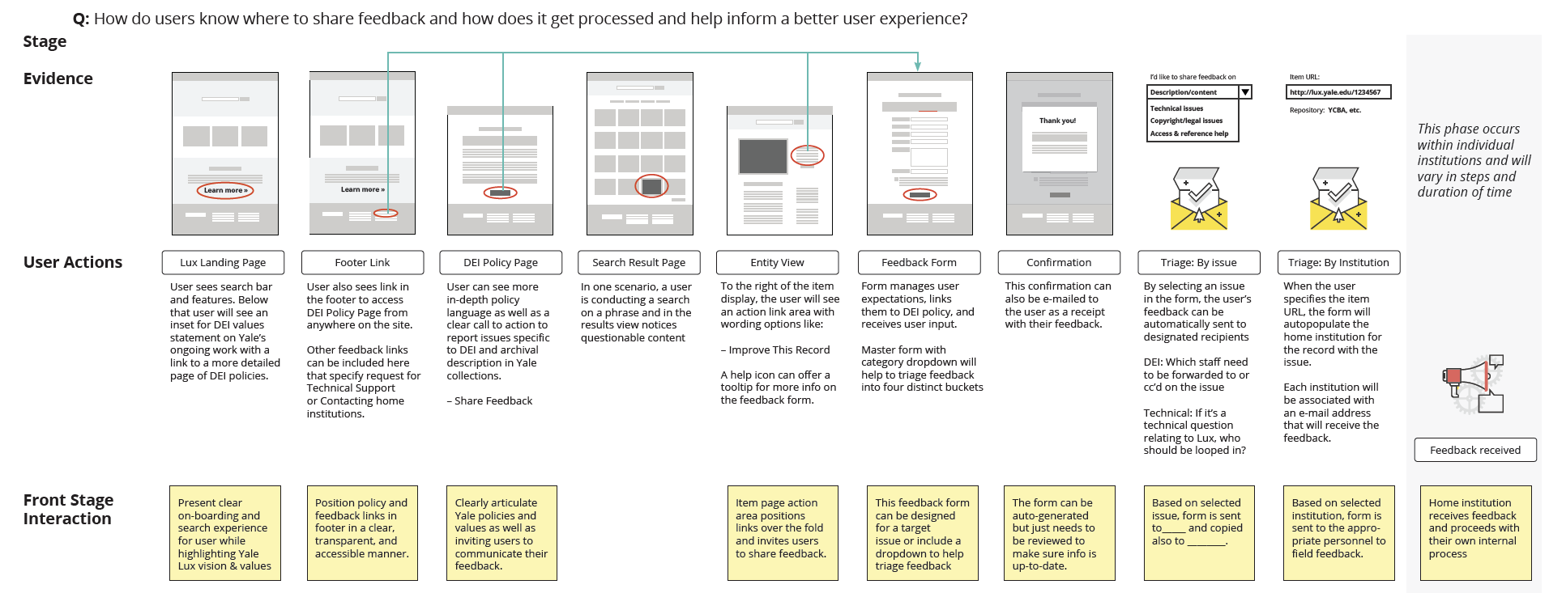
Feedback Design
Service blueprint for guiding users and ensuring responses

Slide 25
Create a Metadata Action Plan
Resourcing and Prioritization Needed
Sources of Information: Original Content vs Metadata
Types of Information
People, Sensitive Items, Text, Images
Types of Issues
Oppression, Racism, Violence, Selection, Transparency
Types of Remediation
Delete, Correct, Contextualize, Warn, No Change

Slide 26
Cross-Collection Challenges
Multiple Domains
Aggregate Scale and Individual Unit Scales
Consistent? Coherent?
Distributed data sources
Feedback and Discussion Routing

Slide 27
Multiple Domains, Multiple Contexts
Art Museums
Natural History Museum
Library Collection
Special Collections
Archives
Nudity, Violence: expected in artwork, more problematic in archives Offensive book title cannot be changed, whereas offensive painting title often can be

Slide 28
Aggregate, Individual Scales
15M collection records ; 45M entity records in LUX
Hard to see the rotten wood for the forest
Hard to manually remediate thousands of similar issues
ILS: 12M bibliographic records ; YCBA: 65k object records
Can’t expect the same level of engagement per record
Easier to add context with smaller scale datasets

Slide 29
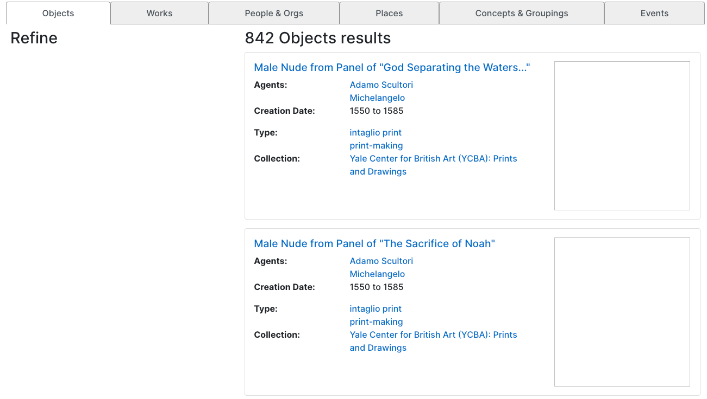
Sneak Peek at LUX
Notes:
Preferences for challenging images … but need to have metadata for which images to hide, as well as registered users with settings.

Slide 30
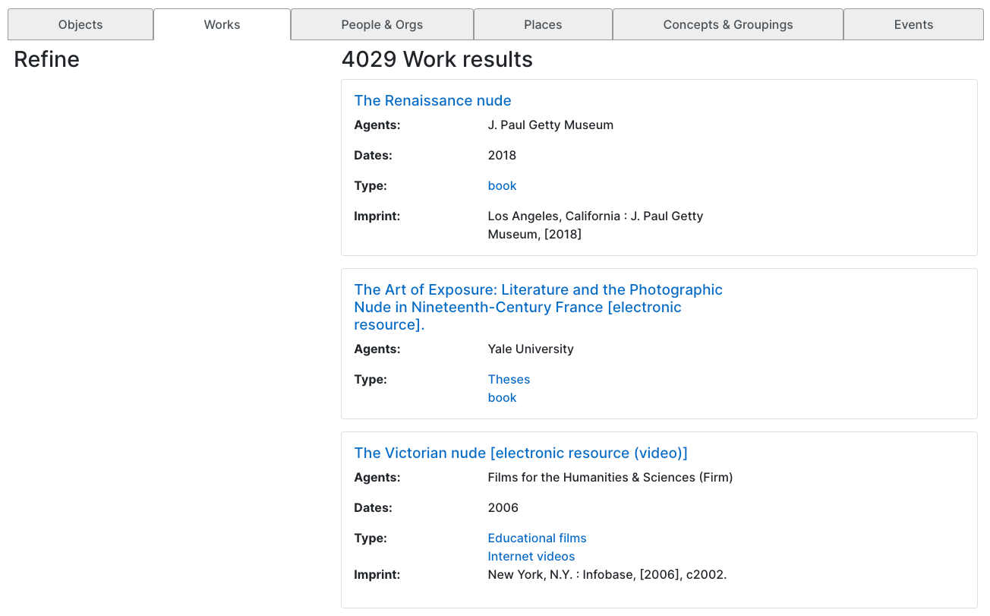
Sneak Peek at LUX

Slide 31
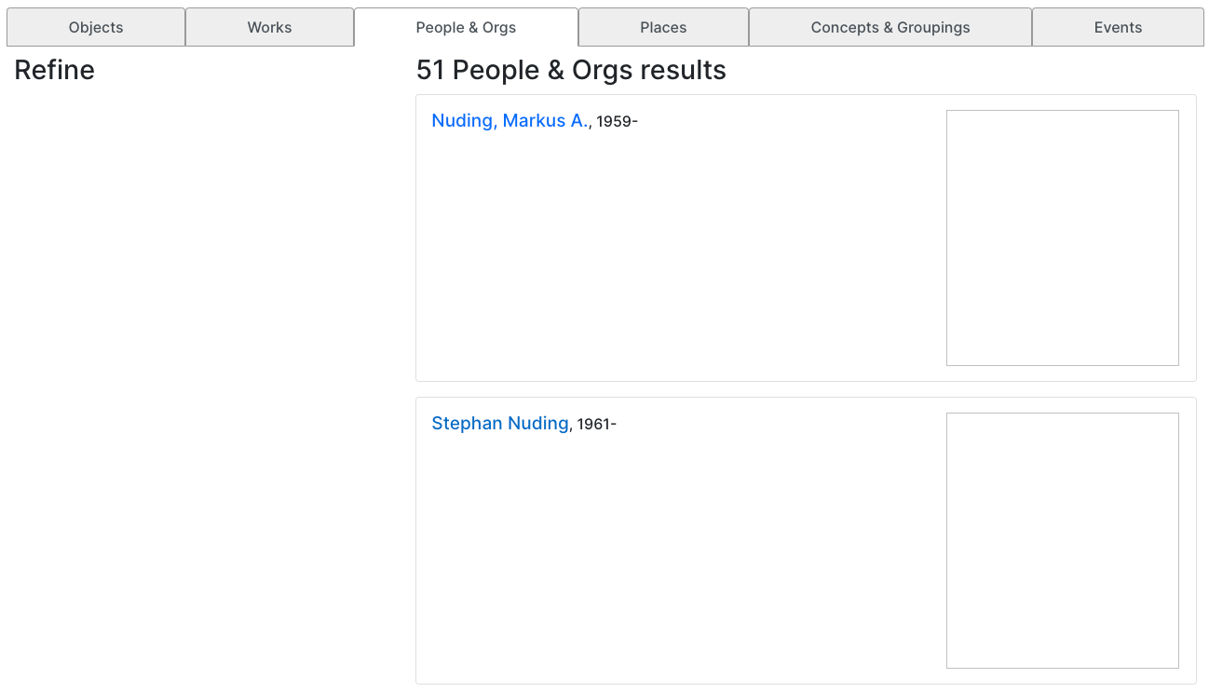
Sneak Peek at LUX

Slide 32
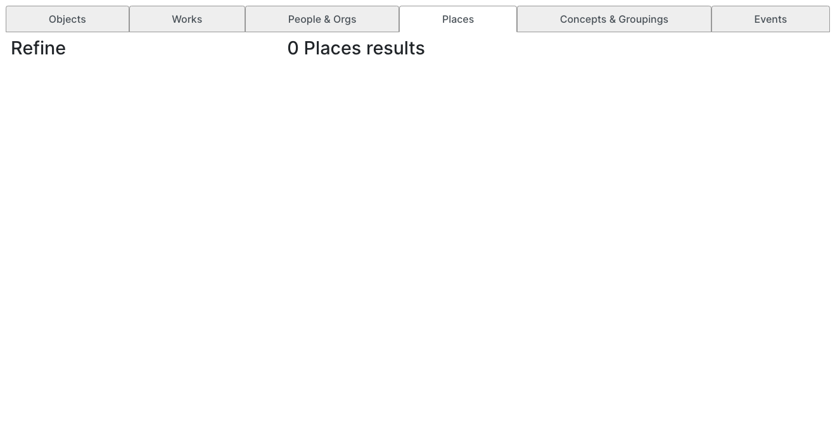
Sneak Peek at LUX

Slide 33
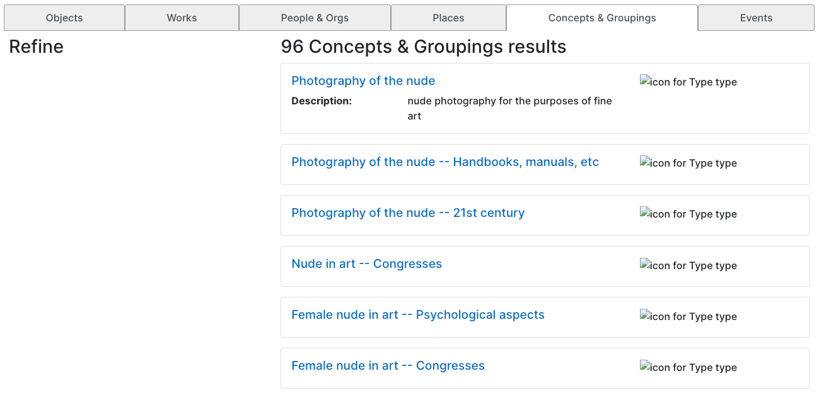
Sneak Peek at LUX

Slide 34
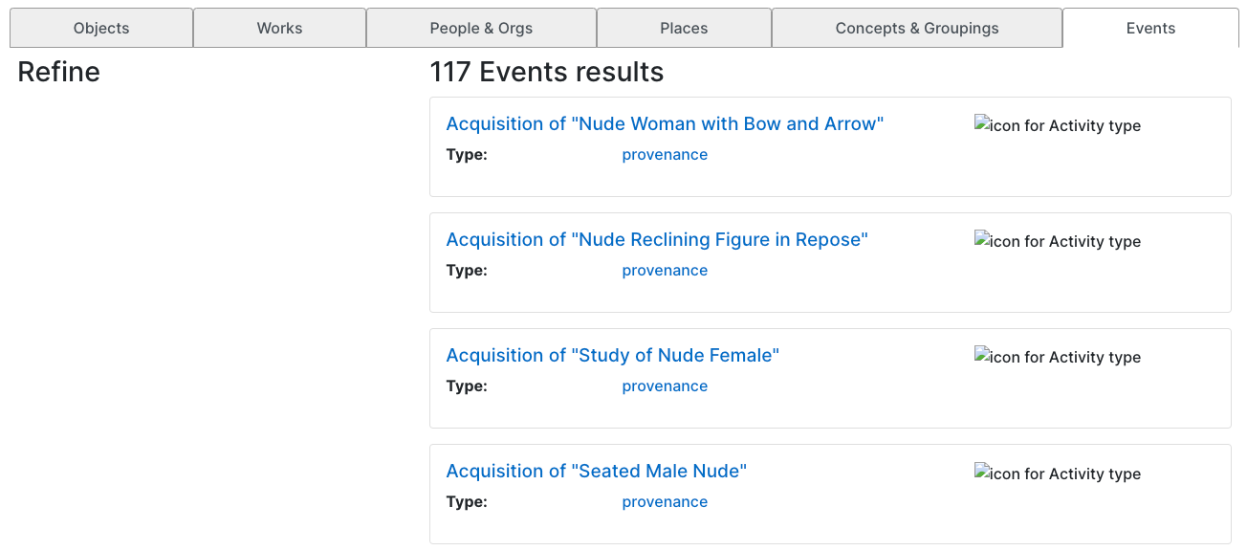
Sneak Peek at LUX

Slide 35
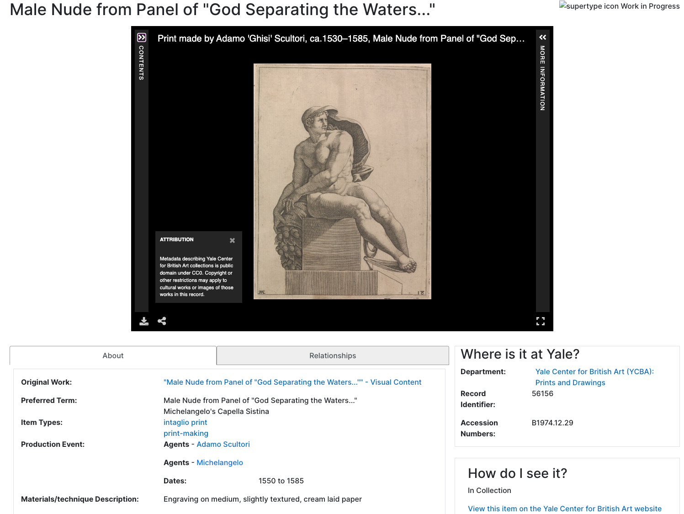
Sneak Peek at LUX

Slide 36
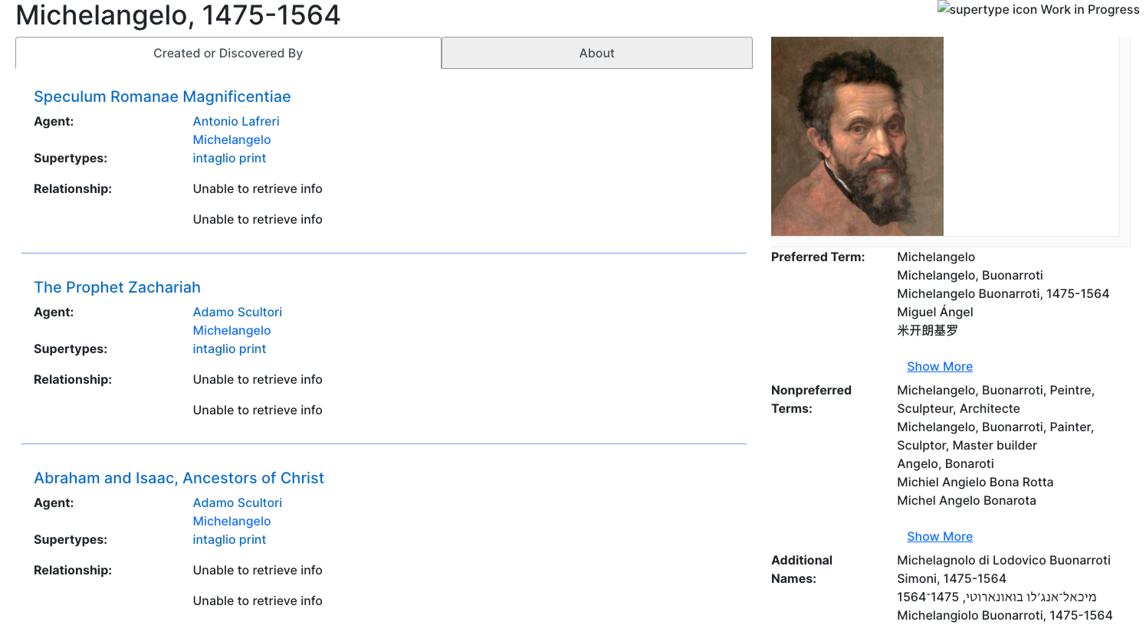
Sneak Peek at LUX

Slide 37
Aim for Coherence, not Consistency
Same rules and processes can’t be applied everywhere
Can’t be rigidly consistent, need to aim for coherency of the result
Contextualization of content or images that cannot be changed is critical
University’s mission is to educate!

Slide 38
Distributed Data Sources
LUX aggregates unit data and reconciles with external authority data for enrichment and discovery
Includes birth dates for people from Authorities
Includes information from wikidata
Different formats, some can be fixed directly, some cannot

Slide 39
Feedback
Challenging to route feedback to the right place from merged, enriched records
Service Plan is necessary
Triage and longer response times

Slide 40
Ongoing Work
Assess Scale
Feedback Process and User Interface
Continuous, Collaborative Learning
Remediation

Slide 41
Current Conclusions
Public statement of values important outcome
Need a sustainable plan for cultural change, cannot be solved with a one-off project
Challenges are different for different domains
Cross-domain, and cross-source platforms multiple the challenges (and benefits)
Recognition and naming of the difficult aspects of the work
Collaboration in a safe space is crucial

Slide 42
Thank You!
Elizabeth Williams
Director for Cross-Collection Initiatives
elizabeth.j.williams@yale.edu
Robert Sanderson
Director for Cultural Heritage Metadata
robert.sanderson@yale.edu

