Slide 1
We acknowledge and celebrate the Indigenous people on whose traditional land and airways we meet, and pay our respect to the elders past and present
If you are unsure whose land you are currently residing upon, we encourage you to visit native-land.ca
Notes:
Incorporating a land acknowledgement as part of a virtual gathering presents a challenge as we are all (speakers and attendees) in different places, and the technology we use similarly flows over and across a multitude of landscapes. We all express gratitude towards those who were here before us and seek to learn more in paying respects to and honoring these people and we invite you to join with us in reflection, knowledge seeking, and appreciation.

Slide 2
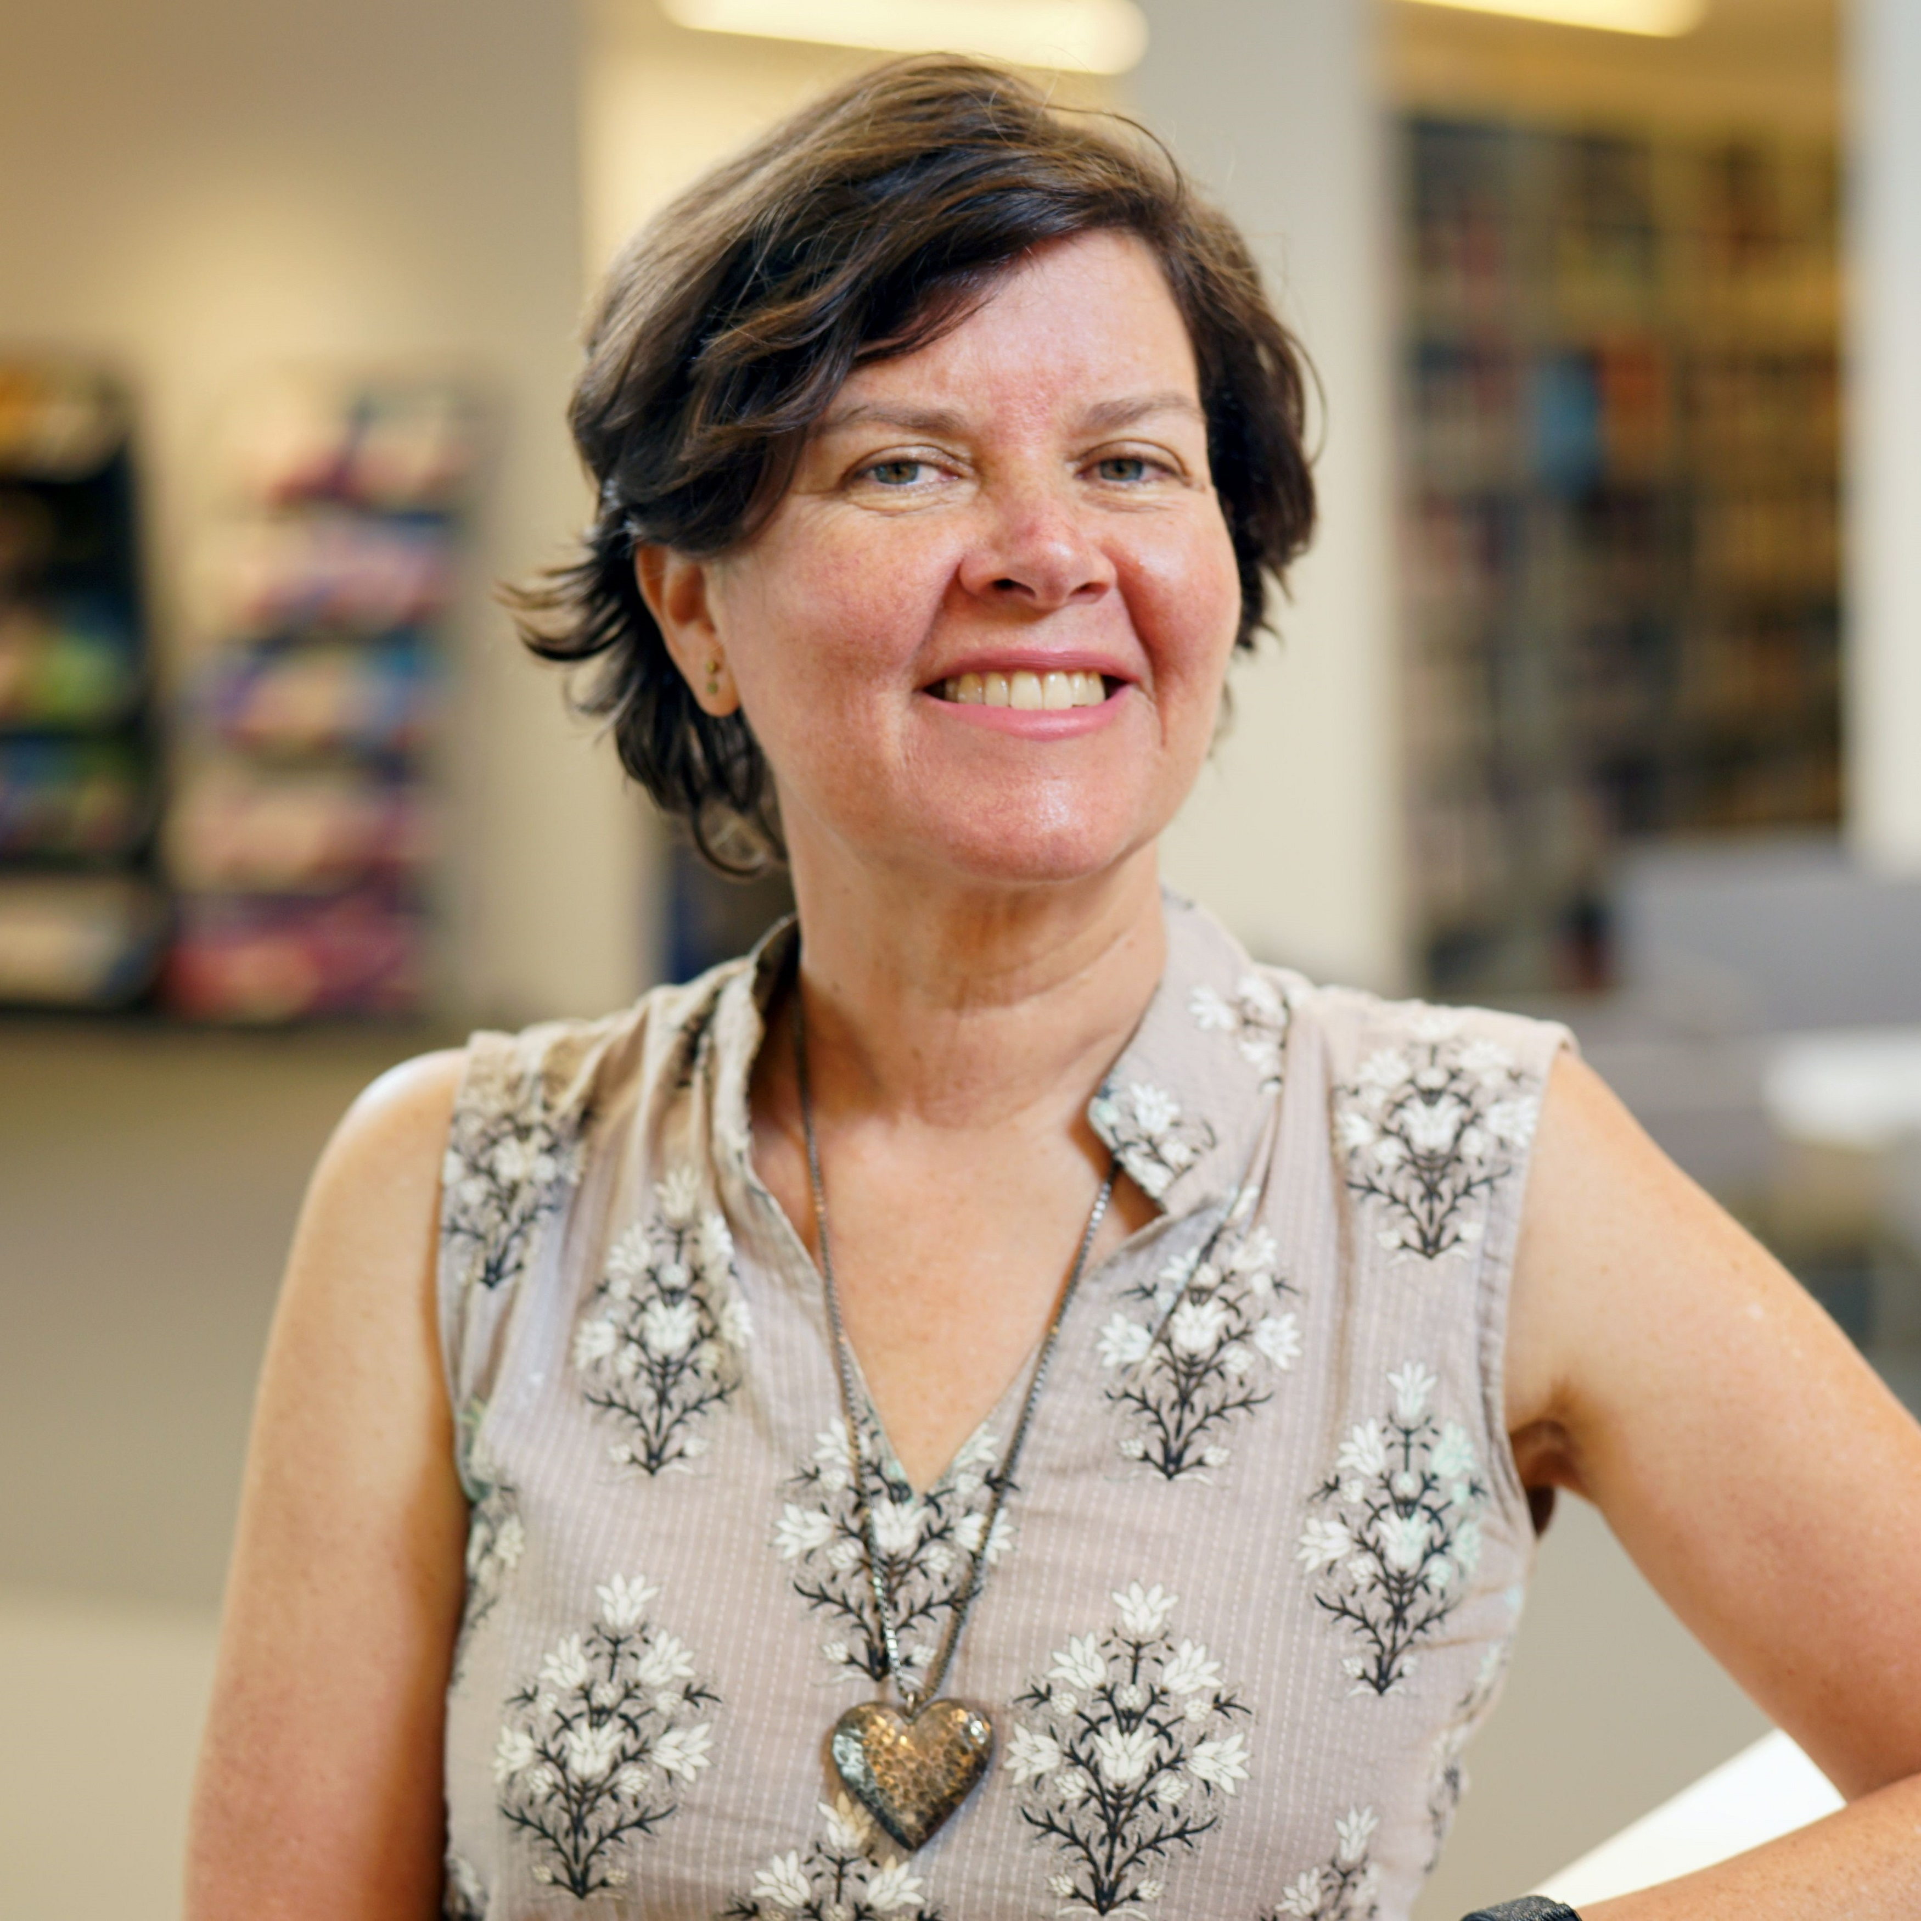
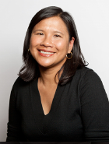
With you today
Today’s host Merrilee Proffitt (she/her)
Additional support Mercy Procaccini (she/her)

Slide 3
Today’s logistics
Brief presentation, followed by discussion
Raise your hand to speak, or use chat
Technical support needs?
Mercy Procaccini and Merrilee Proffitt

Slide 4
Today’s goals and spirit
We seek to facilitate interactions that are:
To achieve this, we ask that you:
Intentional
Meaningful
Open and present
Be fully present
Participate
Contribute
Co-create
We encourage you to turn your cameras on and your devices off, as your responsibilities allow.
Notes:
Today we will be spending two hours together, and our hope is that this participatory format will allow us to engage, learn from, and appreciate the experiences of others. It means that for many of you as introverts, you may be internally groaning right now. But our experience is that, even for introverts, this type of meeting format can be highly motivating and energizing.
Our goals for this workshop are to help facilitate interactions that are:
Intentional
Meaningful
Open and present
. . .and to help us move toward common goals
To do that, we ask that each of you make an effort to:
Be present (undistracted, curious, fully present, and no devices)
Participate (. . . listen fully. Be curious, but without judgement)
Contribute (. . . be willing to share, converse, and engage)
Co-create (recognize your important role as a contributor to the team, without worrying who contributed what part to the whole). In other words, leave your ego outside.

Slide 5
Introduction

Slide 6
Brian Miller
Head, Interlibrary Services
The Ohio State University Libraries

Slide 7
Tools

Slide 8
Checklist for Sharing Special Collections through ILL
Find at https://oc.lc/ILL-special-collections-sharing
Borrowing physical loans
Lending physical loans
Packaging and shipping
Meet with local stakeholders to determine . . .
Borrowing: Who notifies user of item arrival, packages item for return
Lending: Who pulls from shelf, reviews, approves, fills out condition report, checks in/out, packages item
What collections and types of items are eligible for loan

Slide 9
Workflow templates
Find at https://oc.lc/ILL-special-collections-sharing
Borrowing Loan, Lending Loan, & Packaging/Shipping Workflows
Advice:
Copy templates and fill-in-the-blank of who does what and where.
Add steps and edit as needed.
If already doing, review to see how it’s working and if changes desired.

Slide 10
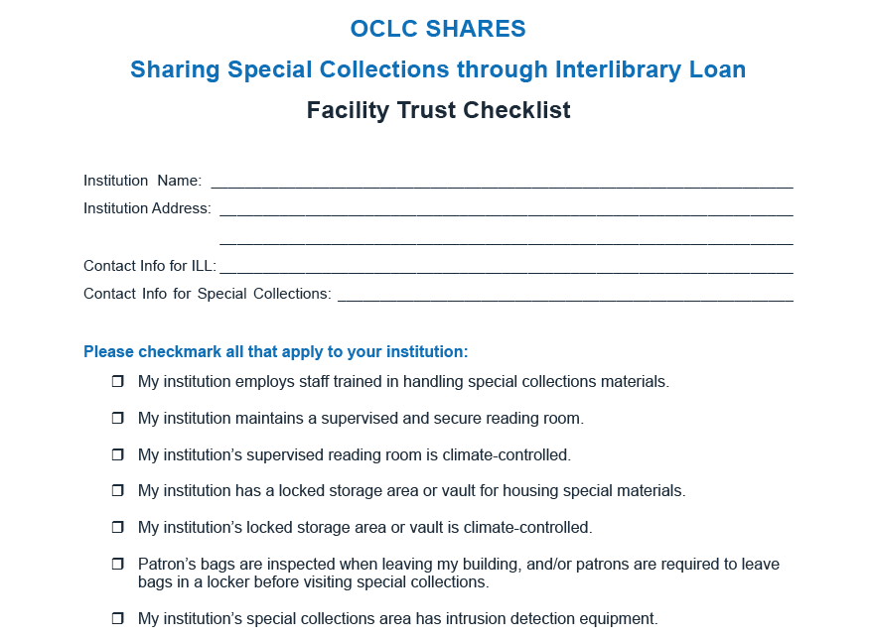
Facility Trust Checklist
Find at:
https://oc.lc/ILL-special-collections-sharing

Slide 11
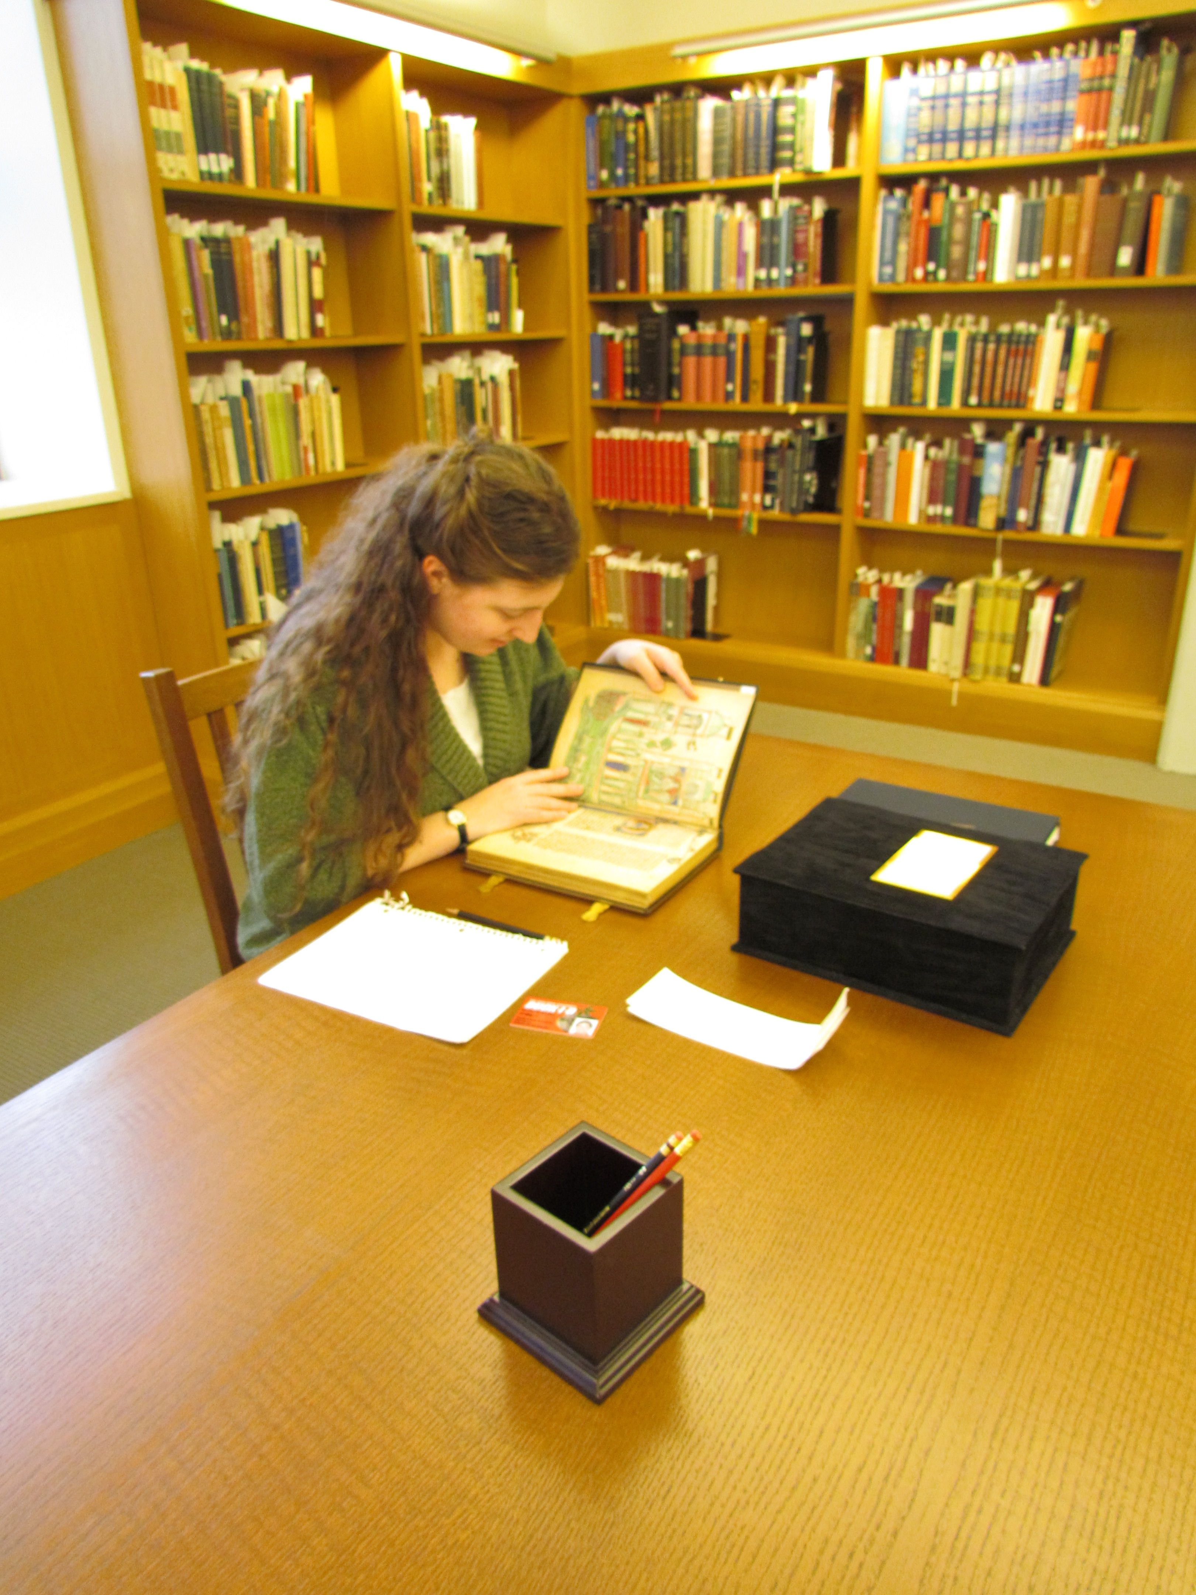
Considerations for borrowing special collection items through interlibrary loan
Must have a supervised and secure reading room and storage area for special collections
Denote SHARES+SC in Affiliations/Borrowing Note of Constant Data
Search open access resources for existing digitized copy
Exhaust domestic circulating collections and consult with user before pursuing special collection loan
Follow lender’s usage and shipping requirements
Return materials with tracking and insurance

Slide 12
Considerations for lending special collection items through interlibrary loan
Remember this is Opt-in (not mandatory) and for SHARES partners
Ask requesting library to exhaust circulating collections and re-request if patron still wishes to pursue
Consider if digitization is appropriate
Request a completed Facility Trust Checklist
Conditional any item specific usage and shipping requirements
Send materials with tracking and insurance

Slide 13
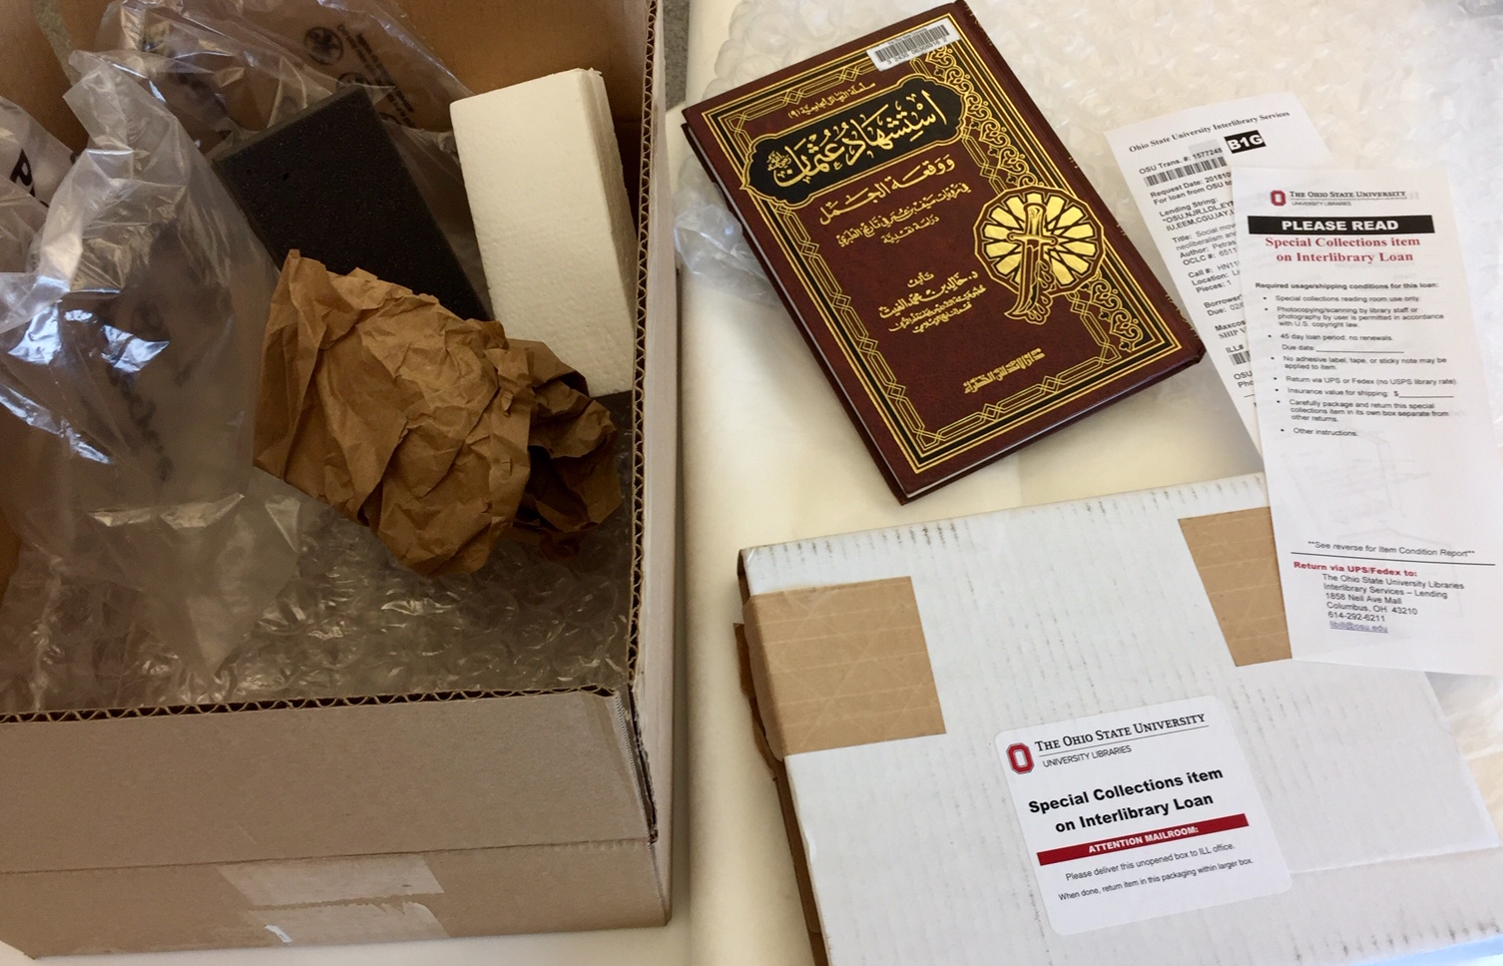
Considerations for packaging/shipping
special collection items through interlibrary loan
Tissue paper, bubble wrap, and multiple box sizes
Include condition report
Ship by courier with tracking and insurance
Ship M-T-W and avoid holiday shipping
Follow all instructions by lending library

Slide 14
Example

Slide 15
The Ohio State University Libraries
ILL-Special Collections procedures
https://go.osu.edu/osuillspeccollprocedures
ILL-Special Collections flowcharts
https://go.osu.edu/osuillspeccollflowcharts

Slide 16
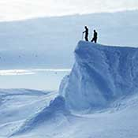
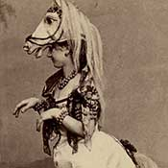
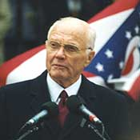
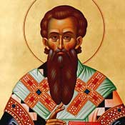
The Ohio State University Libraries
7 special collections under the OSU symbol
320,000+ titles; 515,000+ items
Collections: cartoon research, polar research, medieval Slavic studies, theatre research, Ohio Congressional archives, rare books and manuscripts, and university archives

Slide 17
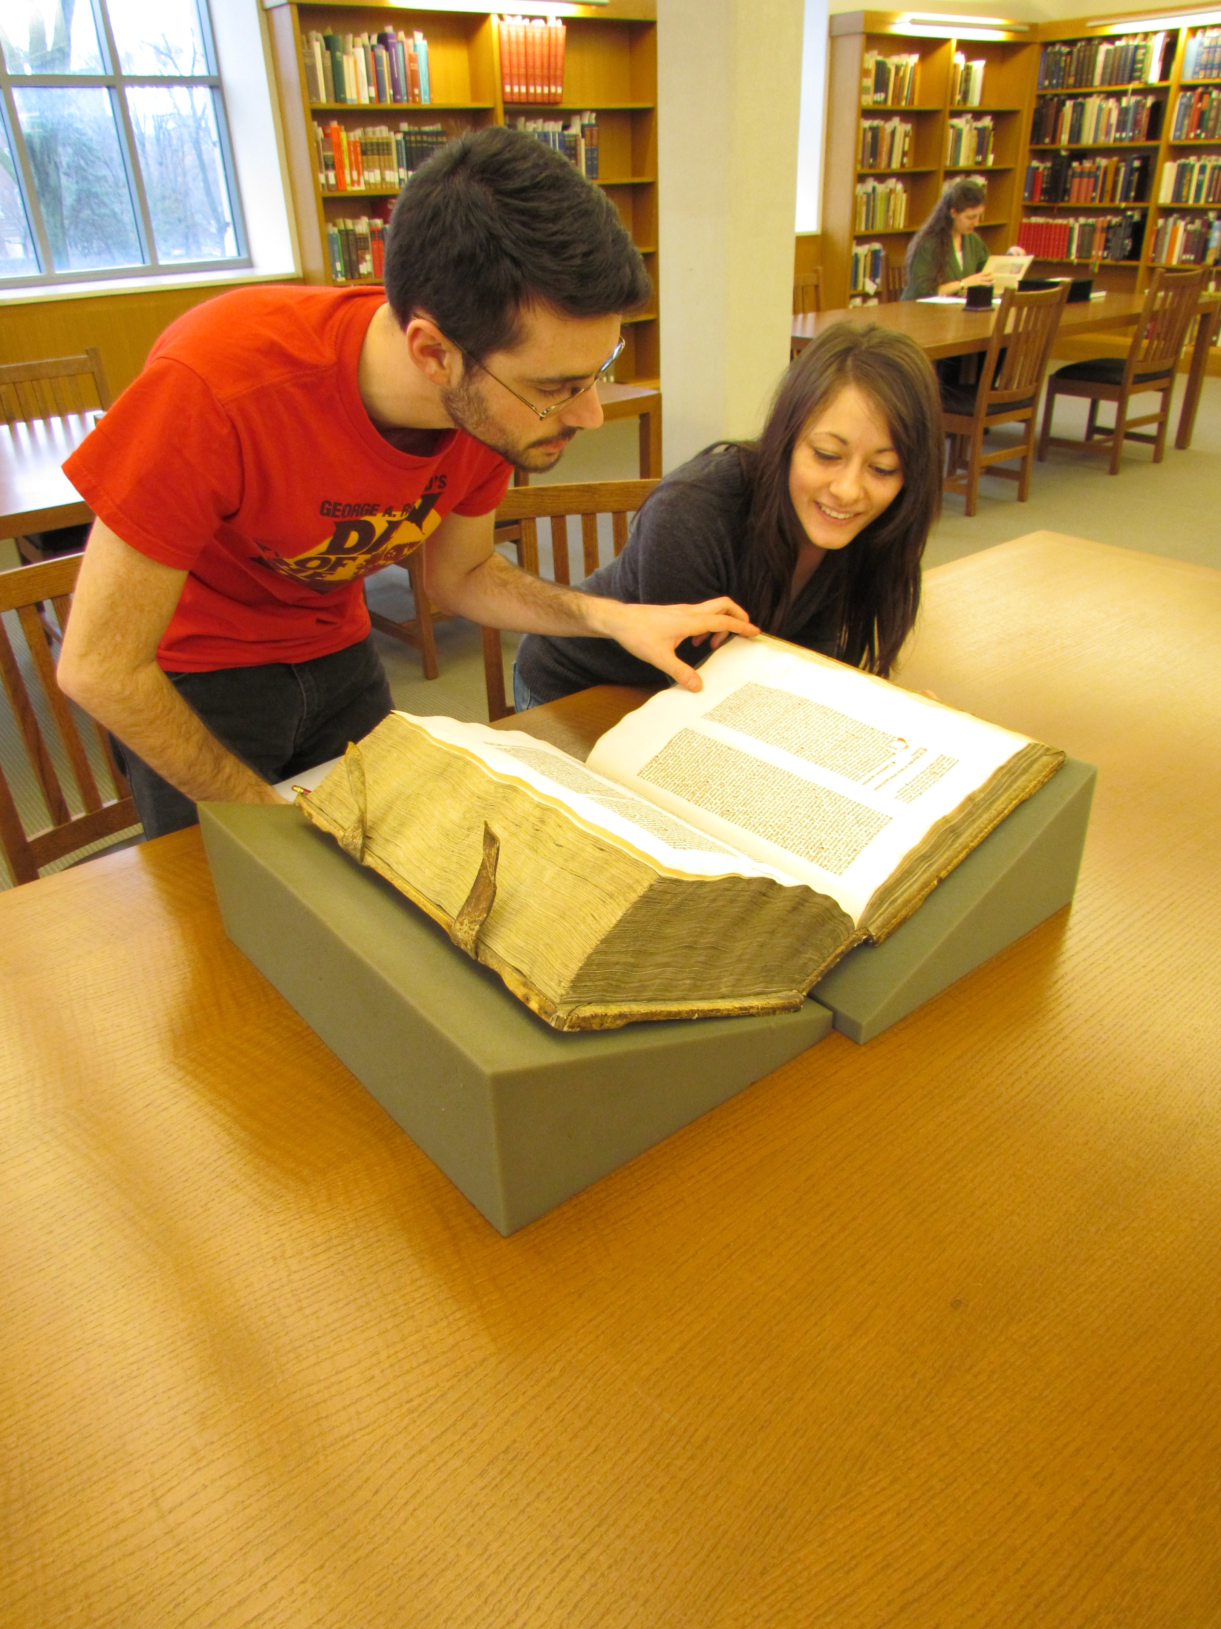
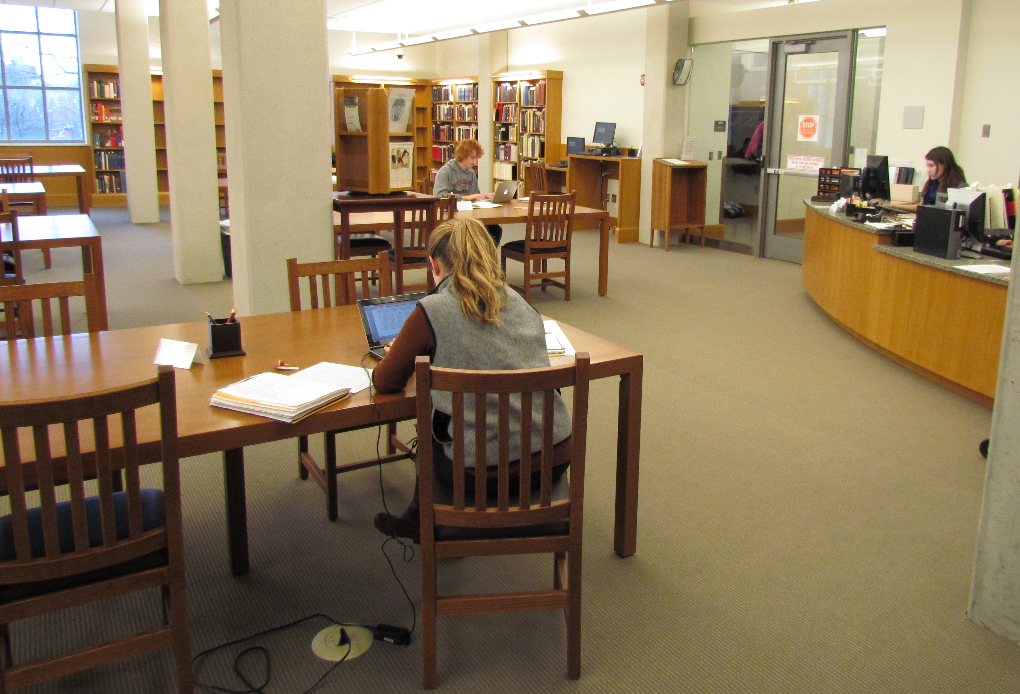
The Ohio State University Libraries
Volume of requests (with our Big Ten partners)
Borrowing special collection items: 1 per year
Lending special collections items: 6 or 7 per year

Slide 18
Example:
OSU conditional text notifying request library about special collections item
Special collection item: Exhaust other lenders first. If not filled elsewhere, rerequest with our symbol 3x in string and include borr note agreeing to conditions at http://go.osu.edu/illsc; we will then seek curator approval to lend.

Slide 19
Example:
OSU email template asking curator for approval to lend

Slide 20
Example: OSU Special Collections streamer and condition report
go.osu.edu/OSUILLSpecCollStreamer

Slide 21
Discussion

