Slide 1
We acknowledge and celebrate the Indigenous people on whose traditional land and airways we meet, and pay our respect to the elders past and present
If you are unsure whose land you are currently residing upon, we encourage you to visit native-land.ca
Notes:
Incorporating a land acknowledgement as part of a virtual gathering presents a challenge as we are all (speakers and attendees) in different places, and the technology we use similarly flows over and across a multitude of landscapes. We all express gratitude towards those who were here before us and seek to learn more in paying respects to and honoring these people and we invite you to join with us in reflection, knowledge seeking, and appreciation.

Slide 2
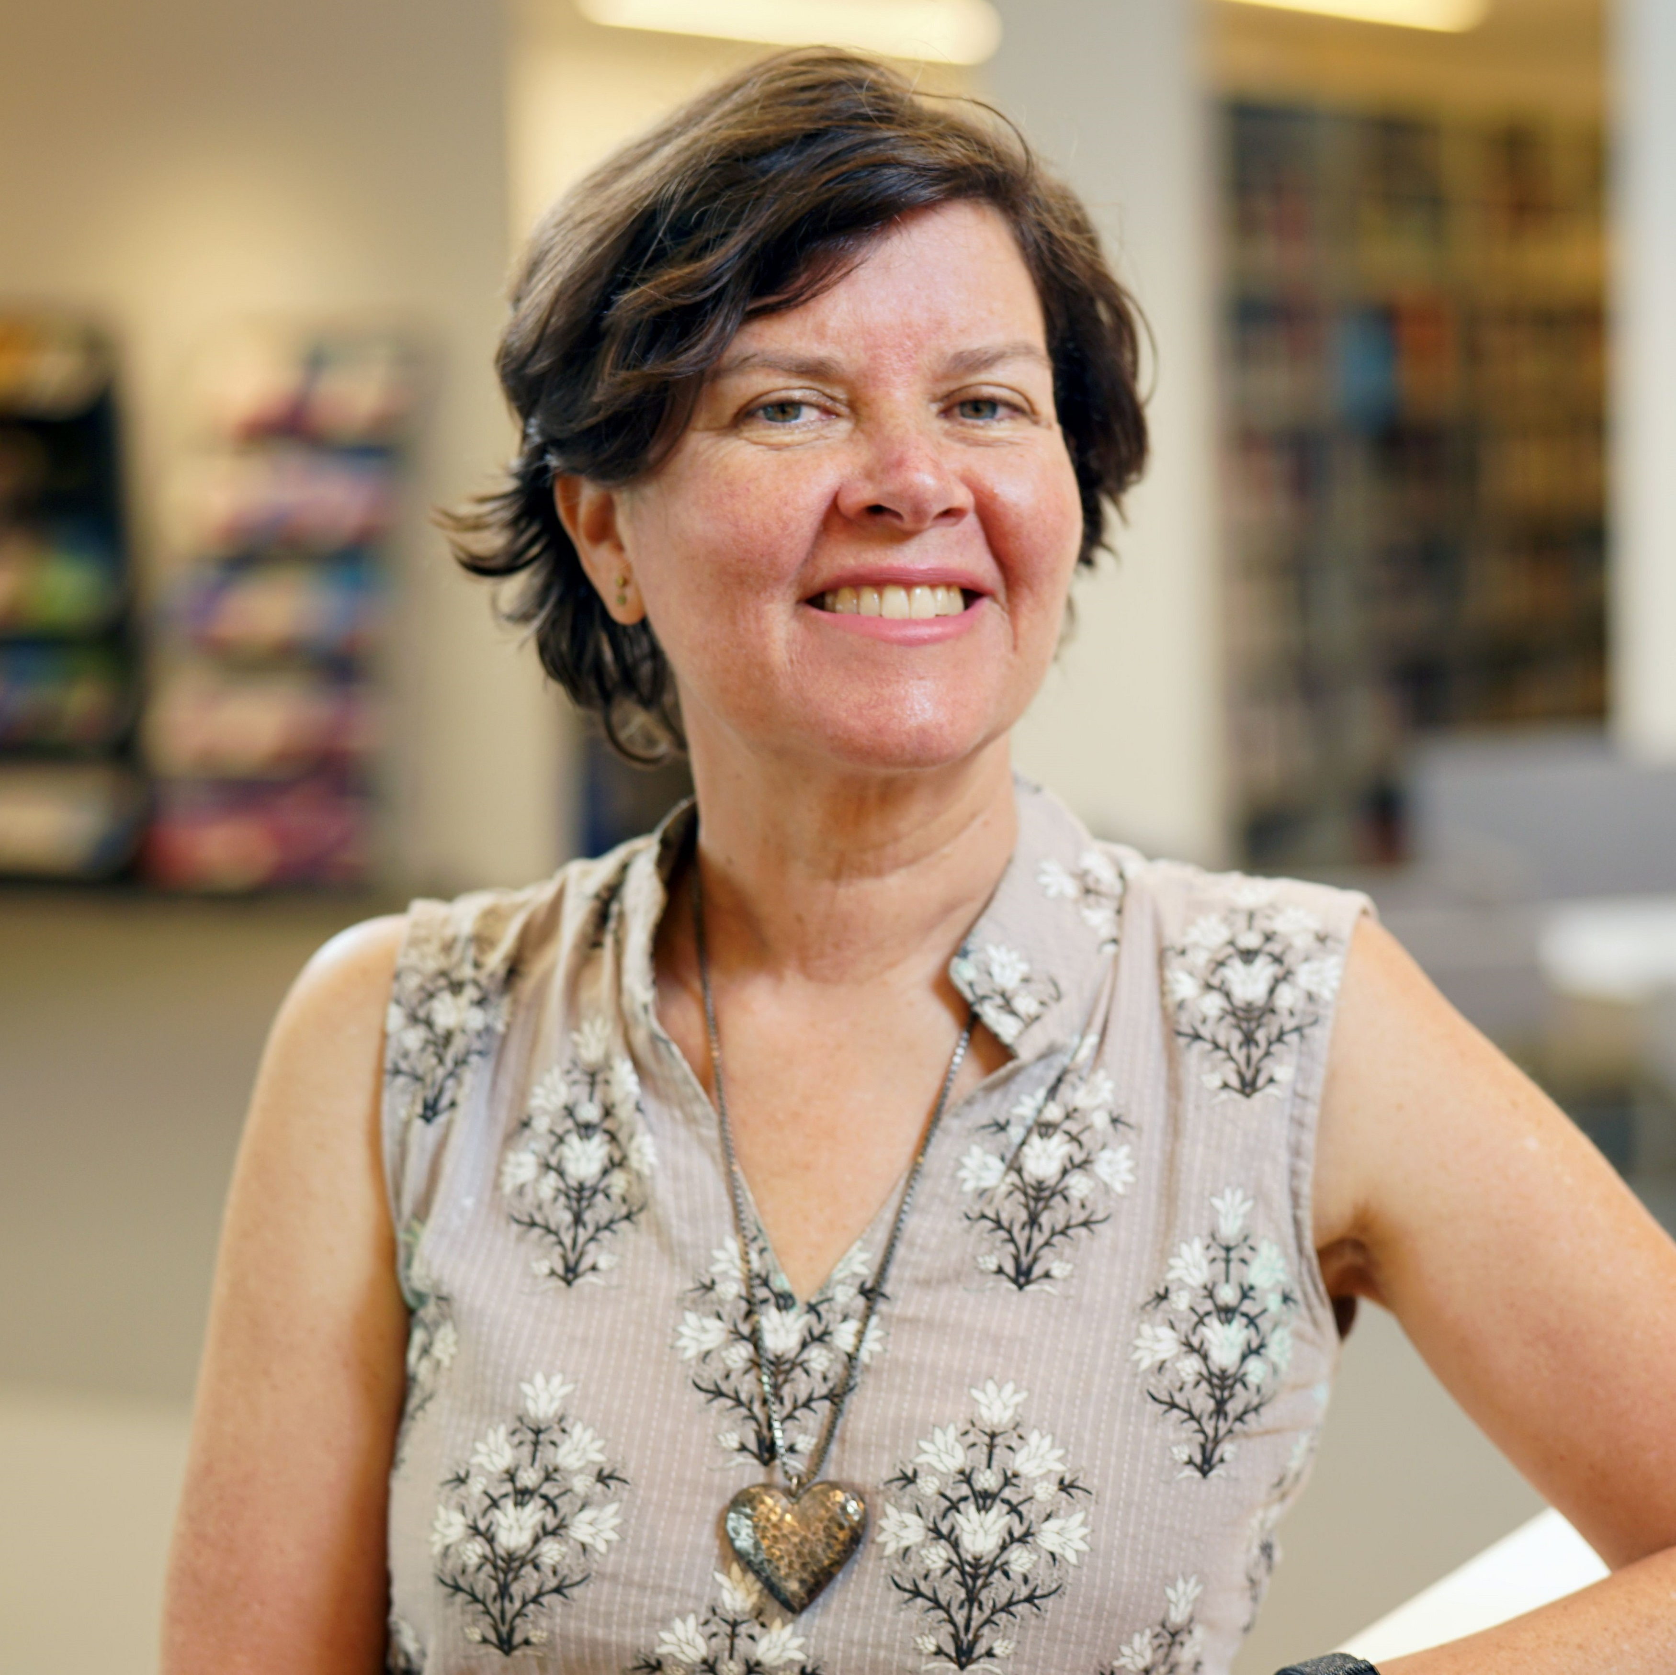
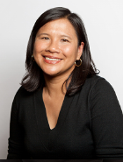
With you today
Today’s host Merrilee Proffitt (she/her)
Additional support Mercy Procaccini (she/her)

Slide 3
Today’s logistics
Brief presentation, followed by discussion
Raise your hand to speak, or use chat
Technical support needs?
Mercy Procaccini and Merrilee Proffitt

Slide 4
Today’s goals and spirit
We seek to facilitate interactions that are:
To achieve this, we ask that you:
Intentional
Meaningful
Open and present
Be fully present
Participate
Contribute
Co-create
We encourage you to turn your cameras on and your devices off, as your responsibilities allow.
Notes:
Today we will be spending two hours together, and our hope is that this participatory format will allow us to engage, learn from, and appreciate the experiences of others. It means that for many of you as introverts, you may be internally groaning right now. But our experience is that, even for introverts, this type of meeting format can be highly motivating and energizing.
Our goals for this workshop are to help facilitate interactions that are:
Intentional
Meaningful
Open and present
. . .and to help us move toward common goals
To do that, we ask that each of you make an effort to:
Be present (undistracted, curious, fully present, and no devices)
Participate (. . . listen fully. Be curious, but without judgement)
Contribute (. . . be willing to share, converse, and engage)
Co-create (recognize your important role as a contributor to the team, without worrying who contributed what part to the whole). In other words, leave your ego outside.

Slide 5
Introduction

Slide 6
Brian Miller
Head, Interlibrary Services
The Ohio State University Libraries

Slide 7
Tools

Slide 8
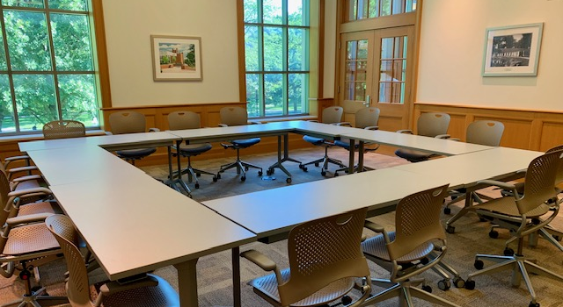
Checklist for Sharing Special Collections through ILL
Find at https://oc.lc/ILL-special-collections-sharing
Scans of small portions (e.g. articles or chapters)
Digitizing Entire works
Meet with local stakeholders to determine . . .
Who: Approves, pulls from shelf, scans/digitizes, delivers
What: Collections for consideration
Where: Location of equipment to be used

Slide 9
Workflow templates
Find at https://oc.lc/ILL-special-collections-sharing
One for portions; another for whole works
Advice:
Copy template and fill-in-the-blank of who does what and where.
Add steps and edit as needed.
If already doing, review to see how it’s working and if changes desired.

Slide 10
Considerations for whole works
What level of scanning will you provide?
On-the-fly production scanning; OR
Archival quality scanning → Repository? Hathi? Internet Archive?
What will you digitize (being mindful of copyright!)?
Public domain items
Orphan works
108(h) last 20 years of copyright
Fair Use analysis on recent imprints
Items where your institution owns the copyright

Slide 11
Example

Slide 12
The Ohio State University Libraries
ILL-Special Collections procedures
https://go.osu.edu/osuillspeccollprocedures
ILL-Special Collections flowcharts
https://go.osu.edu/osuillspeccollflowcharts

Slide 13
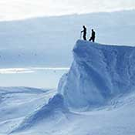
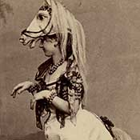
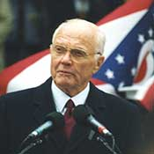
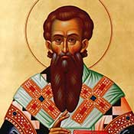
The Ohio State University Libraries
7 special collections under the OSU symbol
320,000+ titles; 515,000+ items
4 in Thompson Library (where ILL office is also located)
3 in other campus buildings

Slide 14
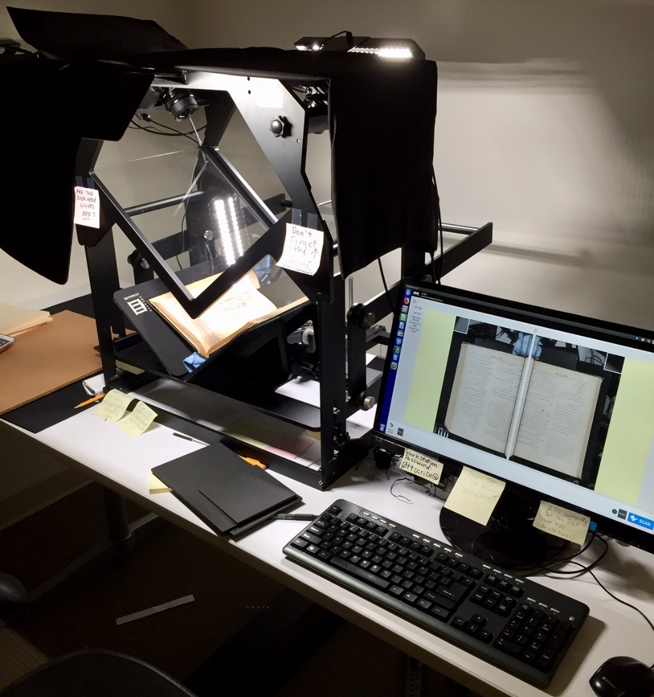
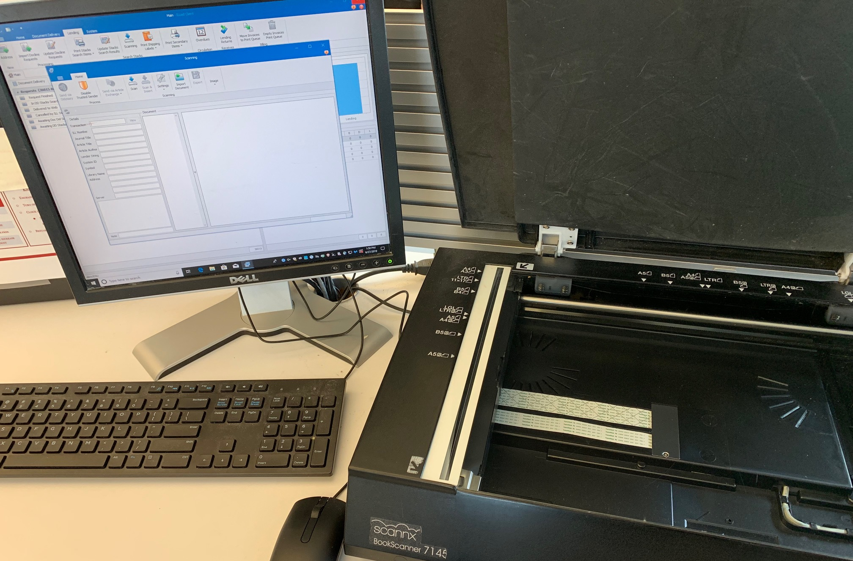
The Ohio State University Libraries
Volume of requests
Scans of small articles/chapters: 9 per month
Digitizing entire works: 4 or 5 per year
Equipment
Plustek and Scannx book edge scanners
Internet Archive Table Top
Scribe Scanner, Sony a6000 cameras,
LED lights

Slide 15
Example: OSU email template asking special collections curator
to review item for potential digitization

Slide 16
Example: OSU email template asking special collections cataloger
and digital imaging specialist to review item for digitization

Slide 17
Discussion

