Slide 1
ARLIS 50th Annual Conference | April 7, 2022
OCLC Research Library Partnership Roundtable:
Operationalizing the Art Research Collective Collection Progress Report
Notes:
Welcome, everybody. I'm Dennis Massie of the OCLC Research Library Partnership. It's great to see you. Thanks for spending this part of the day with us. I'm going to turn things over to my esteemed RLP Teammate, Chela Weber, to kick things off.

Slide 2
WELCOME
Notes:
Welcome, everyone! As Dennis said, we really are so happy to see you all and so glad you chose to spend some of your day with us. I'm going to run through a very brief intro, and then we'll dig into talking about the project.

Slide 3
Land Acknowledgement
We acknowledge that we are gathered today on the traditional, unceded lands of the Council of the Three Fires, including the Ojibwe, Odawa, and Potawatomi Nations and that Chicago has long been a hub of trade, travel, gathering, and building connection for Indigenous people including the Miami, Ho-Chunk, Menominee, Sac, and Fox.
Today, the greater Chicago region is one of the largest urban Native communities in the US, a home to more than 65,000 Native people from more than 150 Native tribes.
Notes:
I'd like to start by taking a moment to recognize that we are gathered today on the traditional, unceded lands of the Council of the Three Fires: including the Ojibwe, Odawa, and Potawatomi Nations. Chicago has long been a hub of trade, travel, gathering, and building connection for Indigenous people including the Miami, Ho-Chunk, Menominee, Sac, and Fox .
I'd also like to acknowledge the impacts to these communities by the forces of settler colonialism and state violence, first through warfare and disease brought by European settlers in the early 1800s, then through systemic forced relocation and land cessation actions taken by the Federal Government beginning with the Indian Removal Act of 1830, and later through the Federal urban relocation programs of 1950s and 1960s.
Today, the greater Chicago region is the third largest urban Native community in the US, a home to more than 65K Native people from more than 100 tribes who continue to contribute to the life of the city and to celebrate their heritage, practice traditions, and care for the land and waterways. We’re grateful to be here today in their home.

Slide 4
The Research Library Partnership is a program of the Research Division of OCLC
It provides a unique transnational collaborative network of peers to address common issues
And the opportunity to engage directly with OCLC Research
Notes:
We have a number of folks here today who may not be very familiar with the RLP, so I want to take just a minute to share what we’re all about. The Research Library Partnership is a program of OCLC Research and is a membership organization, supported by the membership dues of our partner libraries which include academic, museum, and independent research libraries across North America, Europe, Asia, and Australia.
It really is a unique, international collective of peer institutions and colleagues, and together with Dennis and my other fellow program officers, we work hard to create opportunities and spaces for members of the partnership to work together to address common issues facing research libraries through programming like this event today, discussion groups, working groups, and research efforts. If you're at an RLP library and want to learn more – we'll share some more detail at the end of our presentation about ways to connect and stay updated.

Slide 5
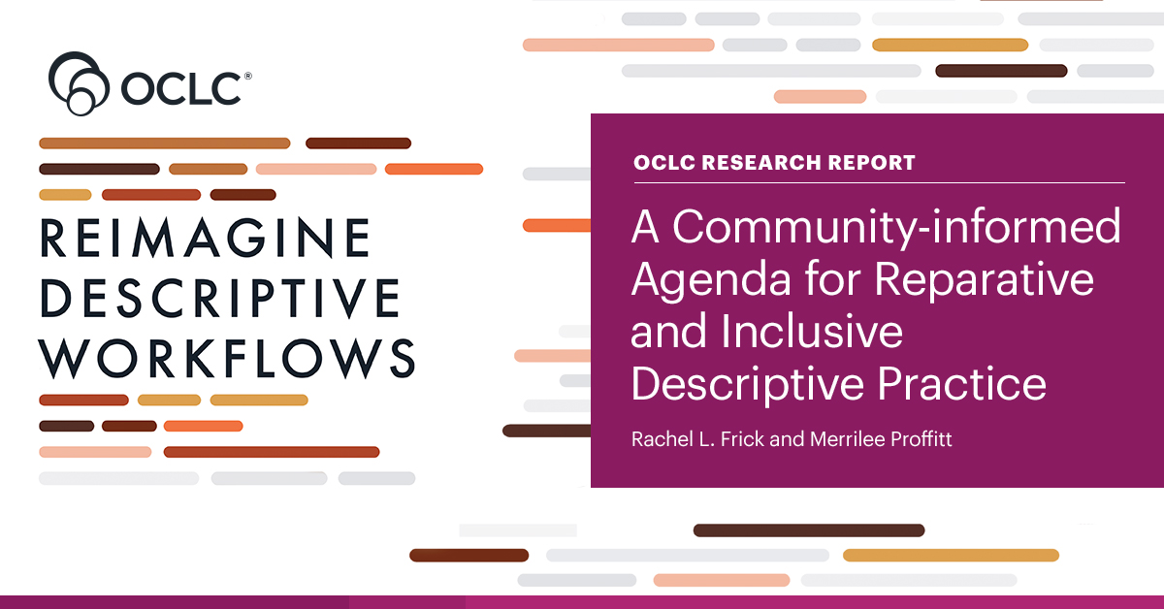
https://oc.lc/reimagine-workflows-report
Notes:
One example of the kind of work we do in the RLP is our Reimagine Descriptive Workflows project, which convened a group of expert practitioners and community members to frame the challenges facing the library field in inclusive and reparative metadata work, and start to chart a path forward toward improving descriptive practices, tools, infrastructure, and workflows in libraries and archives.
A report from the project came out on Tuesday, and we encourage you to check it out.
With that, I'll turn it over to Dennis to give you some background on the project.

Slide 6
Op Art: Overview
Notes:
Hello, again. I'm delighted to get to be the one to tell you the OpArt project origin story, because I was there at the very beginning. So were several of you!

Slide 7
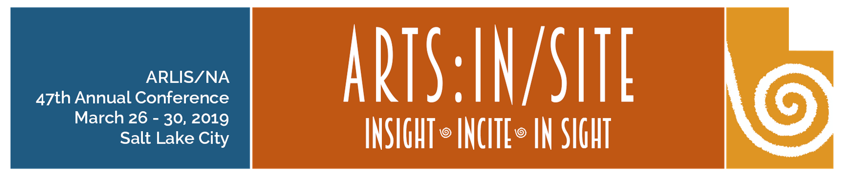
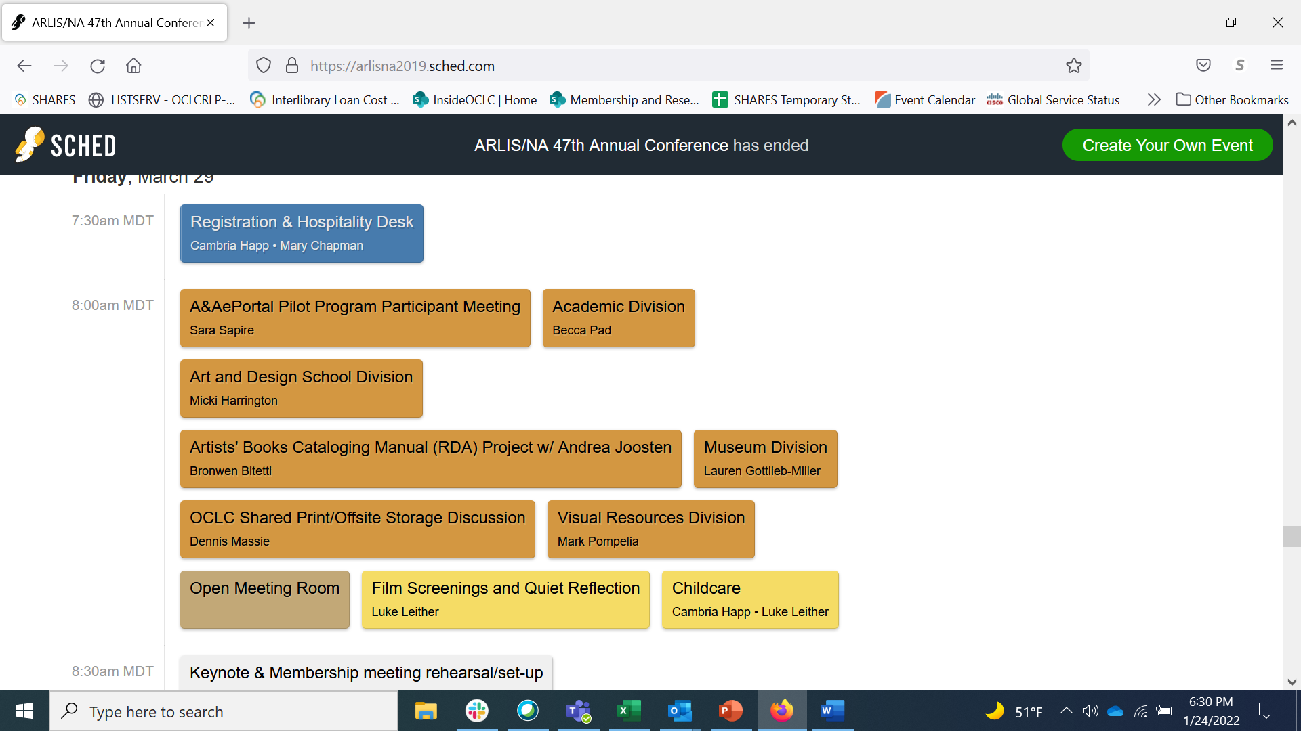
Cleveland Museum of Art
Frick Art Reference Library
Getty Research Institute
Museum of Fine Arts, Houston
University of Nevada, Las Vegas
Notes:
The OpArt project had its beginnings with a conversation around a table at the 2019 ARLIS conference in Salt Lake City. Six of us showed up to a meeting about shared print and offsite storage that in past years drew three dozen. With such a cozy group we scrapped the meeting agenda and just went around the table talking about current challenges.
A few themes quickly emerged: an acute lack of space at art research libraries, difficulties in arranging for offsite storage of print collections, some gaps in shared knowledge regarding the library collections of peer institutions, and the perceived value of art libraries partnering with each other and with other types of libraries on the shared management of print collections.
At the end of that hour we felt like we might have the makings of a collaborative research project.

Slide 8
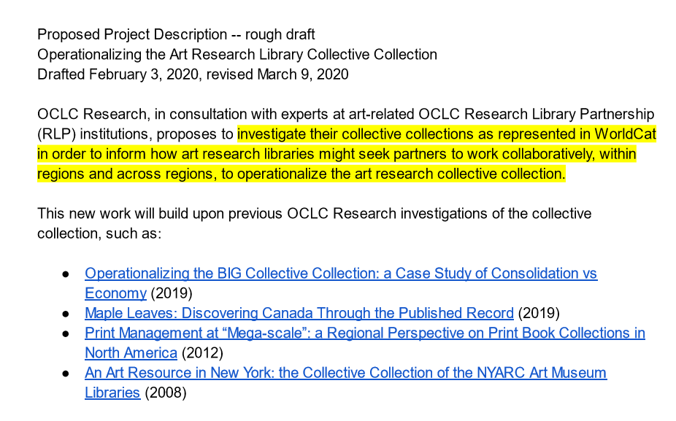
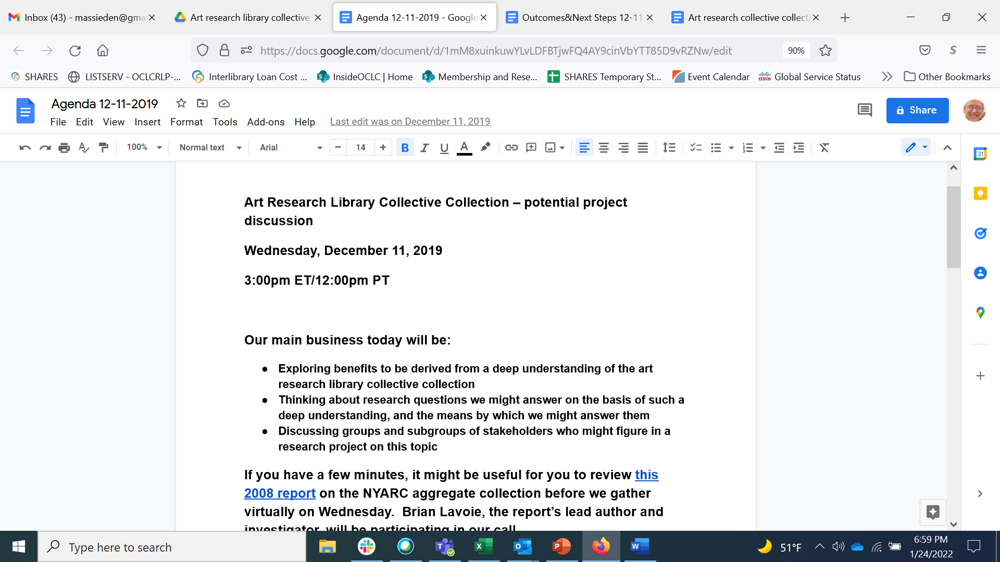
Notes:
We six spent the next year meeting virtually to flesh out our idea, expanding the group to bring in additional expertise from colleagues at all our organizations. By early 2020 the general shape of the project was already established. Investigate the art research library collective collection as represented in WorldCat in order to inform how art research libraries might seek partners to work collaboratively, within regions and across regions, to ensure sustainable access to art research materials.
Then the pandemic hit. Which, among many other effects of which we're all painfully aware, also increased the urgency of addressing the long-term sustainability of art research collections.

Slide 9
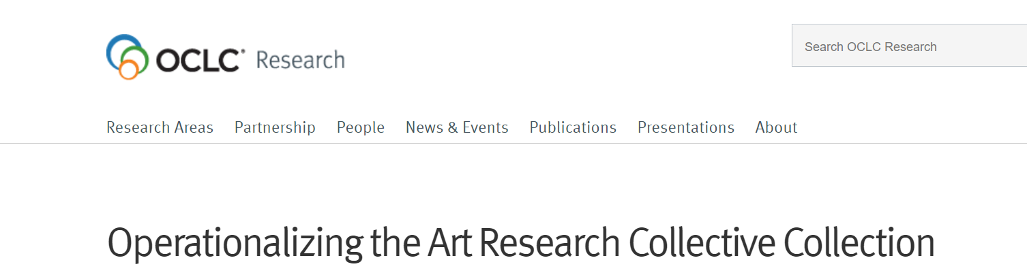
4 phases over 2 years
Analyze art research collective collections
Identify art research collection sharing patterns
Conduct collaborative case studies
Operationalize collaboration
Supported by a generous grant from the Samuel H. Kress Foundation, with considerable co-investment by OCLC.
The goal of the OpArt project is to help art libraries identify potential collaborative models to address shared sustainability barriers and consider practically what institutions will need to make these models operational.
Notes:
We spent the rest of 2020 laying the groundwork. In January 2021, we officially launched the OpArt project, with generous support from the Samuel H. Kress Foundation. Early on we identified the four main phases of the project. And we got our main goal stated as succinctly as possible, so it could fit into that tiny little box on the slide you see here.
The goal of the OpArt project is to help art libraries identify potential collaborative models to address shared sustainability barriers and consider practically what institutions will need to make these models operational.

Slide 10
Project Phases
data-driven analysis
qualitative analysis
I. Opportunities for cooperation
across art research collections
III. “Deep dive” into case studies
of real-world collaboration
II. Cooperation patterns
in resource sharing
IV. Recommendations on how to make collaboration work
Notes:
We imagined an orderly, linear process where we would march through Opart's four phases:
Phase 1: use WorldCat data to identify and analyze the art research collective collection and compare that collective collection with the rest of WorldCat. And then examine these findings in light of identifying potential opportunities for cooperation.
Phase 2: use resource sharing data to examine the sharing patterns occurring among art libraries, and between art libraries and other types of libraries. Could these sharing patterns give us a sense of opportunities for cooperation that art libraries are leveraging already?
Phase 3: build on the findings from the first two phases with a “deep dive” into a small set of case studies of regional art library collaborations, with a focus on the collaborative models used, and the challenges of implementing those models.
And Phase 4: consider the practical challenges of creating and maintaining cross-institutional relationships that deliver on collaborative opportunities within the art research collective collection.
Phases I and 2 are data-driven analyses. Phases 3 and 4 will be work of a more qualitative nature.
Again, we originally thought the work would progress in a fairly straight line – wrap up one phase, move on to the next.

Slide 11
Project Phases
data-driven analysis
qualitative analysis
I. Opportunities for cooperation
across art research collections
III. “Deep dive” into case studies
of real-world collaboration
II. Cooperation patterns
in resource sharing
IV. Recommendations on how to make collaboration work
Notes:
But, in fact, once we started digging into the data, we quickly realized that things aren’t going to be linear. Turns out that the first two phases are informing each other as we go along, and bringing up new questions.

Slide 12
Project Phases
data-driven analysis
qualitative analysis
I. Opportunities for cooperation
across art research collections
III. “Deep dive” into case studies
of real-world collaboration
II. Cooperation patterns
in resource sharing
IV. Recommendations on how to make collaboration work
Notes:
And we anticipate that the case studies will make us want to revisit the collections and ILL data with new questions as the project continues to evolve.
Ah, the best laid plans of mice and Massies, right?

Slide 13


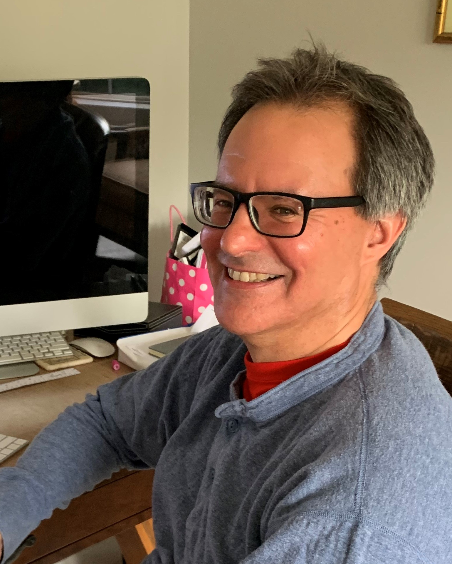
  OpArt project team
Dennis Massie
Chela Scott Weber
Senior Program Officer, Resource Sharing
Senior Program Officer, Archives and Special Collections
Brian Lavoie
Senior Research Scientist
Notes:
That's what we're up to with OpArt. And when I say "we" I mean two groups of people -- the OCLC project team, which consists of Chela and me and our third partner on the project, our Research colleague Brian Lavoie -

Slide 14
Advisory Group
Jon Evans, Museum of Fine Arts, Houston
Rebecca Friedman, Marquand Library, Princeton University
Roger Lawson, National Gallery of Art
Autumn Mather, Art Institute of Chicago
Keli Rylance, Saint Louis Art Museum
Lori Salmon, Institute of Fine Arts, New York University
Kathleen Salomon, Getty Research Institute
Tony White, OCAD University
Notes:
And our magnificent advisory board for the project.
Chela, Brian and I knew that, in order to properly do this work, we would need to rely heavily on experts from art research libraries help shape and scope our work. We're grateful that the members of our advisory board have been willing to play such an essential part in this initiative and give so generously of their time and expertise. None of what follows in this presentation would have been possible without our advisory group's ideas and guidance. So our heartfelt thanks go out to Jon, Rebecca, Roger, Autumn, Keli, Lori, Kathleen and Tony.

Slide 15
Op Art: Collection Analysis
Notes:
And now I'll turn things back over to Chela to walk us through the OpArt collections analysis work done by our OCLC Research colleague, Brian Lavoie.

Slide 16





Phase 1: Collective collection analysis
Art Research
Collective Collection
Proxy
Collective Collection
WHAT?
WHO?
WHERE?
Notes:
This picture gives a brief overview of our collection analysis work. We start on the left with the idea that there is something called an art research collective collection, which is the collective holdings of libraries that support art research. We depicted this collection as a cloud, because the boundaries of this collection are a bit fuzzy. But basically the idea is that there is a corpus of materials supporting art research that is spread across the collections of many institutions.
To do the kind of analysis we want to do in this project, we have to make that fuzzy cloud idea concrete. Identifying every single relevant title and all the relevant institutions just isn’t feasible, so instead, we’re trying to get at that idea via constructing a collection to serve as a proxy for this larger corpus of materials. To do this, we identified a group of institutions that we know support art research as part of their mission and assembled data about their collective collection using WorldCat bibliographic and holdings data. We’ve been examining the characteristics of this collection to gain a better understanding of it. In other words, this Proxy collection helps tell us the “what” – what’s in the art research collective collection.
After defining our proxy collection, we’re be looking at how much of the art research collective collection is also held by institutions outside of our proxy group. This helps us expand our understanding of the network of institutions whose collections are part of the art research collective collections, even though support for art research may not be part of their central or stated mission. In other words, this informs us about the “who” – what kinds of institutions are particularly relevant to the art research collective collection.
And lastly, given the institutions we identified as being part of the network supporting art research, we want to characterize their locations, with the goal of identifying “clusters” or concentrations in geographic areas at a variety of scales, including nationally, or regionally. This part of the analysis informs the “where” aspect of the art research collective collection, by helping us visualize the geographic distribution of the collection, and hopefully, suggest opportunities for coordinated collecting and resource sharing partnerships that have not yet been fully leveraged.
So that’s an overview of our collection analysis. Next I’ll walk you through a few findings from our analysis, to give you a general sense of what the proxy art research collective collection looks like.

Slide 17
Size
Proxy
Art Research
Collective Collection
85 institutions
8.6m distinct publications
16.0m total holdings
Notes:
Starting with some basic size statistics, we have a collection featuring the combined holdings of 85 institutions, that were selected according to a list of criteria we developed in consultation with our advisory committee. The collective holdings of these institutions account for 8.6 million distinct publications, which is roughly equivalent to FRBR manifestations, and 16 million total holdings across all the members of the group. So this is a fairly sizable collection.

Slide 18
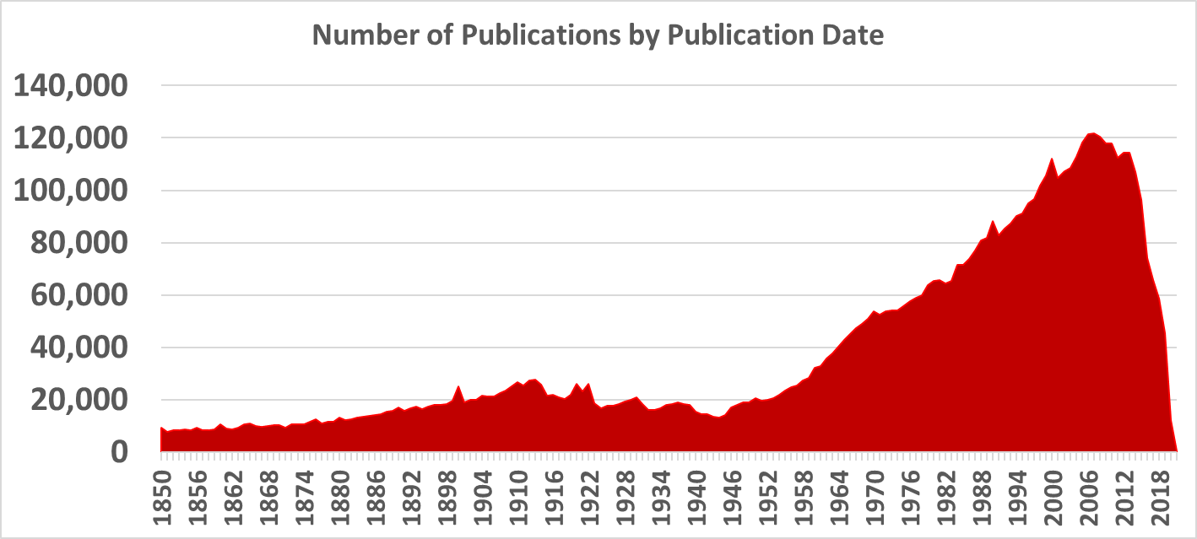
Publication Date Profile
Notes:
This is a profile of the publication dates of the materials in the collection, and as you can see, the collection skews toward relatively recent materials – although the slight bump in materials published in the early 20th century is interesting.
I should mention that the drop-off in # of publications for the years roughly 2010 and forward is probably indicative more of cataloging lag rather than collecting behaviors. Although it would be interesting to see if there was some correlation with reduced acquisitions over the last decade.

Slide 19
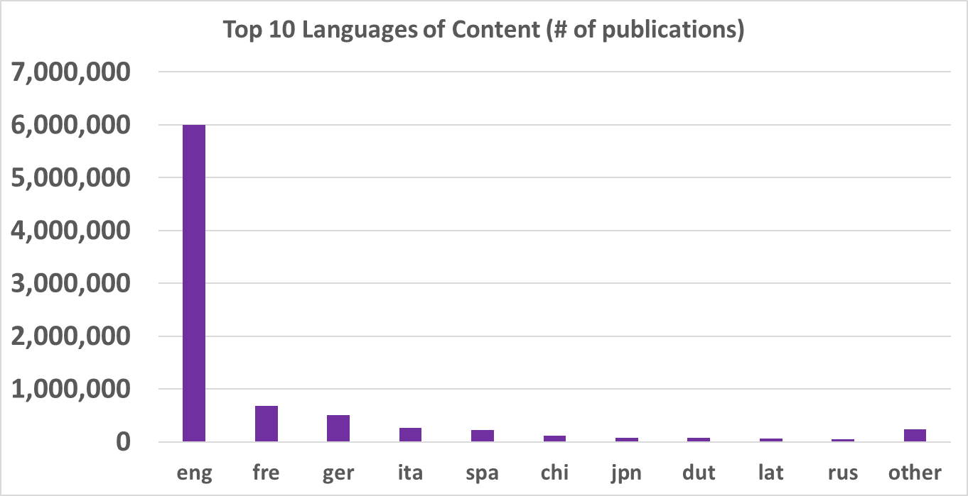
Distribution of Languages
374 languages
Notes:
Here’s the distribution of languages in the collection. No surprise that English predominates, given that our proxy institutions are all North American, but lots of other languages well-represented there as well. And I think its quite remarkable to see that this overall collection of 8.6 million publications includes content in over 370 different languages.
I also think the list of top languages for this collection is probably a bit different from other collective collection analyses we’ve done of general, or non-disciplinary-focused collective collections. For instance, I think Latin ranks much higher here than you would see in other collections.

Slide 20
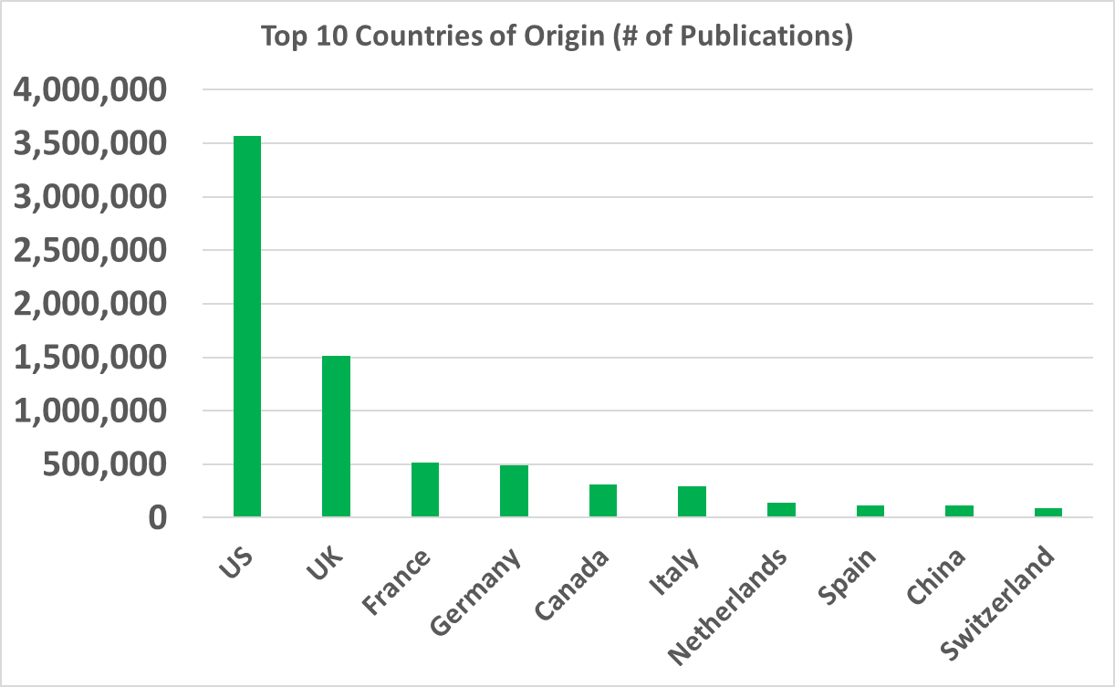
Country of Origin
261 countries & territories
Notes:
Here’s a look at the distribution of countries of publication, or countries of origin, for the publications in the collection. The US and UK predominate here, again likely as a consequence of all our institutions being North American, but, as with languages, we see plenty of other countries represented as well – more than 260 different countries.
(Note: includes countries, territories, dependencies and other entities that are assigned a unique MARC country code.)

Slide 21
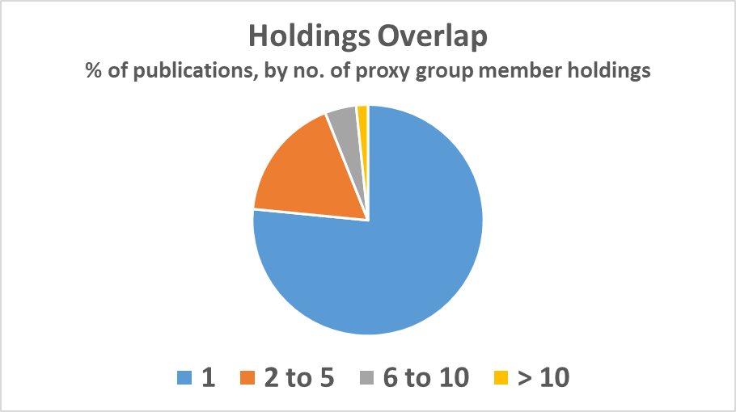
Holdings Overlap in the Proxy Collection
77% held by one group member
Notes:
I mentioned there were about 16 million total holdings on 8.6 million distinct publications, so obviously there’s some overlap in the holdings. This pie chart gives you a sense of what the overlap pattern looks like. I think the headline is that about three quarters of the publications are held by only one member within the group, so clearly a lot of uniqueness is present across the 85 individual collections.
But there is some duplication as well: so for example, according to the chart, only about 2% of the publications are held by more than 10 institutions within the group, but in absolute terms, that accounts for nearly 150,000 distinct publications.

Slide 22
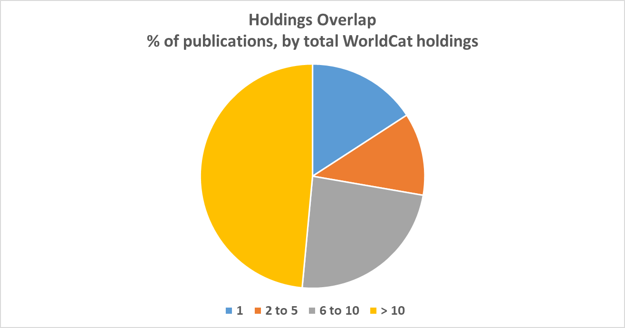
Holdings overlap: the WorldCat universe
Notes:
If we look at the proxy group compared to the totality of holdings in WorldCat, you can see there is a significant difference in the holdings overlap pattern when you compare it to the proxy-group-only pattern which we included as an inset to the right. In particular, that huge fraction of the collection held by a single group member shrinks way down when the frame of reference is WorldCat as a whole, and the tiny sliver of materials held by more than 10 group members expands to nearly half the collection.
But it also shows that more than half of the titles in the art research proxy are held by 10 or fewer libraries, giving an idea that some of the value of art research collections may be their scarcely held titles.
This data is a good reminder that scarcity or abundance depends on your frame of reference, and also suggests the possibility for interesting partnerships between art libraries and the many other libraries that hold similar kinds of materials.

Slide 23
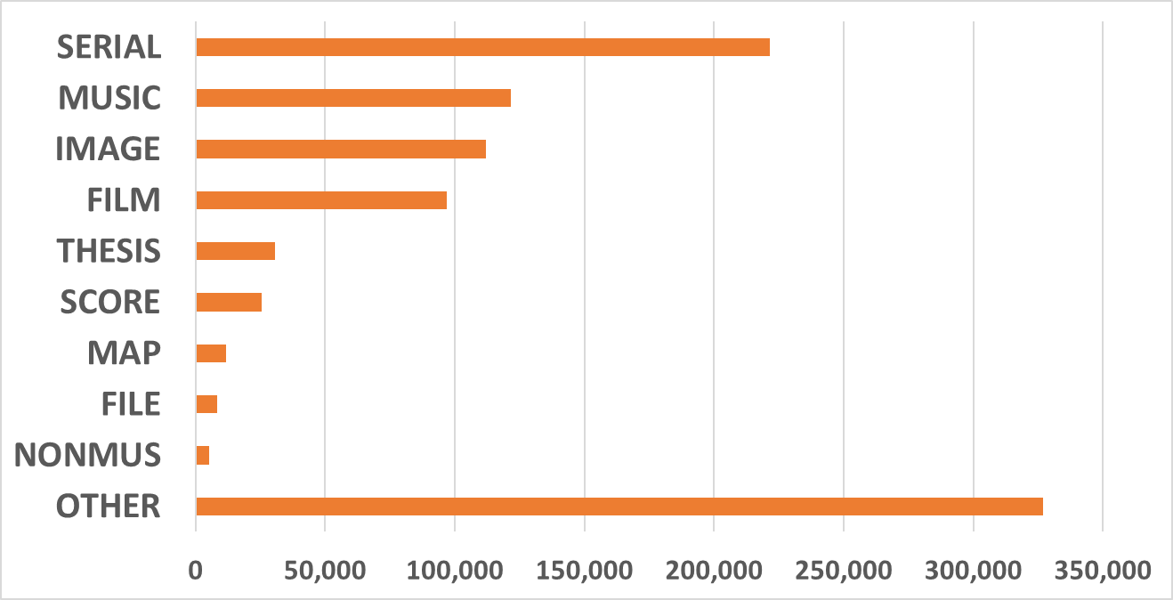
Distribution of Material Types (# of publications)
7.6 million books
Notes:
Here’s a look at the distribution of material types in the proxy collection. The thing that probably sticks out the most is that the vast majority of the publications are books or book-like objects. But as you can see, there’s a wide range of other material types there too, including lots of serials, musical recordings, and images. But again, the takeaway I think is that this collection is very book-focused.

Slide 24
What’s in the proxy collection? A closer look…
Genre | # of publications
Exhibition catalogs | 675,116
Auction catalogs | 143,460
Artist files | 129,550
Artists books | 25,465
Trade catalogs | 10,396
Catalog raisonnes | 8,968
Prints | 5,212
Photo books | 4,922
Zines | 2,716
Data from analysis of 655 field
Notes:
Drilling down a little deeper into the content of the proxy collection, we wanted to look at kinds of materials frequently found in art research collections. We identified a list in consultation with some experts suggested by our advisory committee, and then tried to identify them in our proxy collection, mainly by analyzing data in the 655 field. As you can see, exhibition catalogs, auction catalogs, and artist files are particularly evident, especially exhibition catalogs: nearly 700,000 of those across the holdings of our 85 proxy group members. The zines genre is interesting as well – it looks like at least some art research libraries have focused some of their collecting activity on this relatively new genre of materials.

Slide 25
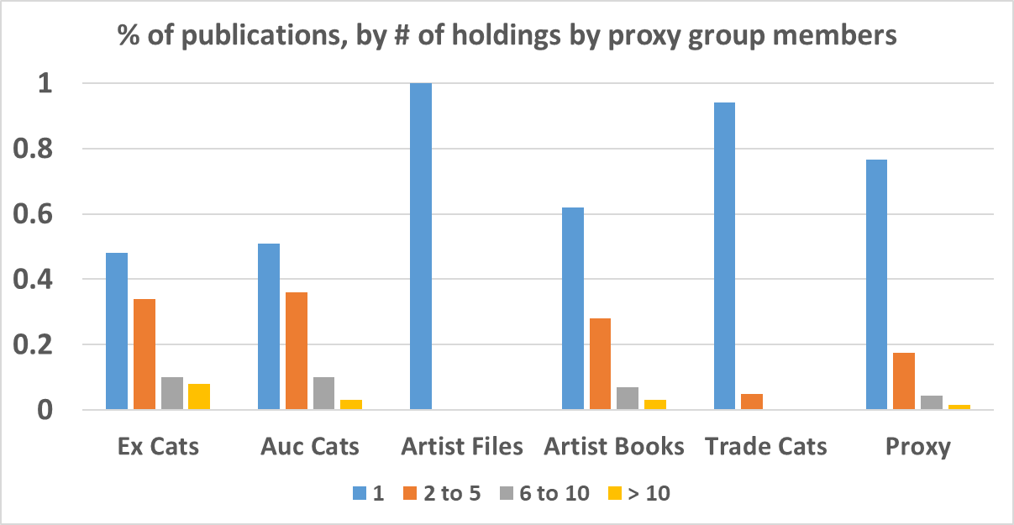
Holdings overlap by material type
Notes:
We thought it would be interesting to calculate the holdings overlap within the proxy group in terms of some of those materials particularly relevant to art research collections that we saw on the last slide. Here are the holding overlaps for the top five material genres on that list: exhibition catalogs, auction catalogs, artist files, artist books, and trade catalogs.
For reference, we also have the holdings overlap that you’ve already seen for the overall proxy collection. So blue bars are publications held by one group member, orange bars are two to five members, gray bars are 6 to 10, and yellow bars are more than 10.
I think the big takeaway here is that when you drill down and look at more focused categories of materials within the proxy collection, you get a pretty diverse range of holdings overlap patterns, with some materials more widely held than average, and others less widely held. For example, the dotted red line in the picture reflects the percentage of the overall proxy collection that is held by a single group member. As you look across the different material types, you see that some have a blue bar that exceeds that benchmark, and others have one that falls below it. This is a nice illustration that within the collective collection there is opportunity for cost savings by reducing redundancies, as well as leveraging complementarities by increasing the visibility of materials unique to a particular institutional collection.

Slide 26
Subjects: A brief look
Church Architecture
42,132
African-Americans
54,209
Proxy Art Research Collective Collection
Silverwork
27,813
Women Artists
33,490
Video Art
23,999
Cows in Art: 173
Based on analysis of 650 field, FAST/LCSH
Notes:
Finally, here is a glimpse of some of the subject headings collected within the proxy collection. We are still in process of looking at our subject analysis, eciding what is particularly interesting and relevant. So in the interest of time today, I skipped over the expansive, generic subject headings like “art”, “architecture”, or “painting”, and instead featured a few more specialized headings, along with the total holdings associated with them in the proxy collection. So for example, there were more than 54,000 holdings associated with the heading “African-Americans”, and almost 28,000 holdings associated with “Silverwork”. And we are happy to report there were exactly 173 holdings associated with the heading “Cows in Art”!
This kind of data offers some clues as to the subject strengths of this collective collection, as well as areas of collecting interest for art research generally.
So this gives you a sense of the kinds of analysis we’re doing with our proxy art research collective collection, and how we’re connecting it to partnership opportunities for art libraries and other institutions. We’ll continue to develop and utilize this analysis throughout the project.

Slide 27
Op ART: ILL DATA analysis
Notes:
And now back over to Dennis for some preliminary findings from the ILL data analysis.

Slide 28
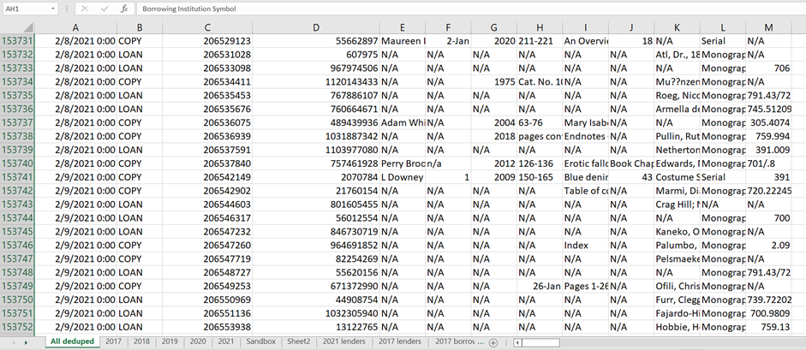
5 years of WorldShare ILL data with a Proxy Group member as borrower or lender
  158,566 total filled transactions
    104,962 originals shared
    53,604 copies shared
OpArt ILL data set
Notes:
Thanks, Chela. Equipped with a basic understanding of the Proxy Group's art research collective collection, the next step is to investigate how that collection is shared both inside and outside the group. To do this we built a data set of 5 years of all WorldShare ILL transactions where a proxy group member was either the borrower or the lender.
I've only had access to this data for a couple of weeks, but already we're learning some interesting things. For instance, between 2017 and 2021 there were twice as many originals shared by the proxy group as there were copies. Perhaps that is not so surprising when we're talking about art research materials.

Slide 29
Proxy Group ILL activity on OCLC
Shared within proxy: 15.1%
Proxy borrower only: 47.7%
Proxy lender only: 37.2%
N=158,566
Notes:
Arguably the biggest takeaway from the analysis I've done so far is that only 15% of the collection sharing done from 2017 to 2021 was done within the proxy group. I expected that number to be a bit higher. So 85% of the ILL transactions involved a library outside the proxy group. We don't fully understand what that means yet, until we take a closer look at what is being shared with outside partners, and who those partners are.
Nearly half of the transactions involve a proxy group member BORROWING from a library outside the group. So, in this data set, covering ILL transactions from 2017 to 2021, proxy group members borrowed considerably more than they loaned.

Slide 30
Proxy Group ILL, originals vs copies on OCLC
Notes:
Breaking down the data by year and comparing originals with copies clearly reveals the impact of the pandemic.
Through the first 3 years, the numbers are extremely consistent, and we see twice as many originals being shared as compared to copies.
Then 2020 arrives. For the next two years, the sharing of originals craters, while the sharing of copies holds steady and then increases.
We know anecdotally why that happened, with many libraries closed during that period and not able to access their print collections, let alone share them. The data suggests many other interesting questions that I will have to save to talk about on another day. One of those is how some art libraries that continued to lend physical items throughout the pandemic started allowing those items to be taken out of the borrower's library, where previously all such loaned items were library use only. In the name of access, longstanding policy was changed due to a global emergency. Will those new policies remain in place after the pandemic recedes? Perhaps an interesting question for the case studies.

Slide 31
Proxy group OCLC ILL activity 2017-2021 – filled requests
Who is lending? (proxy and non-proxy)
2,504 lenders
Top lender, a proxy group member, accounts for 10% of all loans in the data set
Top 15 lenders, all in the proxy group, account for 41.4% of all loans in the data set
702 (28%) loaned just 1 item in 5 years (Note: in any given year, 40% of lenders loaned 1 item)
Notes:
I spent some time learning about who is doing the sharing, or more precisely, how much of the sharing they're doing. A very few lenders did the bulk of the lending. The top 15 were all in the proxy group and accounted for over 40% of the loans. Nearly 30% of the lenders in the data set only loaned 1 item in 5 years.

Slide 32
Proxy group OCLC ILL activity 2017-2021 – filled requests
Who is lending? (proxy and non-proxy)
2,504 lenders
Top lender, a proxy group member, accounts for 10% of all loans in the data set
Top 15 lenders, all in the proxy group, account for 41.4% of all loans in the data set
702 (28%) loaned just 1 item in 5 years (Note: in any given year, 40% of lenders loaned 1 item)
Who is borrowing? (proxy and non-proxy)
2,746 borrowers
Top borrower, a proxy group member, accounts for 9% of all borrows in the data set
Top 20 borrowers, all in the proxy group, account for 54.7% of all borrows in the data set
813 (30%) borrowed just 1 item in 5 years (Note: in any given year, 40% of borrowers borrowed 1 item)
Notes:
We see similar patterns when looking at the borrowers. The top 20 borrowers were all in the proxy group and accounted for nearly 55% of the borrows.

Slide 33
Proxy group OCLC ILL activity 2017-2021 – filled requests
Who is lending? (proxy and non-proxy)
2,504 lenders
Top lender, a proxy group member, accounts for 10% of all loans in the data set
Top 15 lenders, all in the proxy group, account for 41.4% of all loans in the data set
702 (28%) loaned just 1 item in 5 years (Note: in any given year, 40% of lenders loaned 1 item)
Who is borrowing? (proxy and non-proxy)
2,746 borrowers
Top borrower, a proxy group member, accounts for 9% of all borrows in the data set
Top 20 borrowers, all in the proxy group, account for 54.7% of all borrows in the data set
813 (30%) borrowed just 1 item in 5 years (Note: in any given year, 40% of borrowers borrowed 1 item)
Top takeaways from the above:
Relatively few libraries are doing most of the borrowing and lending in the proxy group data set
Proxy group libraries are net borrowers overall within this data set
Peeking under the hood: the lending load outside the proxy group is spread mostly across a group of large North American academic libraries
Notes:
Some top takeaways from these particular numbers:
Again, a few libraries, most of them in the proxy group, are responsible for most of the action.
Proxy group members borrow more than they loan.
Looking more closely at the data, most non-proxy lenders are big North American academic libraries. But what are they lending to the proxy group? That's going to be the really interesting question to answer.

Slide 34
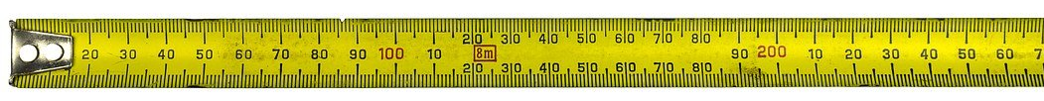
Upcoming OpArt ILL data analysis
Characteristics of the materials shared (subject, format, language, publication place and date, scarcity, etc.)
Frequent sharing partners
Regional sharing
Changes in sharing patterns over time
Unfilled requests
Comparison with a 5-year study we did in 2014 of sharing patterns of 24 OCLC RLP art and museum libraries
Notes:
None of the ILL analysis I've done so far really helps answer our questions about identifying potential collaborative opportunities.
Here are the kinds of analysis we'll be looking at next. Much of the same kinds of subject analysis we've already done with the collective collection. Favorite partners. Sharing within close proximity. How patterns do or don't change over time.
We also have unfilled requests that will be interesting to look at.

Slide 35
Next Steps
Notes:
So what's still on our OpArt to-do list?

Slide 36
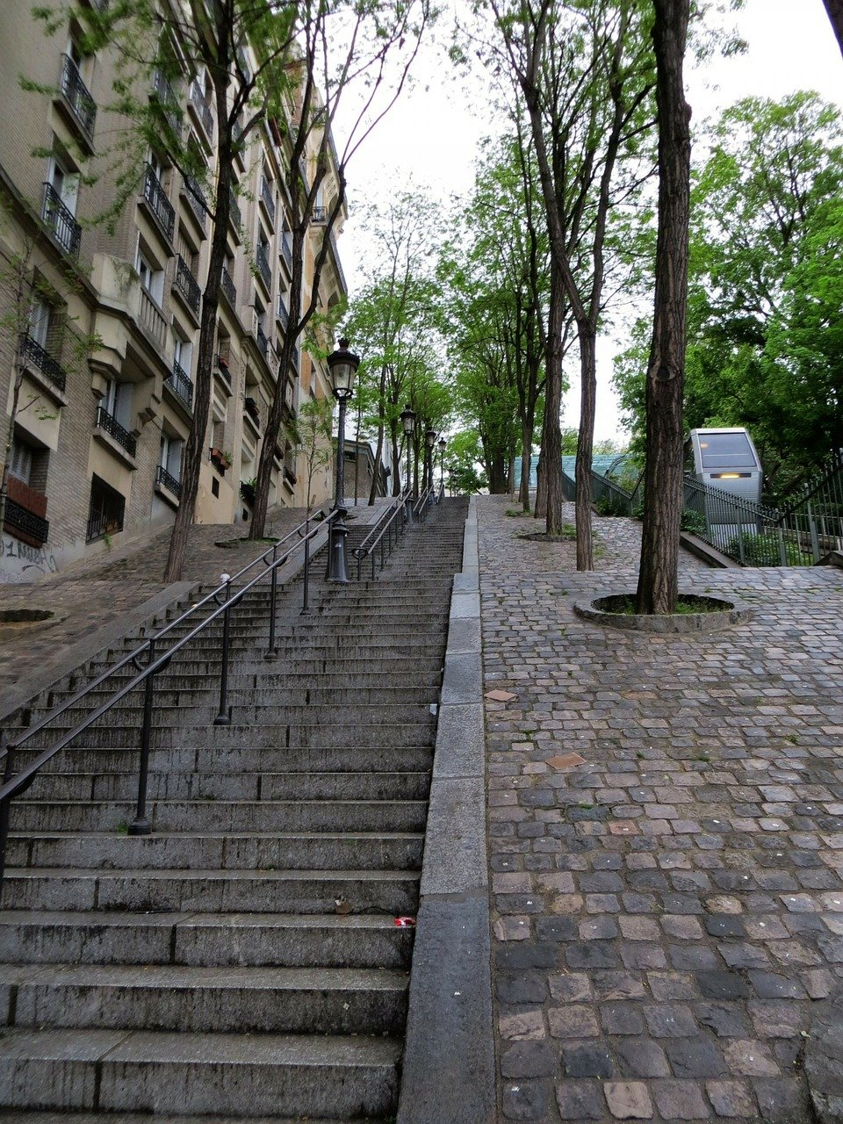
OpArt next steps
Complete Collections Analysis
Complete ILL data analysis
Publish 1st report
Partnership case studies
Synthesize, report out
Identify areas for action and further study
Notes:
Complete the data analyses, obviously. We plan to publish a report on these 2 quantitative aspects of the project sometime in the next 6 months. Then there are the other two phases of the work to be completed, the case studies and reporting out on all of our findings and recommendations. And of course identifying areas for further study.

Slide 37
OpArt next steps
Complete Collections Analysis
Complete ILL data analysis
Publish 1st report
Partnership case studies
Synthesize, report out
Identify areas for action and further study
Notes:
We've begun thinking in detail about the case studies and in fact spent our March meeting with the advisory board seeking their ideas and guidance on this next phase of the work.

Slide 38
OpArt case studies: existing partnerships
The goal of the OpArt project is to help art libraries identify potential collaborative models to address shared sustainability barriers and consider practically what institutions will need to make these models operational.
Some of the criteria we have in mind for the partnership case studies:
  2 or more organizations
  Similar or different library types
    Art and art
    Art and academic
    Art and public
  Might partnerships in other domains provide insight?
Notes:
Again, everything we're doing is in service of identifying and documenting potential collaborative models for art research libraries. We know of a few existing partnerships that might make for good case studies. We've already sought the advice or our advisory board and in fact are here today seeking your advice, too.
You see some of the criteria we have in mind right here. Two or more libraries – duh! Could be partnerships among art libraries, or between art libraries and other types. We might even learn something essential from looking at a partnership outside the library domain.

Slide 39
discussion
Notes:
Which is a nice segue into the discussion portion of our Roundtable today.

Slide 40
Discussion questions
ILL data analysis suggestions?
Case study suggestions?
Any questions or comments about OpArt?
Notes:
Here are some questions we'd like to pose to you.
What would you like to learn from the ILL data analysis we're doing for OpArt?
Do you have ideas for partnerships that would make for good case studies? One example that drew our attention from the very beginning is the partnership between the Hirsch Library at the Museum of Fine Arts Houston and Rice University, which started out as a shared storage arrangement but evolved into truly privileged access to each other's collections. What are other examples of existing partnerships we might look at in detail?
And of course Chela and I are happy to answer questions and hear comments you have about any aspect of the OpArt project.

Slide 41
  Join our Art & Architecture Group email list https://www.oclc.org/research/partnership/lists.html
  Watch for new posts on Hanging Together https://hangingtogether.org/
  Email Chela at weberc@oclc.org
  or Dennis at massied@oclc.org
Keep in Touch!
Notes:
Ways you can get involved

Slide 42

Proxy overlap with ADGC
Without proxy group members
Proxy
Art Research
Collective Collection
Proxy
Art Research
Collective Collection
ADGC
Collective Collection
ADGC
Collective Collection
46% of proxy collection
is in ADGC collection
20% of proxy collection
is in ADGC collection
Notes:
So that moves us to the last slide, where it will be clear why we did this re-calculation of the ADGC collection without the proxy group members included. So here we’re looking at the overlap in publications between the ADGC collective collection on the one hand, and the proxy collective collection on the other. On the left, we see the overlap between the two where the ADGC collection includes all members, which means including the members that are also in the proxy group. In this case, we found that nearly half of the proxy collection is also held, or replicable, within the ADGC collection.
But we know that the ADGC membership includes a sizable cohort of institutions that are also in our proxy group, so by default there’s going to be some overlap across the collections, so a more interesting question to ask might be what is the overlap that remains if we exclude the holdings of the institutions that have dual membership in both groups. And we do that in the figure on the right, where we show that if we exclude from the ADGC collection the holdings of the institutions that are in both groups, it turns out that the ADGC collection overlaps with about 20 percent of the publications in the proxy group.
I think these results are interesting because they start to give you a sense of how collective collection analysis can help identify opportunities for partnership and collaboration – so for instance, in this example, about 80% of the proxy group collection is not held by ADGC members outside of the proxy group, and this helps highlight the differences, and possible respective strengths, of the two collections.

Slide 43
Art Discovery Group Catalogue (ADGC)
ADGC
Collective Collection
70 OCLC symbols
14.9m distinct publications
21.9m total holdings
ADGC
Collective Collection
Without
proxy group
members
55 OCLC symbols
12.7m distinct publications
15.5m total holdings
Notes:
While our proxy group of art research institutions is useful for the purposes of this research project, it’s certainly not the only grouping of institutions relevant to art research. In some of our discussions with our advisory committee, it was mentioned several times that the member institutions of the Art Discovery Group Catalog would be an interesting point of comparison to our proxy collective collection. So we did some basic analysis of the ADGC collective collection in terms of size and total holdings, which we then compared to our proxy group.
Starting with the green figure at the top, we calculated that the ADGC collective collection as it is represented in WorldCat, accounts for 14.9 million distinct publications, based on total holdings of almost 22 million across the group’s membership. And this was based on 70 OCLC symbols in WorldCat attributed to the ADGC’s membership.
As you can see, this is a much bigger collective collection than our proxy group – both in terms of publications and total holdings. And another important difference is that the ADGC membership is international, while our proxy group membership is confined to North America.
Now speaking of our proxy group members, there is some overlap in membership across the two groups – in fact, 15 institutions are in both groups. We thought it would be interesting to re-calculate the size of the ADGC collective collection if the holdings of those 15 proxy group members are removed, and that gives us the orange figure at the bottom of the slide. With these institutions removed, the ADGC collective collection shrinks to 12.7 million publications based on 15.5 million total holdings. So with the proxy group members removed, the ADGC collection is still bigger than our proxy collective collection in terms of publications, but slightly smaller in terms of total holdings.

