Slide 1
A vision for anti-racist and reparative description practices
Merrilee Proffitt Senior Manager, OCLC Research Library Partnership
proffitm@oclc.org / @MerrileeIam

Slide 2
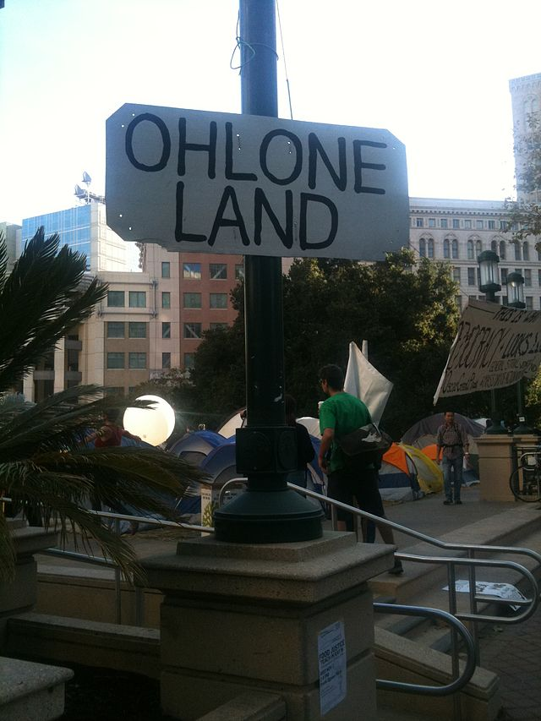
I live and work on the unceded traditional land of the Chochenyo Ohlone people, and am grateful to the past and present leaders for their stewardship of this land.
Occupy general strike 2011, photo by Rachel Librarian, Wikimedia Commons, cc-by-sa

Slide 3
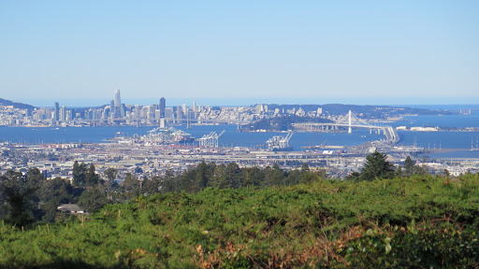

Slide 4
OCLC Research
Mission is to accelerate and scale library learning, innovation, and collaboration that make breakthroughs possible
Serving the global network of OCLC member libraries & beyond since 1978
Devoted exclusively to the challenges facing libraries and archives

Slide 5
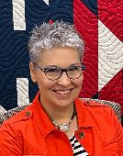
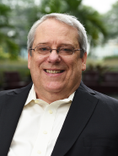
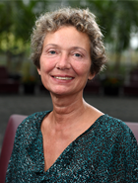
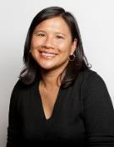
OCLC Research Library Partnership
Activities are led by an energetic team who work with member institutions to develop an array of programming for both senior library leaders and staff, virtually and in person.

Slide 6
Reparative / anti-racist description
My experience level is…
I consider myself experienced
I have done some work in this area
I’ve attended some training
I am here to learn

Slide 7
I’ve read the report in detail
I’ve skimmed the report
I’ve heard of the report
I am here to learn about the project / report

Slide 8
Why is this needed?
More inclusive descriptive data drives a more inclusive discovery experience.
The community of library and archival practitioners, and other stewards of metadata are falling short of our goals to be inclusive and welcoming to all.

Slide 9
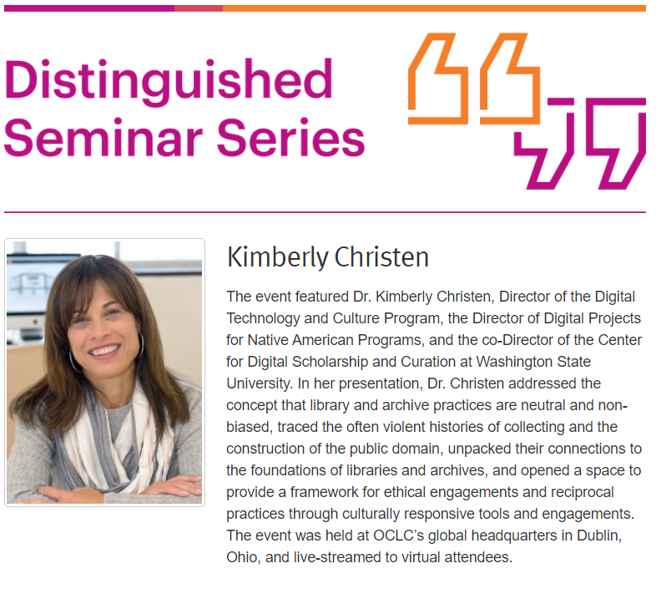
2017
“We Have Never Been Neutral: Search, Discovery, and the Politics of Access"

Slide 10
Equity, Diversity, and Inclusion in the OCLC Research Library Partnership (2017)
Survey
Most changed (ranked)
Activities and events
Recruitment and retention
Outreach to marginalized communities
Collection building
Selection of materials for digitization
Institutional website
Metadata descriptions for archival materials
Space allocation
Most planned (ranked)
Search and discovery interfaces
Metadata descriptions in library catalogs
Metadata descriptions in digital/digitized collections
Terminologies and/or vocabularies

Slide 11
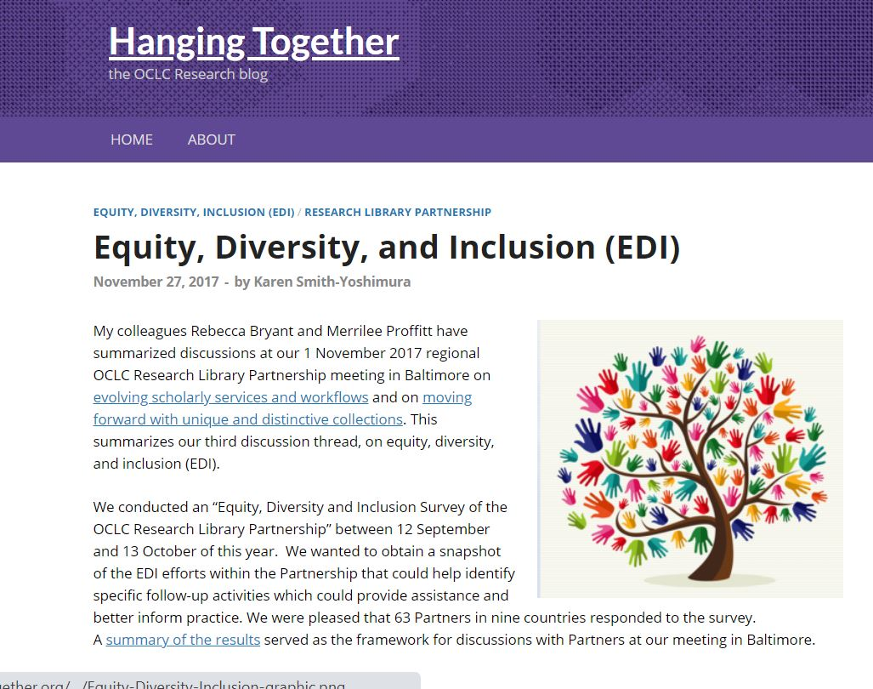

Slide 12
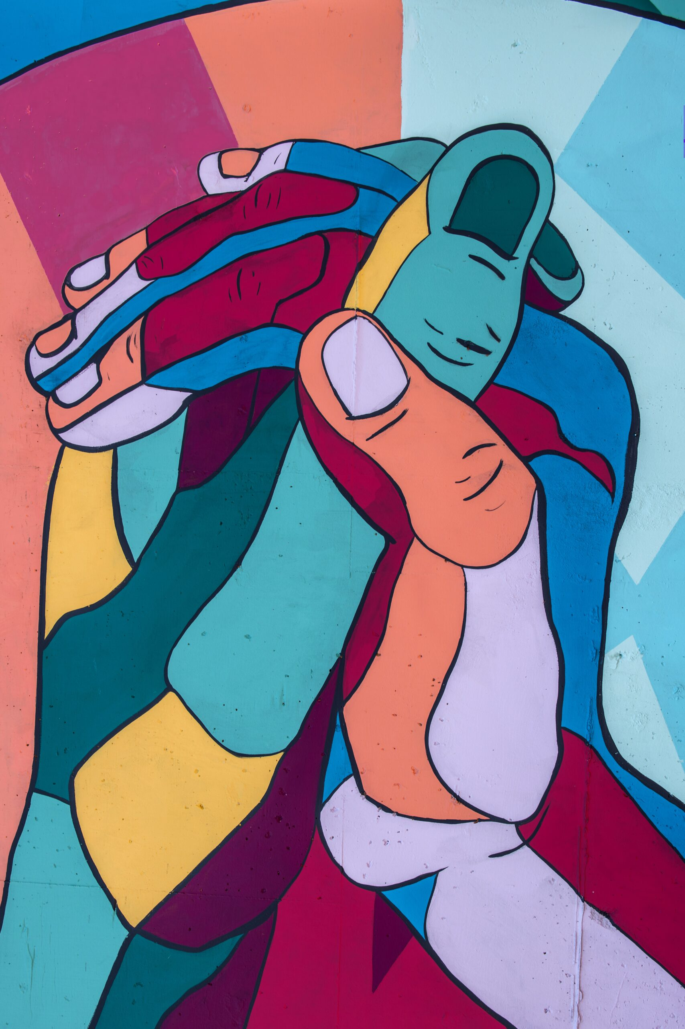

Slide 13
OCLC awarded Mellon Foundation grant
Convening in June 2021 – first step in a global conversation
Diverse group of experts, practitioners, and community members
Examine and learn from localized efforts
Gain insights into improving practices, tools, infrastructure and workflows at scale and at a community level
Develop a community agenda, which identifies the issue and maps a path forward

Slide 14
The Reimagine Descriptive Workflows Project
Convening of experts and practitioners
Published output “community agenda”
Contextual information
A framework of guidance
Undertaken with the guidance of an advisory board
Read the community agenda at https://oc.lc/reimagine-workflows-report Explore more from this project at https://oc.lc/reimagine-workflows

Slide 15
What it means to “radically reimagine”
Reimagine bring a level of creativity and problem-solving to address the challenge of transforming current descriptive practice, infrastructure, and its supporting community of practice.
Radical examine foundational, systemic changes needed to transform the profession at its core.

Slide 16
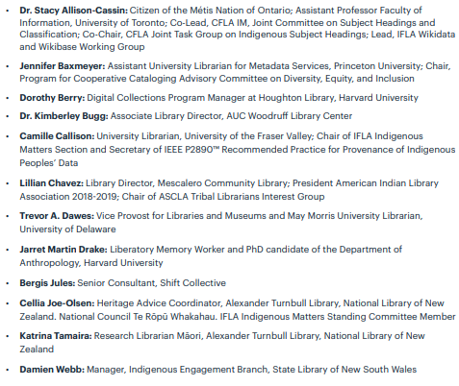
Advisory board
Prioritized areas of focus
Identified how work should be structured
Provided feedback and guided drafts

Slide 17
Goals for three days spent together
Create a safe space to share and connect honestly as humans
Lay the foundations for relationship building and repair
Building a basis for reciprocal relationships between communities and centers of power
Inspire radical thinking to rebuild a more just metadata infrastructure
Start building a concrete roadmap for change in the sector and keep conversation going

Slide 18
Framework of guidance
Descriptive practice reflects library practice.
Solutions rely on organizations and individuals (at all levels) changing practice and culture.
This is not a set of problems for catalogers (alone) to solve
This is not a set of problems for people of color (alone) to solve.

Slide 19
Framework of guidance
Organizational shifts Changes at the institutional and organizational level in terms of restructuring priorities, budgets, and staffing that require investment from leadership.
Operational workflows Changes needed in day-to-day practice. These changes require support from institutional policy, priorities, and funding. Organizational leadership needs to support mid-level managers and practitioners in implementation.
Professional and personal development Investment in education and mind-shift. This work is for everyone in the organization, regardless of role, and must be ongoing.

Slide 20
Organizational shifts
Organizational shifts Changes at the institutional and organizational level in terms of restructuring priorities, budgets, and staffing that require investment from leadership.
Commit to the long game Ongoing effort, supported by shifts in budget allocation, staffing, workflows. This shift is best achieved when it is supported by a critical mass of institutions throughout the ecosystem.

Slide 21
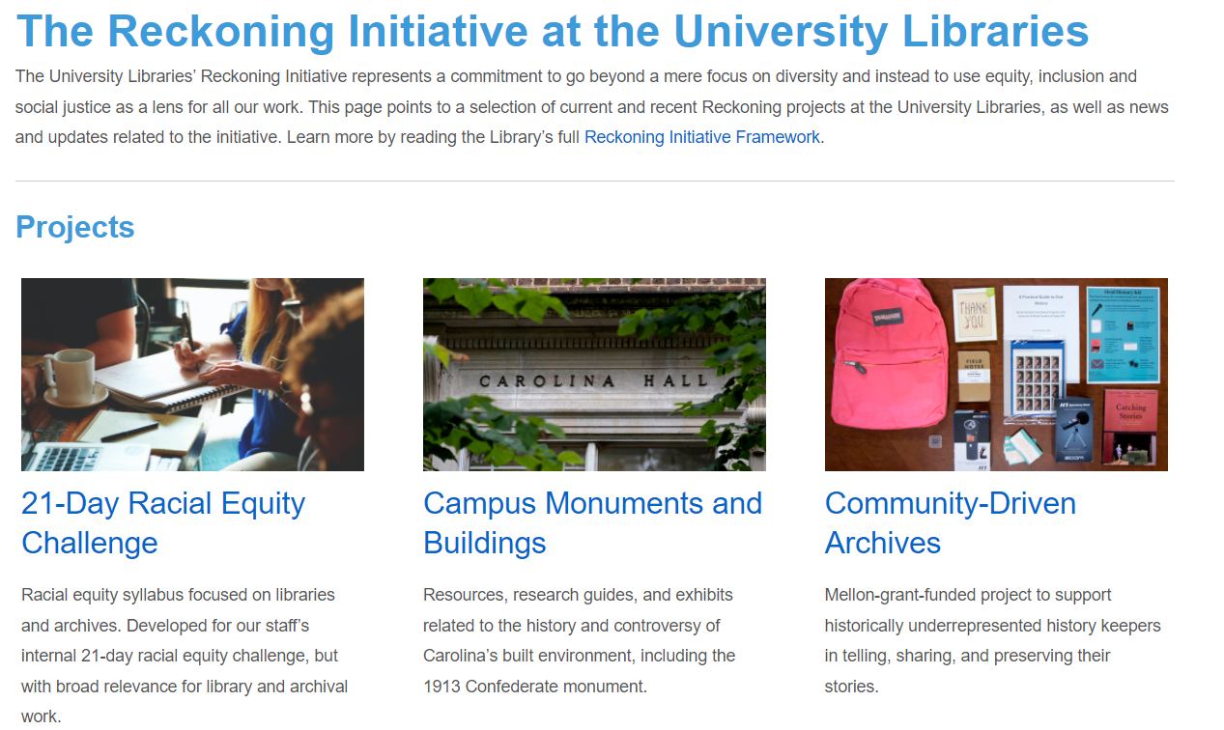

Slide 22
Operational workflows
Changes needed in day-to-day practice. These changes require support from institutional policy, priorities, and funding. Organizational leadership needs to support mid-level managers and practitioners in implementation.
Support new values A feedback process built into library discovery layers that would allow users to report problematic language in library catalogs.

Slide 24
Operational workflows
Changes needed in day-to-day practice. These changes require support from institutional policy, priorities, and funding. Organizational leadership needs to support mid-level managers and practitioners in implementation.
Promote respectful, reciprocal, community codesign Community engagement approaches that are non-extractive, community centered, and stewardship based.

Slide 26
Framework of guidance
Professional and personal development Investment in education and mind-shift. This work is for everyone in the organization, regardless of role, and must be ongoing.
Create systems of support Build strong and multilayered structures of support for people. Mentoring is needed. Recognition, buy-in, and funding from organizations and individuals with power and influence at all levels are critical.

Slide 27
Outcomes

Slide 28
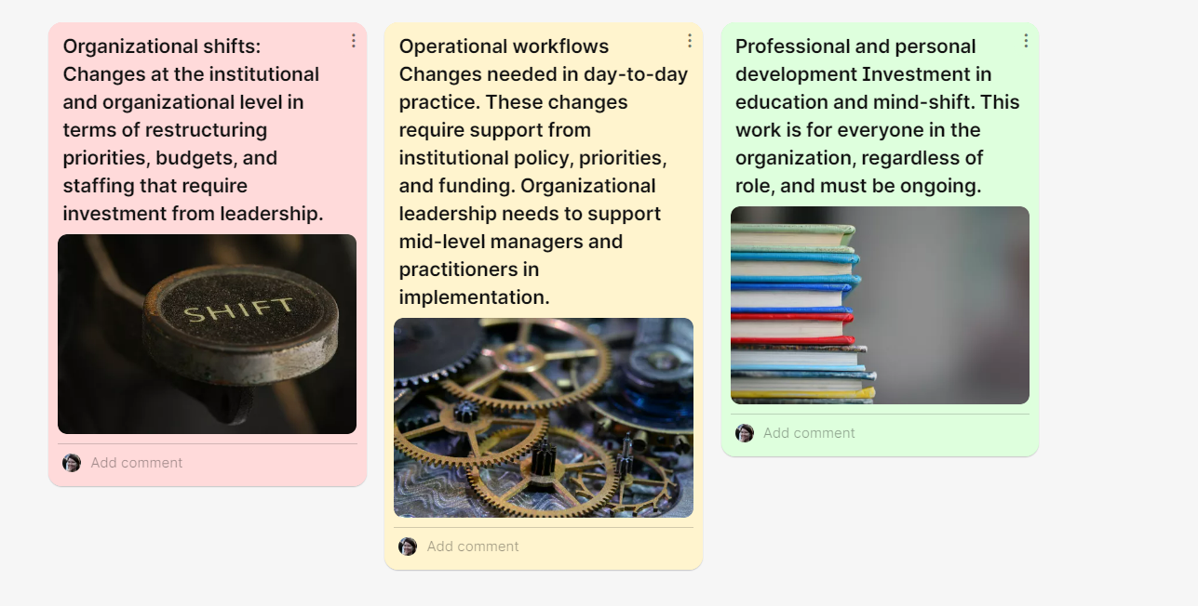
Your work or ideas? Please share!

Slide 29
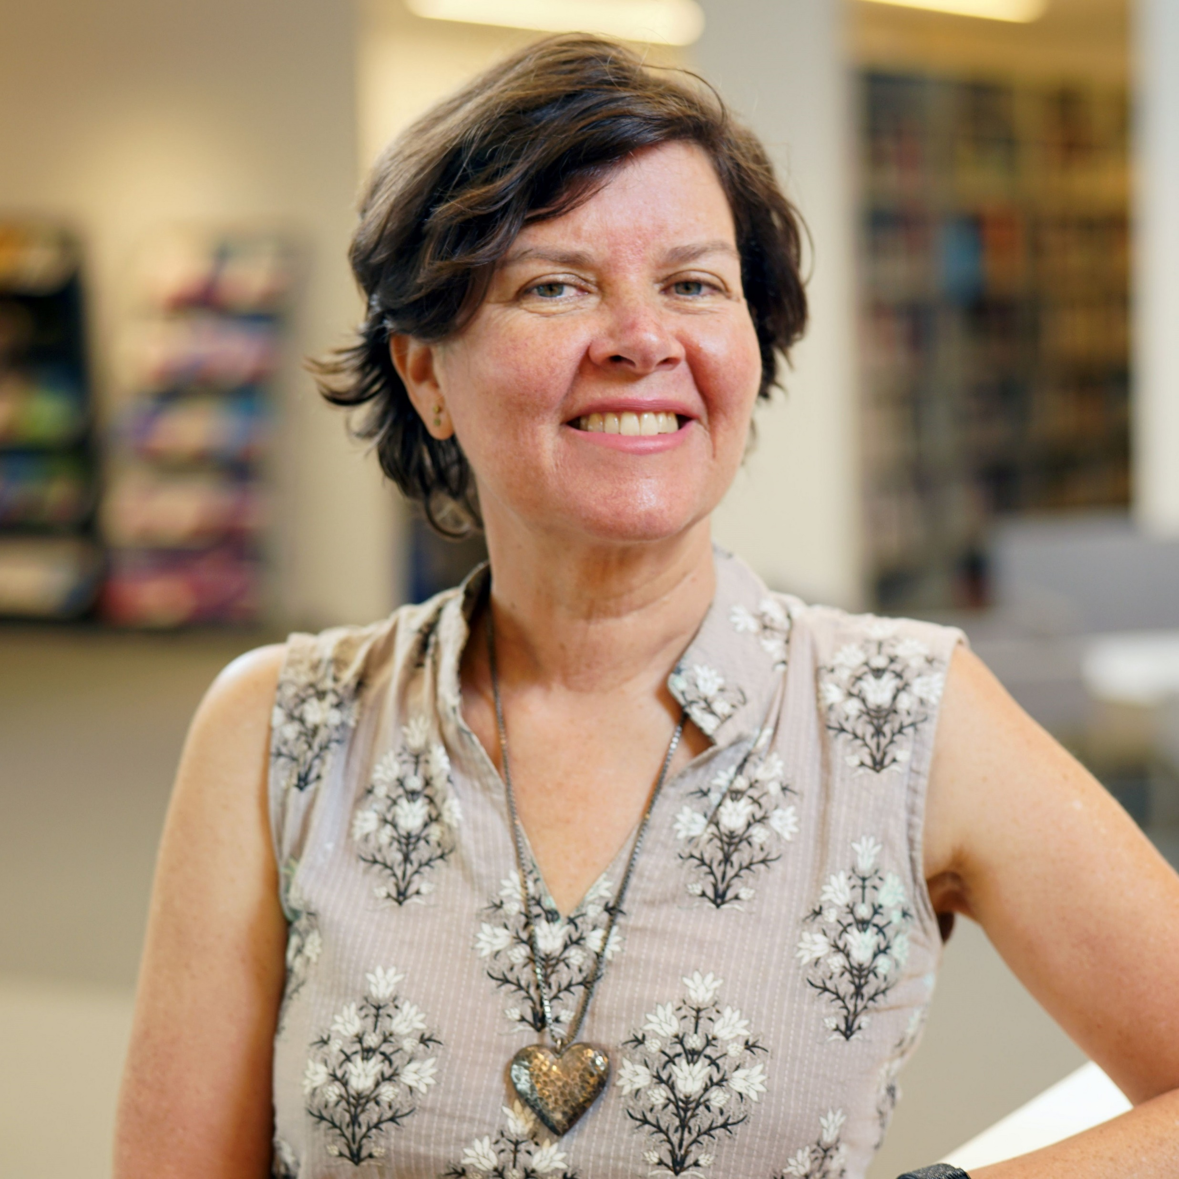
Thank you
I look forward to discussion!
Merrilee Proffitt
Senior Manager
proffitm@oclc.org

