Slide 1
Imagining a Shared Future for Archival Discovery:
Research findings and paths forward from the Building a National Archival Finding Aid Network project
RBMS 2022
https://confluence.ucop.edu/display/NAFAN
This project was made possible in part by the Institute of Museum and Library Services, through grant LG-246349-OLS-20. The IMLS is the primary source of federal support for the nation’s libraries and museums.
Notes:
Speaker Order with speaker time 6-8 mins (join 20 mins ahead of session)
Adrian
Merrilee
Lesley
Itza
Adrian

Slide 2
Project context
Adrian Turner (he/him)
Senior Product Manager
California Digital Library
Notes:
[Adrian]

Slide 3
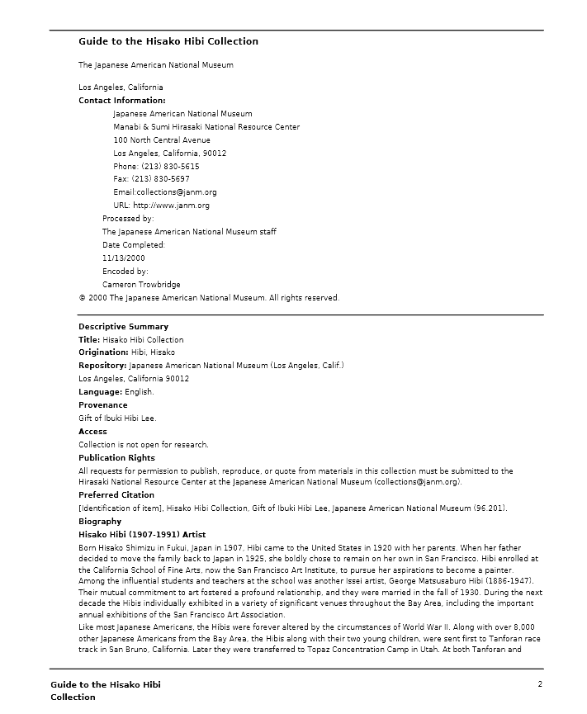
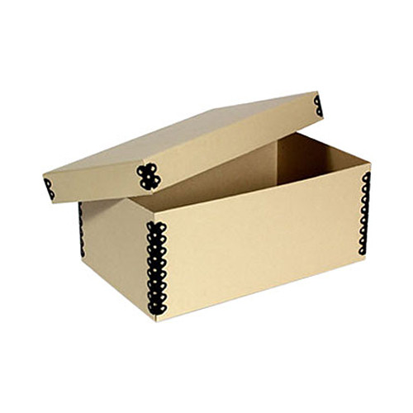
Researchers
Finding aids

Slide 4
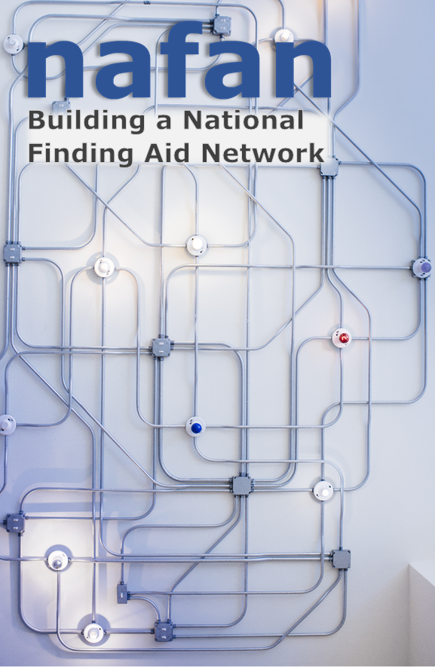
Vision
NAFAN is a 2-year IMLS funded research and demonstration project to create a “blueprint” for a national finding aid network
Goals:
Support the broadest possible range of contributing institutions and minimize barriers to participation
Scale researcher discovery and access to a broader range of collections
Create a network is community-driven, community-sustained, and community-governed
Notes:
[Adrian]

Slide 5
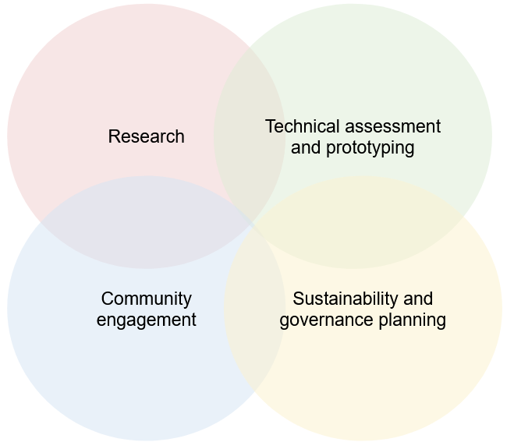
Activities and Timeline
Current R&D phase (2020-2022+)
Launch and maintenance (post-2023)
Notes:
[Adrian]

Slide 6
RBMS 2022
NAFAN Research Overview
Notes:
Merrilee

Slide 7
OCLC Research Team
Chela Scott Weber (she/her)
Senior Program Officer
OCLC Research Library Partnership
Lynn Silipigni Connaway, Ph.D. (she/her)
Director of Library Trends and User Research
OCLC Research
Lesley A. Langa, Ph.D. (she/her)
Associate Research Scientist
OCLC Research
Merrilee Proffitt (she/her)
Senior Manager
OCLC Research Library Partnership
Itza A. Carbajal (she/her)
Associate Researcher
OCLC Research
Bruce Washburn (he/him) - retired
Software Engineer
OCLC Research
Notes:
Merrilee

Slide 8
Research Advisory Working Group
Adrian Turner, California Digital Library (NAFAN) Bergis Jules, Shift Collective (NAFAN) Bill Stingone, New York Public Library Chela Scott Weber, OCLC (Lead) Derek Mosley, Auburn Avenue Research Library on African American Culture and History, Atlanta-Fulton Public Library Hillel Arnold, Rockefeller Archives Center | Holly Mengel, University of Pennsylvania - Kislak Center (PACSCL) Lesley Langa, OCLC (Lead) Lydia Tang, Michigan State University Molly Bruce Patterson, Rhode Island College (RIAMCO) Rachael Hu, California Digital Library (NAFAN) Rachel Walton, Rollins College Ricky Punzalan, University of Michigan
Notes:
Merrilee

Slide 9
Research Goals Summary
Initiate research to gain a current understanding of the needs of both researchers and cultural heritage institutions regarding finding aid aggregation.
Today!
Evaluate the quality of existing finding aid data at scale in order to scope the network's initial functionality to the specific existing characteristics of the data and lay the groundwork for iterative data remediation and expanded network features in subsequent phases.
Notes:
Merrilee

Slide 10
Research Sources
Researchers
Cultural Heritage Institutions
Finding Aid Data Quality
Notes:
Merrilee

Slide 11
Focus group interviews with archivists: overview and preliminary findings
Notes:
Merrilee

Slide 12
Aggregation Contributor Research Questions
What are the enabling and constraining factors that influence whether organizations describe the archival collections in their care?
What are the enabling or constraining factors that influence whether organizations contribute to an aggregation of archival description?
What value does participation in an archival aggregation service bring to organizations?
Notes:
Merrilee

Slide 13
Final Protocol
Please tell us about your role in working with archival collections at your institution.
Please tell us briefly about how archival description gets produced and published in your institution.
This question focuses on producing and publishing archival description where you work. What are the things that make producing and publishing archival description in your home institution easy or difficult? What are the things that support this work and make it easier, either that you have now or would like to have?
Notes:
Merrilee

Slide 14
Final Protocol (continued)
Think about your current process / the hypothetical scenario where your home institution would contribute to an archival aggregation platform. What about the process is/would be easy? What about the process is/would be difficult?
What makes/would make participation in a finding aid aggregation valuable for your institution? What makes/would make your participation in a finding aid aggregation valuable for your researchers? Do you think there are other things an aggregator could offer that would be valuable to your institution or researchers?
If you had a magic wand and could create your ideal national-scale finding aid aggregation system, how would it work and what would it do?
Notes:
Merrilee

Slide 15
Focus Group Interview Summary
10 focus groups
52 participants total
24 participating in aggregation
28 not participating in aggregation
Representing 27 states and District of Columbia
Divided into five group types
Leadership / Administrative
Public Services & Tech Services, small institution
Public Services & Tech Services, large institution
Technical Services & Systems Responsibilities
Very Small Institution / Lone Arrangers
Notes:
Merrilee

Slide 16
Participants by Archive Type (self-reported)
Academic archive | 22
Museum library / archive | 11
Government archive | 6
Public library archive | 4
Community archive | 4
Historical society archive | 3
Independent research library | 2
International organization | 1
Performing arts archive | 1
Regional archive | 1
Notes:
Merrilee

Slide 17
Participants by US Region
11 total
8 total
13 total
2
11
9
3
5
2
2
14
4
20 total
Notes:
Merrilee
US Census Regions and Divisions map from https://www.eia.gov/consumption/commercial/maps.php#census
https://hangingtogether.org/nafan-focus-groups-aligning-participant-selection-with-project-values/

Slide 18
Four Themes
Things that constrain creating archival description
Things that enable creating archival description
Incentives to participate in aggregation (current or perceived)
Disincentives to participating in aggregation (current or perceived)
Notes:
Merrilee
These four themes collapse the six we started with and better align with the research questions.
Theme 1: Circumstances, resources, or realities that prevent the archivist or institution from creating archival description. Use these codes only for the creation of archival description, not to capture what is said about sharing or contributing description to an aggregator/aggregation.
Theme 2: Circumstances, resources, or realities that facilitate the archivist or institution in creating archival description. Use these codes only for the creation of archival description, not to capture what is said about sharing or contributing description to an aggregator/aggregation.
Theme 3: Things people like or value in a current or imagined aggregation or that would help convince them to contribute to the aggregation.
Theme 4: Things people dislike or are frustrated by in a current or imagined aggregation or that would prevent them from contributing to the aggregation.

Slide 19
Description constrainers
Complex workflows / workarounds (n=29)
Dealing with legacy description (n=19)
Lack of control over IT / software (n=16)
Description enablers
Collection Management Systems (n=21)
Worksheets / templates (n=14)
Documentation / manuals (n=8)
n=number of focus group interview participants ​
Notes:
Merrilee

Slide 20
Incentives to participate
Increased visibility / awareness of collections (n=25)
Uncovering connections between collections (n=22)
Ease of contributing records in an automated way (n=21)
Disincentives to participate
Data requirements (n=19)
Difficult to edit / update records(n=14)
Difficult to submit records (n=8)
n=number of focus group interview participants ​
Notes:
Merrilee

Slide 21
User/Researchers
Notes:
Lesley
Hi my name is Lesley Langa and I work in OCLC Research on the Library Trends & User Research team. I’ll be focusing on a different part of the research we’ve undertaken to delve into the users of archival aggregators.

Slide 22
Who are the current users of finding aid aggregations? Do they align with the persona types and needs identified in recent archival persona work?
What are the benefits and challenges users face when searching for descriptions of archival materials within finding aid aggregations?
Researchers: Research Questions
Notes:
Lesley
Based on prior literature we know very little about archival aggregator users. There are personas that exist for prior projects on users of archival discovery systems, and the Online Archive of California performed an evaluation some time ago, and so we went into this project wanting to get a much fuller picture.
Personas from Stanford, Rockefeller, Orbis Cascade Alliance
Stanford University Libraries, Georgia Tech, and University of Michigan. (2017). ArcLight Personas. Stanford Digital Repository. Available at: https://purl.stanford.edu/hk349dn1751

Slide 23
Data that describe need
Demographics: where are researchers located? How old are they? What is their profession?
Purpose for researching: Why are they using the aggregation site?
Behaviors: How frequently do they visit the site? Do they use other sites for their search? If yes, which ones?
Notes:
Lesley
Here you can see what we’re looking to know. This will help us to know what kinds of information drew them to an aggregation site, what their next steps may be, and the functionality that they desire in the new NAFAN platform.

Slide 24
Purpose
Capture data on users of online aggregators
Identify potential interviewees for qualitative analysis
Design
Hosted by 12 aggregators
Convenience sample
Opt-in
Opened March 18 - Closed on May 31
~3,300 responses
Survey
Methods
Notes:
Lesley
The purpose of the survey was to capture data on users of aggregators. Previous studies of this nature generally looked at individual archives themselves, rather than across aggregators, and were generally smaller N than we wanted for this project. We designed and launched a pop-up survey for users that we placed on the websites of each extant archival aggregator. The survey was designed to do two things, first provide descriptive statistics of users, and second to identify potential interviewees.
The survey was hosted by 12 aggregators. It opened on March 18, 2021, and closed on May 31. The sample was a convenience sample, with users opting in, rather than a randomized sample. Future research could use a random sample, but given the lack of large N studies on this, we felt that a convenience sample was a good starting point. We ended up with over 3,000 responses, which as a higher number than we were even expecting.

Slide 25
Demographics
How the user found the aggregator
Purpose for research
Type of material wanted for research
Preference for digital vs. physical materials
Impact of COVID on research
Survey
Questions
Notes:
Lesley
In the survey, we asked questions about demographics such as profession, age and gender. We asked how they found the aggregator. We asked what the purpose of their research was, the type of material they wanted, whether they wanted it physically or digitally, and whether COVID has impacted their archival use.

Slide 26
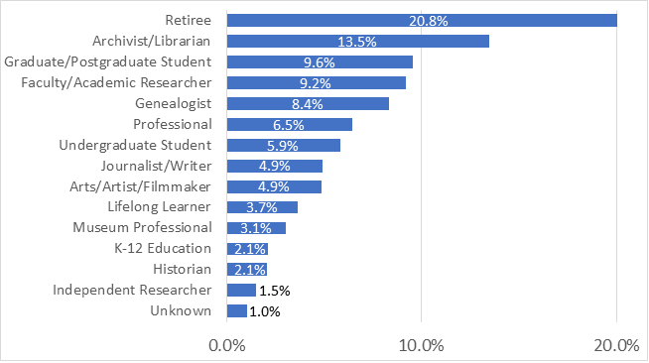
Pop-up Users, by profession
Notes:
Lesley
Across our users, we had a high percentage of respondents that self-identified as retired. In the bar chart on this slide for professions of users ranked by percentage, they appear at the top of our distribution at 20.8%. The next highest ranked profession is archivists and librarians at 13.5% followed by graduate students and post graduate students and faculty or academic researchers that are roughly the same at 9.6% and 9.2%, respectively. Genealogists are ranked fifth at 8.4%.
The remaining 10 professions are 6.5% or less of our respondents. The range of professions include journalist, historian, independent researcher, museum professional, artist, tradespeople, lawyers, lifelong learner and K-12 educators and parents.

Slide 27
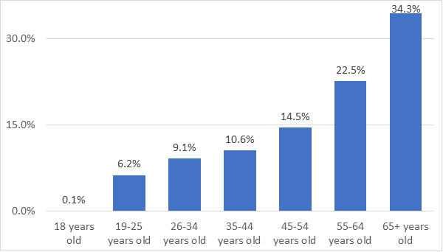
Pop-up Users, by age
Notes:
Lesley
This bar chart shows the distribution of respondents by age with users in each age group from 18 years of age up to 65 years and older.
The largest group of respondents is 65 years and older at 34.3%. With a large percentage of retired users, this is not so surprising. The next largest group of respondents is the 55 to 64 years of age at 22.5% followed by the 45 to 54 age group at 14.5% of respondents. Respodents 44 years of age and younger make up 10% or less of the users.

Slide 28
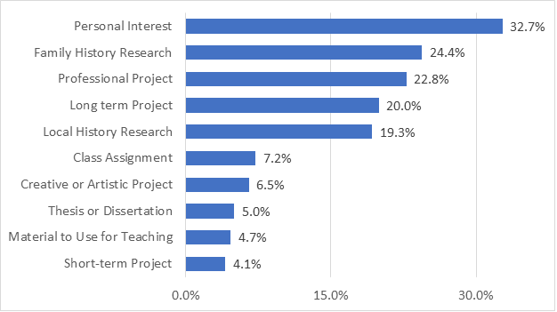
Pop-up Users, by project purpose
*Percentages do not sum to 100%
Notes:
Lesley
We asked participants about their research habits and why they came to the aggregation website. Respondents could select all of the response option, which is why the chart does not sum to 100%.
You can see in the bar chart on this slide that 32.7% of respondents indicated that their project purpose was a personal interest. The next four project purpose categories are strong reasons why respondents came to search at the aggregation websites. Family history research projects make up 24.4% of the reason respondents are searching aggregation websites. Projects that respondents are doing as a part of their professional responsibilities makeup 22.8%. Long term projects that can take months or years to complete make up 20% and 19.3 % of respondents are conducting local history research.

Slide 29
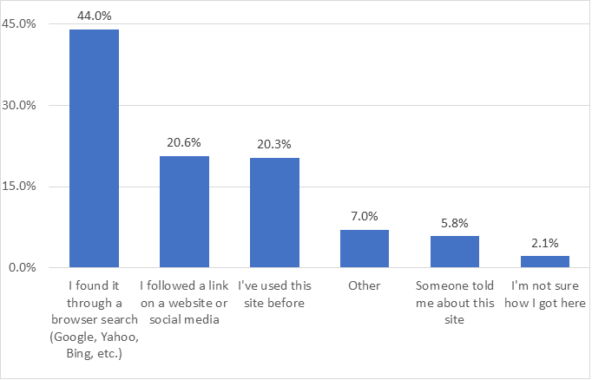
How Pop-up Users Found the Archival Aggregator Website
Notes:
Lesley
Nearly half of the NAFAN pop-up survey respondents indicated that they found the archival aggregation site where they are conducting research through a browser search. Roughly 20% of respondents indicated that they found the aggregation site through a link from another website or social media and/or know the aggregation website and have used the site before.

Slide 30
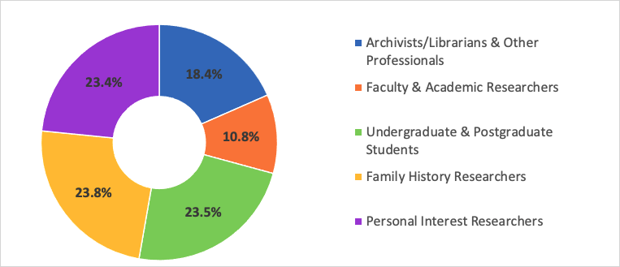
TwoStep Cluster Method
Notes:
Lesley
To identify the individuals we wanted to invite for interviews, we performed further analysis on the survey data. Specifically, we wanted to categorize users into buckets that takes into account how similar they are to one another by characteristics like their project purpose and their profession.
The TwoStep Cluster Analysis procedure is an exploratory tool designed to reveal natural groupings (or clusters) within a data set that would otherwise not be apparent. The algorithm employed by this procedure has several desirable features that differentiate it from traditional clustering techniques:
The ability to create clusters based on both categorical and continuous variables.
Automatic selection of the number of clusters.
The ability to analyze large data files efficiently.
With over 3,000 users in the survey, the cluster analysis was a suitable method. You can see in the top chart on the left that the silhouette measure was “fair” making this analysis a good fit for our data. While moving into “good” is desirable, it’s hard to do with real world data from a convenience sample, like our survey. We feel satisfied with this approach and you can see that it provided useful cluster categories in the donut chart in the middle of the slide.

Slide 31
NAFAN User Clusters
Archivist/Librarian & Other Professionals (N=559) – public and technical service archivists/librarians, journalists, writers, tradespeople
Faculty and Other Doctoral Degrees (N=328) – faculty, post-doc, independent researcher, museum professionals
Family History Researchers (N=722)– local history, professional genealogist, hobby genealogist
Personal Interest Researchers (N=711) – general search with a range of profession and education
Undergraduate and Postgraduate Students (N=712) – Indicate their profession is undergraduate/postgraduate student
Notes:
Lesley
Here’s a more detailed look at the clusters to show you the types of users that are grouped into each. From prior persona studies, we knew that archivists, faculty, and students were common users. What we found in this survey data is a high presence of personal interest and family history interest groupings in our user population.

Slide 32
Individual Interviews
Sampled from pop-survey participants
Semi-Structured, Virtual, 1-1, 45-60 minutes
25 interviews, 5 per persona type
Archivist/Librarian, Faculty and Doctoral Degrees, Family History Researcher, Personal Interest Researcher, and Undergraduates/Postgraduates
Interviews transcribed and collected July to August 2021
Codebook developed through inductive/deductive approach March - June 2022
Coding ongoing through July 2022
Findings unveiled Sept-Dec 2022
Interview Research Methods
Notes:
Itza
Building off analysis on user cluster types, individuals were invited to share their individual experiences.

Slide 33
Who are the current users of aggregated archival description?
Do current user types align with the persona types and needs identified in recent archival persona work (i.e., what characteristics are present
vs not)?
Why are the current users trying to discover and access archival collections via aggregation of archival description?
How are current users discovering and accessing aggregations of archival description?
What are the benefits and challenges users face when searching archival description in aggregation?
Interview
Research Questions
Notes:
Itza
Practices are changing in the evolving digital research environment, which can be attributed to changing contexts, situations, and environments.
(Connaway, White, Lanclos, and Le Cornu 2013; Connaway, Lanclos, White, Le Cornu, and Hood 2012)
Motivation: determine the information-seeking behaviors and research practices of scholars using primary sources beyond the traditional academic researcher from field like the humanities (Rhee 2015) Recent work on archival user personas at multiple intuitions indicate that users of archives are not academic scholars but also genealogists, local historians, hobbists, creatives from fields such as journalism, film, writers; as well as public services librarians and archivists. This data and findings aim to identify the different contexts, situations, and behaviors of end-users both in regards to aggregators as well as other archival information seeking systems.

Slide 34
What future directions would users want archival aggregators to take?
What other tools are users using to discover or access archival materials and
description?
Interview
Supplemental Research Questions
Notes:
Itza
Motivation: There is a significant gap in the literature in understanding researcher needs related to aggregations of archival description

Slide 35
Interview
Preliminary Insights
Users utilize a variety of non-aggregator sources to locate archival resources.
Majority of users fail to to recognize or remember specific archival aggregator sites.
Pandemic aftermath heavily influences user behaviors and potential outcomes
Decision making factors play a key role in how and if users pursue archival resources (in person or online)
Notes:
Itza
Motivation: There is a significant gap in the literature in understanding researcher needs related to aggregations of archival description

Slide 36
Persona types heavy overlap or lack of clarity in distinctions between previously identified roles
Users struggle to recognize or remember specific archival aggregator sites.
COVID-19 pandemic restrictions introduce extraordinary circumstance behaviors and responses (from both user & institution)
Interview Research Challenges
Notes:
Itza

Slide 37
Interview Research Next Steps
June - July 2022 - Thematic coding
Aug 2022 - Data analysis of coded dataset
Sept. thru Dec. 2022 - Share findings via OCLC webinar and online posts
Notes:
Itza

Slide 38
Looking Ahead
Synthesis and reporting on research and community workshop findings
Engagement on design model, functional requirements, and sustainability plan
Next steps to build and launch the network
Notes:
[Adrian]

Slide 39
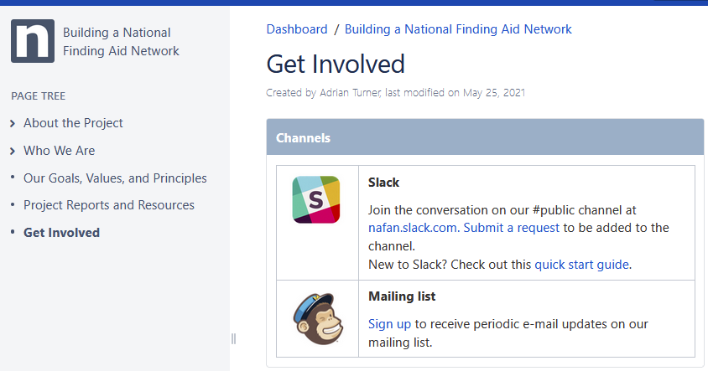
Get Involved
Subscribe to our mailing list for updates
Stay tuned for upcoming info sessions
Feel free to contact us with any questions at nafan@ucop.edu
https://confluence.ucop.edu/display/NAFAN
Notes:
[Adrian]

