Slide 1
SCONUL Project - Libraries after Lockdown: The Dynamic Workforce, 28 June 2022
Evolution of the Working Environment: Visions of a New Model Library
Ixchel M. Faniel, Ph.D.
Senior Research Scientist
OCLC Research

Slide 2
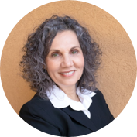
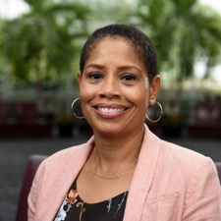
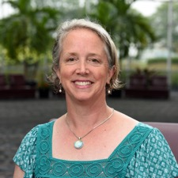
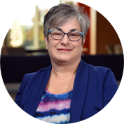
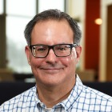
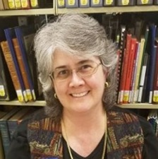
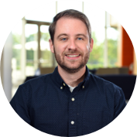

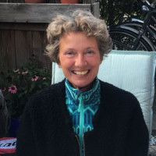
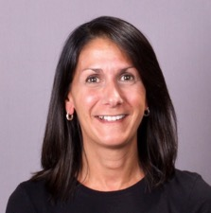
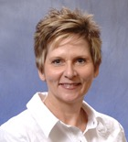
Project Team
Notes:
This project is a collaboration between OCLC Research, the Research Library Partnership, and colleagues in Market Research. As you can see, there are a lot of folks who have been involved in this project, and it wouldn’t have been possible without them.

Slide 3
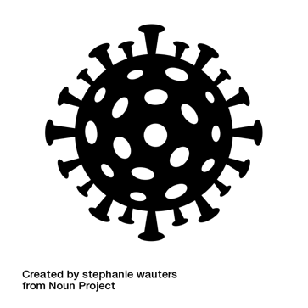

How will the pandemic change
the library model?
?
+
=
Notes:
The goal of this project is to identify the challenges and opportunities brought on by COVID-19. We are interested in how a group of library leaders are responding to the pandemic and what new library models might emerge as a result of the social and economic changes brought about or accelerated by the pandemic.
What we mean by library model is the essence or archetype of what libraries are and how they function. I’m sure that we’re all familiar with the traditional library model, that the library equals books. That’s been a particularly persistent model, both for users and for some who work in libraries as well.
I will give a high-level summary of the changes that a group of library leaders made and what those changes might mean for the future.

Slide 4
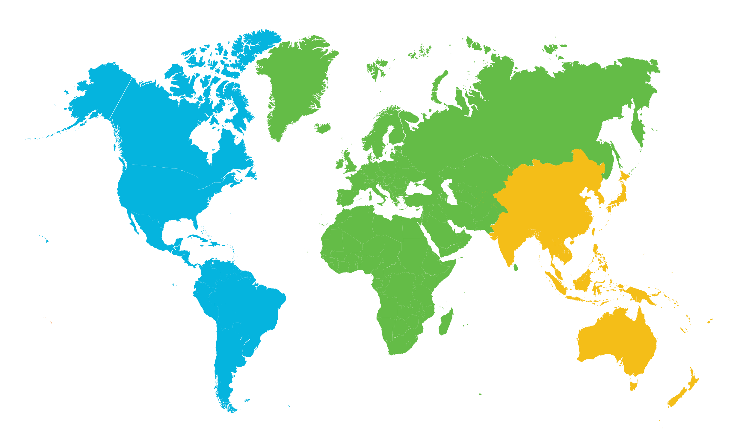
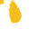
29 Library Leaders
Europe & Middle East
9 interviewees
Netherlands | 3
United Kingdom | 2
Greece | 1
Italy | 1
Spain | 1
United Arab Emirates | 1
Americas
Asia Pacific
17 interviewees
3 interviewees
United States | 12
Canada | 5
Japan | 1
Australia | 1
Hong Kong | 1
As of 30 June 2020
Notes:
From April 23 through July 27 2020, we interviewed 29 library leaders in total, with representation from libraries around the world. 17 of our interviewees were at institutions in North America, 8 in Europe, 1 in the United Arab Emirates, and 3 in Asia Pacific.

Slide 5
Leaders by Library Type (n=29)
Notes:
Our interviewees also came from a variety of library types. 62% were from 4-year academic institutions (research universities, n=10; 4-year colleges or universities, n=8), 10% (n=3) from 2-year academic institutions, and 28% from public (n=7) or national (n=1).

Slide 6
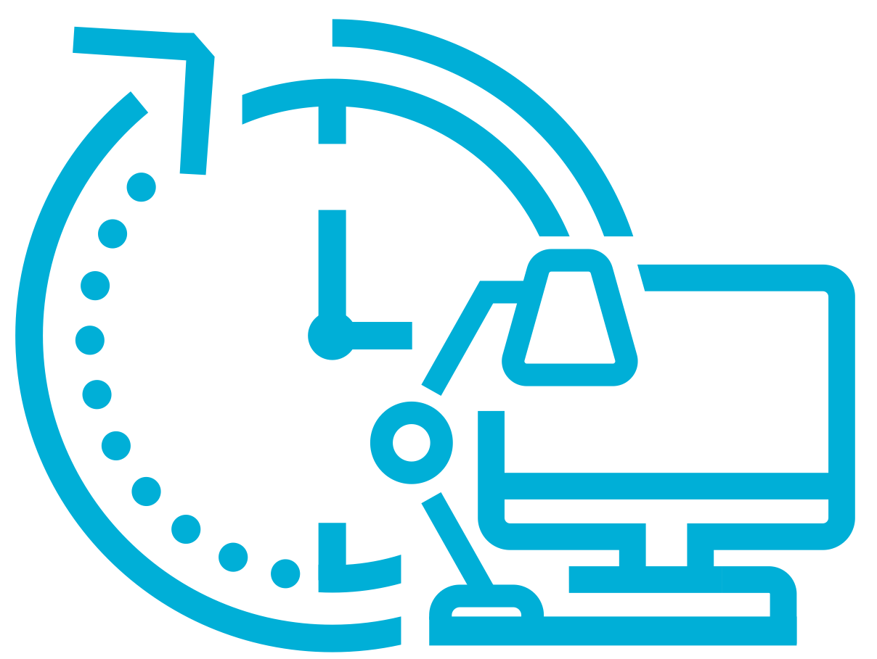

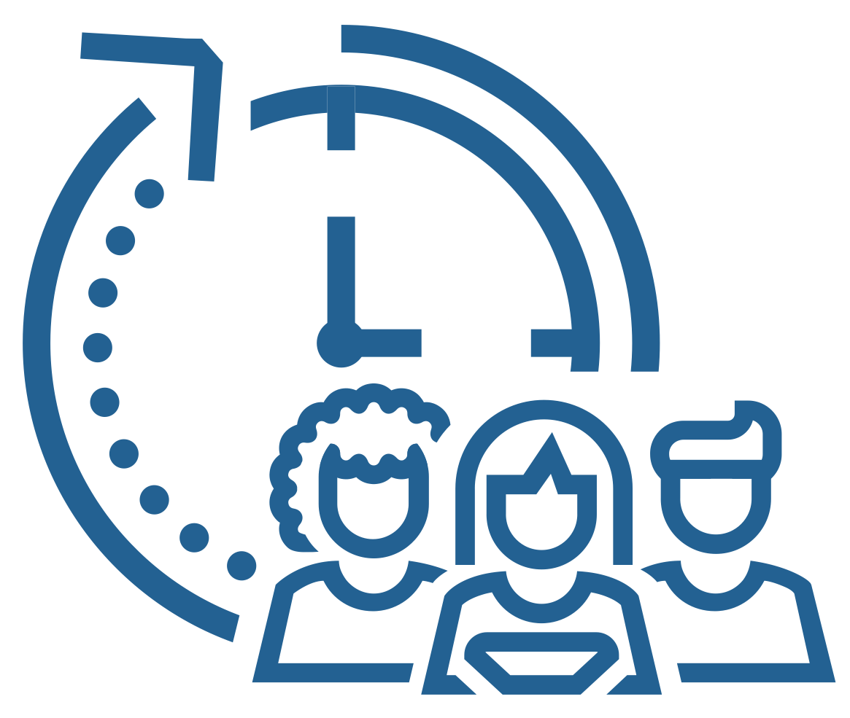
oc.lc/nml-briefing
The New Model Library
Work experiences
Collections experiences
Engagement experiences
Notes:
The themes that come up in the interviews fall into three areas of impact: Work Experiences, Collections Experiences, and Engagement Experiences

Slide 7
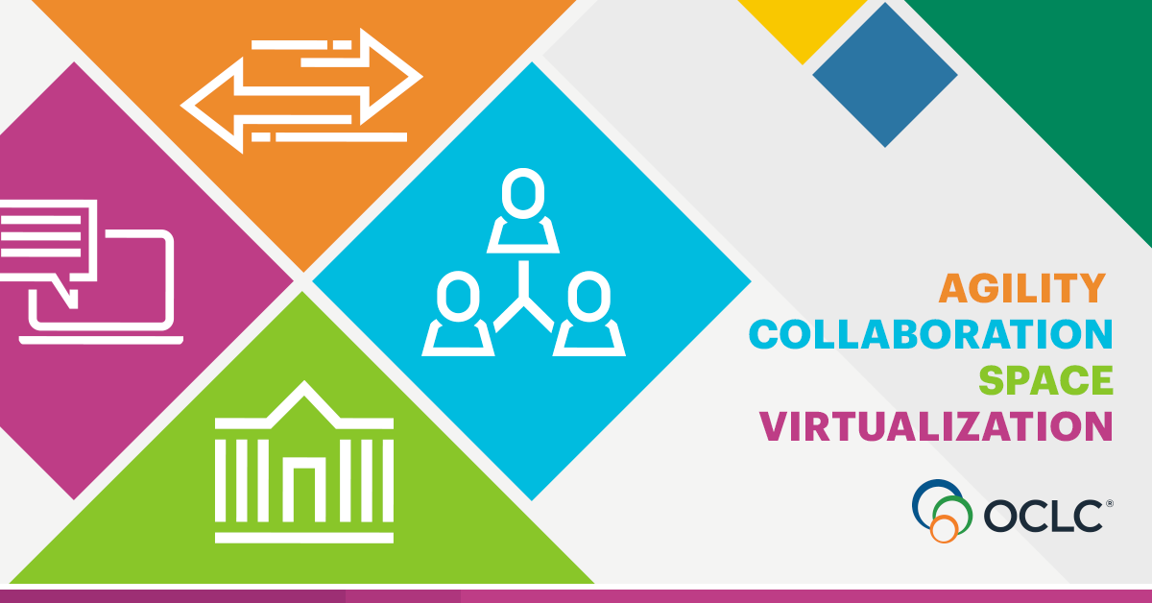
Notes:
Four areas of impact for the New Model Library visions emerged.
Agility
Taking quick and innovative action in response to changing circumstances and expectations
Moved very quickly to meet needs of communities; often the leaders for change in the communities – other agencies/departments could not or did not move as quickly
Staff cross-training and taking on new and shared responsibilities; Shift in staff responsibilities and organizational structures
Collaboration
Working with stakeholders to lead change within libraries, institutions, and communities
Importance of collaboration with other library staff, community agencies, consortia and regional library groups and associations, and other campus departments
teaching and learning – helping faculty develop courses and support materials for online
leading research support – assisting researchers in describing and making data sets available
Dependence on emergency collections, i.e, consortial collections
Virtualization
Expanding online library experiences for staff and the community
Enhancement of library’s virtual presence
Growth of digital materials and new ways of handling physical materials
Space
Finding new ways to engage within the physical library
Adaptation of physical space of library into knowledge center

Slide 8
Work experiences
Embrace work flexibility
Focus on staff’s well-being
Train for the future
Challenge traditional divisions of labor
Notes:
Based on our interviews, when we think about work experiences, the new model library will emphasize work flexibility, training for the future, staff’s well-being, and challenging traditional divisions of labor.
Embrace work flexibility
As remote work became the norm for many during the pandemic, that transition was not always seamless with challenges around adequate technology and competing family needs. Despite this, library staff continued to meet community needs. New library models will offer flexible options for how, where, and when staff work. Common examples include flextime, remote work, compressed work weeks, and family support programs. No single arrangement ensures productivity and work-life balance for everyone and will have to be determined carefully to make sure staff and library needs are met. The NML will have equitable work policies and practices that respond to staff’s varying needs, preferences, and circumstances.
Train for the future.
Formal and informal learning skyrocketed during the pandemic as staff adapted to new work environments and service delivery models. It highlighted the limitations of some of our traditional, siloed models of organization. New library models will include staff with versatile skillsets allowing staff to move with agility between different tasks as the situation demands. This means leaders will need to dedicate and protect the time and resources needed for staff’s professional development and well-being, despite budget constraints and demanding workloads.
Focus on staff’s well-being
The shared experience of stress and uncertainty of the pandemic emphasized the need to make sure the work experience was supportive for all staff. Within new library models we will see places where social connections and staff well-being are valued. Frequent, clear and compassionate communication and transparency around decision making will be the norm.
Challenge traditional divisions of labor.
The pandemic forced people out of their typical work roles – some had to move across departments to support overloaded areas; some had to go outside the library and assist at food banks or homeless shelters. These temporary changes pushed library leaders to consider long-term structural changes to balance staff workloads, expand or modify services, improve efficiency, and demonstrate value. The new library models will consider staff expertise, the library’s mission, and the needs of the community when redesigning staff responsibilities and organizational structures. Some departments may need to be created or combined to better align activities and respond to change. The greater cross training I mentioned will lead to better collaboration, and a dismantling of specializations will help libraries take advantage of staff's diverse skills and maximize expertise while meeting today’s needs. The NML will empower staff to have ownership in the planning and implementation of changes.

Slide 9

“I think it's proved a lesson to a lot of colleagues that they can do their [jobs] perhaps even more effectively by being more flexible in the way that they're working. At a practical level, that will be an interesting one…we'll start to see a lot more staff requesting flexible working, and how will we deal with that? Because we have a typically formalized structure where that happens.”
Research university, United Kingdom

Slide 10

“So we feel like we've been hit with a stick too much…One disaster after another. So I think that has affected our base resilience…We're really needing to recoup in a different way to build that internal resilience.”
Research university, Australia

Slide 11
“For me…looking forward not just for library, but for our institutions, our communities, everywhere is number one…training, needs analysis of skills within our libraries because we need to up our skills and we need to be relevant. It's very, very important. Then I think that our role is going to evolve into more teaching and learning partnership in the future.”
Four-year college, Greece

Slide 12
“…we're going to have a different model. I mean, people aren't going to be, here's your technical services people, here are your circulation people, everybody kind of has a lot of the same skills now which is great. So we're going to reorganize and operate a little differently and we can probably get more done now.”
Four-year college, United States

Slide 13
Thank you
Ixchel M. Faniel, Ph.D.
Senior Research Scientist
fanieli@oclc.org
@imfaniel

