Slide 1
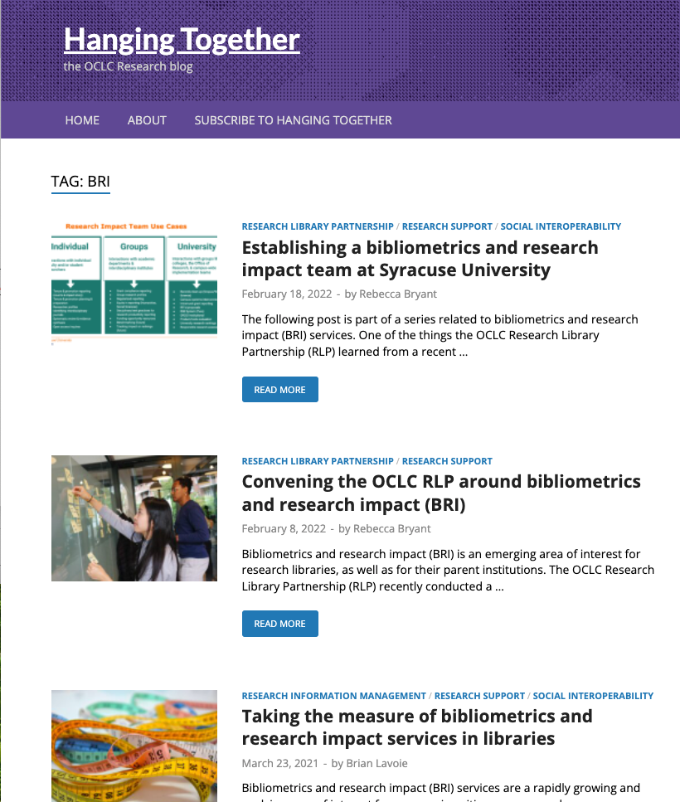
Hanging Together
The OCLC Research blog
Subscribe at https://hangingtogether.org/
Series on BRI at https://hangingtogether.org/tag/BRI/

Slide 2
Save the date
RLP discussion on BRI service development
Join today’s presenters for an informal, follow-up discussion about the opportunities and challenges of establishing BRI services.
Thursday, July 28
11 am – 12 pm EDT
** Watch our listservs for future details
Mei Ling Lo, Rutgers University - New Brunswick
Matthew R. Marsteller, Carnegie Mellon University
William Mischo, University of Illinois at Urbana-Champaign

Slide 3
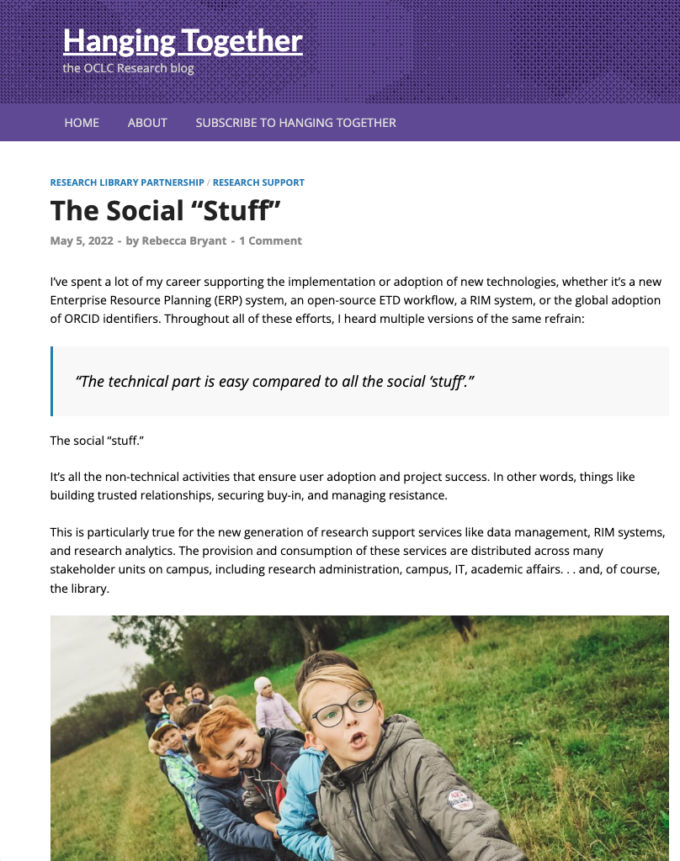
To successfully develop research support services, we must understand:
The campus environment and its cultural barriers
Stakeholders and their interests
Specific strategies and tactics we can leverage for greater impact
https://hangingtogether.org/the-social-stuff/

Slide 4
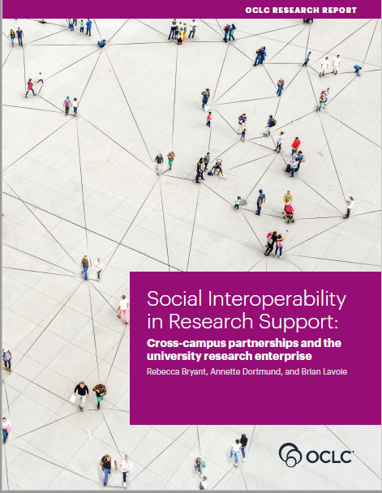
Social Interoperability Workshop
Successfully Engaging Stakeholders Across Campus
Tuesday, 14 June 2022, 10 am – 12 pm EDT (UTC -4)
Tuesday, 21 June 2022, 7 pm - 9 pm EDT (UTC -4)
Exclusively for OCLC RLP affiliates
We particularly encourage:
Groups of learners
Early- to mid-career professionals
Anyone working in an emerging area
Non-library professionals
Facilitators:
Brian Lavoie, PhD
Rebecca Bryant, PhD

Slide 5
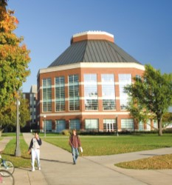
Bibliometric and Research Impact Services at the University of Illinois at Urbana-Champaign Library
William H. Mischo (w-mischo@Illinois.edu)
Berthold Family Professor in Information Access and Discovery; Head, Grainger Engineering Library Information Center
Mary C. Schlembach (schlemba@Illinois.edu)
Physical Sciences and Engineering Librarian; Head, Chemistry Library
Elisandro Cabada (cabada@Illinois.edu)
Bioengineering & Medical Librarian; Interim Head, Math Library
University of Illinois at Urbana-Champaign Library
OCLC BRI Webinar
May 17, 2022

Slide 6
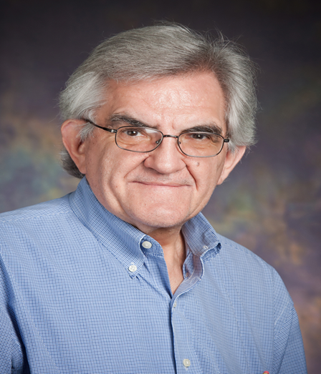
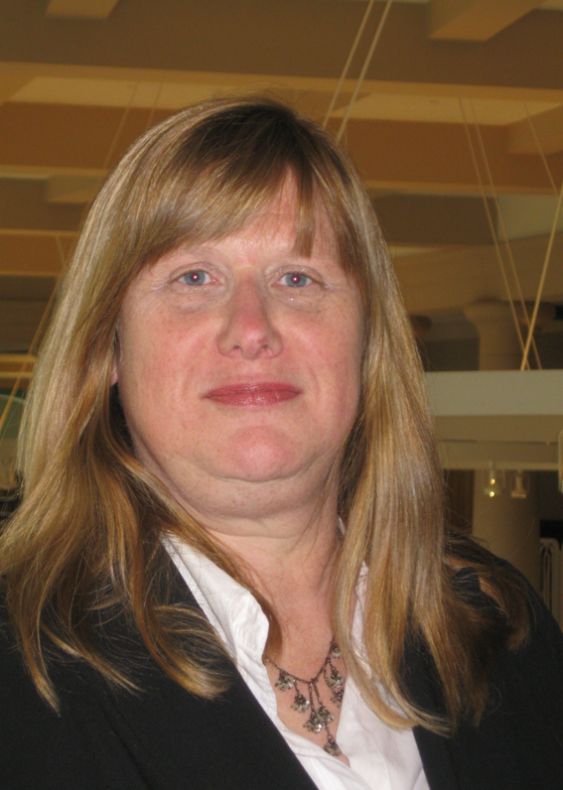
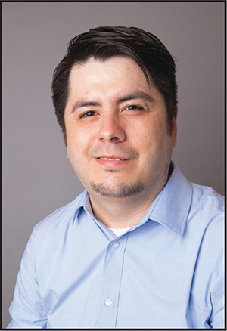

Slide 7
Bibliometrics
The term “bibliometric” was first used by Alan Pritchard in his article “Statistical bibliography or bibliometric” in 1969 in the Journal of Documentation
Bibliometrics refers to the application of mathematics and statistical methods to books and other forms of written communication
Scientometrics refers to “all quantitative aspects of science and scientific research” (Sengupta, 1992); informetrics belongs to information science

Slide 8
Bibliometric and Research Impact Services in Libraries
There is growing library involvement in bibliometrics with many libraries establishing bibliometric and research impact services
Libraries are often partnering with other university units in research indicator gathering and metrics (for P&T, grant requests, hiring decisions, program evaluation, etc.)
Libraries and librarians now have a myriad of tools at their fingertips – A&I, vendor, and repository APIs, visualization software, Machine Learning (ML) and AI algorithms – along with their expertise in scholarly communication

Slide 9
Research Impact Metrics
There is a rich literature on research evaluation and measurement
Much of the focus has been on citation data and publications
Quantitative research indicators are displayed in visualizations
Topic modeling services are being offered using ML clustering and Classification techniques

Slide 10
Tools being Utilized at Illinois
Scopus API, SciVal PURE API (Illinois Experts), Web of Science API
Easy Search bento-style discovery and delivery environment
15 API calls per search
Unpaywall, Altmetrics, Scholix, EBSCO EDS, Scopus, Primo, Bing API
ML tools: Scikit-Learn; Microsoft Azure & Cognitive Toolkit, Google AI; Wolfram Mathematica; MALLET; Amazon Comprehend

Slide 11
PURE Data on Most Heavily Published in Journals by UIUC Researchers
Open Access focus, Publications 2014--2019
PLoS One: 357
Journal of the American Chemical Society 271
Physical review D 270
Scientific Reports 239
Journal of High Energy Physics 237
Physical Review B 227
Astrophysical Journal 211
Proceedings of the National Academy of Sciences 197
European Physical Journal C, Particles and Fields 182
Physical Review Letters 181
Nature Communications 180
Journal of Animal Science 179
Physics Letters B: Nuclear, Elementary Particle, High-Energy 158
Journal of Dairy Science 139
Journal of Chemical Physics 115
Applied Physics Letters 112
ACS Nano 104
Journal of Geophysical Research D, B, C, F 99
ACS applied materials & interfaces 99

Slide 12
Concerns with Responsible Research Metrics
There have been increasing calls for “responsible metrics”
We are following:
2012: The Declaration on Research Assessment (DORA) recognizes the need to improve the ways in which the outputs of scholarly research are evaluated: https://sfdora.org/
2014: Leiden Manifesto: http://www.leidenmanifesto.org/, ten principles for the responsible use of bibliometrics in research evaluation; a broader focus than DORA
INORMS Research Evaluation Working Group https://inorms.net/activities/research-evaluation-working-group/

Slide 13
Illinois Research Impact Visualizations
At University of Illinois, the Library is involved in providing interactive research impact visualizations & dashboards for departments and research groups (e.g. the Cancer Center)
Using Elsevier Scopus API and SciVal Experts API scripts to create databases that drive visualizations
Begins with one table of names and Scopus Author ID numbers
Additional scripts to create co-author, grants and patents received, and cited-by tables

Slide 14
Illinois Research Activity Dashboard
Began with Cancer Center NIH grant, now 11 departments with Graduate Assistants coding faculty and Scopus Author IDs
Multiple Research Indicators Displayed and Clickable:
Articles published in designated time period
Aggregate journal impact total using CiteScore metrics
Number of times the above articles are cited
Number of NSF and NIH grants (DOE to be added)
Number of patents received
Number of and list of coauthors
Custom coauthors within the cohort -- visualization

Slide 15
Illinois System
Database-driven, interactive, and web-based; providing visualizations at individual research group or department faculty level
Scaled and clickable display bubbles and research impact labels
We use the same scripts and display software for all departments and research groups, focusing on science and engineering
Employs server-side scripting, Scalar Vector Graphics (SVG), HTML5, JavaScript Libraries

Slide 16
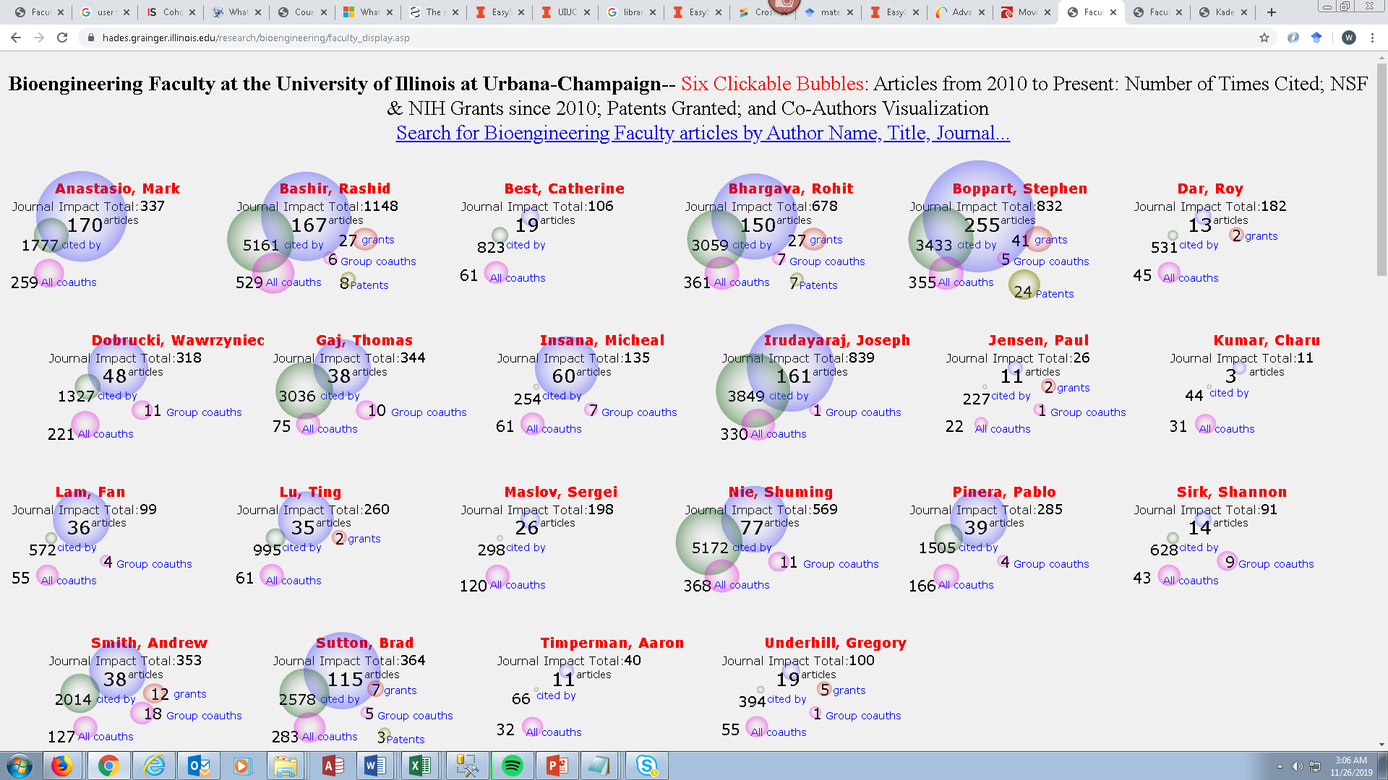
Bioengineering Department at UIUC: Research Indicators Visualization

Slide 17
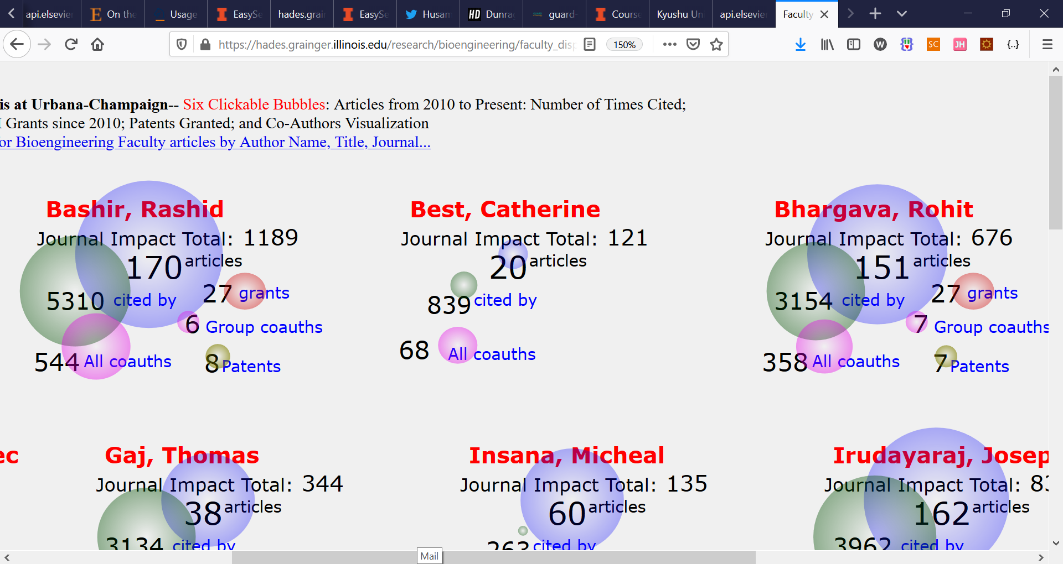

Slide 18
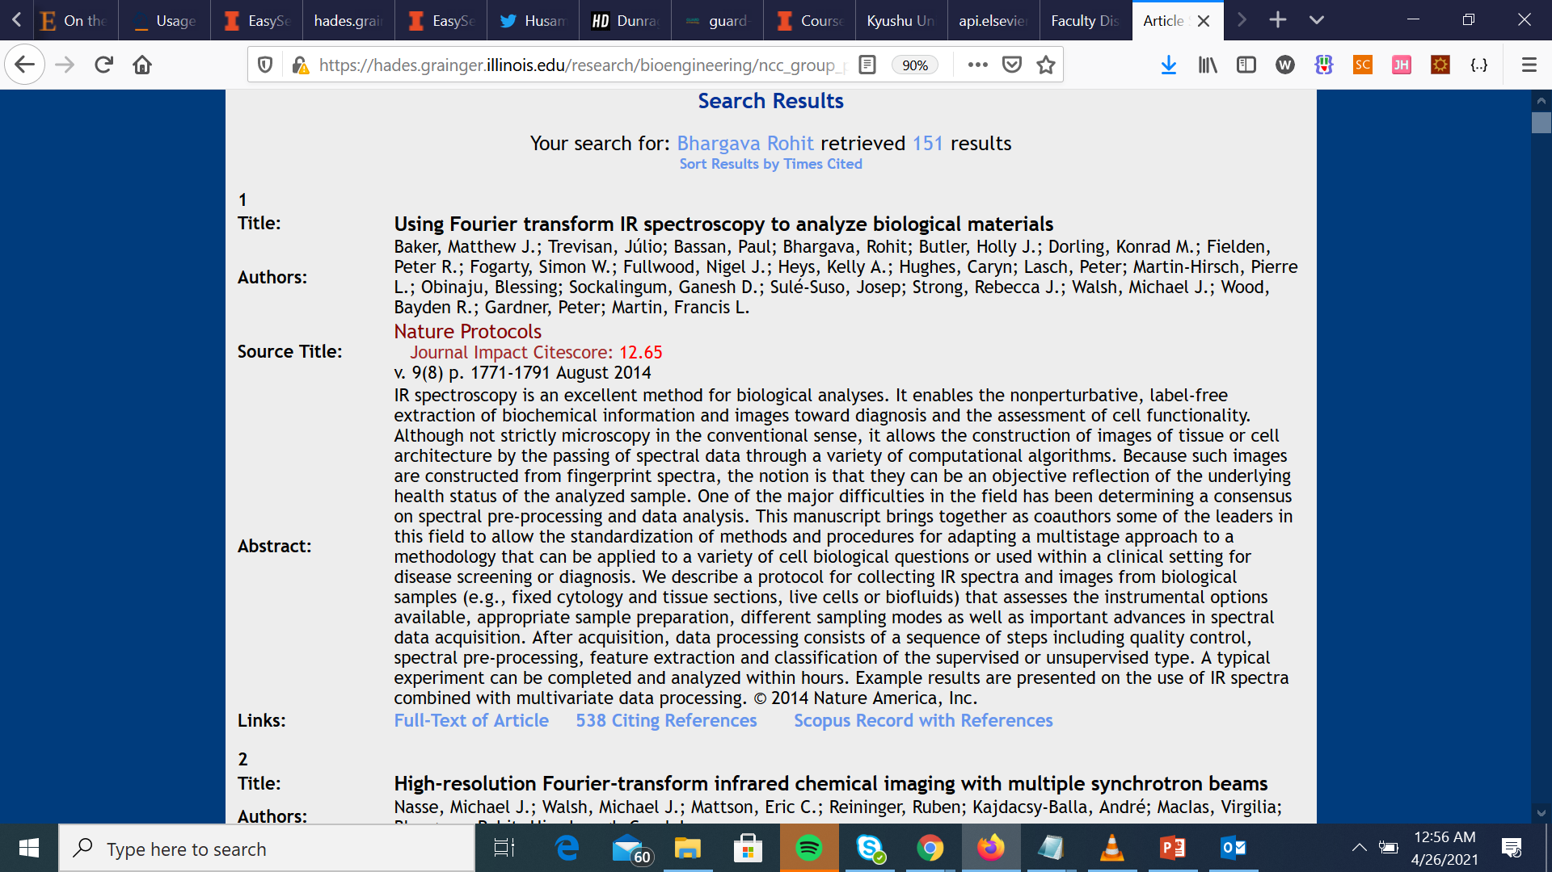
Click on Article Bubble; Retrieve Scopus API Data

Slide 19
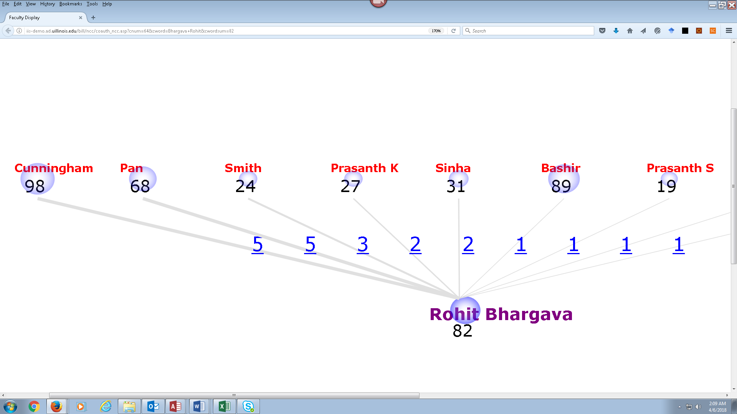
Click on Group Co-Author Display – Displayed Numbers Link to Articles

Slide 20
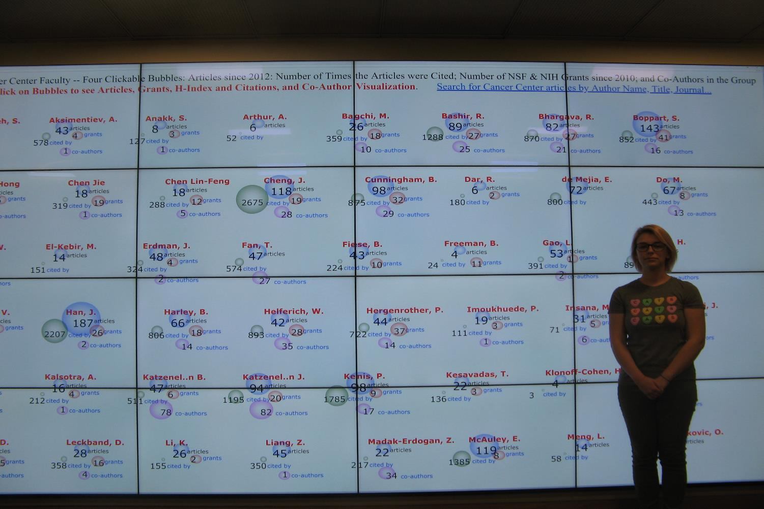
Visualization software that scales to the size of the display – IMLS grant

Slide 21
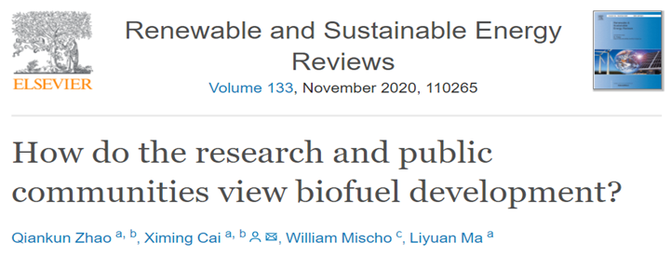
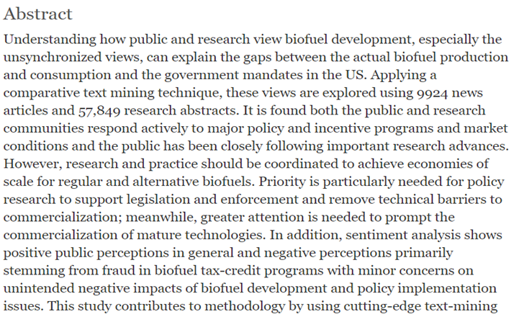
Literature Review with a Machine Learning Component

Slide 22
Bibliometric Work
Bibliometric & metrics work enhance the role of the library in scholarly communication support & foster campus partnerships
Two follow-on studies and projects from the departmental visualizations:
Examining the correlations between various research impact indicators for the 800 faculty for which we have indicator values
Mechanisms developed for weighting indicators & generating composite research impact values
Role of Machine Learning and AI in library activities

Slide 23
Research Metrics Service Efforts at Carnegie Mellon University
May 17, 2022
Matthew R. Marsteller
Associate Dean for Faculty, University Libraries
Principal Librarian, Engineering & Science
Land acknowledgement – I would like to acknowledge the traditional, ancestral, and unceded territory of the Shawnee and the Osage peoples, on which we are learning, working, and growing today.

Slide 24
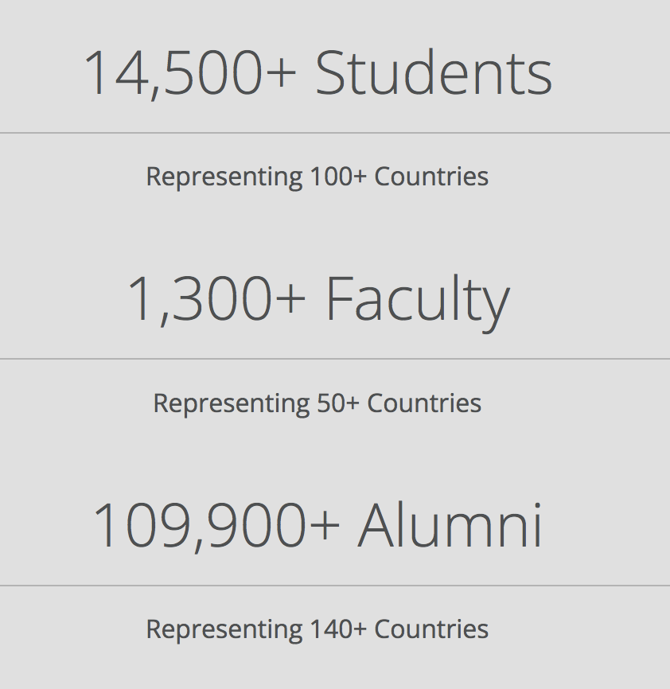
About Carnegie Mellon
From computing to the arts, CMU students, faculty and staff are shaping the future with a strong focus on finding practical answers to complex problems.
Carnegie Mellon has a full-spectrum research and development ecosystem.
Most research at CMU is basic, open research performed on our campus.
CMU also performs restricted research at our world-renowned National Robotics Engineering Center and classified research at our Software Engineering Institute.

Slide 25
… and a Noted College of Fine Arts Crowd

Slide 26
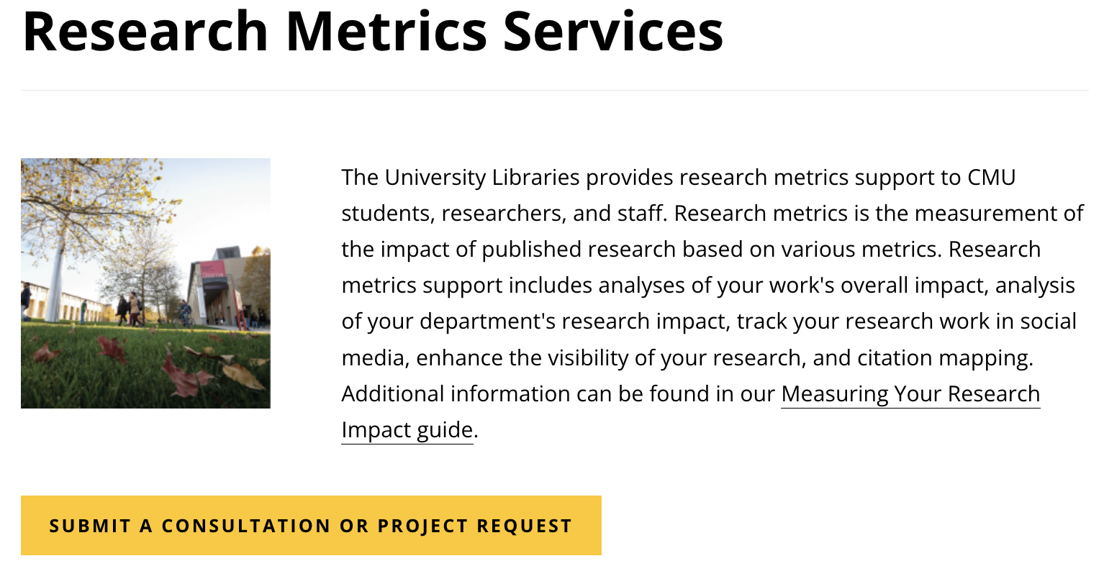
Google Form
https://www.library.cmu.edu/services/research-metrics

Slide 27
How can the Libraries help? - 1
Librarians involved in research impact analysis services can provide support in many ways. For example, we can:
Provide guidance on which tool will best suit your analysis goals.
Recommend resources and methods to perform Author level research analysis.
Recommend resources and methods to perform article-level research analysis.
Design and help in department-level research analysis.
Provide guidance and training on how to use citation analysis tools.

Slide 28
How Can the Libraries Help? - 2
Assist in the use of subject specific citation databases.
Assist in using journal-level metrics such as Journal Ranking, Journal Impact Factors, and Eigenfactor.
Assist in the use of specific Journal Ranking Tools.
Aid in understanding social and alternative metrics such as Altmetrics, Kudos.
Offer guidance on performing comprehensive research metrics analysis.
Offer strategy for research benchmarking analysis with other departments/institutes.
Depending on the involvement level, librarians can serve as consultants or collaborators on your research impact analysis project.

Slide 29
Our Team
Some hours from five different library faculty members (one on professional leave at the time)
Mostly science background, one from social sciences
Neelam Bharti
Julie Chen
Matt Marsteller
Jimmy McKee
Huajin Wang

Slide 30
Tools at Carnegie Mellon
Altmetric Explorer
Dimensions
Journal Citation Reports
SciVal
Scopus
Web of Science
ACM Digital Library
CitRef Explorer
Inspec Analytics
MathSciNet
Publish or Perish
VosViewer

Slide 32
Our Research Information Management Structure
Workday
S3 (Course Data w/ FCE’s)
Annual Reviews
Scopus, Dimensions, WoS Lite, etc.
SPARCS (sponsored projects)
Symplectic Elements
(Digital Science)
Scholars at Carnegie Mellon
Kilthub (figshare)
Manual Entry of Service Activities
ORCID
SDG Tags
FOR Tags

Slide 36
In the Coming Year
Liaison Librarian Training, reflective of competencies
https://thebibliomagician.wordpress.com/competencies/
Product Update Reviews (ongoing)
Establish and Maintain University’s Organizational Structure within SciVal
https://www.brighttalk.com/webcast/13819/317033

Slide 37
And More in the Coming Year
Communications Plan Development
Workshops for Faculty/Post Docs/Graduate Students
Establish/Fine Tune Receipt of Projects
Assess Goals

Slide 38
Thank you!
Matthew R. Marsteller
Associate Dean for Faculty, University Libraries
Principal Librarian, Engineering & Science
Email: matthewm@andrew.cmu.edu
Phone: 412-268-7212

Slide 39
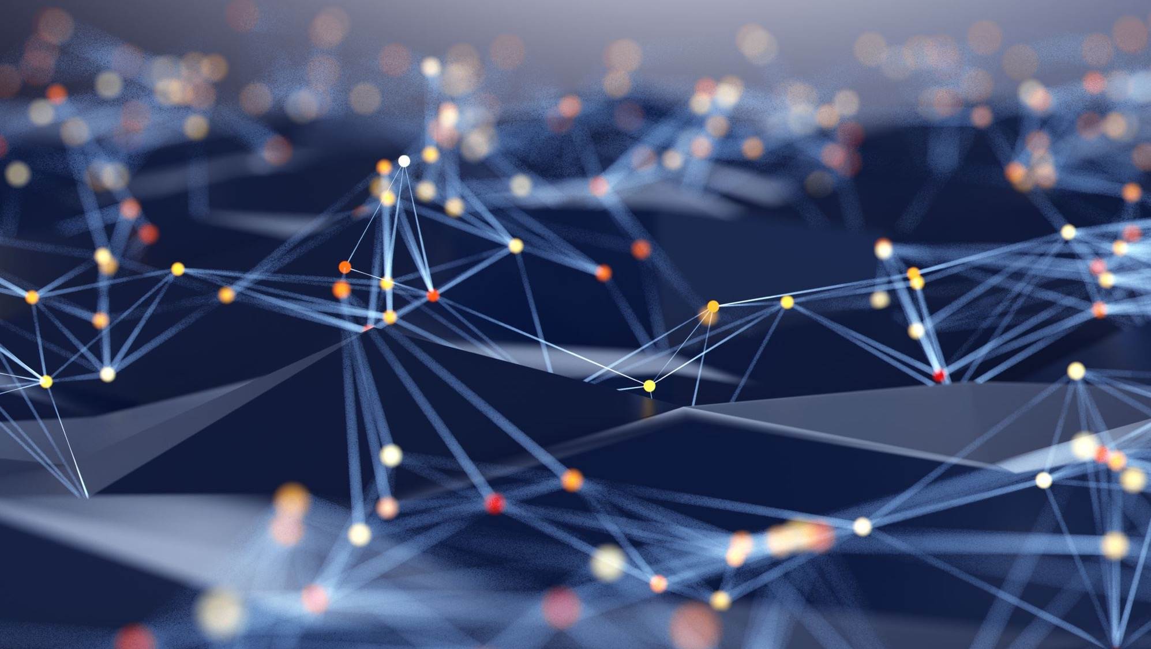
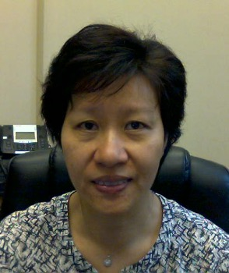
Incorporating bibliometrics into the library's information literacy sessions
Mei Ling Lo (MLO@rutgers.edu)
Science Research Librarian
Rutgers University – New Brunswick Libraries
Works in Progress Webinar: Developing research impact services
May 17, 2022

Slide 40
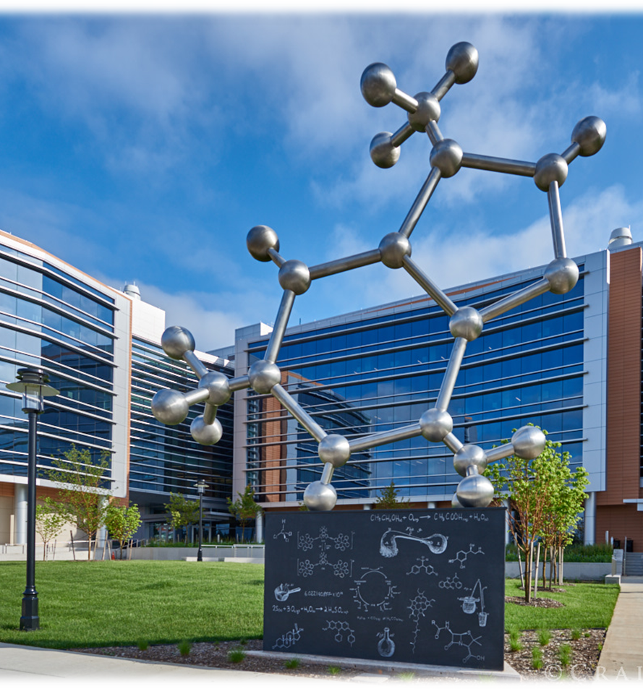
About Rutgers, The State University of New Jersey
69,000+ students from all 50 states and more than 130 countries
8,700 full and part-time faculty
300 research centers and institutes
The PhD Molecule for the front courtyard of the Wright-Rieman Chemistry Building on Busch Campus at Rutgers
Source: https://www.codaworx.com/projects/the-phd-molecule/

Slide 41
Current landscape of RIM at Rutgers
Library Databases
QuickSearch (Ex Libris)
Scopus (Elsevier)
Web of Science (Clarivate)
Faculty Profiling
ORCID@Rutgers
Pivot (Proquest)
Esploro (Ex Libris)
Faculty Survey (Homegrown)
SciENcv (NCBI)
Google Scholar Profiles
RIM Products
Pure (Elsevier) from State of NJ
https://researchwithrutgers.com
Academic Analytics
https://rutgersresearchexperts.rutgers.edu
Personal Identifiers
ORCID@Rutgers
Web of Science ResearcherID
Scopus Author ID

Slide 42
Researchers’ understanding of RIM and research metrics
Academic Analytics? Pure? Are they used to evaluate faculty performance and determine my merit increase?
I only want H-index from Google Scholar. Why do I need to bother with Scopus and Web of Science?
I have no time to maintain so many author profiles
I have never heard of Researchwithrutgers (Pure), let alone use it

Slide 43
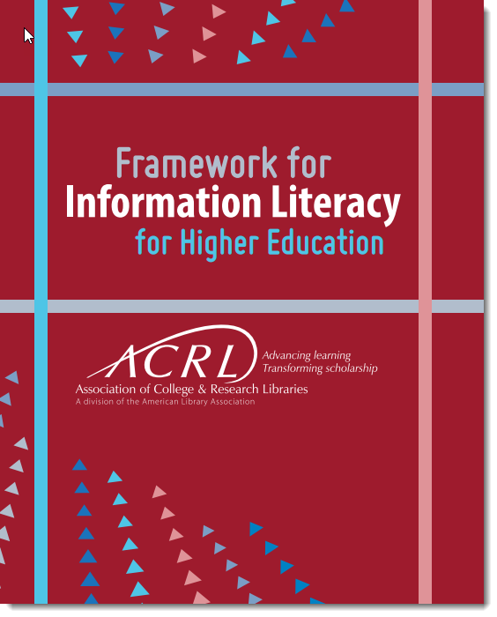
What is Information Literacy?
Information literacy is a set of abilities requiring individuals to “recognize when information is needed and have the ability to locate, evaluate, and use effectively the needed information.” (American Library Association. Presidential Committee on Information Literacy. https://www.ala.org/acrl/publications/whitepapers/presidential) To be information literate, then, one needs skills not only in research but in critical thinking.
Locate
Evaluate
https://www.ala.org/acrl/sites/ala.org.acrl/files/content/issues/infolit/framework1.pdf

Slide 44
Current Practice of Library Instructions
Library instructions mainly focus on college students
Which databases should I use for a research topic?
How to construct a search strategy using keywords and controlled vocabularies
How to evaluate information and determine the reliability of sources

Slide 45
In the biomedical field alone, more than 1 million papers pour into the PubMed database each year — about two papers per minute.
Landhuis, E. (2016). Scientific literature: Information overload. Nature, 535(7612), 457-458. https://doi.org/10.1038/nj7612-457a

Slide 46
Advanced library sessions Weaving bibliometrics into library sessions
Other than text-based search strategy, how do I use cited reference search to expand the search results?
Citations are not equal. A citation can indicate support or it can challenge a finding.
How do I establish my author identity and profile and increase my visibility?
How do I use research metrics responsibly?
What are the alternatives to Google Scholar? Why is H-index lower in Scopus and Web of Science?
How to seek out collaborators to advance your research careers?

Slide 47
Examples of our library workshops
Tools for Building Literature Review and Measuring Research Impact
Beyond Google Scholar and arXiv: Using Library resources for your research
Curating Your Citation Count using EndNote
Using Zotero for Citation Management and Research Metrics
Measuring Your Research Impact in Scopus
Using VOSviewer to Visualize Citation Network
Establishing an Author’s Identity
Beyond Google Scholar: Exploring Other Discovery Tools

Slide 48
Other than text based search strategy, how do I use cited reference search to expand the search results?

Slide 49
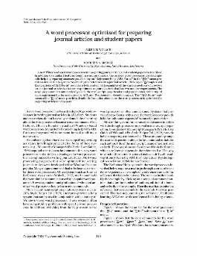
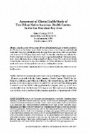
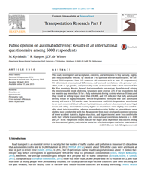
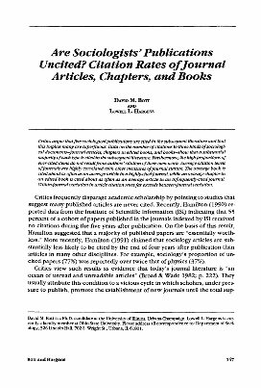
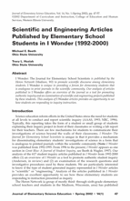
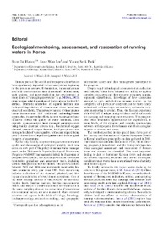
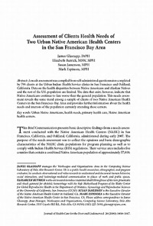
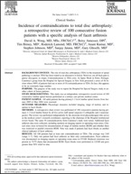
Finding related articles:
Cited reference search
Chasing citations

Slide 50
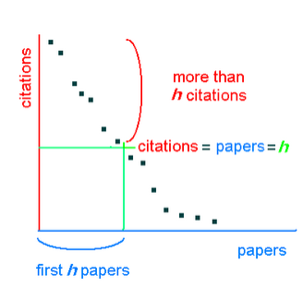
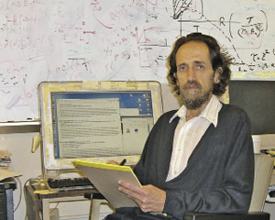
Author level
H-Index
An author has an H-index “8” if his/her top 8 most cited articles have each received at least 8 citations ( been cited 8 times).
H-index is a matric that is used to measure
Productivity of the author
Impact of his/her works
Jorge Hirsch, a physics professor at Univ. California, San Diego
Source: http://bitesizebio.com/24043/getting-to-know-your-h-index/

Slide 51
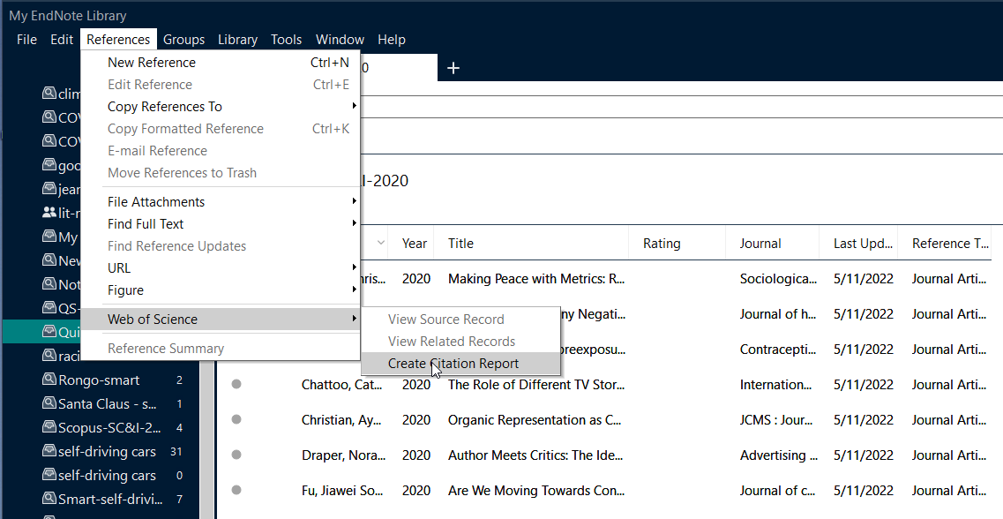
Curating citations using EndNote

Slide 52
What are the alternatives to Google Scholar? Why is H-index lower in Scopus and Web of Science?

Slide 53
Workshop:
Beyond Google Scholar:
Exploring Other Discovery Tools

Slide 54
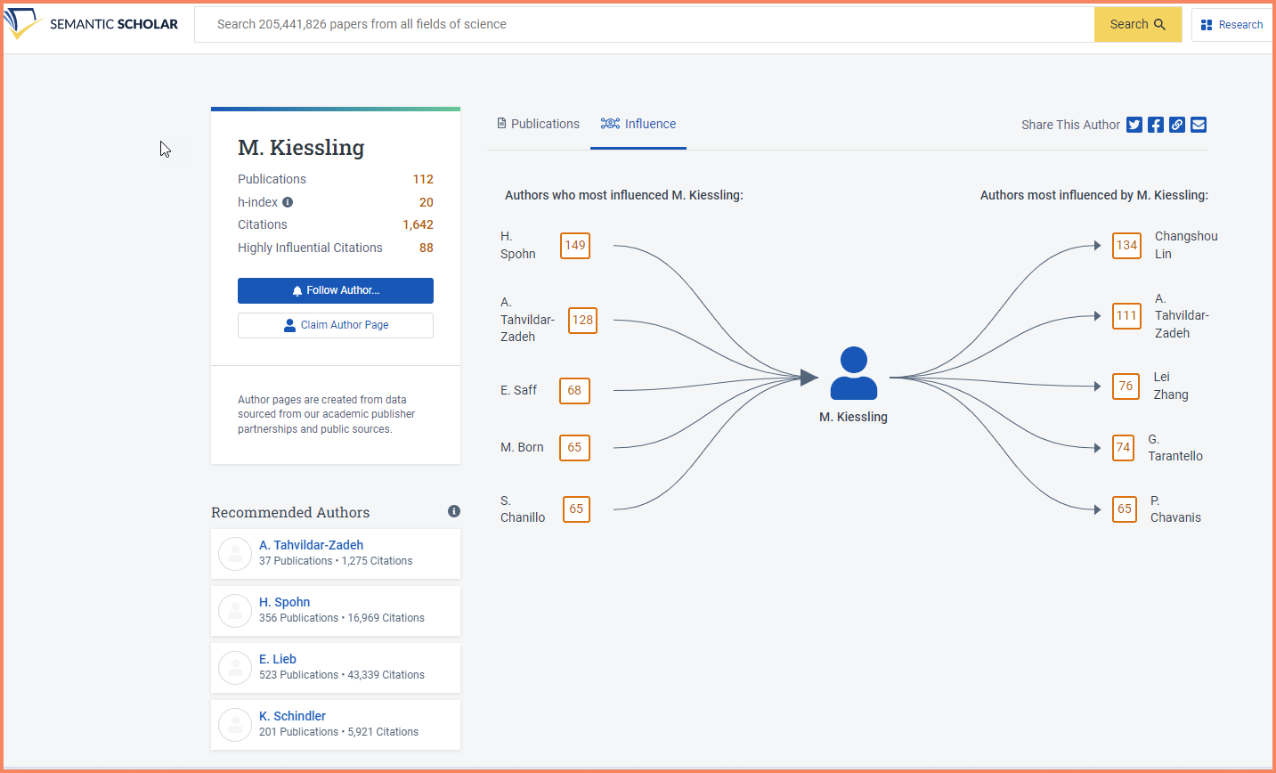
Semanticscholar.org

Slide 55
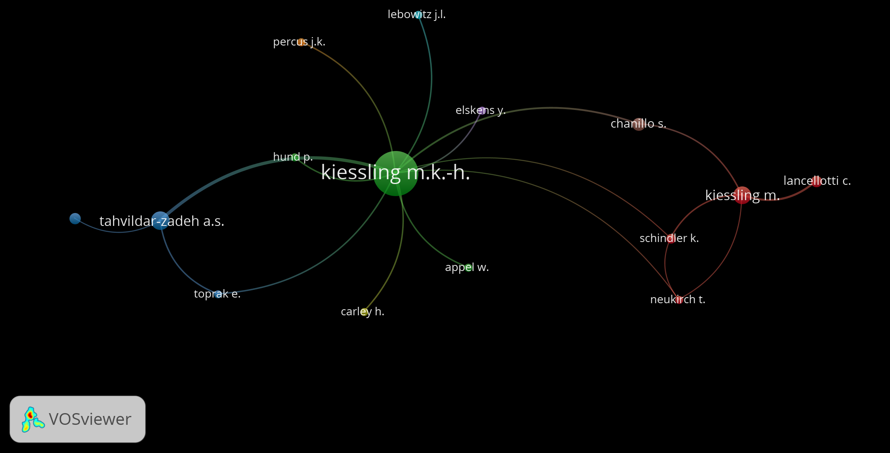

Slide 56
How to seek out collaborators to advance your research career?

Slide 57
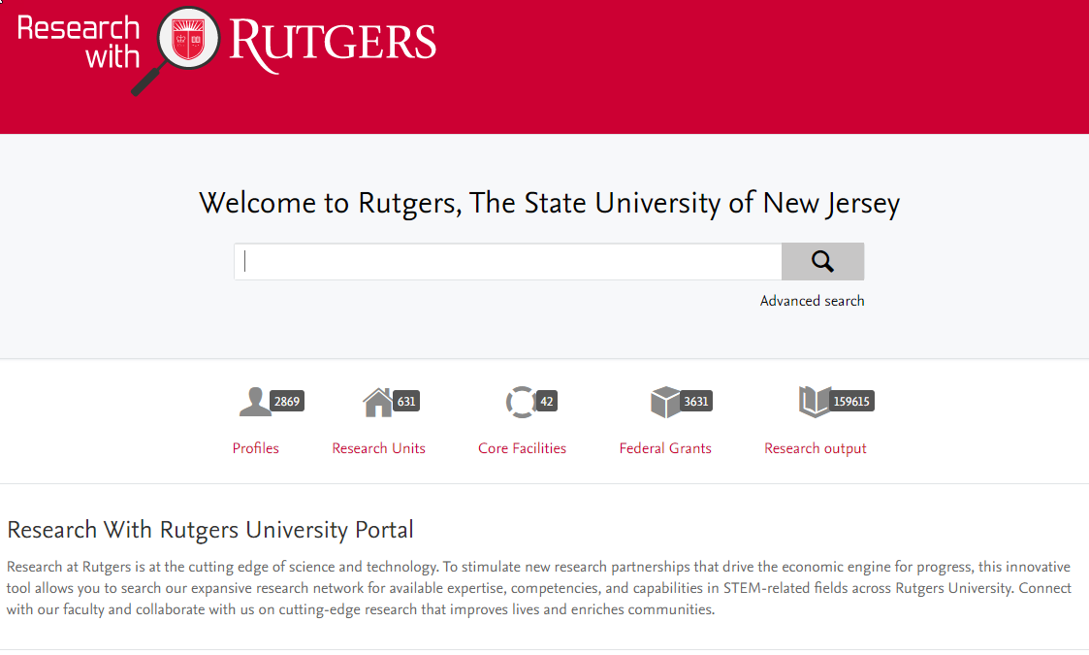
Pure
Pure
Research with Rutgers
https://www.researchwithrutgers.com

Slide 58
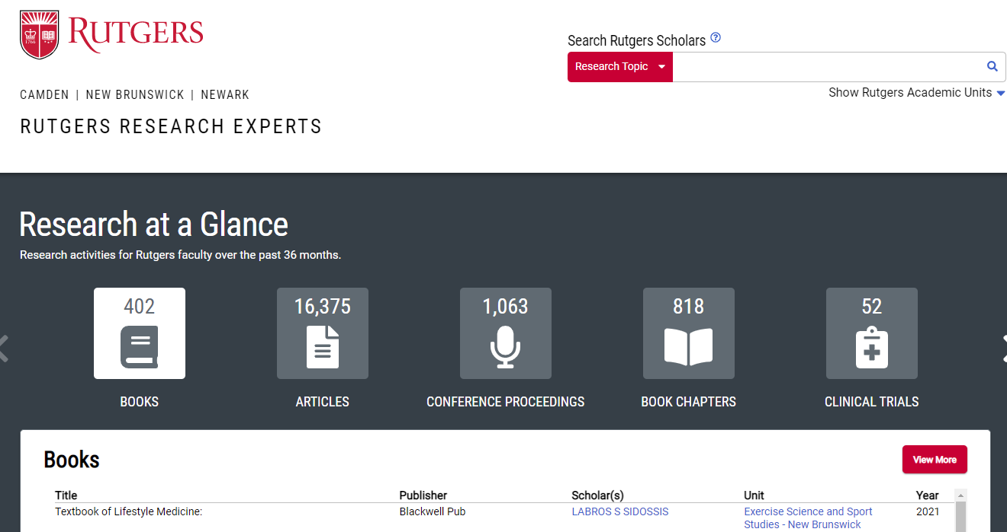
Academic Analytics
https://rutgersresearchexperts.rutgers.edu

Slide 59
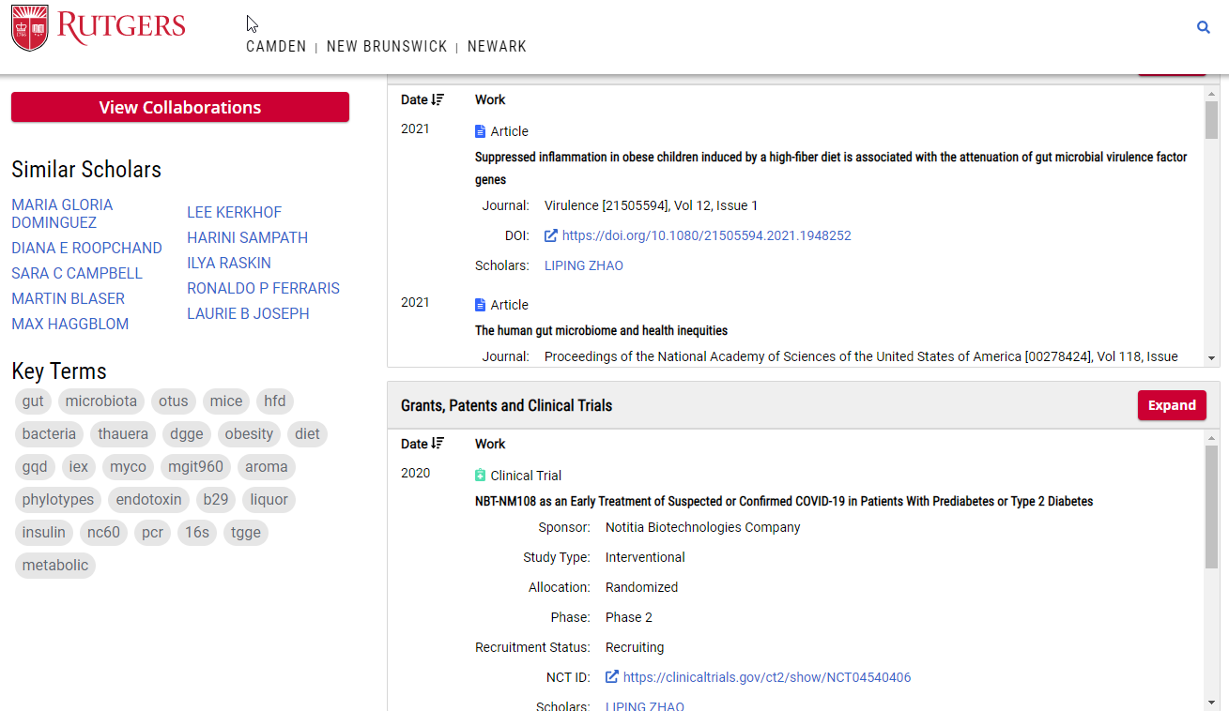

Slide 60
Citations are not equal. A citation can indicate support or it can challenge a finding

Slide 61
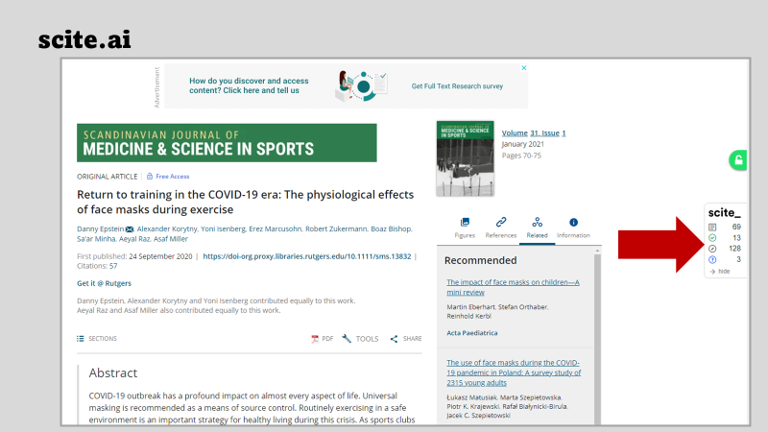

Slide 62
How do I establish my author identity and profile, and increase my visibility?

Slide 63
Increasing an author’s citation counts
Use your name consistently throughout your career
Use a standardized institutional affiliation and address, use no abbreviations
Publish in a journal with a high impact factor
Keep your professional web pages and published lists up to date; Join Linked-in and Google Scholar Profile
Open Access (OA) increases citation rate
Team-authored articles get cited more (Are you the first author or the last author?)
Write comprehensive and substantial review articles
Provide links to the articles on Twitter

Slide 64
Manage your Research Identity
Google Citation Profile
Be sure to have a Google Scholar Citation profile. https://scholar.google.com/intl/en/scholar/citations.html
Be sure to have an ORCID ID and link it with your Rutgers NetID. https://orcid.org/register
ORCID ID
Researcher ID
Be sure to have a profile in ResearcherID (Web of Science). This is useful if you want to have a correct citation analysis in Web of Science. http://www.researcherid.com/

Slide 65
How do I use research metrics responsibly?

Slide 66
DORA Declaration on Research Assessment

Slide 67
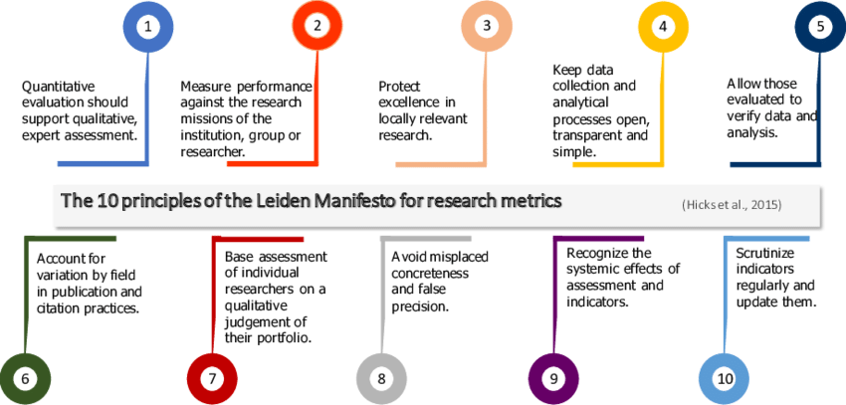

Slide 68
Hosting workshops related to research metrics
Title of each workshop should contain tools or databases that sound familiar to the users.
Partner with grad student coordinators to host seminars
Provide in-depth consultations for individual tools after the workshops

Slide 69
Challenges of weaving bibliometrics into information literacy…
Some librarians believe that bibliometrics falls into a different domain
Not all the tools are available to our faculty and students
Librarians need to have the skillsets and expertise to conduct research metrics
Faculty are unaware of how librarians can support them in the area of research metrics

Slide 70
If you are interested in learning more…
Nakagawa, Samarasinghe, G., Haddaway, N. R., Westgate, M. J., O’Dea, R. E., Noble, D. W. ., & Lagisz, M. (2019). Research Weaving: Visualizing the Future of Research Synthesis. Trends in Ecology & Evolution (Amsterdam), 34(3), 224–238. https://doi.org/10.1016/j.tree.2018.11.007

Slide 71
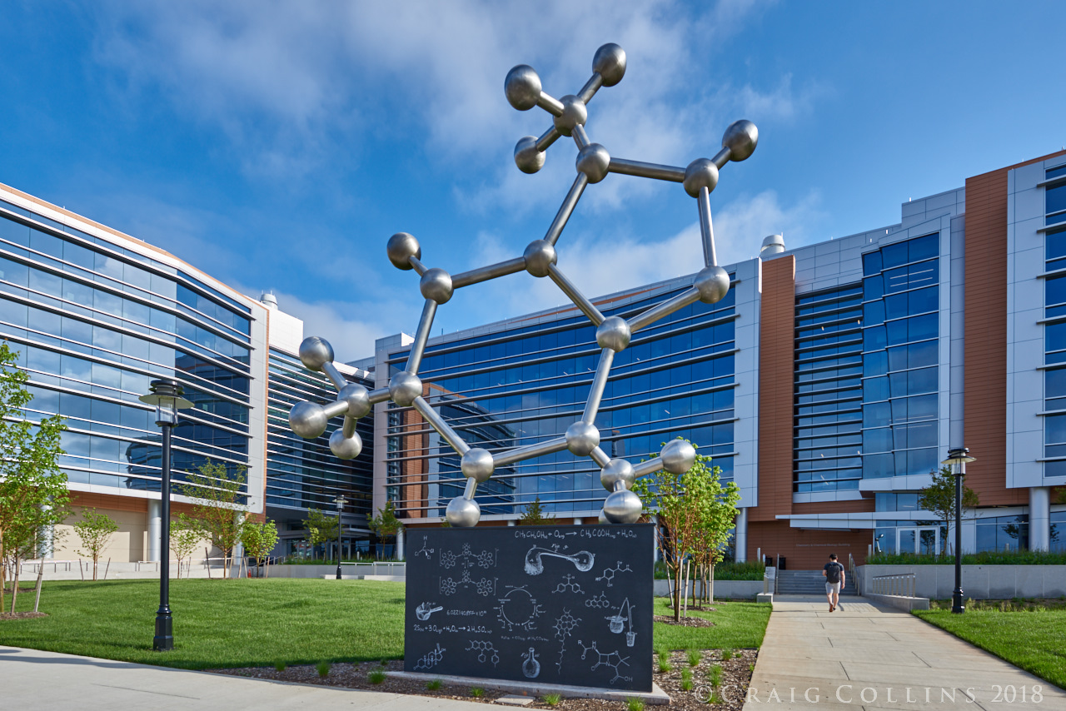
The PhD Molecule for the front courtyard of the Wright-Rieman Chemistry Building on Busch Campus at Rutgers
Source: https://www.codaworx.com/projects/the-phd-molecule/

Slide 72
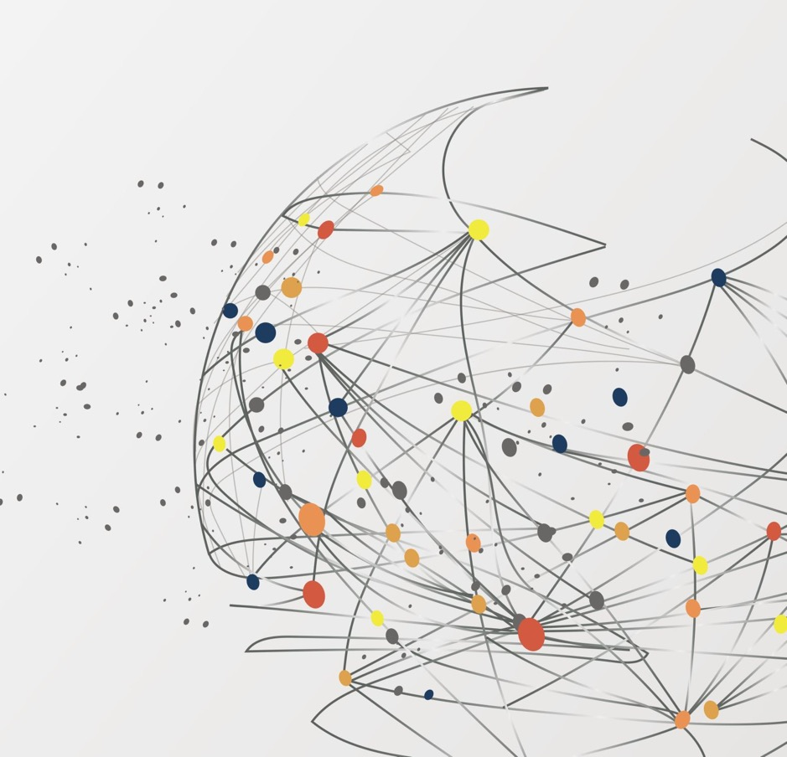
Incorporating bibliometrics into the library's information literacy sessions ​

Slide 73
Questions?
Rebecca Bryant, OCLC
Research Library Partnership
Mei Ling Lo, Rutgers University - New Brunswick
Matthew R. Marsteller, Carnegie Mellon University
William Mischo, University of Illinois at Urbana-Champaign

