Slide 1
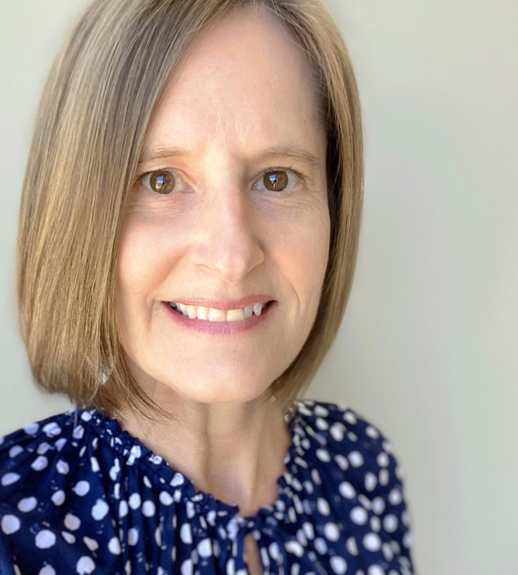
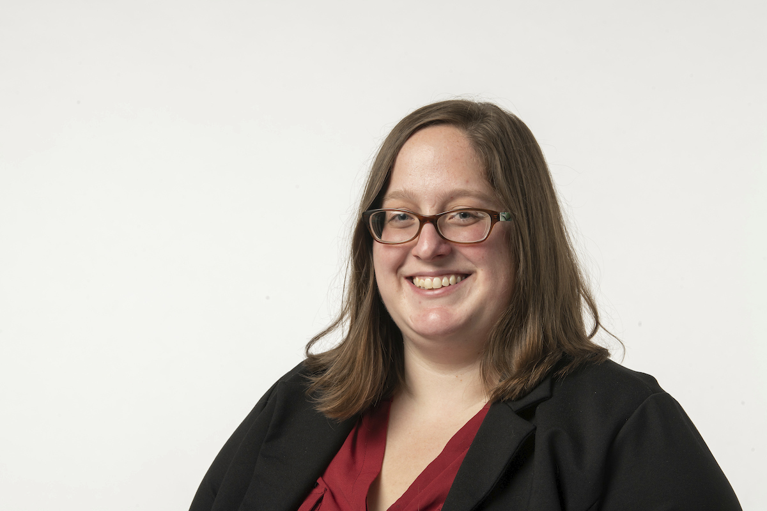

Cross-library learning and knowledge sharing—Metadata Community of Practice at Notre Dame
Works in Progress Webinar
Laura Sill (she/her)
Head of Acquisitions, University of Chicago Library
Peggy Griesinger (she/her)
Head of Metadata Initiatives, University of Notre Dame, Hesburgh Libraries

Slide 2
Agenda for today’s discussion:
Metadata Environment / Culture
Our Model in Action
MCoP Structure
Learning Principles
Lessons Learned

Slide 3

Identifying our need for a CoP
Changing metadata landscape
Retirements/Reorganization
Development of local systems
Siloed operations
Metadata as an asset
Changing collection content

Slide 4
Stakeholder input
Metadata Services
Specialized Collections
Digital Services
IT Web & Software Engineering

Slide 5
Stakeholder input
Specialized Collections
Archival processing and metadata services for rare collections
Metadata management for University Archives
Local digitization of local collections
Digital Preservation Strategy

Slide 6
Stakeholder input
Digital Services
Discovery platform support
Discovery Strategy
Product ownership

Slide 7
Stakeholder input
IT Web & Software Engineering
Software design & development
Software support

Slide 8
Stakeholder input
Metadata Services
Analog cataloging for general and rare collections
Digital collection resource description
Electronic resource metadata management
Metadata Strategy

Slide 9
Stakeholder input
Metadata Services
Analog cataloging for general and rare collections
Digital collection resource description
Specialized Collections
Archival processing and metadata services for rare collections
Metadata management for University Archives
Digital Services
Discovery platform support
Discovery Strategy
IT Web & Software Engineering
Electronic resource metadata management
Metadata Strategy
Local digitization of local collections
Digital Preservation Strategy
Product ownership
Software design & development
Software support

Slide 10
Setting expectations and designing MCoP
MCoP Administration
Metadata Asset Management
Industry & Professional Standards
Metadata Design
Process Improvement & Metadata Enhancement
Preservation, Technical & Rights Management
Metadata Transfer & Reuse
Defining the Domain

Slide 11
Metadata Strategy Development
Learning & Sharing
Ethical Practices & Responsibilities
Metadata Stewardship & Governance
Problem Solving & Decision-making
Network Building & Role Clarification
MCoP Administration
Metadata Asset Management
Industry & Professional Standards
Metadata Design
Process Improvement & Metadata Enhancement
Preservation, Technical & Rights Management
Metadata Transfer & Reuse
Defining Community Success

Slide 12
Metadata Strategy Development
Learning & Sharing
Ethical Practices & Responsibilities
Metadata Stewardship & Governance
Problem Solving & Decision-making
Network Building & Role Clarification
Organizational Support:
Strategic Leaders
Administrative Support
Infrastructure Support
Metadata Producers
MCoP Administration
Metadata Asset Management
Industry & Professional Standards
Metadata Design
Process Improvement & Metadata Enhancement
Preservation, Technical & Rights Management
Metadata Transfer & Reuse

Slide 13
Learning Framework
Outcomes / Deliverables
Methods
Assessment

Slide 14
Learning Framework
Outcomes / Deliverables
What do we want to teach or share?
What do we want members to take away?

Slide 15
Learning Framework
Methods
What activities will resonate with members?
What techniques will foster communication?
What approaches best serve our topic?

Slide 16
Learning Framework
Assessment
Were we successful in meeting our deliverables?
What else do members want?

Slide 17
Learning Framework
Outcomes / Deliverables
What do we want to teach or share?
What do we want members to take away?
Methods
What activities will resonate with members?
What techniques will foster communication?
Assessment
Were we successful in meeting our deliverables?
What else do members want?
What approaches best serve our topic?

Slide 18
Our model in action
Setting expectations
Example 2: Types of metadata instructional meeting
Leveling the knowledge playing field
Example 3: Sub-team projects creation and development
Practical deliverables to demonstrate utility of group
Example 1: Kick-off meeting
Introducing the MCoP
Gauging interest
Ensure all participants have shared vocabulary for discussions
Engagement from members outside of the governance squad
Solving long-standing metadata issues

Slide 19
Kick-off meeting
Outcomes / Deliverables
Methods
Assessment

Slide 20
Kick-off meeting
Outcomes / Deliverables
Introduce the goals and structures of MCoP
Gauge interest and willingness/ability for participation
Facilitate learning for diverse set of learners
Virtual engagement and collaboration during work from home

Slide 21
Kick-off meeting
Pre-work recording and slides
Icebreaker, meeting rules
Presentation, breakout groups, small and large group discussion
Padlet question to spur continued thought
Methods

Slide 22
Kick-off meeting
Assessment
Post-meeting survey
Engagement with future meetings and activities
Informal feedback

Slide 23
Kick-off meeting
Outcomes / Deliverables
Introduce the goals and structures of MCoP
Gauge interest and willingness/ability for participation
Methods
Pre-work recording and slides
Icebreaker, meeting rules
Assessment
Post-meeting survey
Engagement with future meetings and activities
Presentation, breakout groups, small and large group discussion
Facilitate learning for diverse set of learners
Padlet question to spur continued thought
Informal feedback
Virtual engagement and collaboration during work from home

Slide 24
Types of metadata meeting
Outcomes / Deliverables
Methods
Assessment

Slide 25
Types of metadata meeting
Outcomes / Deliverables
Get everyone on close to the same page in terms of basic knowledge of metadata
Encourage participation from those less experienced with metadata

Slide 26
Types of metadata meeting
Methods
Instructional session
Explanation of common metadata jargon including examples

Slide 27
Types of metadata meeting
Assessment
Quiz at end of session to test knowledge of concepts
Post-session survey
Ability of non-specialists to participate in discussions and make use of some metadata terminology

Slide 28
Types of metadata meeting
Outcomes / Deliverables
Get everyone on close to the same page in terms of basic knowledge of metadata
Encourage participation from those less experienced with metadata
Methods
Instructional session
Explanation of common metadata jargon including examples
Assessment
Quiz at end of session to test knowledge of concepts
Post-session survey
Ability of non-specialists to participate in discussions and make use of some metadata terminology

Slide 29
Sub-team projects creation
Outcomes / Deliverables
Methods
Assessment

Slide 30
Sub-team projects creation
Outcomes / Deliverables
Actionable solutions to specific metadata issues
Practical results that demonstrate utility of MCoP to solve stubborn issues
Engagement of members outside the governance squad

Slide 31
Sub-team projects creation
Methods
Formal project proposals including timelines, membership, and deliverables
Seek approval from leadership and get buy-in from all programs
Regular sub-team meetings outside of main MCoP structure

Slide 32
Sub-team projects creation
Assessment
Regular updates to larger MCoP about progress of sub-teams
View effect of new policies and practices on existing metadata problems
Consider how effective this method was at solving the issues presented

Slide 33
Sub-team projects creation
Outcomes / Deliverables
Actionable solutions to specific metadata issues
Practical results that demonstrate utility of MCoP to solve stubborn issues
Methods
Formal project proposals including timelines, membership, and deliverables
Seek approval from leadership and get buy-in from all programs
Assessment
Regular updates to larger MCoP about progress of sub-teams
View effect of new policies and practices on existing metadata problems
Engagement of members outside the governance squad
Consider how effective this method was at solving the issues presented
Regular sub-team meetings outside of main MCoP structure

Slide 34
Topics covered
Types of metadata/metadata terminology
Metadata source of record
Use cases for source of record
Archival stewardship metadata
Persistent identifiers
Series statements in MARC
How technology can assist in metadata work
Metadata and the research consultation process

Slide 35
Topics covered
Types of metadata/metadata terminology
Metadata source of record
Use cases for source of record
Archival stewardship metadata
Persistent identifiers
Series statements in MARC
How technology can assist in metadata work
Metadata and the research consultation process

Slide 36
Topics covered
Types of metadata/metadata terminology
Metadata source of record
Use cases for source of record
Archival stewardship metadata
Persistent identifiers
Series statements in MARC
How technology can assist in metadata work
Metadata and the research consultation process

Slide 37
Topics covered
Types of metadata/metadata terminology
Metadata source of record
Use cases for source of record
Archival stewardship metadata
Persistent identifiers
Series statements in MARC
How technology can assist in metadata work
Metadata and the research consultation process

Slide 38
Topics covered
Types of metadata/metadata terminology
Metadata source of record
Use cases for source of record
Archival stewardship metadata
Persistent identifiers
Series statements in MARC
How technology can assist in metadata work
Metadata and the research consultation process

Slide 39
Topics covered
Types of metadata/metadata terminology
Metadata source of record
Use cases for source of record
Archival stewardship metadata
Persistent identifiers
Series statements in MARC
How technology can assist in metadata work
Metadata and the research consultation process

Slide 40
Topics covered
Types of metadata/metadata terminology
Metadata source of record
Use cases for source of record
Archival stewardship metadata
Persistent identifiers
Series statements in MARC
How technology can assist in metadata work
Metadata and the research consultation process

Slide 41
Topics covered
Types of metadata/metadata terminology
Metadata source of record
Use cases for source of record
Archival stewardship metadata
Persistent identifiers
Series statements in MARC
How technology can assist in metadata work
Metadata and the research consultation process

Slide 42
Lessons learned
.
.
.
.
.
.
.
.

Slide 43
Lessons learned
.
.
.
.
.
.
.
Stakeholder input is critical

Slide 44
Lessons learned
.
.
.
Seek to understand Administrative concerns
.
.
.
.

Slide 45
Lessons learned
.
CoP management takes ongoing work: time & commitment
.
.
.
.
.
.

Slide 46
Lessons learned
Be open and adaptable
.
.
.
.
.
.
.

Slide 47
Lessons learned
.
.
Community is fun and energizing
.
.
.
.
.

Slide 48
Lessons learned
.
.
.
.
Stay focused on why
.
.
.

Slide 49
Lessons learned
.
.
.
.
.
.
Safety comes through neutral facilitation
.

Slide 50
Lessons learned
.
.
.
.
.
Look for small achievable wins first
.
.

Slide 51
Lessons learned
Be open and adaptable
CoP management takes ongoing work: time & commitment
Community is fun and energizing
Seek to understand Administrative concerns
Stay focused on why
Look for small achievable wins first
Safety comes through neutral facilitation
Stakeholder input is critical

Slide 52
Questions?
Let’s continue the discussion!
Laura Sill (she/her)
Head of Acquisitions
The University of Chicago Library
1100 East 57th Street, Room 172
Chicago, IL 60637 USA
T: 773.702.0357
E: lsill@uchicago.edu
Peggy Griesinger (she/her)
Head of Metadata Initiatives
University of Notre Dame, Hesburgh Libraries
414 Hesburgh Library
Notre Dame, IN 46556 USA
T: 574.631.3197
E: mgriesi2@nd.edu

