Slide 1
Art Information: Reflection and Future Conference | 14 Oct 2022
Collaboration for Sustainability: Operationalizing the
Art Research Collective Collection
Brian Lavoie, Senior Research Scientist, OCLC Research
Dennis Massie, Senior Program Officer, OCLC Research Library Partnership
Chela Scott Weber, Senior Program Officer, OCLC Research Library Partnership
Notes:
Hello there. I'm Chela Scott Weber of the OCLC Research Library Partnership, here along with my colleagues Dennis and Brian. We're sorry we can't be with you all in person today. We're grateful to the conference organizers for accommodating our remote presentation, and so pleased to be able to share this work with you.

Slide 2
We acknowledge and celebrate the Indigenous people on whose traditional land and airways we meet, and pay our respect to the elders past and present
If you are unsure whose land you are currently residing upon, we encourage you to visit native-land.ca
Notes:
I'd like to start by offering a virtual land acknowledgement as we are all are in different places, and the technology we use similarly flows over and across a multitude of landscapes. Please take a moment to consider the place where you live and work. We express gratitude towards those who were here before us, and acknowledge present day leaders.
I am presenting to you today from Seattle, Washington, USA, the traditional lands and waters of the Coast Salish People, and specifically the unceded lands of the Duwamish People, past and present.

Slide 3
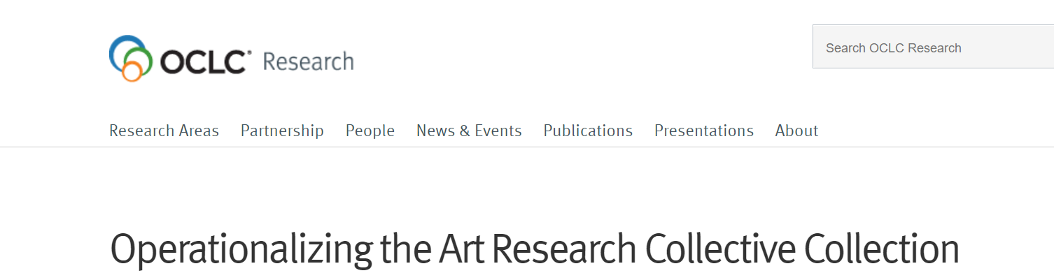
4 phases over 2 years
Analyze art research collective collections
Identify art research collection sharing patterns
Conduct collaborative case studies
Operationalize collaboration
Supported by a generous grant from the Samuel H. Kress Foundation, with considerable co-investment by OCLC.
The goal of the OpArt project is to help art libraries identify potential collaborative models to address shared sustainability barriers and consider practically what institutions will need to make these models operational.
Notes:
I'll start by giving you just a bit of an introduction to this project – Operationalizing the Art Research Collective Collection, or what we affectionately refer to as OpArt for short.
Like much of our work, the seed of the idea for this project came from conversation with our library colleagues – specifically a conversation with Research Library Partnership members around at table at the 2019 ARLIS/NA conference. A few themes emerged in that conversation: an acute lack of space at art research libraries, difficulties in arranging for offsite storage of print collections, gaps in shared knowledge regarding the library collections of peer institutions, and the perceived value of art libraries partnering with each other and with other types of libraries on the shared management of print collections.
At the end of that hour we felt like we might have the makings of research project, and we spent more time having conversations and honing the scope and purpose of the project. In January 2021, we officially launched the OpArt project, with generous support from the Samuel H. Kress Foundation and significant co-investment from OCLC.
The goal of the OpArt project is to help art libraries identify potential collaborative models to address shared sustainability barriers and consider practically what institutions will need to make these models operational.

Slide 4
Project Phases
data-driven analysis
qualitative analysis
I. Opportunities for cooperation
across art research collections
III. “Deep dive” into case studies
of real-world collaboration
II. Cooperation patterns
in resource sharing
IV. Recommendations on how to make collaboration work
Notes:
There are four phases of our project, all focused on identifying potential opportunities for collaboration and cooperation to support sustainability of art research collections
Phase 1: uses WorldCat data to identify and analyze the art research collective collection
Phase 2: uses resource sharing data to examine the sharing patterns occurring among art libraries, and between art libraries and other types of libraries.
Phase 3: builds on the findings from the first two phases with a “deep dive” into a small set of case studies of regional art library collaborations
And Phase 4: we’ll synthesize our findings and make recommendations on building and sustaining inter-institutional collaborations
Today we'll be sharing findings from phases 1 and 2 with you.

Slide 5


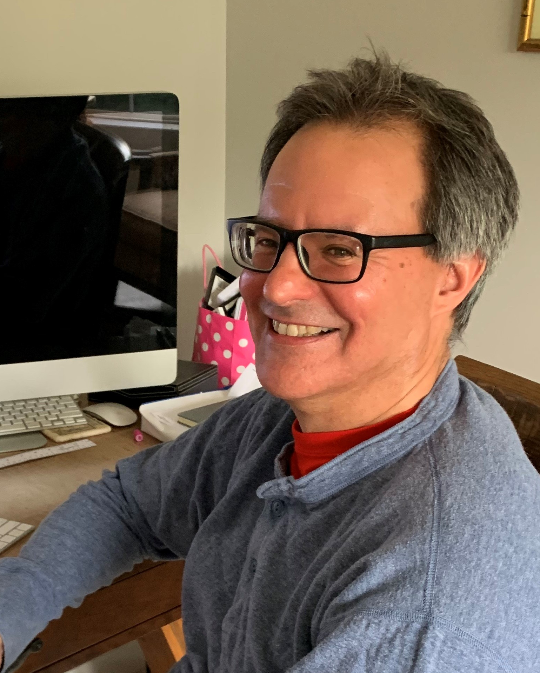
OpArt project team
Dennis Massie
Chela Scott Weber
Senior Program Officer, Resource Sharing
Senior Program Officer, Archives and Special Collections
Brian Lavoie
Senior Research Scientist
Notes:
And since we're not there with you today, here are photos of the three of us, the OpArt project team. You'll be hearing from Brian and Dennis shortly.

Slide 6
Advisory Group
Jon Evans, Museum of Fine Arts, Houston
Rebecca Friedman, Marquand Library, Princeton University
Roger Lawson, National Gallery of Art
Autumn Mather, Art Institute of Chicago
Keli Rylance, Saint Louis Art Museum
Lori Salmon, Institute of Fine Arts, New York University
Kathleen Salomon, Getty Research Institute
Tony White, OCAD University
Notes:
And I'd also like to acknowledge our advisory board, who have brought their deep knowledge of art libraries and supporting art research to help shape and guide our work. We're grateful that they have been willing to play such an essential part in this initiative and give so generously of their time and expertise.
With that, I'll turn it over to Brian.

Slide 7
Op Art: Collection Analysis
Notes:
And now I'll turn things back over to Chela to walk us through the OpArt collections analysis work done by our OCLC Research colleague, Brian Lavoie.

Slide 8





Collective collection analysis
Art Research
Collective Collection
Proxy
Collective Collection
What’s in the
collection?
Who contributes
to the collection?
Where are
they
located?

Slide 9
Size
Proxy
Art Research
Collective Collection
85 institutions
8.6m distinct publications
16.0m total holdings
Notes:
Starting with some basic size statistics, we have a collection featuring the combined holdings of 85 institutions, that were selected according to a list of criteria we developed in consultation with our advisory committee. The collective holdings of these institutions account for 8.6 million distinct publications, which is roughly equivalent to FRBR manifestations, and 16 million total holdings across all the members of the group. So this is a fairly sizable collection, and as we’ve discussed, we’d like to use it as a representation of the overall global art research collective collection.

Slide 10
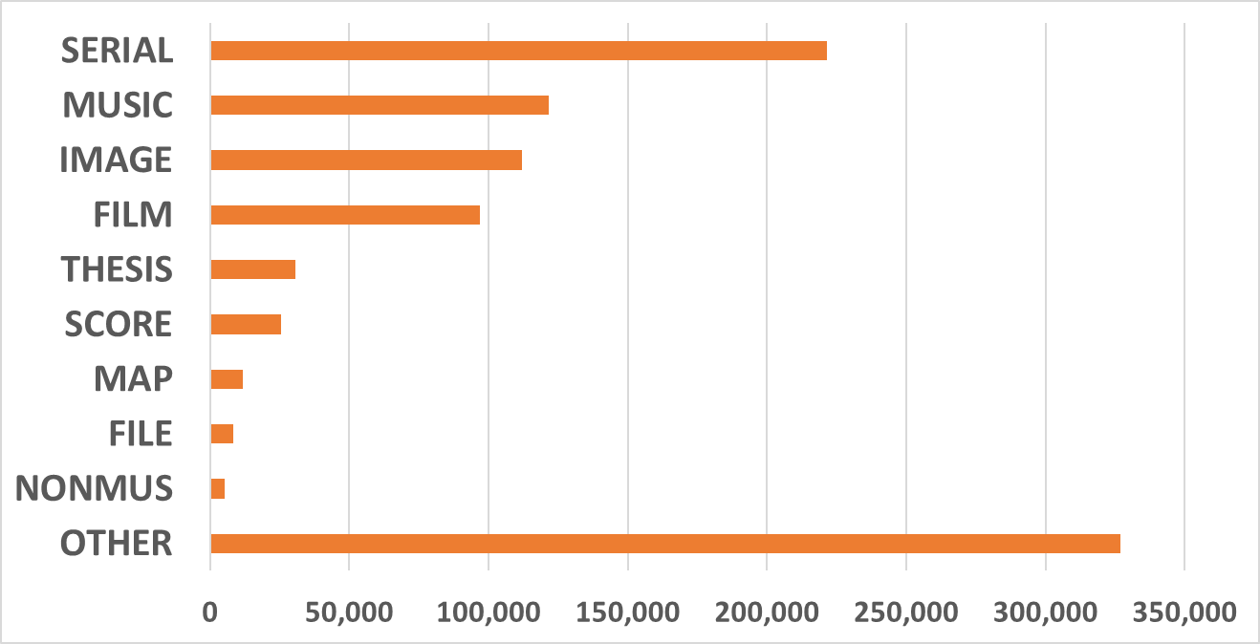
Distribution of Material Types (# of publications)
7.6 million books
Notes:
Here’s a look at the distribution of material types in the proxy collection. The thing that probably sticks out the most is that the vast majority of the publications are books or book-like objects. But as you can see, there’s a wide range of other material types there too, including lots of serials, musical recordings, and images. But again, the takeaway I think is that this collection is very book-focused.
But certainly lots of other stuff as well, including films, theses and dissertations, music scores, maps, computer files, non-musical recordings, and a long-tail of other materials.

Slide 11
What’s in the proxy collection? A closer look…
Genre | # of publications
Exhibition catalogs | 675,116
Auction catalogs | 143,460
Artist files | 129,550
Artists books | 25,465
Trade catalogs | 10,396
Catalog raisonnes | 8,968
Prints | 5,212
Photo books | 4,922
Zines | 2,716
Data from analysis of 655 field
Notes:
Earlier we took a look at the general material types present in the proxy collective collection. Here, we’re drilling down a little deeper into the kinds of materials that are somewhat unique or most frequently found in art research collections. We identified a list in consultation with some experts suggested by our advisory committee, and then tried to identify them in our proxy collection, mainly by analyzing data in the 655 field. On the slide we have a list of some of the more prevalent types, including things like exhibition catalogs, artist files, and even materials like prints and zines. As you can see, exhibition catalogs, auction catalogs, and artist files are particularly evident, especially exhibition catalogs: nearly 700,000 of those across the holdings of our 85 proxy group members. The zines genre is interesting as well – it looks like at least some art research libraries have focused some of their collecting activity on this relatively new genre of materials.

Slide 12
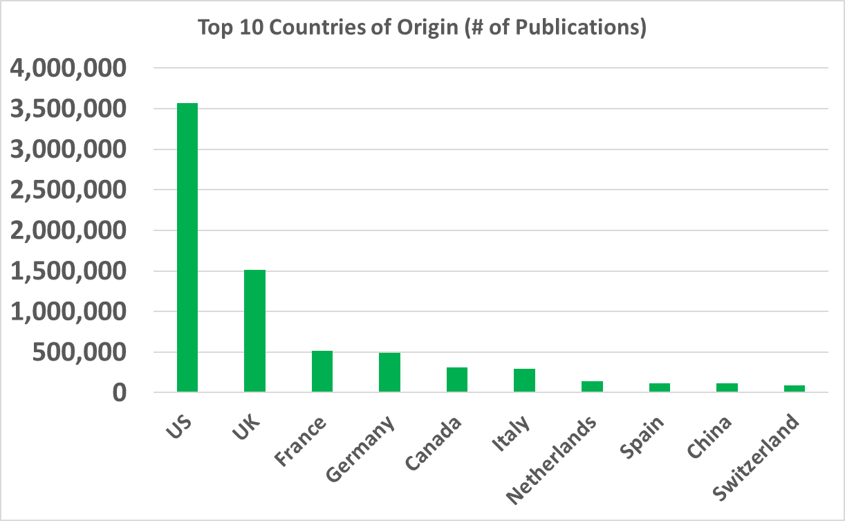
Country of Origin
261 countries & territories
Notes:
Here’s a look at the distribution of countries of publication, or countries of origin, for the publications in the collection. The US and UK predominate here, again likely as a consequence of all our institutions being North American, but, as with languages, we see plenty of other countries represented as well – more than 260 different countries.
Actually, to be precise, it’s not just countries, but countries, territories, dependencies and other entities that are assigned a unique MARC country code.
Again, it would be interesting to compare this list to one from a more general collection. The one thing that strikes me about this distribution is that Switzerland is relatively higher ranked than I think you would see elsewhere – might be interesting to explore why that’s the case.

Slide 13
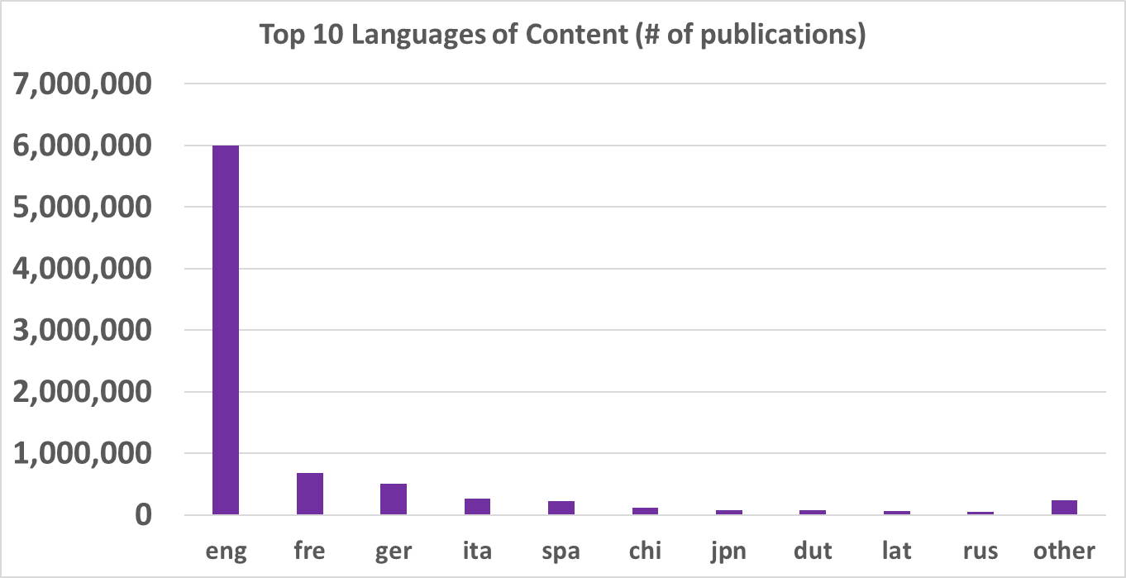
Distribution of Languages
374 languages
Notes:
Here’s the distribution of languages in the collection. No surprise that English predominates, given that our proxy institutions are all North American, but lots of other languages well-represented there as well. And I think its quite remarkable to see that this overall collection of 8.6 million publications includes content in over 370 different languages.
I also think the list of top languages for this collection is probably a bit different from other collective collection analyses we’ve done of general, or non-disciplinary-focused collective collections. For instance, I think Latin ranks much higher here than you would see in other collections.

Slide 14
Subjects
in the
Proxy Collection
LCSH No. of Holdings in Proxy Collection
Art 506,866
Architecture 306,944
Art, Modern 306,884
Photography, Artistic 237,036
Painting 188,791
Artists 162,254
Art, American 149,882
Indians of North America 126,566
Photography 118,584
Painters 113,025
Painting, American 98,543
Drawing 87,335
Christian Art and Symbolism 84,133
Women 83,478
Decorative Arts 76,766
English Language 75,193
Painting, Modern 73,043
Excavations (Archaeology) 66,849
Art, Italian 64,901
Furniture 62,847

Slide 15
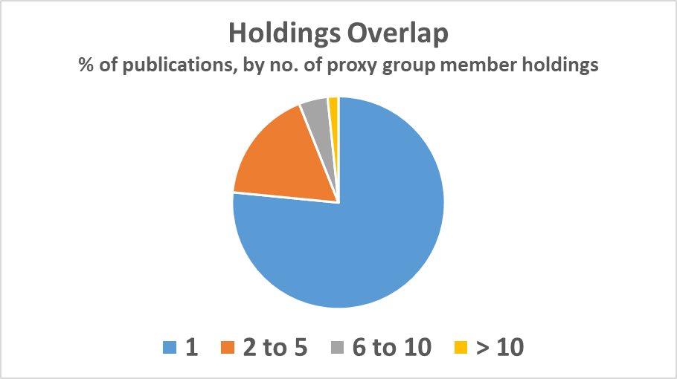
Holdings Overlap in the Proxy Collection
77% held by one group member
Notes:
I mentioned there were about 16 million total holdings on 8.6 million distinct publications, so obviously there’s some overlap in the holdings. This pie chart gives you a sense of what the overlap pattern looks like. I think the headline is that about three quarters of the publications are held by only one member within the group, so clearly a lot of uniqueness is present across the 85 individual collections.
But there is some duplication as well: so for example, according to the chart, only about 2% of the publications are held by more than 10 institutions within the group, but in absolute terms, that accounts for nearly 150,000 distinct publications.

Slide 16
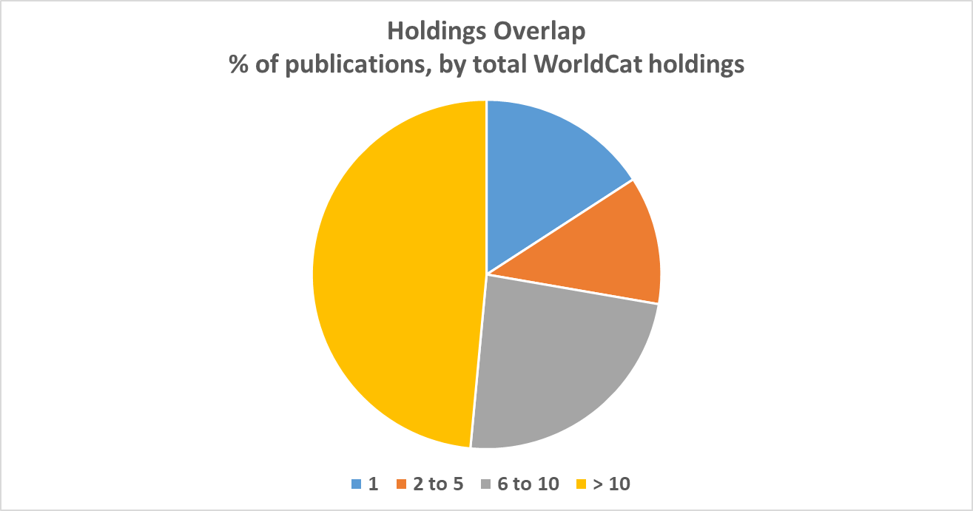
Holdings overlap: the WorldCat universe
Notes:
Here’s another perspective on holdings. Everything we’ve looked at so far represents holdings within the proxy group – in other words, the 85 institutions whose collections form our proxy art research collective collection. But what if we took the publications in our proxy collection, and looked at holdings overlap patterns for them in the broader WorldCat context, which includes libraries of all types and locations? That’s what we have on the slide here, and you can see there is a significant difference in the holdings overlap pattern when you compare it to the proxy-group-only pattern which we included as an inset to the right. In particular, that huge fraction of the collection held by a single group member shrinks way down when the frame of reference is WorldCat as a whole, and the tiny sliver of materials held by more than 10 group members expands to nearly half the collection. This data is a good reminder that scarcity or abundance depends on your frame of reference, and also suggests the possibility for interesting partnerships between art libraries and the many other libraries that hold similar kinds of materials.

Slide 17

Art Discovery Group Catalogue (ADGC)
ADGC
Collective Collection
70 OCLC symbols
14.9m distinct publications
21.9m total holdings
ADGC
Collective Collection
Without
proxy group
members
55 OCLC symbols
12.7m distinct publications
15.5m total holdings
Notes:
While our proxy group of art research institutions is useful for the purposes of this research project, it’s certainly not the only grouping of institutions relevant to art research. In some of our discussions with our advisory committee, it was mentioned several times that the member institutions of the Art Discovery Group Catalog would be an interesting point of comparison to our proxy collective collection. So we did some basic analysis of the ADGC collective collection in terms of size and total holdings, which we then compared to our proxy group.
Starting with the green figure at the top, we calculated that the ADGC collective collection as it is represented in WorldCat, accounts for 14.9 million distinct publications, based on total holdings of almost 22 million across the group’s membership. And this was based on 70 OCLC symbols in WorldCat attributed to the ADGC’s membership.
As you can see, this is a much bigger collective collection than our proxy group – both in terms of publications and total holdings. And another important difference is that the ADGC membership is international, while our proxy group membership is confined to North America.
Now speaking of our proxy group members, there is some overlap in membership across the two groups – in fact, 15 institutions are in both groups. We thought it would be interesting to re-calculate the size of the ADGC collective collection if the holdings of those 15 proxy group members are removed, and that gives us the orange figure at the bottom of the slide. With these institutions removed, the ADGC collective collection shrinks to 12.7 million publications based on 15.5 million total holdings. So with the proxy group members removed, the ADGC collection is still bigger than our proxy collective collection in terms of publications, but slightly smaller in terms of total holdings.

Slide 18
Proxy overlap with ADGC
Without proxy group members
Proxy
Art Research
Collective Collection
Proxy
Art Research
Collective Collection
ADGC
Collective Collection
ADGC
Collective Collection
46% of proxy collection
is in ADGC collection
20% of proxy collection
is in ADGC collection
Notes:
So that moves us to the last slide, where it will be clear why we did this re-calculation of the ADGC collection without the proxy group members included. So here we’re looking at the overlap in publications between the ADGC collective collection on the one hand, and the proxy collective collection on the other. On the left, we see the overlap between the two where the ADGC collection includes all members, which means including the members that are also in the proxy group. In this case, we found that nearly half of the proxy collection is also held, or replicable, within the ADGC collection.
But we know that the ADGC membership includes a sizable cohort of institutions that are also in our proxy group, so by default there’s going to be some overlap across the collections, so a more interesting question to ask might be what is the overlap that remains if we exclude the holdings of the institutions that have dual membership in both groups. And we do that in the figure on the right, where we show that if we exclude from the ADGC collection the holdings of the institutions that are in both groups, it turns out that the ADGC collection overlaps with about 20 percent of the publications in the proxy group.
I think these results are interesting because they start to give you a sense of how collective collection analysis can help identify opportunities for partnership and collaboration – so for instance, in this example, about 80% of the proxy group collection is not held by ADGC members outside of the proxy group, and this helps highlight the differences, and possible respective strengths, of the two collections.

Slide 19
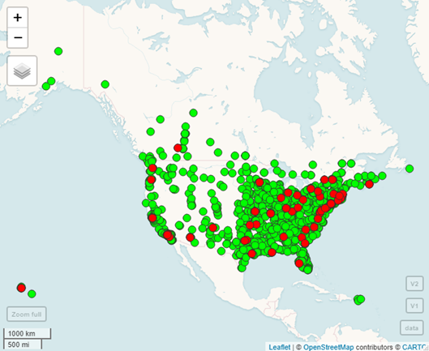
Proxy Group
Members &
Academic Library
“Co-collectors”

Slide 20
Insights on Collaboration
The book-based disposition of the art research collective collection is a fertile ground for creating collective value through collective effort
The distinctive collecting priorities of art libraries can offer a valuable complement to a collective collection involving partners outside the art library community
Specializations in subject collecting could create complementarities both within the collections of a group of art library partners, or those of a mixed group of art libraries and other types of institutions
The network of institutions supporting the art research collective collection is extensive, heavily populated, and well-distributed

Slide 21
Op ART: ILL DATA analysis
Notes:
And now back over to Dennis for some preliminary findings from the ILL data analysis.
Thank you, Brian. Once we established a baseline understanding of the art research collective collection, our next step was to look at how that collection has been shared, as well as how the builders of that collection sought to supplement their holdings through interlibrary loan. By its very nature, interlibrary loan involves partnering with other institutions, which of course lies at the very heart of our investigation.

Slide 22
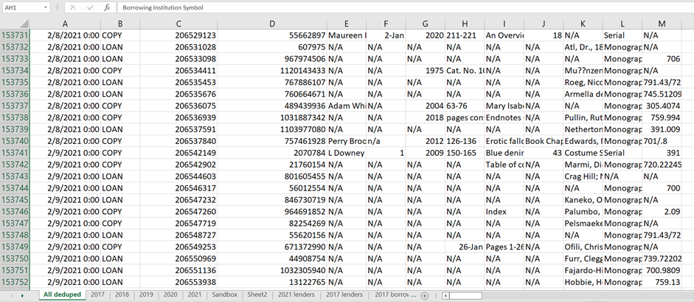
OpArt ILL data set:
5 years of WorldShare ILL data with a Proxy Group member as borrower or lender​
Notes:
To do this we built a data set of 5 years of all WorldShare ILL transactions where a proxy group member was either the borrower or the lender.

Slide 23
OpArt ILL data set:
5 years of WorldShare ILL data with a Proxy Group member as borrower or lender​
158,566 total filled transactions
104,962 originals shared
53,604 copies shared
Notes:
That left us with a data set of nearly 160,000 filled requests, with twice as many originals shared by the proxy group as there were copies. Perhaps that is not so surprising when we're talking about art research materials.

Slide 24
OpArt ILL data set:
5 years of WorldShare ILL data with a Proxy Group member as borrower or lender​
158,566 total filled transactions
104,962 originals shared
53,604 copies shared
244,002 unfilled transactions
60.7% eventually filled with 1st lender string
39.3% unfilled with 1st lender string
Notes:
We also had access to data for nearly 250,000 unfilled requests. Most of these were earlier attempts to borrowing materials that were eventually supplied and that show up as transactions in our filled data set. About 40% were not supplied by the first string of potential lenders. Subsequent attempts would appear under a different transaction number, so it is difficult to tell from our data what the ultimate fate of the request was.
We had hoped to learn something about why certain materials are difficult to borrow via interlibrary loan, by looking at the reasons given by prospective lenders when they declined to supply each item. We were disappointed, however. More than half the transactions lacked any reason for no. The most popular reason was Lacking, meaning that the title was owned by the prospective lender but not the issue. About 10% of the requests for which we have "reasons for no" were denied because the material was non-circulating.

Slide 25
Proxy Group ILL activity on OCLC
Shared within proxy: 15.1%
Proxy borrower only: 47.7%
Proxy lender only: 37.2%
50 of 85 Proxy Group members used OCLC ILL
N=158,566
Notes:
Arguably one of the biggest takeaways from our ILL analysis is that only 15% of the collection sharing done from 2017 to 2021 was done within the proxy group. I expected that number to be a bit higher. So 85% of the interlibrary loan transactions involved a library outside the proxy group.
Nearly half of the transactions involve a proxy group member BORROWING from a library outside the group. And more than a third involve them lending to a library outside the proxy group. So even before we delve into the specifics of what was being shared, and with whom, it seems clear that partnering with institutions outside their immediate peer group is something that is likely to benefit art research libraries.

Slide 26


ILL analysis takeaways
Art research libraries' borrowing patterns resemble their collecting patterns
Subject
Format
Language
Publication date
Special categories
Relative scarcity
P vs E
Collect 43% E, shared 3.7% E
Notes:
Now let's walk through some of the top takeaways from our analysis of the interlibrary loan data.
The first is that the art research libraries in our proxy group mostly borrowed the same types of materials that they themselves collect.
We compared what was collected with what was shared, through the various lenses listed on this slide.
And in just about every way, including, surprisingly, special categories of materials such as exhibition and auction catalogs, the profile of what is collected by art research libraries matches up with what is shared via interlibrary loan.
With one exception.
Our proxy collection is largely comprised of e-resources of various kinds – 43%. But only 3.7% of what was borrowed and loaned by the proxy group was electronic.
There are some likely reasons for this. Art research is highly dependent upon illustrated print matter. Licensing for e-resources can be an issue, less so for journals than for ebooks. And we lack a robust technical infrastructure for sharing e-books either in whole or in part. But this disparity between the percentage of e-resources that are collected and that are shared may signal opportunities for collaborative partnerships.

Slide 27
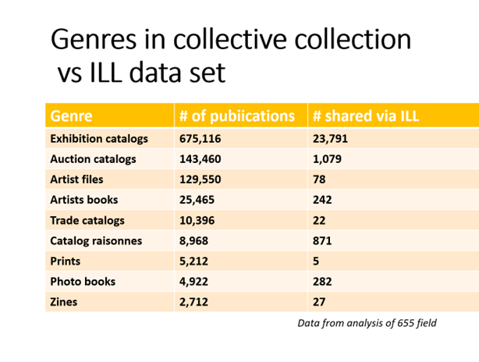
ILL analysis takeaways
Art research libraries' borrowing patterns resemble their collecting patterns
Notes:
I mentioned the special categories of materials often collected by art research libraries and few others. We saw in the collections analysis that the proxy collection contains substantial amounts of exhibition and auction catalogs and artists files. Each of the 9 special categories noted in the collections analysis also show up among the materials borrowed and loaned by art research libraries via interlibrary loan.
Clearly the willingness to share these special materials signals an openness to potentially partnering with other institutions around content typically only held by art research libraries.

Slide 28
ILL analysis takeaways
Art research libraries' borrowing patterns resemble their collecting patterns
All transactions | Within Proxy | Proxy Borr from Non | Proxy Lend to Non
N (18.0%) | N (31.1%) | N (10.2%) | N (23.6%)
ND (9.0%) | ND (18.7%) | ND (6.2%) | ND (8.9%)
NK (5.3%) | NK (7.7%) |  | NK (8.3%)
 |  | NK (2.5%)
Notes:
It was fascinating to break down what was shared via interlibrary loan by subject matter, using Library of Congress Classification classes and subclasses as an indicator of the main topic of each publication. The LCC designates fine art in class N, and narrower topics under fine arts in N subclasses such as ND (painting) and NK (decorative arts).
No matter how we slice the data – whether it's sharing within the proxy group, or proxies borrowing from outside the group, or proxies lending to institutions outside the group --

Slide 29
ILL analysis takeaways
Art research libraries' borrowing patterns resemble their collecting patterns
All transactions | Within Proxy | Proxy Borr from Non | Proxy Lend to Non
N (18.0%) | N (31.1%) | N (10.2%) | N (23.6%)
ND (9.0%) | ND (18.7%) | ND (6.2%) | ND (8.9%)
NK (5.3%) | NK (7.7%) |  | NK (8.3%)
 |  | NK (2.5%)
Notes:
-- general fine arts and fine arts, painting, are the subjects most shared. No matter who is sharing with whom.
The sharing of decorative arts materials is almost as consistent, with it being a slightly less popular topic when proxy group members are borrowing from outside the group.

Slide 30
ILL analysis takeaways
Art research libraries' borrowing patterns resemble their collecting patterns
All transactions | Within Proxy | Proxy Borr from Non | Proxy Lend to Non
N (18.0%) | N (31.1%) | N (10.2%) | N (23.6%)
ND (9.0%) | ND (18.7%) | ND (6.2%) | ND (8.9%)
NK (5.3%) | NK (7.7%) | PN (3.8%) | NK (8.3%)
PN (4.2%) |  |  | PN (6.0%)
 |  | NK (2.5%)
Notes:
We were intrigued at first to see PN (general literature) ranked so highly in what was shared outside the group, with proxy members both borrowing and lending significant numbers of items on this subject. But a close look revealed that most of these materials were graphic novels, manga, and comics. Also a fair number of books about film and television and quite a few DVDs of movies and television programs.

Slide 31
ILL analysis takeaways
Art research libraries' borrowing patterns resemble their collecting patterns
All transactions | Within Proxy | Proxy Borr from Non | Proxy Lend to Non
N (18.0%) | N (31.1%) | N (10.2%) | N (23.6%)
ND (9.0%) | ND (18.7%) | ND (6.2%) | ND (8.9%)
NK (5.3%) | NK (7.7%) | PN (3.8%) | NK (8.3%)
PN (4.2%) | TR (3.5%) |  | PN (6.0%)
 |  | NK (2.5%)
TR (2.8%) |  |  | TR (4.1%)
 |  | TR (1.8%)
Notes:
Photography was another frequently shared subject are, primarily when proxy group members were lending.

Slide 32
ILL analysis takeaways
Art research libraries' borrowing patterns resemble their collecting patterns
All transactions | Within Proxy | Proxy Borr from Non | Proxy Lend to Non
N (18.0%) | N (31.1%) | N (10.2%) | N (23.6%)
ND (9.0%) | ND (18.7%) | ND (6.2%) | ND (8.9%)
NK (5.3%) | NK (7.7%) | PN (3.8%) | NK (8.3%)
PN (4.2%) | TR (3.5%) | DS (3.3%) | PN (6.0%)
 |  | NK (2.5%)
TR (2.8%) |  | F (2.5%) | TR (4.1%)
DS (2.3%) |  | E (2.3%)
F (1.9%)
E (1.7%) | DS (1.8%) | TR (1.8%)
Notes:
Next comes DS (History of Asia and the Middle East) and E and F (History of the Americas). Note that these materials show up the most when proxy group members are borrowing from outside the immediate peer group.

Slide 33
ILL analysis takeaways
Art research libraries' borrowing patterns resemble their collecting patterns
All transactions | Within Proxy | Proxy Borr from Non | Proxy Lend to Non
N (18.0%) | N (31.1%) | N (10.2%) | N (23.6%)
ND (9.0%) | ND (18.7%) | ND (6.2%) | ND (8.9%)
NK (5.3%) | NK (7.7%) | PN (3.8%) | NK (8.3%)
PN (4.2%) | TR (3.5%) | DS (3.3%) | PN (6.0%)
 |  | NK (2.5%)
TR (2.8%) |  | F (2.5%) | TR (4.1%)
DS (2.3%) |  | E (2.3%) | TT (2.3%)
F (1.9%)
 |  | Z (2.0%)
E (1.7%) | DS (1.8%) | TR (1.8%)
Notes:
Two other topics that show up are TT (Handicrafts, Arts and crafts) and Z (Bibliography, Library Science).

Slide 34
ILL analysis takeaways
Art research libraries' borrowing patterns resemble their collecting patterns
All transactions | Within Proxy | Proxy Borr from Non | Proxy Lend to Non
N (18.0%) | N (31.1%) | N (10.2%) | N (23.6%)
ND (9.0%) | ND (18.7%) | ND (6.2%) | ND (8.9%)
NK (5.3%) | NK (7.7%) | PN (3.8%) | NK (8.3%)
PN (4.2%) | TR (3.5%) | DS (3.3%) | PN (6.0%)
NA (3.5%) | NA (3.2%) | NK (2.5%) | NA (5.3%
TR (2.8%) | NB (3.0%) | F (2.5%) | TR (4.1%)
DS (2.3%) | NE (2.7%) | E (2.3%) | TT (2.3%)
F (1.9%) | NC (2.3%) | NA (2.2%) | NC (2.1%)
NE (1.7%) | NX (1.9%) | Z (2.0%) | NX (2.0%)
E (1.7%) | DS (1.8%) | TR (1.8%) | NB (2.0%)
Notes:
And then all the rest of the most frequently requested topics are various fine arts subclasses.

Slide 35
ILL analysis takeaways
Art research libraries' borrowing patterns resemble their collecting patterns
All transactions | Within Proxy | Proxy Borr from Non | Proxy Lend to Non
N (18.0%) | N (31.1%) | N (10.2%) | N (23.6%)
ND (9.0%) | ND (18.7%) | ND (6.2%) | ND (8.9%)
NK (5.3%) | NK (7.7%) | PN (3.8%) | NK (8.3%)
PN (4.2%) | TR (3.5%) | DS (3.3%) | PN (6.0%)
NA (3.5%) | NA (3.2%) | NK (2.5%) | NA (5.3%
TR (2.8%) | NB (3.0%) | F (2.5%) | TR (4.1%)
DS (2.3%) | NE (2.7%) | E (2.3%) | TT (2.3%)
F (1.9%) | NC (2.3%) | NA (2.2%) | NC (2.1%)
NE (1.7%) | NX (1.9%) | Z (2.0%) | NX (2.0%)
E (1.7%) | DS (1.8%) | TR (1.8%) | NB (2.0%)
Notes:
Note how different the profile looks when it's proxy group members borrowing from outside the group.

Slide 36
ILL analysis takeaways
Art research libraries' borrowing patterns resemble their collecting patterns
Art research libraries rely on access to other types of libraries to supplement their collections
All transactions | Within Proxy | Proxy Borr from Non | Proxy Lend to Non
N (18.0%) | N (31.1%) | N (10.2%) | N (23.6%)
ND (9.0%) | ND (18.7%) | ND (6.2%) | ND (8.9%)
NK (5.3%) | NK (7.7%) | PN (3.8%) | NK (8.3%)
PN (4.2%) | TR (3.5%) | DS (3.3%) | PN (6.0%)
NA (3.5%) | NA (3.2%) | NK (2.5%) | NA (5.3%
TR (2.8%) | NB (3.0%) | F (2.5%) | TR (4.1%)
DS (2.3%) | NE (2.7%) | E (2.3%) | TT (2.3%)
F (1.9%) | NC (2.3%) | NA (2.2%) | NC (2.1%)
NE (1.7%) | NX (1.9%) | Z (2.0%) | NX (2.0%)
E (1.7%) | DS (1.8%) | TR (1.8%) | NB (2.0%)
Notes:
This suggested that art research libraries rely on access to other types of libraries to supplement their own collections. Which is an important consideration when considering prospective collaborative partnerships.

Slide 37
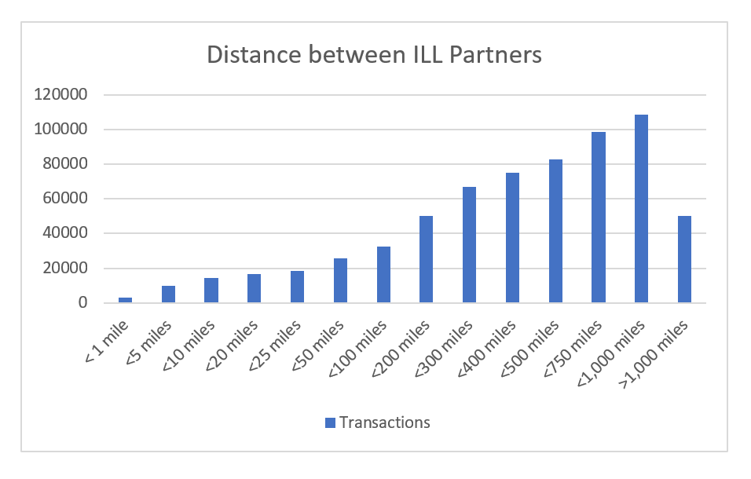
ILL analysis takeaways
Art research libraries' borrowing patterns resemble their collecting patterns
Art research libraries rely on access to other types of libraries to supplement their collections
Trust and reliability can trump distance
N=158,566
Notes:
One of the most surprising findings from our analysis of the ILL data is that distance between partners mattered less than we expected. Trust and reliability seem to be more important factors.
The farther we go out as far as physical distance between partners, the more ILL transactions from our data set are included.

Slide 38
ILL analysis takeaways
Art research libraries' borrowing patterns resemble their collecting patterns
Art research libraries rely on access to other types of libraries to supplement their collections
Trust and reliability can trump distance
N=158,566
Notes:
About 50 thousand transactions – nearly a third of all filled requests – happened between partners located a thousand miles or more away from each other.

Slide 39
ILL analysis takeaways
Art research libraries' borrowing patterns resemble their collecting patterns
Art research libraries rely on access to other types of libraries to supplement their collections
Trust and reliability can trump distance
Average distance traveled for all filled transactions: 899 miles
Notes:
Overall the average distance between partners for all filled requests was 899 miles. Higher than expected.

Slide 40
ILL analysis takeaways
Art research libraries' borrowing patterns resemble their collecting patterns
Art research libraries rely on access to other types of libraries to supplement their collections
Trust and reliability can trump distance
Average distance traveled for all filled transactions: 899 miles
Average distance for copies: 1,046 miles
Average distance for loans: 824 miles
Notes:
It doesn't matter how far apart you are when it comes to copies, as the vast majority of these are delivered electronically. But we were surprised at how little difference that was between copies and physical loans.

Slide 41
ILL analysis takeaways
Art research libraries' borrowing patterns resemble their collecting patterns
Art research libraries rely on access to other types of libraries to supplement their collections
Trust and reliability can trump distance
Average distance traveled for all filled transactions: 899 miles
Average distance for copies: 1,046 miles
Average distance for loans: 824 miles
Average distance between 2 proxy group ILL partners: 1,033 miles
Average distance when 1 ILL partner is outside the proxy group: 1,041 miles
Notes:
It also didn't matter whether the partners were proxy members or not – very little difference.

Slide 42
ILL analysis takeaways
Art research libraries' borrowing patterns resemble their collecting patterns
Art research libraries rely on access to other types of libraries to supplement their collections
Trust and reliability can trump distance
Average distance between each Proxy Group member and their Top 3 sharing partners: 638 miles
29% less than overall average between partners (899 miles)
Notes:
Distance did seem to matter when libraries chose their most frequent partners, the average going down 29% to 638 miles.

Slide 43
ILL analysis takeaways
Art research libraries' borrowing patterns resemble their collecting patterns
Art research libraries rely on access to other types of libraries to supplement their collections
Trust and reliability can trump distance
Average distance between each Proxy Group member and their Top 3 sharing partners: 638 miles
29% less than overall average between partners (899 miles)
First: 652 miles
Second: 616 miles
Third: 647 miles
Notes:
Oddly, the distance didn't vary much when comparing the top 1, 2 and 3 partners.

Slide 44
ILL analysis takeaways
Art research libraries' borrowing patterns resemble their collecting patterns
Art research libraries rely on access to other types of libraries to supplement their collections
Trust and reliability can trump distance
Average distance between each Proxy Group member and their Top 3 sharing partners: 638 miles
29% less than overall average between partners (899 miles)
First: 652 miles
Second: 616 miles
Third: 647 miles
11 Proxies averaged <100 miles from their top 3 partners
4 averaged <25 miles
1 averaged <1 mile
Notes:
And there were a few proxy group members who shared primarily with those in close proximity. So distance clearly mattered to some.

Slide 45
ILL analysis takeaways
Art research libraries' borrowing patterns resemble their collecting patterns
Art research libraries rely on access to other types of libraries to supplement their collections
Trust and reliability can trump distance
Current or previous sharing relationships matter
13 Proxy Group members are members of SHARES
All 13 have SHARES members as their top 3 partners
Avg. distance: 931 miles
Notes:
A current or previous sharing relationship seemed to matter more than distance. 13 proxy group members are also members of SHARES, a multinational multitype resource sharing consortium.
All 13 have SHARES members as their top 3 ILL partners.
And clearly distance was not the determining factor.

Slide 46
ILL analysis takeaways
Art research libraries' borrowing patterns resemble their collecting patterns
Art research libraries rely on access to other types of libraries to supplement their collections
Trust and reliability can trump distance
Current or previous sharing relationships matter
13 Proxy Group members are members of SHARES
All 13 have SHARES members as their top 3 partners
Avg. distance: 931 miles
6 Proxy Group members are former SHARES members
All 6 have SHARES members as their top 3 partners
Avg. distance: 985 miles
Notes:
There are 6 former SHARES members in the Proxy Group.
All 6 have SHARES members as their top 3 ILL partners.
And again distance did not seem to matter.

Slide 47
ILL analysis takeaways
Art research libraries' borrowing patterns resemble their collecting patterns
Art research libraries rely on access to other types of libraries to supplement their collections
Trust and reliability can trump distance
Art libraries can deliver
Track record of sharing non-circulating collections
Collect subject matter and formats not widely available but of great interest to scholars
ILL performance compares favorably to that of large, well-staffed academic libraries
Top R1 Carnegie non-Proxy: 2.5 days
Top Proxy museum library: 2.9 days
Proxies as top 3 partner: 3.0 days
Average all 158,566 requests: 3.4 days
Notes:
One thing the ILL data seems to indicate is that art libraries can hold up their end of the resource sharing bargain.
And we have some data that backs up that statement. Looking at response time, as measured by the time a request is created by the borrower until the lender responds online that they will supply the item, our proxy group members performed quite respectably.

Slide 48
Implications for collaborative partnerships
Art libraries collect subject matter and formats not widely available but of great interest to scholars
Art research libraries rely on access to other types of libraries to supplement their collections
ILL performance of art libraries compares favorably to that of large, well-staffed academic libraries
Trust and reliability can trump distance
Art libraries can deliver
Notes:
Trust and reliability can trump distance, which implies that for certain types of collaborative partnerships art research libraries may be able to seek partners outside their immediate region.
And though we won't put it this way in our published report, basically the ILL data shows that art research libraries make good partners. They bring a lot to the table and can hold up their end of any bargain. We're definitely seeing this in the next phases of the project, the case studies of existing partnerships.

Slide 49
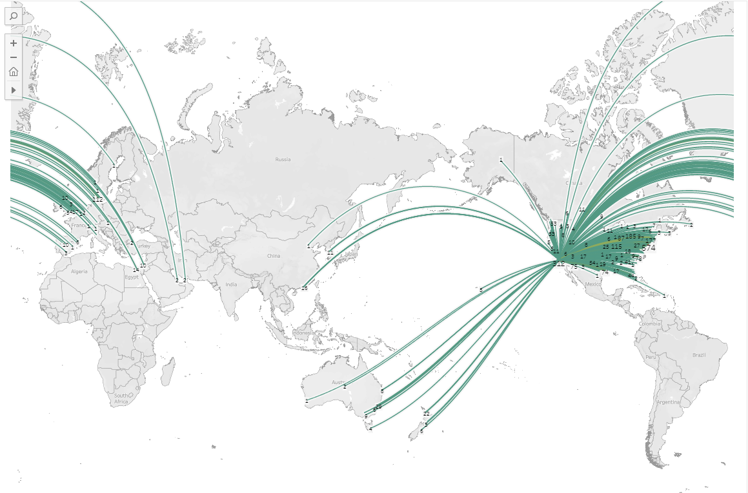
Notes:
I leave you with this image, generated from the ILL lending data for one of our proxy group members, the Getty Research Institute, for the year 2019. Our study has focused very much on North America. But you can see here that the need for art research materials and the ability of art research libraries to share them is truly global. Our study focuses on the US and Canada, but hopefully there will be useful implications for libraries everywhere.
With that, I'll turn things back over to Chela.

Slide 50
Next Steps
Notes:
So what's still on our OpArt to-do list?

Slide 51
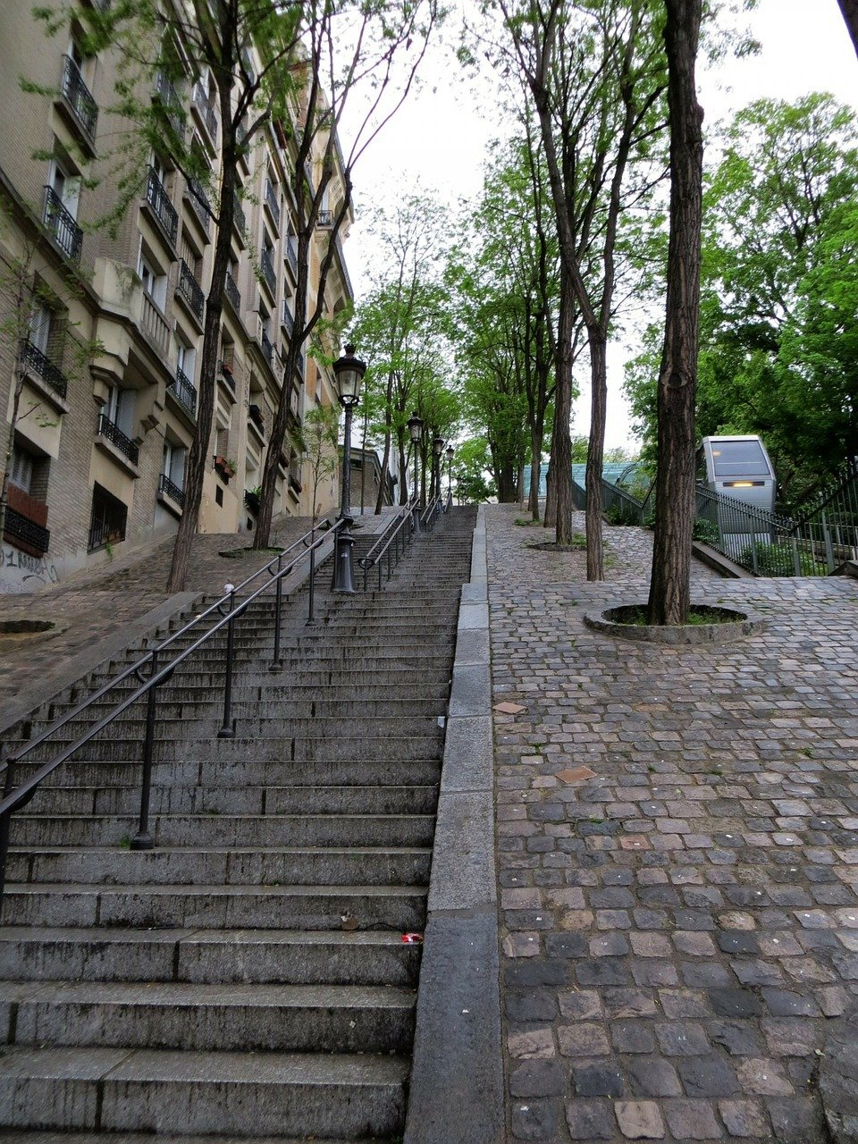
OpArt next steps
Publish first report on collective collections and ILL data analysis
Synthesize and report out on partnership case studies in report two
Identify areas for action and further study
Notes:
We’ll close with just a few words about next steps.
We just handed in the manuscript for report one last week, which should be published in early 2023.
We have conducted a series of case studies examining different models of partnerships between art and other types of libraries, and are at work on a second report synthesizing patterns and takeaways, that will also be published in early 2023. The case study interviews have been rich with insights and we look forward to sharing them.
And lastly we’ll be disseminating and engaging with the community around our findings, hoping to spur further action and areas of additional study. We hope you will keep an eye out for this work as it is released.

Slide 52
Look for updates on our project page oc.lc/art-collective-collection
Watch for new posts on Hanging Together https://hangingtogether.org/
Email Us!
Brian lavoie@oclc.org
Chela weberc@oclc.org
Dennis massied@oclc.org
Questions?
Notes:
Thanks again for your time and attention today.
If you have any questions, please see our project page listed here, watch for updates on the OCLC Research blog Hanging Together, or feel free to email us.

