Slide 1
“OH, THE PLACES YOU’LL GO” together:
Case studies in cross-institutional collaboration
14 November 2022
Anne Rauh
Head of Collections & Research Services, Syracuse University
Ian Milligan, PhD
Associate Vice-President, Research Oversight and Analysis, University of Waterloo
Rebecca Bryant, PhD
Senior Program Officer, OCLC Research
Alison Hitchens
Associate University Librarian, University of Waterloo

Slide 2
Libraries support an array of research support activities
Scholarly communications (& repositories)
Research data management (RDM)
Copyright
Digital humanities
RIM systems and scholarly profiles
Research impact
Library publishing

Slide 3
Research support is an enterprise task
Photo by Stefan Cosma on Unsplash

Slide 4
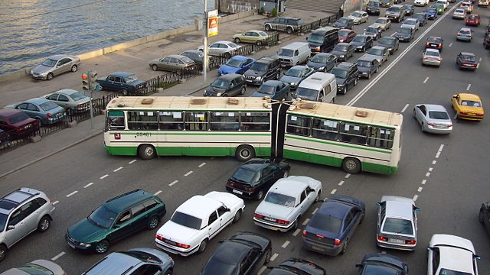
Working across campus can be HARD
“Implementing a campus RIM (CRIS) system is like “herding flaming cats.”
“The technical stuff is easy compared to all of the social stuff”
By Nevermind2 - Own work, CC BY-SA 3.0, https://commons.wikimedia.org/w/index.php?curid=2775045

Slide 5
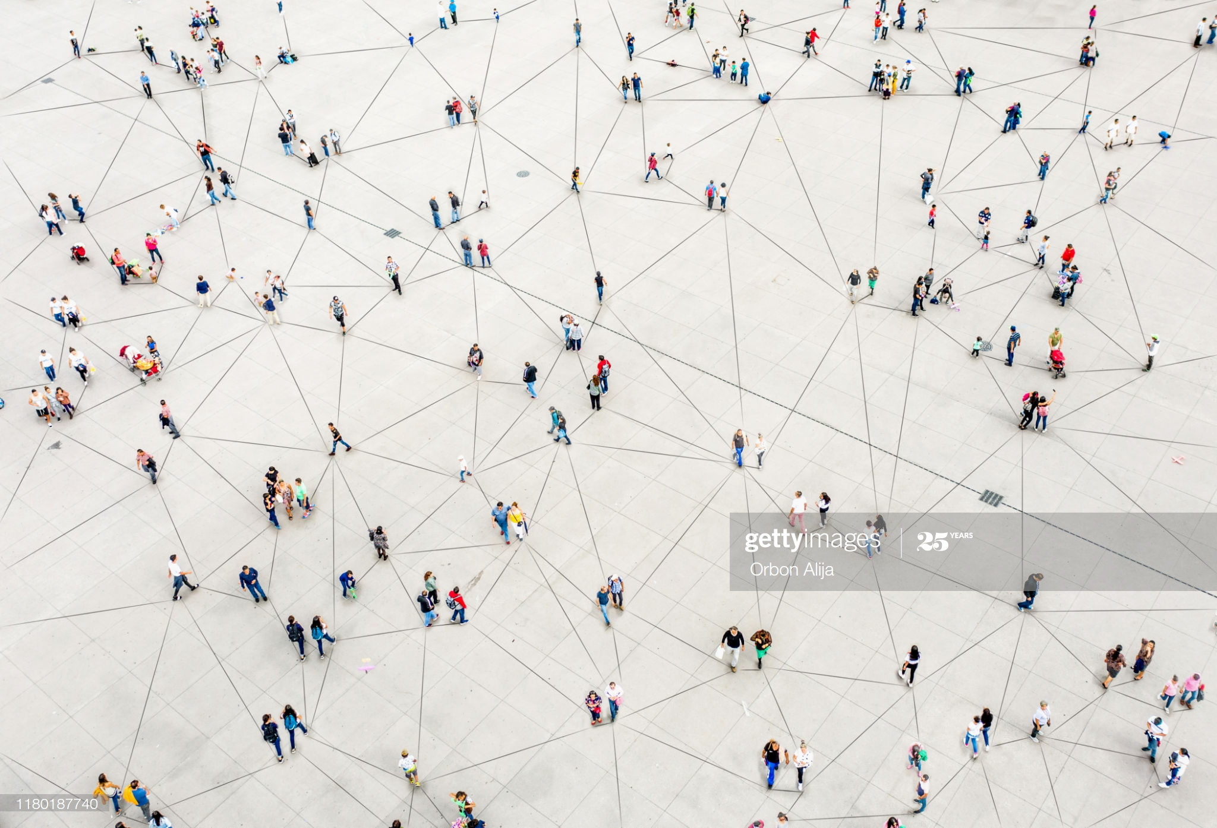
The Social ‘Stuff”? = Social Interoperability
Social interoperability is the creation and maintenance of working relationships across individuals and organizational units that promote collaboration, communication, and mutual understanding.

Slide 6
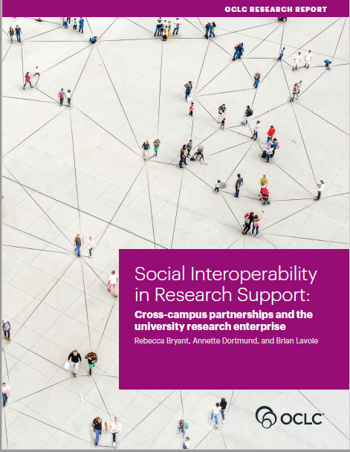
oc.lc/social-interoperability
Brian Lavoie, PhD
Annette Dortmund, PhD
Rebecca Bryant, PhD
Bryant, Rebecca, Annette Dortmund, and Brian Lavoie. 2020. Social Interoperability in Research Support: Cross-Campus Partnerships and the University Research Enterprise. Dublin, OH: OCLC Research. https://doi.org/10.25333/wyrd-n586

Slide 7
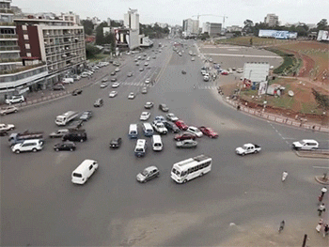
Universities are “complex adaptive systems”
Non-linear, dynamic behavior
Independent agents
Goals and behaviors that differ or conflict
Intelligent and learning agents
Self-organization
No single point(s) of control
Rouse, William B. 2016. Universities as Complex Enterprises: How Academia Works, Why It Works These Ways, and Where the University Enterprise Is Headed. New York: Routledge.
https://media.giphy.com/media/HSxKYjDLc9A6A/source.gif

Slide 8
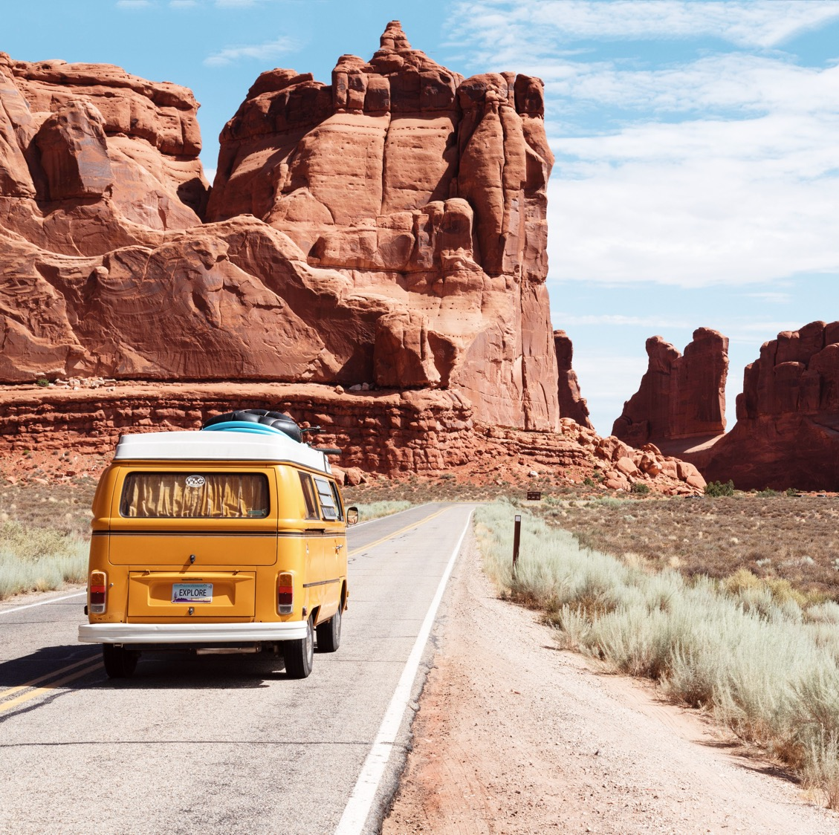
Social interoperability: getting everyone on the same bus
Photo by Dino Reichmuth on Unsplash

Slide 9
Strategies and tactics
Secure buy-in
Know your audience
Speak their language
Offer concrete solutions
Be sensitive to timing
Build relationships
Find opportunities to connect
Leverage shared staff
Utilize embedded staff
Troubleshoot
Find ‘connectors’
Manage personalities
Be confident in your value
Manage resistance & sustain energy

Slide 10
Organizing for effective collaboration
Anne Rauh
Head of Collections and Research Services
Syracuse University Libraries

Slide 11
Previous department organization
Department Head
Collection Development Librarian
Engineering Librarian
Social Science Librarian
Allied Health and Social Work Librarian
Science Librarian
Education Librarian
Information Studies Librarian
Business Librarian
Communication Librarian
Music Librarian
Art Librarian
Humanities Librarian
Government Documents and Geoscience Librarian
Architecture Librarian
Collection Development Librarian
Open Scholarship Librarian
Research Data Librarian

Slide 12
Liaison librarian work
Subject Specialty
Collections
Research
Subject Specialty
Collections
Research
Subject Specialty
Research
Collections
Instruction
Data
Instruction
Data
Scholarly Communications
Scholarly Communications
Instruction
Data
Scholarly Communications

Slide 13
Liaison librarian work…in reality
Subject Specialty
Collections
Research
Subject Specialty
Collections
Research
Subject Specialty
Research
Collections
Instruction
Data
Instruction
Data
Scholarly Communications
Scholarly Communications
Instruction
Scholarly Communication
Digital Scholarship

Slide 14
Focus areas of the department
Liaison Relationships
Instruction
Digital and Open Scholarship
Collections
Research Impact

Slide 15
Current department organization
Department Head
Subject Instruction Team Lead
Research Impact Team Lead
Digital and Open Scholarship Team Lead
Collections Team Lead
3-5 Librarians
3-5 Librarians
3-5 Librarians
3-5 Librarians

Slide 16
Current department organization
Department Head
Collection Development Librarian
Engineering Librarian
Social Science Librarian
Allied Health and Social Work Librarian
Science Librarian
Education Librarian
Information Studies Librarian
Business Librarian
Communication Librarian
Music Librarian
Art Librarian
Humanities Librarian
Government Documents and Geoscience Librarian
Architecture Librarian
Collection Development Librarian
Open Scholarship Librarian
Research Data Librarian

Slide 17
What does that let us do?

Slide 18
Research impact services
Liaison Relationships
Instruction
Digital and Open Scholarship
Collections
Research Impact

Slide 19
Ad hoc services prior to 2020
Research Information Management (RIM) system, Est. 2016
Use of research metrics tools to support individual faculty members for promotion and tenure
Answered questions from the Office of Research about bibliometric tools and counts
Select collaboration on public access requirements to outputs of sponsored research

Slide 20
Research impact team objectives
Developing knowledge and services in support of University research at both the individual and institutional levels.
Understand and communicate the tools available and administer and update them as allowable
Understand and communicate different metrics and their limitations
Create help guides for individuals to utilize library tools to communicate impact
Respond to university request for bibliographic information
Share best practices for responsible research assessment

Slide 21
Defined research impact services by audience
Individual
Tenure and promotion reporting
Group
Grant compliance reporting
Funding opportunity resources and use guides
University
Scopus record clean up
Responsible research assessment
Tenure and promotion planning impact planning
Researcher profiles
Identifying interdisciplinary journals
Systematic reviews and evidence synthesis
Open access for greater impact inquires
Group research profiles or webpages
Regularizing reporting and setting up dashboards
Disciplinary best practices for research productivity reporting
Campus system interconnectivity
Intermural grant reporting
RFI and proposal requests
RIM management
ORCID integration

Slide 22
Collaborative services
RIM administration
Joint training sessions
Funding opportunity source workshops

Slide 23
Interoperability challenges
Language
“Research administration” versus “research development”
Proposal development
File sharing
Google Drive versus Microsoft OneDrive
Scheduling
Outlook expectations

Slide 24
Benefits of collaboration
Broader audience reach for events
Increased registration for sessions due to co-advertisement
Increased use of library resources
Increased capacity by leveraging combined talents
Librarians serve as intermural grant and limited submission reviewers
Intervention and referral at all phases of the research process

Slide 25
Defined library and campus partners
Liaison Relationships
Instruction
Digital and Open Scholarship
Collections
Research Impact
Information literacy program
Graduate School
Digital Stewardship
Acquisitions
Cataloging
Electronic resource management
Program management center
Office of Research
Research development
Proposal support services
Institutional Research
Office of Sponsored Programs
Graduate Student Organization

Slide 26
Anne Rauh
Head of Collections and Research Services
Syracuse University Libraries
aerauh@syr.edu

Slide 27
Building on success at uWaterloo to enhance RDM services
Alison Hitchens, AUL, Collections, Technology, Scholarly Communication
Ian Milligan, AVP, Research Oversight and Analysis
Photo credit: @bruce.digital

Slide 28
Building an institutional RDM strategy
The three federal funding agencies in Canada released its Tri-Agency Research Data Management Policy in 2021
The agencies believe that research data collected through the use of public funds should be responsibly and securely managed and be, where ethical, legal and commercial obligations allow, available for reuse by others.
Institutions must create and post institutional RDM strategies by March 2023
Researchers
Requirement for data management plans (DMPS) being piloted in select funding opportunities in 2022/23
Future requirement for data deposit (date unknown)

Slide 29
Building a strong foundation of partnership
Success of RDM Institutional Strategy Working Group builds on a strong history of cross-campus partnerships, including:
Working group on bibliometrics (library, research, institutional analysis & planning, faculties, research institutes) and community of practice
Exploring research information systems (library, research, information systems & technology, institutional analysis & planning, faculties)
Research computing committee (library, research, information systems & technology, faculties)
Liaison librarian involvement in research and graduate studies & postdoctoral affairs workshops
Liaison librarian successes with research teams on research data management

Slide 30
(Some of) What we’ve learned
There are many data related services, tools and resources available for our researchers, but they aren't coordinated (and that's just on campus!)
Our researchers value both centralized and decentralized resources
Too many confusing and conflicting data-related policies, mandates and expectations (both university and disciplinary). For example, between “open data” and IP/privacy/security
Current state reflects these characteristics of universities:
Non-linear dynamic behaviour
Self-organization
Non single point(s) of control

Slide 31
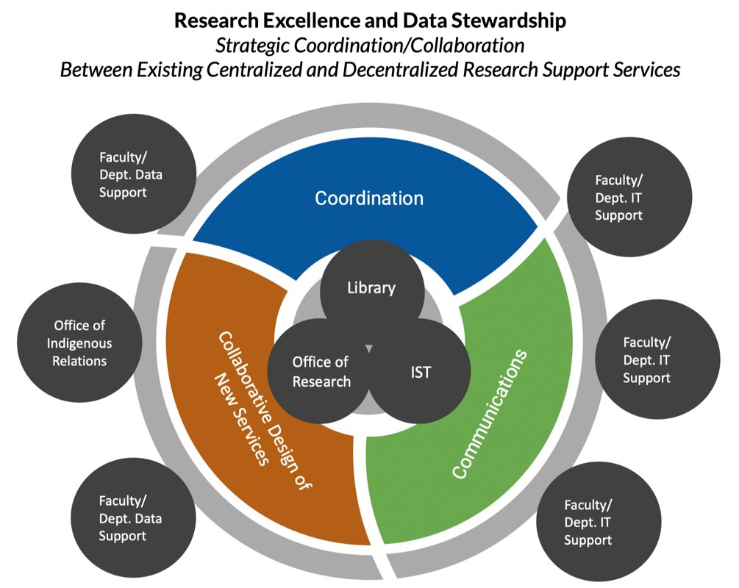
Aiming for greater coordination
Many actors on campus involved in research services
Not about centralization of services, but better coordination – breaking down silos!
Helping researchers meet new mandates (DMPs) without panic and not knowing where to go.

Slide 32
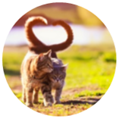
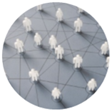
Coordination means building and extending relationships
Talk to lots of people! The "Ian and Alison Roadshow" travelled to:
All six faculty leadership teams
Senate Grad & Research Committee
Research Leadership Council
Computing Technology and Services Committee
Research Computing Committee
Research Ethics Board committees
Affiliated institutions of Waterloo
IT Professional Development seminar
…
The RDM WG has worked with:
Researcher Advisory Board
Focus groups: data managers, IT managers, Indigenous data
And is preparing for a town hall!
And Ian and Alison worked on these slides together!
Secure buy-in
Build relationships
Troubleshoot

Slide 33
All of this sets the stage for implementation.

Slide 35
Silo busting!
Takeaways
Be relentless connectors with lots of people
Invest--schedule!—the time
You may need to make structural changes in the library to optimize your impact
This may be about coordination, not centralization
These efforts forward the value proposition of the library to other campus stakeholders
Social interoperability begets more social interoperability
Photo by Waldemar Brandt on Unsplash

Slide 36
oc.lc/social-interoperability
#socialinteroperability

Slide 37
“OH, THE PLACES YOU’LL GO” together:
Case studies in cross-institutional collaboration
14 November 2022
Anne Rauh
Head of Collections & Research Services, Syracuse University
Ian Milligan, PhD
Associate Vice-President, Research Oversight and Analysis, University of Waterloo
Rebecca Bryant, PhD
Senior Program Officer, OCLC Research
Alison Hitchens
Associate University Librarian, University of Waterloo

