Slide 1
26 June 2022 – ALA 2022
LRRT Research Forum
Understanding Factors that Shape Archivists’ Needs for a New National Finding Aid Platform
Lynn Silipigni Connaway, Ph.D. (she/her/hers)
Lesley A. Langa, Ph.D. (she/her/hers)
Merrilee Proffitt (she/her/hers)
Chela Scott Weber (she/her/hers)
Notes:
Lynn

Slide 2
What is NAFAN?
Building a National Archival Finding Aid Network (aka NAFAN)
IMLS 2-year IMLS Research and Demonstration Grant (LG-246349-OLS-20)
NAFAN Partners
OCLC
California Digital Library (CDL)
University of Virginia (UVA) Libraries
Focus
Address researchers’ fundamental challenges and barriers to locating archival materials
Inform possible creation of national archival finding aids aggregator platform
Notes:
Lynn
This project is a two-year National Leadership Grant from IMLS in the Research and Demonstration category. The lead on NAFAN is the California Digital Library with OCLC Research and UVA Libraires partnering.
This project is a big undertaking and seeking to inform a national aggregation of archival finding aids or as one person put it “A WorldCat for archives”
Today we will talk about one of the four data collection efforts underway for this project.

Slide 3
Aggregation Contributor Research Questions
What are the enabling and constraining factors that influence whether organizations describe the archival collections in their care?
What are the enabling or constraining factors that influence whether organizations contribute to an aggregation of archival description?
What value does participation in an archival aggregation service bring to organizations?
Notes:
Lynn
Here are the research questions that guide our work speaking with cultural heritage or information professionals. We wanted to speak to them about their processes to create archival finding aids and to understand their experiences in current archival aggregation contributor relationships.

Slide 4
Final Focus Group Interview Protocol
Please tell us about your role in working with archival collections at your institution.
Please tell us briefly about how archival description gets produced and published in your institution.
This question focuses on producing and publishing archival description where you work. What are the things that make producing and publishing archival description in your home institution easy or difficult? What are the things that support this work and make it easier, either that you have now or would like to have?
Notes:
Lynn

Slide 5
Final Focus Group Interview Protocol (continued)
Think about your current process / the hypothetical scenario where your home institution would contribute to an archival aggregation platform. What about the process is/would be easy? What about the process is/would be difficult?
What makes/would make participation in a finding aid aggregation valuable for your institution? What makes/would make your participation in a finding aid aggregation valuable for your researchers? Do you think there are other things an aggregator could offer that would be valuable to your institution or researchers?
If you had a magic wand and could create your ideal national-scale finding aid aggregation system, how would it work and what would it do?
Notes:
Lynn

Slide 6
Data Collection Summary
Notes:
Lynn

Slide 7
Focus Group Interview Summary
10 focus groups
52 participants
24 participating in aggregation
28 not participating in aggregation
Representing 27 states and District of Columbia
Matrix representing 5 job responsibilities and institution size
Leadership / Administrative
Public Services & Tech Services, small institution
Public Services & Tech Services, large institution
Technical Services & Systems Responsibilities
Very Small Institution / Lone Arrangers
Notes:
Lynn
A year ago, in June 2021 we completed focus group interviews with cultural heritage information professionals across a wide variety of types and sizes of archives, both that do and do not participate in current archival aggregation. The interviews were recorded and transcribed for coding and analysis.

Slide 8
Participants by Archive Type
Academic archive | 22
Museum library / archive | 11
Government archive | 6
Public library archive | 4
Community archive | 4
Historical society archive | 3
Independent research library | 2
International organization | 1
Performing arts archive | 1
Regional archive | 1
Total | 52
Carnegie Classifications Breakdown
2 worked at archives in Baccalaureate Colleges (1 Arts & Sciences Focus, 1 Diverse Fields) ​
5 worked in Master’s Colleges & Universities (2 M1, 3 M2)​
15 worked in Doctoral Universities (10 R1, 4 R2, 1 D/PU) ​
Notes:
Lynn
Museum library and archive type with 11 participants included those from large and small art, history, and other types of museums.
R1: Doctoral Universities – Very high research activity
R2: Doctoral Universities – High research activity
D/PU: Doctoral/Professional Universities
M1: Master's Colleges & Universities – Larger programs
M2: Master's Colleges & Universities – Medium programs

Slide 9
Participants by US Region
11 total
8 total
13 total
2
11
9
3
5
2
2
14
4
N= 52 participants
20 total
Notes:
Lynn
Here is the breakout of focus group interview participants by region.
Reference: US Census Regions and Divisions map from https://www.eia.gov/consumption/commercial/maps.php#census
https://hangingtogether.org/nafan-focus-groups-aligning-participant-selection-with-project-values/

Slide 10
Focus Group Interview results
Notes:
Lesley

Slide 11
Four Themes Emerged
Things that constrain creating archival description
Things that enable creating archival description
Incentives to participate in aggregation (current or perceived)
Disincentives to participating in aggregation (current or perceived)
Notes:
Lesley
These four themes emerged and align with the research questions.
Theme 1: Circumstances, resources, or realities that prevent the archivist or institution from creating archival description. Use these codes only for the creation of archival description, not to capture what is said about sharing or contributing description to an aggregator/aggregation.
Theme 2: Circumstances, resources, or realities that facilitate the archivist or institution in creating archival description. Use these codes only for the creation of archival description, not to capture what is said about sharing or contributing description to an aggregator/aggregation.
Theme 3: Things people like or value in a current or imagined aggregation or that would help convince them to contribute to the aggregation.
Theme 4: Things people dislike or are frustrated by in a current or imagined aggregation or that would prevent them from contributing to the aggregation.

Slide 12
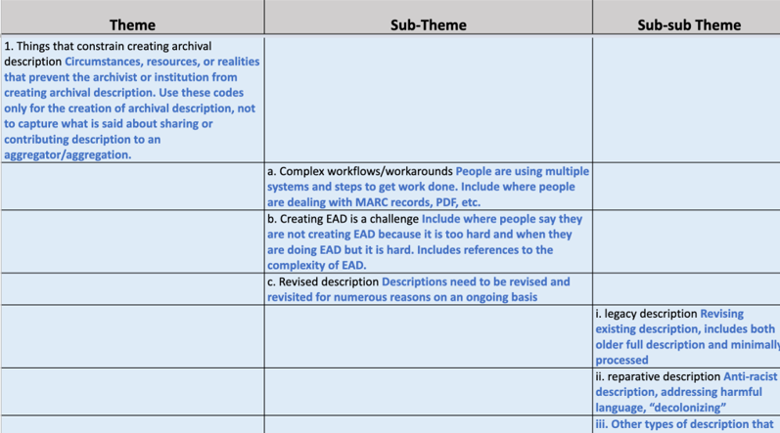
Codebook
Notes:
Lesley

Slide 13
Constraints
Complex workflows / workarounds (n=29)
Dealing with legacy description (n=19)
Lack of control over IT / software (n=16)
Enablers
Collection Management Systems (n=21)
Worksheets / templates (n=14)
Documentation / manuals (n=8)
n=number of focus group interview participants
Notes:
Lesley

Slide 14
Constraints
Enablers
“...our library IT is baffled by our needs.”
-Special Collections Archivist, Academic archive, West
“ArchivesSpace makes it easy for us...It's been a sea change for us in terms of time savings."
-Supervisory Archivist, Academic archive, West
Notes:
Lesley

Slide 15
Incentives to participate
Increased visibility / awareness of collections (n=25)
Uncovering connections between collections (n=22)
Ease of contributing records in an automated way (n=21)
Disincentives to participate
Data requirements (n=19)
Difficult to edit / update records (n=14)
Difficult to submit records (n=8)
n=number of focus group interview participants
Notes:
Lesley

Slide 16
Incentives
Disincentives
“...we're so small and such a niche [topical archive] that we're not a destination necessarily for a lot of people.”
-Archivist, Independent research library, West
"We can't delete things. It is a process for us to delete, we have to put in a request and make sure that it gets taken down...We're doing an anti-racist descriptive practices deep-dive into all of our finding aids, we're having to do this whole process of uploading and editing over and over again."
-Special Collections archivist, Academic archive, West
Notes:
Lesley

Slide 17
What’s next?
Individual interviews with users of archival aggregation
Theme analysis underway
Coding June to August 2022
Summarize findings
Synthesize and report research and community workshop findings
Engagement on design model, functional requirements, and sustainability plan
Build and launch the network
Notes:
Lesley

Slide 18
Discussion & Questions
Lynn Silipigni Connaway, Ph.D.
Director of Library Trends & User Research
Lynn_connaway@oclc.org
@LynnConnaway
Lesley A. Langa, Ph.D.
Associate Research Scientist, OCLC Research
Lesley_langa@oclc.org
@lesleylanga
Notes:
Lesley

